Slide 1
Components of Polarization-transfer to a bound proton in a deuteron measured by quasi-elastic scattering
Israel Mardor, for the A1 Collaboration
School of Physics and Astronomy, Tel Aviv University, Tel Aviv, Israel
Soreq NRC, Yavne, Israel

Slide 2
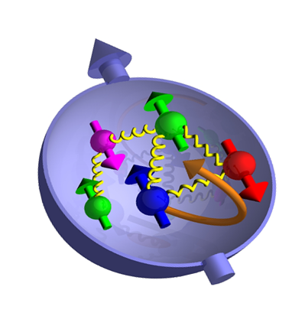
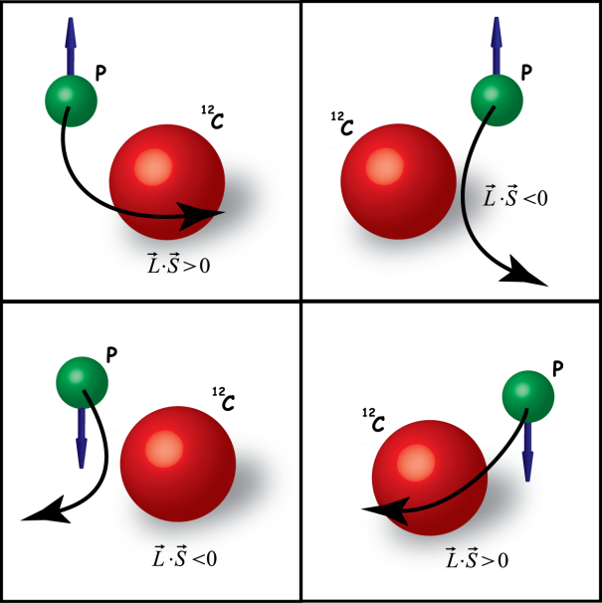
Outline
Physics motivation
Electromagnetic form factors
Polarization transfer measurements (at MAMI)
Survey of polarization transfer data (ratios)
Focus on the deuteron
Measuring separate components
Results
Conclusions
Outlook

Slide 3
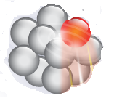
Physics Motivation
Are nucleon global properties (mass, radius) modified inside nuclei?
Do their EM form factors G_{E}(Q²), G_{M}(Q²) change?
If so, how do these changes depend on:
The nucleus size
Nuclear density
Q²
Can one disentangle inter-nucleon effects (FSI, nucleon-nucleon interactions) from intra-nucleon medium modifications?
Free neutron
Bound neutron

Slide 4
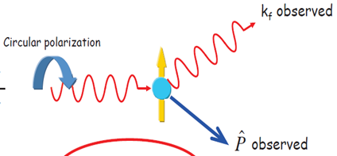
The observables of choice (1)
Polarization transfer to a knocked-out proton in QE $A\left(\vec{e},e^{′}\vec{p}\right)$
Search for deviations w.r.t.${}_{}^{1}H\left(\vec{e},e^{′}\vec{p}\right)$
e’
${}_{}^{1}H\left(\vec{e},e^{′}\vec{p}\right)$, 1-γ exchange approximation:
A
Polarized e
p
E’
E

Slide 5
The observables of choice (2)
E’
G_{E}, G_{M}: Proton Form Factors (FFs)
E
Since ${\left(\frac{P_{x}}{P_{z}}\right)}_{p}∝\frac{G_{E}}{G_{M}}$ , then perhaps ${\left(\frac{P_{x}}{P_{z}}\right)}_{A}∝\frac{G_{E}^{∗}}{G_{M}^{∗}}$
$G_{E}^{∗}$, $G_{M}^{∗}$: nuclear-medium modified electromagnetic proton FFs
The measurement of ${\left(\frac{P_{x}}{P_{z}}\right)}_{A}$ is:
obtained from a single measurement with a few % syst. and stat. uncertainties
minimally affected by radiative corrections

Slide 6
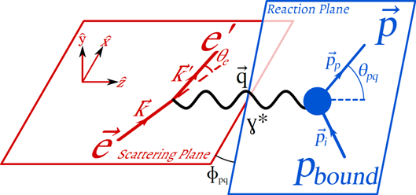
The observables of choice (3)
${\left(\frac{P_{x}}{P_{z}}\right)}_{A}$: Reaction Plane is rotated w.r.t. Scattering Plane
Measure ${\left(\frac{P_{x}}{P_{z}}\right)}_{A}\left({\vec{p}}_{i}\right)$
${\vec{p}}_{i}$ is unmeasurable, but ${\vec{p}}_{miss}=\vec{q}−{\vec{p}}_{p}$ is measurable
Within PWIA, and assuming no FSI → ${\vec{p}}_{i}=−{\vec{p}}_{miss}$

Slide 7
The observables of choice (4)
Goal: measure gradual increase of nuclear effects on ${\left(\frac{P_{x}}{P_{z}}\right)}_{A}$
Possible by reaching for higher ${\vec{p}}_{miss}$
More straight-forward: measure ${\left(\frac{P_{x}}{P_{z}}\right)}_{A}$versus nuclear effect on the proton: → how deeply it is bound → how ‘off-shell’ it is → how virtual it is:
$ν=P_{miss}^{2}−M_{p}^{2}={\left(M_{A}−\sqrt{M_{A−1}^{2}+{\left|\vec{p}\right|}_{miss}^{2}}\right)}^{2}−{\left|\vec{p}\right|}_{miss}^{2}−M_{p}^{2}$
Note: assume that only struck proton is off-shell

Slide 8
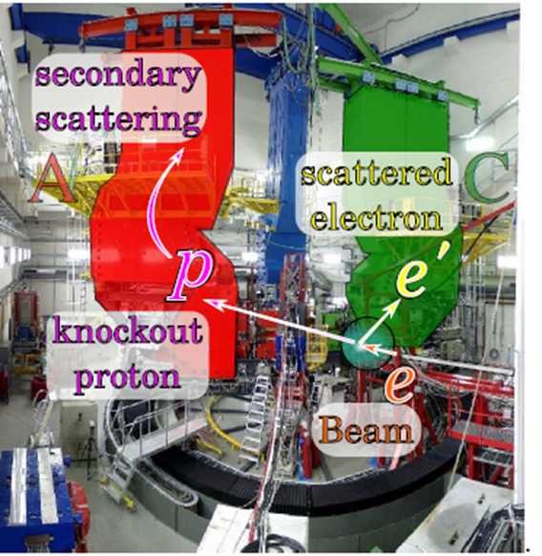
Polarization transfer measurements (1)
${\left(\frac{P_{x}}{P_{z}}\right)}_{A}$ were measured at
JLAB (Q² = 0.4 – 2.6 (GeV/c)²)
MAMI (Q² = 0.18 – 0.4 (GeV/c)²)
Measurements performed on: ²H, ⁴He and ¹²C
At MAMI:
Used 2 spectrometers in coincidence (A, C)
E_{e} = 600, 630 MeV (Q2 = 0.18, 0.4 (GeV/c)²)
Ie = 10 μA CW
Beam polarization ~ 80%
Used Focal Plane Polarimeter (FPP) in spectrometer A for polarization measurements
MAMI A1 Setup

Slide 9
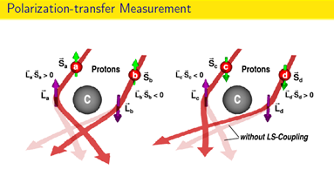
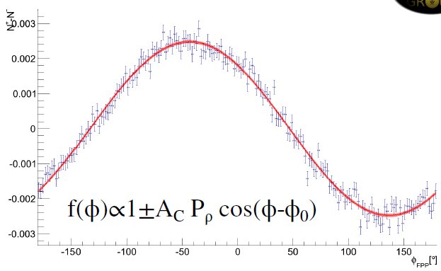
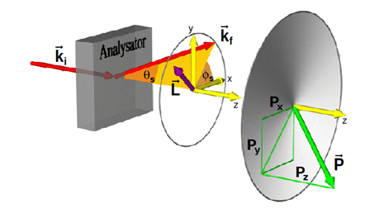
Polarization transfer measurements (2)
Due to the spin-orbit interaction, the proton scattering off the ¹²C polarimeter has azimuthal asymmetry, related to its polarization

Slide 10
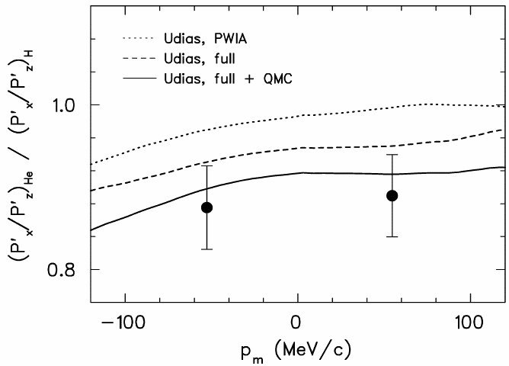
Polarization transfer data (1)
Consistent with: full RC+ medium modification of the proton FF (QMC model)
In clear disagreement with: PWIA and NR calculations
The statistical significance is not sufficient to exclude calculations without form factor modification
S. Dieterich et al., PLB 500 (2001) 47
⁴He
Q²=0.4 (GeV/c)²

Slide 11
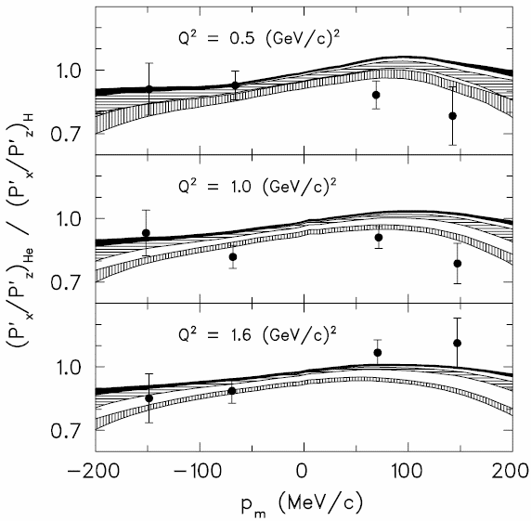
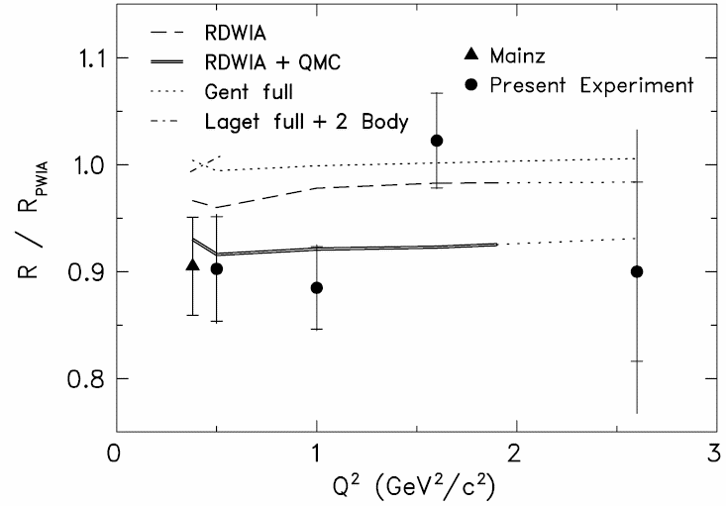
Polarization transfer data (2)
⁴He
RDWIA
RPWIA
Practically Q² independent
Differs from a full RC
Favors a medium modification of the proton form factors predicted by a QMC model
RDWIA + QMC
⁴He
S. Strauch et al., PRL 91 (2003) 052301

Slide 12
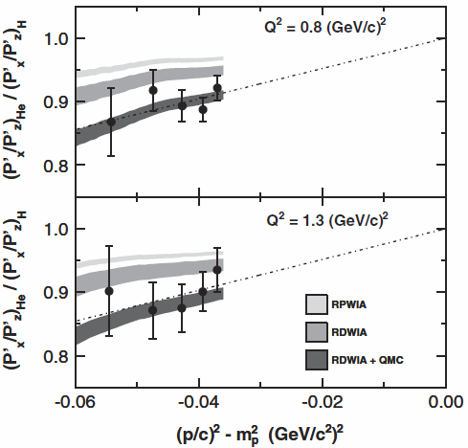
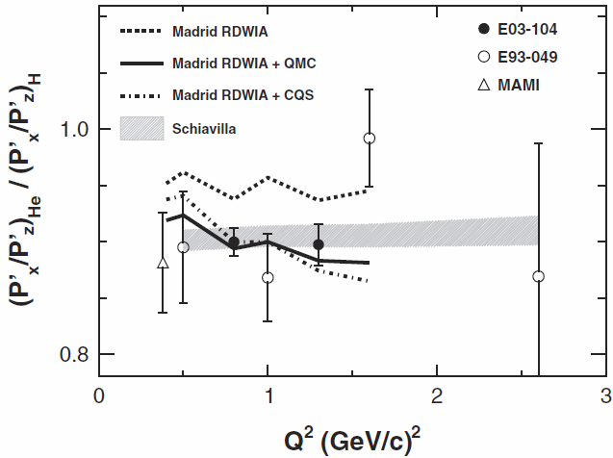
Polarization transfer data (3)
M. Paolone et al., PRL 105 (2010) 072001
Q² independence stays intact
Enter presentation of data versus virtuality
Results contradict a relativistic DWIA
Results favor either: medium-modified proton FFs by QMC (Madrid) or spin-dependent CX FSI (Schiavilla)
⁴He
⁴He
ν =

Slide 13
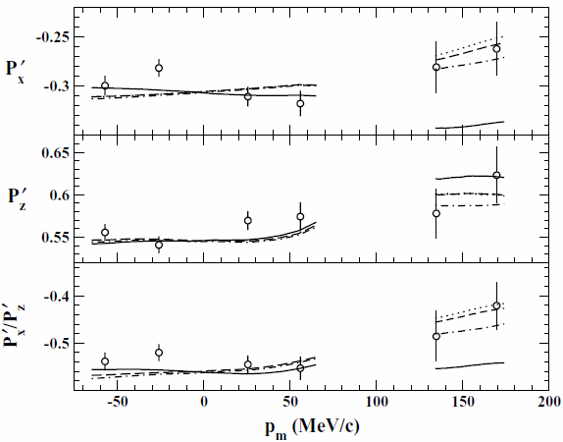
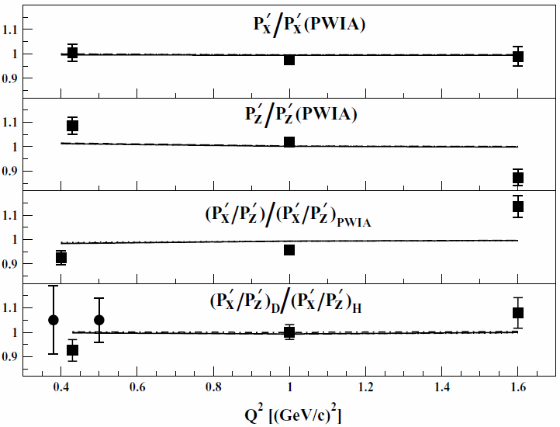
Polarization transfer data (4)
High p_{miss}: P_{x} is inconsistent with deuteron reaction model
Low p_{miss}: Q² dependence of P_{z} is inconsistent with deuteron reaction model
Full ²H calculations, inc. RC
²H Q² = 1.0 (GeV/c)²
²H
|p_{miss}| < 60 MeV/c
B. Hu, et al. PRC 73, 064004 (2006)
Deuteron reaction model: Arenhovel et al.

Slide 14
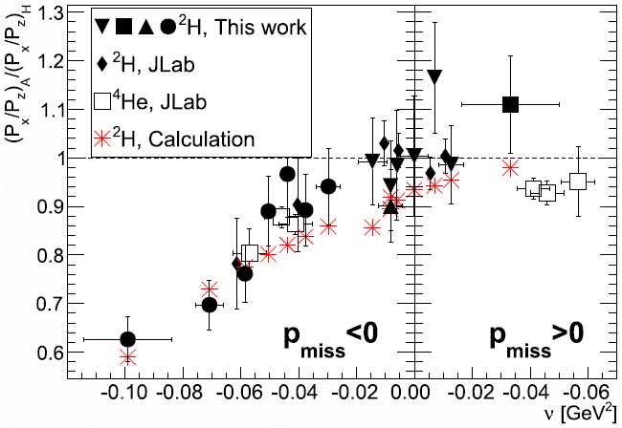
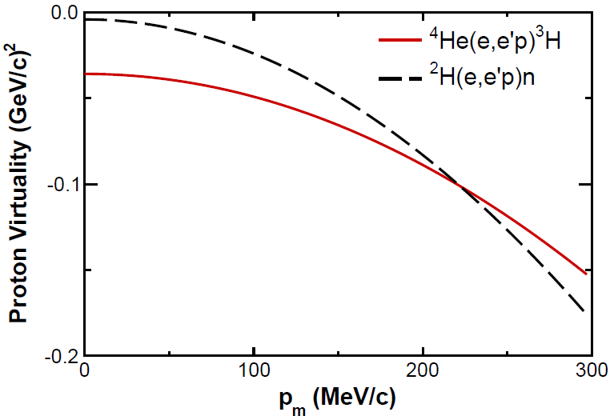
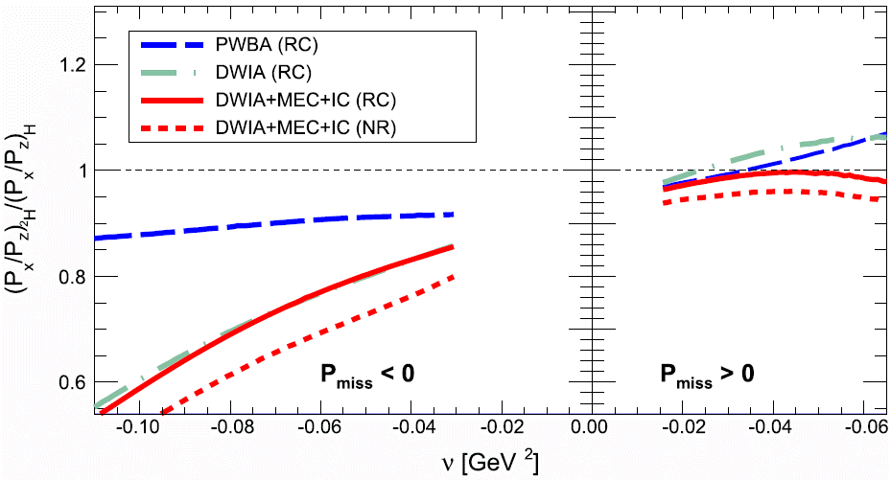
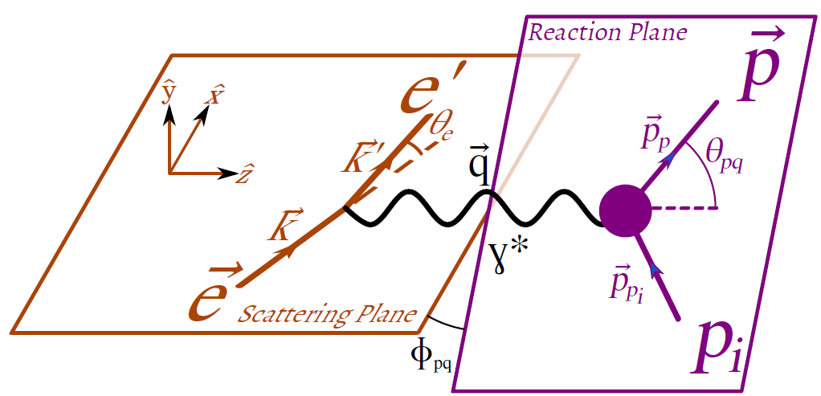
Polarization transfer data (5)
I. Yaron et al., PLB 769 (2017) 21–24
${\left(\frac{P_{x}}{P_{z}}\right)}_{2H}/{\left(\frac{P_{x}}{P_{z}}\right)}_{1H}$and ${\left(\frac{P_{x}}{P_{z}}\right)}_{4He}/{\left(\frac{P_{x}}{P_{z}}\right)}_{1H}$behave similarly
Nuclear effect: function of virtuality of the knock-out proton and the p_{miss} direction
Seems independent of the average nuclear density and Q²
General agreement between data and full calculations, which assume free proton form factors
${\vec{p}}_{miss}>0↔$ has a component ‖ to $\vec{q}$
${\vec{p}}_{miss}<0↔$ has a component ‖ to -$\vec{q}$
Kinematical relation between p_{miss} and ν

Slide 15
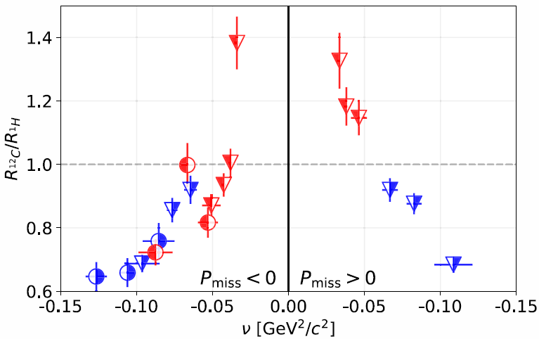
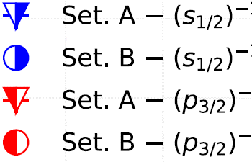
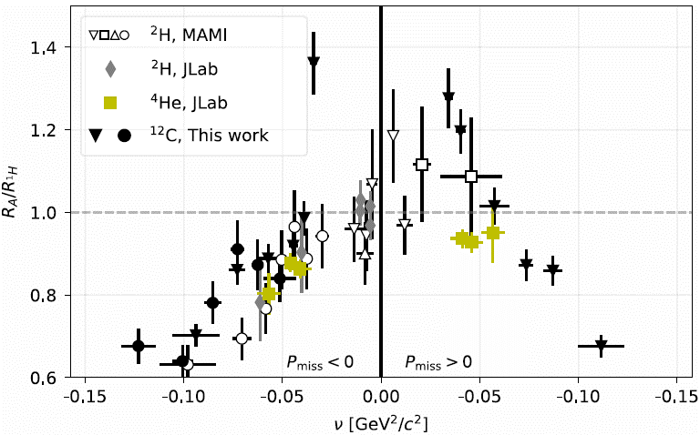
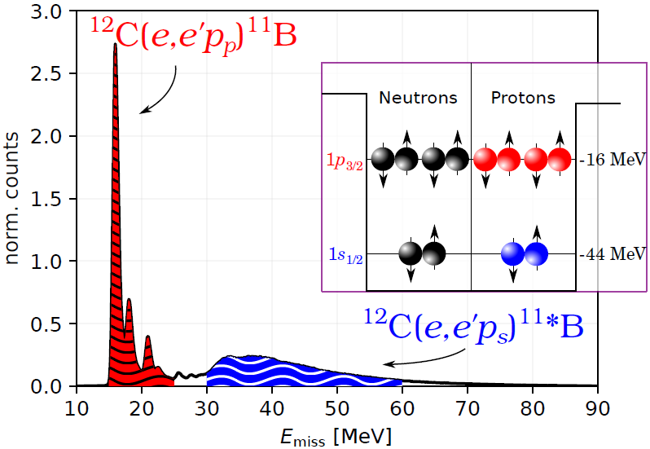
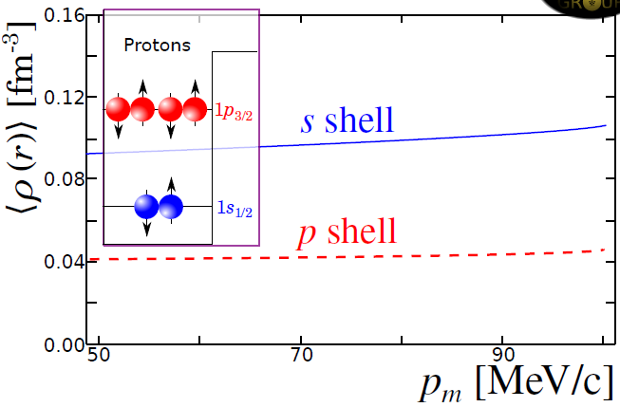
Polarization transfer data (6)
D. Izraeli et al., PLB 781 (2018) 95–98
Enter ¹²C. Data from different density regions by separating knockout protons from S- and P-shells
R_{A}/R_{1H} for ²H, ⁴He, ¹²C(S), ¹²C(P) are consistent, even when obtained in different kinematics.
Data suggest universal behavior, independent of average local density and Q².
A: Q²=0.40 (GeV/c)²
B: Q²=0.18 (GeV/c)²
$$R_{A}≡{\left(\frac{P_{x}}{P_{z}}\right)}_{A}$$
E_{miss} < 28 MeV:
p-shell knockout
28 < E_{miss} < 50 MeV:
s-shell and multi-particle knockout
$E_{miss}=ω−T_{p}−T_{11B}$
G. Ron et al., PRC 87, 028202 (2013)

Slide 16
Physics Motivation – stock taking so far
Are nucleon global properties (mass, radius) modified inside nuclei?
Do their EM form factors G_{E}(Q²), G_{M}(Q²) change?
If so, how do these changes depend on:
The nucleus size
Nuclear density
Q²
Can one disentangle inter-nucleon effects (FSI, nucleon-nucleon interactions) from intra-nucleon medium modifications?
Some ⁴He data may suggest it, but no smoking gun yet
Apparently, relevant measured variables are independent of all 3
Models are seemingly able to separate ‘regular’ nuclear effects from medium modifications

Slide 17
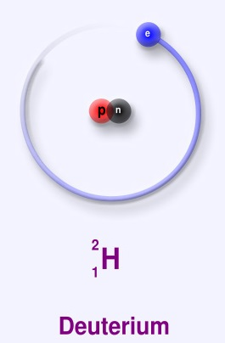
Deeper investigation of the deuteron
The most loose nuclear system
Often used as a ‘free neutron’ target
Nevertheless, bound nucleons can still be ‘off-shell’
No local nuclear density changes
Perform experiments as low Q² - nucleon radius
Good calculations (H. Arenhövel et al.*)
Meson Exchange Currents (MEC)
Isobar Configuration (IC)
Relativistic Correction (RC)
Final State Interactions (FSI)
Free proton EM Form Factors
B. E. (²H) = 2.2 MeV
B. E. (⁴He) = 28.3 MeV
*H. Arenhövel et al., Eur. Phys. J. A 23 (2005) 147–190

Slide 18
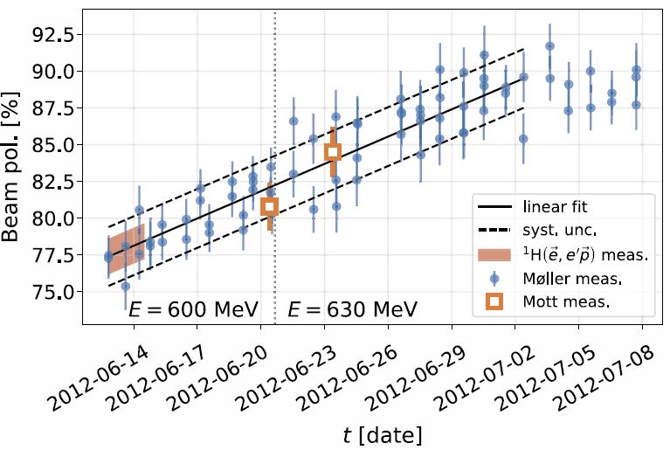
Extraction of ²H polarization transfer components (1)
Precise determination of e⁻ beam polarization → reduced systematic uncertainties on the components
Enabled detailed comparison to Arenhövel’s calculation using free-proton EM FFs
Used fitted beam-polarization instead of fluctuating periodic measurements
Overall normalization determined by ${}_{}^{1}{H\left(\vec{e},e^{′}\vec{p}\right)}$ measurements
Beam-polarization uncertainty significantly reduced
D. Izraeli et al., PLB 781 (2018) 107–111

Slide 19
Extraction of ²H polarization transfer components (2)
Beam polarization was precise enough for extracting polarization transfer components with the required uncertainty (not only P_{x}/P_{z})
P_{y} component determined as well
For ¹H, P_{y}=0 → P_{y} can be compared only to calculations
While P_{x}/P_{z} is sensitive (almost linearly) to G_{E}/G_{M}, some nuclear effects may cancel out in the ratio.
The measured individual polarization transfer components may provide a more stringent test of the calculation
D. Izraeli et al., PLB 781 (2018) 107–111

Slide 20
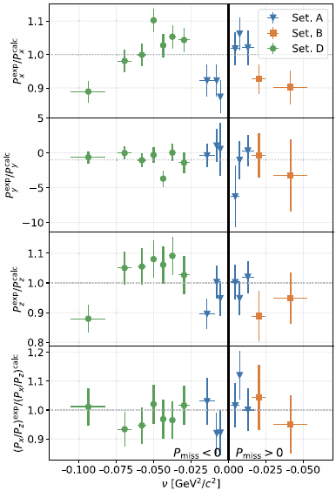
²H polarization transfer components results (1)
Exp/Calc ratios were extracted event-by-event over the entire data set
P_{x}/P_{z} agrees highly significantly with the calculation (p = 0.91)
This indicates no need for modifications in G_{E}/G_{M}
Experimental P_{x} and P_{z} values differ from calc, especially at high p_{miss}
Py differs highly, maybe due to division of very small numbers
Modifications in G_{E} and G_{M} are thus possible, but only if they keep the ratio G_{E}/G_{M} intact
Excluding FF modifications, deviations of P_{x} and P_{z} suggest that nuclear effects and/or RC included in the calculation should be improved
D. Izraeli et al., PLB 781 (2018) 107–111

Slide 21
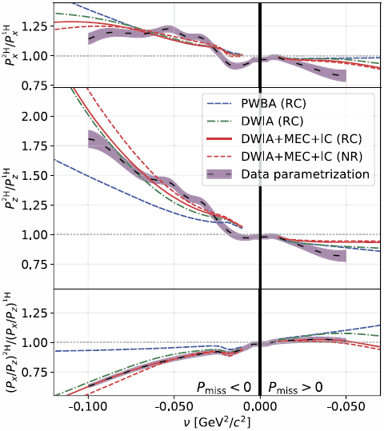
²H polarization transfer components results (2)
A continuous parametrization of the data (avoids losing information due to averaging within bins) was derived for ²H polarization transfer ratios to ¹H
Done by a novel method*, relating the data to a realistic model of the deuteron
This process requires extraction of experimental polarization transfer components
Number of parameters was optimized to avoid over-fitting
Main deviation from the free proton is due to FSI (compare PWBA and DWIA)
Observed deviation of P_{x}/P_{z} is mainly due to P_{z}, which seems to be more sensitive to FSI and RC than P_{x}
D. Izraeli et al., PLB 781 (2018) 107–111
*D. Izraeli et al., arXiv:1803.06729 (2018)

Slide 22
²H polarization transfer components comparison
Low p_{miss}: All exp./calc. ratios seem similar at high and low Q²
High positive p_{miss}:
P_{x} exp./calc. deviates similarly at high & low Q²
P_{z} exp./calc. ratio deviates more at low Q²
P_{x}/P_{z} exp./calc. ratio deviates more at high Q²
No measurement at high Q², high negative p_{miss}
Full calculations, inc. RC
Q² = 0.18, 0.40 (GeV/c)²
All calculations by Arenhovel et al.
P_{miss} [MeV/c]:
-220 → -130 -80 → 75 75 → 175
Q² = 1.0 (GeV/c)²
B. Hu, et al. PRC 73, 064004 (2006)
D. Izraeli et al., PLB 781 (2018) 107–111

Slide 23
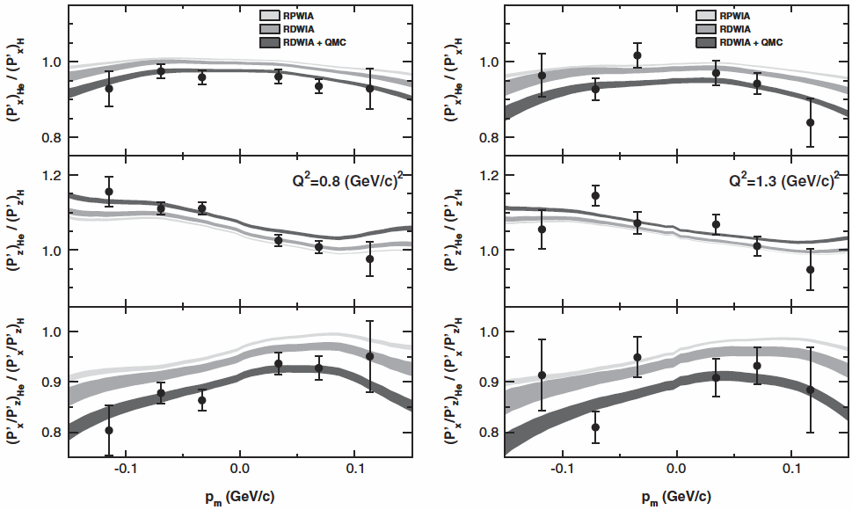
²H – ⁴He polarization transfer components comparison
⁴He
⁴He
²H
Q² = 0.18, 0.40 (GeV/c)²
P_{miss} [MeV/c]:
-220 → -130 -80 → 75 75 → 175
M. Paolone et al., PRL 105 (2010) 072001
⁴He (high Q²) - data seems to require medium-modified proton FFs (QMC) or spin-dependent SCX FSI
²H (low Q²) – medium-modified proton FFs seem to be ruled out, except for modifications which keep P_{x}/P_{z} intact
D. Izraeli et al., PLB 781 (2018) 107–111

Slide 24
Summary and conclusions (1)
Polarization transfer for ²H, ⁴He and ¹²C was collected at relatively wide kinematic conditions (Q² = 0.18 – 2.6 (GeV/c)²)
2.6 (GeV/c)² point is with a large error
Still no polarization transfer measurement that requires medium-modified EM FFs for its theoretical interpretation
Nuclear models give good handles in disentangling inter-nuclear effects from intra-nucleon effects. RC and FSI are required for good interpretation
Polarization transfer ratios seem to be independent of the nuclear size, nuclear density and Q², in the measured ranges
M. Paolone et al., PRL 105 (2010) 072001
D. Izraeli et al., PLB 781 (2018) 95–98

Slide 25
Summary and conclusions (2)
Polarization transfer has a universal smooth behavior in virtuality. This behavior is reconstructed by calculations
It is possible to select events from specific local density regions within certain nuclei, by controlling the nuclear shell of the knocked-out proton, via cuts on the missing energy
Polarization components may provide more stringent tests on calculations, since in ratios some of the nuclear effects might cancel out
D. Izraeli et al., PLB 781 (2018) 107–111

Slide 26
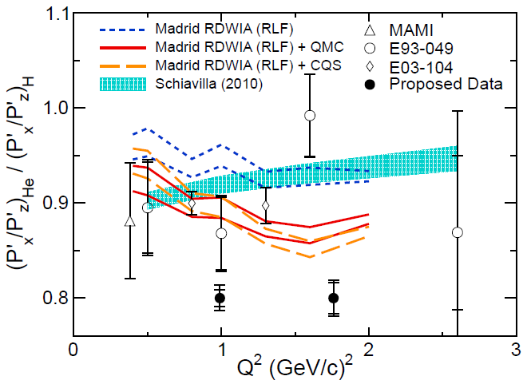
Outlook (1)
To verify whether medium modifications of nucleons occur or not, more polarization transfer measurements are required
Measurements on ²H, ⁴He and ¹²C should be extended to higher virtuality (p_{miss})
Approved at JLAB: ${}_{}^{4}{He}\left(\vec{e},e^{′}\vec{p}\right)$ @ Q²=1.8 (GeV/c)², -200 < p_{miss} < +300 MeV/c
Nuclear medium effects are expected to increase with virtuality
S. Strauch et al., JLAB E12-11-002

Slide 27
Outlook (2)
Elaborate measurements on specific nuclear shells (s, p in ¹²C). Especially compare s and p results at same virtuality and kinematics
Continue measuring polarization components, and not only ratios. Specifically, compare components at different shells
Measure specific nuclear shells at high Q² – in this regime, the contribution of multi-nucleon reactions to deep-shell single proton knockout may be reduced
The effect of FSI on polarization transfer may be investigated by measuring heavier nuclei
¹²C
D. Izraeli et al., PLB 781 (2018) 95–98

Slide 28
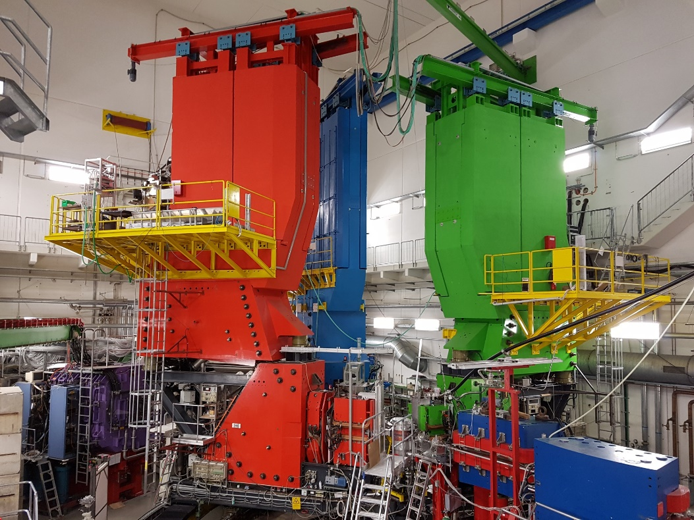
Acknowledgements
The A1 Collaboration: D. Izraeli, T. Brecelj, I. Yaron, P. Achenbach, A. Ashkenazi, R. Böhm, E. O. Cohen, M. O. Distler, A. Esser, R. Gilman, T. Kolar, I. Korover, J. Lichtenstadt, I. Mardor, H. Merkel, M. Mihovilovic, U. Müller, M. Olivenboim, E. Piasetzky, G. Ron, B. S. Schlimme, M. Schoth, C. Sfienti, S. Sirca, S. Stajner, S. Strauch, M. Thiel, A. Weber
Tel Aviv University, Israel
Jozef Stefan Institute, Slovenia
Johannes Gutenberg-Universität, Germany
Rutgers, The State University of New Jersey, USA
NRCN, Israel
Soreq NRC, Israel
Hebrew University of Jerusalem, Israel
University of Ljubljana, Slovenia
University of South Carolina, USA
We would like to thank the Mainz Microtron (MAMI) operators and technical staff for the excellent operation of the accelerator
Thanks to the Spin-Praha-2018
organizing committee for this talk invitation

