Slide 1
Programme Advisory Committee
for Condensed Matter Physics
Follow-up after the 59th meeting, 24-25 June 2024
Dénes Lajos Nagy
60th meeting of the PAC for Condensed Matter Physics, 27 January 2025

Slide 2
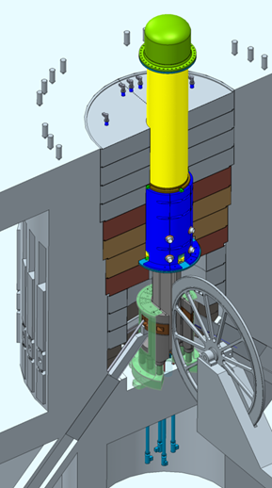
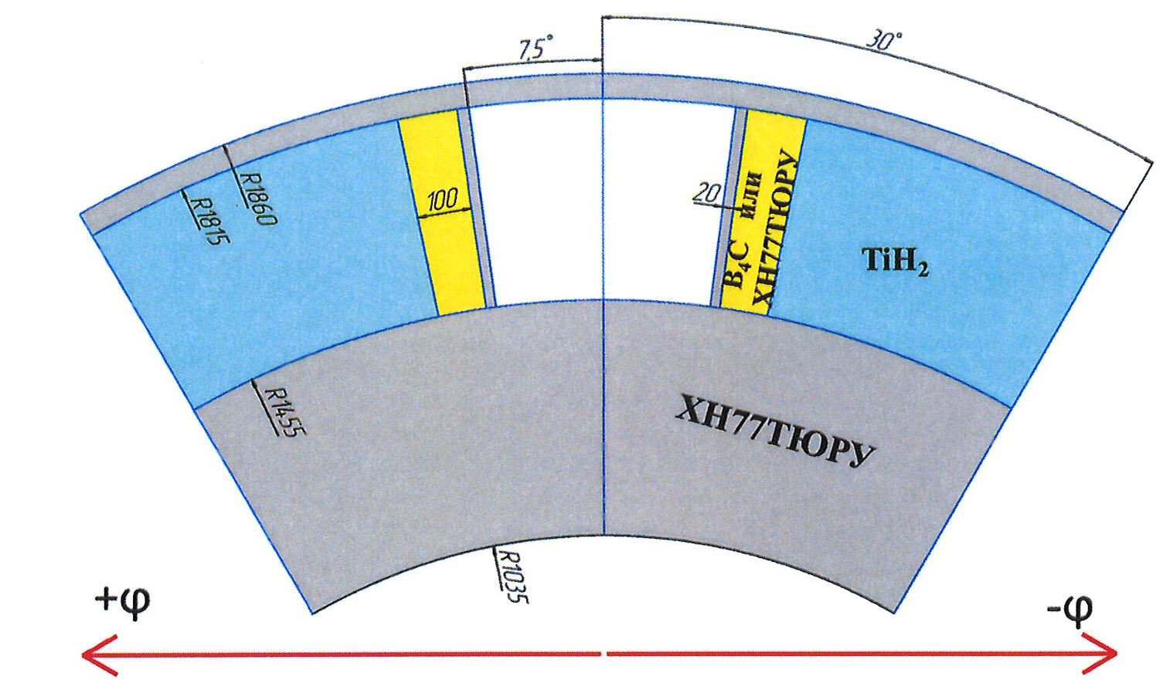
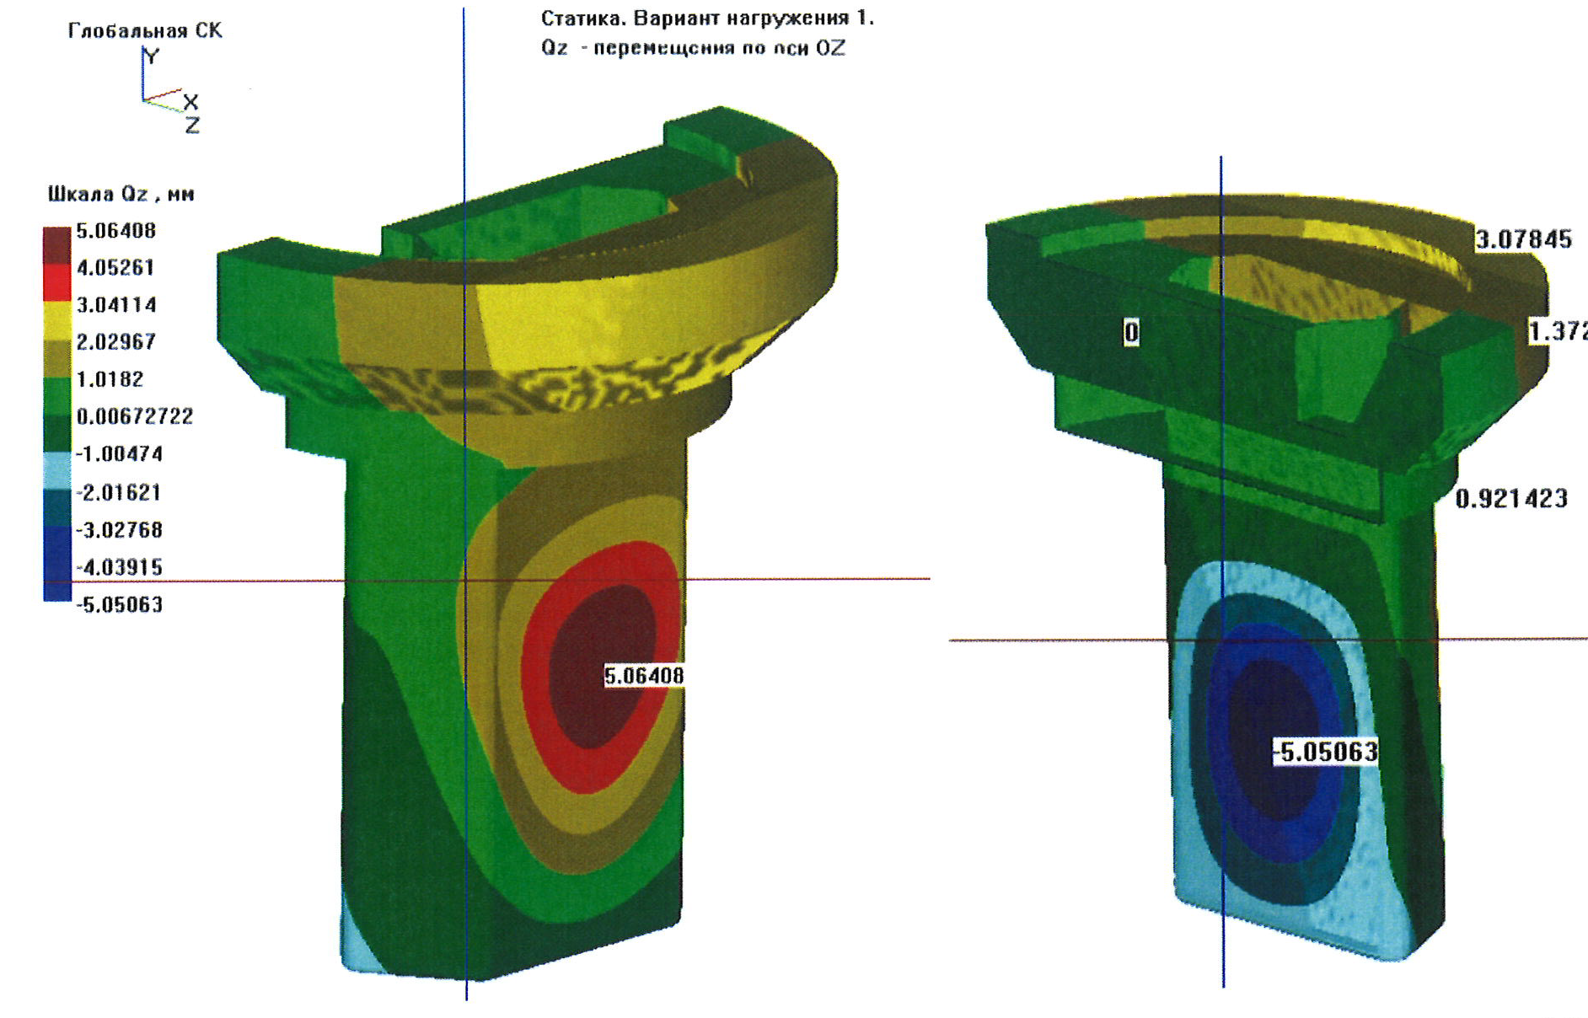
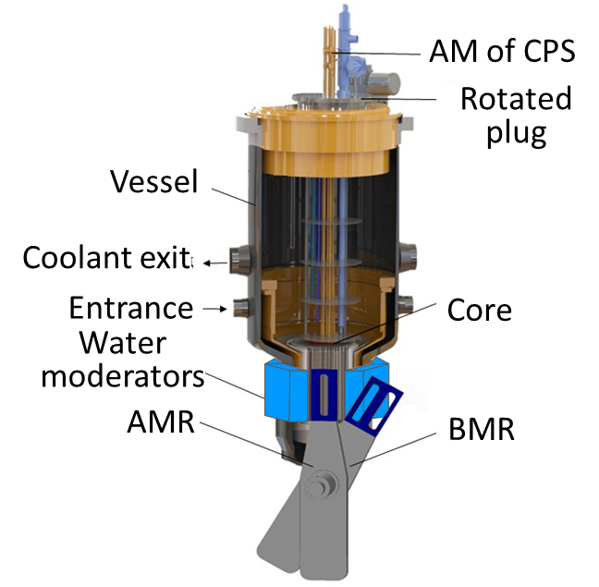
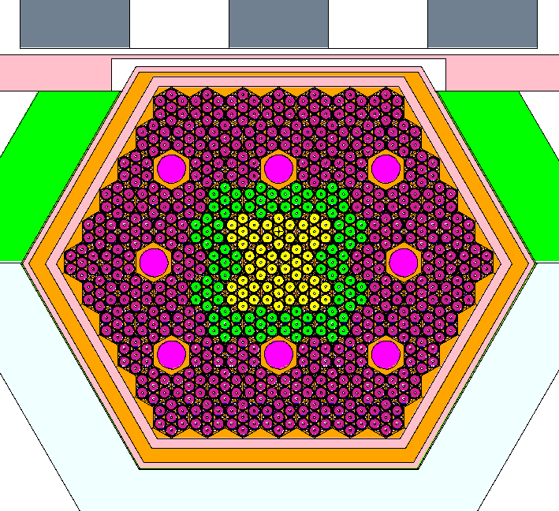
Current status of work on the new neutron source
The PAC took note of the information on the development of the new neutron source, presented by Egor Lychagin.
Thermal-hydraulic calculations of the reactivity modulator, core, housing and safety housing were performed by NIKIET in 2023-2024.
Deformations
Another concept of the reactor from FLNP (2020-2024):
fuel as in IBR-2;
existing PO-3 modulator of reactivity for IBR-2;
vessel is practically the same as the MBIR vessel;
new core design.

Slide 3
Current status of work on the new neutron source
RESOLUTION OF THE JINR SCIENTIFIC COUNCIL:
The Scientific Council welcomed the efforts of the FLNP team working on the development of the new neutron source.
The Scientific Council supported the main directions of this activity, including work to outline the suite of necessary instruments of the facility, develop models of reactor dynamics, and study the heating of the modulator elements and the reactor vessel.
The Scientific Council concurred with the PAC that in further work on the project of the new reactor facility, the most pressing tasks are to study the mechanisms of power feedback formation and develop mathematical models describing the processes leading to fluctuations in pulse energy, on the basis of the IBR-2 operation experience.
The Scientific Council shared the PAC’s opinion on the need to continue work on the project for the development of the new neutron source.

Slide 4
Current plans to resume operation of the IBR-2 reactor and preparations
for the restart of the FLNP User Programme
The PAC took note of the information on the progress of obtaining a license to operate the IBR-2 nuclear research facility and on the preparatory work to replace the air heat exchangers of the reactor’s secondary cooling circuit, presented by Bagdaulet Mukhametuly.
Assembling of
a tower crane
on-site.
Removing the
insulation of air
heat exchanger.
Preparing the air
heat exchanger
for dismantling.
The heat
exchanger drain
manifold is
prepared for
cutting.
Tower crane
near the
reactor.

Slide 5
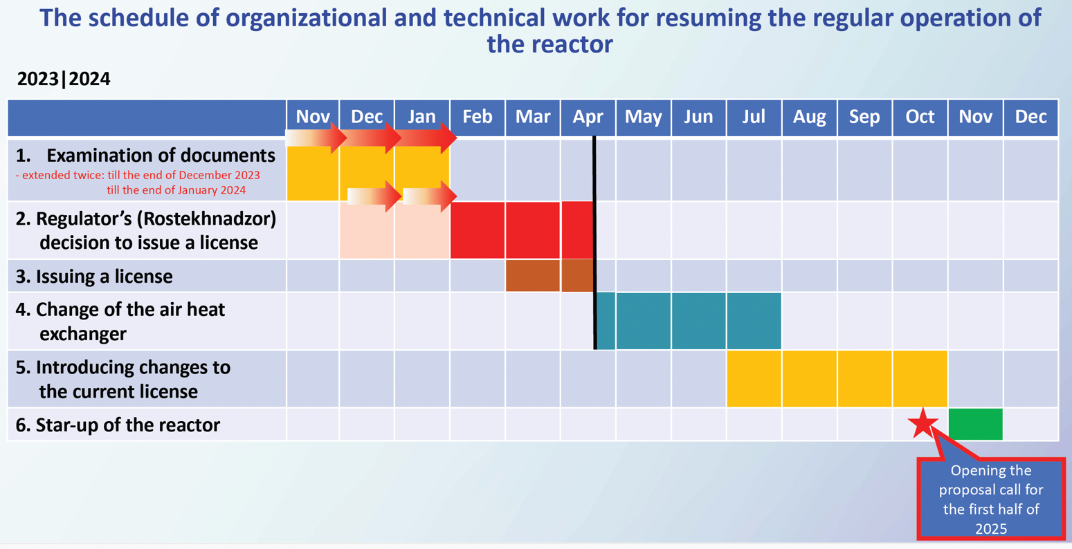
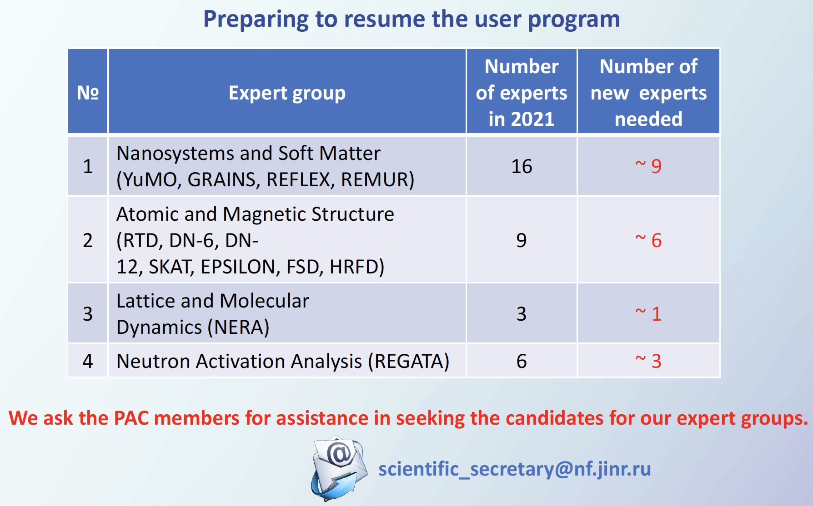
Current plans to resume operation of the IBR-2 reactor and preparations
for the restart of the FLNP User Programme
The PAC highly appreciated and supported FLNP’s plans and efforts to restart the operation of the IBR-2 nuclear research facility in 2024–2025 and resume the FLNP User Programme in 2025. The PAC noted the need to attract a sufficient number of experts to review projects.

Slide 6
Current plans to resume operation of the IBR-2 reactor and preparations
for the restart of the FLNP User Programme
RESOLUTION OF THE JINR SCIENTIFIC COUNCIL:
The Scientific Council took note of the information on the progress of obtaining a license to operate the IBR-2 nuclear research facility and on the preparatory work to replace the air heat exchangers of the secondary cooling circuit of the reactor.
The Scientific Council welcomed the intention of the FLNP Directorate to restart the operation of the IBR-2 nuclear research facility in 2024–2025 and resume the FLNP User Programme in 2025.

Slide 7
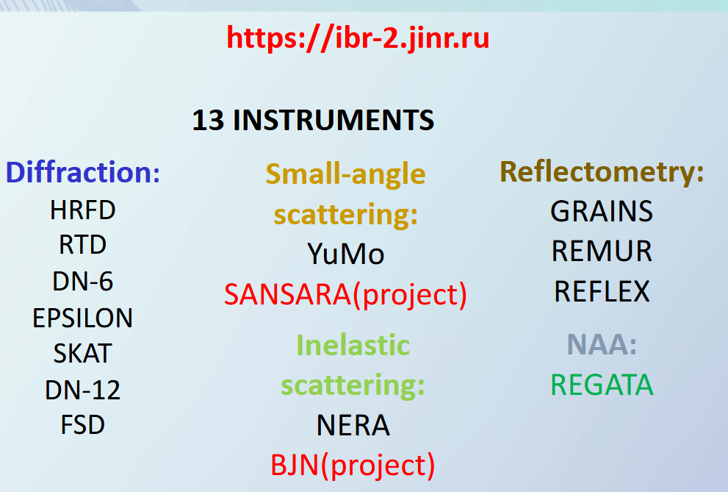
Status reports on the upgrade of FLNP instruments
The PAC was informed about the status and progress of instrument modernization at the IBR-2 reactor, presented by Viktor Bodnarchuk.
Distribution of the beam time
In the FLNP JINR, the neutron beam time at the high flux pulsed IBR-2 reactor is distributed between internal users (FLNP) and general
science community (GSC) in the ratio of
35% (internal proposals),
55% (external regular proposals),
10% (external urgent beam time requests).

Slide 8
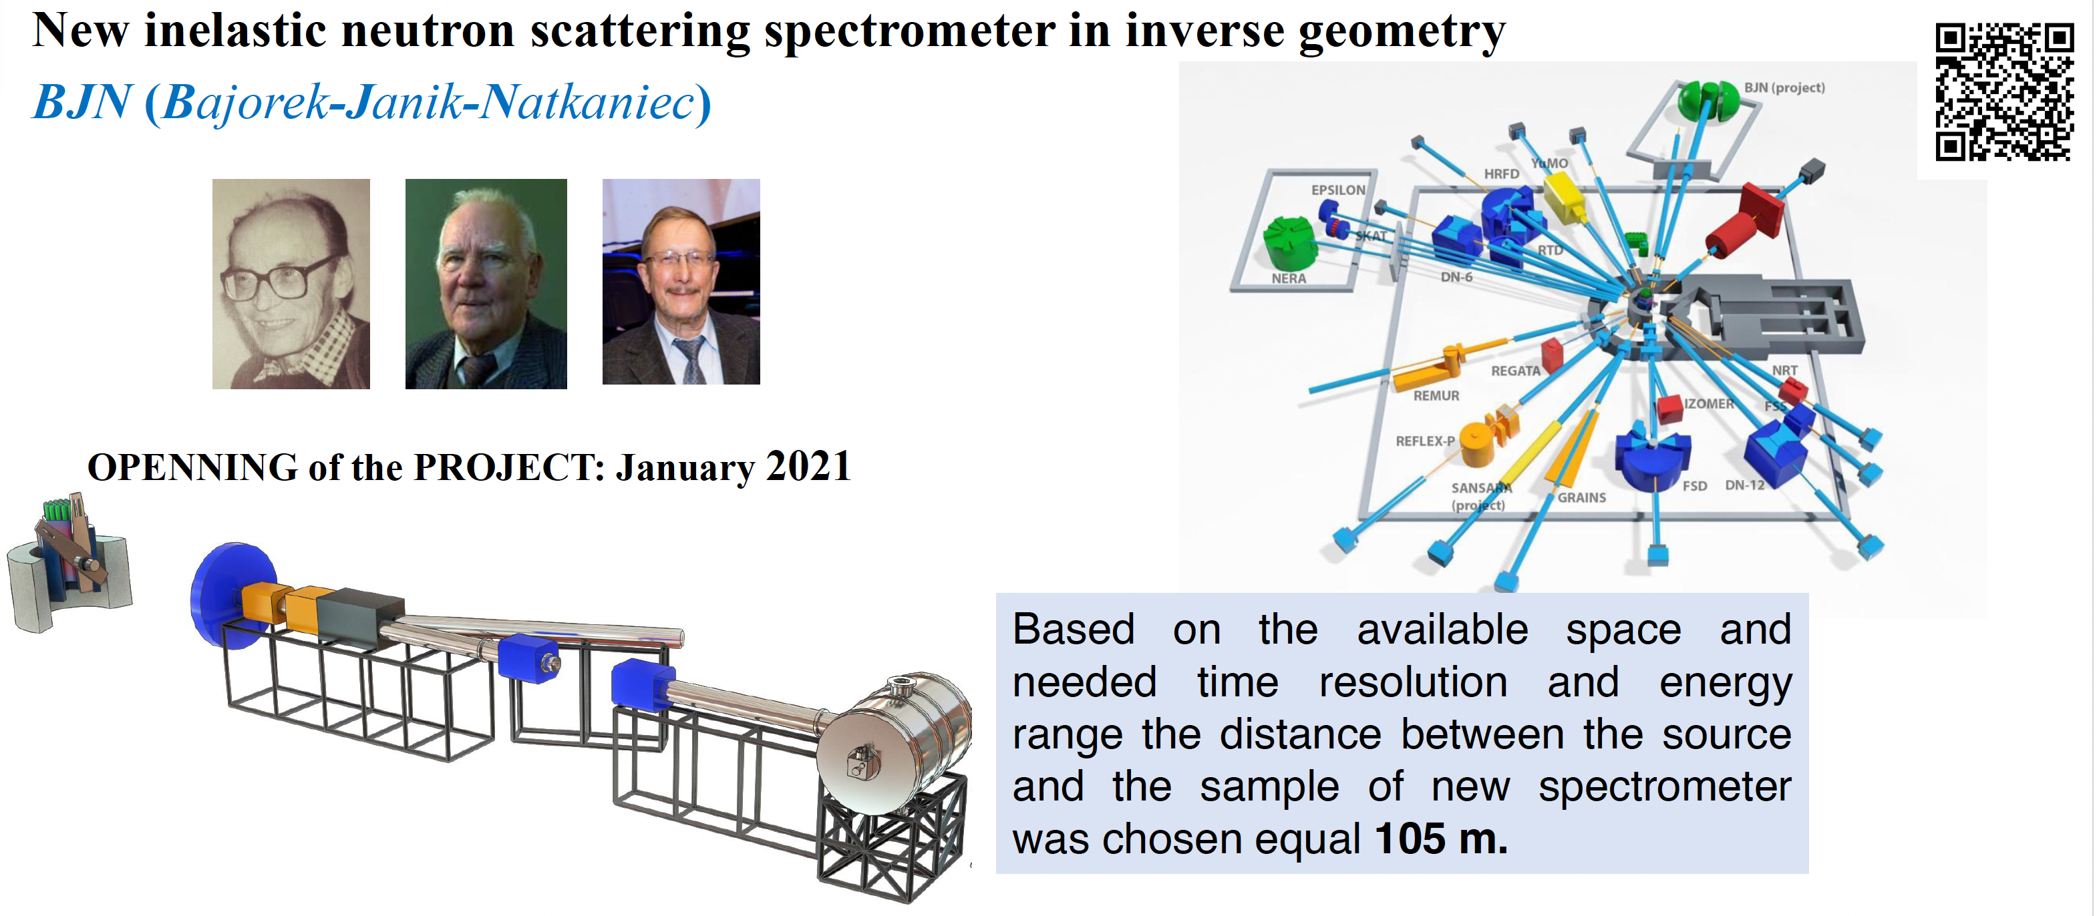
Status reports on the upgrade of FLNP instruments
The PAC supported overall progress in preparing spectrometers and equipment for the reactor start-up. In particular, the PAC supported activities on the development of the new BJN spectrometer.

Slide 9
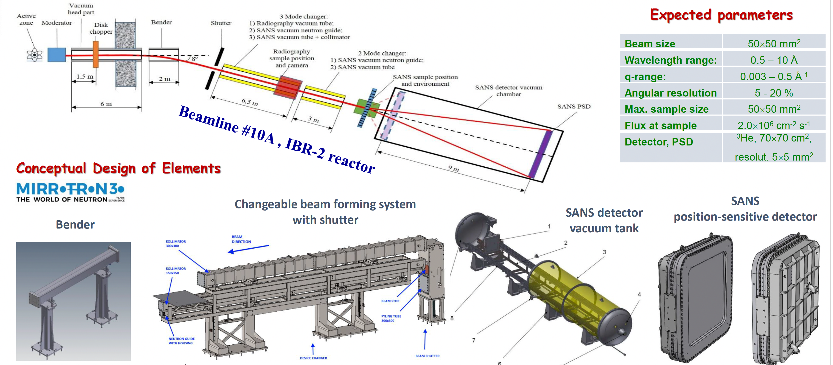
SANSARA Spectrometer
SANS/ Neutron Tomography
The PAC heard a report on the status of the SANSARA instrument and noted the progress in its creation within the instrument development programme of the project “Investigations of functional materials and nanosystems using neutron scattering”.

Slide 10
Status reports on the upgrade of FLNP instruments
RESOLUTION OF THE JINR SCIENTIFIC COUNCIL:
The Scientific Council endorsed the progress of instrument modernization
at the IBR-2 reactor and notes the active preparations of instruments
for the reactor start-up at the end of 2024.
All important elements of the spectrometers are being tested and adjusted for correct operation. The detector systems of the spectrometers are undergoing routine testing to ensure their readiness for the reactor start-up. Two new scintillation detectors (ASTRA-M, BSD) have been installed on the IBR-2 beamlines and are ready for test measurements after the IBR-2 reactor starts its operation. At present, implementation of the BJN project and activity on the SANSARA instrument are in progress.
The Scientific Council endorsed overall progress in preparing spectrometers and equipment for the reactor start-up, highly appreciates the development of the BJN project and recommends continuing its implementation.

Slide 11
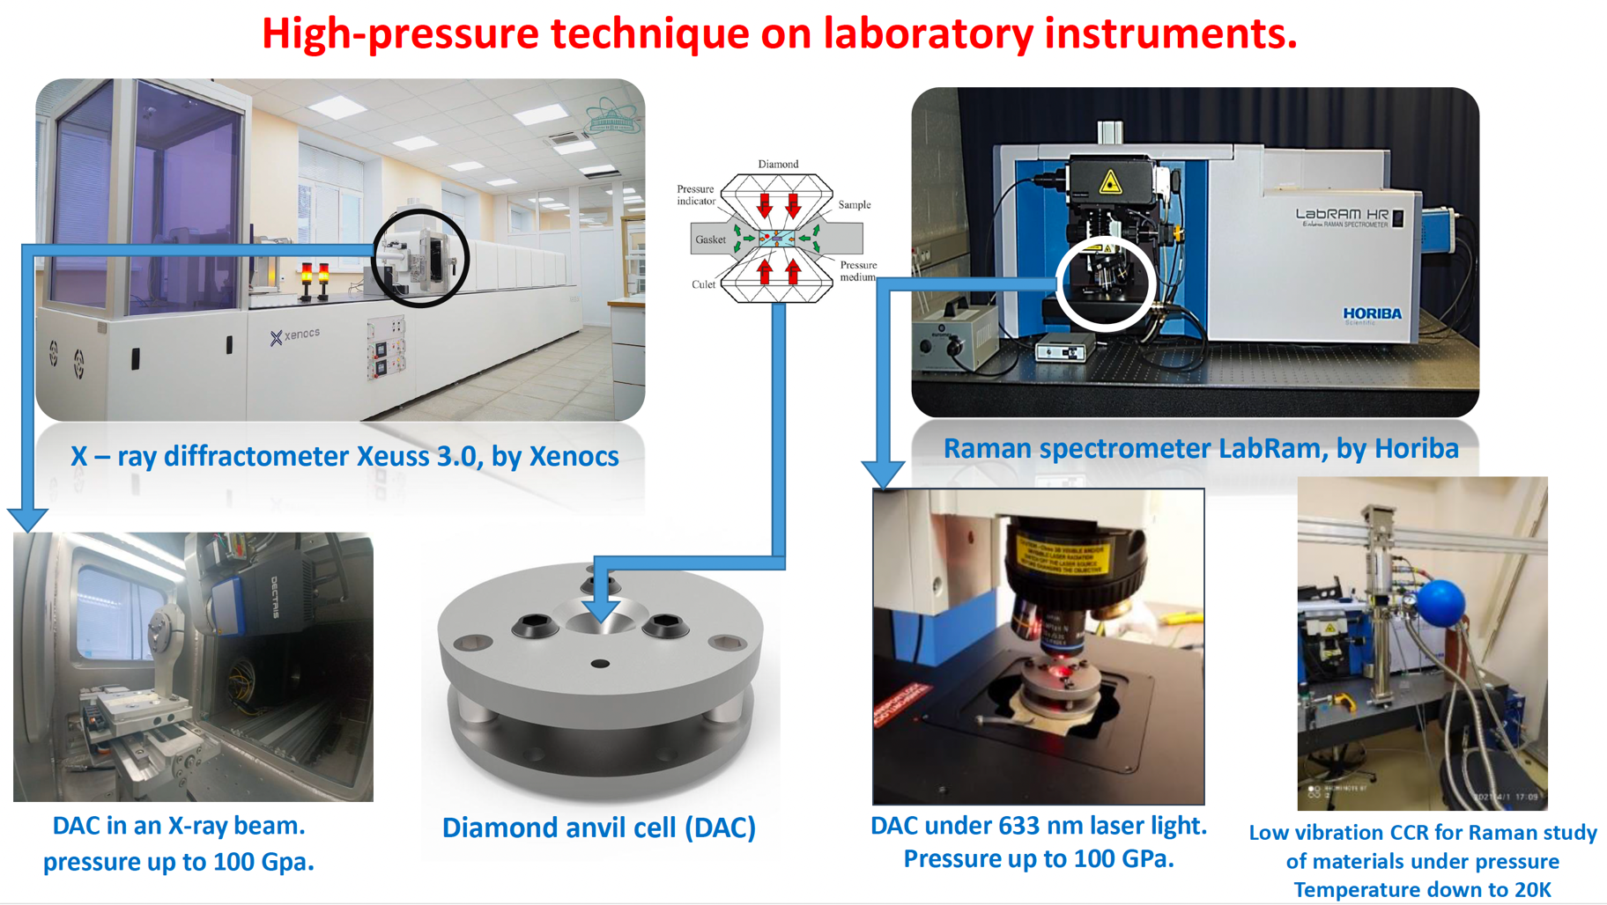
DN-6 diffractometer
The PAC heard the report on the current state of the DN-6 diffractometer for the study of materials at ultrahigh pressures, presented by Evgeny Lukin.

Slide 12
DN-6 diffractometer
RESOLUTION OF THE JINR SCIENTIFIC COUNCIL:
The Scientific Council was pleased with the current state of the DN-6 diffractometer for the study of materials at ultrahigh pressures.
In particular, the Scientific Council noted a significant modernization of the instrument, which will improve the quality of experimental data.
Considering that the DN-6 diffractometer is one of the most advanced facilities in the world for neutron scattering studies of materials under extreme conditions, the Scientific Council shared the PAC’s opinion on the continuation of the development of this instrument.

Slide 13
Reports on projects
The PAC took note of the proposal to open a new project, “High-sensitivity sensors based on molecular recognition for virus detection”, presented by Alexander Nechaev.
The PAC also noted the progress report on the project “Protection against physical and chemical stresses with tardigrade proteins (TARDISS)”, presented by Mikhail Zarubin.
RESOLUTION OF THE JINR SCIENTIFIC COUNCIL:
The Scientific Council supported the PAC’s recommendations to open a new FLNR project, “High-sensitivity sensors based on molecular recognition for virus detection”, for its implementation in 2025–2029, and to continue activities within the DLNP project “Protection against physical and chemical stresses with tardigrade proteins (TARDISS)”.

Slide 14
Scientific reports
The PAC heard with interest the scientific reports
“Functional renormalization group approach to some problems of condensed matter physics ” (by Georgii Kalagov)
“Study of phase transitions in cathode materials for sodium-ion batteries” (by Natalia Samoylova)
The PAC thanked the speaker for the excellent reports.

Slide 15
Virtual presentations by young scientists
The PAC reviewed 19 virtual presentations made by young scientists in the field of condensed matter physics and related fields. The virtual poster presentation “Pressure effect on crystal, magnetic structure and vibrational properties of van der Waals materials” made by Olga Lis was selected as the best presentation of the session.
The PAC also noted two more virtual poster presentations of a high level: “Convolutional neural networks for reconstruction of three-dimensional neutron tomography models from incomplete data” by Bulat Bakirov and “The effect of calcium ions on the structure and morphology of lipid membranes in the presence of amyloid-beta peptide” by Sergei Kurakin.
The winners of the virtual poster competition will be awarded at this meeting of the PAC.

Slide 16
Thank you for your attention

