Slide 1
Information on the progress of work at IBR-2 in preparation for resumption of reactor operation
Egor Lychagin
Joint Institute for Nuclear Research

Slide 2
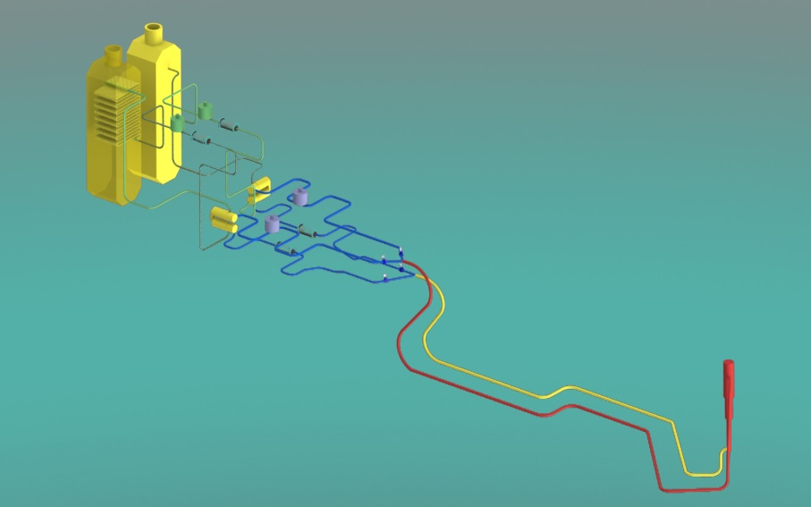
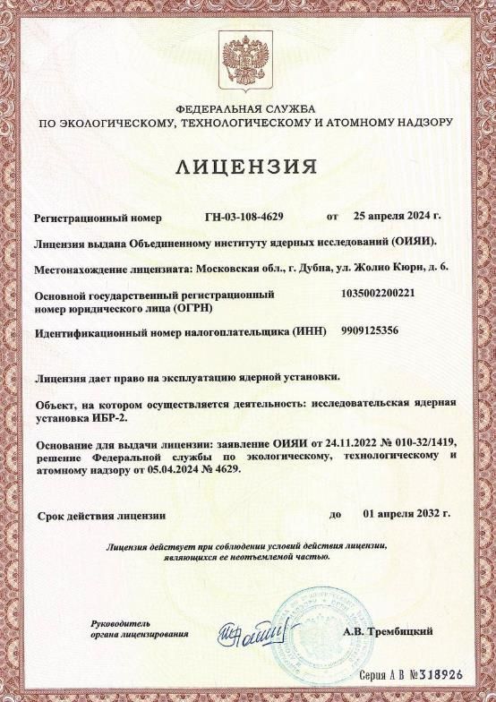
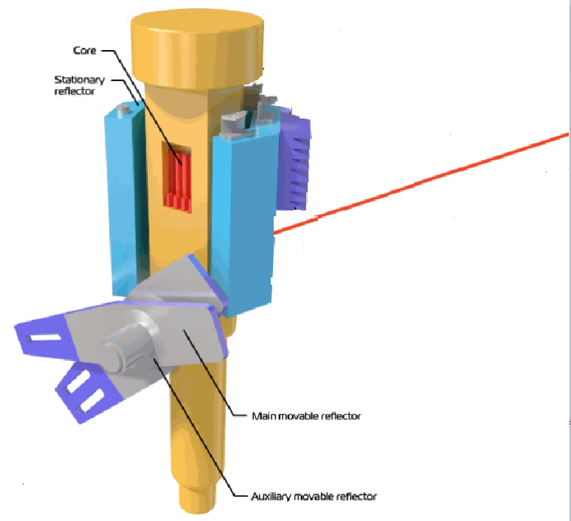
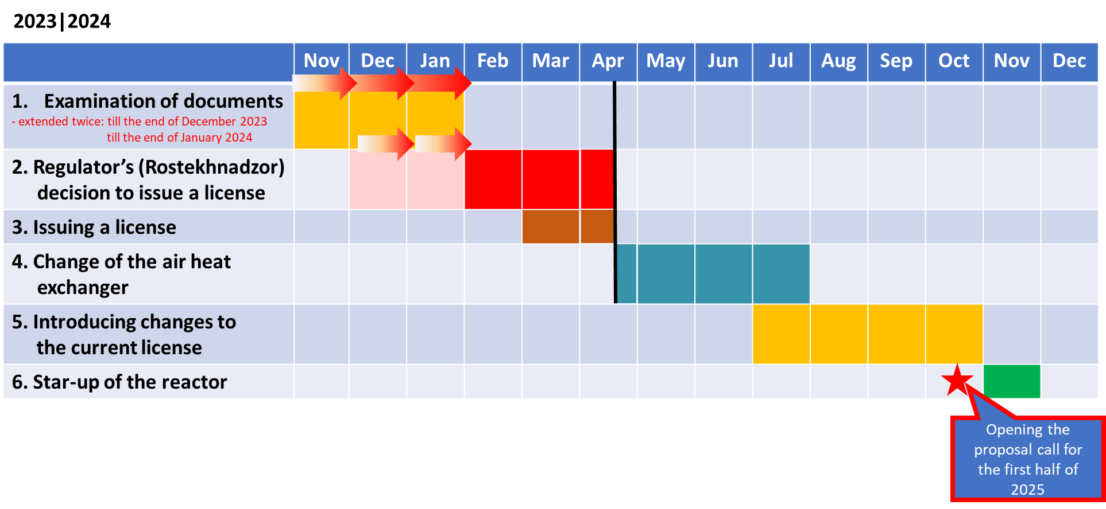
October 16, 2021 – reactor shutdown due to a leak in the secondary cooling circuit of the air heat exchanger (HE)
Repair of the faulty HE (safety regulations require operation of 2 HE) was carried out in April 2021;
On April 25, 2024, a license was received from ROSTEKHNADZOR for the operation of the IBR-2 research nuclear facility until April 1, 2032;
Primary circuit
April 25 2024
Core
Secondary circuit
Our plan at the beginning of 2024 and the previous PAC.
By the end of the summer, it became clear that the technical work could only be completed by the end of the year.

Slide 3
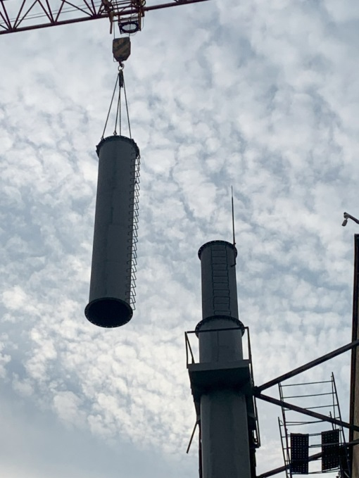
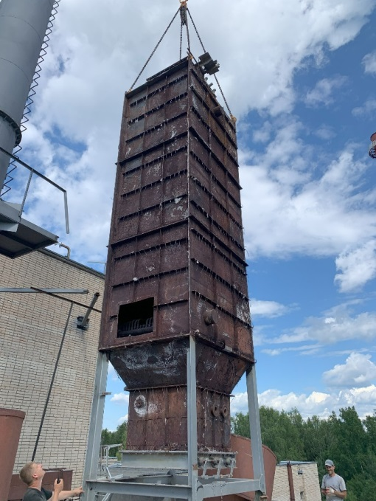
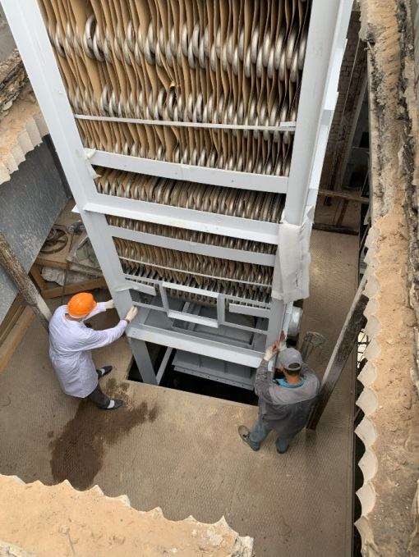
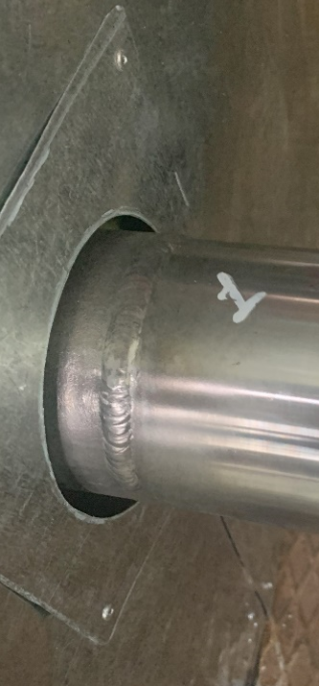
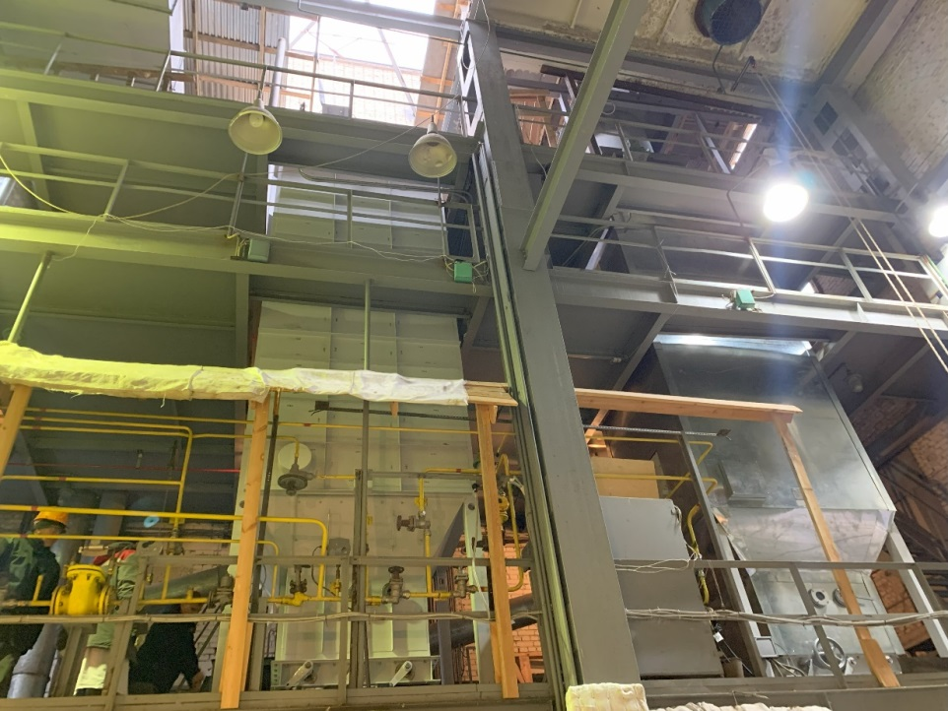
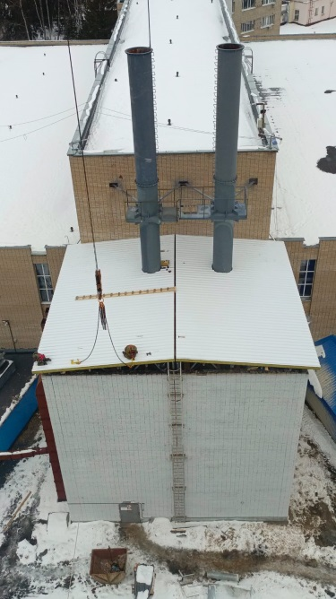
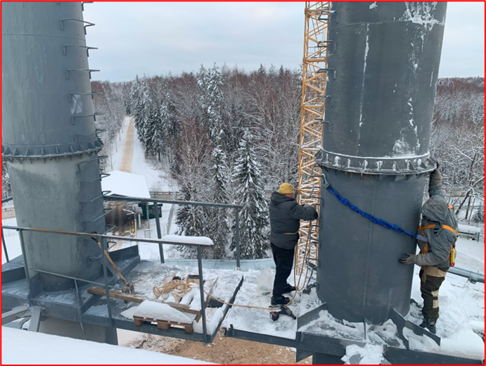
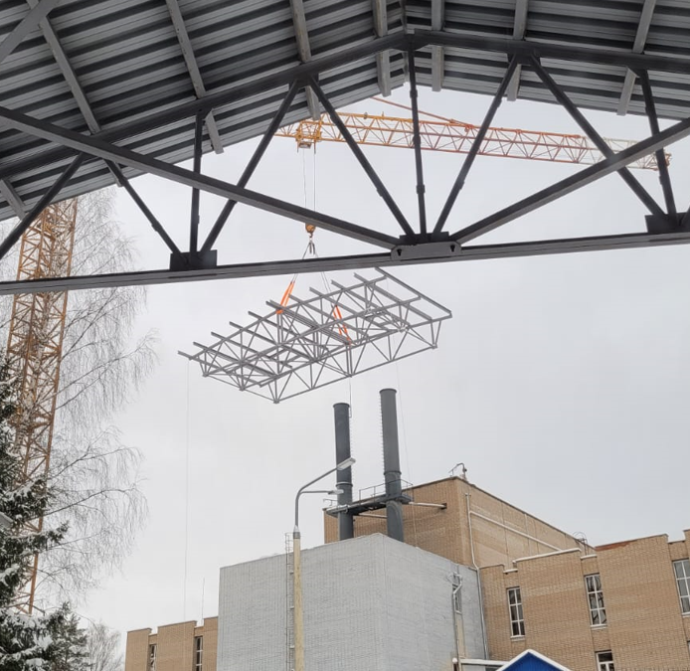
The replacement of the air heat exchanger (HE) was carried out step by step under the control of all technological stages by Rostekhnadzor.
Welding of
sodium
pipelines
Dismantling of pipes
Dismantling of the old HE
Installation of a new HE
Installation of pipes and construction of ceilings
Heat exchanger
before dismantling
Operating new heat exchanger
By the end of 2024, the work on replacing the Na-Air heat exchangers was fully completed.

Slide 4
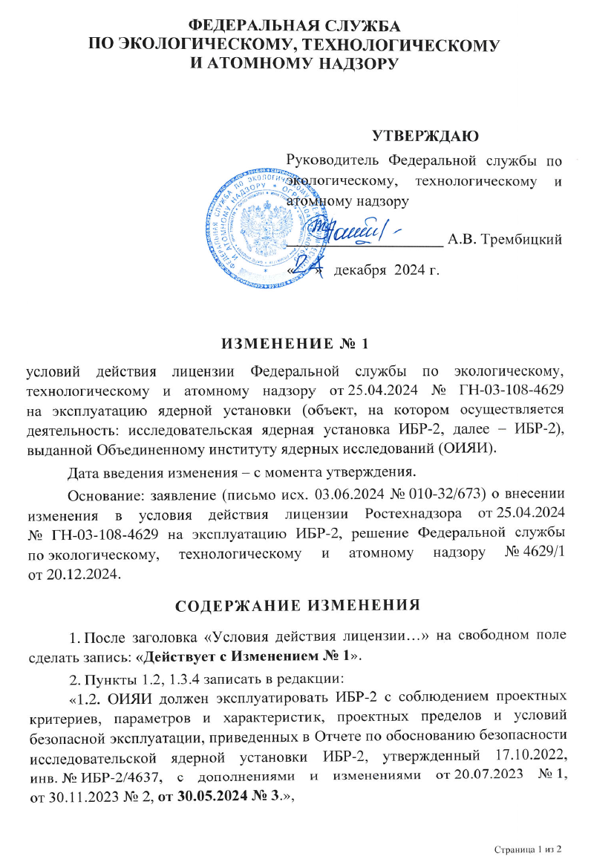
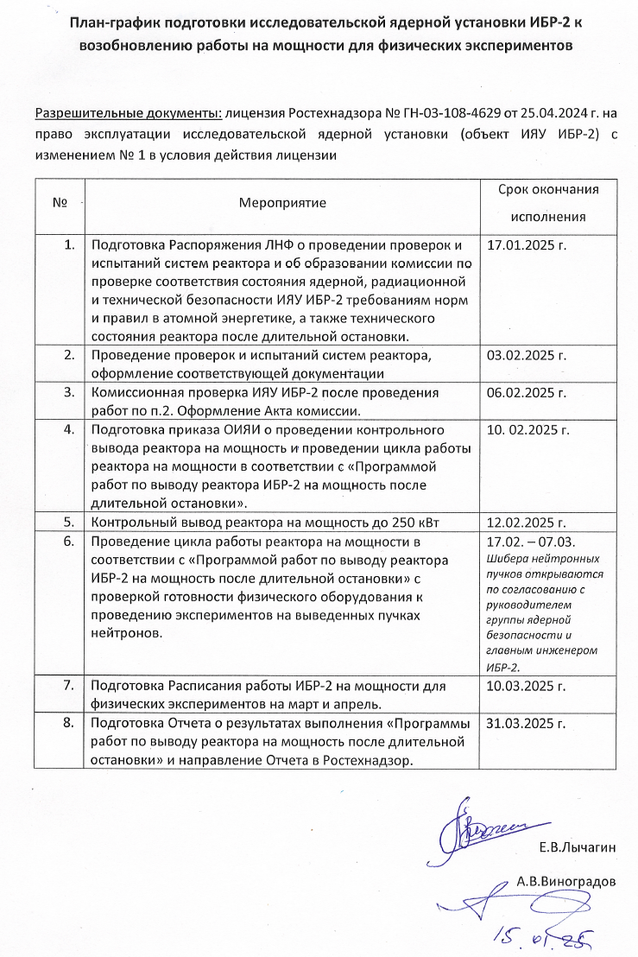
On December 24, 2024, an addendum to the license was received from Rostekhnadzor. It permits bringing the IBR-2 to power.
A plan was prepared to resume the operation of IBR-2 nuclear facility at power.
Test cycle of the reactor operation with a gradual increase in power and first experiments are planned for February 17, 2025.
In spring 2025, beam time in operation cycles will be allocated to JINR researchers and for fast-access requests. The reactor operation power for these cycles will be chosen based on the test cycle results.
Resumption of the User Program is scheduled for autumn 2025.

Slide 5
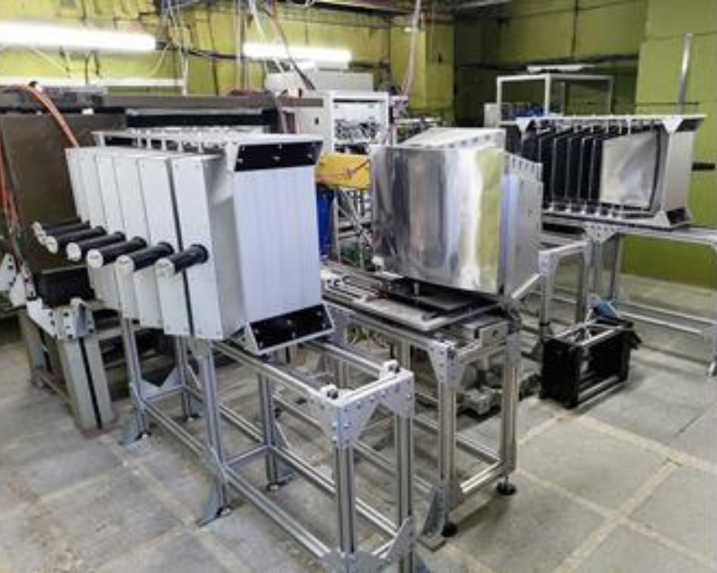
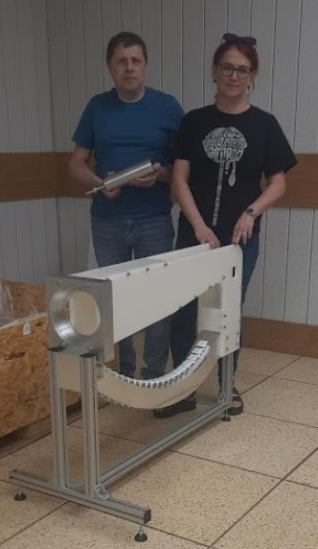
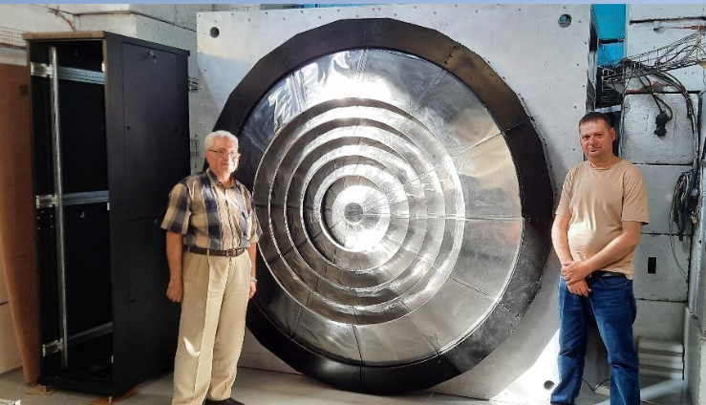
Modernization and development of instruments
Work on upgrading the instruments and preparing them for the resumption of the reactor operation was carried out throughout the entire period of the reactor shutdown. (Detailed report about this was presented by V.Bodnarchuk at the last Meeting).
On January 21, 2025, a joint Scientific and Technical Council of two departments (Department of Neutron Investigations of Condensed Matter and Department of the Spectrometers’ Complex of IBR-2) was held with a discussion on the readiness of the instruments for the resumption of the reactor operation.
Most of the instruments will be ready by February 17.
Today, the Head of the Department of Neutron Investigations of Condensed Matter D.Kozlenko will present detailed information about the situation.
Cryogenic moderators will be ready for operation in the cycles following the reactor test cycle.

Slide 6
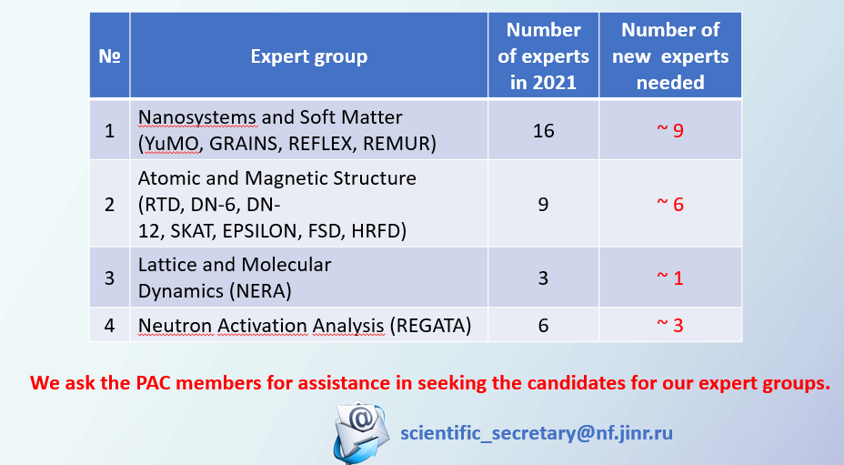
Resumption of the User Program
Upon successful completion of the test reactor cycle, the call for proposals for the second half of the year will be opened in spring 2025.
We still do not have enough experts to evaluate proposals. We have found 5 new experts during the past six months, but this does not fully cover our needs.
Unfortunately, we have not received any nominations from the PAC members.
At previous PAC meeting
We plan to disseminate information about the resumption of the reactor operation and related research opportunities as widely as possible among our users and potential new partners in the JINR Member and Non-Member States. We would appreciate suggestions on possible options.

Slide 7
2026
?

Slide 8
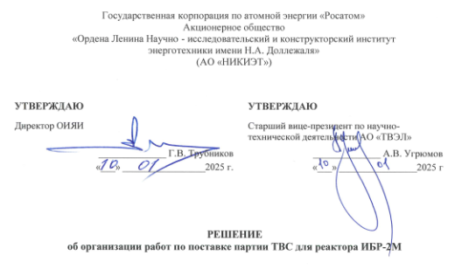
Prospects for the operation of IBR-2
Today, the most important task of the Laboratory is the longest possible operation of the IBR-2 reactor at high power.
Since the fuel degradation process during operation forces a reduction in power, we are exploring the possibility of manufacturing a new fuel load that should allow return the reactor to a power close to nominal.
On January 10, 2025, the Decision on the organization of the necessary works to accomplish this task was signed.
Successful completion of this task opens up the prospect of operating IBR-2 until the early 2040s (if other necessary tasks as licensing etс. will be solved).

Slide 9
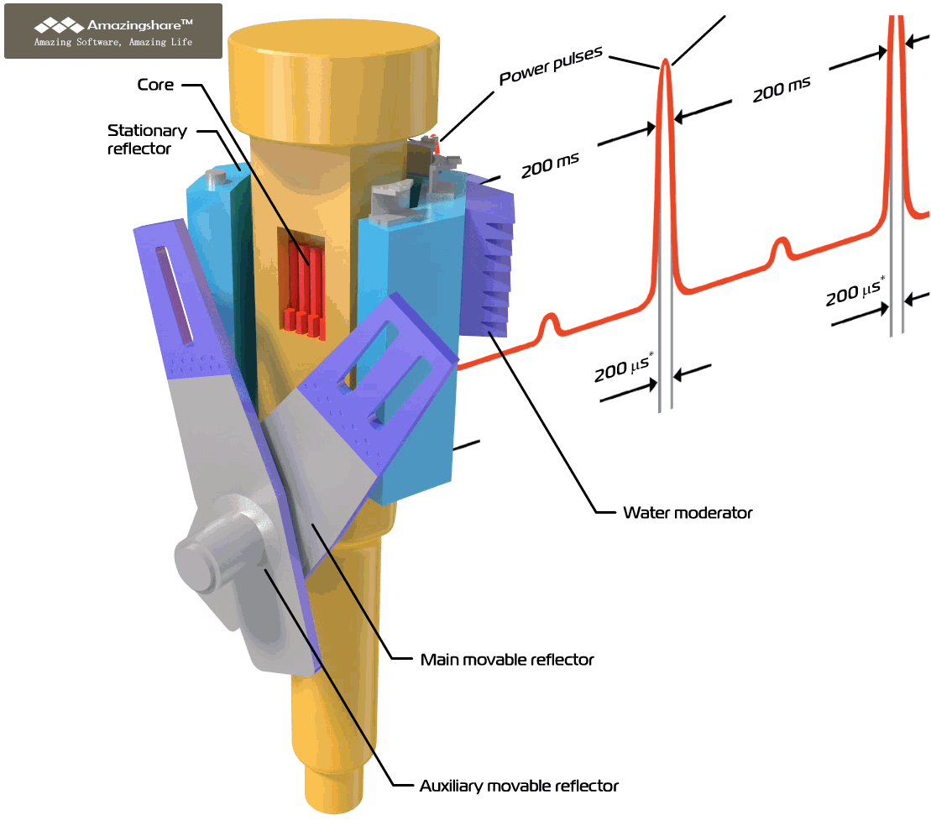
Thank you for attention

