Slide 1
Spectrometer Complex of the IBR-2 High Flux Pulsed Reactor: Current State and Recent Developments
D.P. Kozlenko
Frank Laboratory of Neutron Physics, Joint Institute for Nuclear Research, 141980 Dubna, Russia

Slide 2
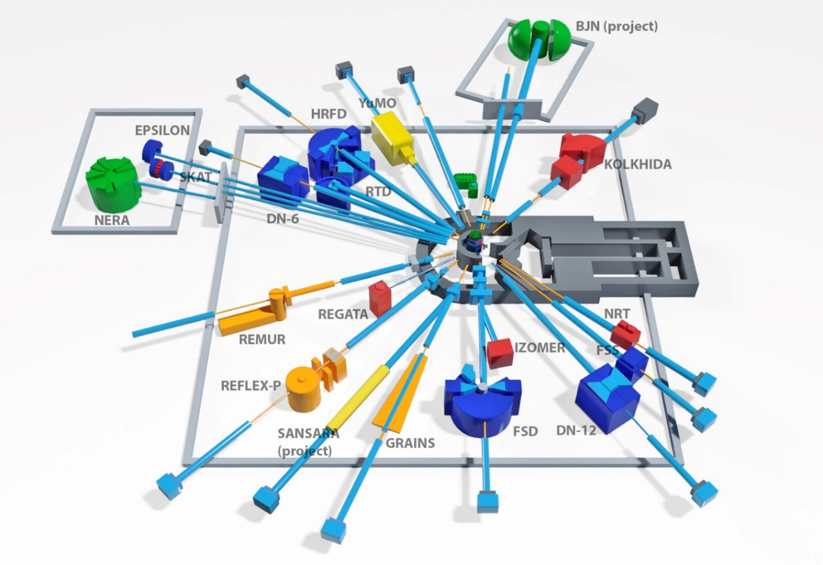
SPECTROMETER COMPLEX OF IBR-2
Diffractometers:
HRFD, DN-6, RTD, DN-12, FSD, SKAT, Epsilon, FSS
Reflectometers:
REMUR, REFLEX, GRAINS
Small Angle Scattering Spectrometer: YuMO
Inelastic Neutron Scattering Spectrometer:
NERA
Radiography and Tomography Spectrometer:
NRT
14 instruments for condensed matter research,
2 in development stage
New Instruments in development:
Small Angle Neutron Scattering and Imaging (Radiography and Tomography) Spectrometer
BJN (INS in inverted geometry)

Slide 3
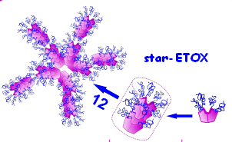
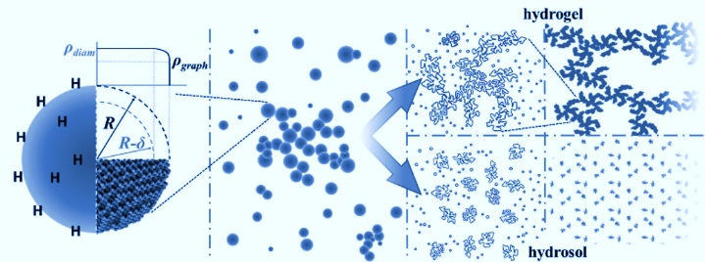
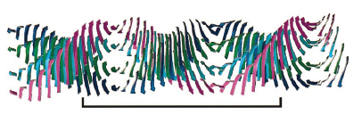
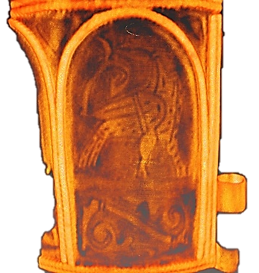
Main research directions :
1. Condensed Matter Physics and Materials Science,
2. Physics of Nanosystems and Nanoscale Phenomena,
3. Physics of Complex Liquids and Polymers,
4. Biophysics and Pharmacology,
5. Applied Materials and Engineering Sciences.

Slide 4
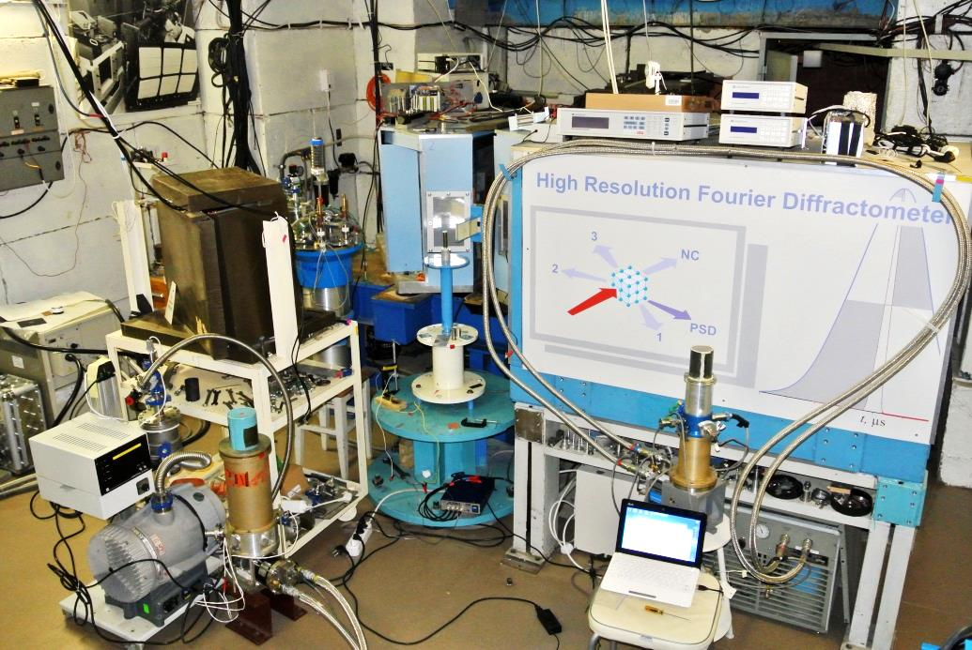
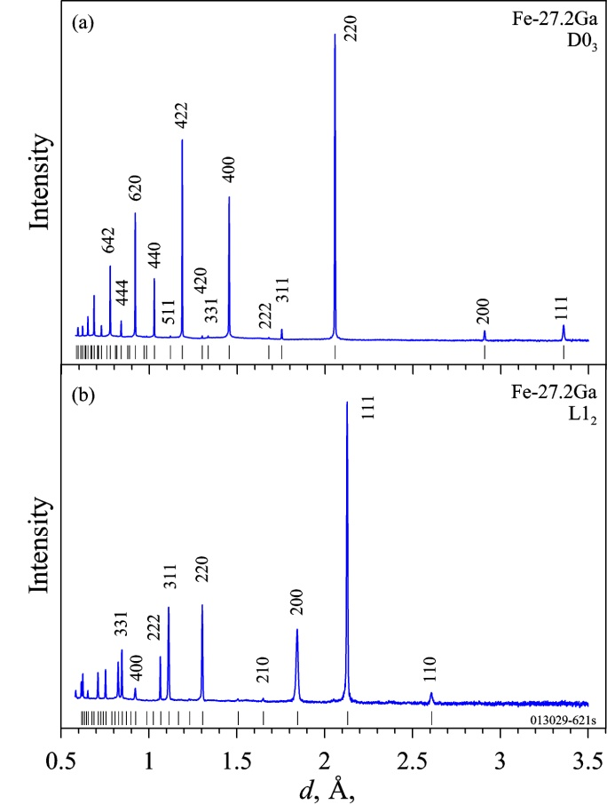
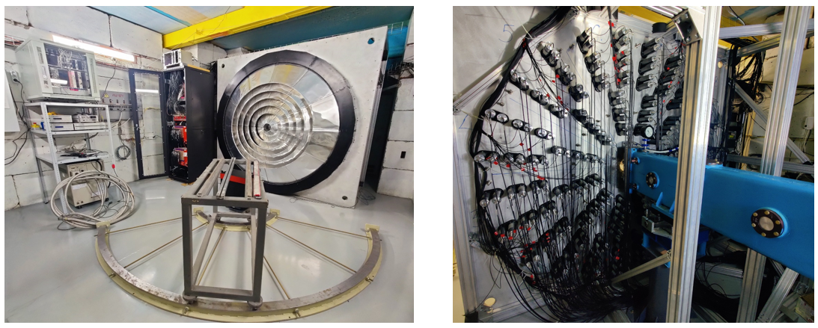
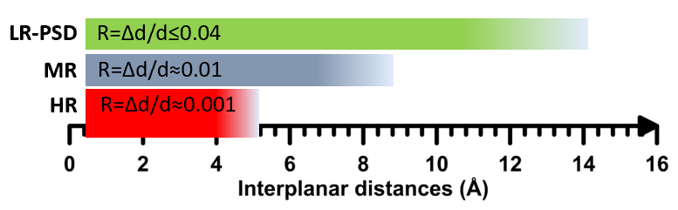
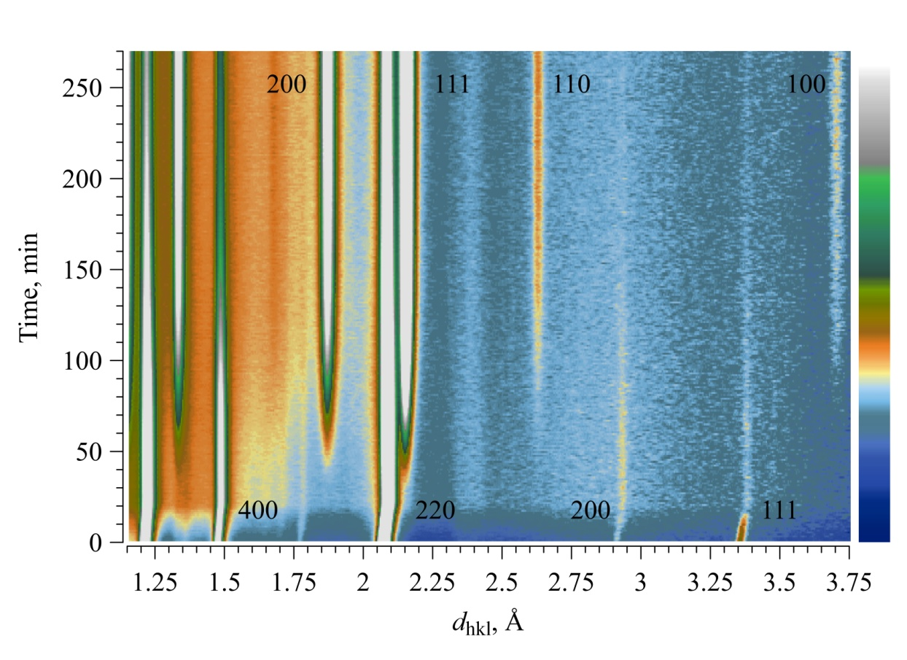
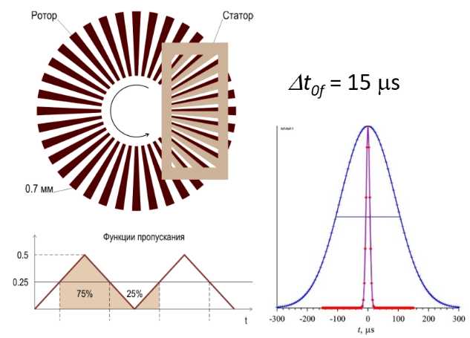
High resolution Fourier Diffractometer
For precise studies of crystal structure and microstructure of materials
Development of the backscattering detector system with a large solid angle
Sub-project 04-4-1149-3-1-2021/2028 “Construction of a wide-aperture backscattering detector (BSD-A) for the HRFD diffractometer”, leader V.M.Milkov
Basic Parameters
Type of detector Scattering angles range | scintillation ZnS(Ag) with time-focusing geometry 2θ = (133−175)°.
Total solid angle | ∼2.0 sr (12.5 times greater than the existing one)

Slide 5
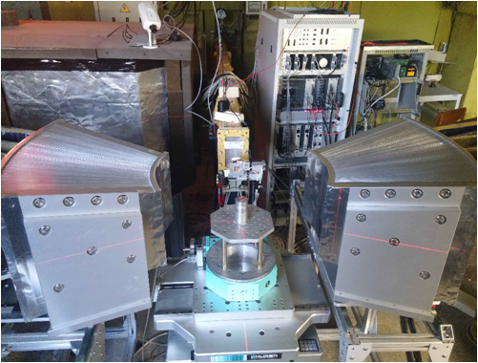
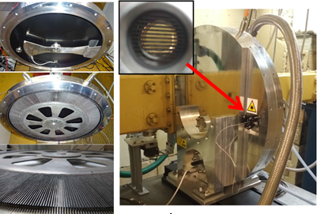
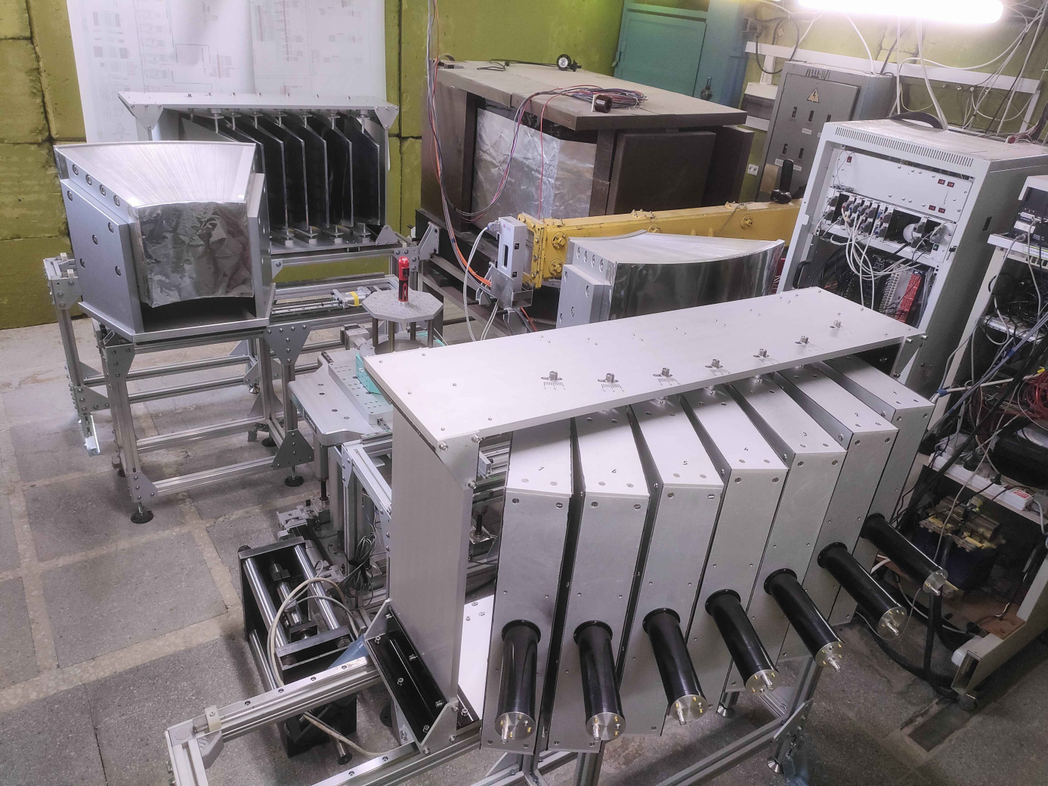
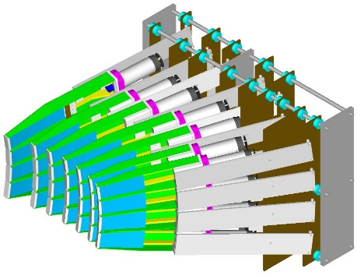
Fourier Stress Diffractometer
for studies of internal stresses in constructional materials and industrial products
New Fourier Chopper (Airbus Defense and Space), fabricated in the end of 2020)
ASTRA detector system: 14 new modules were installed at scattering angles 2θ = ±90°
Gauge volume of 1.8 mm
3D model of 90° ASTRA detector made of 7 elements with time focusing geometry)
Arrangement of sensitive ZnS(Ag) layers of the ASTRA 90°-detector in the horizontal scattering plane
Beam profiles:
analytical calculations and Monte Carlo simulation
High-resolution RTOF diffraction pattern measured with a new Fourier chopper on a standard α-Fe sample
The expected increase in the intensity of registered neutrons is about 1.5 times.

Slide 6
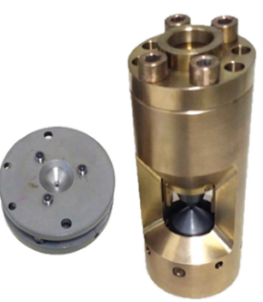
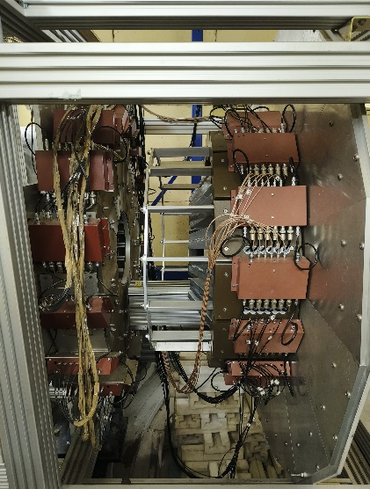
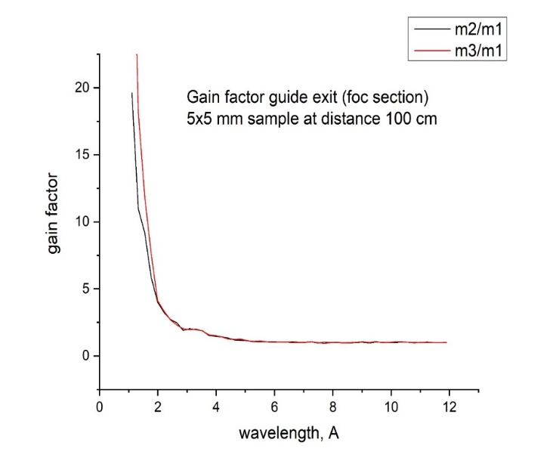
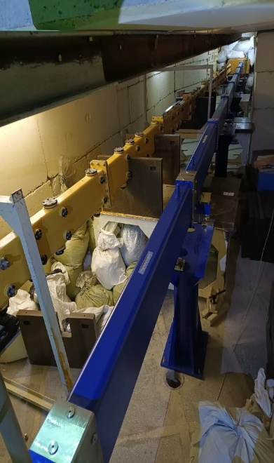
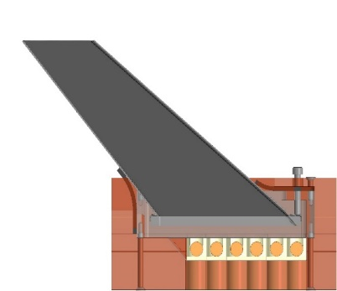
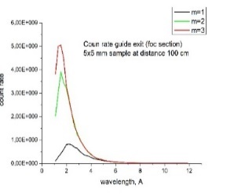
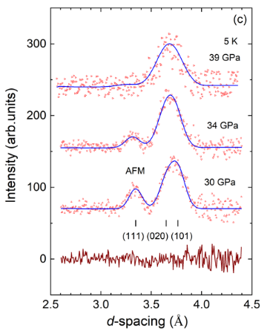
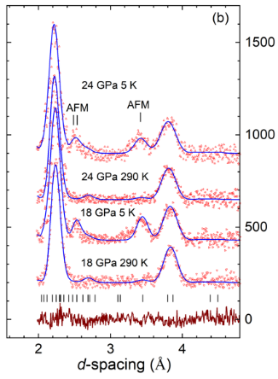
DN-6 Diffractometer
for studies of crystal and magnetic structure of materials at ultrahigh pressures up to 40 GPa
Replacement of the central part of the neutron guide (from m = 1 to m = 3, made by SwissNeutronics)
Upgrade of the detector system: new forward scattering bank (2θ=32-54°)
Expected intensity gain ≈ 2 times
Diamond anvil cells (DAC), Almax plate (left) and home-made (right) design
Minimal sample volume: V ~ 0.02 - 0.05 mm³
General view of the upgraded detector system, the new detector bank on the right . It contains 15 independent modules
arranged in a ring. Design of one module composing of 6 independent ³He neutron counters
Calculated dependence of the gain factor
of the flux density on the neutron wavelength
for different coating for side mirrors
of curved neutron guide: m2, m3 vs m1
Insertion of a new curved neutron guide
section with m=3 side coating
into the beam delivery system
of DN-6 diffractometer
The upgraded detector system will provide new opportunities for studies of magnetic structures of materials in the extended d-spacing range 0.8 – 12 Å.
Neutron diffraction patterns of LaMnO₃ measured at pressures up to 39 GPa

Slide 7
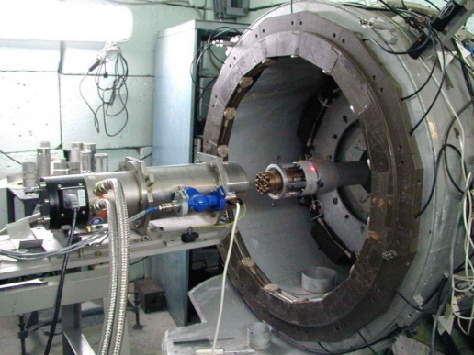
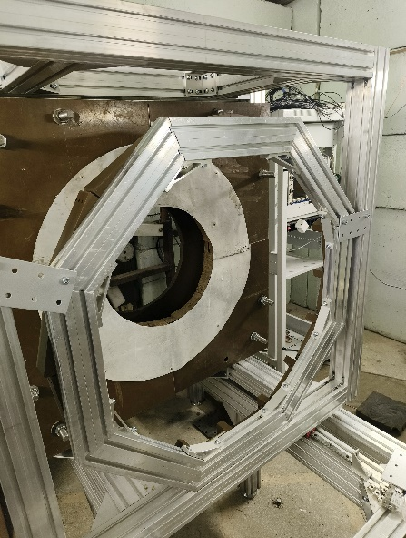
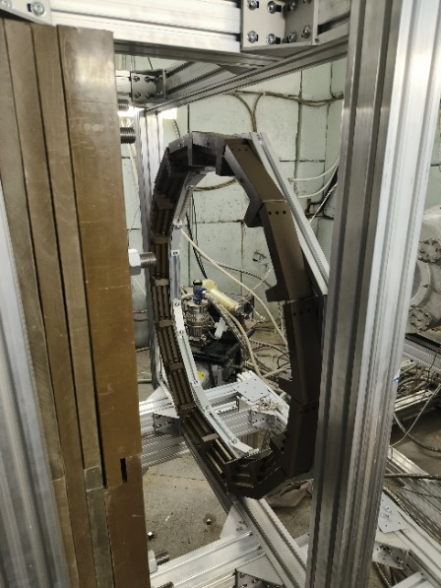
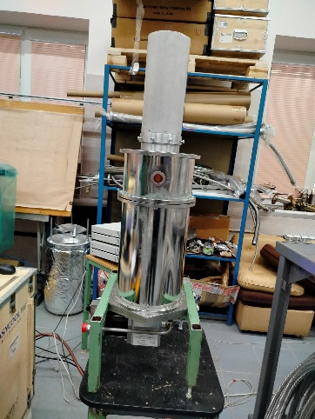
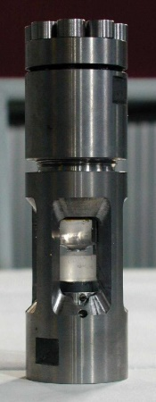
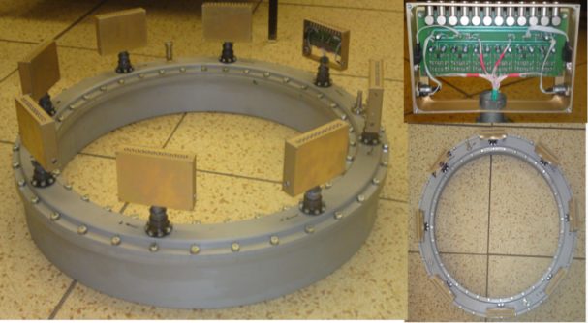
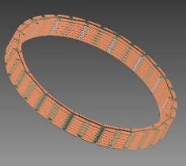
DN-12 Spectrometer
for studies of crystal and magnetic structure of materials at high pressures up to 7 GPa and microsamples
Upgrade of the detector system and sample environment:
Installation of the multisectional ³He detector module (2θ=90°), consisting of 96 independent counting elements in the common gas volume.
Upgrade of the forward scattering detector module (2θ=45°) by installation of 2 additional circular arrays of individual ³He counters (16 counters in each array) to available one.
Development of new cryostat based on CCR (min T ~ 5 K)
DN-12 spectrometer (view before Dec 2024)
Detector system of DN-12
Detector modules at 2θ=90 (left) and 45° (right)
New cryostat
Sapphire anvil cell
The expected increase in the intensity of registered neutrons is up to 6 times (2θ=90°) and 2-3 times (2θ=45°).
The expected increase in the accessible pressure range from 7 to 10-12 GPa.
The expected reduction of the minimal sample volume from 1.0 to 0.2-0.5 mm³.

Slide 8
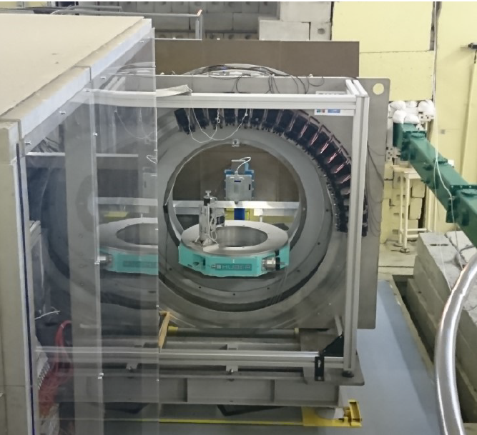
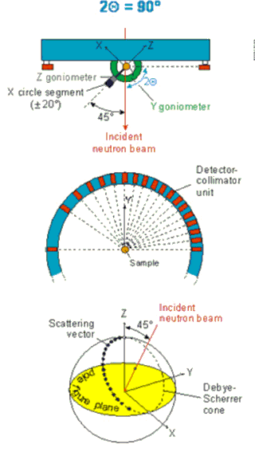
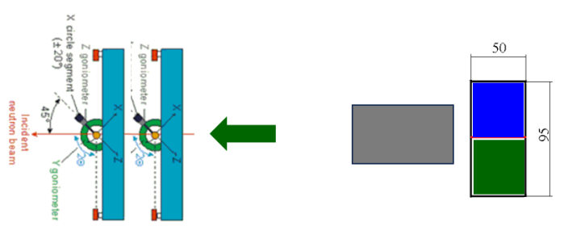
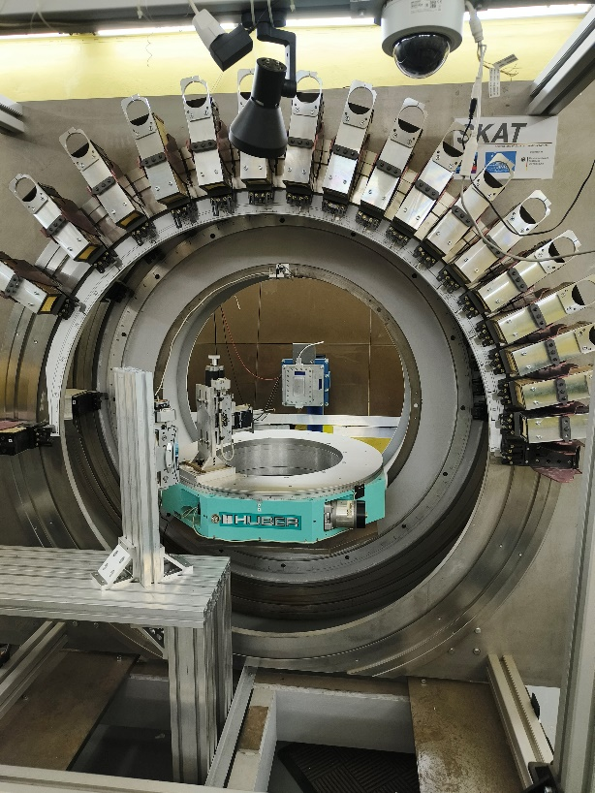
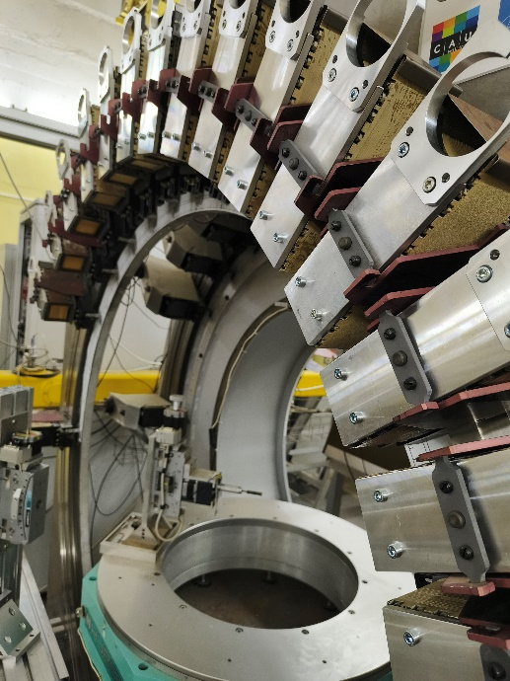
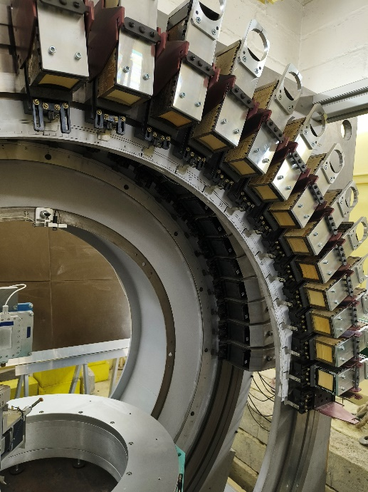
SKAT Diffractometer
for texture analysis of earth rocks, materials, biological and paleontological objects
Operated before 2022 in collaboration with the Bonn University, Prof. N.Froitzheim group, Germany)
Installation of an additional detector module behind the existing one with the same scattering angle and geometry and split of neutron beam into two parts.
The electronics for the second module is fabricated, the manufacturing of detector pre-amplifiers and installation of neutron counters is planned in 2025.
The second goniometer unit is installed.
Typical sample measurement time: 24-48 h.
Measurement demands exceed possibility in 2-3 times.
Crystallographic Preferred Orientations (CPO) in eclogites
Two samples could be measured simultaneously in two experimental positions.
The number of experiments will be increased in 2 times.

Slide 9
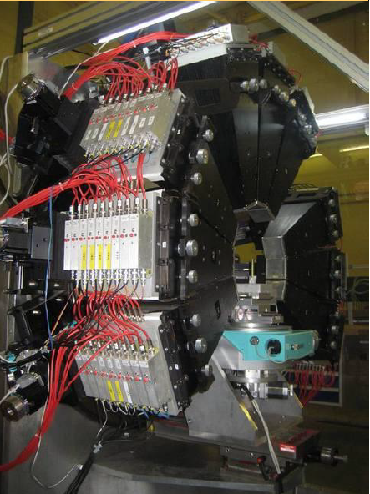
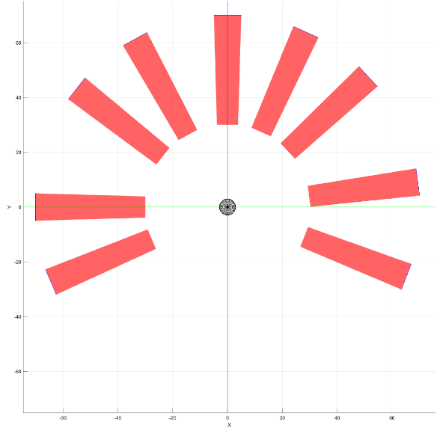
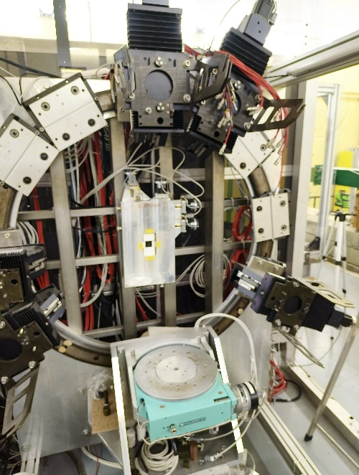
EPSILON Diffractometer
Operated before 2022 in collaboration with the KIT, Prof. F.Schilling group, Germany)
Upgrade for texture analysis:
With minor changes of orientation of the detector system elements with respect to the sample position Epsilon could be used for texture measurements with a pole figure measurement grid varied from 15 x 15 to 7.5 x 7.5 deg.
Replacement of old ³He counters (being in operation for about 25 years) by new ones. Expected intensity gain up to 2 times.
Previous use: stress and strain measurements in earth rocks and construction materials.
Demand for experimental time was insufficient.
Most Users were from Germany and Poland.
Extension of research program: upgrade for texture measurements (geophysics, cultural heritage, materials science).
Epsilon spectrometer (view before Nov 2024)
Calculated positions of detector modules for texture measurements

Slide 10
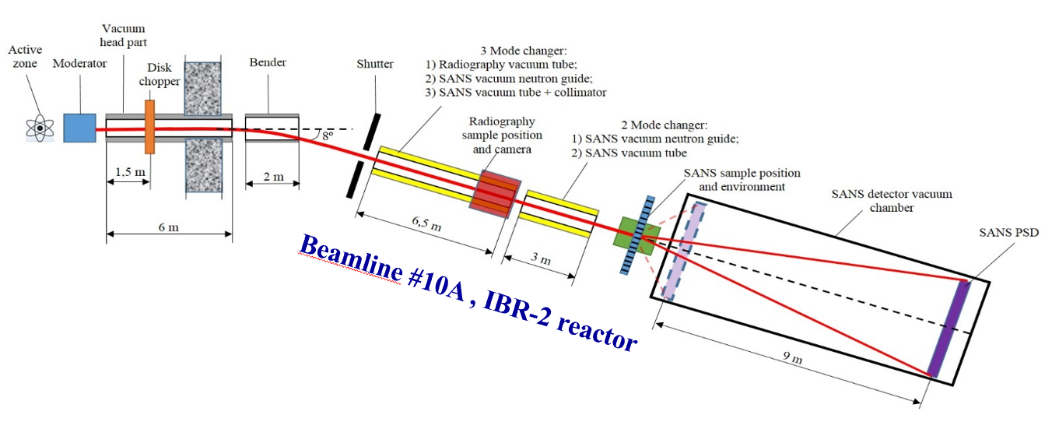
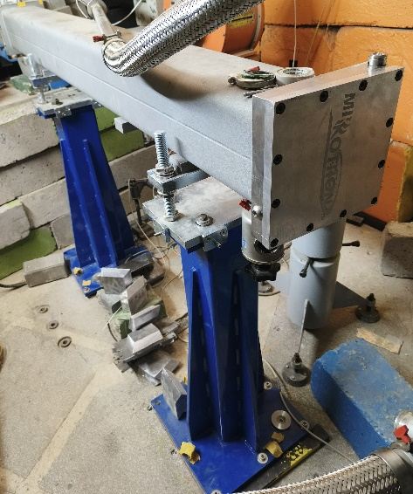
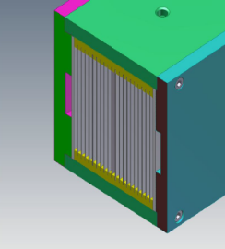
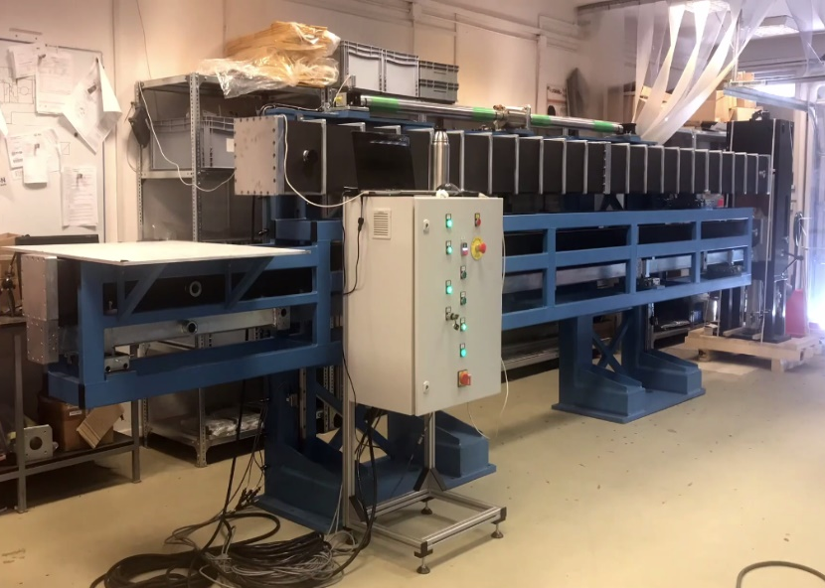
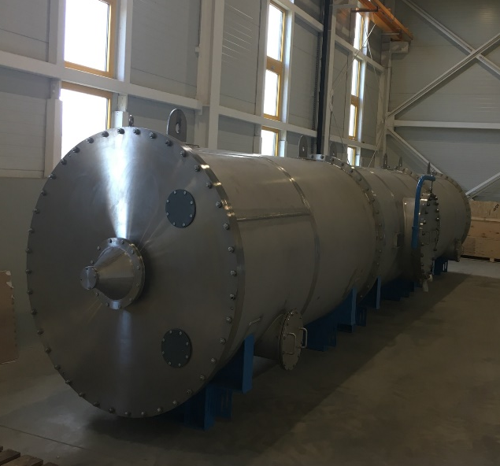
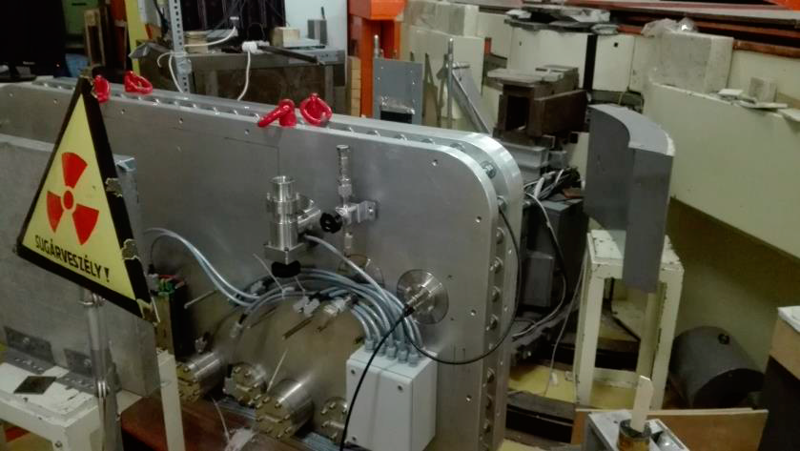
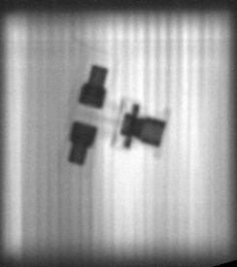
Small-Angle Neutron Scattering and Imaging Spectrometer
Expected parameters
Beam size | 50×50 mm²
Wavelength range: | 0.5 – 10 Å
q-range: | 0.003 – 0.5 Å⁻¹
Angular resolution | 5 - 20 %
Max. sample size | 50×50 mm²
Flux at sample | 2.0×10⁶ cm⁻² s⁻¹
Detector, PSD | ³He, 70×70 cm², resolut. 5×5 mm²
Current State
Bender
Changeable beam forming system
Vacuum tank for PSD
PSD
Produced by Mirrotron (Hungary)
L = 2 m, R = 14 .3 m, N = 20 ( m = 2)
L = 6 m
D = 1.6 m, L = 12 m
Delivered to JINR, in preparation for installation
Delivery is delayed, considered for 2025
Installed at IBR-2
Delivered to JINR

Slide 11
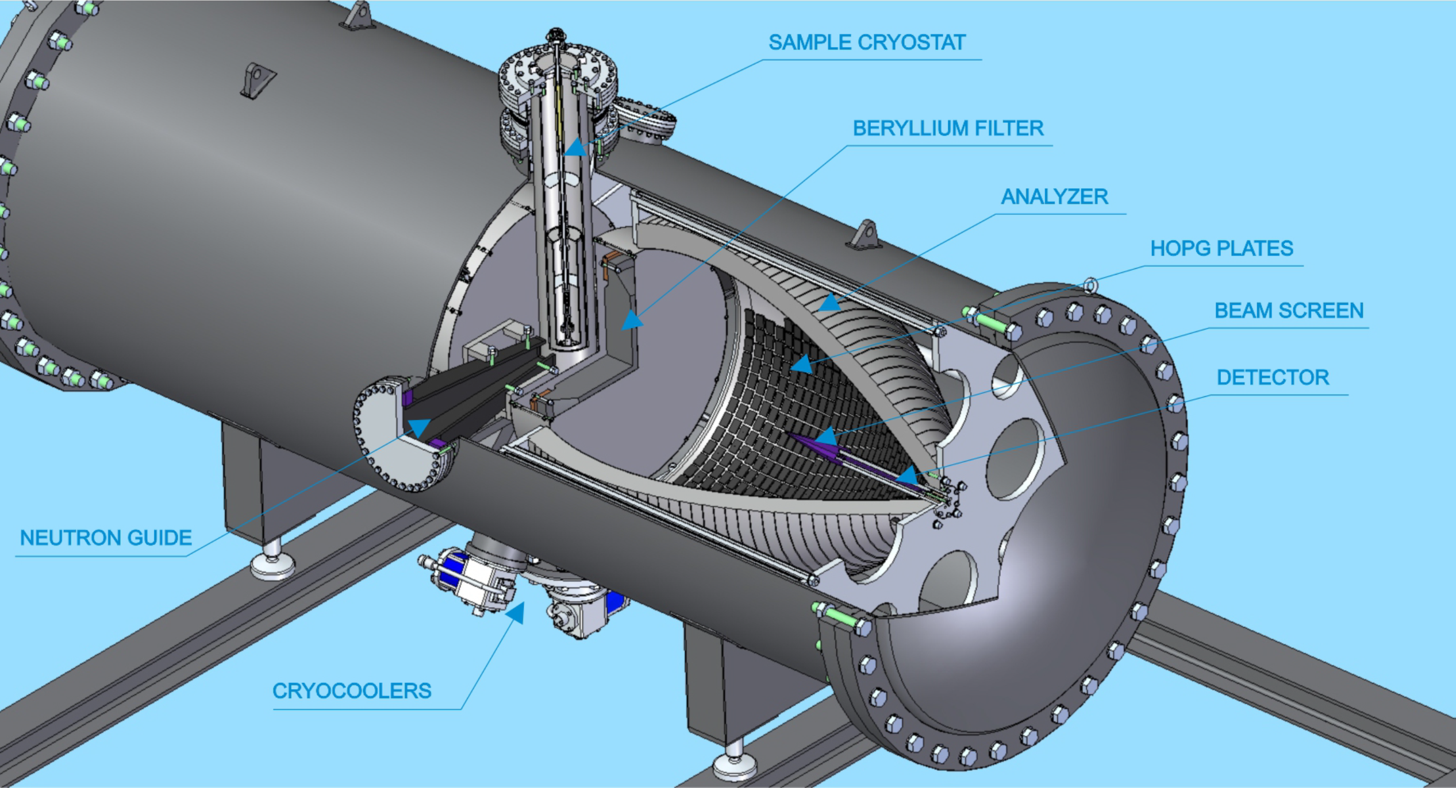
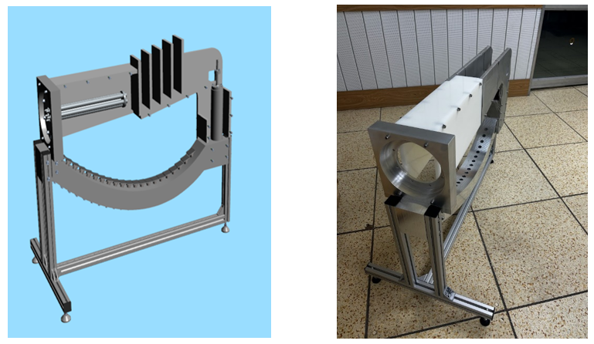
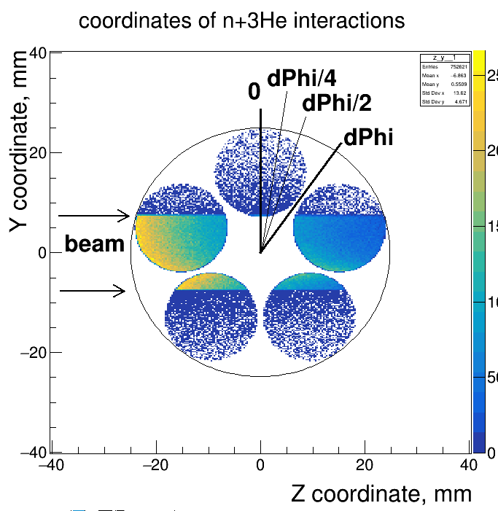
Progress in Development of New Inelastic Scattering Spectrometer in Inverse Geometry BJN
A prototype element of the focusing analyzer of the new inelastic neutron scattering spectrometer BJN was designed and fabricated, delivered to Dubna (Frako-Term, Poland).
Schematic layout of BJN
The ³He counters for the detector system are purchased and development of the detector system is in progress.
250 HOPG crystals were purchased and their quality was tested at IR-8 reactor (NRC KI).
The prototype element of the focusing analyzer will be equipped with the HOPG crystals and test measurements will be planned at one of the available neutron beams of IBR-2.
Bell-shaped analyzers composed of sets of highly oriented pyrolytic graphite (HOPG) single crystals
Detector system: two assemblies of cylindrical ³He counters d=18 mm (analogue of SNM-18), 5 counters each.

Slide 12
Thank You for Your Attention!

