Slide 1

Neutron tomography for structural analysis of cement materials, rocks and meteorites
Zel I.Yu.,
S.E. Kichanov, D.P. Kozlenko, K. Nazarov, M. Kenessarin, M. Petružálek, T. Lokajíček, I. Porosnicu, P. Schnabl, P. Pruner, T.I. Ivankina, M. Balasoiu, M. Nicu, L. Ionascu, A.C. Dragolici, F. Dragolici, B. A. Abdurakhimov, A. K. Kirillov, I. K. Lapina, Y. L. Mentsin, O. Lis, E. Myrzabekova, M. Tashmetov, K. Ishbaev, K. Kosbergenov, O.G. Duliu
JINR, Frank Laboratory of Neutron Physics, Russia
State University “Dubna”, Russia
Museum of the History of Astronomy, Sternberg Astronomical Institute, Russia
Institute of Physics, Kazan Federal University, Russia
Institute of Geology of the Czech Academy of Sciences, Czech Republic
Institute of Nuclear Physics, Ministry of Energy of the Republic of Kazakhstan, Kazakhstan
“Horia Hulubei” National Institute of Physics and Engineering, Romania
National Institute for Laser, Plasma and Radiation Physics, Romania
University of Bucharest, Faculty of Physics, Romania
Institute of Nuclear Physics, Academy of Sciences of the Republic of Uzbekistan, Uzbekistan
Institute of Geology and Geophysics Named after Kh.M. Abdullaev, State Committee for Geology of the Republic of Uzbekistan, Uzbekistan

Slide 2
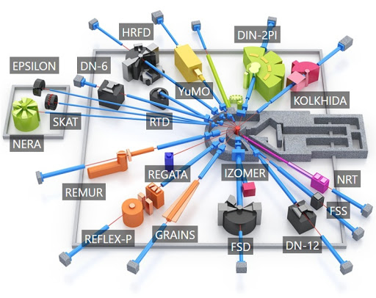
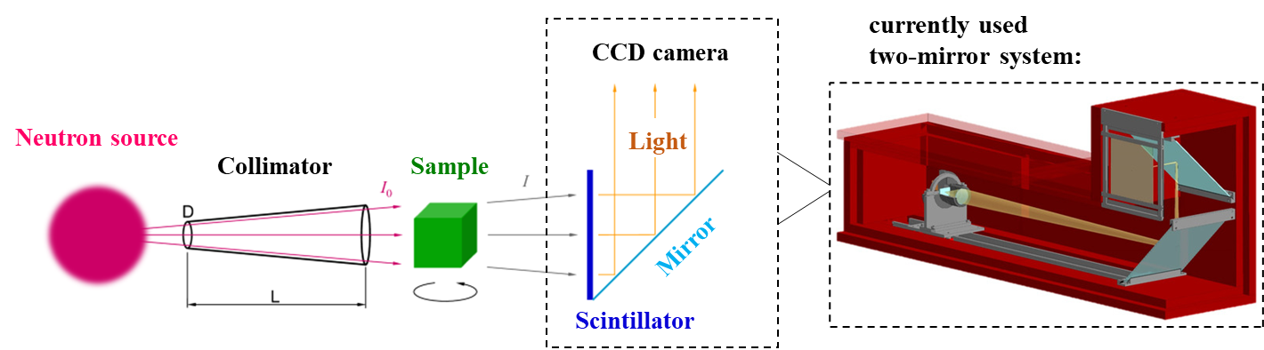
2
1. Neutron tomography at IBR-2
Key parameters:
neutron spectra: 0,2-8 Å
neutron flux: 5.5x10⁶ m/cm²/s
max. field of view: 20x20 cm
(optional) rotation step: 0,5^{о}
(optional) projections number: 360
(optional) exposition: 20 s
(optional) mean meas. time: 4 h
min. voxel size: 52x52x52 µm³
spatial resolution > 140 µm
First experiments in 2014
Principal scheme

Slide 3
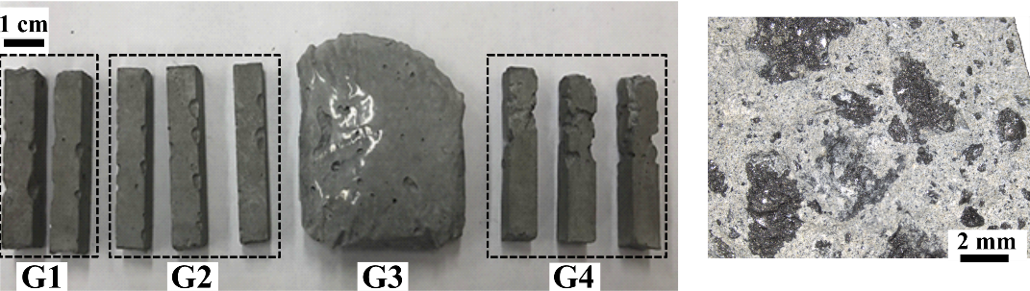
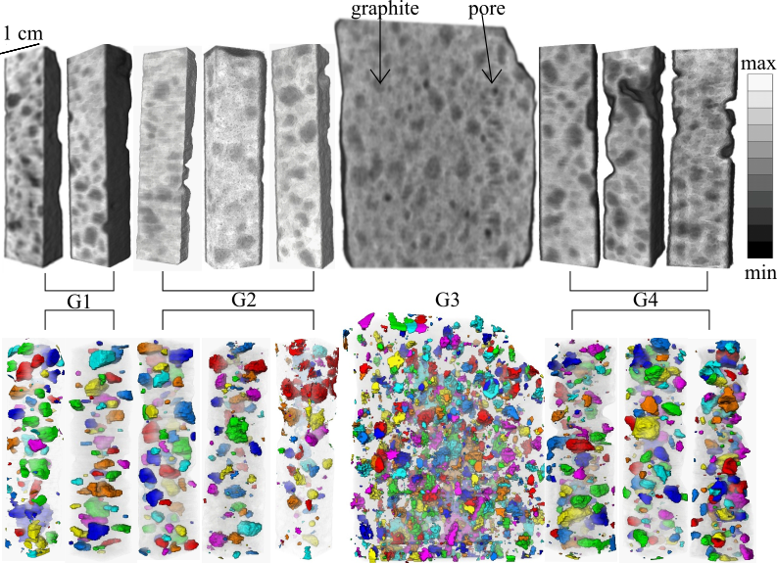
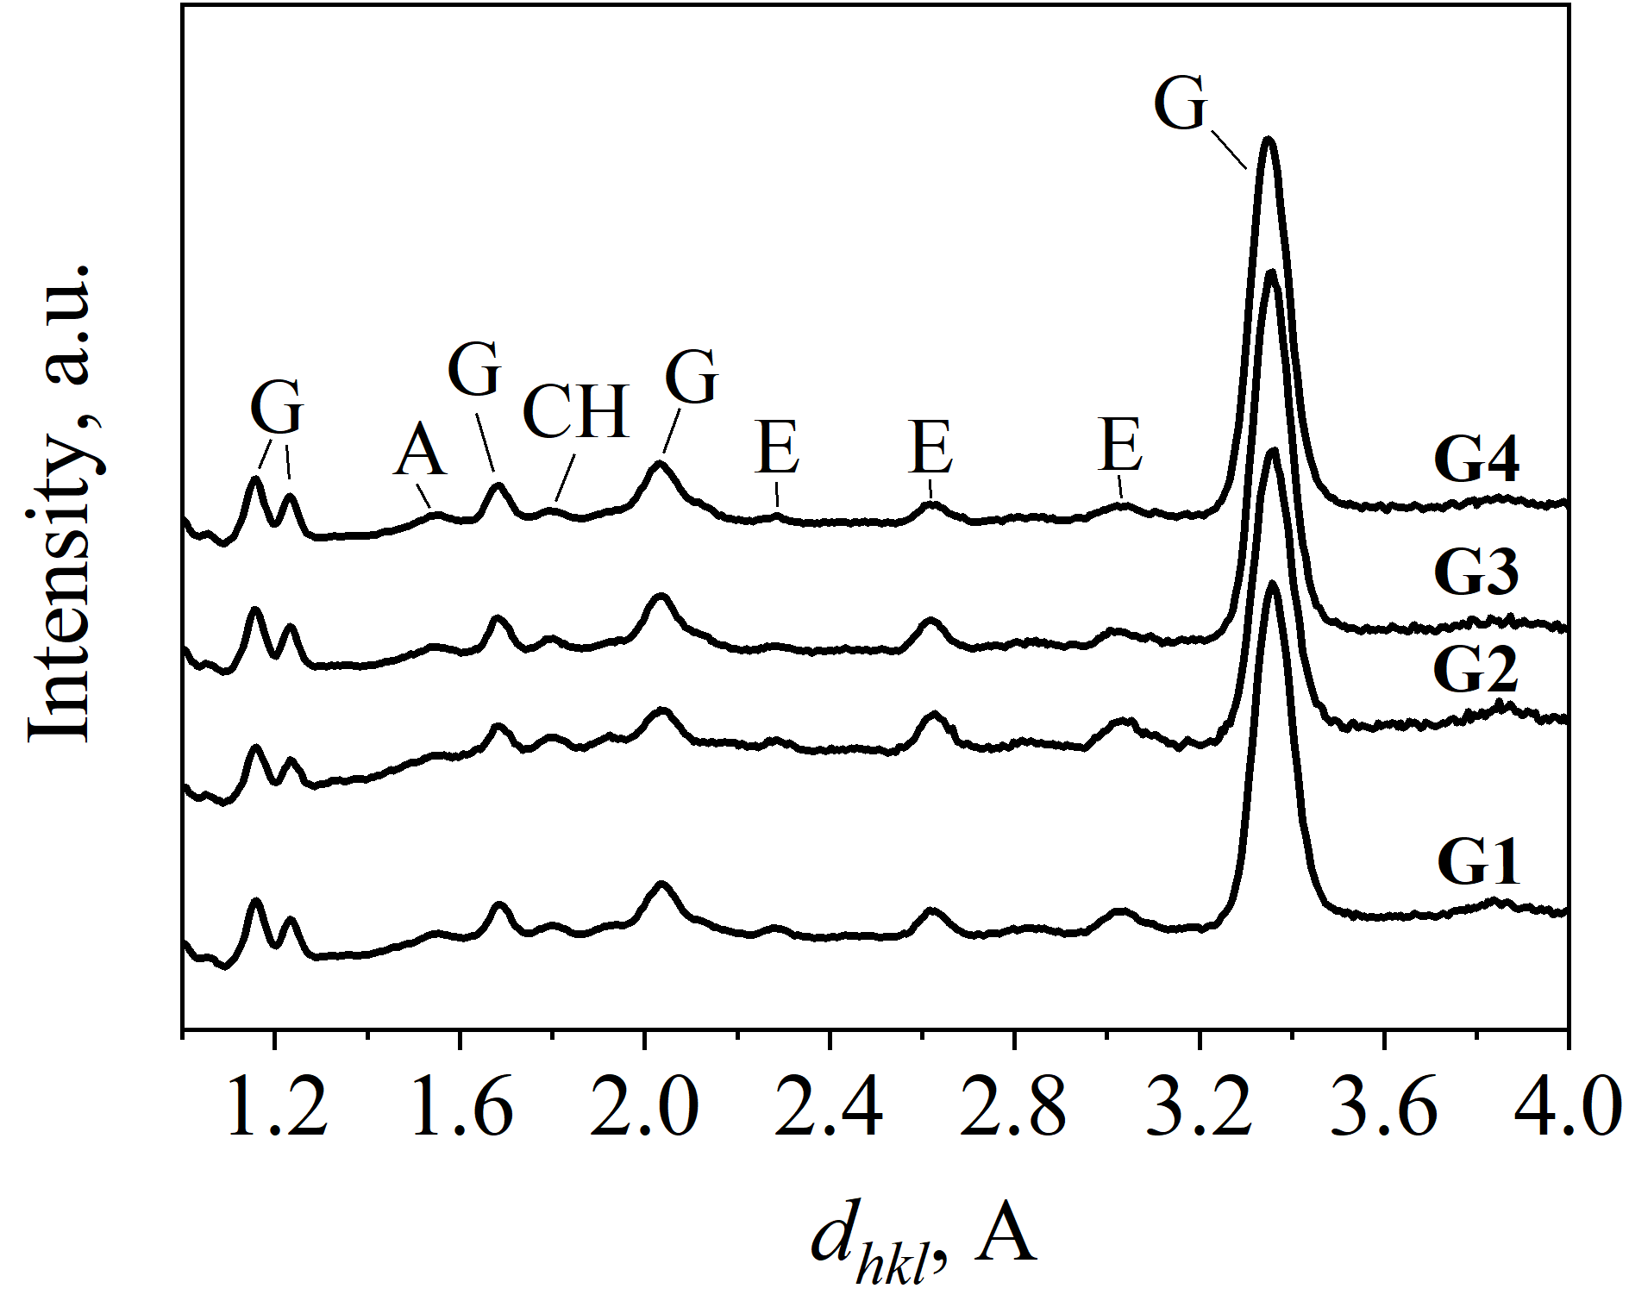
3
2. Cement materials for radioactive graphite conditioning
2.1 Experimental data
Sample Composition
G1 CEM V + D₂O + 50 wt% graphite
G2 CEM V + D₂O + 50 wt% graphite +0.5 wt % additive (Sika ®)
G3 CEM V + D₂O + 75 wt% graphite
G4 CEM V + D₂O + 75 wt% graphite + 0.5 wt% additive (Sika ®)
Neutron tomography results
Neutron diffraction results

Slide 4
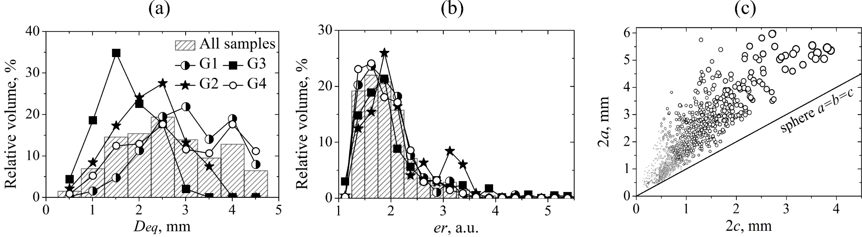
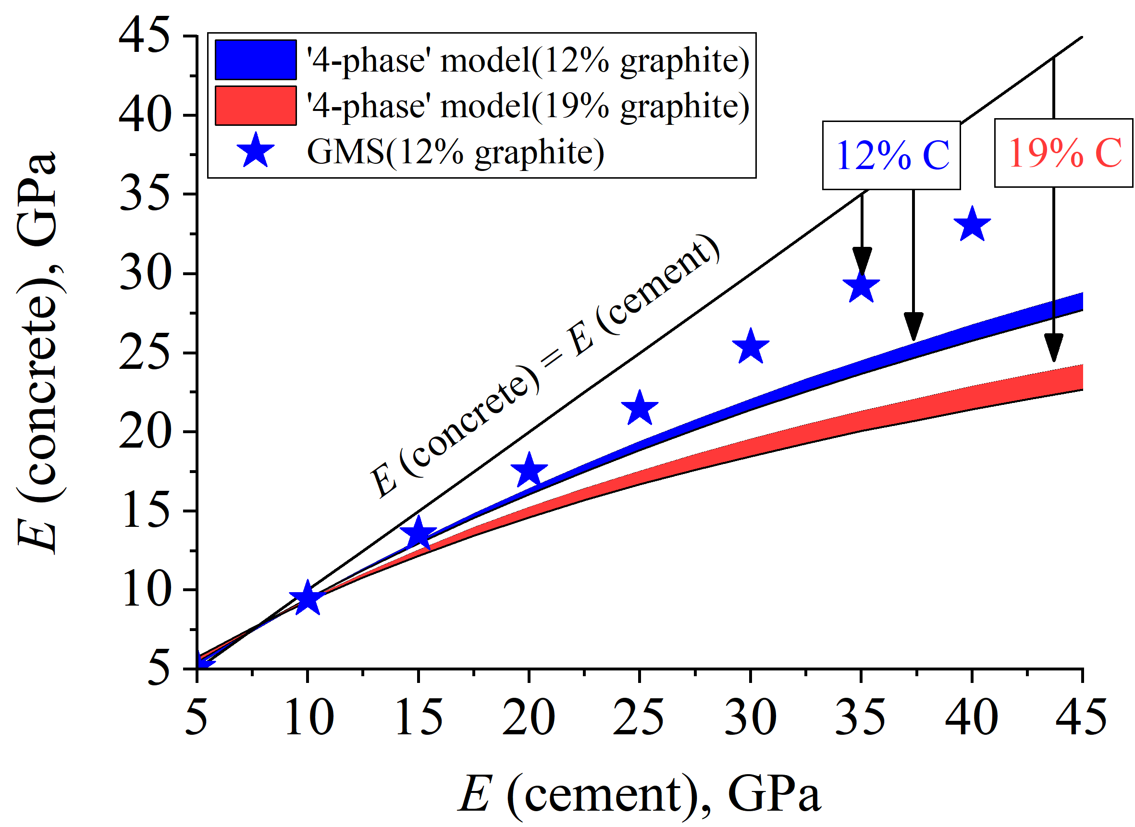
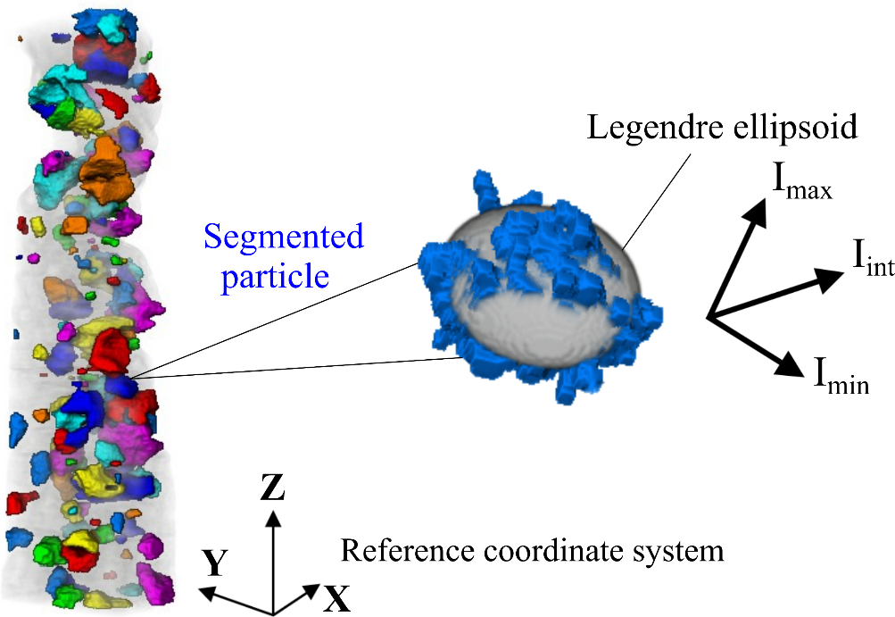
4
2. Cement materials for radioactive graphite conditioning
2.2 Particle analysis

Slide 5
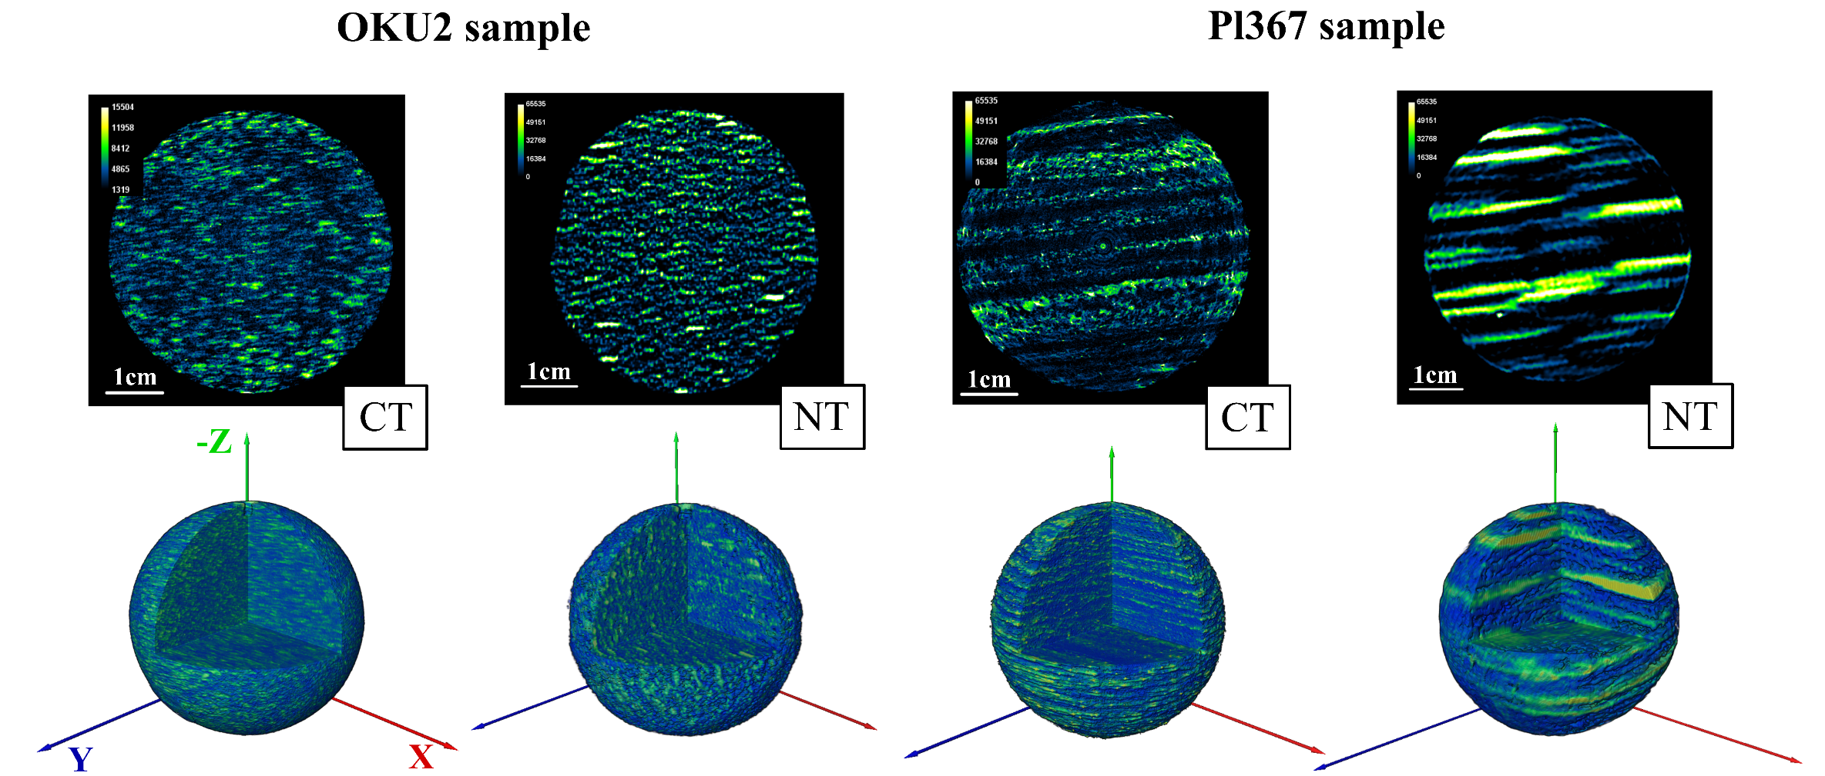
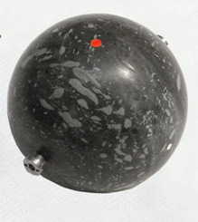
5
3. Structure and anisotropy in biotite gneisses
3.1 Experimental data
Biotite gneiss
OKU2
Biotite gneiss
Pl367
Content:
Neutron attenuation:
Content:
Neutron attenuation:
quartz – 39,6 %
plagioclase – 36,9 %
biotite – 23,4 %
quartz – 27,6 %
plagioclase – 26,4 %
biotite – 31,8 %
muscovite – 14,2 %
Tomography results

Slide 6
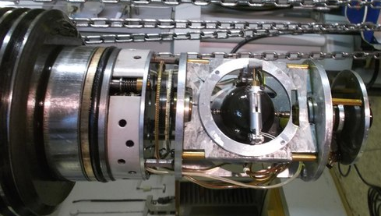
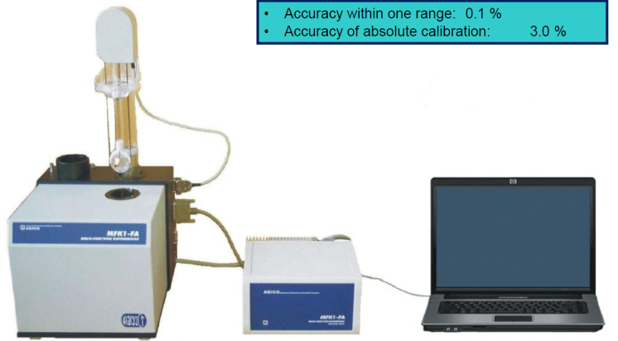
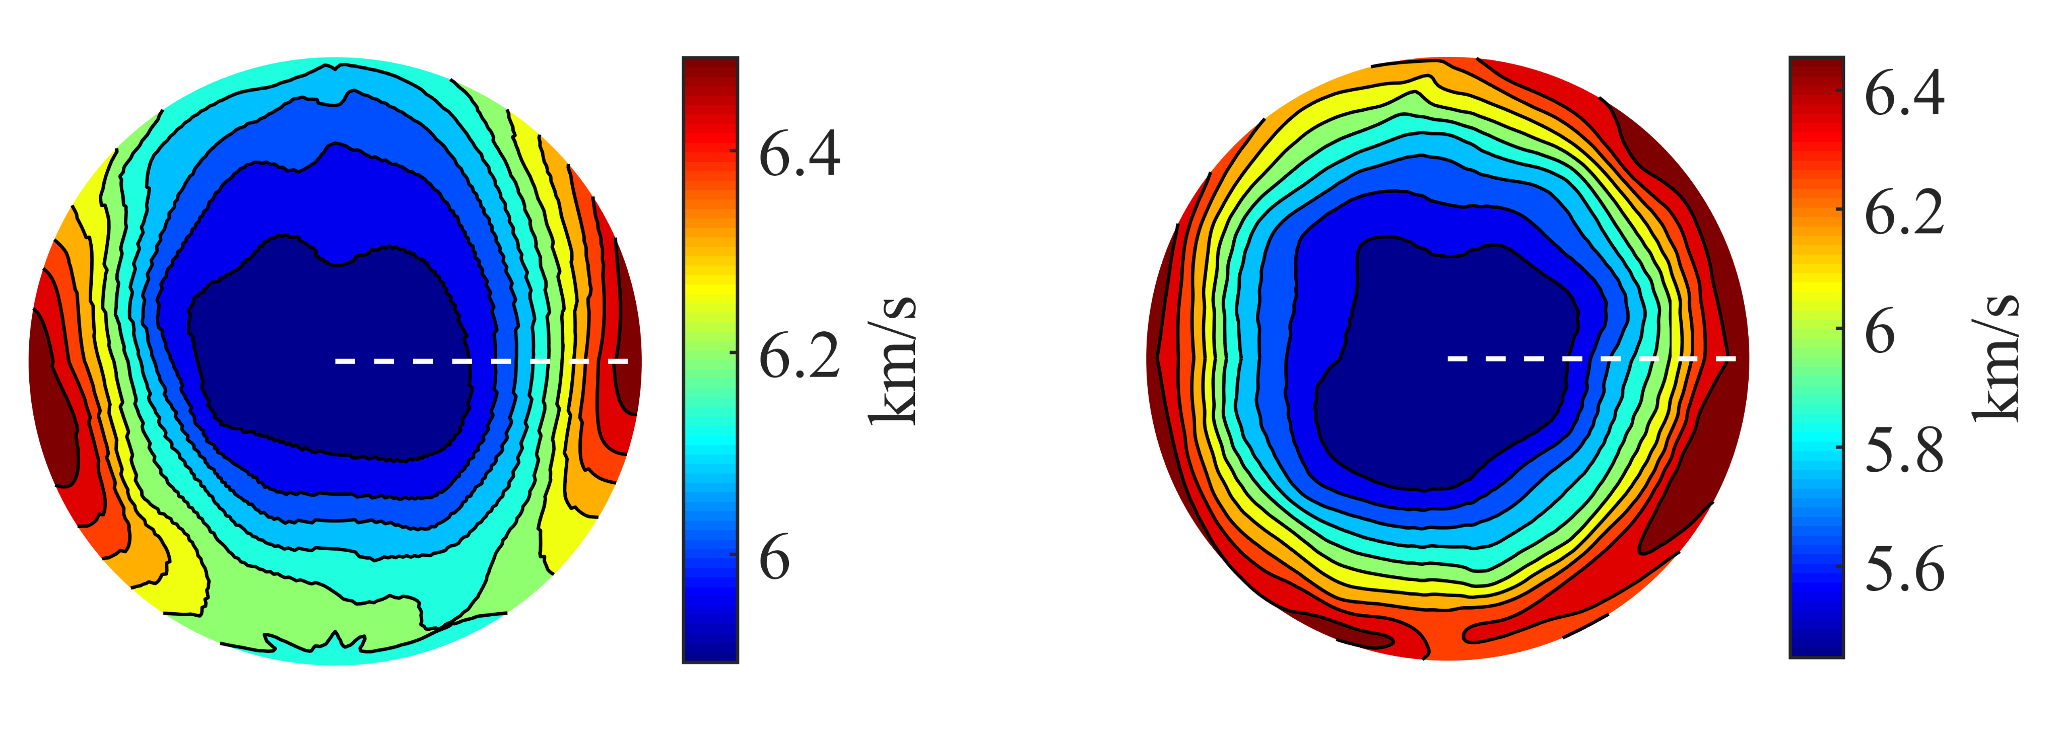
6
3. Structure and anisotropy in gneisses
3.1 Experimental data
MFK1 Kappabridge (Agico Ltd., Brno)
Measurements of P-waves on spheres:
magnetic field: 200 А/m
frequency: 976 Hz
Institute of Geology of the Czech Academy of Sciences
Pair of transducers with 2 MHz ,
Sample diameter 49,99 mm,
Number of measurement directions – 150,
High hydrostatic pressure up to 400 MPa,
Velocity error ~ 1%.
Measured magnetic anisotropy:
P-wave velocities at 200 MPa:
OKU2
Pl367
OKU2
Pl367

Slide 7
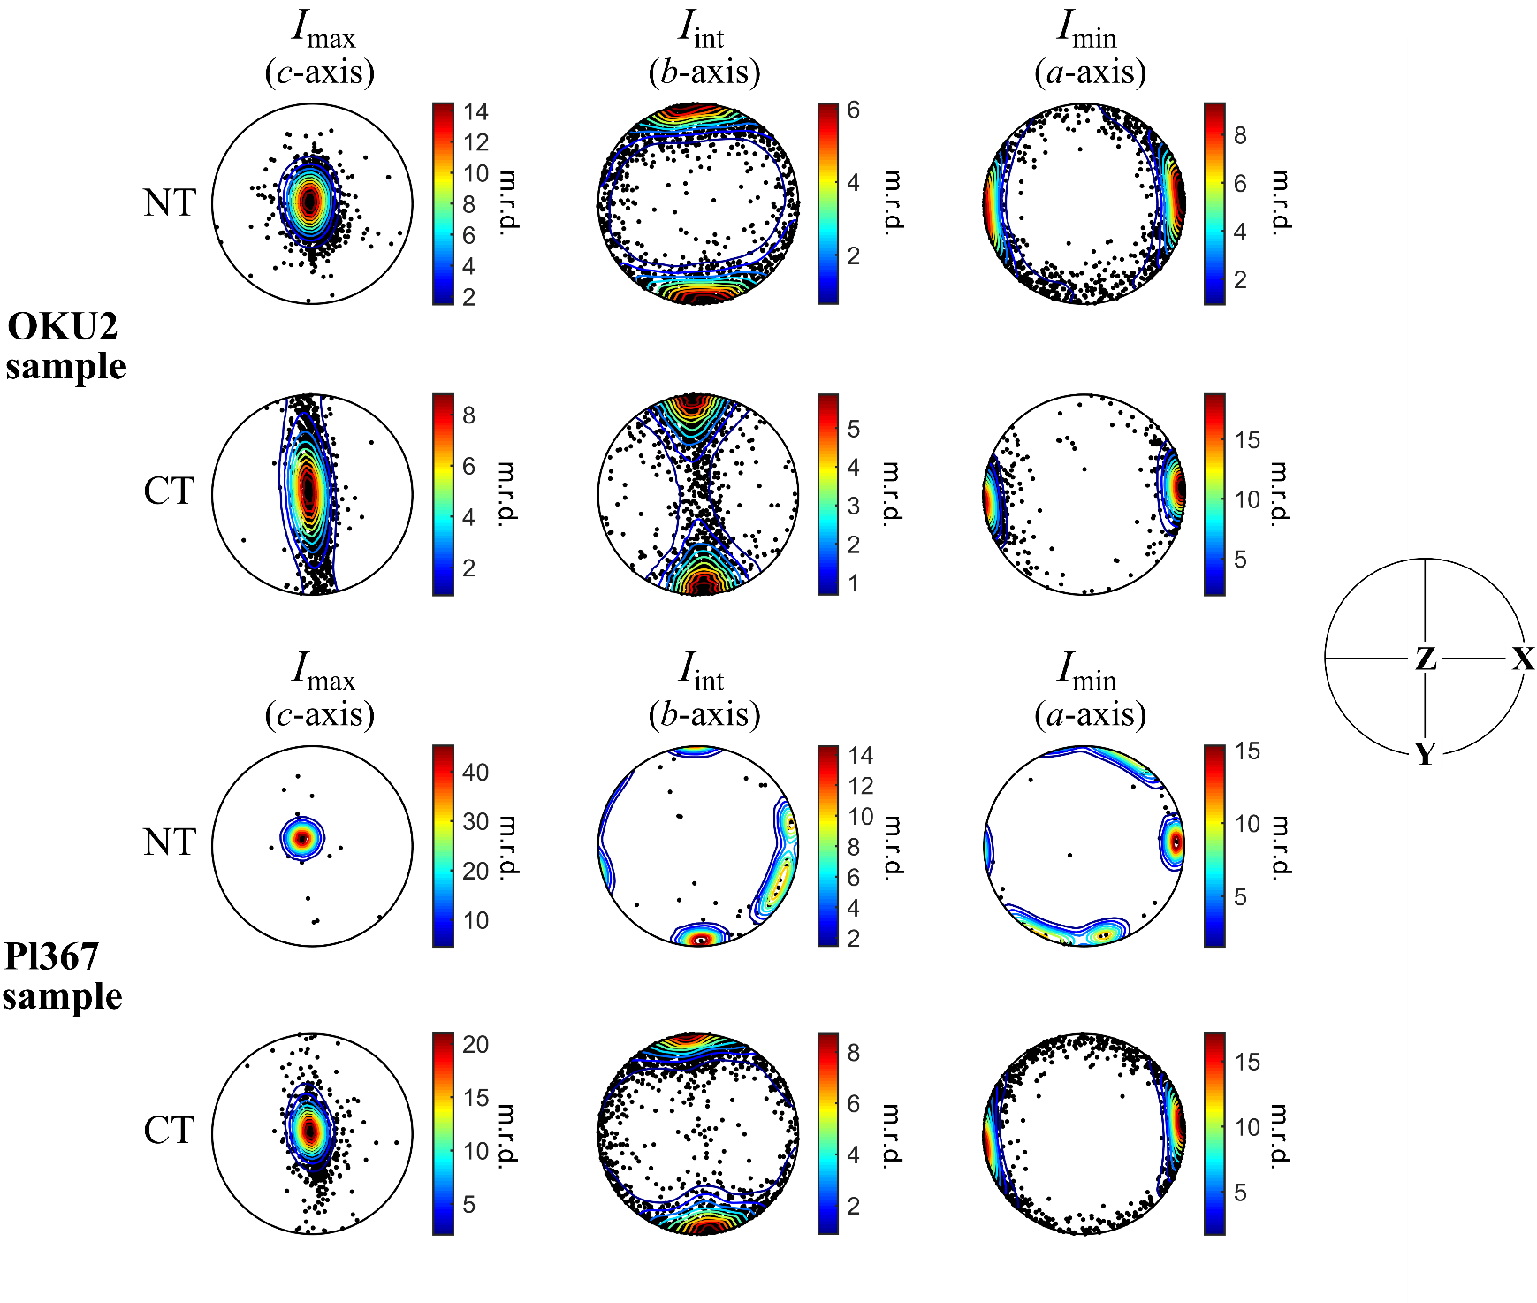
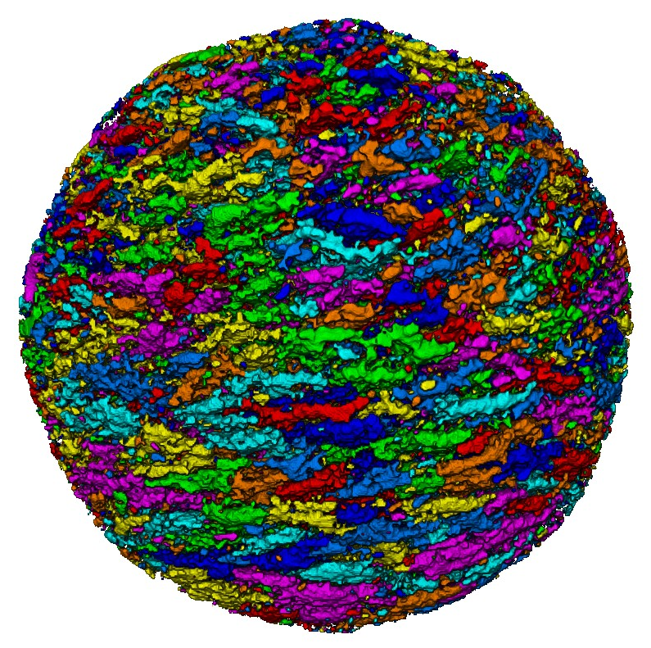
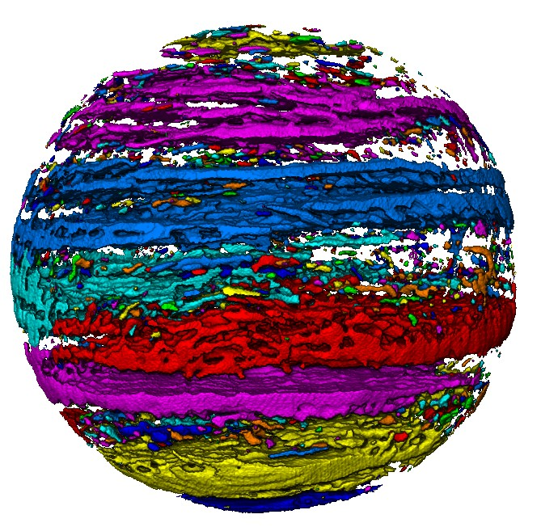
7
3. Structure and anisotropy in gneisses
3.2 Particle analysis

Slide 8
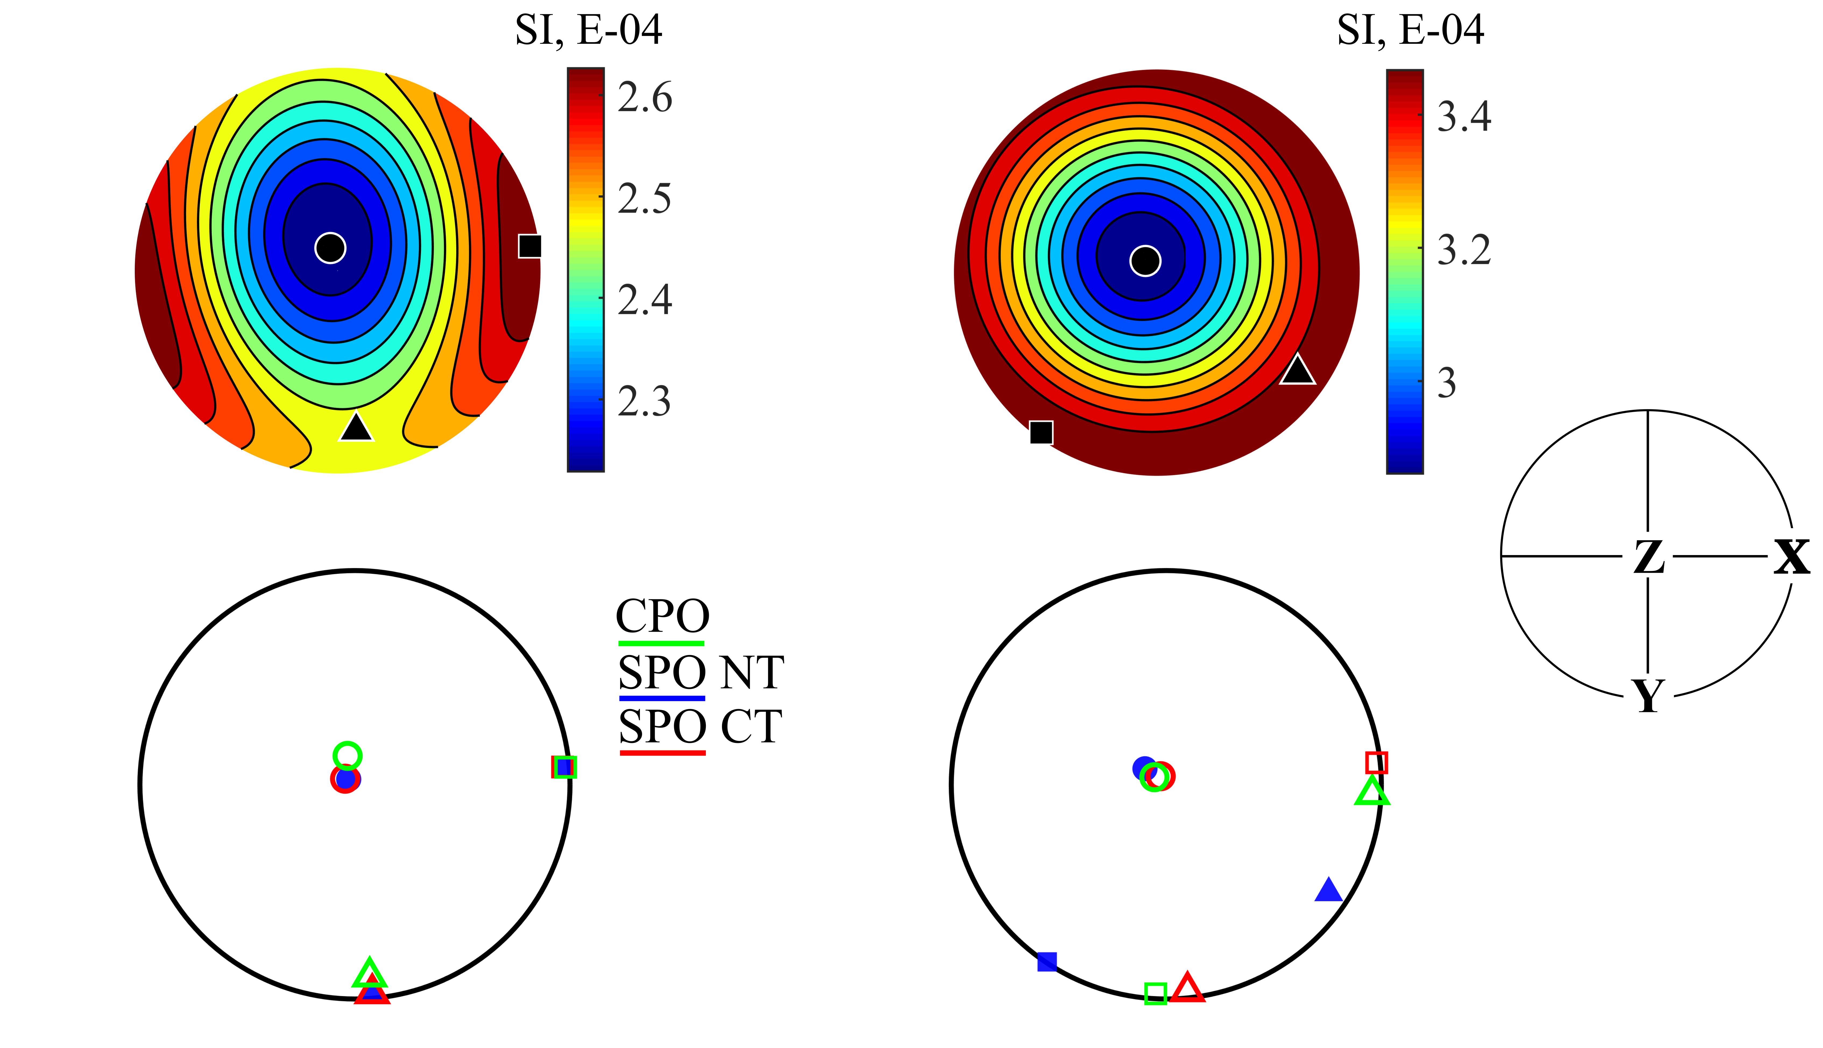
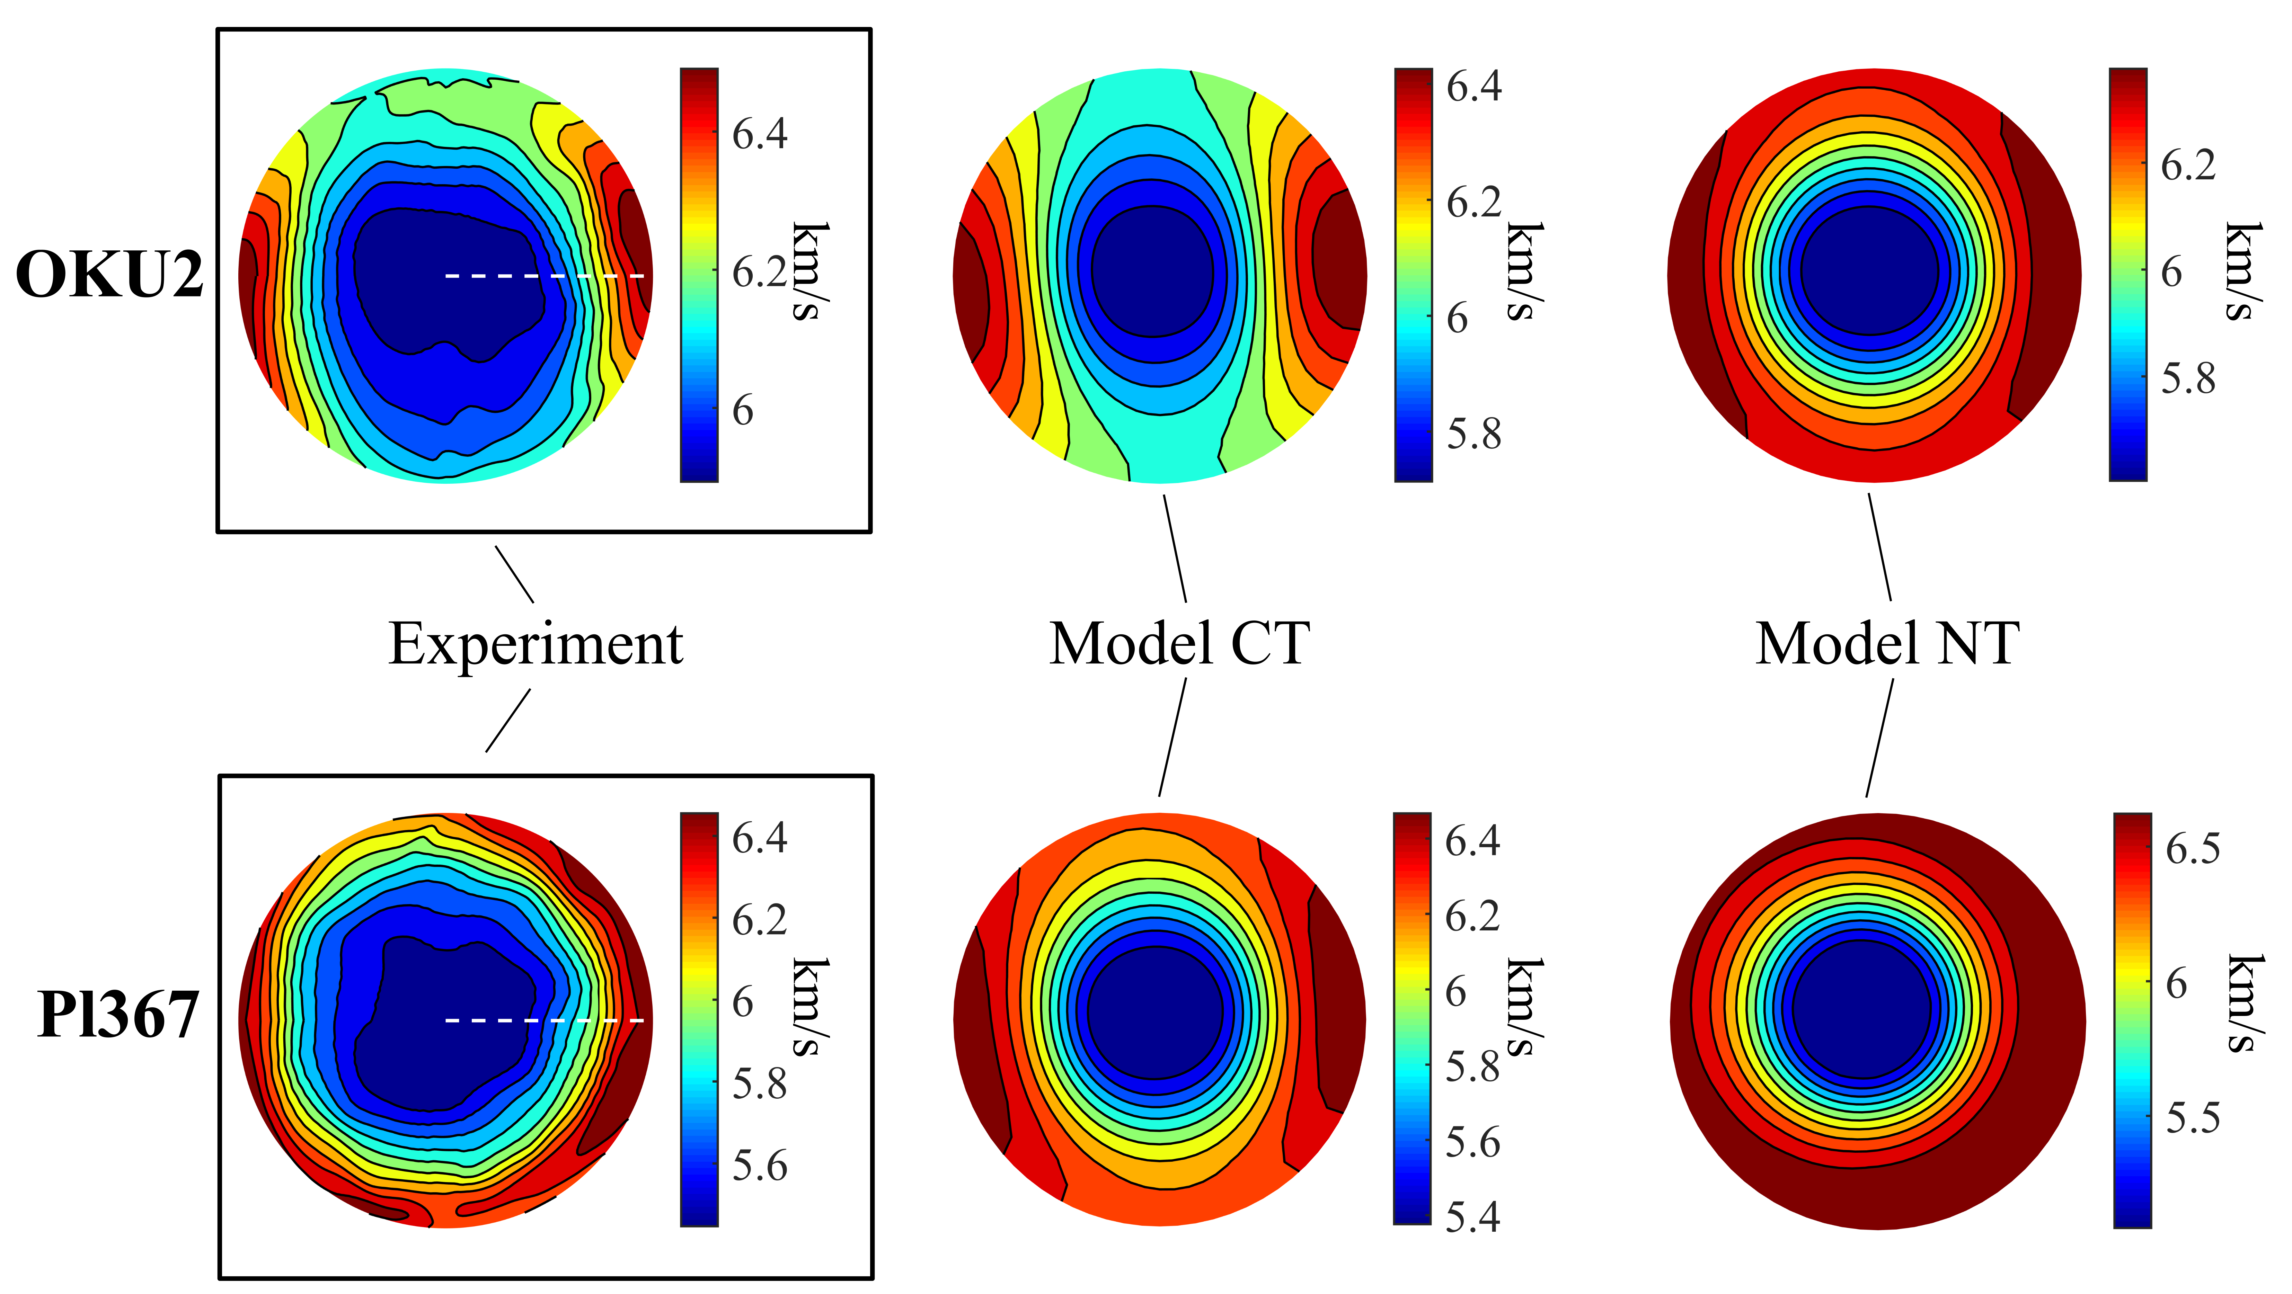
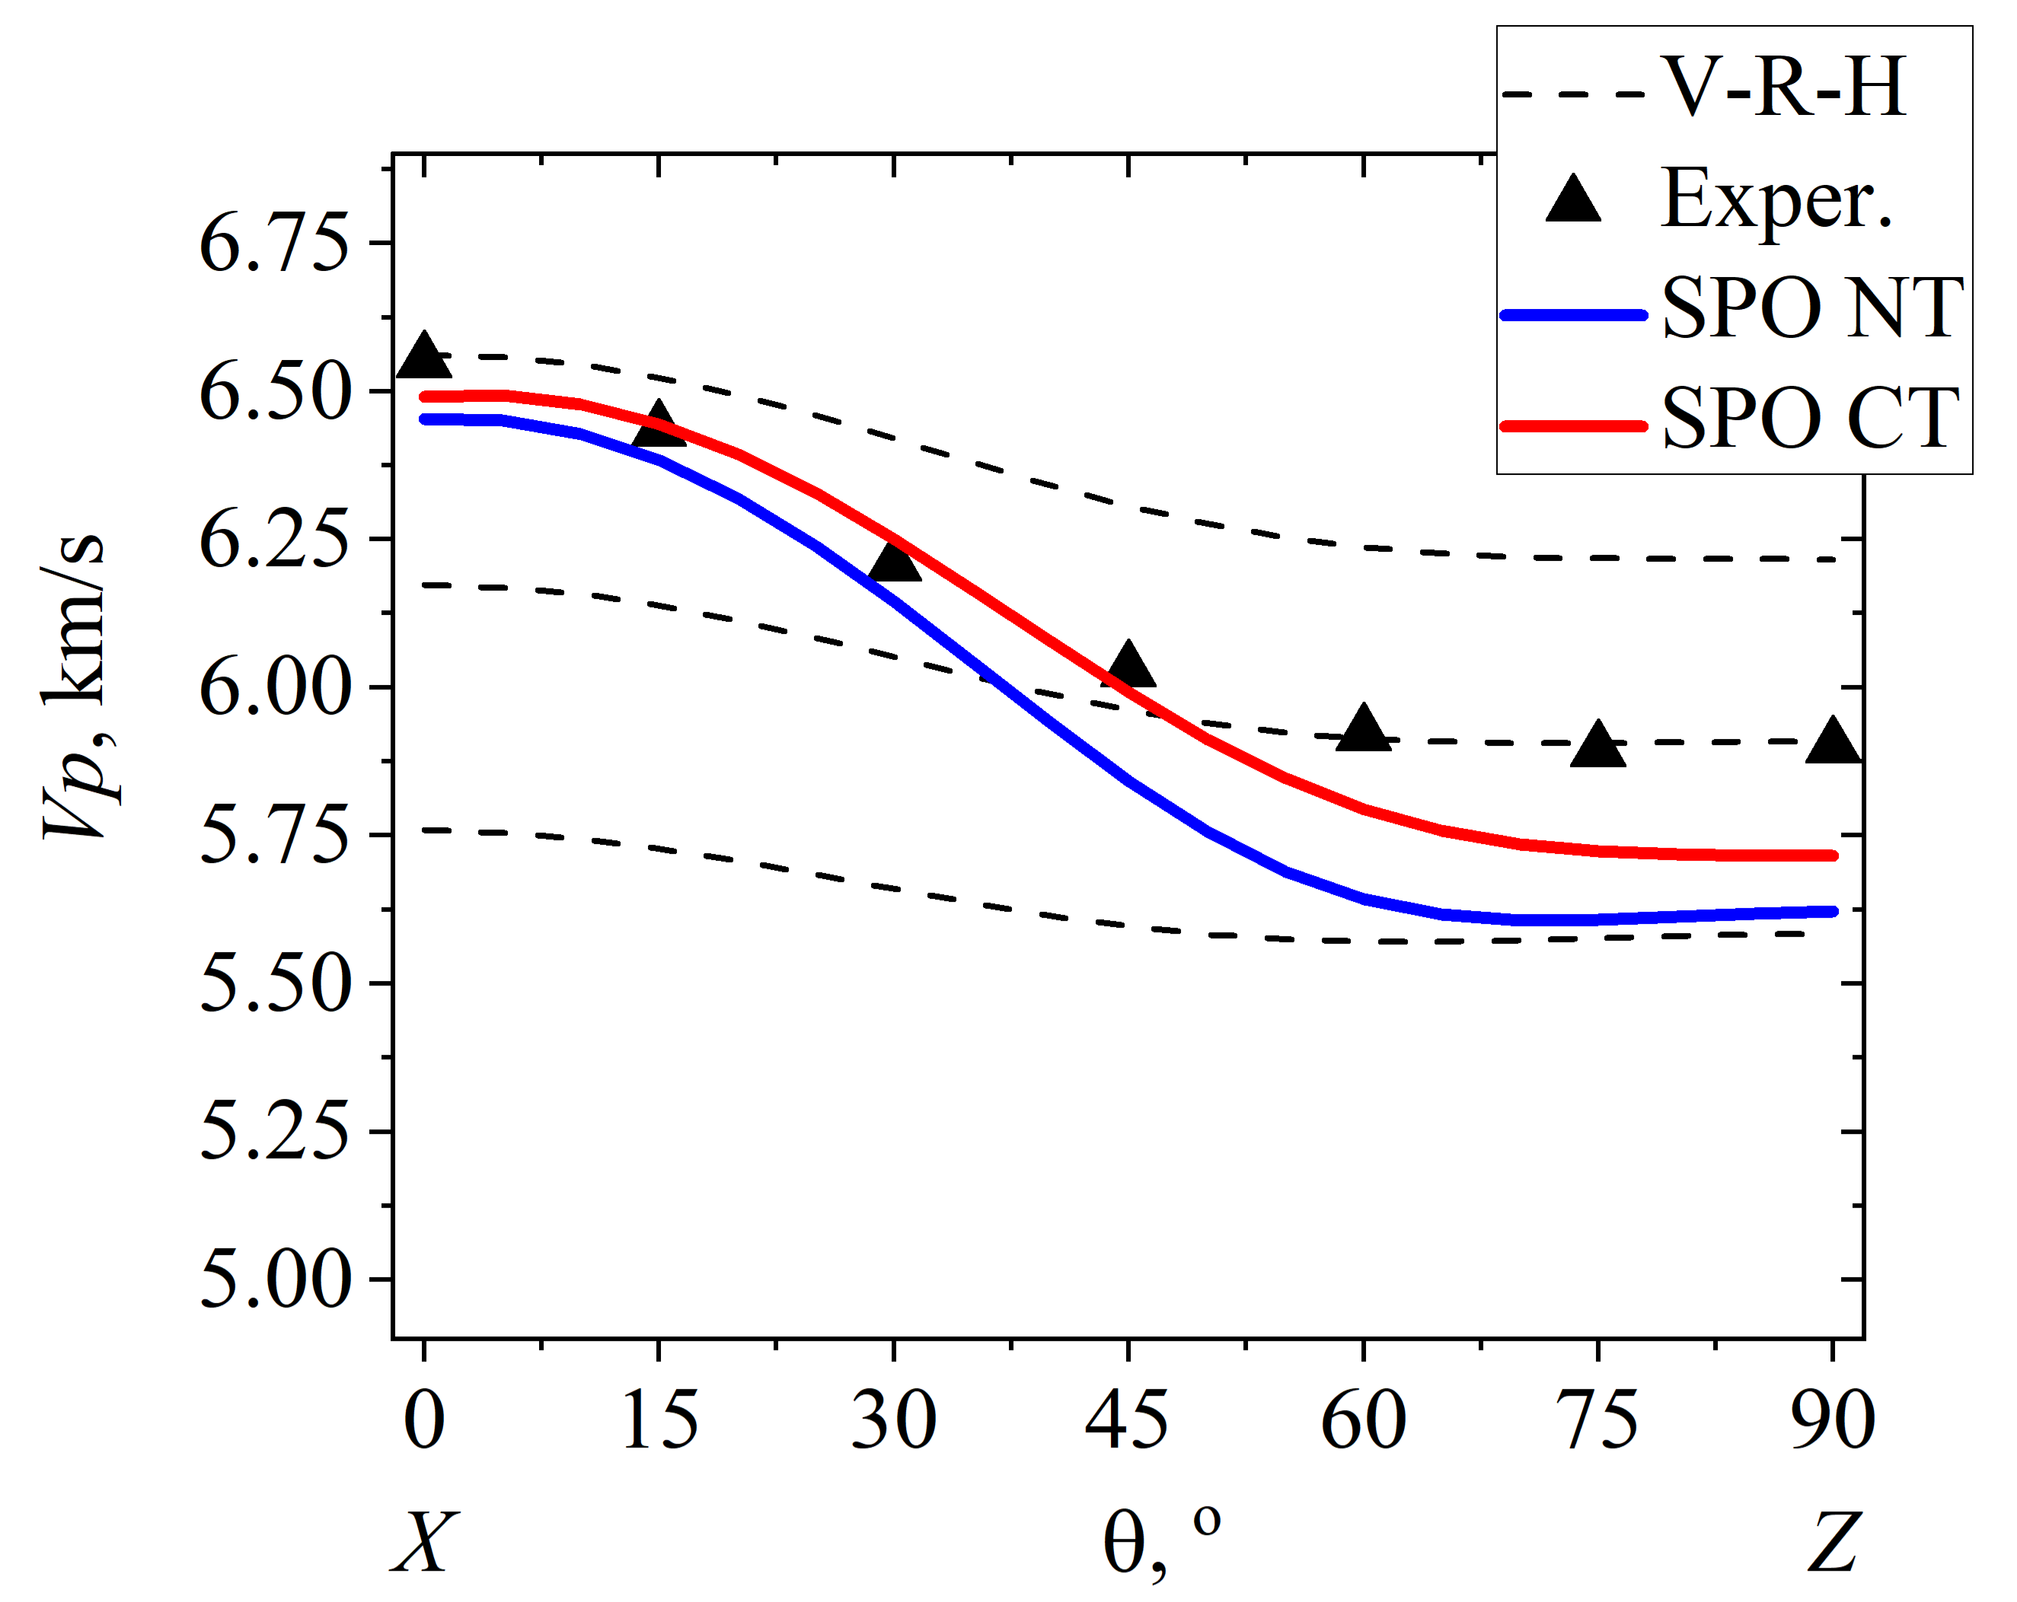
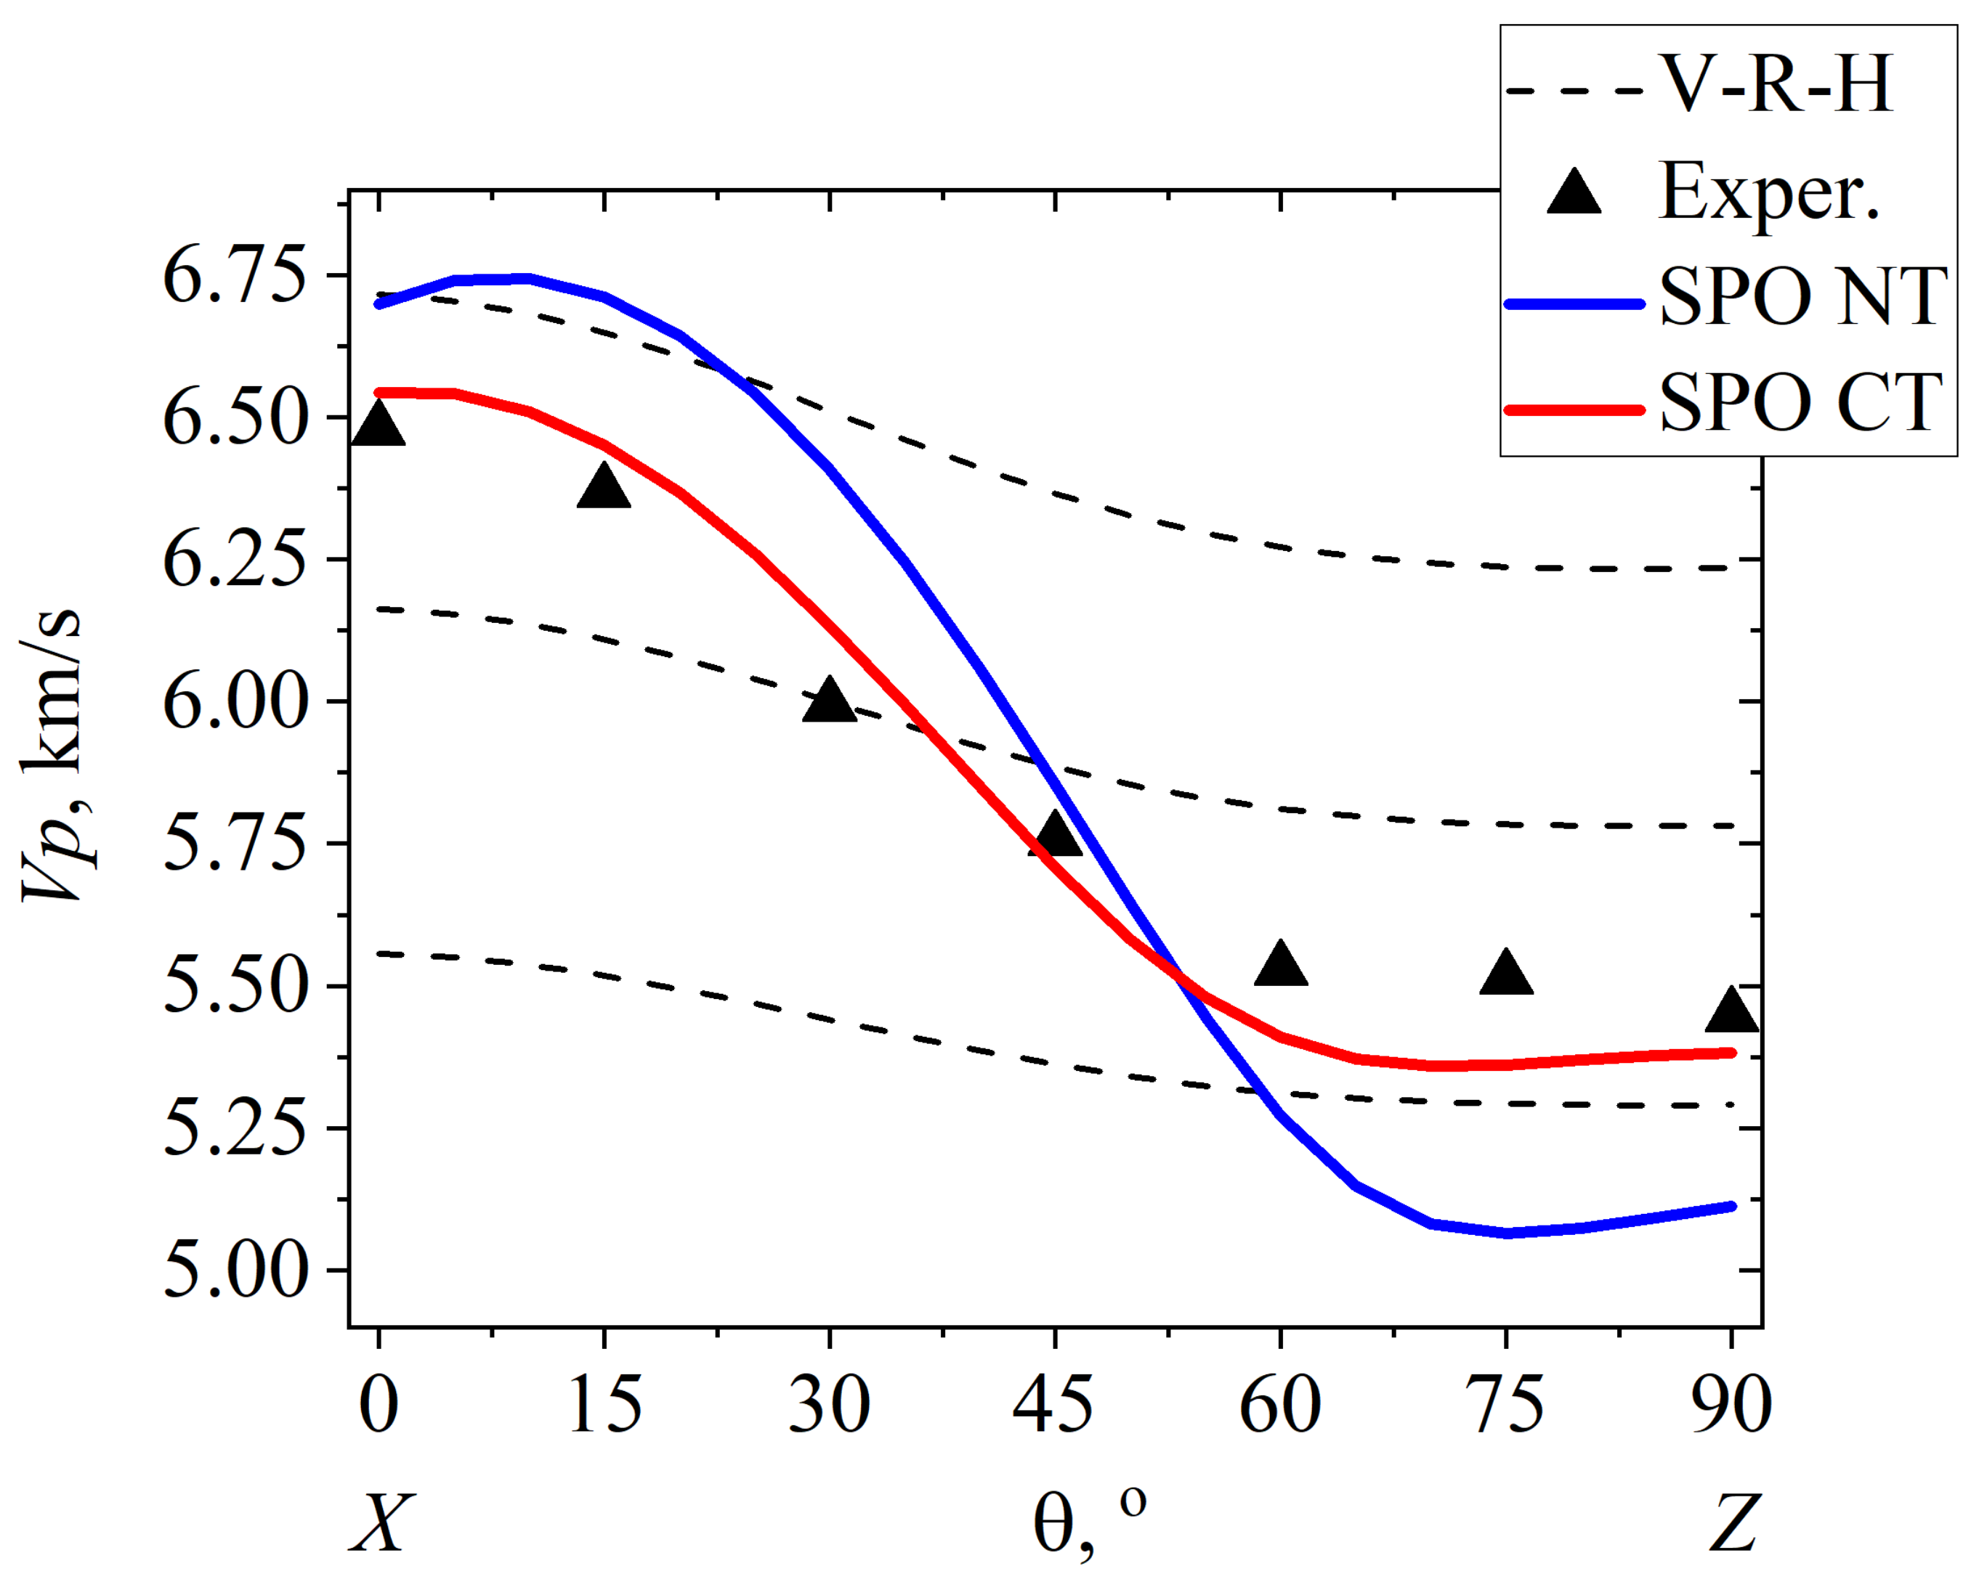
8
3. Structure and anisotropy in gneisses
3.3 Anisotropy modeling
Magnetic susceptibility anisotropy
P-wave velocity anisotropy
OKU2
Pl367
OKU2
Pl367

Slide 9
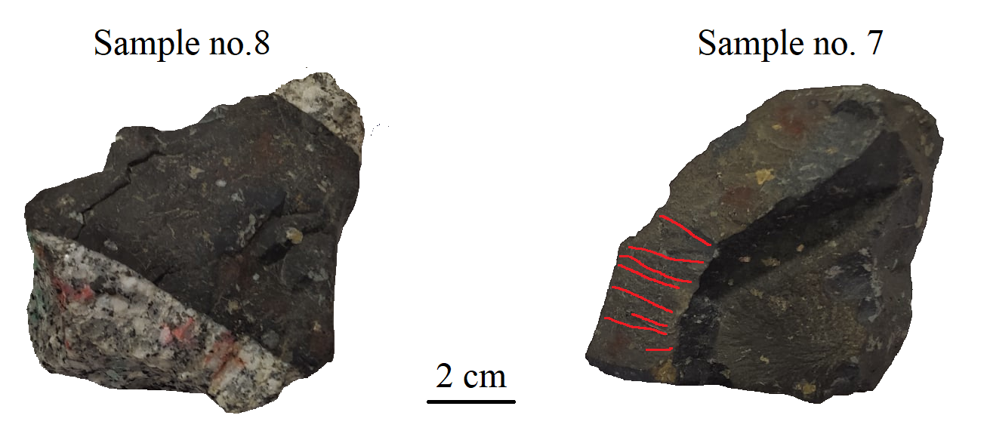
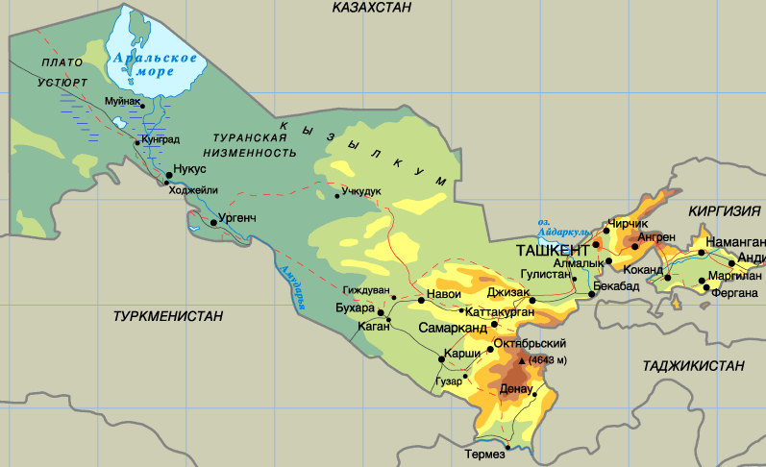
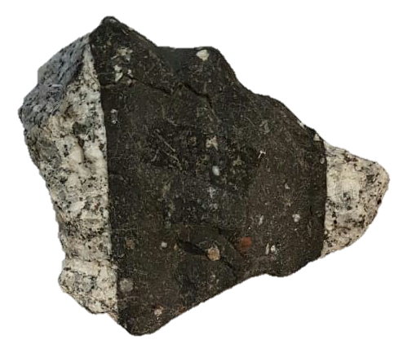
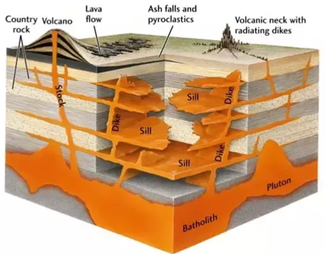
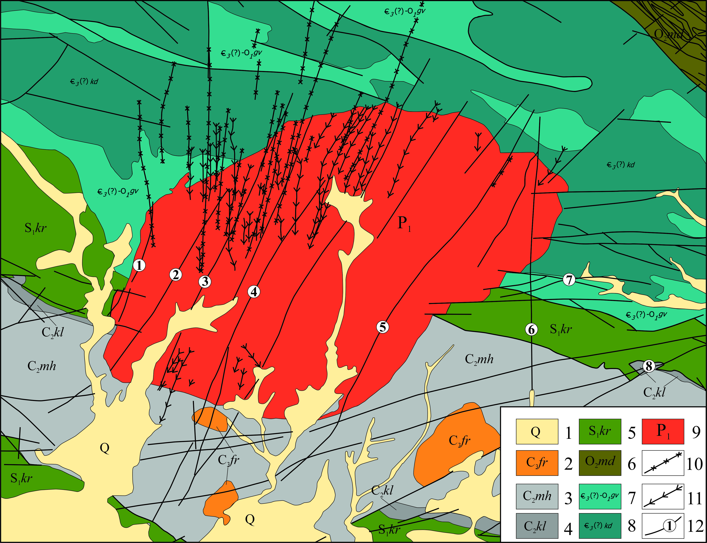
9
4. Lamprophyre Dike
4.1 Samples description
Locality:
Lamprophyre dikes:
Uzbekistan
Koytash
amygdules
ocelli
xenocrysts
(vesicles)
Rock matrix (opaque):
amphibole (30-70%)
plagioclase (70-30)%
Spheroidal inclusions:
quartz
feldspars
calcite
dikes
wrinkles

Slide 10
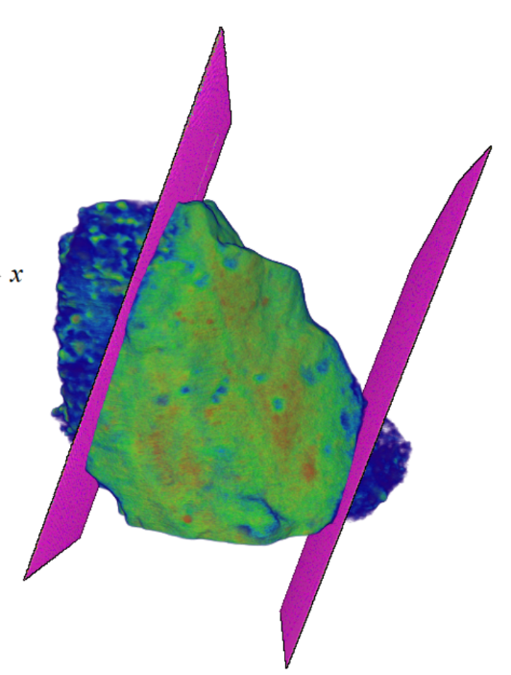
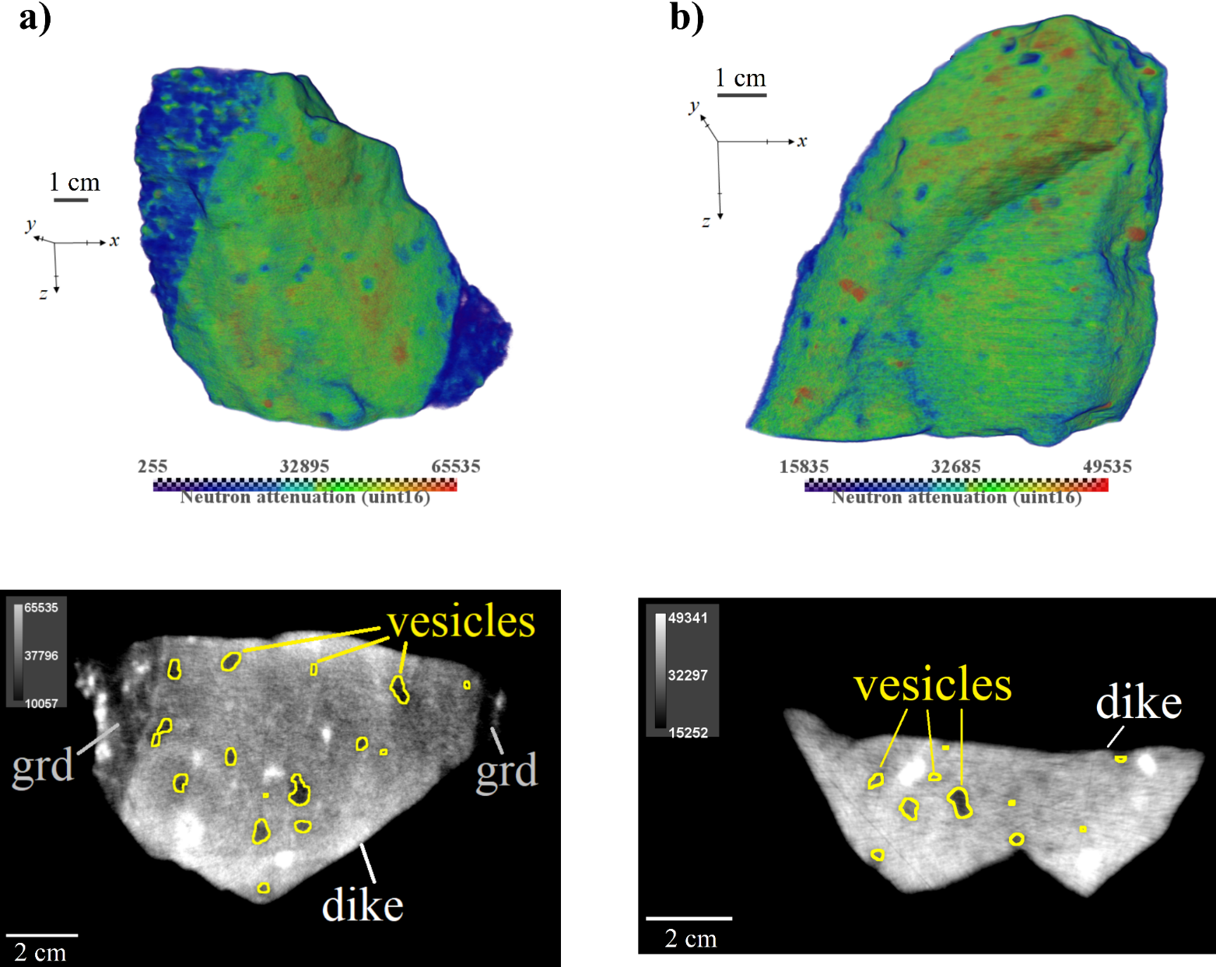
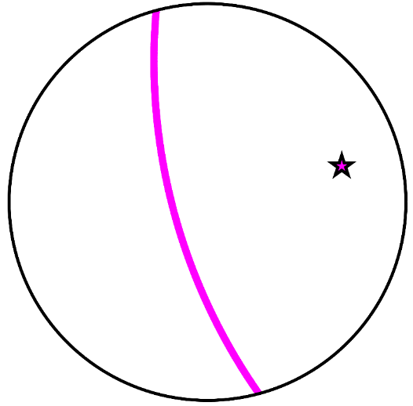
10
4. Lamprophyre Dike
4.2 Neutron tomography
3D models of dike samples
Dike’s wall model
granodiorite
dike
position of the walls in the stereoplot
y
z
x

Slide 11
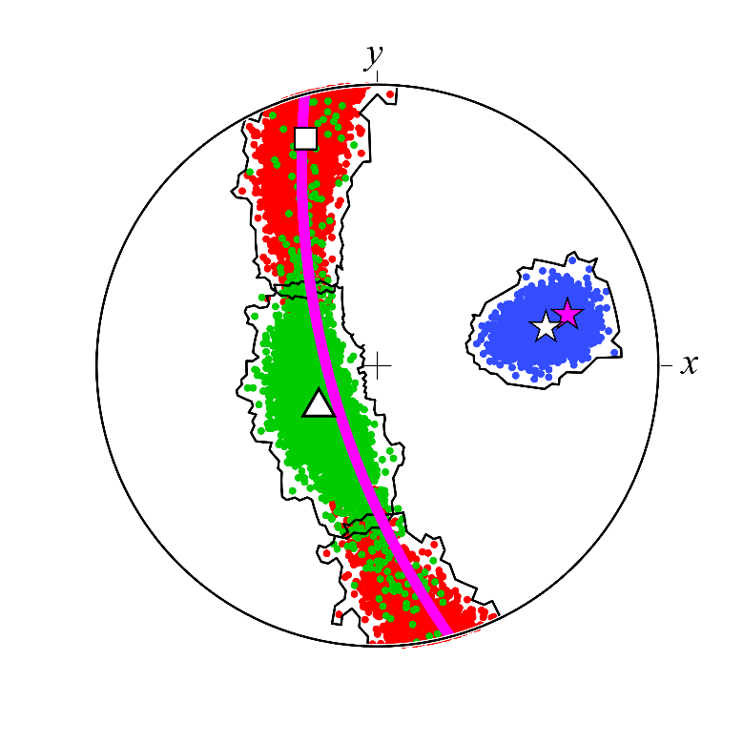
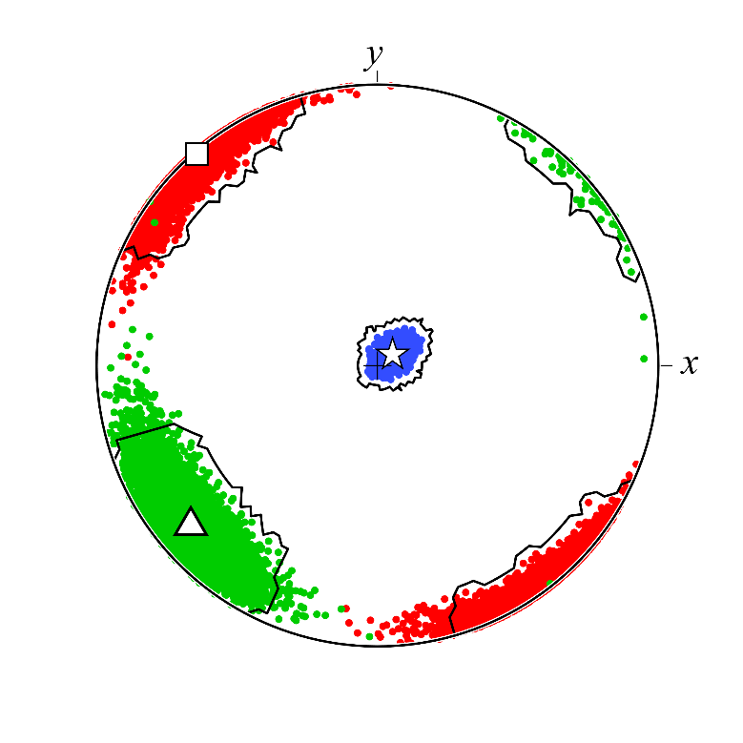
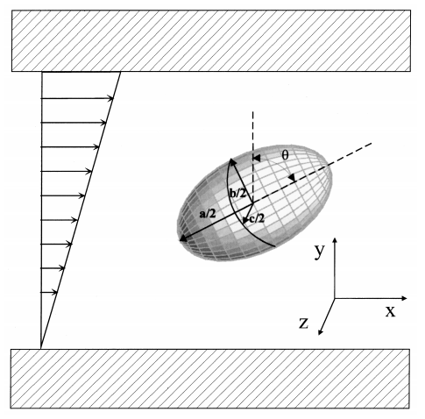
11
4. Lamprophyre Dike
4.3 Particle analysis
Sample no. 8
Sample no. 7
mean
data
I min
walls
I int
I max
Black lines contour the 95% confidence regions
Isolated gas or liquid filled vesicle undergoing simple shear flow
?
Estimation of magma flow direction &
conduit walls orientation

Slide 12
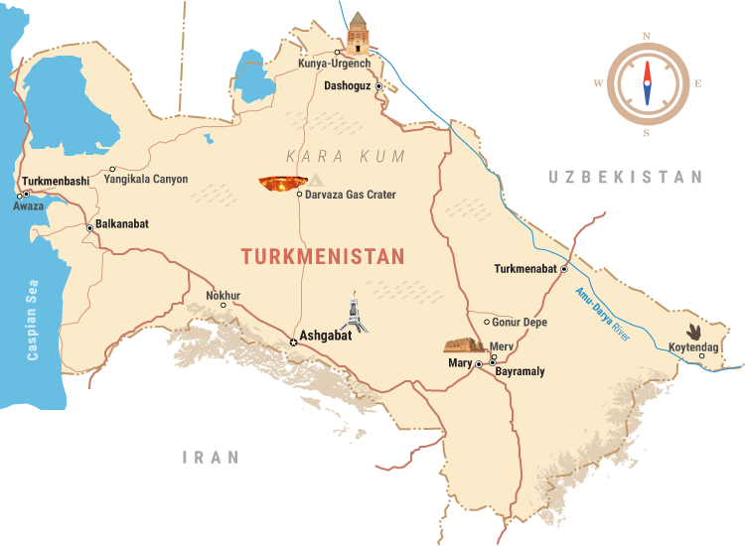
12
5. Kunya-Urgench chondrite
5.1 Sample description
Sample
Kunya-Urgench
Dashkhowus Velayat, Turkmenistan
Fell 1998 June 20, 17:25 local time
Ordinary chondrite
Major phases:
Pyroxene – Enstatite
Olivine – Fa92Fo08
Kamacite – Fe97Ni03
Neutron diffraction (DN-12)

Slide 13
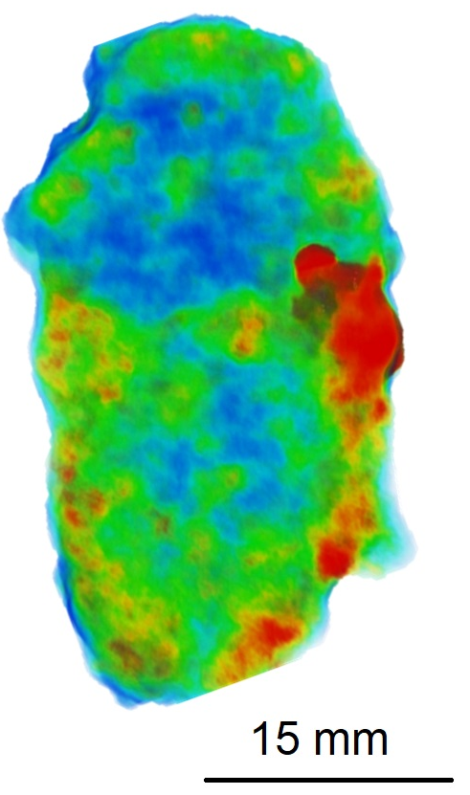
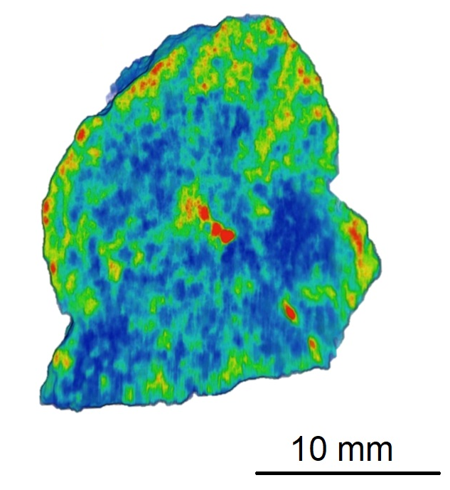
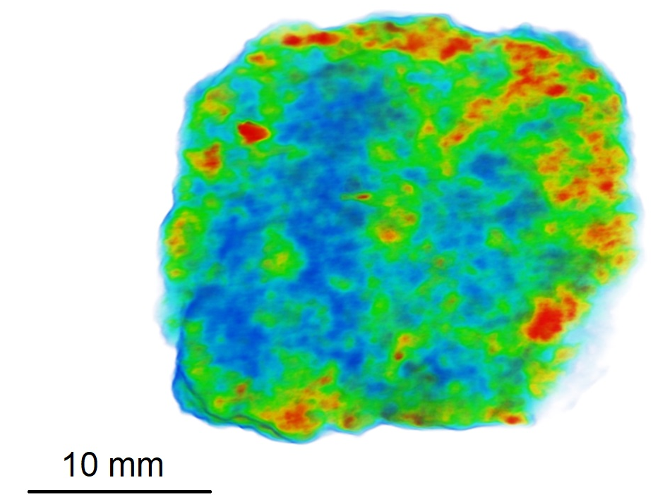
13
5. Kunya-Urgench chondrite
5.1 Experimental data
Neutron tomography results
longitudinal slice
transverse slice
transverse slice
iron-rich phase
iron-rich phase

Slide 14
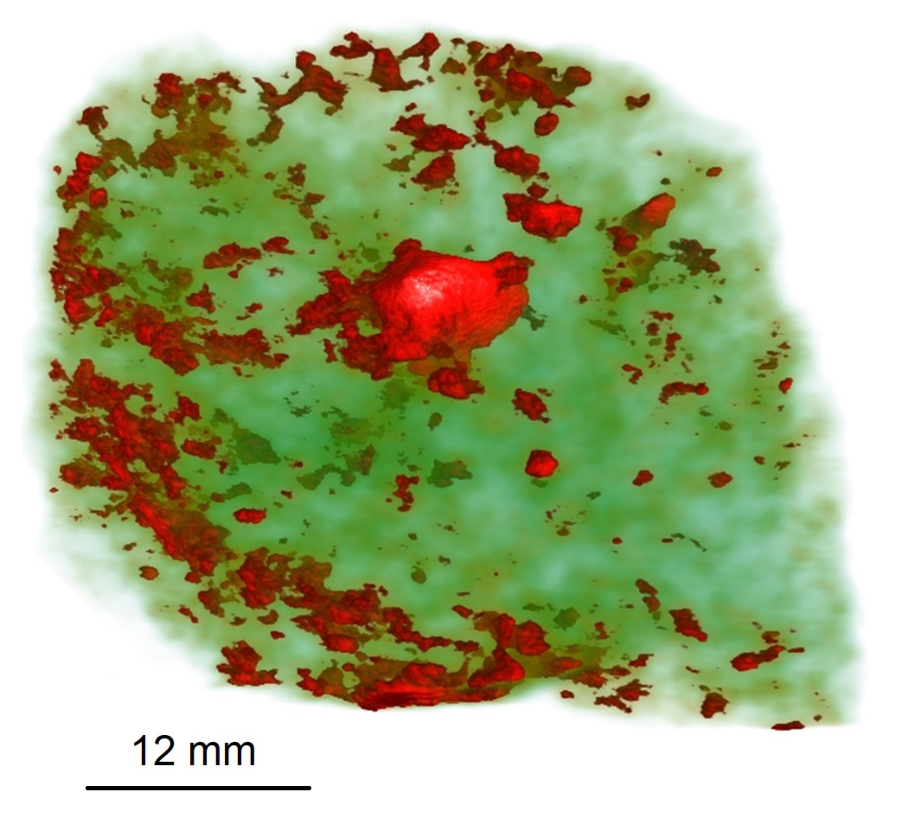
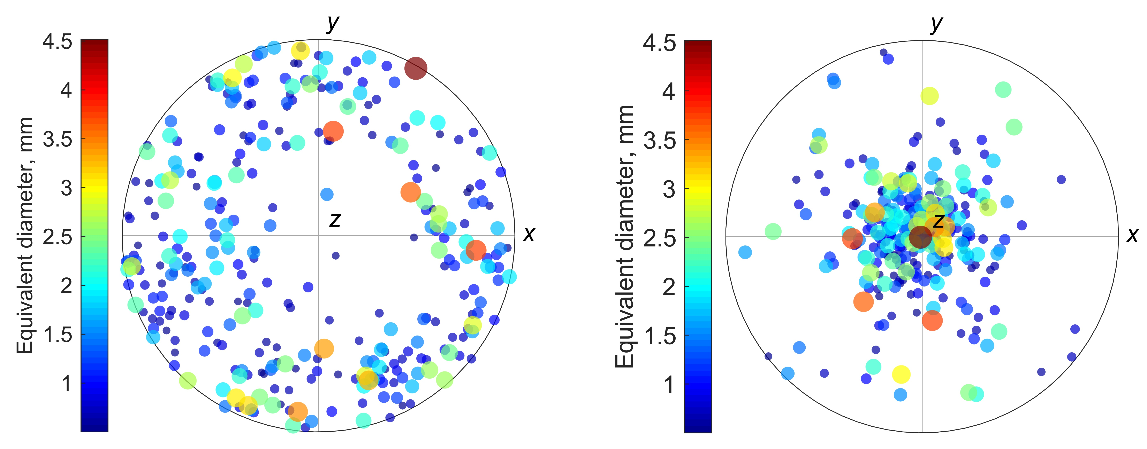
14
5. Kunya-Urgench chondrite
5.2 Particle analysis
Kamacite particle’s principal inertia axis (min)
Kamacite particle’s principal inertia axis (max)
Kamacite spatial distribution
Foliation fabric is due to shock loading?
Friedrich, J. M. et al. (2008)
Friedrich, J. M. et al. (2017)

Slide 15
Thank you !

