Slide 1
60th meeting of the PAC for Condensed Matter Physics
Analysis of Aβ-42 Conformational Dynamics in Various Lipid Membrane Mimetics:
Spectroscopic and Atomistic Study
Heba Esawii
Frank Laboratory of Neutron Physics, Sector of Raman Spectroscopy, Joint Institute for Nuclear Research, Dubna, Russia
heba@jinr.com - Heba.Esawii@aucegypt.edu
Monday, 27 January 2025

Slide 2
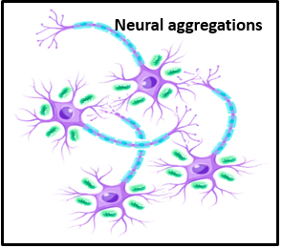
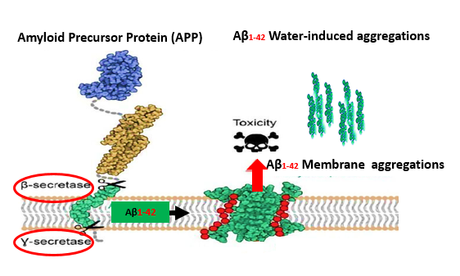
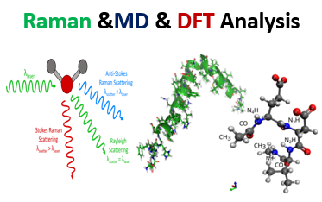
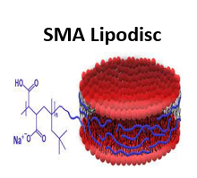
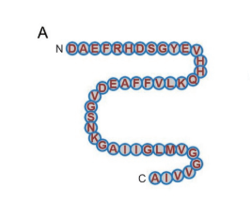
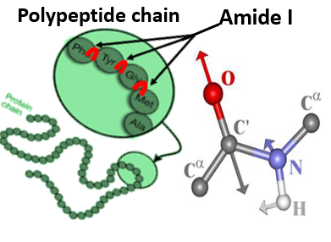
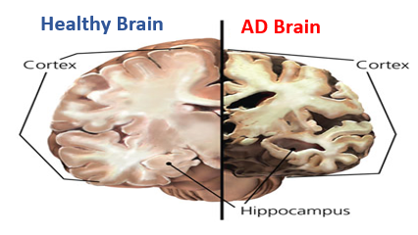
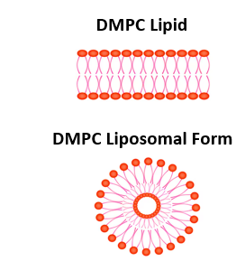
The Grand Scheme of our Research Topic

Slide 3
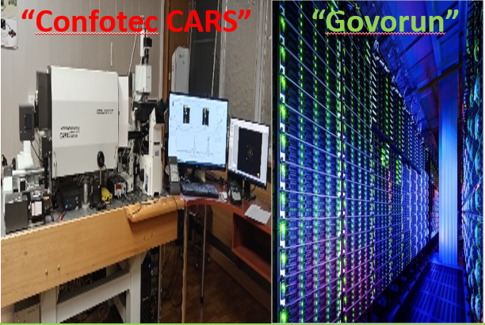
Methodology & Analysis Flow

Slide 4
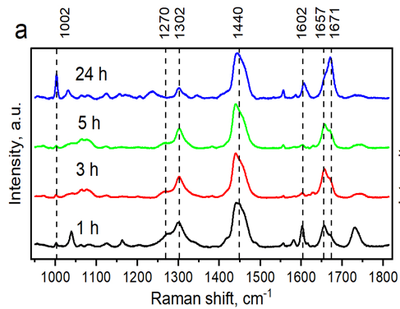
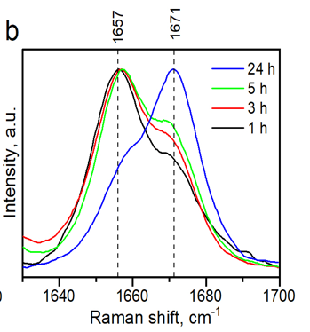
Spectroscopic Results : Raman Analysis
All Raman Spectra : Solubilized Aβ42
Amide I Region : Aβ42 Polypeptide
Wavenumber Range: | Alpha-Helix | Beta-Turns
Typical Amide I region: | 1650 to 1658 cm^-1 | 1660 to 1680 cm^-1
Solubilized Aβ42-Amide I region: | 1657cm^-1 | 1671cm^-1
1h | Alpha-Helix
3h | Alpha-Helix
5h | Alpha-Helix
24h | Beta-Turns

Slide 5
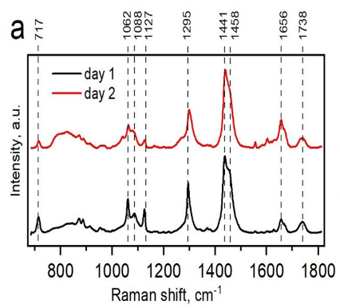
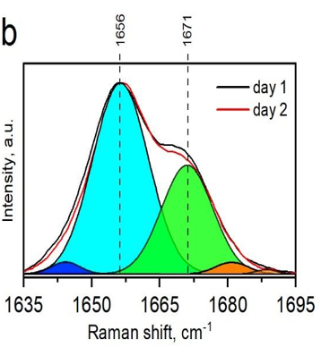
Spectroscopic Results : Raman Analysis
All Raman Spectra : Liposome-Peptide
Amide I Region : Aβ42 Polypeptide
Wavenumber Range: | Alpha-Helix | Beta-Turns
Typical Amide I region: | 1650 to 1658 cm^-1 | 1660 to 1680 cm^-1
Liposome-Aβ42-Amide I region: | 1656cm^-1 | 1671cm^-1
Day1 | Alpha-Helix
Day2 | Beta-Turns

Slide 6
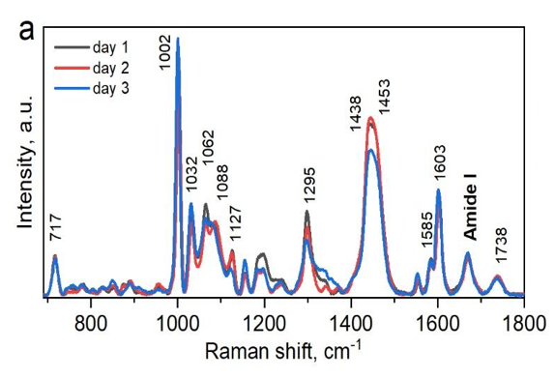
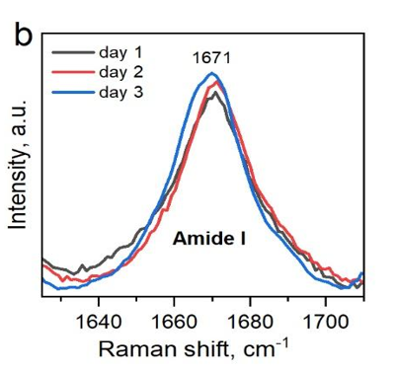
Spectroscopic Results : Raman Analysis
All Raman Spectra : Lipodisc (SMA-DMPC)- Aβ42
Amide I Region : Aβ42 Polypeptide
Wavenumber Range: | Alpha-Helix | Beta-Turns
Typical Amide I region: | 1650 to 1658 cm^-1 | 1660 to 1680 cm^-1
Lipodisc (SMA-DMPC) Aβ42 -Amide I region: | ------ | 1671cm^-1
Day1 | Beta-Turns
Day2 | Beta-Turns
Day3 | Beta-Turns

Slide 7
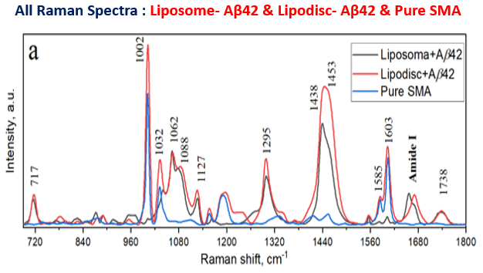
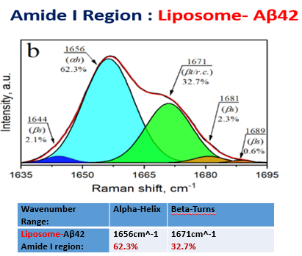
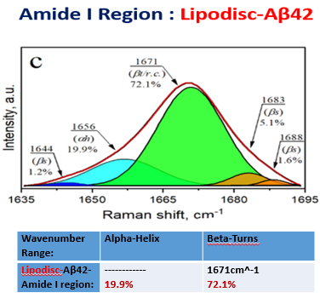
Spectroscopic Results: Raman Analysis

Slide 8
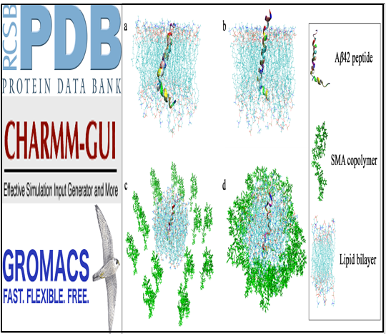
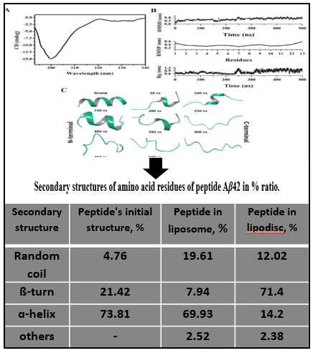
Computational Results: Molecular Dynamics
System to simulate
Simulation Run
(JINR-Supercomputer)
Starting structure
Trajectory analysis

Slide 9
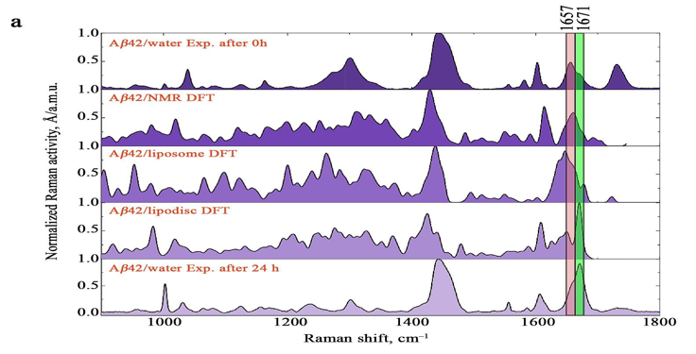
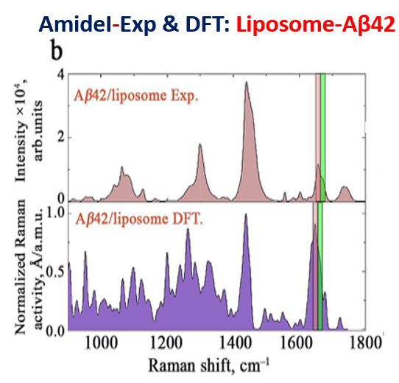
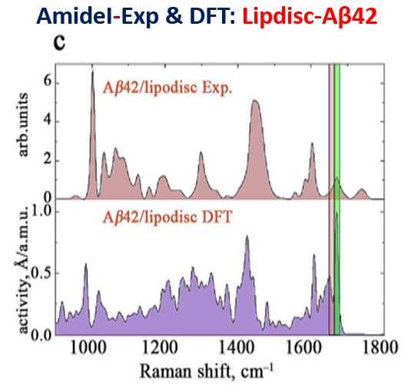
Computational Results: DFT Validation
All Raman& DFT Spectra

Slide 10
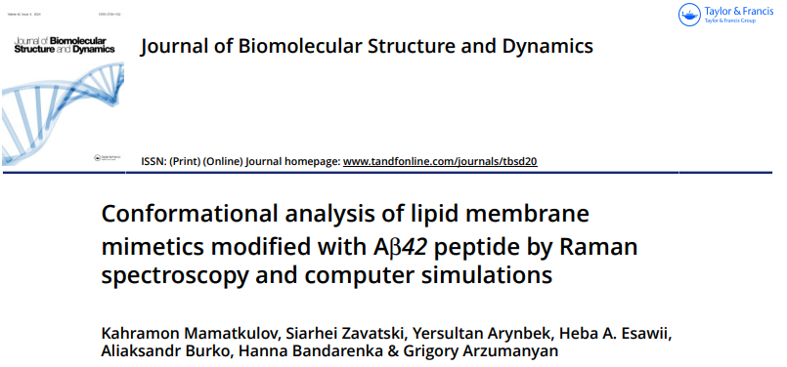
Key Findings of Our Study
Ab42 predominantly adopts a stable α-helix conformation in liposomes.
Ab42 primarily adopts a β-turns/random coil conformation in lipodiscs.
Ab42 longer maintains its native form in liposomes unlike in lipodiscs.
SMA copolymer is NOT recommended for use in lipid-protein systems when characterizing peptides sensitive to conformational changes.
High correlation observed between experimental data and theoretical modeling for both simple and complex systems.

Slide 11
Thank You So much For Your Gentle Attention!
SCIENCE BRINGS NATIONS TOGETHER

