Slide 1
WLS ans Scintillator spectra for ECAL SPD
On behalf of SPD Collaboration
JINR 2024
11/25/2024
Gavrishuk Oleg
1
Notes:
1

Slide 2
Scintillator for ECAL SPD
Scintillator production for ECAL SPD : Vladimir, April-June 2024
165000 tiles 40х40х1.5 мм³ with composition:
  1.5% p-Terphenyl + 0.04% POPOP
  1.5% p-Terphenyl + 0.05% POPOP
  2.0% p-Terphenyl + 0.05% POPOP
11/25/2024
Gavrishuk Oleg
2
Notes:
2

Slide 3
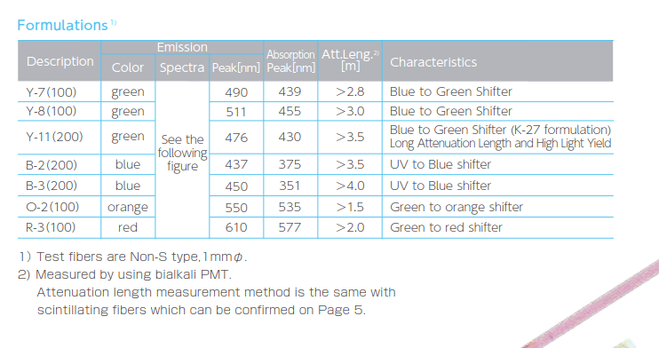
WLS absorption and emission Peaks
Description | Emission |  |  | Absorption Peak[nm] | Att.Leng.²⁾ [m] | Characteristics
 | Color | Spectra | Peak[nm]
Y-7(100) | green | See the following figure | 490 | 439 | >2.8 | Blue to Green Shifter
Y-8(100) | green |  | 511 | 455 | >3.0 | Blue to Green Shifter
Y-11(200) | green |  | 476 | 430 | >3.5 | Blue to Green Shifter (K-27 formulation) Long Attenuation Length and High Light Yield
B-2(200) | blue |  | 437 | 375 | >3.5 | UV to Blue shifter
B-3(200) | blue |  | 450 | 351 | >4.0 | UV to Blue shifter
O-2(100) | orange |  | 550 | 535 | >1.5 | Green to orange shifter
R-3(100) | red |  | 610 | 577 | >2.0 | Green to red shifter
This table from Kuraray Data
http://kuraraypsf.jp/psf/ws.html
11/25/2024
Gavrishuk Oleg
3
Notes:
3

Slide 4
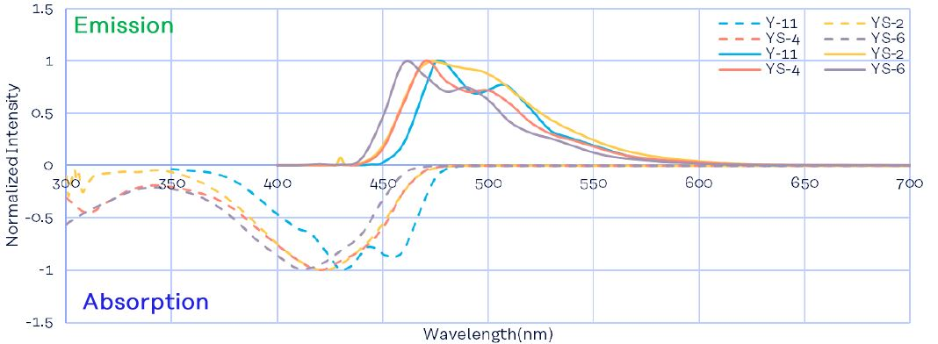
WLS and Scintillator emission and absorption spectra
This table from Kuraray Data
11/25/2024
Gavrishuk Oleg
4
Notes:
4

Slide 5
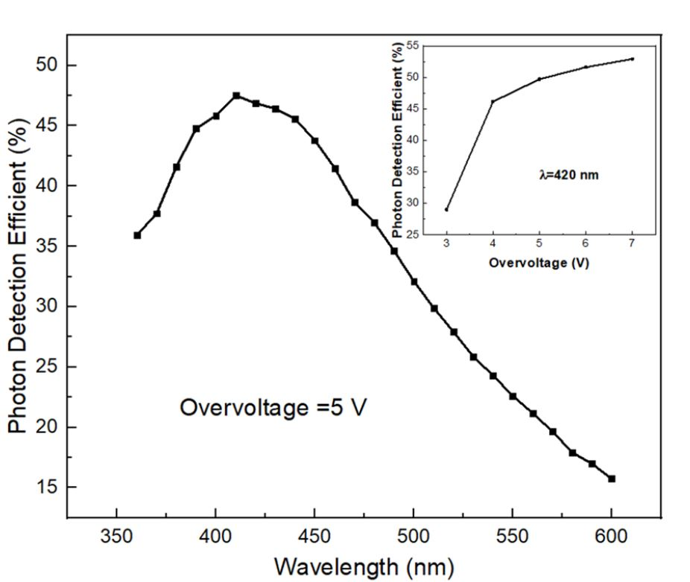
Photon Detection Efficient for SiPm EQR11-15-60 http://www.ndl-sipm.net/PDF/Datasheet-EQR15.pdf
PDE Maximum close to 420-440 nm
11/25/2024
Gavrishuk Oleg
5
Notes:
5

Slide 6
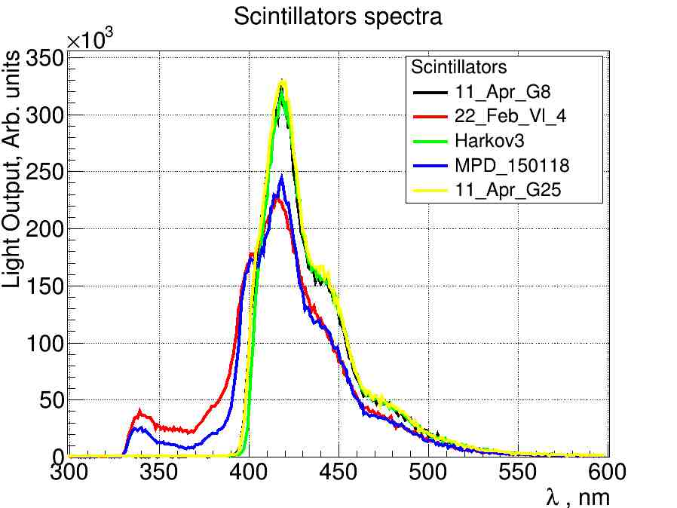
Scintillators spectra (Vladimir)
Red - 1.5% pTP + 0.04% POPOP
Blue – look like same – MPD
Yellow – 1.5% pTP + 0.05 POPOP
Green – 2.0% pTP + 0.05% POPOP
This Data obtained in February-April 2024 and presented by Vladimir Baranov
11/25/2024
Gavrishuk Oleg
6
Notes:
6

Slide 7
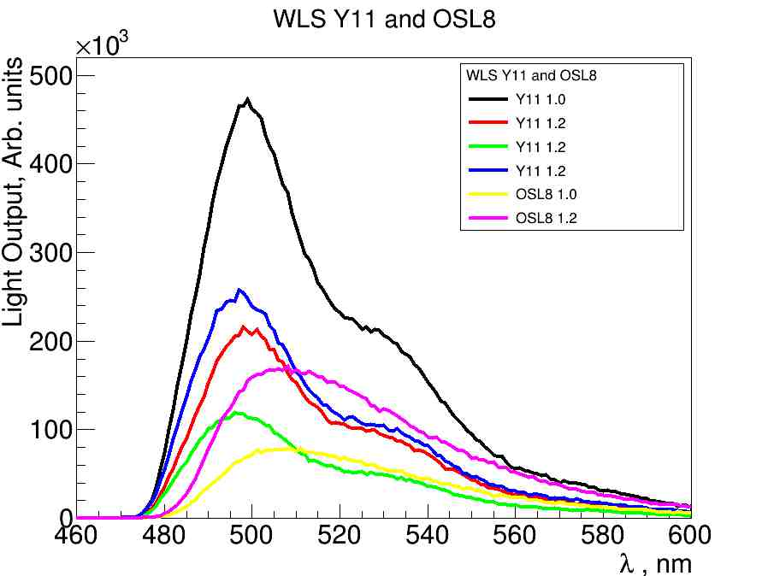
WLS spectra
Black – Y11
Red – Y 11
Green – Y11
Blue – Y11
Yellow – OSL8
Magenta – OSL8
This Data obtained in November 20-24 2024 and presented by Vladimir Baranov
11/25/2024
Gavrishuk Oleg
7
Notes:
7

Slide 8
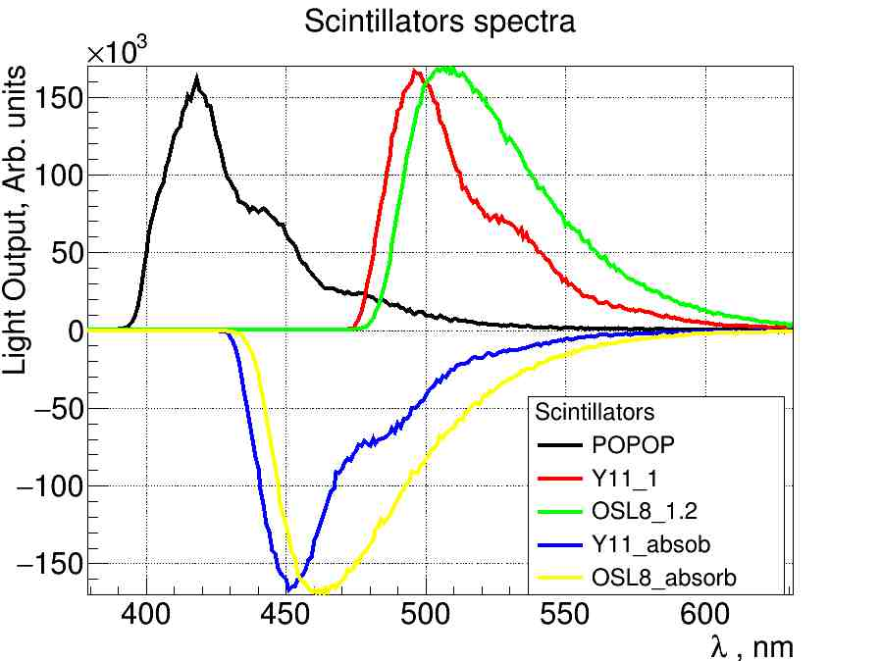
Absorption (red and green) and emission spectra for POPOP – Black, Y-11 – Blue, OSL8 – Yellow
420 nm
EQR11-15 PDE vs l
Peak ~ 425 nm
This Data obtained in November 24 2024
11/25/2024
Gavrishuk Oleg
8
Notes:
8

Slide 9
Y11 – OSC8=20 nm
POPOP – 420 nm
SiPm – 430 nm
At 500 nm – PDE~30%
Y11 more close to POPOP
As result:
OSL8 - potentially never going to be better of Y11
This Data obtained in November 24 2024
11/25/2024
Gavrishuk Oleg
9
Notes:
9

Slide 10
WLS and Scintillator spectra
Conclusions:
1. In such composition OSC8 will never be better than Y11
1. That's why, optimization WLS composition is needed.
2. Shift the scintillator peak over of 420 nm.
3. Or shift the spectrum OSC8 closer to green - 460-480 nm.
11/25/2024
Gavrishuk Oleg
10
Notes:
10

