Slide 1
WLS ans Scintillator spectra for ECAL SPD
On behalf of SPD Collaboration
JINR 2024
11/25/2024
Gavrishuk Oleg
1
Notes:
1

Slide 2
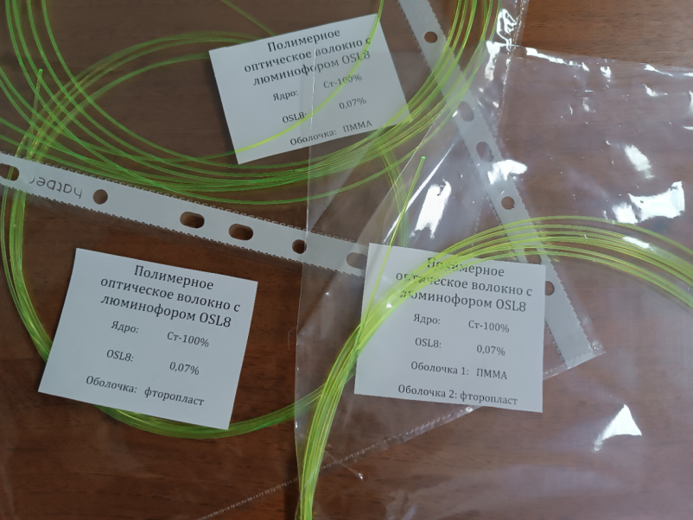
WLS and Scintillator spectra Some remarks concerning WLS OSC8 composition : 1. Dopant concentration is equal to 0.07% 2. I have studied in some dopant properties: https://inis.iaea.org/collection/NCLCollectionStore/_Public/16/039/16039338.pdf That dopant conversion efficiency go to Plato at concentration ~100 µkg/cm² . Recalculation this units in WLS (with diameter 1 mm) show the concentration ~70 µkg/cm². It look like it is OK’. Rem.: Mass for diam. 1 mm fiber with length 1000 m (1km) is equal to 1000 gr (1 kg). - The dopant 0.07% weight – 0.07*1000/100 gr =0.7 gr/km - For 25000 ECAL cells (8m/cell) – WLS lengths = 200 km - Dopant weight – 200*0.7=140 gr.
11/25/2024
Gavrishuk Oleg
2
Notes:
2

