Slide 1
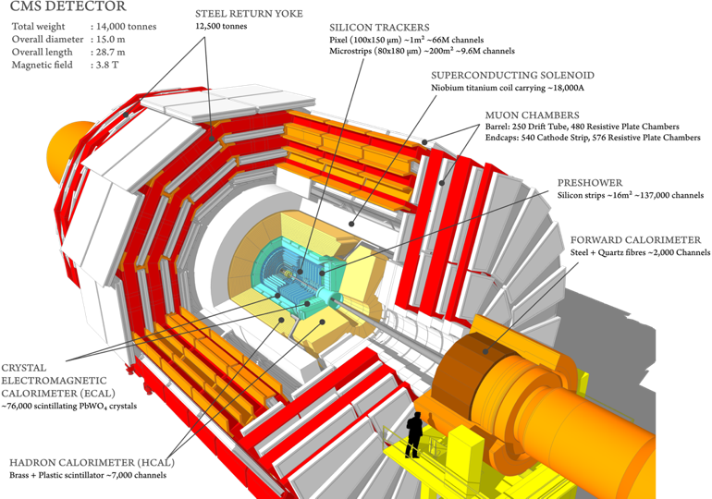
Report on the scientific results obtained
by the JINR group in the CMS experiment
JINR Topic 02-1-1083-2009
 | CMS composition
218 | full member institutes
29 | associated institutes
10 | cooperating institutes
5864 | active members
58 | countries
2062 | phd physicists
1171 | physics doctoral students
1293 | non doctoral students
978 | engineers
252 | technicians
108 | administrates
Vladimir Karjavine
for JINR CMS group
61 Meeting of the Programme Advisory Committee. 20.01.2025.

Slide 2
JINR Group Activities
Participants: 77 from JINR; 12 from JINR member-states (DMS), 20 members of JINR associated personnel
11 young researchers: 6 PhD Students from JINR, 5 PhD Students from DMS.
Authors: 21 from JINR and 3 from DMS (21 paid by JINR and 3 unpaid PhD students ), 19 of JINR associated personnel (unpaid by JINR)
  JINR team obligations
  Detectors maintenance and operation
  JINR Tier-1 and Tier-2 centers robust operation
  Participation in shifts. 64 central shifts were
  served by JINR in 2024
  Experimental Physics responsibilities (EPR), due for 1 author is 4.0 months tasks (including shifts)
  Participation in CMS upgrade
  Phase1: upgrade of HCAL and Endcap Muon system
  Phase2: construction of the High Granularity Calorimeter
  and Endcap Muon system upgrade.
  Participation in physics analysis and software development
CMS duties executed by JINR physicists
HCAL Technical Coordination
Co-convening the CMS Generator group
CMS data managers for Tier-1 and Tier-2 sites.
Deputy Chairman of the CMS Conference Committee
Participation in Analysis Review Committee (ARC) and Institutional publication review (IR).
Members of institution and collaboration boards.
JINR EPR 2024 results
Work Due: 96.91
Work done: 105.09
Shifts done: 6.88
Work + Shifts done: 111.97
Ratio done/expected: 1.16
2

Slide 3
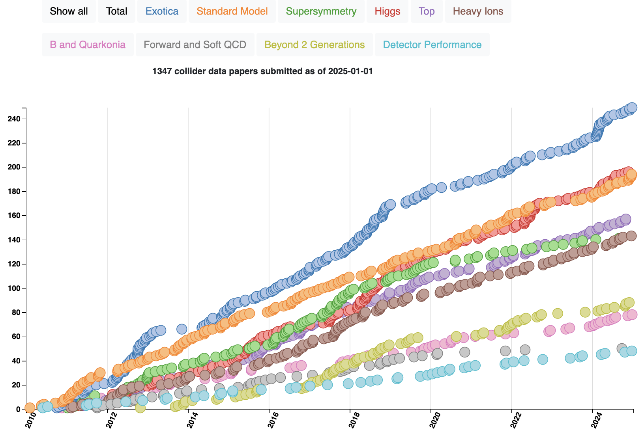
Publications
JINR group publication in 2024
The full list of CMS collaboration publications for 2024, authored by JINR representatives, includes 82 scientific CMS papers.
In 2024, JINR physicists made a significant contribution to the preparation of 35 scientific papers (including 7 CMS papers)
The results of the work were presented in more than 50 reports at various conferences, workshops, and seminars
CMS publications statistics
1347 papers based on collision data (RUN-1/RUN-2/RUN3) submitted so far
102 papers submitted in 2024
The International Conference on Neutrinos and Dark Matter (NuDM-2024, Cairo, Egypt)
XV Latin American Symposium on High Energy Physics (Mexico City, Mexico)
LHC Days in Split (Croatia)
Higgs Days in Santander (Spain)
Workshop Extended scalars sectors from all angles (CERN, Switzerland)
Mathematical Modeling and Computational Physics (MMCP2024, Yerevan, Armenia)
XXXVI Worshop on high energy physics, (Protvino, Russia)
Scientific session of the Nuclear Physics Section of the Russian Academy of Sciences (Dubna, Russia)
VII International Conference on Particle Physics and Astrophysics (ICPPA 2024, Moscow, Russia)
LXXIV International conference Nucleus-2024 (Dubna, Russia)
XXII International Seminar on High Energy Physics (Pereslavl, Russia)
7th International Conference on Particle Physics and Astrophysics (Moscow, Russia)
China-JINR Workshop on Software and Computing for Future HEP Experiments, JINR (Listvyanka, Russia)
7 countries, ~20 scientific events
~15 talks by young scientists
3

Slide 4
JINR areas of activity in the CMS physics analysis
Searching for Physics Beyond the Standard Model
Channels with a pair of leptons (extended gauge models, scenarios with additional spatial dimensions, models with dark matter, testing of lepton universality, search for LFV processes, etc.)
Channels with a pair of leptons/b-quarks and missing transverse energy ET (dark matter, extended Higgs sector)
Multiple jet/lepton/photon production (microscopic black hole scenarios)
Testing the predictions of the Standard Model (EWK and QCD processes)
Precision measurements of the characteristics of the Drell-Yan process (cross-sections, angular characteristics)
Discovery and study of the properties of the Higgs boson (4l, 2b)
Study of the characteristics of QCD jets (cross-sections, fragmentation functions, etc.)
B-physics
Heavy Ion Physics
Multiple particle production
Algorithms and Software
Development of algorithms for high-momentum muons reconstruction. Muon hit reconstruction and segment builder.
Data Certification (DC) software development.
4

Slide 5
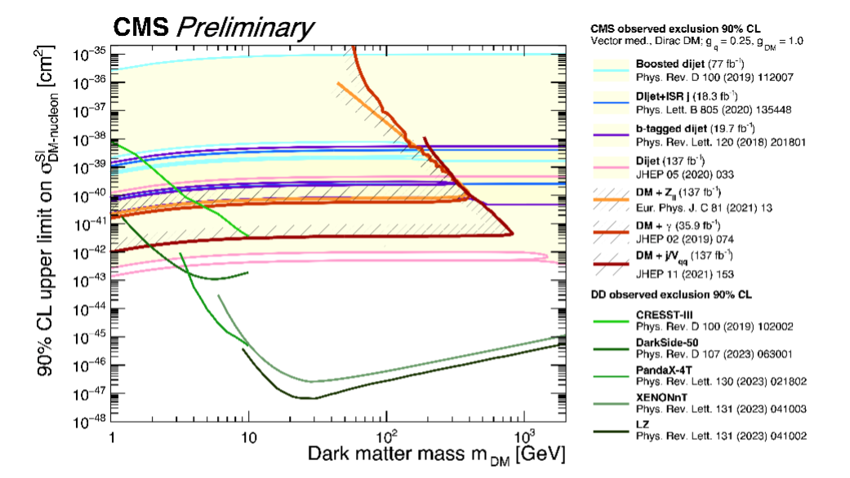
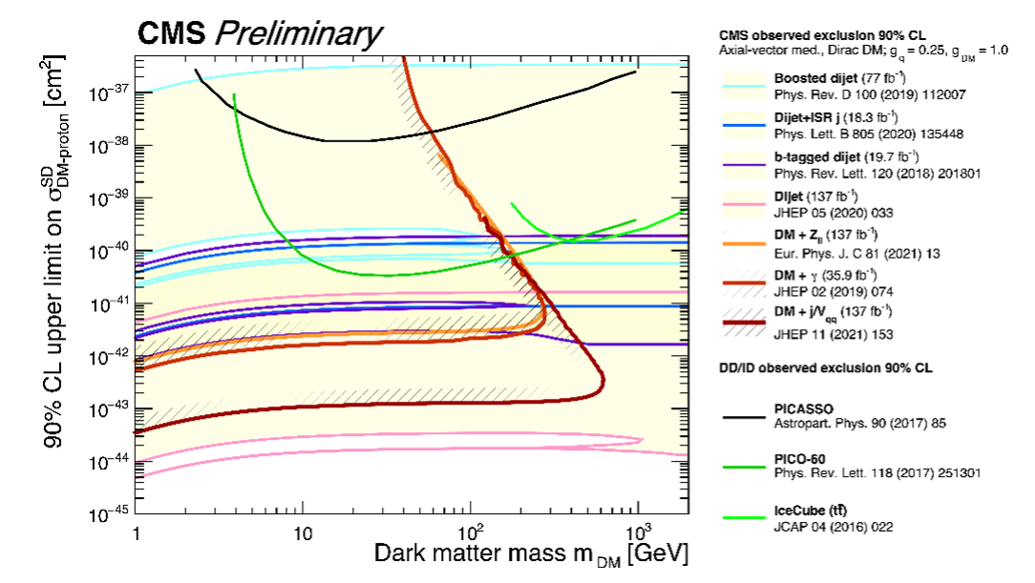
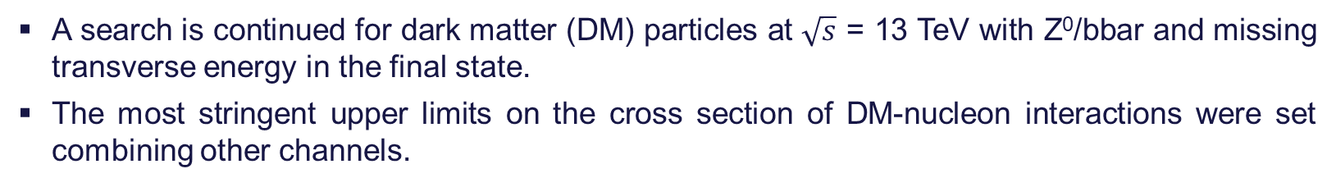
Searching of Candidates for Non-baryonic Dark Matter
A search is continued for dark matter (DM) particles at $\sqrt{s}$ = 13 TeV with Z⁰/bbar and missing transverse energy in the final state.
The most stringent upper limits on the cross section of DM-nucleon interactions were set combining other channels.
The CMS excluded region is for both vector (left) and axial-vector (right) mediators, and
Dirac DM with couplings g_{q} = 0.25 and g_{DM} = 1.0.
The exclusion contour is compared with limits from the non-collider underground experiments.
5

Slide 6
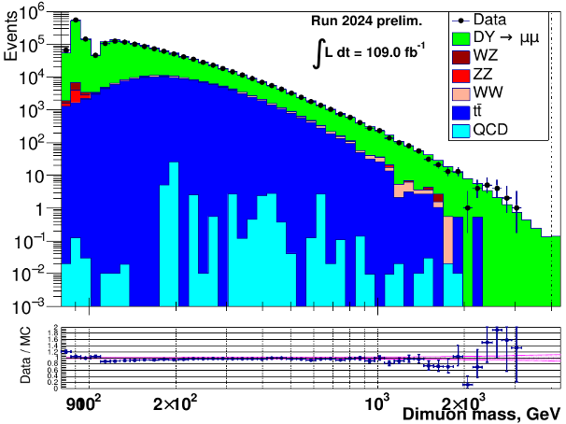
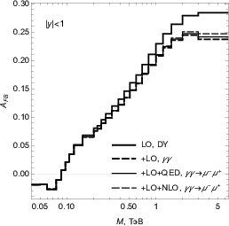
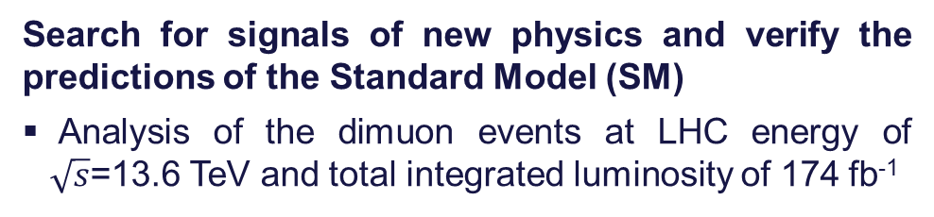
The analysis of muon pair spectra with Run 3 data
Search for signals of new physics and verify the predictions of the Standard Model (SM)
Analysis of the dimuon events at LHC energy of $\sqrt{s}$=13.6 TeV and total integrated luminosity of 174 fb⁻¹
Study of the Photon-induced background
Preliminary
One-loop electroweak radiative corrections to dilepton production in hadron collisions via photon fusion are estimated
Forward-backward asymmetry
Experimental data shows good agreement of the with the MC predictions
Photon-induced background has to be accounted for m > 1 TeV.
6

Slide 7
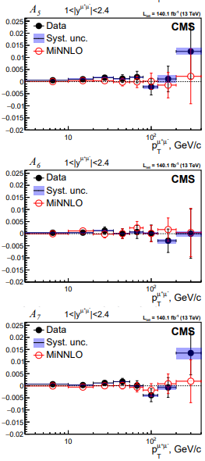
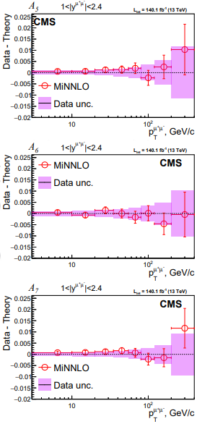
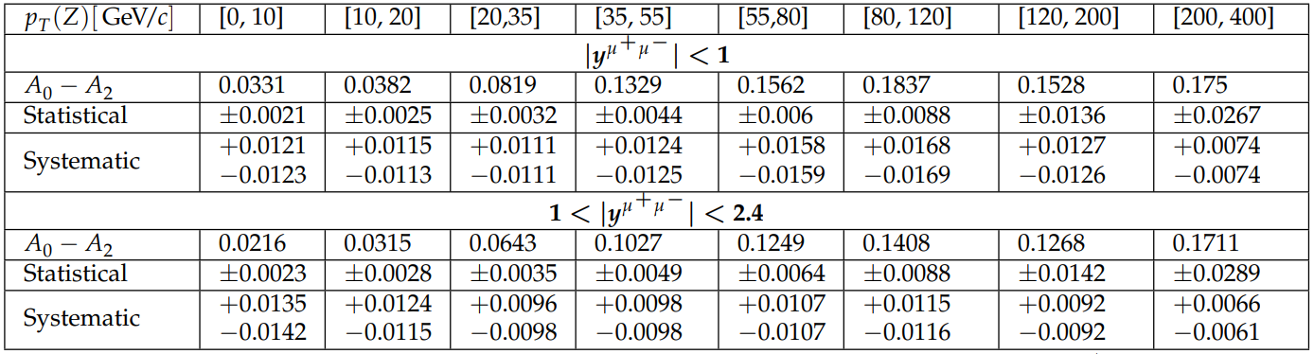
Measurement of Drell-Yan Angular Polarization Coefficients at 13 TeV
The full set of angular polarization coefficients A₀-A₇ were measured
  coefficients A₅-A₇ measured for the first time on CMS
  no significant deviations from 0 were found
The measurements were checked
  Verification of the quality of the approximation model
  Measurement of correlations between parameters
  Calculation of theoretical uncertainties
  Limited detector acceptance impact on the result stability
Lam-Tung relation 𝐴₀−𝐴₂=0 versus Pt for different rapidity of muon pair
Work status
Results were approved by the CMS Analysis Review Committee (ARC)
Internal CMS publications: Paper Draft SMP-23-007 and Analysis Note AN-2020/220
Physical Letters B article is under CMS collaboration review
PhD thesis based on this analysis going to defense
More information in poster session presentation by Vladislav Shalaev
7

Slide 8
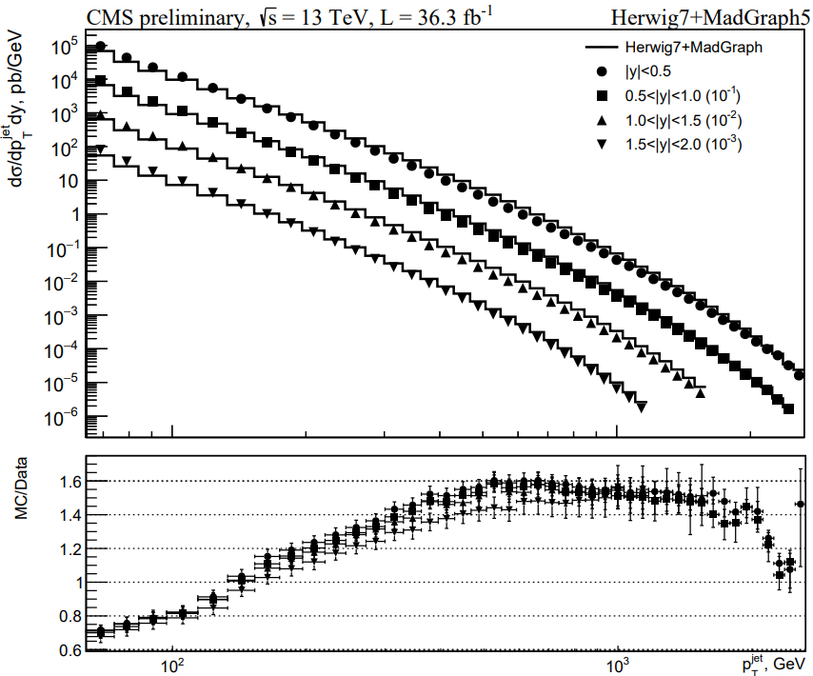
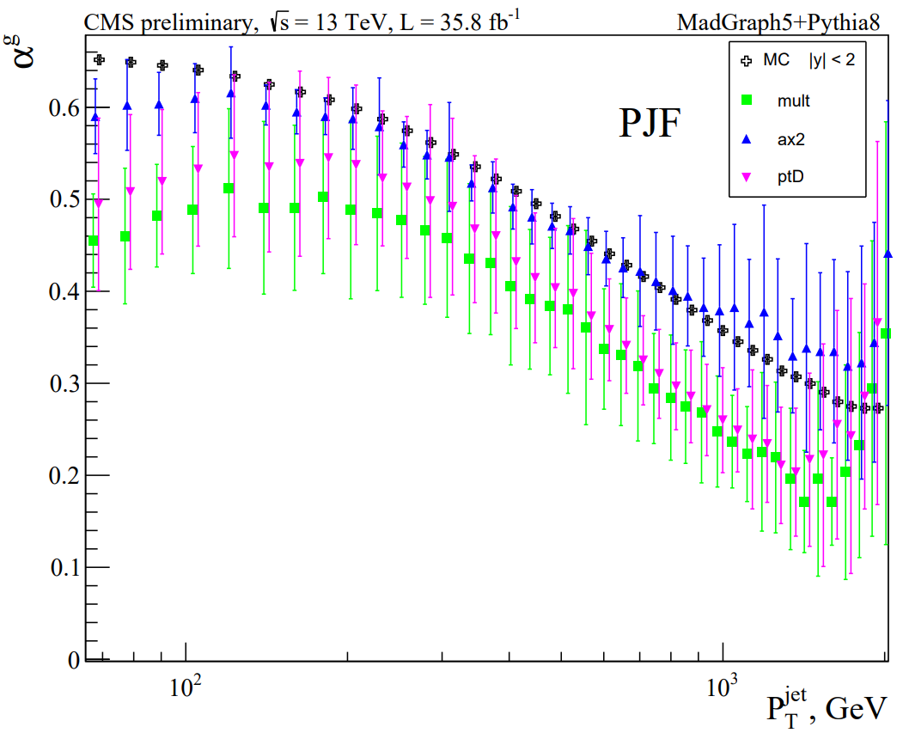
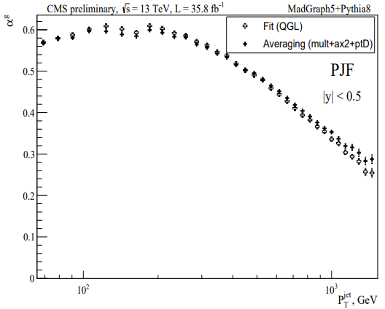

Measurement of g-jet fractions
Measurement of the g-jet fractions with different methods:
- using simple q/g-jet properties: “mult”, “ax2”, “ptD” (left fig.)
- using new QGL-discriminator (right fig.)
  The concept of “Model Uncertainty” (M.U.) of measured
  g-fraction is introduced
  - M.U. is estimated for model MadGraph+Pythia8 (left fig.)
Further development:
measurement of g-jet fractions with MadGraph+Herwig7 model
MadGraph+Herwig7 MC datasets have been created
Inclusive jet cross-section
g-jet fractions in $p_{T}^{jet}$ bins
g-jet fractions with
QGL and “mult+ax2+ptD”
The new “data-driven correction” of MC q/g-jet properties is proposed
- M.U. of g-jet fractions after correction ~ 0 (within statistical error)
Disagreement between Data and MC due to MadGraph does not take into account higher orders of QCD
8

Slide 9
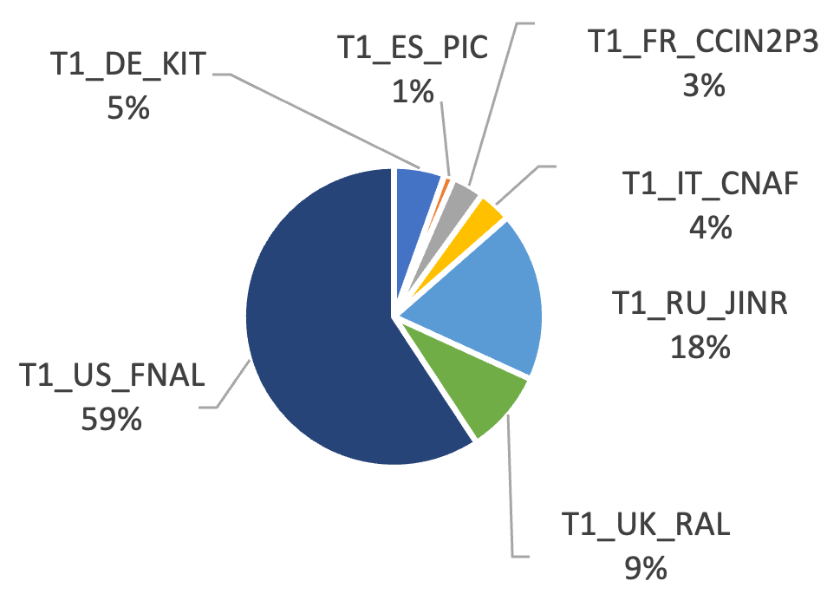
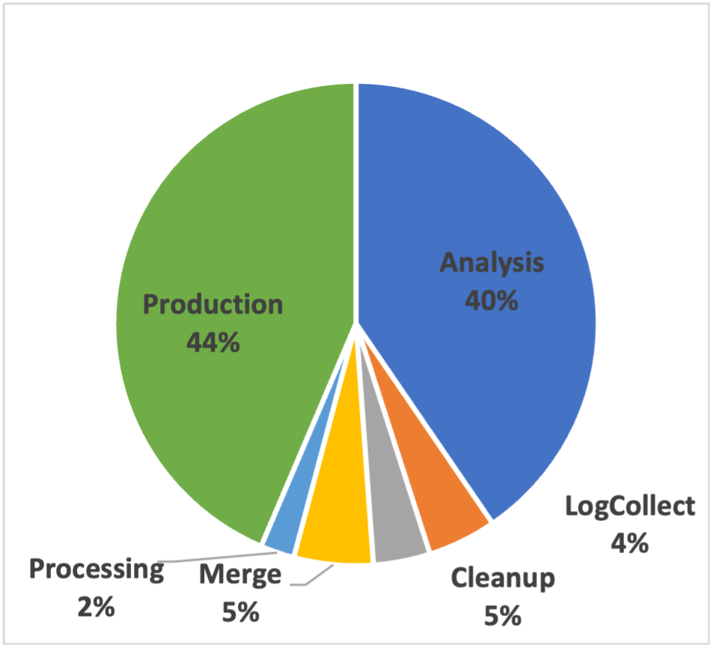
JINR contribution in CMS Computing
In the 2024 JINR grid Tier-1 and Tier-2 centers extensively used for processing and storing CMS data, ensuring 100% availability and reliability of services
More than 2.1 billion events were successfully processed by JINR Tier-1 in 2024
The JINR Tier-1 is ranked the second place (with 18.0%) among all Tier-1 world centers for CMS
Events processed by Tier-1 world centers
Completed jobs ratio by JINR Tier-2 center
More than 1.2 million CMS jobs were completed on JINR Tier-2 center, most of them being Monte-Carlo production and analysis jobs
9

Slide 10
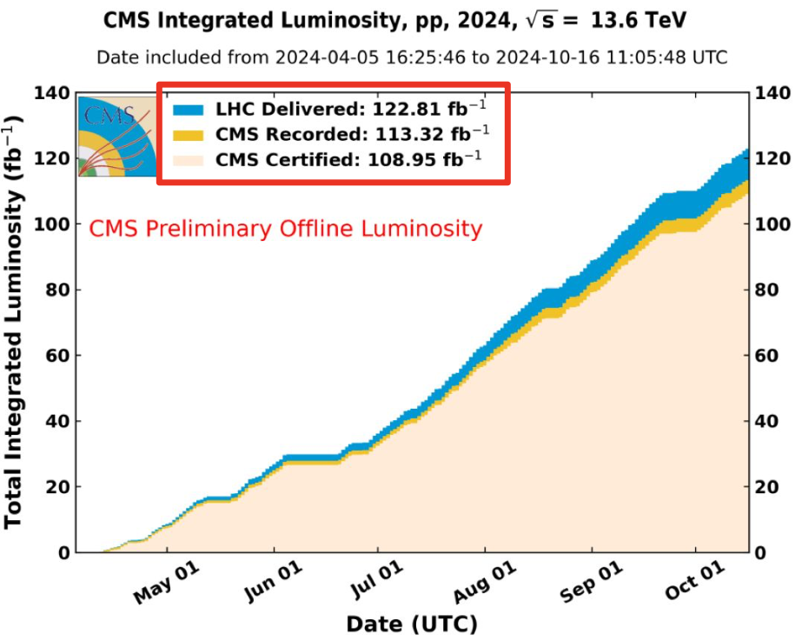
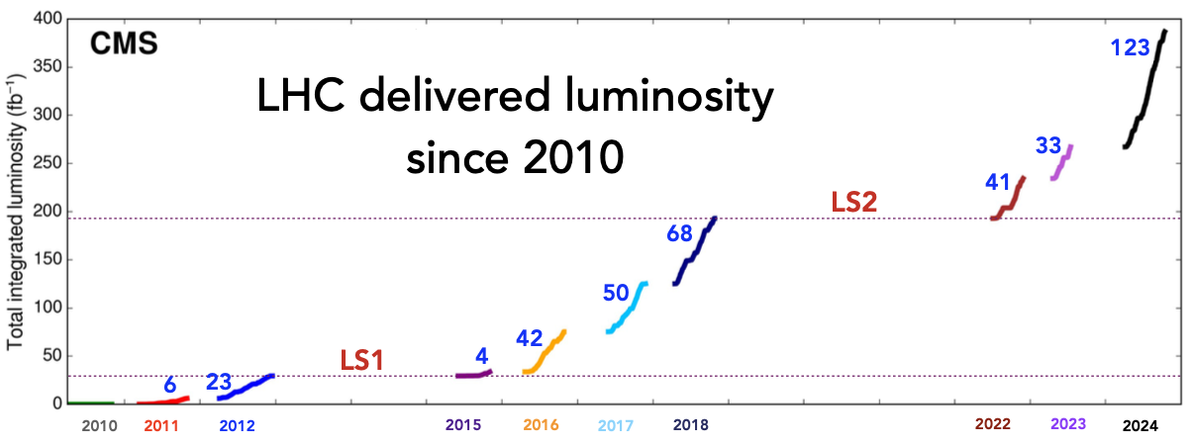
CMS operation in RUN-3 2024
Unprecedented quantity of data in one year
LHC Operations
๏ Availability: 73%
๏ Stable beams: 49%
CMS efficiencies
๏ Data taking: 92.33%
๏ Certification: 96.32%
CMS certified
๏ 109.08 fb⁻¹
LHC Integrated Luminosity delivered to CMS in 2024
123 fb⁻¹ delivered,
113 fb⁻¹ recorded (92%),
109 fb⁻¹ certified (88.5%)
Total delivered: 391 fb⁻¹
Run 3: 197 (13.6 TeV)
Run 2: 165 (13 TeV)
Run 1: 6 (7 TeV) + 23 (8 TeV)
10

Slide 11
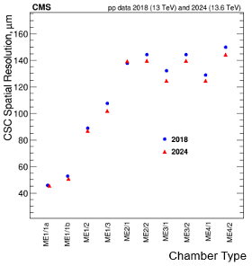
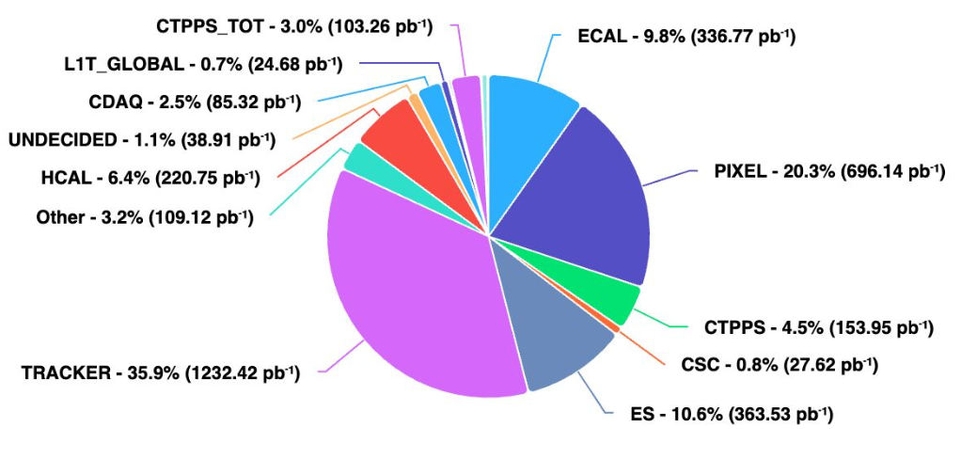
Detectors Operation in RUN-3 2024
Cathode strip chambers, CSC
The Muon system shows good performance, comparable to previous years.
CSC operating well: 99.32% active channels.
Hadron Calorimeter, HCAL
To ensure robust operation of HCAL in 2024:
regular monitoring of data quality
alignment of amplitude signals and calibration of detector channels
Timing alignment was improved
SiPM temperature stabilization was improved.
HCAL was running fine without any issues.
CMS downtime in 2024
CSC spatial resolution of ME muon stations in Run3 (2024) are in good agreement with Run2 (2018) data - indicate the stability of the CSC operation
11

Slide 12
JINR contribution to CMS Phase 2 Upgrade
CMS Phase-2 upgrade task: reliable work of detectors in the High Luminosity LHC operation mode (HL-LHC) at energy √s = 14 TeV and instantaneous luminosity L= 5-7х10³⁴сm⁻²с⁻¹
Participation in High Granularity Calorimeter (HGCal) project.
  Design and construction of the HGCAL silicon and scintillator cassettes test facility
Participation in the Endcap Muon system upgrade.
  Cathode Strip Chambers maintenance during LS3 long shutdown period.
  CSC longevity study and searches for eco friendly gas mixtures R&D.
  Design and construction of the new ME1/1 Patch Panel.
  Design and construction of new tooling for ME1/1 CSC assembly and installation
12

Slide 13
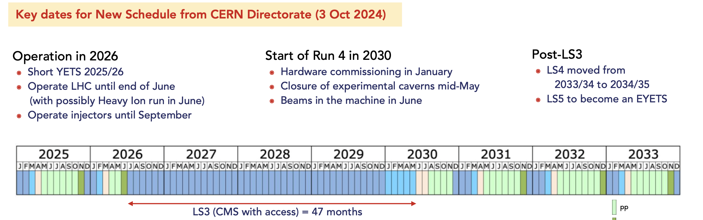
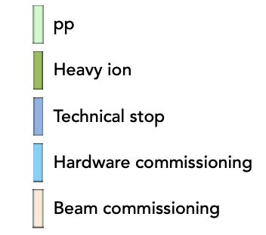
New LS3 Schedule
Three identified risks for CMS
๏ readiness of detectors for installation
๏ readiness of infrastructures to commission the detectors
๏ very dense LS3 program and with high person-power needs
13

Slide 14
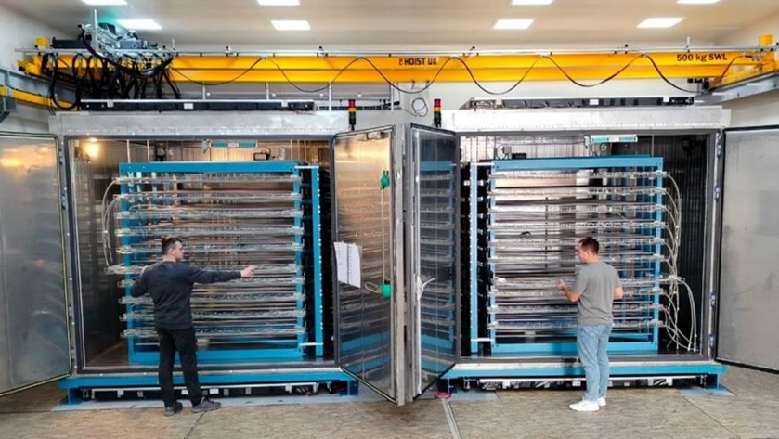
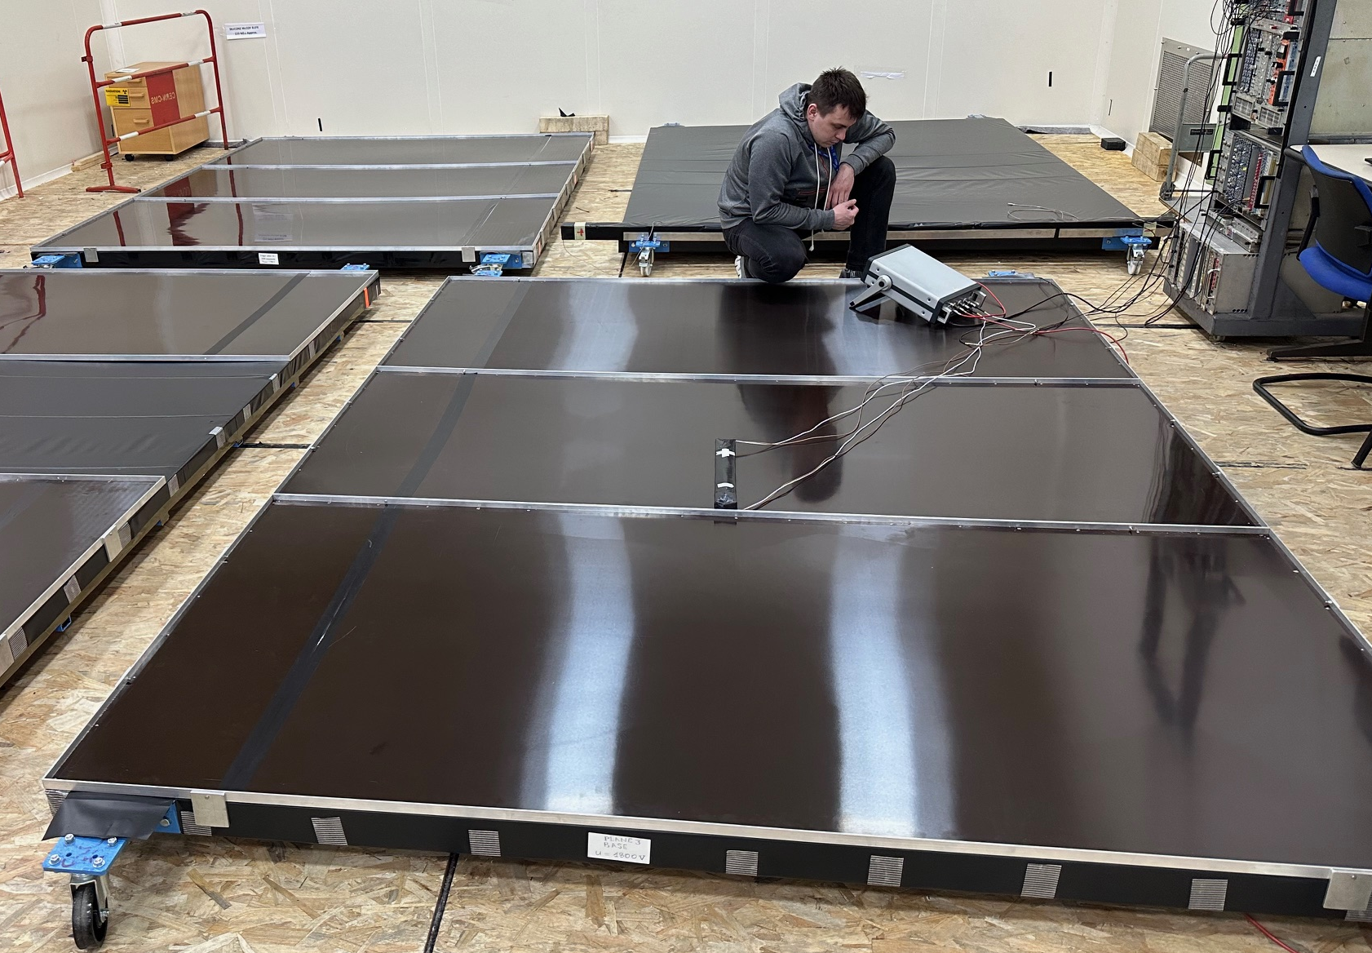
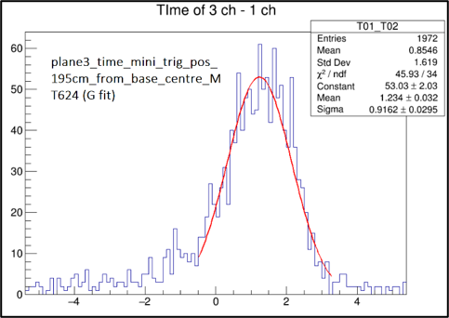
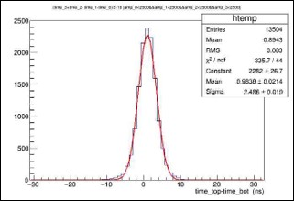
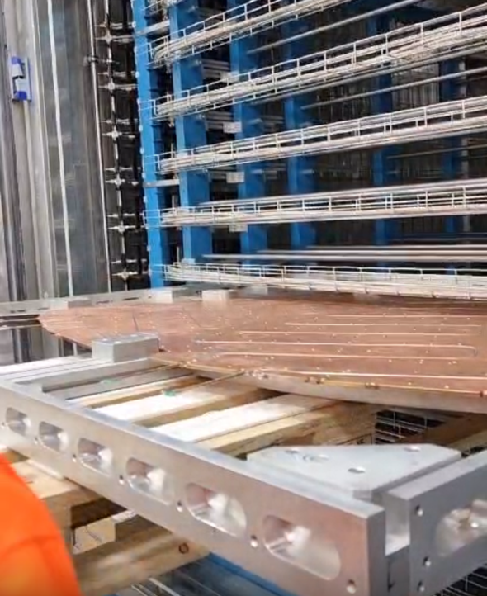
Setup for HGCAL Cassettes Testing
2 Cold rooms were assembled at SX5 CERN
Commissioning of the scintillation trigger planes.
σ_{1 plane}~0.9 ns
Test setup includes:
Racks for cassettes
(inside cold rooms)
Supporting frames for cassettes
Scintillation trigger planes
(on top and bottom of rooms)
Readout electronics
Cassette on the supporting frame
Plane efficiency of ~98%.
1 plane time resolution ~0.9 ns.
Time resolution of 2 planes ~3ns.
σ_{2 plane}~2.4 ns
Triggers frequency in the fourfold coincidence mode: 130-160 Hz
- corresponds to ~3000 triggers per 1cm² in 10 days
- matches with the simulation: 10 days cassettes test cycle
required minimum 1000 triggers per 1cm²
Plan to have the test facility is ready for operation by the middle of 2025
14

Slide 15
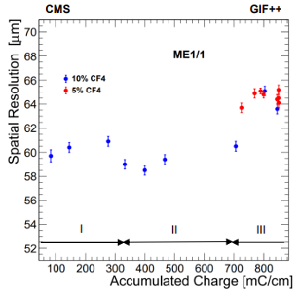
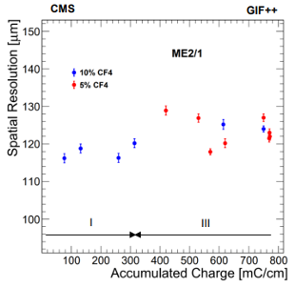
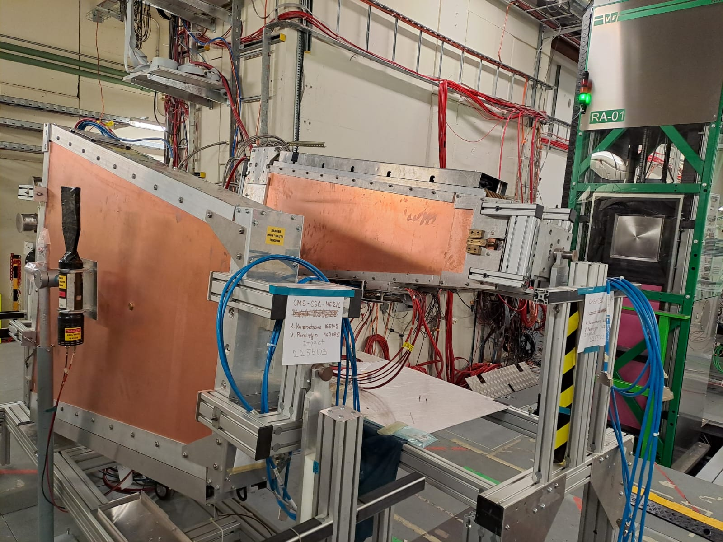
Cathode Strip Chamber Longevity Study @ GIF++
Irradiation setup: ME1/1 and ME2/1 CSCs exposed with the 12 TBq ¹³⁷Cs gamma source
at the GIF++ Facility (HV-ON on 4 layers and HV-OFF on 2 layers kept as reference).
CSCs spatial resolution as a function of the accumulated charge
¹³⁷Cs
ME1/1
ME2/1
2023 Test Beam at GIF++
ME CSCs irradiation setup at GIF++
No aging effects observed so far
The slight degradation of the ME1/1 resolution in period III (2023-2024) is to be investigated
15

Slide 16
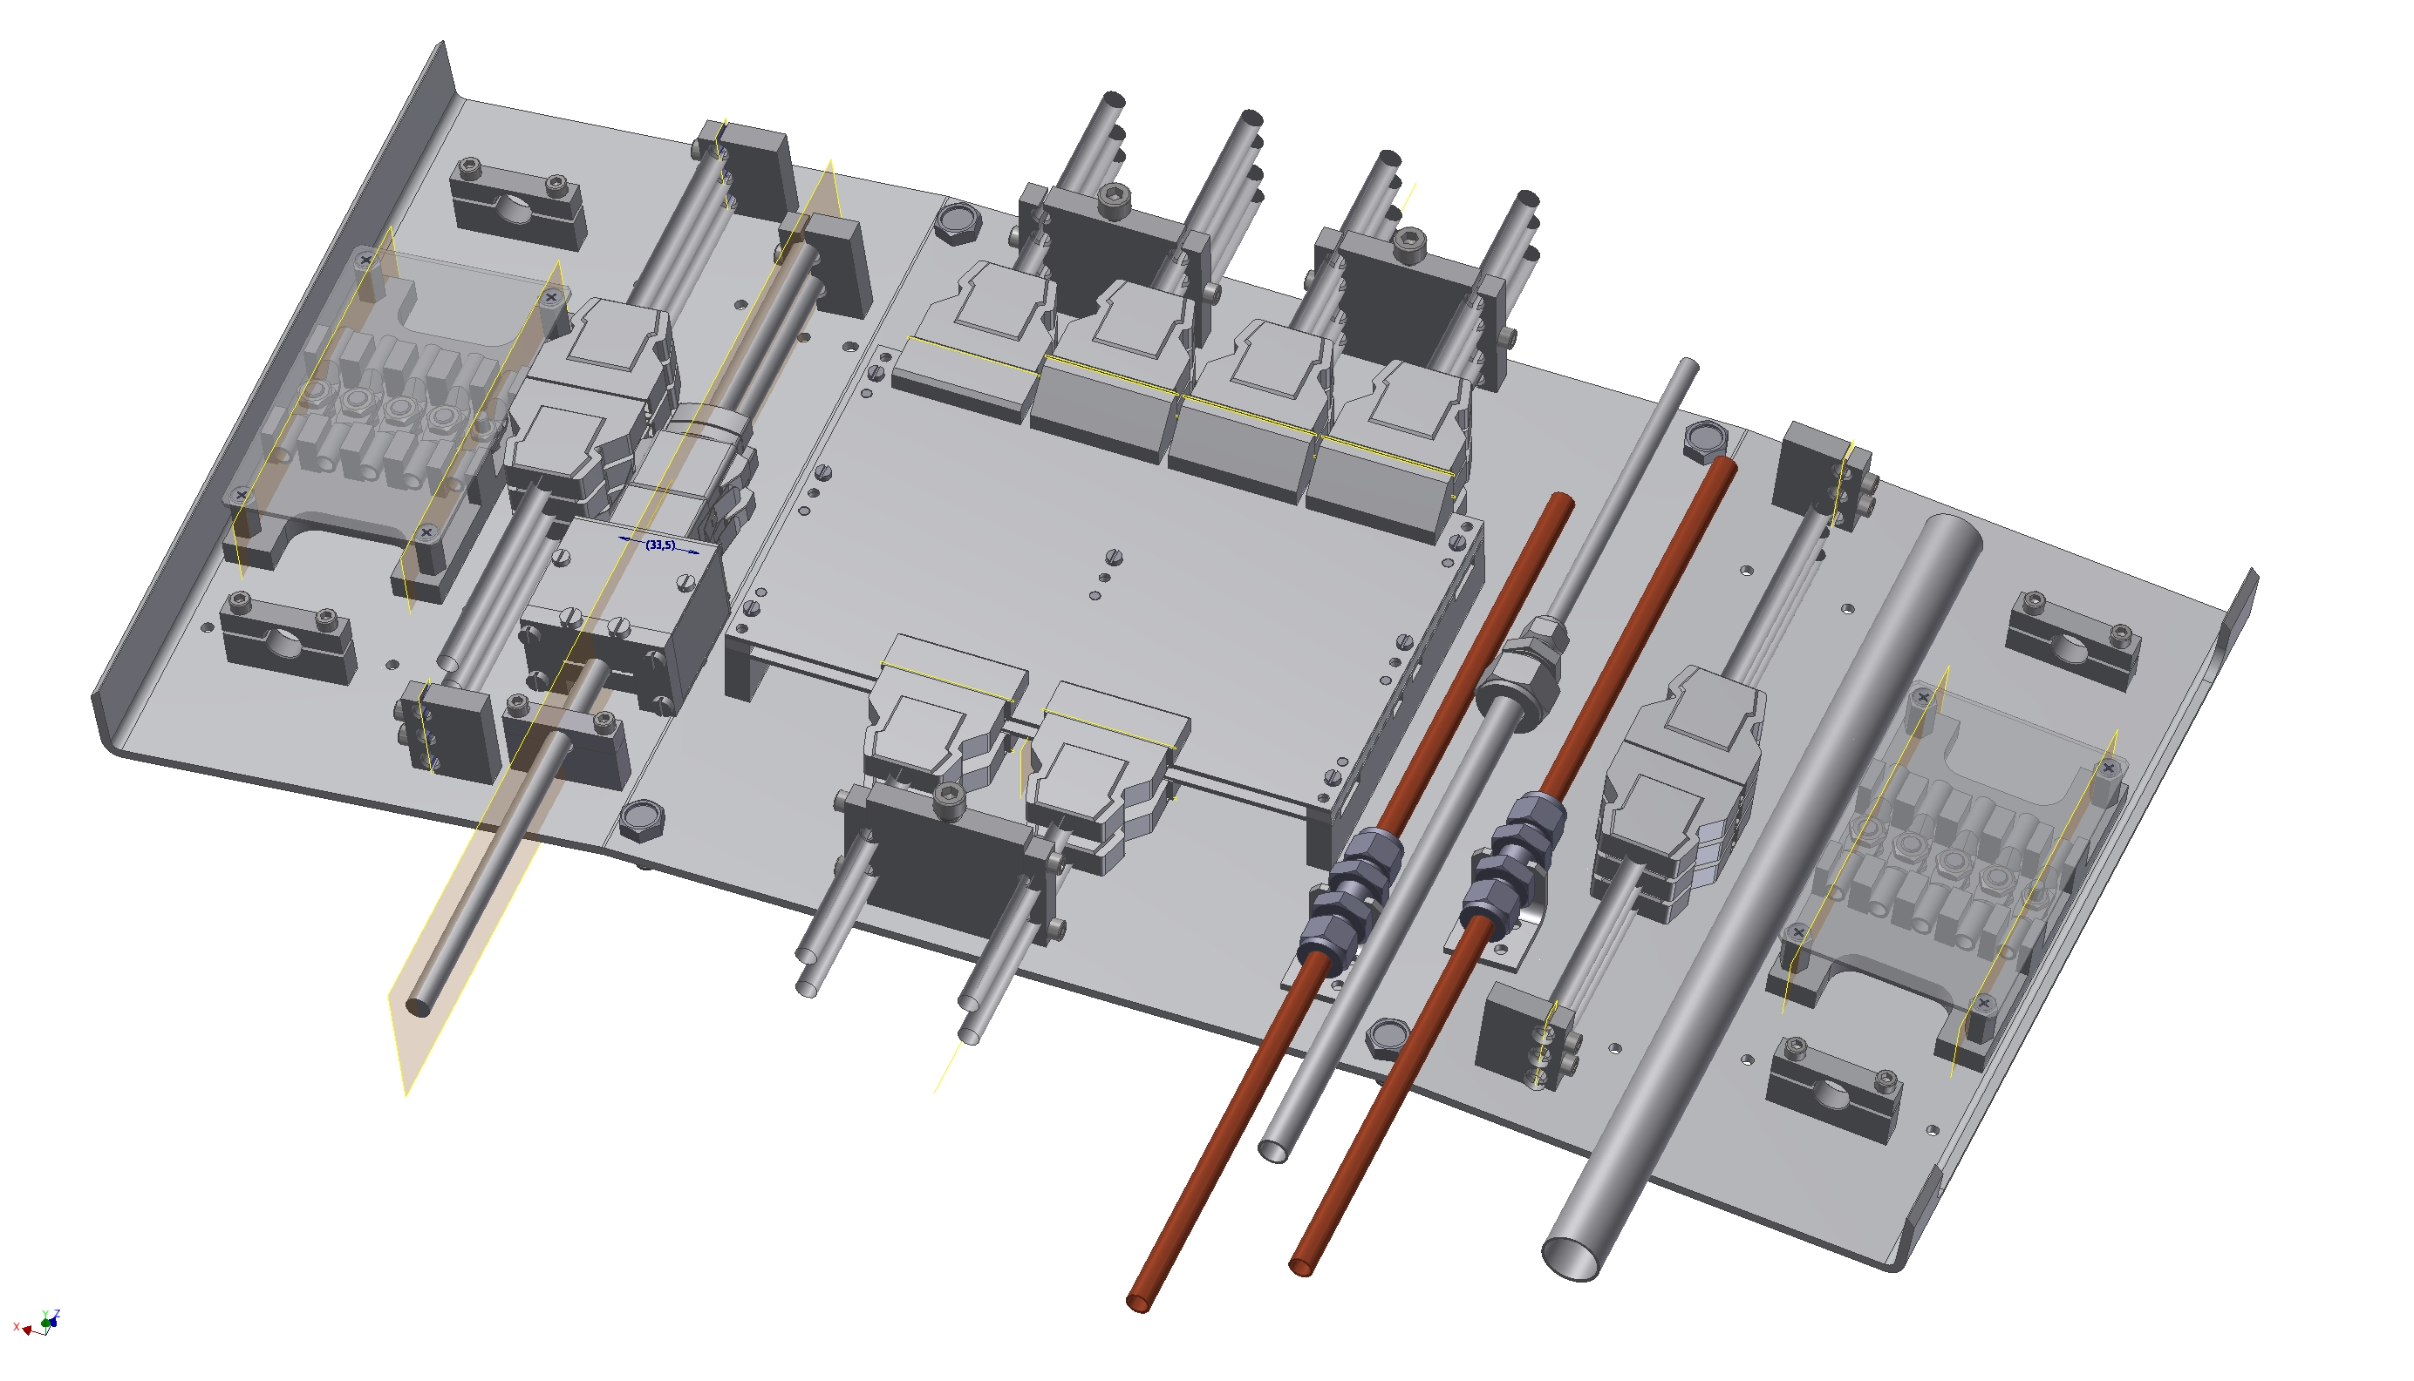
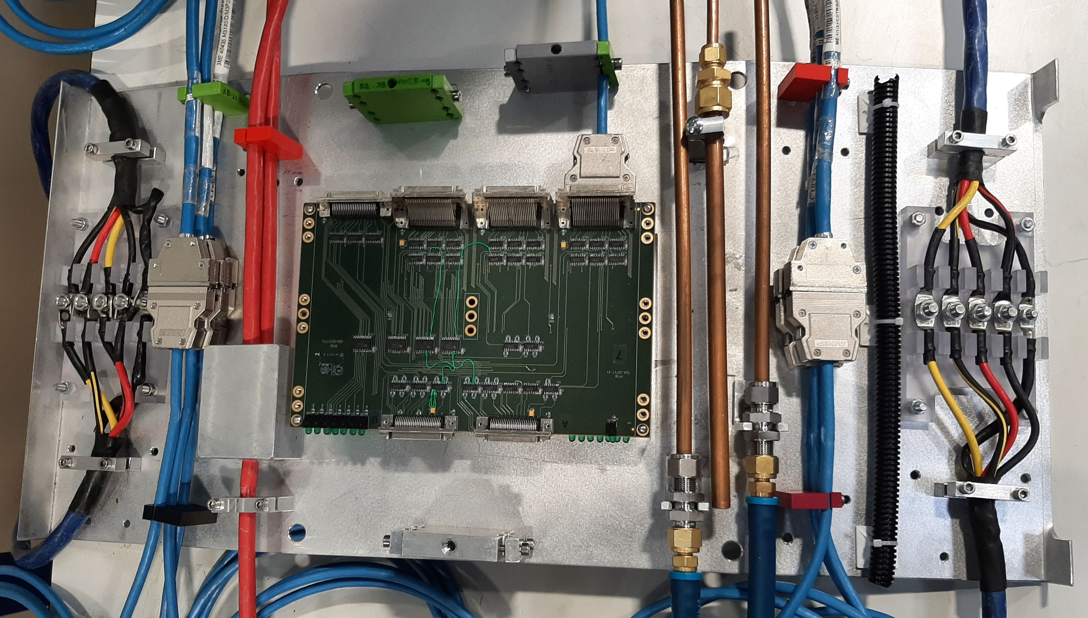
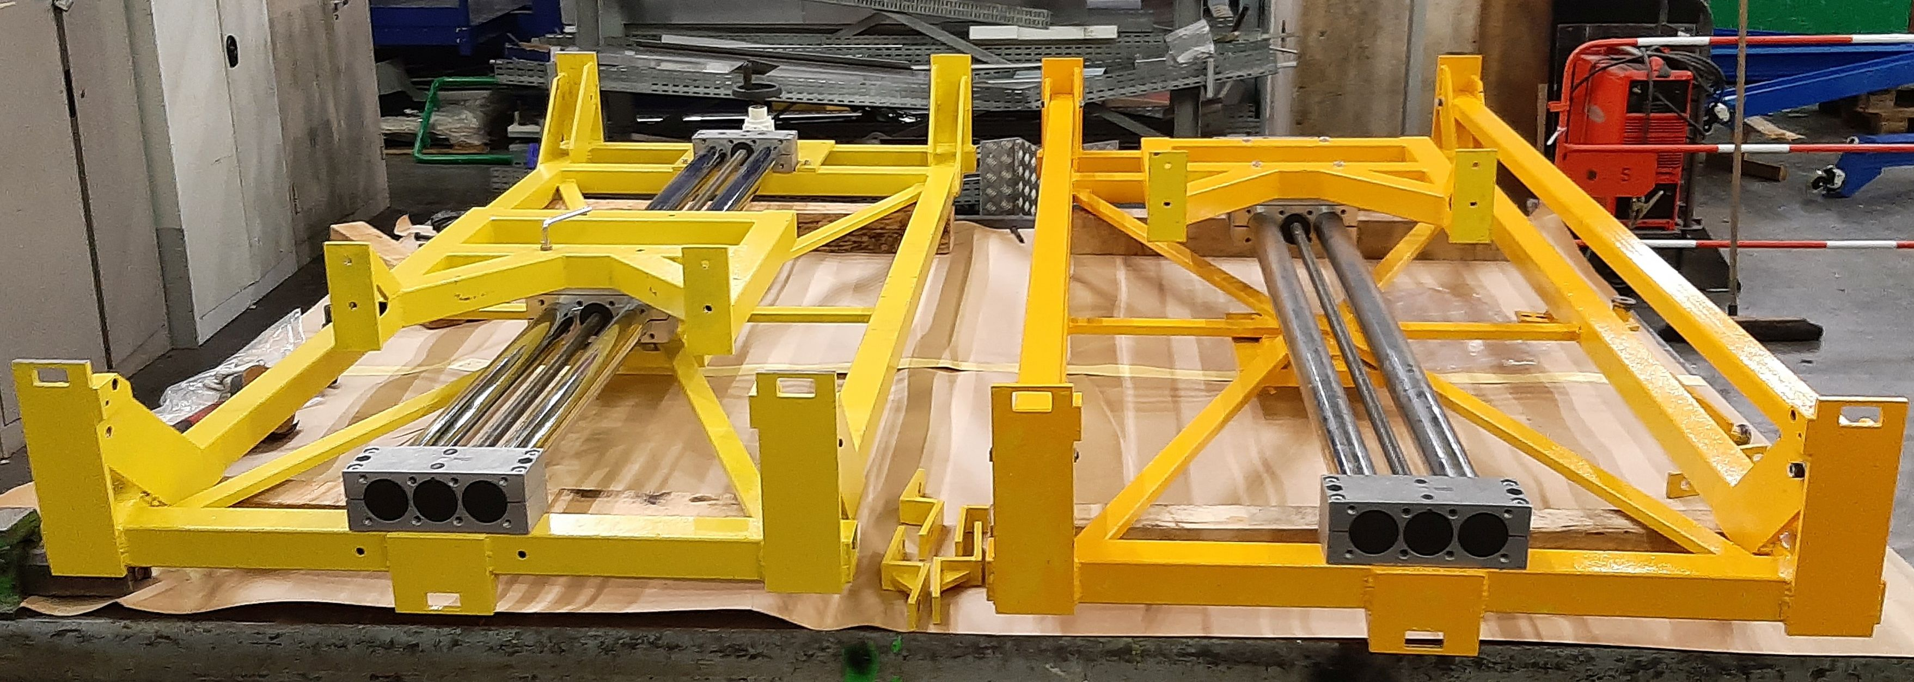
ME1/1 Preparation to the Phase-2 CSC Upgrade in LS3
ME1/1 Patch panel
3d model
Prototype
ME1/1 Patch Panel redesigned to fit more rigid envelope for endcap detectors cables and services in the CMS Phase-2 configuration
Parts for 36 ME1/1 PP have been constructed
Loading machines
ME1/1 two loading machines for extraction/installation of ME1/1 CSCs were constructed
16

Slide 17
Summary
2024 Physics Run successfully completed. Unprecedented quantity of data recorded by CMS in one year.
  JINR group contribute to maintenance and operation of the CSC Endcap Muon system and Hadron Calorimeter. Detectors are performing reasonably well during 2024 RUN-3 data taking.
In 2024, the JINR group continue physics analysis based on RUN-2 and RUN-3 data.
In 2024 JINR grid Tier-1 and Tier-2 centers shows stable and robust operation for CMS data processing.
JINR group performed a good progress in CMS Phase-2 Upgrade.
  Participation in High-Granularity Calorimeter (HGCal) project
  - Construction of the test setup for HGCAL is close to completion.
  Participation in CMS Muon Endcap system upgrade.
  - CSC patch panel parts have been constructed.
  - Two ME1/1 loading machines were constructed and ready for operation in LS3
  - The CSC longevity and the CSC operation with a new gas mixtures studies are in progress
17

Slide 18
Plan for 2025
Continue RUN-2 and RUN-3 data analysis.
Dimuons, Z + MET, bbar + MET, dimuons + MET to search for the new physics and test the SM.
Continue optimization of the hadronization model for the q/g jet fractions measurement.
Participation in 2025 RUN-3 data taking within JINR responsibilities.
- Participation in shifts.
- Detectors operation and maintenance.
- Detectors performance study.
Participation in Phase-2 HGCAL project.
- Launching of the HGCAL cassettes test facility.
Participation in Phase-2 upgrade of Muon Endcap System.
Preparation to the ME1/1 CSC upgrade during LS3.
Continue of the CSC detectors ageing effects study at GIF ++ facility.
Development and test of algorithms for reconstruction of the muon track segments.
18

