Slide 1
Implementation of the recommendations
Meeting of the
Programme Advisory Committee for Nuclear Physics
13-14 June 2024,
59
th
Valery V. Nesvizhevsky

Slide 2
1. | Opening of the meeting | V. Nesvizhevsky
2. | Implementation of the recommendations of the 58th PAC meeting | V. Nesvizhevsky
3. | Information on the Resolution of the 135th session of the JINR Scientific Council (February 2024) and on the decisions of the JINR Committee of Plenipotentiaries (March 2024) | S. Dmitriev
4. | Status of the U-400M accelerator | V. Semin
5. | Synthesis and study of the decay properties of isotopes of superheavy elements Ds and Lv | N. Kovrizhnykh
6. | Results of the first experiments at the ACCULINNA-2 separator and the scientific programme for 2024 | V. Chudoba
7. | Development of low-temperature detection systems for the study of coherent elastic scattering of neutrinos on atoms and nuclei and measurement of electromagnetic characteristics of neutrinos in the frame of theme 03-2-1100-2010 | V. Trofimov
8. | Status and prospects of radiochemical research at the JINR Laboratory of Nuclear Problems | Baimukhanova
9. | Scientific reports:
 | 9.1 Supercomputer “Govorun” for JINR tasks | D. Podgainy
 | 9.2 Radiobiological research at JINR: applications in radiation medicine and space exploration | A. Bugay
10. | Presentations of the new results and proposals by DLNP young scientists in the field of nuclear physics (6 reports)
11. | Closed discussion and voting for the best young scientists’ presentations
PAC for Nuclear Physics 59th meeting, 13 June 2024

Slide 3
PAC for Nuclear Physics 59th meeting, 14 June 2024
 | Closed session:
12. | Meeting of the PAC members with the JINR Directorate
13. | Drafting the PAC recommendations including proposals for the agenda of the next PAC meeting
16. | Presentation of the PAC recommendations to the directorates of JINR and the laboratories
 | Closing of the meeting

Slide 4
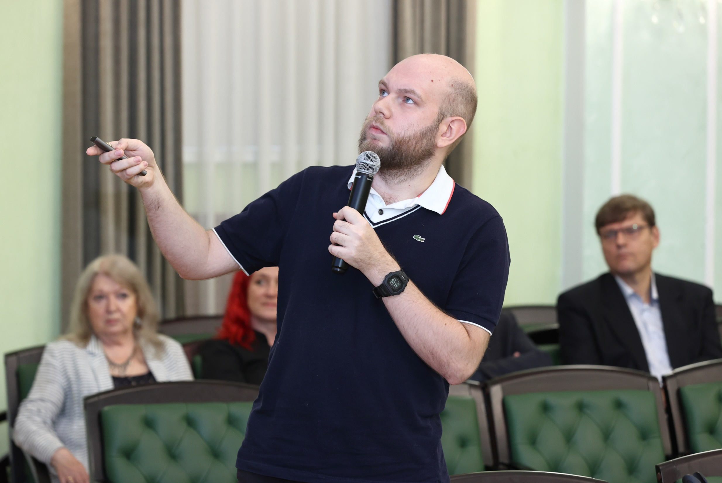
Synthesis and study of the decay properties of isotopes of superheavy elements Ds and Lv
The PAC heard with interest the report presented by Nikita Kovrizhnykh.
These results were obtained under the project “Investigation of heavy and Superheavy elements”.

Slide 5
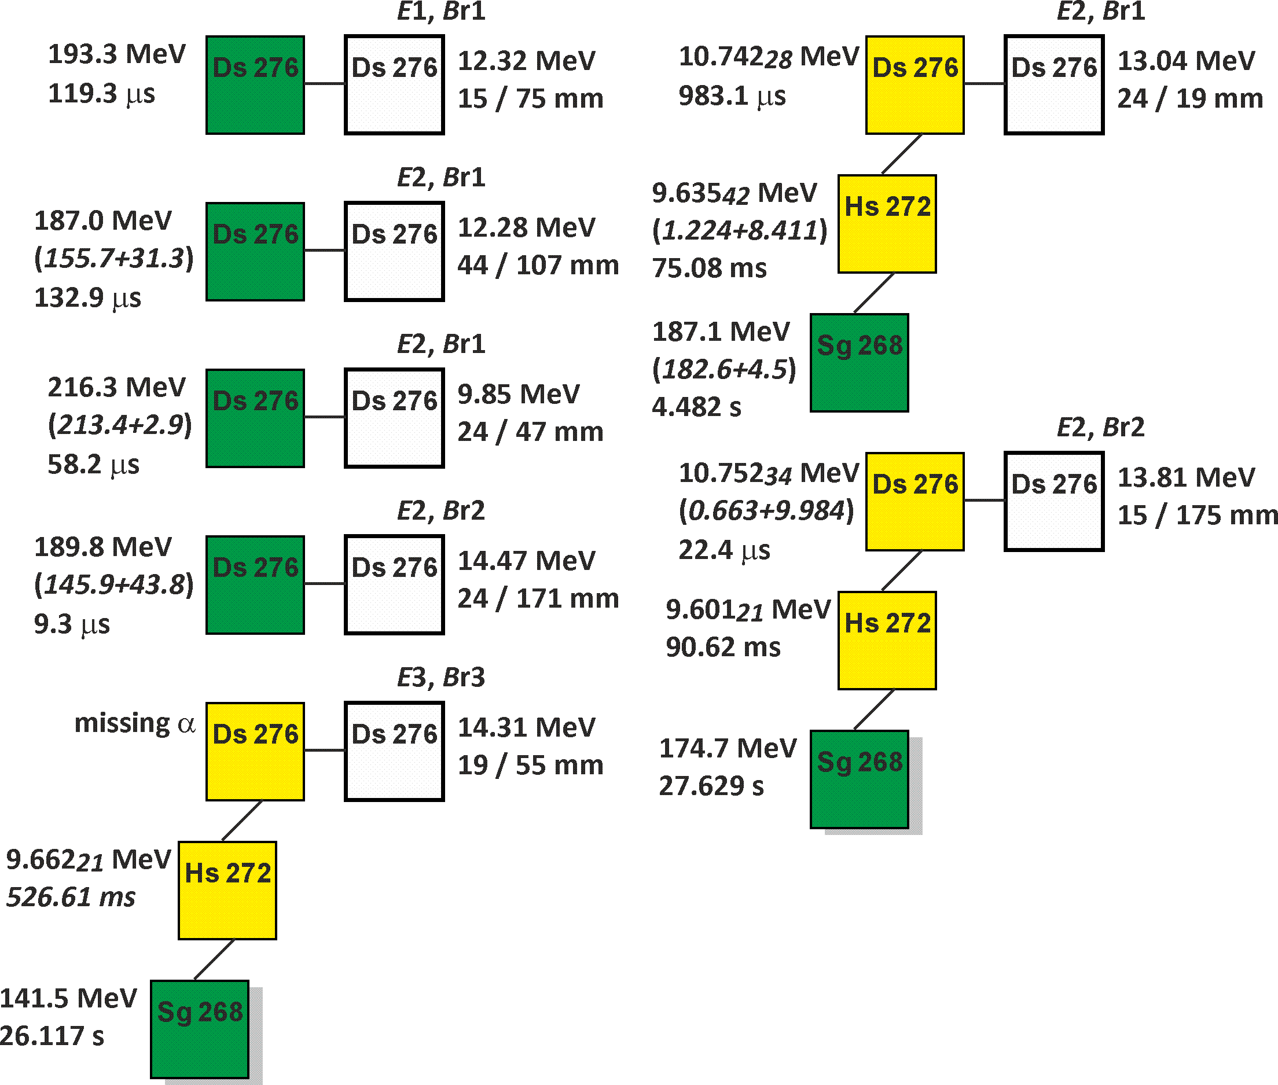
Reaction ²³²Th + ⁴⁸Ca → ²⁸⁰Ds*
7 decay chains
²⁷⁶Ds – α and SF
Experiments to synthesize isotopes ^{275,276}Ds in the reaction ⁴⁸Ca+²³²Th were continued on the gas-filled DGFRS-2 separator of the DC-280 cyclotron at the SHE Factory
The complete fusion reaction ⁴⁸Ca+²³²Th was studied at four beam energies above the Coulomb barrier.
One decay chain of the ²⁷⁶Ds isotope, discovered in 2022, was detected at two maximum beam energies.
E₁ = 231 MeV
E₂ = 238 MeV
E₃ = 251 MeV
3 new isotopes

Slide 6
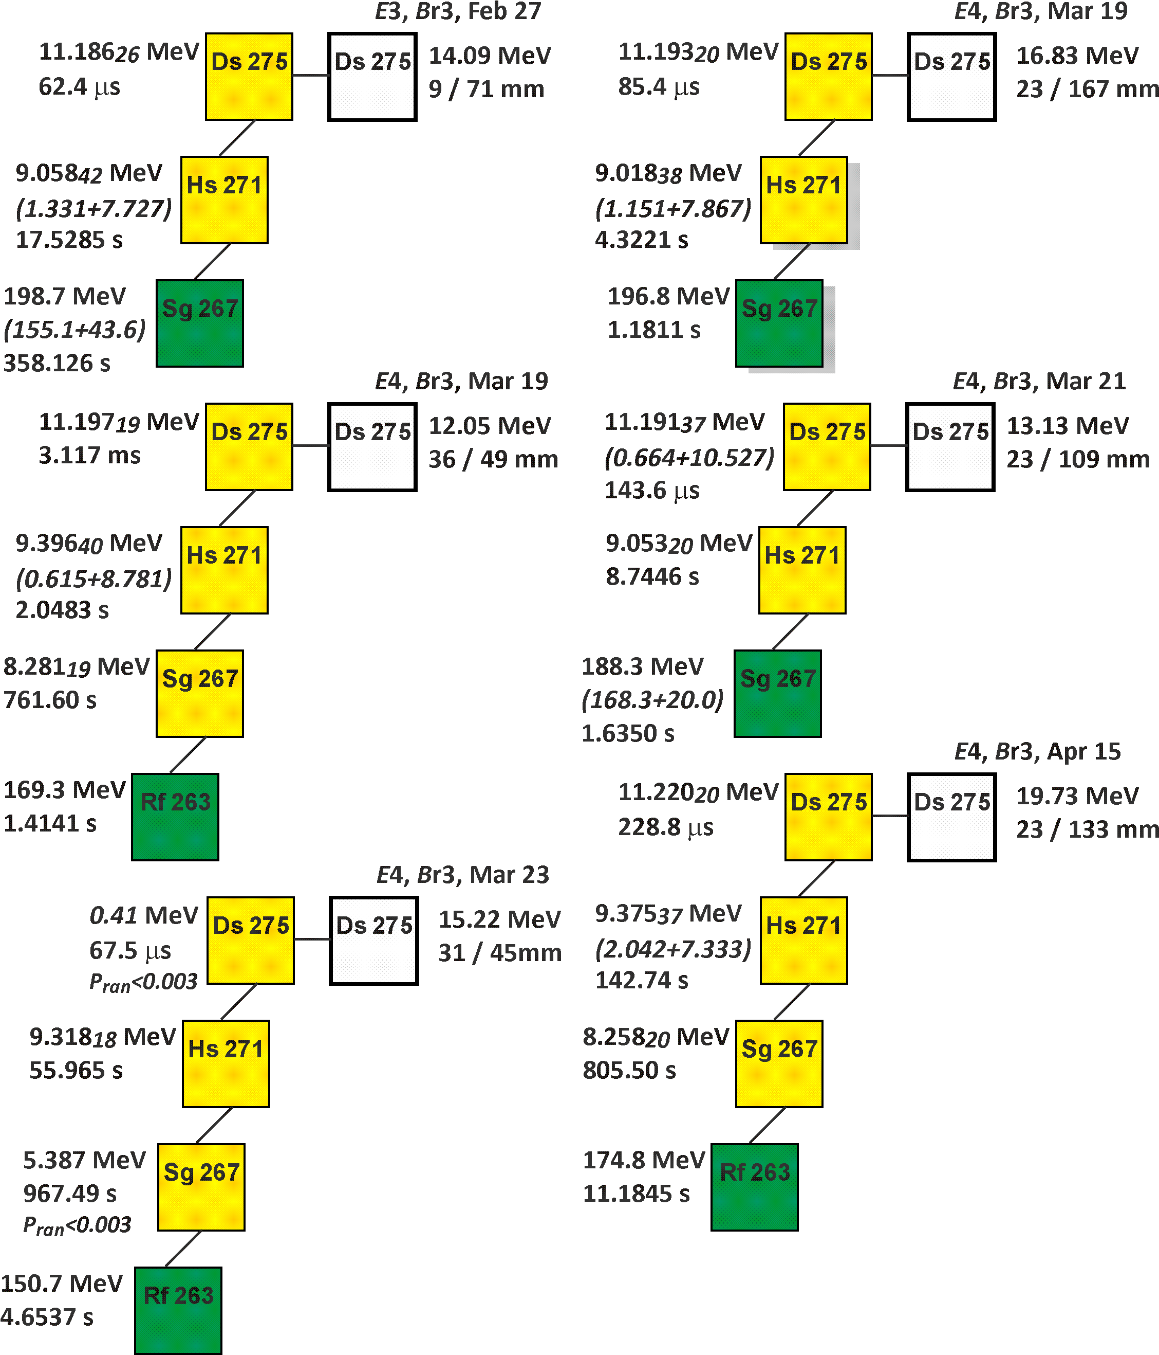
Reaction ²³²Th + ⁴⁸Ca → ²⁸⁰Ds*
6 decay chains
²⁷⁵Ds
²⁶⁷Sg – α and SF
Six decay chains of the new isotope ²⁷⁵Ds were identified.
²⁷⁵Ds was for first produced in a reaction with ⁴⁸Ca.
Decay of SHE nucleus to known isotopes ²⁷¹Hs, ²⁶⁷Sg, ²⁶³Rf.
E₃ = 251 MeV
E₄ = 257 MeV

Slide 7
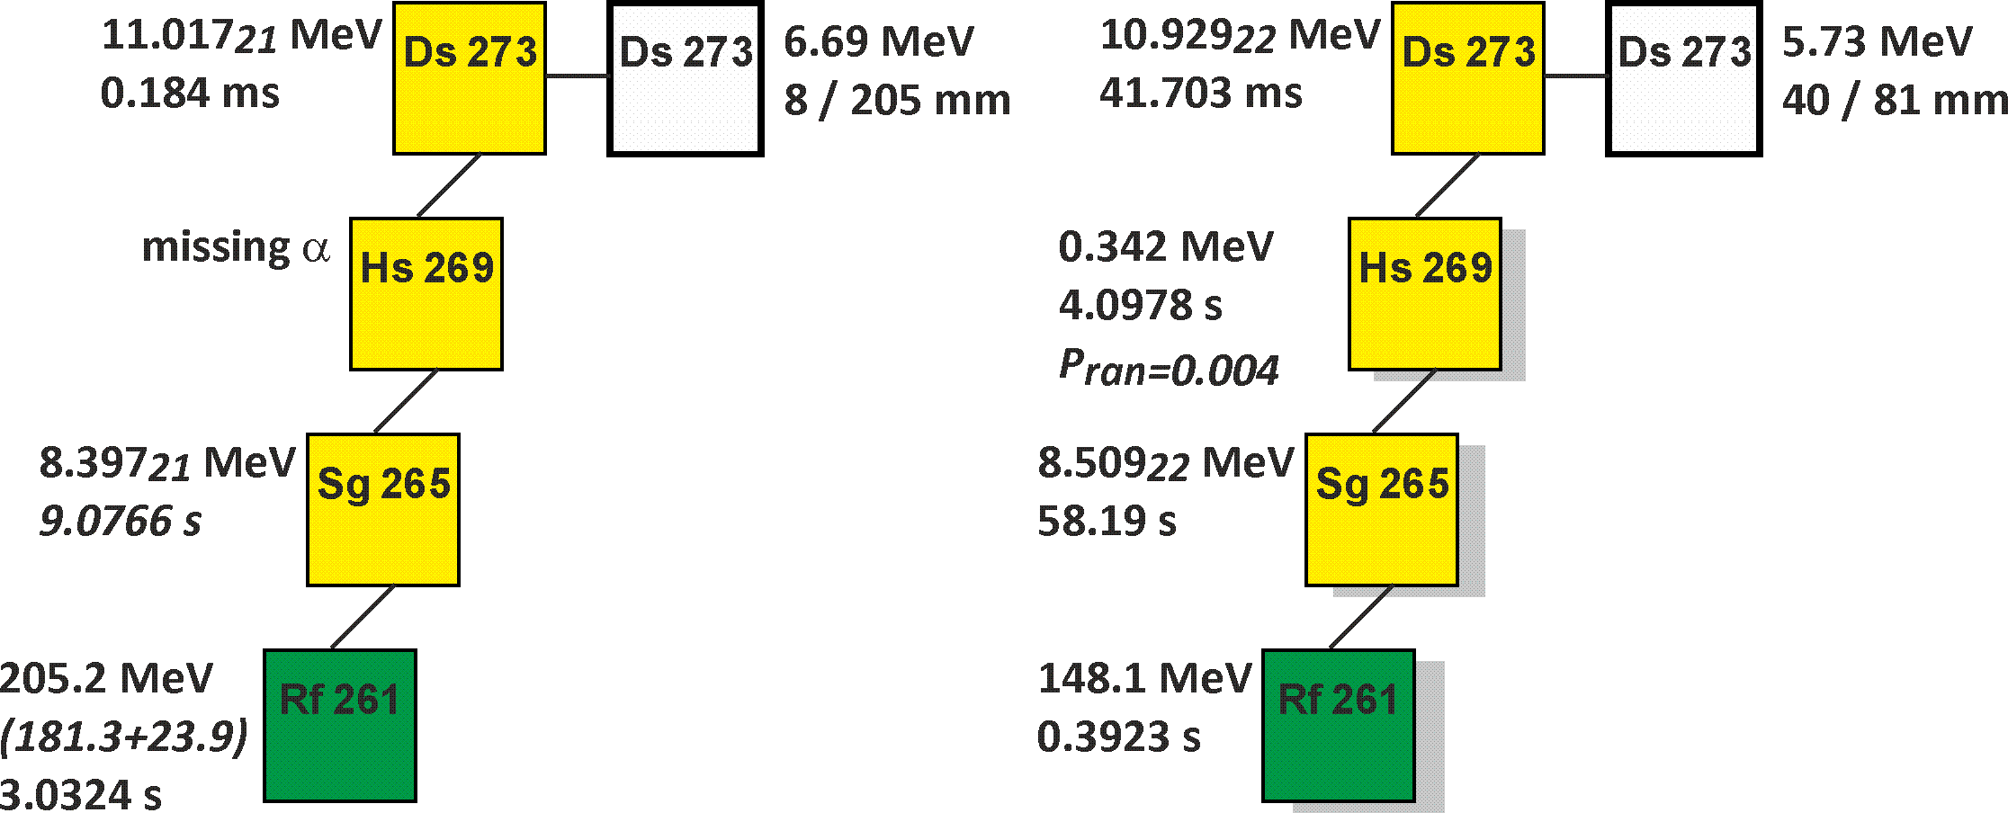
Reaction ²³⁸U + ⁴⁰Ar → ²⁷⁸Ds*
Two decay chains of ²⁷³Ds with a cross section of 0.2 pb were registered in the ²³⁸U+⁴⁰Ar reaction.
The properties of nuclei synthesized in both reactions point to the existence of isomeric states in ²⁶⁷Sg, ²⁷¹Hs,²⁷³Ds and its daughter nuclei.
A possible decay scheme of the synthesized isotopes was proposed on the basis of these results.
Reaction ²³⁸U + ⁵⁴Cr
For the first time:
Actinide + ⁵⁴Cr
New isotope ²⁸⁸Lv
Confirmation of ²⁸⁴Fl

Slide 8
Synthesis and study of the decay properties of isotopes of superheavy elements Ds and Lv
The PAC notes that the data on the properties of nuclei in the ^{275,276}Ds decay chains are of great importance for the identification of a new element with Z=120 that can be synthesized in the ⁵⁴Cr+²⁴⁵Cm reaction.
The PAC notes that the experiment with the ⁵⁴Cr beam is an important step for setting up experiments on the synthesis of elements with Z>118.
PAC recommendation:
The PAC recommends that work on the synthesis of the isotopes of superheavy elements and study of their decay properties be continued, in particular, using ⁵⁴Cr and ⁵⁰Ti beams.
SC recommendation:
The SC notes that the experiment with the ⁵⁴Cr beam is an important step for setting up experiments on the synthesis of elements with Z>118.
The SC recommends that work on the synthesis of the isotopes of superheavy elements and study of their decay properties be continued, in particular, using ⁵⁴Cr and ⁵⁰Ti beams.

Slide 9
Status of the U-400M accelerator
The PAC heard with interest the report on the status of the FLNR accelerators presented by Vasily Semin.
Particular emphasis was placed on the status of the U-400M cyclotron that is in the final stage.
Its upgrade aimed at enhancing the operation reliability and stability of the accelerator (replacement of the main magnet coils, accelerator vacuum system components, control system, and radiation control system), as well as at increasing the intensity and energy of heavy-ion beams.

Slide 10
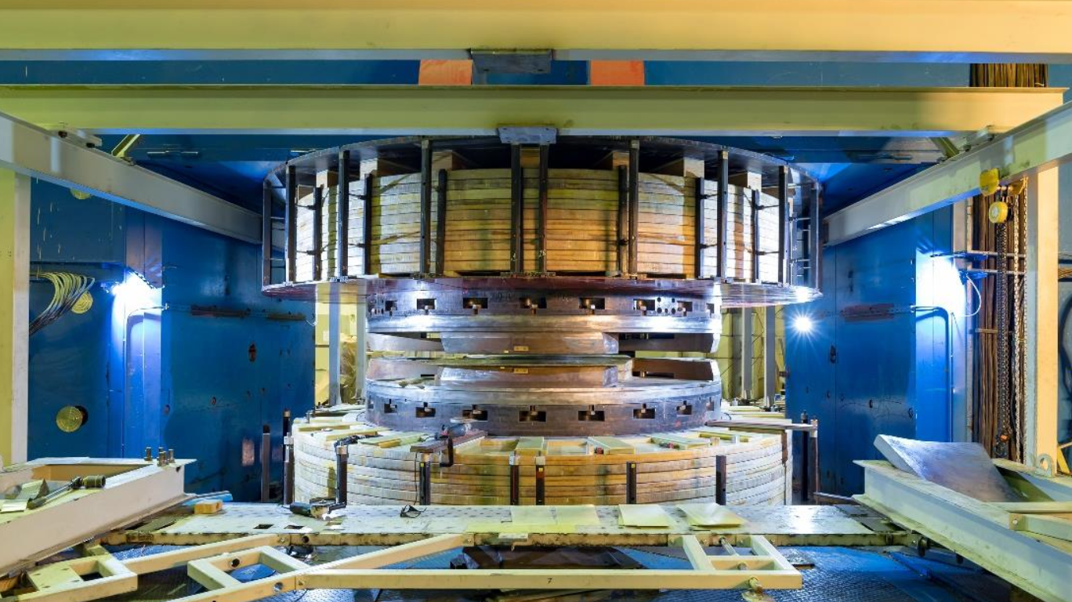
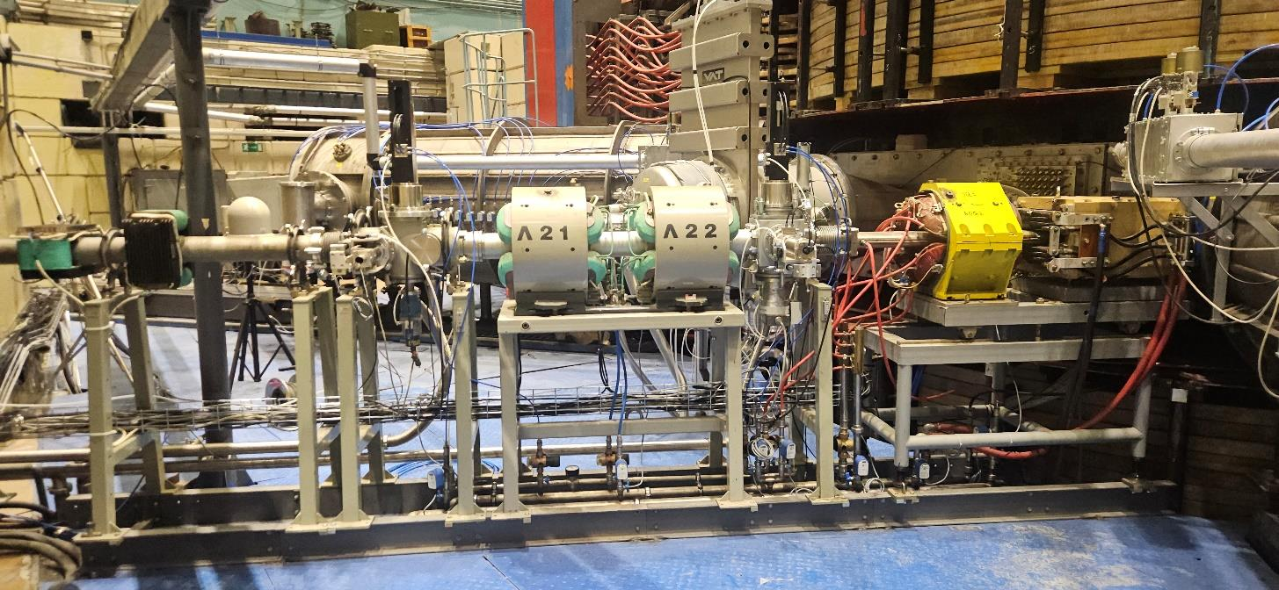
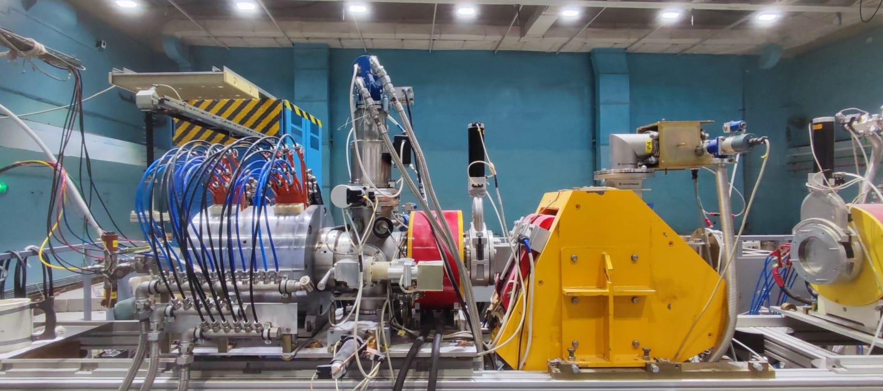
U-400M accelerator
Cyclotron magnet system
Transport channel modernization
Replacing ECR source DECRIS-2 → DECRIS-2M
The new magnetic channel for the extraction system allowed for a significant improvement of beam focus.
A new ion source DECRIS-2M with higher intensity as compared to DECRIS-2 was installed.
Improving the magnetic system allowed an increase in the mean field and the extraction radius by 10–17 mm, which consequently increased the beam energy by 10– 15%.
Some U-400M components were reconstructed: the water-cooling system was improved; new power supply sources were installed; pre-vacuum equipment, compressors, and vacuum cryopumps were replaced; and the control system was upgraded.

Slide 11
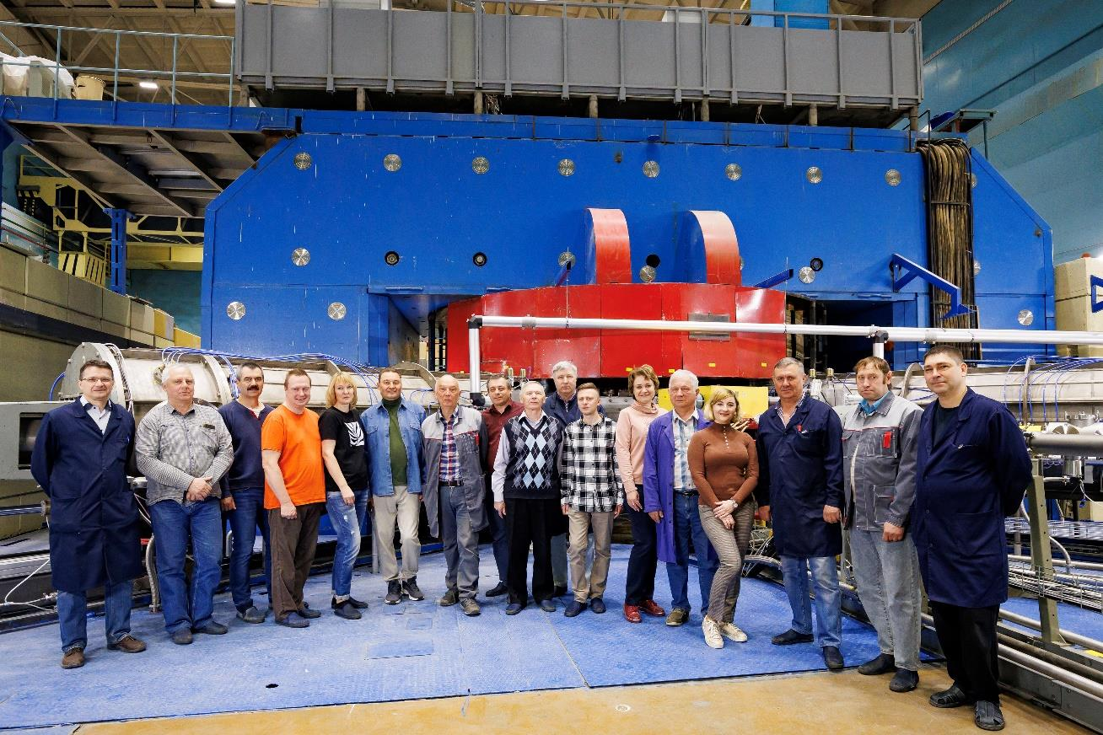
Status of the U-400M accelerator
PAC recommendation:
The PAC noted the immense work on the upgrade of the U-400M cyclotron and recommends that thorough monitoring be provided during the commissioning of all the above-mentioned systems in order to guarantee the reliable performance of the U-400M cyclotron with design parameters.
The PAC recommends that the FLNR Directorate should concentrate its efforts on preparing the first experiments.
SC recommendation:
The SC notes the extensive work on the upgrade of the U-400M cyclotron, aimed at increasing the intensity and energy of heavy ion beams, as well as improving the reliability and stability of the accelerator.

Slide 12
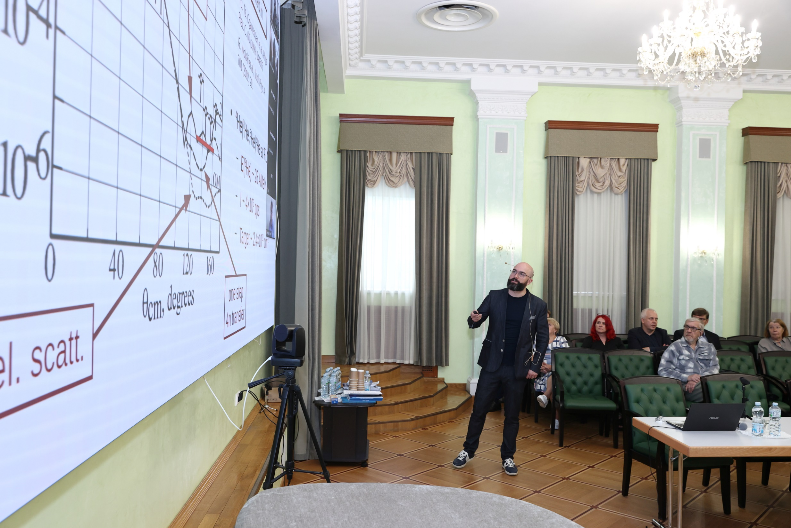
Results of the first experiments at the ACCULINNA-2 separator and the scientific programme for 2024
The PAC heard with interest the report on the results of first experiments carried out at the ACCULINNA-2 fragment separator in 2018–2020 and on the research programme for 2024 under the project “Light exotic nuclei at the borders of nucleon stability”, presented by Vratislav Chudoba.

Slide 13
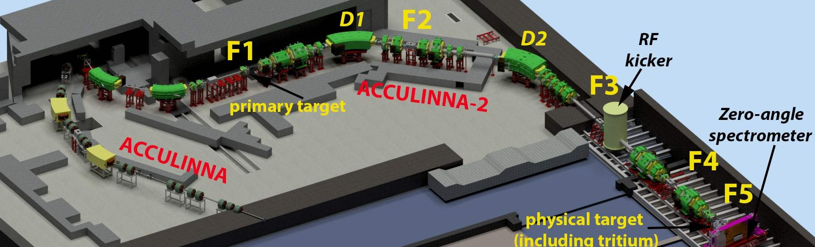
Results of previous experiments:
In 2018–2020, first experiments with the high-intensity radioactive beams of ⁶He, ⁸He, and ⁹Li, were carried out at the ACCULINNA-2 separator of the U-400M accelerator complex.
The characteristics of produced radioactive ion beams were in good agreement with technical specifications and estimations.
The analysis of the experimental data made it possible to determine energy resolution as a function of the deuterium target thickness, and the efficiency of the detection system registration.
The report presented interesting and important data on the low-energy spectra of the unbound nuclear systems 4n, ^{5–7}H, ^{7,9}He, ^{8,10}Li produced in transfer reactions.
The results are published in Phys. Rev. Lett., Phys. Rev. C, and other journals.

Slide 14
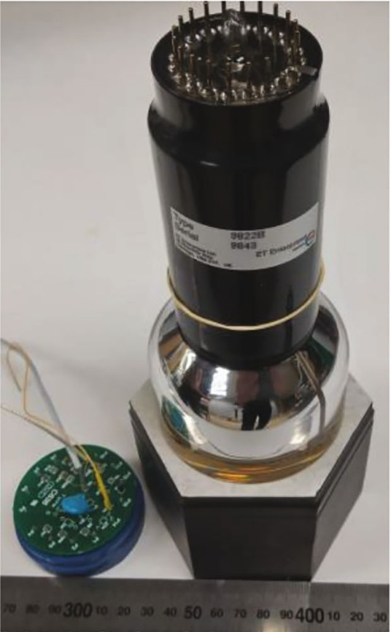
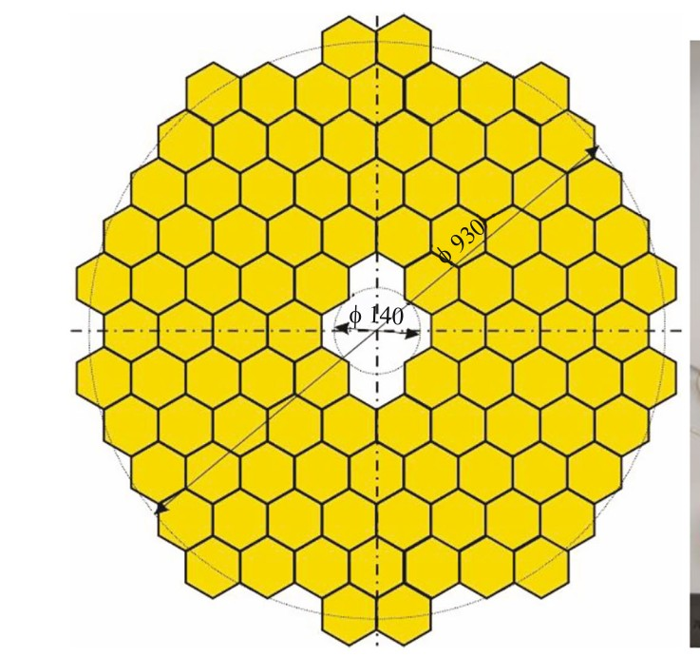
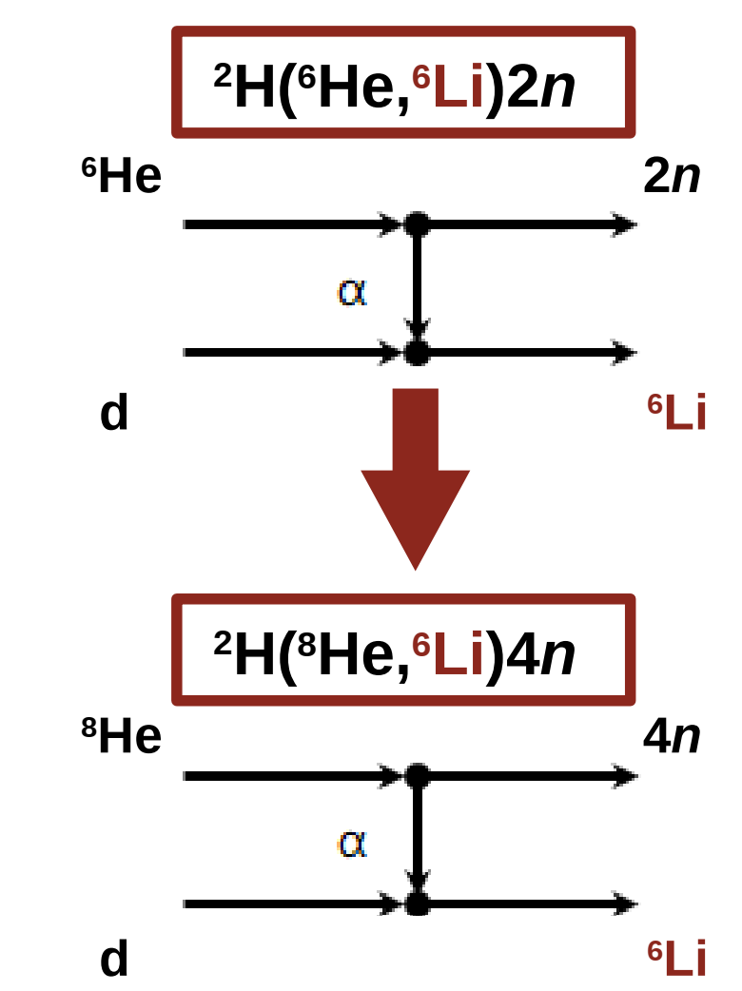
Experiments for 2024 year: Production of ³H, ^{6,8}He, and ^{10,12}Be beams in a wide energy range 10-44 MeV/A
In the second half of 2024, experiments are planned to study the neutron, proton, and α-particle transfer reactions using radioactive ^{6,8}Не beams and a cryogenic ²Н gas target.
In particular, the reaction ²H(⁶He,⁶Li)2n was proposed, which can provide additional data on the formation mechanism of the tetraneutron in the similar reaction ²H(⁸He,⁶Li)4n.
Test of modules for neutron wall.
100 units of ВС-404 scintillators
75 mm thick, 100 mm diameter
En = 20 – 35 MeV
ε ~ 0.2 for single neutron

Slide 15
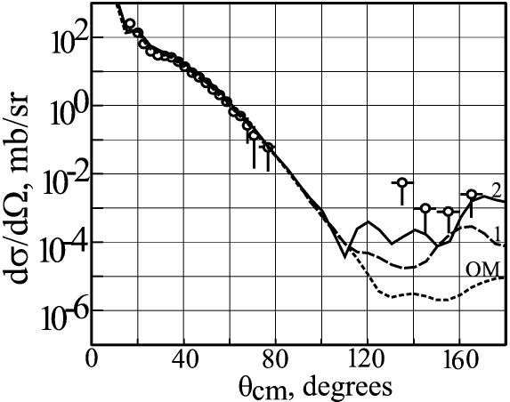
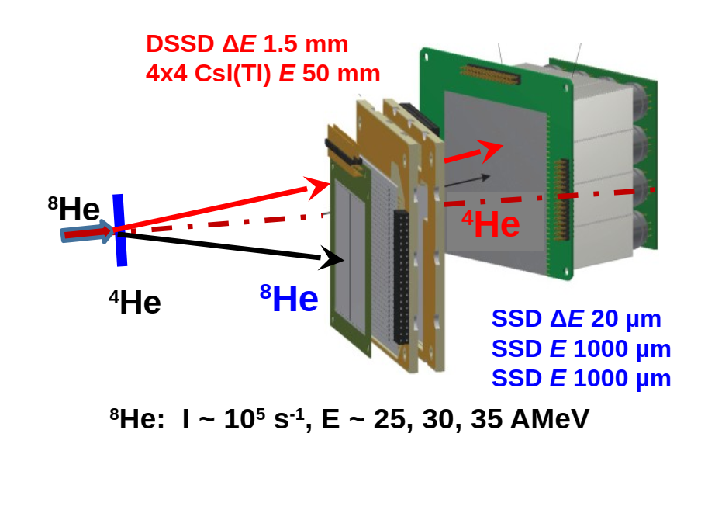
It is planned to study the exotic structure of ^{6,8}Не nuclei in the 2- and 4-neutron transfer reactions ⁴He(⁶He,⁶He)⁴He, ⁴He(⁸He,⁸He)⁴He, and ⁴He(⁸He,⁶He)⁶He.
~80 coincidences of 8He-4He per week expected
~20 coincidences of 6He-6He per week expected
~104 coincidences of 6He-4He per week expected
Experiments for 2024 year: ⁴He(⁸He,⁸He)⁴He
sequential 2n-2n transfer
el. scatt.
one step 4n transfer
Yu. Ts. Oganessian et al., Phys. Rev. C. 60 (1999) 044605.
R. Wolski et al., Nucl. Phys. A 701 (2002) 29.

Slide 16
Results of the first experiments at the ACCULINNA-2 separator and the scientific programme for 2024
PAC recommendation:
The PAC acknowledges the important results obtained in experiments at the ACCULINNA-2 separator conducted prior to upgrading the U-400M accelerator complex, to mention in particular the resolution of ⁶H and ⁷H ground states and a complicated experiment with ⁷H with extremely low cross sections.
The PAC looks forward to the results of the first experiments on the upgraded accelerator, in particular profiting from the new efficient neutron detection system.
SC recommendation:
The Scientific Council notes the important results obtained in the analysis of the first experiments.

Slide 17
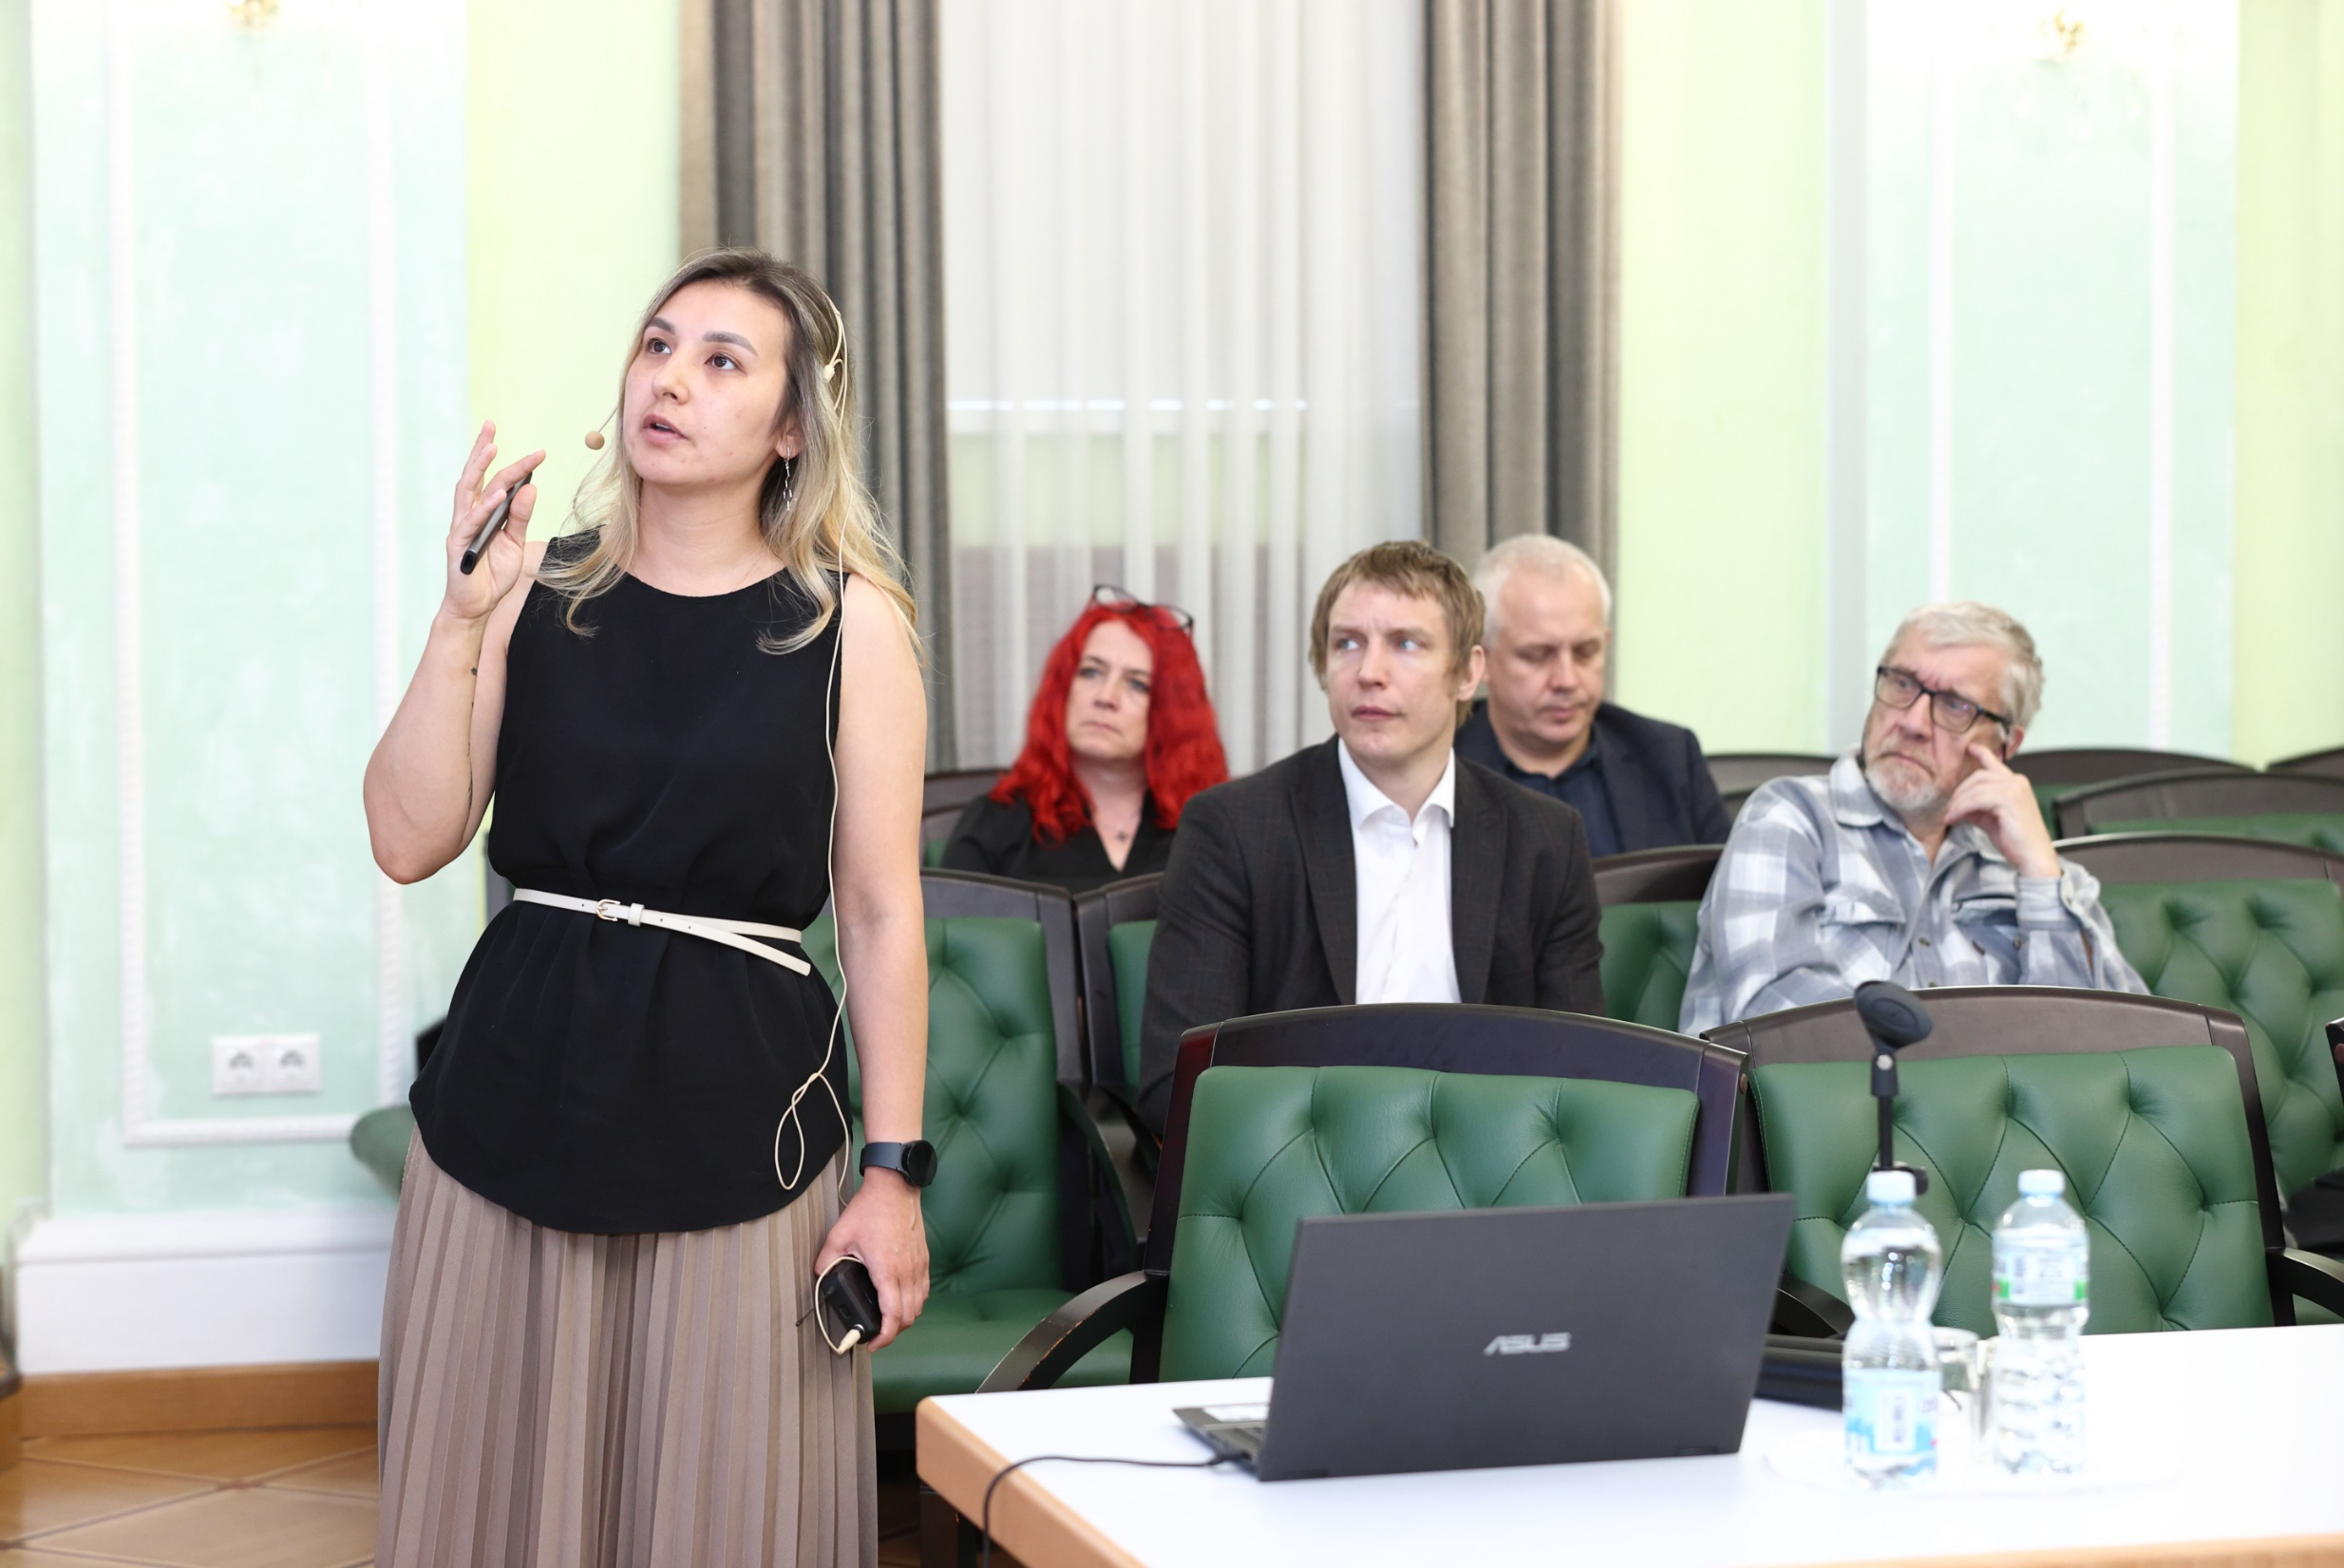
Status and prospects of radiochemical research at the Dzhelepov Laboratory of Nuclear Problems
The PAC has heard with interest the report presented by Ayagoz Baimukhanova.
Radiochemical research carried out at the DLNP JINR is implemented within the project “Radiochemistry and spectroscopy for astrophysics and nuclear medicine”.
It is devoted to the development of radiochemical methods for studying rare processes, associated with weak interaction and a number of problems in astrophysics, as well as for synthesizing radiopharmaceuticals.

Slide 18
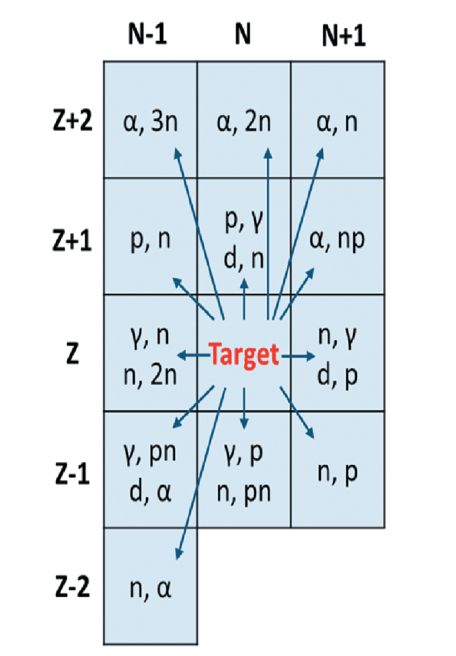
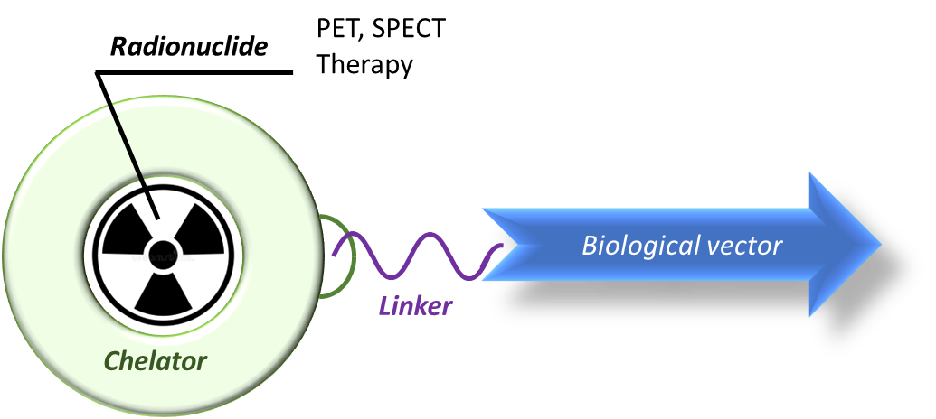
Status and prospects of radiochemical research at the Dzhelepov Laboratory of Nuclear Problems
Production and
purification of radionuclide preparations for the synthesis of radiopharmaceuticals and
manufacture of spectrometric sources;
Analysis of radiopharmaceuticals and
their precursors, as well as the purity of resulting radiopreparations and low-background
materials
Production of low-background materials with a
uniquely low content of radioactive impurities
Production of radionuclides:
1. At JINR facilities
2. By commercial suppliers
3. In cooperation with INP UZ, INP KZ and others
Development of sample production methods (⁸²Se; ⁹⁶Zr; shielding materials – Pb, Cu, Zn; solder; etc.) with impurity content of μBq/kg
Structure of a modern radiopharmaceutical
Radiopharmaceuticals based on:
²¹¹At with DTPA
⁶⁸Ga with DOTATOC
⁴⁴Sc with DOTA/DOTATOC
⁹⁰Nb with rituximab/bevacizumab
Complex requirements:
thermodynamic stability
kinetic insertion
high kinetic of complexation
radiation resistance
Development of sample analysis methods at an ultralow-sensitivity level using Inductively Coupled Plasma Mass Spectrometry (ICP-MS) and other analytical and nuclear spectroscopic methods

Slide 19
Status and prospects of radiochemical research at the Dzhelepov Laboratory of Nuclear Problems
PAC recommendation:
The PAC highly appreciates the radiochemical research carried out at DLNP JINR, its high-quality and high-precision results, and notes a significant contribution of this research to nuclear medicine, spectrometry and astrophysics.
The PAC recommends that work on radiochemical research be continued within the framework of the project “Radiochemistry and spectroscopy for astrophysics and nuclear medicine”.
SC recommendation:
The SC highly appreciates the radiochemical research carried out at DLNP JINR, its high-quality and high-precision results, and notes a significant contribution of this research to nuclear medicine, spectrometry and astrophysics.
The SC recommends that work on radiochemical research be continued within the framework of the project “Radiochemistry and spectroscopy for astrophysics and nuclear medicine”.

Slide 20
Development of low-temperature detection systems for the study of coherent elastic scattering of neutrinos on atoms and nuclei and measurement of electromagnetic characteristics of neutrino
The PAC has heard the proposal of a new project “Nuclear bolometer” presented by Vladimir Trofimov.
This project is part of the programme “Study of coherent elastic neutrino scattering on atoms, nuclei and electrons and measurements of neutrino electromagnetic properties using a high-intensity tritium antineutrino source” (SATURNE project, SArov TritiUm neutRiNo Experiment) being financed by the federal budget of the Russian Federation and Rosatom.
Within this project, DLNP JINR is involved in the development of low-temperature detection systems operating in the energy range below 1 eV.
PAC recommendation:
The PAC supports the opinion that it is timely and important to develop novel detection systems intended for studying rare events in the range of low energies.
The PAC highlights that the project “Nuclear bolometer” does not require extra financing from JINR, and recommends that the above-mentioned work be carried out as an activity within the theme “Non-Accelerator Neutrino Physics and Astrophysics”.
SC recommendation:
The SC agreed that it is timely and important to develop novel detection systems intended for studying rare events in the domain of low energies.
The SC highlights that the project “Nuclear bolometer” does not require extra funding from JINR and endorses the recommendations of the PAC for Nuclear Physics that the above-mentioned work be carried out as an activity within the theme “Non-Accelerator Neutrino Physics and Astrophysics”.

Slide 21
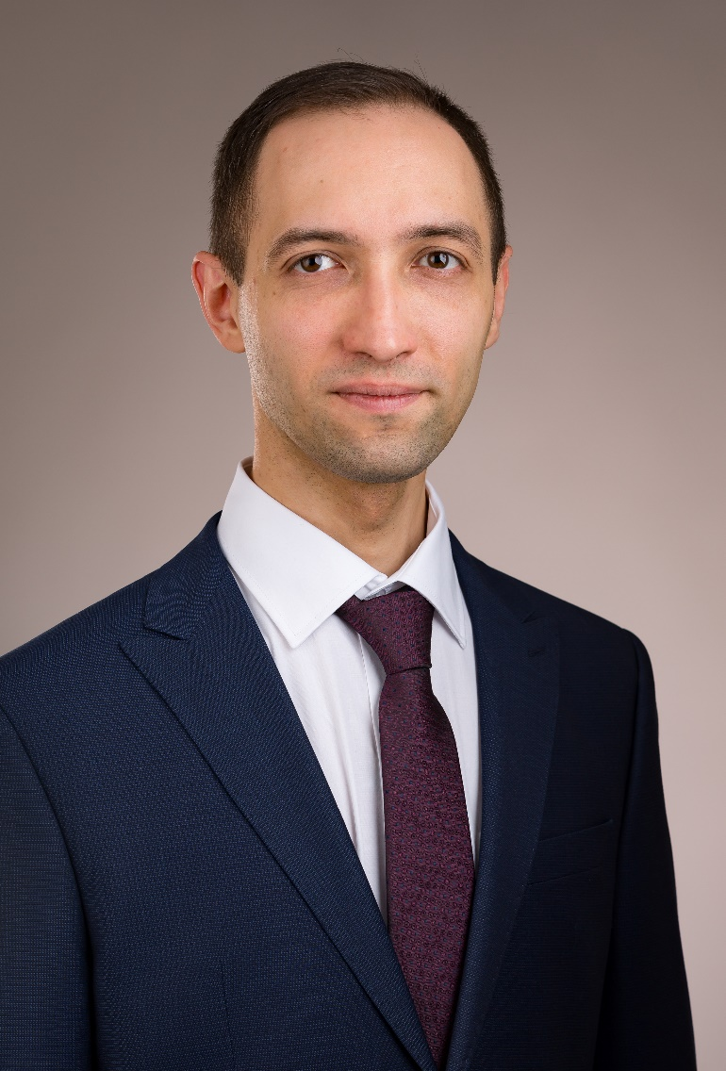
Scientific reports:
Dmitry Podgainy
“Supercomputer “Govorun” for JINR tasks”
Alexander Bugay
“Radiobiological research at JINR: applications in radiation medicine and space exploration”

Slide 22
Short presentations by young scientists
The PAC reviewed 6 short presentations in the field of nuclear physics research by young scientists from DLNP
Three best short presentations:
Viktoriya Dik
“Real-time followup of multimessenger alerts at the Baikal-GVD telescope”
Elena Kurakina
“Production of trivalent radionuclides for nuclear medicine and analysis via nuclear-spectrometric methods”
Dmitry Ponomarev
“Status of the Ricochet experiment”

Slide 23
THANK YOU FOR YOUR ATTENTION!

