Slide 1

Information on the Resolution of the JINR Scientific Council
136th session, 12–13 September 2024
and
on the decisions of the JINR Committee of Plenipotentiaries
15-16 November 2024, Minsk

Slide 2
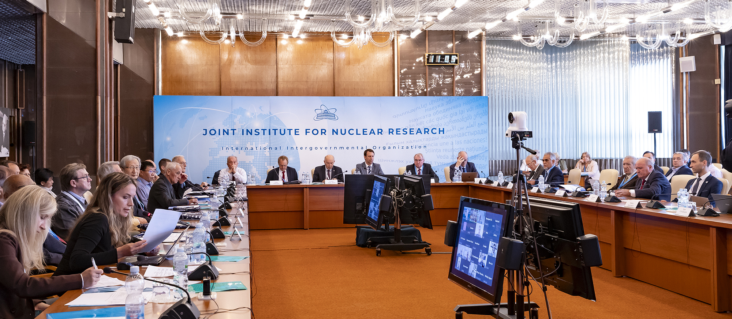
Information on the Resolution of the JINR Scientific Council
136th session, 12–13 September 2024
https://indico.jinr.ru/event/4771/
Co-chaired by Grigory Trubnikov and by Sergei Kilin

Slide 3
PROGRAMME
12 September 2024
Opening of the session | G. Trubnikov
Approval of the session Programme | S. Kilin
Report by the JINR Director | G. Trubnikov
Discussion of the Director’s report | S. Kilin
Appointment of the Editing Board for drafting the Resolution of the SC Council | S. Kilin
Appointment of the Committee for the election of Director of the LRB | S. Kilin
Recommendations of the PAC’s taken at the meetings in June 2024:
PAC for Particle Physics | I. Tserruya
PAC for Nuclear Physics PAC for Condensed Matter Physics | V. Nesvizhevsky D. L. Nagy
Memberships of the PACs | G. Trubnikov
Scientific report “The Search for Quark-Gluon Plasma at the LHC: What is Next?” Election of Director of LRB: - recommendations of the Election Committee - presentation by the candidate for the position of Director of LRB - discussion of the candidate - voting, counting of votes, announcement of the voting results | Raghunath Sahoo S. Kilin Election Committee A. Bugay

Slide 4
13 September 2024
Reports by young scientists as recommended by the PACs:
“Study of Λ-hyperon production in carbon collisions with solid targets in BM@N” | K. Alishina
“Real-time follow-up of multimessenger alerts at the Baikal-GVD telescope” | V. Dik
“Pressure effect on crystal, magnetic structure and vibrational properties of van der Waals materials” | O. Lis
Jury’s recommendations on the award of the V. Dzhelepov Prize | N. Russakovich
Jury’s recommendations on the award of the G. Flerov Prize | Yu. Oganessian
Jury’s recommendations on the award of the Oganesson Prize | G. Trubnikov
Jury’s recommendations on the award of the N. N. Bogoliubov Prize Award of the N. N. Bogoliubov Prize | V. Matveev
Presentation by the laureate of the N. N. Bogoliubov Prize | Á. de Rújula
Presentation of diplomas to the winners of JINR annual prizes for best scientific, methodological, technological, & applied research papers | G. Trubnikov S. Nedelko
General discussion. Adoption of the Resolution of the Scientific Council | S. Kilin
Closing of the session | G. Trubnikov

Slide 5
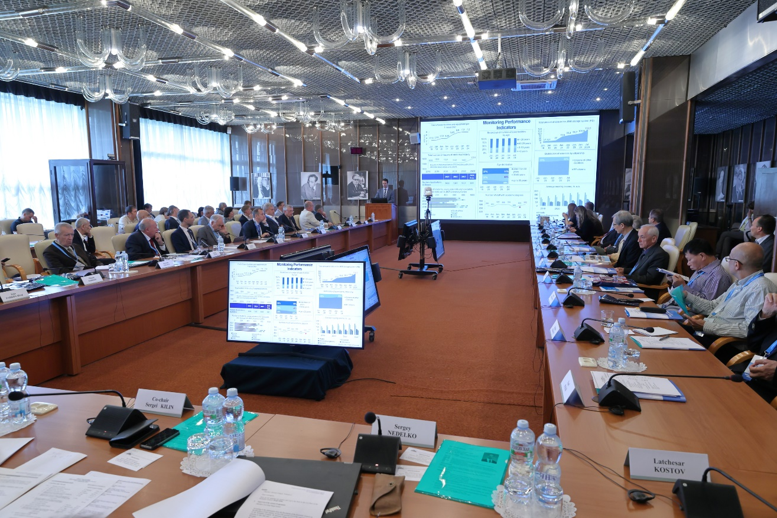
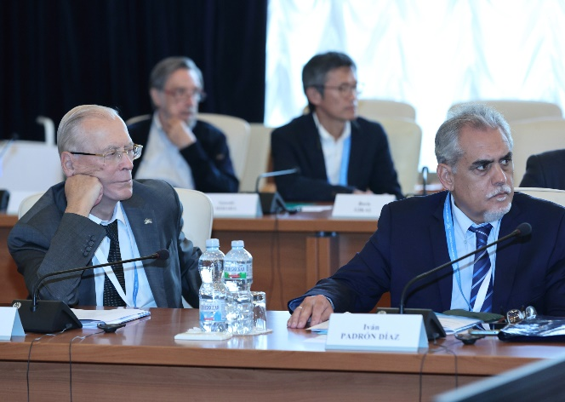
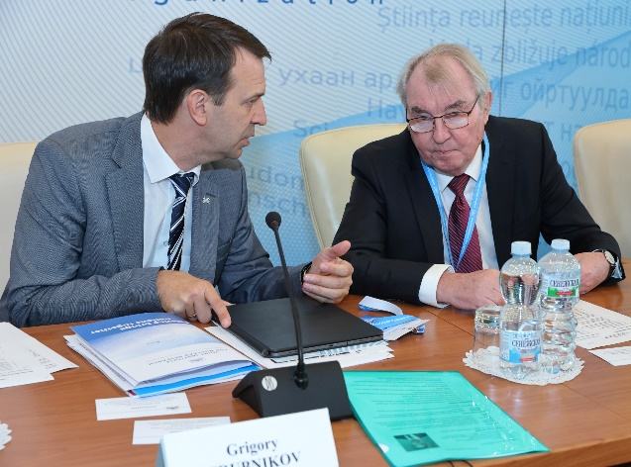
136th Session of the JINR Scientific Council
12–13 September 2024, Dubna
G. Trubnikov presented a comprehensive report highlighting the decisions of the CP (March session), the results of the implementation of the 7-Year Plan for the Development of JINR for 2024–30, the progress in the realization of the Topical Plan, & recent events.
The SC noted with gratitude the high level of attention of the RF to the maintenance & development of favourable & fruitful conditions for the work of JINR.
The SC appreciated the CERN Council decision not to terminate the cooperation with the JINR & expresses confidence on mutually beneficial cooperation despite the geopolitical complications.
The SC highly welcomed the signing of a high-level agreement between JINR & the Ministry of Science & Technology of China on the beginning of implementation of 8 joint projects, & strongly supports the ongoing strengthening of cooperation with Mexico, Brazil, & India.

Slide 6
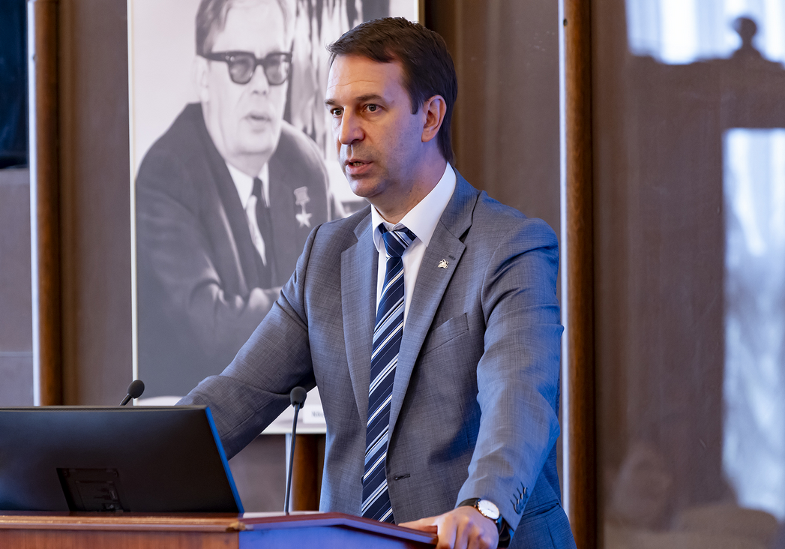
After the Director’s report the members of the SC noted with great satisfaction the successful fulfilment of the current 7-Year Plan, obtained remarkable results in scientific research & the development of research infrastructure, as well as the positive dynamics of all important indicators of the JINR development.
The SC appreciated the Institute recent achievements, in particular:
progress of the NICA Collider technological tests, including installation of the magnetic cryostat system, 2 RF stations & Final Focusing lenses, the merging of the West & East arcs high-vacuum volumes, installation of cryogenic equipment & Power Supplies in the collider building, connection of power lines & energy evacuation systems;
striving to achieve the goal of detecting the first Xe-beams collisions in the MPD in Aug. 2025;
progress in the analysis of Λ & K⁰s production & flow of protons in Xe+CsI interactions by the BM@N Collaboration & publication of the BM@N detector paper in NIM A;
successful cooling of the MPD solenoid down to 72 К, preparations for the analysis of the first data sets in fixed-target mode;
finalization of the updated SPD TDR & its approval by the PAC in June, progress in the development of detector prototypes;
development of the ARIADNA Collaboration & its research programme, preparation for the biosatellite experiment scheduled in 2025;

Slide 7
progress in developing the Baikal-GVD telescope in 2024: total number of installed optical modules reached 4104 & 8 laser stations, significant improvement of the on-shore infrastructure;
successful continuation of experiments at the Superheavy Element Factory aimed at preparing the synthesis of elements 119 & 120 with ⁵⁴Cr & ⁵⁰Ti beams. The known region of the nuclear chart has been enlarged by the discovered isotopes ²⁸⁸Lv, ²⁸⁹Lv synthesized in the ⁵⁰Ti+²⁴²Pu & ⁵⁴Cr+²³⁸U reactions. The testing of a new large 48 cm-diameter target will significantly speed up upcoming experiments on the spectroscopy of superheavy nuclei due to a twice larger beam current on a target. The first experiments on isotopes of element 114 & their decay products synthesized in the ⁴⁸Ca+²⁴²Pu reaction are scheduled for autumn 2024;
completion of the U-400M upgrade, acceleration & transportation of ¹⁶O, ⁴⁰Ar, ¹³²Xe ion beams, continuation of work to reach the design parameters & preparation for the first experiments scheduled for autumn 2024;
rapid progress in the construction of the new experimental hall of U-400R, & completion of the gallery construction from the U-400 hall to the new experimental hall;
preparatory work underway to start the IBR-2 reactor after a long shutdown. A license for the operation was recently obtained. One of the two air heat exchangers has been replaced, work is underway to replace the second one. The technical readiness of the IBR-2 for its start-up is scheduled for Nov. 2024. Experimental work on external beams is scheduled for spring 2025;

Slide 8
important results in fundamental & applied areas of research related to materials science & ecology, & in the field of life sciences due to the development of the interlaboratory research programme;
interesting results in the field of theoretical physics of elementary particles, atomic nuclei, condensed matter physics, & advanced mathematical physics, aimed, in particular, at supporting the JINR experimental programme;
successful operation & development of the Multifunctional Information & Computing Complex, increase in the power of the Govorun supercomputer, the JINR grid site function extension with the inclusion of resources in the system for modelling, processing & storage of the BM@N, MPD & SPD experimental data, the tape storage capacity increase from 50 PB to 90 PB, & ranking the JINR Tier1 centre first among Tier1 centres for CMS by the processed CPU time;
successful participation in the work of collaborations at CERN, including the II phase of the ATLAS, CMS & ALICE upgrade, & new results in the experiments at CERN-SPS;
efficient participation of the JINR group in the first phase of the COMET experiment at J-PARC.
The Scientific Council noted with satisfaction JINR’s activities to enhance cooperation with research organizations in JINR Member States and Associated Member States.

Slide 9
Recommendations of the Programme Advisory Committees
Particle physics. The SC appreciated the PAC’s support for the plans of the Directorate to ensure full-fledged cooperation of scientists & specialists from the JINR Member States with CERN, & the efforts undertaken to enhance ongoing cooperation & establish new scientific connections with China, India, Mexico, & Brazil. The SC acknowledged the successful completion of the first stage of the megascience project NICA. The SC appreciated the contributions of the JINR teams participating in the LHC experiments in physics analyses & detector upgrades.
Nuclear physics. The SC noted the extensive work on the U-400M upgrade. The SC noted that the experiment with the ⁵⁴Cr beam is an important step for setting up the synthesis of elements with Z>118. The SC noted the important results obtained in the analysis of the first experiments carried out at the commissioned ACCULINNA-2 fragment separator. The SC highly appreciated the radiochemical research carried out at DLNP, its high-quality & high-precision results, & notes of its significant contribution to nuclear medicine, spectrometry & astrophysics.
Condensed matter physics. The SC welcomed the efforts of the FLNP in the development of the new neutron source & supported this activity. The SC welcomed the FLNP Directorate intention to restart the IBR-2 research facility operation in 2024–25 & resume the User Programme in 2025. The SC endorsed the progress of instrument modernization at the IBR-2 & noted the active preparations of instruments for the reactor start-up at the end of 2024. The SC was pleased with the current state of the DN-6 diffractometer for the study of materials at ultrahigh pressures.

Slide 10
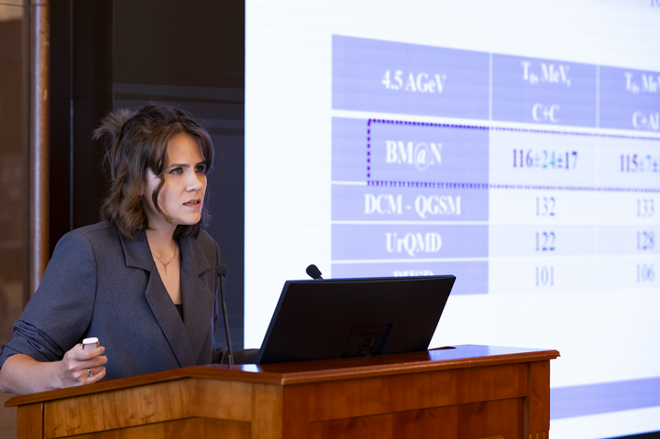
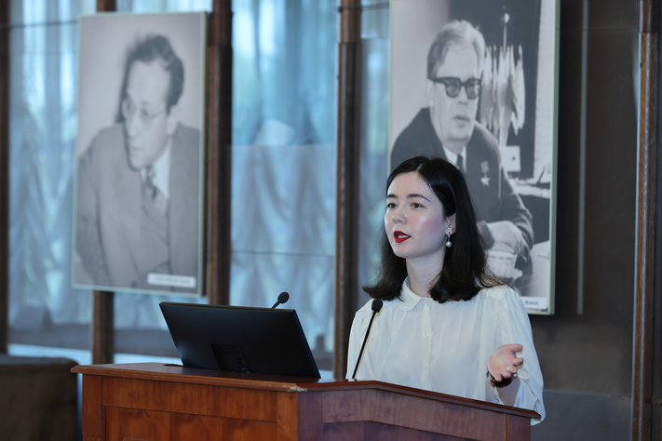
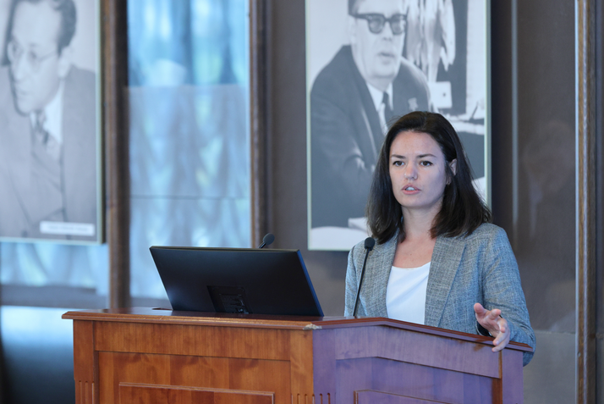
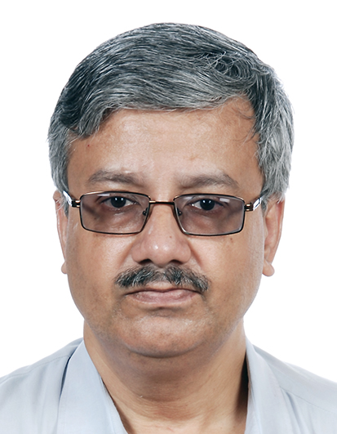
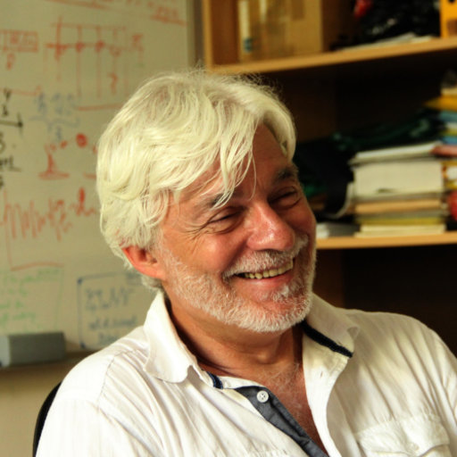


Reports by Young Scientists
The SC followed with interest the reports by young scientists, selected by the PACs for presentations: “Study of Λ-hyperon production
in carbon collisions with solid targets in BM@N experiment” by K. Alishina (VBLHEP), “Real-time follow-up of multi-messenger alerts at the Baikal-GVD telescope” by V. Dik (DLNP), & “Pressure effect on crystal, magnetic structure & vibrational properties of van der Waals materials” by O. Lis (FLNP). The SC thanked the speakers & welcomed such selected reports in the future.
Memberships of the PACs
On the proposal by the JINR Director the SC appointed:
– Amaresh Jaiswal (NISER, Bhubaneshwar, India),
– Leandar Litov (Sofia University “St. Kliment Ohridski”, Bulgaria),
– Gobinda Majumder (TIFR, Mumbai, India),
as members of the PAC for PP for a term of 3 years;
– Ravi Kumar N V (IIT Madras, Chennai, India), as a member
of the PAC for CMP for a term of 3 years.
Scientific Report
The SC heard with interest the report “The Search for Quark-Gluon Plasma at the Large Hadron Collider: What is Next?” presented by Raghunath Sahoo (IIT Indore, India) & thanked the speaker.

Slide 11
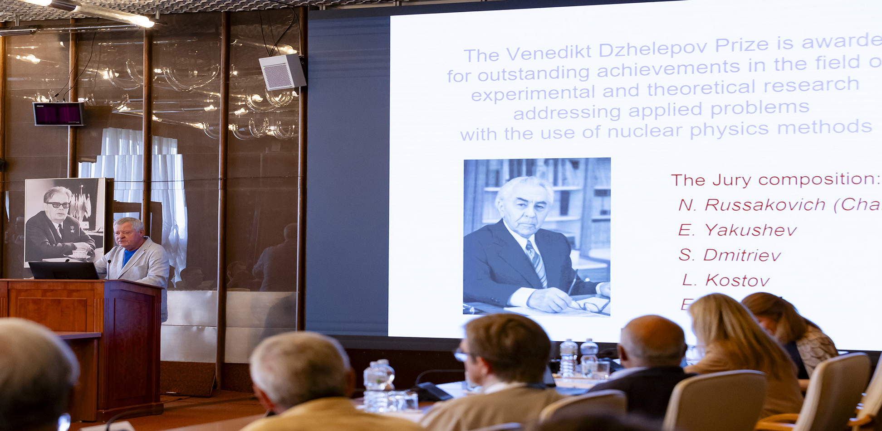
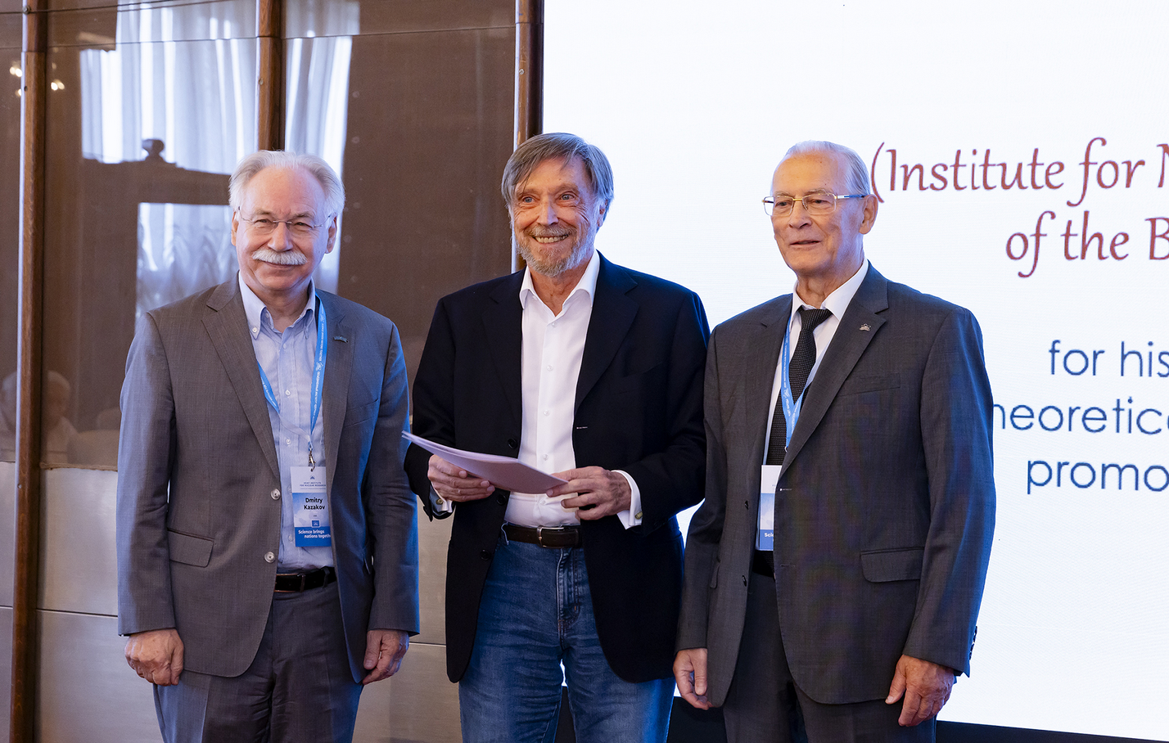
Awards and Prizes
The SC approved the Jury’s recommendations on the award of the V. Dzhelepov Prize to M. Frontasyeva (FLNP) for her significant contribution to the development of international programme on the assessment of air quality using neutron activation analysis.
The SC approved the Jury’s recommendations on the award of the G. Flerov Prize to:
Academician R. Ilkaev (VNIIEF), co-author of the discovery of element 114 (flerovium), for his great contribution to the synthesis & study of the properties of superheavy nuclei;
E. D. Donets & E. E. Donets (VBLHEP, JINR), Zhao Hongwei (Institute of Modern Physics, CAS)
for the development of sources of highly charged ions to produce intense accelerated beams of medium & high energies.
The SC approved the Jury’s recommendations on the award of the N.N .Bogoliubov Prize to Á. de Rújula (CERN) & I.Todorov (INRNE, BAS) for their outstanding achievements in theoretical & mathematical physics & promoting international cooperation. The SC thanked Á. de Rújula for his brilliant presentation.

Slide 12
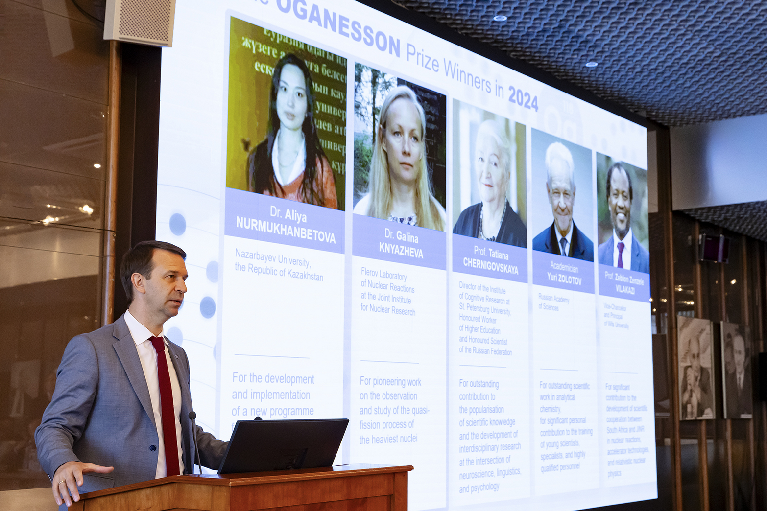
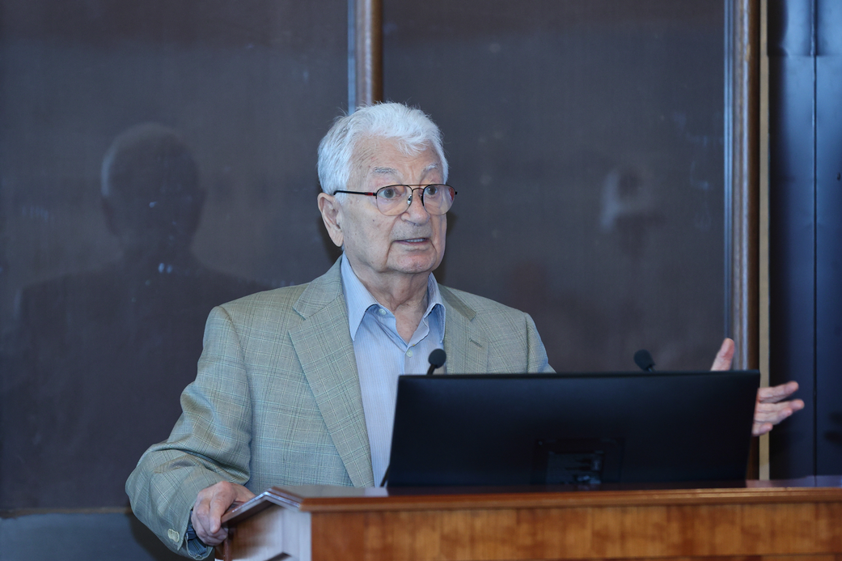
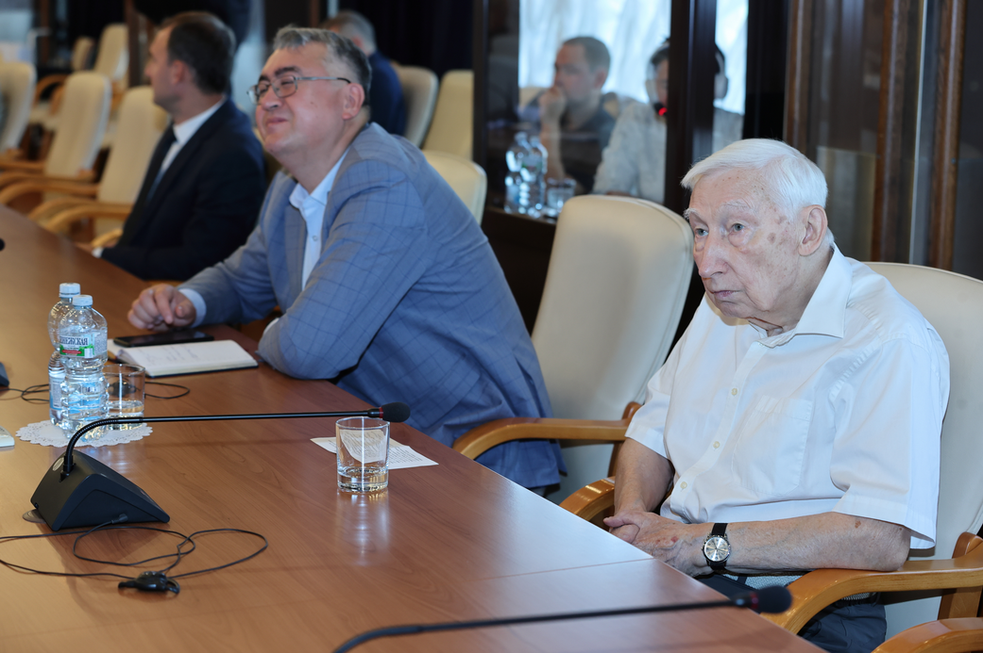
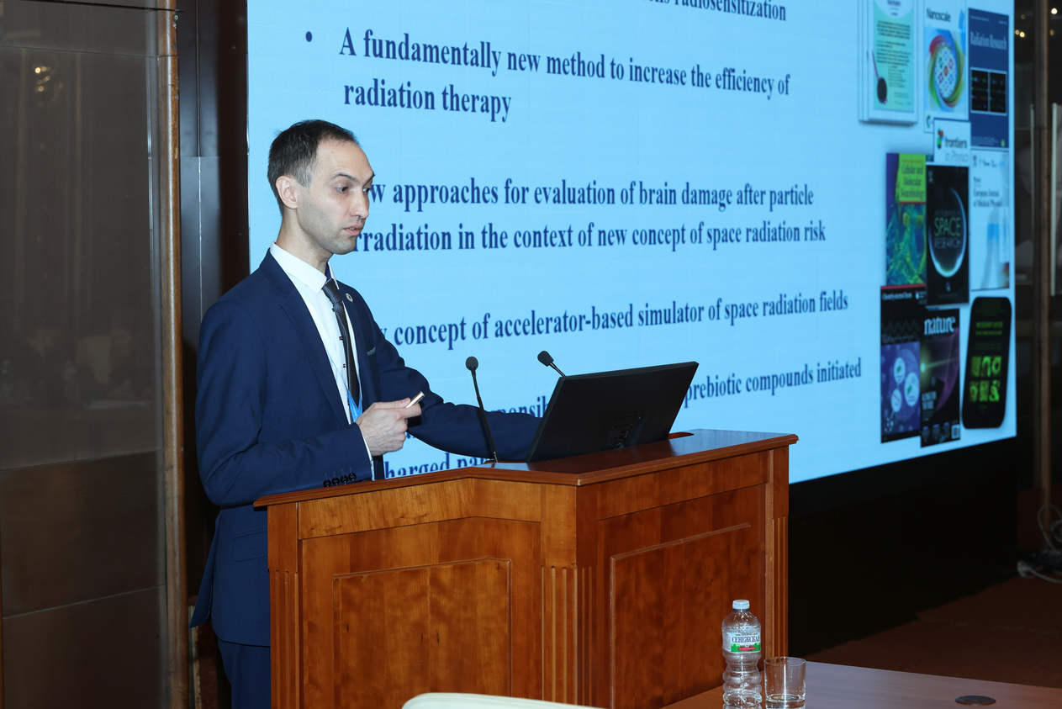
The SC welcomed the Jury’s decision presented by JINR
Director to award the Oganesson Prize to T. Chernigovskaya,
G. Knyazheva, A. Nurmukhanbetova, Z. Vilakazi, & Yu. Zolotov.
The SC congratulated the winners of JINR annual prizes for best scientific, methodological, technological,& applied research papers.
Election & announcement of vacancies in the directorates
of JINR Laboratories:
The SC elected A. Bugay as Director of the Laboratory of Radiation Biology for a second term of 5 years.
The SC announced the vacancies of positions of LRB Deputy Directors. The endorsement of appointments will take place at the 137th session of the Scientific Council in Feb. 2025.

Slide 13
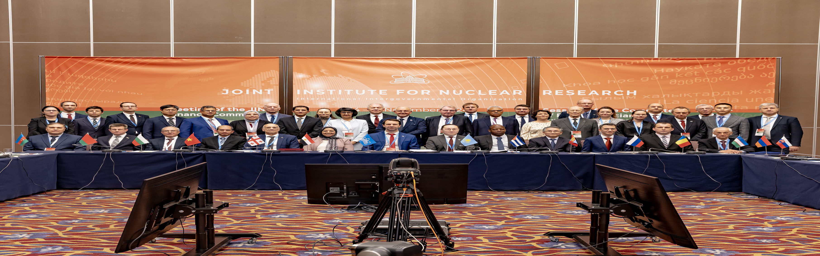
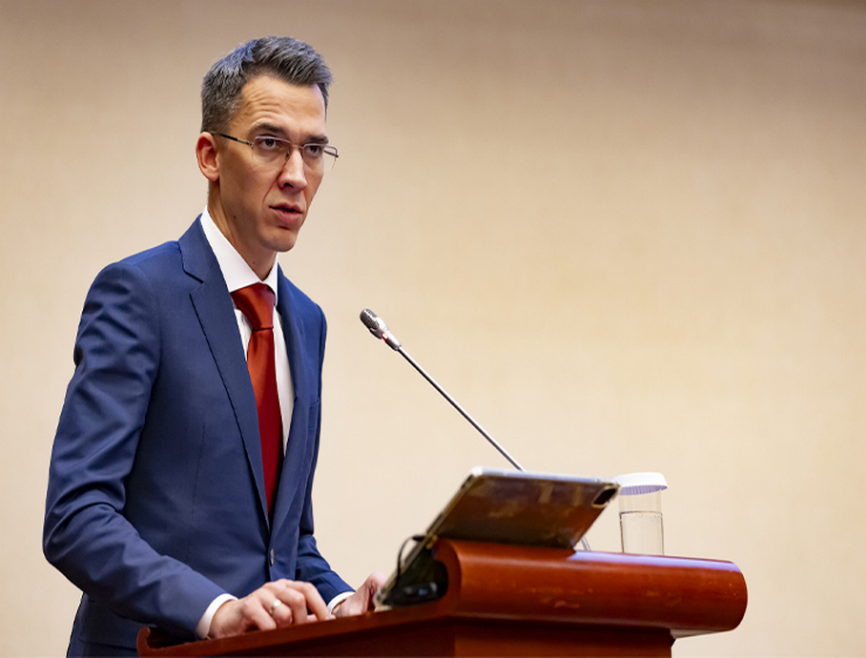
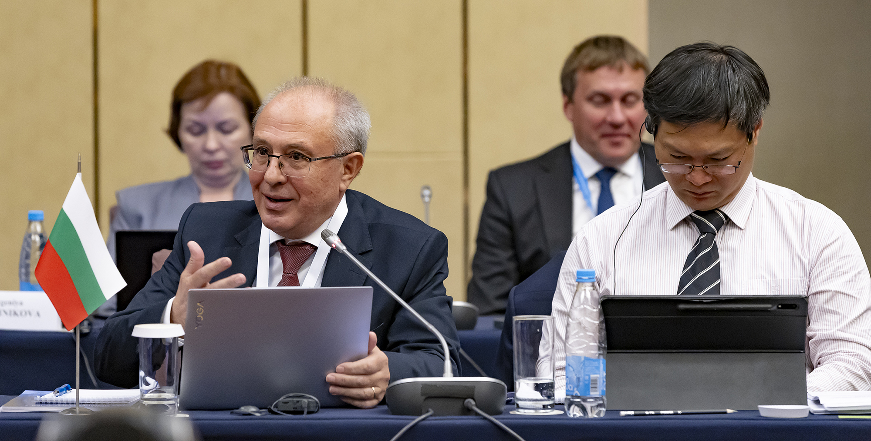
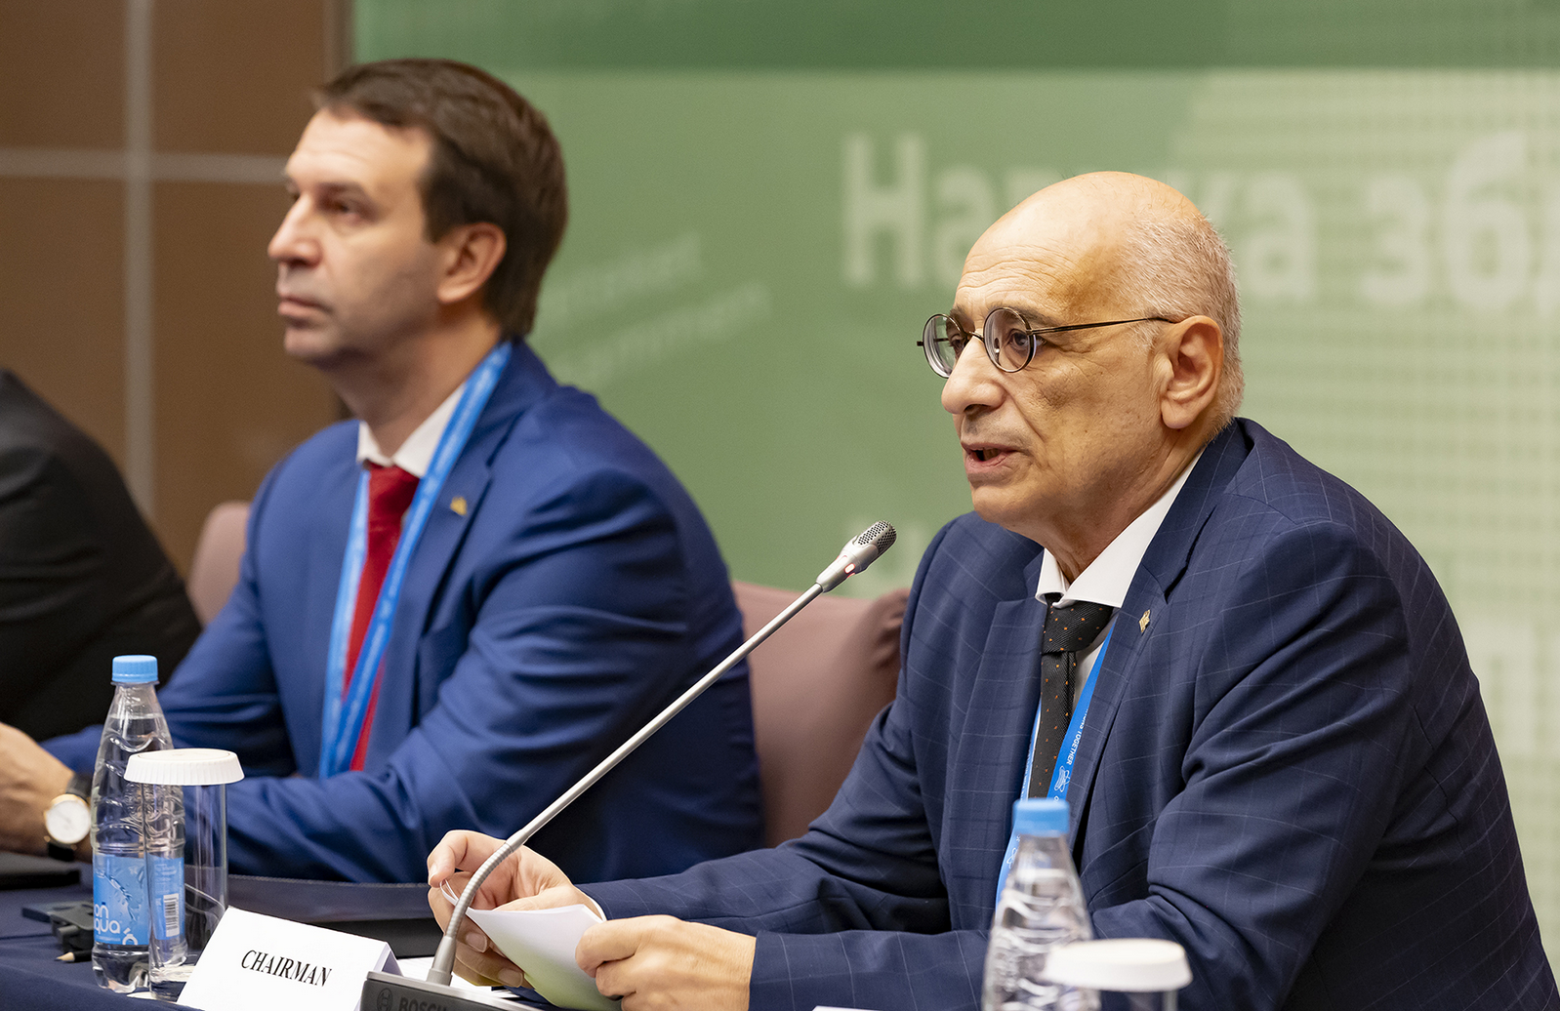
THE SESSION OF THE JINR COMMITTEE OF PLENIPOTENTIARIES
15-16 November 2024, Minsk
Chair of the Committee of Plenipotentiaries ― representative of Georgia A. Khvedelidze
Plenipotentiary representatives of 10 JINR Member States attended the meeting of the CP sessions in person, representatives of other member states attended online. The meeting was attended by representatives of Italy, Serbia & South Africa as associated member states, & international organizations - IAEA & the Arab Atomic Energy Agency.

Slide 14
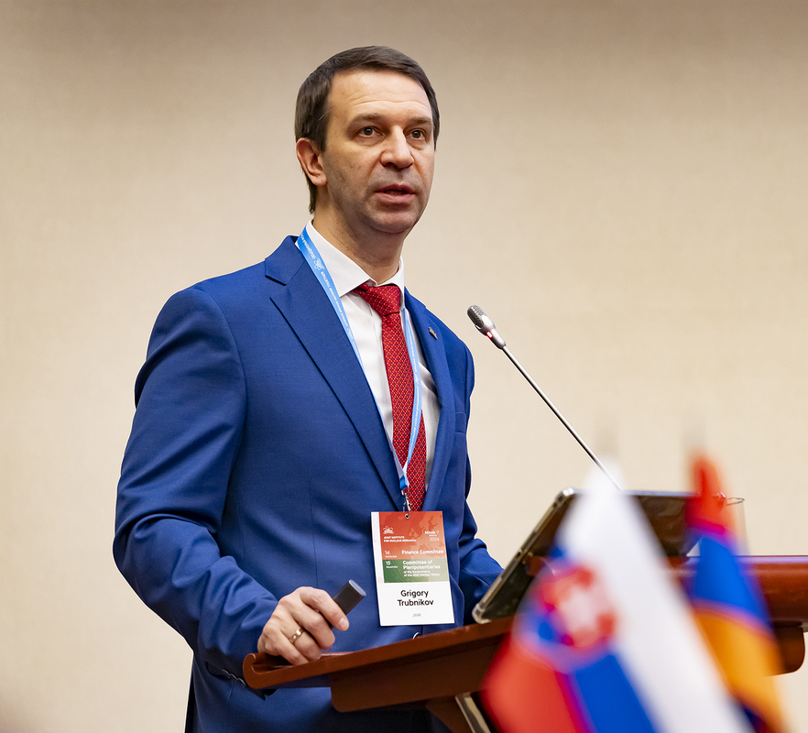
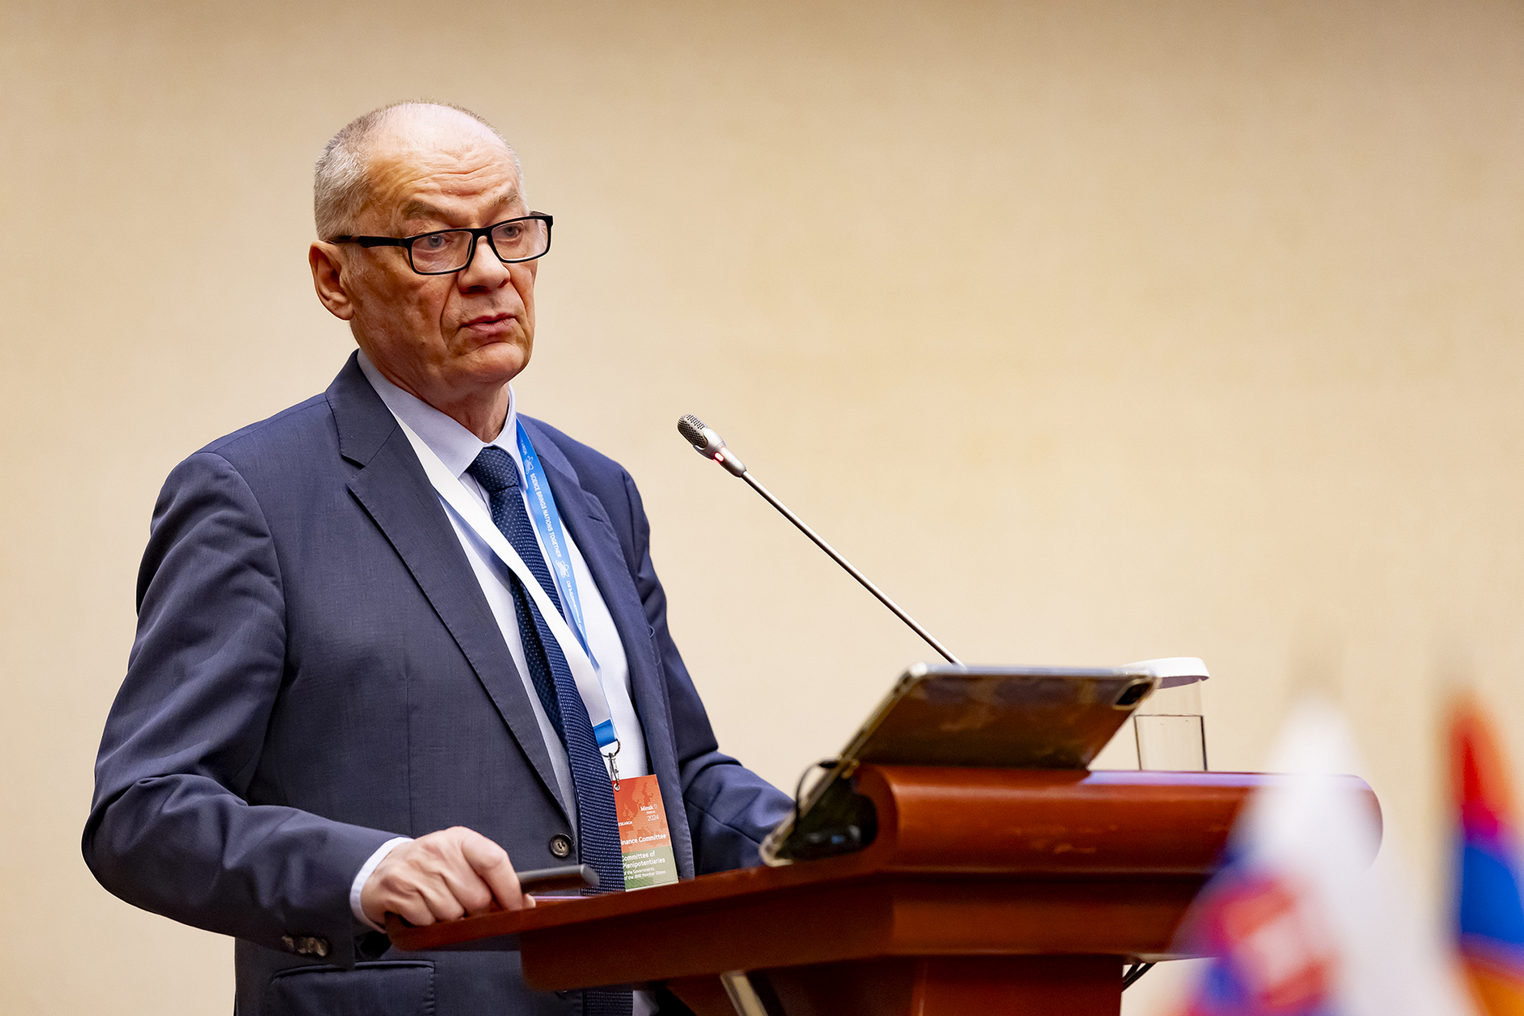
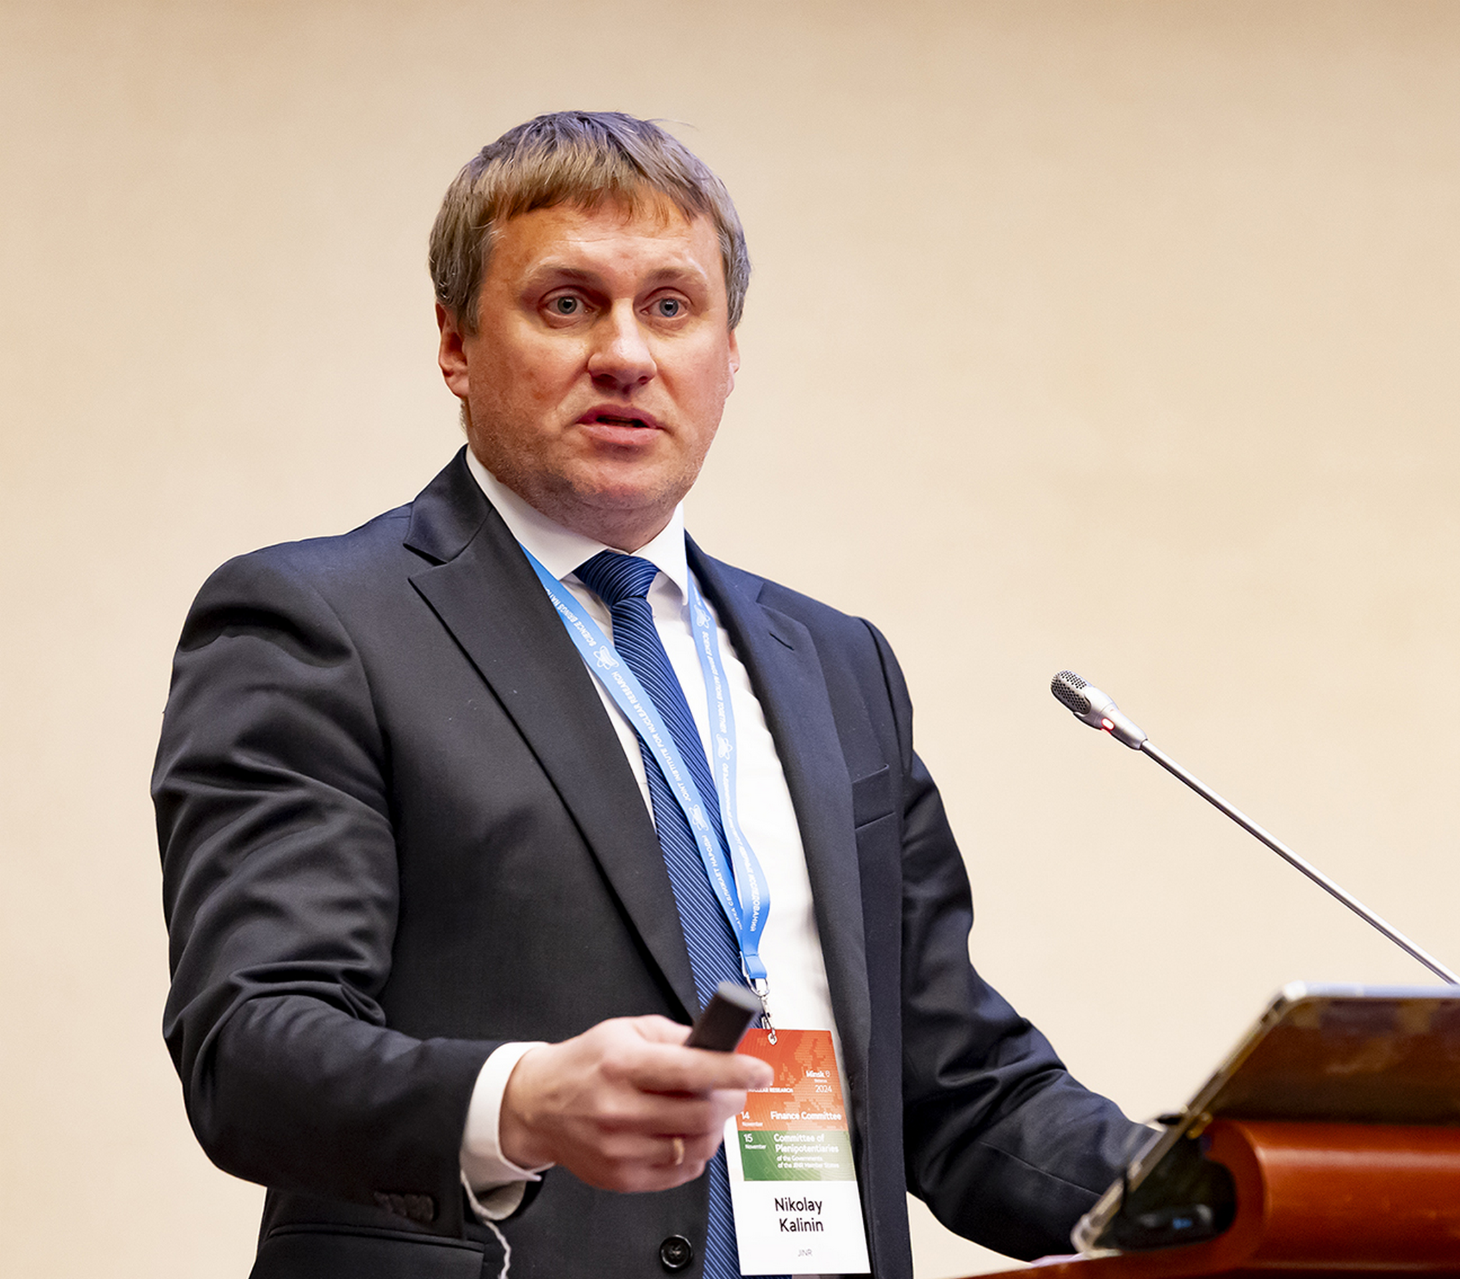
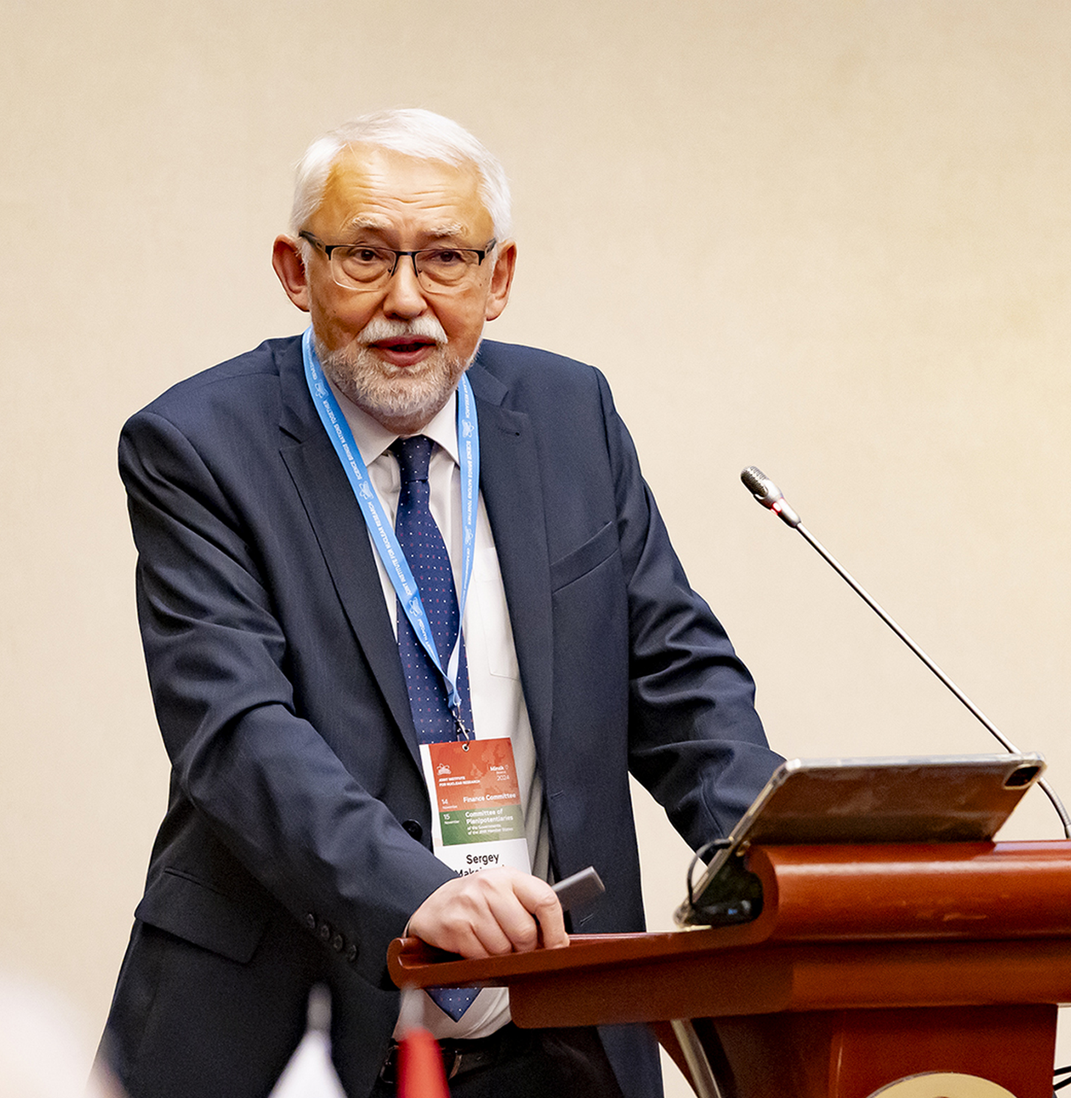
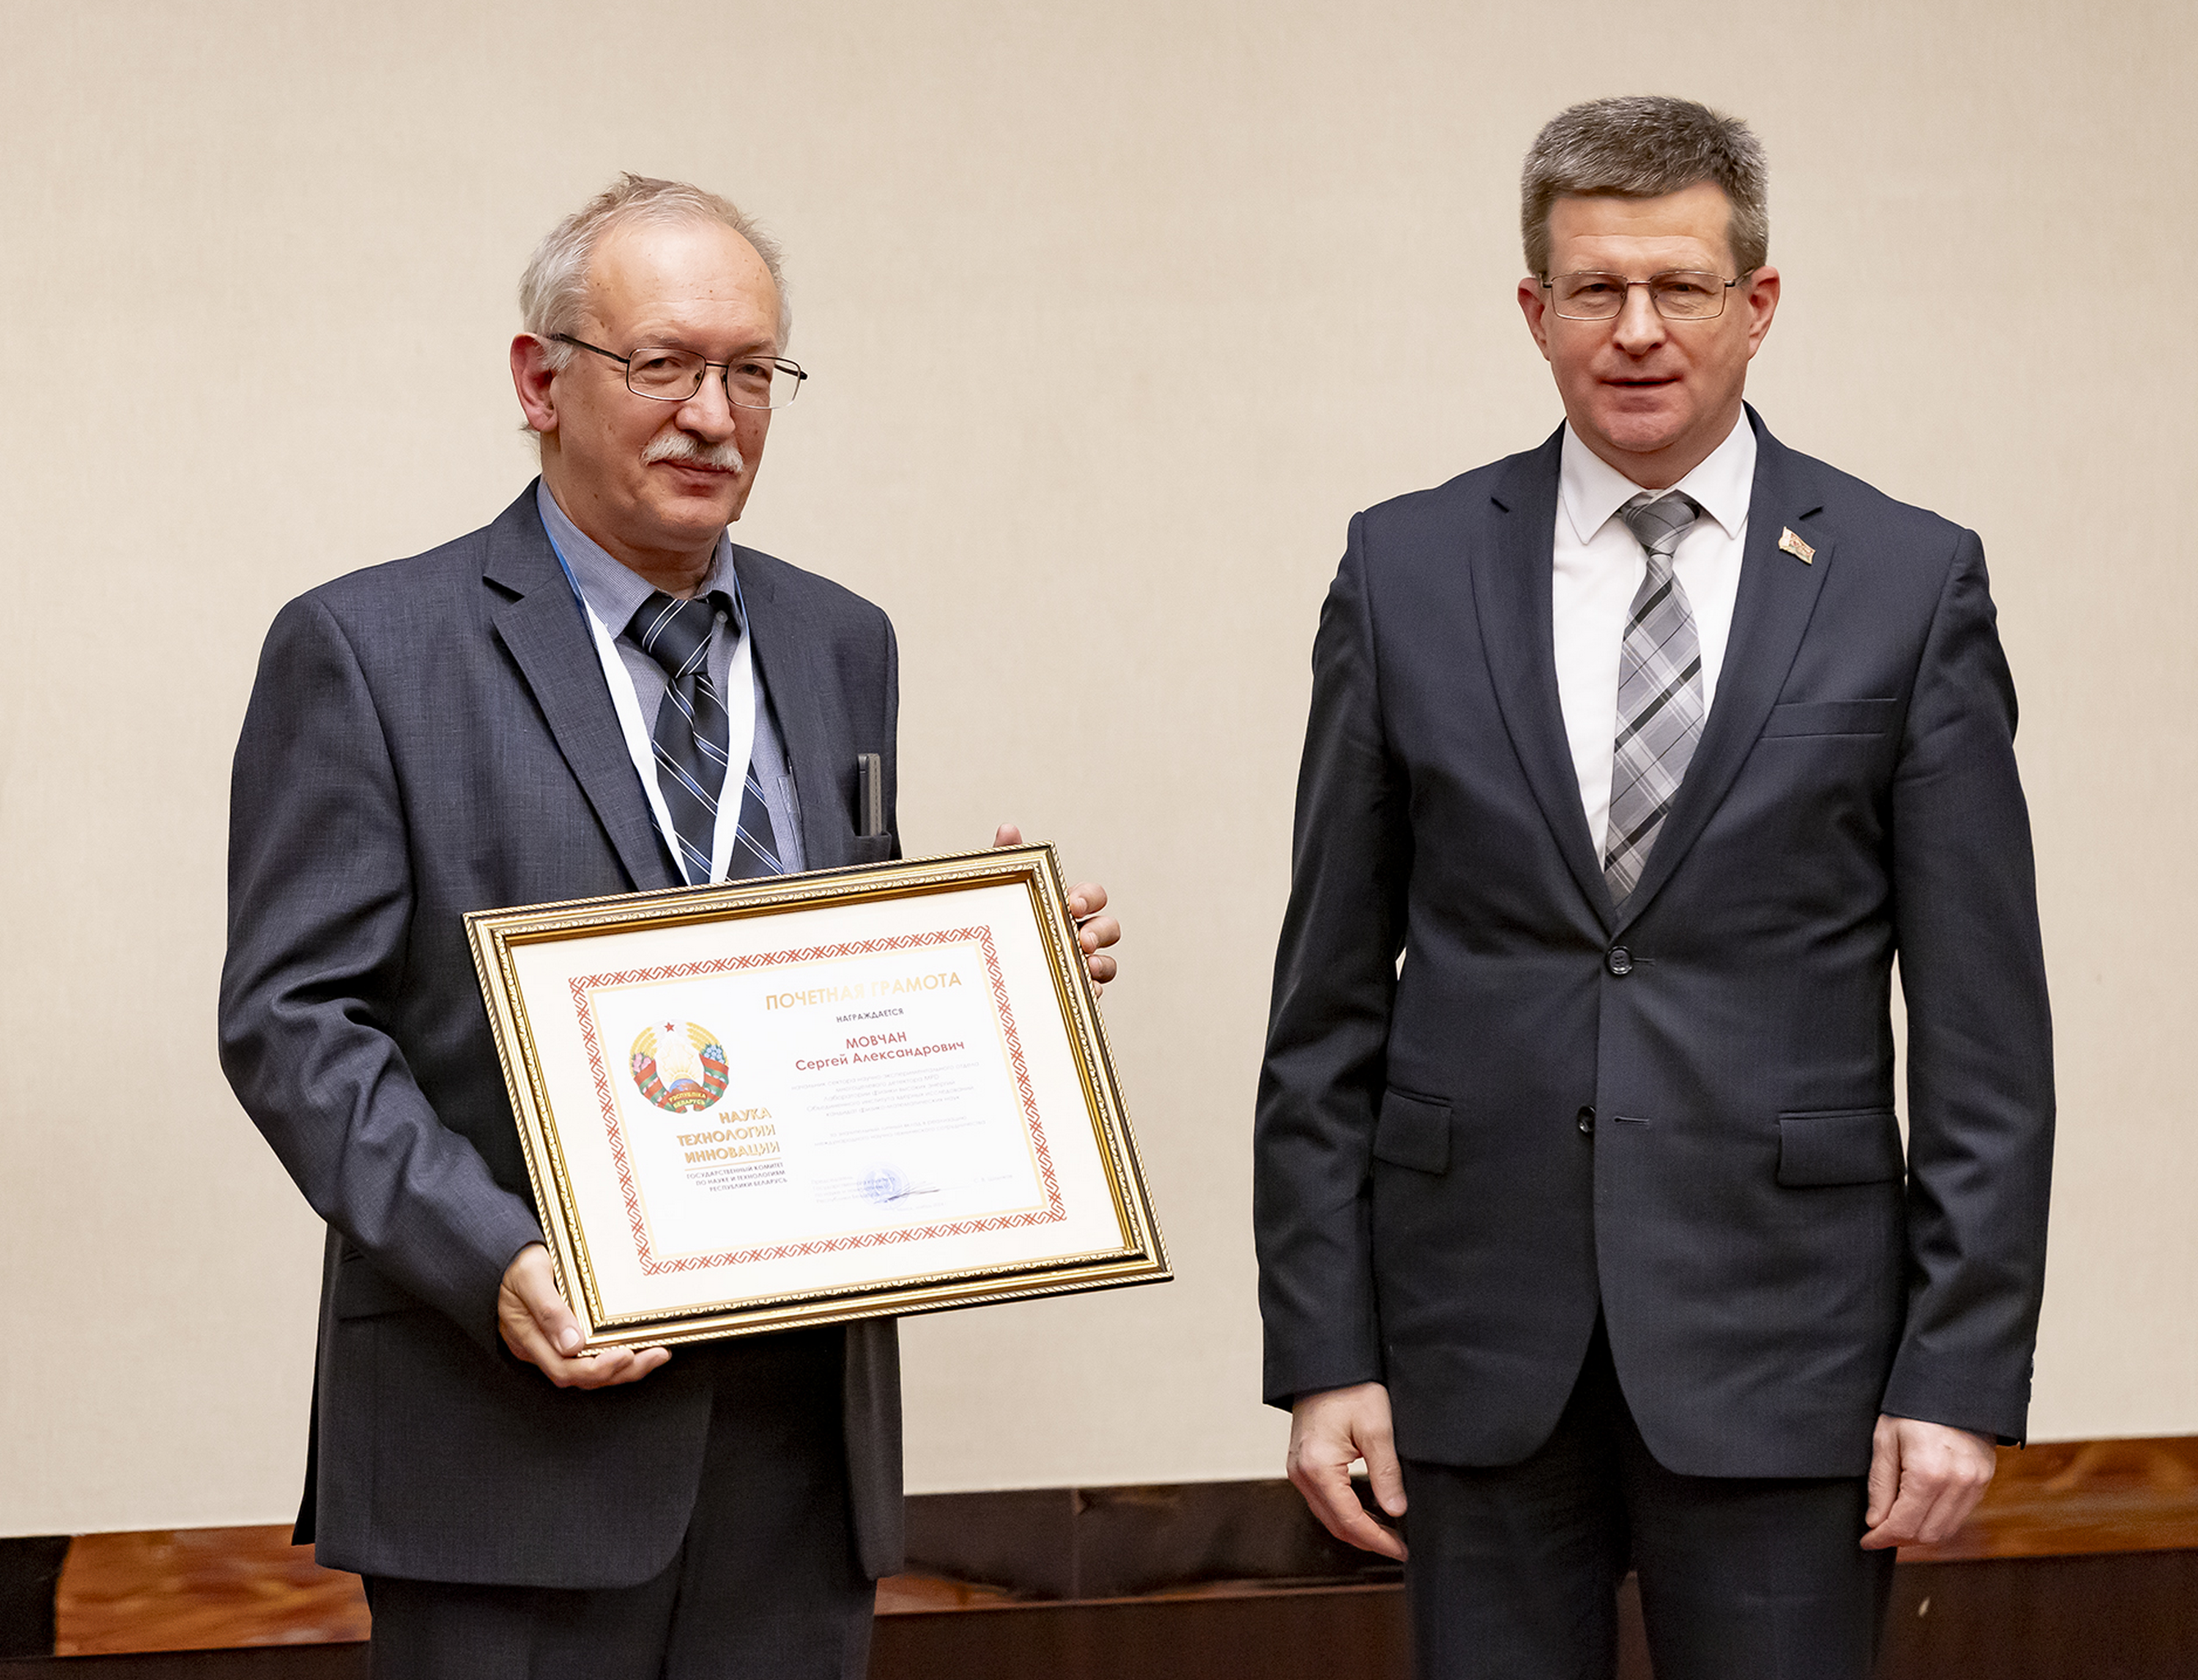
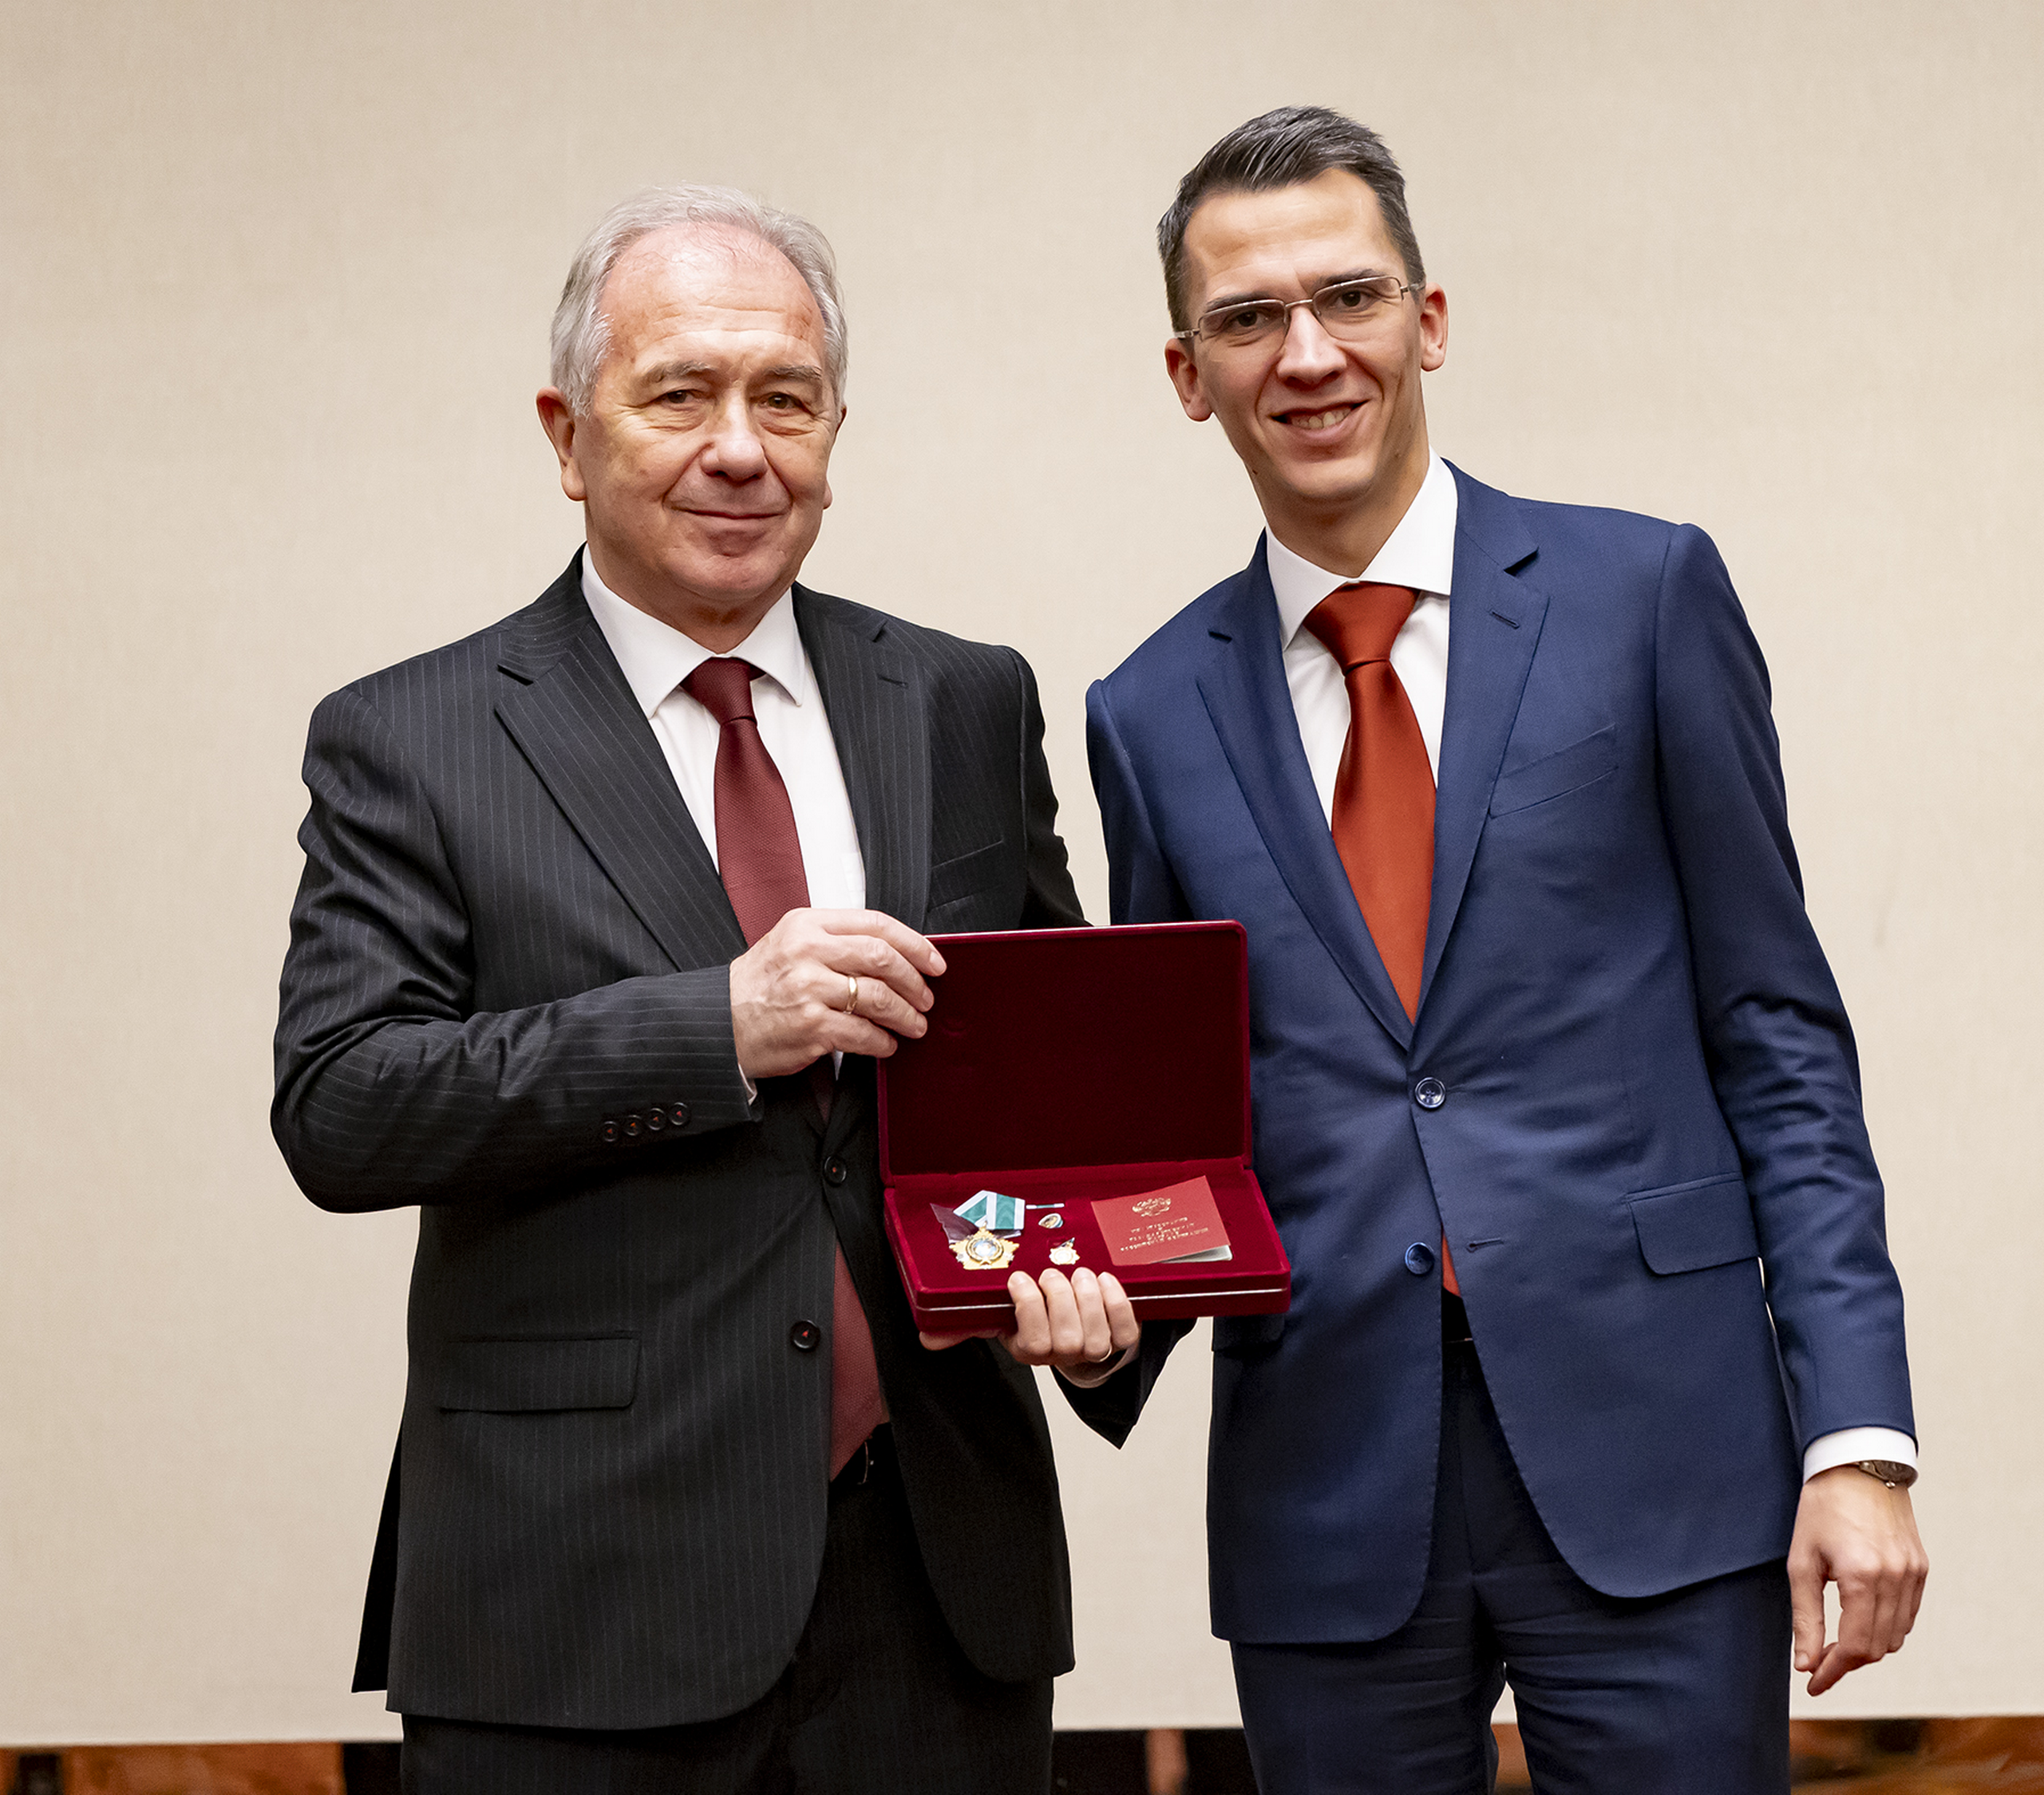
AGENDA
1. Report by the JINR Director - G. Trubnikov
2. On the progress of work on launching the basic configuration of the NICA Complex & decisions of the NICA Project
Supervisory Board - V. Kekelidze
3. Draft budget of JINR for the year 2025, provisional contributions of the Member States for the years 2026, 2027, 2028 - N. Kalinin
4. Results of the meeting of the JINR Finance Committee - A. Omelchuk
5. On approval of the List of JINR officials - A. Khvedelidze
6. Recommendations of the 136th session of the Scientific Council - S. Nedelko
7. Changes in the membership of the Scientific Council - G. Trubnikov
8. Scientific report “Institute for Nuclear Problems, Belarusian State University:
main research directions & potential
for cooperation” - S. Maksimenko
9. Awards

Slide 15
Main results
CP took note with satisfaction of the information about the implementation of the current 7-year Plan for the Development of JINR, the new scientific & technological results obtained. CP endorsed the systematic activities of JINR to strengthen cooperation with research organizations of the JINR Member States & Associate Members.
CP noted with gratitude the high level of attention of the RF to the creation of favourable conditions for the JINR & the implementation of the international mega-science project NICA.
CP accepted with satisfaction the decision of the CERN Council not to terminate the agreement on international cooperation with JINR, & to express hope for the earliest possible resumption of full-scale participation of JINR in CERN activities.
Particular satisfaction was expressed with the signing of the agreement between JINR & the Ministry of Science & Technology of the People’s Republic of China on the launch of 8 joint projects, & to strongly support the strengthening of cooperation with government bodies, scientific organizations, & universities in Mexico & India. To welcome the signing of a cooperation agreement between the National Nuclear Energy Commission (CNEN) of Brazil & JINR was welcomed.
CP reviewed & approved the recommendations of the 136th sessions of the JINR Scientific Council.
The Topical Plan for JINR Research & International Cooperation for 2025 was approved.

Slide 16
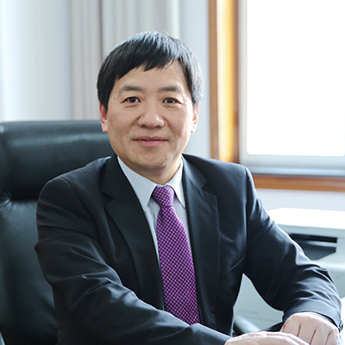
CP agreed to determine the amount of contributions of the Member States for 2025-2030 by annually increasing the contribution of each Member State by 5%. For the Arab Republic of Egypt, taking into account the approved schedule of gradual entry into payment of the contribution, this method of calculating the contribution shall be used from 2028.
The JINR budget for 2025, along with the indicative contributions of the Member States for 2026-28, was approved.
CP agreed with the presented working schedule for the construction &
launch of the basic configuration of the NICA Complex.
Prof. Raghunath Sahoo (Indian Institute of Technology Indore) & Prof. Song Yuntao (Director General of the Institute of Plasma Physics of the CAS) were elected as members of the JINR SC.
The List of JINR Officials to be incorporated as annex to the Agreement between the Government of the RF & the JINR on the Location & Terms of Activity of the JINR in the RF was approved.
CP endorsed the opening of the new scientific journal “Natural Science Review”, published by JINR, & recommended that JINR Member States & partners provide proactive assistance to the Directorate in popularizing this journal by all means available to them.
CP approved the Director’s initiative to organize a programme for the support of interlaboratory innovative projects with the aim of stimulating applied scientific research & innovative developments.

Slide 17

Thank you
for your attention!

