Slide 1
Creation of test benches for testing individual systems of the MSC-230 cyclotron Cоздание испытательных стендов для тестирования отдельных систем циклотрона MSC230.
JINR
Karamysheva G.A.
Yakovenko S.L.
On behalf of New accelerator department DLNP JINR

Slide 2
MSC-230 cyclotron for proton therapy
With the advent of the new irradiation method FLASH in proton therapy, the demand for high-current accelerators has significantly increased. This need has driven the development of a new project at JINR, the MSC230—a compact isochronous cyclotron designed with a relatively modest magnetic field strength of 1.7 T at its center. The isochronous cyclotron accelerates a quasi-continuous beam, making it one of the most promising types of accelerators for producing high-intensity beams. The MSC230 is designed to deliver a beam current of approximately 10 μA in short pulses at an energy of 230 MeV. This capability is sufficient to investigate the efficiency of the FLASH method.
The study of the FLASH method underscores the critical importance of establishing a research and innovation center at the Joint Institute for Nuclear Research (JINR). Such a facility would be equipped with a modern proton accelerator, an advanced beam delivery system, and state-of-the-art laboratory equipment for biomedical research.
Currently, the technical design of the cyclotron and manufacture of some systems are in progress in D.V. Efremov Institute of Electrophysical Apparatus (NIIEFA).

Slide 3
It is advisable to have the following test benches in the experimental hall of DLNP NEONU:
1. A test bench of the internal source. Testing of internal source, deflector.
2. Calibration test bench . Calibration of Hall sensors.
3. Stand for winding coils from HTS tape.
4. Stand for winding copper windings.
5. Central region test bench.

Slide 4
Test benches in ASIPP Hefei, China

Slide 5
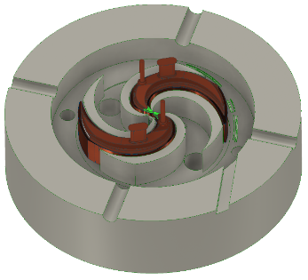
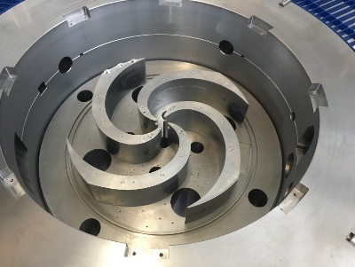
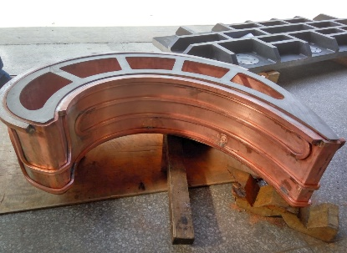
Collaboration with ASIPP (Hefei, China) Superconducting proton cyclotron SC200
From JINR project to start-up in Hefei!

Slide 6
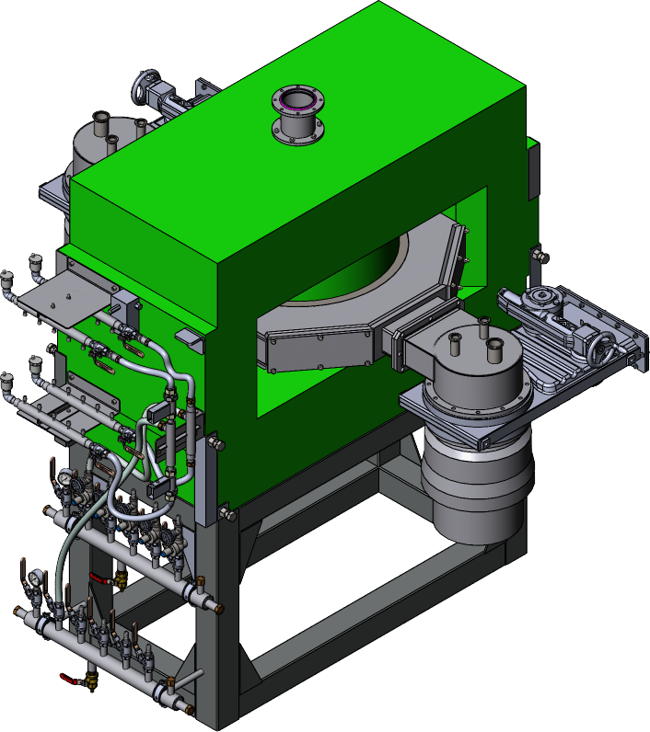
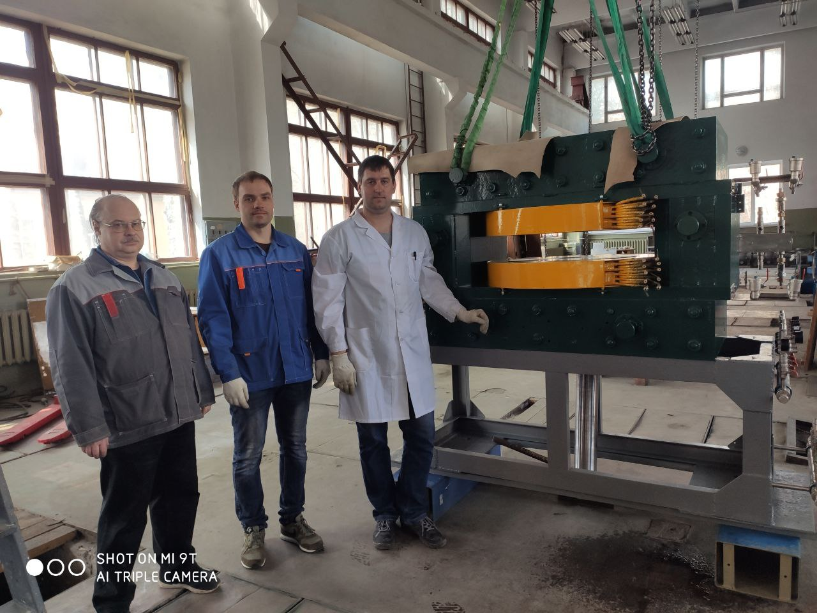
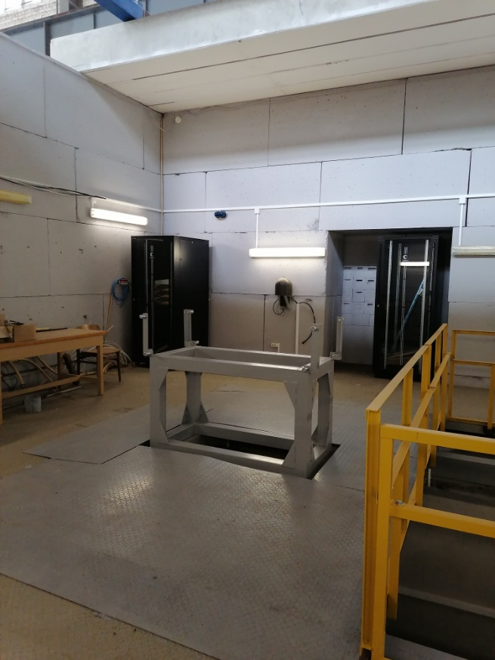
A test bench of the internal source. Testing of internal source, deflector.
Computer model
Revised magnet Fedorenko S.B. Galkin R.V. Petrov D.S.

Slide 7
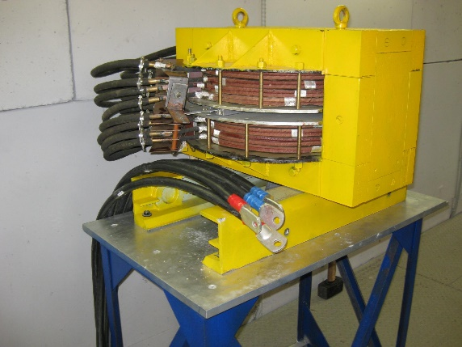
Calibration magnet
A technical project has been prepared and a new pole has been manufactured for the calibration magnet.
Magnetic field will be increased upto 3.2 T.
Magnetic field upto 2.9 T

Slide 8
Virtual prototyping
The framework of the cyclotron VP Matlab integrated platform
The idea of a new engineering methodology Virtual Prototyping is to replace physical mock-ups by an integrated software prototypes that include all functional simulations based on CAD techniques.
Usually when designing a cyclotron some systems are developing separately. An integrated platform which encapsulates these distributed components and provides an inter-communication mechanism is extremely useful, as it will contribute to the creation of a more optimal cyclotron.
MATLAB
Scripts for determining the shape of sectors and cavities
CORD – Closed Orbits Dynamics
Beam tracking
SOLIDWORKS
CAD
Parametrized integrated
model of the cyclotron:
Magnet
RF system
Deflector / Inflector
Simulation results
(2D/3D field maps)
CST studio/ Comsol/ Tosca
Magnetostatic
RF eigenmode, Conjugate heat transfer, Time/Frequency domain
Electrostatic
Directly in Matlab the main parameters, shape of the magnet sectors and cavities are selected, then sent to CAD (Solidworks) to create parametrized models of the cyclotron, and then sent to CST studio to simulate in the corresponding modules. The calculation results of the electromagnetic fields from CST are imported into Matlab, where they are analyzed using code CORD and beam tracking codes.

Slide 9
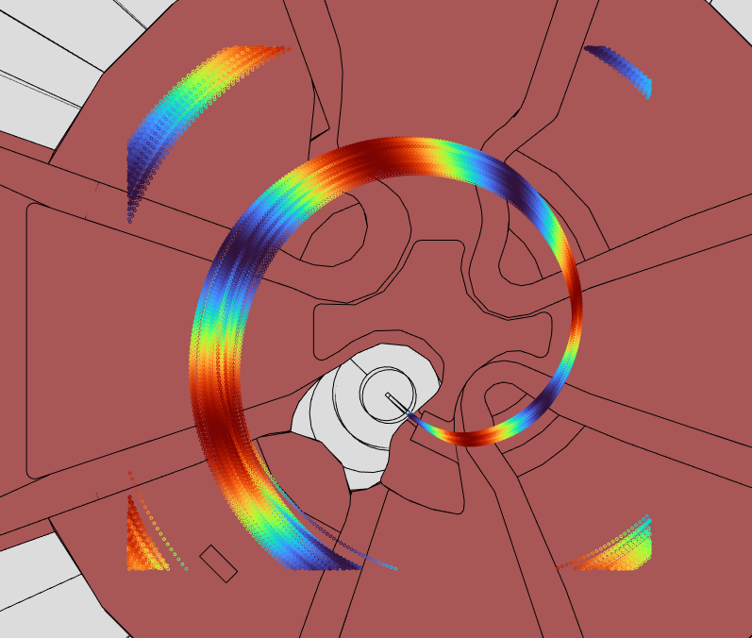
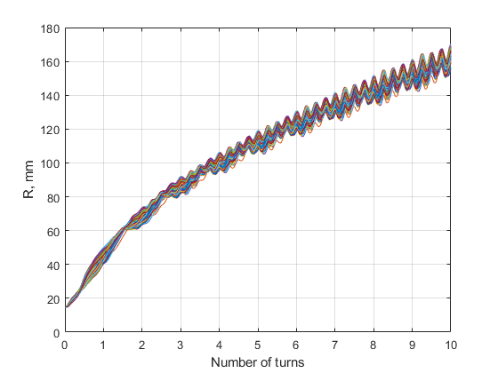
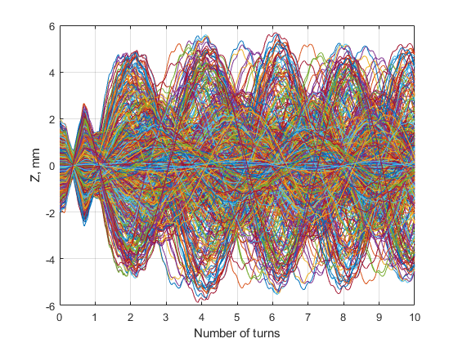
Beam dynamics simulation in the central region
Transmission -10%

Slide 10
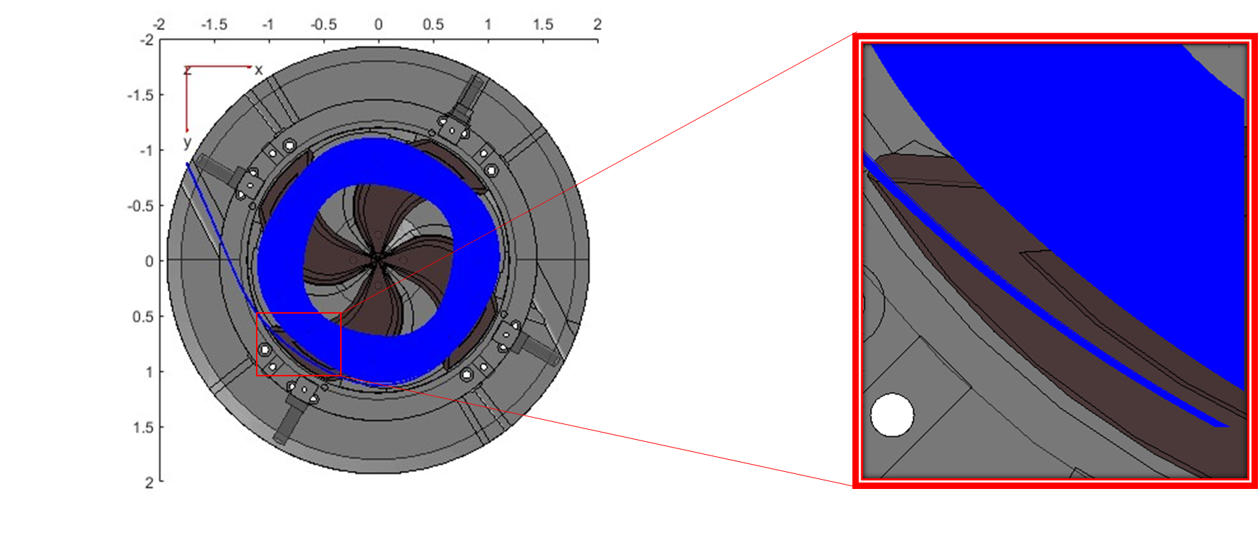
Beam acceleration and extraction

Slide 11
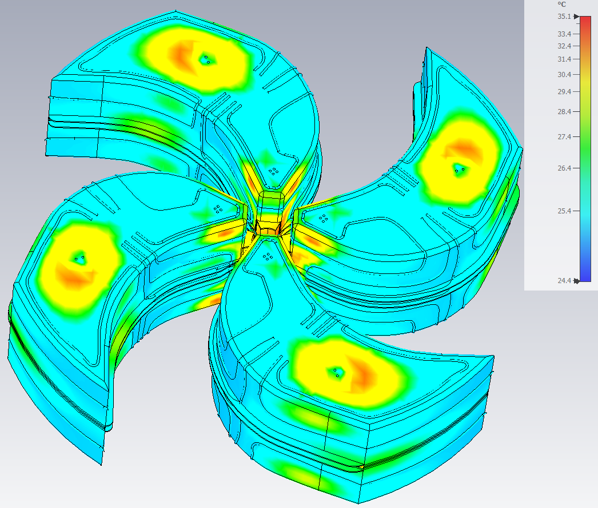
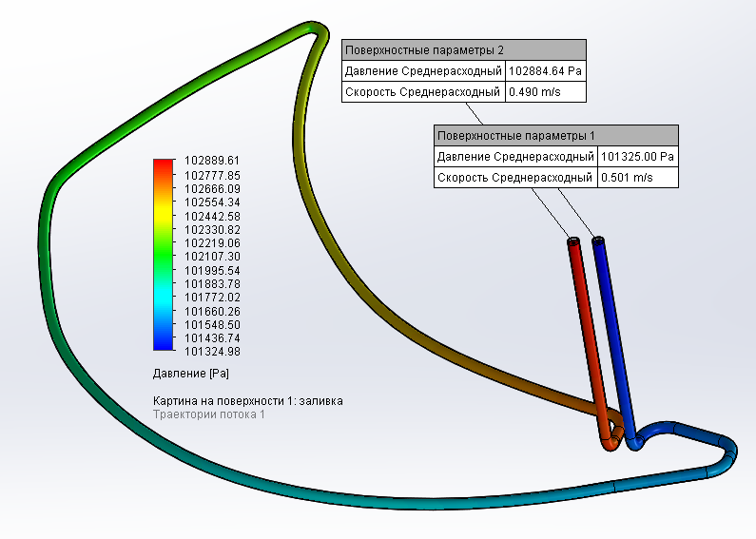
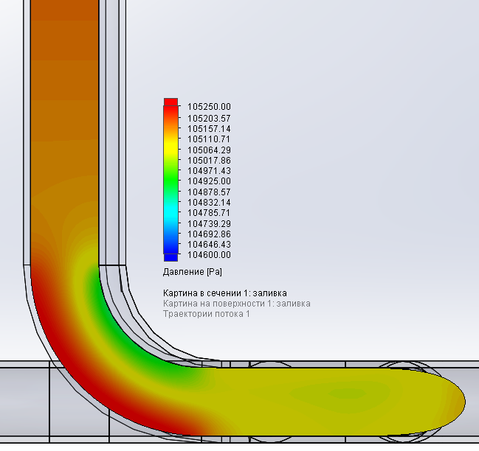
Accelerating system MSC-230 (examples)
Visualization of flow velocity at a tube bend
Visualization of pressure loss in the cooling tube of the dee electrode
Heating in CST Studio

Slide 12
Artificial intelligence (AI)
Artificial intelligence has truly become an integral part of our daily lives, with a wide range of applications. In everyday life, AI is used to recognize faces in devices like smartphones, computers, and security systems, as well as to automatically translate texts and voice messages. In medicine, AI assists in diagnosing diseases, analyzing medical images, and even developing new drugs. While the impact of AI extends far beyond these common applications, its potential in the field of accelerator design is particularly intriguing. One such application is the use of AI in cyclotron design, a critical component in the field of nuclear medicine.

Slide 13
Artificial Intelligence in Cyclotrons short review
The following applications of AI in cyclotrons can be distinguished :
Design of the systems of the Cyclotron
Beam Dynamics
Control systems

Slide 14
1. Isochronisation of the magnetic field
Isochronization of one cyclotron variant may require about 10 iterations of calculations of the magnetic field of the model with a modified sector width. Machine learning (ML) can speed up this process.
2. Application of computer vision methods to improve the quality of the cyclotron magnetic field map
Improving the quality of the measured magnetic field maps based on a neural network Approach, namely super resolution (SISR, Single Image Super-Resolution), will allow measurements of the magnetic field to be carried out with a large step.
Our applications

Slide 15
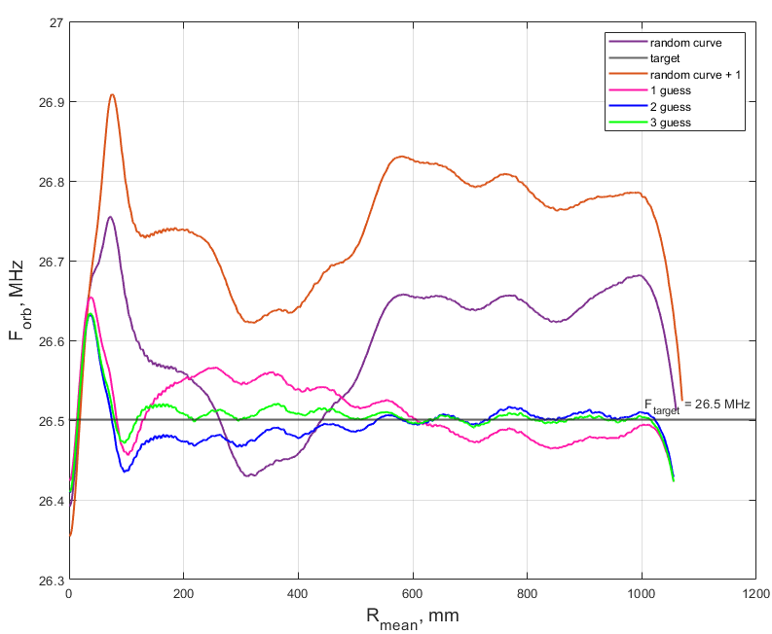
Response function for magnetic field isochronization
$$F_{resp}=\frac{∆f\left(r\right)}{∆w\left(r\right)}$$
Guess | MSE to target
Random | 132
Random + 1 | 653
1 | 12
2 | 3,6
3 | 0,86
Response function is– the ratio of the deviation in the frequency of rotation of particles to the deviation in the angular width of the sector.
It takes 5 simulations to reach necessary isochronism
15

Slide 16
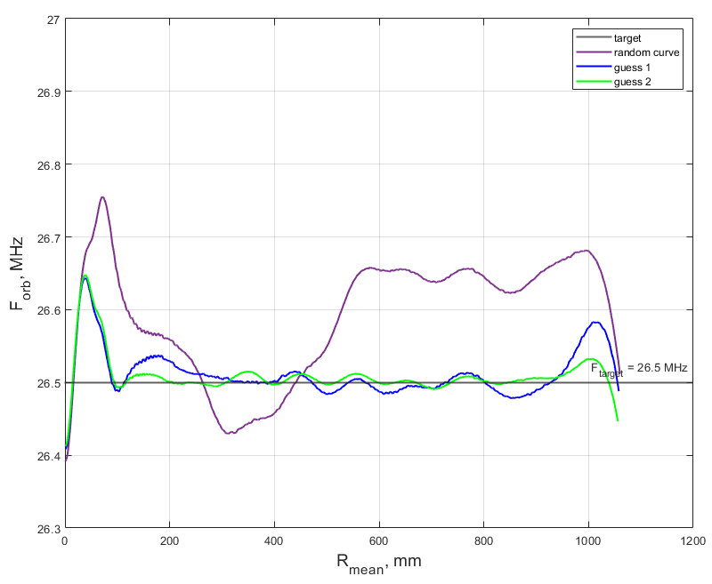
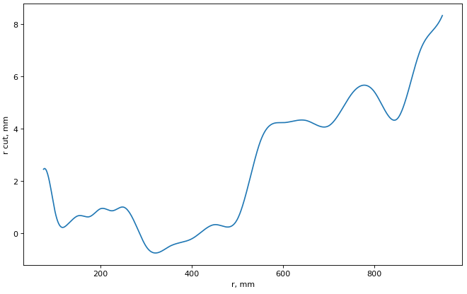
Machine learning (ML)
Guess | MSE to target
Random | 132
1 | 2
2 | 0,7
The difference between the initial sector width and the second iteration using machine learning.
Machine learning application
The traditional method of applying the response function required 5 iterations of calculations, while using machine learning -2 iterations to achieve the required isochronism
16

Slide 17
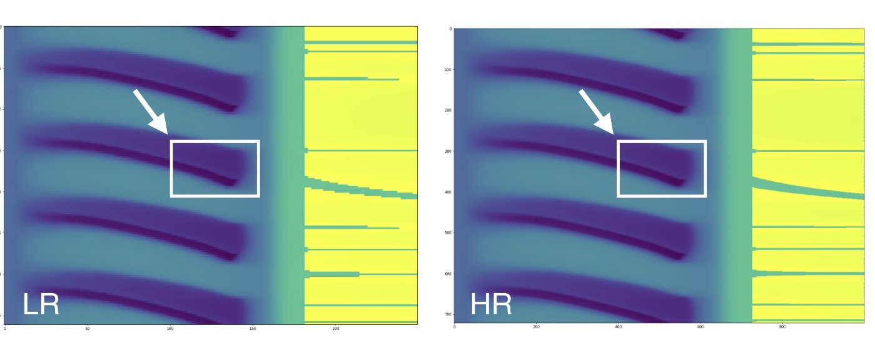
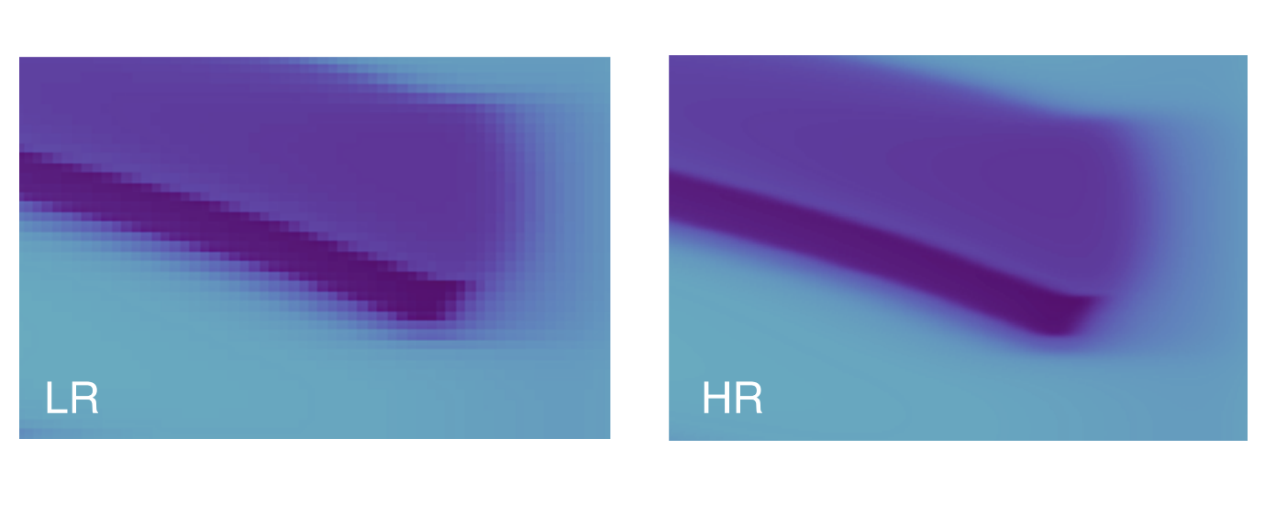
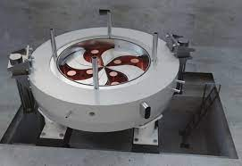
Application of computer vision methods
The models were trained using calculated magnetic field maps on grids with small and large increments (the difference in resolution is visible in the figures below). The goal: having a map similar to the map on the left to get a better map, as in the picture on the right

Slide 18
Future plans for machine learning (ML)
Continue training models to isochronize the magnetic field.
A large amount of information was obtained during the optimization of the MSC 230 RF resonator, based on this information, to train models and test trained models for new cyclotron models.
Parameterized models were previously used to calculate magnetic channels. Conduct training of models, check the effectiveness.
To develop approaches for the application of AI in ion source management. To work on the ion source test bench.

Slide 19
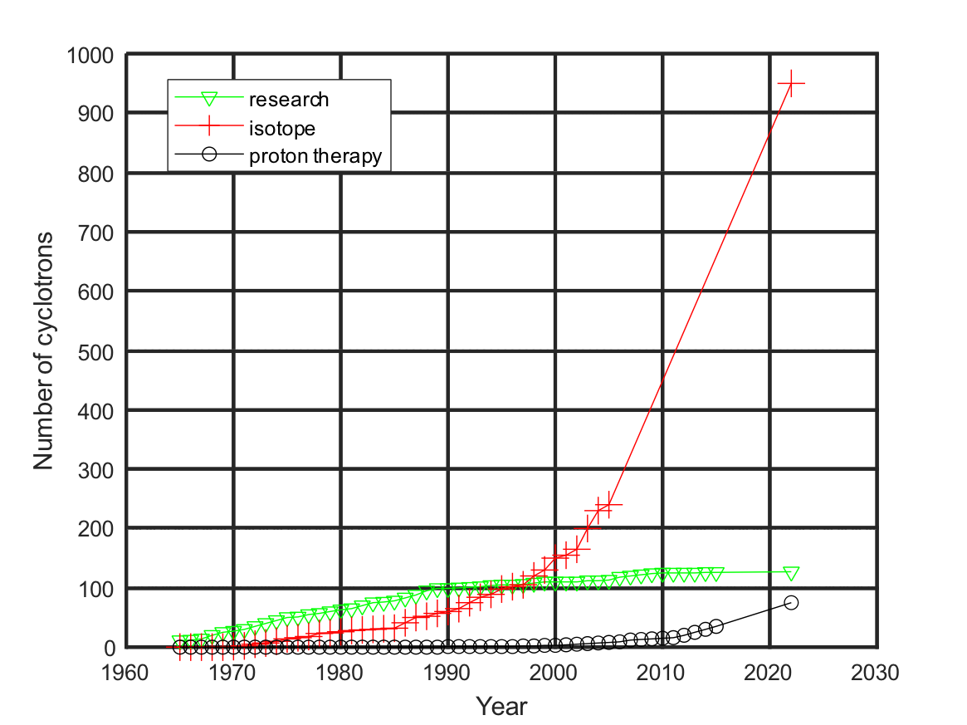
Motivation
Demand for cyclotrons for isotope production and proton therapy is growing.
Cyclotrons have limited lifetime due to irradiation etc., need to replace older cyclotrons with new ones.
Cyclotrons are becoming better: more compact, cheaper, more reliable, power efficient.
Number of cyclotrons. The green triangles are cyclotrons in operation at research centers, the red crosses the cyclotron for medical radioisotopes production, and the black circles cyclotron for proton therapy [1]. Graphs are updated for year 2020 by data from [2, 3].
[1]Calabretta L., Seidel M., 50 Years of Cyclotron Development, IEEE Trans.Nucl.Sci. 63 (2016) 2, 965-99, DOI: 10.1109/TNS.2015.2499238.
[2]Schaffer P. et al. Direct Production Of 99mTc via 100Mo(p,2n) on Small Medical Cyclotrons // Physics Procedia 66 (2015 ) 383 – 395.
[3]https://www.ptcog.ch/index.php/facilities-in-operation
YBCO HTS tape

Slide 20
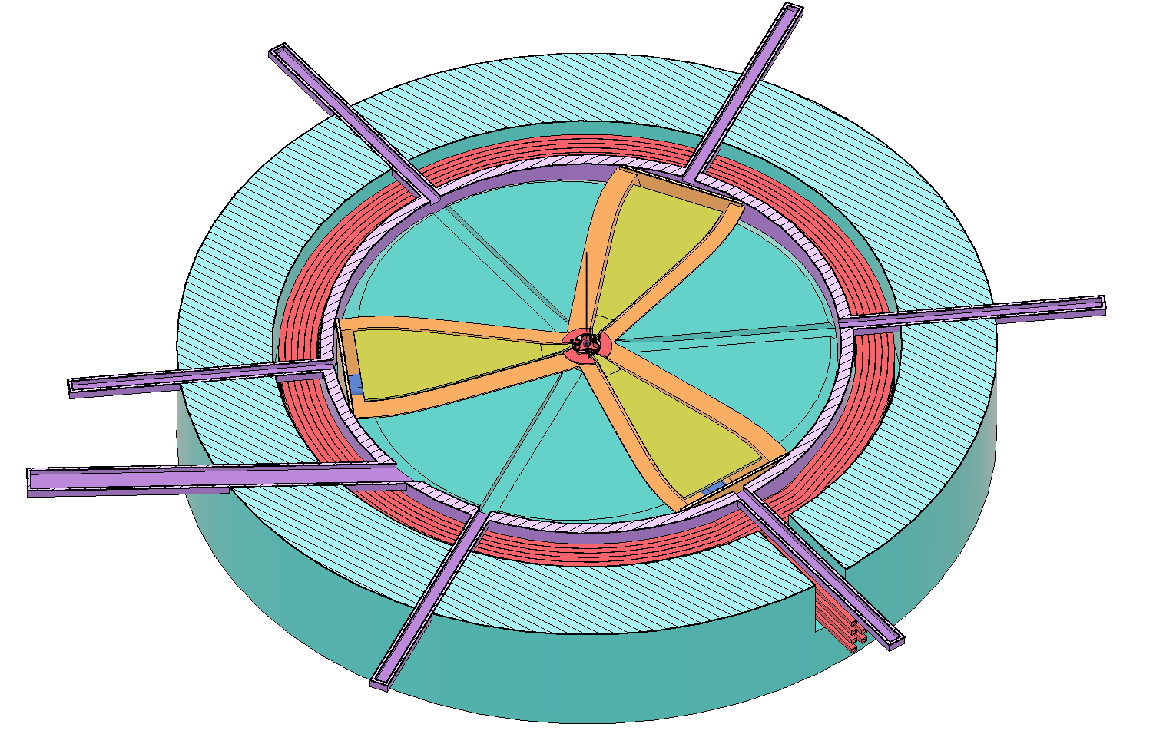
15 MeV, 3 sectors, harmonic 6 frequency 145 MHz
Motivation
Parameter
Magnet type | Electromagnet with resistive coil
Ion source | Internal/External
Final energy MeV | 15
Final radius, mm | 360
Mean magn. field, T | 1.55
Dimentions (h×d), mm | 700 × 1390
Weight, kg | 6800
Hill/Valley field, T | 2.2/0.4
Hill/Valley gap,mm | +- 25/210
A*Turn number | 27 000
Magnet power consumption, kW | 20
RF freq., MHz | 145
Harmonic number | 6
Voltage, kV | 30-50
RF power, kW | 8
Turn number | 120
Beam intensity, µA | Up to 1000
Extraction type | stripping foil
scheme 30deg/90deg
6th harmonic mode of acceleration

Slide 21
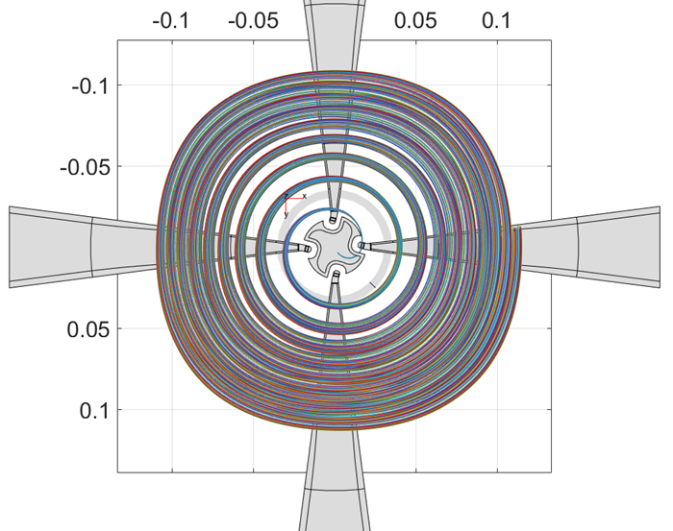
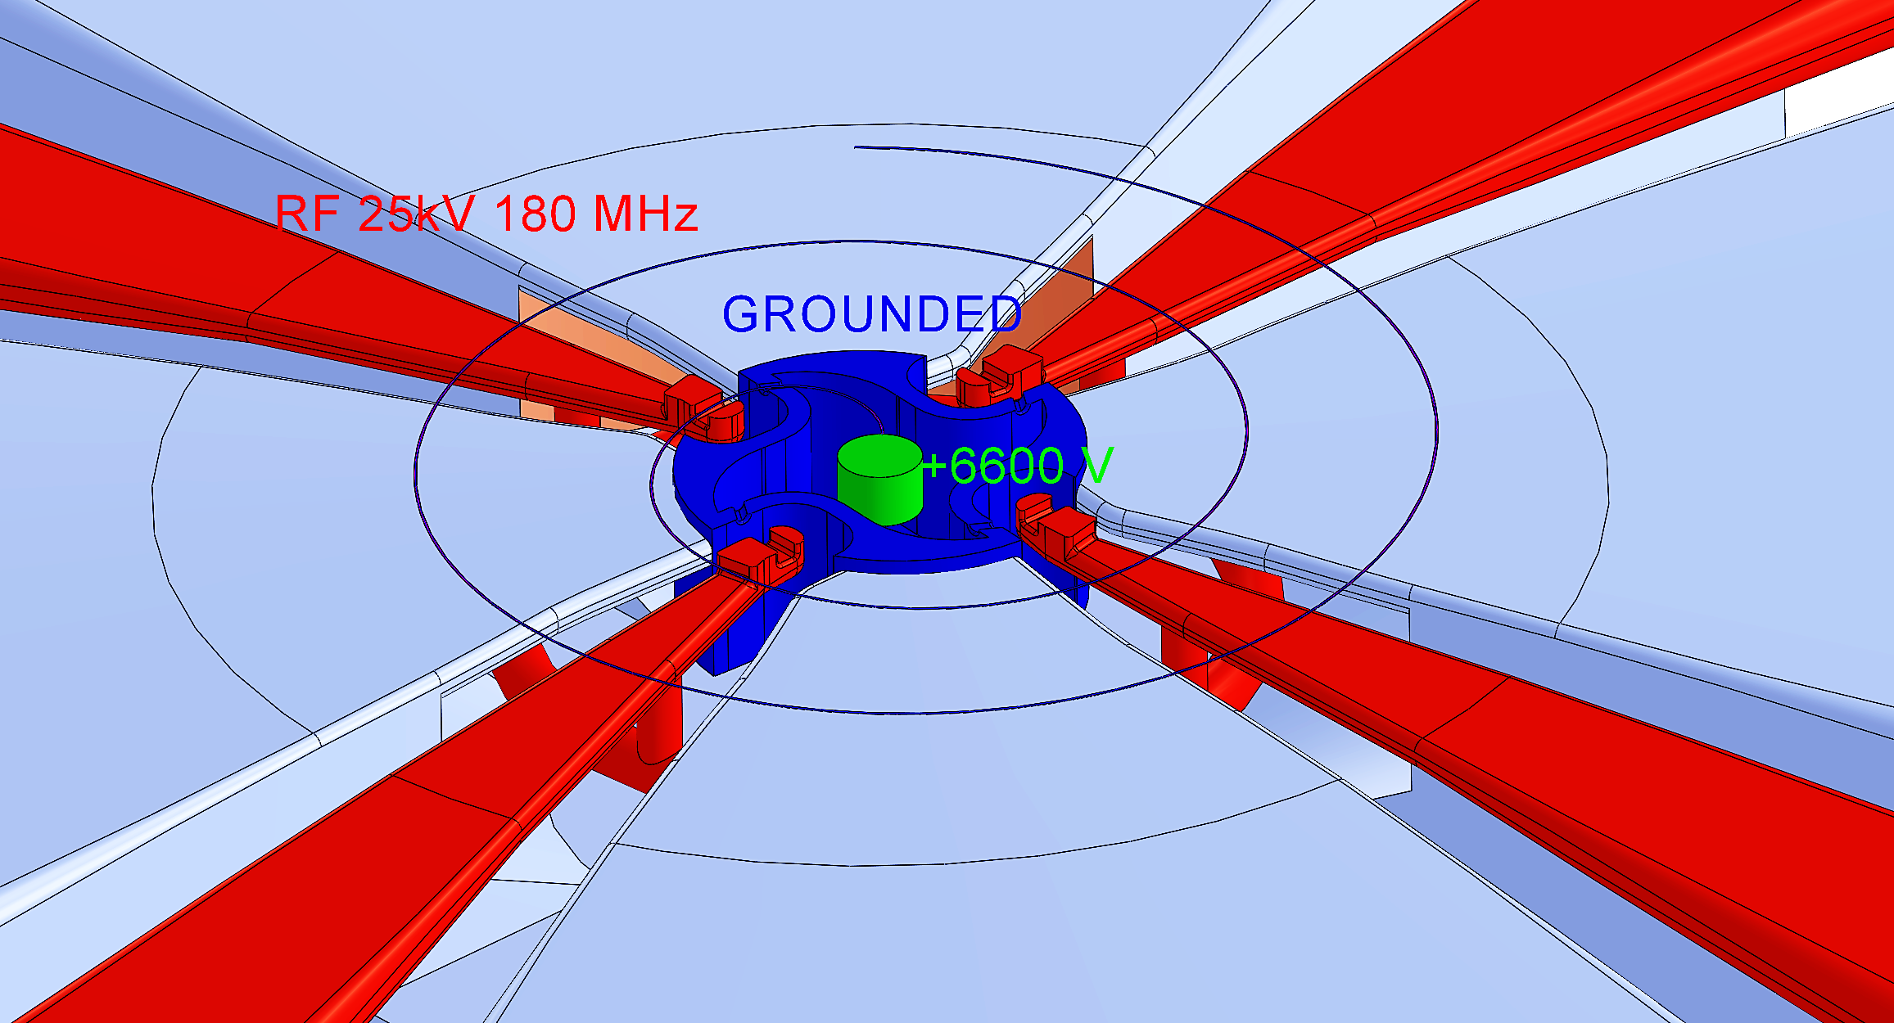
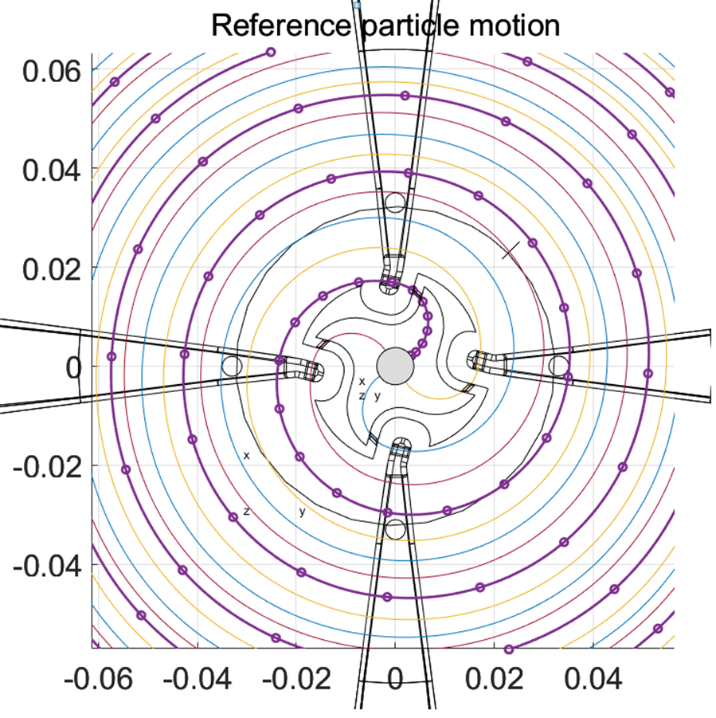
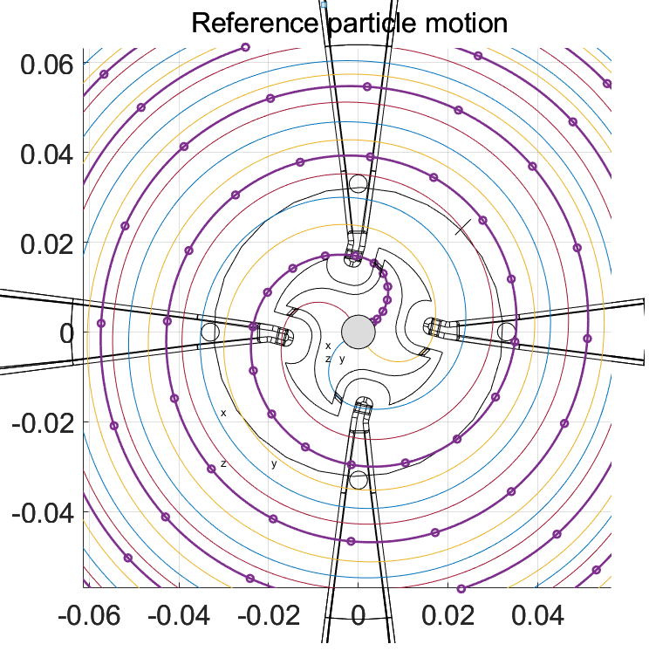
“Ninja star” ion source
Center region view. Dark blue – “ninja star” housing, blue – grounded dummy dee, red – dee tips, green- PIG ion source .

Slide 22
Manpower

Slide 23
Requested resources

Slide 24
Thank you for your attention

