Slide 1

Linear electron accelerator LINAC-200 as a core for a new test beam facility at DLNP JINR
Status report
Development of Scientific DLNP Infrastructure for Research Using Semiconductor Detectors, laser Metrology, Electrons, Positrons and Cryogenic Technology
08-2-1126-2015
Design and development of a test zone for methodological studies of detectors at a linear electron accelerator LINAC-200 in the DLNP
08-2-1126-1-2024/2028
Aleksei Trifonov
Dzhelepov Laboratory of Nuclear Problems
60th meeting of the PAC for Nuclear Physics, January 23, 2025

Slide 2
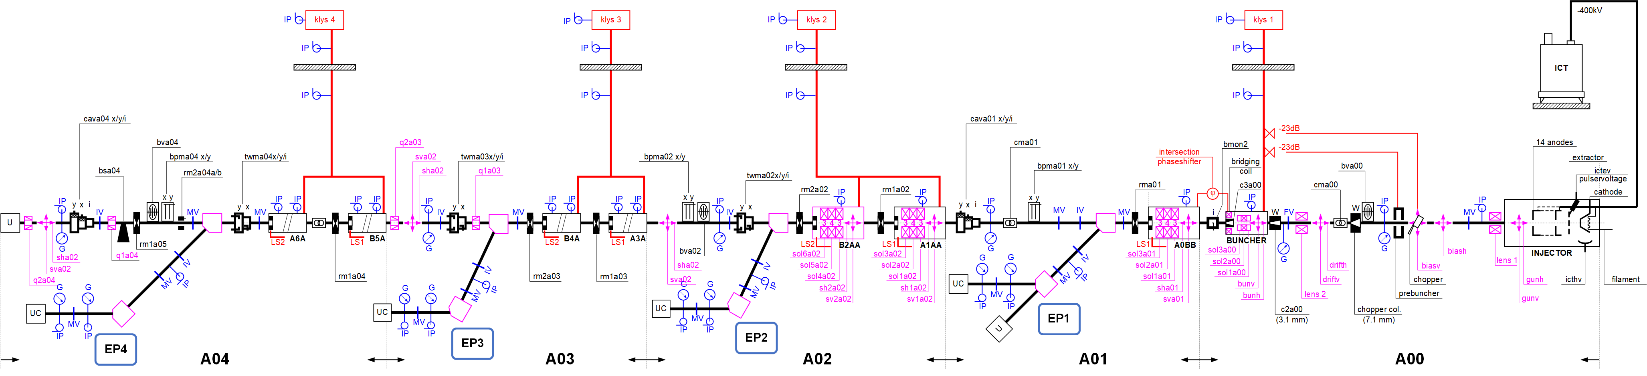
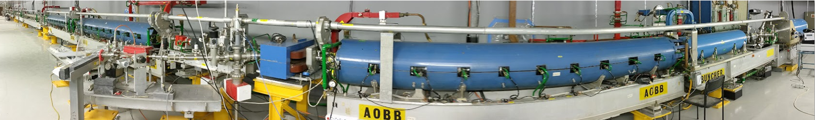
Accelerator layout
A. Trifonov Linear electron accelerator LINAC-200 as a core for a new test beam facility at DLNP JINR
Notes:
Detailed accelerator layout are presented on the slide.
In the late 1990s and early 2000s, the equipment of the synchrotron radiation source AmPS (Amsterdam Pulse Stretcher, NIKHEF) was transferred to JINR.
Based on this equipment, it was planned to create a synchrotron radiation source in Dubna. The project was called DELSY – Dubna Electron Synchrotron.
Unfortunately, the project did not receive sufficient funding.
After some time, a decision was made to develop a test zone for research with electron beams on the basis of this equipment.
Based on the equipment of the MEA accelerator (which served as an injector for the AMPS synchrotron radiation source) the LINAС-200 linear electron accelerator and a beam extraction channel system for experiments with electron beams were created.
4 test beam channels (EP1–EP4) will be discussed later in the report.

Slide 3
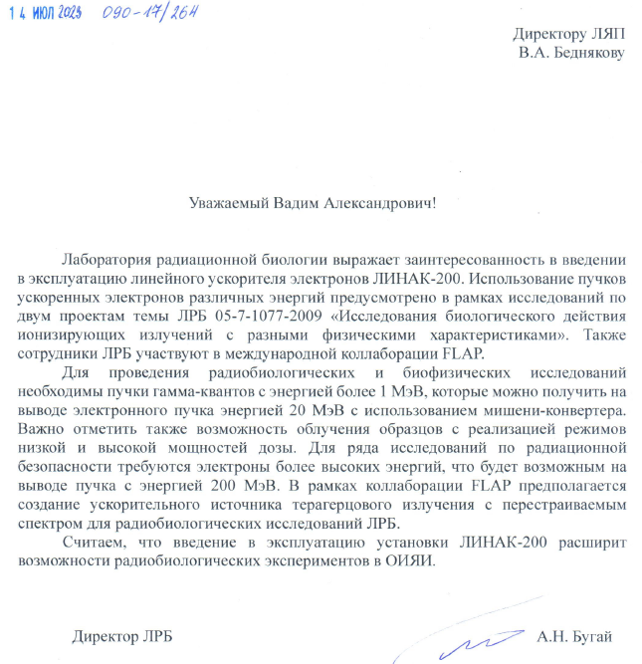
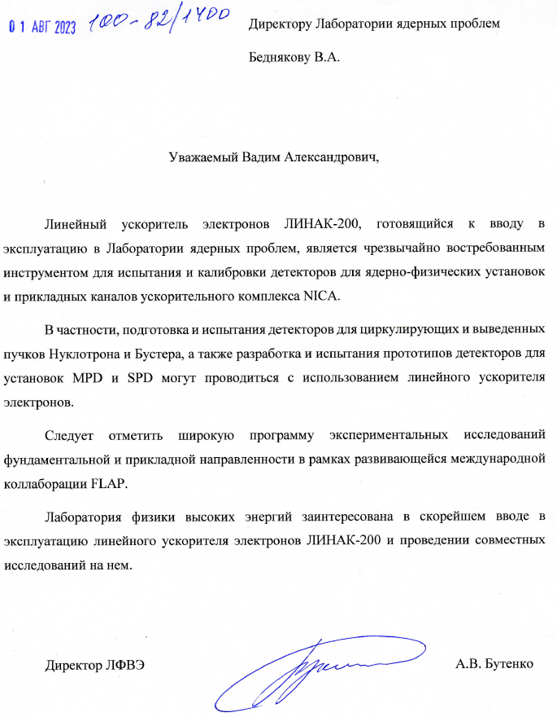
Relevance
Notes:
The JINR laboratories, as well as other scientific organizations, showed interest in experiments with electron beams.
The presence of the electron test beams facility makes it possible to conduct research in various fields:
to carry out particle detectors R&D;
for scientific and methodological research of advanced methods of electron beam diagnostics and creation of equipment for electron beam diagnostics;
for applied research in the field of materials science, radiobiology and radiochemistry;
for conducting experiments in the field of nuclear physics;
and for educational projects.

Slide 4
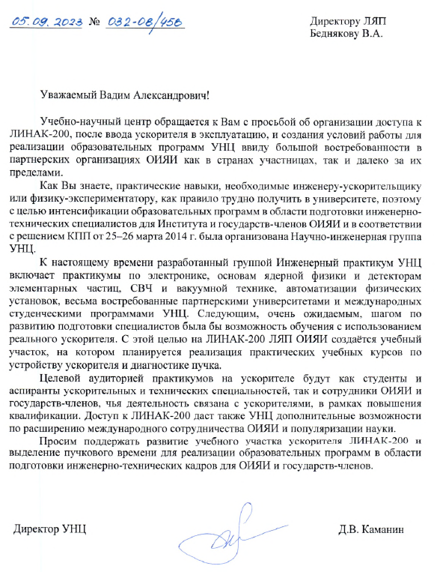
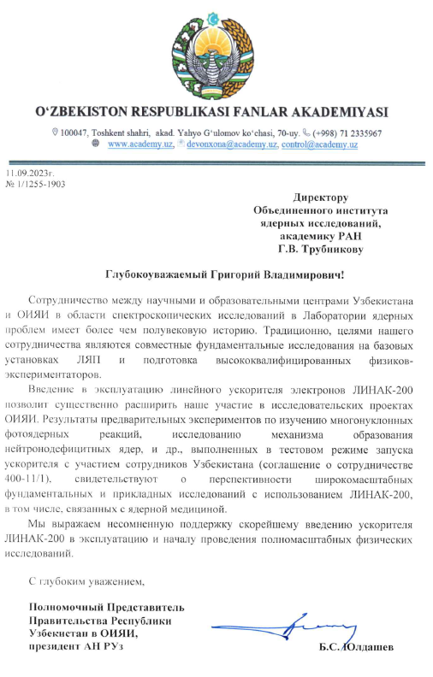
Relevance
Notes:
The JINR laboratories, as well as other scientific organizations, showed interest in experiments with electron beams.
The presence of the electron test beams facility makes it possible to conduct research in various fields:
to carry out particle detectors R&D;
for scientific and methodological research of advanced methods of electron beam diagnostics and creation of equipment for electron beam diagnostics;
for applied research in the field of materials science, radiobiology and radiochemistry;
for conducting experiments in the field of nuclear physics;
and for educational projects.

Slide 5
Main systems of the LINAC-200 accelerator
Electron Gun
Acceleration & RF
Magnetic system
Control system
Beam Diagnostics
Radiation safety system & Interlock and alarm system
Notes:
Main systems of the LINAC-200 accelerator are presented on the slide.
Each system will be discussed in more detail below.

Slide 6
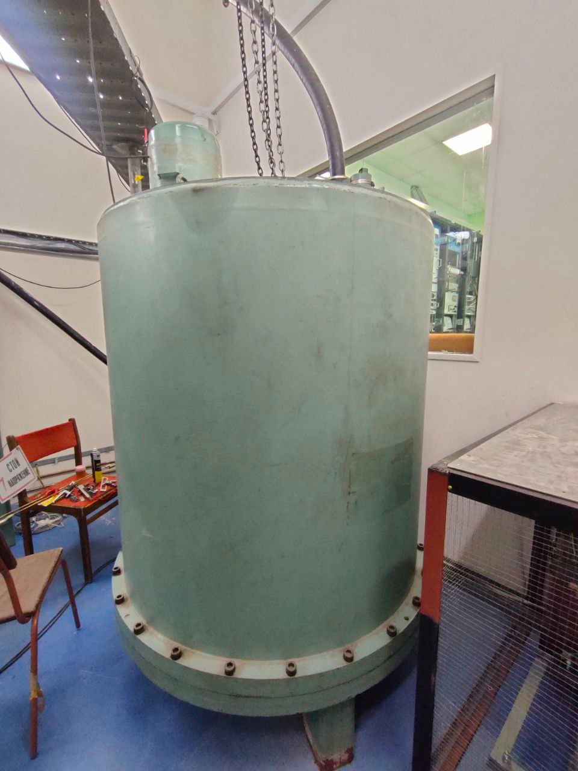
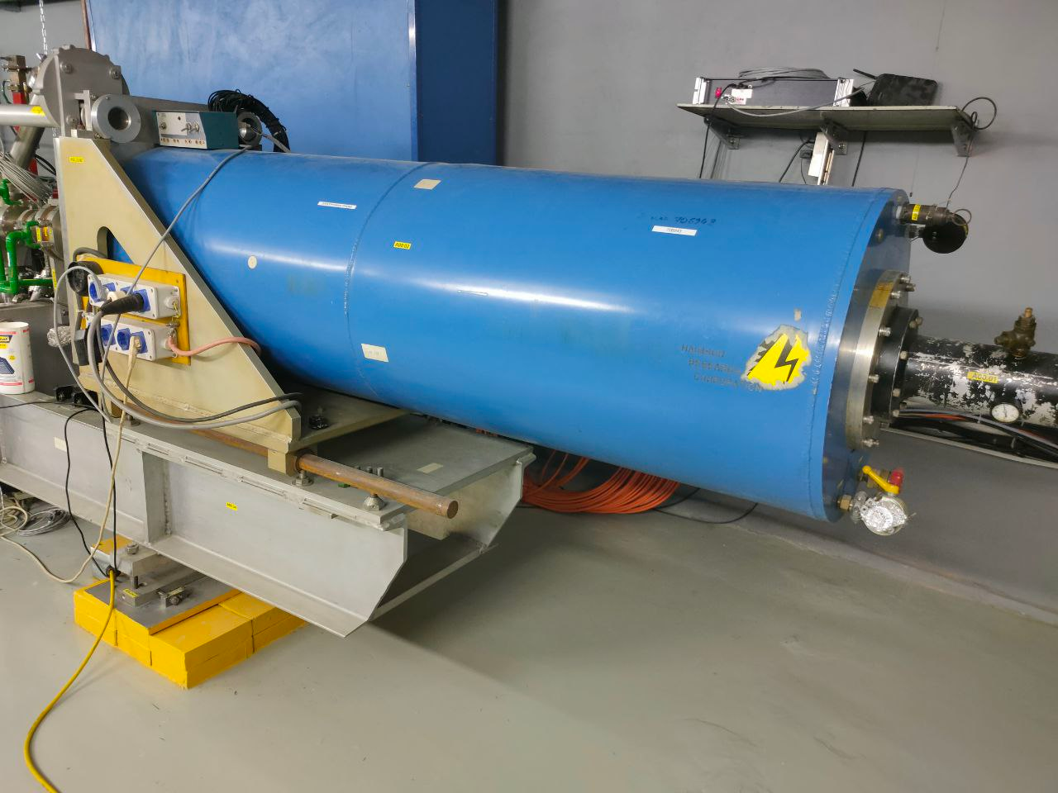
Electron Gun
Type | Thermionic
Max. energy | 400 keV
Peak beam current | 300 mA
Normalized emittance | 8 𝜋 · mm · mrad
Beam diameter | 1,5 mm
A. Trifonov Linear electron accelerator LINAC-200 as a core for a new test beam facility at DLNP JINR
Notes:
400-kV DC triode-type electron gun with a thermionic cathode is used.
Main parameters are presented in the table.
The left figure shows the appearance of the electron gun. The right figure shows the high-voltage power supply for the electron gun.

Slide 7
Acceleration & RF
Total linac length, m | 55
Number of short (3.7 m) sections | 3
Number of long (7.3 m) sections | 4
Frequency, MHz | 2856
Wave type | TW
Field mode | 2π/3
Filling time, μs | 1.3
v_{g}/c range | 0.0093–0.0389
Shunt impedance, MΩ/m | 56.5–48
Iris aperture: diameter, mm | 32–17
thickness, mm | 5.84
Number of klystrons | 4
RF power: peak, MW | 10
mean, kW | 20
Linac-200 modulators hall
A. Trifonov Linear electron accelerator LINAC-200 as a core for a new test beam facility at DLNP JINR
Notes:
Beam is accelerated by the travelling wave structures. Main parameters of the structures are presented in the table.
RF power is provided by the 20-MW Thomson TH 2129 klystrons. Each klystron feeds two accelerating sections. The exception is the first one, which feeds one accelerating section and bunching devices. Due to the modulator limitations only half of the klystrons peak power is used (i.e. each accelerating section receives 5MW of RF power).

Slide 8
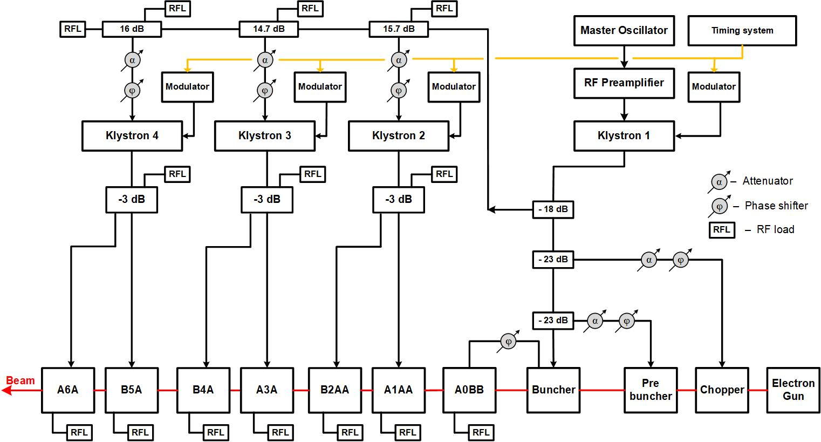
Functional diagram of the RF system
A. Trifonov Linear electron accelerator LINAC-200 as a core for a new test beam facility at DLNP JINR
Notes:
In the pre-excitation system of the microwave power supply of the accelerator, the serial generator SG384 of Stanford Research Systems is used as the initial frequency synthesizer, which produces a signal of the main accelerating frequency of 2856 MHz of low power.
The signal of 2856 MHz is amplified in power to 100 W. To amplify the signal to 100 W, a self-developed preamplifier is used - a preliminary power amplifier (UMP-300).
The RF signal amplified to 100 W excites the first klystron, the main part of whose power is used to power the chopper, prebuncher, buncher and the first section of the accelerator.
Through the attenuator (18 dB), part of the RF power of the first klystron is distributed by a rectangular waveguide along the klystrons of the accelerator stations.

Slide 9
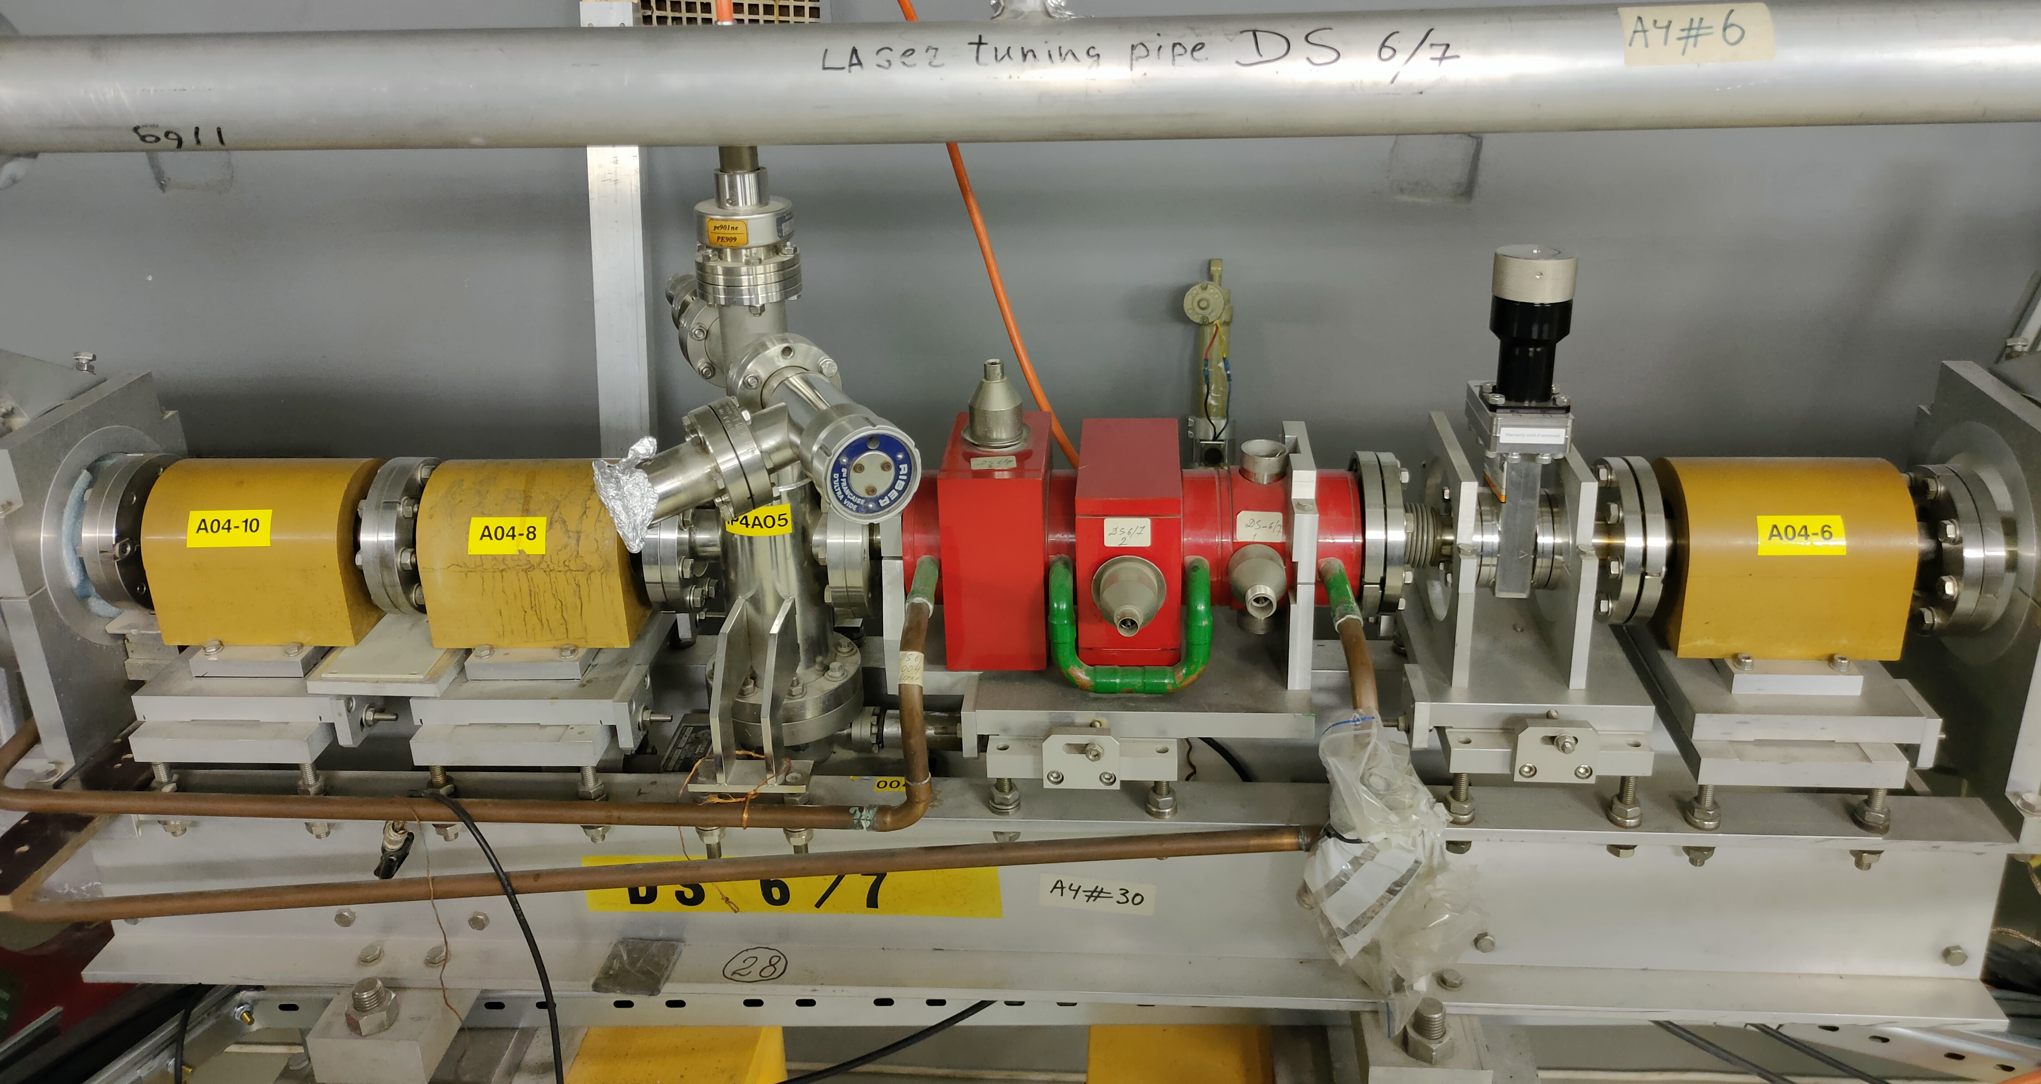
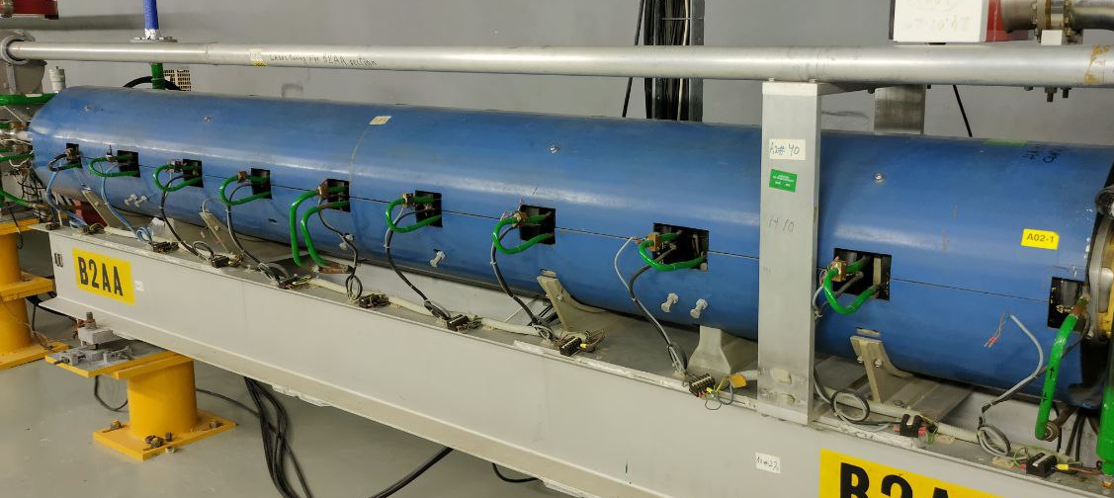
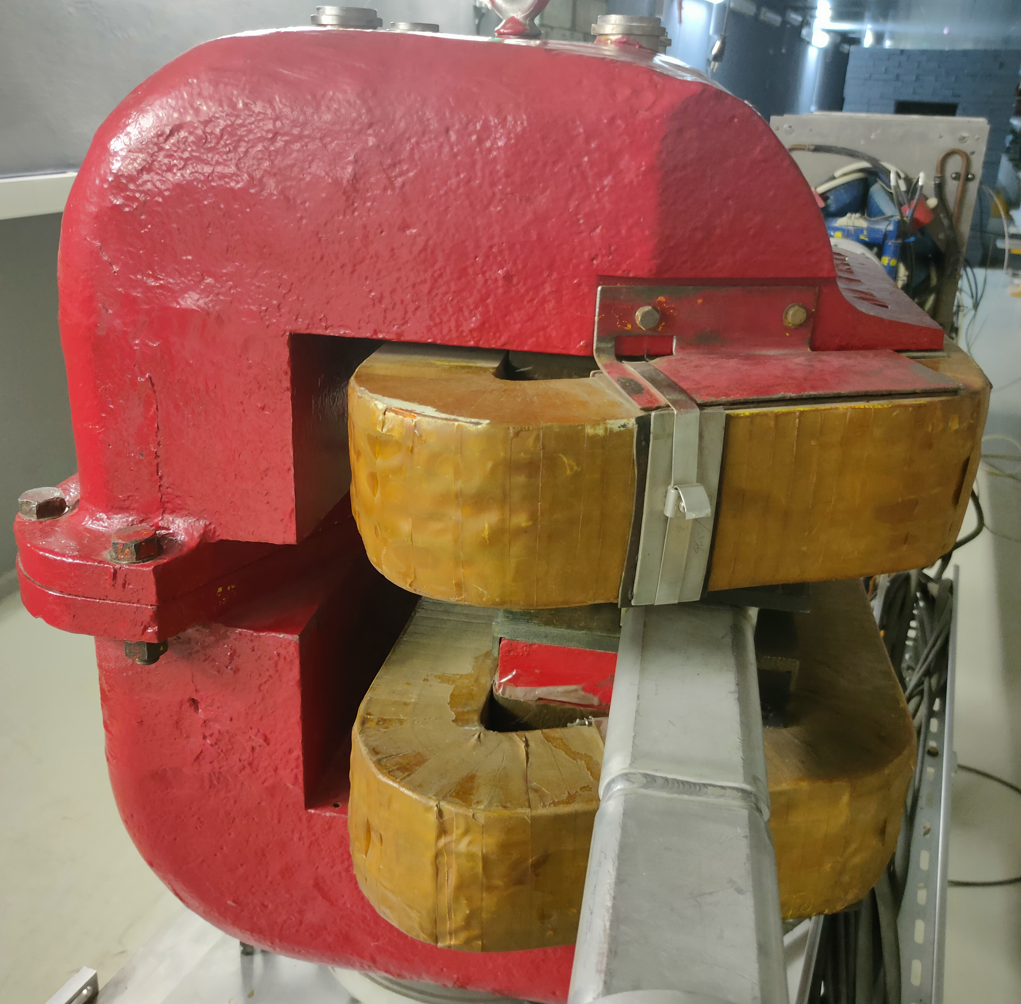
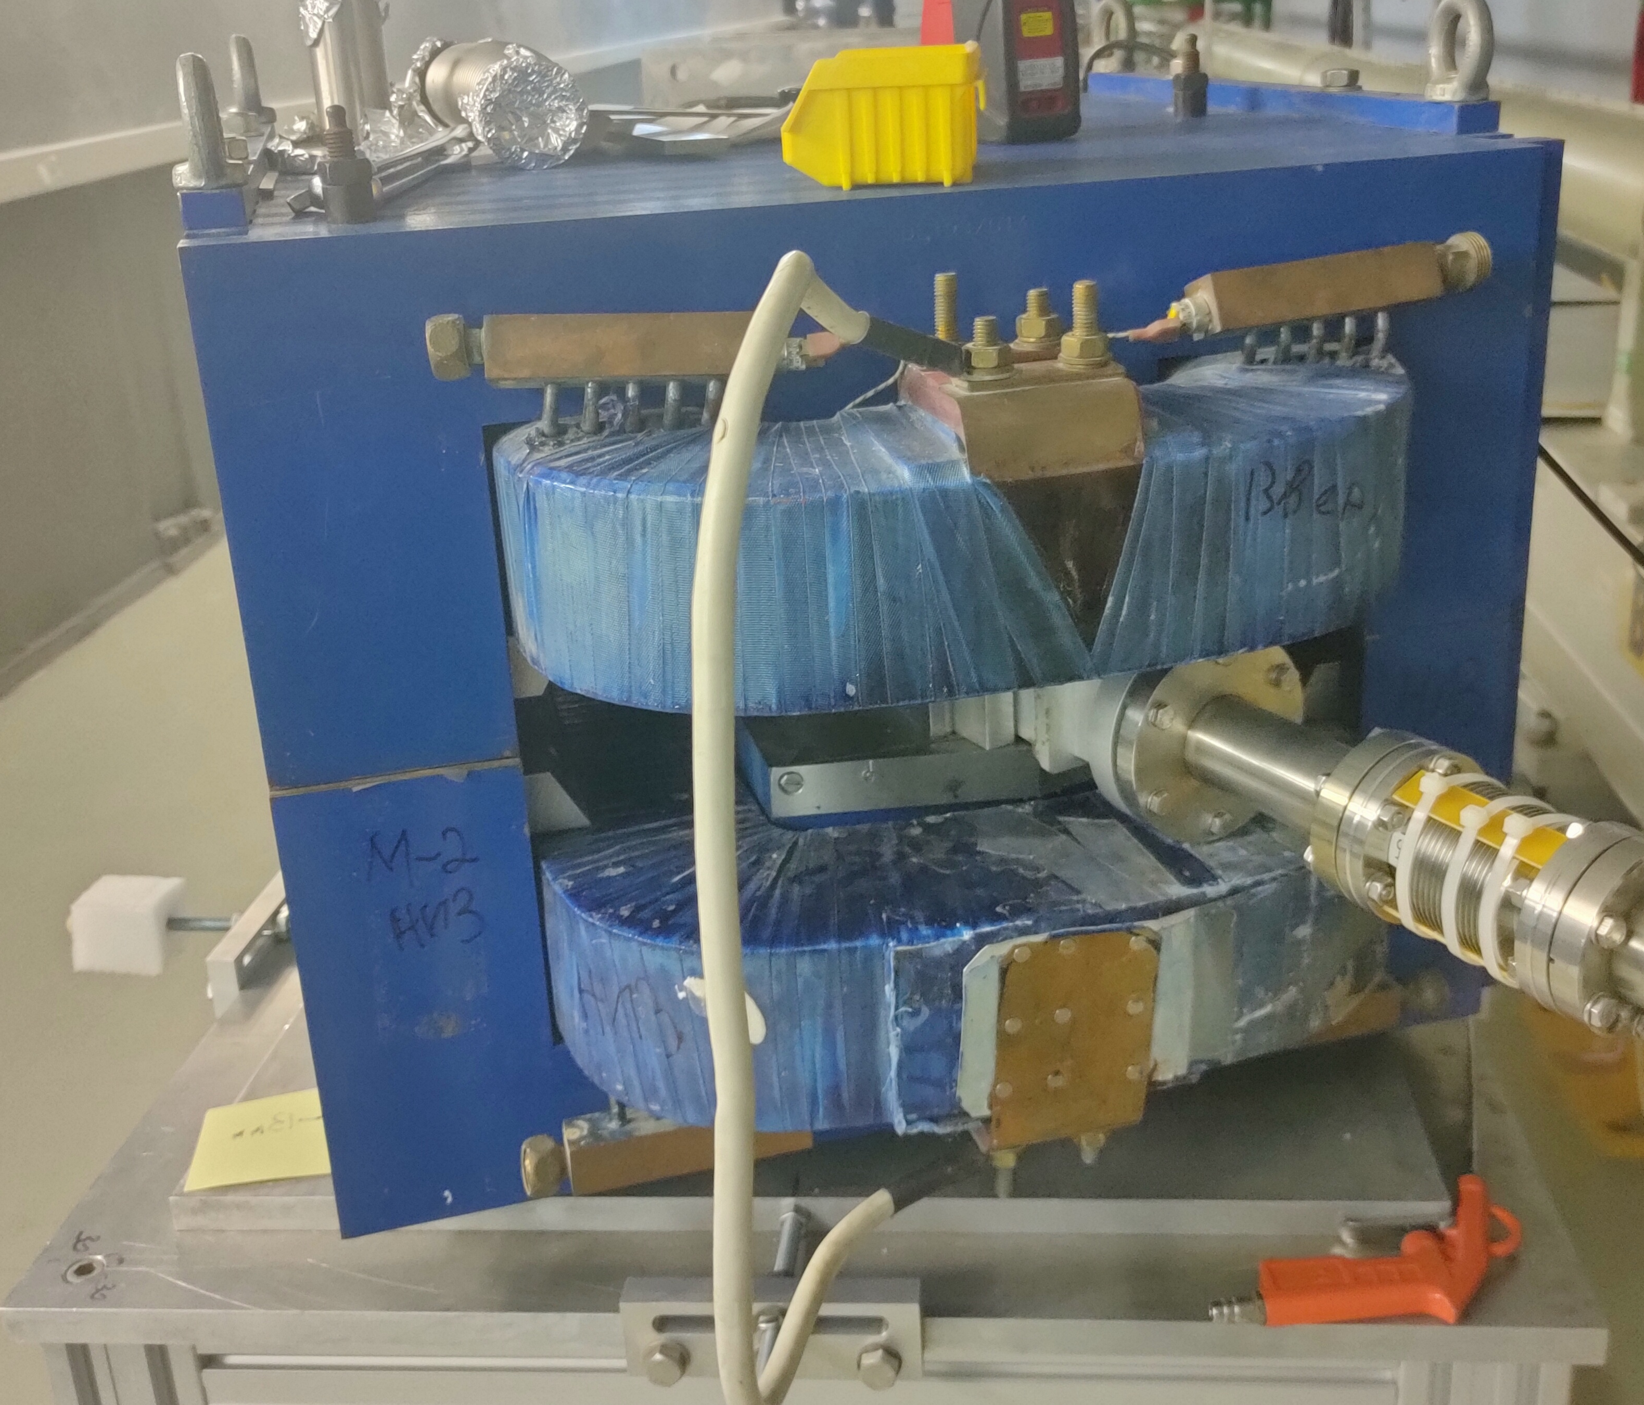
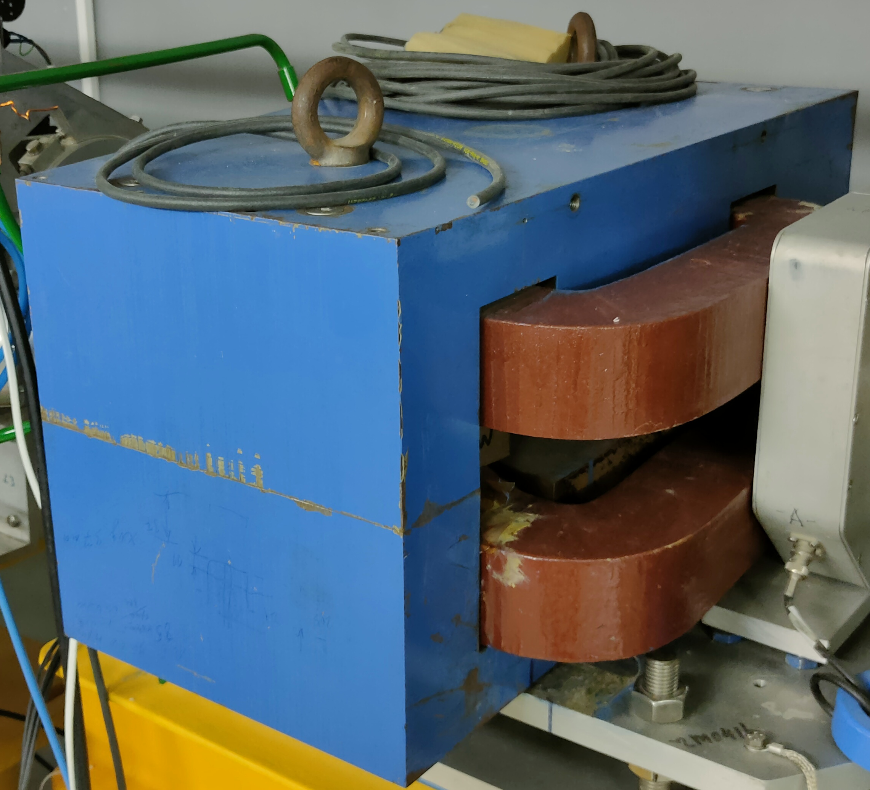
Magnetic system
Steerers (X, Y)
Solenoidal Focusing
Quadrupoles
A. Trifonov Linear electron accelerator LINAC-200 as a core for a new test beam facility at DLNP JINR
Notes:
Steerers for positioning the beam.
Quadrupole and solenoidal focusing.
Dipole magnets used as a bending magnets for extract the beam at the extraction points.

Slide 10
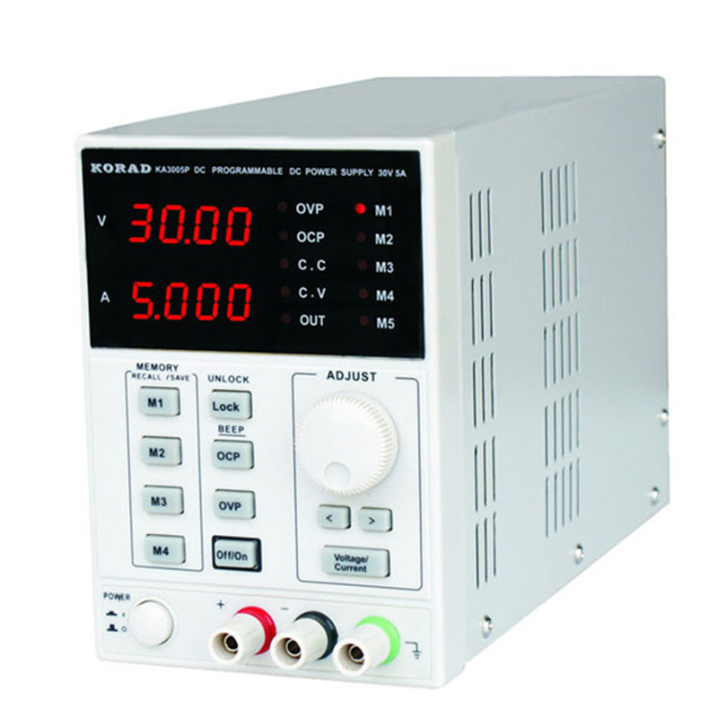
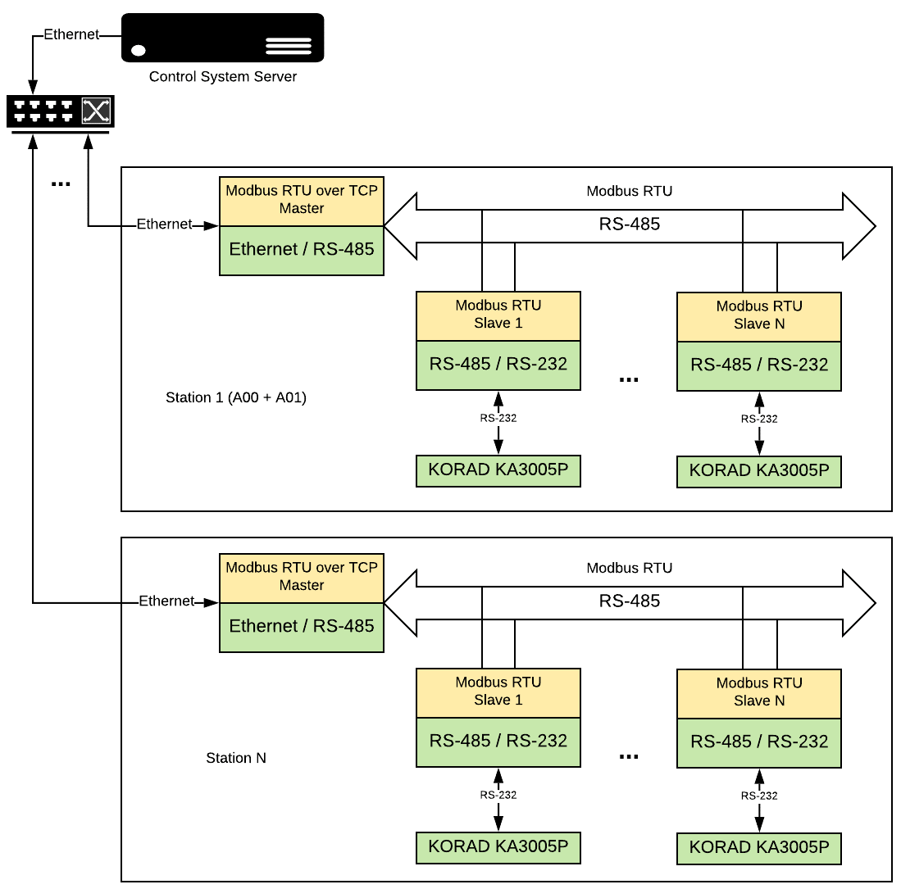
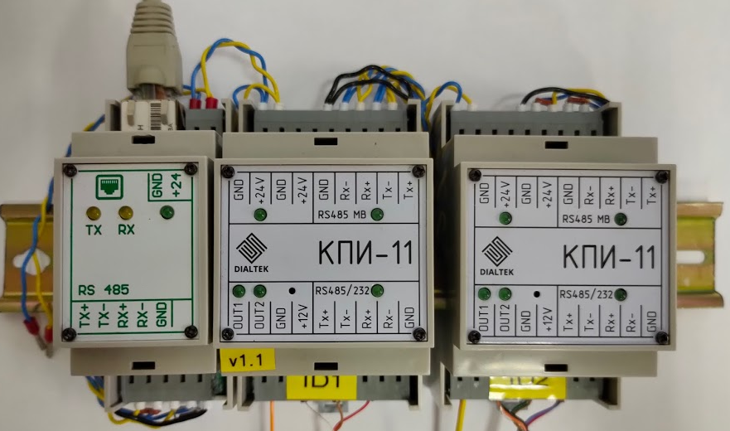
Focusing and Steering Magnets Control
24 KORAD power supplies
22 (30 V, 5 A)
2 (60 V, 3 A)
Ethernet to RS485 converter
Modules for communication with power supplies
Magnetic element control system layout
A. Trifonov Linear electron accelerator LINAC-200 as a core for a new test beam facility at DLNP JINR
Notes:
Magnetic elements are used to focus and steer the position of the beam, which are mainly required to reduce the loss of particles during acceleration. Focusing is carried out using solenoidal and quadrupole lenses. Steering magnets are used to adjust the position of the beam relative to the accelerator axis.
For powering magnetic lenses and steering magnets are used Korad power supplies.
Korad power supplies have interfaces, which are unsuitable for data transmission over long distances. And these power supplies also don't support standard communication protocols. Therefore, to control Korad power supplies were designed and manufactured specific intelligent interface modules.
Magnetic elements control system scheme is presented on this slide.
Data exchange between this system and the global control system is implemented using Modbus RTU over TCP protocol. Since the existing Tango class does not support this protocol, a new class to handle the Modbus protocol was implemented base on the PyModbus library.

Slide 11
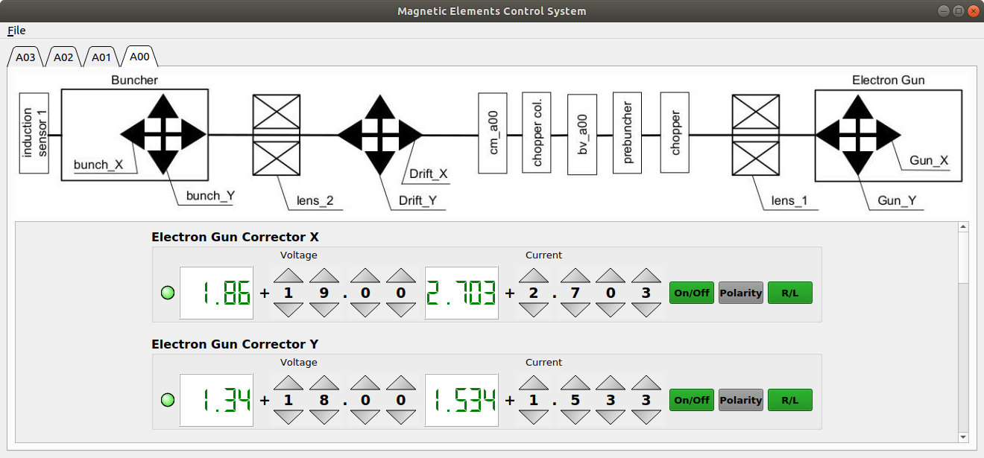
Focusing and Steering Magnets Control
A. Trifonov Linear electron accelerator LINAC-200 as a core for a new test beam facility at DLNP JINR
Notes:
This is a graphical user interface application (TANGO client) for controlling Focusing and Steering magnetic system.

Slide 12
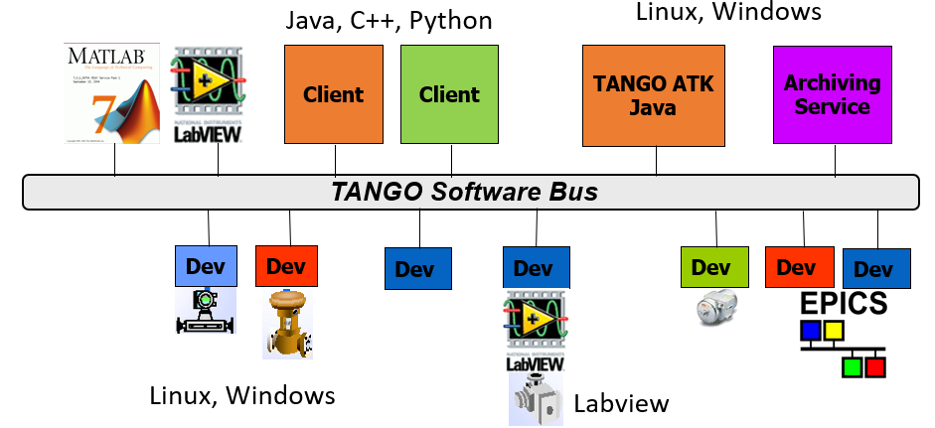
TANGO-based Control System
Official website: https://www.tango-controls.org/
A. Trifonov Linear electron accelerator LINAC-200 as a core for a new test beam facility at DLNP JINR
Notes:
TANGO – open-source distributed control system framework for controlling any kind of hardware or software, from small laboratory setups to large-scale scientific facilities.
Advantages:
Open-Source – developed under the GNU General Public License (GPL), TANGO is freely available to use, modify, and distribute.
Scalability – designed to handle systems of any size, from single devices to complex installations spanning multiple locations.
Interoperability – supports integration with a wide range of programming languages and communication protocols, ensuring compatibility with diverse hardware and software components.
Flexibility – offers a microservice architecture that allows customization and extension to suit specific requirements.
Tango software could be split on device servers and client applications. Device servers communicate directly with hardware or with different software systems via specific protocols. Client applications provide a graphic user interface for interacting with device servers.
Tango was chosen because it is flexible and highly scalable. And because our colleges from Veksler and Baldin Laboratory of High Energy Physics use it for implementing a NICA Collider control system.

Slide 13
Control System Concept
A
Graphical user interface
Beam users equipment
TANGO Clients Software
Beam users software
Data transmission channels (1 GbE, RS-485)
ADC
TANGO Software Bus
Analog signals
Digital signals
Controlling accelerator elements
Control system servers (Linux)
...
...
...
TANGO device servers
TANGO Database
TANGO Database
backup
Data archiving
...
...
...
LINAC-200
A
A. Trifonov Linear electron accelerator LINAC-200 as a core for a new test beam facility at DLNP JINR
Notes:
Concept of the control system.
Conditionally, the system can be divided into 3 levels:
hardware access level,
server level,
client level.
At the hardware access level, digital and analog signals are collected and analog signals are converted to digital. This level also includes all equipment that needs to be controlled.
The hardware access layer is connected to the server layer through data transmission channels.
The server level is required for the effective collection, processing and storage of data from the elements of the hardware access level, as well as for the implementation of subsystems control algorithms.
The client layer provides GUI for monitoring and controlling various parameters of the accelerator.
Also, it is possible to transfer the necessary data to the beam users.

Slide 14
Local Control
Local done with the Weintek MT8071iP operator panel.
In addition to displaying the local control graphical interface, the Weintek MT8071iP panel acts as a Modbus server.
A. Trifonov Linear electron accelerator LINAC-200 as a core for a new test beam facility at DLNP JINR
Notes:
Local control is available for modulator control units and phase shifters. It’s done with HMI touch panel by Weintek company.
In addition to displaying the local control graphical interface, the Weintek panel acts as a Modbus server. Slave devices are connected to the panel by means of RS-485 interface according to Modbus RTU protocol. Data is transmitted to the Tango-based global control system via Ethernet using Modbus TCP and Modbus RTU over TCP protocols.
The other subsystems have the ability to control locally directly from the equipment.

Slide 15
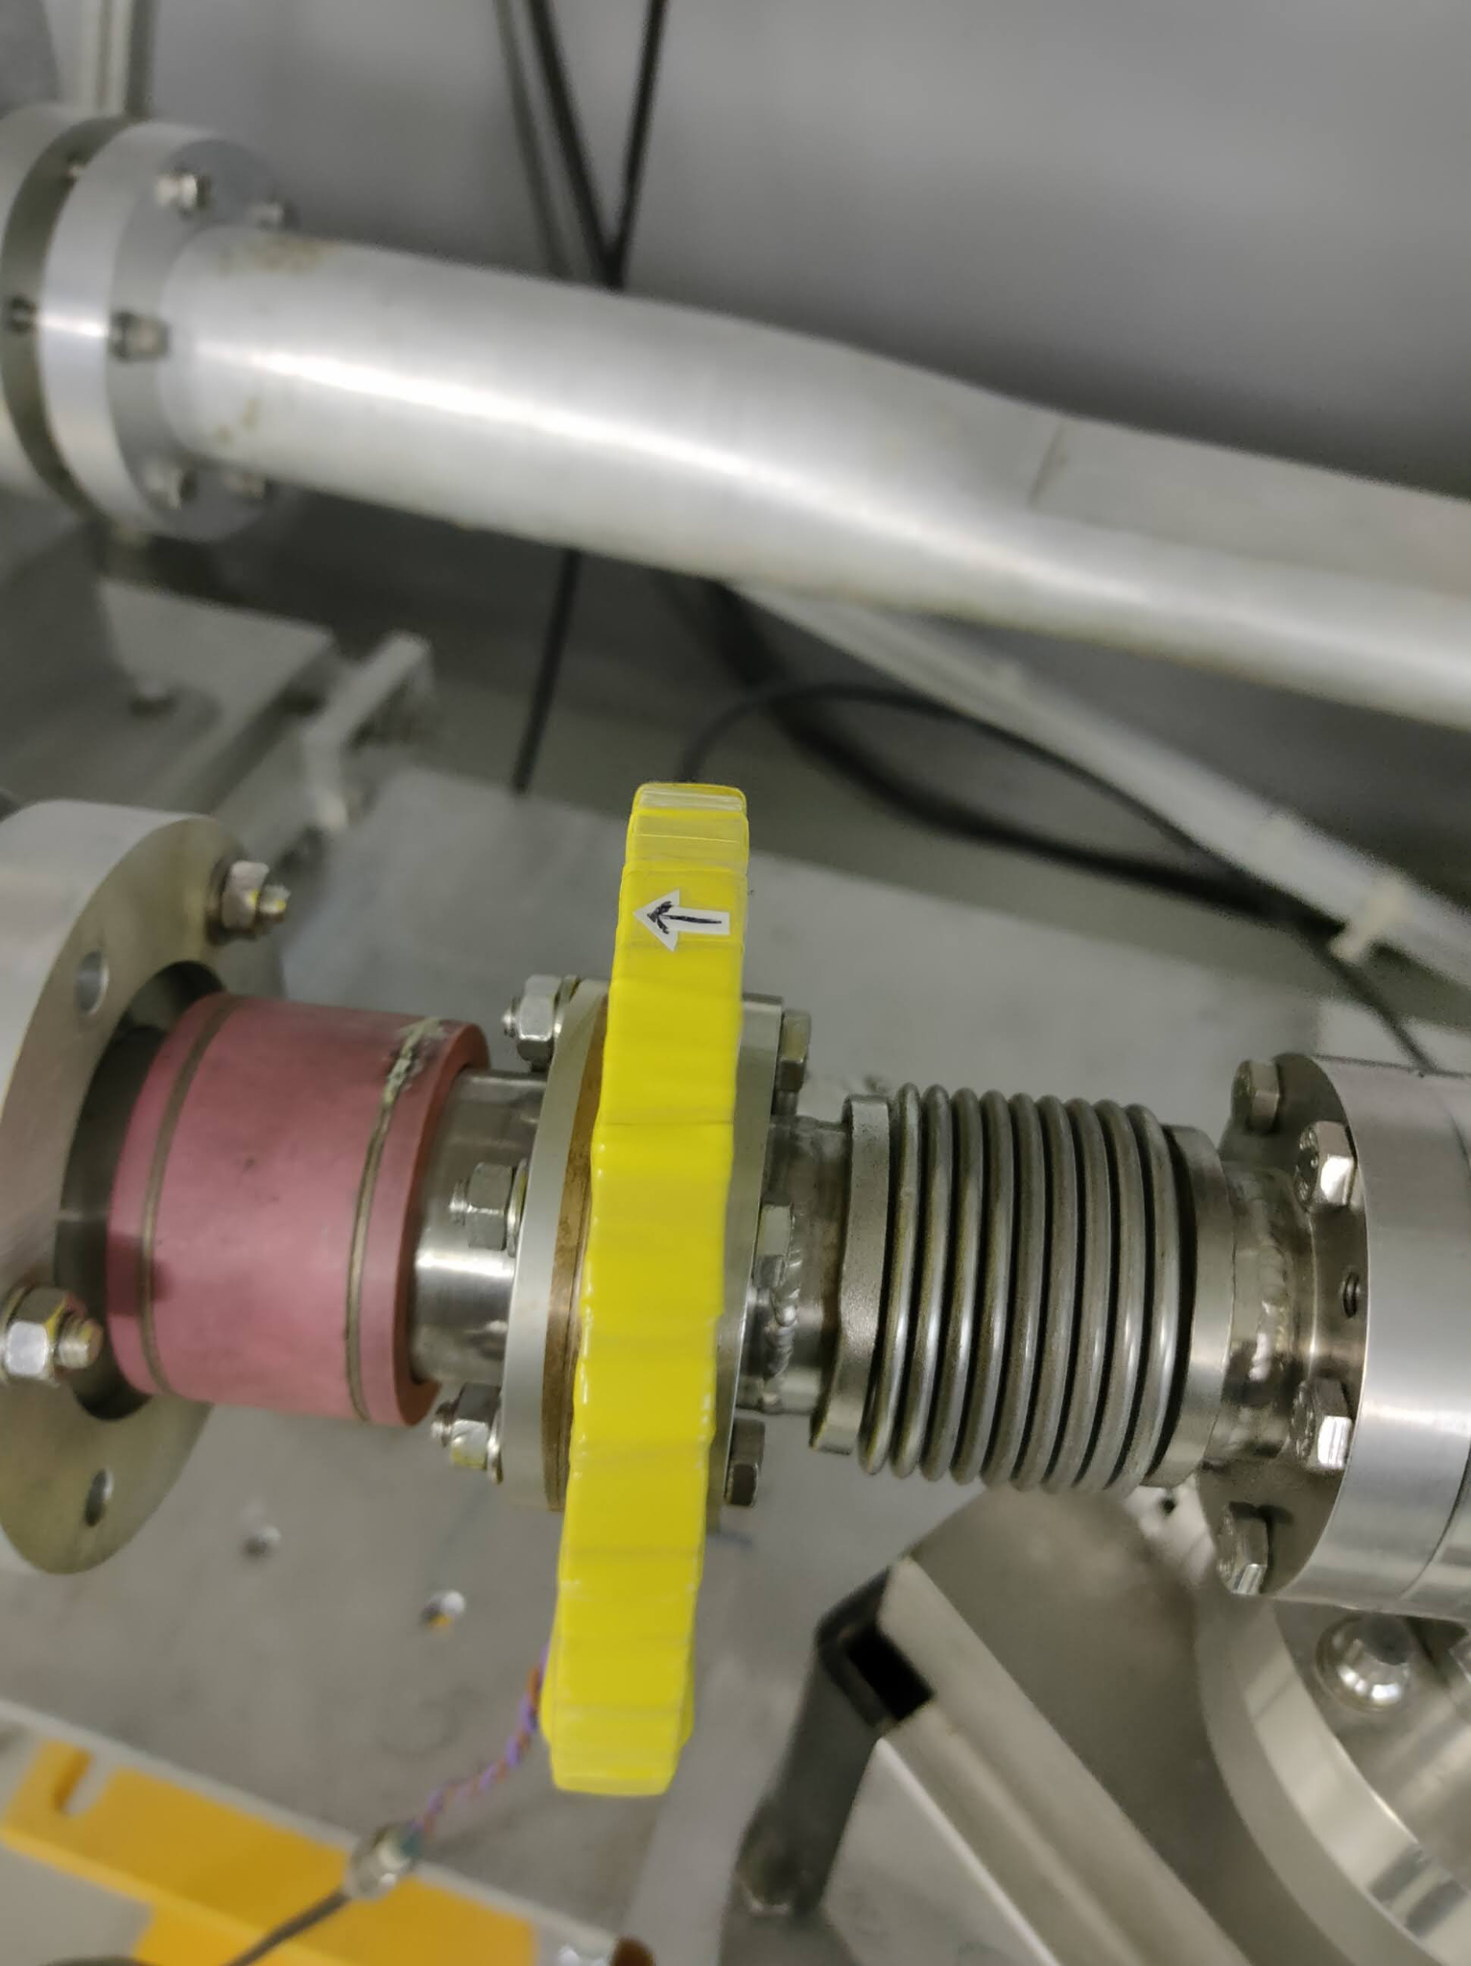
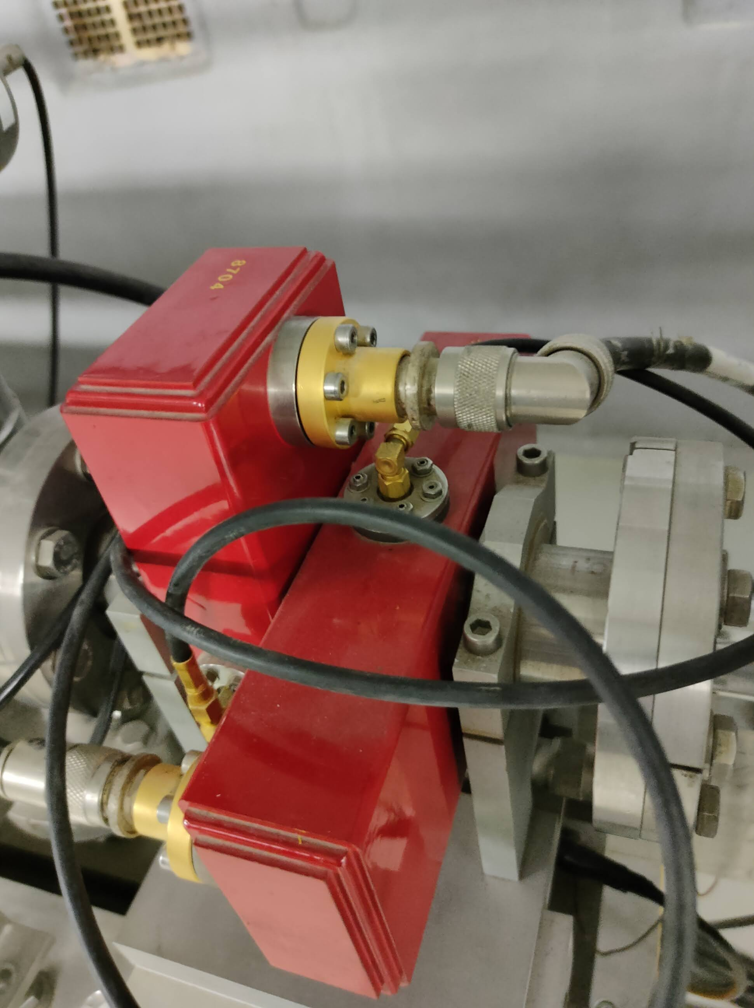
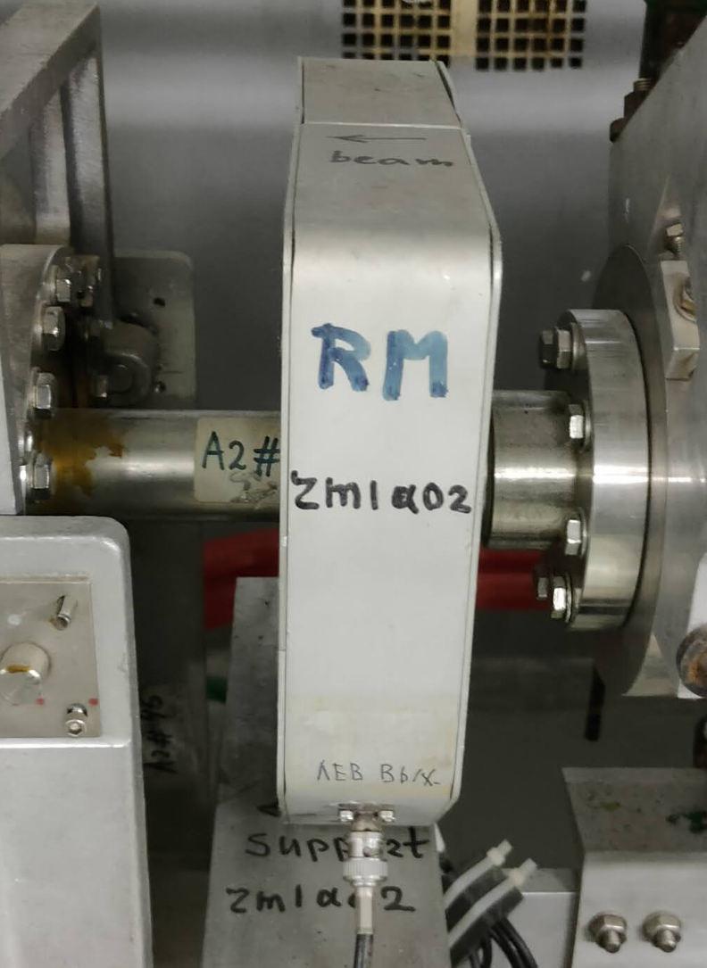
Diagnostics
Beam current transformer
Compton radiation monitor
Traveling wave monitor (TWM)
A. Trifonov Linear electron accelerator LINAC-200 as a core for a new test beam facility at DLNP JINR
Notes:
At the moment for beam diagnostics we are use:
Compton radiation monitors to detect major beam trajectory errors.
Current transformers for current measurement in the operation mode.
Traveling wave monitors allow to define both beam current and position. (Work with TWM in progress)
Beam viewers with scintillator screens and video cameras.

Slide 16
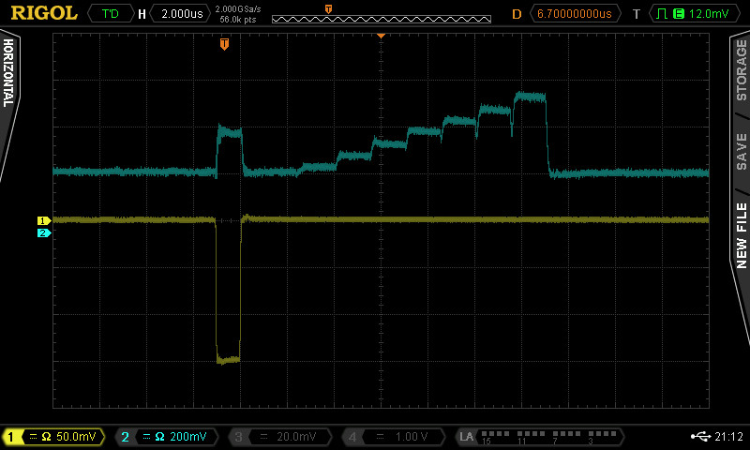
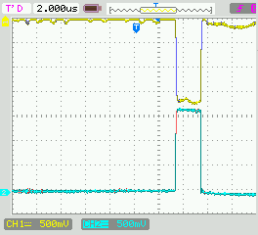
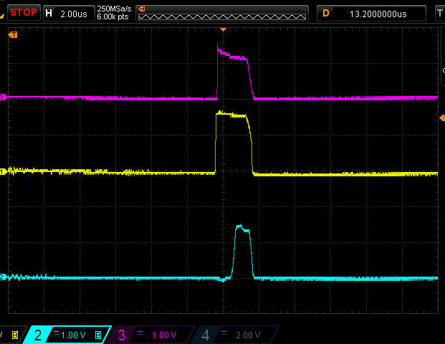
Beam Diagnostics
Signal from Gun electronics
TWM signal
80 mA @ buncher
80 mA @ A04
130 mA @ Electron Gun
80 mA @ A01
75 mA @ EP2
A. Trifonov Linear electron accelerator LINAC-200 as a core for a new test beam facility at DLNP JINR
Notes:
The slide shows oscillograms of a number of signals from the accelerator. The oscillograms show high current throughput.
The current after the electron gun does not travel all the way to the first accelerating section because of a specially installed collimator. The collimator is needed to limit the current because the accelerating sections have a limit on the maximum charge they can accelerate.

Slide 17
The software for data acquisition from Rigol DS1000Z and MSO/DS4000
►Control Module communicates with the oscilloscope to control various settings, including turning specific channels on and off, adjusting horizontal and vertical scale values, and capturing screenshots of the oscilloscope display. The backend for the control module is implemented using Django, which handles communication with the oscilloscope via Ethernet. It processes incoming HTTP requests from the React frontend to control the oscilloscope settings and returns the updated status.
►Visualization Module fetches waveform data from the oscilloscope and displays it. The use of sockets ensures quick data transfer and updates, enhancing the reliability and responsiveness of the visualization module. Flask is used to handle socket connections for real-time data fetching, providing a reliable two-way communication channel between the oscilloscope and the application.
►Data Archiving Module is developed using Flask and Python, with PostgreSQL and Timescale DB for data storage. This module provides functionalities to save oscilloscope data to the database and retrieve it based on specified IP addresses, start times, and end times.
A. Trifonov Linear electron accelerator LINAC-200 as a core for a new test beam facility at DLNP JINR
Notes:
Most of the signals from the Accelerator Diagnostic System sensors are connected to Rigol oscilloscopes.
A system for the acquisition of data from these oscilloscopes are under development. This system has 3 main modules:
Control Module communicates with the oscilloscope to control various settings, including turning specific channels on and off, adjusting horizontal and vertical scale values, and capturing screenshots of the oscilloscope display. The backend for the control module is implemented using Django, which handles communication with the oscilloscope via Ethernet. It processes incoming HTTP requests from the React frontend to control the oscilloscope settings and returns the updated status.
Visualization Module fetches waveform data from the oscilloscope and displays it. The use of sockets ensures quick data transfer and updates, enhancing the reliability and responsiveness of the visualization module. Flask is used to handle socket connections for real-time data fetching, providing a reliable two-way communication channel between the oscilloscope and the application.
Data Archiving Module is developed using Flask and Python, with PostgreSQL and Timescale DB for data storage. This module provides functionalities to save oscilloscope data to the database and retrieve it based on specified IP addresses, start times, and end times.

Slide 18
The software for data acquisition from Rigol DS1000Z and MSO/DS4000
A. Trifonov Linear electron accelerator LINAC-200 as a core for a new test beam facility at DLNP JINR
Notes:
Graphical user interface of the software for data acquisition from Rigol DS1000Z and MSO/DS4000 are presented on this slide.

Slide 19
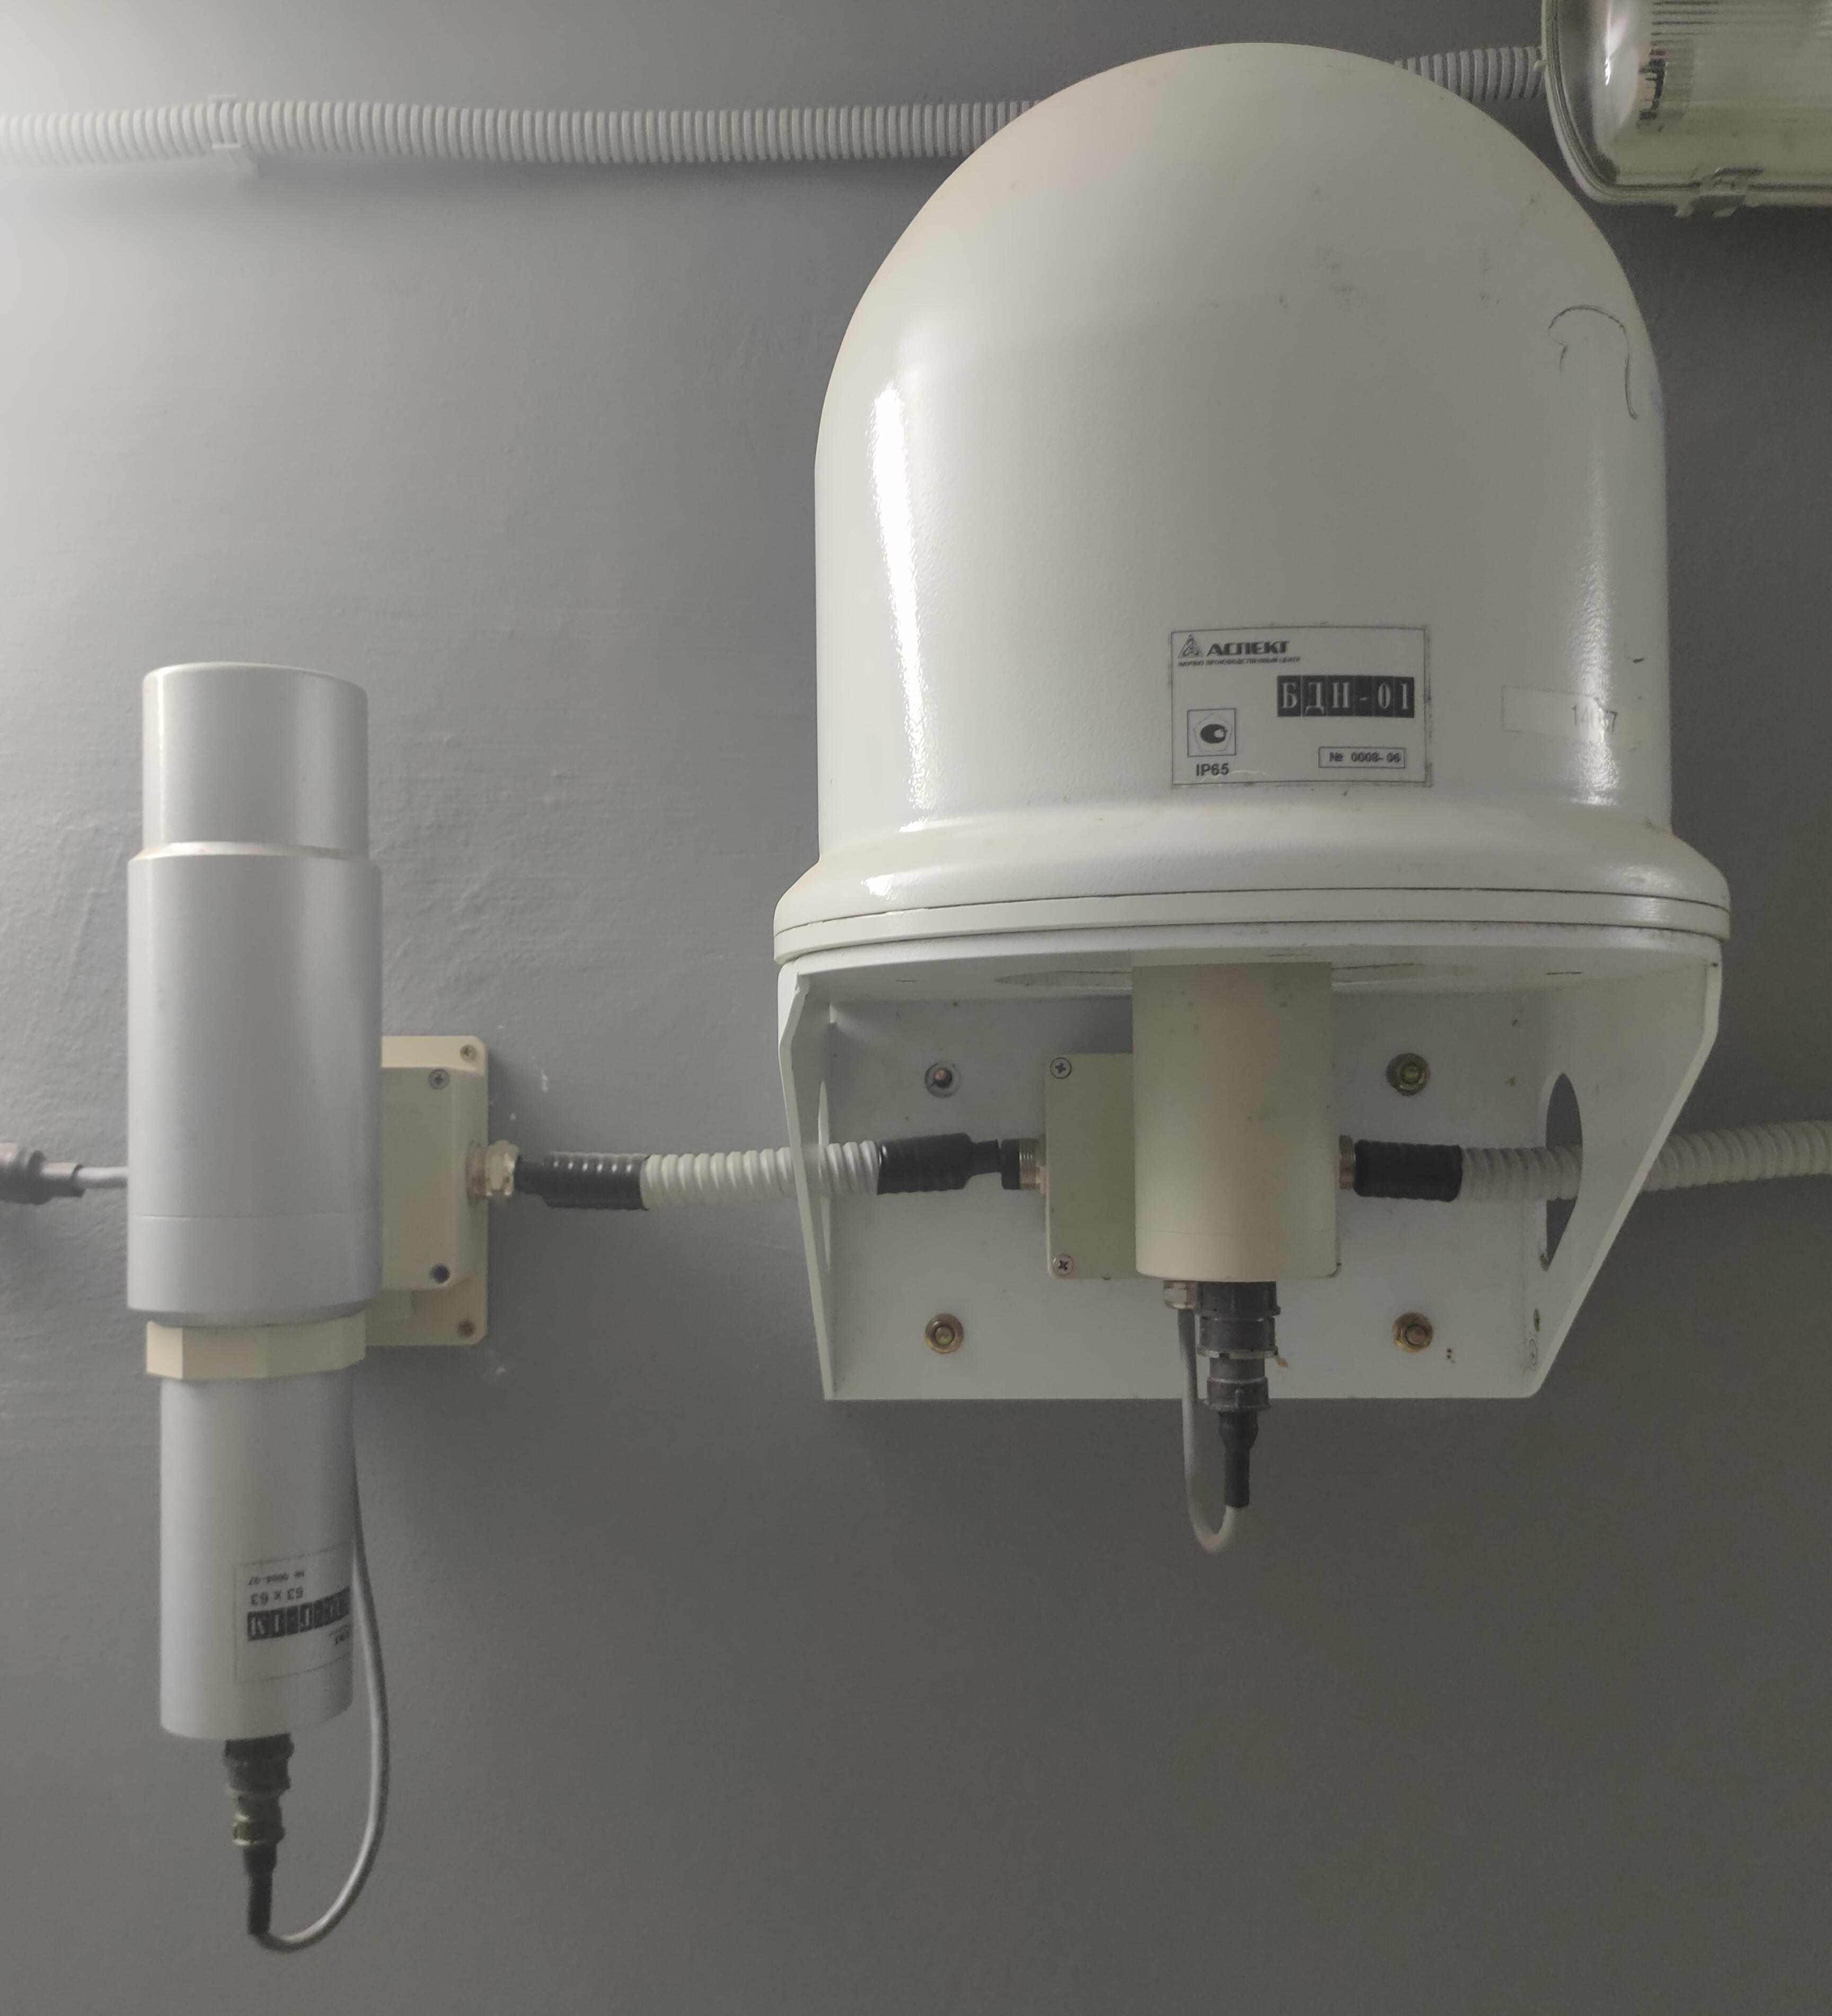
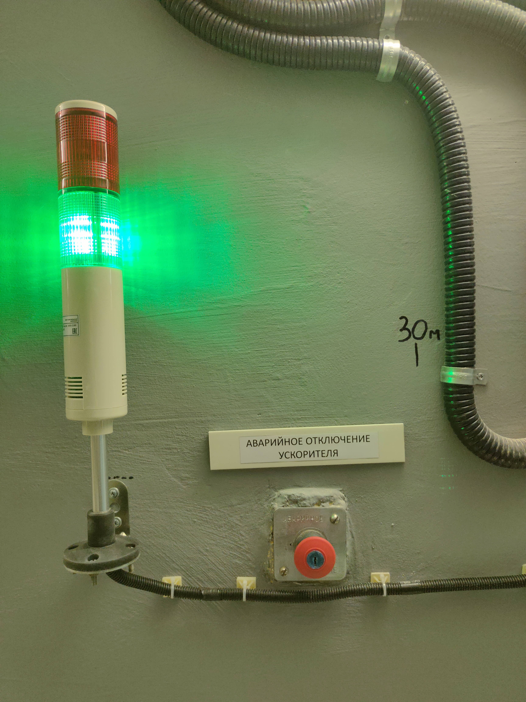
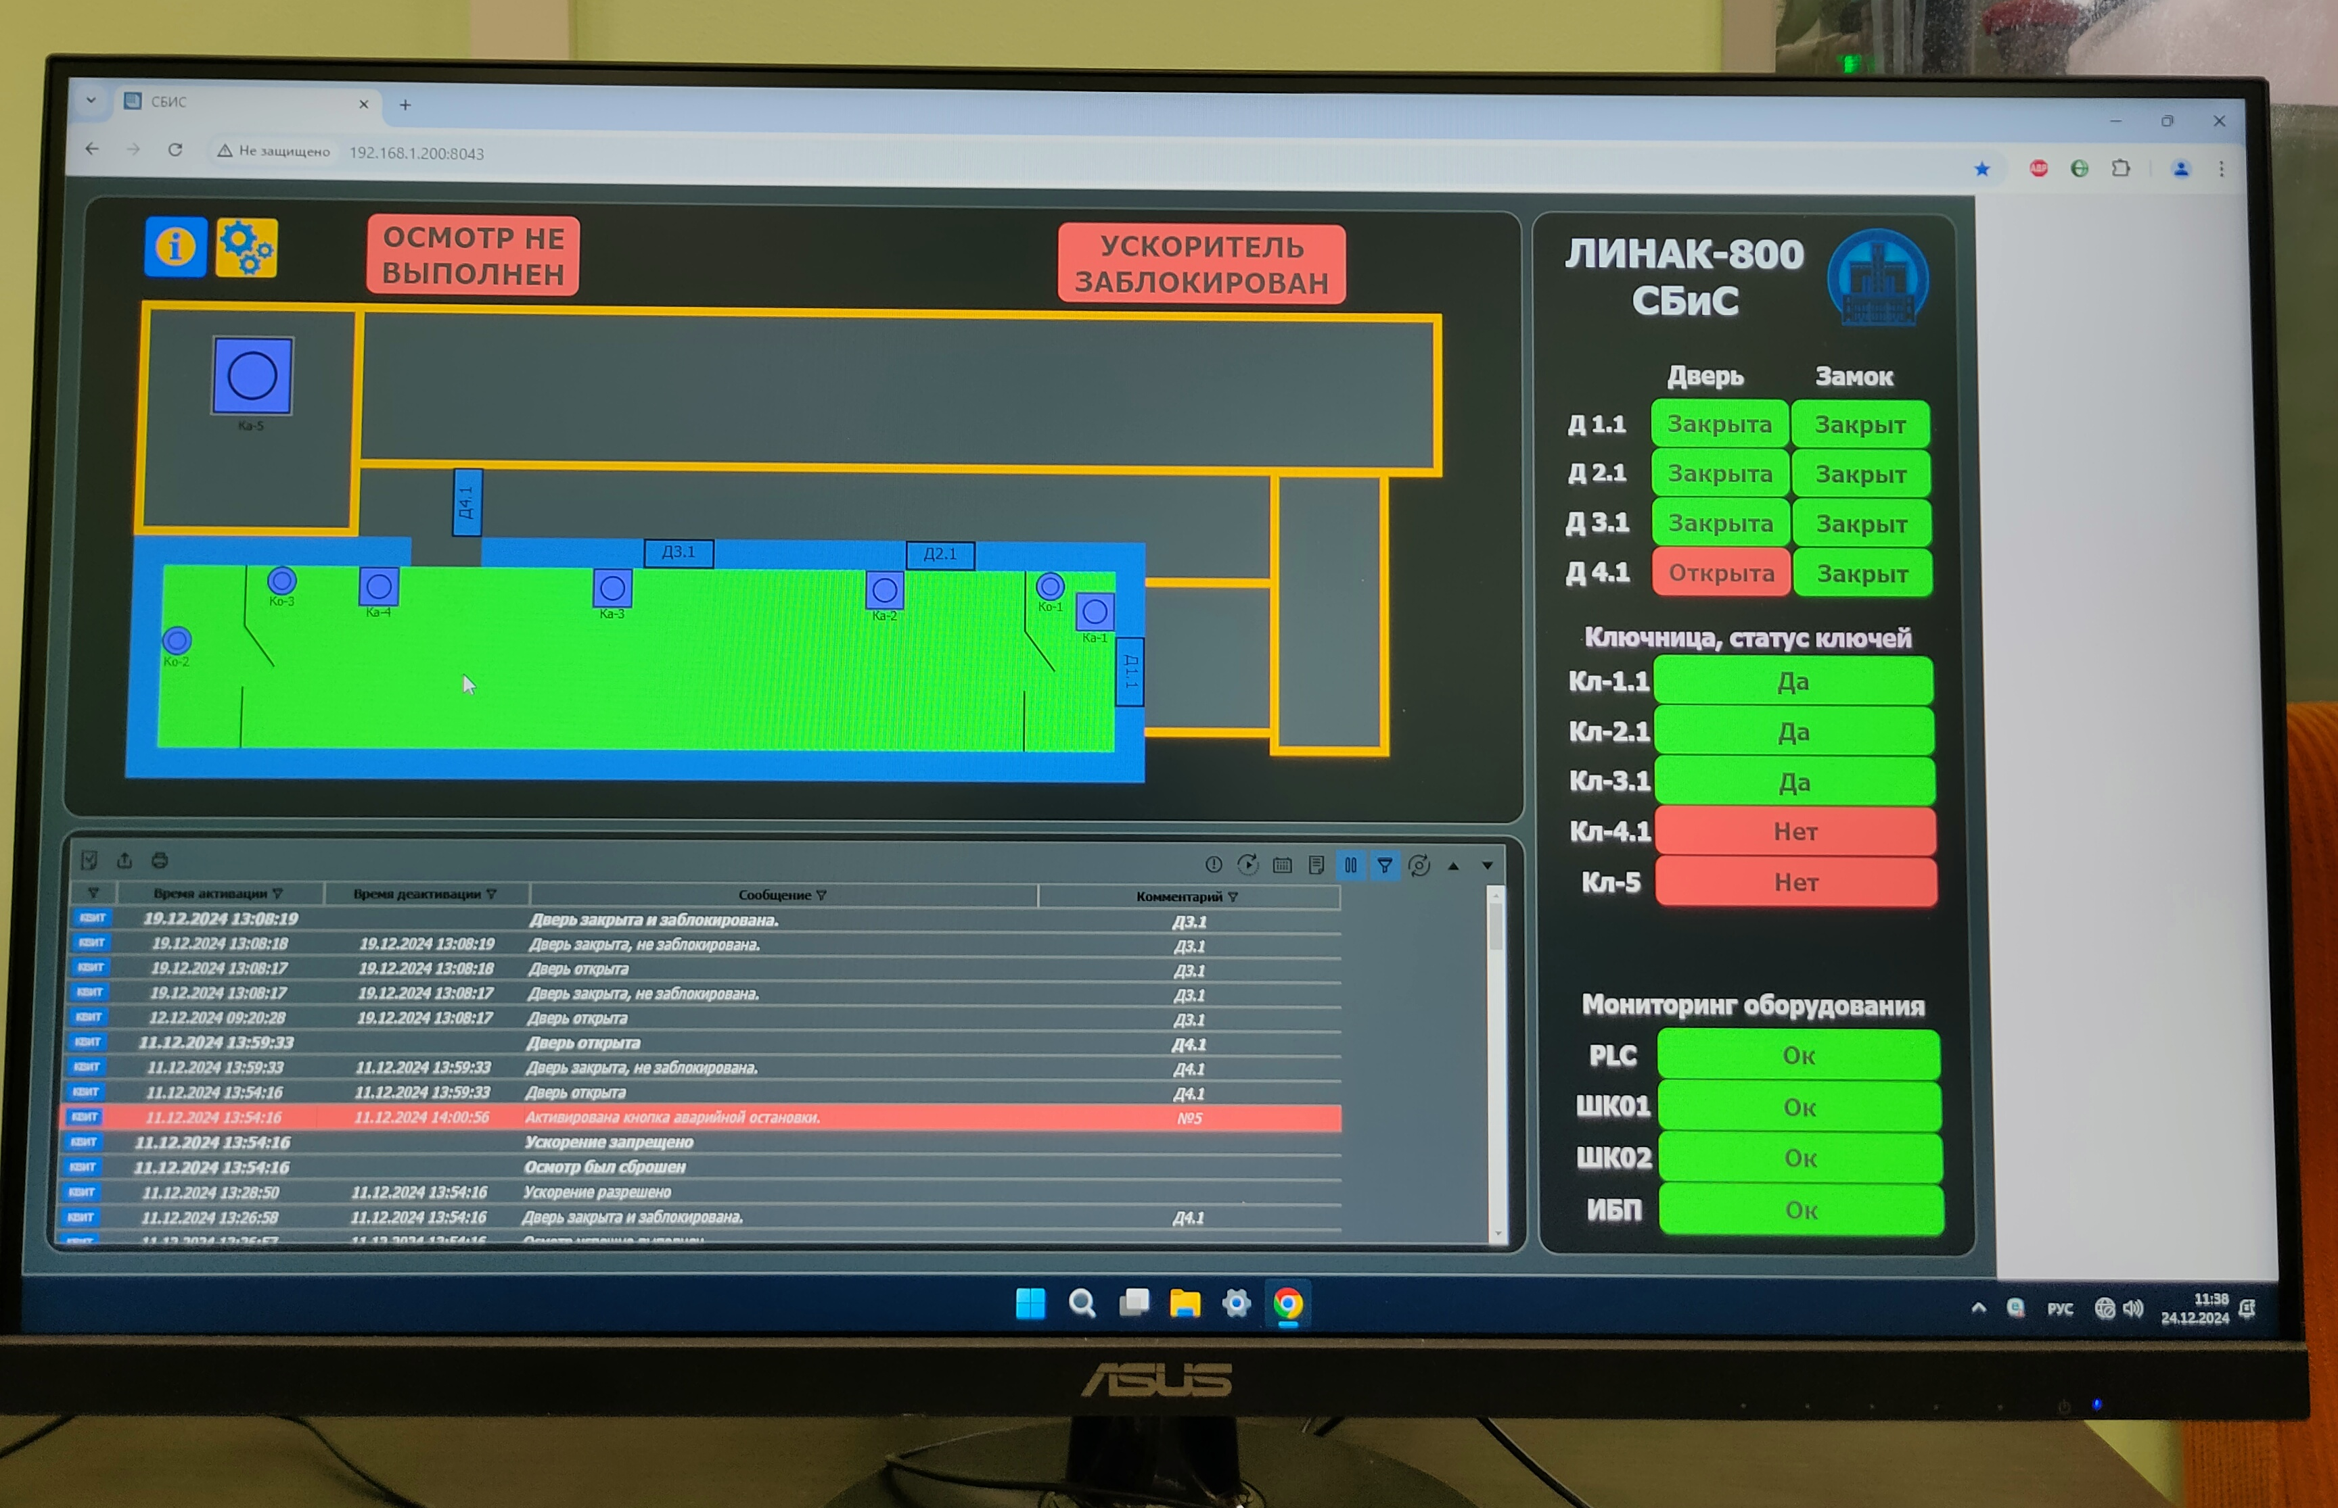
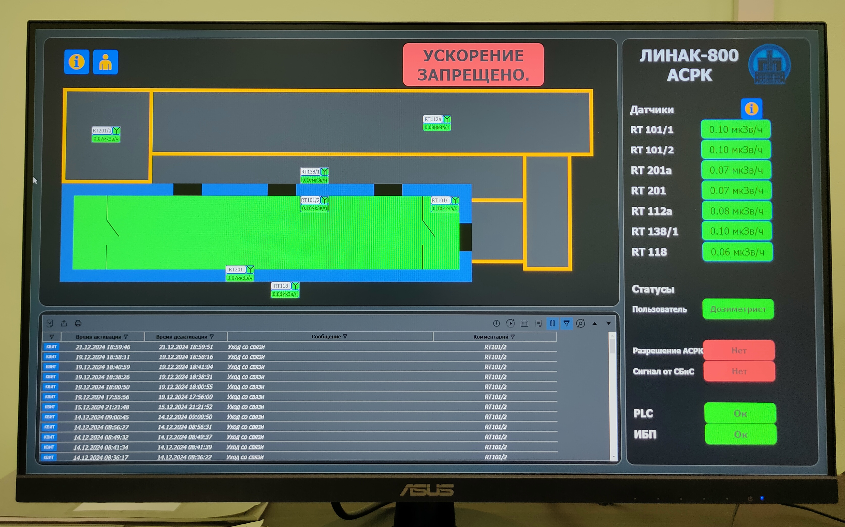
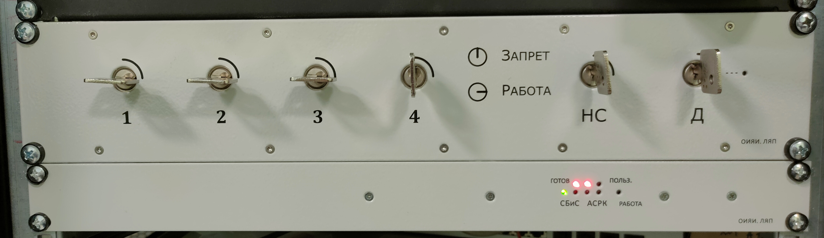
Radiation safety system & Interlock and alarm system
Notes:
The development of new Radiation Safety System and Interlock and Alarm System was completed, and beam absorbers in the accelerator hall were designed and installed.

Slide 20
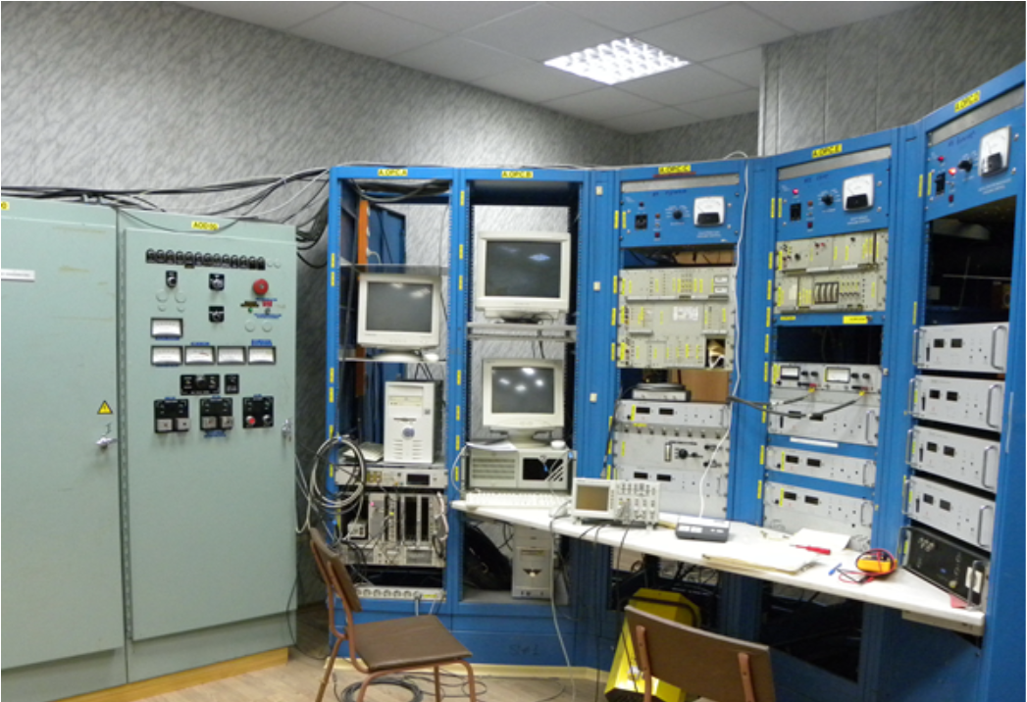
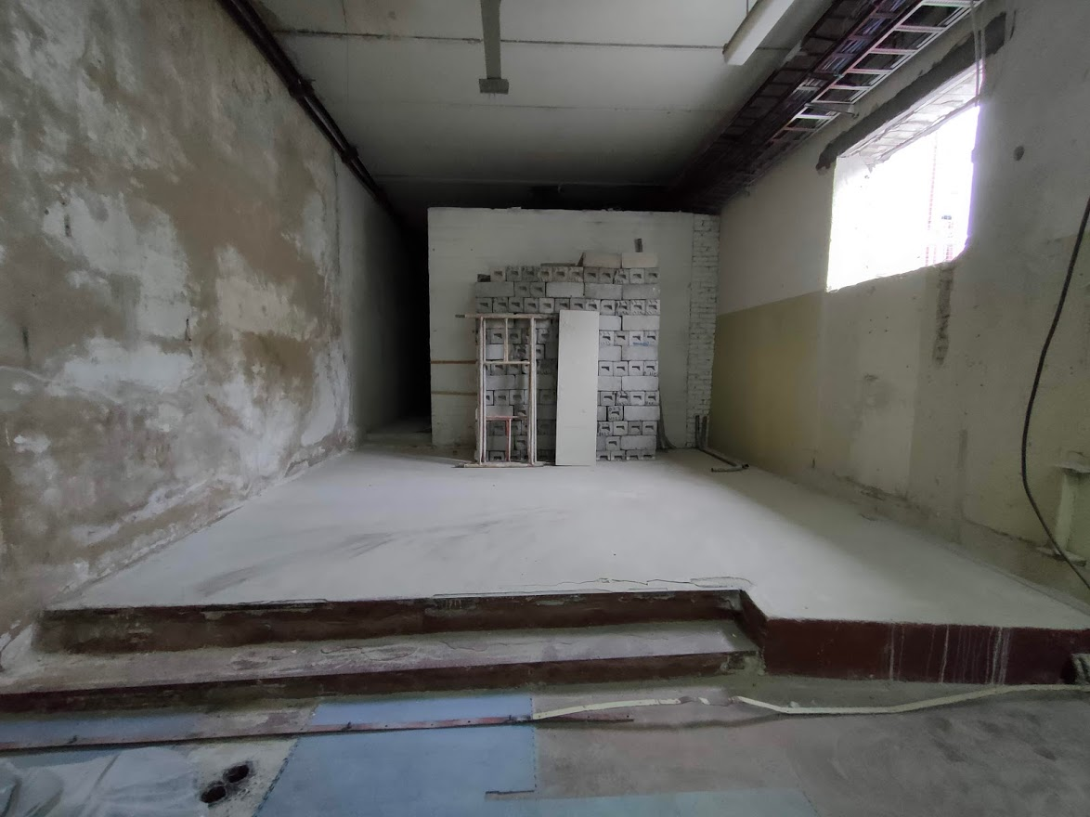
Accelerator Control Room
A. Trifonov Linear electron accelerator LINAC-200 as a core for a new test beam facility at DLNP JINR
Notes:
The slide shows a photo of the Accelerator Desk before the renovation in Building 118 (2018), a photo taken during the renovation (2021), and a photo of the Accelerator Desk after the renovation is complete (2022).

Slide 21
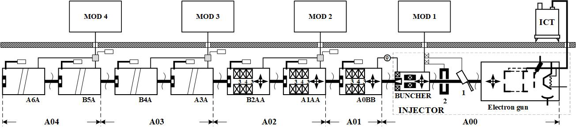
Beam characteristics
 | EP1 | EP2 | EP3 | EP4
Electron energy, MeV | 5–25 | 25–60 | 60–130 | 130–200
Pulse duration, μs | 0,2–3,5
Max. pulse current, mA | 80
Pulse repetition rate, Hz | 1–50 | 1–25
Beam
Notes:
At the moment, it has 4 accelerating stations and the electron energy is about 200 MeV.
In the future it is possible to increase the number of stations up to 13, and energy up to 800 MeV.
For now, the electron beam is available for users in two places: after stations A01 and A04. Channel after station A03 has been assembled and needs to be tested.
Channel after station A02 is under development.
Main characteristics of the electron beam are presented in the table.

Slide 22
Beam characteristics
Each pulse consists of a sequence of bunches with a duration of 1 ps and an interval between bunches of 350 ps
Intensity from 10² to 10¹³ e⁻/s
The transverse size of the extracted beam is ~1.5—5 mm
Max. average current 5 μA
Possible to produce photon and neutron beams
A. Trifonov Linear electron accelerator LINAC-200 as a core for a new test beam facility at DLNP JINR

Slide 23
Accelerator layout
A. Trifonov Linear electron accelerator LINAC-200 as a core for a new test beam facility at DLNP JINR
Notes:
More detailed accelerator layout.
Channels that are complete are highlighted in green.
Channels that are under development are highlighted in orange.

Slide 24
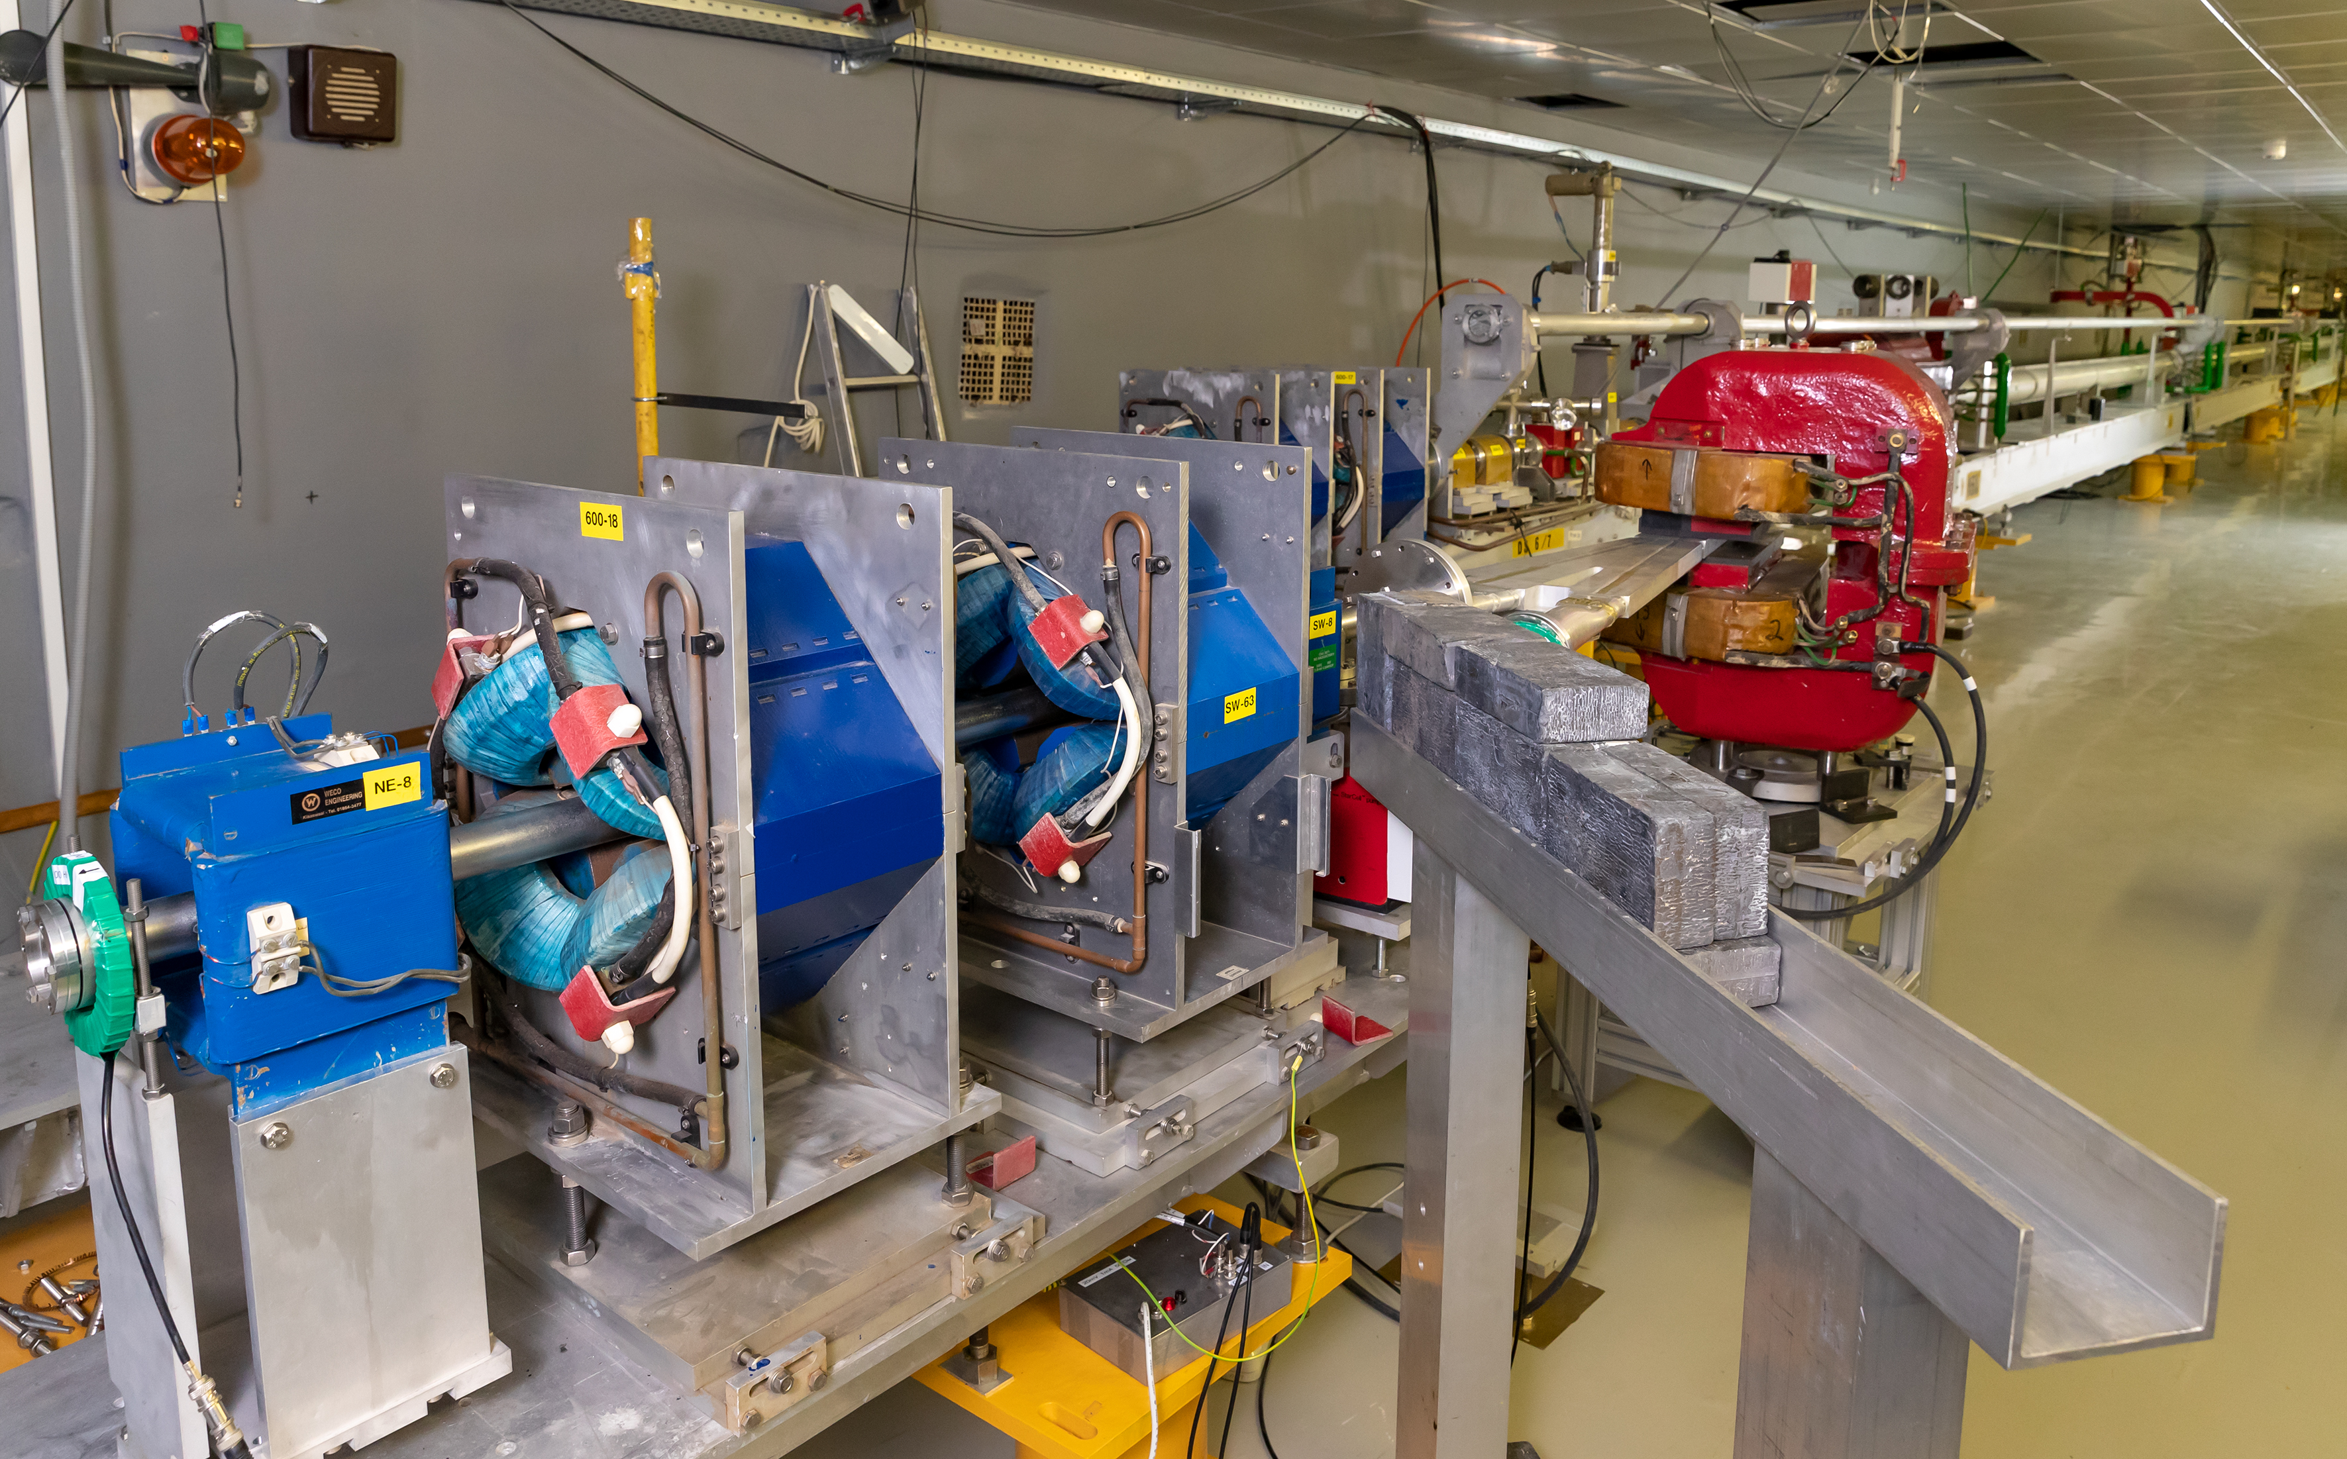
Beam Extraction Points
Beam extraction point №4 (EP4)
Beam extraction point №1 (EP1)
A. Trifonov Linear electron accelerator LINAC-200 as a core for a new test beam facility at DLNP JINR

Slide 25
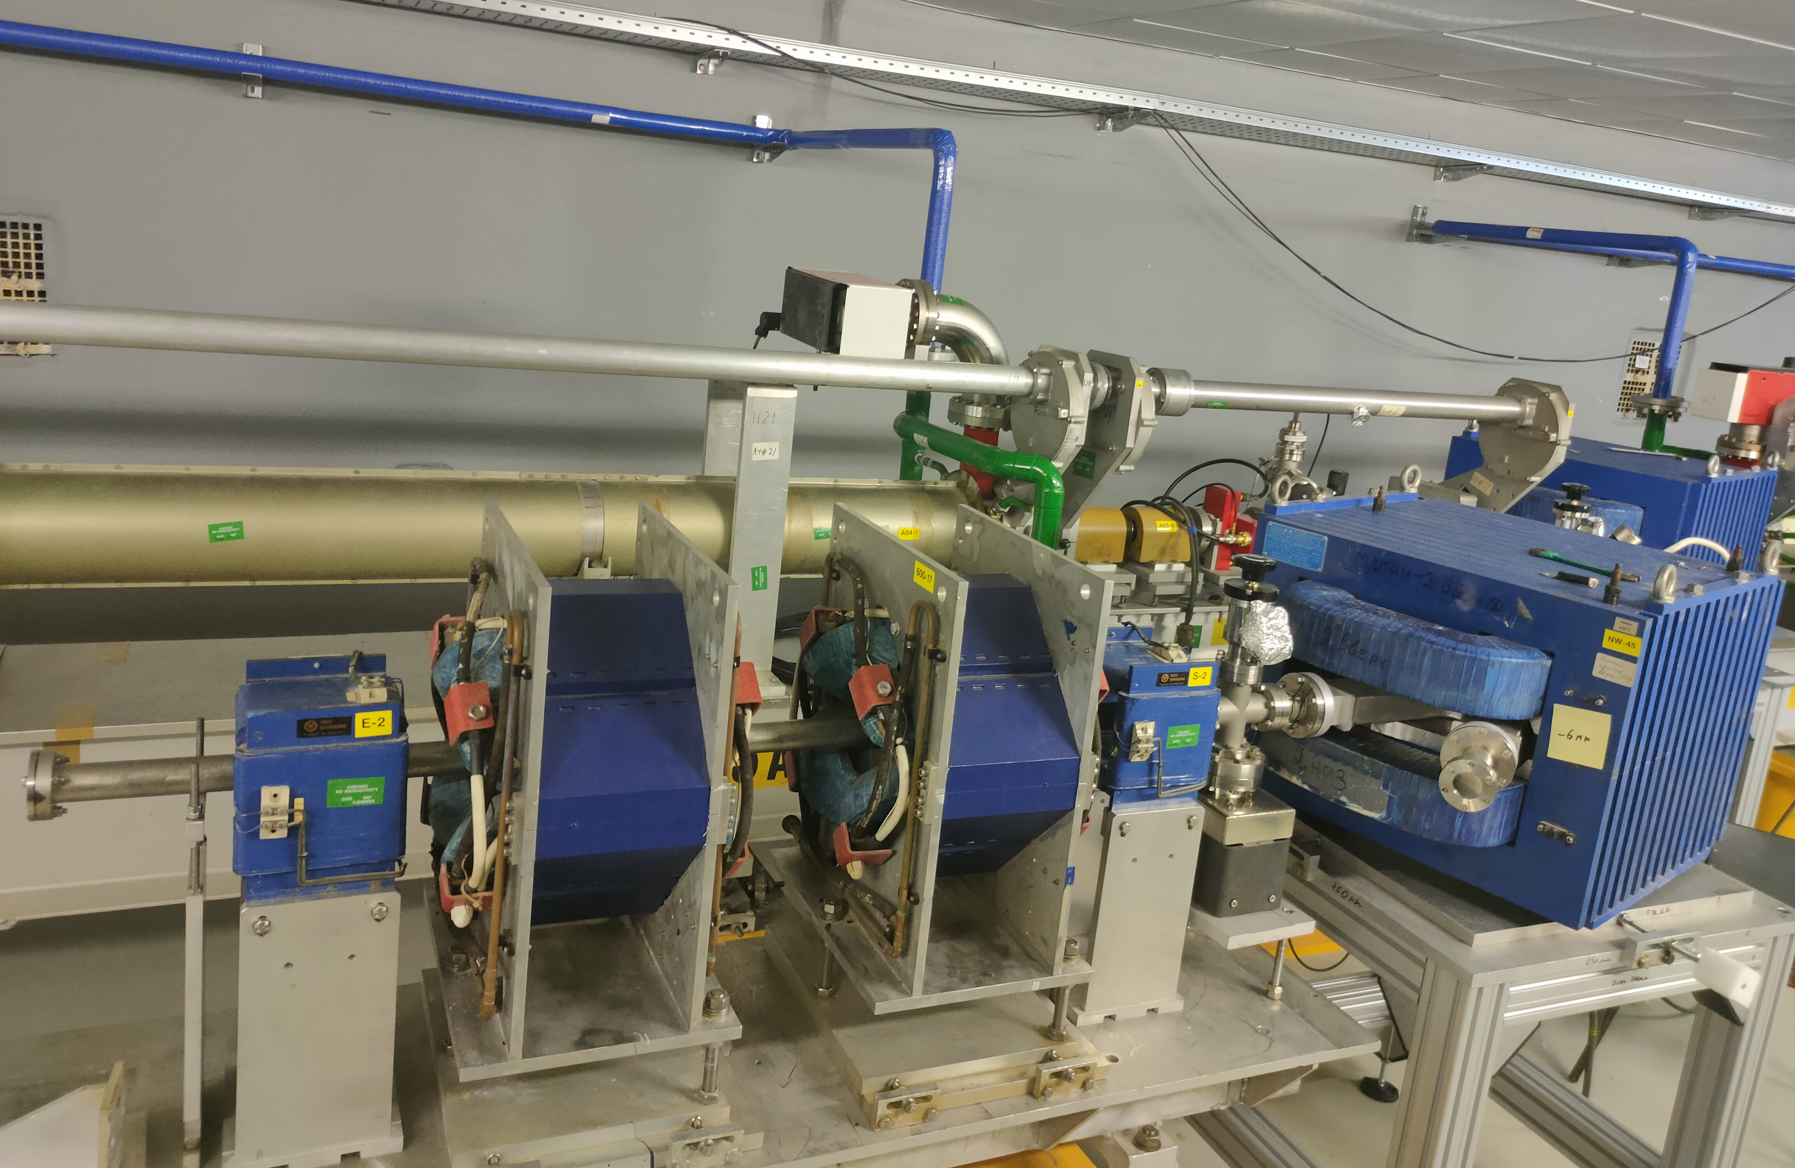
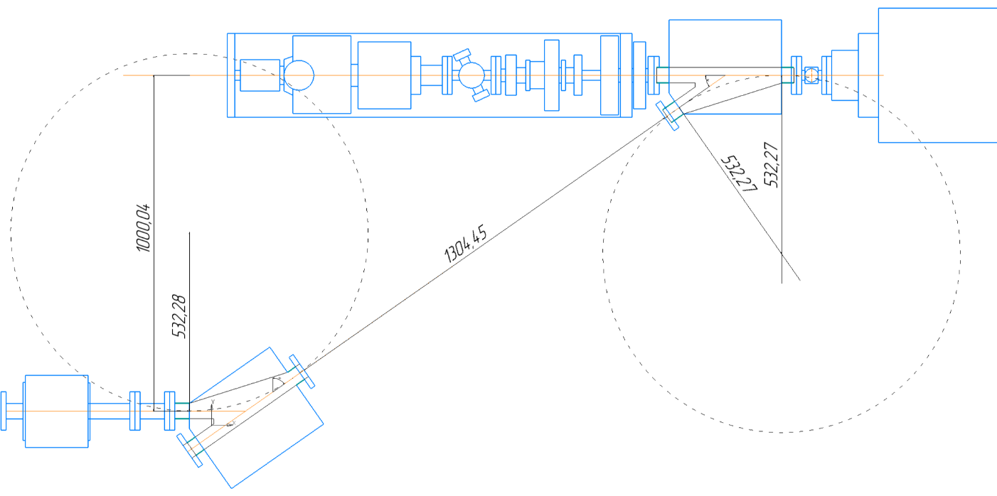
Beam Extraction Points
Beam extraction point №2 (EP2)
Beam extraction point №3 (EP3)
A. Trifonov Linear electron accelerator LINAC-200 as a core for a new test beam facility at DLNP JINR

Slide 26
Research program
A. Trifonov Linear electron accelerator LINAC-200 as a core for a new test beam facility at DLNP JINR
Notes:
The research program at the LINAС-200 accelerator includes 5 main directions. Each direction will be discussed in more detail below.

Slide 27
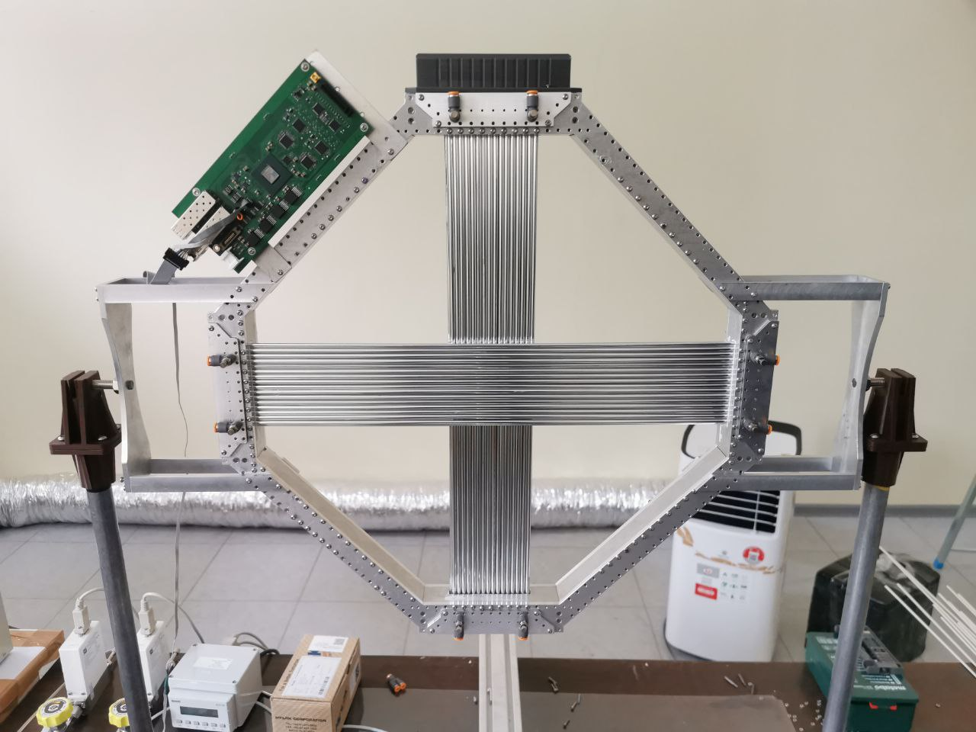
Particle detectors R&D
Study of monolithic active pixel detectors (MAPS) Alpide, determination of their efficiency, spatial resolution, study of the mechanism of cluster formation
Research and optimization of the prototype electromagnetic calorimeter of the SPD facility and its calibration in the range of 50-200 MeV
Response study, determination of efficiency, spatial resolution of straw detectors for the SPD experiment
Investigation of pulsed (up to 10,000 particles per 50 ns) loading of MCP-based detectors depending on the frequency of arrival of subsequent pulses
Investigation of characteristics (efficiency, spatial resolution, maximum load) of bulk Micromegas gas detectors
Study of the response of neutron pulse detectors, development of detectors for determining the fluence and energy spectrum of neutrons for dynamic neutronography and neutron resonance spectroscopy.
Drift straw chamber¹
1 – Volkov A., Evtoukhovich P., Kravchenko M., Kuno Y., Mihara S., Nishiguchi H., Pavlov A., Tsamalaidze Z. Properties of straw tubes for the tracking detector of the COMET experiment // Nucl. Instrum. Meth. A. — 2021. — V. 1004. — P. 165242.
A. Trifonov Linear electron accelerator LINAC-200 as a core for a new test beam facility at DLNP JINR
Notes:
We have several directions for particle detectors R&D:
Study of monolithic active pixel detectors, determination of their efficiency, spatial resolution, study of the mechanism of cluster formation.
Different studies for the SPD experiment.
MCP-based detectors studding.
Investigation characteristics of bulk Micromegas gas detectors.
Studies of neutron pulse detectors.

Slide 28
Terahertz radiation source and beam diagnostics R&D
Approbation of the method for measuring the position and shape of the charge density distribution of relativistic electron beams using a monitor based on the measurement of the characteristic X-ray radiation spectra.
Study of the processes of passage of relativistic electrons through micro- and nano-capillaries, including those with a structure along the axis.
Study of the diffraction mechanisms of radiation in the vacuum ultraviolet and soft X-ray regions under conditions of anomalous dispersion for diffracted photons
Measuring the average length of micro-bunches and the length of the bunch chain using Vavilov-Cherenkov radiation in the diffraction mode
Stimulation mode (stimulated emission) during generation of THz radiation
Approbation of a method for measuring the transverse profile of an electron beam based on multi-angle scanning
Measurement of the volumetric shape of the electron beam using multi-angle scanning.
A. Trifonov Linear electron accelerator LINAC-200 as a core for a new test beam facility at DLNP JINR

Slide 29
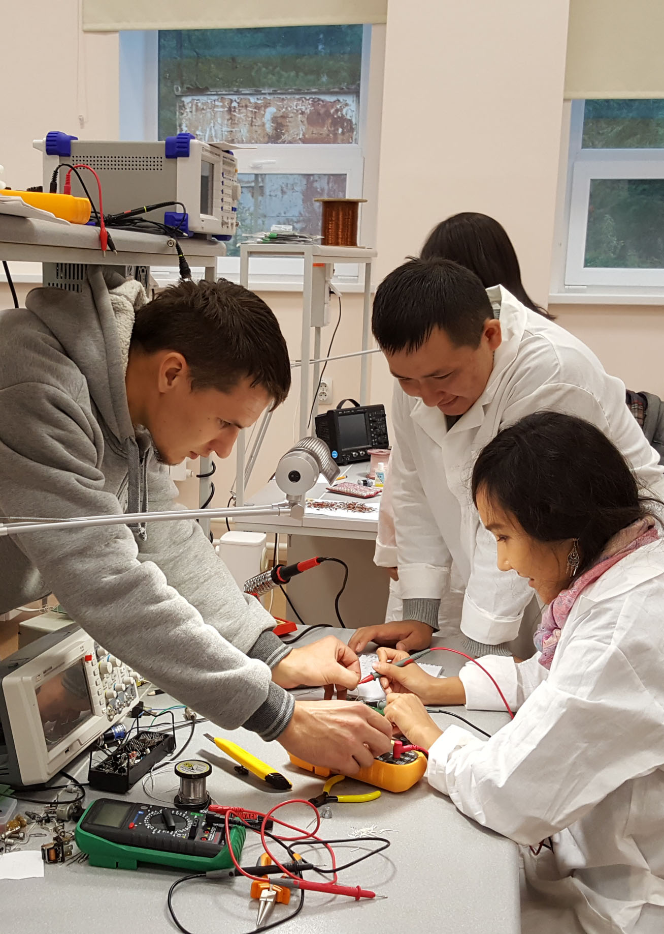
Education and training
The educational program includes the development of practical training at the LINAC-200 facility in the following areas:
Accelerator physics and technologies (magnetic optics, RF technology, vacuum, automation control systems, beam diagnostics)
Elementary particle detectors (study of the response of gas, scintillation and semiconductor detectors)
Applied problems (radiation materials science, generation and registration of synchrotron and terahertz radiation)
A. Trifonov Linear electron accelerator LINAC-200 as a core for a new test beam facility at DLNP JINR
Notes:
The educational program includes the development of practical training at the Linac-200 facility in the following areas:
Applied problems
Accelerator physics and technologies
Elementary particle detectors

Slide 30
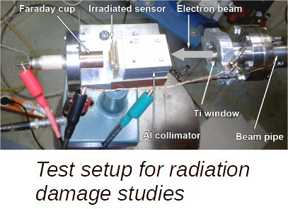
Applied research
Investigation of radiation resistance of GaAs and SiC semiconductors
Irradiation of living organisms. Study of the possibility of irradiation with short (1 ps) pulses and development of appropriate methods of microdosimetry.
Obtaining small quantities of radioisotopes for radiochemical research using gamma rays with an energy of 20–200 MeV, which complements the capabilities of the FLNR microtron
Creation of a terahertz radiation source for radiobiological research
Electronic radiography of fast processes in gases.
A. Trifonov Linear electron accelerator LINAC-200 as a core for a new test beam facility at DLNP JINR
Notes:
Investigation of radiation resistance of GaAs and SiC semiconductors
Irradiation of living organisms.
Obtaining small quantities of radioisotopes for radiochemical researches.
Creation of a terahertz radiation source for radiobiological research.
ect.

Slide 31
Nuclear physics experiments
Measurement of isotope yields and verification of nuclear models in the 20–200 MeV range
Measurement of the cross section for the production of photoneutrons on various targets in the energy range of gamma rays 20–200 MeV
Study of multiparticle photonuclear reactions
A. Trifonov Linear electron accelerator LINAC-200 as a core for a new test beam facility at DLNP JINR
Notes:
Measurement of isotope yields and verification of nuclear models (in the 20-200 MeV rang)
Measurement of the cross section for the production of photoneutrons on various targets (in the energy range of gamma rays 20-200 MeV)
Study of multiparticle photonuclear reactions

Slide 32

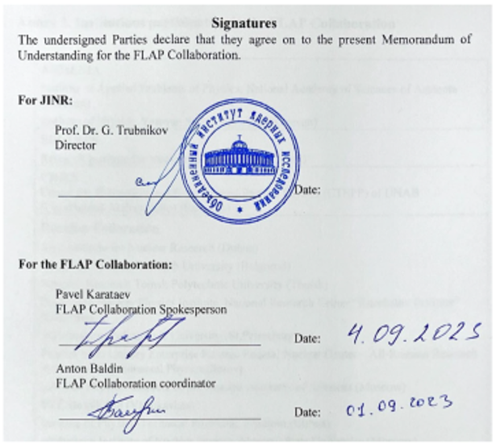

FLAP Collaboration
Memorandum of understanding
for the FLAP collaboration at JINR
A. Trifonov Linear electron accelerator LINAC-200 as a core for a new test beam facility at DLNP JINR
Notes:
The high attractiveness of the LINAC-200 facility for scientific teams both in Russia and in other countries led to the creation of a new scientific collaboration FLAP (Fundamental and Applied Linear Accelerators Physics). The FLAP collaboration is aimed at studying the subtle effects of electromagnetic interaction with matter and new applications of controlled generation of electromagnetic radiation by relativistic electrons using functional materials. The FLAP collaboration program has been approved by the PAC for Particle Physics.

Slide 33
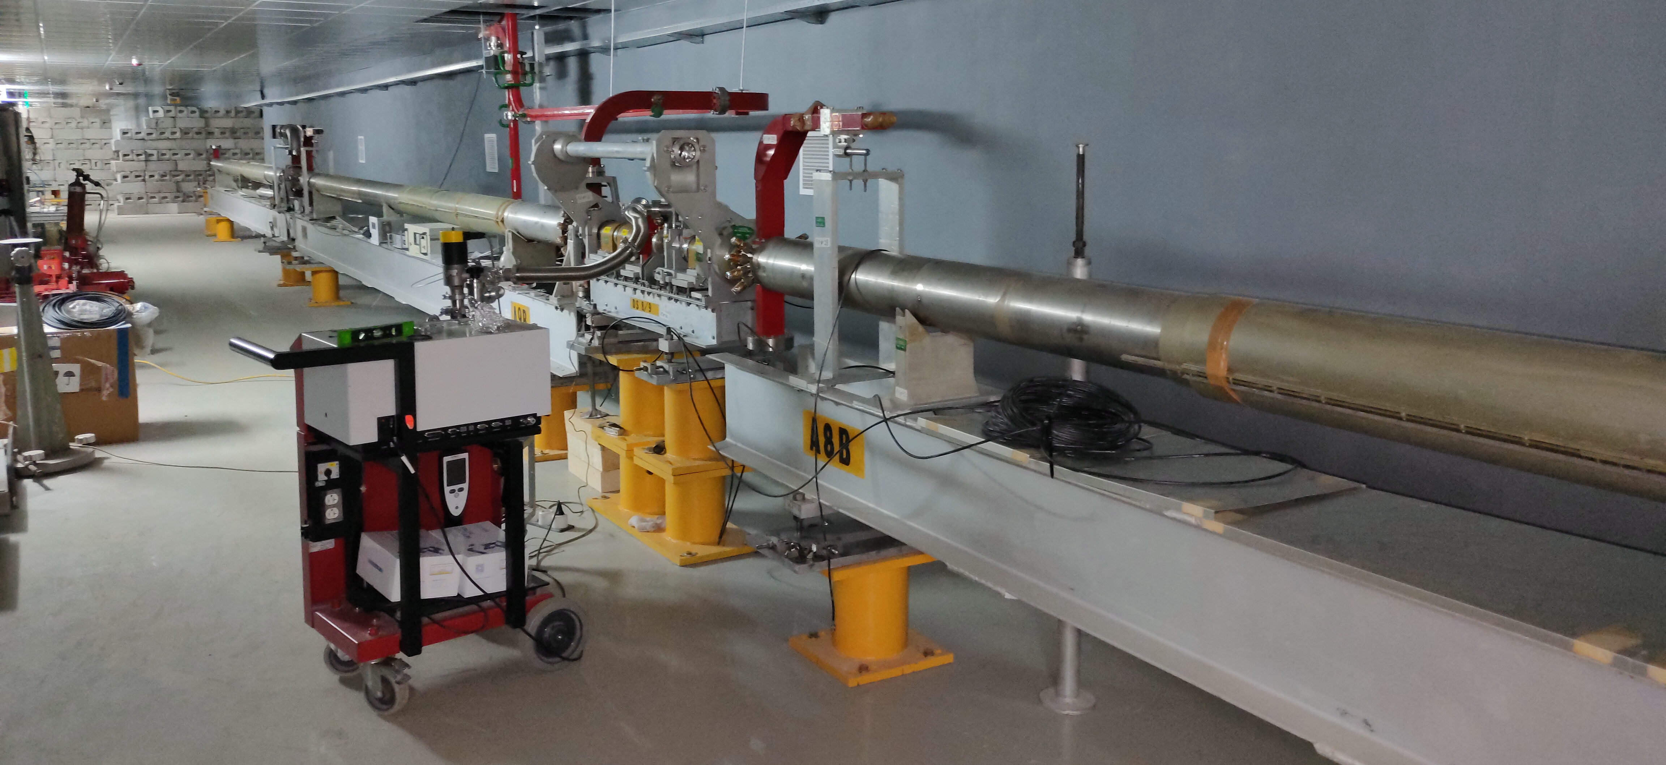
Future prospects
Increasing the accelerator energy up to 400 MeV – commissioning of accelerator stations 4 and 5 – 2026. In the future, it is possible to increase the energy up to 800 MeV
A. Trifonov Linear electron accelerator LINAC-200 as a core for a new test beam facility at DLNP JINR

Slide 34
Conclusion
Two beam extraction points (EP1, EP4) are available;
EP3 – has been assembled and needs to be tested;
EP2 – under development.
The preparation of documentation for commissioning and then operation is nearing completion.
In order to coordinate the research programs of beam users an Organizational and Program Committee is being established.
The test beam facility will be open for particle detectors and beam diagnostics R&D, nuclear physics experiments, material irradiation, radiobiological and other studies.
A. Trifonov Linear electron accelerator LINAC-200 as a core for a new test beam facility at DLNP JINR

Slide 35
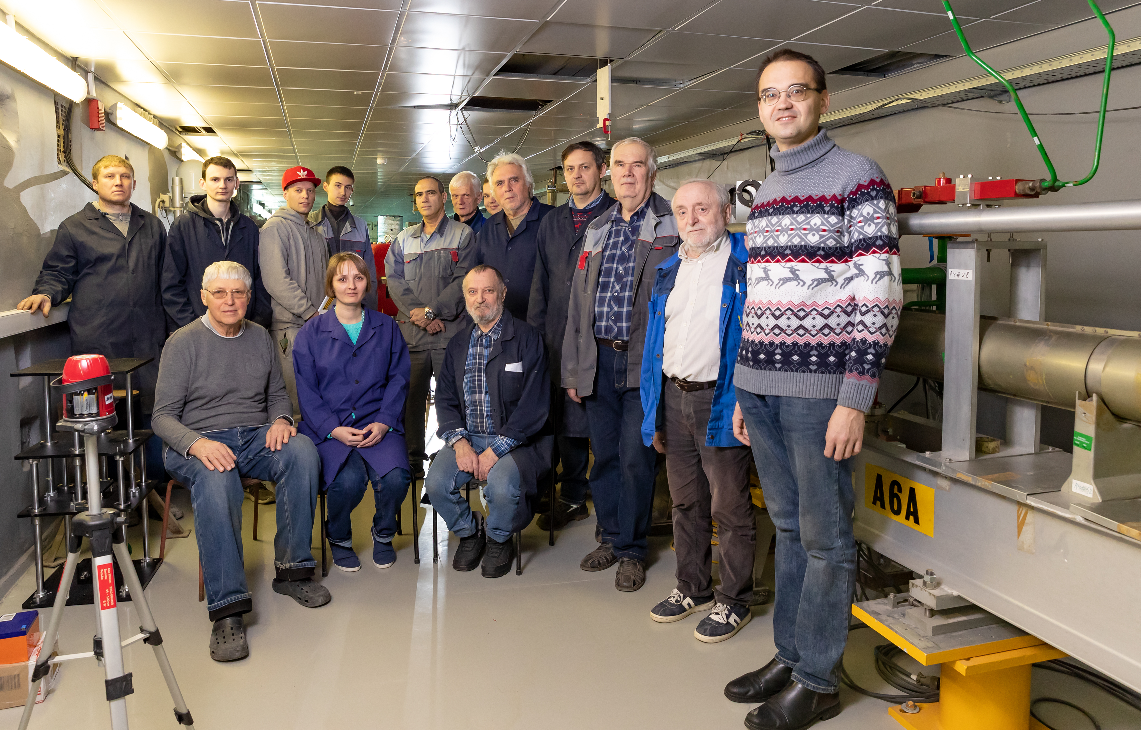
Thank you for attention!
Notes:
I’m present this report on behalf of the LINAC-200 working group.
And I would like to say that I’m grateful to all team, to all engineers and researchers who participated in this work and provided us with useful comments and ideas.

