Slide 1
Precision mass measurement of the heaviest nuclei in Dubna FLNR
60th meeting of the Programme Advisory Committee for Nuclear Physics
Novoselov A.S.
23 – 24 January 2025 (Dubna, Russia)

Slide 2
The precise mass measurement allow the determination of the full binding energy of the nucleus - the integral characteristic of all atomic and nuclear forces which is the key for solving the fundamental physics questions. For the study of proton and neutron shells structure, it is enough to know the nuclide mass with the relative accuracy (ΔM/M) of ~10⁻⁶.

Slide 3
The experimental setup in the new hall of the cyclotron U-400R
Fig. 1. The preliminary location plan

Slide 4
Mass measurement of the heaviest nuclei (atoms)
The task of the study is to measure the masses of the heaviest atoms
with an error of < 0.2 ppm (60 keV).
The range of mass numbers A = 250 – 300
Specific conditions:
Simultaneous presence of 1+ and 2+ ions.
The frequency of the occurrence of the ion under study is ~ 1 per day
The lifetime of the ion under study is ≥ 50 msec
The accuracy of the mass determination depends on
- the resolution of the analyzer by mass R_{m}
- measurement statistics N
ΔM/M = 10⁻⁷, N = 10 => R_{m} = 1 500 000
Currently, only one type of mass analyzer provides simultaneous access
to a resolution of > 1,000,000 with an analysis time of < 0.1 sec
– multi-reflective time-of-flight mass analyzer

Slide 5
The scheme of the mass spectrometer
TOF detector
MRTOF
analyzer
10⁻⁸
Torr
Gas-filled cell
A = 266 – 294
(1+, 2+)
CID
cell
Calibrant ion source
Bancher
Current
detector
Cs
Ion source
Quadrupole
mass filter
Quadrupole
mass filter
10⁻³
Torr
RFQ guide
2х10⁻² Torr He
10⁻⁵
Torr
MS
detector
Si
detector
Bancher
Gate valve
Gate valve
Charge state selector
Si
detector
Gate valve
Fig. 2. The scheme of the MR-TOF-MS

Slide 6
More than 80% of the cores in the Z>102 region are available for study
Fig. 3. Region of interest for research

Slide 7
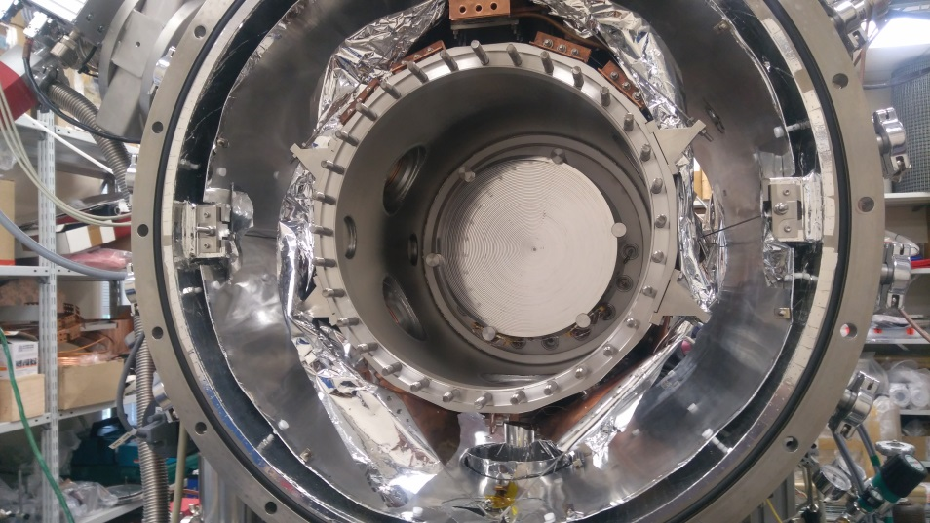
Cryogenic gas stopping cell structure
Entrance window
DC cage
RF funnel
Laval nozzle
RFQ
Fig. 4. Cryogenic gas stopping cell at FLNR JINR
The CGSC consists of the stainless-steel outer and inner chambers. The outer chamber is at the vacuum pressure and works like the thermal insulation. It also reduces the radiation heat transfer to the inner chamber by the insulation foil. The temperature inside of the outer chamber is the room temperature (293 K). The inner chamber is filled by the helium buffer-gas and it is also platted from the outside by the copper for the homogenous distribution of the temperature. The inner chamber is cooled to the 40 K by the cryocooler. The set of the cylindrical and the conic electrodes are installed inside of the inner chamber.

Slide 8
Why cryogenic gas cell?
Not influenced from any physical and/or chemical environment properties.
No need in additional ionization.
Significantly shorter separation and extraction time in comparison to solid or liquid states ion catchers (~30-40 ms).
Dimensions: length 300 mm, diameter 250 mm.
Buffer gas: helium of the highest purity (99.99999%).
Work pressure: P ≤ 10 mbar for the temperature T ≤ 40 K.
Gas flow through the cell: ~1 Torr*l/s.

Slide 9
Cryogenic gas stopping cell principle of work
Fig. 5. Principle of work

Slide 10
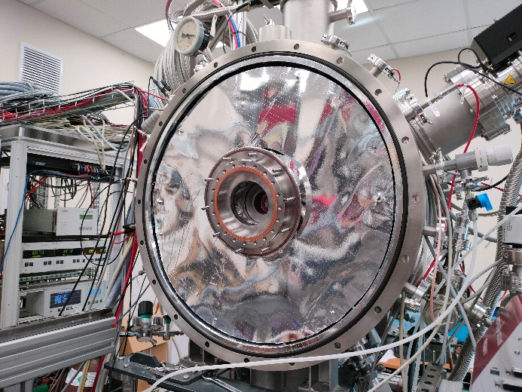
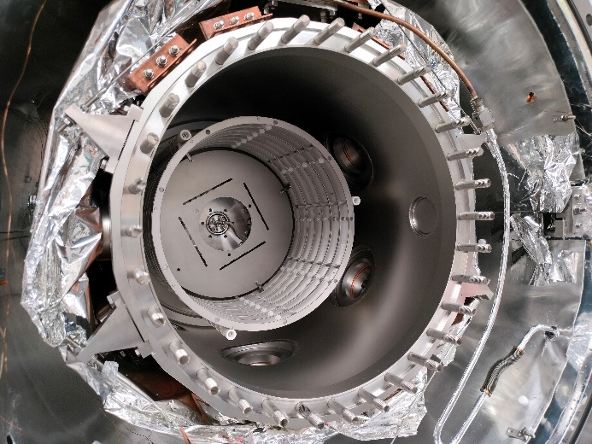
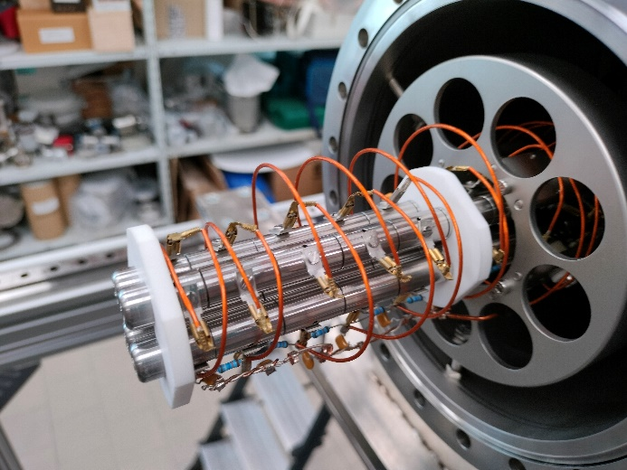
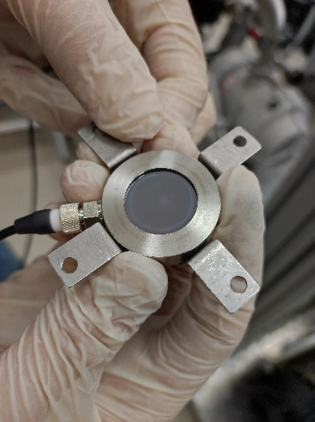
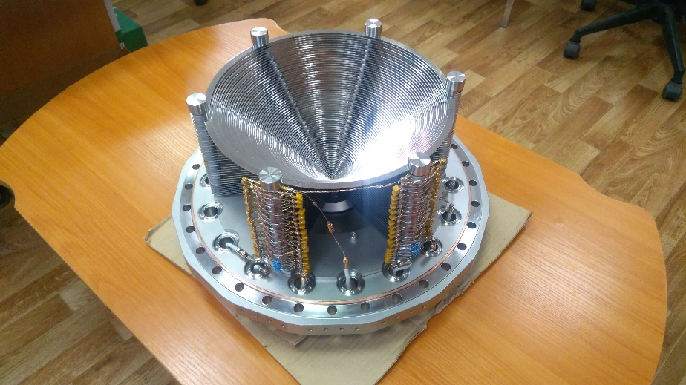
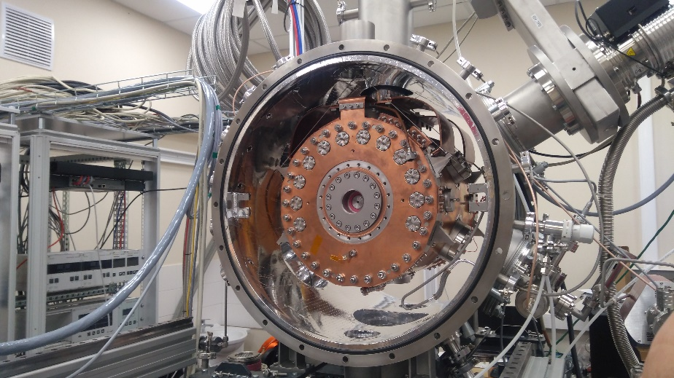
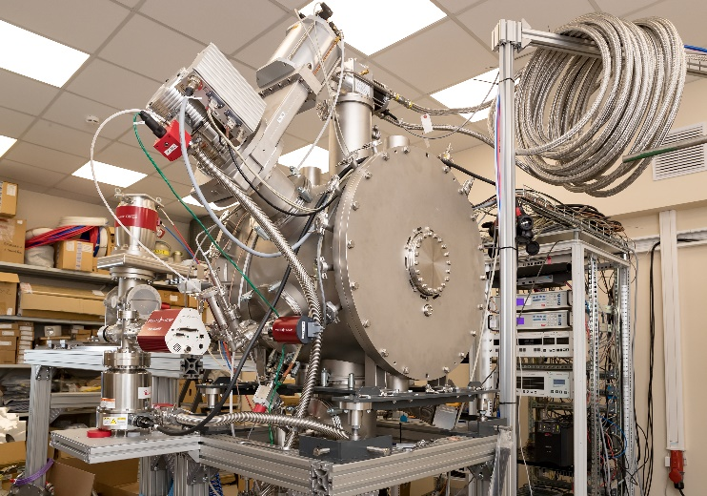
Cryogenic gas stopping cell gallery
Fig. 6. Photos of the CGSC

Slide 11
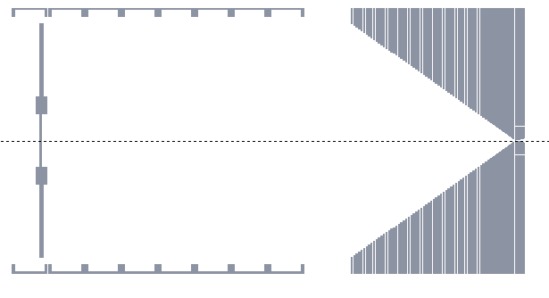
Alpha source testing
²²³Ra
Nozzle
RFQ
Al foil
Aperture
Si detector
²²³Ra → ²¹⁹Rn → ²¹⁵Po → ²¹¹Pb → ²¹¹Bi → ²⁰⁷Tl → ²⁰⁷Pb
Fig. 7. Alpha source testing scheme
11,4d 3,96s 1,78ms 36,1m 2,14m 4,77m stable

Slide 12
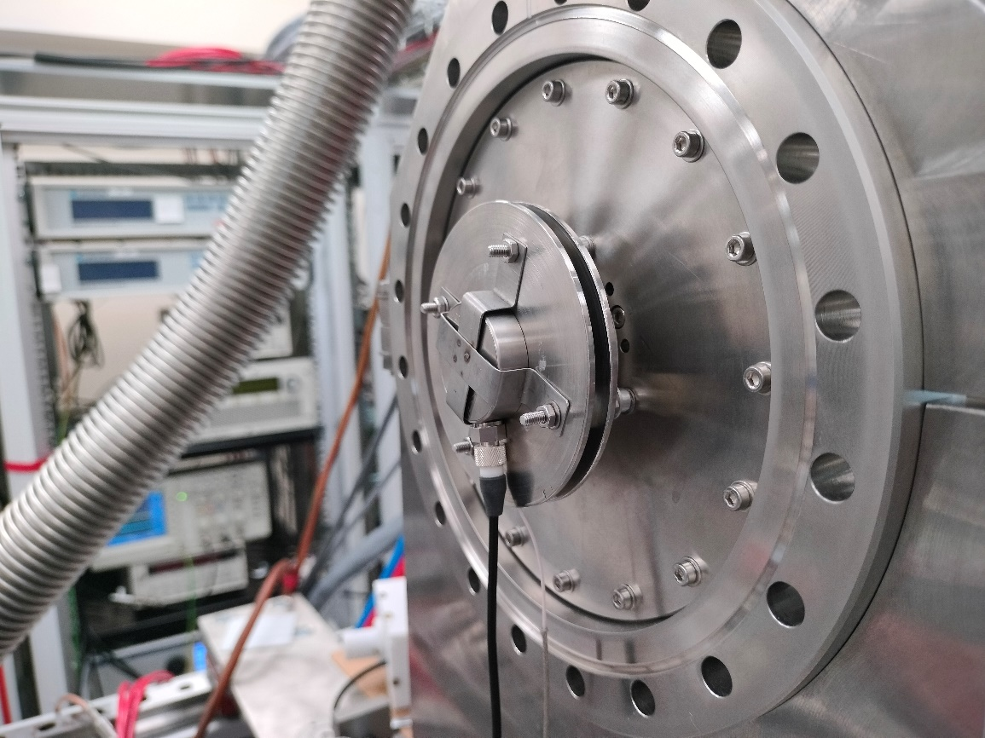
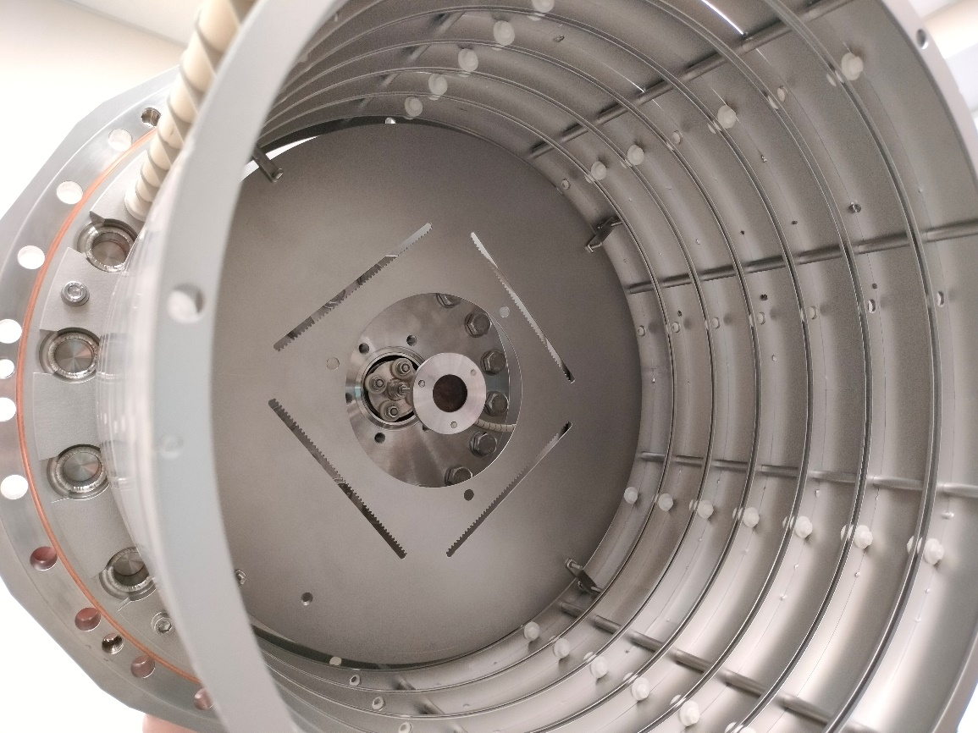
Alpha source testing
Fig. 8. Detector-foil assembly (left), source holder inside DC cage of the CGSC (right).
Geometrical efficiency of the detector-foil assembly ~17,5%

Slide 13
First results
Fig. 9. Energy spectra: source position at the detector-foil assembly (left) and at the holder inside of the DC cage (right). Total ²²³Ra lines intensity 260,7 Bq at the detector 21.06.2024.

Slide 14
First results
Fig. 10. Examples of the parameters are measured

Slide 15
Conclusion
First tests of the Cryogenic gas stopping cell with the ²²³Ra alpha source are started. The daughter products are guided trough the helium with the help of the inside structures of electrodes, extracted, filtered from gas, penetrated to the aluminum foil and registered after its alpha decays.
Several dependences of normalized intensities versus voltage ranges and levels of the inside electrodes at the T=293,7K are measured.
Dependency of the helium pressure at the T=293,7K inside the cold chamber and normalized intensity is also done.
Preliminary efficiency about 35,7% at T=293,7K inside and the best suitable voltages was achieved.

