Slide 1
60th meeting of the PAC for Nuclear Physics 23-24 January, 2025 JINR, Dubna
Experimental study of multinucleon transfer reactions in collisions of heavy nuclei at CORSET setup I.V. Vorobiev¹, E.M. Kozulin¹, G.N. Knyazheva¹, A.V. Karpov¹, A.A. Bogachev¹, K.V. Novikov¹, I.M. Itkis¹, V.V. Saiko^{1,2}
¹Flerov Laboratory of Nuclear Reactions, Joint Institute for Nuclear Research (JINR), Dubna, Moscow oblast, 141980 Russia ²Institute of Nuclear Physics, 050032 Almaty, Kazakhstan
E-mail: rc_38@jinr.ru

Slide 2
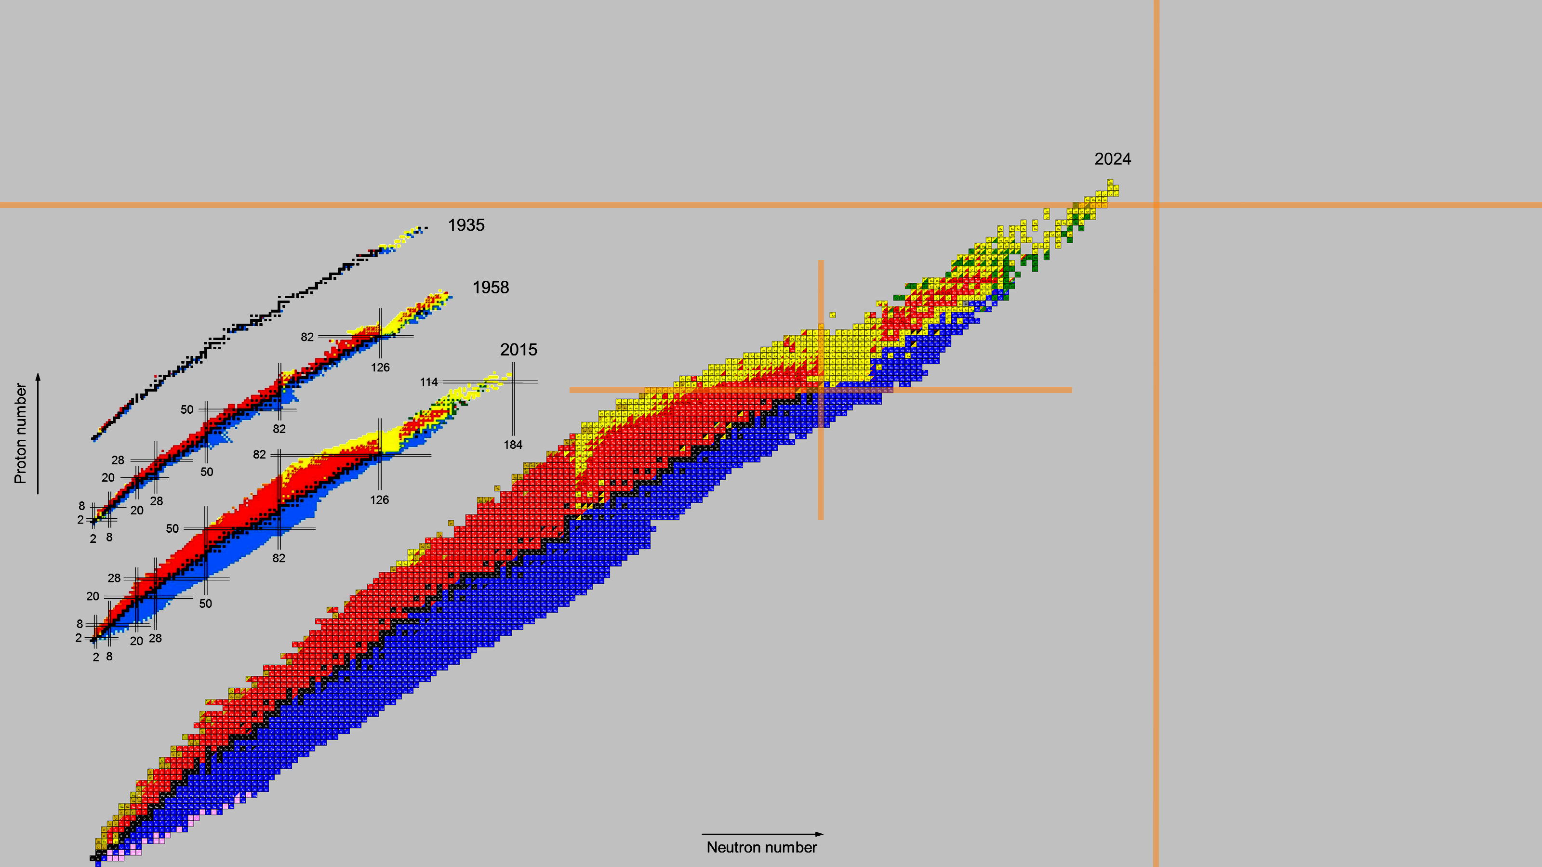
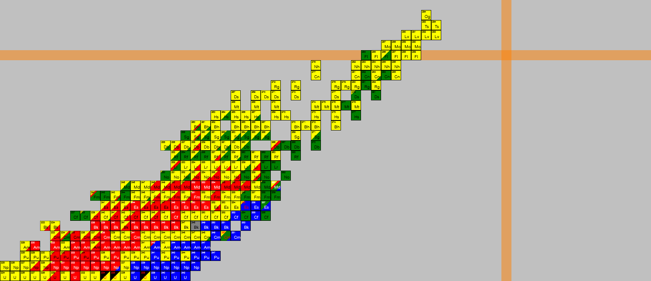
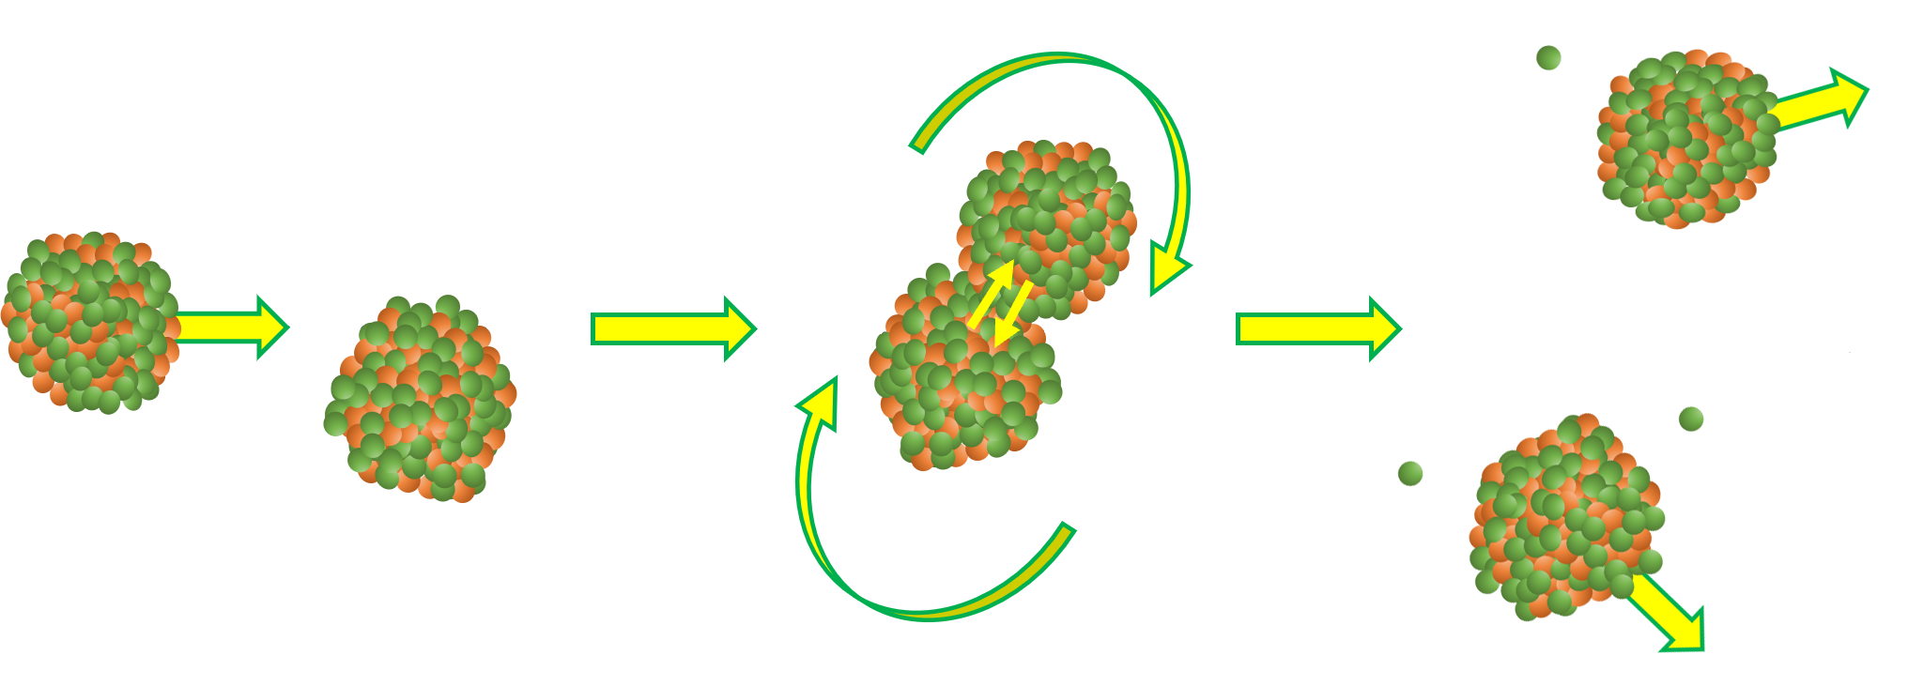
Synthesis of new nuclei
114
MultiNucleon Transfer (MNT) reactions are considered as a perspective way to produce new neutron-rich heavy and superheavy nuclei!
82
126
Projectile-like fragment (PLF)
Projectile
Target
(TLF) Target-like fragment
G. G. Adamian et al., Eur. Phys. J. A (2020) 56:47 http://nrv.jinr.ru/nrv/webnrv/map/
184

Slide 3
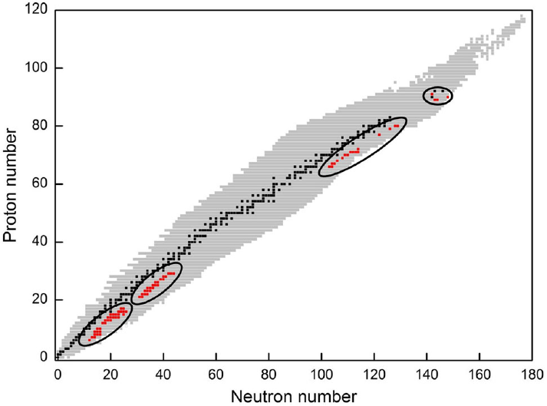
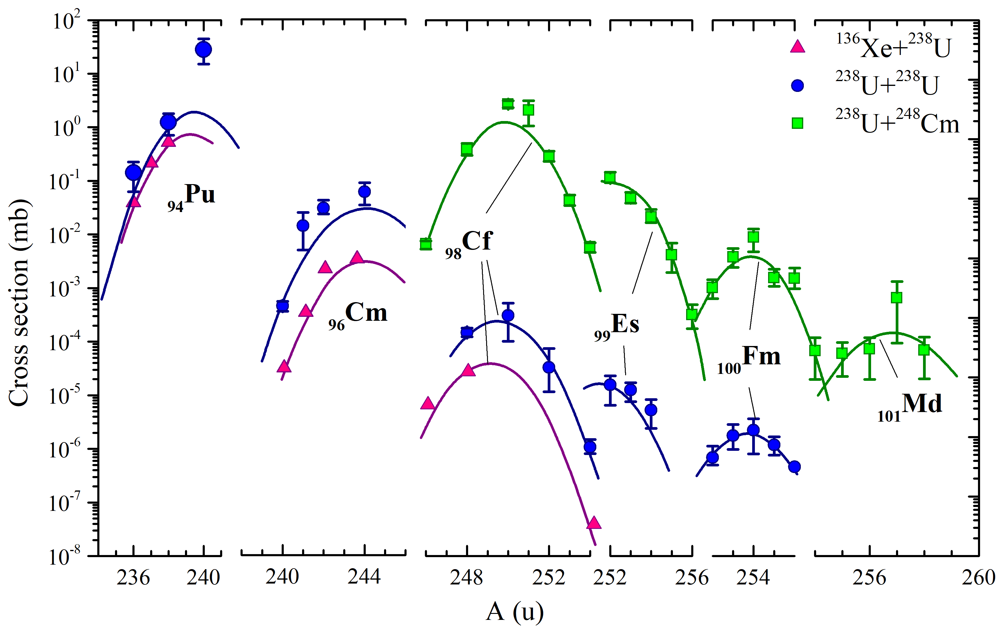
Nucleosynthesis in MNT reactions
G. G. Adamian et al., Eur. Phys. J. A (2020) 56:47
M. Schädel et al., Phys. Rev. Lett. 48 (1982) 852
Chart of nuclides with all known isotopes in 2020. During the years 1969–1995 the 76 neutron-rich nuclides which were discovered in MNT reactions are marked in red.
Production cross sections of transuranium nuclei in the reactions ¹³⁶Xe+²³⁸U, ²³⁸U+²³⁸U and ²³⁸U+²⁴⁸Cm at the interaction energy E_{lab} ≤ 7.5 MeV/u.

Slide 4
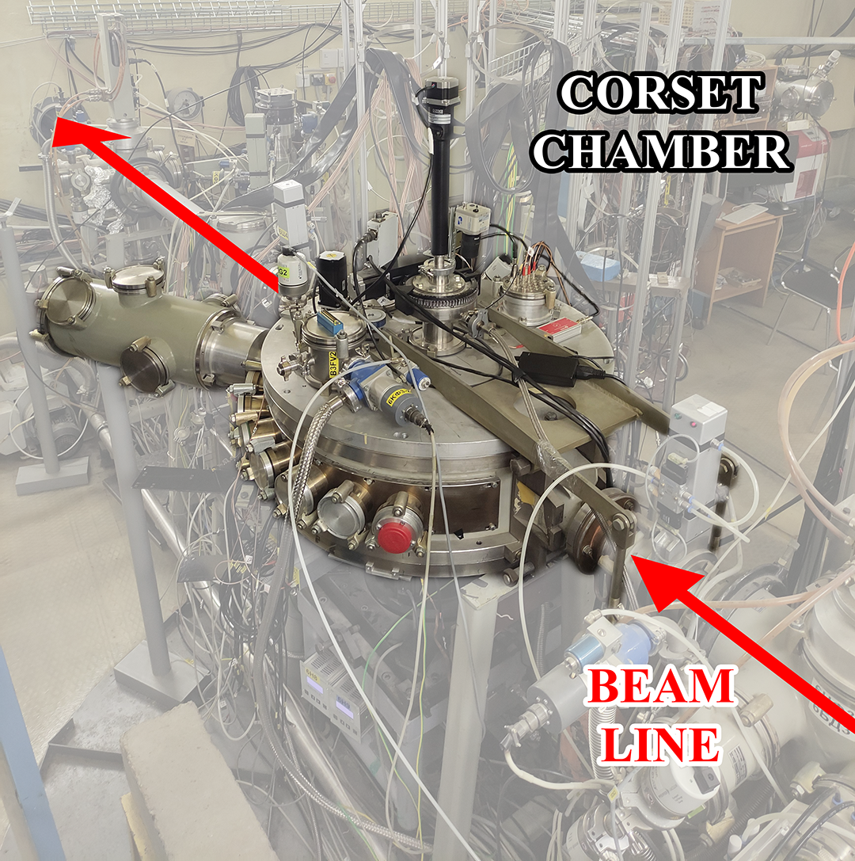
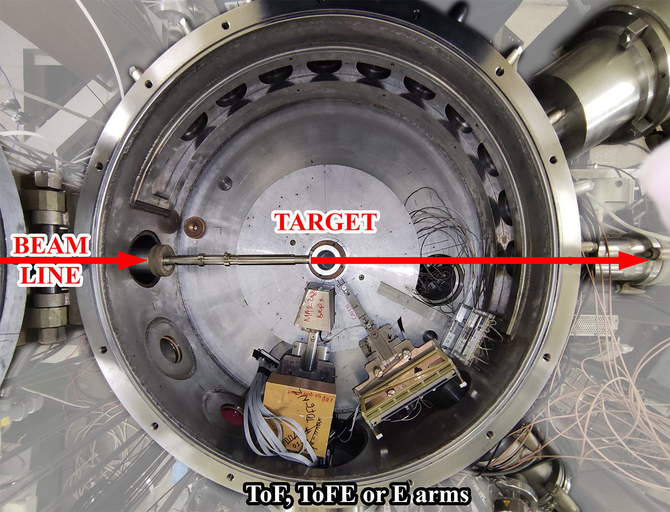
Experimental study of MNT reactions at CORSET setup
Measured reaction | E_{lab}
¹³⁶Xe + ²³⁸U | 1.11 GeV
²⁰⁹Bi + ²³⁸U | 1.85 GeV
²⁰⁹Bi + ¹⁹⁷Au | 1.44 GeV
²⁰⁹Bi + ²⁰⁸Pb | 1.75 GeV
²⁰⁹Bi + ²³²Th | 1.75 GeV

Slide 5
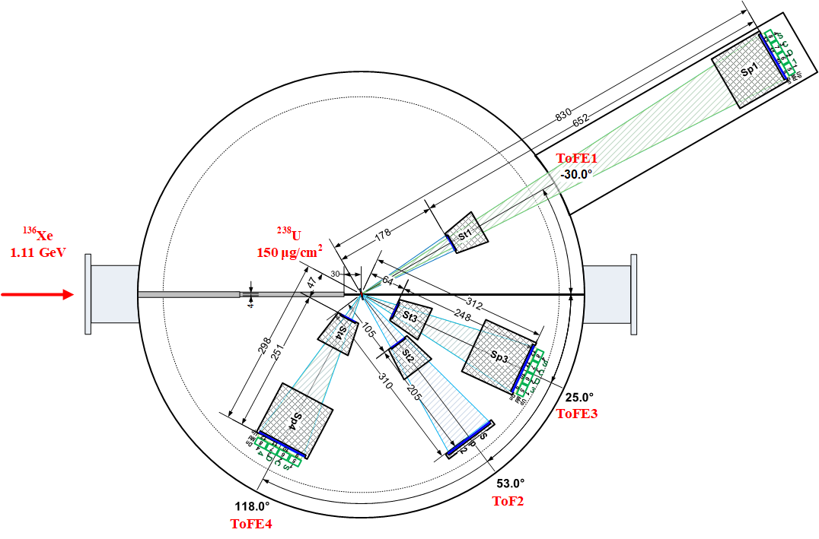
Experiments ¹³⁶Xe, ²⁰⁹Bi + ²³⁸U at energy ≈ 1.45 E_{Coulomb}
¹³⁶Xe (1.11 GeV) + ²³⁸U
 | ¹³⁶Xe + ²³⁸U | ²⁰⁹Bi + ²³⁸U
E_{lab} | 1.11 GeV | 1.85 GeV
E_{c.m.} | 706 MeV | 985 MeV
E_{c.m.}/E_{Coulomb} | 1.48 | 1.42
Θ_{c.m.} grazing of Ion | 57° | 61°
Θ_{lab} grazing of Ion | 37° | 34°
Θ_{lab} grazing of ²³⁸U | 61.5° | 59.2°
CORSET setup, FLNR
E.M. Kozulin et al., Phys. Rev. C 109, 034616 (2024)

Slide 6
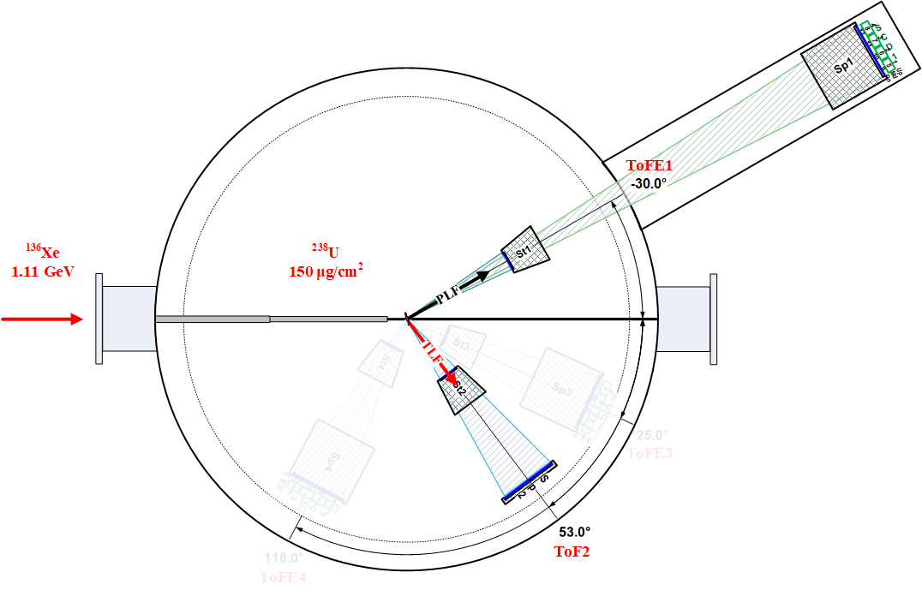
Experiments ¹³⁶Xe, ²⁰⁹Bi + ²³⁸U at energy ≈ 1.45 E_{Coulomb}
¹³⁶Xe (1.11 GeV) + ²³⁸U
¹³⁶Xe + ²³⁸U (150 μg/cm²)
ToFE1 acceptance angle | X: ±2.8° Y: ±2.1°
ToF2 acceptance angle | X: ±7.4° Y: ±5.5°
Time resolution | 150-200ps
CORSET setup, FLNR
E.M. Kozulin et al., Phys. Rev. C 109, 034616 (2024)

Slide 7
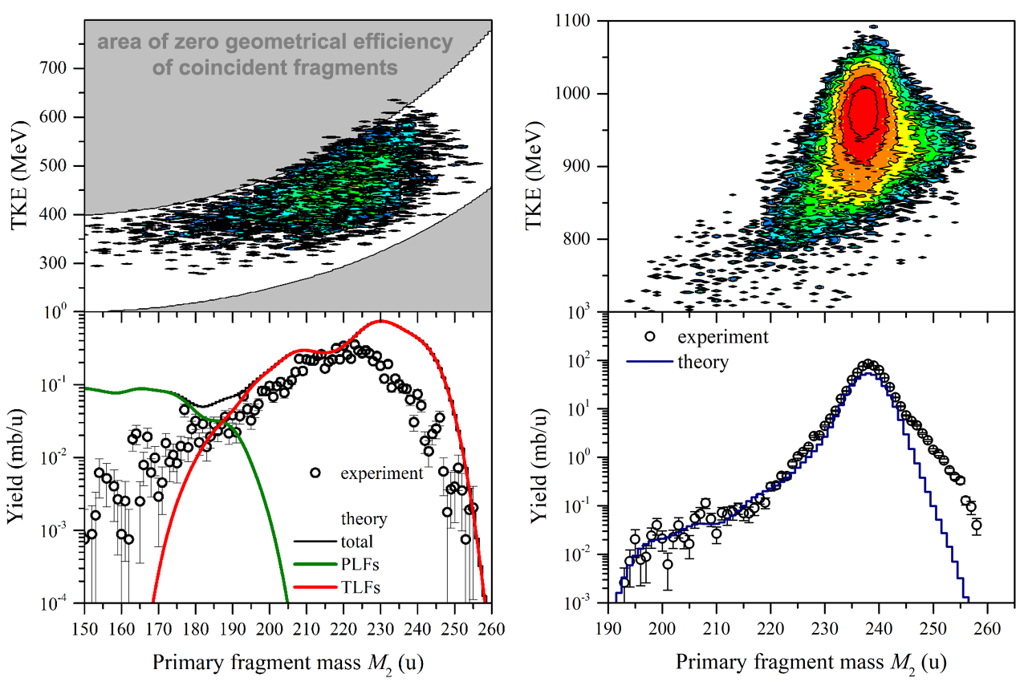
Mass-energy distributions of survived primary TLFs
(before deexcitation process)
¹³⁶Xe (1.11 GeV) + ²³⁸U
²⁰⁹Bi (1.85 GeV) + ²³⁸U
~ 200 μb
~ 2 μb
The heaviest primary fragment mass found in the mass distribution for survived primary TLFs is:
255 u (Z ≈ 99–100, Es–Fm isotopes)
with the cross section of about 2 μb.
257 u (Z ≈ 101, Fm–Md isotopes)
with the cross section of about 30 μb.

Slide 8
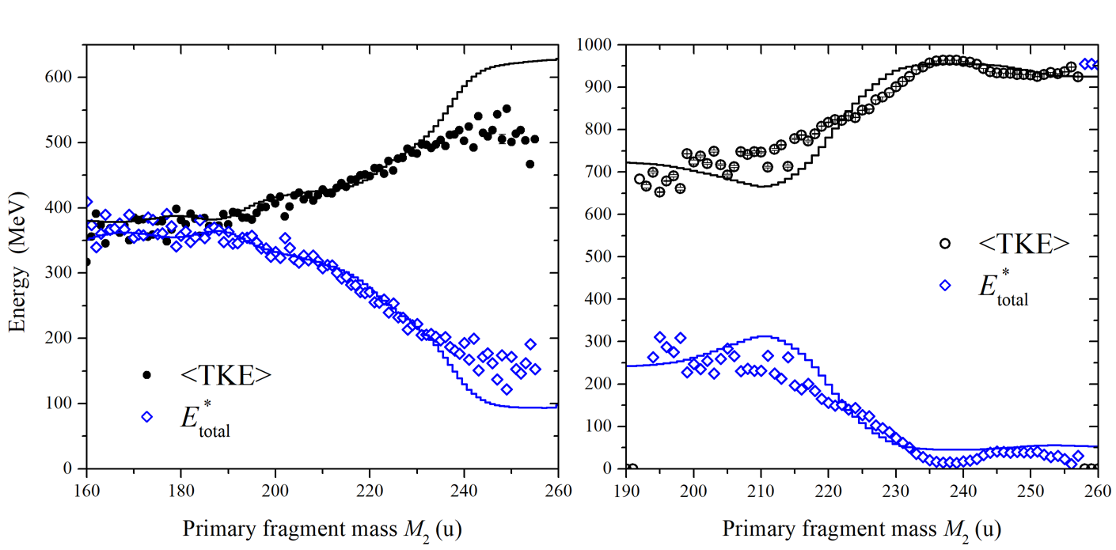
Total excitation energies for survived primary TLFs
¹³⁶Xe (1.11 GeV) + ²³⁸U
²⁰⁹Bi (1.85 GeV) + ²³⁸U
The total excitation energy may be estimated from TKE measurements:
For survived primary transuranium fragments the total excitation energies of composite nuclear systems for the reaction ²⁰⁹Bi (1.85 GeV) + ²³⁸U are less than 70 MeV => sufficiently good conditions for survival of such MNT fragments!

Slide 9
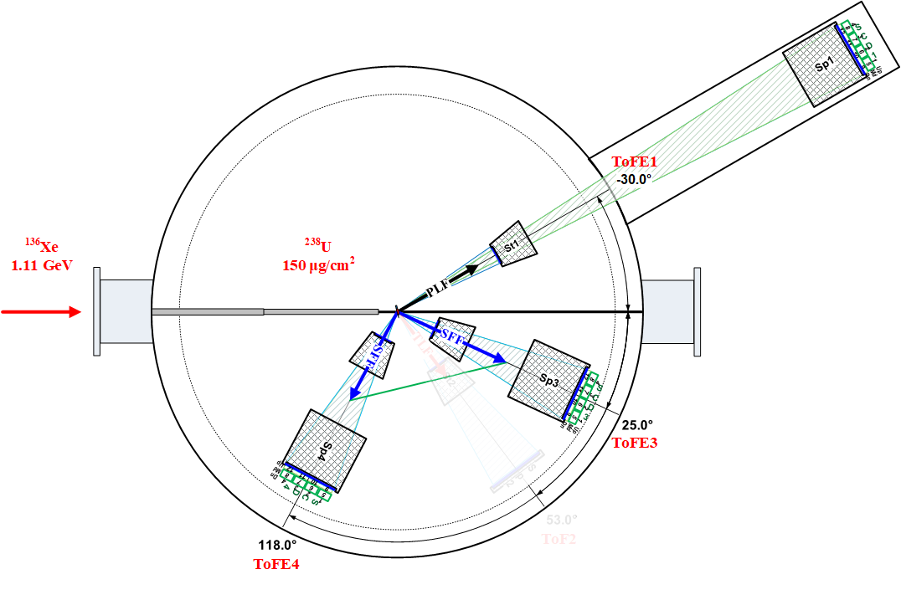
Experiments ¹³⁶Xe, ²⁰⁹Bi + ²³⁸U at energy ≈ 1.45 E_{Coulomb}
¹³⁶Xe (1.11 GeV) + ²³⁸U
¹³⁶Xe + ²³⁸U (150 μg/cm²)
ToFE1 acceptance angle | X: ±2.8° Y: ±2.1°
ToFE3 acceptance angle | X: ±7.3° Y: ±5.5°
ToFE4 acceptance angle | X: ±7.6° Y: ±5.7°
Time resolution | 150-200ps
CORSET setup, FLNR
E.M. Kozulin et al., Phys. Rev. C 109, 034616 (2024)

Slide 10
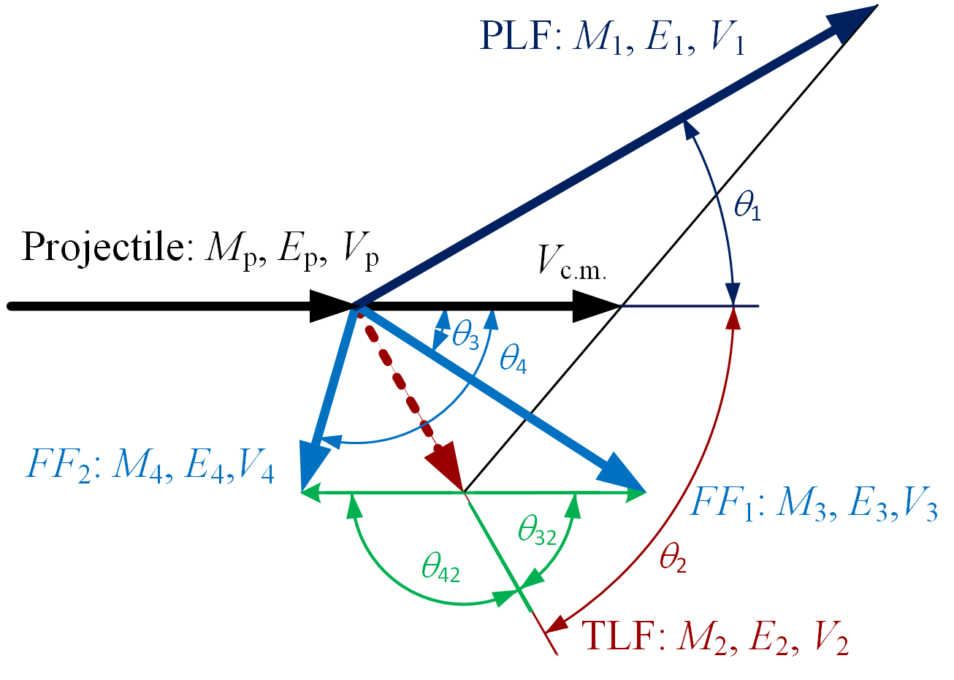
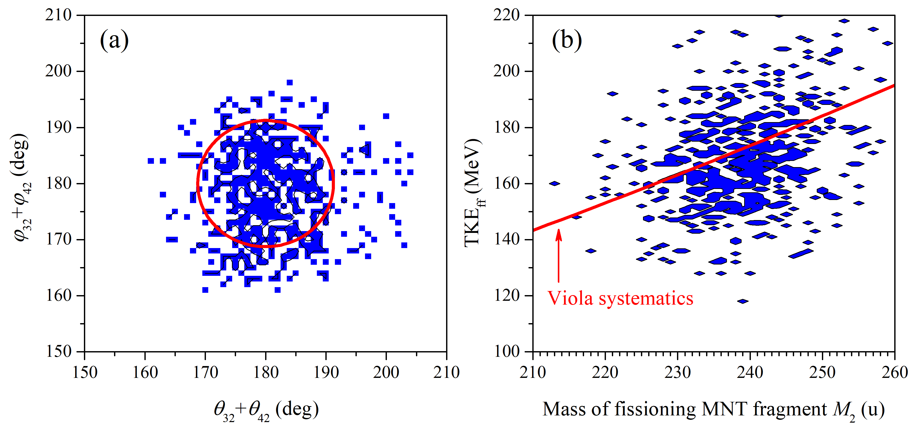
Sequential fission of excited TLF
¹³⁶Xe (1.11 GeV) + ²³⁸U
E.M. Kozulin et al., Phys. Rev. C 109, 034616 (2024)
The localization of folding angles around 180° and TKE_{ff} value close to the Viola systematics proves that the detected three-body events are formed as products of the two-stage process: the formation of 2 MNT fragments in the MNT reaction and then the sequential fission of the excited MNT fragment (TLF).

Slide 11
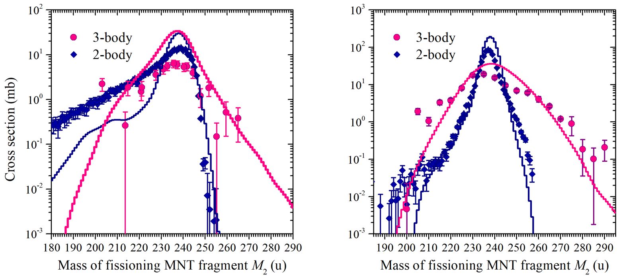
Mass distributions of primary TLFs for 2- and 3-body events
¹³⁶Xe (1.11 GeV) + ²³⁸U
²⁰⁹Bi (1.85 GeV) + ²³⁸U
The heaviest primary fragment mass found in the mass distribution for 3-body events for primary TLFs is:
265 u (Z ≈ 103, Lr isotopes)
with the cross section of a few hundred μb.
289 u (Z ≈ 113, Nh isotopes)
with the cross section of a few hundred μb.

Slide 12
Conclusion
In the investigation of MNT reactions as a possible tool to produce new isotopes of heavy and superheavy nuclei, the measurements of mass and energy distributions of fragments formed in the ¹³⁶Xe + ²³⁸U and ²⁰⁹Bi + ²⁰⁸Pb, ²³²Th, ²³⁸U reactions have been performed. For now modified CORSET setup allows studying binary processes, as well as 3-body events (projectile-like fragment + sequential fission of heavy MNT fragment).
The measurements of TKE of binary reaction fragments (via ToF-ToF method) allow to estimate the total excitation energy of composite system formed in MNT reaction. For survived transuranium fragments formed in the ²⁰⁹Bi + ²³⁸U reaction the total excitation energy is less than 70 MeV.
The heaviest survived observed primary fragments have mass around 255 u (Z ≈ 99-100, Es – Fm isotopes under the assumption of unchanged charge density) formed in the ¹³⁶Xe + ²³⁸U reaction with the cross section of about 2 microbarns and 257 u (Z ≈ 101, Fm – Md isotopes) formed in the ²⁰⁹Bi + ²³⁸U reaction with the cross section of about 30 microbarns.
Due to registration of 3-body events the heaviest fissioning TLFs have been observed, which have masses around 265 u (Z ≈ 103, Lr isotopes) formed in the ¹³⁶Xe + ²³⁸U reaction and 289 u (Z ≈ 113, Nh isotopes) formed in the ²⁰⁹Bi + ²³⁸U reaction with the cross sections of a few hundred microbarns, i.e. the massive nucleon transfers from projectile to target nucleus of about 27 u and 51 u respectively have been observed!

Slide 13
Thank you for your attention!
60th meeting of the PAC for Nuclear Physics 23-24 January, 2025 JINR, Dubna

