Slide 1
Possibilities of producing medically relevant Auger electron emitter ^{195m}Pt
Alexander S. Madumarov
Flerov Laboratory of Nuclear Reactions, JINR
60th meeting of the PAC for Nuclear Physics

Slide 2
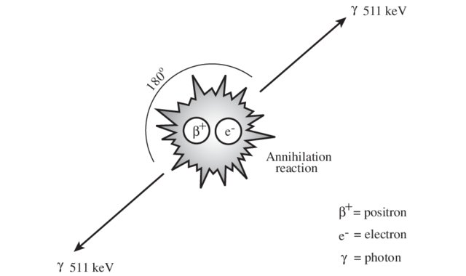
Radiation ‘in service’ to Nuclear medicine
Nuclear medicine
therapy
diagnostics
-gamma SPECT
-positron PET
(half life 0.125 ps)
high LET
low LET
-alpha
-conversion
electrons
-Auger
electrons
-beta
particle radiation
electromagnetic
Theranostics

Slide 3
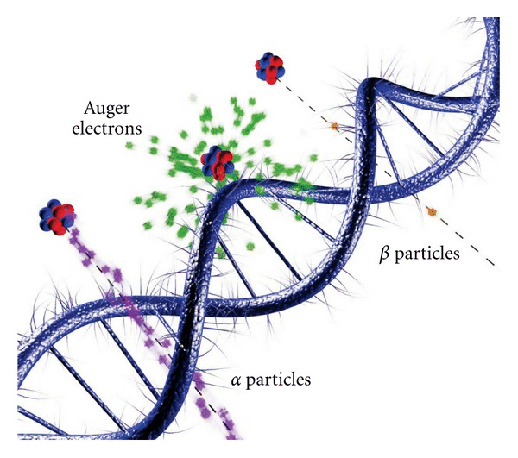
Auger Emitters in Medicine
High LET
(about 10⁴-10⁷ Grey/decay/nm³)
Available radionuclides:
⁶⁷Ga, ¹¹¹In, ^{123,125}I, ^{99m}Tc, ²⁰¹Tl
Taken from Web site of Department of Nuclear Physics Research School of Physics & Engineering ANU College of Physical & Mathematical Sciences

Slide 4
Nuclear properties of ^{195m}Pt
Nuclide | T_{1/2}, d | E_{γ}, keV | Yield per 100 decays | Decay type | Auger electrons per decay
^{195m}Pt | 4.02 | 98.9 | 11.4 | IT | 36.6
 |  | 129.8 | 2.83
Theranostics (personalised medicine)

Slide 5
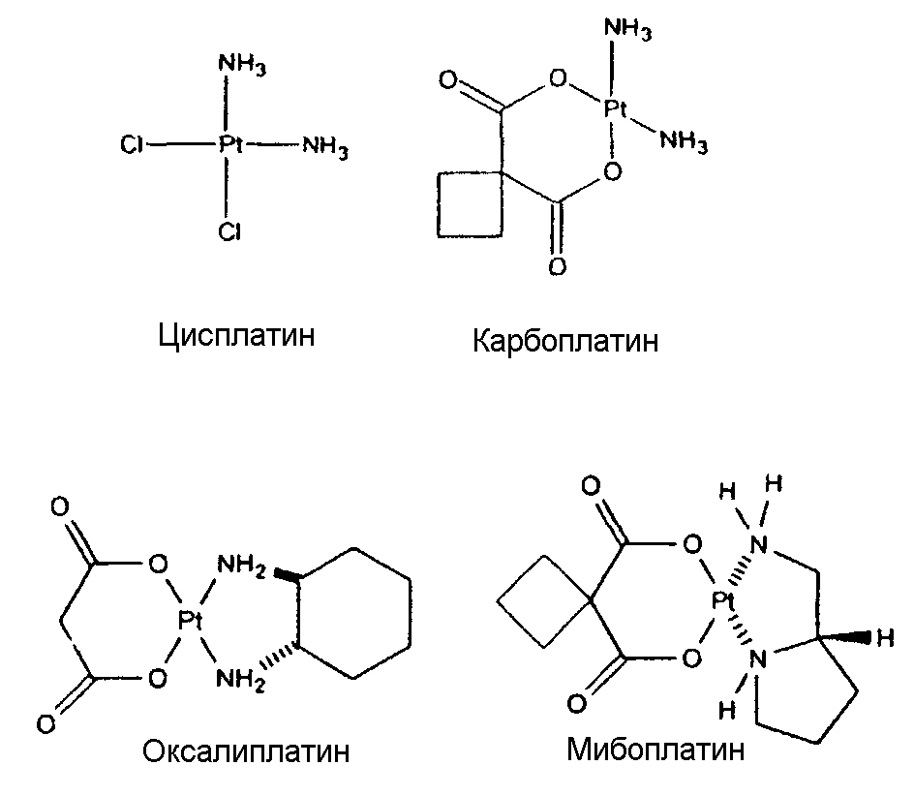
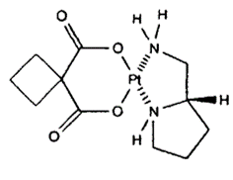
Platinum complexes
Carboplatin
Miboplatin
Cisplatin
Oxaliplatin
Pt→*Pt same efficacy, smaller toxic effect!

Slide 6
^{195m}Pt Production
Reactions | Cross section, <σ> | Specific activity (SA)
Reactor
¹⁹⁴Pt(n,γ)^{195m}Pt | 0.09 | Max SA = 44 MBq/mg Pt
Accelerator
¹⁹⁹Hg(γ,α)^{195m}Pt | (Max yield ≈ 1.1 GBq) | High SA ≈ 370 GBq/mg
¹⁹⁷Au(γ,np)^{195m}Pt | ≈ 2⋅10⁻³ | SA ≈ 37 GBq/mg
¹⁹²Os(α,n)^{195m}Pt | 3.7⋅10⁻³ (Max yield: 1 MBq) | No carrier added, high SA
¹⁹⁶Pt(γ,n)^{195m}Pt ¹⁹⁵Pt(γ, γ’)^{195m}Pt | (Yield > 1 MBq/mg Pt) | Max SA ≈ 259 MBq/mg Pt
Hoeschele,
1982
Dikiy,
2007
Dikiy, 2005
Qaim, 2008
Method to produce with high specific activity and yield is needed!

Slide 7
Photonuclear method
Eγ, MeV | Radionuclide | Specific activity A, MBq/mg | Yield, kBq/(μА⋅mg⋅h) | Radionuclide ratio [Y_{m}/Y_{x}]
23 | ^{195m}Pt | 0.20 | 8.55 | 0.15
 | ¹⁹¹Pt | 1.30 | 57.0
Reactions involved:
¹⁹²Pt(γ,n)¹⁹¹Pt
¹⁹⁶Pt(γ,n)^{195m}Pt
¹⁹⁵Pt(γ,γ′)^{195m}Pt
Irradiation parameters:
W = 0.57 kW
I_{e} = 12 μA
E_{e} = 23 MeV.

Slide 8
Photonuclear cross sections
¹⁹⁶Pt(γ,n)^{195m}Pt

Slide 9
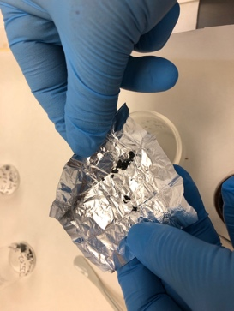
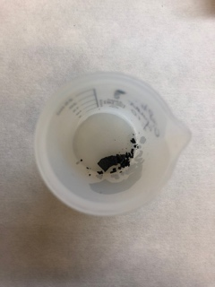
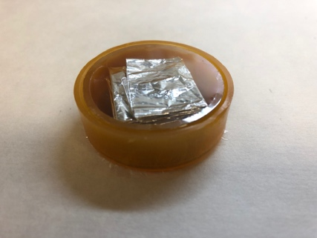
Target composition
Target: {cis-[Pt(NH₃)₂Cl₂], KMn₈O₁₆}.
m(cis-[Pt(NH₃)₂Cl₂]) ≈ 20 mg.
m(cis-[Pt(NH₃)₂Cl₂]):m(KMn₈O₁₆) = 1:b, where b = 1, 2, 5, 8, 10.
Szillard-Chalmers technique for specific activity elevation:
1. Cisplatinum – recoil nuclei emitter
2. Cryptomelane K₂(Mn⁴⁺,Mn²⁺)₈(0,OH)₁₆ (KMn₈O₁₆) – recoils acceptor
3. Initial Pt compound and released atoms of Pt* show different chemical properties
Target assembly
Irradiation

Slide 10
Radioactive platinum separation
Target cisPt+KMn₈O₁₆
10 ml H₂O (80-90 °С)
10 ml H₂O (80-90 °С)
cisPt
Decantation
KMn₈O₁₆
Dissolution in
1 М HCl + 1.5 % H₂O₂
Platinum elution
Dowex 50Wx8
Separation
0.5 ml 0.1 M HCl
Evaporation

Slide 11
Isolation of Pt out of cryptomelane
0.1 M HCl
3 M HCl
Resin Dowex50Wx8 (200 mesh), H⁺
h = 4.3 cm
Ø10-11.3 cm

Slide 12
Ratio impact on yield and SA of ^{195m}Pt

Slide 13
Conclusions
Photonuclear approach:
Maximum yield and carrier discard are found for platinum to be 81% and 90% respectively, further improvements of the technique are being explored.

Slide 14
Thank you for your kind attention!

