Slide 1
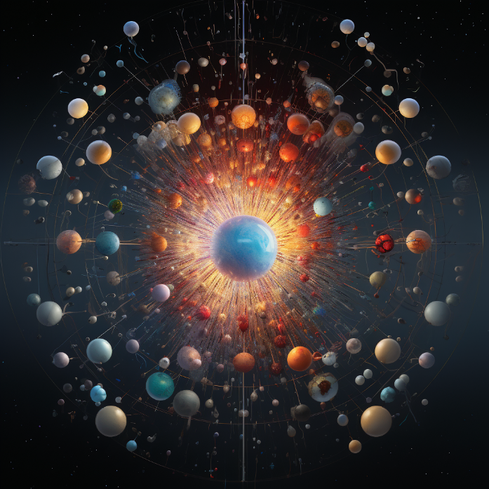

Study of the properties of elements with Z ≥ 100.
«Joint Institute for Nuclear Research»
«Flerov Laboratory of Nuclear Reactions»
«60th meeting of the PAC for Nuclear Physics»
Dubna, 2025

Slide 2
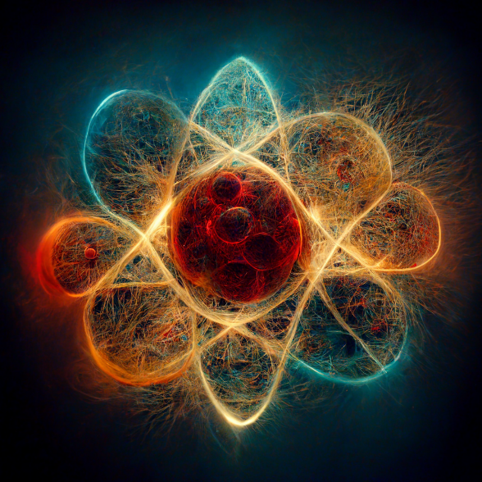
Outlook
Areas of interest
Description of facilities
Detection systems and their characteristics
Experiments for 2024 year
Conclusions

Slide 3

Areas of interest
⁴⁸Сa+²⁴²Pu→²⁸⁶Fl+4n σ_{max}= 4.4 pb !
…
Experiments carries out in region:
Transuranium isotopes (from Po to Fm)
Heavy nuclei (from No to Sg)
Super heavy elements
⁴⁰Ar+²⁰⁹Bi→²⁴⁶Md+3n σ_{max}= 10 nb
²⁶Mg+²⁰⁸Pb→²³⁰Pu+4n σ_{max}= 21.5 nb
²⁶Mg+²⁰⁶Pb →²²⁷Pu+5n σ_{max}= 0.11 nb
²⁶Mg+²⁰⁴Pb →²²⁶Pu+4n σ_{max}= 20 pb
…
⁴⁸Сa+²⁰⁴Pb→²⁵⁰No+2n σ_{max}= 10 nb
⁴⁸Сa+²⁰⁶Pb →²⁵²No+2n σ_{max}= 0,5 µb
⁴⁸Сa+²⁰⁸Pb →²⁵⁴No+2n σ_{max}= 2 µb
⁵⁰Ti+²⁰⁸Pb → ²⁵⁶Rf+2n σ_{max}= 12 nb
⁵⁰Ti+²⁰⁹Bi → ²⁵⁸Db+2n σ_{max}= 4 nb
…

Slide 4
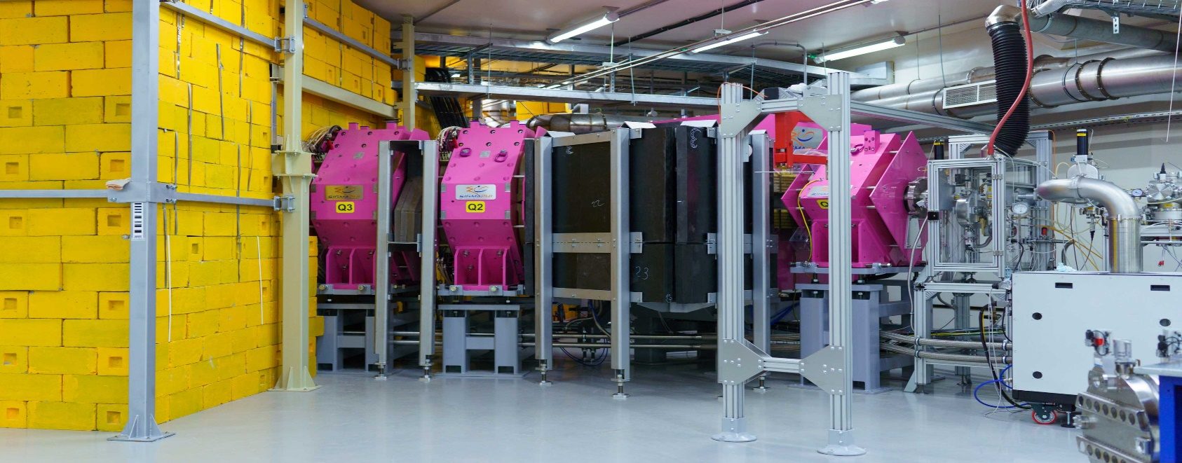
Facilities
SHELS
GRAND
Separator for Heavy Elements Spectroscopy
Gas-filled Recoil Analyzer and Nuclei Detector
 | SHELS | GRAND
System | Vacuum | Gas (He, H)
Transmission (⁴⁸Ca) | < 45 % | < 60 %
Cyclotron | U-400 | DC-280
Detection system | Digital GABRIELA/SFiNX | GABRIELA/CRYOdetector

Slide 5
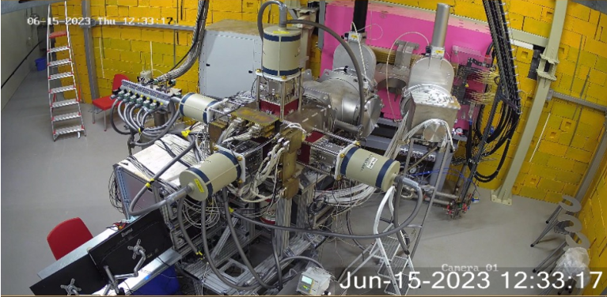
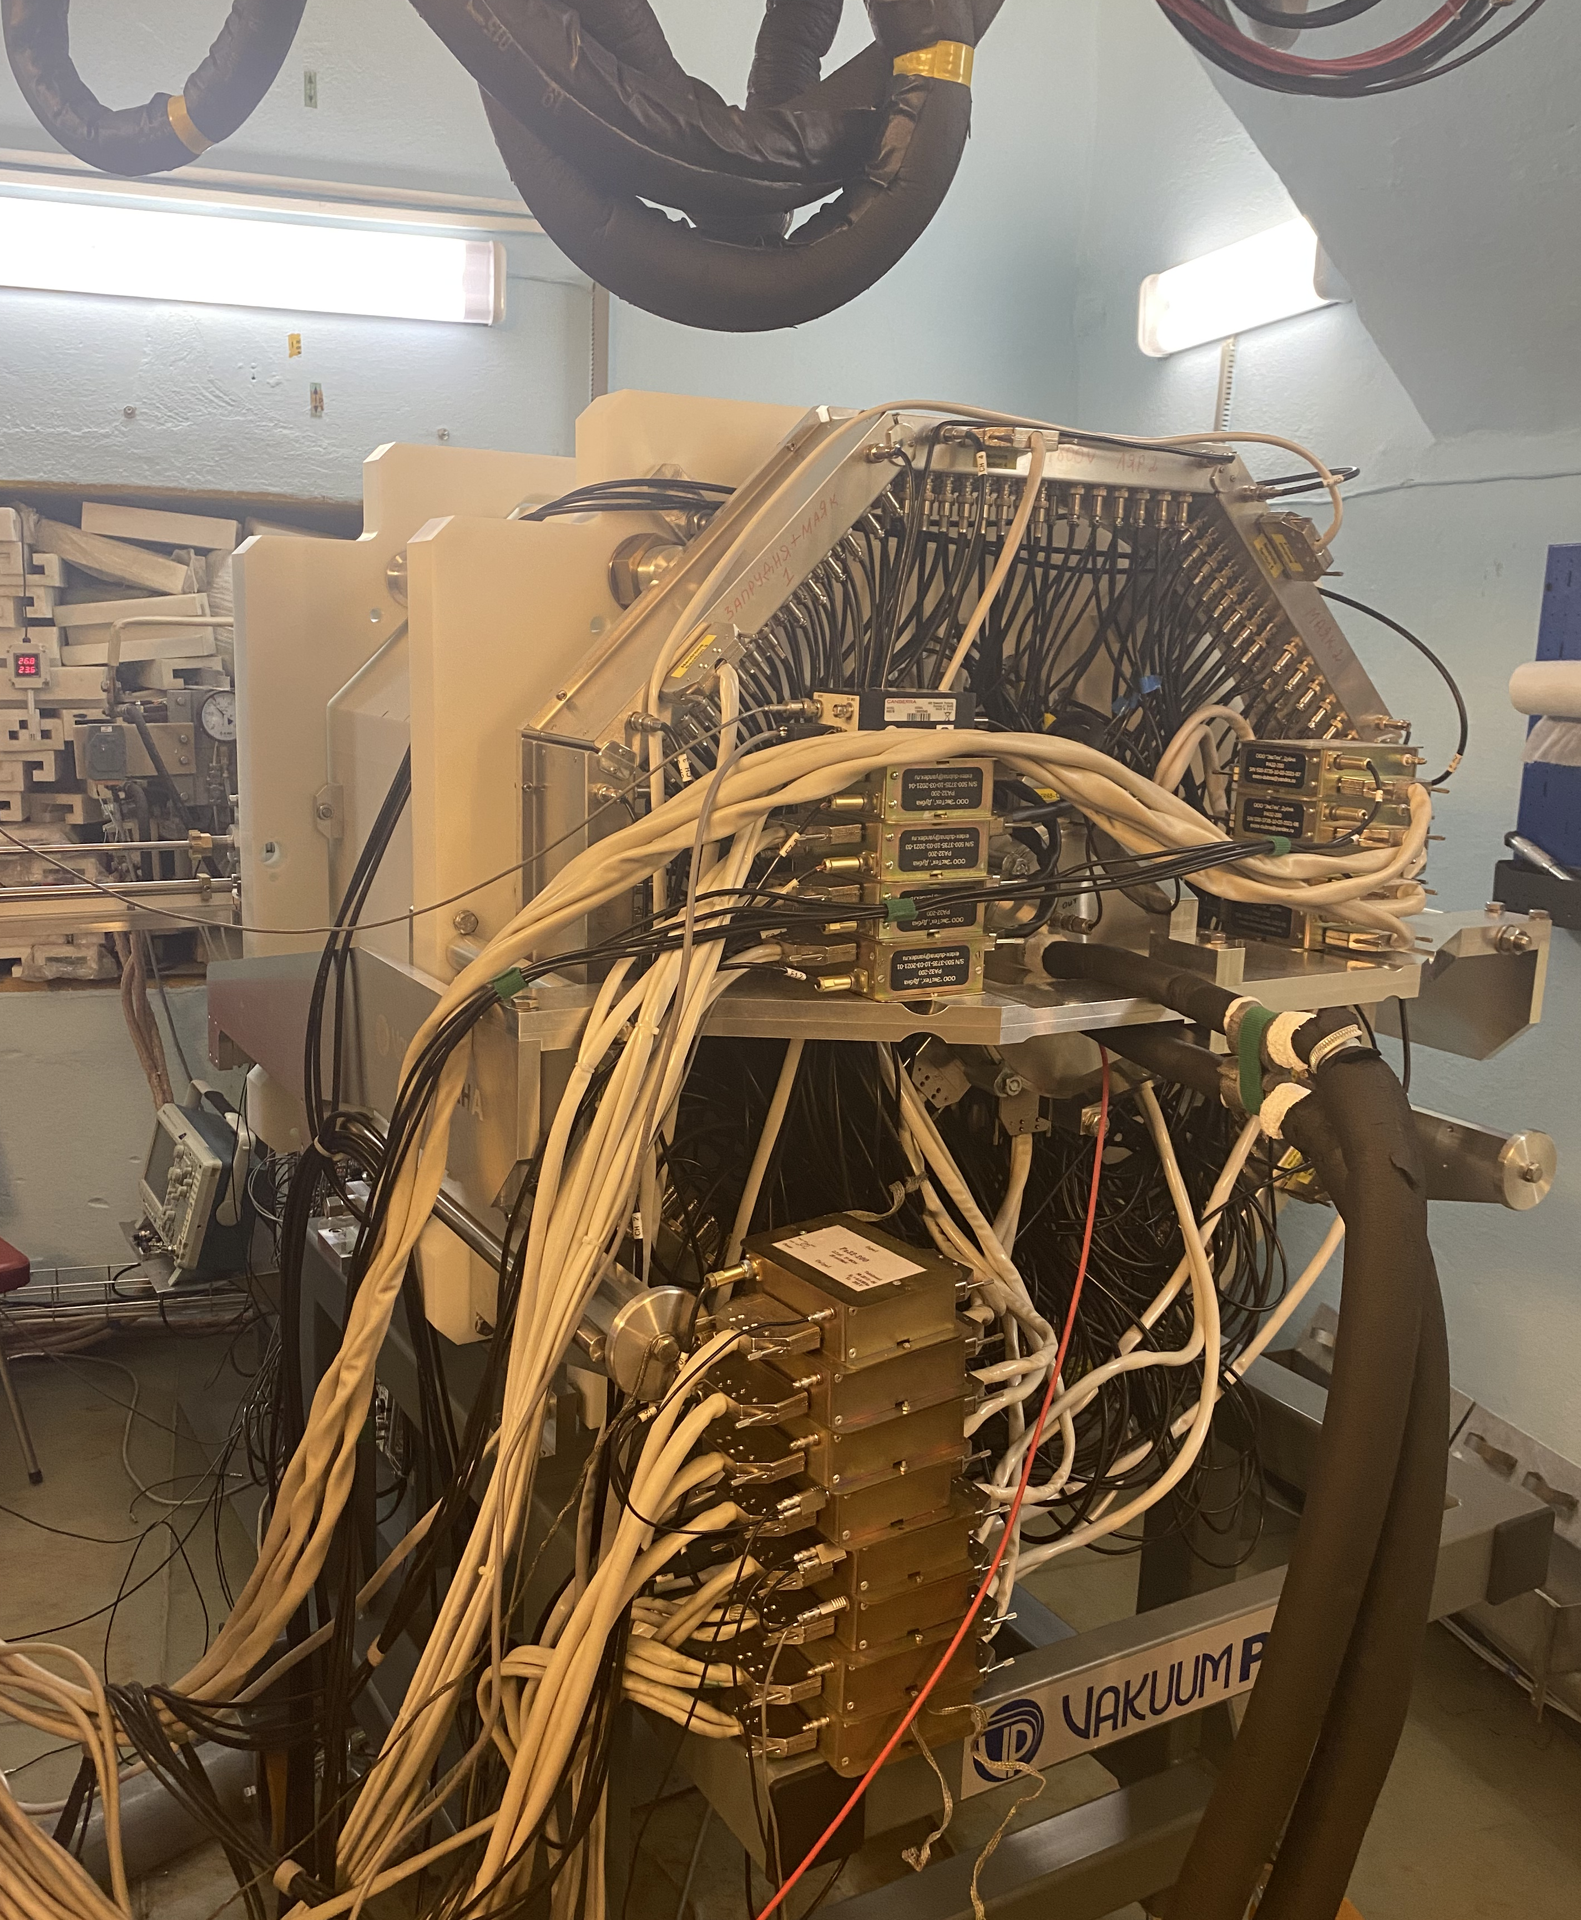
Detection systems
GABRIELA-III
Gamma Alpha Beta Recoil Investigation with the Electromagnetic Analyser
SFiNX
Spontaneous Fission, Neutrons and X-rays
Characteristics of the GABRIELA:
Characteristics of the SFiNX:
Focal Si-detector (DSSD)
Size: 100x100mm² or 128x128 strips;
16384 pixels;
Thickness: 500µm.
Tunnel Si-detectors (DSSD)
Size: 50x60mm²,
8 plats;
Thickness: 700 µm;
Neutron-detector
116 ³He neutron counters.
Focal Si-detector (DSSD)
Size: 100x100mm² or 128x128 strips;
16384 pixels;
Thickness: 500µm.
5 Ge-detectors
Clovers (a 4-crystal diameter 100 mm, length 70 mm)
BGO
Time-Of-Flight system
2 foils
4 MCP (70х90 mm²)
9 Gamma-detectors
CLLBC scintillators
Tunnel Si-detectors (DSSSD)
Size: 50x60mm²,
8 plats;
Thickness: 700 µm;

Slide 6
Experiments 2024
 | Reaction | Recoil nuclei | Beam dose, 10¹⁸ ions | Target thickness, μg/sm² | I, pμA. | E_{beam}, MeV | Set-up/ Detector
1 | ⁴⁰Ar+²⁰⁹Bi | ^{246,247}Md | 2.9 | 526 | 0.5 | 202-206 | SHELS/ SFiNX
2 | ⁴⁸Ca+²⁰⁶Pb | ²⁵²No | 9.4 | 690 | ≤ 6 | 228-231 | GRAND/ GABRIELA
3 | ⁵⁴Cr+²⁰⁷Pb | ^{259,260}Sg | 1.5 | 455 | 0.5 | 267 | SHELS/ SFiNX

Slide 7
⁴⁰Ar+²⁰⁹Bi→²⁴⁹Md*
Experiment’s characteristics:
We used target pure ²⁰⁹Bi with thickness d_{t} = 526 μg/cm², ion charge ⁴⁰Ar is 16⁺, I_{b} = 0.5 μpA.
Energy beam is 202—206 MeV.
Objectives of the experiment: to study the properties of the isotopes ^{246,247}Md and to measure the cross-section of formation of evaporation residues for the reaction ⁴⁰Ar+²⁰⁹Bi.
Data analysis was carried out using correlation methods.
Detection system: SFiNX
α-spectrum, which was received in the reaction ⁴⁰Ar+²⁰⁹Bi.

Slide 8

²⁴⁶Md
Literature data
43 decays of ²⁴⁶Md, which were got in mother-daughter correlations ER-α₁-α₂.
Energy of α-particles and half-lives of ²⁴⁶Md, ²⁴²Es in good agreement with literature data.
b_{α}~100%
²⁴⁶Md
900 ms
8530, 8741
IT
4.4 s
8178
b_{α}~23%
b_{EC}~77%
b_{α}~23%
b_{EC}~77%
α-spectrum of isotopes ²⁴⁶Md and ²⁴²Es, which was received in the reaction ⁴⁰Ar + ²⁰⁹Bi.
b_{α}~93%
b_{EC}~1.3%
b_{SF}~6.8%
b_{α}~57%
b_{EC}~43%
²⁴⁶Fm
1.54 s
8198, 8242
²⁴²Es
17 s
7870, 8025
Experimental data
Isotope | T_{1/2} | E_{α}, keV
²⁴⁶Md | 1.3±0.2 s | 8543±32, 8759±31
²⁴²Es | 16.4±3 s | 7891±22, 7851±20, 8021±19
The distribution of lifetimes ²⁴⁶Md and ²⁴²Es, which was received in the reaction ⁴⁰Ar + ²⁰⁹Bi.

Slide 9
²⁴⁷Md
Literature data
35 decays of ²⁴⁷Md, which were got in mother-daughter correlations ER-α₁-α₂.
Energy of α-particles and half-lives of ²⁴⁷Md and ²⁴³Es in good agreement with literature data.
²⁴⁷Md
1.2 c
8416, 8345, 8616
IT
0.25 с
8660, 8783
b_{α}~99%
b_{α}~79%
b_{SF}~21%
α-spectrum of isotopes ²⁴⁷Md and ²⁴³Es, which was obtained in the reaction ⁴⁰Ar + ²⁰⁹Bi.
²⁴³Es
21 с
7893,7850,7939,7745
b_{α}~61%
b_{SF}~1%
Experimental data
Изотоп | T_{1/2} | E_{α}, keV
²⁴⁷Md | 1.18±0.2 s | 8421±26, 8380±20
²⁴³Es | 12±2.5 s | 7875±35
The distribution of lifetimes ²⁴⁷Md and ²⁴³Es, which was received in the reaction ⁴⁰Ar + ²⁰⁹Bi.

Slide 10
Fusion-evaporation cross sections for the reaction ⁴⁰Ar+²⁰⁹Bi
[1] M. Wang et al., Chin. Phys. C 41, 030003 (2016).
[2] F. P. Heßberger et al., Eur. Phys. J. A 26, 233 (2005).
[3] Karpov A. V. et all, Phys. Part. Nucl. Lett., 2018. V. 15. P. 247.
MeV
MeV
Excitation function for 2n, 3n-channels in the complete function reaction ⁴⁰Ar+²⁰⁹Bi. Dots – the experiment data, dashed lines – theoretical estimates, which were made in NRV [3] program.

Slide 11
Isotopes ^{246,247}Fm in ⁴⁰Ar+²⁰⁹Bi
b_{α}~100%
²⁴⁶Md
900 ms
8530, 8741
IT
4.4 с
8178
b_{α}~99%
²⁴⁷Md
1.2 c
8416, 8345, 8616
IT
0.25 с
8660, 8783
b_{α}~23%
b_{EC}~77%
b_{α}~79%
b_{SF}~21%
Question!
How does the formation of ²⁴⁶Fm nucleus occur?
though EC in ²⁴⁶Md
Or in p2n-channel
b_{α}~93%
b_{EC}~1.3%
b_{SF}~6.8%
²⁴⁷Fm
31 s
7824
IT 5.1 с 8172
²⁴⁶Fm
1.54 s
8198, 8242
b_{α}~64%
b_{EC}~36%
9 chains
6 chains
²⁴²Cf
3.4 m
7358, 7392
(p2n)
b_{α}~61%
b_{EC}~39%
²⁴³Cf
10.7 m
7060, 7170
(p1n)
b_{α}~14%
b_{EC}~86%
Isotope | Lifetime, τ | E_{α}, keV
²⁴⁶Fm | 5 s | 8161, 8242
²⁴⁷Fm | 17 s | 7821
α-spectrum of isotopes ²⁴⁶⁻²⁴⁷Fm and ²⁴²⁻²⁴³Cf, which was received in the reaction ⁴⁰Ar + ²⁰⁹Bi.

Slide 12
Fusion-evaporation cross sections for the reaction ⁴⁰Ar+²⁰⁹Bi
Cross section, nb
Cross section, nb
MeV
MeV
Excitation functions for p1n, p2n-channels in the complete function reaction ⁴⁰Ar+²⁰⁹Bi. Dots – the experiment data, lines – theoretical estimates, which were made in NRV [1] program.
[1] Karpov A. V. et all, Phys. Part. Nucl. Lett., 2018. V. 15. P. 247.

Slide 13
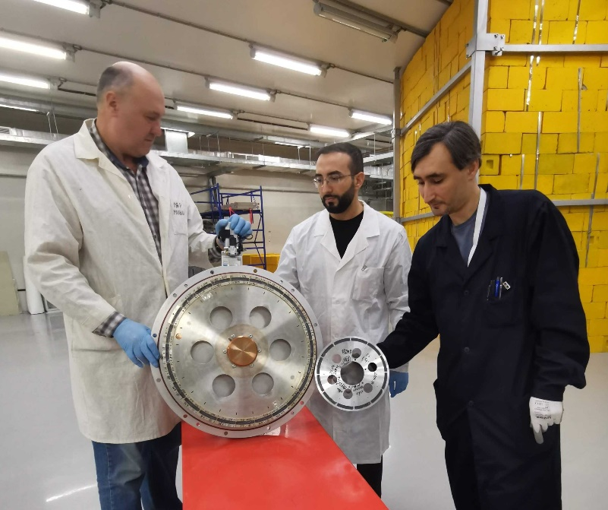
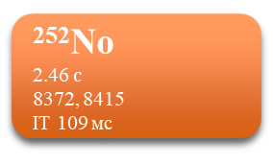
⁴⁸Ca+²⁰⁶Pb→²⁵⁴No*
²⁵²No
2.46 $с$
8372, 8415
IT 109 мс
b_{α}~65%
b_{EC}~1.7%
b_{SF}~33%
Testing new big target (D= 480 mm) with thickness 690 μg/cm².
Beam dose 9.4·10¹⁸ ions was received by intensity beam ≤ 6 pμA (DC-280).
Detection system: GABRIELA
²⁴⁸Fm
34.5 с
7830, 7870
b_{α}~95%
b_{EC}~5%
b_{SF}~0.1%
²⁴⁴Cf
19 м
7174, 7209
Statistic of isotope ²⁵²No:
In correlation type ER-α ~ 3.5·10⁵
In correlation type ER-SF ~ 1.7·10⁵
b_{α}~100%
Comparison of two targets 480 and 240 mm.
The two dimensional energy spectrum of the α₁ of first generation energy correlated to the α₂ of second generation energy.

Slide 14
Fusion-evaporation cross sections for the reaction ⁴⁸Ca+²⁰⁶Pb
E*, MeV
Cross section, nb
[a] Belozerov et. Al., European Physical Journal, A 16 (2003) 447
[b] Karpov A. V. et all, Phys. Part. Nucl. Lett., 2018. V. 15. P. 247.
MeV
Experimental cross-section for 1n, 2n, 3n evaporation channels in complete fusion reaction ⁴⁸Ca+²⁰⁶Pb. Dots – the experiment data, dashed lines – theoretical estimates, which were made in NRV [b] program.

Slide 15
Gamma spectroscopy ^{252m}No
Gamma spectrum for the isomeric state in ²⁵²No with T_{1/2} = 104 ms.
Data in progress!

Slide 16
⁵⁴Cr+²⁰⁷Pb→²⁶¹Sg*
b_{α}~70%
b_{EC}~10%
b_{SF}~20%
b_{α}~50%
b_{SF}~50%
²⁵⁹Sg
290 ms
9550, 9050, 9607
²⁶⁰Sg
3.6 ms
9720, 9750
Experiment’s characteristics:
We used target ²⁰⁷Pb with thickness d_{t} = 455 μg/cm², ion charge ⁵⁴Cr is 22⁺, I_{b} = 0.5 μpA.
Energy beam is 268 MeV.
Objectives of the experiment: to study the properties of isotopes ^{259,260}Sg and to measure the neutron multiplicity for isotope ²⁶⁰Sg.
Data analysis was carried out using correlation methods.
Detection system: SFiNX
²⁵⁵Rf
1.6 s
8716
IT 25μs
b_{α}~0.3%
b_{SF}~99.6%
b_{α}~48%
b_{EC}~41%
b_{SF}~1%
²⁵⁶Rf
6.6 ms
8790
IT 25μs
2023-2024
Result
We are among the first to see the fine structure of ²⁶⁰Sg in the α-spectrum.
α-spectrum, which was obtained in the reaction ⁵⁴Cr+²⁰⁷Pb.

Slide 17
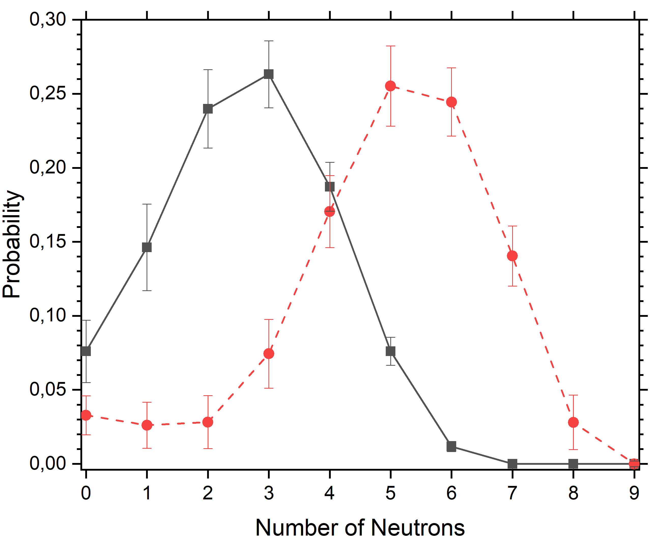
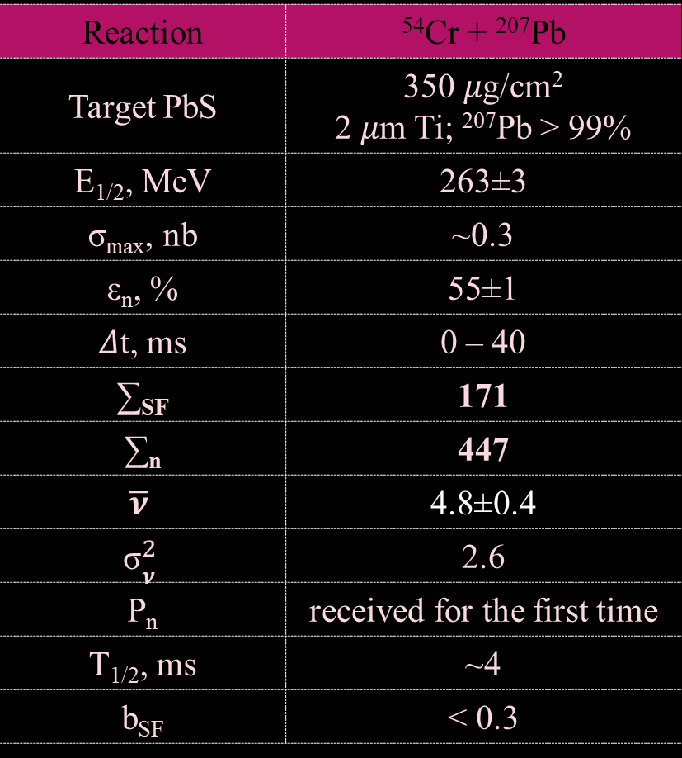
The neutron multiplicity for ²⁶⁰Sg
Reaction | ⁵⁴Cr + ²⁰⁷Pb
Target PbS | 350 𝜇g/cm² 2 𝜇m Ti; ²⁰⁷Pb > 99%
E_{1/2}, MeV | 263±3
σ_{max}, nb | ~0.3
ε_{n}, % | 55±1
𝛥t, ms | 0 – 40
∑_{SF} | 171
∑_{n} | 447
$$\overline{\text{ν}}$$ | 4.8±0.4
$${\text{σ}}_{\text{ν}}^{2}$$ | 2.6
P_{n} | received for the first time
T_{1/2}, ms | ~4
b_{SF} | < 0.3
2023
Exp.
Preliminary results
Res.
The neutron multiplicity distribution for isotope of ²⁶⁰Sg
The Tikhonov method of statistical regularization was successfully adapted for the SFiNx detection system experimental data analysis [1].
[1] R.S. Mukhin, V.N. Dushin, A.V. Eremin, et. al, Physics of Particles and Nuclei Letters, Vol. 18, No. 4, pp. 439–444 (2021)

Slide 18
Results
Reaction | 1n | 2n | 3n
 | nb | nb | nb
⁴⁰Ar+²⁰⁹Bi | - | 0.36 (мах.) | 2 (мах.)
⁴⁸Ca+²⁰⁶Pb | 7.1 (мах.) | 194 (мах.) | 1.11
 |  | p1n | p2n
⁴⁰Ar+²⁰⁹Bi |  | 0.86 (мах.) | 0.137
1)
Statistic of isotope ²⁵²No:
In correlation type ER-α ~ 3.5·10⁵
In correlation type ER-SF ~ 1,7·10⁵
The collected statistics of the nobelium isotopes probably allow us to see new data.
2)
3)
The properties of ²⁶⁰Sg were study. The fine structure was observed in α-spectrum.
We measured the neutron multiplicity for this isotope.

Slide 19
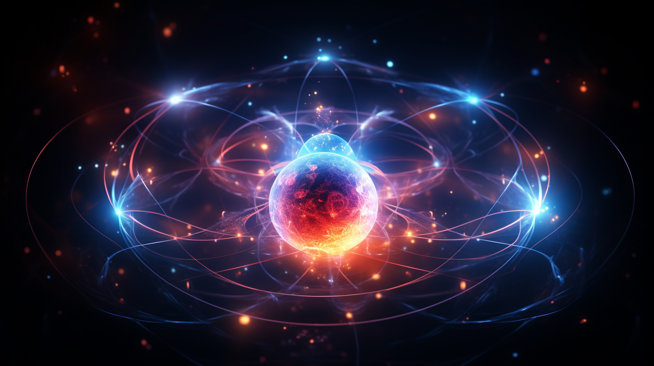
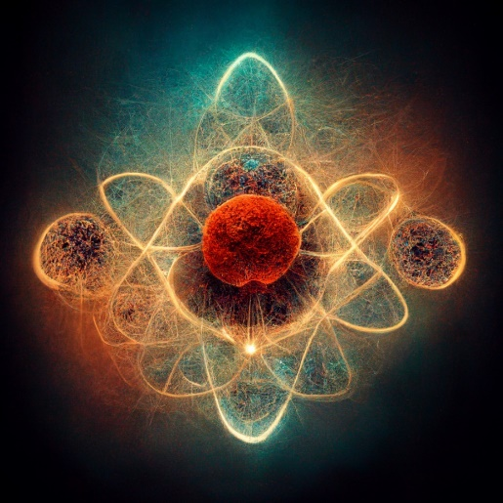
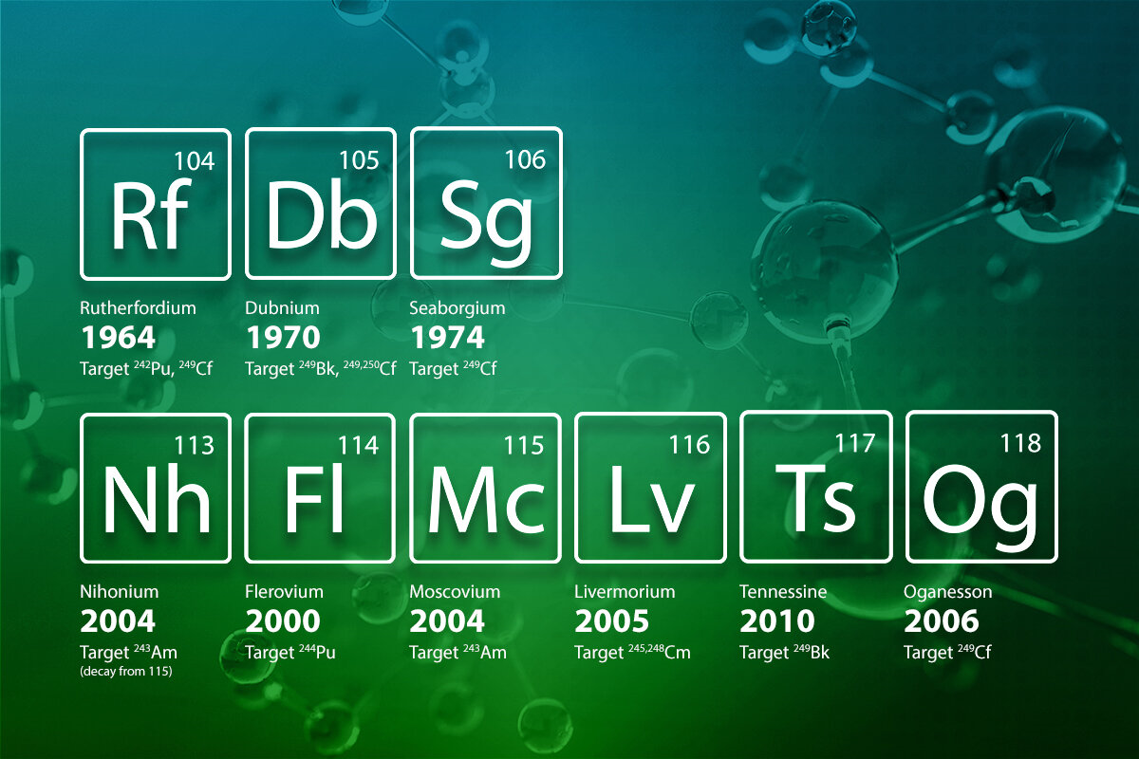
Thank you for your attention!

Slide 20
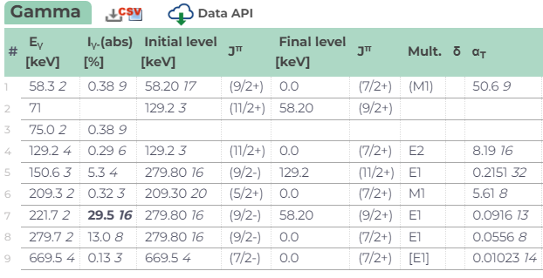

⁴⁸Ca+²⁰⁶Pb→²⁵⁴No*

Slide 21
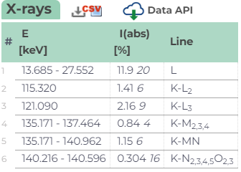

Slide 22
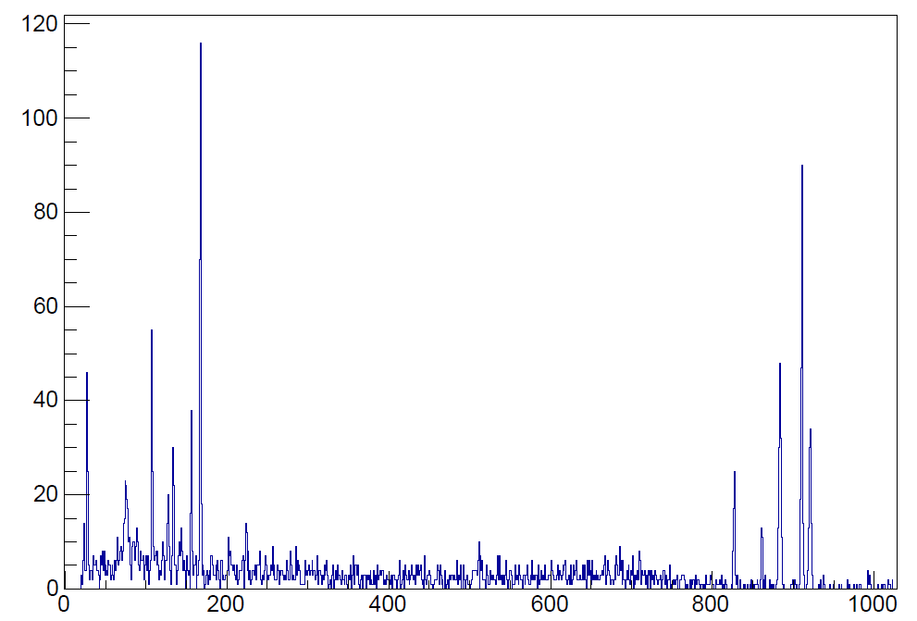
SHELS 2022
GRAND 2023

