Slide 1
On behalf of the Editorial Board 60th meeting of the PAC for Nuclear Physics, 23 Jan 2025

Slide 2
Motivation
✔ Approximately 4,000,000 articles in 40,000+ scientific journals worldwide per year
✔ Scientific journals are a profitable business: journal prices increase many times faster than inflation (615% / 70% over 17 years in the US)
Open Access:
– A global trend towards open access to scientific articles instead of traditional subscription access
– In keeping with the spirit of science, all the scientific achievements should be publicly available without commercial or military restrictions
– Open access increases the visibility and impact of scientific papers, leading to faster knowledge transfer and accelerating scientific and technological progress
Hybrid Open Access:
– Many libraries and academic organizations cannot afford to pay for journal subscriptions, exacerbating global inequalities between developed and developing countries
– Hybrid models shift publication costs to authors, creating a financial barrier for researchers
– The trend towards lower quality of Open Access publications due to publishers' interest in more publications
A new Diamond Open Access journal is a solution!

Slide 3
New journal for JINR Member States
Establishment Prerequisites:
– Wide discussion of the problem (G20-CSAR, EU Council, UNESCO)
– JINR Member States have only a few national journals from Q3-Q4 in high-energy and nuclear physics (Russia, Kazakhstan)
– Most of the English-language versions of highly rated journals belong to Pleiades Publishing (USA) and Turpion Ltd (UK)
– Geopolitical risks may affect the publication activity of researchers from these countries
Gold OA publications in the JINR Member States*:
Russia | 40,749 | Uzbekistan | 1,066
Egypt | 19,519 | Azerbaijan | 712
Romania | 9,067 | Cuba | 658
Vietnam | 4,719 | Georgia | 530
Slovakia | 3,184 | Armenia | 463
Kazakhstan | 2,551 | Mongolia | 442
Bulgaria | 2,261 | North Korea | 110
Belarus | 1,587
JINR Associate Members*:
Germany | 55,329 | Hungary | 5,723
Italy | 49,913 | Serbia | 4,461
South Africa | 12,239
*Plan S. Developing a globally fair pricing model for academic publishing. 2023.

Slide 4
New journal
JINR scientific journals:
- PEPAN (since 1970) - PEPAN Letters (since 1984) - Natural Science Review Concept proposal: - Analytical work and proposal preparations during 2023 - JINR Science and Technology Council (Dec 2023) - approved - JINR Committee of Plenipotentiaries (Mar 2024) - approved
English versions belong to Pleiades Publishing All reforms are nearly impossible due to existing contract

Slide 5
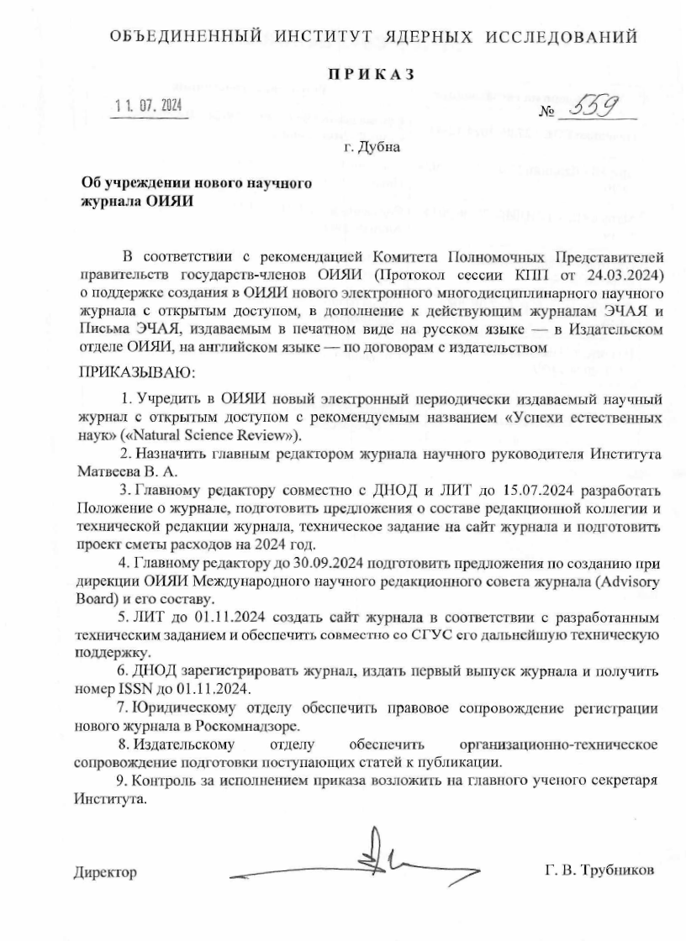
New journal
Decree no. 559 (11.07.2024) initiated the creation of the journal
– These days, the Natural Science Review is accepting papers
– The first issue closed with 7 articles in December 2024
– The second issue is open until the end of March 2025 Decree no. 1024 (10.12.2024) - Journal Regulations Decree no. 1044 (16.12.2024) - Editorial Board

Slide 6
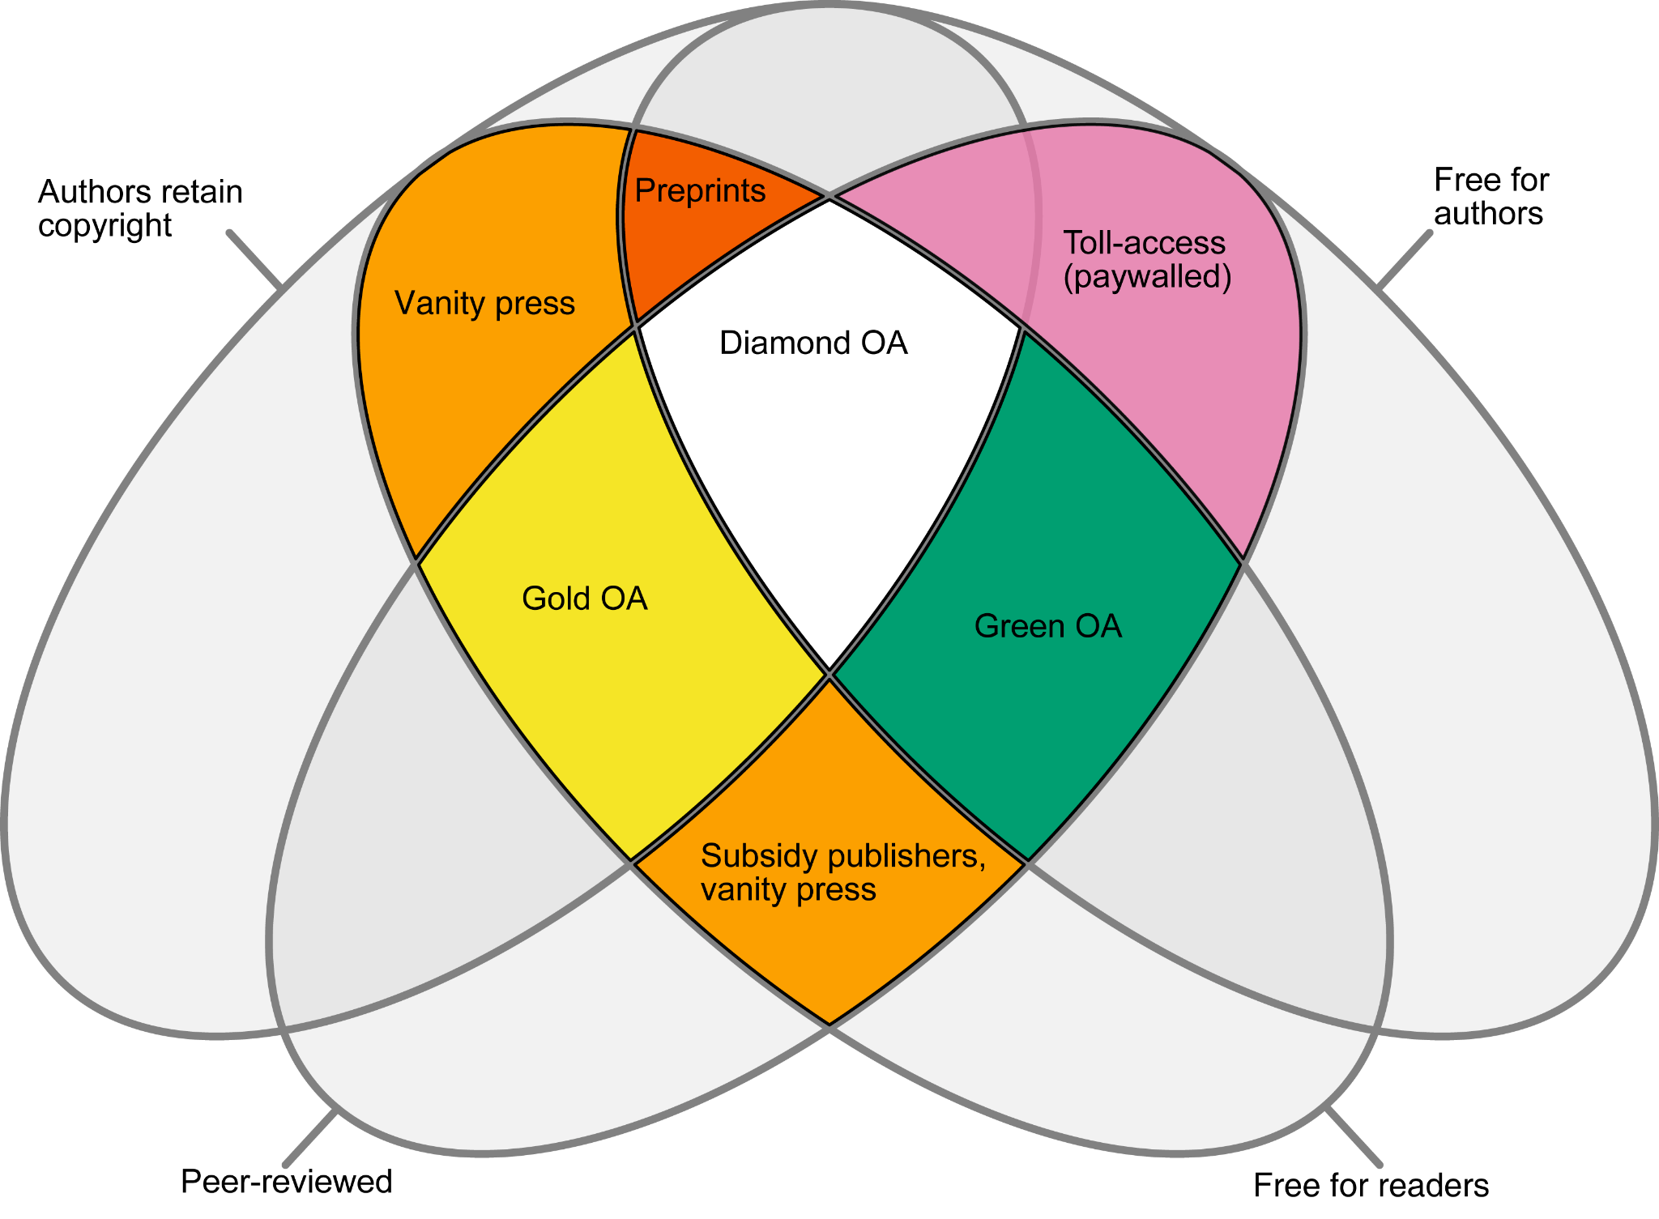
Workflow
Key concepts:
- online journal, no hard copy - scientific articles, reviews, intellectual products, TDR/CDR’s are accepted for publication - 4 issues per year, English language - accepting only top quality articles (no matter how many) - free for readers and authors (Diamond Open Access) - easy to adapt to modern trends as JINR is a publisher - various sections: historical and jubilee reviews, etc. - 2 weeks for one round of review (but good quality of reviewing is a priority) - 1 week for editing after being accepted - putting on the website in the current open issue = publishing
Prompt publication process:

Slide 7
Journal Topics
Physics: High Energy Physics (Theory and Experiment), Condensed Matter Physics (Theory and Experiment), Nuclear Physics (Theory and Experiment), Low Temperature Physics, Astronomy and Astrophysics, Accelerator Physics, Instruments and Methods, etc.
Mathematical and Computer Sciences: Statistical Methods, Mathematical Modelling, Numerical Methods, Information Technology and Software, etc.
Chemistry: Radiochemistry, etc.
Life Sciences: Biology, Nuclear Medicine, Ecology and Radiobiology, etc.
Earth and Environmental Sciences
Interdisciplinary Research
The list of possible topics is not full

Slide 8
Structure
Editor-In-Chief is V. A. Matveev
Deputy Editor-In-Chief is E. A. Kolganova
International Scientific Advisory Board G. V. Trubnikov (co-chair), Yu. T. Oganessian (co-chair), V. A. Matveev, D. I. Kazakov, V. D. Kekelidze, I. N. Meshkov, V. G. Riabov (PNPI), S. V. Troitsky (INR)
Editorial Board I. Ya. Aref'eva (MI), A. V. Boreyko, V. V. Braguta, D. S. Gorbunov (INR), R. V. Jolos, A. V. Karpov, V. T. Kim (PNPI), E. E. Kolomeitsev, Yu. N. Kopatch, V. V. Korenkov, N. Kučerka, V. A. Lebedev, R. Lednický, A. G. Olshevsky, V. N. Shvetsov, A. S. Zhemchugov
Technical editors JINR Publishing Department staff, PEPAN Editorial Office
This list is being updated

Slide 9
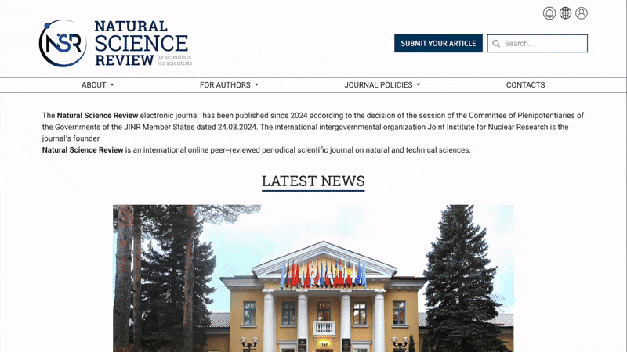
Current progress
Journal is ready to accept papers: - website: nsr-jinr.ru or nsr.jinr.int (alias) - all policies and workflow are settled - technical side is ready
Several articles were already reviewed and accepted for publication. Several more are still reviewing
So far, 1 issue with 7 articles is on the website

Slide 10
Current progress
Journal is ready to accept papers: - website: nsr-jinr.ru or nsr.jinr.int (alias) - all policies and workflow are settled - technical side is ready Any feedback on workflow is very appreciated - e-mail: NSR@jinr.int
Goals for current work period: - continue the regular work with a second and further issues, fine-tune the publishing process - finalise the registration of the ISSN and DOI tag - settle down all workflow of editors and technical editors with processing the articles - introduce the journal to the world

Slide 11
Further plans
There are more registrations to complete: trademark, etc.
Indexing in:
Web of Science: can apply in two years of work
Scopus: can apply from the beginning, but it's better to fulfil the requirements first
Higher Attestation Commission (ВАК): can apply in two years of work
Russian Science Citation Index: can apply after 50 articles published
After that, we will work on entering in Higher Attestation Commission (ВАК) analogues in Member States and other databases
There is a plan to obtain equal legal status in all Member States

Slide 12
Takeaways
Natural Science Review is a new scientific journal of JINR
It is ready to accept and process papers
Please consider this journal for your next publication
Any feedback on workflow or ideas are very appreciated
There is a good chance that in several years it will be a decent journal that all JINR will be proud of
nsr-jinr.ru or nsr.jinr.int (alias)

Slide 13
Credits to Working Group
Acknowledgements
JINR Directorate for scientific and methodological guidance
All JINR laboratories’ directorates for caring involvement
V. A. Matveev (Editor-In-Chief, Directorate) E. A. Kolganova (deputy Editor-In-Chief, BLTP) S. N. Nedelko (Directorate) A. S. Zhemchugov (DLNP, DSOA) O. Culicov (ICD) Legal Department Publishing Department Innovation and intellectual property Department L. D. Kolupaeva (DLNP) A. Yu. Nezvanov (FLNP)
D. R. Badreeva (MLIT) D. R. Bulatova (Press Office) V. V. Bytev (BLTP) N. A. Davydova (MLIT) R. M. Iakhibbaev (BLTP) O. V. Krupa (DSOA) D. K. Pugachev (FLNR) M. M. Shandov (VBLHEP) Yu. O. Solovyova (Editorial Office)

Slide 14
Takeaways
Natural Science Review is a new scientific journal of JINR
It is ready to accept and process papers
Please consider this journal for your next publication
Any feedback on workflow or ideas are very appreciated
There is a good chance that in several years it will be a decent journal that all JINR will be proud of
nsr-jinr.ru or nsr.jinr.int (alias)

