Slide 1
Modeling the survival rate of a heterogeneous population of neural stem cells in response to irradiation with ⁵⁶Fe particles
Competition for the JINR Awards for Young Scientists and Specialists
Glebov A.A., Kolesnikova E.A., Bugay A.N.
E-mail: glebov.atth@gmail.com

Slide 2
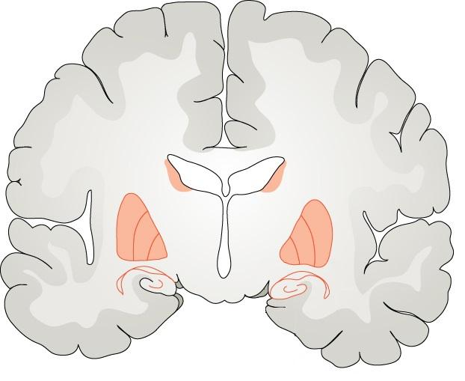
INTRODUCTION
MODELING
RESULTS
CONCLUSION
⁵⁶Fe

Slide 3
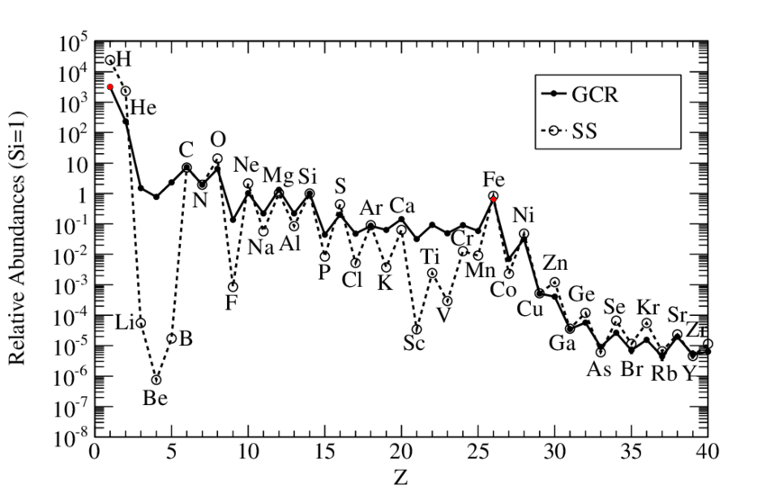
IRRADIATION WITH GALACTIC COSMIC RAYS
⁵⁶Fe
Solar System (SS) and Galactic cosmic ray (GCR) relative abundances at 2 GeV/nuc normalized to ¹⁴Si = 1. The number of protons is more than 1000 times greater than the number of iron particles.
Galactic cosmic rays pose a potential danger to the health of astronauts who will participate in interplanetary flights. Iron particles, although they make up only a small part of cosmic rays, have high linear energy transfer and high energy, which makes them a significant factor in the overall biological effect of cosmic rays on the human health and cognitive functions.
Left picture is taken from: Denoth-Lippuner, Annina, and Sebastian Jessberger. Nature Reviews Neuroscience 22.4 (2021): 223-236.
Right picture is taken from: Rauch, B. F. PoS (ICRC2019) 678 (2019).
3

Slide 4
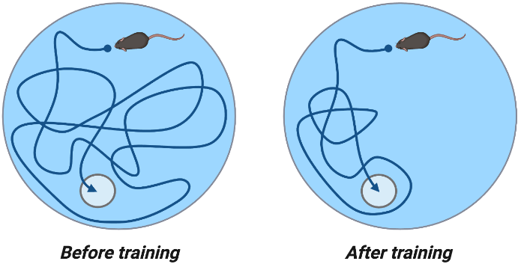
COGNITIVE IMPAIRMENT AFTER IRON IRRADIATION
The Morris Water Maze test measures the ability of rodents to learn and remember the spatial location of visual cues in a pool.
A platform is placed in the pool to prevent the mouse from seeing it. When a mouse first enters the pool, it swims aimlessly until it finds the hidden platform. Each time the mouse visits the pool, they get better at finding the platform. Using the clues on the wall, the mouse remembers where the platform is located.
⁵⁶Fe ion radiation (E=600 MeV/nucleon) induced deficits of spatial learning and memory of kunming mice, one month after exposure. Mice in irradiated groups showed significant increment of escape latency on days 2 – 6 compared to control group.
visual clue
hidden platform
visual clue
Control
1 Gy
2 Gy
Top picture is taken from: BioRender (2019). Morris Water Maze Test. https://app.biorender.com/biorender-templates/t-5e1f34bc6bca2300870629c0-morris-water-maze-test
Bottom picture is taken from: Yan, Jiawei, et al. Toxicology research 5.6 (2016): 1672-1679.
4

Slide 5
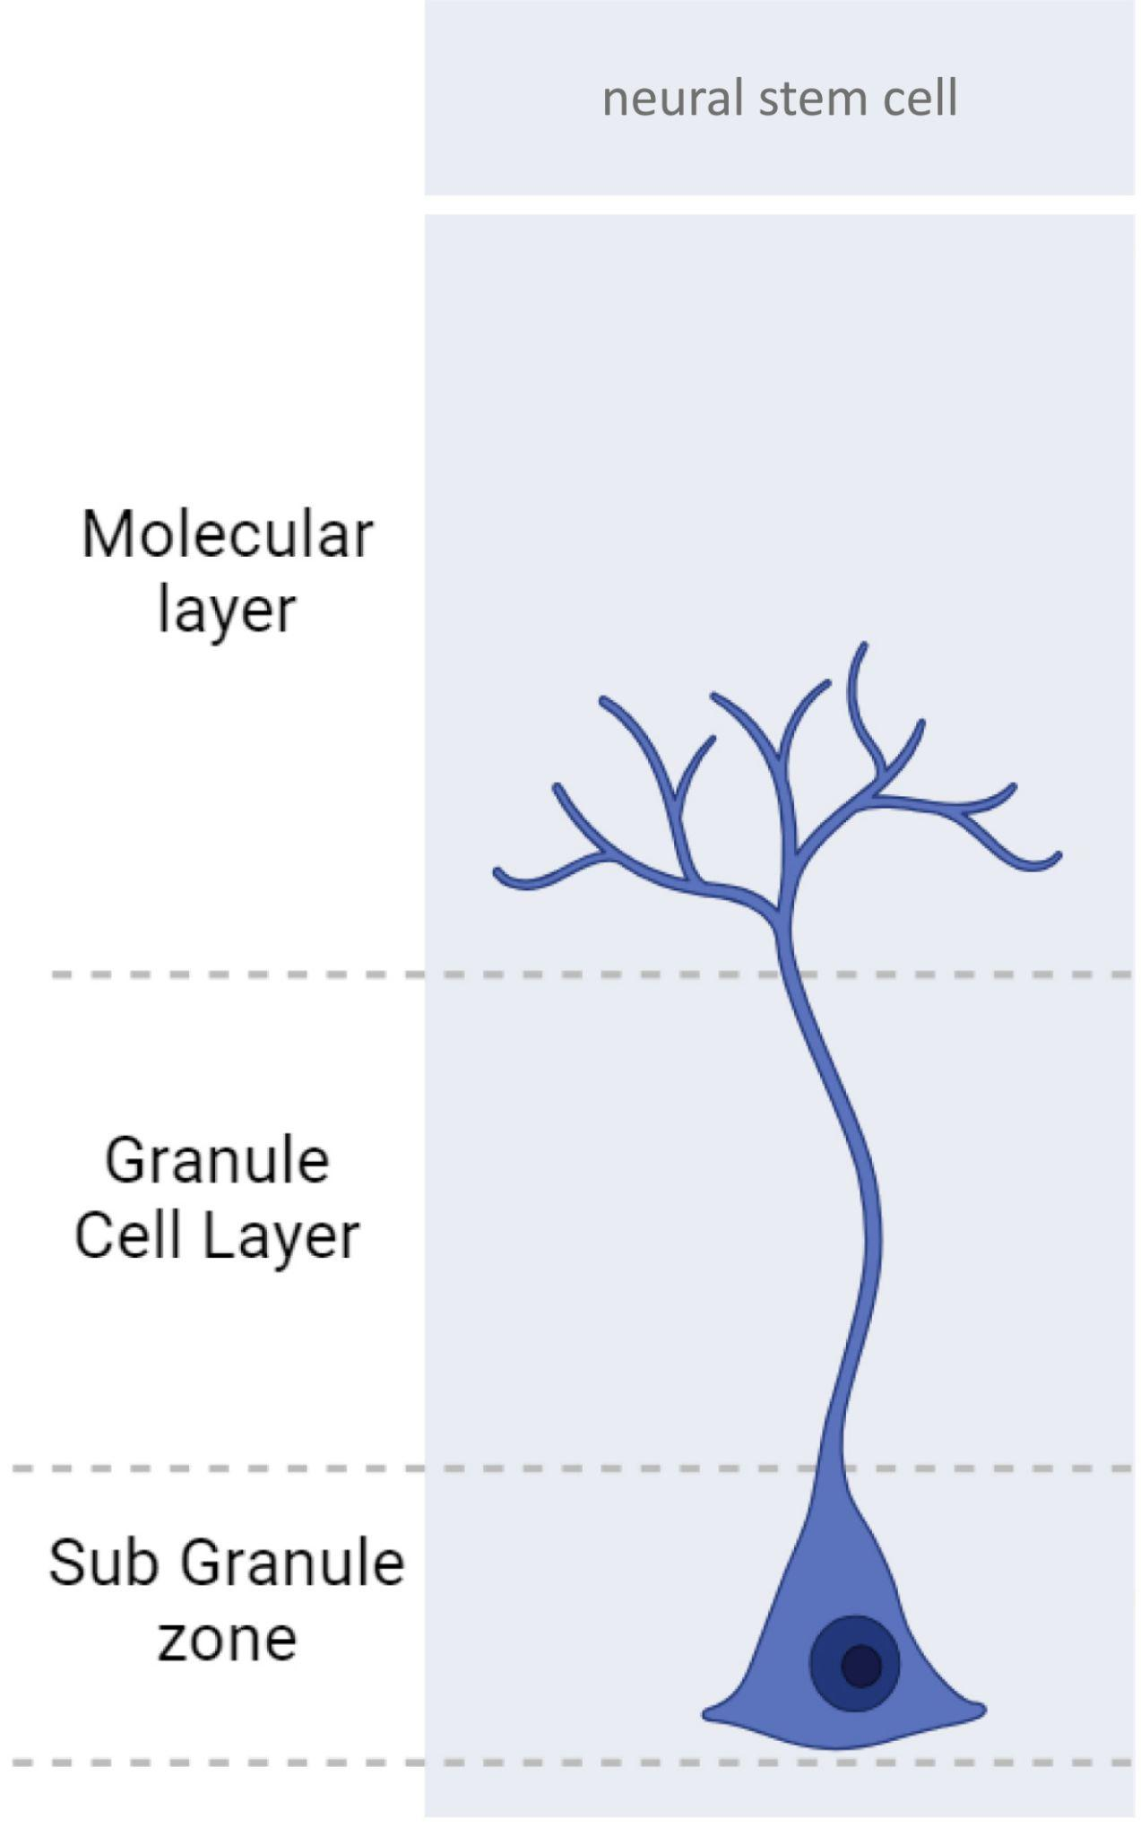
IMPAIRMENT OF NEUROGENESIS AFTER IRON IRRADIATION
control
irradiated
Representative photomicrographs of dentate gyrus sections from control (F, G) and irradiated (I, J) animals. ⁵⁶Fe particle radiation decreases the number of neural stem cell and their progenitors (green arrows).
Left picture is taken from: Kasza, T. (2024). Adult Neurogenesis. https://app.biorender.com/biorender-templates/t-65bdaf5a5fafd26874044314-adult-neurogenesis
Right picture is taken from: Encinas, Juan M., et al. Experimental neurology 210.1 (2008): 274-279.
5

Slide 6
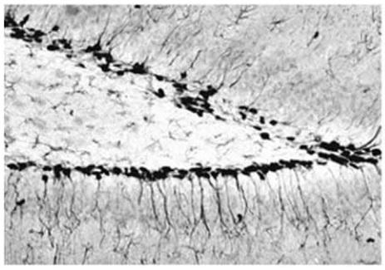
CONNECTION BETWEEN DATA
⁵⁶Fe
parameters of irradiation
quantitative experiments of cell survival
behavioral
experiments
Ideally, we want to know how the number of neural stem cells changes after irradiation and what cognitive effects occur.
However, in reality, most experimental work relates radiation parameters to the number of cells or to behavioral experiments. Mathematical modeling is used to try to reproduce the dependence of the influence of radiation on cell populations and animal behavior.
6

Slide 7
CONNECTION BETWEEN DATA
⁵⁶Fe
parameters of irradiation
quantitative experiments of cell survival
behavioral
experiments
Ideally, we want to know how the number of neural stem cells changes after irradiation and what cognitive effects occur.
However, in reality, most experimental work relates radiation parameters to the number of cells or to behavioral experiments.
Mathematical modeling is used to try to reproduce the dependence of the influence of radiation on cell populations and animal behavior.
7

Slide 8
CONNECTION BETWEEN DATA
⁵⁶Fe
dx
dx
parameters of irradiation
quantitative experiments of cell survival
behavioral
experiments
Ideally, we want to know how the number of neural stem cells changes after irradiation and what cognitive effects occur.
However, in reality, most experimental work relates radiation parameters to the number of cells or to behavioral experiments.
Mathematical modeling is used to try to reproduce the dependence of the influence of radiation on cell populations and animal behavior.
8

Slide 9
CONNECTION BETWEEN DATA
⁵⁶Fe
dx
parameters of irradiation
quantitative experiments of cell survival
behavioral
experiments
Ideally, we want to know how the number of neural stem cells changes after irradiation and what cognitive effects occur.
However, in reality, most experimental work relates radiation parameters to the number of cells or to behavioral experiments.
Mathematical modeling is used to try to reproduce the dependence of the influence of radiation on cell populations and animal behavior.
9

Slide 10
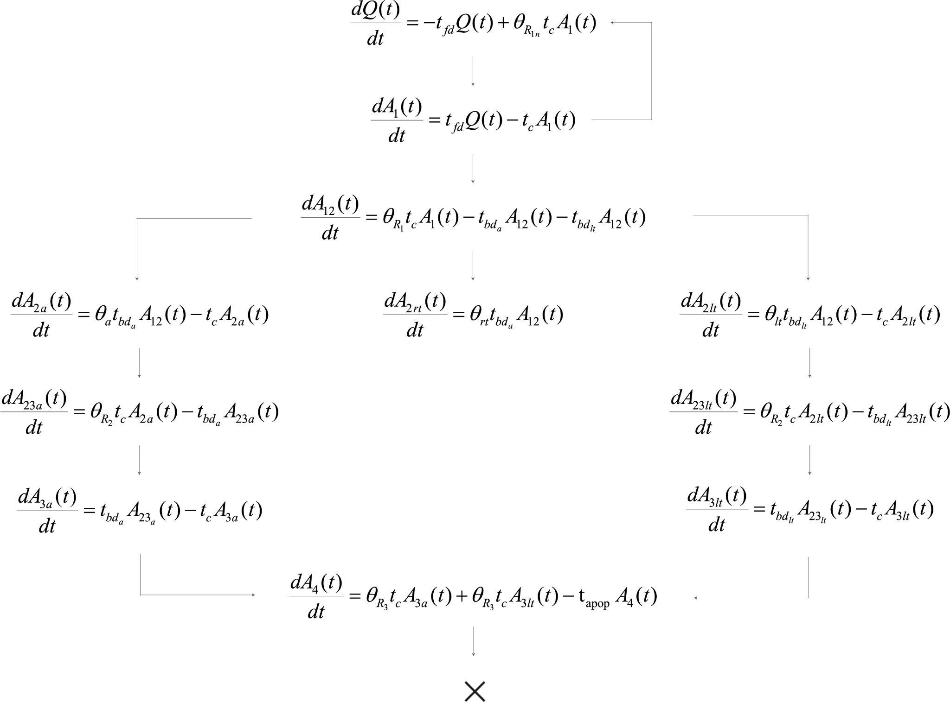
INTRODUCTION
MODELING
RESULTS
CONCLUSION

Slide 11
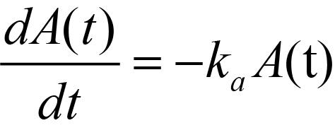
OLD APPROACH FOR MODELING OF NSC POPULATION
quiescent
activation
proliferation
Equation of dynamic of NSCs population [Cacao2016]
Part of surviving NSC
quiescent
activation
Equation of dynamic of NSCs population [Glebov2022]
Day after irradiation
The results of modeling the part of surviving neural stem cells after ⁵⁶Fe irradiation with dose 1 Gy. Experimental data takes from [DeCarolis2014]. Population dynamic are calculated based on a model of a neurogenesis [Glebov2022].
Equation is taken from: Cacao, Eliedonna, et al. Radiation research 186.6 (2016): 624-637. // Glebov, A. A., et al. Physics of Particles and Nuclei Letters 19.4 (2022): 422-433.
Experimental data is taken from: DeCarolis, Nathan A., et al. Life sciences in space research 2 (2014): 70-79.
11

Slide 12
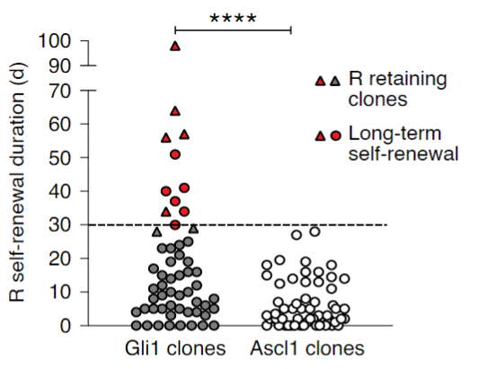
DIFFERENT TYPES OF NEURAL STEM CELLS
Differences in morphology
Differences in rate of dividing
Confocal maximal projection micrographs of types α and β neural stem cells in Nestin-GFP mice.
Time (days) between first and last division in each lineage of Gli1- and Ascl1-targeted R cells (NSC). Triangles depict clones where R cells were still present at the end of the imaging. Red circles depict R cells showing long-term self-renewal. The dashed line represents a long-term self-renewal threshold.
Left picture is taken from: Gebara, Elias, et al. Stem cells 34.4 (2016): 997-1010.
Right picture is taken from: Bottes, Sara, et al. Nature neuroscience 24.2 (2021): 225-233.
12

Slide 13
DIFFERENT TYPES OF NEURAL STEM CELLS
Differences in morphology
Differences in rate of dividing
Confocal maximal projection micrographs of types α and β neural stem cells in Nestin-GFP mice.
Time (days) between first and last division in each lineage of Gli1- and Ascl1-targeted R cells (NSC). Triangles depict clones where R cells were still present at the end of the imaging. Red circles depict R cells showing long-term self-renewal. The dashed line represents a long-term self-renewal threshold.
Left picture is taken from: Gebara, Elias, et al. Stem cells 34.4 (2016): 997-1010.
Right picture is taken from: Bottes, Sara, et al. Nature neuroscience 24.2 (2021): 225-233.
13

Slide 14
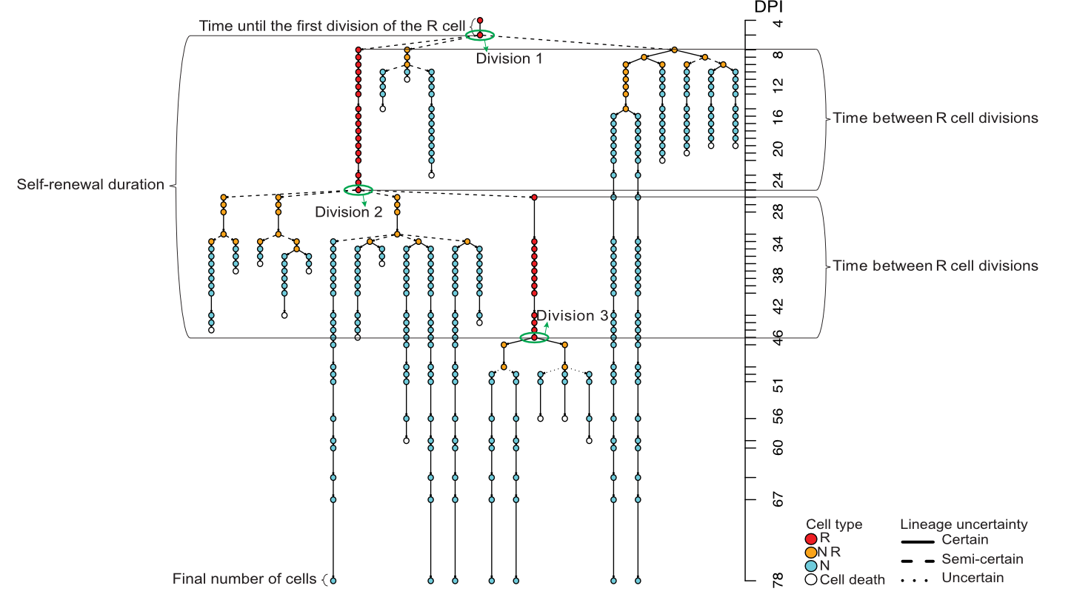
DIFFERENCES IN RATE OF DIVIDING
Adult mice were implanted with a cortical window that left the hippocampal formation intact and allowed for two-photon imaging. Only R cells were analyzed as a starting population.
Individual clones were imaged every ~12 to 24 hours (unless otherwise indicated) and followed for up to 60-115 days. Imaged clones were characterized on the basis of behavioral and morphological criteria, allowing for the construction of individual lineage trees. After imaging, the final fate of progeny was confirmed using immunohistochemistry.
(A) Explanatory scheme of the different parameters extracted from lineage data of the imaged clones.
(B) Selected imaging time points for two R cells (respectively indicated with open and filled arrowheads) over the course of 1 months.
A
B
Picture A is taken from: Bottes, Sara, et al. Nature neuroscience 24.2 (2021): 225-233.
Picture B is taken from: Pilz, Gregor-Alexander, et al. Science 359.6376 (2018): 658-662.
14

Slide 15
MODELING OF A HETEROGENEOUS POPULATION OF NSC
quiescent cells
proliferation
A scheme of the process of division of neural stem cells, where:
Q - quiescence cells
A₁, A₁₂ – active cells
A_{2a} , A_{23a} , A_{3a} - active fast dividing cells
A_{2lt} , A_{23lt} , A_{3lt} - active slow dividing cells
A_{2rt} - resting cells
A₄ – non-dividing cells
Calculation of dynamics were performed for adult mice starting from the sixtieth day of life.
The initial number of cells in population Q was 1, while the numbers of cells in the remaining populations were 0.
activation
fast divisions
resting cells
slow divisions
apoptosis
15

Slide 16
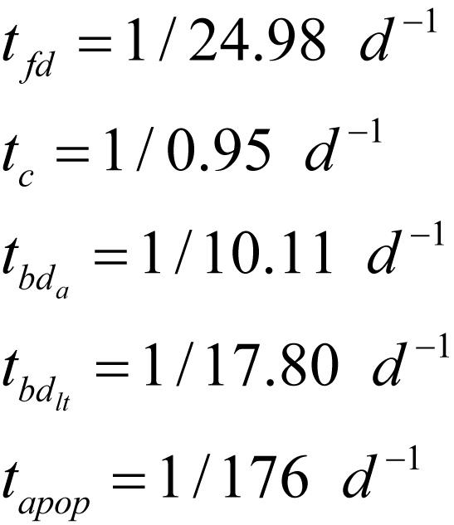
MODELING OF A HETEROGENEOUS POPULATION OF NSC
Rate of processes:
activation rate of first division of NSC
rate of cell cycle of NSC
activation rate of second and third division of fast dividing NSC
activation rate of second and third division of slow dividing NSC
rate of apoptosis
Proportion of cell formed:
proportion of newborn NSC
proportion of NSC after first division
proportion of active fast dividing NSC
proportion of active slow dividing NSC
proportion of resting NSC
proportion of NSC after second division
proportion of NSC after third division
The rate of processes and the proportion of cells formed is taken from: Wu, Yicheng, et al. Nature Aging 3.4 (2023): 380-390.
Duration of the NSC cell cycle is taken from: Brandt, Moritz D., et al. Stem cells 30.12 (2012): 2843-2847.
16

Slide 17
CALCULATED SURVIVAL OF NEURAL STEM CELLS
AGE-RELATED DYNAMICS OF NEURAL STEM CELLS SURVIVING
HOMOGENEITY MODEL OF NSC
HETEROGENEITY MODEL OF NSC
Part of surviving NSC
Age, [day]
Age, [day]
Results of modeling the part of surviving neural stem cells depending on age.
Left - taking into account the homogeneity of neural stem cells, right - taking into account the heterogeneity of neural stem cells.
Experimental data is taken from:
green dots Encinas, Juan M., et al. Cell stem cell 8.5 (2011): 566-579.
blue dots Ziebell, Frederik, et al. Development 145.1 (2018): dev153544.
17

Slide 18
MODELING OF RESPONSE TO RADIATION
Cell response
The initial number of cells after irradiation was calculated based on the age-dependent dynamics of the NSC number at 0 Gy. The exponential term in the equation takes into account the instantaneous death of cells after irradiation.
Microenvironment response
We found that changing the rate of the first division activation significantly modifies the dynamic curve. Therefore, we fitted this parameter depending on the absorbed dose of radiation.
absorbed dose
rate of first division activation
number of cells
in population X
after irradiation
number of cells
in population X
before irradiation
Transcriptomic studies have shown that quiescent NSCs are actively integrating signals from their microenvironment. Activation of NSCs leads to a shut down of their ability to respond to external stimuli, switching the expression of genes from the membrane to the nucleus.
characteristic dose
(dose at with 37% of cell is survived)
Transcriptomic studies is taken from: Shin, Jaehoon, et al. Cell stem cell 17.3 (2015): 360-372.
18

Slide 19
INTRODUCTION
MODELING
RESULTS
CONCLUSION

Slide 20
CALCULATED SURVIVAL OF NEURAL STEM CELLS
SHORT- AND MEDIUM-TERM SURVIVAL OF NSC AFTER ⁵⁶FE PARTICLE IRRADIATION
E = 1000 MeV/nucleon, LET = 148 keV/μm
HOMOGENEITY MODEL OF NSC
HETEROGENEITY MODEL OF NSC
0 Gy
0 Gy
1 Gy
1 Gy
Part of surviving NSC
D₃₇ = - (cells not die)
D₃₇ = - (cells not die)
t_{fd}= 1/15 day⁻¹
Day after irradiation
Day after irradiation
The results of modeling the part of surviving neural stem cells after ⁵⁶Fe irradiation. On the left - taking into account the homogeneity of the NSC, on the right - taking into account the heterogeneity of the NSC. D₃₇ is the characteristic dose of NSCs, t_{fd} is the rate of the first division activation.
Experimental data is taken from: DeCarolis, Nathan A., et al. Life sciences in space research 2 (2014): 70-79.
20

Slide 21
CALCULATED SURVIVAL OF NEURAL STEM CELLS
SHORT- AND MEDIUM-TERM SURVIVAL OF NSC AFTER ⁵⁶FE PARTICLE IRRADIATION
E = 300 MeV/nucleon, LET = 240 keV/μm
HOMOGENEITY MODEL OF NSC
HETEROGENEITY MODEL OF NSC
0 Gy
0 Gy
Part of surviving NSC
1 Gy
1 Gy
D₃₇ = 1.6 Gy
D₃₇ = 1.6 Gy
t_{fd}= 1/100 day⁻¹
Day after irradiation
Day after irradiation
The results of modeling the part of surviving neural stem cells after ⁵⁶Fe irradiation. On the left - taking into account the homogeneity of the NSC, on the right - taking into account the heterogeneity of the NSC. D₃₇ is the characteristic dose of NSCs, t_{fd} is the rate of the first division activation.
Experimental data is taken from: DeCarolis, Nathan A., et al. Life sciences in space research 2 (2014): 70-79.
21

Slide 22
CALCULATED SURVIVAL OF NEURAL STEM CELLS
SHORT- AND MEDIUM-TERM SURVIVAL OF NSC AFTER ⁵⁶FE PARTICLE IRRADIATION
E = 300 MeV/nucleon, LET = 240 keV/μm
HOMOGENEITY MODEL OF NSC
HETEROGENEITY MODEL OF NSC
0 Gy
0 Gy
Part of surviving NSC
1 Gy
1 Gy
D₃₇ = 3.5 Gy
D₃₇ = 3.5 Gy
t_{fd}= 1/50 day⁻¹
Day after irradiation
Day after irradiation
The results of modeling the part of surviving neural stem cells after ⁵⁶Fe irradiation. On the left - taking into account the homogeneity of the NSC, on the right - taking into account the heterogeneity of the NSC. D₃₇ is the characteristic dose of NSCs, t_{fd} is the rate of the first division activation.
Experimental data is taken from: Rivera, Phillip D., et al. Radiation research 180.6 (2013): 658-667.
22

Slide 23
CALCULATED SURVIVAL OF NEURAL STEM CELLS
SHORT- AND MEDIUM-TERM SURVIVAL OF NSC AFTER ⁵⁶FE PARTICLE IRRADIATION
Nestin-GFP
Nestin-CreER^{T2}/R26R:YFP
E = 1000 MeV/nucleon, LET = 148 keV/μm
E = 300 MeV/nucleon, LET = 240 keV/μm
control
control
Part of surviving NSC
2
1
D₃₇ t_{fd}
Control - 1/25 day⁻¹
Curve 1 - 1/15 day⁻¹
3
D₃₇ t_{fd}
Control - 1/25 day⁻¹
Curve 2 3.5 Gy 1/50 day⁻¹
Curve 3 1.6 Gy 1/100 day⁻¹
Day after irradiation
Day after irradiation
The results of modeling the part of surviving neural stem cells after irradiation with iron particles, taking into account the heterogeneity of NSCs. On the left - for transgenic Nestin-GFP mice, on the right - for transgenic Nestin-CreER^{T2}/R26R:YFP mice. The green curve for all presented graphs corresponds to a dose of 1 Gy. D₃₇ is the characteristic dose of NSCs, t_{fd} is the activation rate of the first division of neural stem cells.
Experimental data is taken from:
Left picture green dots DeCarolis, Nathan A., et al. Life sciences in space research 2 (2014): 70-79.
Right picture green squares Rivera, Phillip D., et al. Radiation research 180.6 (2013): 658-667.
green dots DeCarolis, Nathan A., et al. Life sciences in space research 2 (2014): 70-79.
23

Slide 24
CALCULATED SURVIVAL OF NEURAL STEM CELLS
LONG-TERM SURVIVAL OF NSC AFTER ⁵⁶FE PARTICLE IRRADIATION
HOMOGENEITY MODEL OF NSC
HETEROGENEITY MODEL OF NSC
Nestin-GFP
E = 1000 MeV/nucleon
LET = 148 keV/μm
Part of surviving NSC
Nestin-CreER^{T2}/R26R:YFP
E = 300 MeV/nucleon
LET = 240 keV/μm
Nestin-CreER^{T2}/R26R:YFP
E = 300 MeV/nucleon
LET = 240 keV/μm
Day after irradiation
Day after irradiation
The results of modeling the part of surviving neural stem cells after ⁵⁶Fe irradiation. On the left - taking into account the homogeneity of the NSC, on the right - taking into account the heterogeneity of the NSC. The green curve for all presented graphs corresponds to a dose of 1 Gy.
24

Slide 25
INTRODUCTION
MODELING
RESULTS
CONCLUSION
⁵⁶Fe
dx

Slide 26
CONCLUSION
1.
Modeling the number of neural stem cells taking into account their heterogeneity makes it possible to reproduce age-related changes in the number of cells
2.
The dependence of the first division activation rate parameter on the dose allows us to reproduce experimental data on the number of neural stem cells after irradiation with iron particles of different energies
3.
Depending on the energy of the particles, neural stem cells can restore their numbers by accelerating the entry into division or preserving cell divisions
MODELING
Further development of the model and comparison of the results with behavioral experiments will help to assess the risk of cognitive impairment in people during interplanetary flights
RESULTS
26

Slide 27
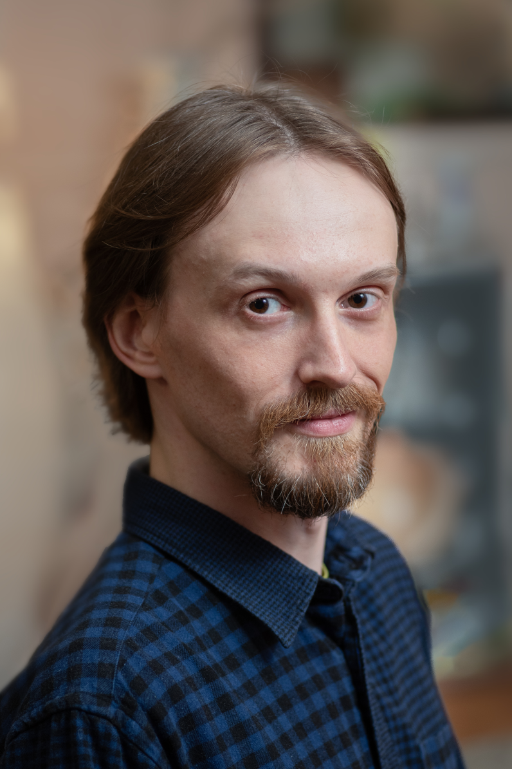
Глебов Артем Александрович
младший научный сотрудник ЛРБ ОИЯИ, отдел радиационных исследований,
сектор №1 математического моделирования
С 2009 по 2015 год учился в МУПОЧ «Дубна», где окончил бакалавриат и магистратуру по направлениям «Материаловедение» и «Физика наносистем и наноматериалов». С 2015 по 2019 год учился и окончил аспирантуру МФТИ по направлению «Теоретическая физика».
Работаю в ОИЯИ с 2013 года. С 2013 по 2015 год занимал должность старшего лаборанта в ЛТФ, где занимался квантово-химическими расчётами энергетических характеристик графеновых наноструктур. С 2015 по 2019 год на должности младшего научного сотрудника ЛТФ занимался моделированием электронных характеристик графеновых наноструктур, содержащих дефекты.
С 2019 года работаю младшим научным сотрудником ЛРБ, где занимаюсь моделированием и оценкой влияния радиации на гиппокампальный нейрогенез у взрослых.
Личный вклад в работу:
1. Подготовил литературный обзор на тему гетерогенности нервных стволовых клеток и математических моделей выживаемости нервных стволовых клеток в зависимости от возраста.
2. Разработал математическую модель выживаемости нервных стволовых клеток в ответ на воздействие радиации. Были рассмотрены такие виды излучения, как рентгеновские лучи, гамма-лучи и частицы железа.
3. Проанализировал и интерпретировал результаты моделирования
4. Выступил с устным докладом на The 28th International Scientific Conference of Young Scientists and Specialists (AYSS-2024) и
участвовал в онлайн постер-сессии 59th meeting of the PAC for Condensed Matter Physics
Публикации, в которых представлены результаты доклада:
Glebov A. A., Kolesnikova E. A. & Bugay A. N. Modeling the survival rate of a heterogeneous population of neural stem cells in response to irradiation with ⁵⁶Fe particles [отправлено в журнал "PEPAN letters"]
Предыдущие работы на тему:
Glebov A. A., Kolesnikova E. A. & Bugay A. N. Analysis of the Influence of Dose-Dependent Effects of Irradiation with Heavy Particles ¹²C, ²⁸Si, and ⁵⁶Fe on Neurogenesis in Adult C57BL/6J Mice. Phys. Part. Nuclei – V.55. – 2024. – P. 978–983
Glebov A. A., Kolesnikova E. A., Bugai A. N. Mathematical Model of a Radiation-Induced Neurogenesis Impairment. Phys. Part. Nuclei Lett. – Vol. 19.– 2022.– P. 422-433.
27

