Slide 1
Multiple heavy ion injection into NICA Booster
Andrei Martynov
Dubna, 2024

Slide 3
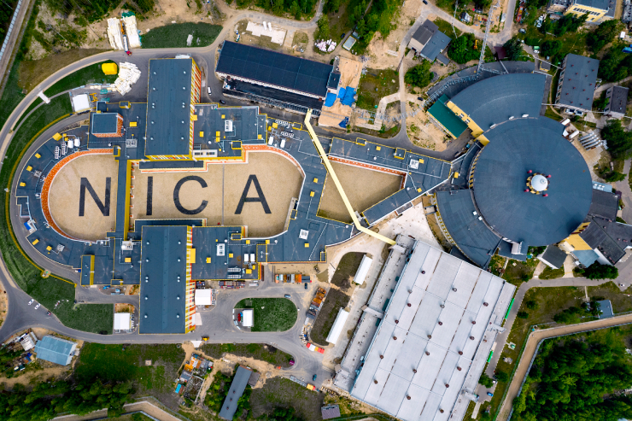

Slide 4
Nuclotron 0.6-3.9 GeV/u
MPD
BOOSTER (600 MeV/u)
SPI + LU-20 (5 MeV/u
COLLIDER (1-4.5 GeV/u, C = 503 m
KRION 6-T + HILAC (3.2 MeV/u)
SPD
Experiments with fixed targets (BM@N)

Slide 5
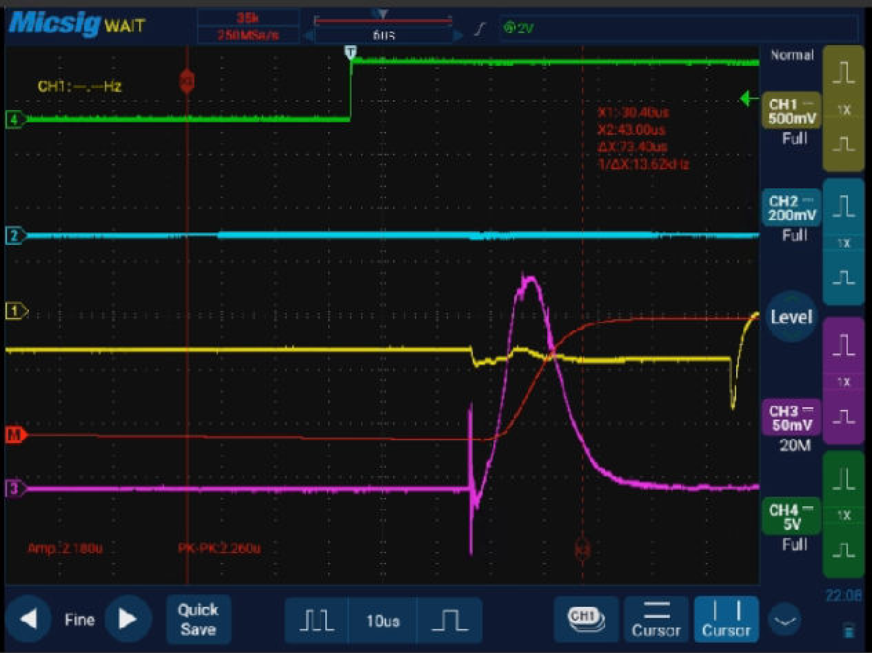
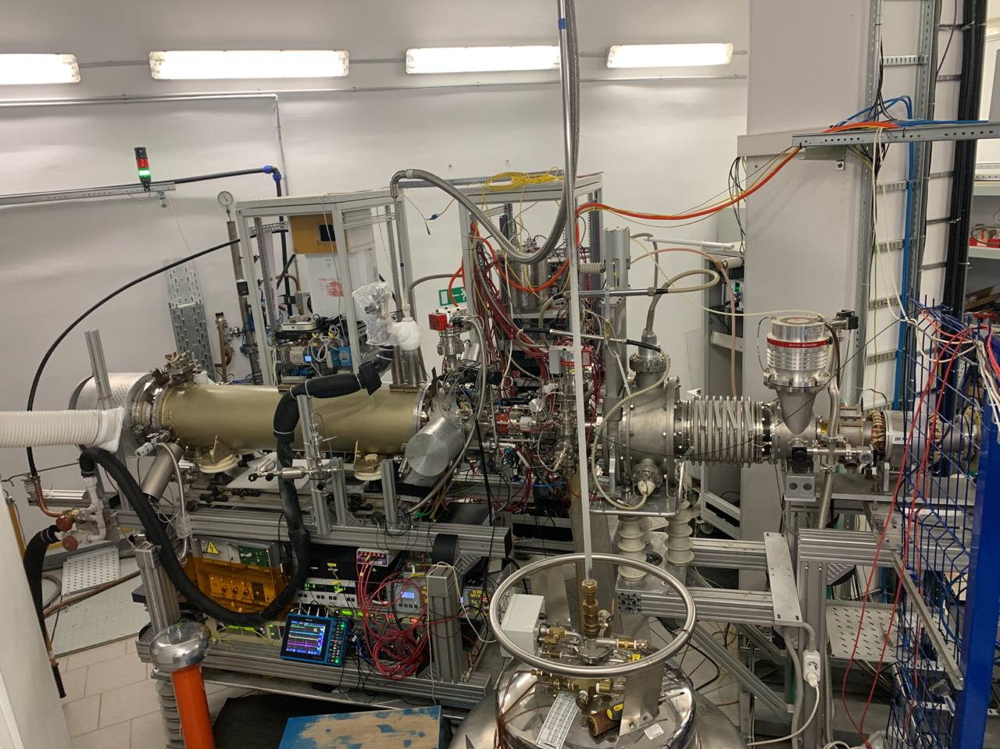
KRION – 6T Electron String Ion Source
¹²⁴Xe
Q=2,18 nК, I= 200 μΑ, t= 25 μs
Source type | Electron string (ESIS)
Ion type | ¹²⁴Xe28+
Magnetic field in the trap | 5T
Magnetic field at the cathode | 0.25 T
Effective cathode voltage | 6 kV
Cathode diameter | 1.2 mm
Electron beam current | 4-6 mA
Ion trap length | 70 cm
Total ion charge | 2.3 nC
Number of target ions at source exit | 10⁸

Slide 6
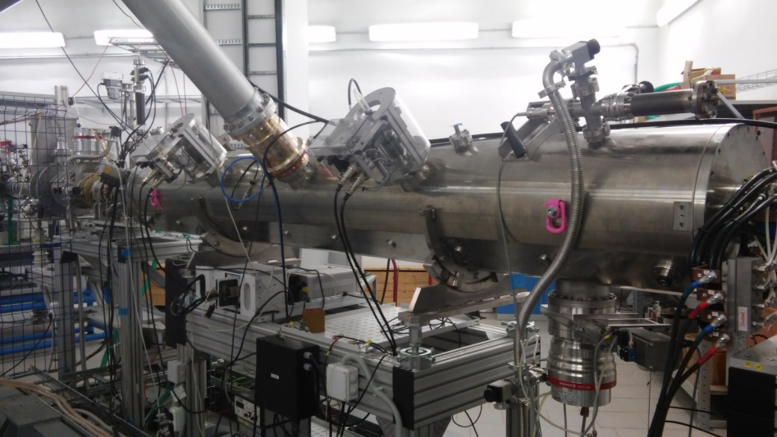
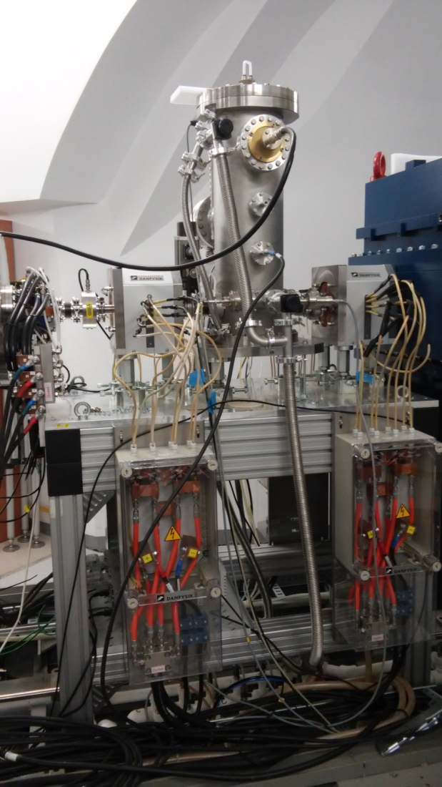
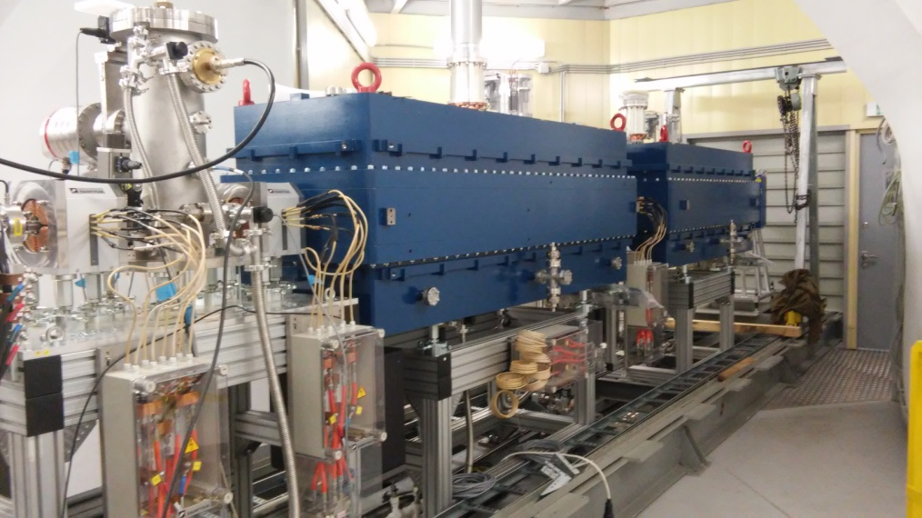
HEAVY ION LINEAR ACCELERATOR (HILAC)
RFQ
Buncher
IH-1
IH-2

Slide 7
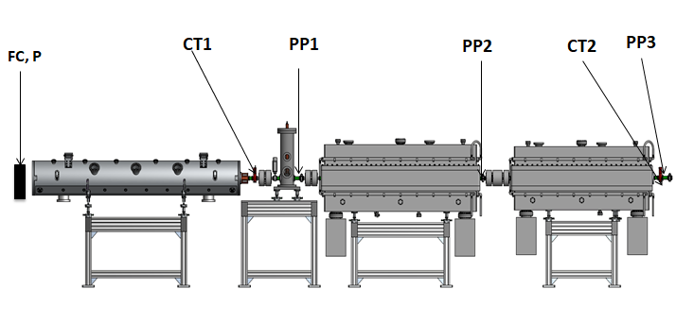
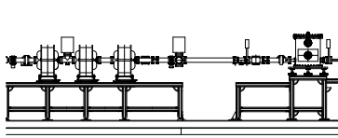
Auxillary diagnostic equipment along the injector
FC1
beam
PM 2
beam
FC3
CT3
CT4
PM 5
beam
beam
Booster
CT – Current transformer, FC – Faraday Cup, PM- Profilometer, РР- Phase Probe )фазовый датчик)

Slide 8
Injection line into Booster
Heavy Ion linac consists of:
- Electron String Heavy ion source (ESIS) KRION-6T, 6T conducting solenoid of 1.2m length, extraction voltage up to 25.0 kV;
- Low energy beam transport channel LEBT, E_{out} = 17 keV/n;
- Heavy ion LINAC: 4-rod RFQ is followed by two IH DTL section with the KONUS accelerating structure, accelerates ions with
Charge-to-mass ratio of q/A = 6.25, E_{in} = 17 keV/n, E_{out} = 3.2 MeV/u;
-High energy beam transport channel (HILAC – BOOSTER)

Slide 9
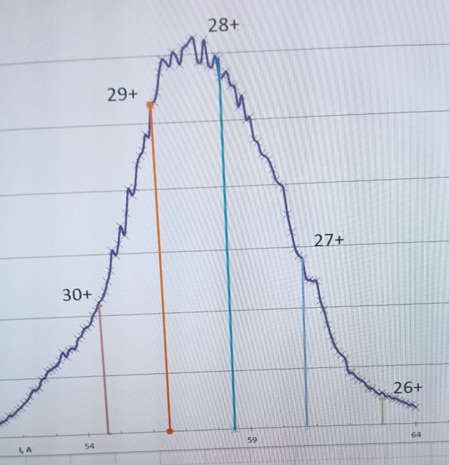
Ion Source Main Parameters for the Run 4
Source type | Electron string (ESIS)
Ion type | ¹²⁴Xe28+
Magnetic field in the trap | 5T
Magnetic field at the cathode | 0.25 T
Effective cathode voltage | 6 kV
Cathode diameter | 1.2 mm
Electron beam current | 4-6 mA
Ion trap length | 70 cm
Total ion charge | 2.3 nC
Number of target ions at source exit | 10⁸
Ion composition at the linac end:
Ionization time – 18 ms;
Target charge 28+ ~20-25%
(% is close to SBSIM calculations, 23%)

Slide 10
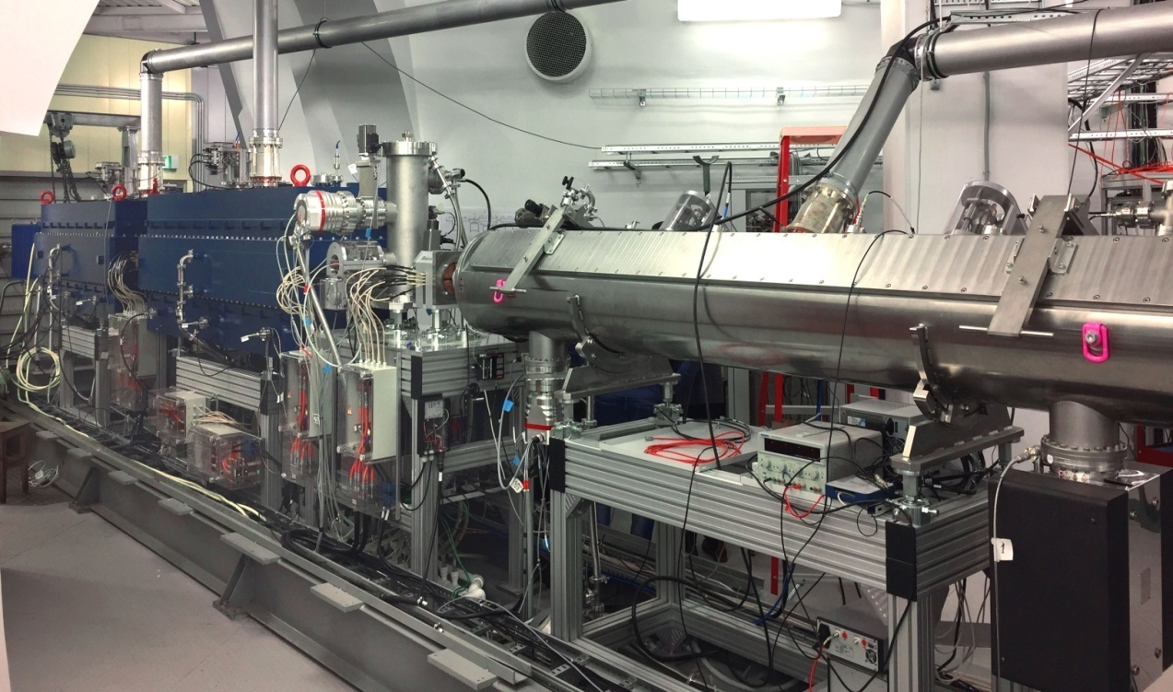
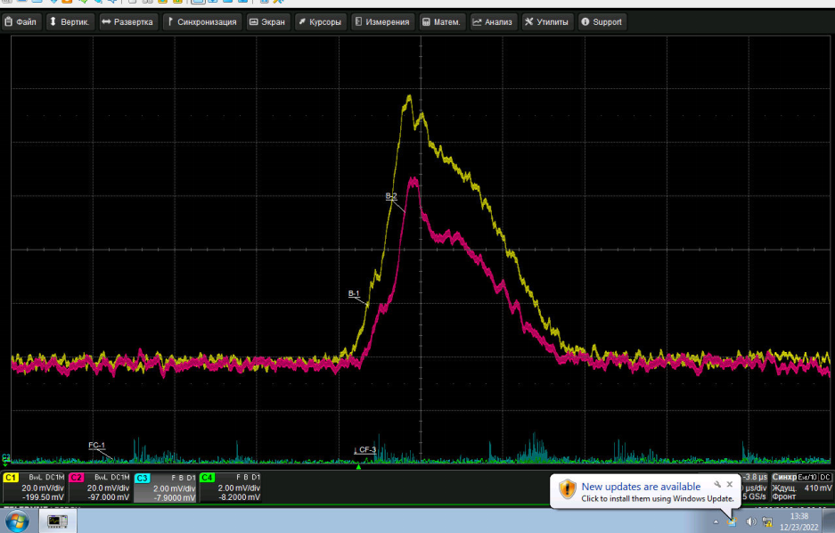
Stable and safe HILAC operation with Ar¹³⁺ and Xe²⁸⁺ beams
At RFQ exit I=100 μΑ (yellow line). At HILAC exit I=65 μΑ at ion pulse duration 22 μs (red line), about 70% at this pulse of target ions ¹²⁴Xe²⁸⁺. Number of ions accelerated in HILAC at energy 3,2 МeV/n is about 1×10⁸.
Project HILAC intensity ²⁰⁹Bi³⁵⁺ at energy 3,2 МeV/n is about 1.8×10⁹ per pulse.
Realization of multi cycle injection and upgrade of KRION-6T

Slide 11
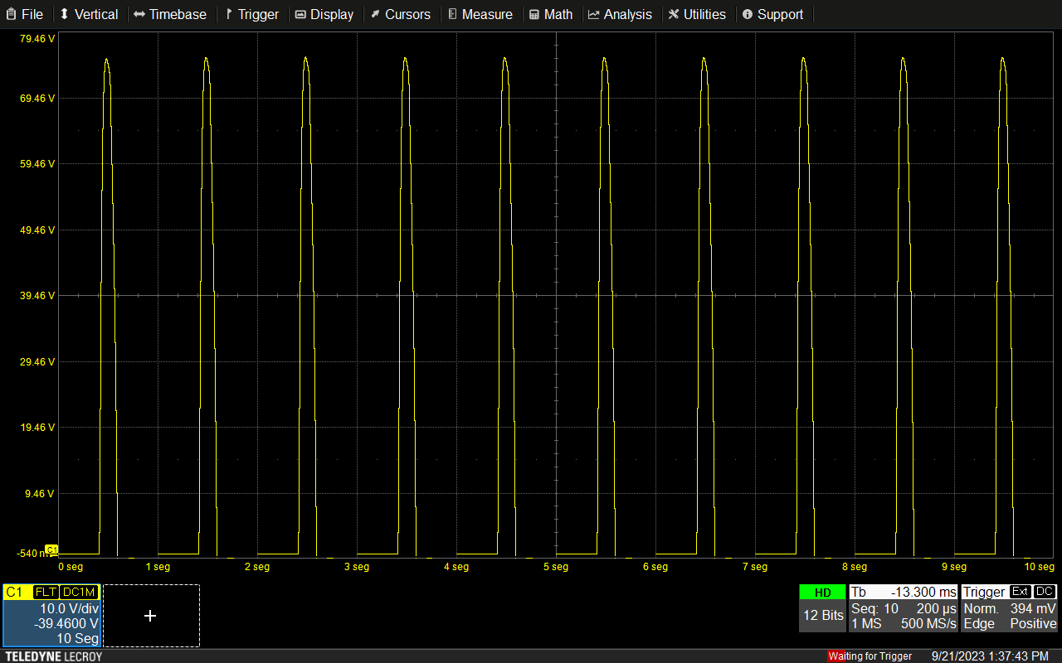
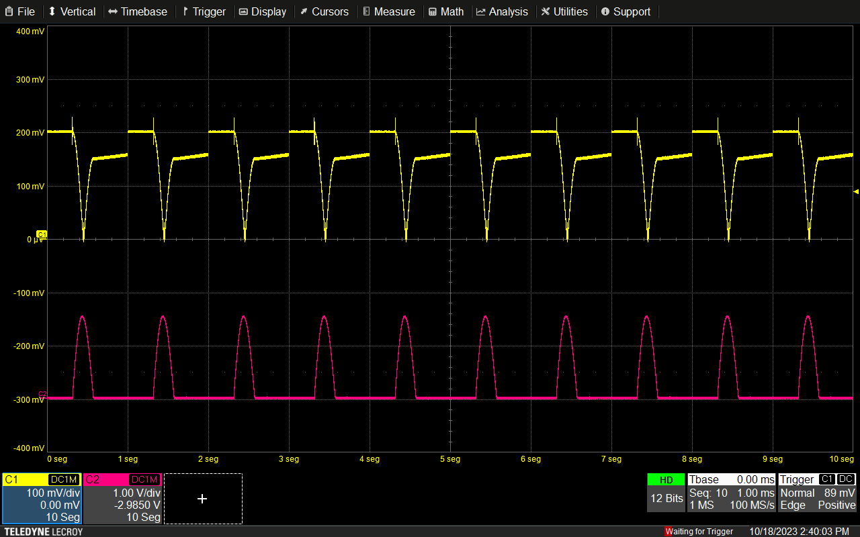
HILAC status
Preparation for multi-injection.
Includes system check-ups:
power supply for platforms with pulse injection voltage
Solenoid focusing
Quadrupole focusing
RF power supply
System of synchronisation
Voltage pulses (top) and injection current (bottom) in quadrupole doublets for A/Z= 6.25
Injection voltage pulses, 75 kV

Slide 12
HILAC STATUS Preparation for multi-injection cycle RF system
Signals obtained by ion hits on the Faraday Cup at HILAC output (FC-3, red) and phase probes(green and blue).
Pickup signals from RFQ, IH1, IH2, Buncher

Slide 13
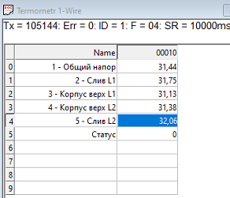
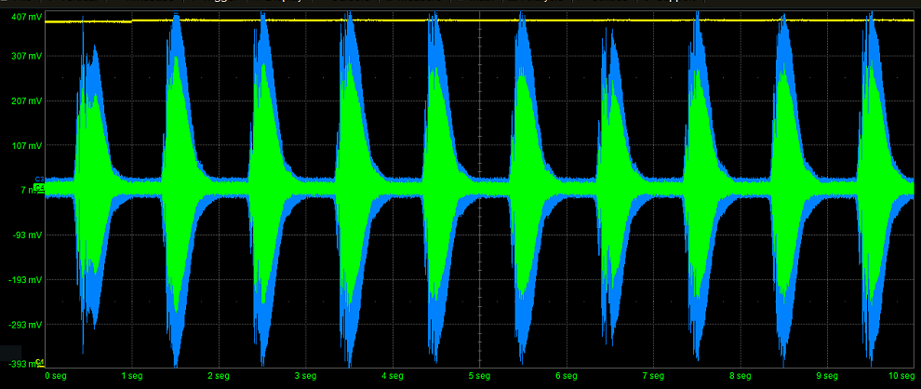
Water cooling system chart
Water
temperature
Time
Beam signal from phase probe (10x injection)
A.Martynov 11/30

Slide 14
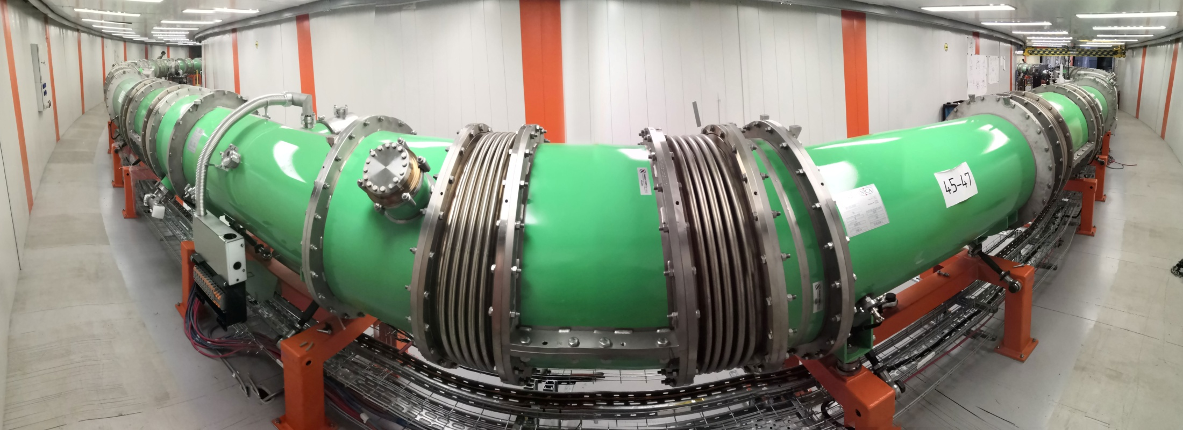
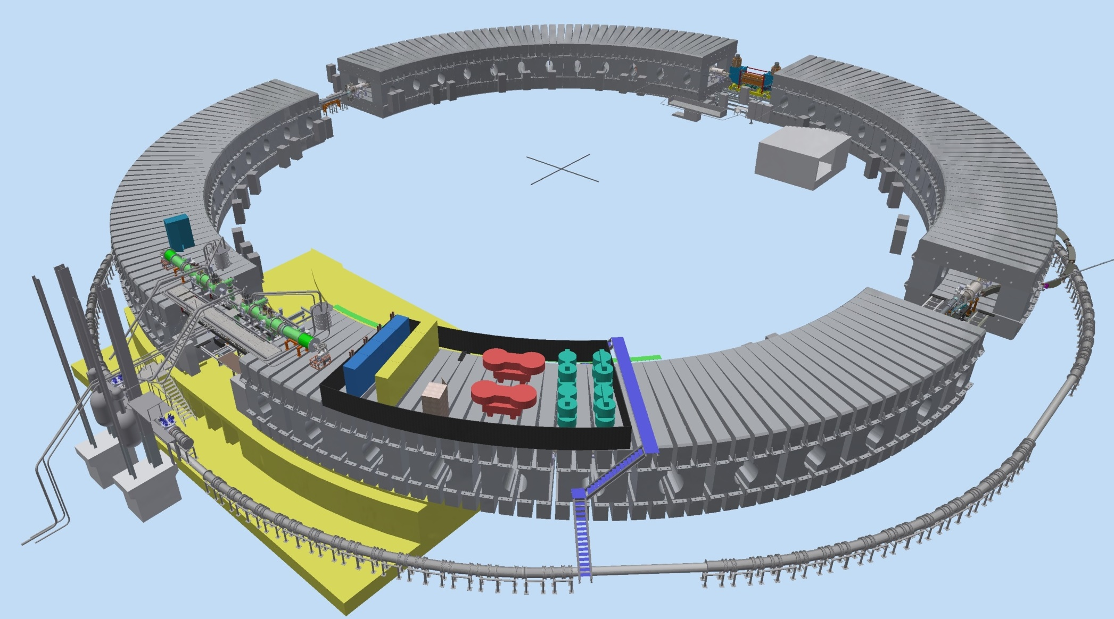
Booster ring
layout
Injection system
E-cooling system
Synchrophasotron iron yoke
Fast Extraction system
RF system
Reference magnets section
Power supply & energy evacuation
Nuclotron ring

Slide 15
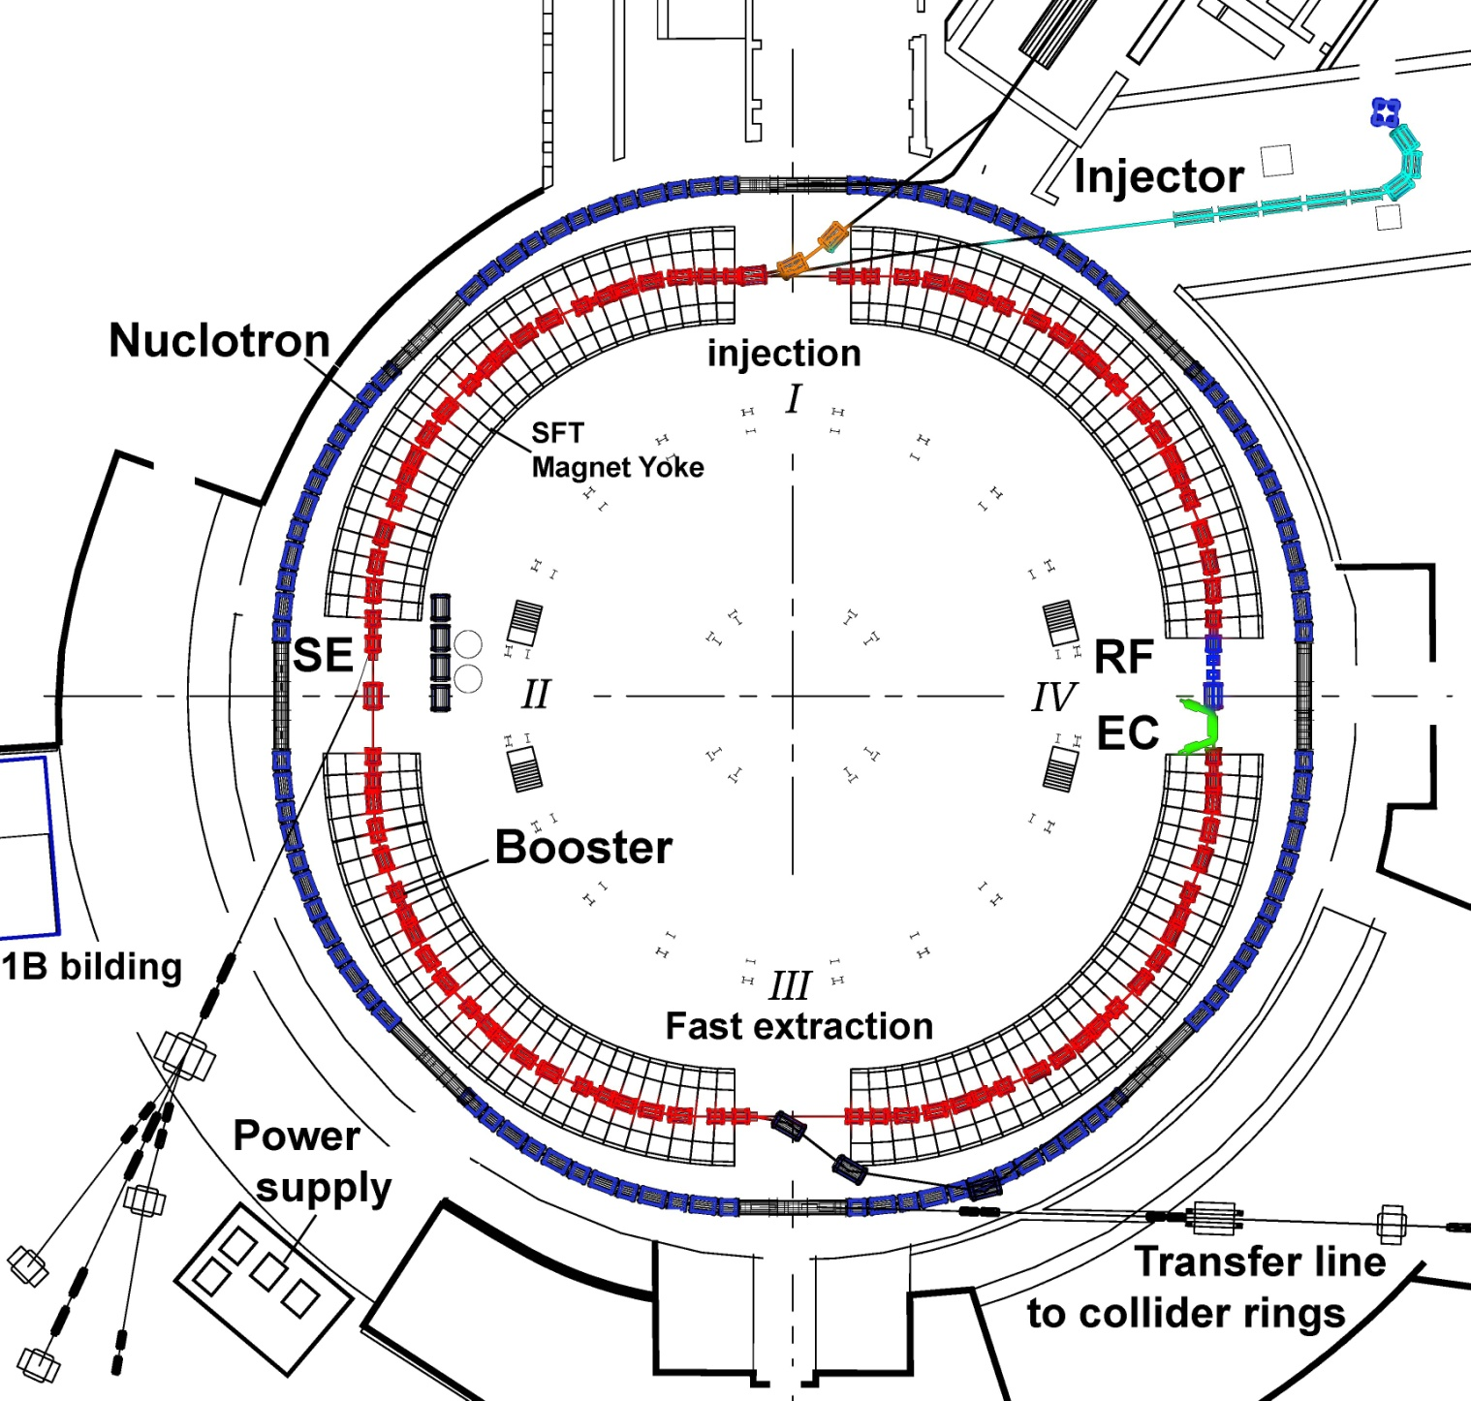
NICA Booster
 | Booster
Magnetic rigidity, T/m | 25
Radius, meters | 211
Beam intensity, particles per pulse | 2-6x10⁹
Max. energy | 600 MeV/u
Dipoles
Number of dipoles | 40
Maximum magnetic field, T | 1.8
Effective field length, m | 2.2
Bending angle, deg | 9.0
Curvature radius, m | 14.09
Vacuum chamber, mm² | 128x64
Quadrupoles
Number of quadrupoles | 48
Field gradient, T/m | 19.7/-20.3
Effective field length, m | 0.4

Slide 16
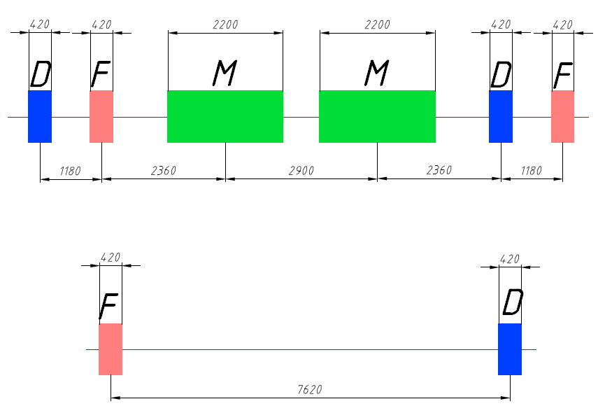
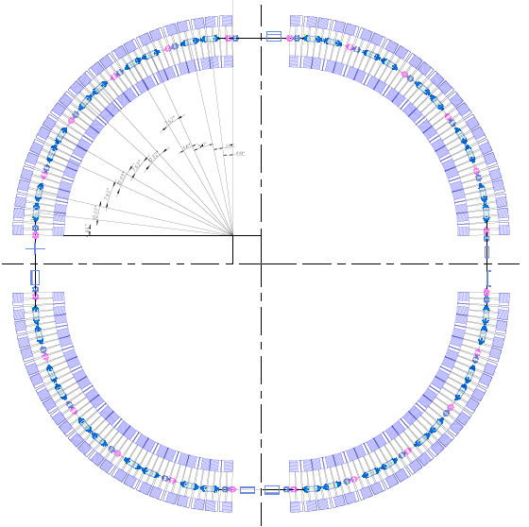
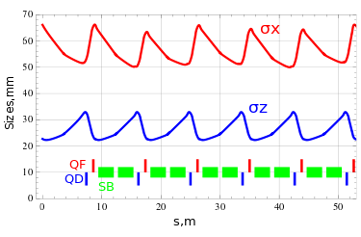

Slide 17
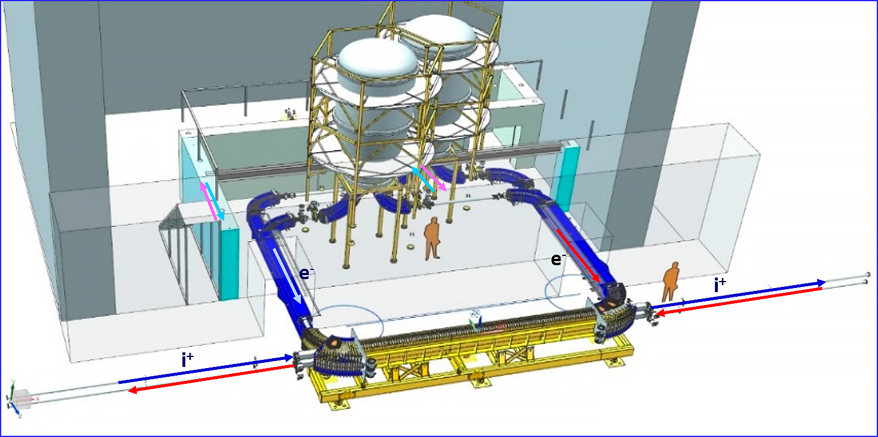

Slide 19
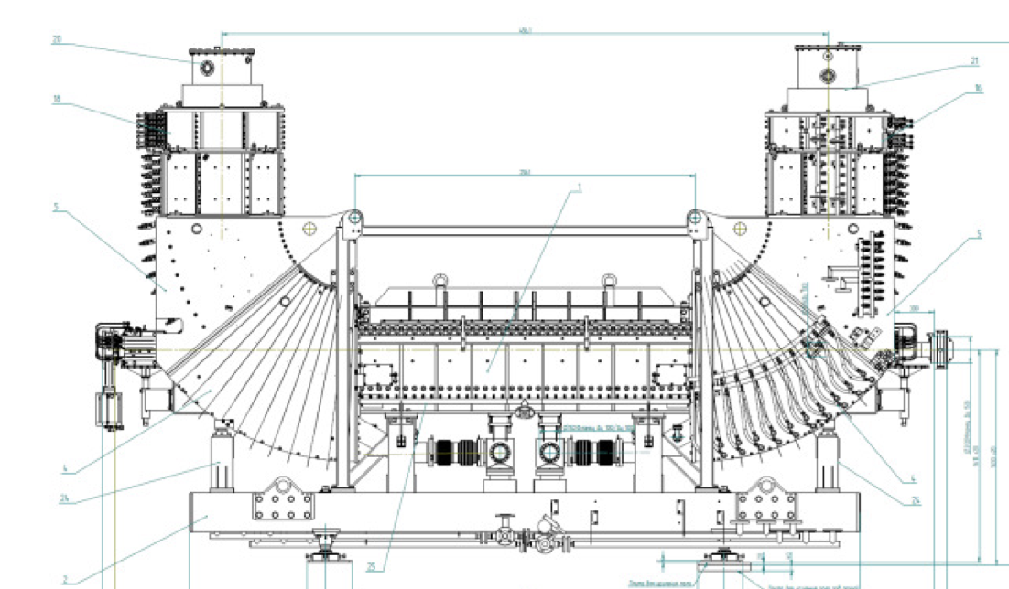

Slide 20
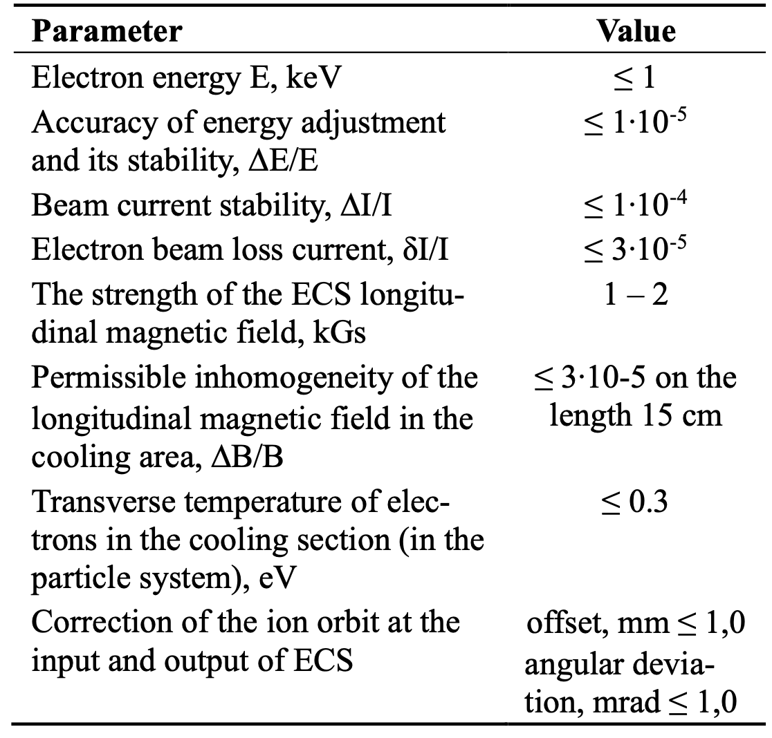

Slide 26
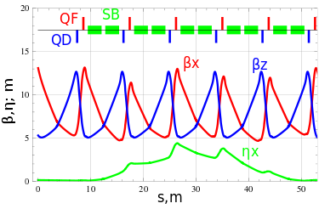

Slide 27
Cooling of the ¹²⁴Xe28+ ion beam by electron beam with 50mA current at the energy of 1,830 keV
3мм
3мм
3мм
3мм
The uncooled and cooled ion beams.
При работе с пучком ионов, охлаждённых и ускоренных в Бустере, полностью «ободранных» на выходе из Бустера, доускоренных в Нуклотроне и выведенных на детектор BM@N, его скорость счёта возросла в два раза.

Slide 28
Electron Cooling in Booster
Electron cooling was demonstrated with the RF voltage present as it is required for beam accumulation
Measurements support the accumulation rate of about 10 Hz
t [μs]
Beam current dependence on time with and without electron cooling. Rf harmonic number – 5. Cooling cycle duration - 200 ms. Electron beam current 50 mA. Electron beam voltage 1.83 keV

Slide 29
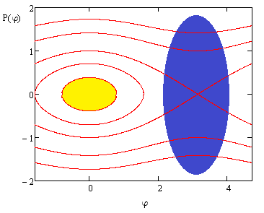
Beam Accumulation at electron cooling
Beam accumulation happens in the longitudinal plane at Booster injection
4 μs bunch – 8 μs revolution time
Each new injection happens after the previous one is cooled to the core
Expected injection rate – 10 Hz
10 – 15 injections will require
Total cycle duration ~5 s
The permanently present 1st RF harmonic weakly affects large amplitude particles
For small amplitude particles the cooling force will be intentionally reduced to avoid overcooling
To avoid anticoolig we need to match well the injection magnetic field and e-beam energy
It happens since for large Δp/p, dF/dt changes sign after reaching the peak
An increase of ion accumulation intensity by a factor of 5 is planned. However application of electron cooling is restricted by ion bunch space charge effects at a level of ⋅10⁹ ions of Bi³⁵⁺

Slide 30
CONCLUSION
The HILAC is modified for multi-injection and successfully tested (Summer 2024)
New power supplies for solenoids are developed, installed and proved their reliability under a long-duration operation,
New water-cooling system for lenses is ready and tested
The beam transportation channel is capable to transfer the beam of increased intensity to the Booster (Summer 2024)
The Booster Run with multi-injection is scheduled for the Winter 2024-2025

Slide 31
Thank you for attention!

Slide 33
BACKUP SLIDES

Slide 34
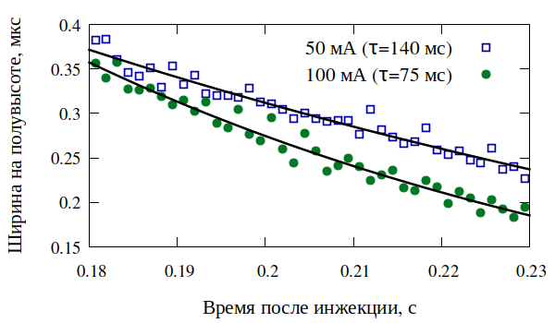
Полная ширина импульса на полувысоте в зависимости от времени
$\frac{∆p\left(t\right)}{p}$ = $Const$ $∙$ $e^{−t/}$, τ - характерное время охлаждения
ВЧ включены, пучок сгруппирован. Уменьшается продольный разброс.

Slide 35
Результаты настройки ЛУТИ
Parameter | ^{KRION}
 | ₄₀Ar¹¹⁻¹⁶⁺ | ₁₂₄Xe²⁸⁺
Даты | 15 сент – 15 окт | 26 окт – до конца сеанса
ЦФ0 (вход RFQ) | 450 μA 3 nC | 250 μA 1,75 nC ?
Bergoz1 (выход RFQ) | 280 μA 12.10.22 1,7 nC | 220 μA 18.01.23 1,54 nC
Bergoz2, ЦФ1 (выход ЛУТИ) | 80 μA, 130 0,4 nC | 70 μA, 140 0,42 nC
Bergoz4, ЦФ4 (перед бустером) | 33 μA, 40 0,17 nC | 53 μA, 60 0,32 nC
FCT (Bergoz5) Бустер | 26 μA 0,13 nC ~ 6∙10⁷ ions | 34 μA 0,2 nC ~ 4,5∙10⁷ ions
Крион 2,4 нКл
ПНР 04
Осень - зима
2022-2023

Slide 36
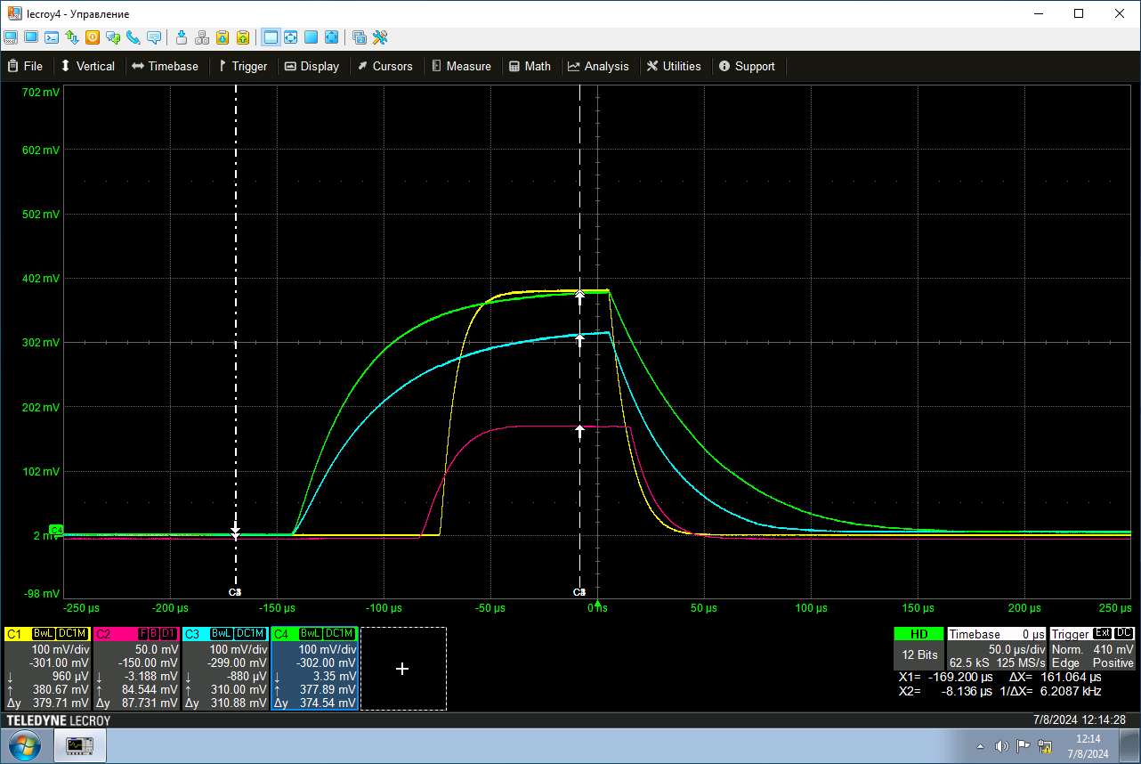

Slide 37
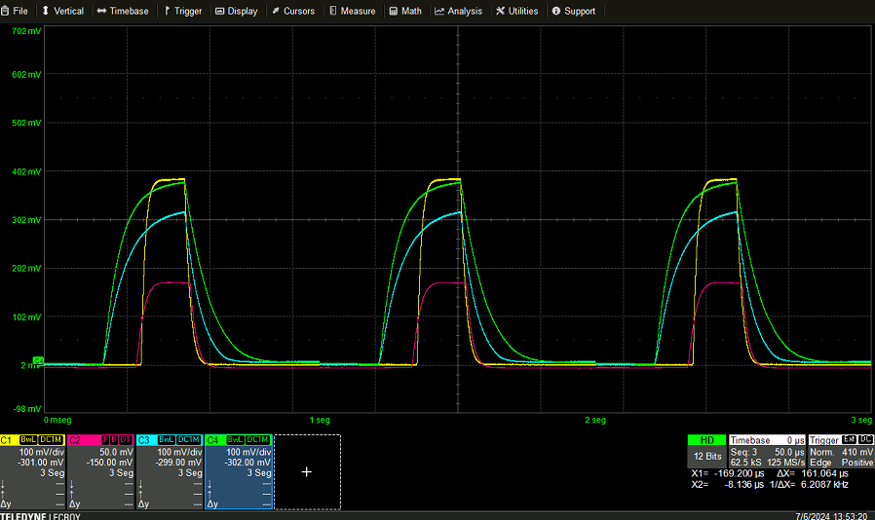

Slide 38
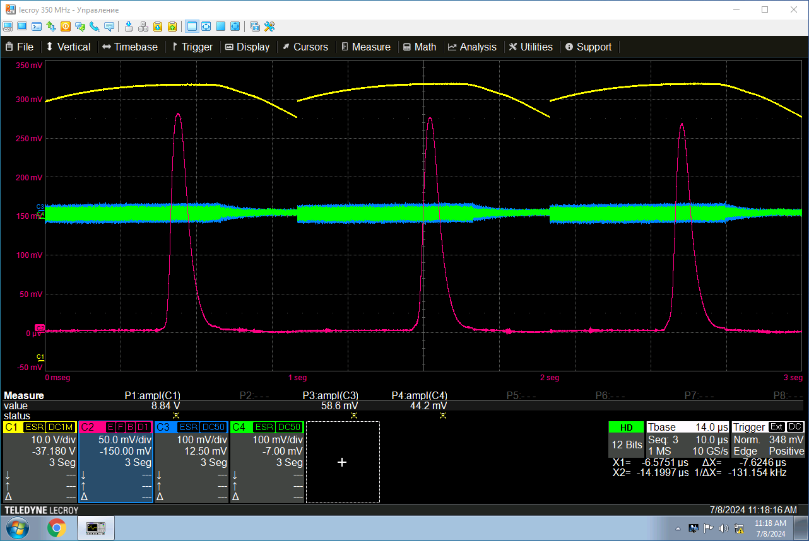

Slide 39
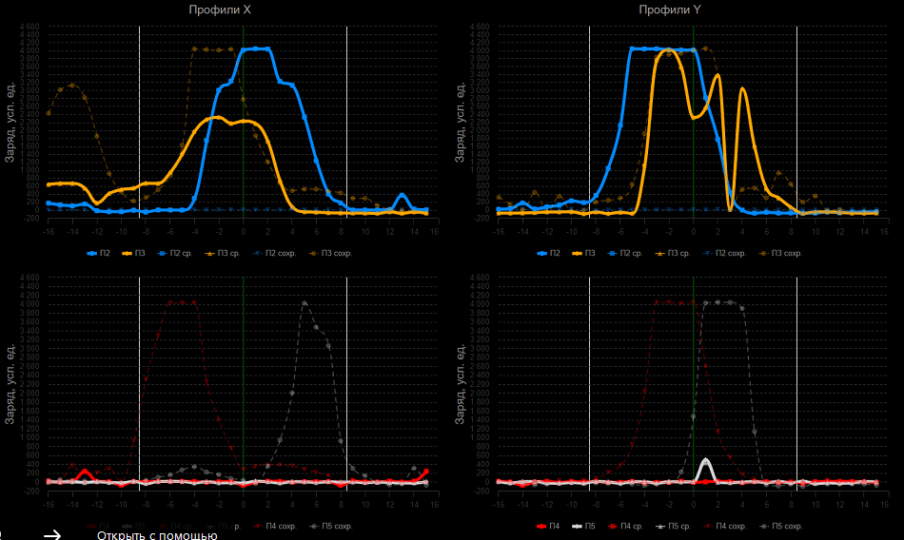

Slide 40
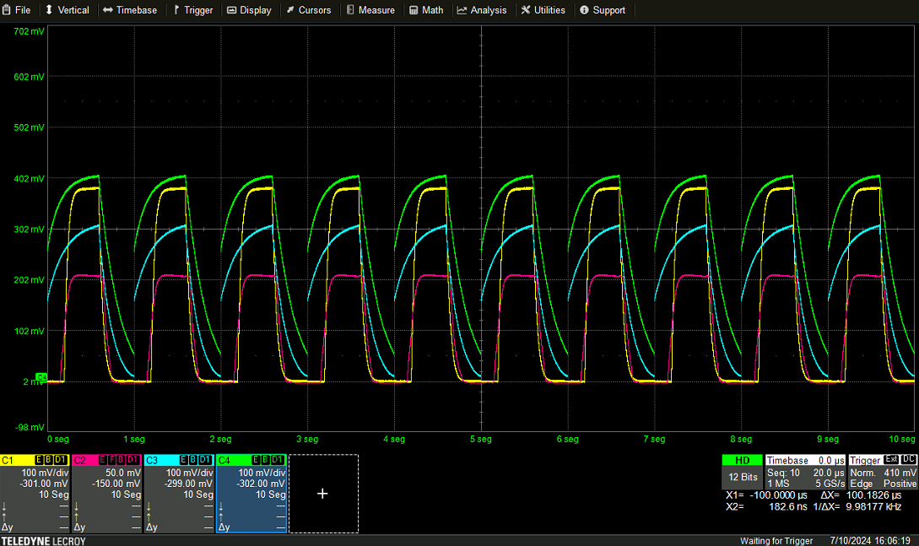

Slide 41
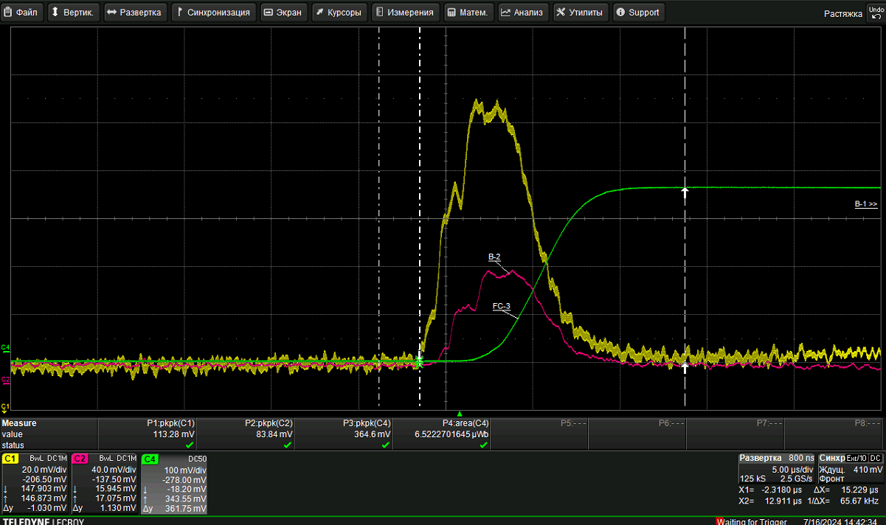

Slide 42
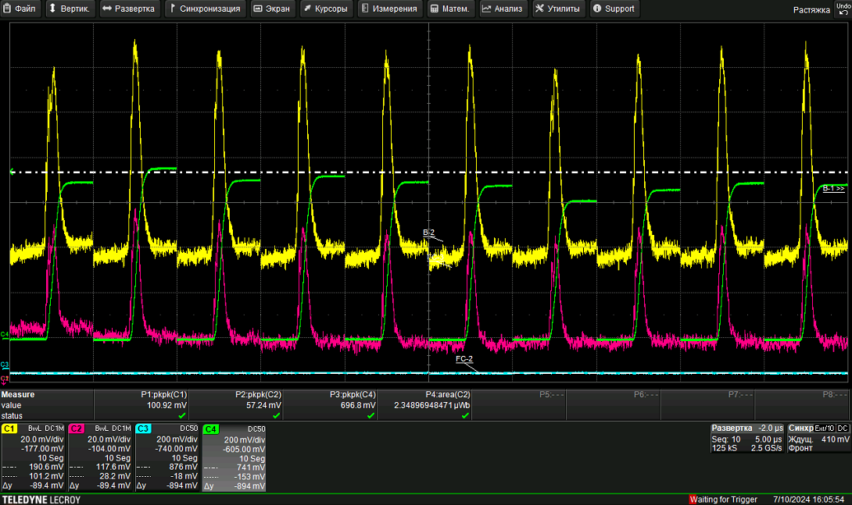

Slide 43
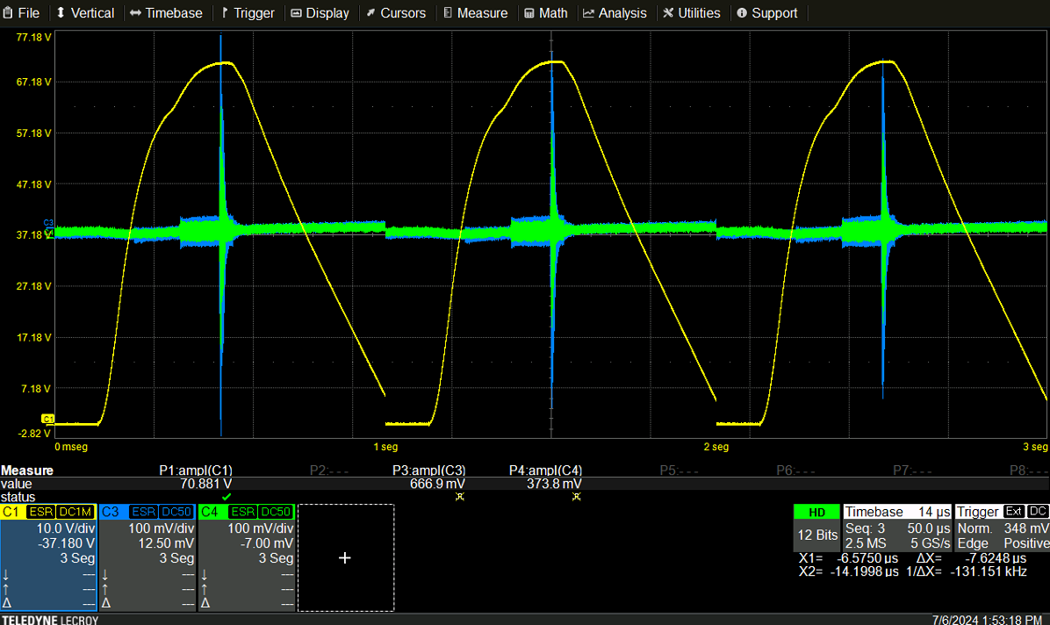

Slide 44
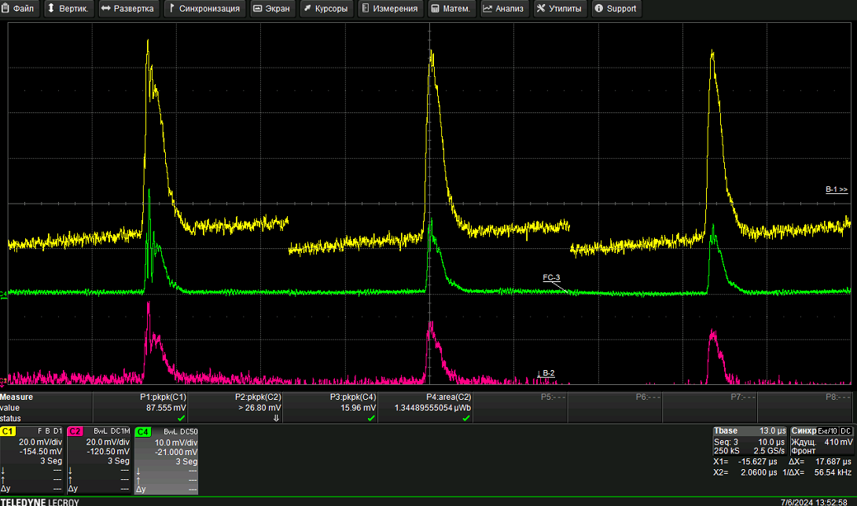

Slide 45
Одновременное прохождение по линейному ускорителю и каналу нескольких зарядностей Ar и Xe в окрестности целевой зарядности
Спектр на выходе RFQ

Slide 46
Профили пучков Xe^{27,28,29}, ПМ-1Б 192А.
29+
28+
27+

Slide 47
Профили пучков Xe^{26,27,28}, ПМ-1Б 192А.
29+
28+
27+

Slide 48
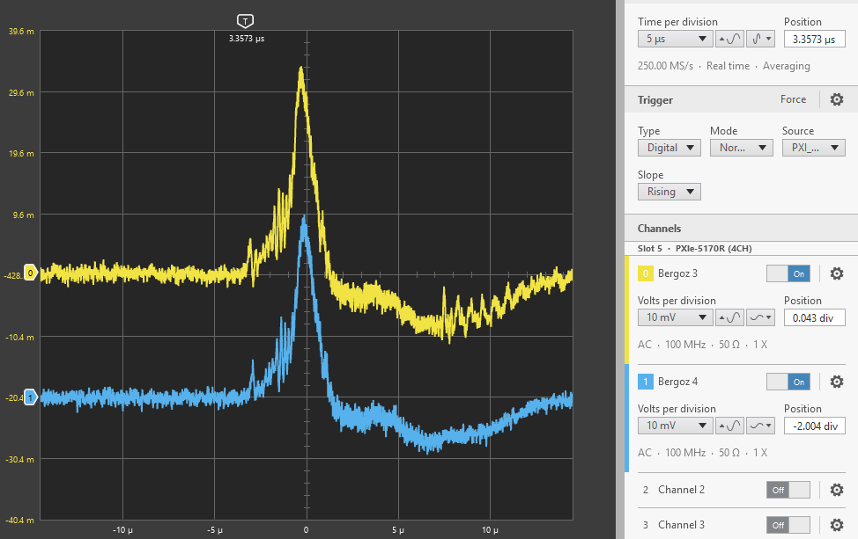
Пучок ₁₂₄Xe²⁸⁺ в канале инжекции в Бустер

Slide 49
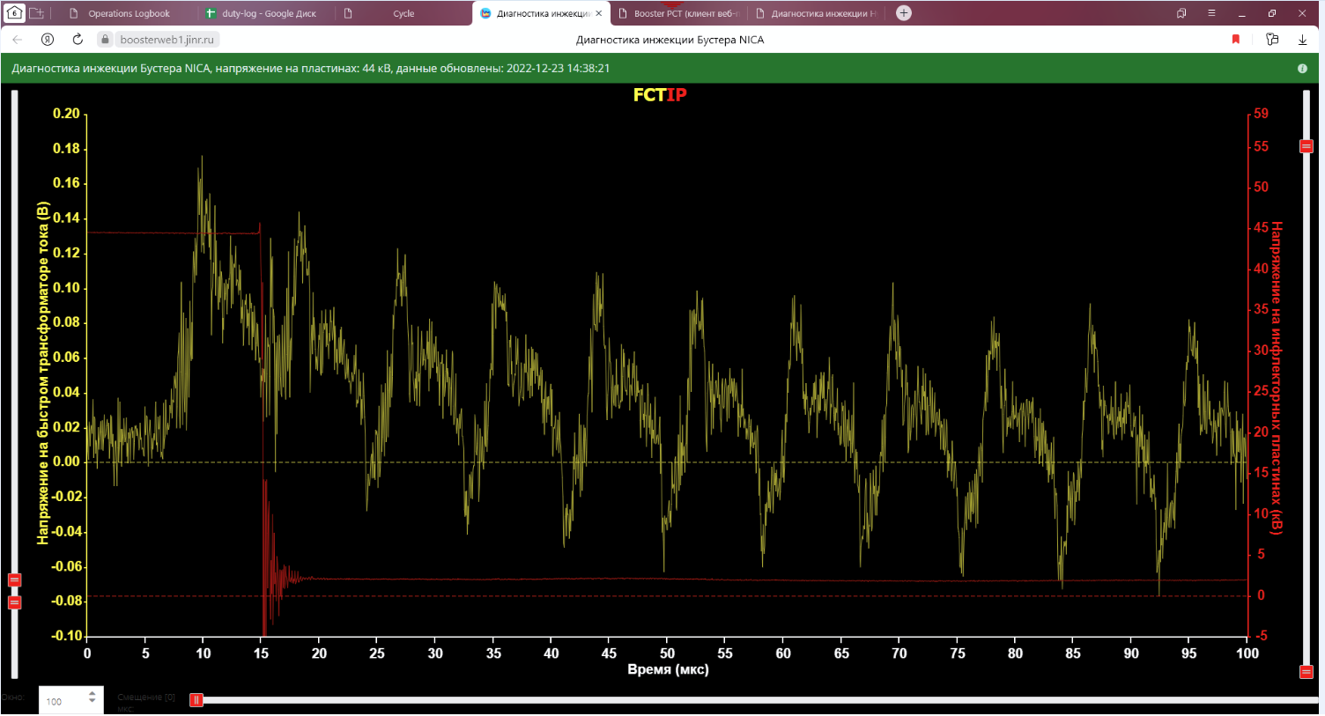
Картинка циркуляции Xe

Slide 50
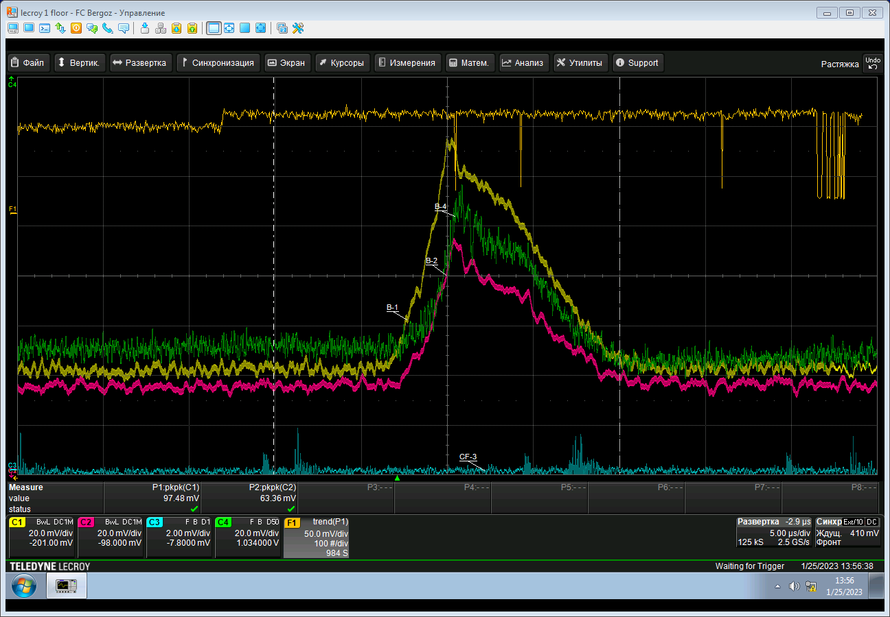
Стабильная работа источника ионов КРИОН
Срыв электронной струны происходил только во время «экспериментов» с накалом катода
Линия тренда макс. амплитуды
сигнала
с Bergoz1

Slide 51
