Slide 1
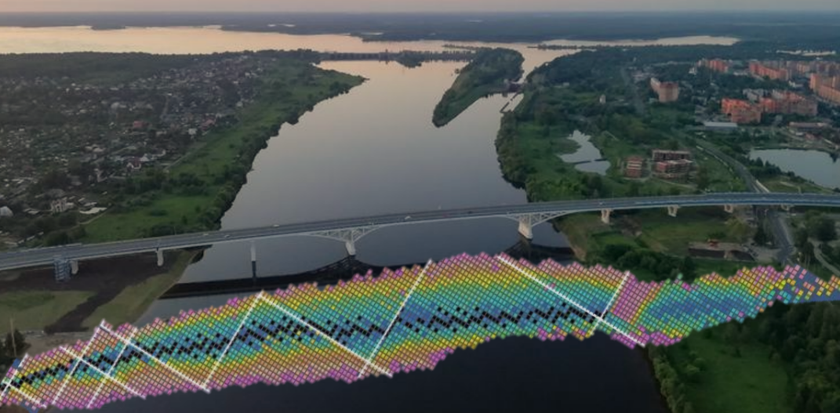
Study of fission and quasifission reaction
mechanisms through mass-energy distribution measurements
Aniruddha Dey^{1*}, E. M. Kozulin^{1,2}, Moumita Maiti³, A. A. Bogachev¹, G. N. Knyazheva¹, V. Saiko^{1,4}, I. M. Itkis¹, Y. S. Mukhamejanov^{4,5,6}, K. V. Novikov¹, I. V. Vorobiev¹, K. A. Kulkov¹, I. V. Pchelintsev¹, R. S. Tikhomirov¹
1. Flerov Laboratory of Nuclear Reactions, JINR, 141 980 Dubna, Russia
2. Dubna State University, Dubna, Moscow region, 141 982 Russia
3. Department of Physics, Indian Institute of Technology Roorkee, Roorkee 247 667, Uttarakhand, India
4. Institute of Nuclear Physics, 050 032 Almaty, Kazakhstan
5. VBLHEP, International Intergovernmental Organization, JINR, 141 980 Dubna, Russia
6. Al-Farabi Kazakh National University, Almaty, 050 040 Kazakhstan
(*Email: deyaniruddha@jinr.ru)
JINR 2024 Youth Award Competition
Joint Institute for Nuclear Research (JINR)
Dubna, Moscow Region, Russia
BASED ON THE REPORT FROM XXVIII International Scientific Conference of Young Scientists and Specialists (AYSS-2024)

Slide 2
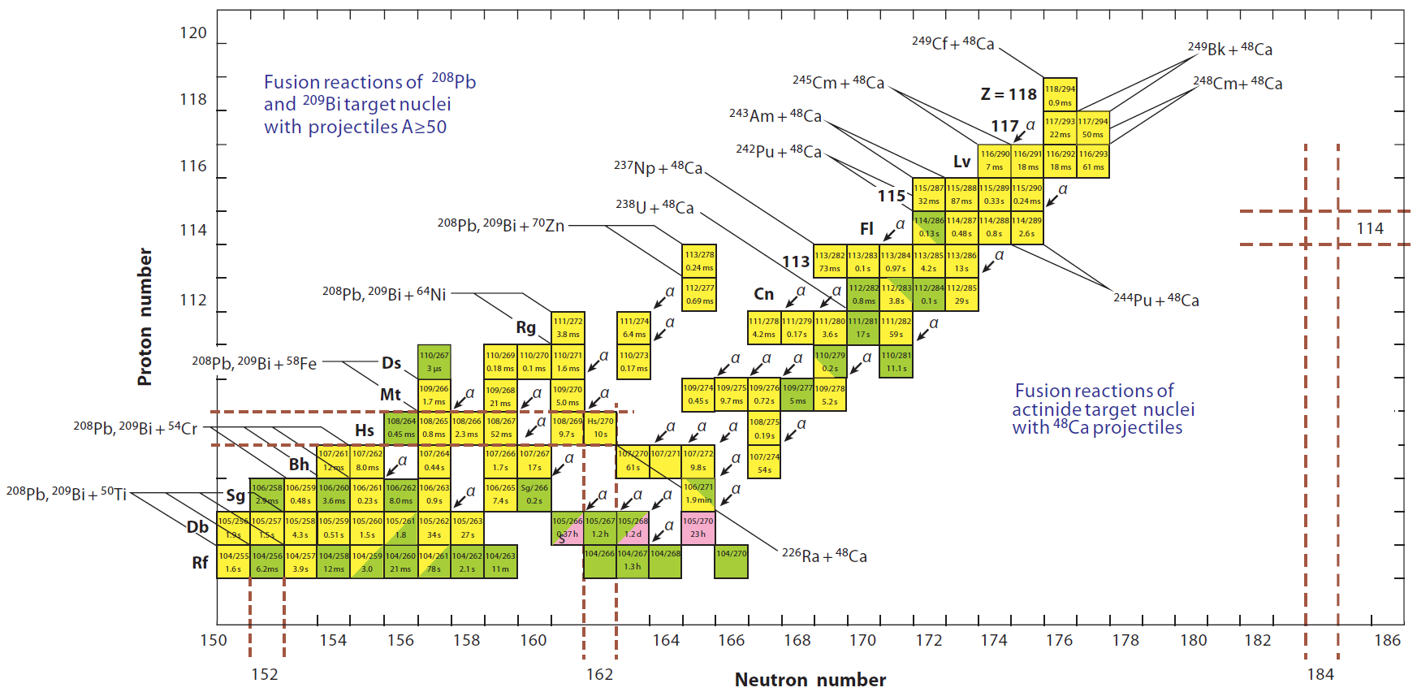
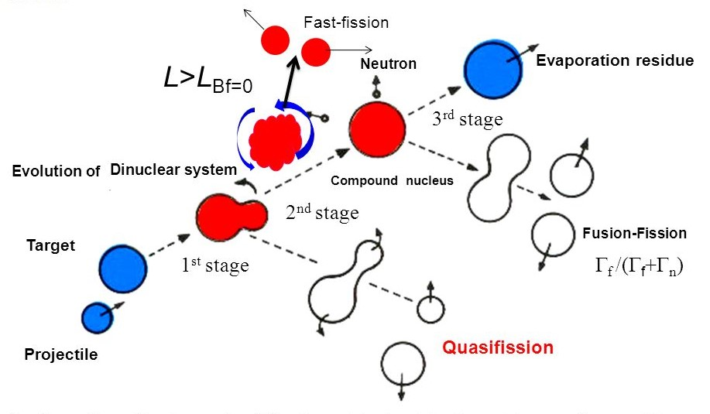
Introduction and Motivation
JINR – One of the prime laboratories exploring the limits of the periodic table in search of Super Heavy Elements (SHEs)
Approach Heavy-ion fusion reactions
‘Island of stability’
Ref. J. H. Hamilton, S. Hofmann, Y. T. Oganessian. Annu. Rev. Nucl. Part. Sci. 63, 383 (2013)
Multiple stages
Binary decay channels
Following complete equilibration in all degrees of freedom (mass, charge, etc.)
Non-compound nucleus process; Separation is extremely difficult!
Formation of a DiNuclear system (DNS) followed by two bifurcation points
Competition between Compound Nucleus (CN) formation and Quasifission (QF) process
Competition between Fusion-Fission (FF) process and Evaporation residue (ER) formation
Depends on multiple entrance channel parameters
JINR 2024 Youth Award Competition
1/9

Slide 3
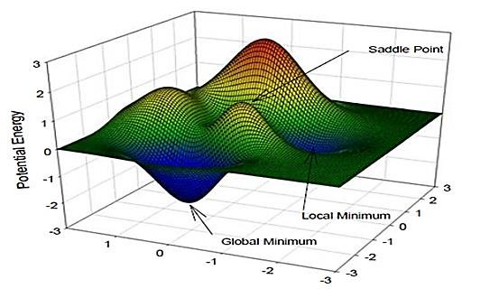
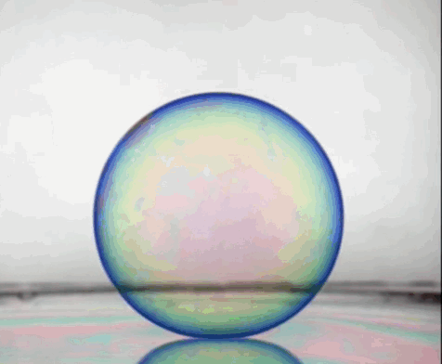
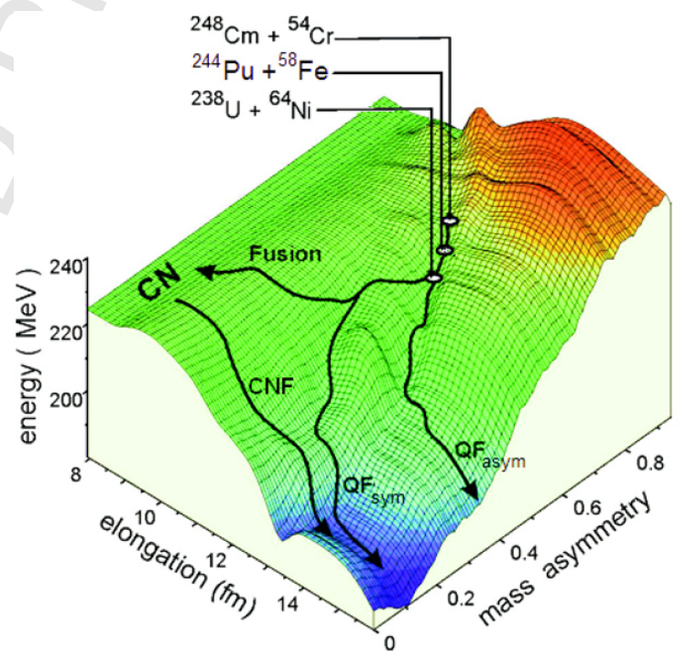
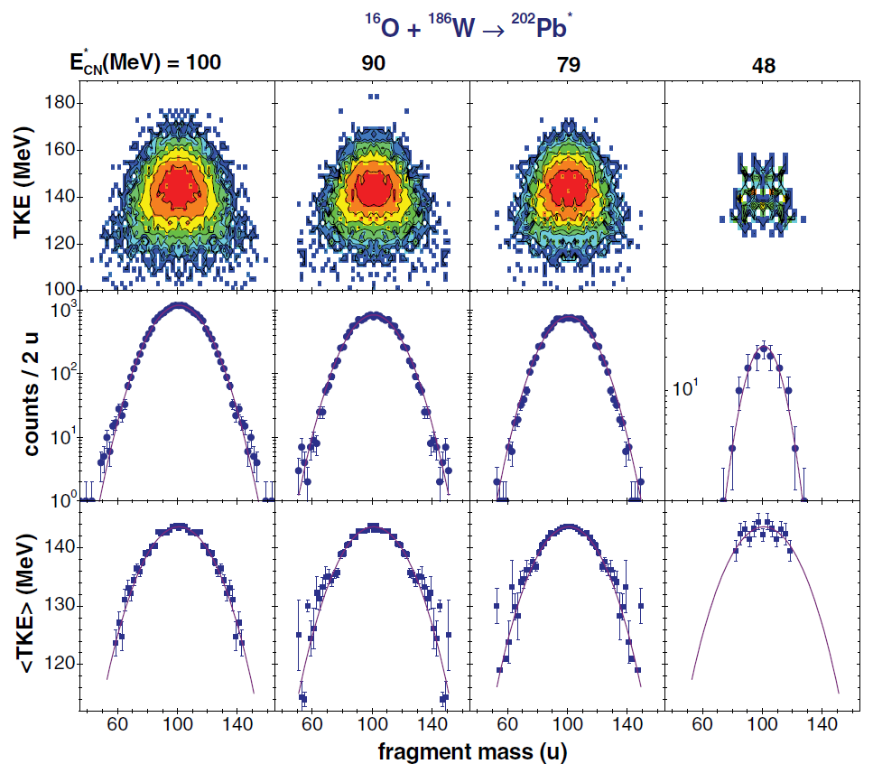
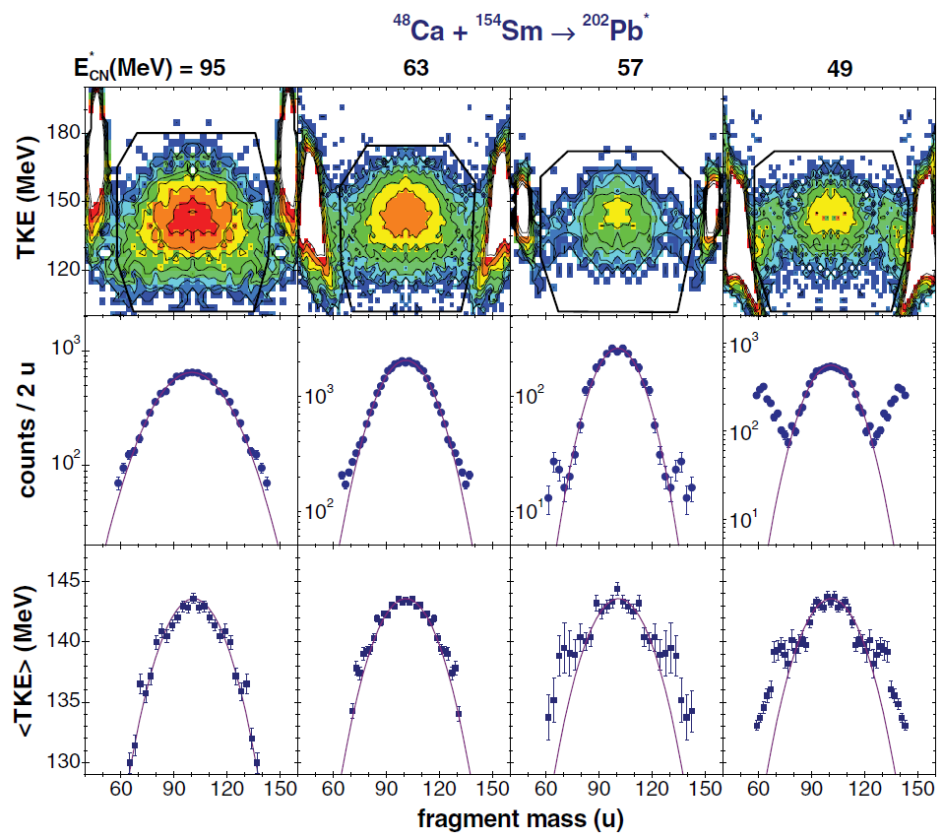
Introduction and Motivation
‘Evolution of the DiNuclear System’
Studied based on a multidimensional potential energy surface (PES) valley
Influence of shell structural effects, leads to multiple ‘Saddle’ and ‘Scission’ points
Following different fission channels, generates multiple modes of fission process
Multimodal fission process
Non-Compound nucleus process – Quasifission (QF)
Depends on the reaction entrance channel
Dependence on reaction excitation energy and angular momentum
Experimental approach – Measurement technique
Ref. G. N. Knyazheva et al., Phys. Rev. C 75, 064602 (2007)
Typical mass-energy, MTKE distributions
1D projections
Ref. E. M. Kozulin et al., Phys. Lett. B 686, 227 (2010)
Signatures of Quasifission process
JINR 2024 Youth Award Competition
2/9

Slide 4
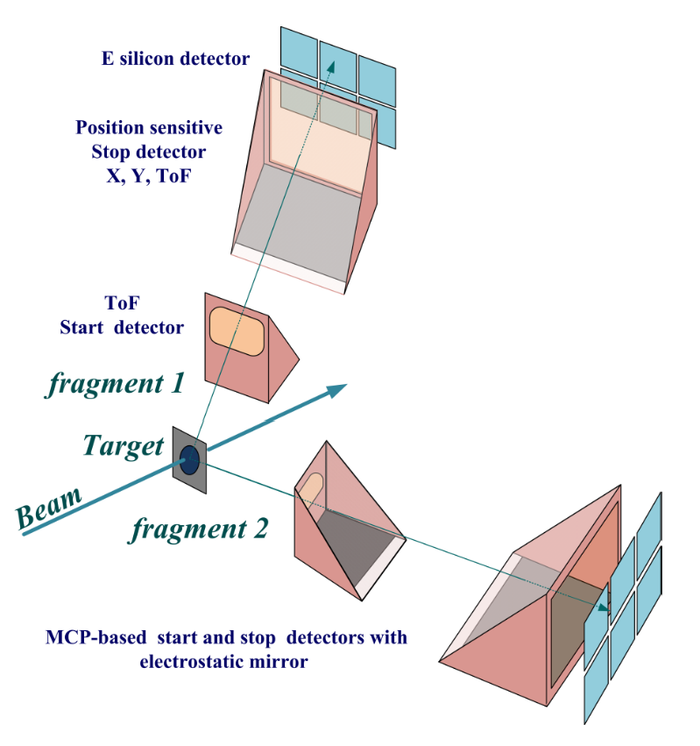
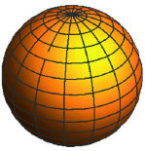
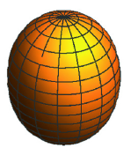
Experimental setup: CORSET Time-of-Flight Spectrometer
CORSET (CORrelation SETup) is a two-arm time-of-flight position-sensitive spectrometer developed at the Flerov Laboratory of Nuclear Reactions (FLNR), JINR.
SCD
Time resolution ≈ 180 ps
Mass resolution ≈ 2 amu
Position resolution ≈ 2 mm
Angular resolution ≈ ± 0.3˚
MCP Detector size = 18 × 7 cm²
Solid angle of each arm ≈ 360 msr
Arm angles_{1,2} ≈ 20˚ – 160˚
MCP
7 cm
18 cm
-54˚
Experiment – 1
Experiment – 2
54˚
Z_{P}Z_{T} = 656
²⁰⁸Pb
Z_{P}Z_{T} = 1400
¹⁷⁶Yb
SCD
¹⁶O
(β₂ = 0.06)
⁴⁸Ca
(β₂ = 0.31)
5.5 cm
(β₂ = 0.35)
(β₂ = 0.11)
26.5 cm
χ_{eff} = 0.439
χ_{m} = 0.520
V_{coulomb} = 77.1 MeV
χ_{eff} = 0.628
χ_{m} = 0.662
V_{coulomb} = 154.2 MeV
MCP
E_{beam} = 84.0, 93.0, 99.0, 106.5 MeV
E_{CM}/V_{B} = 1.01, 1.12, 1.19, 1.28
Targets : 191 µg/cm² on C backing
Arm angles_{1,2} = 70˚ – 80˚
E_{beam} = 188, 198, 209, 226 MeV
E_{CM}/V_{B} = 0.96, 1.01, 1.06, 1.14
Targets : 214 µg/cm² on Ti backing
Arm angles_{1,2} = 50˚ – 60˚
Ref. E. M. Kozulin et al., Instrum. Exp. Tech. 51, 44 (2008)
JINR 2024 Youth Award Competition
3/9

Slide 5
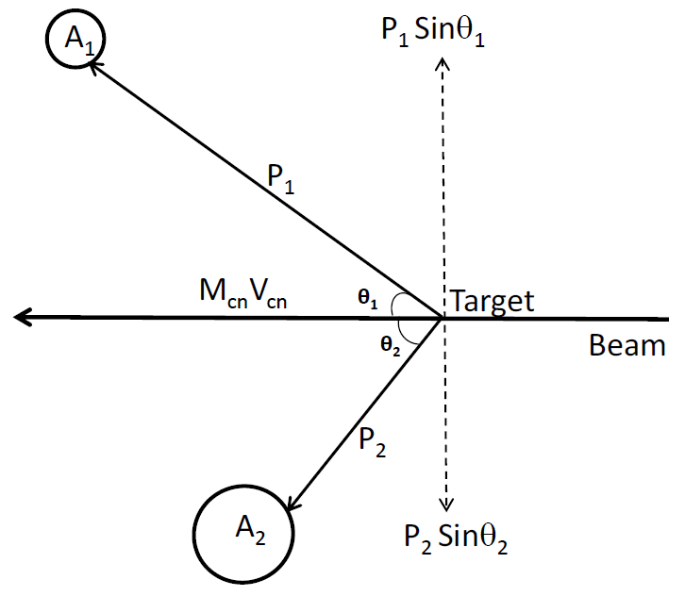
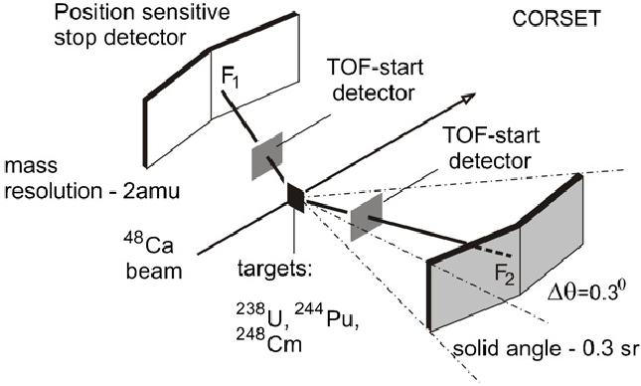
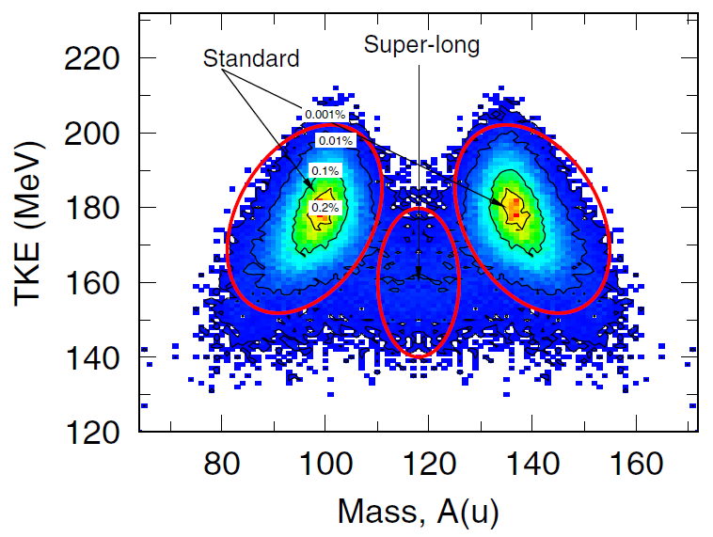
Data Processing: Double-Velocity Measurement Technique
^{Double-velocity measurement}
Y₁
X₁
^{Subsequent Multimodal analysis}
Y₂
²³⁶U
X₂
(E_{ex} ~ 7 MeV)
¹⁷⁶Yb
JINR 2024 Youth Award Competition
4/9

Slide 6
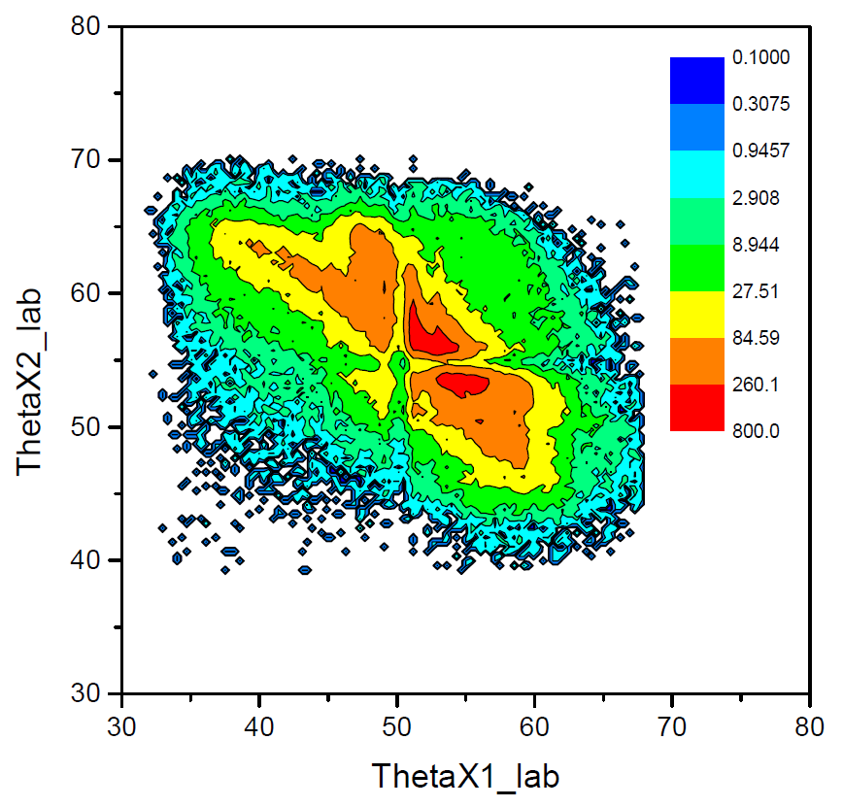
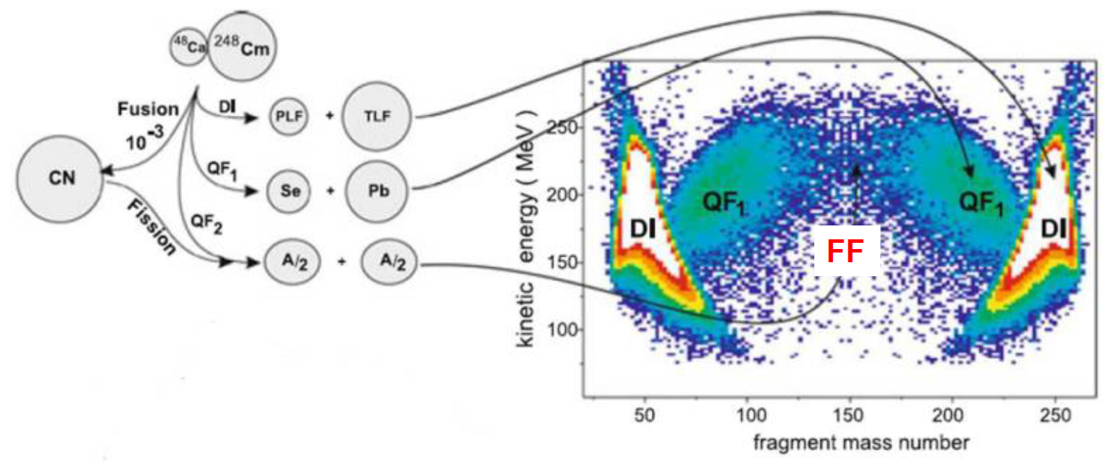
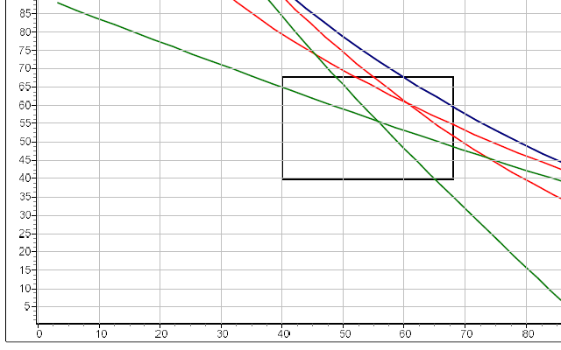
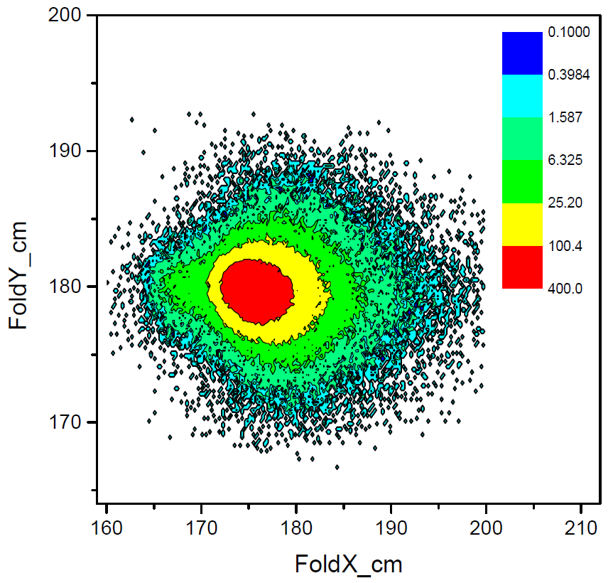
Data Processing: Double-Velocity Measurement Technique
^{Double-velocity measurement}
Y₁
X₁
^{Subsequent Multimodal analysis}
Y₂
²³⁶U
X₂
(E_{ex} ~ 7 MeV)
¹⁷⁶Yb
^{Fusion-fission}
⁺
^{Symmetric Quasifission}
^{Folding angle selection}
⁴⁸Ca
¹⁷⁶Yb
^{Asymmetric}
^{Quasifission}
^{Deep Inelastic}
^{FFs}
In-house developed Flipper Software
Full Momentum Transfer Collisions
^{Elastic Collisions}
JINR 2024 Youth Award Competition
4/9

Slide 7
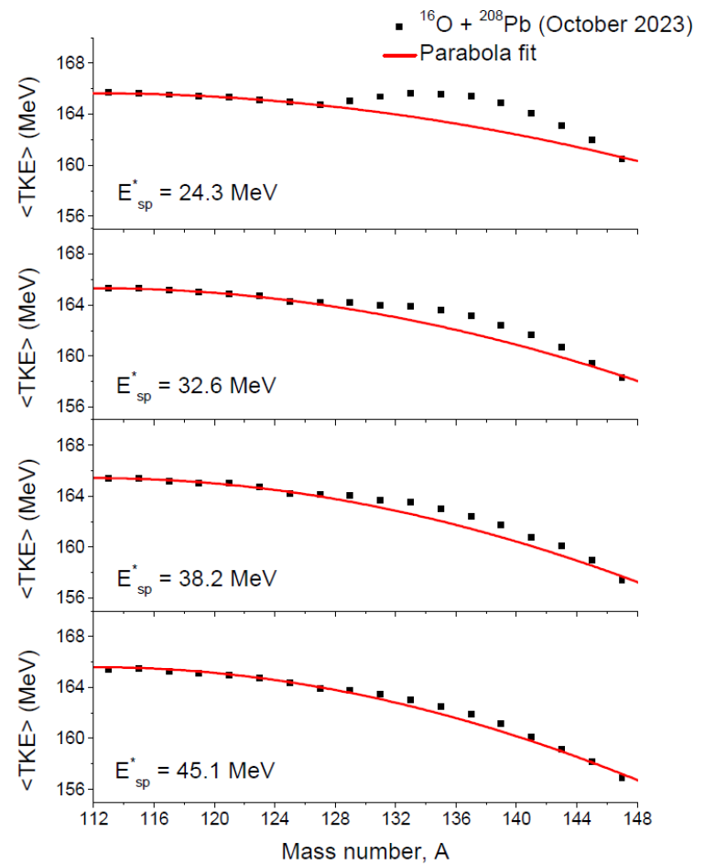
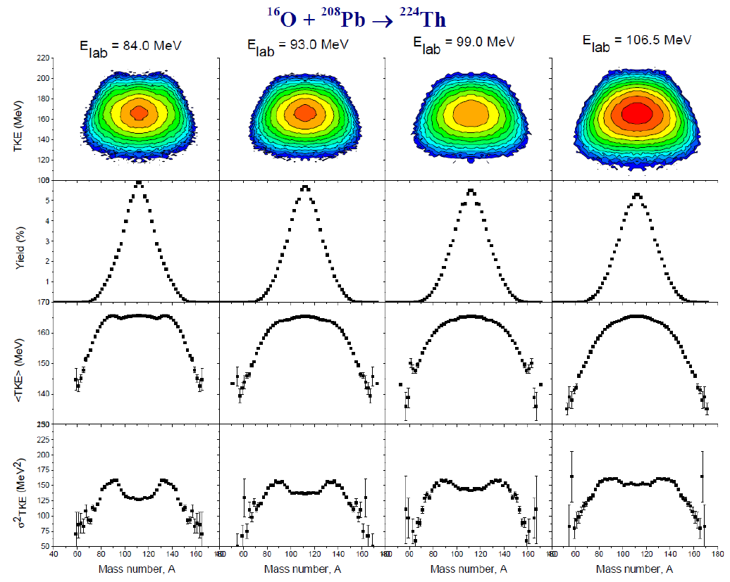
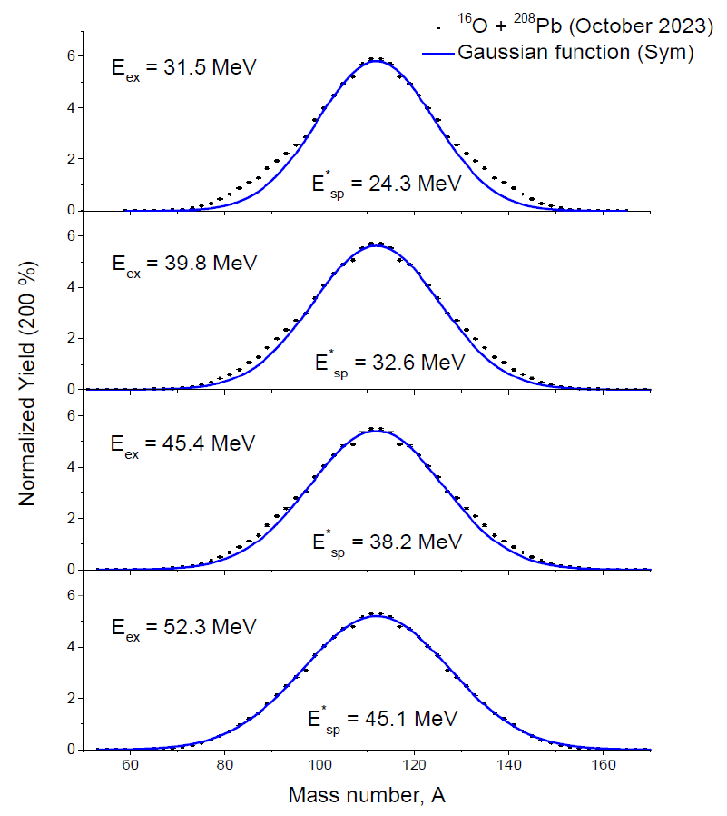
Experimental Results: Measured M-TKEs ²⁰⁸Pb(¹⁶O,f)
MTKEs were measured just above the barrier, E_{CM}/V_{B} ≈ 1.01 to 1.28
Parabolic function based on classical LDM model
Lower E_{ex}, the <TKE>(M) has a hump-like structure near A ≈ 138
Indicates the existence of a high TKE mode
Distributions can be represented by a single Gaussian function
σ²_{M} directly proportional to the saddle point energy (E_{sp})
JINR 2024 Youth Award Competition
5/9

Slide 8
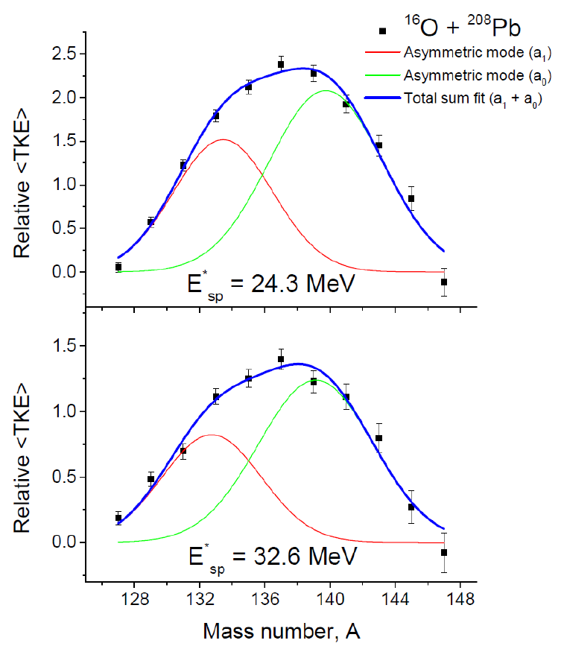
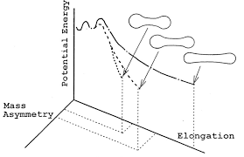
Experimental Results: Measured M-TKEs ²⁰⁸Pb(¹⁶O,f)
Asymmetrical shoulder was extracted
<TKE>_{Asym} = <TKE>_{exp} – <TKE>_{Parabolic fit}
Standard I (S1)
Potential Energy
Superlong
Mass Asymmetry
Standard II (S2)
“Due to spherical shell closures Z = 50 and N = 82”
Elongation
“Due to deformed shell closures Z = 56 and N = 88”
Indicates the persistence of shell structural effects at low excitation energies for ²²⁴Th
Origin of the two asymmetric modes was correlated with M_{a0} ≈ 140 and M_{a1} ≈ 132
With increase E_{sp} energy, the contribution of S1 asymmetric mode decreases in the total asymmetrical shoulder region
JINR 2024 Youth Award Competition
5/9

Slide 9
Experimental Results: Measured M-TKEs ²⁰⁸Pb(¹⁶O,f)
Asymmetrical shoulder was extracted
<TKE>_{Asym} = <TKE>_{exp} – <TKE>_{Parabolic fit}
Standard I (S1)
Potential Energy
Superlong
Mass Asymmetry
Standard II (S2)
“Due to spherical shell closures Z = 50 and N = 82”
Elongation
“Due to deformed shell closures Z = 56 and N = 88”
Indicates the persistence of shell structural effects at low excitation energies for ²²⁴Th
Origin of the two asymmetric modes was correlated with M_{a0} ≈ 140 and M_{a1} ≈ 132
With increase E_{sp} energy, the contribution of S1 asymmetric mode decreases in the total asymmetrical shoulder region
JINR 2024 Youth Award Competition
5/9

Slide 10
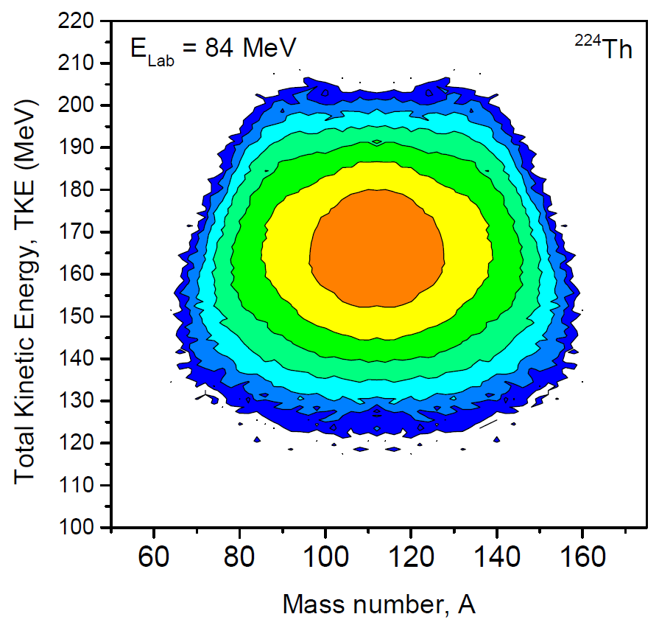
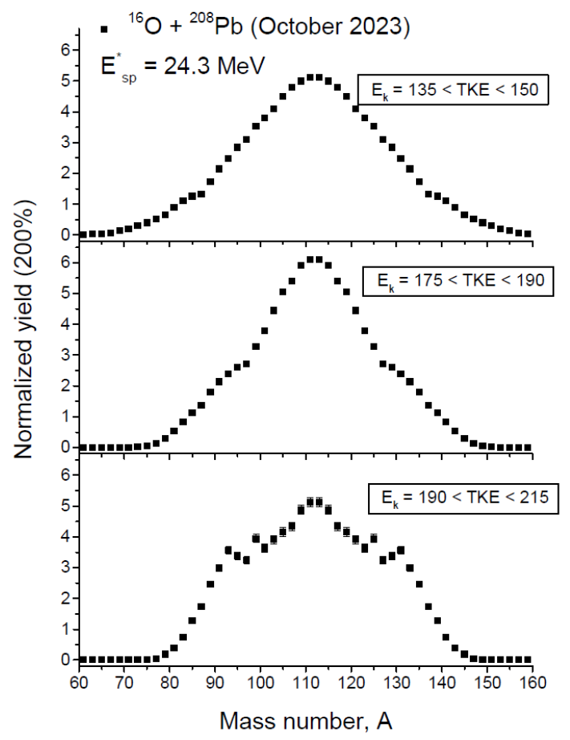
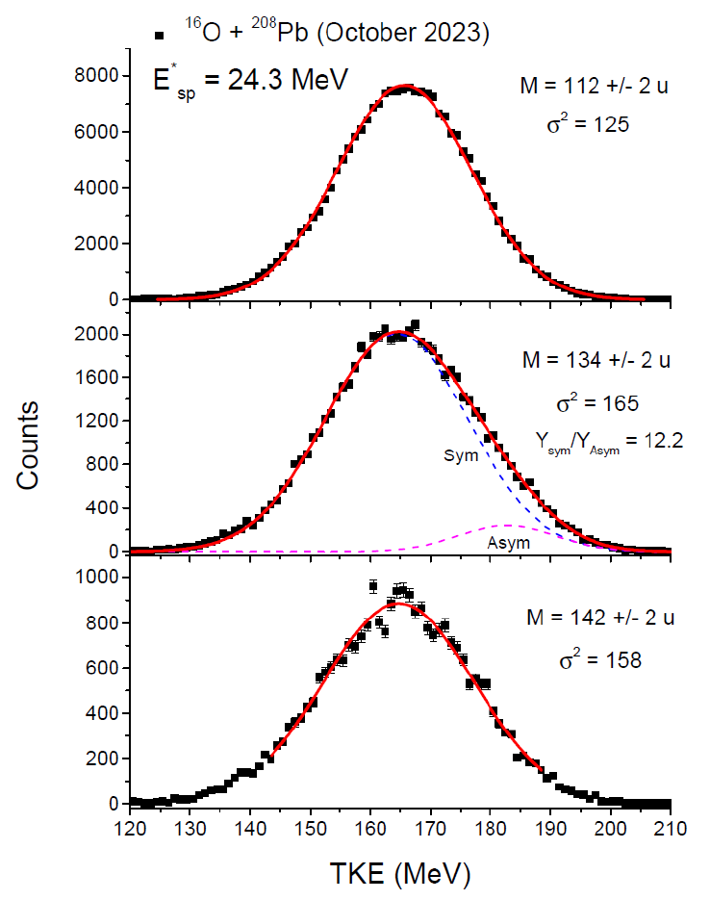
Experimental Results: Measured M-TKEs ²⁰⁸Pb(¹⁶O,f)
Single Gaussian due to the existence of only one type of fission mode
Three-peak structure is due to the coexistence of two different types of fission modes
Asymmetric comp. < 10 %
Single Gaussian distribution due to existence of only one type of fission mode at A ≈ 112
At A ≈ 142, the TKE(M) distribution again regains the single Gaussian distribution profile
Distribution get broadened at around A ≈ 134 due to simultaneous existence of two different types of fission modes
JINR 2024 Youth Award Competition
5/9

Slide 11
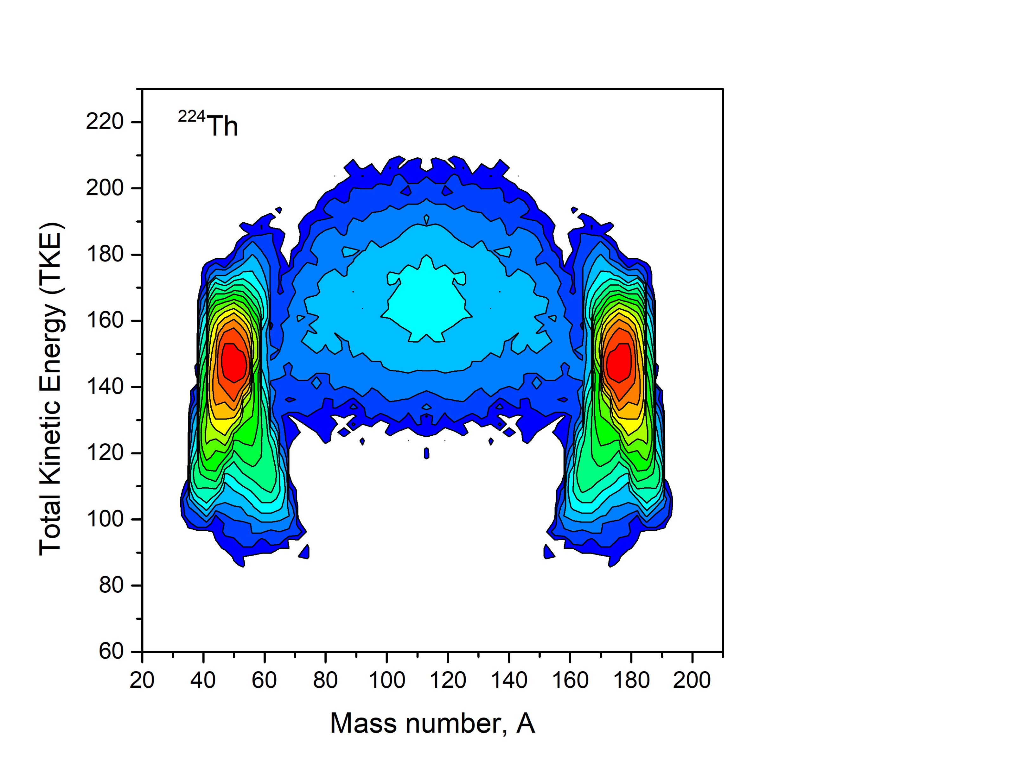
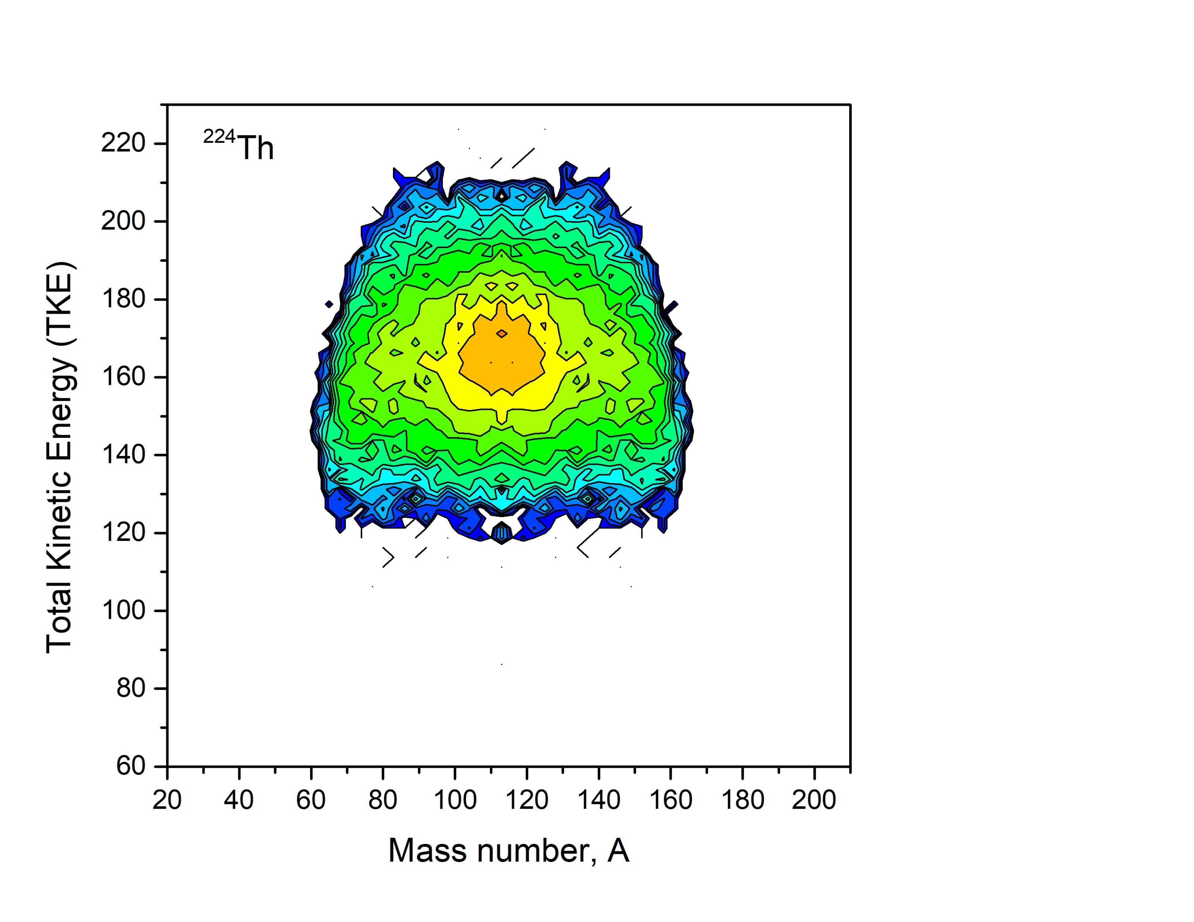
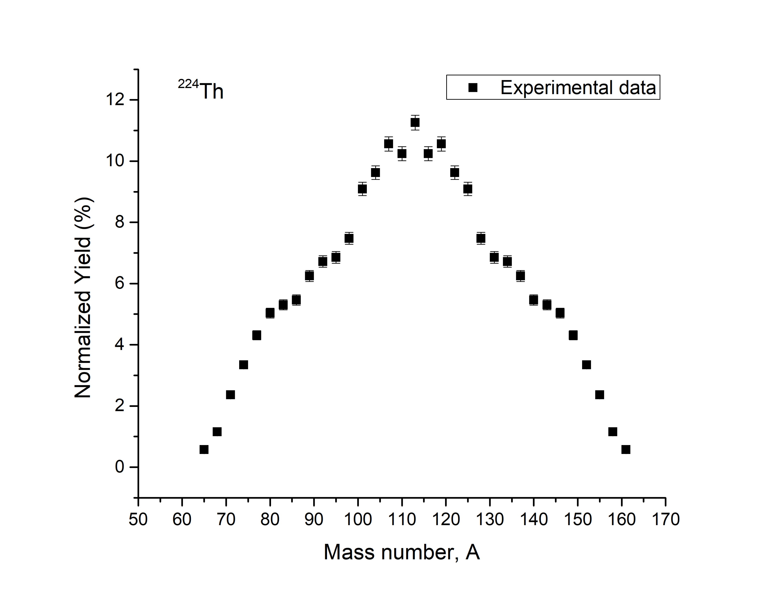
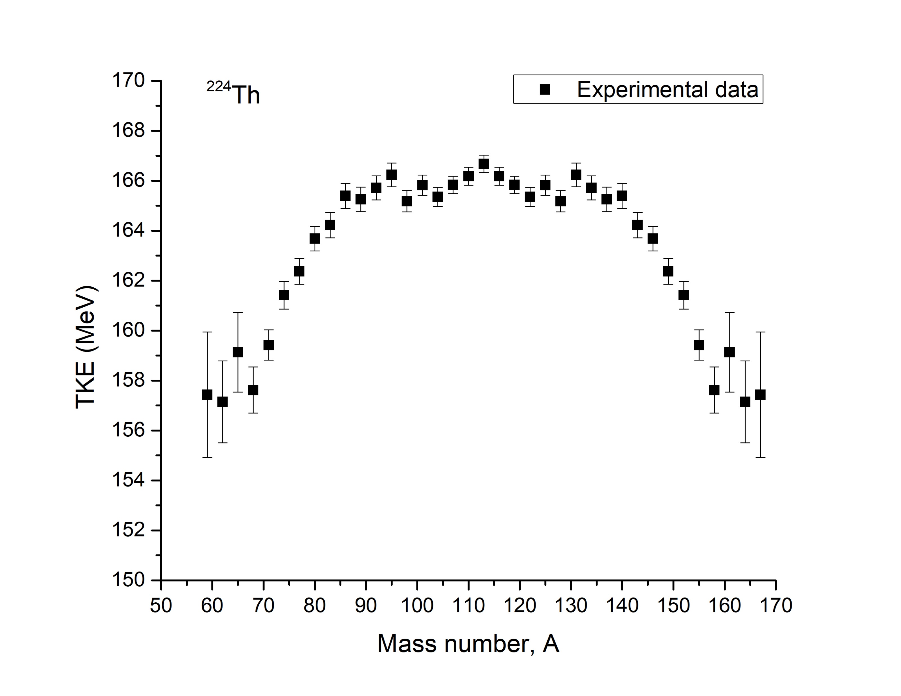
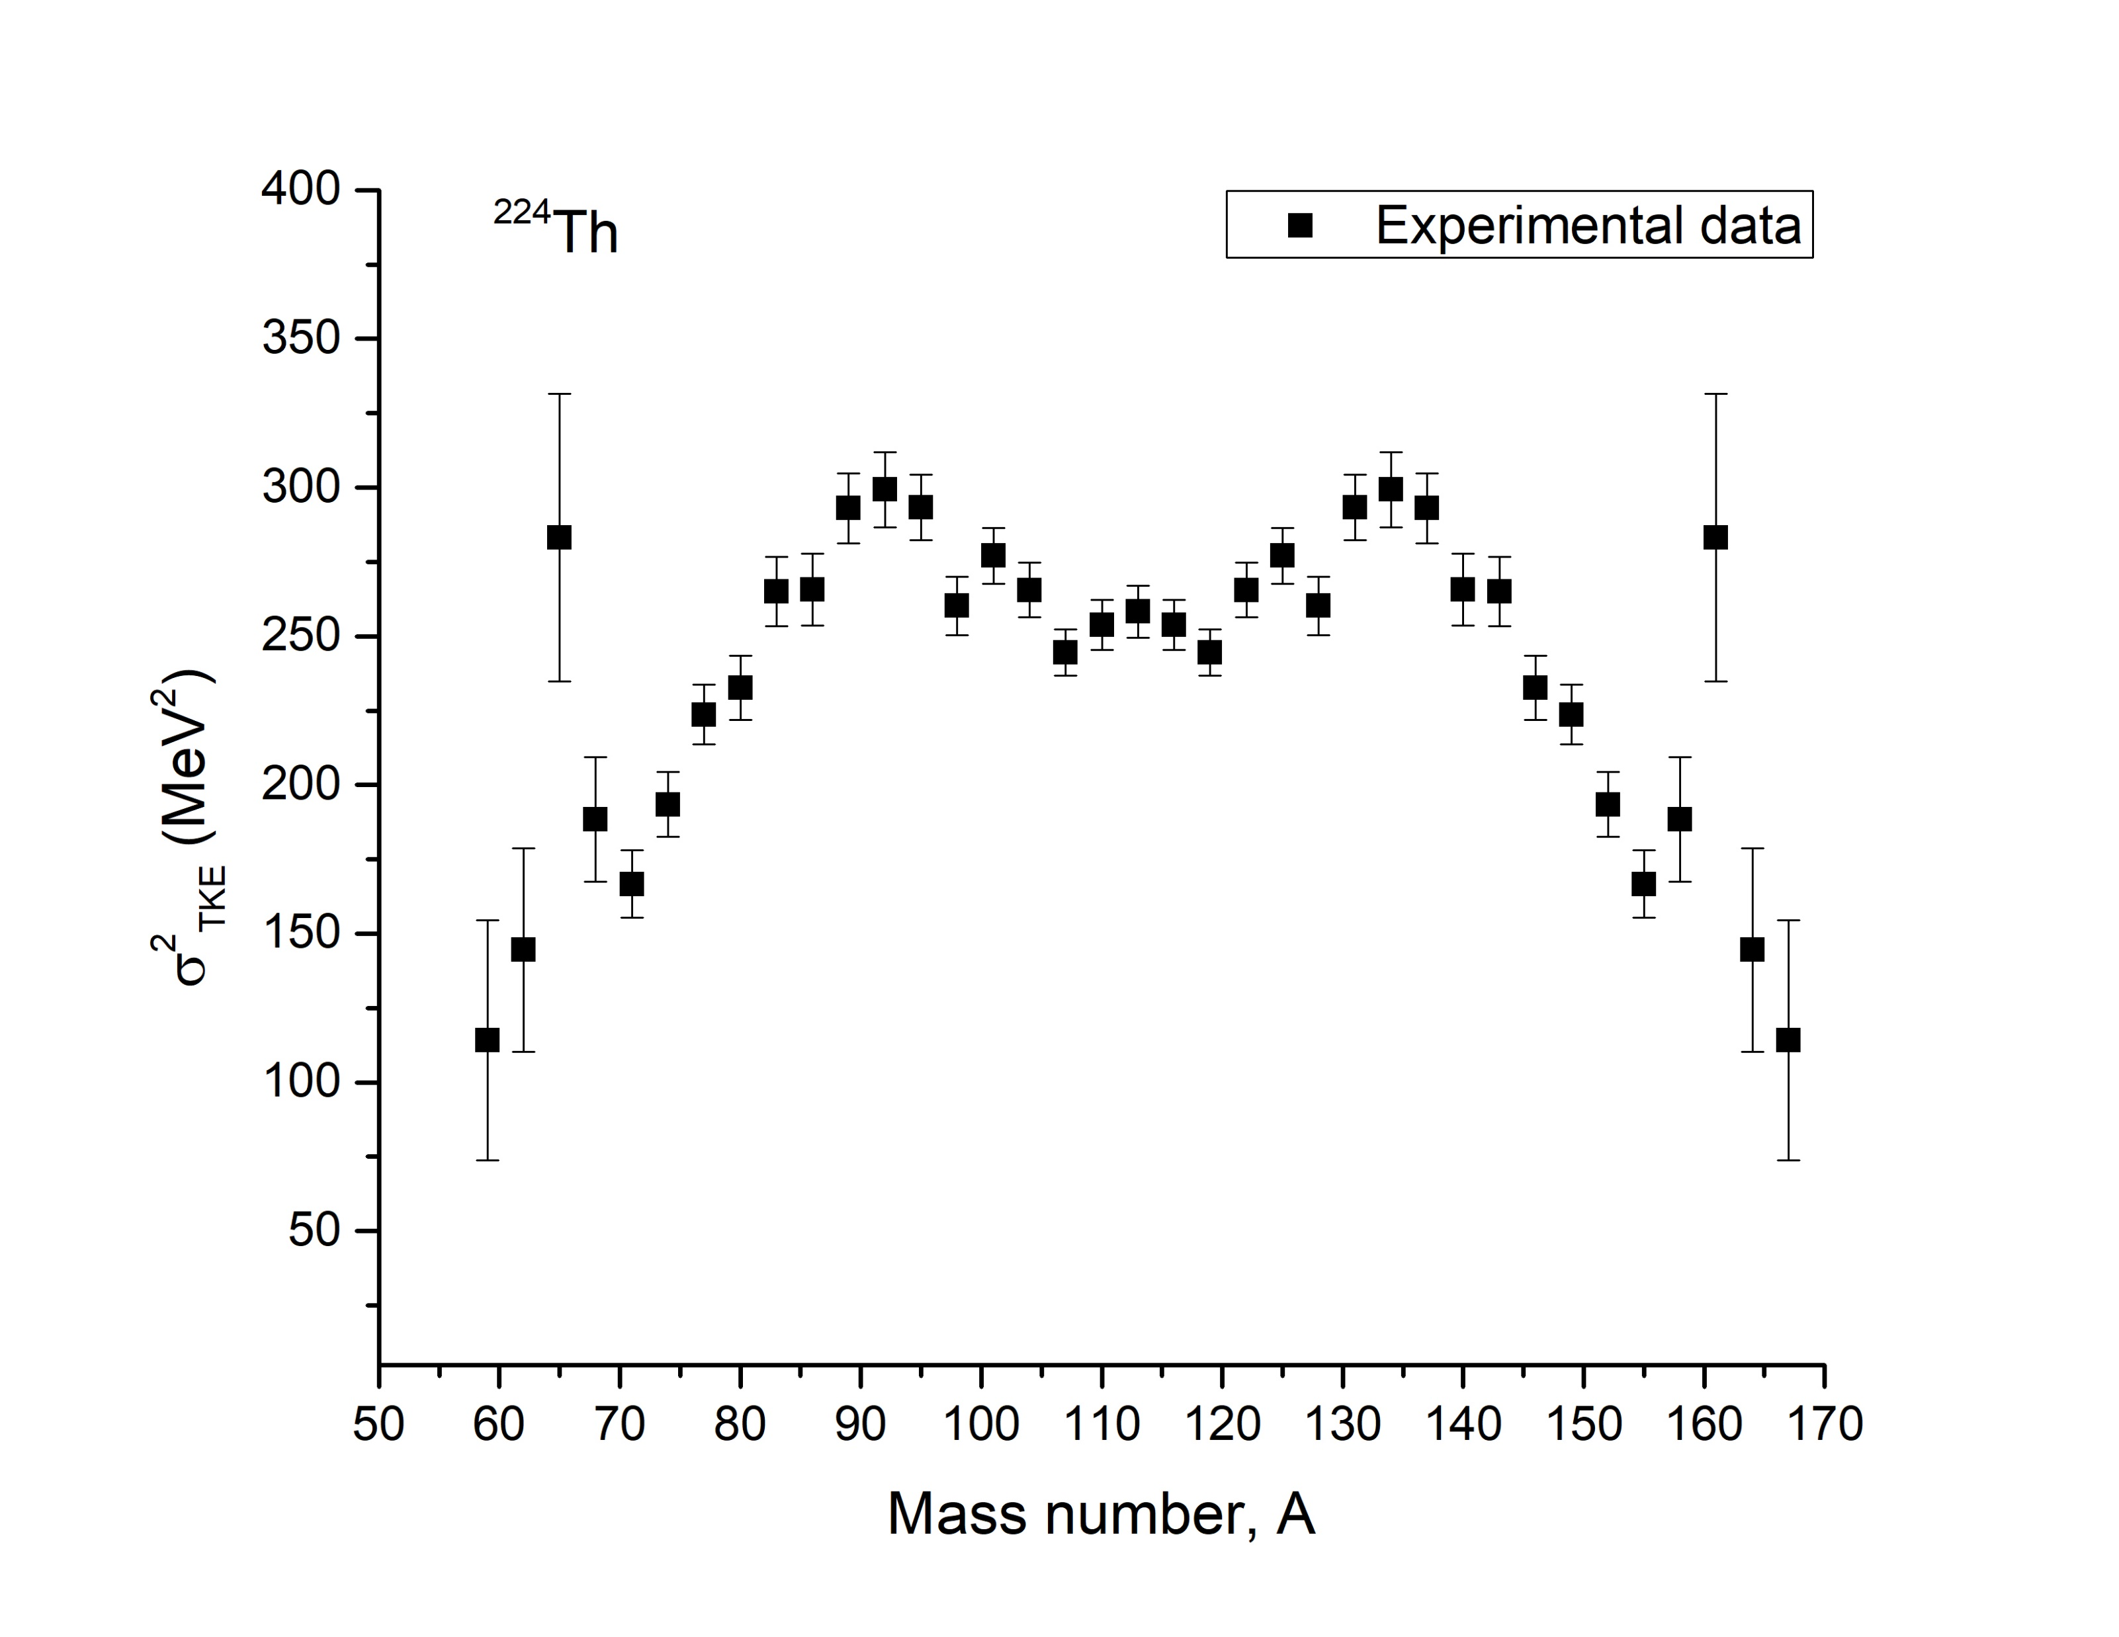
Analysis of Mass-Energy distributions, MTKE
A_{CN} / 2
Reaction : ⁴⁸Ca + ¹⁷⁶Yb → ²²⁴Th
∼ 84
∼ 140
Selection of Fission-like fragments
Viola Systematics
TKE_{FF} = 165.1 MeV
E_{cm} = 147.7 MeV
PLF, ⁴⁸Ca
<TKE>_{viola} = $0.1189\frac{Z2}{\sqrt[1/3]{A}}+7.3$ MeV
TLF, ¹⁷⁶Yb
N_{P}/Z_{P} = 1.4
N_{T}/Z_{T} = 1.51
Ref. V. E. Viola et al., Phys. Rev. C 31, 1550 (1985)
Evidences indicates existence of multiple fission modes
∼ 84
∼ 140
∼ 84
∼ 140
∼ 84
∼ 140
Symmetric
Asymmetric
Ref. E. M. Kozulin et al., Phys. Rev. C 105, 024617 (2022)
Ref. M. G. Itkis et al., AIP Conf. Proc. 425, 189 (1998)
JINR 2024 Youth Award Competition
6/9

Slide 12
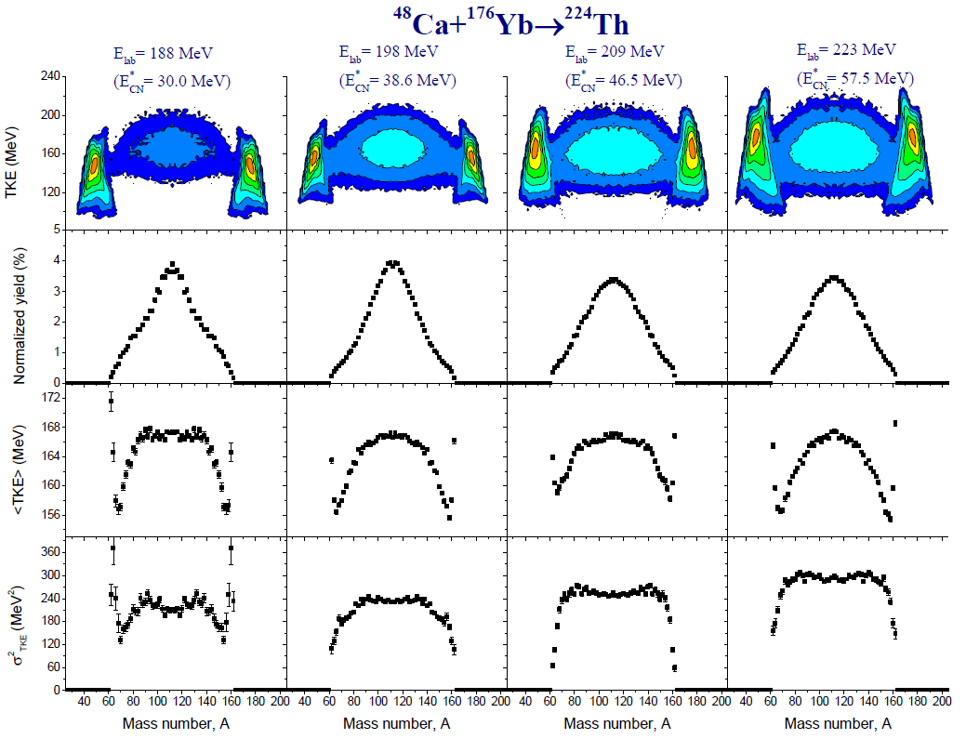
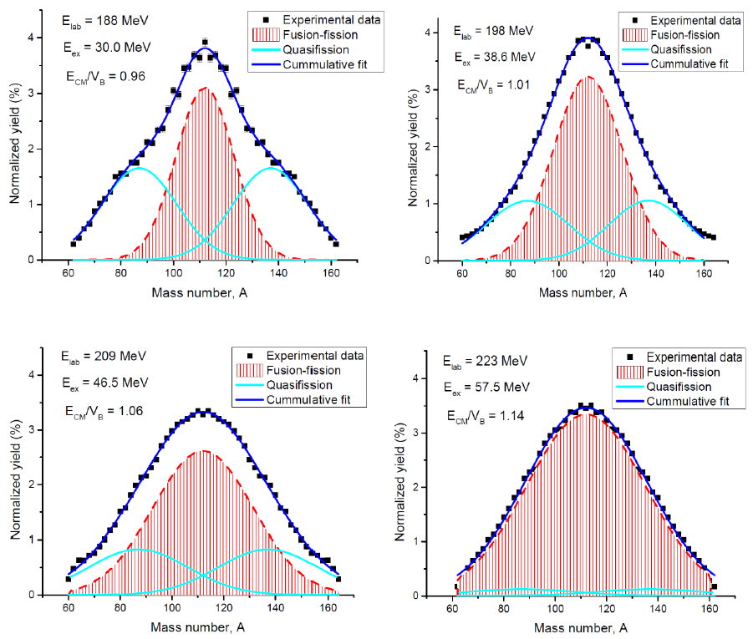
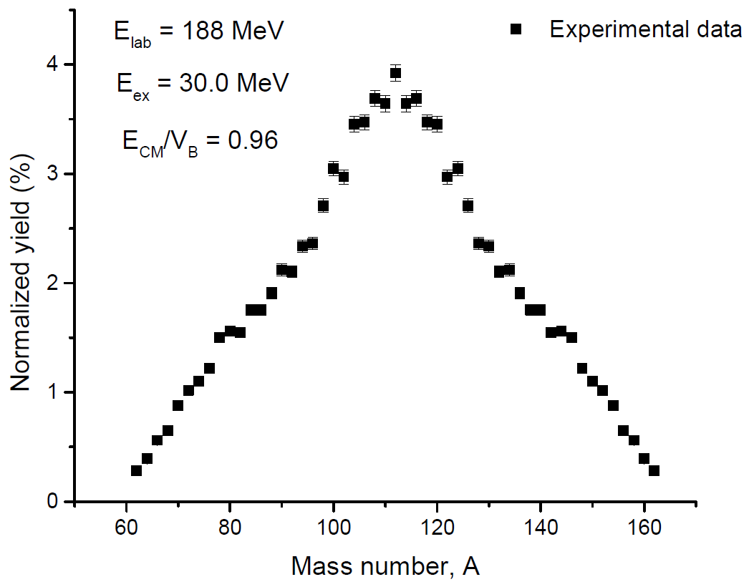
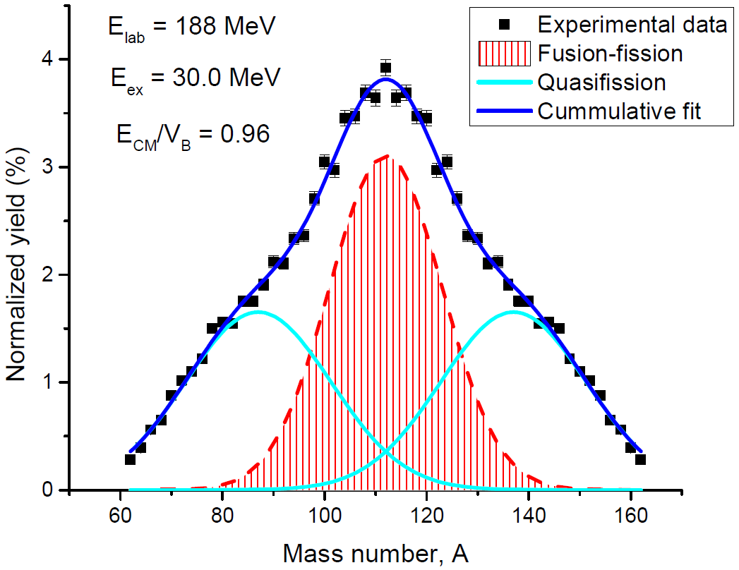
Experimental Results: Measured M-TKEs ¹⁷⁶Yb(⁴⁸Ca,f)
JINR 2024 Youth Award Competition
7/9

Slide 13
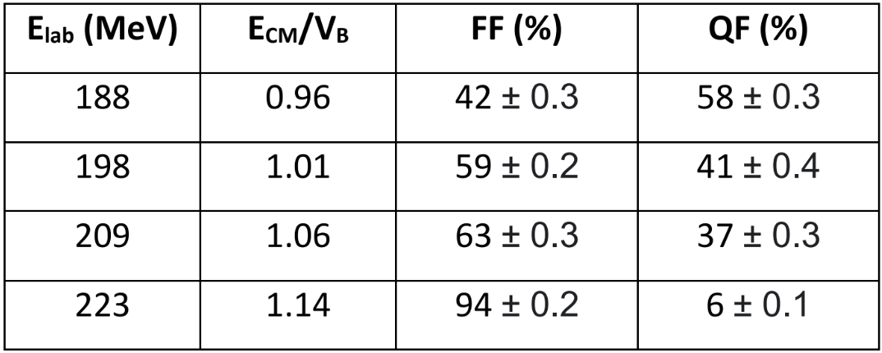
Experimental Results: Measured M-TKEs ¹⁷⁶Yb(⁴⁸Ca,f)
Significant contribution of QF just below barrier, E_{CM}/V_{B} ≈ 0.96
Peak of asymmetrical shoulders are around A ≈ 87 and 137
Contribution of QF process decreases with increase in E_{ex}
Z_{H} = 50
Z_{H} = 28
Signature of Quasifission (QF) process
Positions of spherical shell closures
JINR 2024 Youth Award Competition
7/9

Slide 14
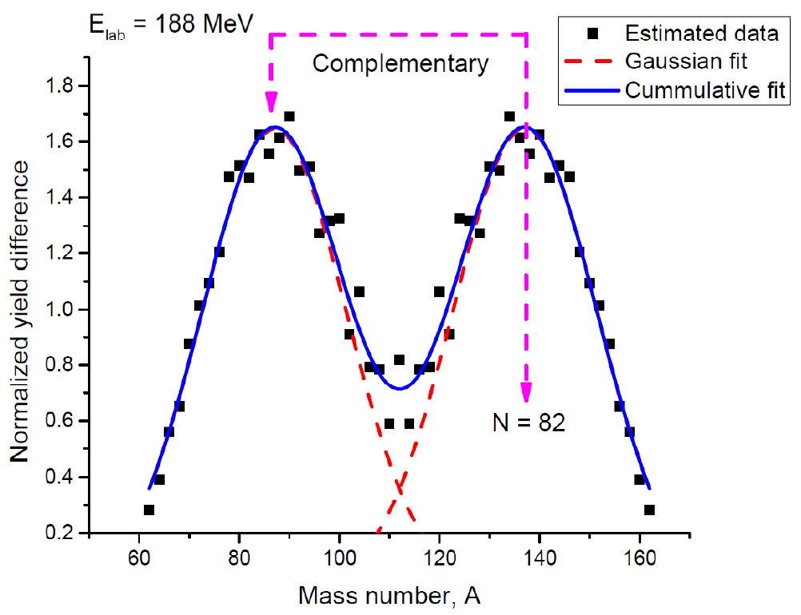
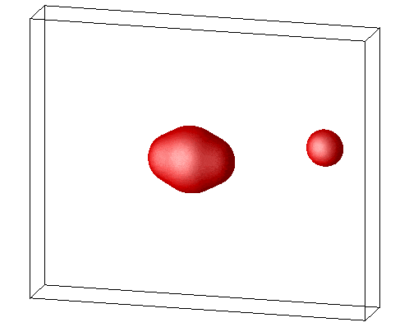
Experimental Results: Measured M-TKEs ¹⁷⁶Yb(⁴⁸Ca,f)
QF mass distribution
Y_{QF} = Y_{exp} – Y_{FF}
Composite system - ²²⁴Th
$\frac{N}{A}=$ $\frac{(224 −90)}{224}$ $= \frac{134}{224}$
According to UCD approximation -
$$AH=\frac{134}{224}∗82≈137$$
A_{L} = 224 – 137 ≈ 87
Complementary fragment
Indication of shell structural effects at excitation of as high as E_{ex} ≈ 57 MeV
QF is comparatively colder process than FF process, therefore exhibits shell effects at even higher excitation energies
Partial mass equilibration due to the short interaction time between projectile and target nuclei
JINR 2024 Youth Award Competition
8/9

Slide 15
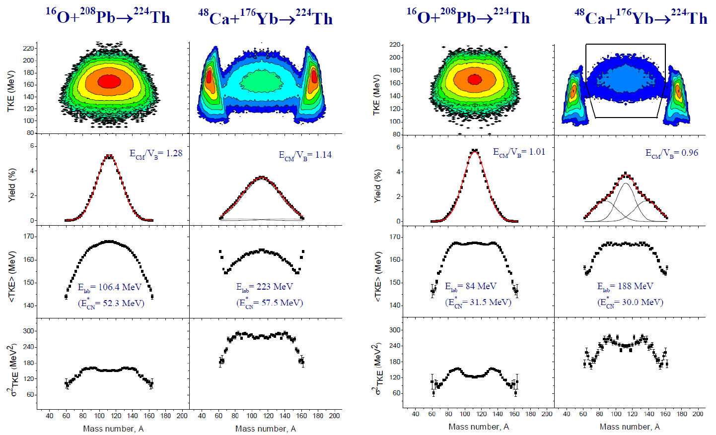
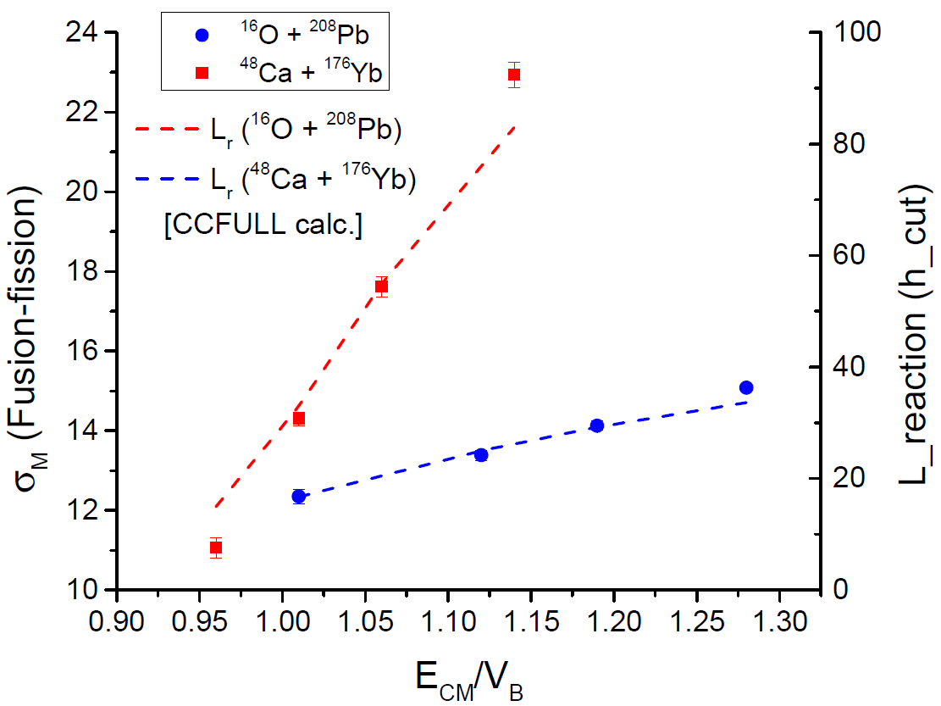
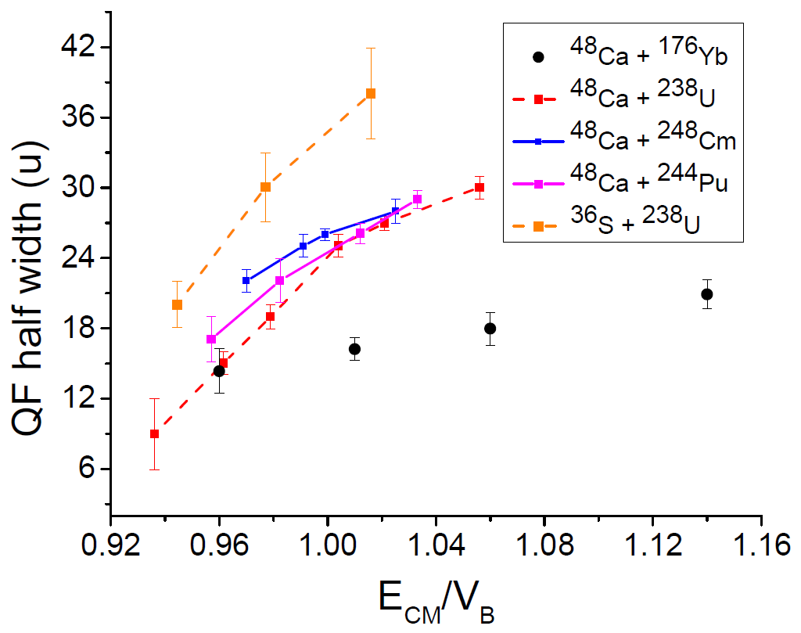
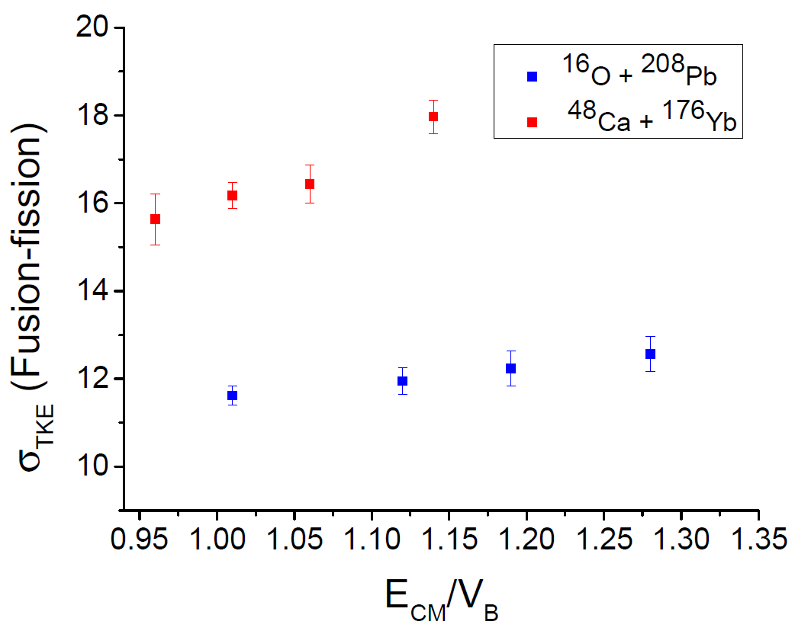
Conclusion and Summary
Take home observations and curiosities
Time-of-flight (TOF) measurement technique
Asymmetric and Symmetric Fusion-Fission
Multimodal fission in ¹⁶O + ²⁰⁸Pb
Significant enhancement in σ_{m}
σ²_{TKE} value is different due to different processes
Marked changes in σ²_{TKE} distribution indicates presence of two different reaction mechanisms
Asymmetric shoulders in mass distributions
Flat-top <TKE> distribution instead of parabolic profile
Significant QF contribution for the reaction, ⁴⁸Ca + ¹⁷⁶Yb
Entrance channel dependence
Signature of Quasifission process
“Affected by shell closures”
E_{ex} ≈ 55 MeV
E_{ex} ≈ 30 MeV
“Structure due to the Asymmetric Quasifission process”
Then –
Detailed investigations carried out !
JINR 2024 Youth Award Competition
9/9

Slide 16
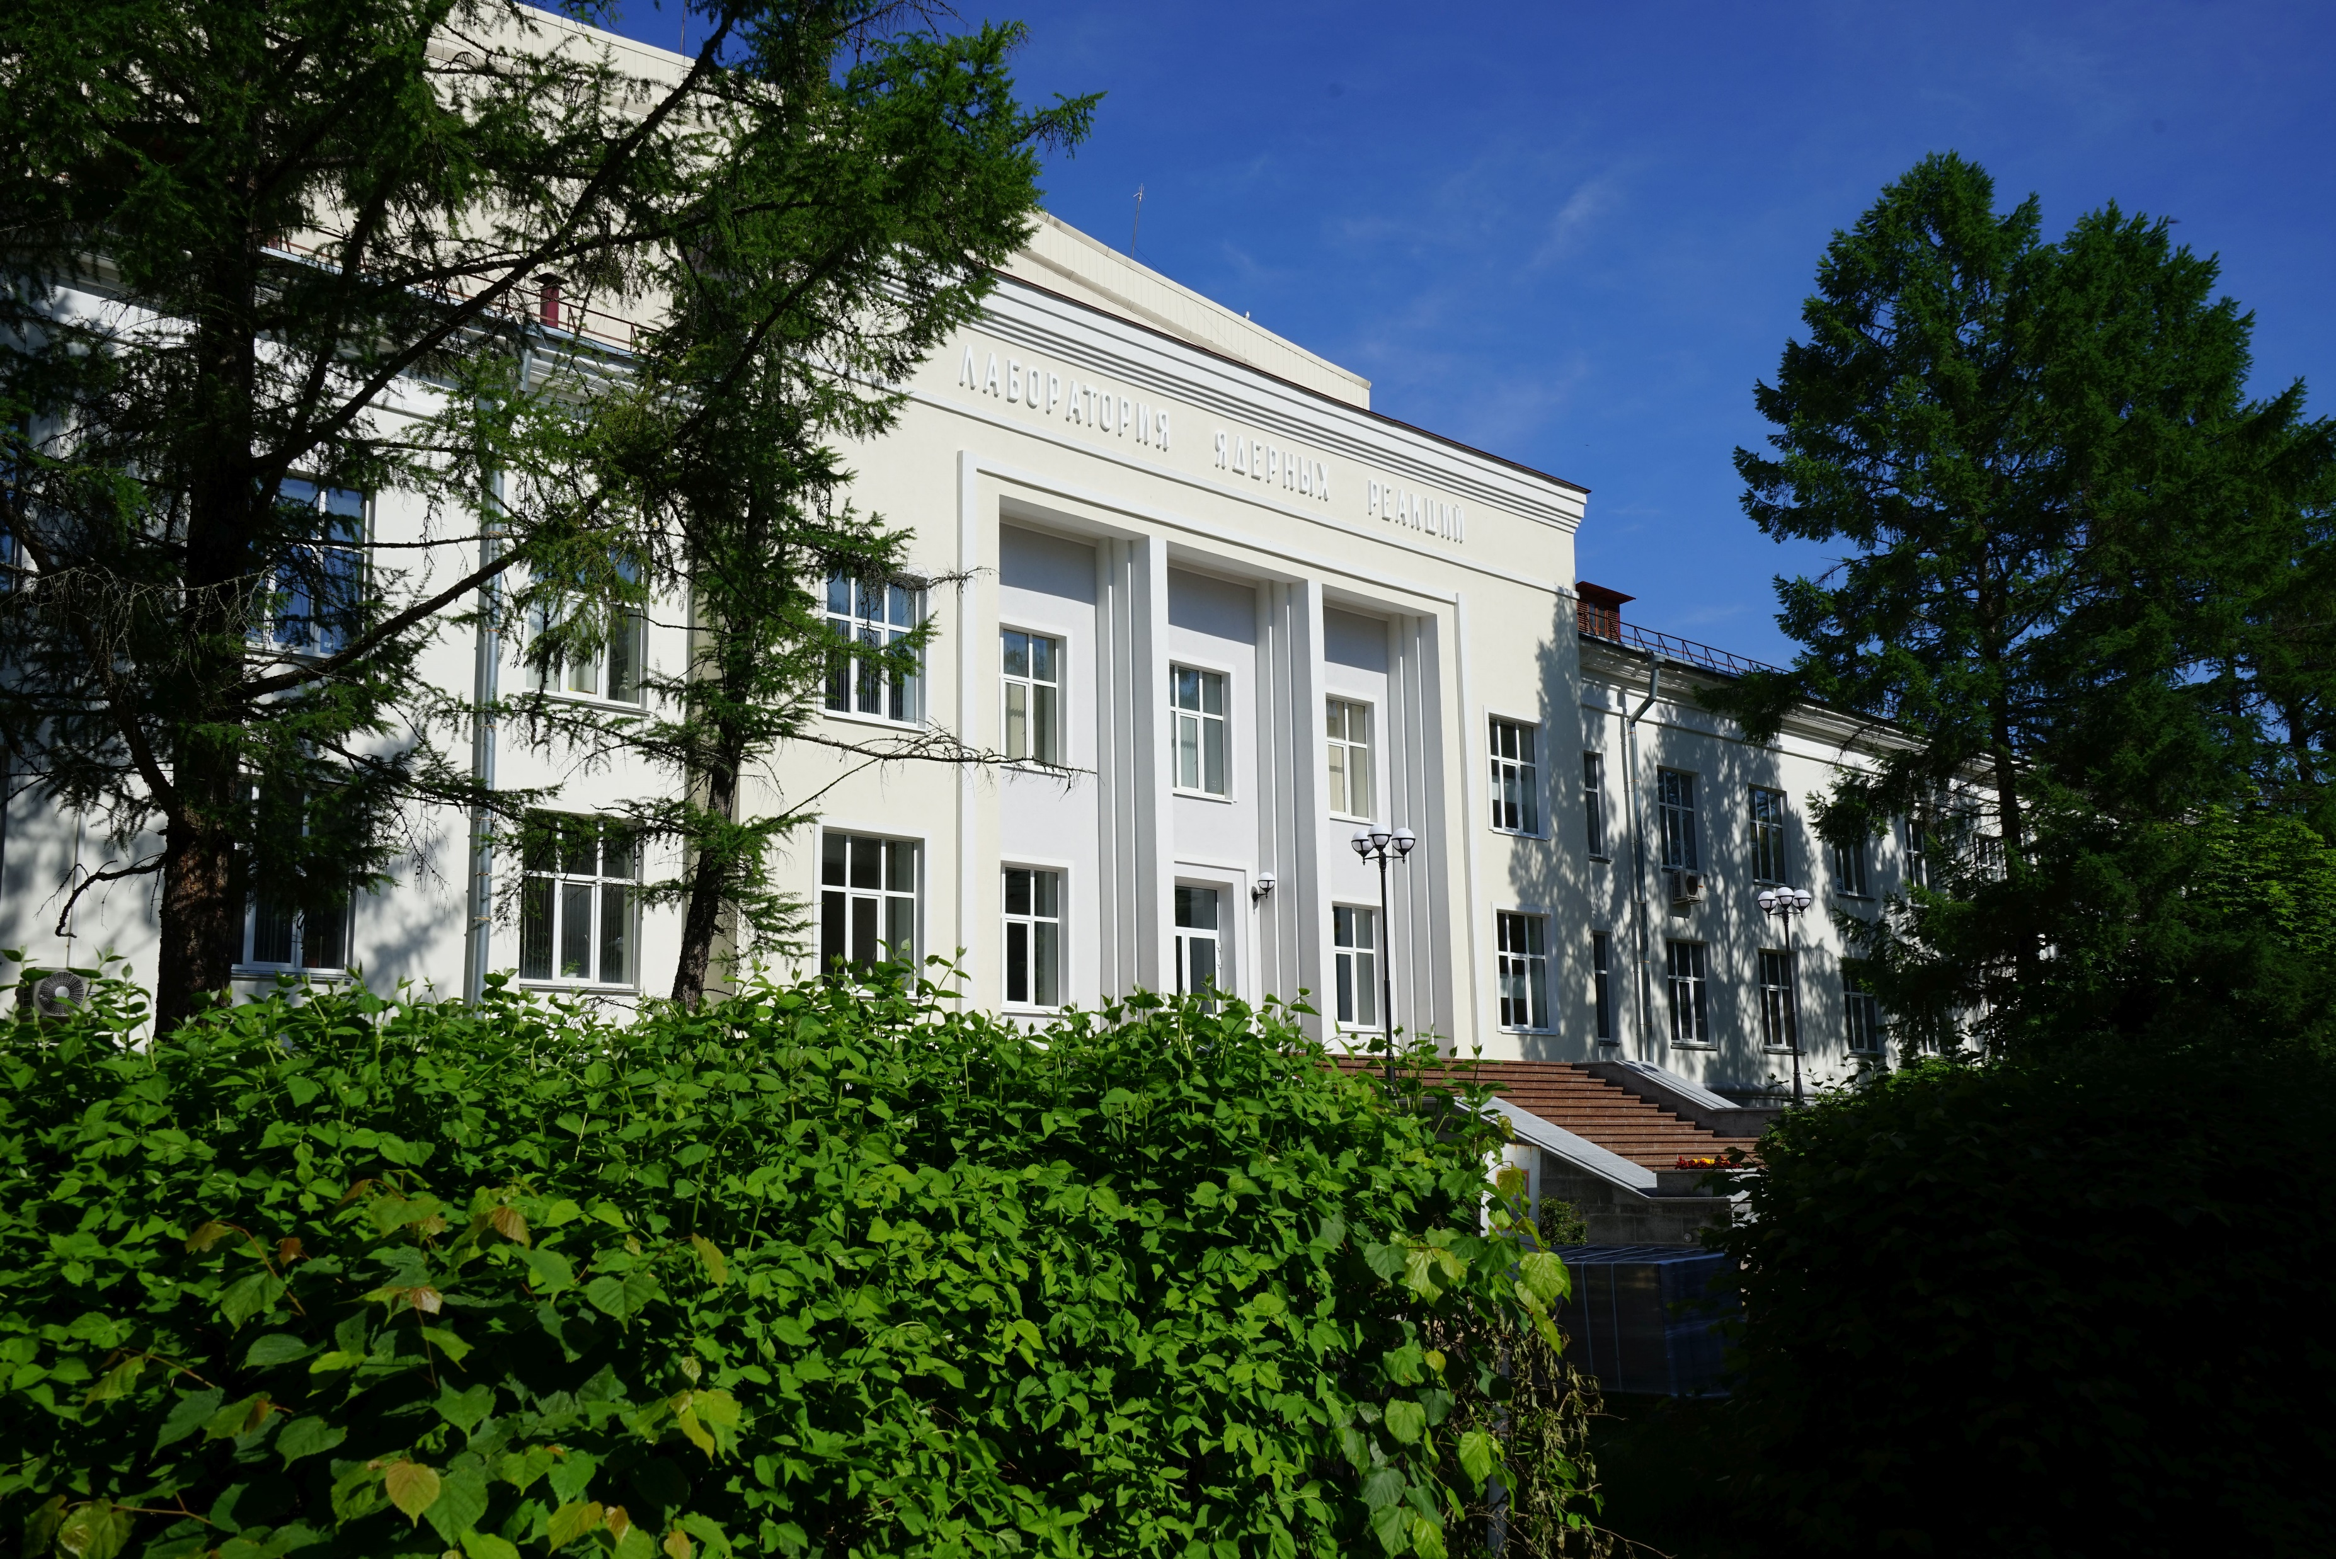
THANK YOU FOR YOUR KIND ATTENTION
Спасибо за Ваше внимание !
“EVERY BRILLIANT EXPERIMENT,
LIKE EVERY GREAT WORK OF ART,
STARTS WITH AN ACT OF IMAGINATION”
- JONAH LEHRER -
ACKNOWLEDGEMENTS
Help and support from the U400 Cyclotron operation staffs at Flerov Laboratory of Nuclear Reaction (FLNR), JINR, Dubna are thankfully acknowledged

Slide 17
Applicant Scientific Biography
Applicant: Dr. Aniruddha Dey (Candidate of Science in Physics, Research Scientist)
Laboratory: Sector 5, Fission of heavy and superheavy nuclei Group, Flerov Laboratory of Nuclear Reactions (FLNR)
Work experience in JINR: 1 Year, 9 Months, ORCID id: 0000-0001-7999-0454
Bachelor of Science (B.Sc.) in Physics (University of Delhi, India) 2014
Master of Science (M.Sc.) in Physics (University of Delhi, India) 2017
Ph.D. in Experimental Nuclear Physics (VBU and BARC, India) 2022
Thesis title: Fission fragment spectroscopy in and around near-spherical and deformed nuclei
Presently working on the double-arm time-of-flight (TOF) spectrometer CORSET at FLNR to study fission and quasifission dynamics of heavy and superheavy nuclei
Contribution in the present work: Active participation during experiment; Data processing and analysis; Interpretation of results; Preparation of manuscript
Manuscript under preparation for peer-reviewed journal
Awards and Certificates:
Awarded diploma for the best report in the XXVIII International Scientific Conference of Young Scientists and Specialists (AYSS-2024), Russia 2024
Awarded certificate for the best poster in the DAE Symposium on Nuclear Physics (SNP 2023), India 2023
Awarded ‘Young Physicist’ diploma for best quality of innovative research work in the 38th Young Physicists’ Colloquium, India 2023
Awarded ‘Best Thesis’ diploma in Nuclear Physics at the DAE Symposium on Nuclear Physics (SNP 2022), India 2022
Publications in refereed journals (First Authored) in the field of fission reaction dynamics:
Multimodal Fission Dynamics in ²³⁵U(n_{th},f): An investigation following fission fragment spectroscopy, Nucl. Phys. A 1053, 122962 (2025)
Excitation energy dependency of the low-energy fission dynamics: Probing through prompt gamma-ray spectroscopy, EPJ Web of Conf. J. 306, 01022 (2024)
Evidence for competing bi-faceted compound nucleus fission modes in ²³²Th(α,f) reaction, Phys. Lett. B 825, 136848 (2022)
Measurement of relative isotopic yield distribution of even-even fission fragments from ²³⁵U(n_{th},f) following γ-ray spectroscopy, Phys. Rev. C 103, 044322 (2021)
Collaborative publications in refereed international journals: 4
Conference presentations and proceedings total: 15 (Venues includes: France, India, Japan, Russia, and South Africa)

