Slide 1


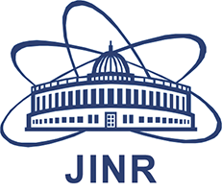


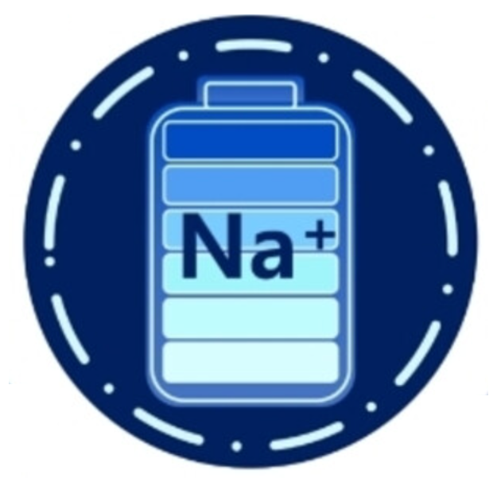
Correlation between morphology and electrochemical performance of cathode materials for sodium-ion batteries
M.E. Donets, O.Yu. Ponomareva, S.V. Sumnikov, R.N. Vasin, E.A. Korneeva and N.Yu. Samoylova
Notes:
Good evening ladies and gentlemen, my name is Marina Donets and today I’d like to give a talk on Ball Milling Treatment Effects on the Electrochemical Capacity of P2-NMO cathode material.
Nowadays, Li-ion batteries are used everywhere and many types of technologies do rely on this type of cells. But we should not forget that Lithium natural reserves are limited. Sodium, in turn, is one of the most abundant elements in the Earth’s crust and also it’s very close to lithium in terms of chemical properties. That’s why the study of compounds that can be used as cathodes for Na-ion batteries is very relevant today. In our work we investigated layered oxide NMO as it’s very perspective cathode material. We used two options of cathode material preparation - mechanical milling of slurry and mechanical milling of pure NMO powder.
Two options of cathode material preparation were used: mechanical milling of slurry and mechanical milling of pure NMO powder. Further, samples obtained via milling of powder/slurry will be referred to as p-milled and s-milled. Both of them reveal higher electrochemical capacity than it is shown in [Zhao 2020, Yang 2022, Dong 2023, Jiang 2023, Zhabg 2020, Zhang 2023, Xia 2020]. Also, our results reveal that s-milled NMO works better at high rates e.g. 2C, 5C, 10C with capacities of 140mAh/g, 118 mAh/g and 90 mAh/g, respectively.

Slide 2
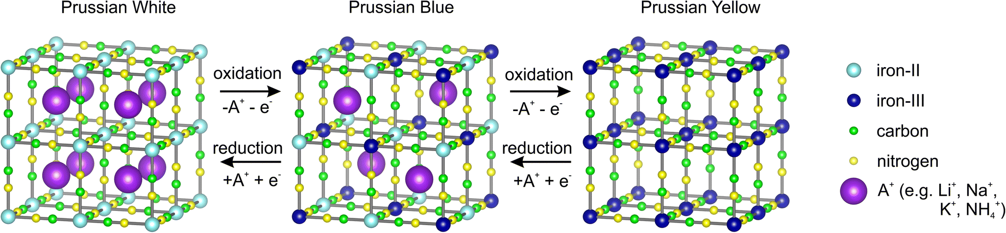
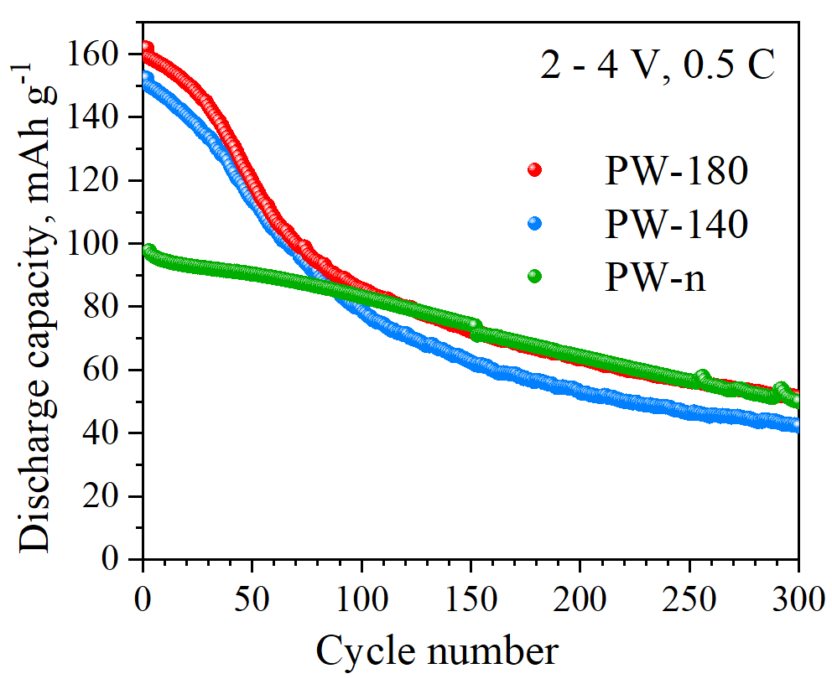
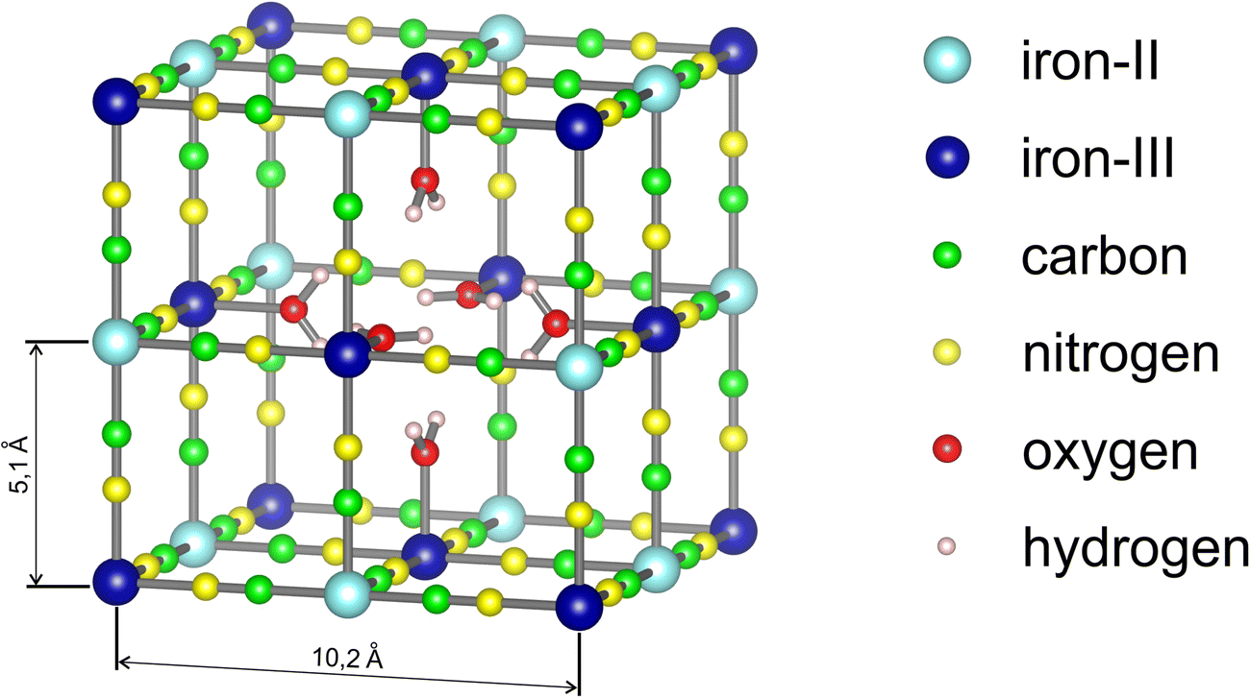
Perspective cathode matherials: Prussian Blue and its analogues
Na₂Fe^{II}[Fe^{II}(CN)₆] NaFe^{III}[Fe^{II}(CN)₆] Fe^{III}[Fe^{III}(CN)₆]
Na₂Fe[Fe(CN)₆]_{1-y∙}□_{∙y}∙mH₂O
□ - Fe(CN)₆ vacancies,
y – number of vacancies Fe(CN)₆

Slide 3
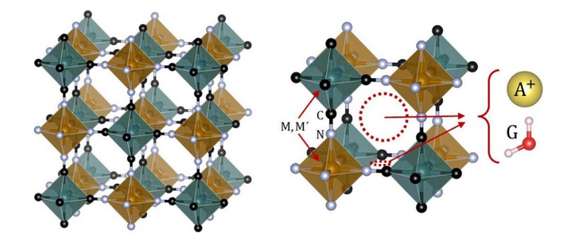
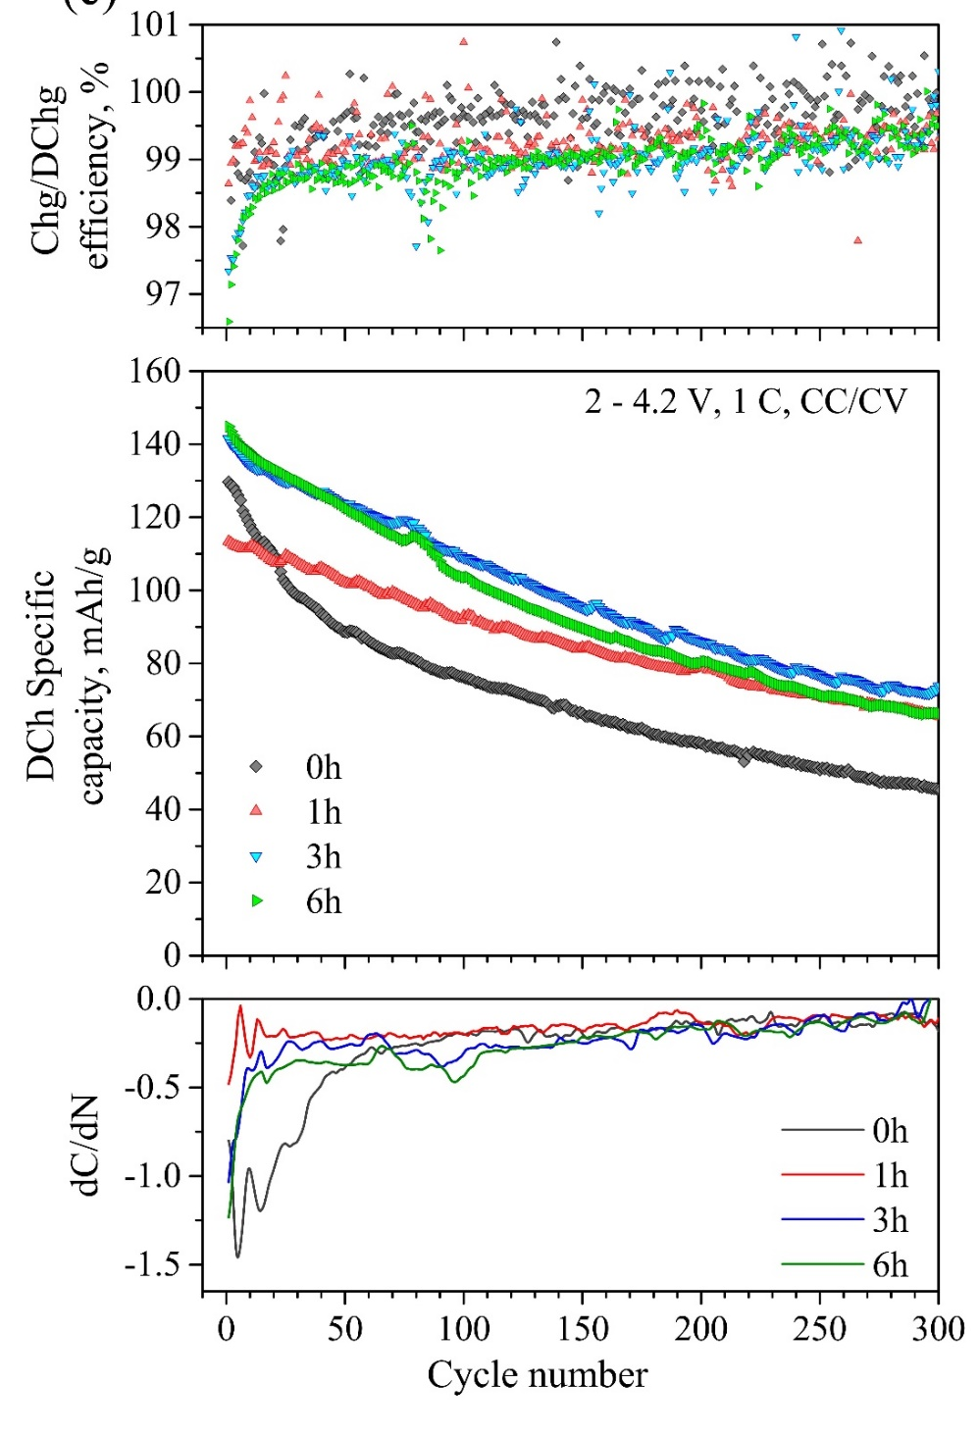
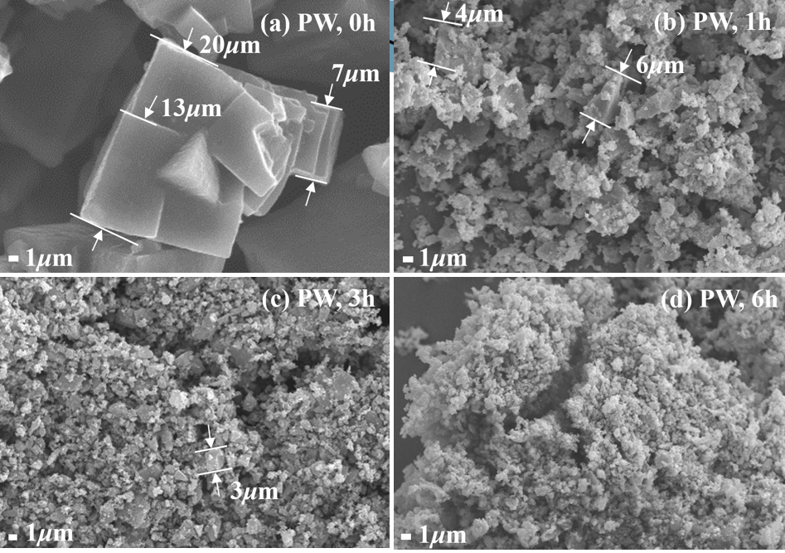
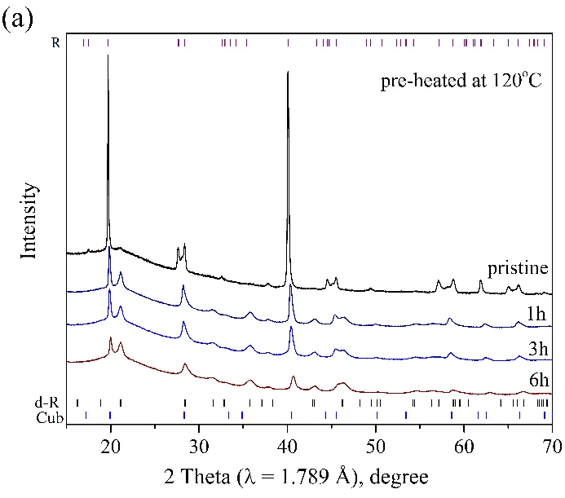
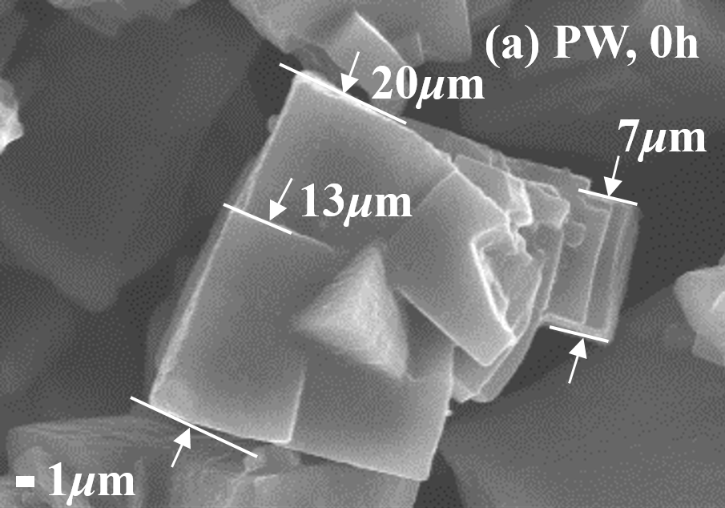
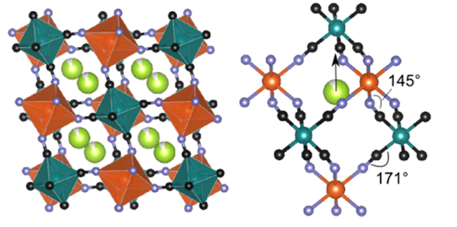
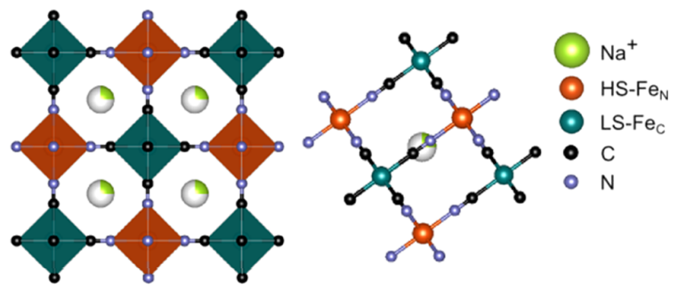
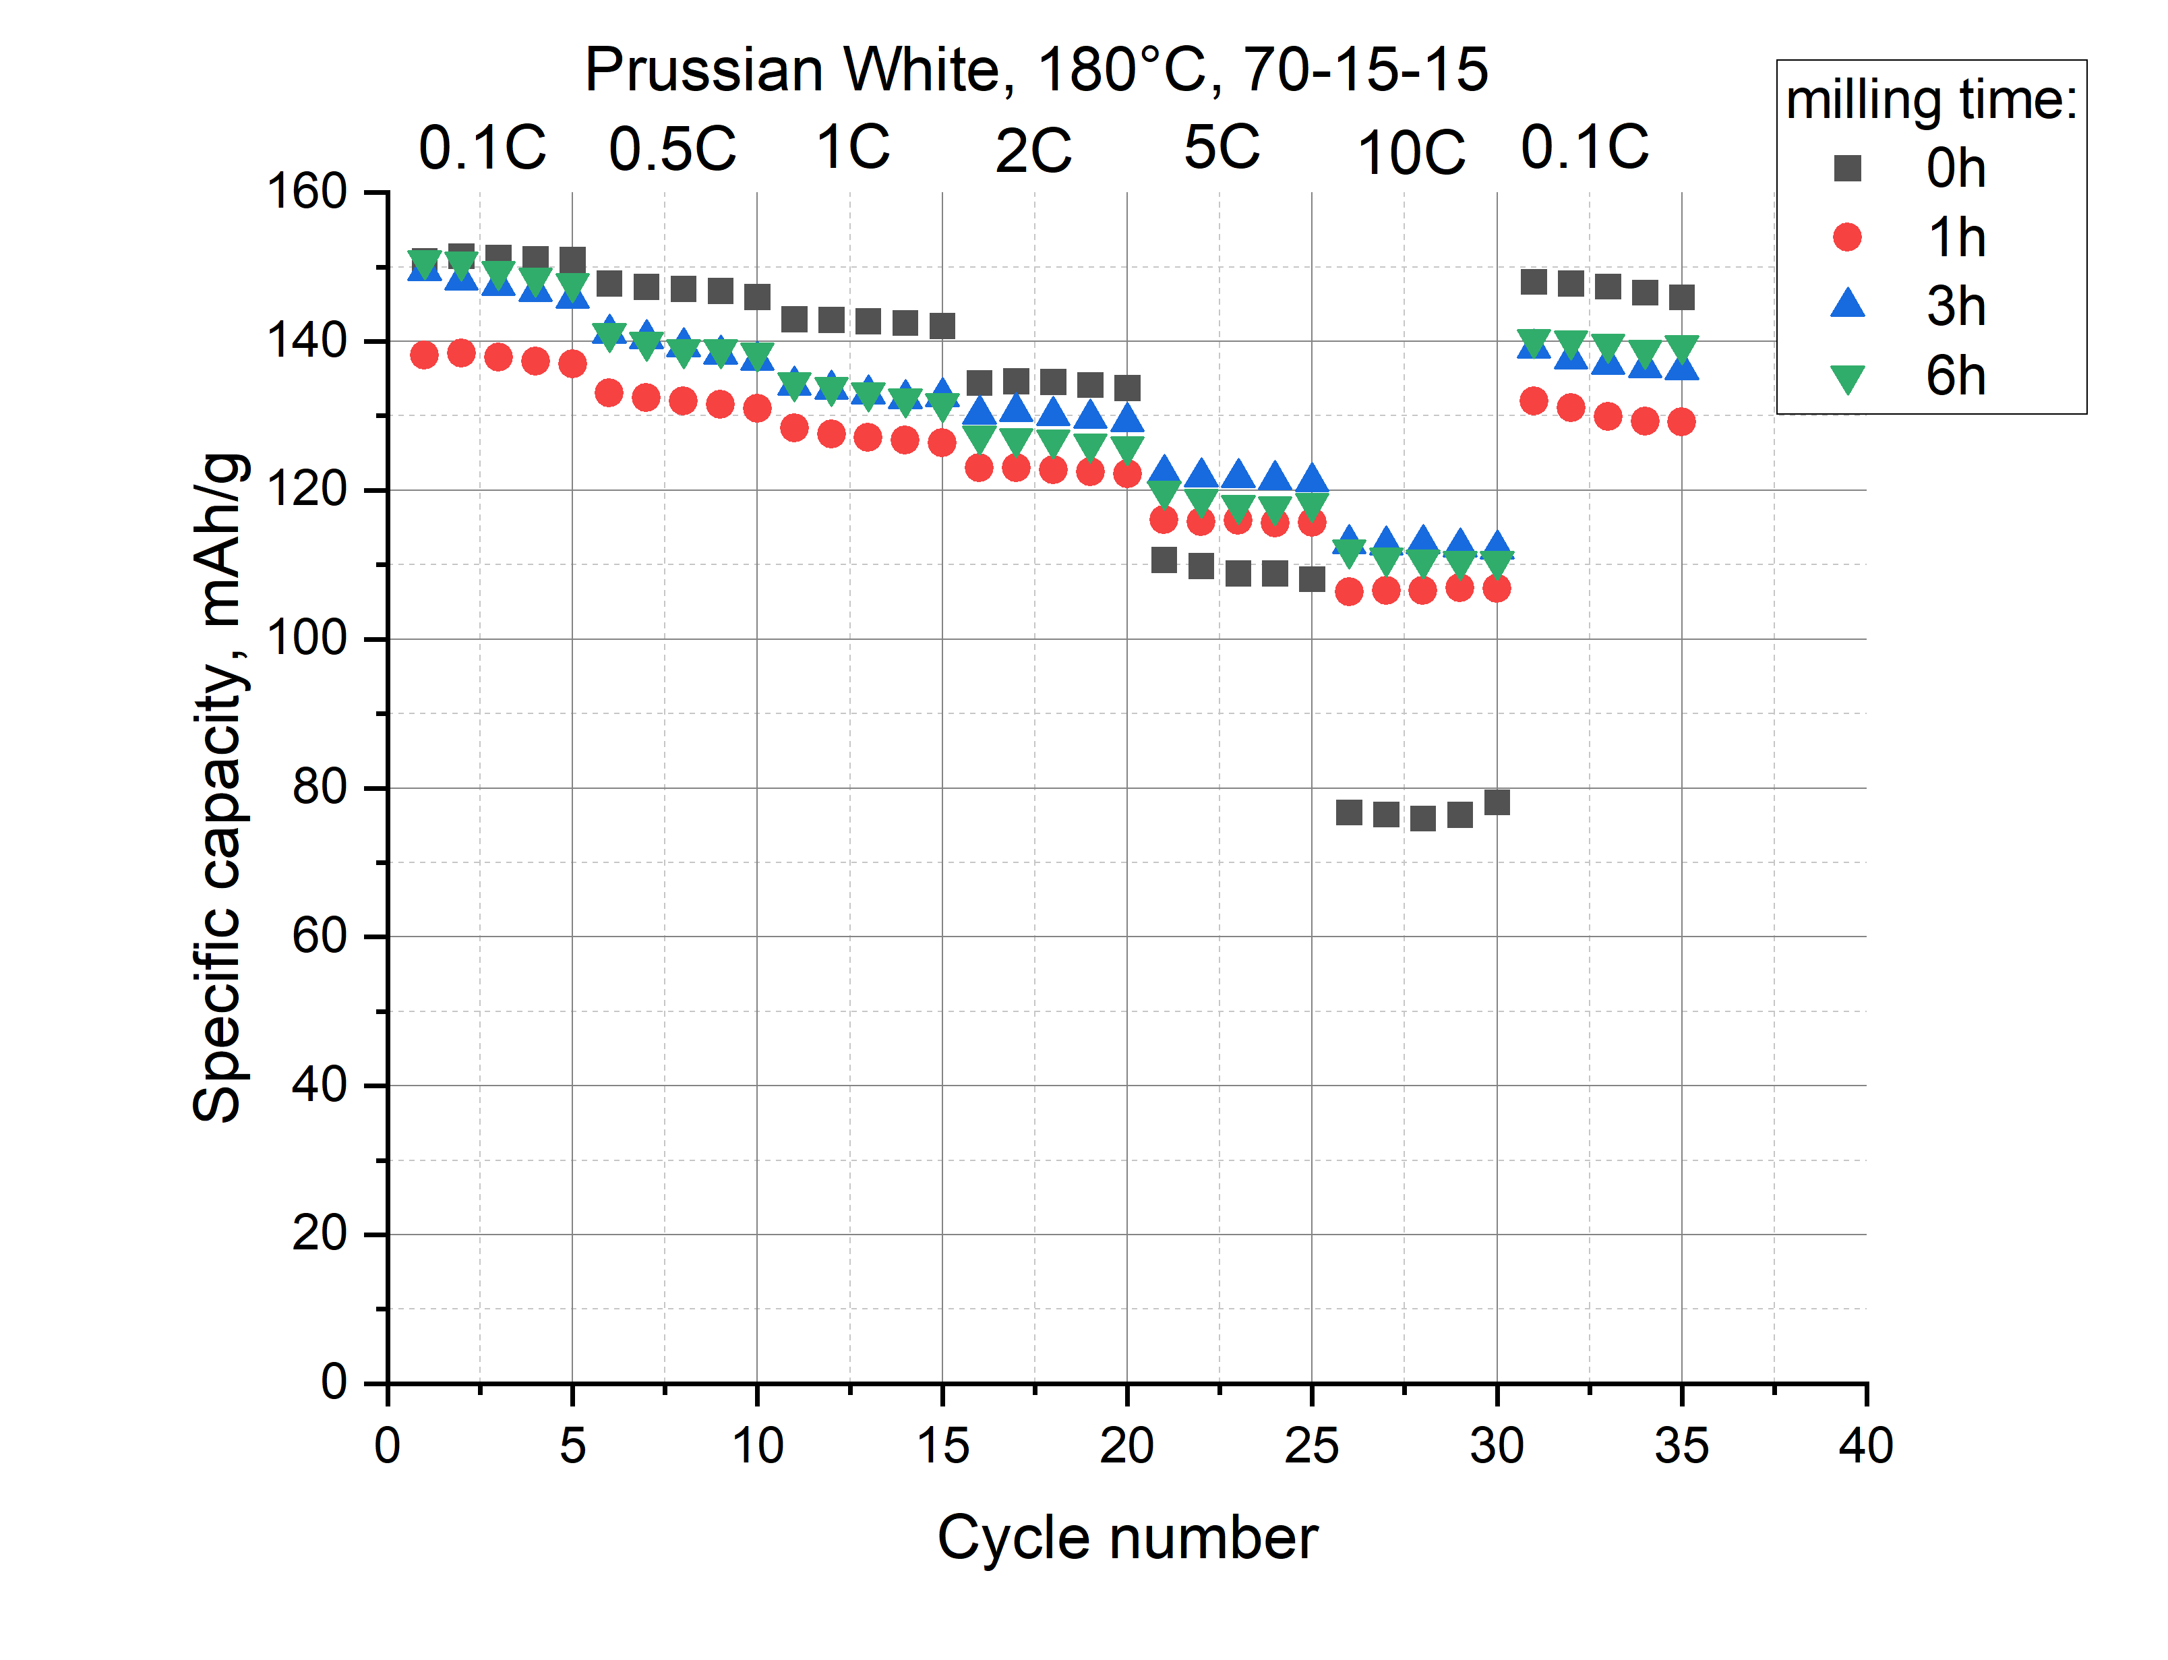
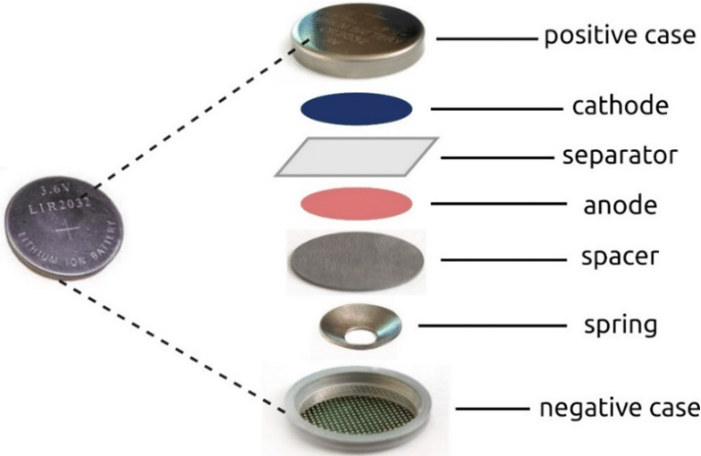




Microstructure modification of the Prussian White cathode material and its effect on the electrochemical performance of sodium-ion batteries
$$R\overline{3}$$
$$Fm\overline{3}m$$
$$R\overline{3}$$
$$Fm\overline{3}m$$
M. E. Donets, N. Yu. Samoylova et al, Ball milling effect on the microstructure and electrochemical properties of the Prussian White cathode material – sent to NanoRes

Slide 4
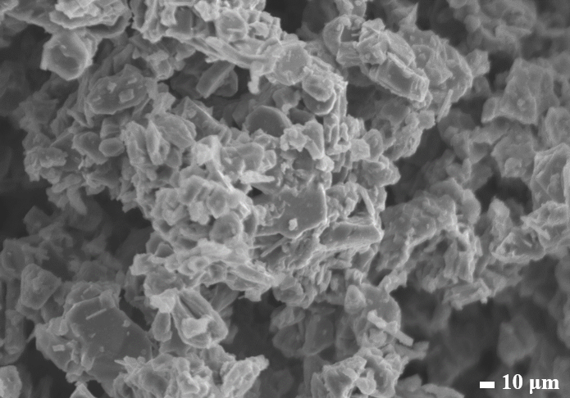
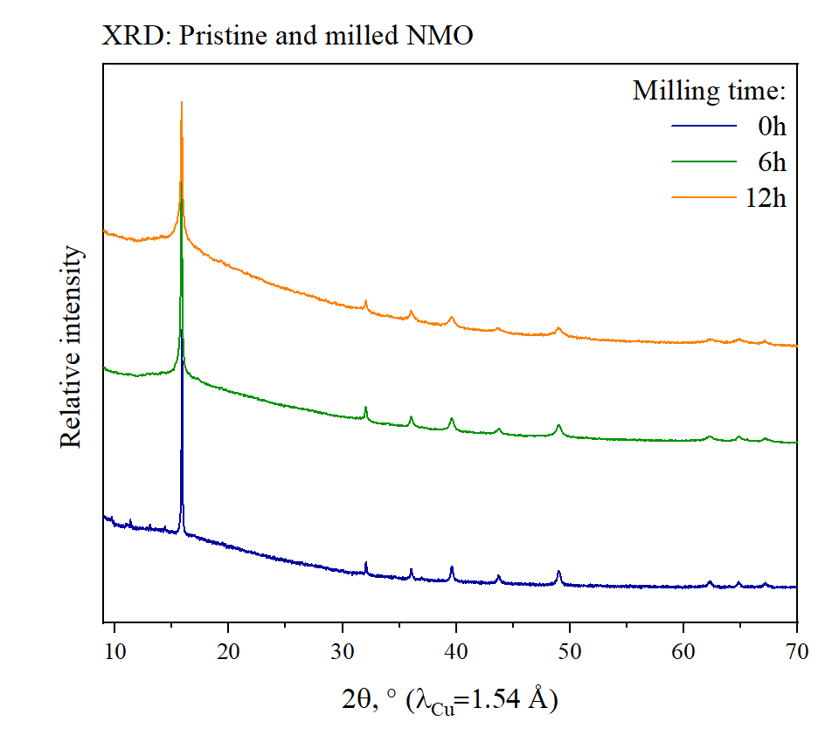
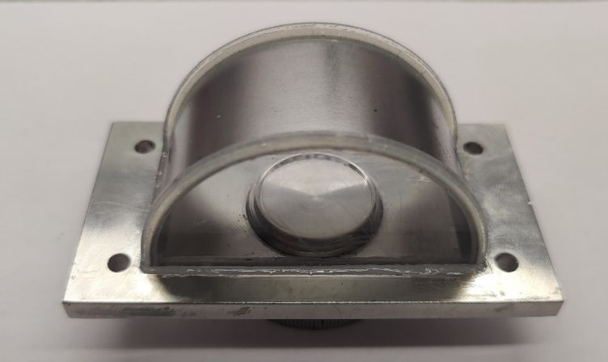
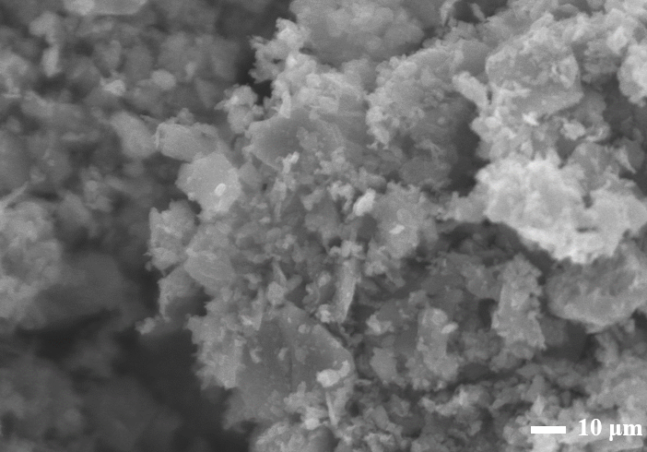
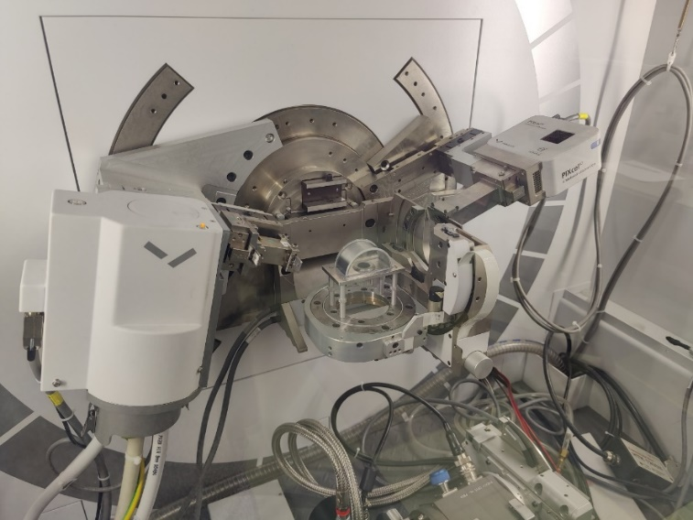
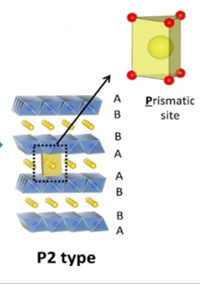
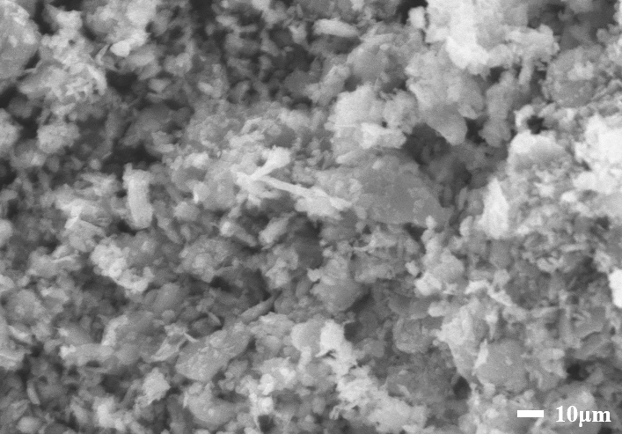
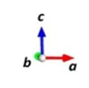
0h
XRD patterns and SEM-images of pristine and milled NMO samples
hexagonal P2 phase (sp. gr/ P6₃/mmc)
6h
12h
Pristine NMO material has the morphology of a regular hexagonal prism.
Milling program in a planetary mill: 6h and 12h at 600 rpm.
Milling was carried out in acetone to provide better homogenization.
The destruction of prism-shaped particles occurs as milling time increases.
10 μm
10 μm

Slide 5
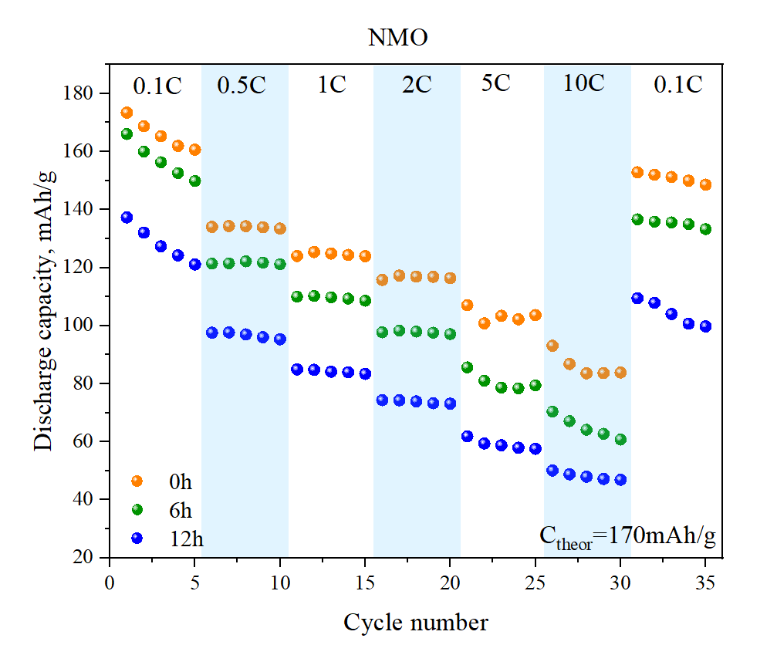
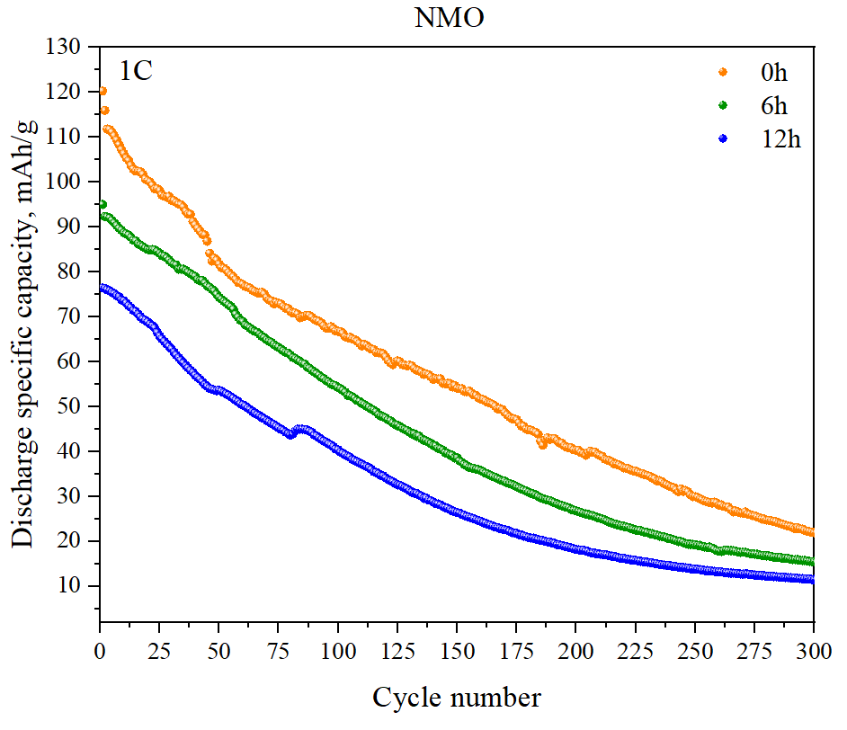
Electrochemical study
Electrode composition: NMO (70%) / KetJen Black (15%) / PVDF (15%)
Voltage window: 2 ÷ 4 V

Slide 6
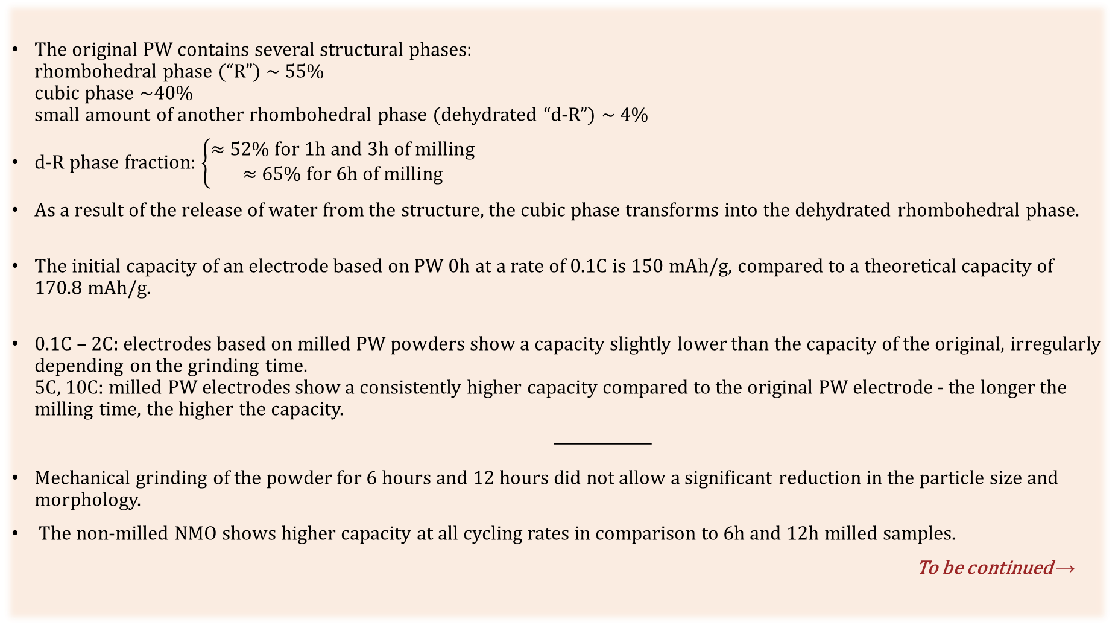
Main results
The original PW contains several structural phases:
rhombohedral phase (“R”) ~ 55%
cubic phase ~40%
small amount of another rhombohedral phase (dehydrated “d-R”) ~ 4%
d-R phase fraction: $\left\{\begin{aligned}\text{≈ 52\% }\text{for}\text{ 1}\text{h} \text{and}\text{ 3}\text{h} \text{of} \text{milling} \\ \text{≈ 65\% }\text{for}\text{ 6}\text{h} \text{of} \text{milling}\end{aligned}\right.$
As a result of the release of water from the structure, the cubic phase transforms into the dehydrated rhombohedral phase.
The initial capacity of an electrode based on PW 0h at a rate of 0.1C is 150 mAh/g, compared to a theoretical capacity of 170.8 mAh/g.
0.1С – 2С: electrodes based on milled PW powders show a capacity slightly lower than the capacity of the original, irregularly depending on the grinding time.
5C, 10C: milled PW electrodes show a consistently higher capacity compared to the original PW electrode - the longer the milling time, the higher the capacity.
───────
Mechanical grinding of the powder for 6 hours and 12 hours did not allow a significant reduction in the particle size and morphology.
The non-milled NMO shows higher capacity at all cycling rates in comparison to 6h and 12h milled samples.
To be continued →

Slide 7
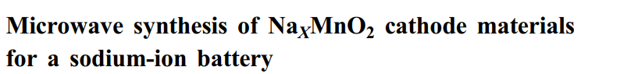
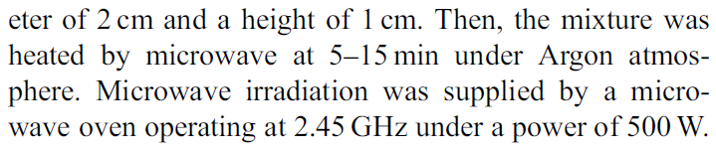
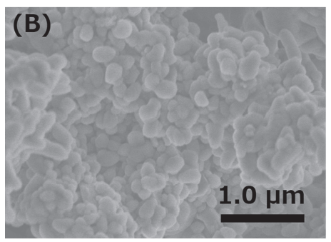
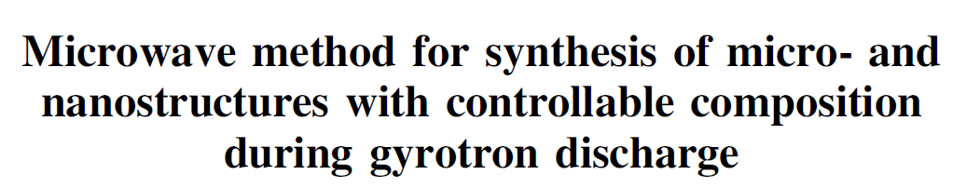
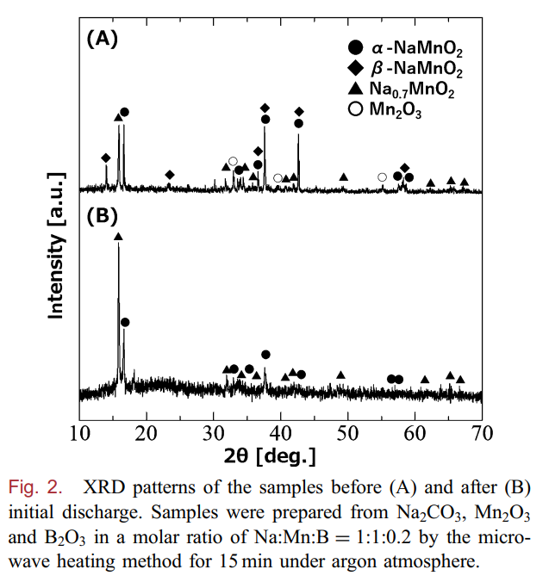

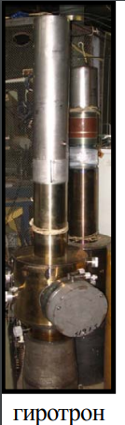
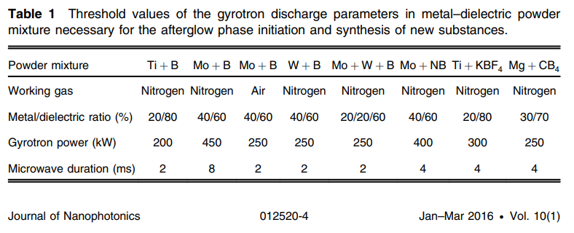
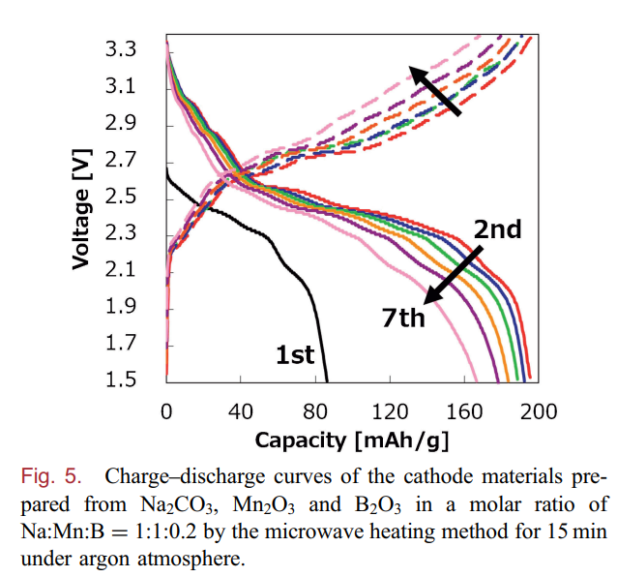
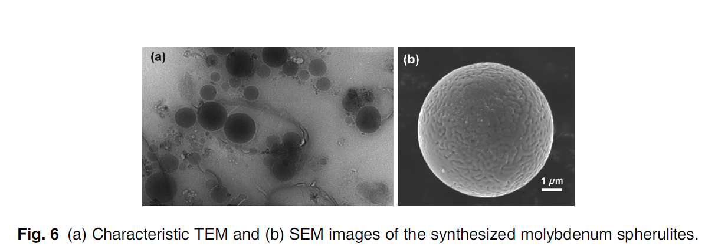
The nearest future plans: Plasmochemical synthesis of NMO at the gyrotron complex
MIG-3 (GPI RAS)
Yoshiharu Matsumae et. al., 2020
…
German Batanov et. al. , 2016

Slide 8
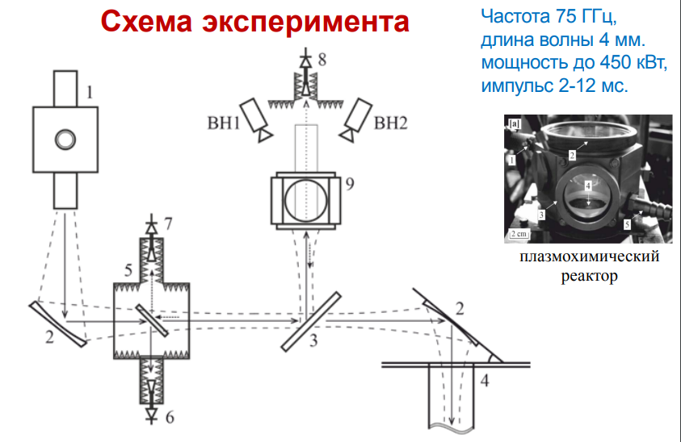
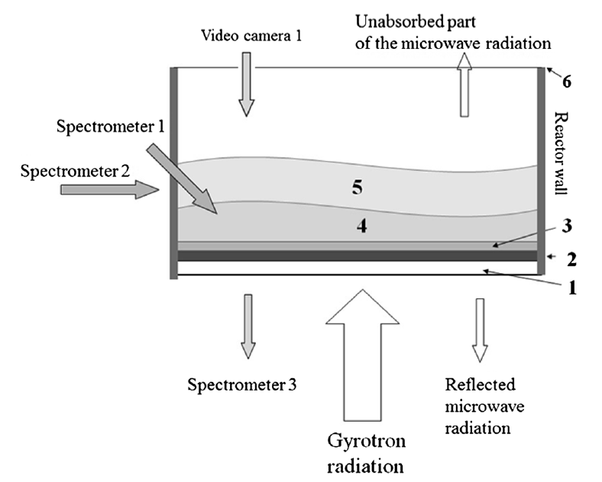
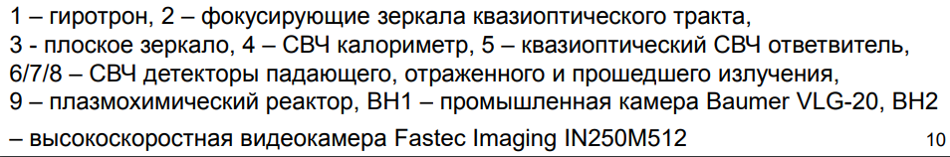


Плазмохимический реактор
- gas
- plasma

Slide 9
Thank You for Your Kind Attention!

