Slide 1
SPD FIRST STEPS
Spin precession and birefringence of
proton and nuclei in fixed polarized (nonpolarized) target as one of the
first steps for NICA
Vladimir Baryshevsky
10.12.2024
Research Institute for Nuclear Problems,
Belarusian State University, Minsk 220050, Belarus

Slide 2
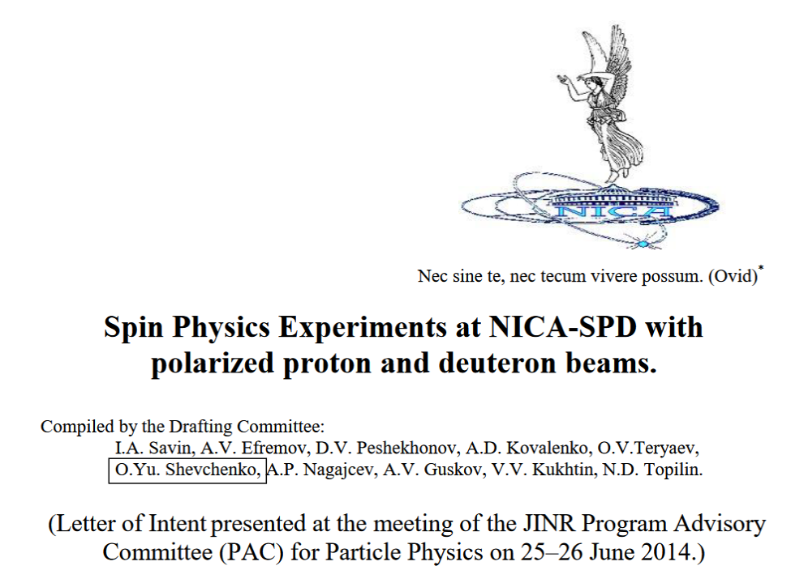
SPD FIRST STEPS
2.6.1. Investigation of the birefringence phenomenon at NICA facility.
One of the most interesting quasi-optical effects – the birefringence phenomenon for deuterons (or other particles with spin S ≥ 1) passing through matter – has recently become the area of research [35]….
Birefringence occurs when spin S ≥ 1 particles pass through isotropic non-polarized matter and is due to the inherent anisotropy of particles with spin S ≥ 1 (as distinct from spin- ½ particles).
The birefringence phenomena can be further studied at NICA:
- in few-nucleon systems involving protons and deuterons;
- appearing through the interaction of protons or deuterons with heavy nuclei;
- for heavy nuclei with spin S ≥ 1.
- with vector particles produced in inelastic collisions.

Slide 3
SPD FIRST STEPS
According to SPD proposal investigation of different processes occurring at collisions of polarized protons, deuterons and nuclei should be performed.
To carry out such studies one should develop methods enabling to measure polarization and to control polarization state of colliding beams. Therefore, extensive theoretical analysis, numerical simulation and numerous experiments should be performed.

Slide 4
SPD FIRST STEPS
There is no possibility to carry on experiments in the ring with colliding beams of polarized protons, deuterons and nuclei at NICA now.
Therefore, it is reasonable to draw attention to possibility to perform experiments at the extracted beam of the Nuclotron with fixed targets.

Slide 5
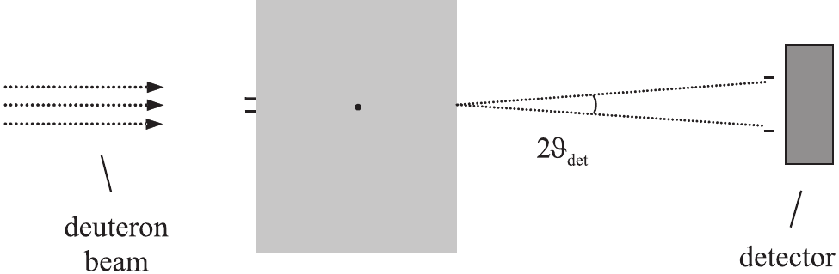
Transmission experiment
Further discussion deals with the effects to be observed in beams transmitted through the target in direction of particle initial momentum rather than scattering experiments.
Usually, transmitted particles are registered within a certain interval of finite momenta because the collimator of the detector has a finite angular width. Therefore, we should study the characteristics of the beam transmitted through the target in the interval of solid angles ΔΩ with respect to the initial direction of the beam propagation.
target

Slide 6
Particle spin rotation in pseudomagnetic field of matter with polarized nuclei

Slide 7
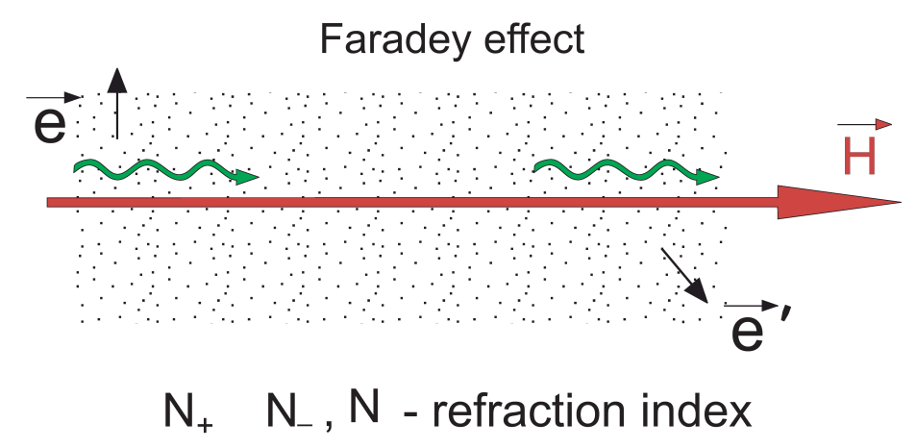
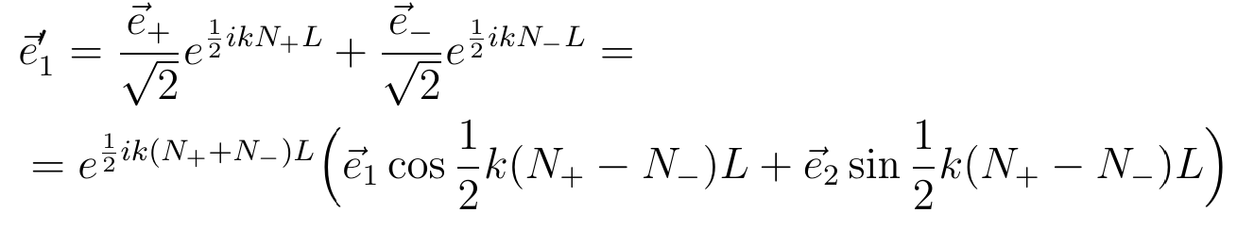
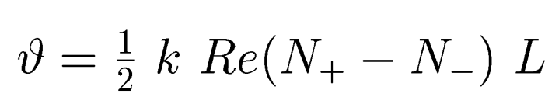
Photon polarization plane rotates in a matter placed in magnetic field. Faradey effect.
Let photons with the linear polarization is incident on matter
Polarization vector of a photon in matter
L is the photon propagation length in a medium,
Photon polarization plane rotates in a matter and the angle of rotation
corresponds to the right rotation of the light polarization plane (clockwise rotation)
corresponds to the left rotation (i.e. counter-clockwise rotation)

Slide 8
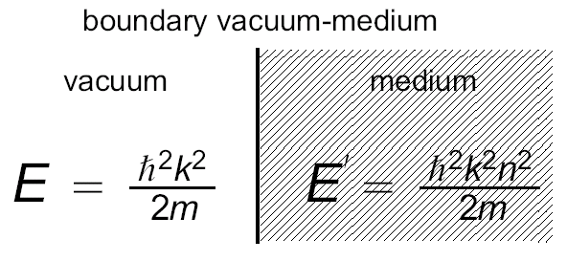
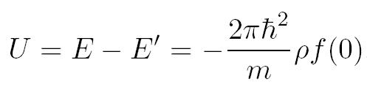

The index of refraction and effective potential energy of particles in matter
The wave number of the particle in vacuum is denoted k, k’=kn is the wave number of the particle in medium, n=1+2πρf(0)/k² is the refraction index, f(0) is a forward coherent scattering amplitude.
Kinetic energy of a particle in vacuum is not equal to that in medium.
From the energy conservation condition we immediately obtain the necessity to suppose that a particle in medium possesses effective potential energy. This energy can be found easily from the evident equality:

Slide 9

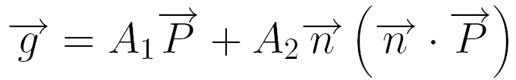
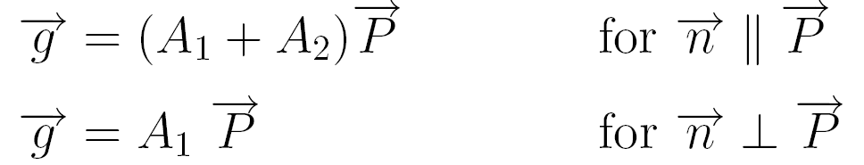
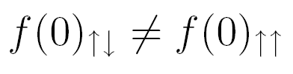

Scattering amplitude in the polarized target, caused by strong interaction
, where
Hence, the corresponding refractive indices are not equal to each other:

Slide 10
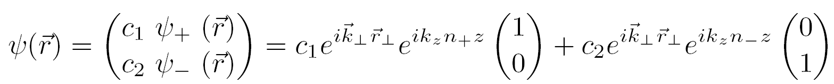
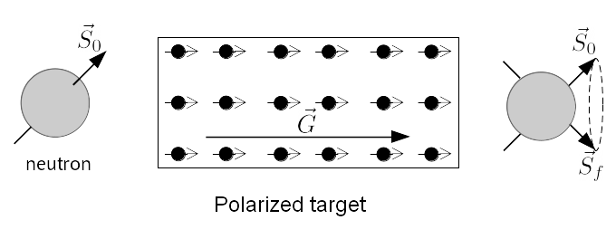
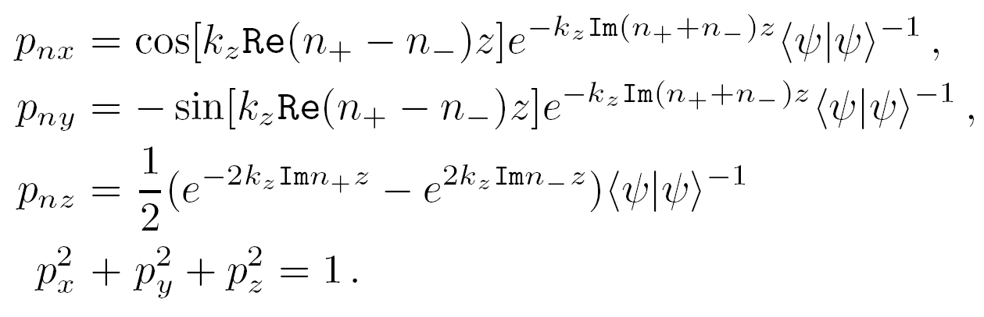
Neutron nuclear precession (nuclear pseudomagnetism)
V. G. Baryshevskii and M. I. Podgoretskii, Nuclear precession of neutrons,
Zh. Eksp.Teor. Fiz. 47 (1964) 1050 (Sov.Phys. JETP, 20 (1965) 704)

Slide 11
A. Abragam, G.L.Bacchella, H.Glattli, P. Meriel, J. Piesvaux, M. Pino, and P. Roubeau, C.R. Acad. Sci., (Paris) B274 (1972) 423.
M. Forte, Nuovo Cimento A18, v4 (1973) 726-736.
A. Abragam and M. Goldman, Nuclear Magnetism: Order and Disorder, Oxford University Press, 1982.
V.G.Baryshevsky, High–Energy Nuclear Optics of Polarized Particles, World Scientific, 2012.

Slide 12
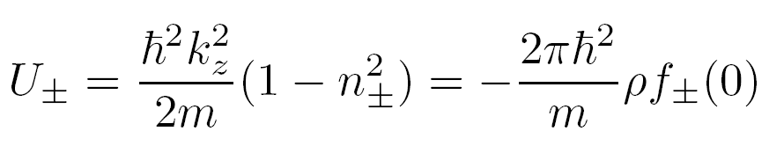
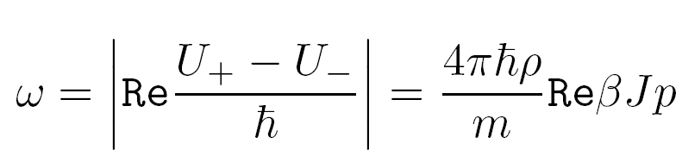
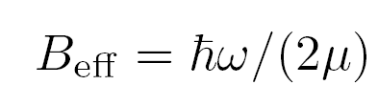
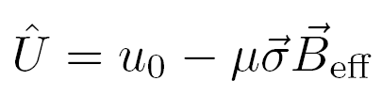
Neutron nuclear precession (nuclear pseudomagnetism)
In perfect analogy with spin behavior in a magnetic field, the non-zero difference U₊−U₋ leads to the neutron spin precession about the direction of the nuclear polarization vector with the frequency [Baryshevskii and Podgoretskii (1964)]:
For a completely polarized proton target ω = 5·10⁸ s⁻¹, B_{eff} ≈ 3·10⁴ Gs = 3T (which exceeds by two orders of magnitude the ordinary magnetic field created by polarized magnetic moments of protons).
For thermal neutrons v = 2.2·10⁵ cm/s and the full rotation of spin will occur over the length L ≈ 10⁻³ cm.

Slide 13



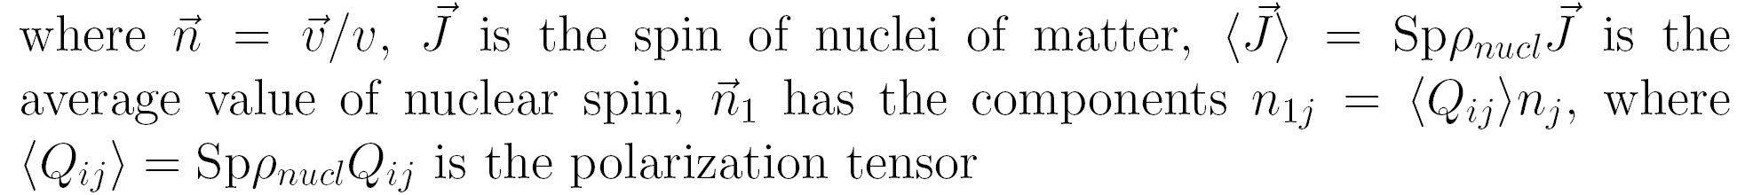
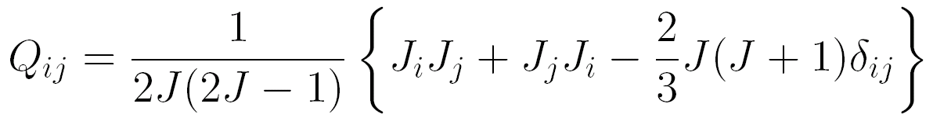



Particle interaction with the pseudomagnetic nuclear field
Interaction with the field contains two summands: the first corresponds to the strong interaction, which is T,P-even, while the second describes spin rotation by the weak interaction, which has both T,P-odd (the term containing the constant b1) and T-odd, P-even (the term containing the constant b5) terms.

Slide 14
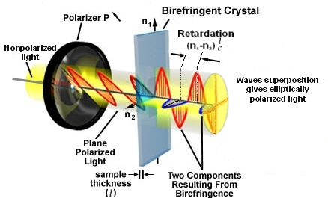
Birefringence effect
Could the similar effect exist for particles
with the nonzero mass ?
V.G. Baryshevsky, Birefringence of particles (nuclei, atoms) of spin S≥1 in matter, Phys. Lett. A 171, 5-6 (1992) 431
V.G. Baryshevsky, Spin oscillations of high-energy particles (nuclei) passingthrough matter and the possibility of measuring the spin-dependent part of the amplitude of zero-angle elastic coherent scattering, J. Phys. G 19, 2 (1993) 273

Slide 15
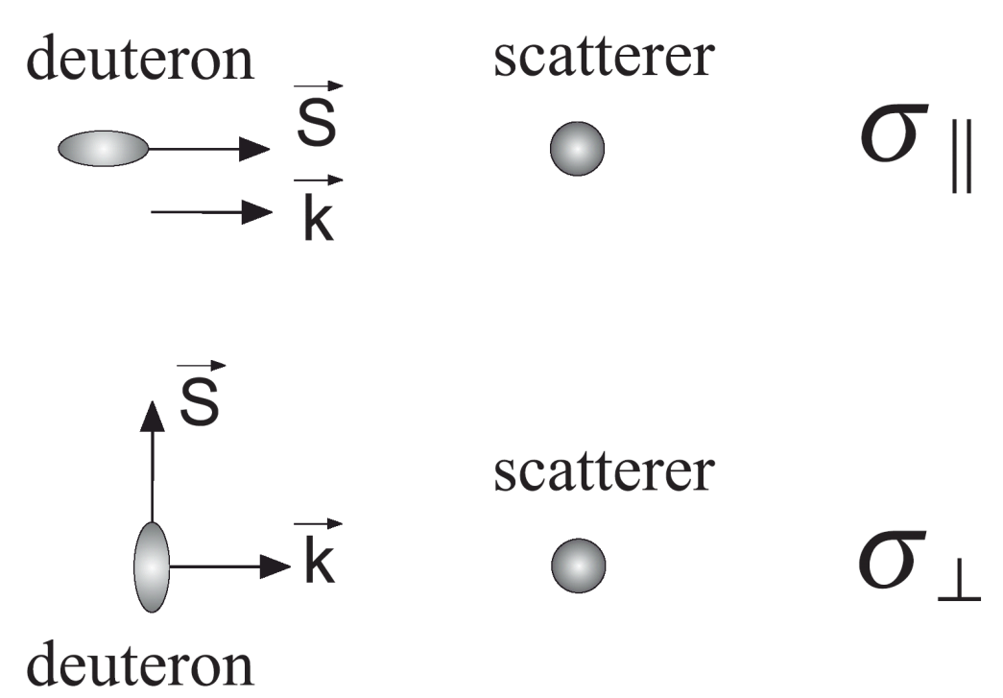
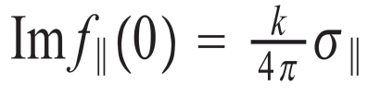
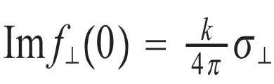
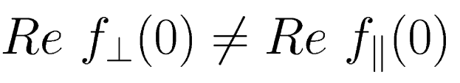
Birefringence phenomenon
Appearance of two refraction indices of deuteron can be easily explained
As the ground state of a deuteron is non-spherical, then the scattering cross-section depends on the angle between the spin and momentum of the deuteron
≠
According to the dispersion relation Re f(0) ~ Φ (Im f(0)), therefore
Unlike optical birefringence, the birefringence effect for particles appear in isotropic matter (and even the spin of matter nuclei is either zero or unpolarized !). Anisotropy is provided by the particle itself (a particle with the spin S ≥ 1 and mass M ≠ 0 has the intrinsic anisotropy).

Slide 16
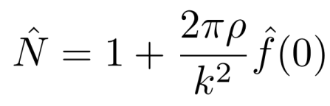



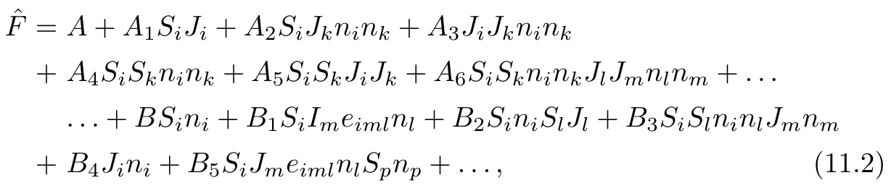
Spin rotation and birefringence phenomena
Refractive index for particles with spin S:
where ; is the spin matrix of the scatterer; is the operator. Amplitude of forward scattering that acts in the spin space of the particle and the scatterer with spin J.
where the three dots stand for the terms containing the products of S_{i} and J_{i} up to 2S and 2J.

Slide 17
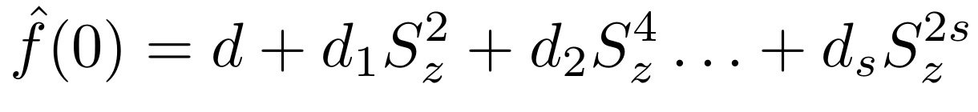
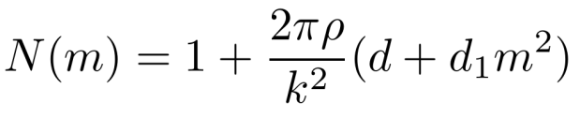
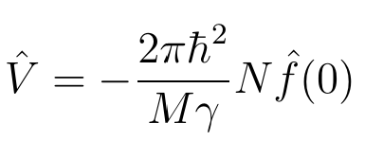
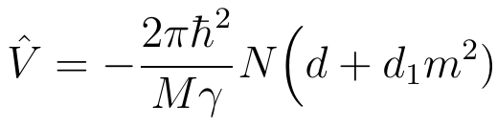
Birefringence phenomenon
For a nonpolarized target (oz || particle momentum, contribution of weak interactions is omitted
For particles with spin 1 and 3/2 refractive index reads
Effective potential energy
i.e.
Splitting of the deuteron energy levels in matter is similar to splitting of atom energy levels in an electric field aroused by the quadratic Stark effect. Therefore, the above effect could be considered as caused by splitting of the spin levels of the particle in the pseudoelectric field of matter.

Slide 18
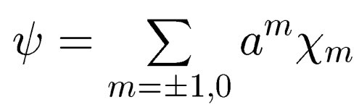
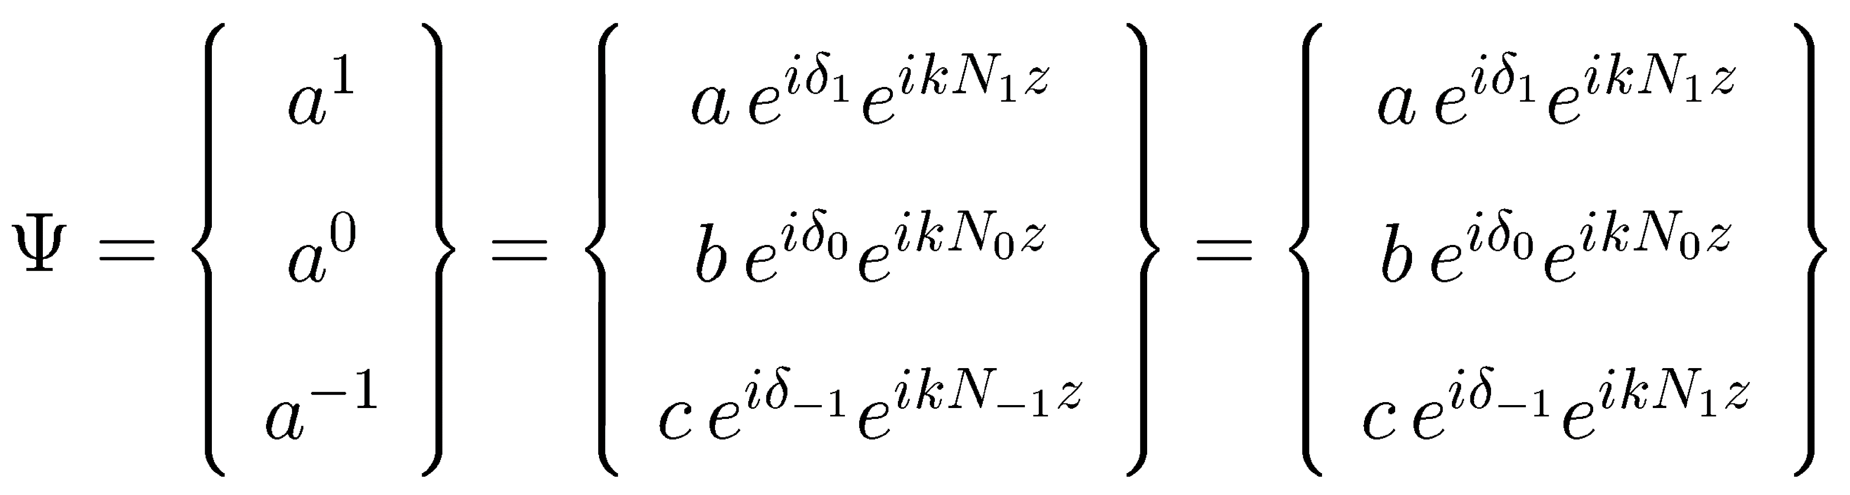
Deuteron (spin = 1) in nonpolarized target
The deuteron spin wave function can be represented as a superposition of basis spin wave functions χ_{m} that are eigenfunctions of the operators
Suppose the particle enter the target at z=0. Wave function of the particle inside the target at the depth z (! N₁=N₋₁):

Slide 19
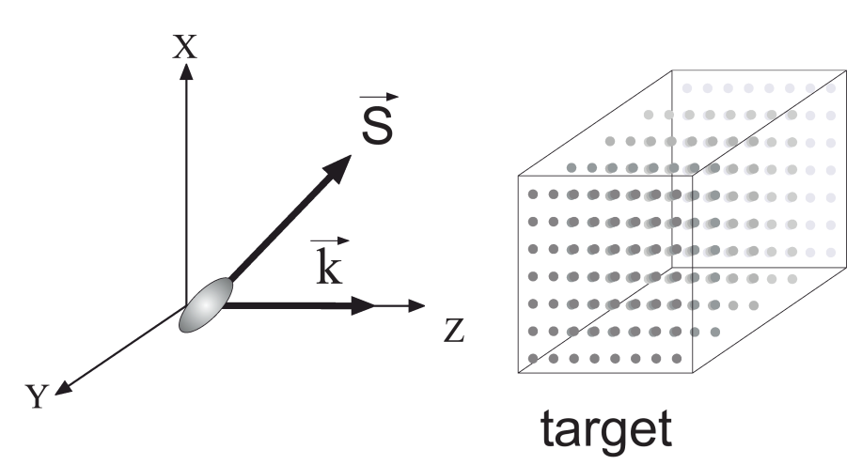



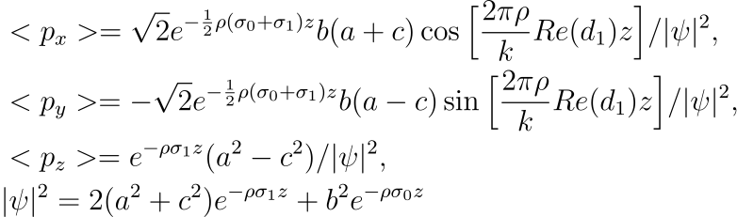
Deuteron (spin = 1) in nonpolarized target
Let us look for the mean value of the spin operator in state ψ.
Plane (xz) coincides with that formed
by polarization vector and deuteron momentum before entering the target
In this case δ₁- δ₀=0 at z=0, <p_{x}>≠0, <p_{y}>=0
z is the pathlength of particle inside medium

Slide 20

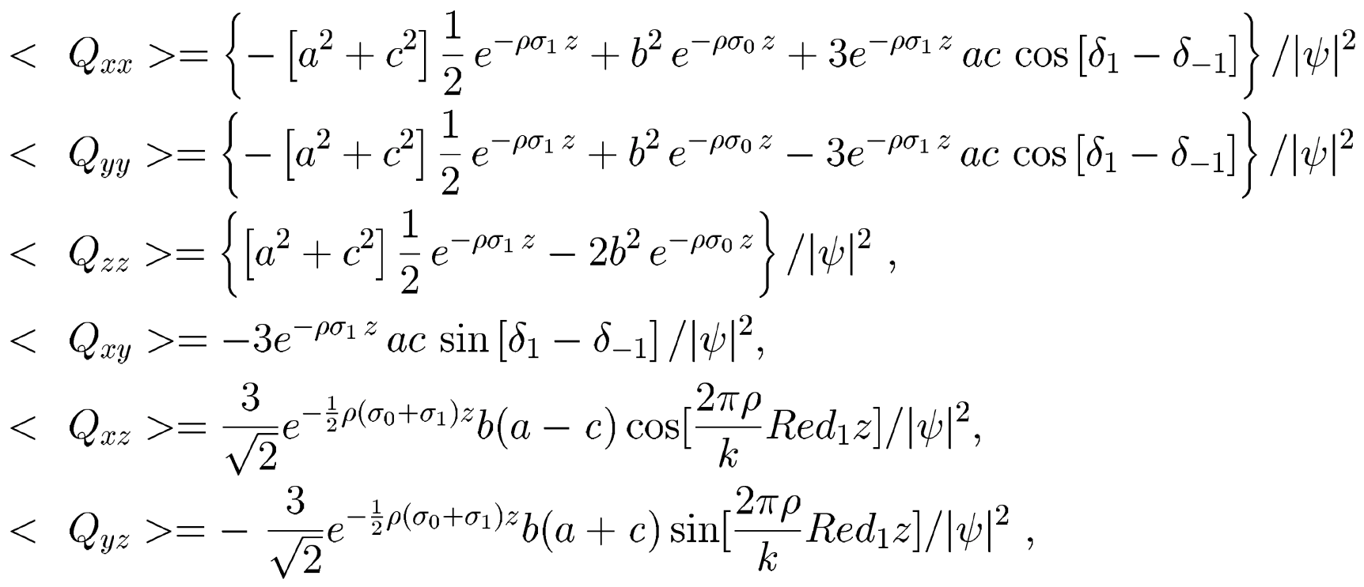
Deuteron (spin = 1) in nonpolarized target
Particle with spin 1 also possesses tensor polarization i.e. tensor of quadrupolarization
z is the pathlength of particle inside the medium

Slide 21
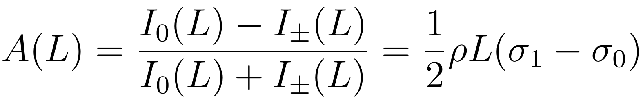
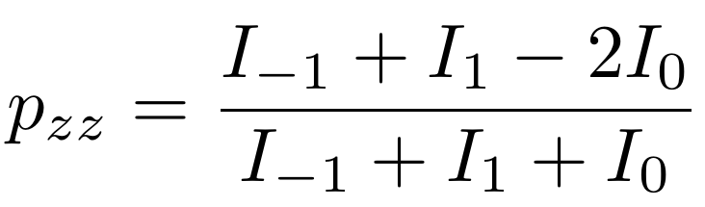
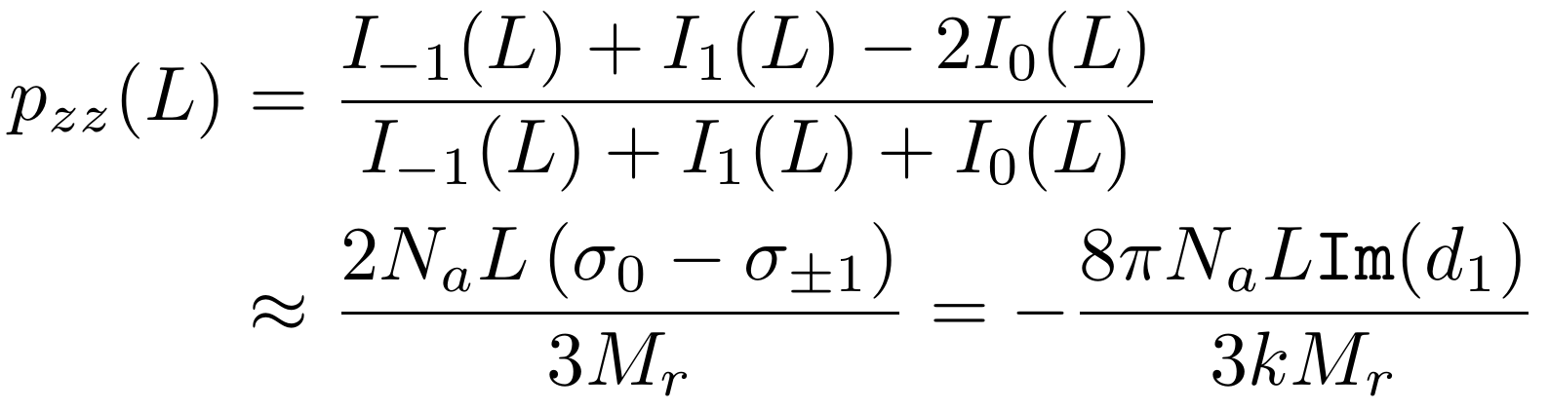
Unpolarized deuterons in nonpolarized target
Due to nonequality of cross-sections σ₁ and σ₀ target possesses dichroism
Tensor polarization p_{zz} (quadrupolarization tensor Q_{zz} ) after passing through a target

Slide 22
Deuteron spin dichroism: experiments
First observation of spin dichroism with deuterons up to 20 MeV in a carbon target
V. Baryshevsky, A. Rovba, R. Engels, F. Rathmann, H. Seyfarth, H. Stroher, T. Ullrich, C. Duweke, R. Emmerich, A. Imig, J. Ley, H. Paetz gen. Schieck, R. Schulze, G. Tenckhoff, C. Weske, M. Mikirtytchiants, A. Vassiliev (LANL arxive: hep-ex/0501045)
Proceedings of the 17th Int. spin phys. symp.,SPIN 2006, Kyoto, Japan, 2–7 October 2006. / AIP Conf. Ser, v.915 (2007) 777-780
Production of a beam of tensor-polarized deuterons using a carbon target
Phys. Rev. Lett. 104, 22 (2010) 222501

Slide 23
Deuteron spin dichroism: experiments
Observation of Tensor Polarization of Deuteron Beam Traveling through Matter
L. S. Azhgirei, Yu. V. Gurchin, A. Yu. Isupov, A.N. Khrenov, A. S. Kiselev, A.K. Kurilkin, P.K. Kurilkin, V.P. Ladygin, A.G. Litvinenko, V.F. Peresedov, S.M. Piyadin, S.G. Reznikov, P.A. Rukoyatkin, A.V. Tarasov, T.A. Vasiliev, V.N. Zhmyrov, and L.S. Zolin,
Physics of Particles and Nuclei Letters 5, 5 (2008) 432.
Measurement of tensor polarization of a deuteron beam passing through matter
Phys. of Particles and Nuclei Lett. 7, 1 (2010) 27–32.

Slide 24
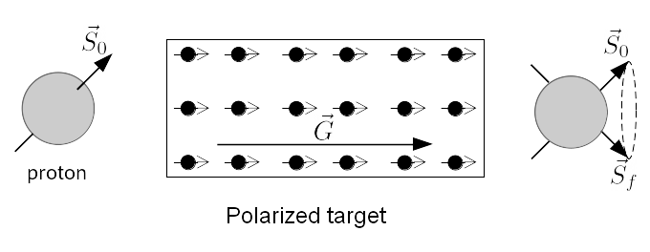
SPD: polarized colliding beams vs fixed target
SPD main goal: experiments with colliding polarized beams.
However, many results, which are important for the main goal, could be obtained in experiments with fixed target. Especially, experimental approaches, procedures and techniques applicable for testing polarized colliding beams could be tested and improved in experiments with fixed target.

Slide 25
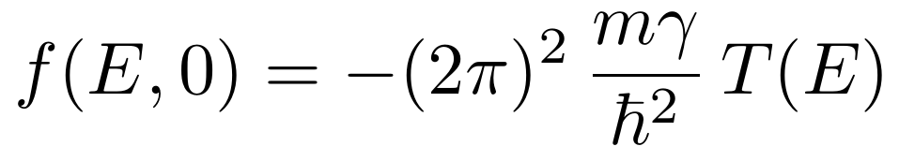
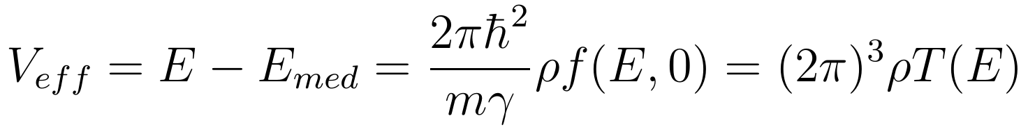
Nucleon (nucleus) nuclear spin precession (nuclear pseudomagnetism)
Scattering amplitude relates to scattering matrix T as follows
Therefore, effective potential energy reads

Slide 26
SPD: experiments with polarized beams
Polarized targets are required for experiments.
Such targets are used in experiments for investigation of polarized γ-quanta scattering by polarized protons and deutrons at Bonn accelerator facility ELSA and at the Mainz accelerator MAMI, namely:
¹⁴NH₃,
butanol C₄H₉OH,
ND₃,
⁶LiD
Target ¹⁴NH₃ can be considered as a candidate for an experiment enabling to evaluate spin rotation effect.

Slide 27
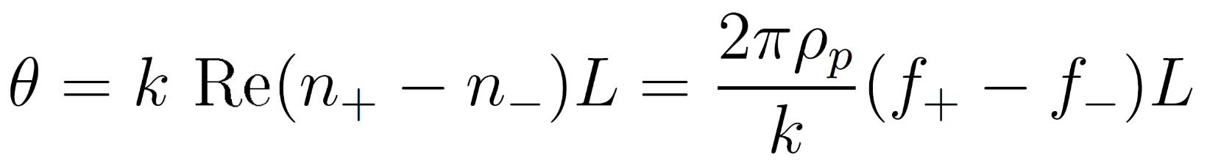
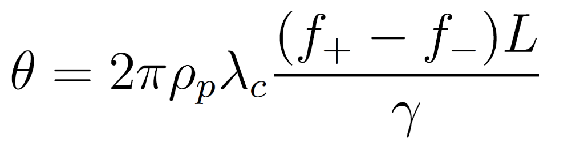
SPD: evaluation for spin rotation effect
Scattering amplitude relates to scattering matrix T as follows
λ_{c} is the Compton wavelength of the particle, f‘=f/γ ~ T(E).
For NH₃ target density of polarized protons (the number of particles per cm³) ρ_{p}= 5 ⋅10²² cm⁻³.
Using evaluation for f‘=f/γ≈10⁻¹³ cm at path length in the target L=30 cm one can obtain for rotation angle θ=10⁻² rad.

Slide 28
SPD: unpolarized deuterons in nonpolarized target
We have no access to polarized targets yet. So we could start from studying spin rotation and effect of acquiring tensor polarization for deuterons passing through nonpolarized matter (for example, DSS project at NICA, Изучение поляризационных явлений и спиновых эффектов на ускорительном комплексе Нуклотрон-М/NICA ОИЯИ, руководитель Ладыгин В.П.)
Further activities could deal with study of depolarization of protons and deuterons in nonpolarized matter.

Slide 29
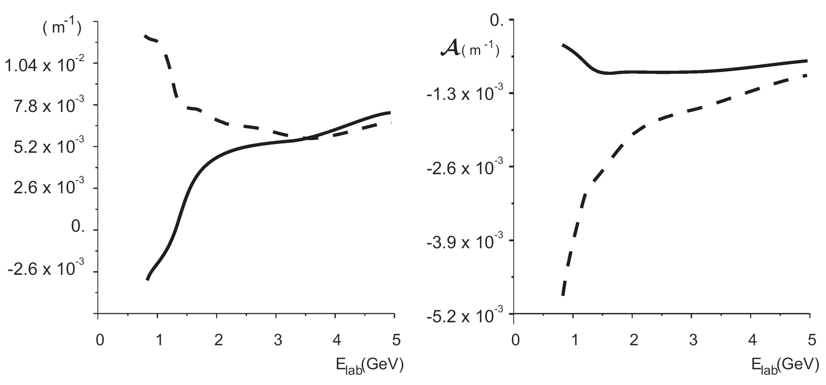
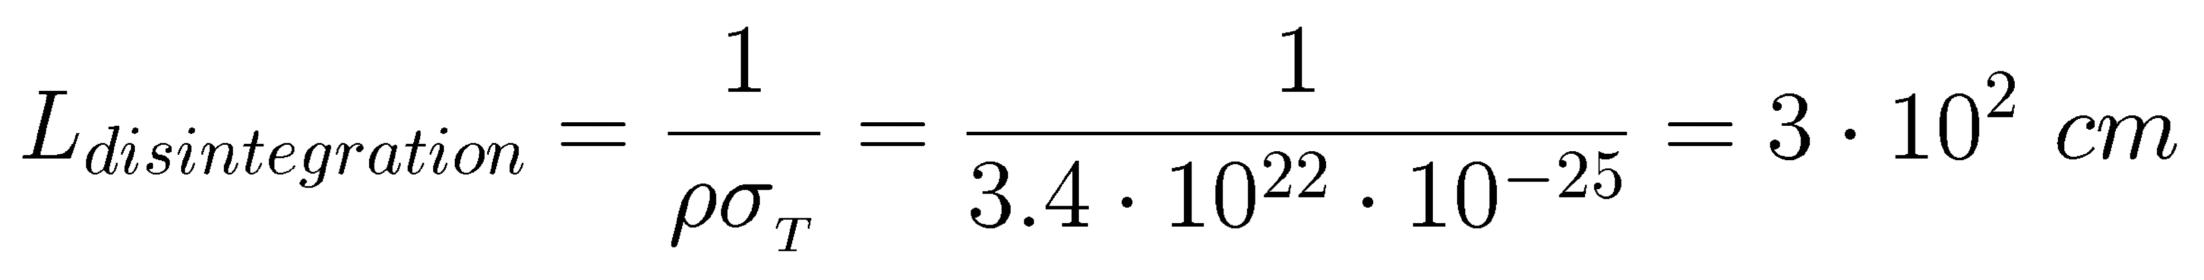
Spin rotation angle and dichroism in hydrogen target
Calculations for liquid hydrogen target with density 0.0675 g/cm²
Spin rotation angle and dichroism in hydrogen target at deuteron energies lower than 5 GeV. Solid curve corresponds to calculations with spinless N-N amplitude

Slide 30
SPD: unpolarized nuclei in nonpolarized target
Similar experiments could be performed with other light and heavy nuclei.
In case of heavy nuclei it is important to study how initially unpolarized nuclei acquire tensor polarization when they pass through nonpolarized target.
This possibility was emphasized by Valery Lebedev and Stepan Shimansky. Evaluations we made together are very much promising.

Slide 31

Thank you for attention!!

