Slide 1
Memberships of the PACs
Acad. Grigory V. Trubnikov

Slide 2
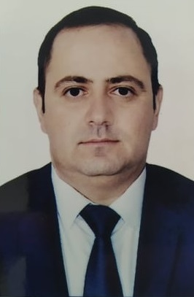
PAC for Condensed Matter Physics
Prof. Sakin Jabarov (Supreme Attestation Commission under the President of the Republic of Azerbaijan, Baku, Azerbaijan) as a new member of the PAC for Condensed Matter Physics for a term of three years.
Prof. Jabarov graduated from Baku State University in 2007, received his PhD in Physics of Semiconductors and Dielectrics in 2012 and his Dr. Hab. in Crystallography, Crystal Physics in 2021.
In JINR Prof. Jabarov worked as Junior Researcher, Researcher in 2010‒2014, as Senior Researcher in 2017‒2018.
Also, he did his research at DORIS IV Synchrotron and PETRA III Synchrotron at DESY (Hamburg, Germany), Scientific and Practical Center for Materials Science of the National Academy of Sciences of Belarus (Minsk, Belarus), and Adam Mickiewicz University (Poznan, Poland).
He held the position of Deputy Dean, Associate Professor in Azerbaijan State Pedagogical University (Baku) in 2018‒2022.
Since 2018 Prof. Jabarov has been working at the Supreme Attestation Commission under the President of the Republic of Azerbaijan and has made his way up to its Deputy Chairman.
Prof. Sakin Jabarov has more than 220 scientific publications.

Slide 3
The JINR Directorate asks the Scientific Council
to approve this proposal

