Slide 1

PAC for Particle Physics
61st Meeting:
Report to Scientific Council
JINR, February 13, 2025
Itzhak Tserruya

Slide 2
61st PAC-PP agenda January 20, 2025
Highlights of today's meeting:
Update reports on NICA, BM@N and SPD
Extension of project: MPD
New project: Neutrino Oscillations
Reports from the LHC experiments
Two scientific reports: SRC and Dark Matter
Posters from Young Scientists

Slide 3
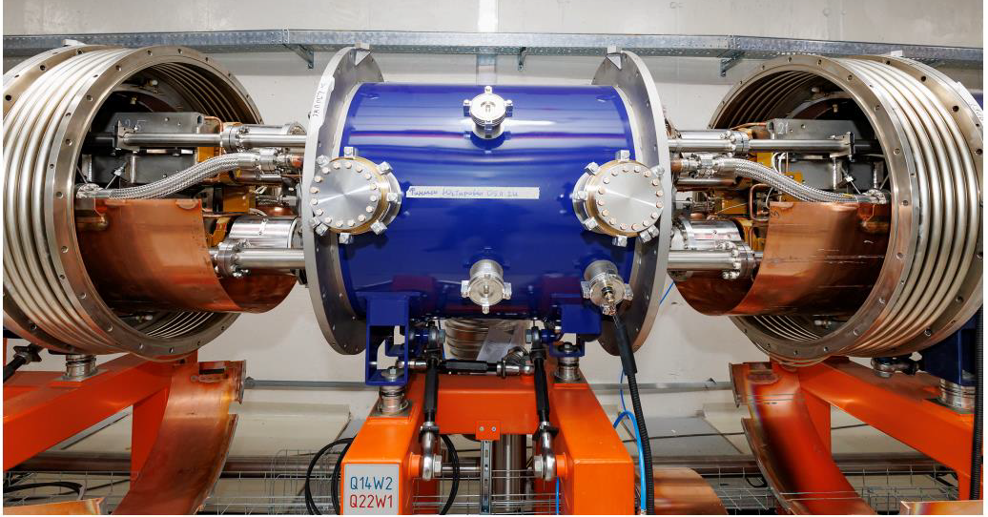
Report on the Nuclotron-NICA project
Anatoly Sidorin
The Committee appreciates the significant progress achieved in preparation for the NICA collider commissioning, including the installation of the collider magnetic cryostat system, RF stations and final focusing lenses, the merging of the high-vacuum sections in the West and East arcs, the installation of cryogenic equipment and power supplies in the collider building, and the connection of power lines and energy evacuation systems.
A detailed program for the physical launch of the complex has been developed that foresees first collisions in the summer of this year.
Several channels for applied research are ready for operation; 5 runs have already been conducted at the SOCHI chip irradiation station.
The PAC congratulates the accelerator team for all these achievements.

Slide 4
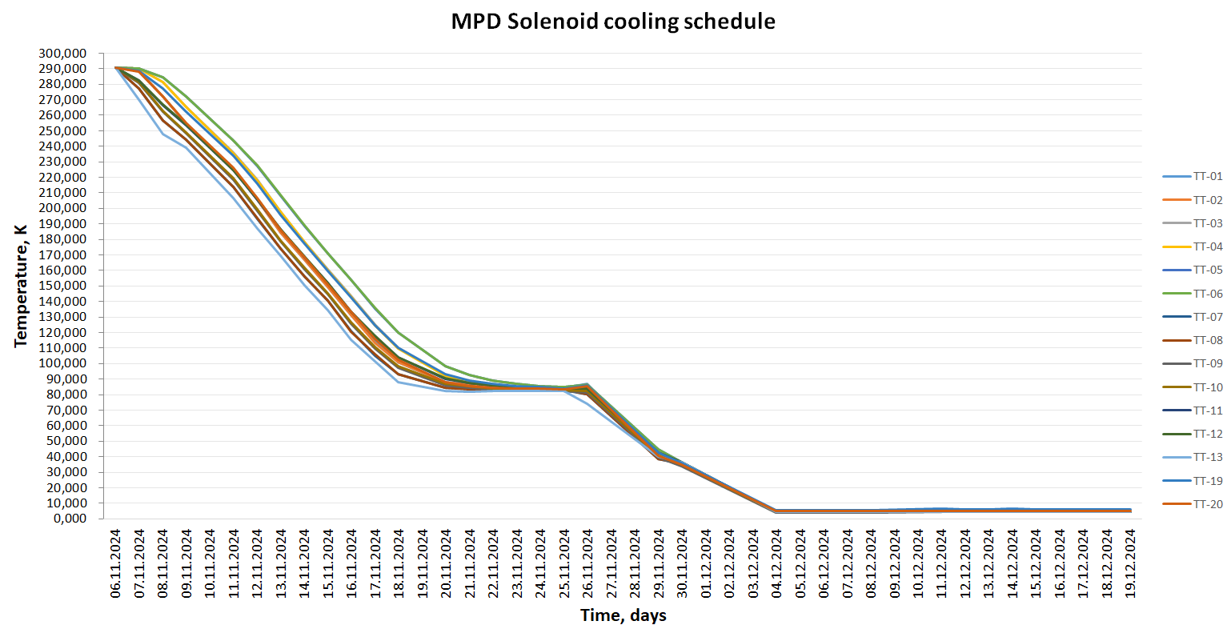
Report on MPD
Victor Riabov
The main elements of all detector subsystems of the Phase-I MPD are fabricated, which include the time-projection chamber (TPC), the time-of-flight system (TOF), the electromagnetic calorimeter (ECal), the forward fast detector (FFD) and the front hadronic calorimeter (FHCal). Assembly, testing and calibration are currently underway.
Extensive work has been done to assemble and commission the solenoid superconducting magnet. A test cooling of the magnet to liquid helium temperature was successfully performed at the end of 2024.
MPD cooling
The cooling lasted 15 days to N₂ temperature and 6 days to LHe temperature.
No cold helium and nitrogen leaks were detected.
LHe temperature was maintained for 15 days.

Slide 5
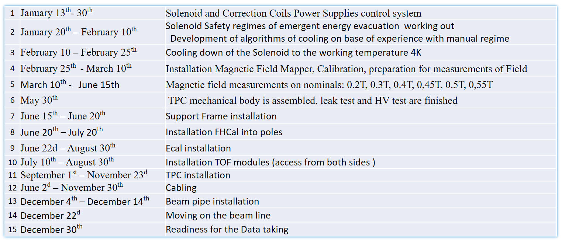
Report on MPD
Victor Riabov
The MPD experimental facility is in the final stage of construction, with the detector commissioning expected in late 2025. The PAC notes a significant delay in the readiness of the MPD detector compared to the anticipated timeline of the NICA collider. The PAC urges the MPD Collaboration to check whether the construction and installation tasks could be sped up to match the collider schedule better.
The PAC recommends extending the MPD project for 5 years with ranking A.

Slide 6
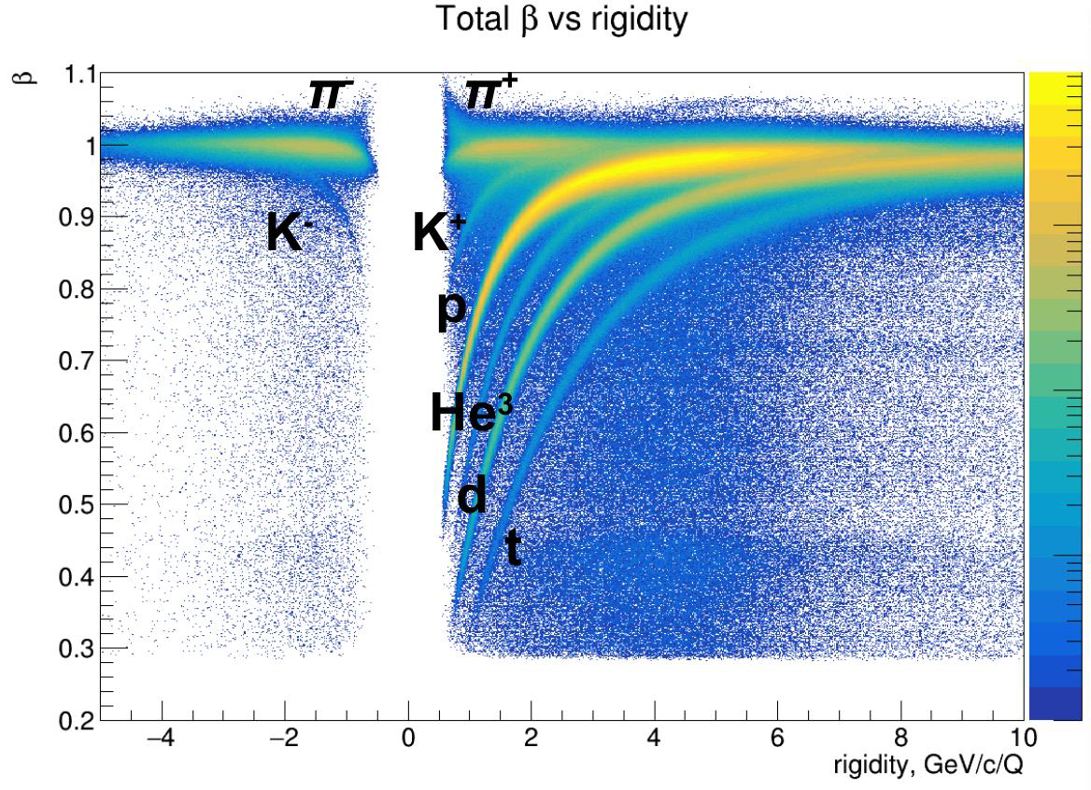
Report on BM@N
Mikhail Kapishin
A paper describing the complete configuration of the BM@N detectors in the first physics run of a Xe ion beam with a CsI target has been published in NIMA.
The BM@N team is focusing on physics analyses of the Xe + CsI collision data at an energy of 3.8 A GeV collected in 2023.
A physics paper on the production of protons, deuterons, and tritons in argon-nucleus interactions at 3.2 A GeV is under discussion in the BM@N Collaboration.
The next physics run of the BM@N experiment is planned with a Xe beam at an energy of 2–3 A GeV.
Particle id – Xe + CsI data

Slide 7
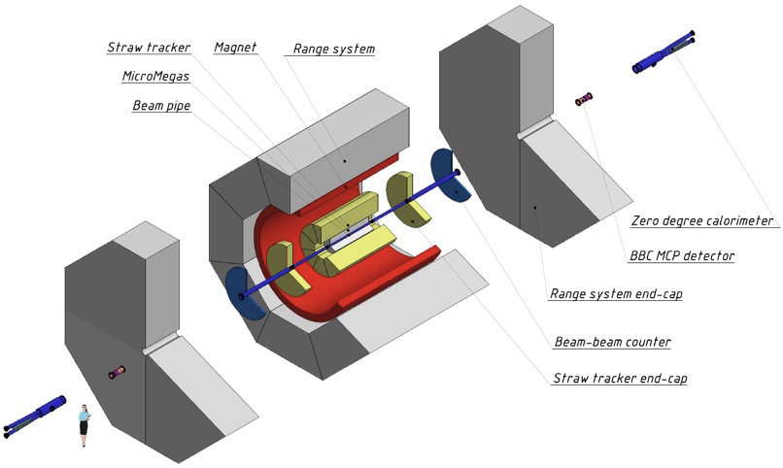
SPD Report
Alexey Guskov
Having finalized the Technical Design Report, the SPD team has started working on the first stage of the detector, which includes a superconducting solenoid magnet, a muon system, a straw tube-based main tracker, and a Micromegas-based central tracker. There will also be a pair of zero-degree calorimeters and beam-beam counters, as well as an electromagnetic calorimeter. Manufacturing of elements of the main detector systems has started.
Progress has been achieved in establishing the computing infrastructure of the project.
The PAC encourages the SPD collaboration to continue working on the production of the first-stage setup.
SPD setup – Stage I

Slide 8
Report on a new project
“Study of neutrino properties in accelerator experiments” on JINR’s participation in the ongoing accelerator neutrino experiments NOvA, T2K, FASER and DsTau, presented by L. Kolupaeva.
The main objectives of the project are measurements of the neutrino masses ordering and lepton CP violation, searches for neutrinos from supernovae and exotic signals, as well as measurement of cross-sections and development of neutrino interactions models.
During several years, JINR teams have made significant and diverse contributions to the development of these experiments and data analyses, and group members have taken coordinator positions in the collaborations.
The presented project combines the participation of JINR in experiments with neutrinos from accelerators into one project, which will make it possible to use the complementary experience of the participating groups.
Recommendation:
Taking into account the significant role of the JINR group in the NOvA experiment, and prospects for its scientific contribution to the T2K, FASER and DsTau experiments, the PAC recommends opening the project “Study of neutrino properties in accelerator experiments” from 2026 for three years with ranking A.

Slide 9
Reports from the LHC experiments
Reports presented by:
  ALICE – Elena Rogochaya
  ATLAS – Ivan Yeletskikh
  CMS – Vladimir Karjavin
The PAC heard detailed reports on the activities of the JINR groups involved in the three LHC experiments, ALICE, ATLAS and CMS with emphasis on their scientific and detector upgrade contributions.

Slide 10
Poster presentations by young scientists
The PAC reviewed with interest 17 reports by young scientists from DLNP and VBLHEP at the poster session.
The Committee selected the report “Construction of the ISCRA and SIMBO stations for applied research on high-energy ion beams. Radiation hardness testing of microchips by low energy pulsed ion beams at the SOCHI station” made by A. Silvin to be presented at this session of the Scientific Council.

Slide 11
Next PAC-PP Meeting – January 20-21, 2025
The next meeting of the PAC-PP is scheduled for June 23-24, 2025.
The following items are proposed to be included in the agenda of the next meeting:
  Status report on the Nuclotron-NICA project
  Report from the Coordinator of the Nuclotron experimental programme
  Status report on the MPD project
  Status report on the BM@N project, including physics results from the Xe run
  Status report from the SPD project
  Progress reports on JINR’s participation in the LHC experiments
  Consideration of new projects
  Reports and recommendations on the projects to be completed in 2025
  Posters from young physicists

Slide 12
Thank you!

