Slide 1
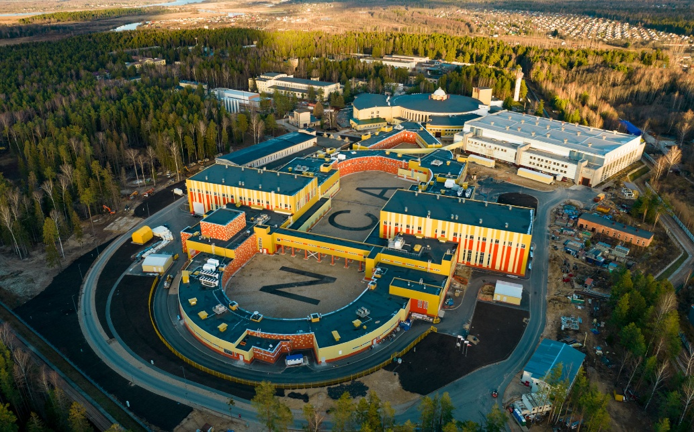
137th session of the Scientific Council
Construction of the ISCRA and SIMBO stations for applied research on high-energy ion beams. Radiation hardness testing of microchips by low energy pulsed ion beams at the SOCHI station
Speaker: Aleksei Slivin [slivin@jinr.ru]
Scientific supervisor: Evgeny Syresin
14 February 2025
Dubna

Slide 2
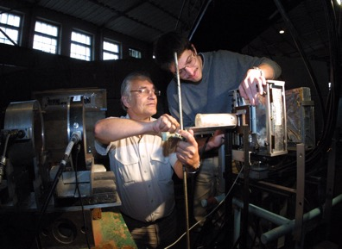
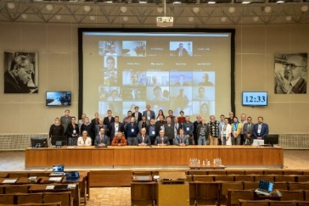
HISTORICAL NOTE
Applied research based on the NICA injection complex
International space experiment «PAMELA»
(Payload for Antimatter Matter Exploration and Light-nuclei Astrophysics)
The SOCHI station is designed to research and tests of promising semiconductor micro- and nanoelectronics products for the determination of SEE sensitivity to low energy (3.2 MeV/nucleon) heavy charged particles at the exit from the heavy ion linear accelerator.
The ISCRA station is designed to research and tests of promising semiconductor micro- and nanoelectronics products for the determination of SEE sensitivity to high energy (150-500 MeV/nucleon) heavy charged particles extracted from NUCLOTRON.
The SIMBO station is designed for radiobiological research to simulate the effects of high energy (400-1000 MeV/nucleon) heavy charged particles of galactic and solar cosmic rays on the cognitive functions of lower primates and small laboratory animals.
Radiation hardness testing of microelectronics of the PAMELA telescope-spectrometer with magnesium ion beams extracted from the Nuclotron at the energy of 150 MeV/nucleon in December 2001.
Radiobiological experiments with carbon $C^{6+}$ ion beams extracted from the Nuclotron at the energy of 500 MeV/nucleon were conducted to study interaction with biological objects at the cellular and organismic levels.
The technology of radiation hardness test of capsulated microchips has already been implemented at NASA Space Radiation Laboratory at Brookhaven National Laboratory, but not in Russia.
In September 2021, within the framework of the International Round Table on Applied Research and Innovations at the NICA facility, participants welcomed the proposed name for the infrastructure of applied stations and beamlines ― ARIADNA (Applied Research Infrastructure for Advanced Developments at NICA fAcility).
Courtesy: jinr.ru
14.02.2025
137th session of the Scientific Council, Slivin Aleksei
2

Slide 3
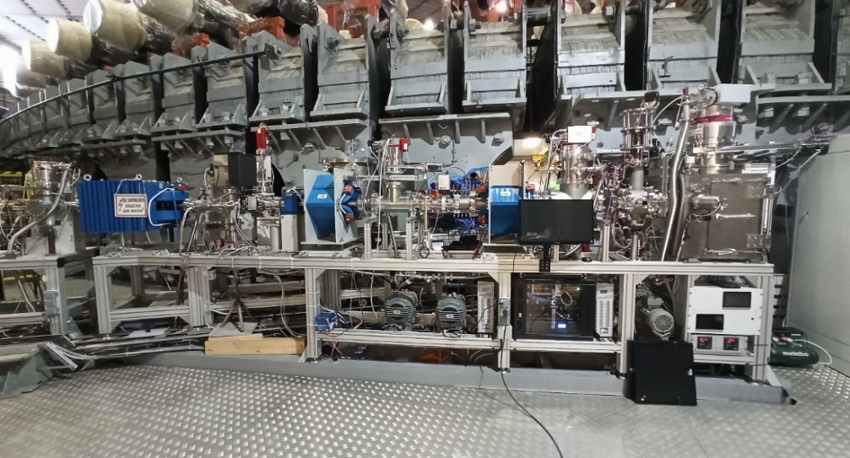
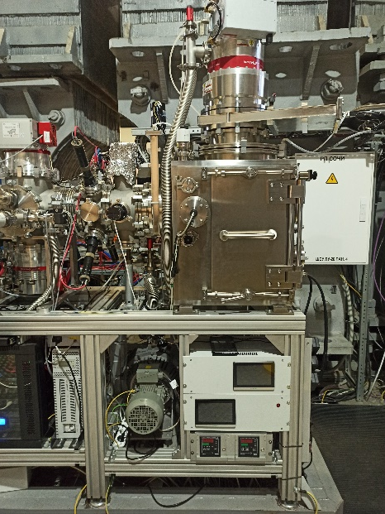
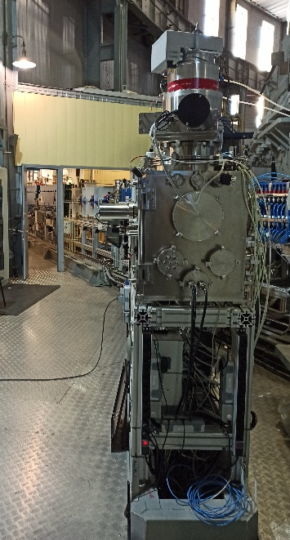
Station of CHip Irradiation (SOCHI)
SOCHI ─ an applied research station for Single Event Effects (SEE) testing on decapsulated microchips (ion energy up to 3.2 MeV/n). The equipment was mounted in autumn 2021.
Particle collimation system
8
7
2
5
1
4
6
The SOCHI station
Back view
3
Dipole magnet
Vacuum Station № 3
Two-axis steerer
Quadrupole magnet № 1
Vacuum Station № 2
Quadrupole magnet № 2
Vacuum Station № 1
SOCHI station
1020 mm
650 mm
540 mm
500 mm
The SOCHI ion beam diagnostics system includes:
The ionization detector based on microchannel plates;
The system for online diagnostics and control of peripheral ion flux density and fluence;
A detector based on Faraday cup;
The fast total-absorption scintillation detector with optical readout;
The fast total-absorption phosphor detector with optical readout.
14.02.2025
137th session of the Scientific Council, Slivin Aleksei
3

Slide 4
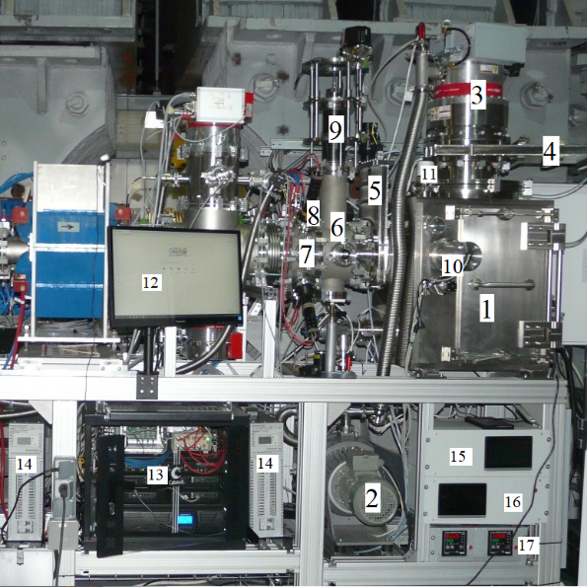
The main elements of the SOCHI station
Ion beam parameters at the SOCHI station during last tests
Main vacuum chamber (chamber volume 140 liters);
forevacuum pump (Geowell, GWSP-1000);
turbomolecular pump (Pfeiffer vacuum ATH2303M);
gate valve of the turbomolecular pump;
gate valve of the beamline;
vacuum chamber №2 (detector based on Faraday cup; scintillation detector);
vacuum chamber №1 (detector based on microchannel plates; scintillator based detectors for online diagnostics);
photomultiplier tubes for online diagnostics;
positioning system for detectors;
video-based control system for DUT positioning;
pressure sensor (Pfeiffer Vacuum PT R26 001/PKR251);
monitor of the SOCHI systems control panel;
Type of ions | ¹²C⁴⁺, ⁴⁰Ar⁸⁺, ¹³¹Xe²²⁺, ⁸⁴Kr¹⁴⁺
Ion energy at the exit from the HILac, MeV/nucleon | 3.2
Ion flux density, particles/(cm²∙s) | 10³..10⁵
Maximum fluence per run, ion/(cm²) | 2∙10⁷
Maximum irradiation area, mm | Ø29
Uniformity in the beam center at the 20x20 mm area, % | 10
Beam diameter, mm | Ø73
System of positive temperature setting for test objects | +25°C … +125°C, ±5°C; 10 min
13 - control equipment rack; 14 - voltage stabilizer Stil InStab IS7000RT (2 pcs.); 15 - vacuum system control unit; 16 - control unit of the DUT positioning system; 17 - control units of the temperature setting system.
14.02.2025
137th session of the Scientific Council, Slivin Aleksei
4

Slide 5
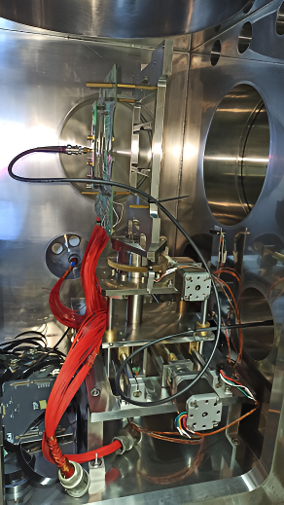
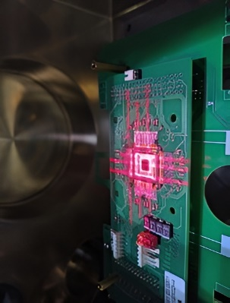
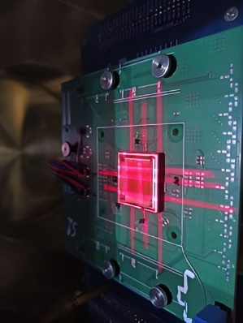
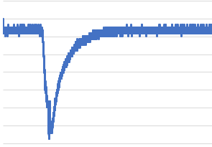
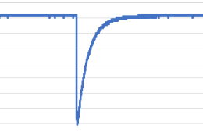
The results obtained at the SOCHI station
At the SOCHI facility five sessions for decapsulated microcircuits irradiation tests were conducted.
Six types of integrated microcircuits were irradiated in order to study the impact of the pulsed beam structure on the electronic component base.
At the moment, the types of microcircuits for which pulsed ion beam lead to a significant increase in the number of single events in comparison with CW-beam have not been identified.
For a number of microcircuits, the same behavior for both pulsed ion beams from the heavy ion linear accelerator and CW-beam from FLNR JINR cyclotrons was found.
During the sessions, the diagnostic equipment of the station was improved to determine the main parameters of ion beams on the target.
Test chip with storage cells C-MOS technology 90 nm
FPGA C-MOS technology
65 nm
Table 1*
Oscillograms of the output response of the operating amplifier: (a) typical oscillogram under tests with a «wide-slit» at the SOCHI; (b) typical oscillogram under tests at the cyclotron in the FLNR JINR.
Объект | Коллиматор | $$N_{ОС}$$ | Количество сбросов пучка, N | $σ_{ОС \left(У−400\right)}$, см² | $$Ф_{СОЧИ}$$ 1/см²
ОЗУ 180 нм Объем памяти 4194304 бит | «Широкая щель» | 5296 | 20 | 1,08·10⁻² | 2,45·10⁴
 |  | 5448 | 20 | 1,08·10⁻² | 2,52·10⁴
 |  | 5361 | 20 | 1,08·10⁻² | 2,48·10⁴
ТК 90 нм Блок памяти №1 Объем памяти 10240 бит |  | 6 | 20 | 1,71·10⁻⁴ | 1,75·10³
 |  | 19 | 50 | 1,71·10⁻⁴ | 2,22·10³
ТК 90 нм Блок памяти №2 Объем памяти 32768 бит |  | 27 | 20 | 3,78·10⁻⁴ | 3,57·10³
 |  | 81 | 50 | 3,78·10⁻⁴ | 4,29·10³
ТК 90 нм Блок памяти №3 Объем памяти 65536 бит |  | 41 | 20 | 7,96·10⁻⁴ | 2,58·10³
 |  | 110 | 50 | 7,96·10⁻⁴ | 2,76·10³
ПЛИС 65 нм Объем памяти 18147984 бит |  | 4533 | 10 | 1,62·10⁻¹ | 2,80·10³
A
B
Placement of an operating amplifier in the main vacuum chamber of the SOCHI station
*[1] Бобровский Д. В. и др. ИСПОЛЬЗОВАНИЕ СТЕНДА «СОЧИ» ДЛЯ ПОДТВЕРЖДЕНИЯ НЕИЗМЕННОСТИ КРИСТАЛЛА МИКРОСХЕМ //Безопасность информационных технологий. – 2025. – Т. 32. – №. 1. – С. 46-53.
14.02.2025
137th session of the Scientific Council, Slivin Aleksei
5

Slide 6
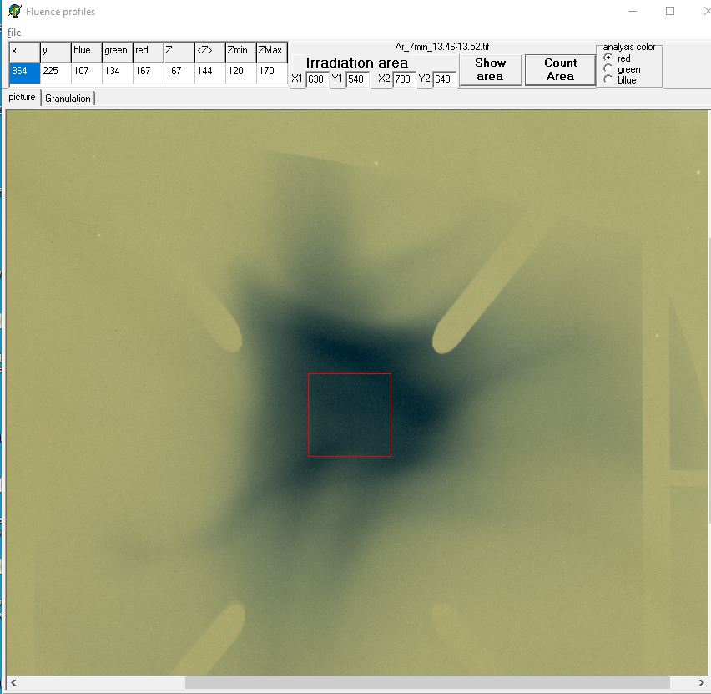
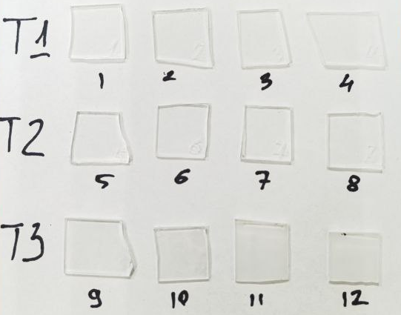
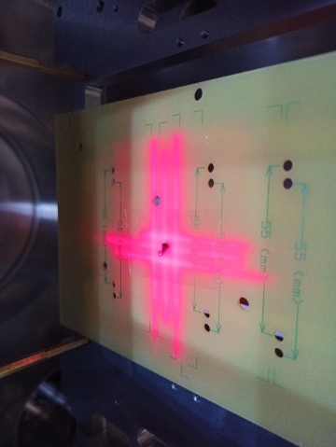
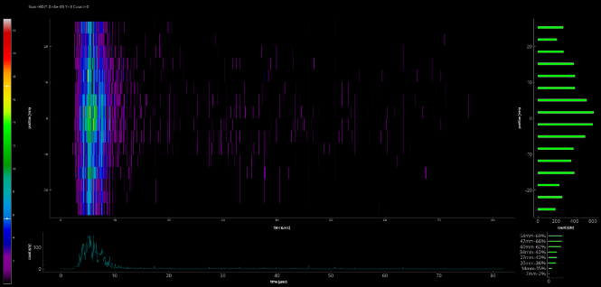
The results obtained at the SOCHI station
Radiotherapy films EBT3 are used to determine the size of the ion beam spot during a session; to determine the uniformity of the irradiation area.
EBT3 radiotherapy films
Solid state track detector CR39
~10×10 mm² and 1 mm thick
SSTD CR39 are used to determine the actual ion fluence in each irradiation session.
Four/ five SSTDs were placed at equal distance from the chip before irradiation on the DUT. The results of irradiated the SSTDs after being processed and analyzed are subsequently compared with estimates of the total equivalent fluence from the microcircuit readings.
Metastable compound for spintronics La_{0.5}Ba_{0.5}CoO_{2.87}
Study of the effect of pulsed ion beam irradiation on the magnetic properties of metastable compound.
Ion beam profile (horizontal) by MCP-detector during beam run
14.02.2025
137th session of the Scientific Council, Slivin Aleksei
6

Slide 7
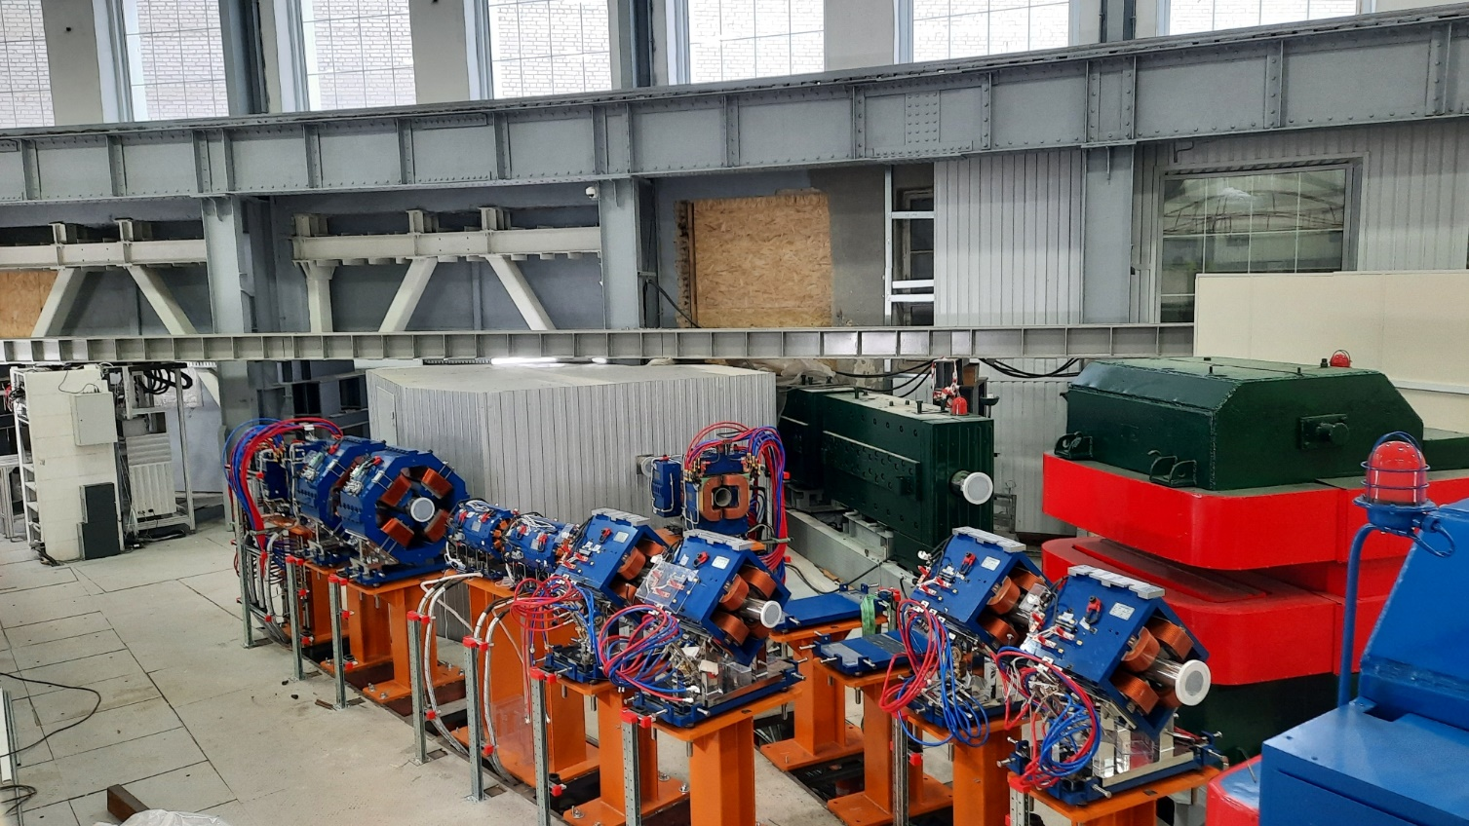
ISCRA & SIMBO stations at the VBLHEP JINR
The equipment of the ISCRA and SIMBO stations was mounted in December 2023. The commissioning of the diagnostics equipment of the ISCRA and SIMBO stations with ionizing radiation source & magnets tests were carried out in November-December 2024. The equipment is ready for the first beam run in spring 2025. The technology of radiation hardness testing of capsulated microchips with high-energy ion beams will be realized in Russia for the first time.
ISCRA
SIMBO
BM@N
The new ion beam delivery system allows following operating modes:
operating mode with high-energy ion beams
operating mode with variable depth Bragg peak in the target’s sensitive volume
nonscanning operating mode
scanning operating mode
14.02.2025
137th session of the Scientific Council, Slivin Aleksei
7

Slide 8
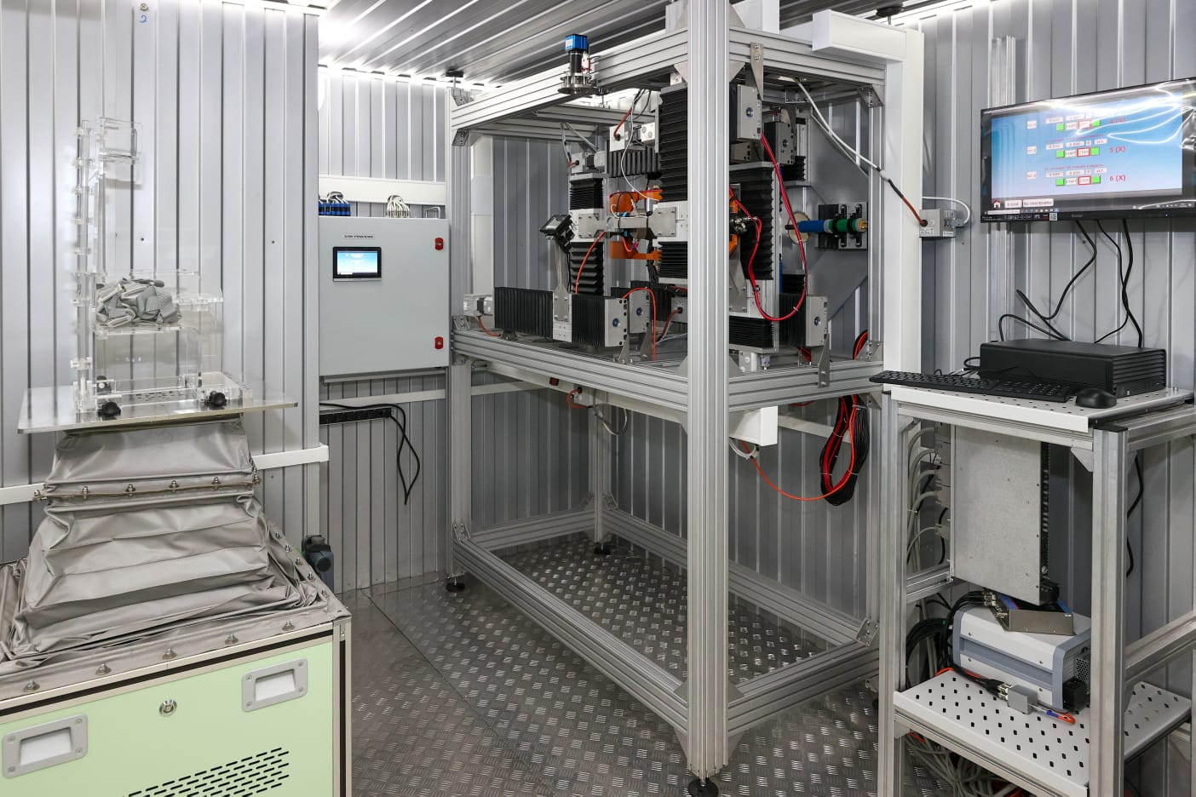
Setup for Investigation of Medical Biological Objects (SIMBO)
The equipment for the SIMBO station was manufactured as part of the JINR ─ «Vacuum systems and technologies» LLC (Belgorod) collaboration.
SIMBO ─ an applied research station for space radiobiological research and modelling of influence of heavy charged particles on cognitive functions of the brain of small laboratory animals and primates (energy range 400-1000 MeV/nucleon).
Technical requirements for the ion beams at the SIMBO station
Type of ions | ¹²C⁶⁺, ⁴⁰Ar¹⁸⁺, ⁵⁶Fe²⁶⁺, ⁸⁴Kr³⁶⁺
Ion energy at the exit from the NUCLOTRON, MeV/nucleon | 400-1000
Ion flux density, particles/(cm²∙s) | 10³..10⁶
Irradiation time per run, min | 1-5
Radiation dose, Gy | 1-3
Maximum irradiation area in the scanning mode/nonscanning mode, mm | 100×100/Ø10
Flux uniformity for the maximum irradiation area in the scanning mode/nonscanning mode, % | 5/10
Beam FWHM at the target, mm | 25-35
The equipment was mounted in December 2023
14.02.2025
137th session of the Scientific Council, Slivin Aleksei
8

Slide 9
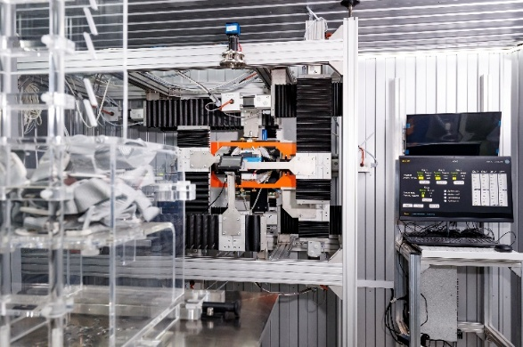
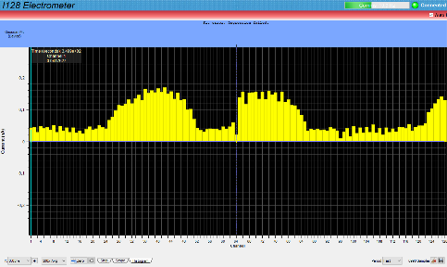
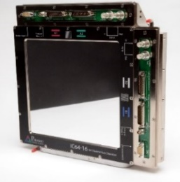
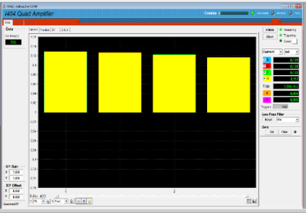
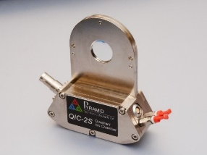
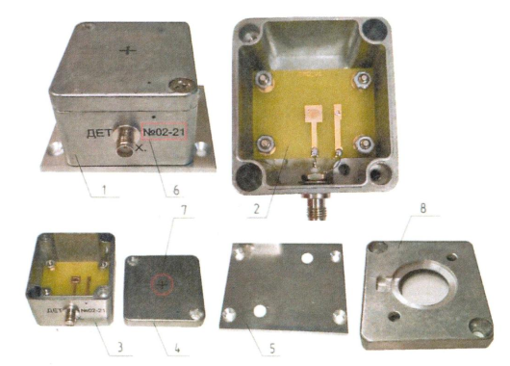
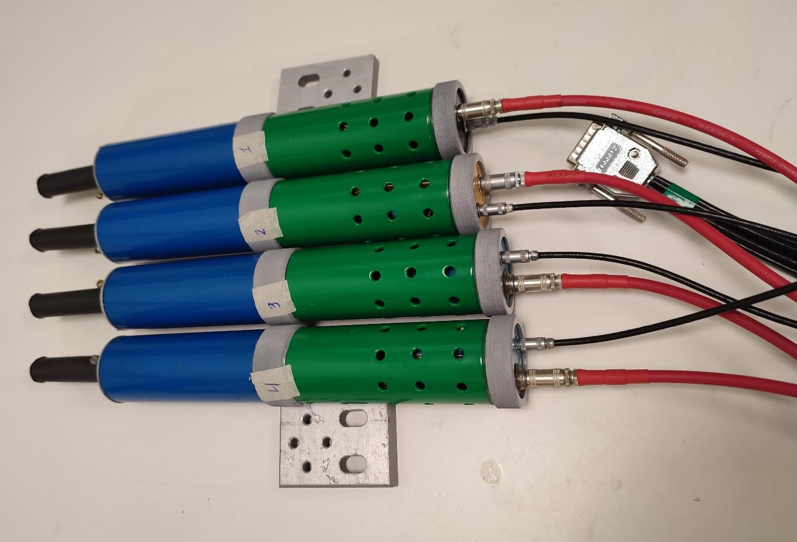
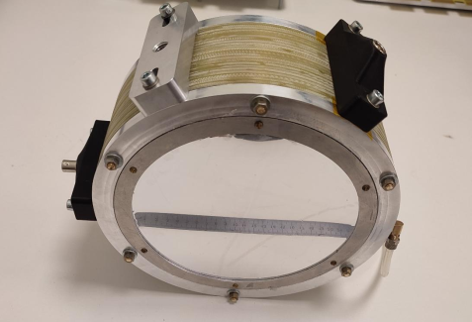
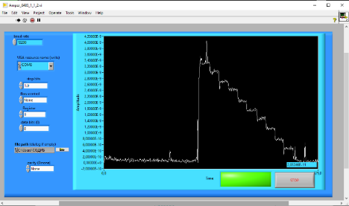
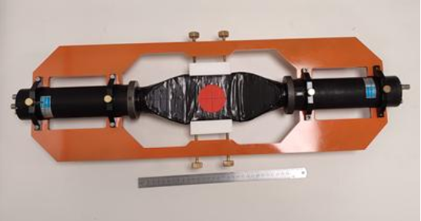
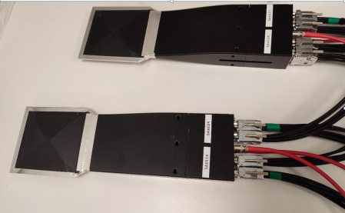
SIMBO diagnostics system and it’s commissioning tests with ionizing radiation source
Diagnostics equipment at the
Strip Ionization chamber IC64-16 with I128r5-XP20 readout electronics
Commissioning tests of SIMBO diagnostics equipment
QIC-2S - Mini Quadrant Ion Chamber with I404 readout electronics
Diamond detector
Scintillation detectors
Ionization chamber
Thin scintillation spectrometer
Fiber scintillation detector
14.02.2025
137th session of the Scientific Council, Slivin Aleksei
9

Slide 10
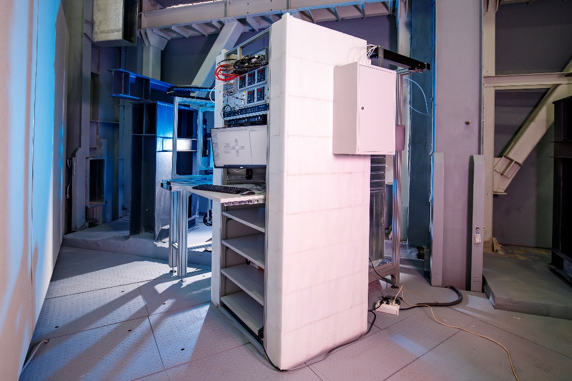
Irradiation Setup for Components of Radioelectronic Apparatus (ISCRA)
ISCRA ─ an applied research station for Single Event Effects (SEE) testing on capsulated microchips with high energy ion beams (150-500 MeV/nucleon). The equipment for the ISCRA station was manufactured as part of the JINR ─ National Research Centre «Kurchatov Institute»-ITEP (Moscow) collaboration with JSC «Experimental Research and Production Association SPECIALIZED ELECTRONIC SYSTEMS»/National Research Nuclear University MEPhI (Moscow) ─ «GIRO-PROM» LLC (Dubna) participation.
Technical requirements for the ion beams at the ISCRA
Type of ions, energy MeV/nucleon | ¹⁹⁷Au⁷⁹⁺ | 150-350
 | ¹³¹Xe⁵⁴⁺ | 150-367
 | ⁸⁴Kr³⁶⁺ | 150-392
 | ⁵⁶Fe²⁶⁺ | 150-449
 | ⁴⁰Ar¹⁸⁺ | 150-426
 | ¹²C⁶⁺ | 150-507
Ion flux density, particles/(cm²∙s) | 10²..3∙10⁵
Maximum irradiation area in the scanning mode/ nonscanning mode, mm | 200×200/20×20(Ø29)
Beam diameter in nonscanning mode, mm | Ø73
Flux uniformity for the maximum irradiation area in the scanning mode/nonscanning mode, % | 15/10
2000 mm
Beam direction
(over the air)
The equipment was mounted in December 2023
2000 mm
14.02.2025
137th session of the Scientific Council, Slivin Aleksei
10

Slide 11
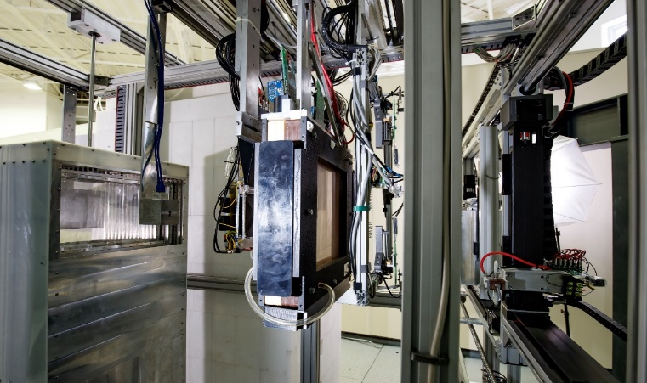
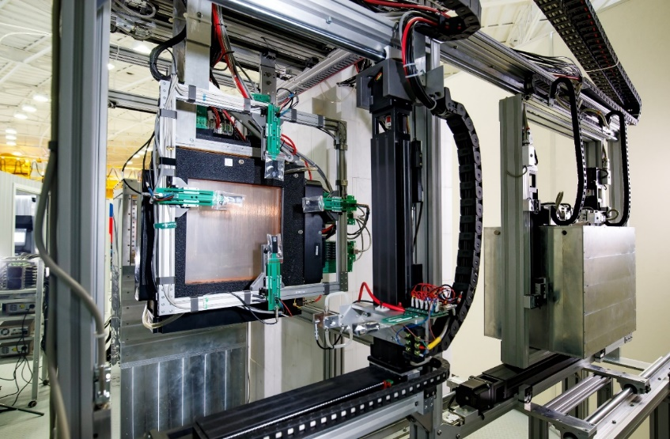
Irradiation Setup for Components of Radioelectronic Apparatus (ISCRA)
The station includes the following components
5
6
Energy degrader (polycarbonate);
System of ion beam profile projection and video control;
Ionization chamber №1;
Scintillation-fiber detector;
Proportional wire ionization chamber №2;
A particle flux density meter;
1
4
2
3
Miniature gas-filled ionization chamber №3;
Silicon detector;
Device under test (DUT) positioning system;
Chamber with drained atmosphere for testing at negative temperatures;
System of positive temperature setting for test objects
(+25°C … +125°C, ±5°C, 10 min);
System of negative temperature setting of test objects
(minus 60 ºС … 0 ºС, ±5ºС, 15 min);
Equipment for connections between test equipment and DUT
Workplace in the Measurement Hall of Building 1
9
7
8
10
14.02.2025
137th session of the Scientific Council, Slivin Aleksei
10

Slide 12
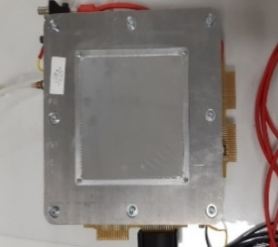
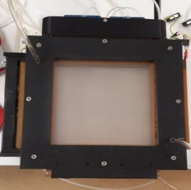
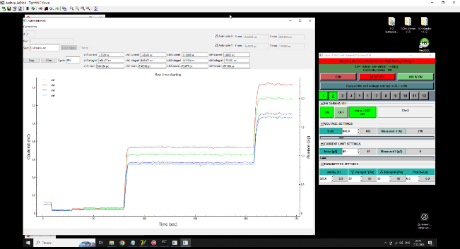
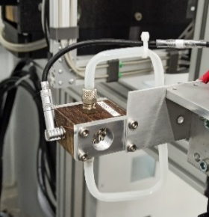
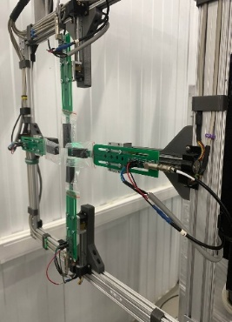
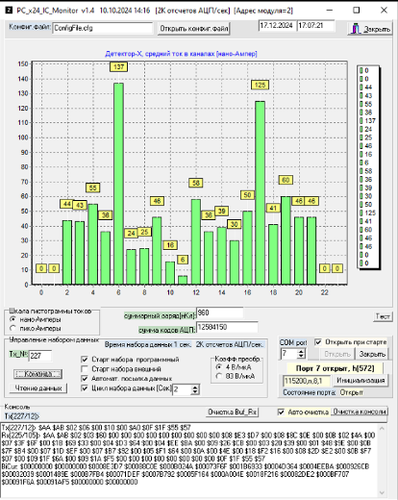
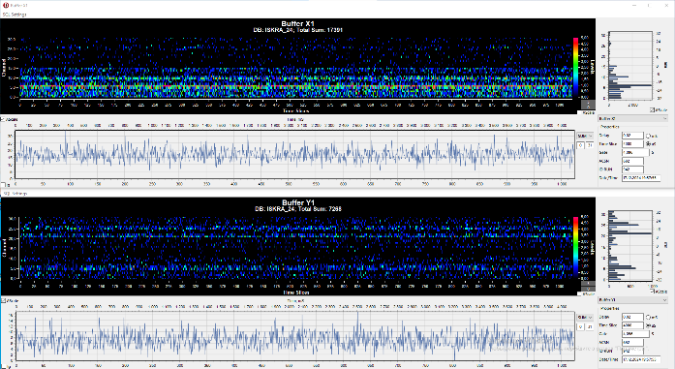
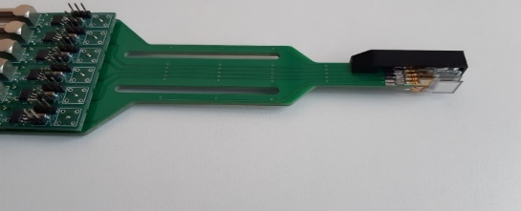
ISCRA diagnostics system and it’s commissioning test with ionizing radiation source
Ionization chamber №1
Ionization chamber №2
Ionization chamber №3
1
Fiber scintillation detector
3
2
Semiconductor detector for online diagnostics
Semiconductor detector
Commissioning tests of ISCRA diagnostics equipment:
Ionization chamber №1
Fiber scintillation detector
Ionization chamber №3
14.02.2025
137th session of the Scientific Council, Slivin Aleksei
12

Slide 13
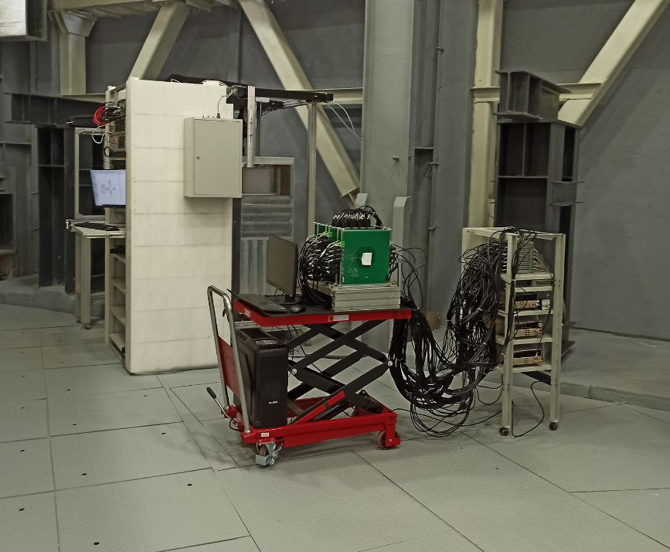
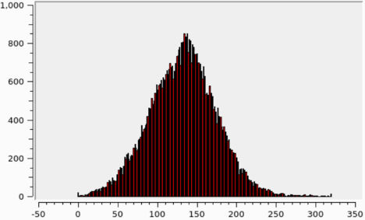
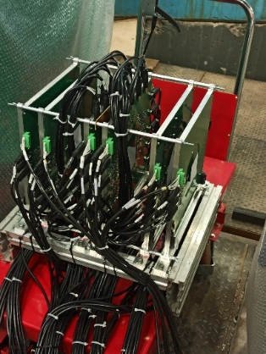
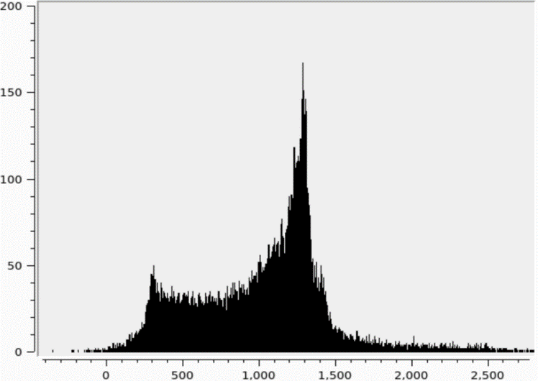
The DPS-NICA project (as a part of ISCRA station)
The Detector Part of the Station (DPS) is manufactured as part of the JINR ─ Skobeltsyn Nuclear Physics Research Institute (Moscow State University, Moscow) collaboration. The DPS is an experimental facility that allows recovering trajectories (tracks) and energies (by energy release in the layers) of an individual particle entering it. The DPS is designed to mass test the microchips by precise localization of the most vulnerable regions in them. The DPS-NICA prototype was tested on ion beams (¹²⁴Xe⁵⁴⁺ 3,8 GeV/nucleon) extracted from the Nuclotron in December 2022.
Ion beam profile in horizontal direction. Detecting planes with high coordinate resolution (HCR): strip spacing
100 µm, 320 strips, detector dimensions of 34.0 mm
(across strips) × 32.4 mm (along strips), and detector
thickness of 300 µm
Energy release from Xe in ADC counts
The DPS provides an accuracy of determining the energy release (energy loss) in the microchip that is no worse than 10% and an accuracy of determining the point of the nucleus entry into the microchip that is no worse than ±100 µm.
14.02.2025
137th session of the Scientific Council, Slivin Aleksei
13

Slide 14
Future plans
SOCHI
Conducting experimental studies of decapsulated integrated microchips to SEE sensitivity occurring under the influence of a pulsed heavy ion beam’s low energy (3.2 MeV/nucleon). Comparing the SOCHI results with the results at the stands using CW-beam of the U-400 and U-400M cyclotrons. Recommendations for conducting research on decapsulated microchips at the SOCHI station.
ISCRA
The development of a new technology of SEE sensitivity estimation in packaged integrated circuits
Conducting computational-experimental studies of capsulated integrated microchips to SEE sensitivity occurring under the influence of high-energy (150-500 MeV/nucleon) heavy ion beams to develop a new testing procedure:
recommendations on determining the mass thickness of the microchip package by X-ray methods;
modeling of LET spectrum formation of primary ion beam after passing the energy degrader;
modeling of LET spectrum formation of secondary particles after passing the energy degrader, estimation of their contribution;
modeling and experimental evaluation of the primary ion beam energy required for the occurrence of the Bragg peak outside the microchip package.
Heterogeneous structure of the integrated circuit package.
Uncertainty of ion beam energy coming to the device’s sensitive volume.
Formation of secondary particles as a result of the interaction of the beam with the degrader and the integrated circuit’s package.
SIMBO
Achievement of 1-3 Gy radiation dose in shorter irradiation time (1-5 min vs. 20 min in previous experiments) due to high ion beam intensity
14.02.2025
137th session of the Scientific Council, Slivin Aleksei
14

Slide 15
137th session of the Scientific Council
Thank you for your attention
Aleksei Slivin [slivin@jinr.ru]
Veksler and Baldin Laboratory of High Energy Physics
Joint Institute for Nuclear Research
14 February 2025
Dubna

