Slide 1
Intense metallic ion beams for SHE synthesis
FLNR Ion source group
Pugachev D.

Slide 2
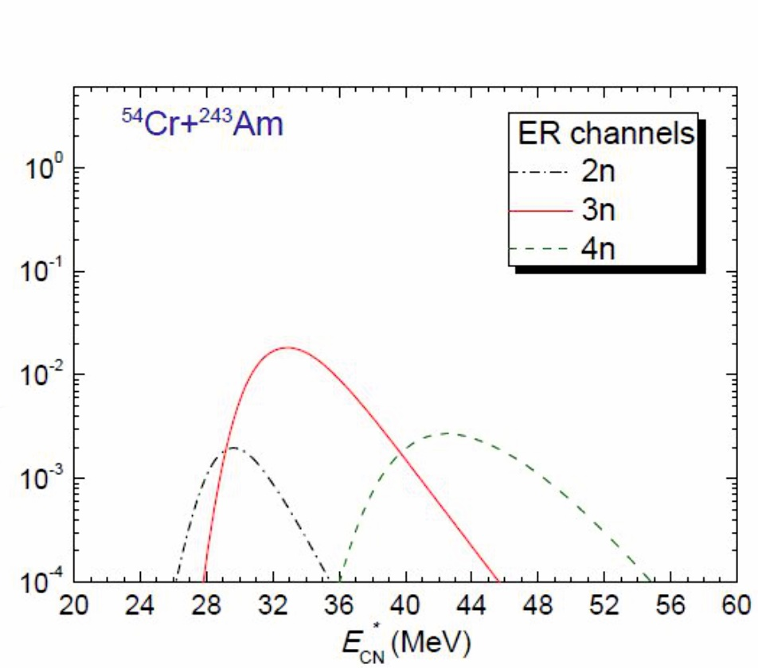

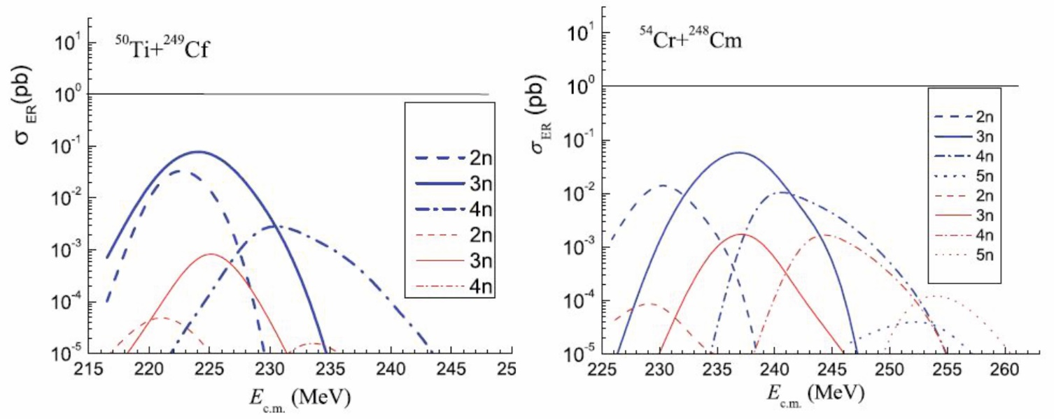
Ion beams for SHE synthesis
^{Z=119}
¹¹⁸
⁴⁸ Ca
²⁴⁹Cf
⁵⁰Ti
²⁴³Am
²⁴⁹Bk
²⁴⁹⁻²⁵¹Cf
²⁴⁸Cm
¹¹⁹
up to 3 pmkA
up to 5 pmkA
⁵⁴Cr
¹²⁰
^{Z=120}
The heaviest target for experiments on synthesis of superheavy elements in heavy-ion reactions is ²⁴⁹Cf, so further progress in the synthesis of elements with Z > 118 requires the production of intense beams of accelerated neutron-enriched isotopes, such as ⁵⁰Ti, ⁵⁴Cr, ⁵⁸Fe, ⁶⁴Ni, etc.

Slide 3
Ion production methods
Low temperature oven – Ca, Mg, Bi, etc.
High temperature oven – Fe, Al, Cr, Ti, etc.
MIVOC – Cr, Ti, Al, Zr, Fe, etc.
Direct insertion into plasma – Al, Ti?, Cr?
Sputtering – Al, Ta, Cu, Ti?, Cr?
Using alternative methods - Ti?
< 1000 ºC
> 1000 ºC

Slide 4
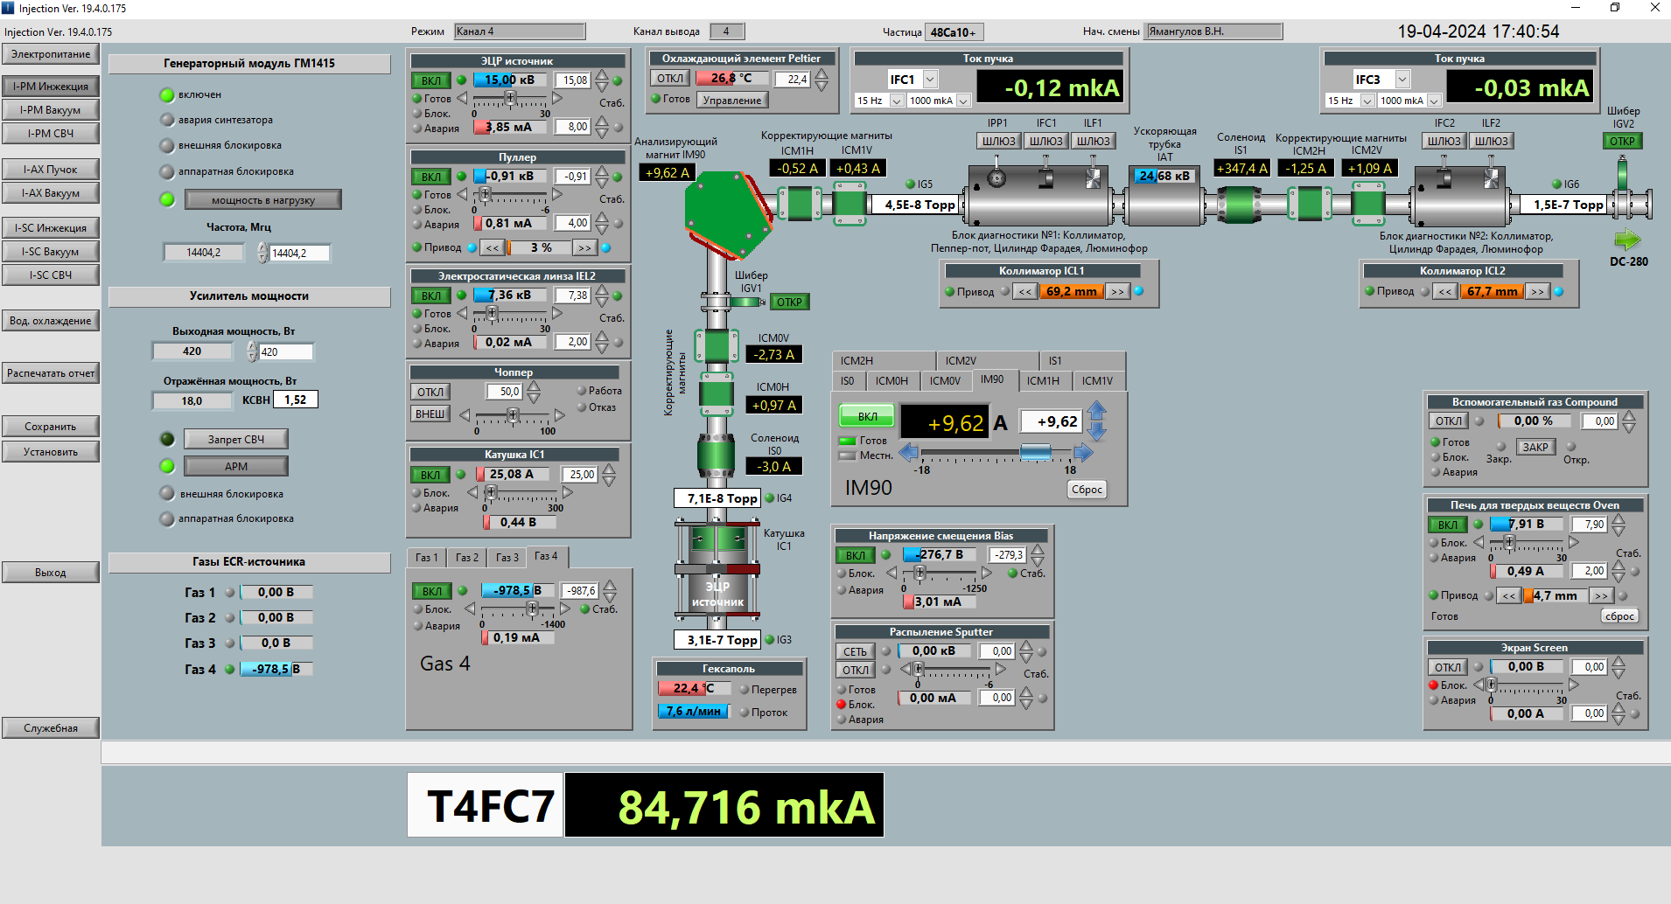
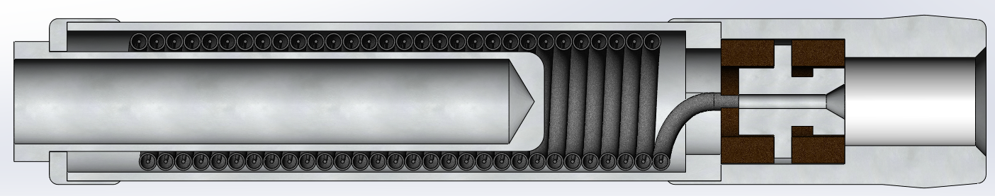
Production of ⁴⁸Са ion beam at the DC-280 cyclotron
Resistive oven
50
7
8.4 pµA of ⁴⁸Ca close to target (19.04.2024)
Ɛ_{acc}=35%

Slide 5
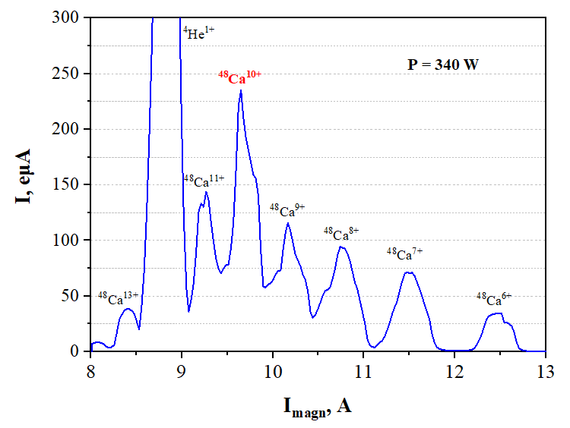
Calcium consumption
~24 pµA of ⁴⁸Ca from ion source
Consumption ~ 3.4 mg/h
Dependence of the consumption on the beam intensity ⁴⁸Ca¹⁰⁺

Slide 6
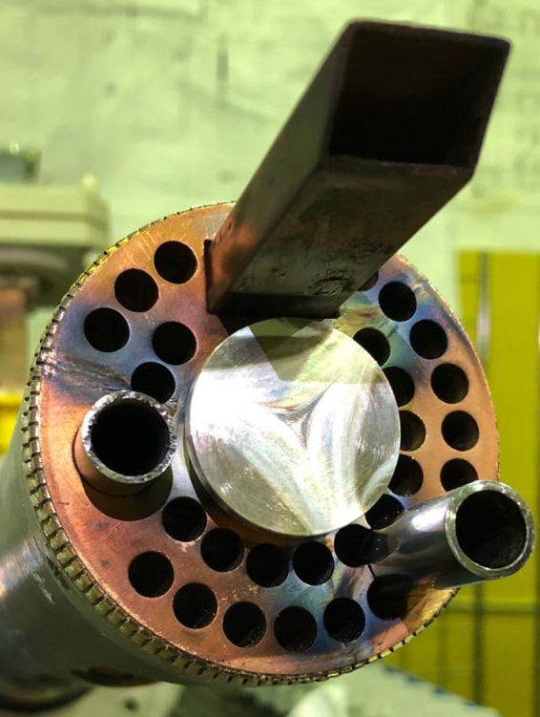
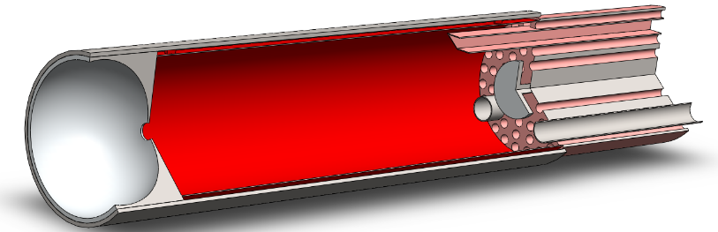
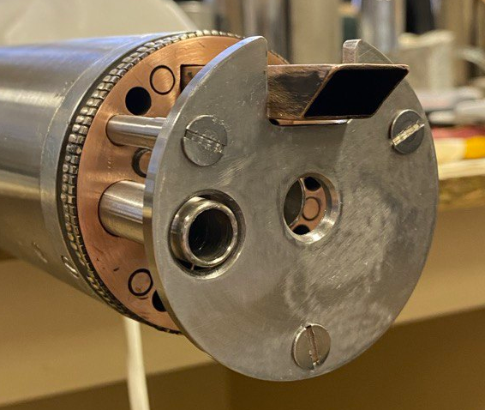
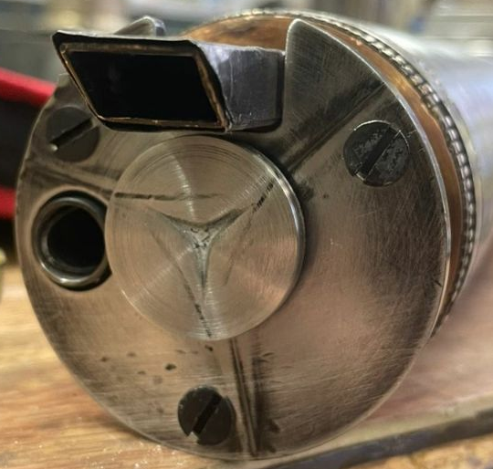
Calcium consumption
Hot Ta screen (heated by microwaves)
Old
New
Tests from 16.12.24

Slide 7
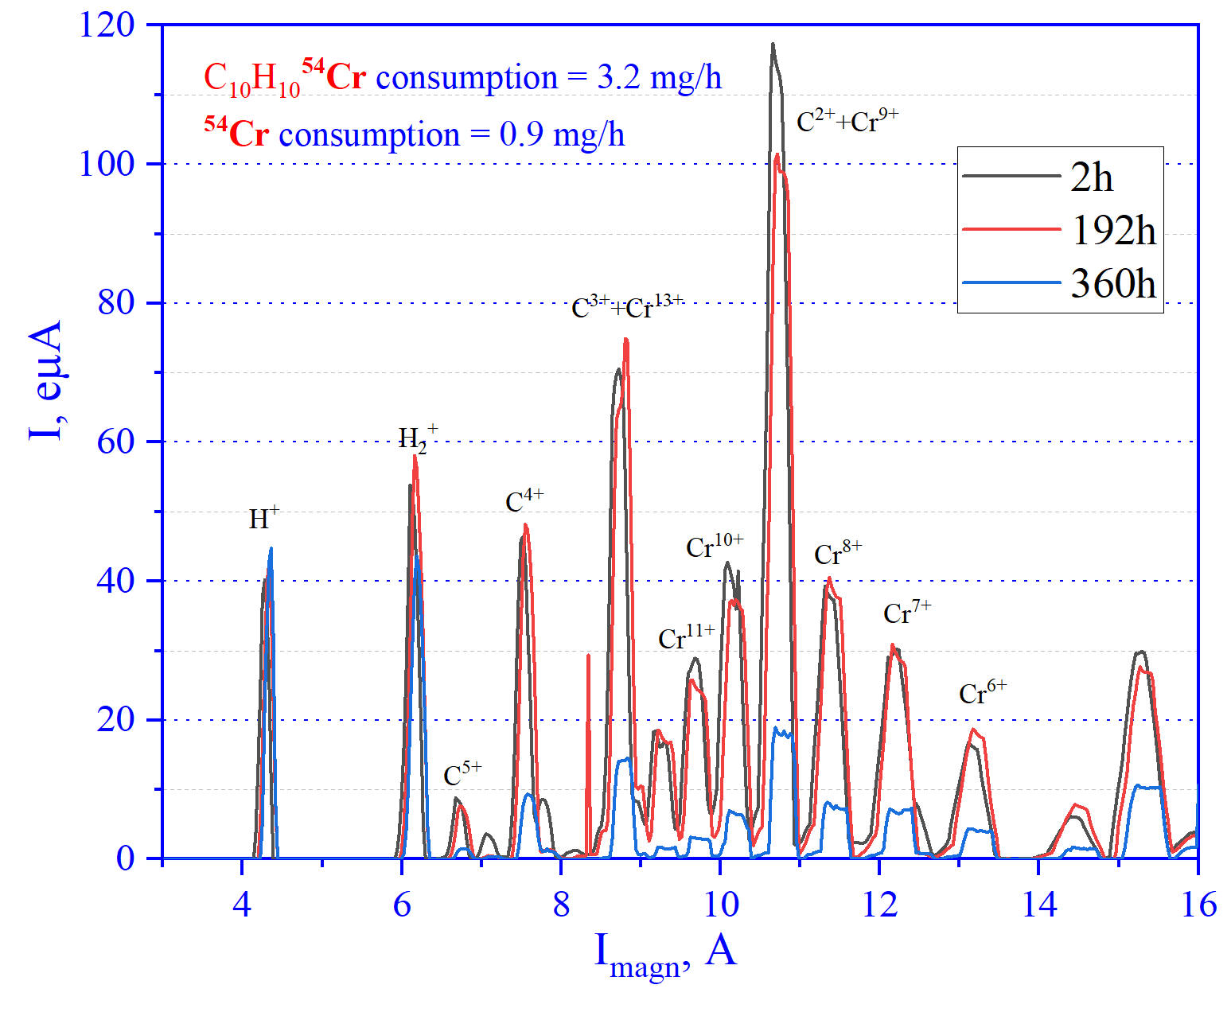
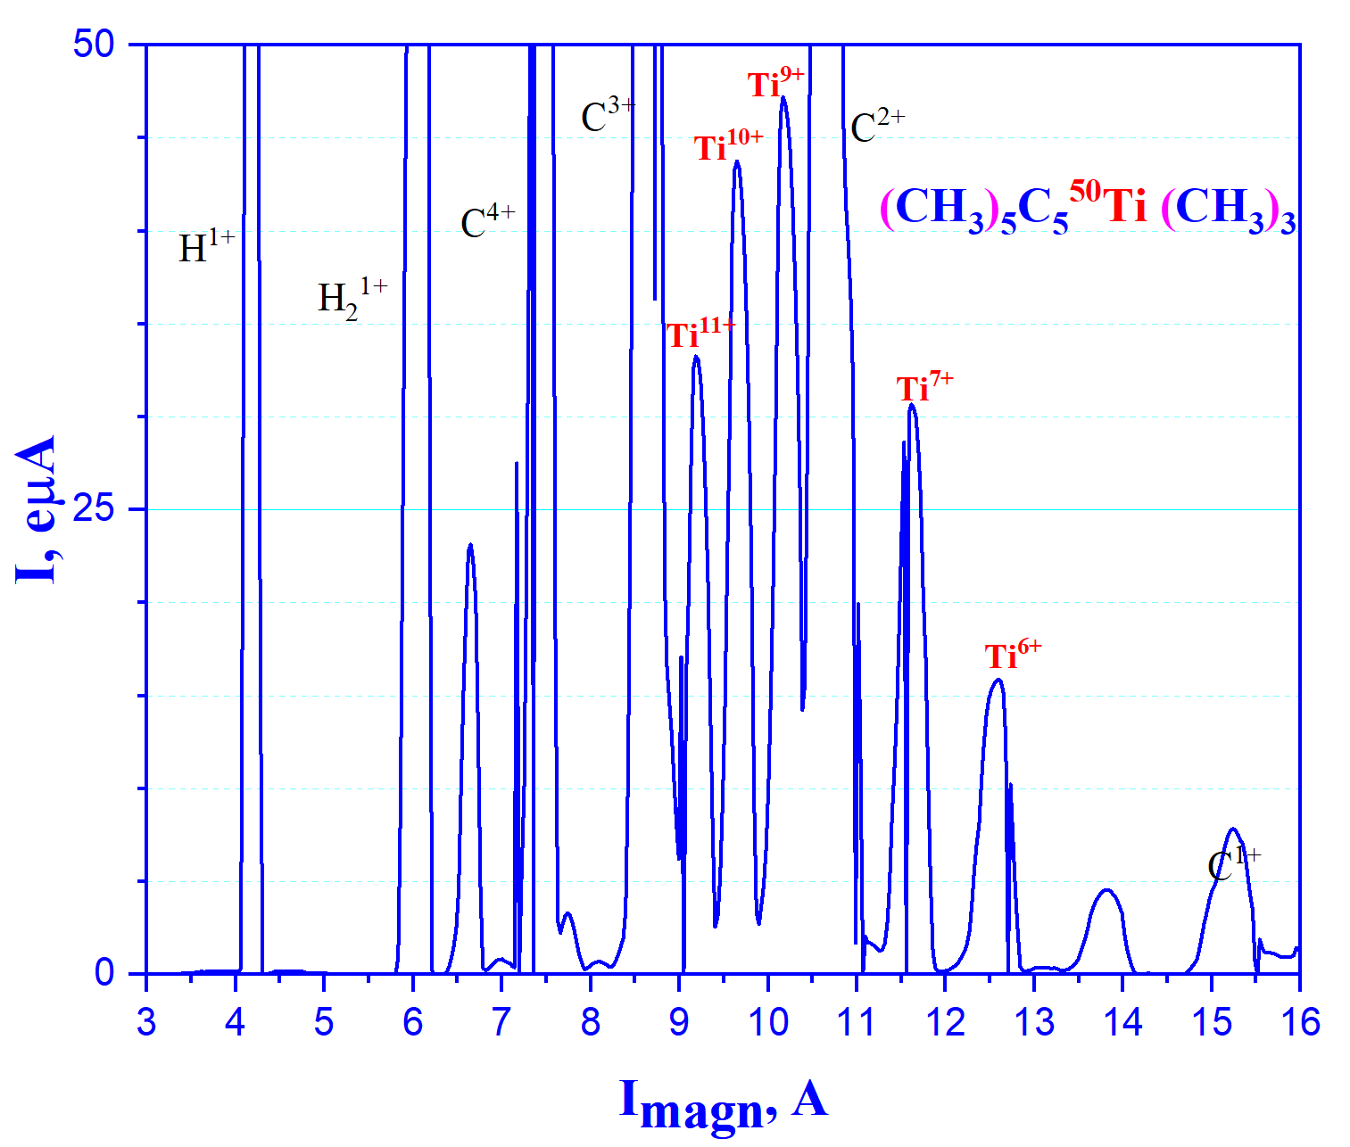
MIVOC - [⁵⁴Cr(C₅H₅)₂] and (CH₃)₅C₅⁵⁰Ti (CH₃)₃
MIVOC: DECRIS-PM 14 GHz (Cr - 0.9 mg/h)
MIVOC: DECRIS-PM 14 GHz (Ti - 0.46 mg/h)
February – March 2024, accelerated beam of ⁵⁴Cr¹⁰⁺~2.5 pµA at the target
May – June 2024, accelerated beam of
⁵⁰Ti⁹⁺ ≤ 2pµA at the target

Slide 8
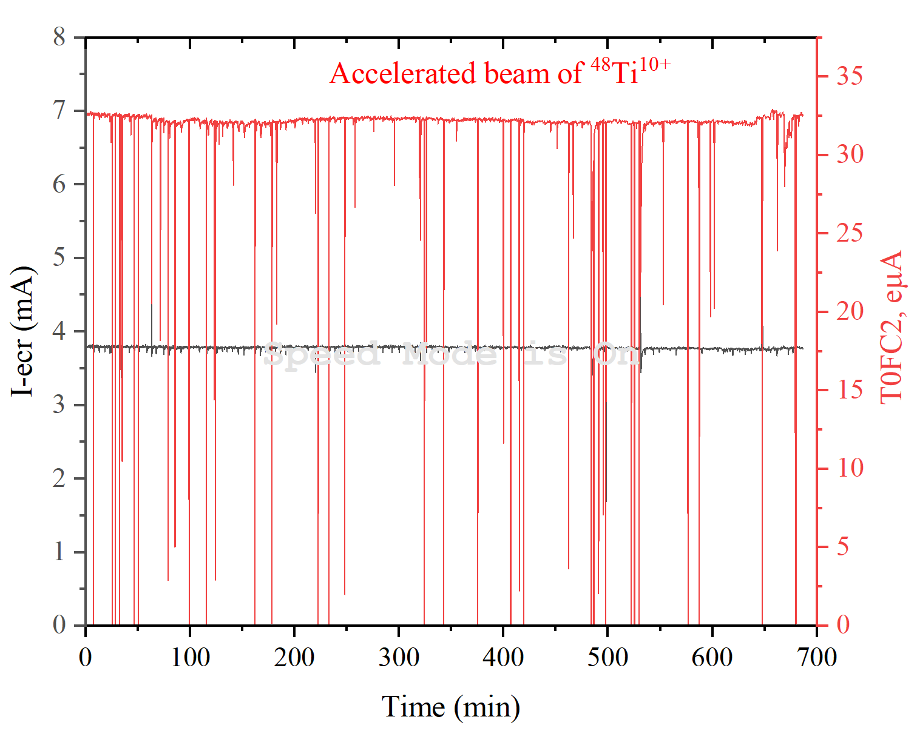

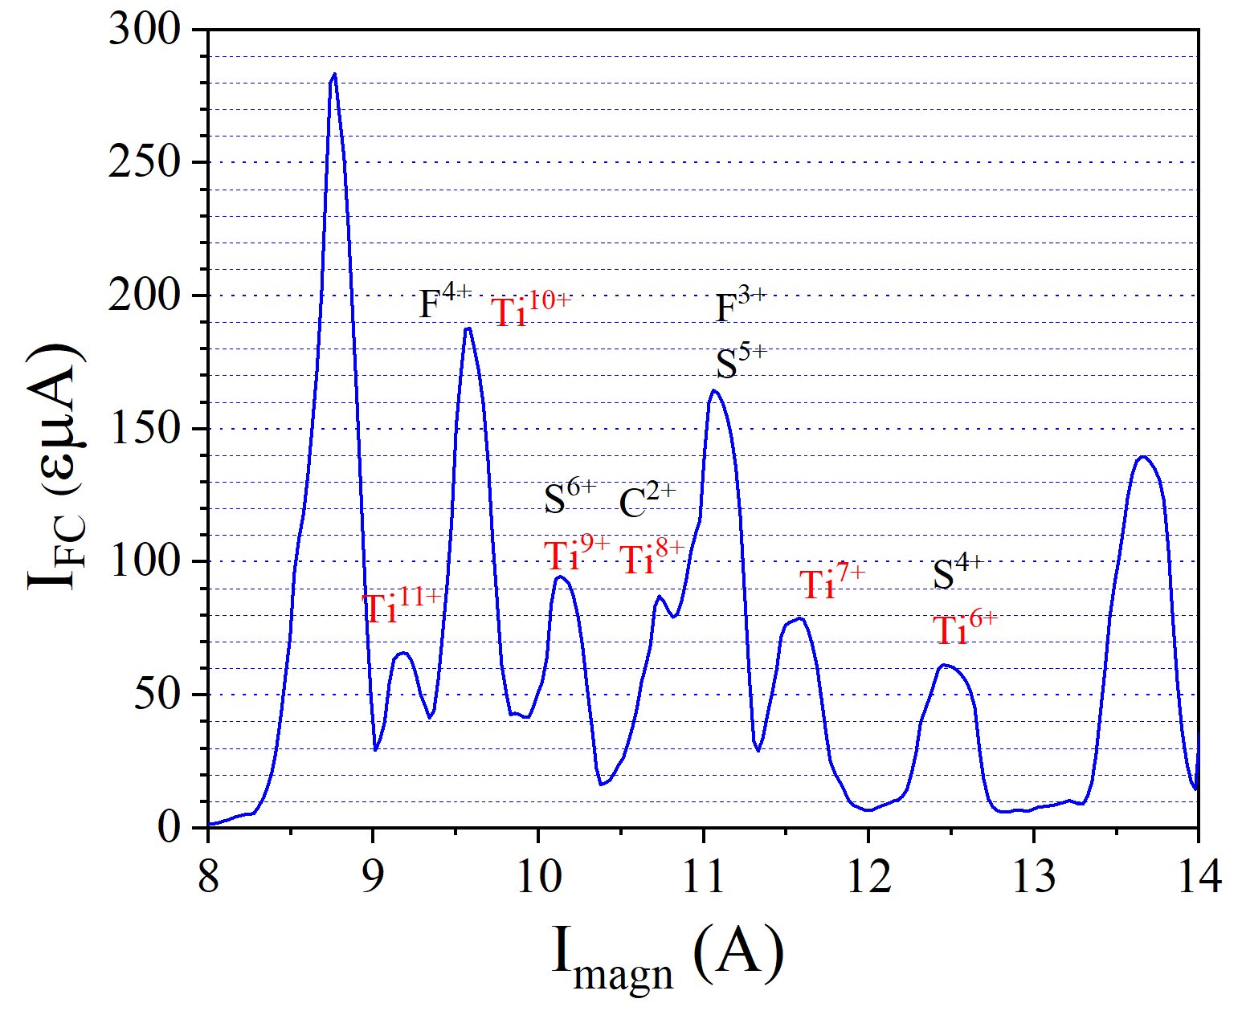
Ti ion production using SF₆ plasma
ECR ion source plasma chamber
UHF
He + SF₆
i⁴⁸Ti ion spectrum, optimized for ⁴⁸Ti¹¹⁺
Ti foil ~ 100 µm
~300 W
Ti + F TiF_{x}
Volatile compounds

Slide 9
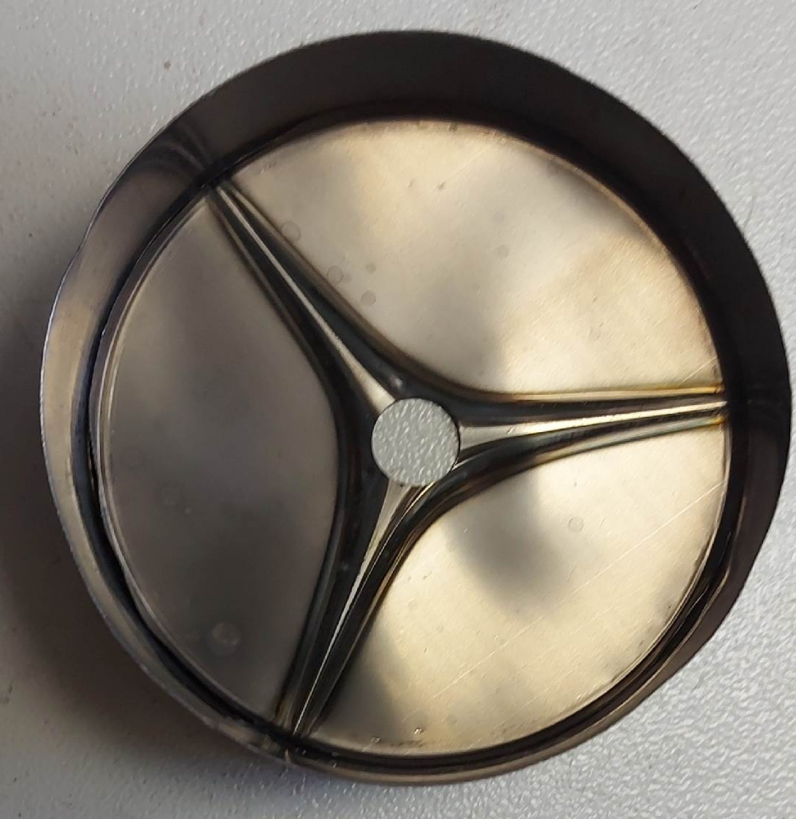
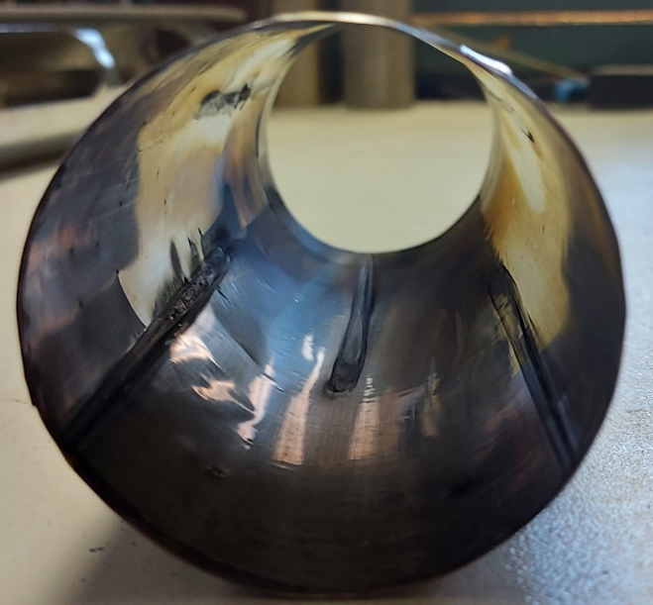
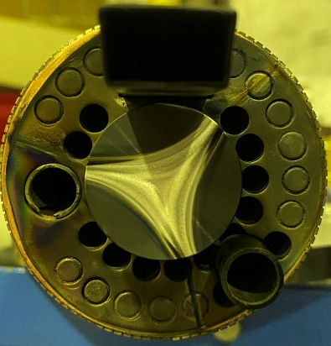
Titanium foil after operation with SF₆ plasma
1)
2)
Ø 30 mm
Ti biased-electrode
Ta screen
S_{eff} ≈ 600 mm²
S_{eff} ≈ 4500 mm²
S_{biased-electrode} = 707 mm²
S_{total} ≈ 5100 mm²
S_{total} ≈ 254 mm²
1): S_{total} ≈ 5100 mm²
Ti⁷⁺=80 eµA;
Ti¹¹⁺=70 eµA
2): S_{total} ≈ 254 mm²
Ti⁷⁺=40 eµA
Ti¹¹⁺=30 eµA
We need to find the right place and optimal surface area to ensure maximum results.
Deposition of ⁵⁰Ti on the substrate surface (?)

Slide 10
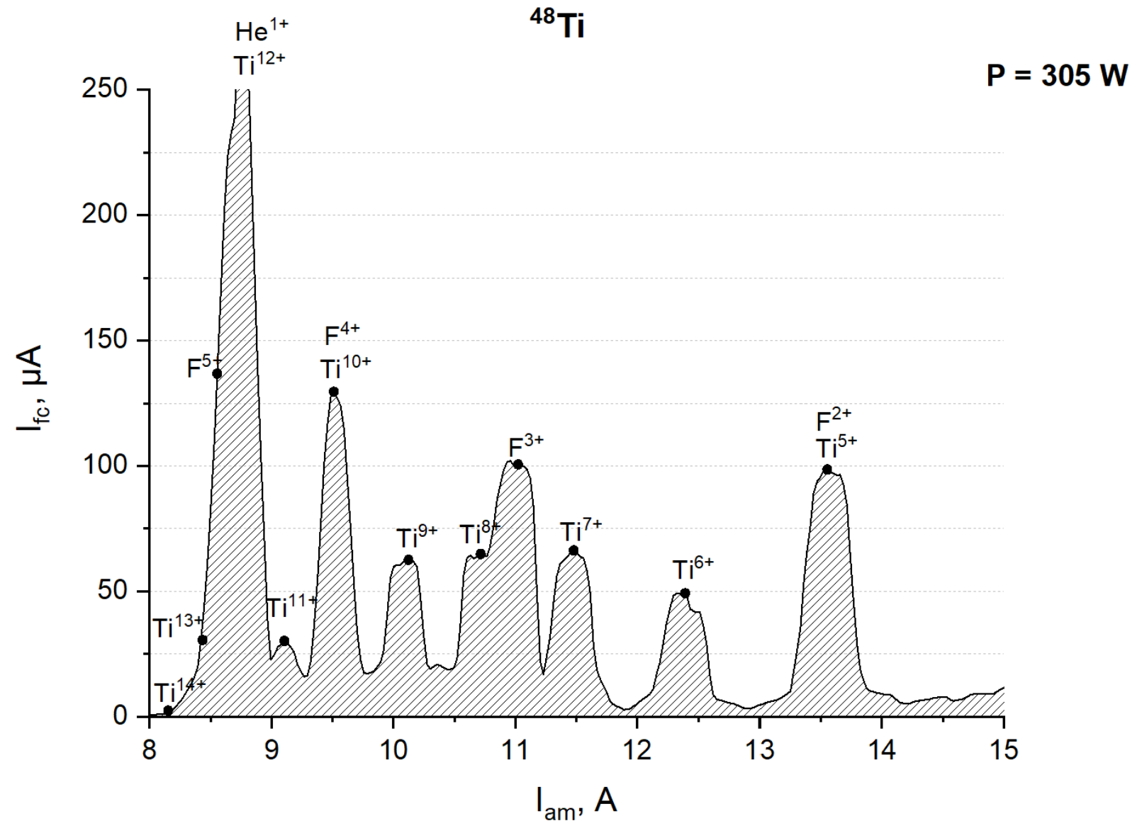
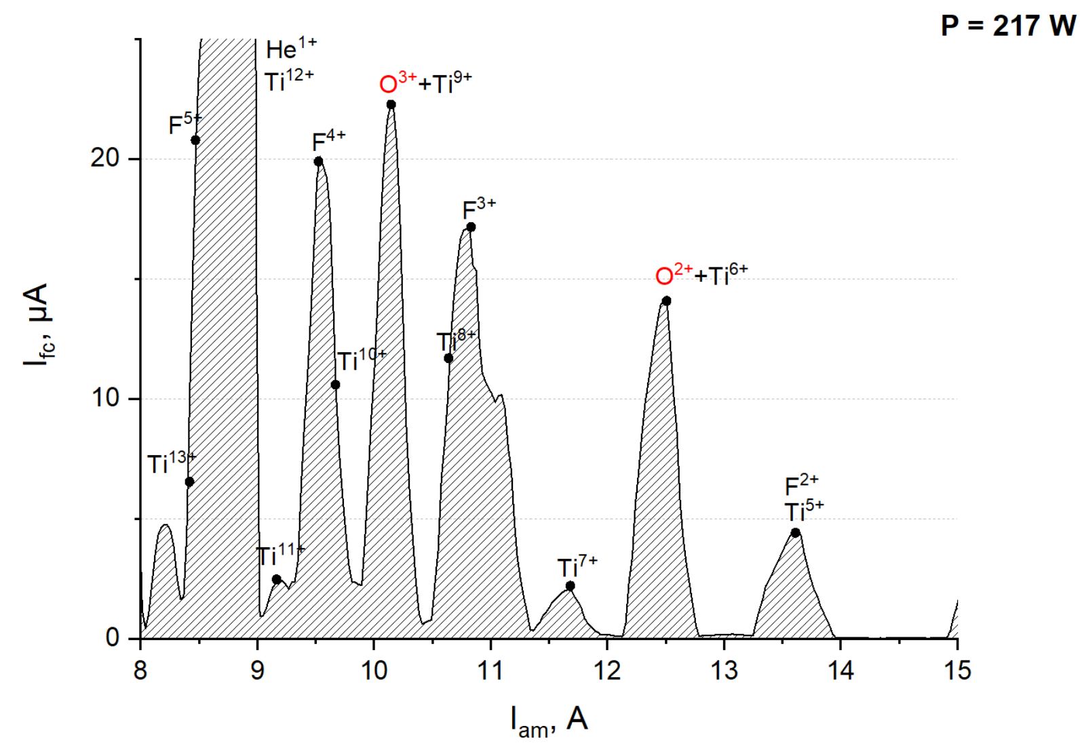
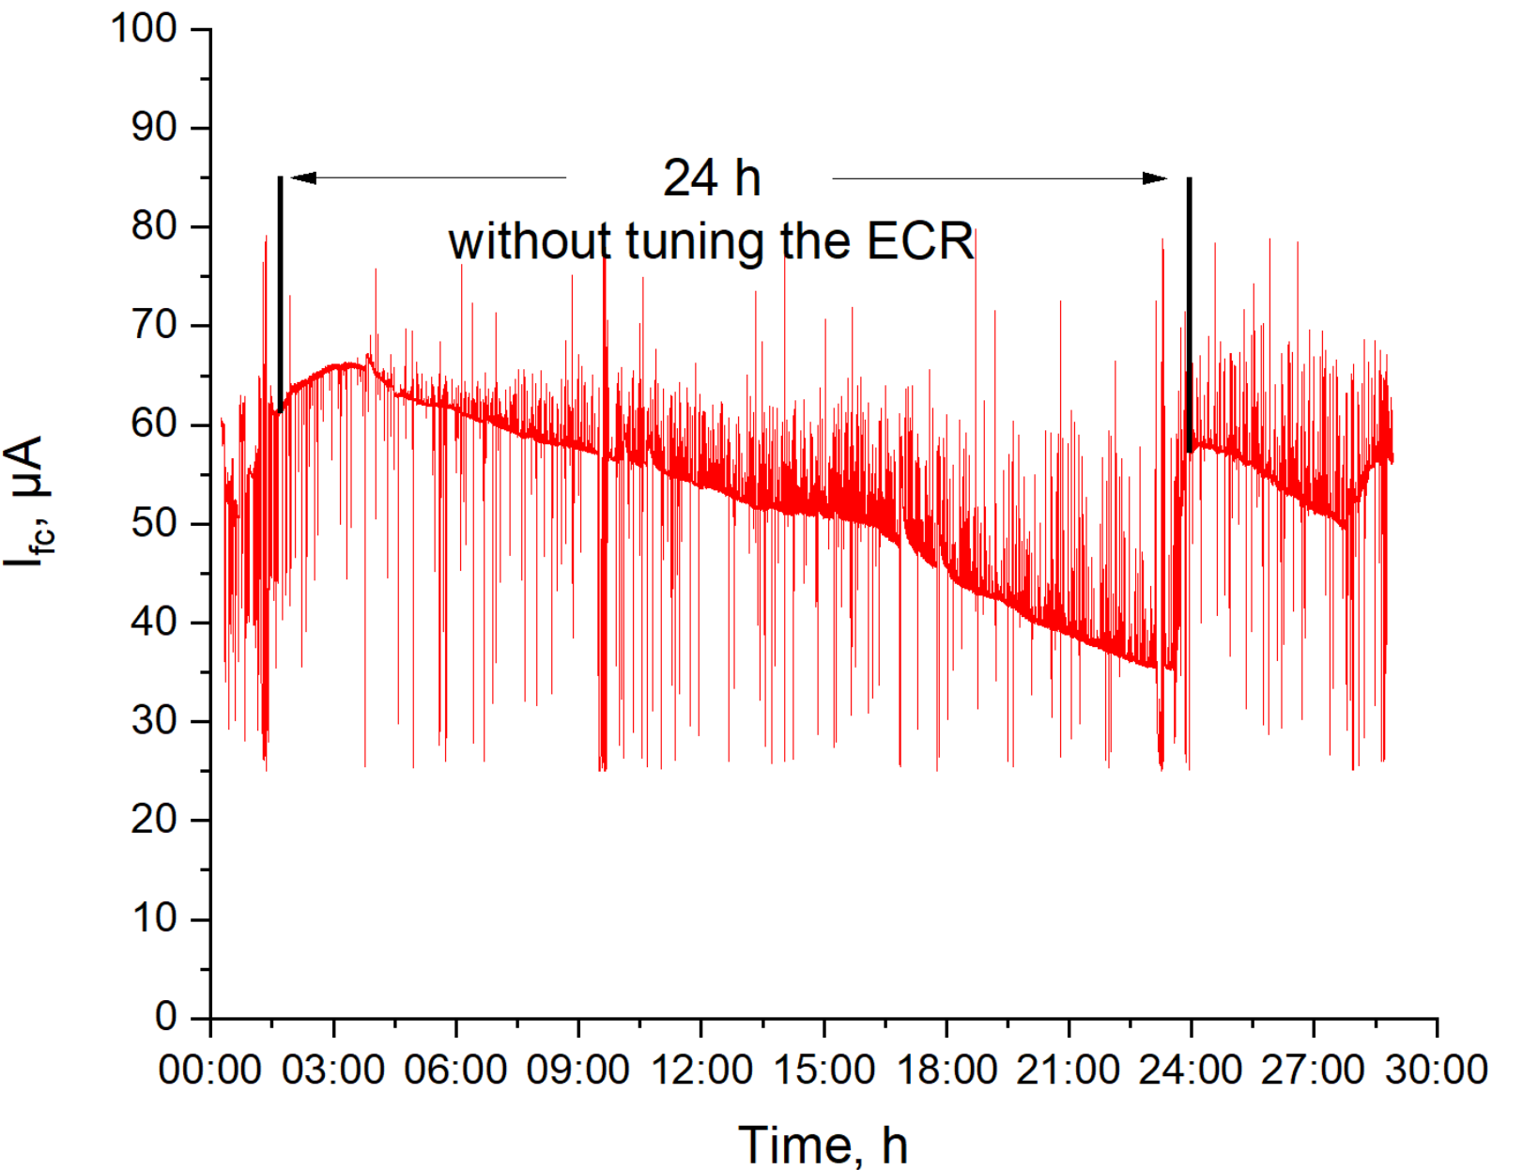
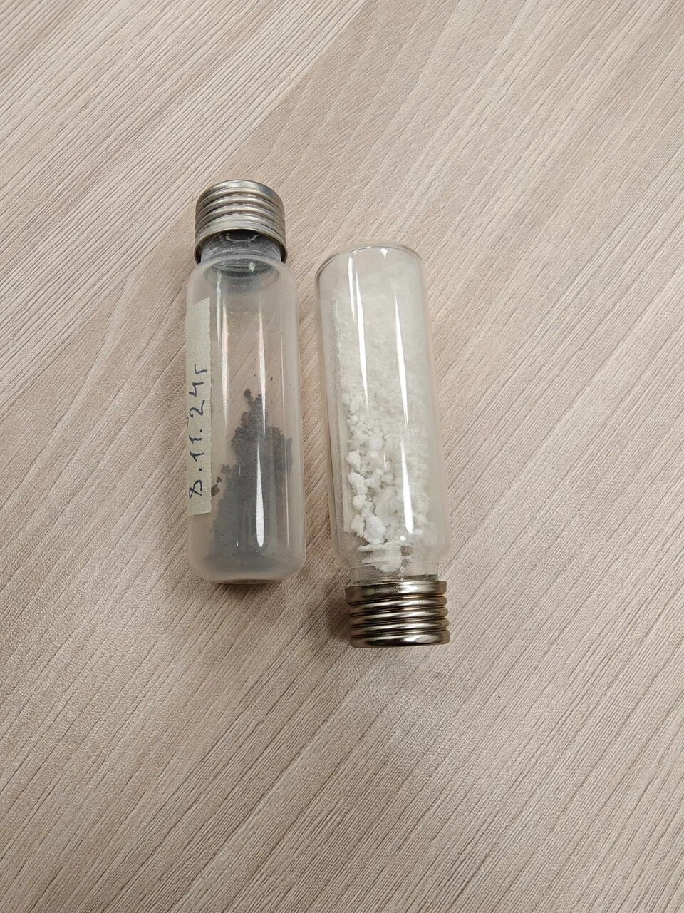
Ti ion production using TiF₄/TiF₃
TiF₄
TiF₃
TiF₃
TiF₄
⁴⁸Ti⁹⁺
Low beam intensity
Unstable operation mode
Difficult to control the evaporation
Hygroscopic
T_{evap.} ~ 288 °С.
T_{evap.} ~900 °С
does not oxidize in air
TiF₃: Av. consumption (⁴⁸Ti) = 2.5 mg/h, IE_{tot} = 4.5% (I=65mkA – Ti⁹⁺)
MIVOC: Av. consumption (Ti) = 0.5 mg/h, IE_{tot}= 11% (I=40mkA – Ti⁹⁺)

Slide 11
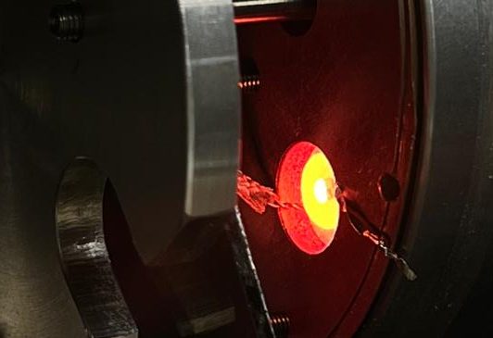
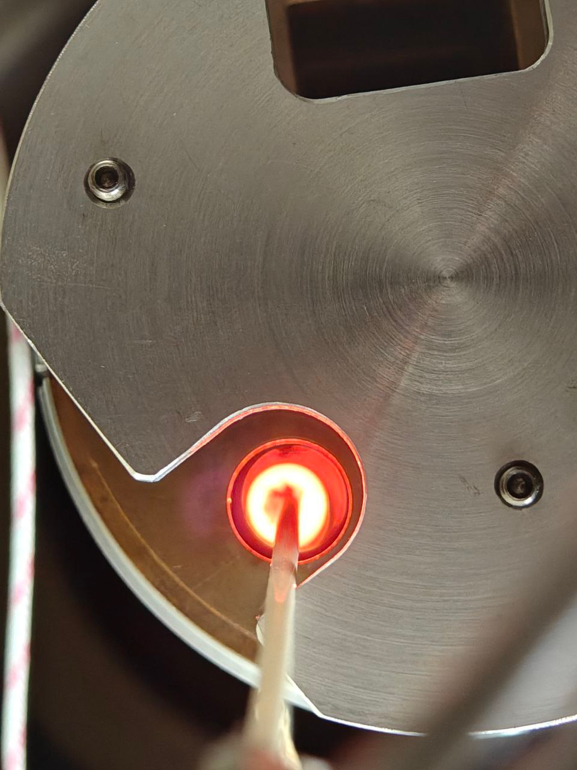
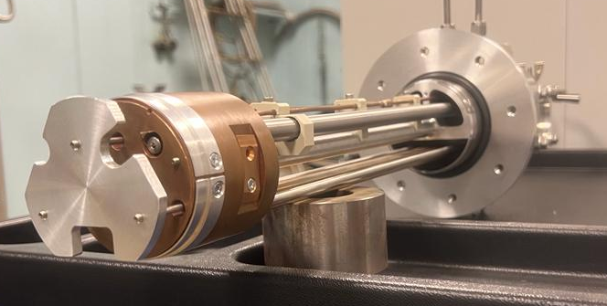
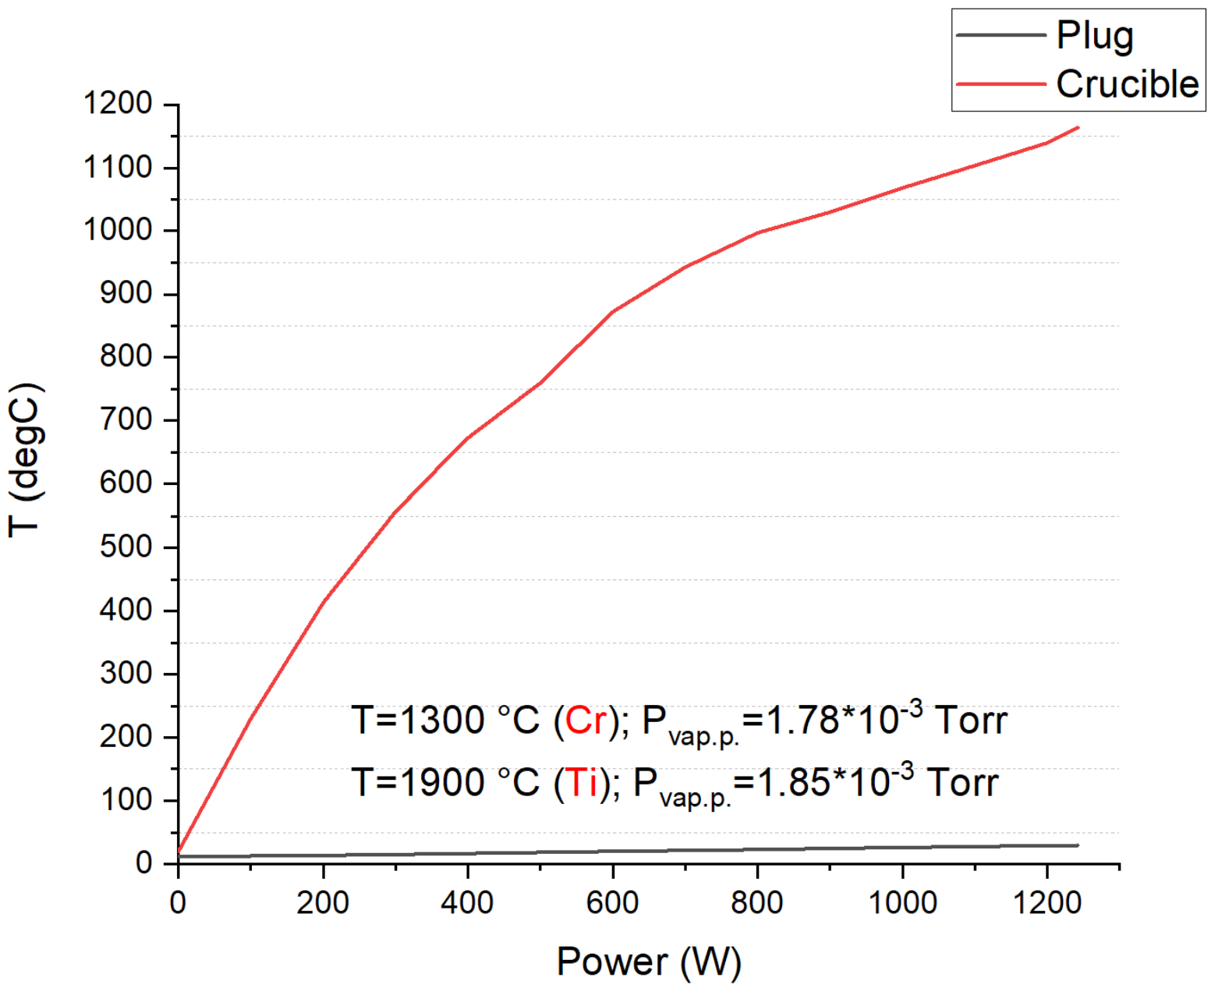
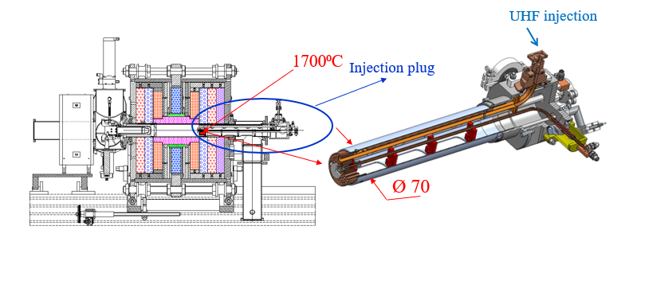
Chromium & Titanium: HT oven development
FLNR inductive oven (off-line tests)
plug
Outer surface of plug should be well cooled to avoid damage of permanent magnets!!
crucible
1300⁰С
Adaptation to DECRIS-PM

Slide 12
CONCLUSION and Plans for the Future*
Oven technique: high currents, but the consumption of material still too high. “Hot screen” is useful for calcium, but for Cr & Ti we need a rather high temperature.
MIVOC technique: good beam stability, but low current.
A lot of needless species, therefore high drain current from the source, hence poor transmission. It would be useful to eliminate at least H₂.
Non-Evaporable Getters (NEGs) pumping inside chamber?
Direct insertion technique: recently we obtain good results with Aluminum beam obtained with Al₂O₃ rod. We are waiting the titanium ceramic to try this method.
Experiments with SF₆ and TiF₃ plasma look promising.
*More questions than answers

Slide 13
Thank you for your attention!

