Slide 1
Proposal for Awarding the Title “Honorary Doctor of JINR”
Academician Grigory V. Trubnikov
137th Session of the JINR Scientific Council

Slide 2
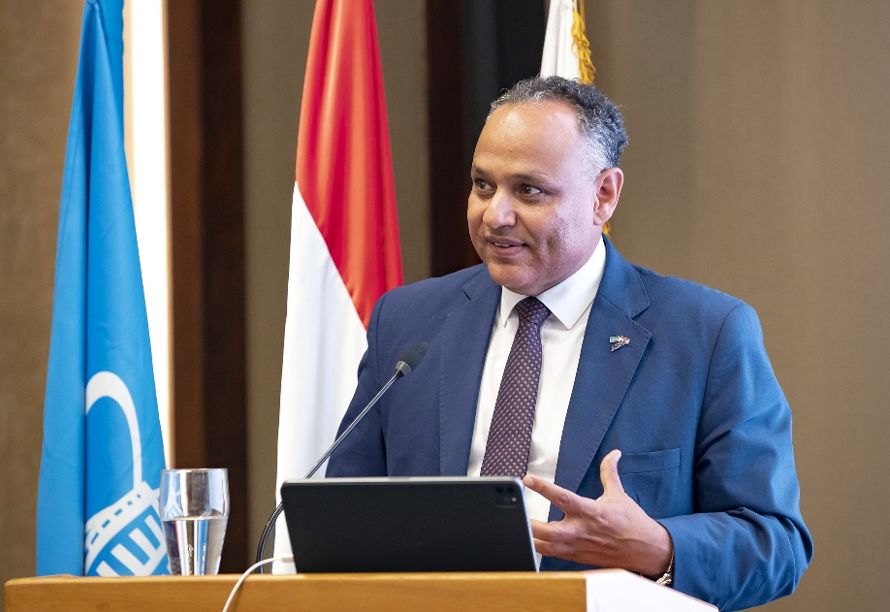
Prof. Mahmoud M. Sakr
NOMINEE
Cultural and Scientific Counsellor,
Head of Education Mission,
Education, Culture and Science Bureau, Egyptian Embassy, Tokyo, Japan
Ex-President, Academy of Scientific Research and Technology (ASRT), Egypt (2014–2024)
First Plenipotentiary of the Arab Republic of Egypt to JINR
(2021–2024)
Since the Arab Republic of Egypt became the full member of the Joint Institute for Nuclear Research in November 2021, Professor Sakr has made many efforts to strengthen scientific ties between scientists and research institutions in Egypt and JINR.
The JINR Directorate proposes to award Professor Mahmoud Sakr the title of “Honourary Doctor of JINR” for his great personal contribution to enhancing the role of the Arab Republic of Egypt in JINR’s scientific life, strengthening scientific cooperation between the Arab Republic of Egypt and JINR.
Notes:
2

Slide 3
The JINR Directorate asks the Scientific Council
to approve this proposal

