Slide 1
Introduction of Nuclear Research Centre in Huizhou, China
NICA-HIAF
JINR-IMP,CAS
DUBNA
02/07/2018
Wenlong Zhan, IMP/Chinese Academy of Sciences

Slide 2
Outline
    Overview of New Research Centre
      Motivation
      Introduction of HIAF + CIADS
      Opportunity of Research Center in Large Bay
      Further Developments Base on HIAF+CIADS
    R&D Progress
      HIRFL+CSR R&D
      ADS/ADANES
      …

Slide 3
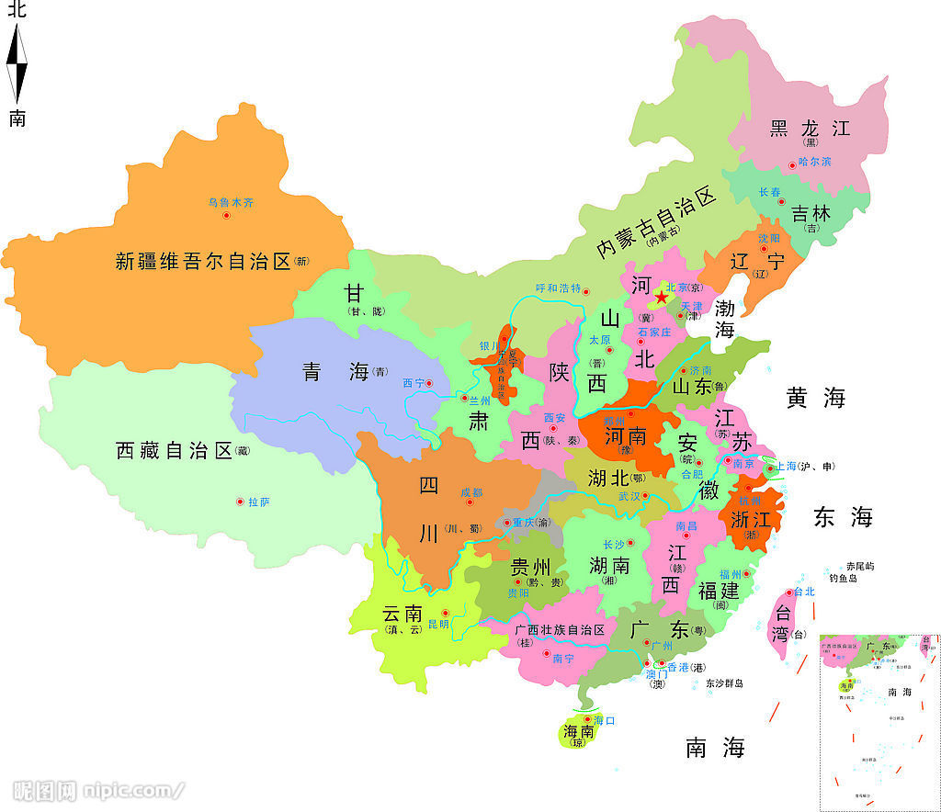
Research Center in Huizhou, China
CAS: IMP, IHEP, HIPS,USTC, UCAS, …
GNC, CNNC, Universities, Other Inst.…
Lanzhou
HIAFL+CSR
Innovation or Research Center:
1, Beijing
2, Shanghai
3, Hefei
4, Large Bay
Huizhou
CIADS+HIAF

Slide 4
Motivation (I)
National Scientific Facilities in 12-5(2011→)
Total:16
7 Fields
  Energy：2（1）
  Biology：2
  Earth & Env. ：3
  Material：3
  Space & Astr. ：2
  Part. & Nucl. ：2（1）
  Eng. & Tech. ：2
Physics & Related 7+4
International Research Facility
Field | Facility
Energy | CIADS
 | 燃气轮机科学研究设施
Biology | Transform Medical Research Infrastr.
 | 动物表型与遗传机制分析研究设施
Earth & Environment | Seabed Observatory Network
 | Atmosphere Simulator
 | Precise Gravity Research Infrastruc.
Material | R&D of High Energy SRL
 | Extreme Experiment Infrastructure
 | 2nd Phase SSRL
Space & Astronomy | Space Simulation Facility
 | Astronomy Observer in Antarctica
Particle & Nuclear | LHAASO
 | HIAF
Engineering & Technology | Future Network Research Infrastruc.
 | 大型低速风洞建设

Slide 5
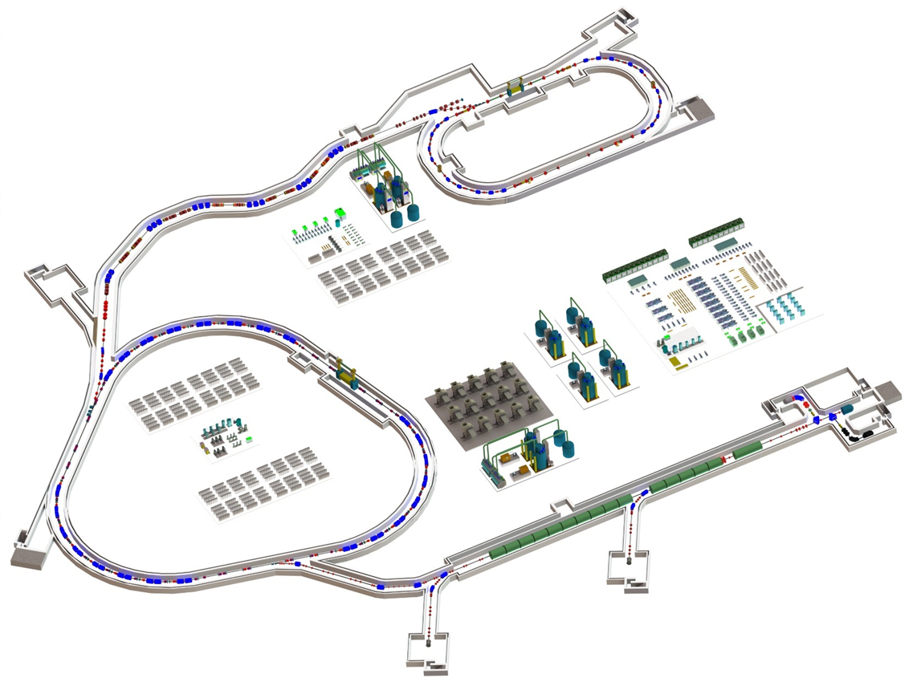
HIAF (CDR1 Approved)
E_{B1}: 0.8 AGeV, 3×10¹⁰ppp ²³⁸U³⁵⁺
1.75AGeV, 7.5×10¹⁰ppp ⁷⁸Kr¹⁹⁺
2.6AGeV, 1.0×10¹¹ppp ¹⁶O⁶⁺
HIAF-I: 2018-2024
Budget: 1.5+1.1 B CNY, approved
External target station
High Energy Density Physics
Nuclear Matter study-CEE
Hypernuclear
High energy irradiation
L: 180m, Bρ: 25 Tm
HFRS
SRing: Spectrometer ring
Circumference: 273m
Rigidity: 13-15 Tm
Electron/Stochastic cooling
Two TOF detectors
Four operation modes
BRing1: Booster ring 1
Circumference: 600 m
Rigidity: 34 Tm
Large acceptance (200/100)
Two planes painting injection
Fast ramping rate（5-10Hz）
SECRAL and FECR
28-45GHz,1.0emA(U³⁵⁺)
Low energy nuclear
structure terminal
iLinac: Superconducting linac
Length:100 m
Energy: 17~22 MeV/u(U^{35+ ~ 46+})

Slide 6
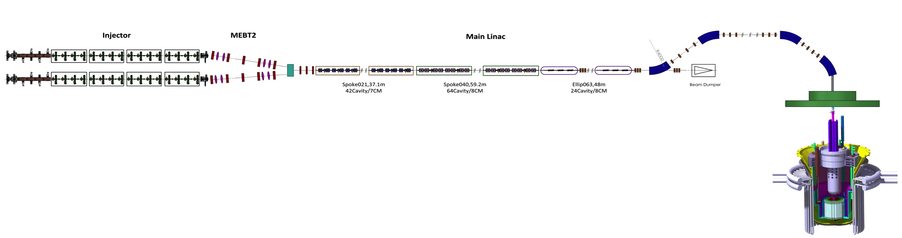
Chines Initial Accelerator Driven System (CIADS)
CIADS Main Parameters:
  High CW Power (>2.5MW, >500MeV) SC-LINAC
  High Power (>2.5MW) Spallation Target
  Sub-Core (<10MW_{th})
  Coupling all Components → Full System (~10MW)
CIADS Time Schedule :
  6 years （2018—2024）

Slide 7
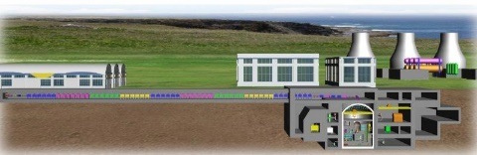
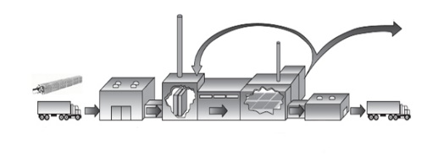
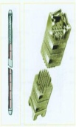
ADANES Summary
Energies 10(7);944 July 2017
Accelerator Driven Burner（CIADS→ADB）
Transmutation + Breeding + Generation Burning
1，AD Starter + Long Refueling (16~36y) FR
2，Burning ~50% FP Recycle UNF (Raw Fuel)
Feature：Low Carbon→Clean
Fuel Close within Station
Resource Utilizing>95%→10000y，“Waste”<FP(4%) & <500y
Electricity
ADB
ADANES
ADRUF
AD Recycle Used Fuel （ADRUF）
AD Simplify Process → Removing >50% FP (<4%UNF)，Converting as Recycle UF（Dry, Less Contamination）
1，Dry Process(Gas + Volatile + Separate + Extracting）
2，HT, Long Live Fuel Device + Core Component
3，Irradiating Setup for Recycle UF, Core Components
SNF Etc.
AD + Ceramic Reactor HT→ Coherence Safety
Low Dose, Heat Waste → Dry Storage
Higher Cost Effective
Anti-Proliferation in Principle
<“Waste”:
Gas + Volatile FP
+RE FP

Slide 8


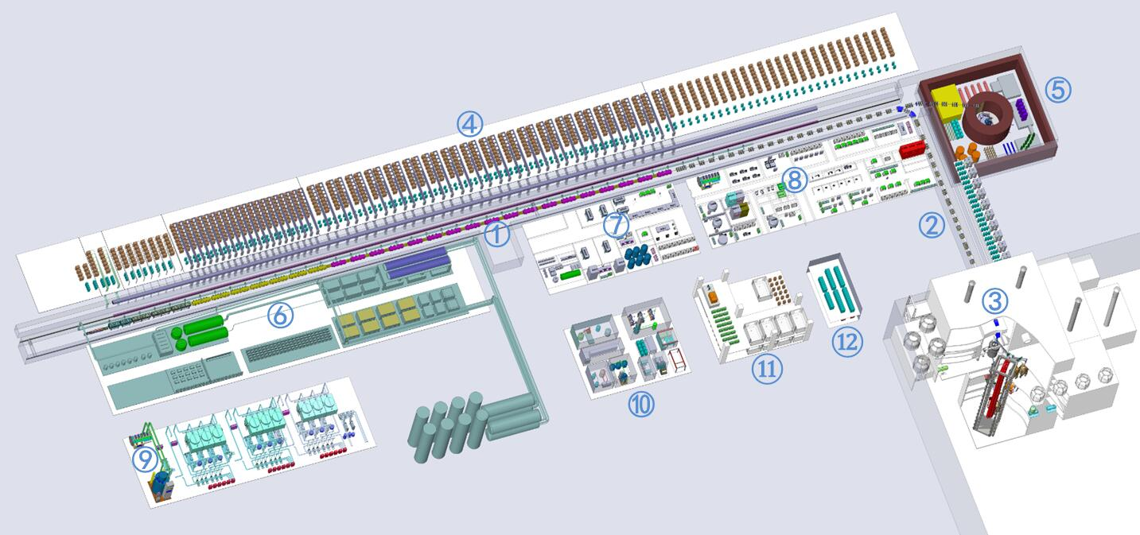
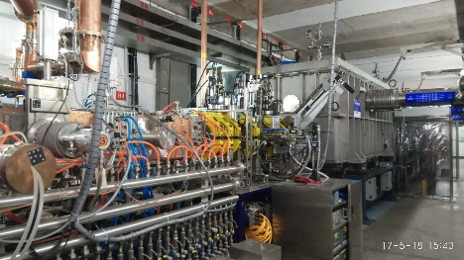


ADS/ADANES Roadmap in China
>￥1.8 B
-II→ CIADS
2018--2024
Phase IV
￥1.78 B
Phase I
2011--2017
Phase III
~2024
$\sim$1MW Close
Fuel Recycle
Inject I
Inject II
10 MeV
>10 MW_{t}
>600 MW_{t}
~1.5 GW_{t}
2014
~2.5 MeV
&10mA
2016
~25 MeV
&~10mA
2024
400~600 MeV
$\&$>5mA
<2032
~1.0 GeV
&10~15mA
~203x
~2×1.0 GeV
&10~20mA
Key Tech. R&D : Acc., Target, Blanket… Prototype
Initial Facility
Demo. Facility
Indust. Facility

Slide 9
Nuclear Research Center in Huizhou (New Site)
Researches on Intense Beam at CIADS+HIAF
Nuclear Physics
  Nuclear Structure & Nuclear Astrophysics
  Nuclear Matter, Hadron Nuclear Physics
Foundation Physics
  Ultra-high E_Field QED, HEDM
  π, μ, κ meson rare decay, reaction with nucleon, neutrino, Potential：EIcC-1,...
Nuclear Energy
  CIADS → ADANES Burner
Nuclear Fuel Research base on Accelerator
  High Flux Neutron Source (~14MeV 10¹⁶n/cm².s, >60dpa)
  Intensive Ion Irradiation
  V. Convert UNF → Recycle Fuel

Slide 10
Opportunity of Research Center in Large Bay
Genome Bank
Daya Bay (Neutrino Measurement θ₁₃)
Super-Computer (TianHe-2)
Chinese Spallation Neutron Source
JUNO (On Going)
Heavy Ion Accelerator Facility (Start before end of 2017)
Chinese Integrate Accelerator Driven System (same above)
Light Source (proposing by local gov.)
Gravitation Research Facility (proposing by Univ. Zhongshan and Supporting by Shenzhen Local Gov.)
Nuclear Fuel Research Facility
….

Slide 11
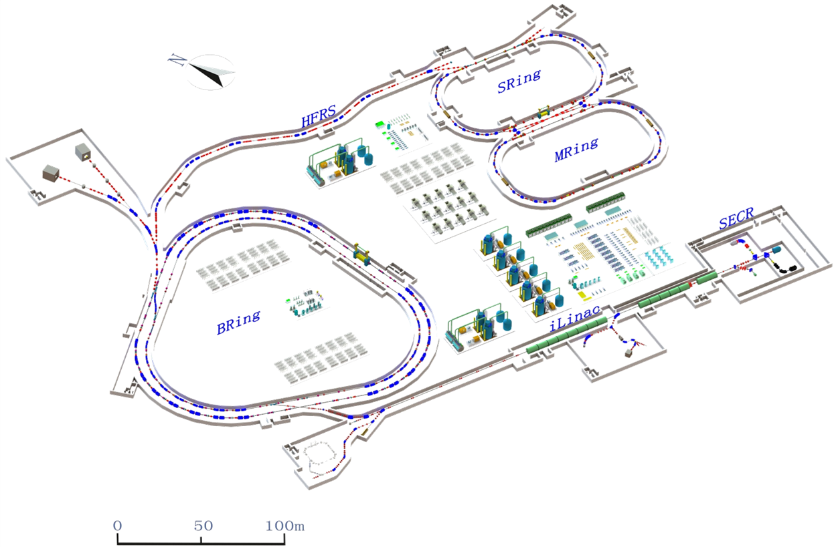
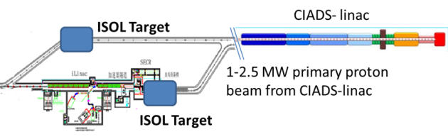
HIAF-CIADS Upgrade
E_{B2}: >9AGeV, 1×10¹²ppp U⁹²⁺
~10GeV, >1×10¹³ppp Xe⁵⁴⁺ ~12AGeV, >5×10¹³ppp He²⁺
~24.8GeV, >1×10¹⁴ ppp H
HIAF-U
5, + Polarized e, h beam and inject to Figure “8” ring → EIcC-1
4, Pion, Muon…2nd beam by Intense ion beam
2, MRing: Figure “8” ring
Circumference: 273m
Rigidity: 15→25 Tm
Ion-ion merging
1, BRing2: Booster ring 2
Circumference: 600 m
Rigidity: 86 Tm
Beam stacking
Superconducting
1, iLinac: Superconducting linac
Energy: 100~150 MeV/u(U^{35+ ~ 46+})
3, ISOL machine
HIAF+CIADS linac

Slide 12
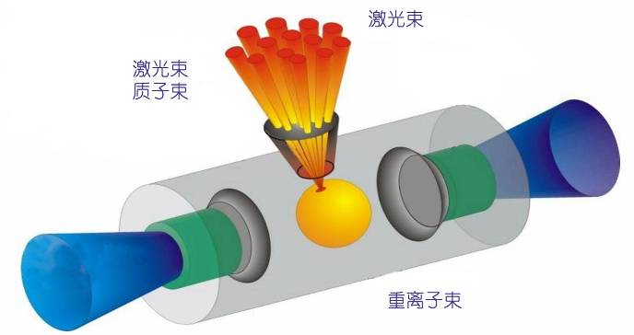
1, Higher Intense Ion Beam of HIAF
Higher ions inside of Ring (4D painting gain >150):
  Higher HI-SCL energy & Intensity → higher injection energy, eff. & reducing spacing-charge
  HI-RCS + BRing2 → higher storage, charge stripping eff. of DC inject to ring and higher energy (34Tm→86Tm) of system
Improvements:
  Luminosity on (internal) target exp.
  2nd beam Intensity
    RIB
    Meson beam…
  HEDM (>100kJ/ppp)
…
Pulse Electron
Laser / Deuteron
HI Beam

Slide 13
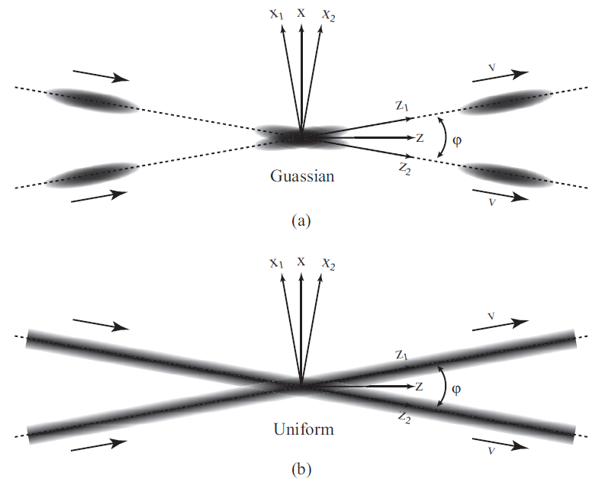
2, Merging Beam High Accuracy Experiment
Complete the Figure 8 ring and provide merging exp.
Researches
  RIB, HI direct reaction:
    E_{cm} < 10MeV/u
    Luminosity: <10^{24~29}/cm².s
  QED Validation under Ultra-high E-field:
    a, Vacuum Excitation e-pair;
    b, Super-Critical Atom
    U⁹²⁺ + U⁹²⁺ → Ec > 2*10¹⁶ V/cm
    Collision Time >10^{-21~-19} sec.
    E_{cm} 5~8 MeV/u (R_{min}~30fm) could be tuned by changing E_{lab} of U
    Luminosity：~10^{~26}/cm².sec

Slide 14
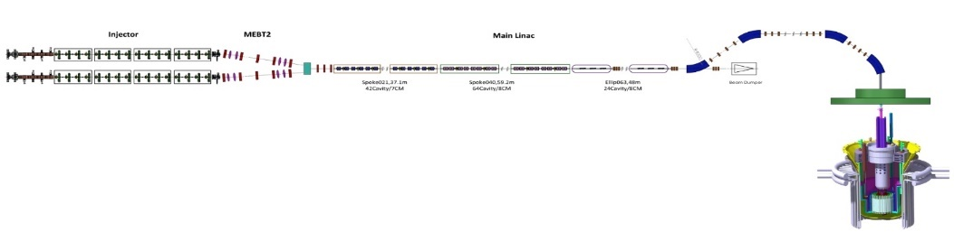
3, Integration of HIAF + CIADS
HIAF+CIADS(ADANES) → >2.5(10s’)MW ISOL Target, RIB by Extracting RI (ex. Kr, Xe) from CIADS’s Target and Inject to HIAF Complex

Slide 15
4, 2nd Meson’s and anti-Proton Beams (Intensity Frontier)
2nd DC μ Beam driven by intense proton of CIADS
  “ISOL” Type (surface muon), 1.0~1.5GeV&10mA→10^{~12}/s μ⁺ (>10 time than existing Setups)
  Research Topics:
    μ⁺ → e⁺γ (◊10^{−15∼−16}), μ⁺ g-2, ...
    Application: μSR, tomography, condense matter, …
2nd Pulse Beams (>3GeV/c π, μ, k) from HI-BRing2 of HIAF
  “In Flight” ~10^{10~9}/ppp 2nd Beam/Inject into Ring (100*μ Campus)
  Research Topics:
    Mu2e, μ g-2, …
    Neutrino: υ_{μ} oscillation, precise measurement…
    κ Rare Decay, nuclei EDM,…
    large scale tomography…
2nd Pulse anti-Proton Driven by 86 Tm Intense proton / Hi ?
μ⁺ only
μ⁺ only
π◊μ
proton
Surface μ+

Slide 16
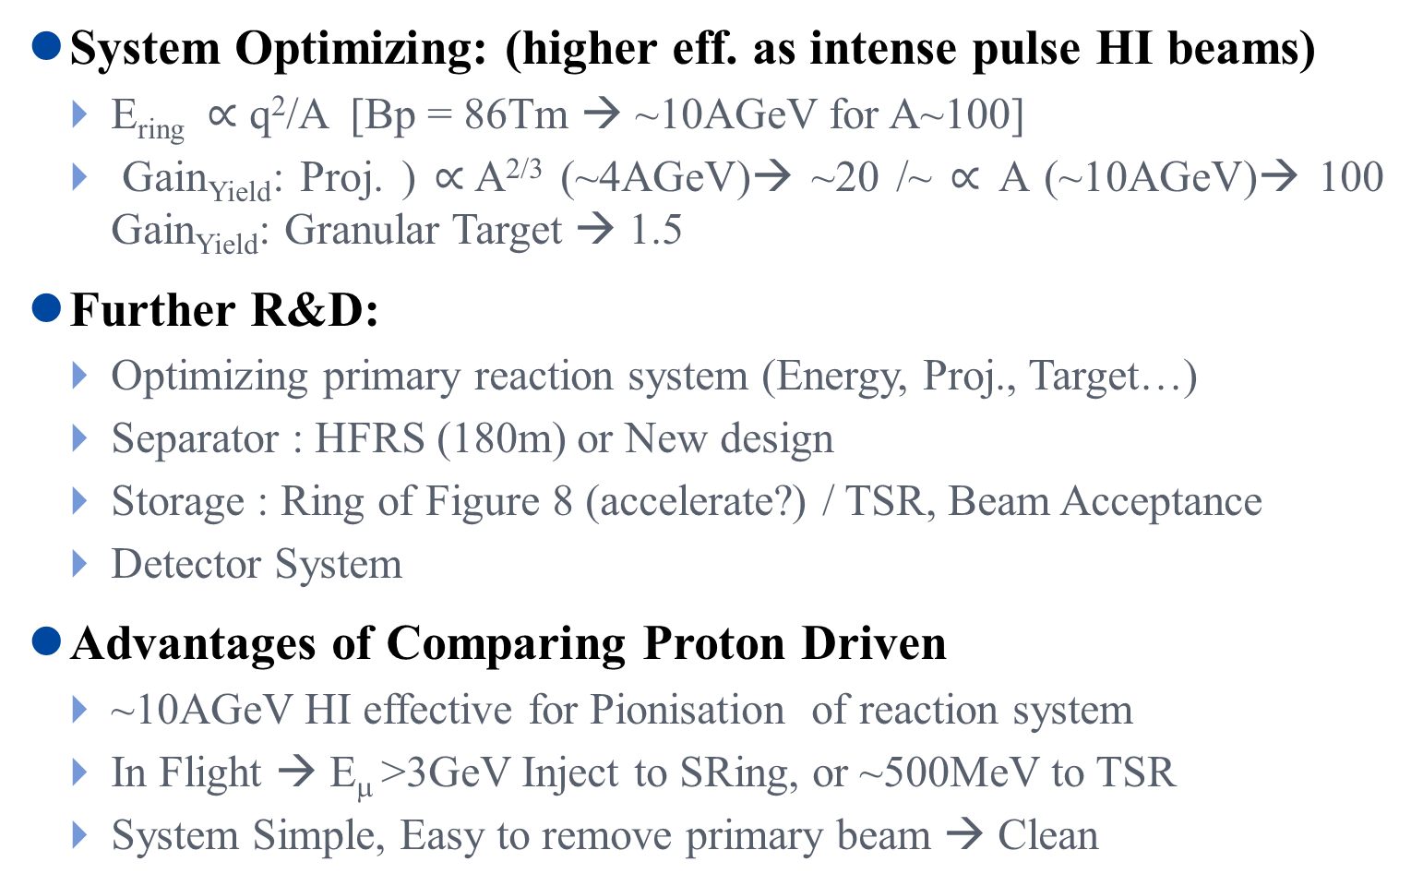
4, 2nd Muon (& Neutrino) Driven by HI (Heavy Ion)
System Optimizing: (higher eff. as intense pulse HI beams)
  E_{ring} $∝$ q²/A [Bp = 86Tm → ~10AGeV for A~100]
  Gain_{Yield}: Proj. ) $∝$A^{2/3} (~4AGeV)→ ~20 /~ $∝$ A (~10AGeV)→ 100 Gain_{Yield}: Granular Target → 1.5
Further R&D:
  Optimizing primary reaction system (Energy, Proj., Target…)
  Separator : HFRS (180m) or New design
  Storage : Ring of Figure 8 (accelerate?) / TSR, Beam Acceptance
  Detector System
Advantages of Comparing Proton Driven
  ~10AGeV HI effective for Pionisation of reaction system
  In Flight → E_{μ} >3GeV Inject to SRing, or ~500MeV to TSR
  System Simple, Easy to remove primary beam → Clean

Slide 17
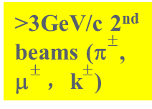

Dream: In-Flight Muon Beam → Muon Factory
π$±$converted to μ$±$after few turn
>3GeV/c 2nd beams (π$±$, μ$±$，k$±$)
~10AGeV/c 10¹²~¹⁴ppp HI-Beam on target

Slide 18
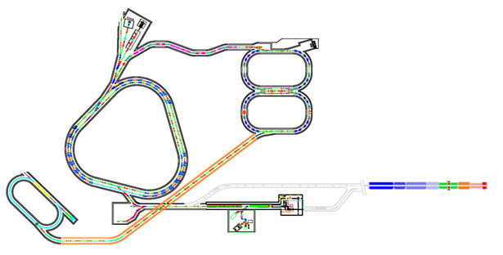
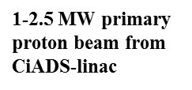
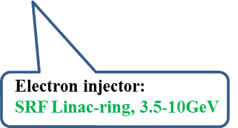
5, HIAF- EicC-I (Cover Sea Quark)
HIAF-EicC-I : 2027-2032
L: 1 x10³³cm⁻²s⁻¹
p/e, polarized
EicC-I
SRing
BRing2
Update to 45 Tm
p: 12.5GeV
3-5 GeV/A
C: 600 m
MRing
eRing
BRing1
e: 3-5 GeV
1-3 GeV/A
C: 600 m
HIAF-II
iLinac
200 MeV/A
ISOL machine
HIAF+CIADS linac
HIAF-I
A working group for EIC was established
at IMP led by Dr. Nu Xu and Jianping Chen.

Slide 19
Nuclear Fuel Research Facility
ECR
LEBT
MEBT
RFQ
CM1 + …… + CMn
Granular Target
Neutron Flux: >10¹⁶/cm².s &>60dpa/yr
Irradiating
chamber
~300MeV &30nC e /pp quasi-on line measure
Main Goals
1, Fission Fuel & Recycle Fuel Verified
  Fuel Devices Test
  Recycle Fuel Transmutation, Breeding rate …
2, Fusion Fuel Sustainable: Li(14MeV n, T)⁴He
3, Irradiation of Materials (Filtered by Ion beam, final, by Neutron )
  Cladding（SiC_{f}/SiC…）
  Core Structure、Window (Oxide + Carbide Ceramics…)
Main Facilities
1，High Flux Neutron Source (Similar as Fusion Neutron Spectrum)
2，Intense light Ion Accelerator (~1dpa/d → >80MeV&1mA He)
3，Short Pulse Electron Quasi-online Imaging (~300MeV&30nC <1ns)
4, Associate Test Bench with hot cell

Slide 20
Research Capabilities at New Center
Feature:
  Multidisciplinary Research Complexes (CIADS+HIAF-U)
  Integration of CIADS+HIAF-U
  Intense Primary Ion Beam & 2nd Beams
  Highest Spallation Neutron
 | HIAF⁺ + CIADS (~2025) | HIAF-U + ADANES (<2032)
HI | <1000 MeV/A <10^{10~12}pps | Heavy species close to 9~12AGeV, 10¹³pps(<U)
Proton | ~500MeV&5mA ~10GeV/C&10^{~13}ppp | <1.5GeV&10mA ~25GeV/C&10^{~14}ppp
RIB | In Flight + ISOL? | In Flight +ISOL
Spallation Neutron &Flux | >2.5MW&10^{14~15} n/cm².sec | >10MW&10^{15~16} n/cm².sec
2nd Meson beam | ? | π, μ, κ...
EIC | Polarized Proton Booster, ERL R&D | ???

Slide 21
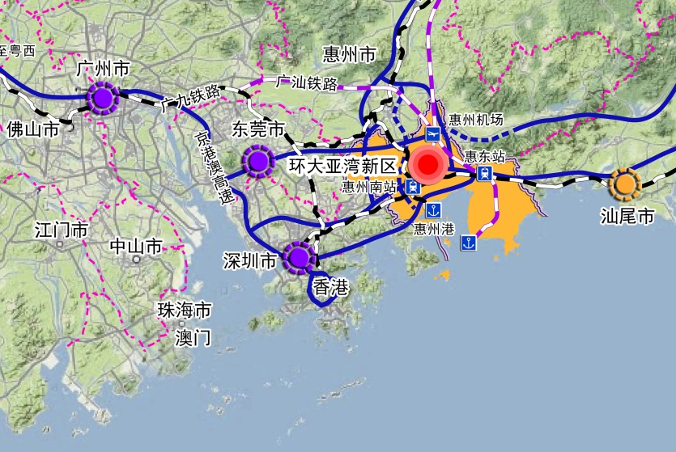
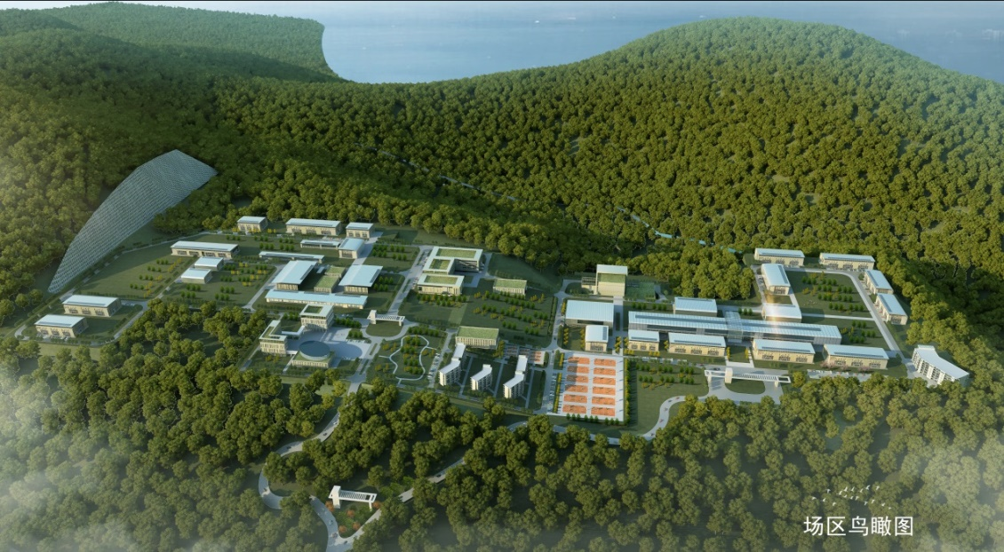
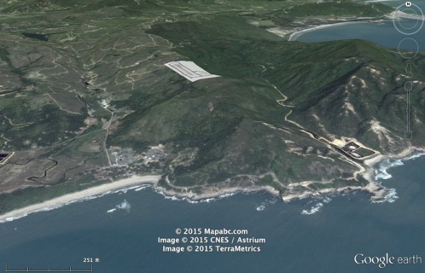
ADANES Sites（Huizhou, Guangdong）
Pre-Civil Infrastructure Started 2017
Projects Starting in mid of 2018
项目厂址

Slide 22
Outline
    Overview of New Research Center
      Motivation
      Introduction of HIAF + CIADS
      Opportunity of Research Center in Large Bay
      Further Developments of HIAF+CIADS
    R&D Progress
      HIRFL+CSR R&D
      ADS/ADANES
      …

Slide 23
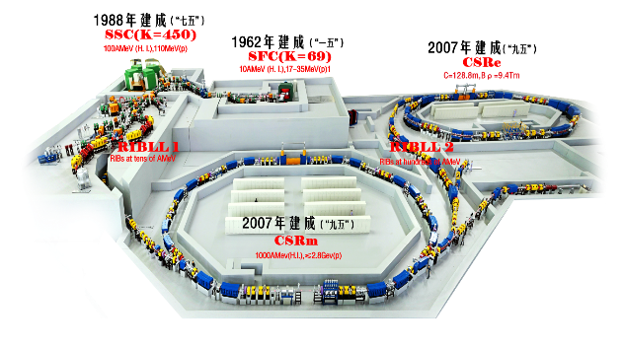
HIAF R&D (Detail Presentation by other talks )
Ion Source → LEAF
SC-LINAC→ ADS Key Tech. R&D
Synchrotron → HIRFL-CSR, Cancer Therapy
E-Cooling → HIRFL-CSR, Pulsed electron cooling R&D
Experiment Setup→
  HIRFL-CSR
  BEPC
  RHIC-STAR
  Dark Matter Satellite

Slide 24
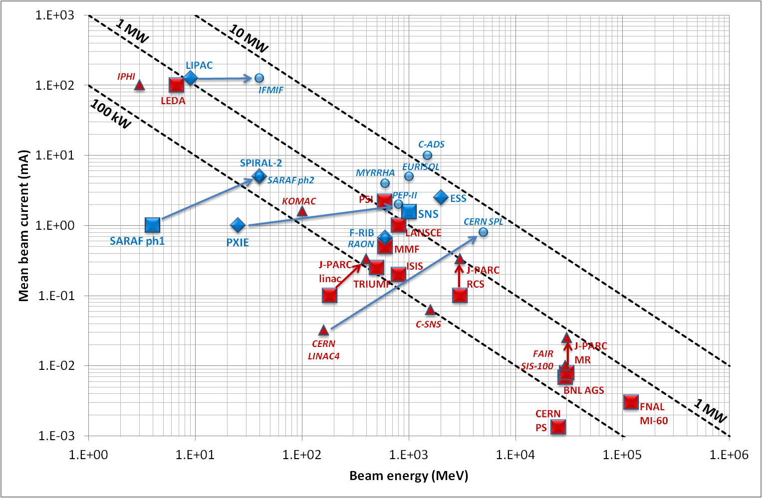
Challenge of SCL for CIADS/ADANES
Scale
  Transmutation Demo
  Industrial transmutation
  Industrial Power Generation (IPG)
Mean Beam Power (IPG) : 10~20MW
  Energy : ~1GeV
  Mean current : 10~20mA
Beam Strips & Availability（IPG）
ADANES Burner
.
t < 1 sec. | 1 < t < 10 sec. | 10s < t <5 min. | t > 5min. | Availability
< 25000/yr. | < 2500 / yr. | < 250 / yr. | < 3 / yr. | > 85%

Slide 25

Principle of Granular Fluid Spallation Target
Granular Fluid by Gravity
Granular fluid operate stable as sand clock
Target heat removing off line and grain update on line simply
Higher target power capacity: 10~100 MW
Dissipation the shock wave induced by beam trip, and relieve short beam trip (<10s) requirement of system
Useful for 2nd beam
Dust handling require
High cost effective
Inject
Inject
Ball
Beam Pipe
Spallation neutron
Outlet
Science China
Tech. Sci. 58(10)
July 2015

Slide 26
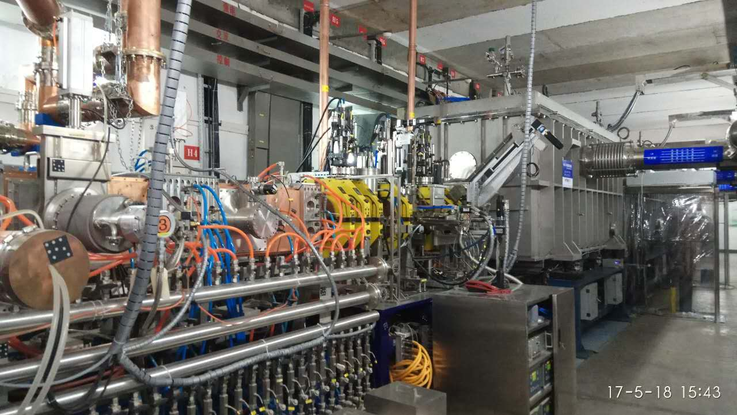
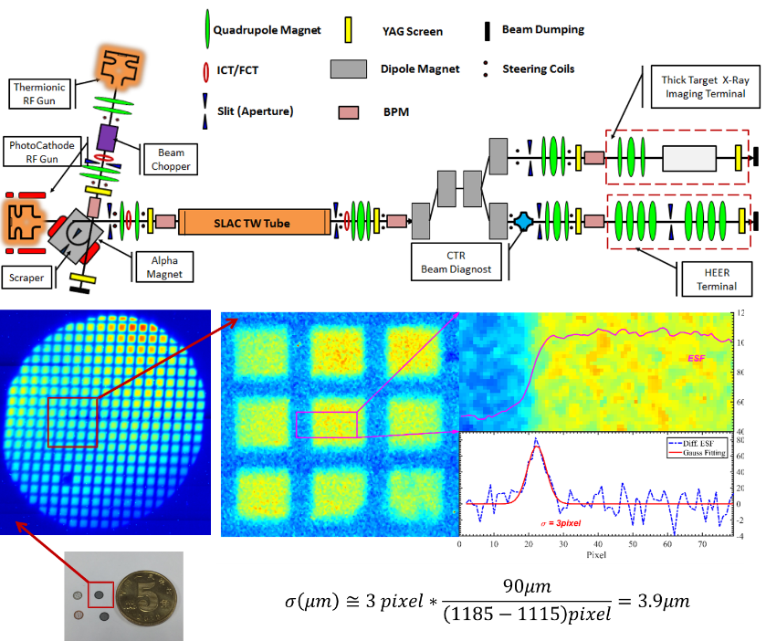
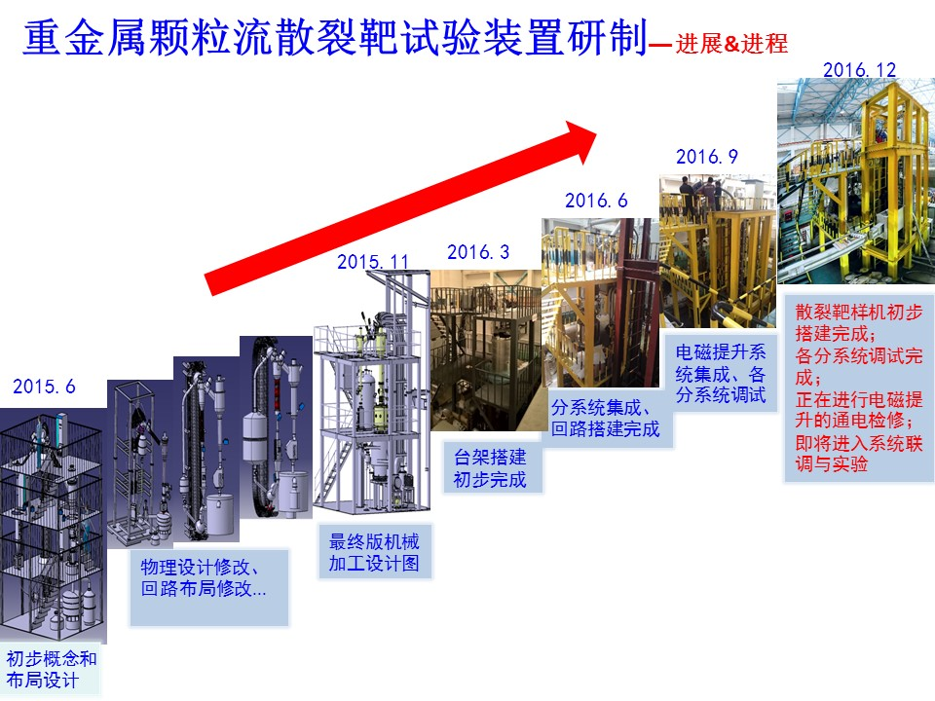
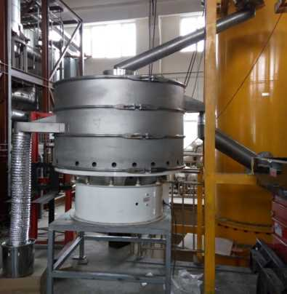
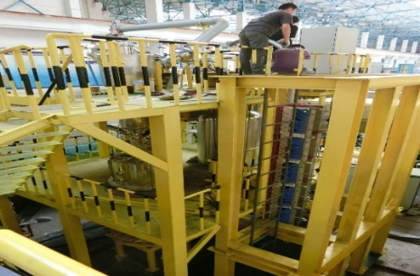
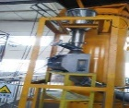
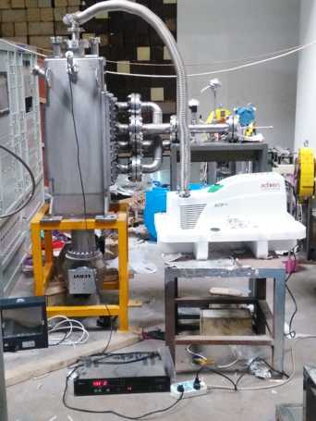
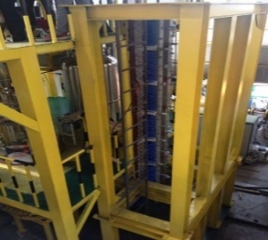
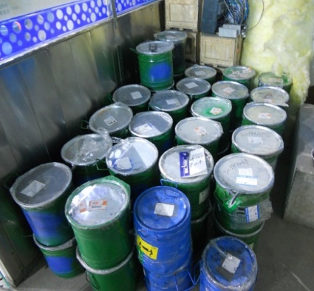
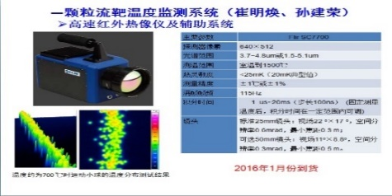
CIADS R&D (Detail Presentation by other talks )
25MeV SCL（Prototype）
Granular high power target and useful for 2nd beams (new)
High energy pulse electron imaging quasi-in line (new)
IMP

Slide 27
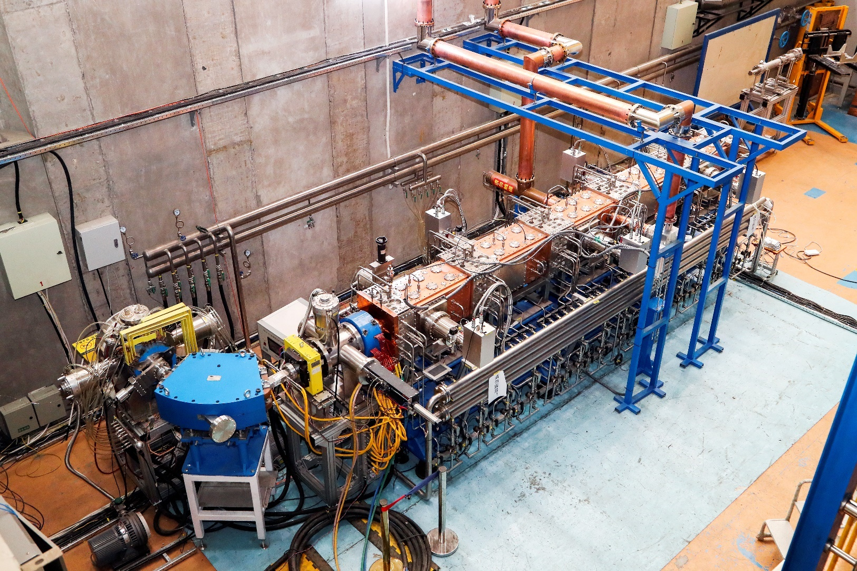
RFQ for Q/A = 1/2
RFQ (Q/A=1/2) → H₂⁺ , D, ⁴He, ⁶Li，¹²C…
Commissioning >3.3MeV&7mA by H₂⁺
replaced the proton ion source of 25 MeV SCL to accelerate ions ~20AMeV

Slide 28
Thanks for attention
Welcome to
Collaboration !

