Slide 1
HIAF-iLinac and key technology R&D
Hongwei Zhao
Institute of Modern Physics (IMP), Chinese Academy of Science,
Lanzhou, 730000, China
NICA-HIAF Accelerator Workshop, Dubna, July 2-3, 2018

Slide 2
Outline
Brief overview of HIAF
HIAF iLinac design
Key technology R&D
Summary

Slide 3
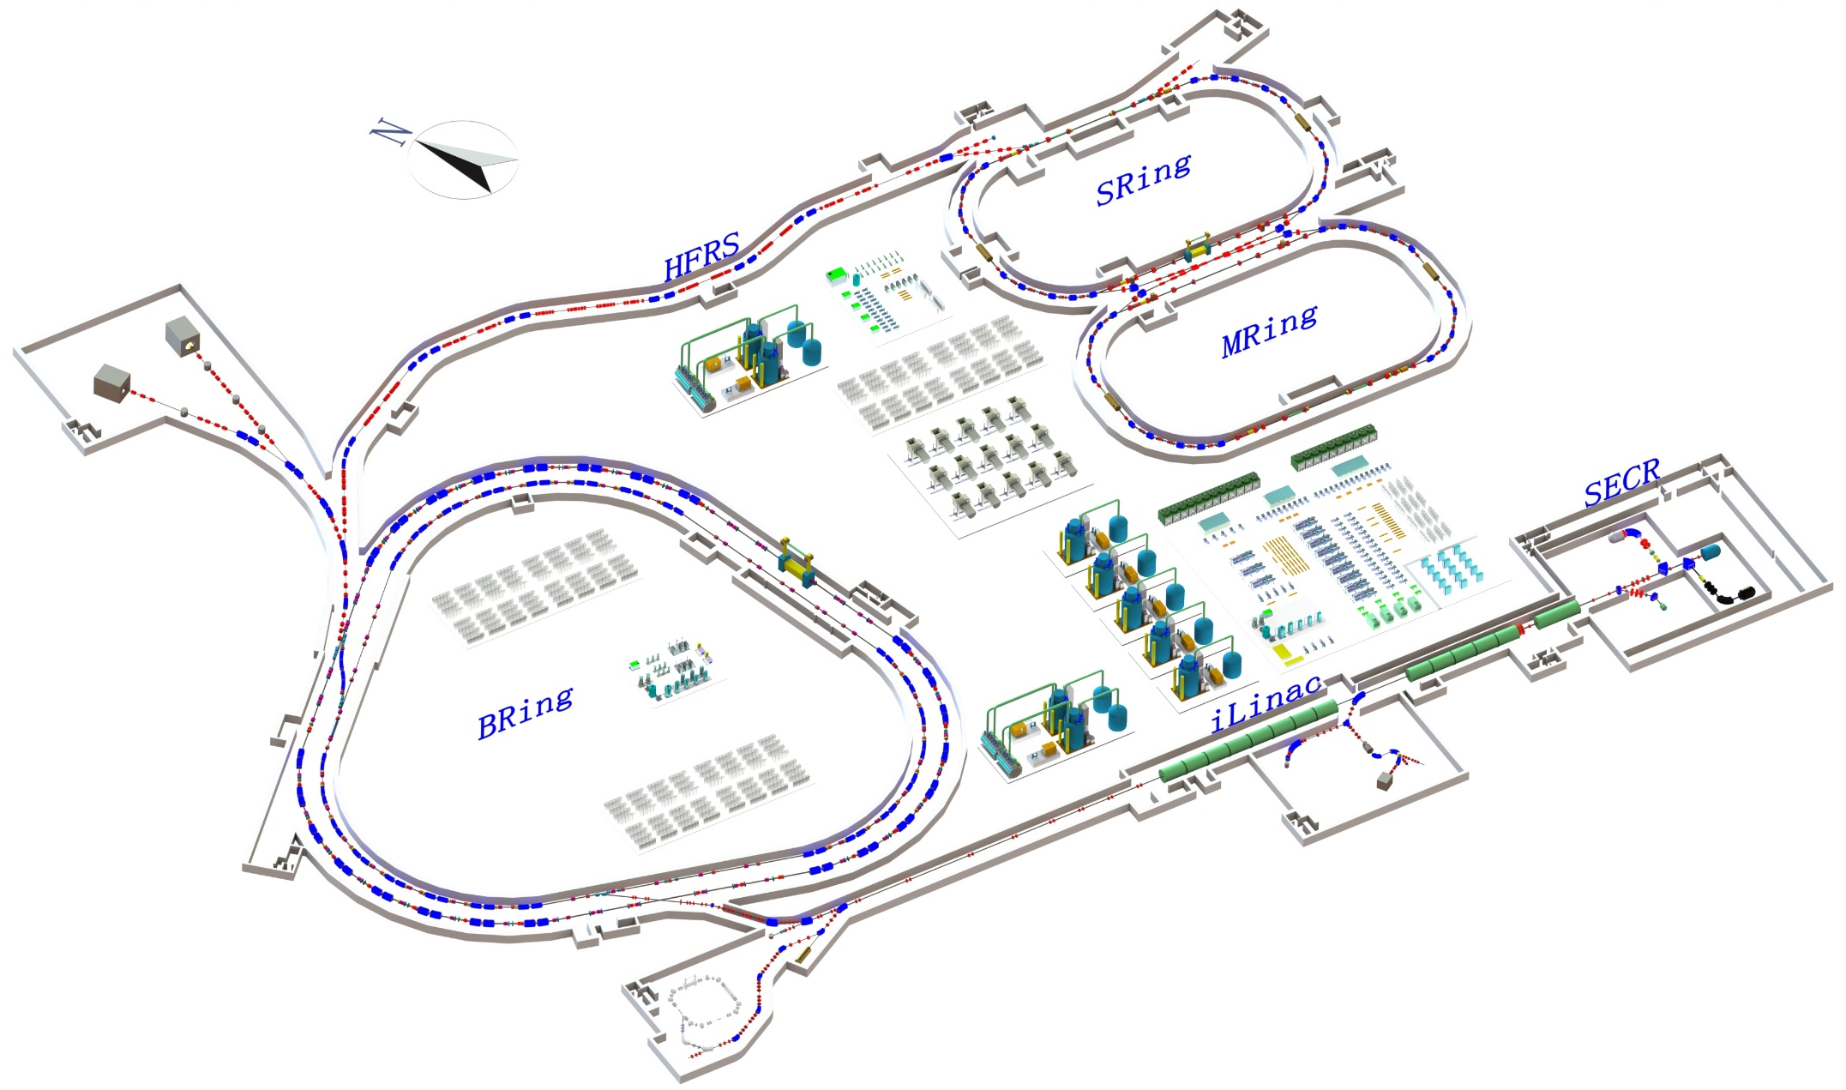
HIAF Layout Overview
SRing: Spectrometer ring
Circumference: 273m
Rigidity: 13-15 Tm
Electron/Stochastic cooling
Two TOF detectors
Four operation modes
BRing-S: Booster ring
Circumference: 650 m
Rigidity: 86 Tm
Beam stacking
Beam acceleration
L: 180m, Bρ: 25 Tm
MRing: Figure “8” ring
Circumference: 273m
Rigidity: 15 Tm
Ion-ion merging
BRing-N: Fast cycle ring
Circumference: 590 m
Rigidity: 34 Tm
Large acceptance (250/120)
Two planes painting injection
Fast ramping rate（3-5-10Hz, 20Hz）
iLinac: Superconducting linac
Length:100 m
Energy: 17-22 MeV/u(U³⁵⁺⁻⁴⁵⁺)
These tunnels will be built in a cut and cover method and will be filled with 5 m overlay of soil. This conforms to the requirements of radiation safety.
Notes:
The concept and layout of HIAF facility has evolved from the scientific requirements. This is the whole layout of the HIAF accelerator, it consists of superconducting ECR source, superconducting linac as injector, synchrotron booster, radioactive beam separator, and storage rings for in-ring experiments. ECR source is the next generation ECR source with high operation frequency, the superconducting linac can provide the highest intensity heavy ion beam for low energy research and synchrotron injection. The output energy is the about 17-22MeV, we keep the free space for update to 100MeV/u in the future. The central part of the HIAF facility is a synchrotron complex consisting of two rings. Both rings have near the same circumference and will be installed in the same tunnel.
The maximum rigidity of separator is 25Tm and the length is 180m, with this separator we can produce and separate the secondary beam, these secondary beam will be injected and accepted by storage system. For storage systems, first is SRing,

Slide 4
HIAF unique features
Unprecedented heavy ion beam intensity
Multi-function storage ring
Figure-8 shape ion-ion merging ring
Notes:
The HIAF project addresses a wide scope of scientific issues similar to the FAIR project of GSI, but with focus on different topics.
As I mentioned, HIAF will be a unique machine with unprecedented beam intensity for some new search field. How can HIAF provide unprecedented beam intensity and be a unique machine, now let me introduce the design concept and unique features of HIAF. First is

Slide 5
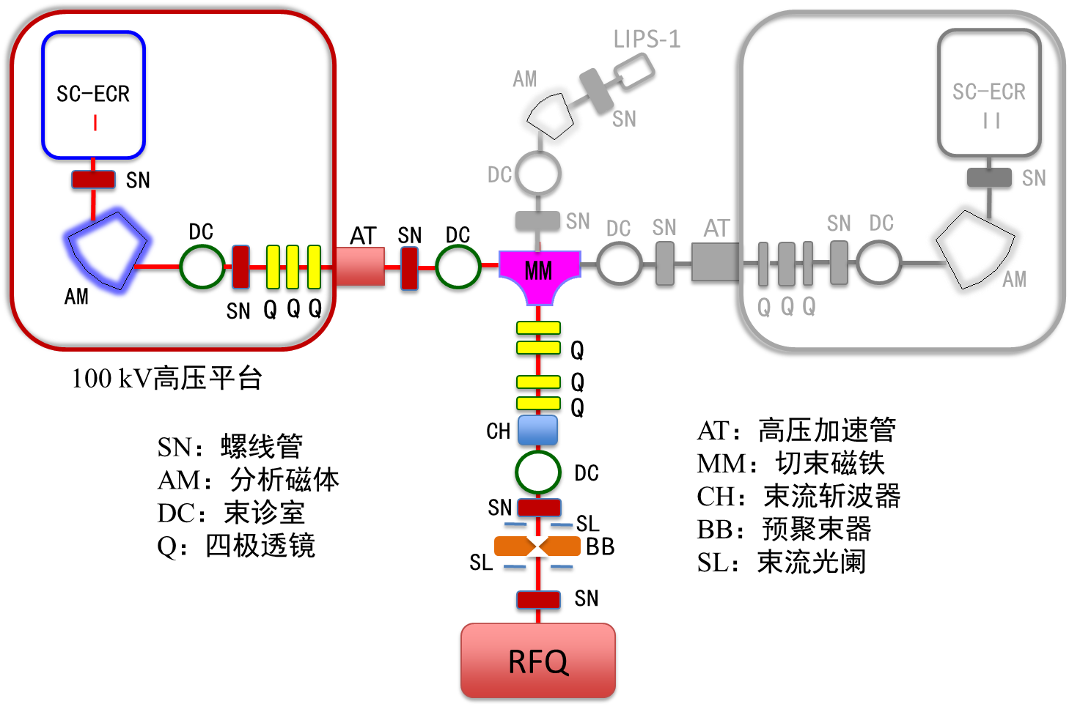

Unprecedented heavy ion beam intensity
High intensity ion sources
SECRALII
24-28 GHz
FECRAL
45 GHz
100 kV HV
100 kV HV
HIAF requires source to deliver:
Pulsed 30 pμA
²³⁸U³⁵⁺
CW 20 pμA
Ion source be able to produce:
Pulsed >50 pμA
²³⁸U³⁵⁺
CW >30 pμA
Challenging !!

Slide 6
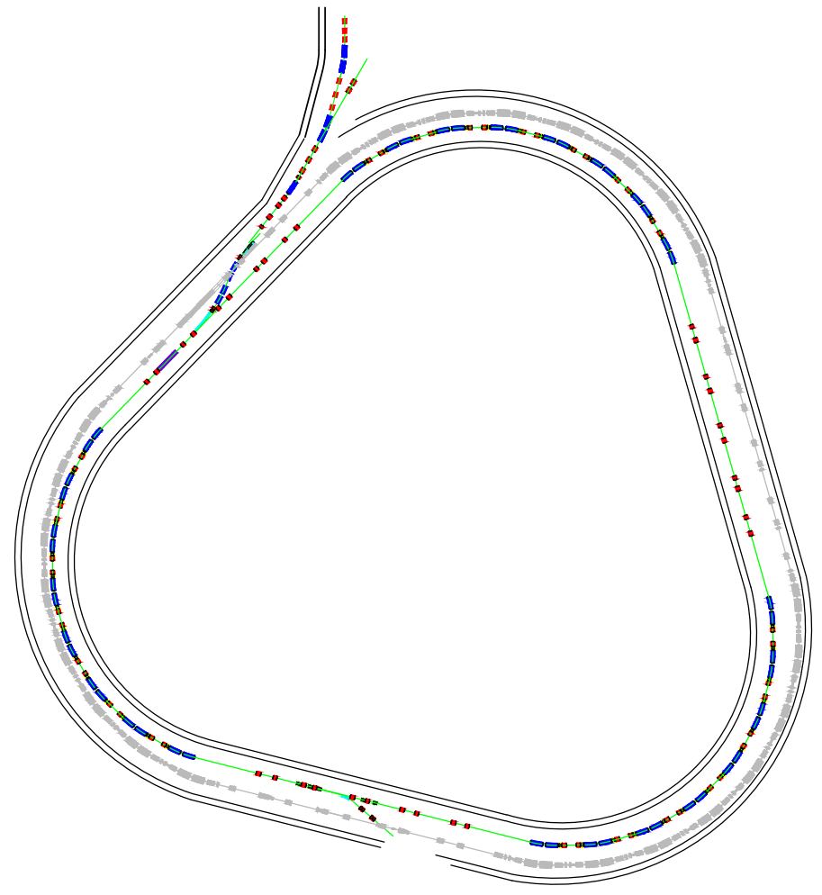
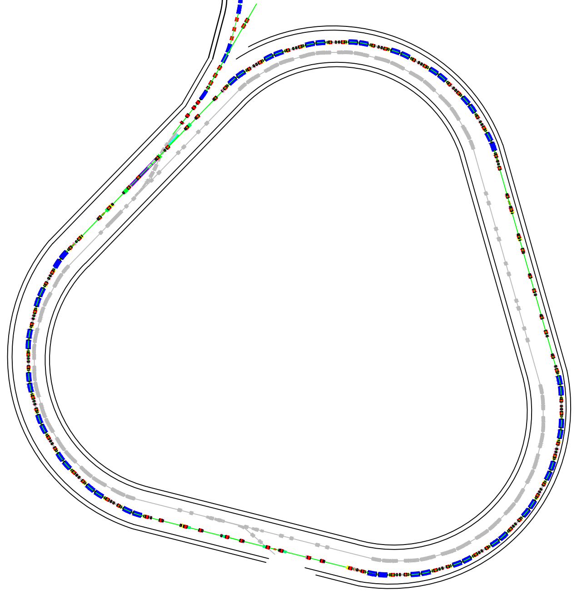
Unprecedented heavy ion beam intensity
Concepts for approaching the highest heavy ion intensity
BRing-N
Novel two planes painting injection scheme - 2.0×10¹¹ ppp
Fast ramping rate operation mode- 3-5-10 Hz (12T/s dipole)
BRing-N
Barrier bucket stacking longitudinal
BRing-S
Innovative timing system of RF synchronization
5 times increase of intensity
1.0×10¹² ppp
BRing-S
Notes:
Quite different from the FAIR of Germany, HIAF will use the superconducting Linac as the injector, the basic ideas for high intensity are: firstly a novel two planes painting injection scheme with the fast ramping rate mode in BRing-N, and secondly beam stacking from BRing-N to BRing-S with new barrier bucket technology .

Slide 7

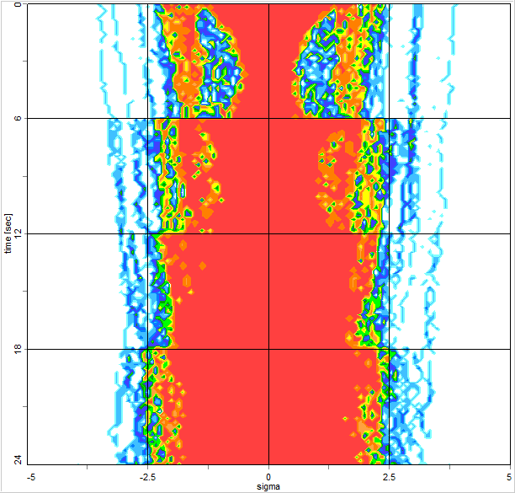
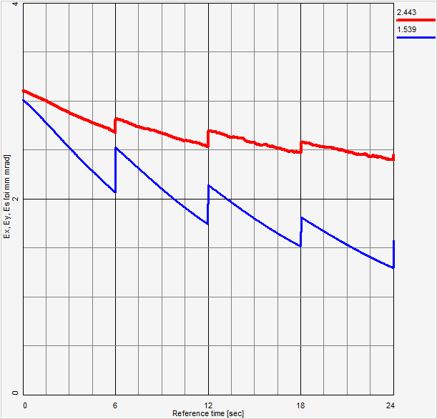
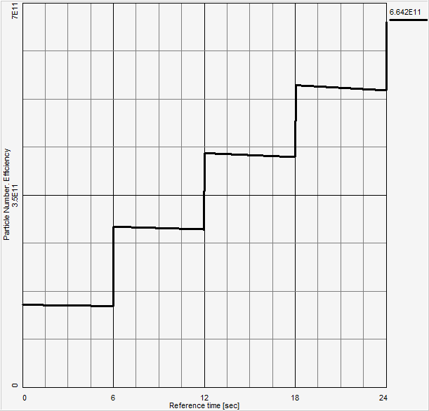
Unprecedented heavy ion beam intensity
Barrier bucket stacking
800MeV/u (²³⁸U³⁵⁺)
2.0×10¹¹
5 times
Barrier bucket
2.3GeV/u (²³⁸U³⁵⁺)
1.0×10¹²
iLinac
Innovative RF timing system
BRing-N
BRing-S
Challenges:
Fast e-cooling for high energy heavy ion
High intensity effect of barrier bucket stacking
Momentum spread
Emittance
Intensity
5 times increase of beam intensity through barrier bucket
Notes:
Then beam will be stacked longitudinal through from BRing-N to BRing-S, a new timing system of RF synchronization is designed, and

Slide 8
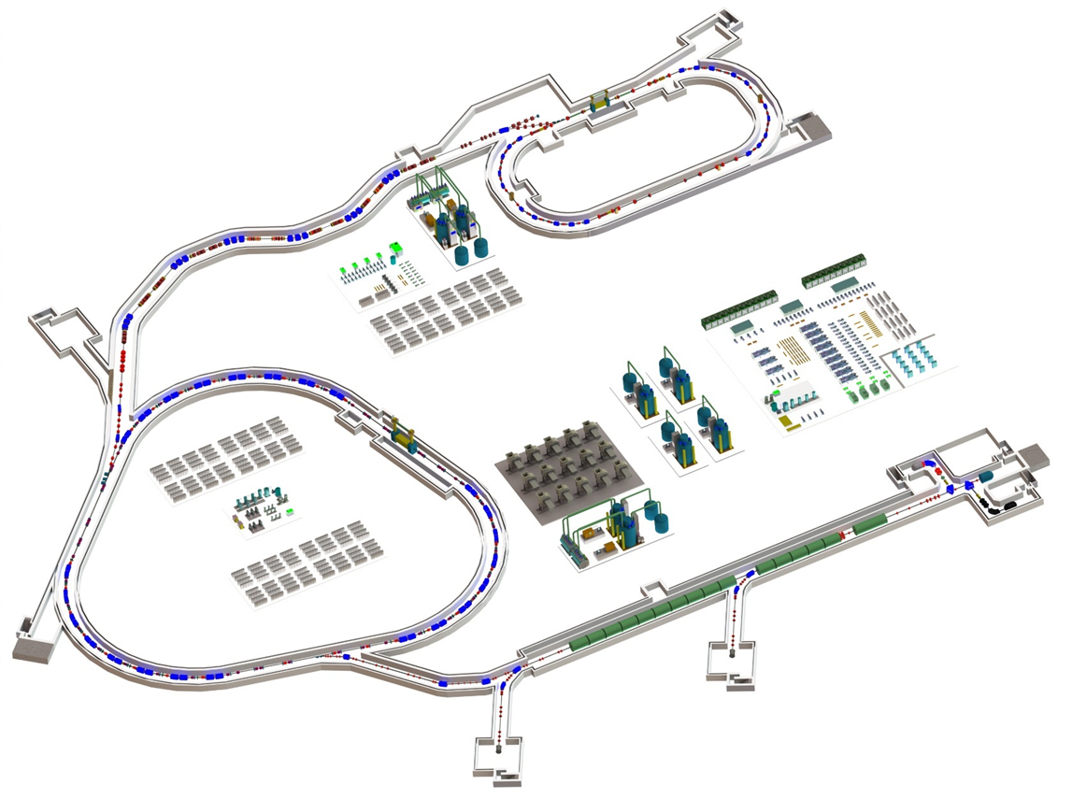
HIAF First phase
Bring-N: 0.8 GeV/A, 3×10¹⁰ppp
HIAF: 2018-2024
Budget: 1.5+1.1 B CNY, approved
External target station
High Energy Density Physics
Nuclear Matter study-CEE
Hypernuclear
High energy irradiation
L: 180m, Bρ: 25 Tm
HFRS
SRing: Spectrometer ring
Circumference: 273m
Rigidity: 13-15 Tm
Electron/Stochastic cooling
Two TOF detectors
Four operation modes
Bring-N:
Circumference: 590 m
Rigidity: 34 Tm
Large acceptance (200/100)
Two planes painting injection
Fast ramping rate（3-5-10Hz）
SECRAL and FECR
28-45GHz,
1.0emA(U³⁵⁺- U⁴⁶⁺)
Low energy nuclear
structure terminal
iLinac: Superconducting linac
Length:80 m
Energy: 17~22 MeV/u(U^{35+ ~ 46+})

Slide 9
Outline
Brief overview of HIAF
HIAF iLinac design
Key technology R&D
Summary

Slide 10
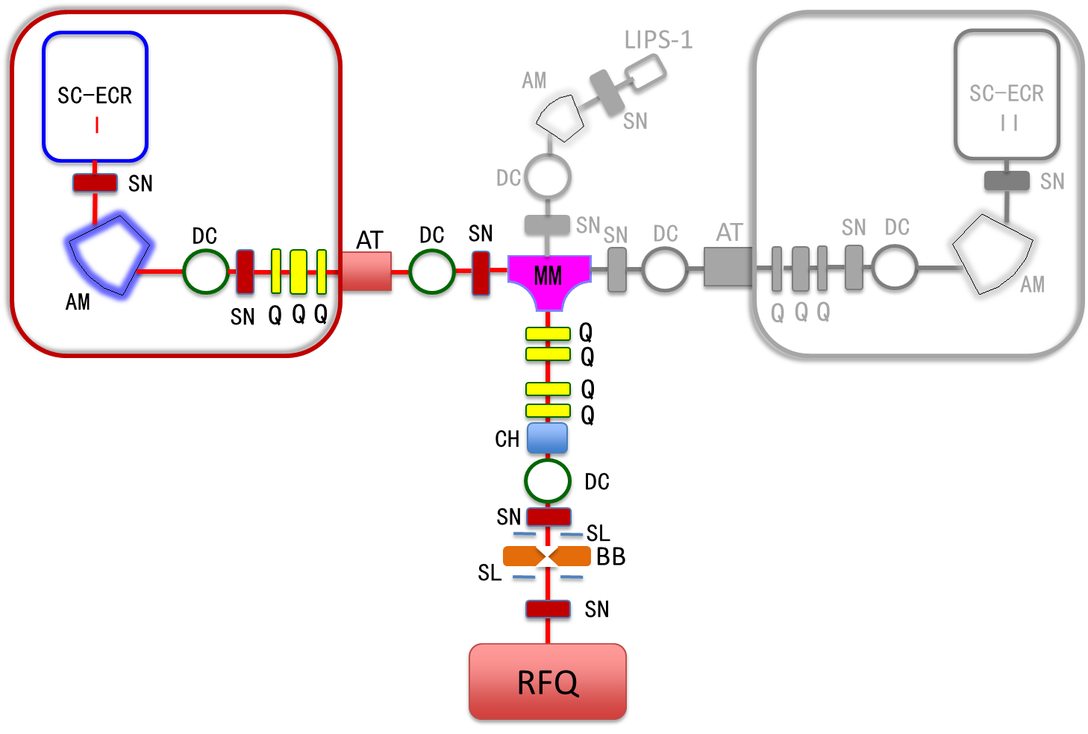
HIAF iLinac Front End
100 kV Platform
100 kV Platform
SECRAL II
24-28 GHz
FECR
45GHz
SN：Solenoid
AM：Analyzing Magnet
DC：Diagnostic Chamber
Q：Quad
AT：Acceleration Tube
MM：Merge Magnet
CH：Chopper
BB：Beam Buncher
SL：Slits

Slide 11
Ion Source Beam Requirements
Key Parameters from Ion Sources
 | HIAF | State of the Art and record
Ion | H₂⁺~²³⁸U³⁵⁺ | H₂⁺~²³⁸U³⁵⁺
Extraction Energy (keV/q) | 30~50 | 25~30
Total drain (emA) | 20~30 | ~10
Ion Beam Intensity CW mode (emA) | >1.5 (¹⁶O⁶⁺) > 1.5 (¹²⁹Xe²⁷⁺) > 1.5 (²⁰⁹Bi³¹⁺) >1.0 (²³⁸U³⁵⁺) | 6.0 (¹⁶O⁶⁺) SECRAL ~ 1.0 (¹²⁹Xe²⁷⁺) SECRAL ~ 0.7 (²⁰⁹Bi³¹⁺) SECRAL ~0.32 (²³⁸U³⁵⁺) VENUS
Transverse ε (π.mm·mrad) | ε_{n, rms} ≤ 0.20 & ε_{n, 6rms} ≤ 1.2 | ε_{n, rms} ≤ 0.20
Pulsed mode | Pulse length: 0.2~2.0 ms Repetition rate: 0.5~5 Hz | --
Energy Spread | Δp/p < ±5.0×10⁻³ | Δp/p < ±5.0×10⁻³

Slide 12
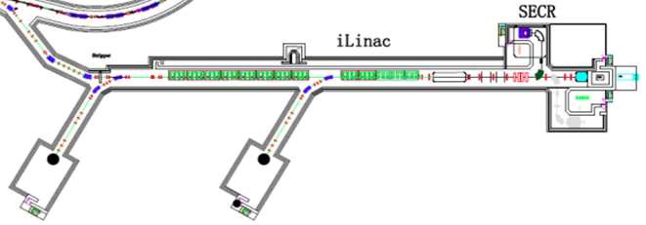
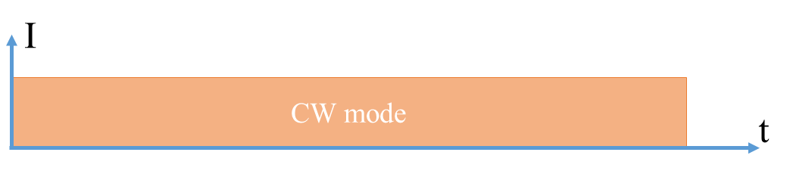
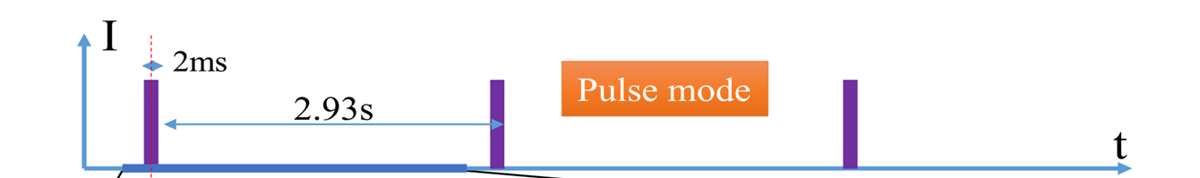
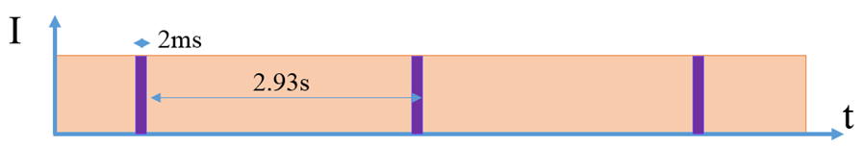
iLinac operation mode
To BRing
Phase I: 17-22 MeV/A
Phase II: 100-200 MeV/A
CW mode
Independent machine
Pulsed mode
BRing injector only
Parallel mode
BRing and experiments
¹⁶O⁶⁺ 1 emA
¹²⁹Xe²⁷⁺ 1 emA
²⁰⁹Bi³¹⁺ 1 emA
²³⁸U³⁵⁺ 0.7 emA
¹⁶O⁶⁺ 2 emA
¹²⁹Xe²⁷⁺ 2 emA
²⁰⁹Bi³¹⁺ 1.5 emA
²³⁸U³⁵⁺ 1 emA
0.3-5 Hz/0.2-2 ms
Challenge
- High intensity operation
- Switching from one to
another setting.
- Long-term reliability
The world highest intensity CW HI linac

Slide 13
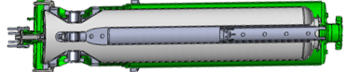
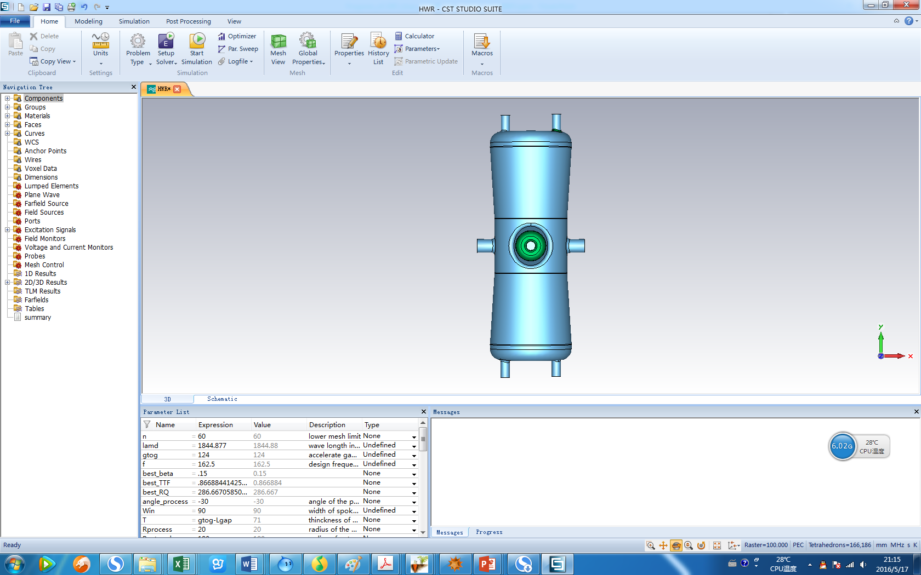
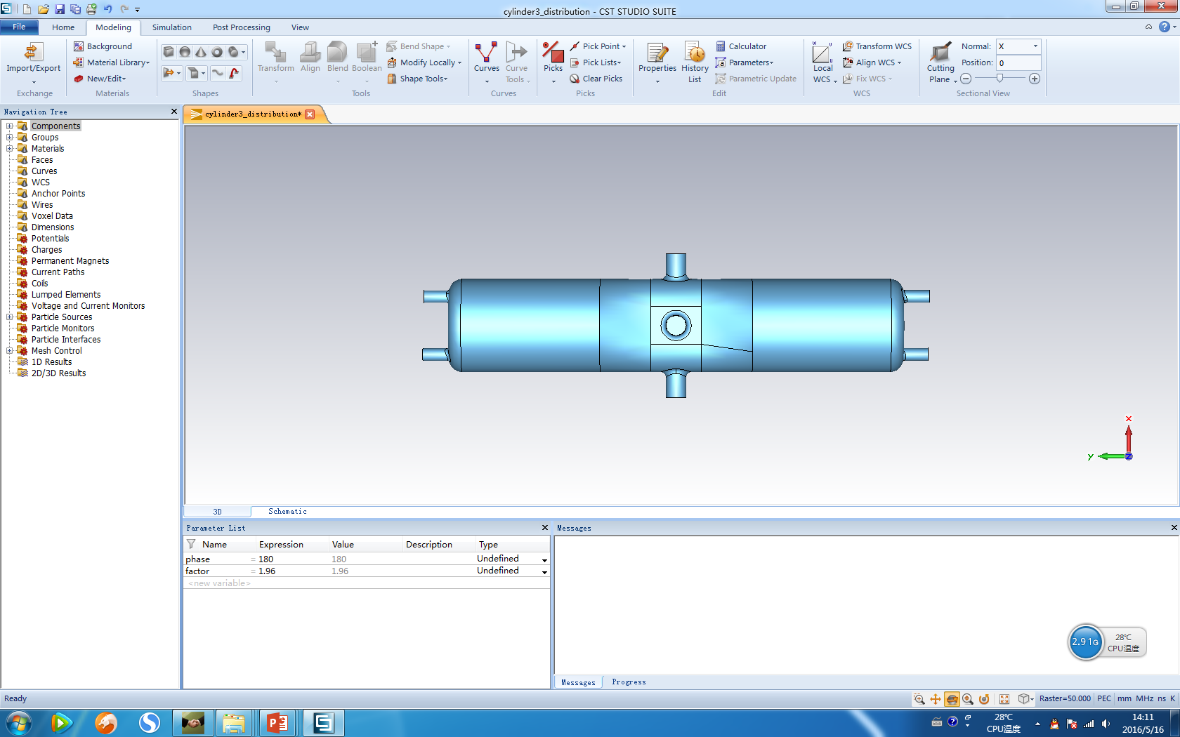


Design option of iLinac
Scheme1:QWR+HWR
β =0.03
β =0.19
SECR
LEBT
RFQ
Low energy section
High energy section
0.5MeV/u
17MeV/u
²³⁸U³⁵⁺
QWR cavity
β = 0.05
f = 81.25MHz
HWR cavity
β = 0.10
f = 162.5MHz
HWR cavity
β = 0.15
f = 162.5MHz
Scheme2: Only QWR
QWR cavity
β = 0.05
f = 81.25MHz
QWR cavity
β = 0.11
f = 81.25MHz
²³⁸U³⁵⁺
β =0.03
β =0.19
SECR
LEBT
RFQ
Low energy section
High energy section
0.5MeV/u
17MeV/u

Slide 14
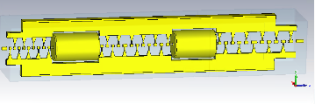
Design Option of iLinac
Scheme3: QWR+HWR
QWR cavity
β = 0.08
f = 81.25MHz
HWR cavity
β = 0.19
f = 162.5MHz
²³⁸U³⁵⁺
²³⁸U⁴⁶⁺
β =0.046
β =0.19
SECR
LEBT
RFQ
Low energy section
High energy section
1.0MeV/u
22MeV/u
NC IH-DTL
E: 1.5 MeV/A
f = 81.25MHz
Scheme4: Only QWR
QWR cavity
β = 0.10
f = 81.25MHz
²³⁸U³⁵⁺
²³⁸U⁴⁶⁺
β =0.03
β =0.19
SECR
LEBT
RFQ
Low energy section
High energy section
0.5MeV/u
22MeV/u
SRF cavity option: Pure Nb cavity or Nb coating on Cu-cavity?

Slide 15
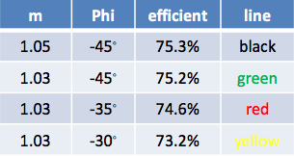
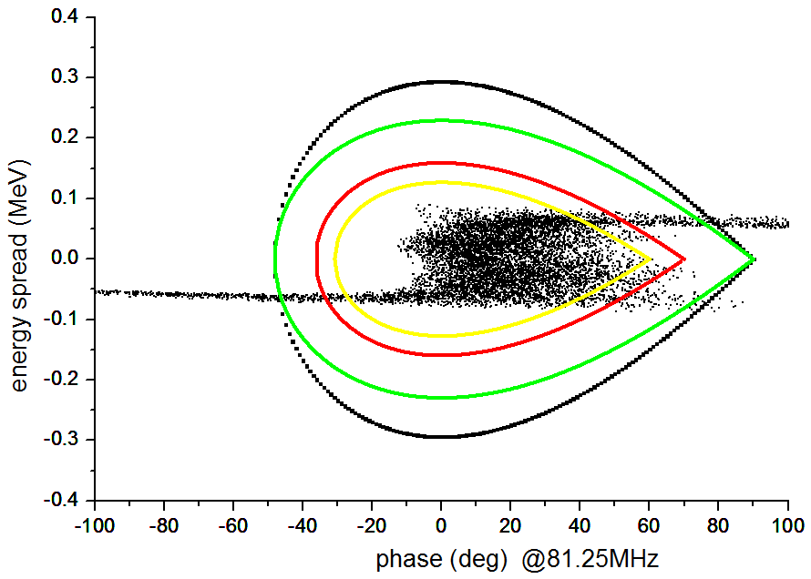
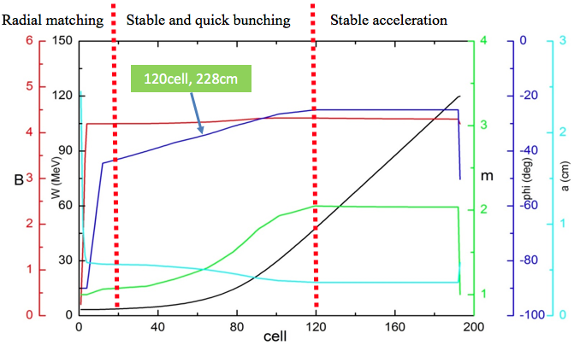
Design of RFQ (1)
Design ion | ²³⁸U³⁵⁺
Frequency (MHz) | 81.25
Current (emA) | 2
Vane voltage (kV) | 70
Kilpatrick Coefficient | 1.55
Input/Output energy (MeV/u) | 0.014/0.5
Average Aperture (mm) | 5.805
Synchronous Phase | -45°~ -25.5°
Modulation Factor | 1.05~2.04
Length (cm) | 596.352
Transmission efficiency (%) | 97.2 @dW/W<5%
Input Nor. RMS. transverse emit (pi.mm.mrad) | 0.3/0.3
Output Nor. RMS. transverse emit (pi.mm.mrad) | 0.292/0.293
0utput 99.9% transverse emit (pi.mm.mrad) | 1.65/1.66
Output Nor. RMS. Longitudinal emit (pi.mm.mrad) | 0.098
Output 99.9% Longitudinal emit (pi.mm.mrad) | 1.407
Notes:
The design particle for RFQ is U,the beam current is 2mA. The vane voltage is 70 Kv in order to reduce the power consumption（功率损耗）。 Given the running stability and the RF condition(高频老练), the Kp is 1.55。 The RFQ acceptance study with different m and synchronous phase is done, when the m is 1.05 and the initial synchronous phase is minus 45 degree, the 83% particles going through the 3 harmonic buncher are in the linear acceptance of RFQ. So, we select the m of 1.05 and initial bucket synchronous phase of minus 45 degree. The RFQ length is 5.96m. (The 99.9% longitudinal emittance is 133 deg.kev/u,and the longitudial accetance of superconducting section is 1000 deg.kev/u)
Principle:Kp is inversely proportional to average pore size, and the focusing strength is inversely proportional to the square of the average pore size. So Kilpatrick coefficient less than 1.6
RFQ output longitudinal emittance can be accepted
Average radius is selected compromising KP and radial focusing strength
minimize the length
The input energy of the RFQ is selected compromising the LEBT and RFQ, RFQ need a low energy so that bunching as fast as possible, but the space charge will be very strong at low energy section.

Slide 16
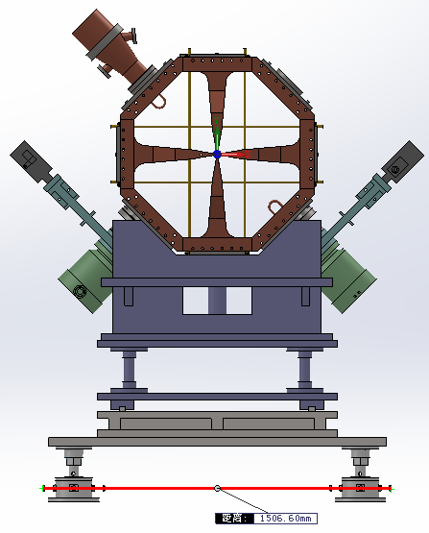
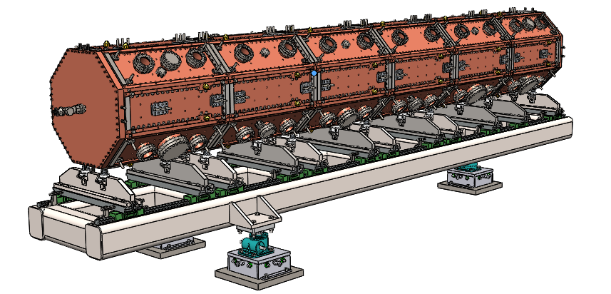
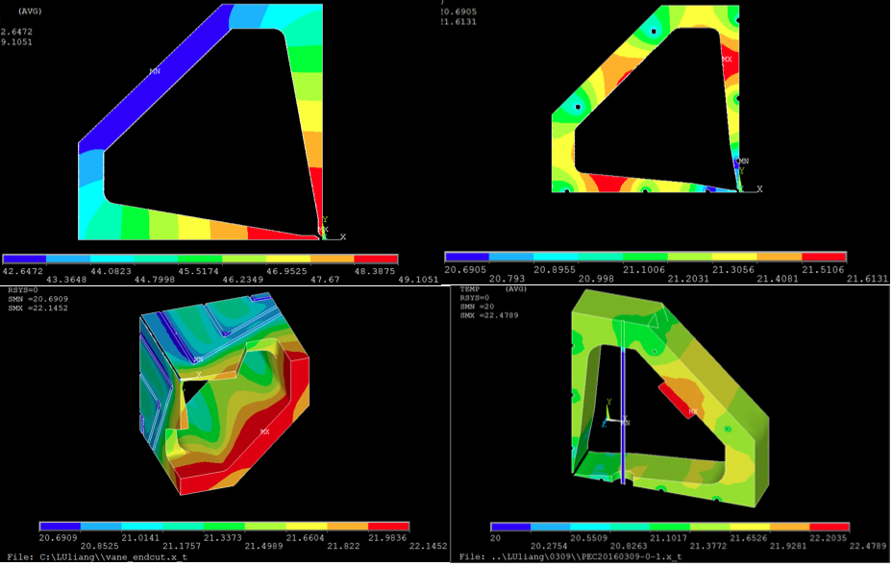
Design of RFQ (2)
Parameters of the final model | value
Frequency (MHz) | 81.261
Q factor | 17963
Nearest dipole mode frequency (MHz) | 86.827
Total Power (kW) | 56.76
Power loss per length (kW/m) | 8.945
Max temp rising (deg) | 2

Slide 17
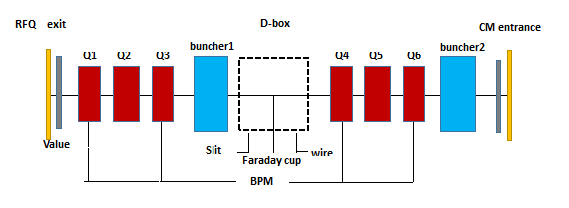
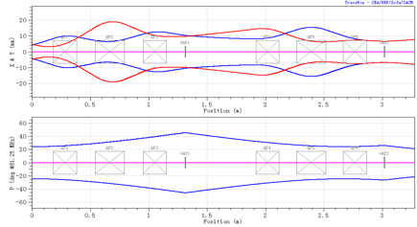
Design of MEBT
Point to initial beam
D-Box
Beam line between RFQ and SC :
  Design with 2 emA @0.5 MeV/u
  6 quadroples and 2 bunchers for transverse and longitudinal matching.
  Enough diagnostics for the re-initialization of beam
Notes:
this is the acceptance of rfq，83% percent particles are in the acceptance of RFQ
The normalize rms emittance at different position are listed ：before the buncher，entrance of RFQ and exit of RFQ. The whole transmission efficient is 75 percent and the transmission efficient of rfq is 90 percent. the matching work is optimizing.

Slide 18
Design of the iLinac for scheme 3
²³⁸U⁴⁶⁺
0.014MeV/u
8MeV/u
²³⁸U⁴⁶⁺
22MeV/u
1.0 MeV/A
RFQ
81.25MHz
81.25MHz
QWR008
7/8 cavity
4 CM
162.5MHz
HWR019
8 cavity
5CM
71.3 m
 | Unit | QWR008 | HWR019
f | MHz | 81.25 | 162.5
Vmax | MV | 2.0 | 2.5
Ep | MV/m | 32 | 32
Q0 | E+09 | 8.00 | 5.00
M/C |  | 8/8&4/7&3/7 | 3/7
CM | number | 4 | 5
M:magnet C:cavity CM:croymodule

Slide 19
Lattice design of iLinac
Cavity Type 1
Cavity type / β | QWR / 0.05
Frequency(MHz) | 81.25
NO of cavity/CM | 29 / 4
NO of solenid | 18
Vacc@Epeak=32MV/m | 1.4
Cavity Type 2
Cavity type / β | QWR / 0.11
Frequency(MHz) | 81.25
NO of cavity / CM | 35/ 5
NO of solenoid | 15
Vacc@Epeak=32MV/m | 2.5
Total length （m） | 71.3
sol
CAV
sol
CAV
sol
CAV
sol
CAV
sol
CAV
sol
CAV
sol
CAV
sol
CAV
~8.4m
sol
CAV
CAV
sol
CAV
CAV
sol
CAV
CAV
sol
CAV
QWR008
section
~7.36m
sol
CAV
CAV
CAV
sol
CAV
CAV
CAV
sol
CAV
~6.97m
HWR019
section
sol
CAV
CAV
CAV
sol
CAV
CAV
CAV
sol
CAV
~7.44m

Slide 20
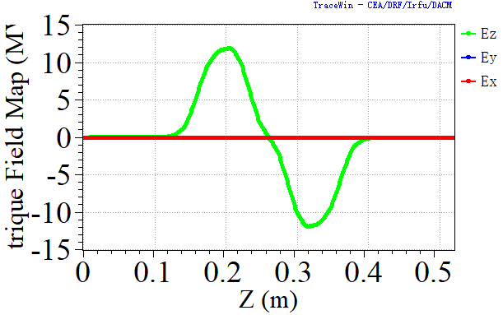
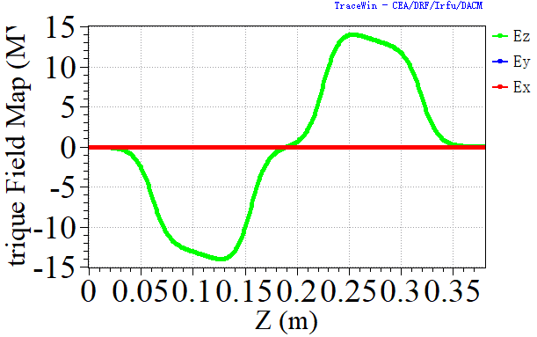
Lattice design
TraceWin program is used for beam dynamics
Solenoid is 3D field ,cavity is 1D field
Using Gaussian distribution.
  6d Gaussian with100000macroparticles for the entrance.
  Normalized rms emittance in x/y/z: 0.2π.mm.mrad / 0.2π.mm.mrad / 0.126π.mm.mrad.
QWR008
HWR019

Slide 21
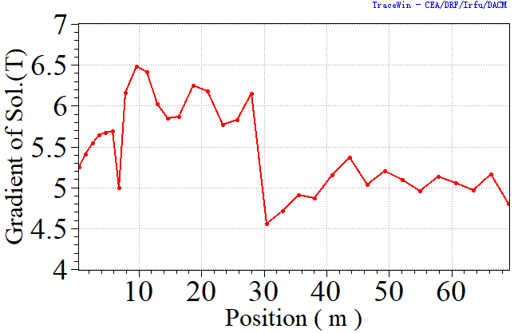
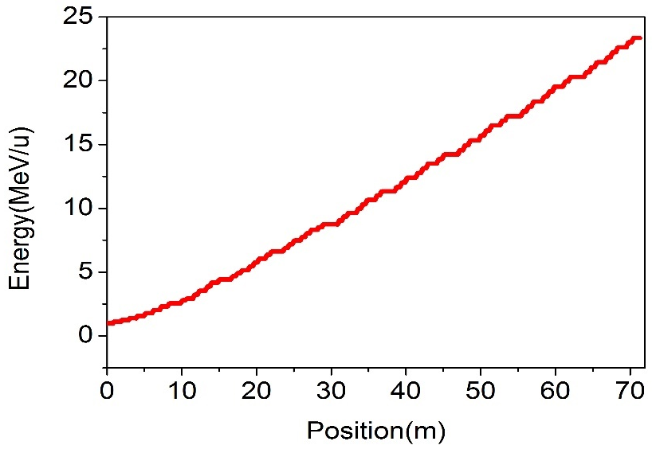
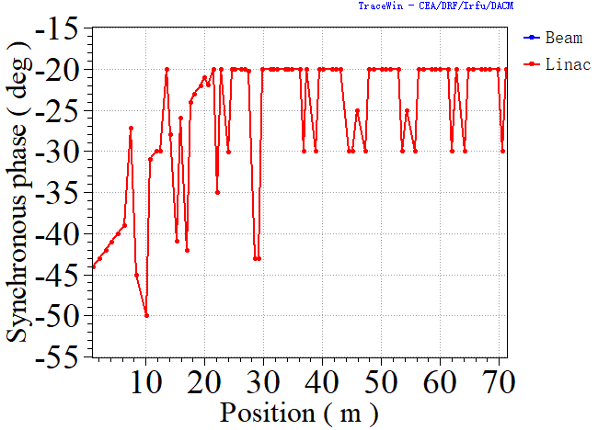
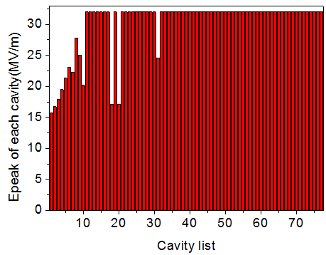
Lattice design
Gradient of solenoid
Energy
Epeak per cavity
Synchronous phase of cavities

Slide 22
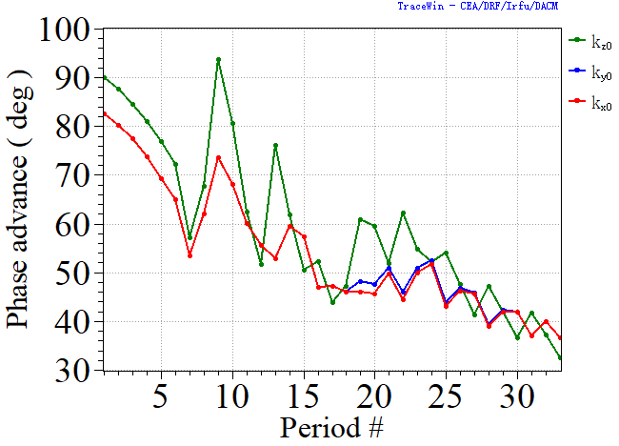
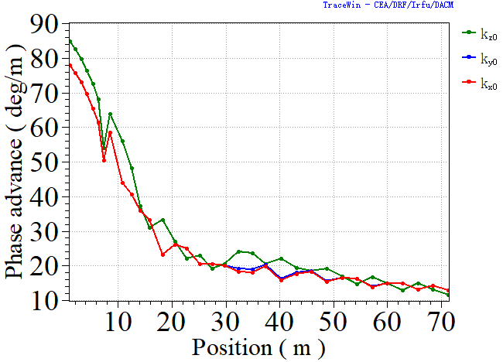
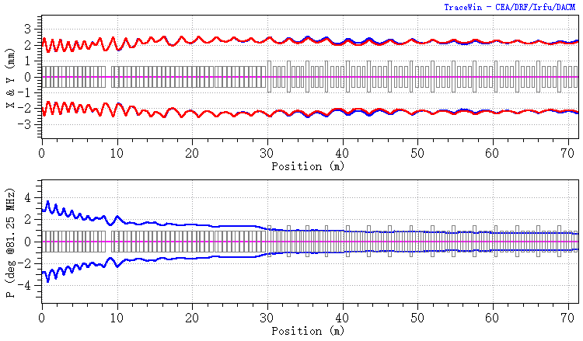
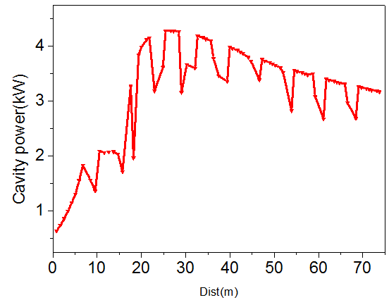
Lattice design
Period phase advance<90deg
Phase advance per meter smooth
RMS envelop smooth
Beam power

Slide 23
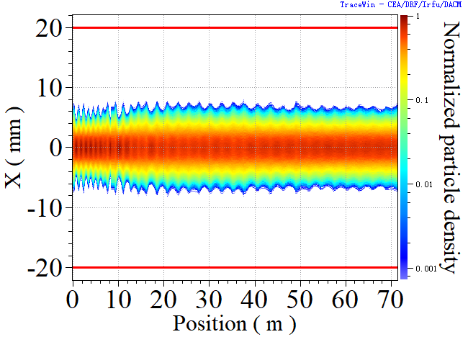
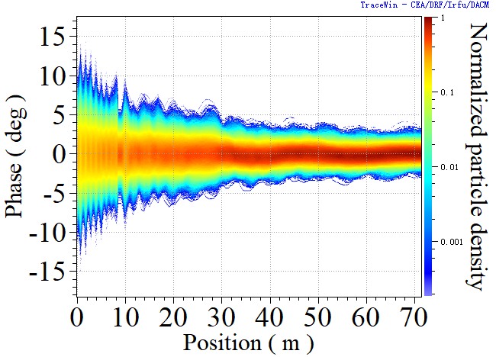
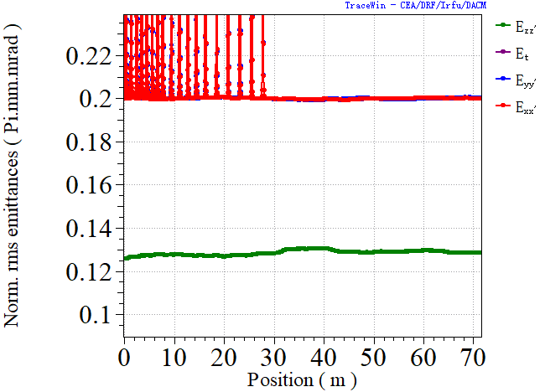
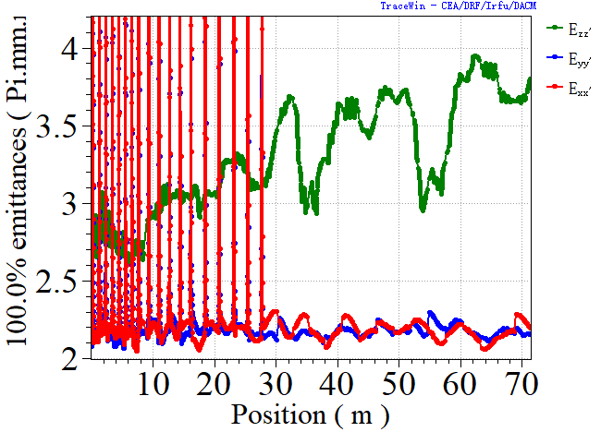
Multiparticle simulation
Aperture/beam size>2
RMS emit growth_X:0%
RMS emit growth_Y:0%
RMS emit growth_Z:2.4%
Max emit growth_X:4.5%
Max emit growth_Y:3.5%
Max emit growth_Z:37.6%

Slide 24
Outline
Brief overview of HIAF
HIAF iLinac design
Key technology R&D for iLinac
  Ion source
  RFQ
  SC linac
Summary

Slide 25
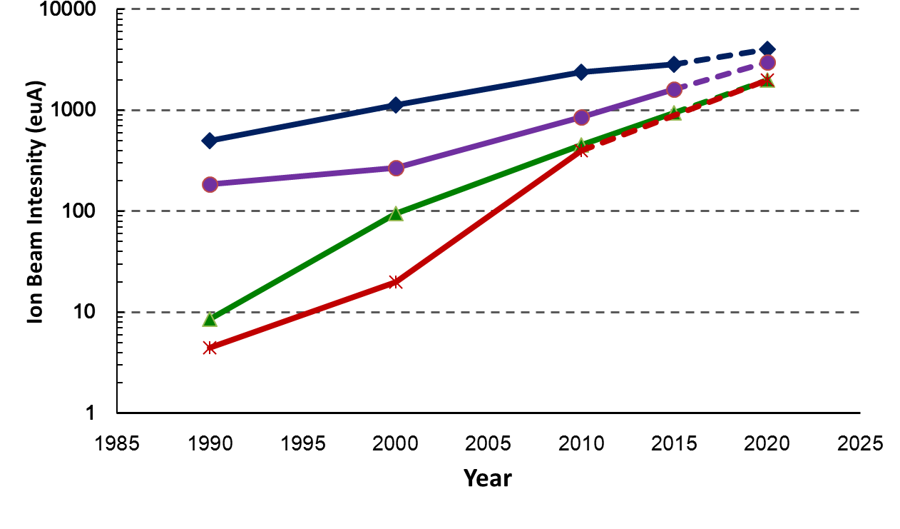
Highly charged ECR ion source
Past, present and future
10 eμA — 100 eμA — 1 emA
2nd G.
3rd G.
4th G.
O⁶⁺
45GHz FECR
at IMP only
Ar¹²⁺
Caprice
ECR4
AECR-U
SERSE
GTS
LECR3
…
VENUS (LBNL)
SECRAL (IMP)
SuSI (MSU)
SCECR (RIKEN)
FRIB ECR (MSU)
…
Xe²⁷⁺
U³⁴⁺
6.4~18 GHz
24~28 GHz
40~60 GHz

Slide 26
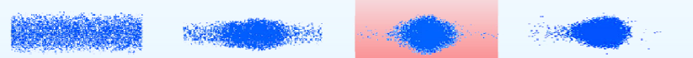
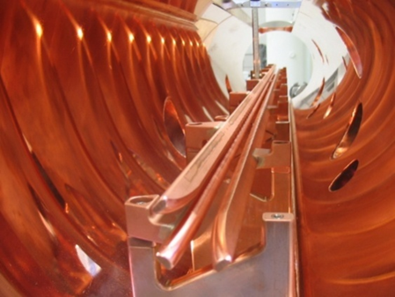
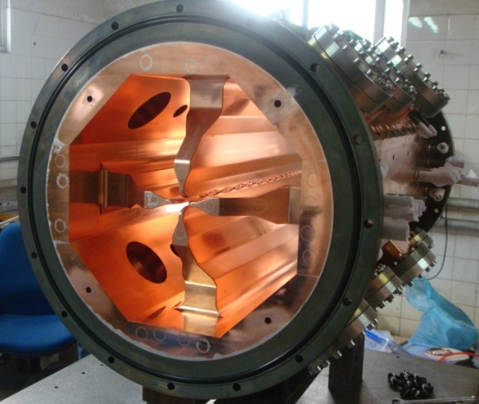
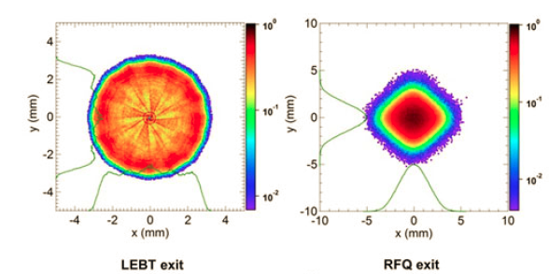
RFQ accelerator for high intensity ion beam
RFQ is utilized as a low energy front-end accelerator
for high intensity ion beam
Transversal
focusing
Longitudinal
bunching
Beam match
Acceleration
400MeV/u@1MW 重离子
总体设计
理论模拟
Integrated into one cavity

Slide 27
Status of high intensity CW ion RFQ and SC linac
Up to now in the world
No any CW proton RFQ with current >3 mA in routine operation
No any CW heavy ion ( > Ar) RFQ with current
>10 pµA in routine operation
No any CW proton SC linac with current > 1 mA in routine operation
No any CW heavy ion ( > Ar) SC linac with current > 10 pµA in routine operation

Slide 28
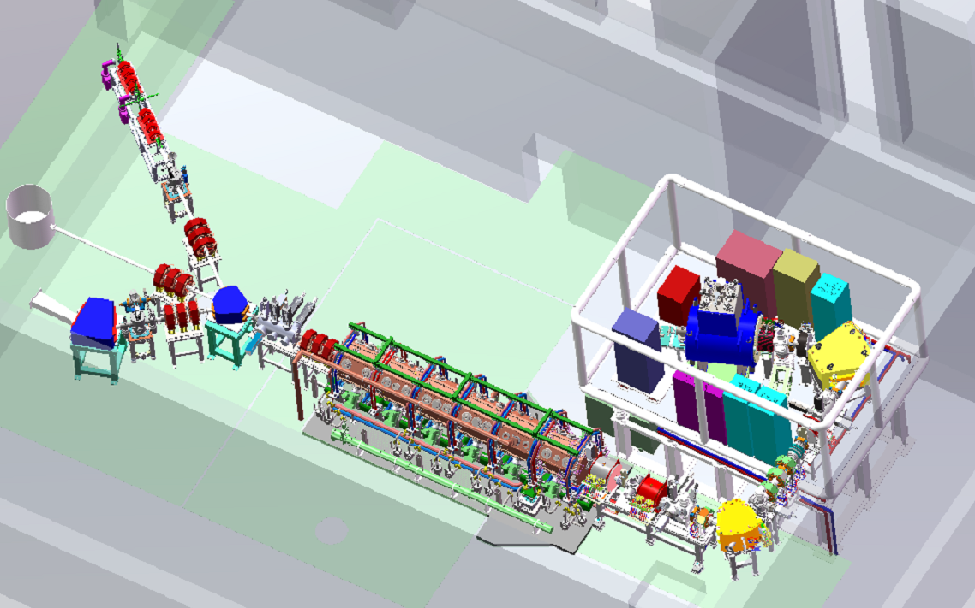
LEAF Layout---HIAF iLinac front-end R&D
Dedicated to
mA heavy ion beams
Power Supplies
45GHz FECR
Irradi-Material
MEBT
HV platform
6m×4m
Atomic Physics
Irradi-Material
RFQ
L= 6 m
LEBT

Slide 29
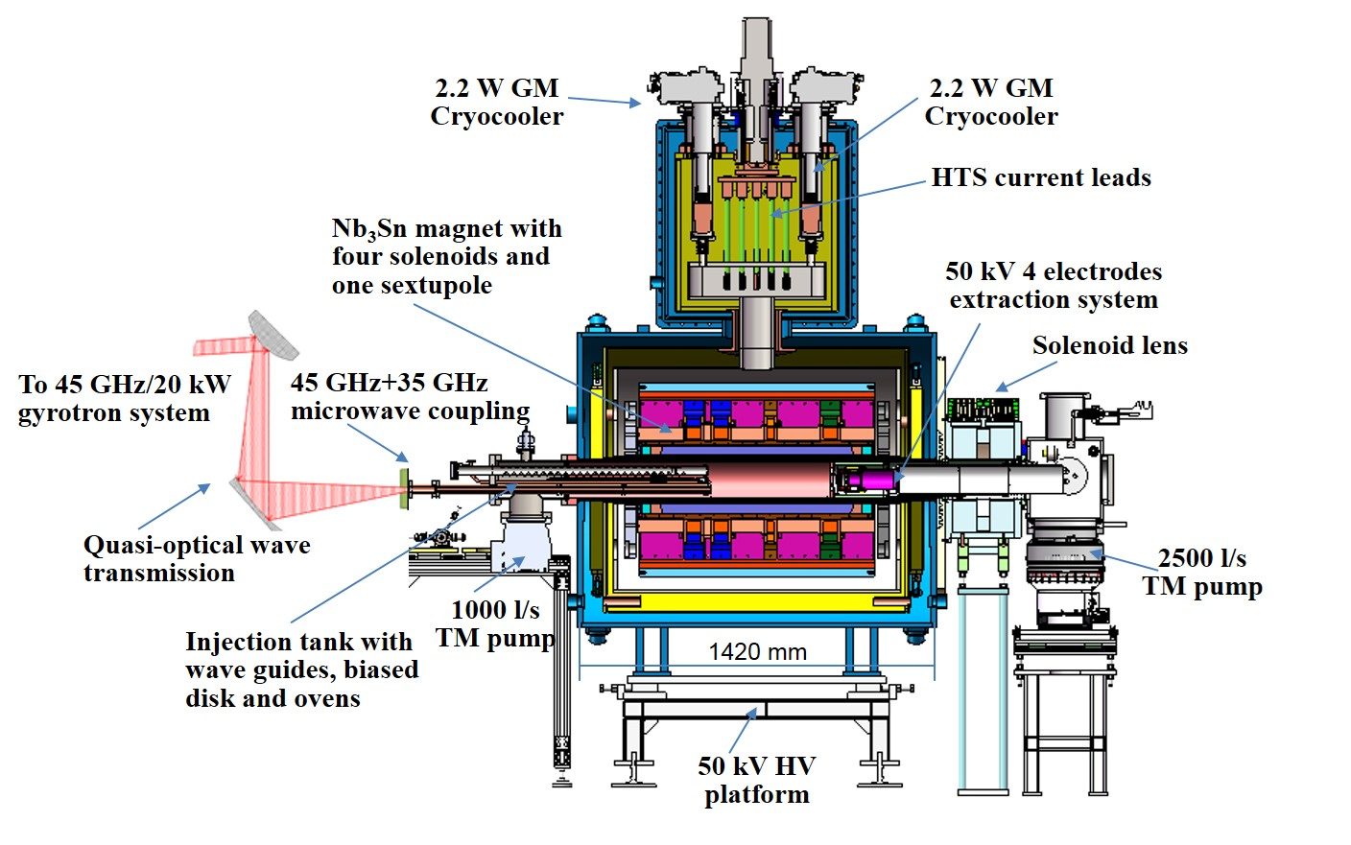
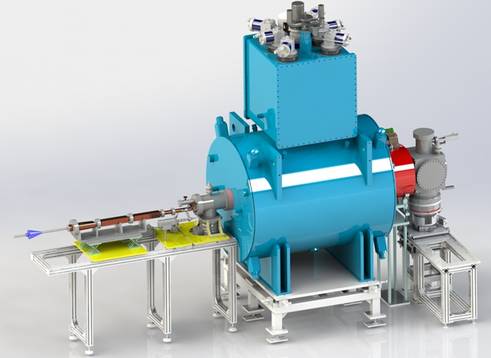
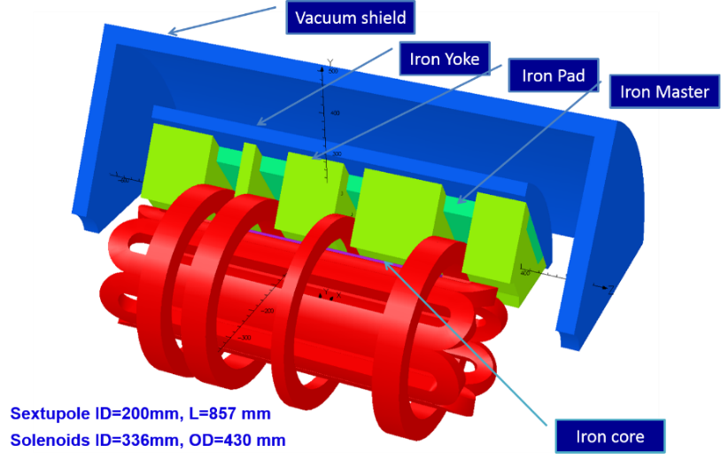
The world first 45 GHz ECR ion source
45 GHz FECR
Microwave | 45 GHz/20 kW
Magnet conductor | Nb₃Sn
Axial fields（T） | 6.5/1.0/3.5
Sextupole field （T） | 3.8@r=75 mm
Maximum field（T） | 11.8 T
Magnet bore（mm） | Ø161~165
Extraction （kV) | 50
Typical beam | 1.0 emA U³⁵⁺
H.W. Zhao, et.al. RSI, (2018)

Slide 30
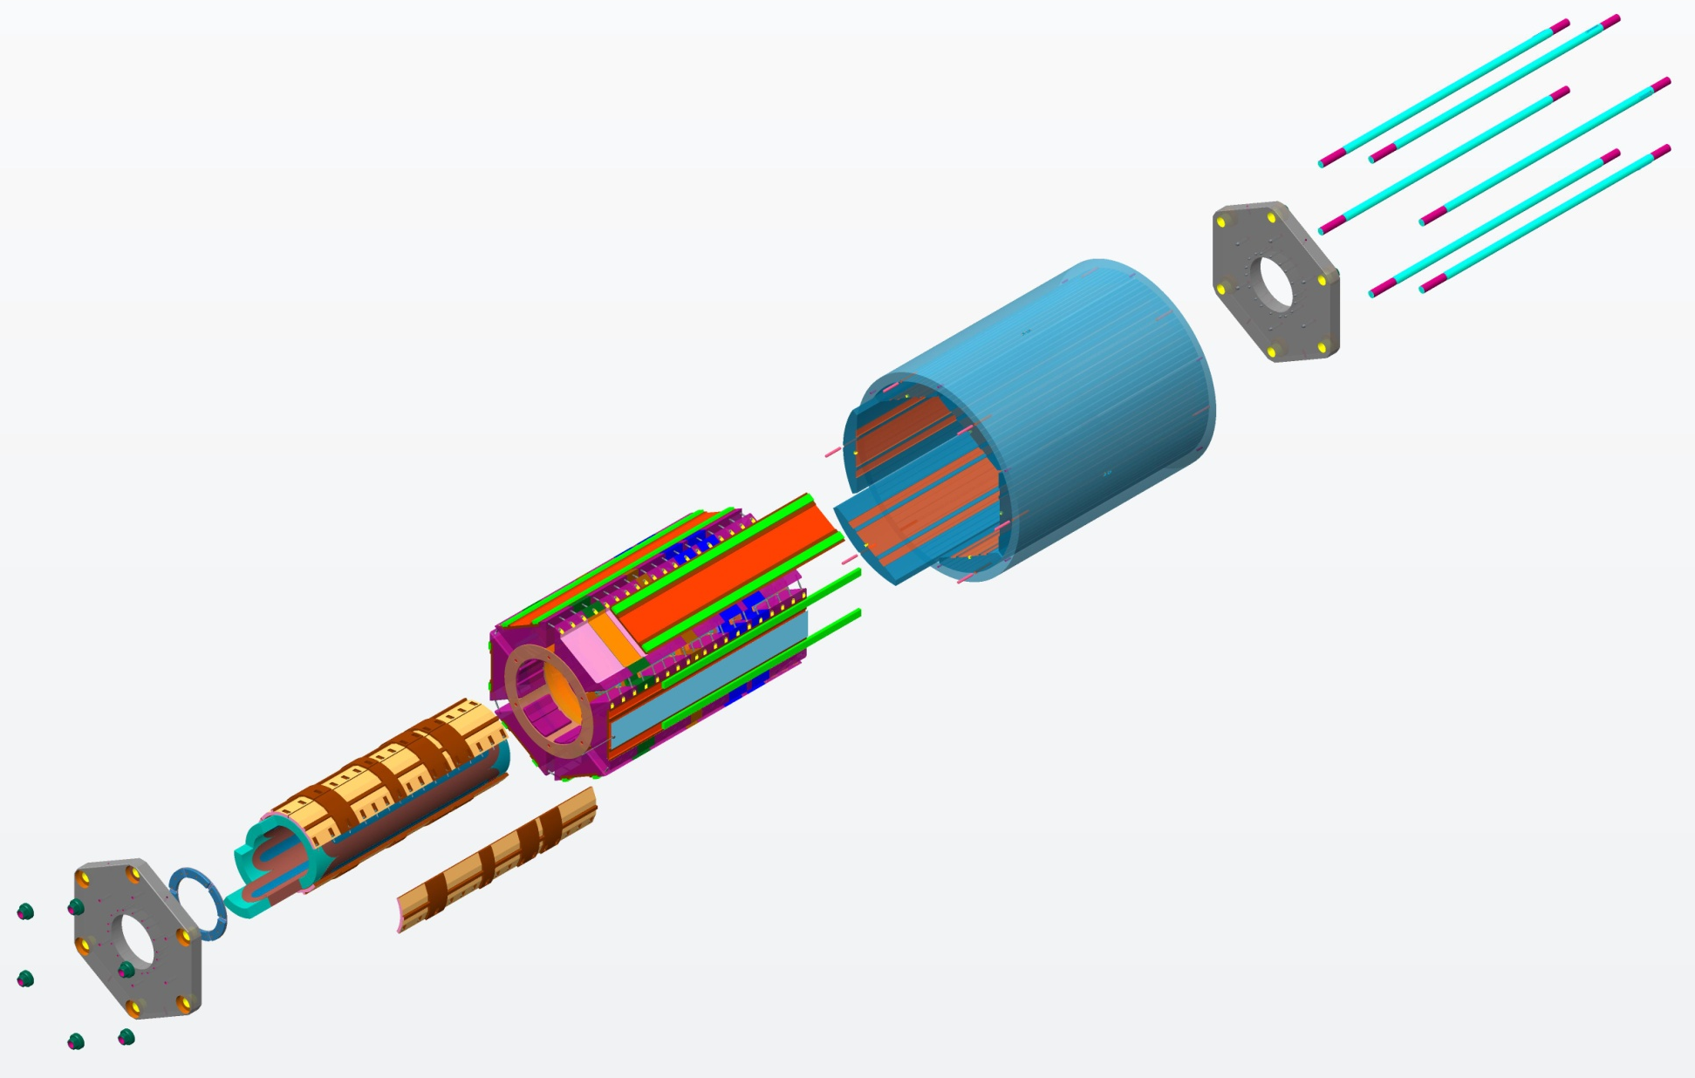
FECR Nb₃Sn magnet mechanical structure
The magnet mechanical structure was designed by
collaboration with ATAP magnet group at LBNL
AXIAL RODS
(Strain Gauged)
YOKE-SHELL
ALIGNMENT PINS
MASTER-KEY PLATES
SOLENOID
STRUCTURE
SUBASSEMBLY
COIL-PACK
SUBASSEMBLY
AXIAL-LOAD
END PLATE
SUBASSEMBLYS
YOKES
SHELL-YOKE
SUBASSEMBLY
(Shell is strain gauged)
COIL END
BLOCKS
LOAD-KEYS
BLADDER
SUBASSEMBLY
COLLARS
SEXTUPOLE
COILS
This Nb₃Sn magnet is being built in China

Slide 31
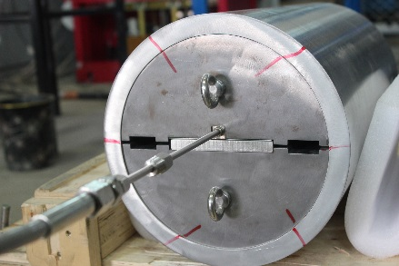





Key technology R&D for FECR Nb₃Sn magnet
Quench protection
2.2W@4.2K GM
Cryo-cooler test
Bladder & Keys
Coil prototype

Slide 32





FECR Nb₃Sn magnet prototyping

Slide 33




Laser ion source for HCI
Ni beam reproducibility < 2%
The world best performance
CSD for different heavy ions

Slide 34




LEAF key components
LEAF components: LEBT, HV platform, RFQ
45 GHz/20 kW gyrotron system
RFQ accelerator, first beam Feb. 9, 2018
RFQ: CW 200 µA He¹⁺ , 98% efficiency, E: 0.497 MeV/A
81.25 MHz/60 kW solid-state amplifier

Slide 35




CW RFQ accelerators for high intensity ion beam at IMP
ADS CW RFQ
CMIF CW RFQ
总体设计
理论模拟
1.5MeV/A, 162.5 MHz,
CW 10mA, H₂⁺/D⁺, 2015-2018
2.1 MeV/162.5 MHz, CW proton 10 mA,
2011-2014, collaborated with LBNL
SSC CW RFQ
LEAF CW RFQ
0.5 MeV/A 81.25 MHz,
CW ²³⁸U³⁵⁺, 1 emA, 2015-2018
0.142MeV/A, 53.667 MHz,
CW 50-200 µA, O-Ar-Bi, 2013-2016

Slide 36



ADS RFQ 2.1 MeV/CW proton 10 mA
The world highest beam intensity for currently operating CW proton RFQ.
CW 6mA@5hours
Total operation time is ~3000 hours
including CW@10mA around 10 hours
CW 10mA@ 2 hours

Slide 37




LEAF RFQ 0.5 MeV/A--81.25 MHz
75 kW/70 kV
LEAF RFQ rf power conditioning

Slide 38



Beam commissioning of LEAF-RFQ
@ without MHB
He¹⁺
Transmission efficiency ~ 98.5%
Acceleration efficiency ~ 46.5%
Beam energy 0.497±0.001 MeV/u
RFQ CW commissioning @ 200 eμA He¹⁺
1.9E10⁻⁵ Pa
Beam current @ 100 eμA at FC
RFQ vacuum
2E10⁻⁶ Pa
RFQ Vane temperature
6 Hr
RFQ wall temperature
Notes:
Vacuum went bad because of leakage of a pickup.

Slide 39




Beam commissioning of LEAF-RFQ
Transverse emittance after RFQ
Measurement
@ slit+slit+FC
0.08 π.mm.mrad
0.078 π.mm.mrad
0.074 π.mm.mrad
0.062 π.mm.mrad
TRACK simulation

Slide 40




SC proton linac development at IMP
2011-2016
ECRIS + RFQ + MEBT + TCM1 (single HWR)
Energy is ~2.5 MeV
First beam October, 2014
1
162.5 MHz HWR010
ECRIS + RFQ + TCM6
Energy is ~5 MeV
First beam June 6th, 2015
2
162.5 MHz HWR010
ECRIS + RFQ + CM1 + CM2
Energy is ~10 MeV
First beam September , 2016
3
162.5 MHz HWR010

Slide 41






25 MeV SC proton linac with 4 CM
The world’s first 10-25 MeV CW proton superconducting linac
 | CM1/IMP | CM2/IMP | CM3/IMP | CM4/IHEP
Frequency | 162.5 MHz | 162.5 MHz | 162.5 MHz | 325 MHz
Energy | 6 MeV | 11 MeV | 18.6 MeV | 26.2 MeV
Type | HWR010 | HWR010 | HWR015 | Spoke021
Number | 6 | 6 | 5 | 6
IMP+IHEP
First beam was achieved on May, 2017.
The energy is up to 26.2 MeV
162.5 MHz Taper HWR
162.5 MHz
CW RFQ
2.45 GHz
ECR source

Slide 42

CW 4 mA/4.6 MeV/40min. Beam Demonstration

Slide 43





CW Beam Commissioning of 10-25 MeV
The most challenging is the long-term reliability without beam trip
CW 10 MeV@1-2 mA, ̴30 min.
140~200uA
CW 25 MeV@0.15 mA, >2 min.
CW 18 MeV@0.2 mA，>80 min. no trip

Slide 44
Summary
HIAF will be one of the next-generation world leading heavy ion facility for advances in nuclear physics and related research fields, which requests high intensity highly-charged ion source and heavy
ion linac as an injector.
To reach a better performance-cost effective design, iLinac should be carefully optimized and finalized. Prototyping cavities are being developed.
Baseline design of HIAF ion source and iLinac was defined which can meet HIAF initial operation.
The world first 45GHz FECR is being developed, will meet HIAF requirement for high intensity of those very heavy ion beams.
Four CW proton and heavy ion RFQs were built at IMP in the past years which have demonstrated
high intensity CW ion RFQ performance and technology, also a solid basis for HIAF RFQ.
As baseline design, HIAF iLinac can utilize the HWR cavities developed for ADS linac, which already
demonstrated good performance through 5-25 MeV proton beam commissioning, that is the world
first demonstrations of CW 1-2 mA/10 MeV and CW 25 MeV proton superconducting linac. These
development may guarantee success of HIAF iLinac.
However, very challenging for 45 GHz FECR, reliable and stable operation of HIAF-iLinac with expected high intensity beams.

Slide 45
Thank you very much for your attention !

Slide 46


SECRAL Beam Emittance
Supported by SECRAL tests
ε_{n.rms.1 emA}~0.2 π.mm.mrad
Emittance control is necessary in LEBT
Higher emittance with higher beam intensity, but ε increasing not so significantly.

Slide 47
Beam long-term stability at high RF power
SECRAL II
SECRAL
O⁶⁺ 3.3 mA at 3.5 kW—2 hours
28+18 GHz
Bi³¹⁺ 329 eµA at 3.7 kW—2.5 hours
For accelerator operation, long-term
operation (days) at high microwave
power (> 5kW) for the 3rd G ECRIS need
to be demonstrated.

Slide 48
FECR key parameters and goal
FECR key parameters
FECR expected beams
and intensities
Microwave | 45 GHz/20 kW
Magnet conductor | Nb₃Sn
Axial fields（T） | 6.5/1.0/3.5
Sextupole field （T） | 3.8@r=75 mm
Maximum field（T） | 11.8 T
Magnet bore（mm） | Ø161~165
Extraction （kV) | 50
Typical beam | 1.0 emA U³⁵⁺
¹²⁹Xe³⁰⁺ | >1000 μA
¹²⁹Xe⁴⁵⁺ | > 50 μA
²⁰⁹Bi³¹⁺ | >1000 μA
²⁰⁹Bi⁵⁵⁺ | > 50 μA
²³⁸U³⁵⁺ | >1000 μA
²³⁸U⁴¹⁺ | > 200 μA
²³⁸U⁵⁶⁺ | > 30 μA

Slide 49
Why we need high charge state ion beam
E～Q² for Cyclotrons, E～Q for Linac
Ion source determines beam intensity of an accelerator
Developing intense highly charged ion source is both
performance-effective and cost-effective.
Budget estimate for 100 MeV/u SC-Linac
 | ²³⁸U³⁵⁺ | ²³⁸U⁴⁶⁺ | ²³⁸U⁵⁵⁺
E_{inj}（MeV/u） | 1.3 | 1.3 | 1.3
E_{out}（MeV/u） | 100 | 100 | 100
Design I_{max}（emA） | 1.0 | 1.0 | 1.0
Cavity Families | HWR009+HWR015+ Spoke021 | HWR009+HWR015+ Spoke021 | HWR009+HWR015+ Spoke021
Cavity Quantity | 44+100+248=392 | 40+92+176=308 | 32+80+152=264
SC-Solenoid | 78 | 65 | 55
CRM Reduced |  | 11 | 16
Total length（m） | 288 | 225 | 197
Budget reduced* |  | >70 M$ | >100 M$
*not including MP and infrastructure

Slide 50

HCI ion source status and challenge
No any existing ion source is able to fully reach the requirements
proposed by those accelerators in terms of beam intensity and
long-term stability.
Only SECRAL/IMP and VENUS/LBNL can partially reach the beam
intensities, but long-term mA intensities of highly-charged ions
have not yet been demonstrated (days and weeks).
The only solution is to produce higher beam intensity and higher
charge state heavy ion beams by ion source.
Ion source will have to be operated at 50-70% maximum intensity
in order to achieve good long-term reliability.
HIAF requires source to deliver:
Pulsed 30 pμA
²³⁸U
CW 20 pμA
Challenging !!

