Slide 1
Methods of high-performance numerical study of physical characteristics of superconducting Josephson structures in dependence of parameters of the models
Bashashin M.V.^{1,2}, Rahmonov I.R.^{1,2,3}, Zemlyanaya E.V.^{1,2}
¹Joint Institute for Nuclear Research, Dubna, Russia
²Dubna State University, Dubna, Russia
³Moscow Institute of Physics and Technology, Dolgoprudny, Russia
60th Meeting of the Programme Advisory Committee for Condensed Matter Physics,
January 2025
1/7

Slide 2
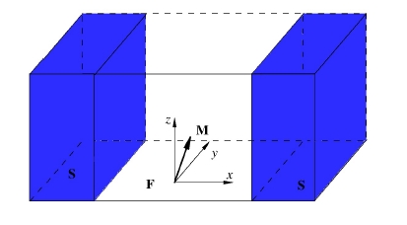
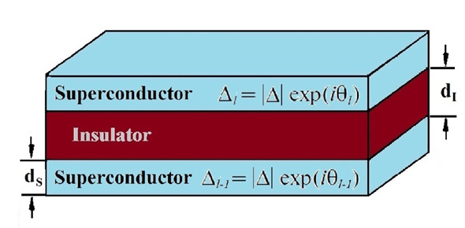
Models
Two models are considered:
The first model describes a system of long Josephson junctions (JJ) taking into account the capacitive and inductive coupling between adjacent JJs.
The second model is a model of a point anomalous JJ taking into account the spin-orbit and ferromagnetic coupling, the so-called ϕ₀ junction.
Both models are described by multiparameter systems of nonlinear differential equations. Numerical studies are characterized by a significant amount of calculations and require the use of parallel computing methods and technologies to organize high-performance computer modeling.
2/7

Slide 3
Mathematical Formulation of Problem: Model 1
Phase dynamic of the LJJ system with capacitive and inductive coupling between the contacts is described by a system of equations with respect to the phase difference ϕ_{l} and voltage V_{l} at each l-th contact :
where £ - inductive coupling matrix, β=σV₀/(d_{l} j_{c})- dissipation parameter, inductive coupling parameter S takes a value in the range 0<|S|<0.5. D_{c} - the effective electrical thickness of JJ, normalized to the thickness of the dielectric layer. s_{c} – capacitive coupling parameter. V_{l} – voltage at l-th JJ, I - external current. All quantities converted to dimensionless.
Calculation of Current-Voltage Characteristic (CVC): three steps
(1) Calculation dependence <V> on I.
At each time step, calculation of integral
using Simpson's formula.
(2) Integral
Is calculated by means of
rectangles formula.
(3) Voltage is averaged by the
number of contacts
3/7

Slide 4
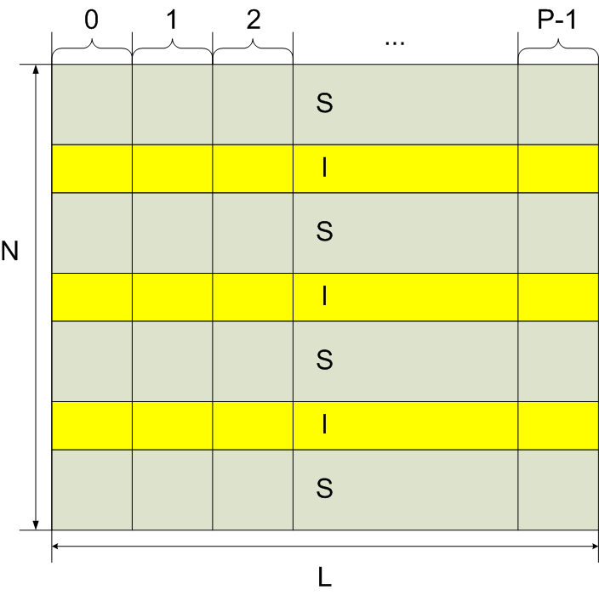
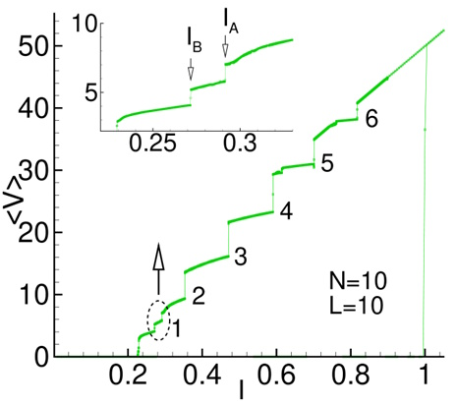
Numerical scheme: parallelism
The calculation of CVC is reduced to calculation of voltage <V> at each value external current while I changes from 0 to I_{max} and then decreases back to 0.
Parallel algorithm is based on the distribution of calculations over the nodes of a discrete grid along the x-coordinate along the length of JJ.
Each parallel MPI process is assigned its own portion of nodes of the discrete grid along the coordinate.
Each MPI process recursively calculates 4 Runge-Kutta coefficients in its x-nodes and then solutions of the system. After calculating each of the Runge-Kutta coefficients, their values ​​are exchanged between neighboring processes.
When calculating the <V>, each process first calculates averaged partial sums of v_{l}, then they are assembled into the 0th process, where the final CVC characteristic calculations are performed and written to files.
4/7

Slide 5
Mathematical Formulation of Problem: Model 2
The dynamics of magnetization in the ferromagnetic layer in the φ0-Josephson junction is described by the Landau-Livshits-Gilbert equation.
(1)
where 𝜶 is the dissipation parameter, 𝝎_{𝑭} is the normalized ferromagnetic resonance frequency. Here $\vec{H}$ is the effective magnetic field with components:
(2)
where G is the ratio of the Josephson energy to the magnetic anisotropy energy, r is the spin-orbit coupling parameter, m_{x,y,z} are the x,y,z components of the magnetic moment $\vec{m}$.
Initial conditions: m_{x}(0)=0, m_{y}(0)=0, m_{z}(0)=1. The Josephson phase difference φ can be found using the equation:
(3)
$\frac{d\vec{m}}{dt}=−\frac{ω_{F}}{1+{\vec{m}}^{2}α^{2}}\left\{[\vec{m}×\vec{H}]+α\left[\vec{m}\left(\vec{m}\vec{H}\right)−\vec{H}{\vec{m}}^{2}\right]\right\},$
$$\left\{\begin{matrix}H_{x}=0 \\ H_{y}=Gr\sin\left(φ\left(t\right)−rm_{y}\left(t\right)\right) \\ H_{z}=m_{z}\left(t\right) \end{matrix}\right.$$
$\frac{dφ}{dt}=I_{pulse}\left(t\right)−\sin\left(φ−rm_{y}\right)$,
5/7

Slide 6
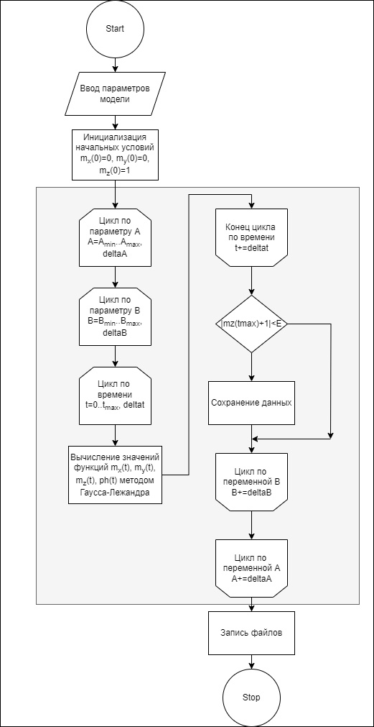
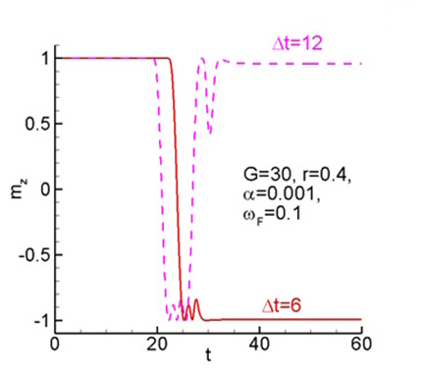
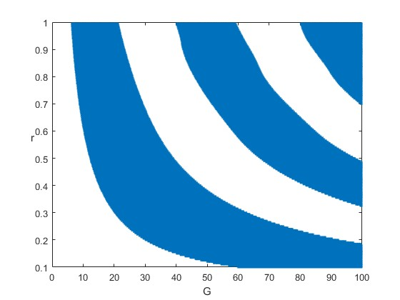
Numerical scheme: parallelism
System (2) is a Cauchy problem for a system of ordinary differential equations.
The calculations were performed in two ways: based on the four-step Runge-Kutta method and based on the two-step Gauss-Legendre method.
The aim of the study within the framework of this problem was to identify the domains of magnetic moment reversal in a point ϕ0 junction.
The parallelization is based on the distribution of points in the model parameters plane ((A, B) for example) between parallel processes/threads. The values ​​of A, B, in which the condition |m_{z}(T_{max})+1|<ε is satisfied, are saved in the structure and written to the output file.
6/7

Slide 7
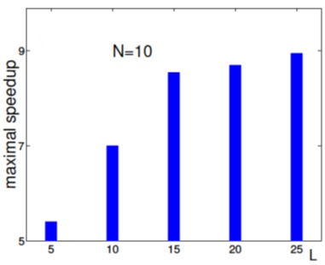
Effect of Parallel implementation
Maximal speedup obtained on HybriLIT cluster depending on the contact length for problem 1.
Maximal speedup obtained on the HybriLIT cluster and the Govorun supercomputer with a total of 40,000 points for problem 2.
By using parallelism, it was possible to significantly speed up the execution time of calculations in numerical studies of the presented models in wide range of parameters.
7/7

