Slide 1
Status of the BM@N Setup
Piyadin S.M.
04.03.2025
Notes:
The title of my presentation is Detector installation experimental zone.

Slide 2
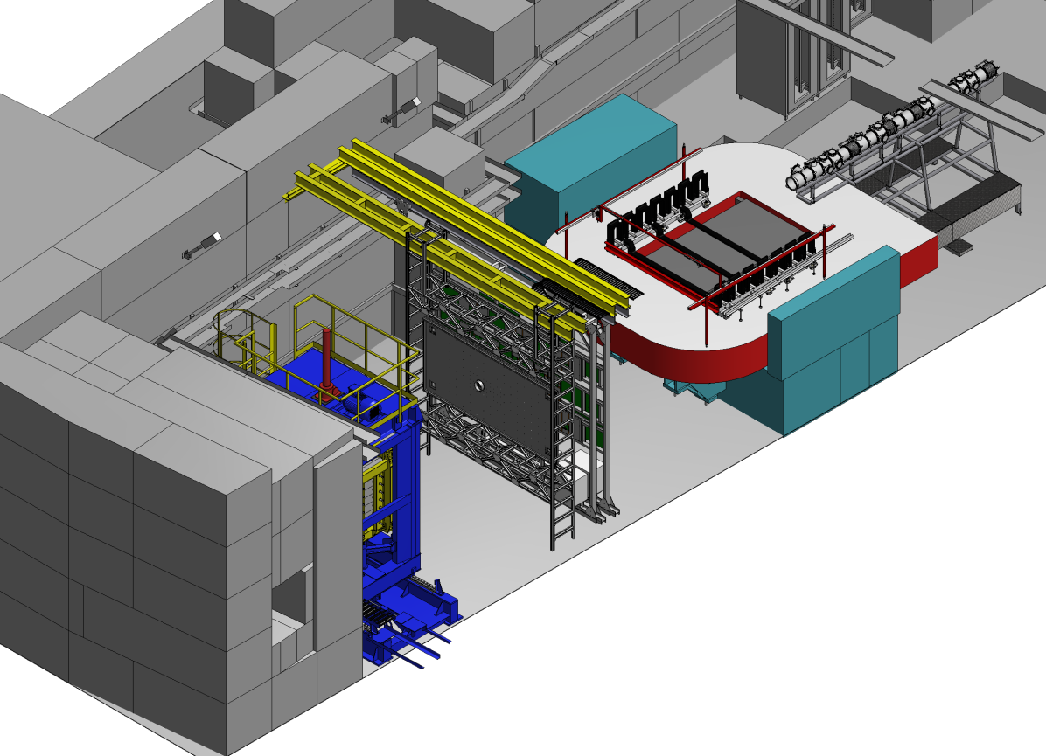
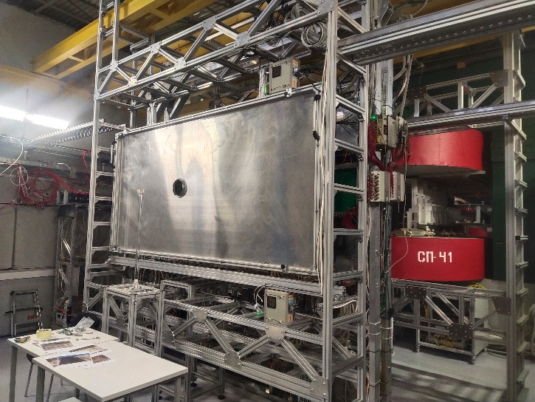
ScWall detector
The following mechanical support elements have been prepared:
Kruglova I.
1. Mechanical support materials: Yes
2. Supporting structure for mechanical support : Yes
3. Brackets for fastening the supporting structure : Yes
4. Mechanical Support Project: Yes
5. The detector is ready for installation: Yes
Kruglova I.
ScWall is completely installed in the experimental hall now
Novozhilov S.
&
Martovitsky E.

Slide 3
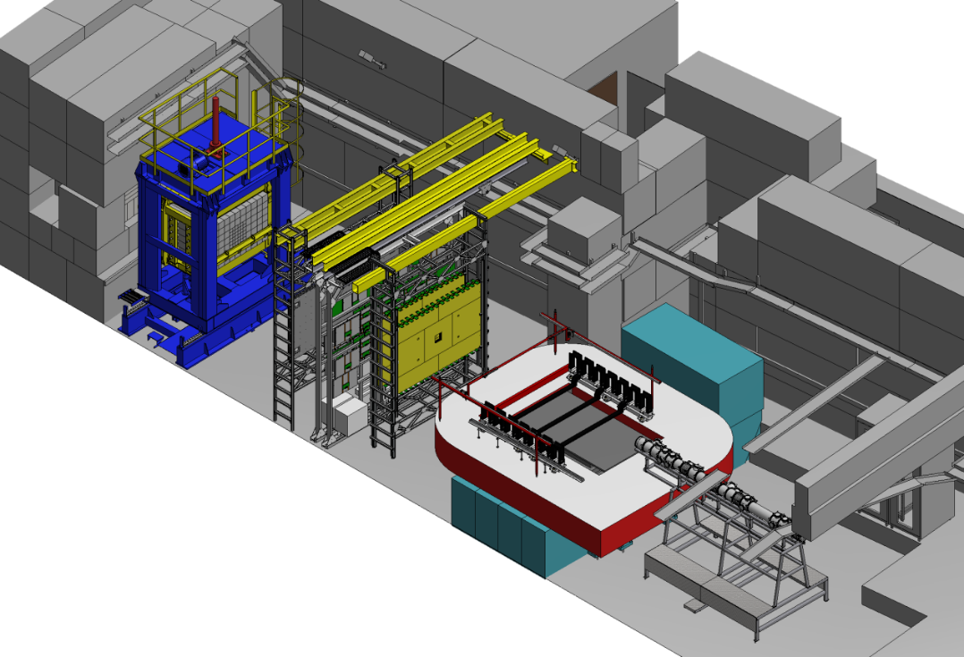
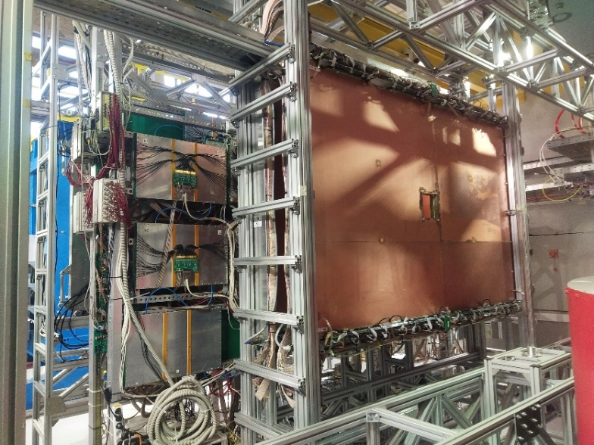
Installation of 2 CSC big detectors
The following mechanical support elements have been prepared:
1. Mechanical support materials: Yes
2. Supporting structure for mechanical support : Yes
3. Brackets for fastening the supporting structure : Yes
4. Mechanical Support Project: Yes
5. The detector is ready for installation: Yes
Kruglova I.
2 CSC big are completely installed in the experimental hall now
Novozhilov S.
&
Martovitsky E.
Kruglova I.
Notes:
All infrastructure for installing the detector is ready
Both CSC big planes will be installed before the detector

Slide 4
The location of new vacuum boxes to the target of the BM@N setup
BD
SiBT3
BC2
VC
SiBT2
SiBT1
BC1
Kruglova I.
Box for profilometer size 128x128mm
The contract for the production of this box has already been drawn up.
box for scintillation detector
Kruglova I.
Box for profilometer size 200x200mm
Notes:
Currently, work is underway to create a mechanical support for mounting the ScWall and large CSC

Slide 5
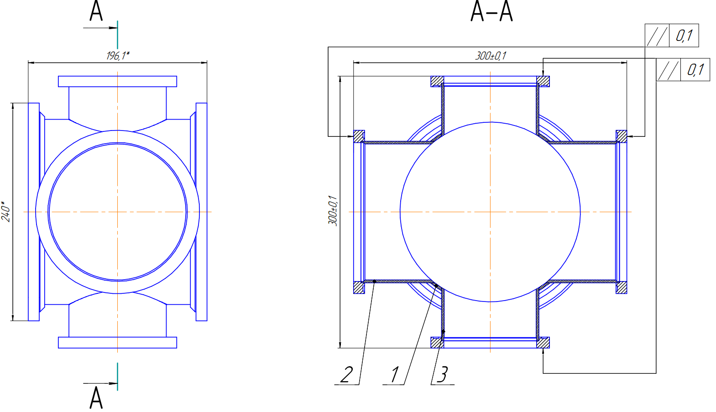
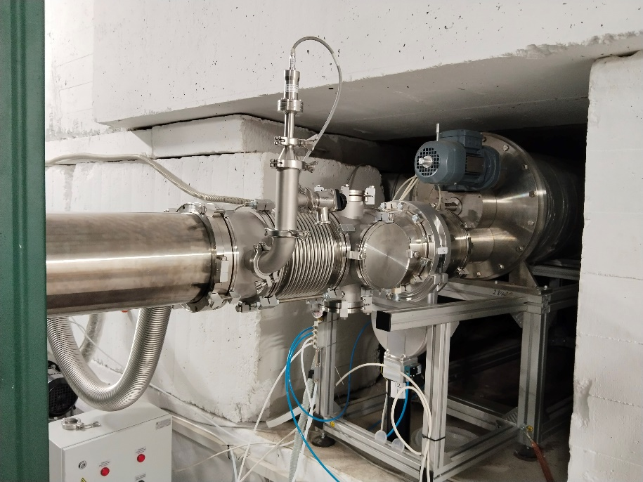
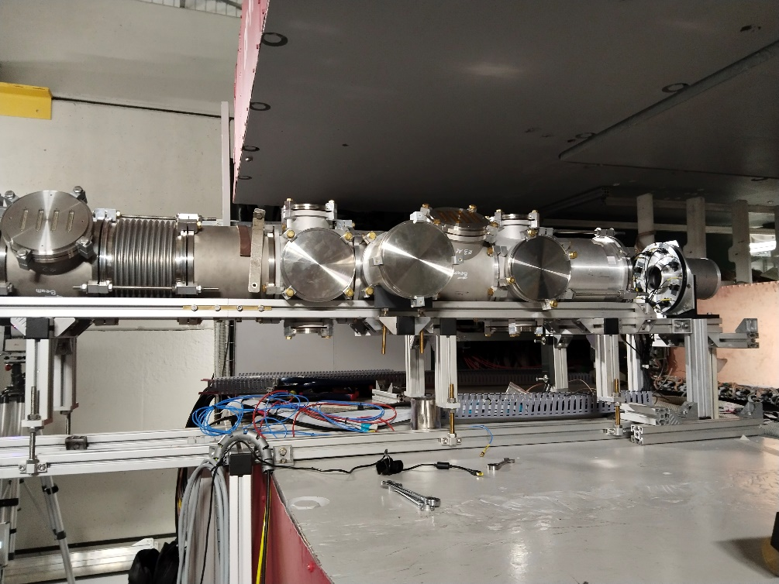
New configuration of vacuum boxes for BC0, BC1, BC2 & VC detectors
Novozhilov S.
&
Martovitsky E.
BC0
ø160mm
ø160mm
VC
BC2
Vacuum box for trigger detectors installed in front of the target station
The beam pipe to the target is being adjusted taking into account the installation and new configuration of the vacuum boxes.
Novozhilov S.
&
Martovitsky E.
Notes:
Currently, work is underway to create a mechanical support for mounting the ScWall and large CSC

Slide 6
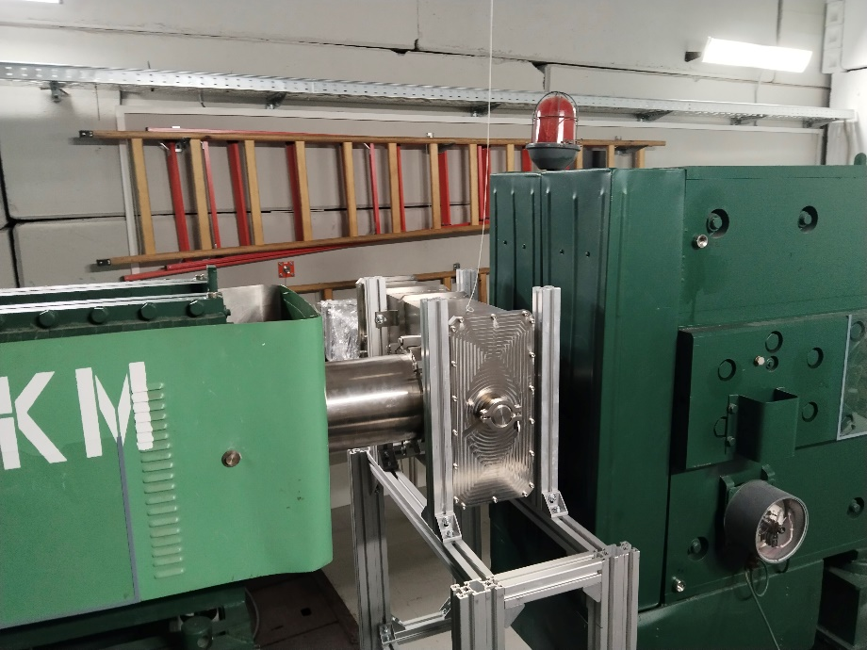
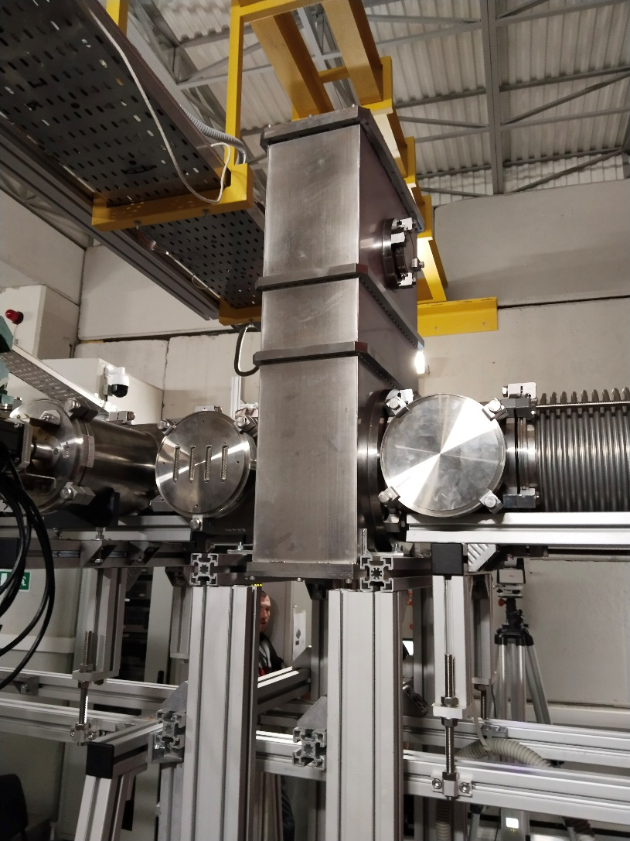
New configuration of vacuum boxes for profilometer
Novozhilov S.
&
Martovitsky E.
Novozhilov S.
&
Martovitsky E.
The vacuum box for the profilometer is installed between the quadrupole lenses К200 and the VKM magnet.
The vacuum box for the profilometer is installed between the SP-57 correction magnet and the SP-41 analyzing magnet.
Notes:
Currently, work is underway to create a mechanical support for mounting the ScWall and large CSC

Slide 7
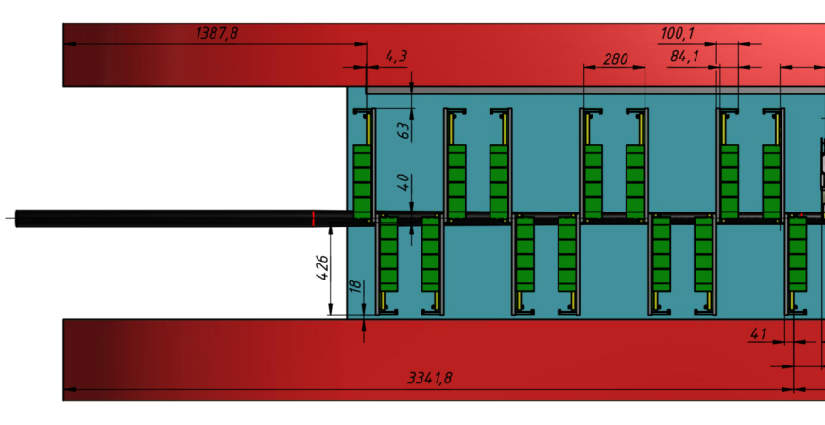
Installation of Gem detectors
Kruglova I.
Demonstration of distances between the surface of the analyzing magnet and the GEM detectors
3D model of GEM detectors. Side view
3D model of GEM detectors. Top view
Notes:
The assembly inside the SP-41 magnet was started with the installation of GEM detectors.
The difficulty of installing Gem Detectors is that the detectors are very large and close to each other.
Each GEM detector was installed and immediately connected and tested.
After installing and connecting the detector, the adjustment procedure was performed.
And so 14 detectors,

Slide 8
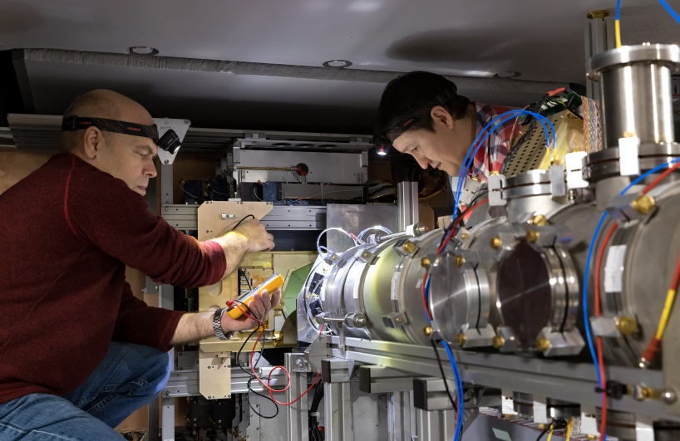
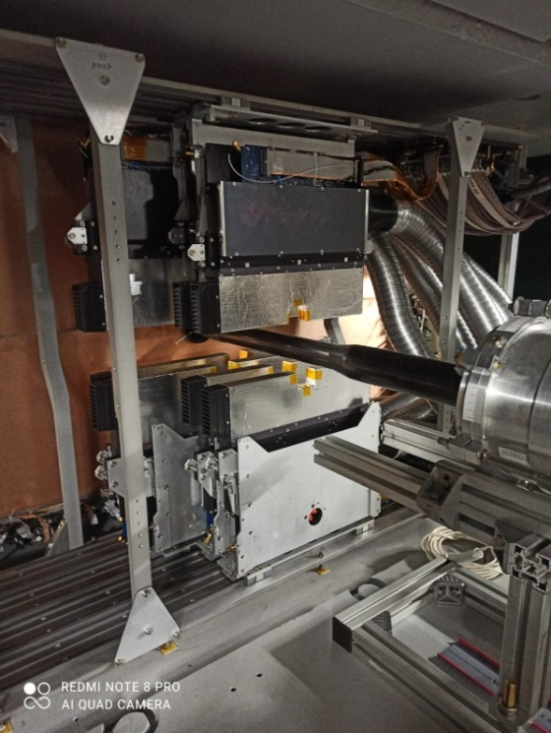
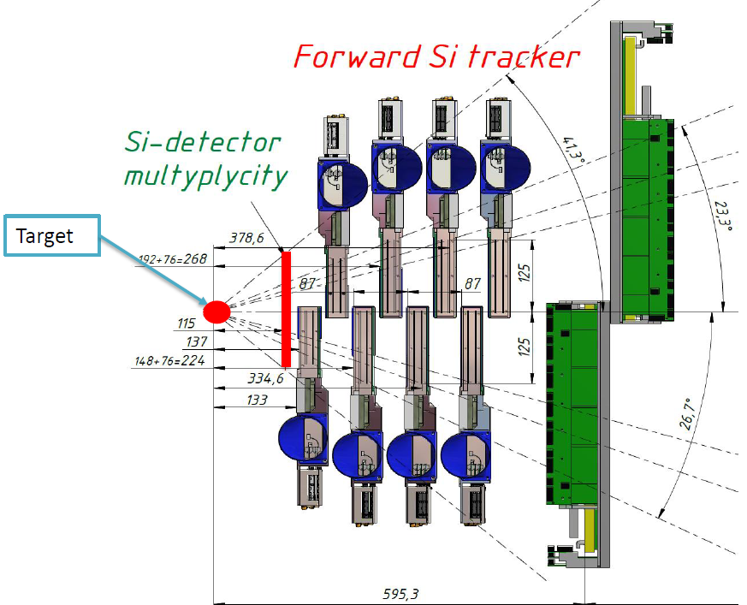
Installation of Forward Si detectors
N.Zamyatin will talk in more detail about the operation of Si detectors
forward SI installed in BM@N
3D view of forward Si
Notes:
After installing the first up GEM detectors, 8 forward Si detectors were installed.

Slide 9
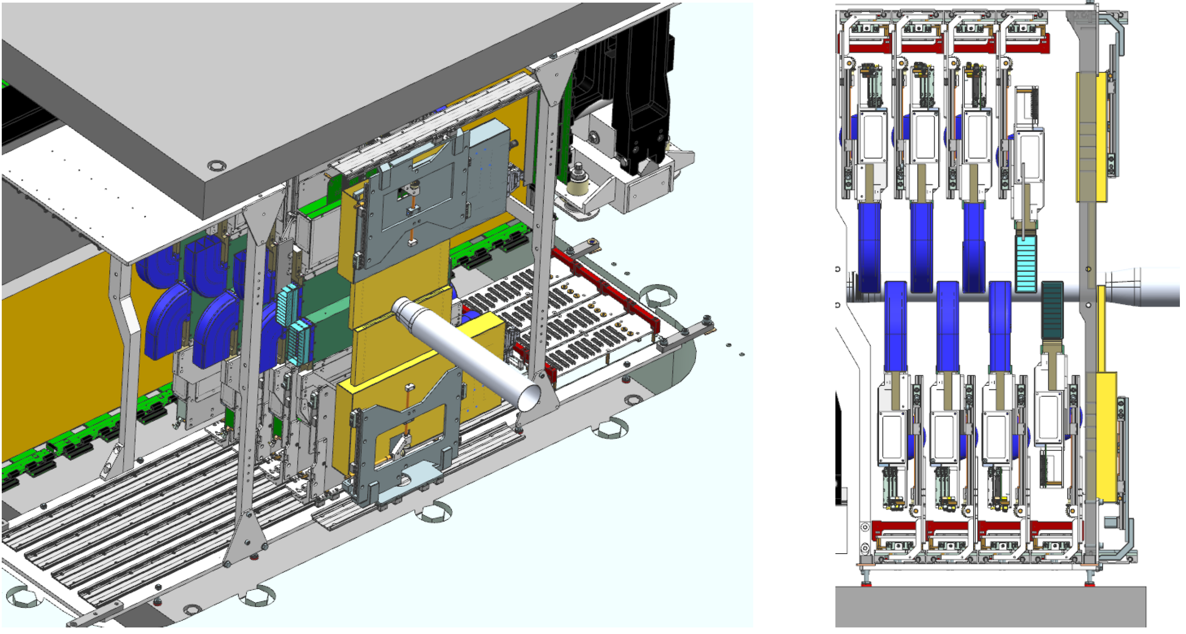
Installation of Si-station based on STS modules
D. Dementev will talk in more detail about the operation of Si-station

Slide 10
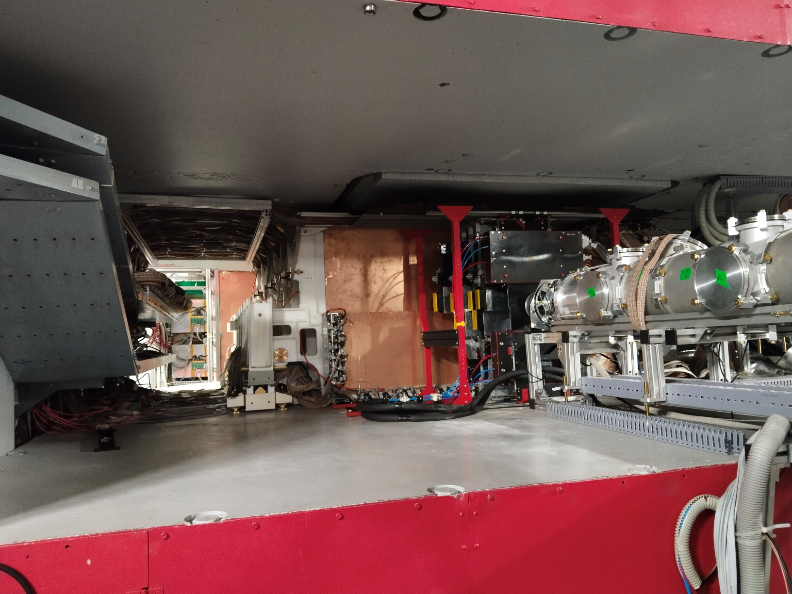
Inside the SP-41
Notes:
The assembly inside the SP-41 magnet was started with the installation of GEM detectors.
The difficulty of installing Gem Detectors is that the detectors are very large and close to each other.
Each GEM detector was installed and immediately connected and tested.
After installing and connecting the detector, the adjustment procedure was performed.
And so 14 detectors,

Slide 11
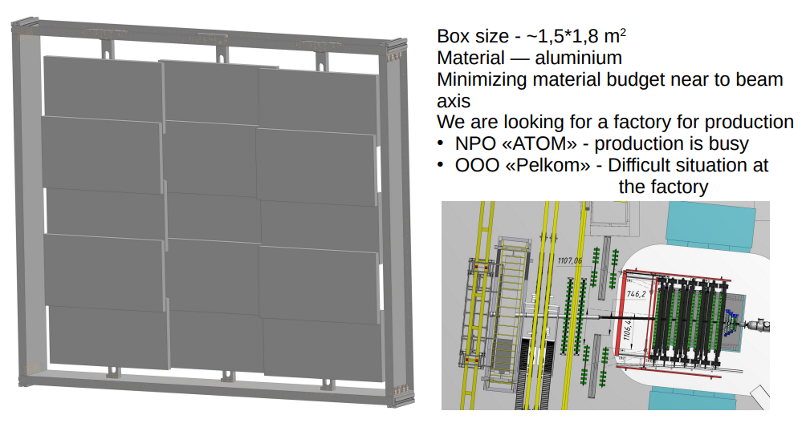
ToF400 modernization
We decided to expand ToF400 acceptance.
To do this we will have to change the detector boxes.
The aluminum box guides are currently fully manufactured
The aluminum box guides are currently fully manufactured
Kruglova I.
M. Rumyantsev will talk in more detail about the operation of ToF400.
Notes:
We decided to expand Toph400 acceptance;
To do this we will have to change the detector boxes.
M. Rumyantsev will talk in more detail about the operation of ToF detectors.

Slide 12
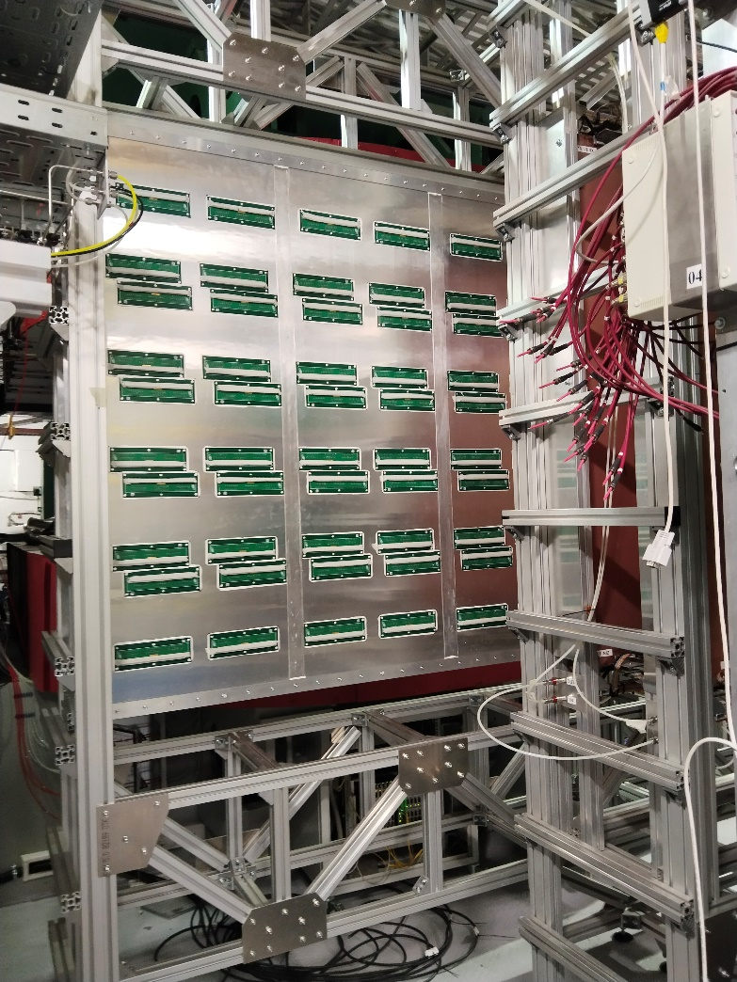
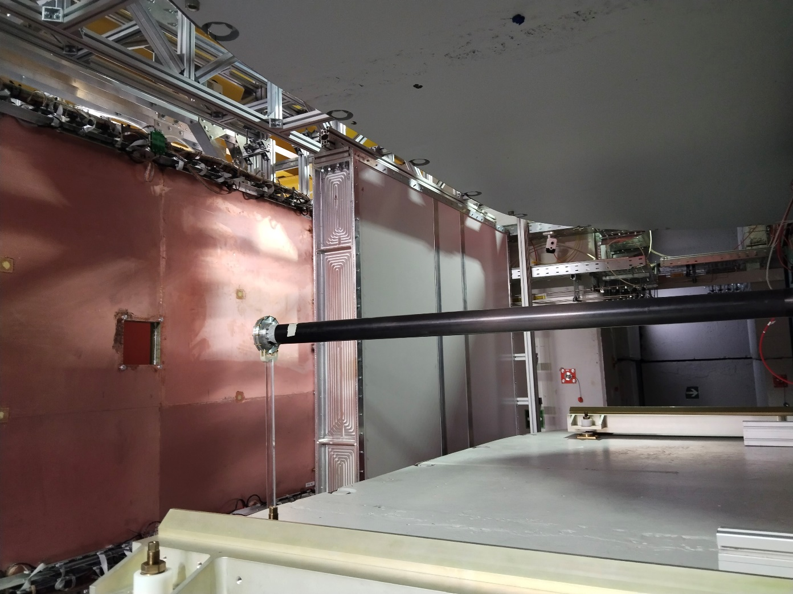
ToF400 modernization
The aluminum box guides are currently fully manufactured
M. Rumyantsev will talk in more detail about the operation of ToF400.
Notes:
We decided to expand Toph400 acceptance;
To do this we will have to change the detector boxes.
M. Rumyantsev will talk in more detail about the operation of ToF detectors.

Slide 13
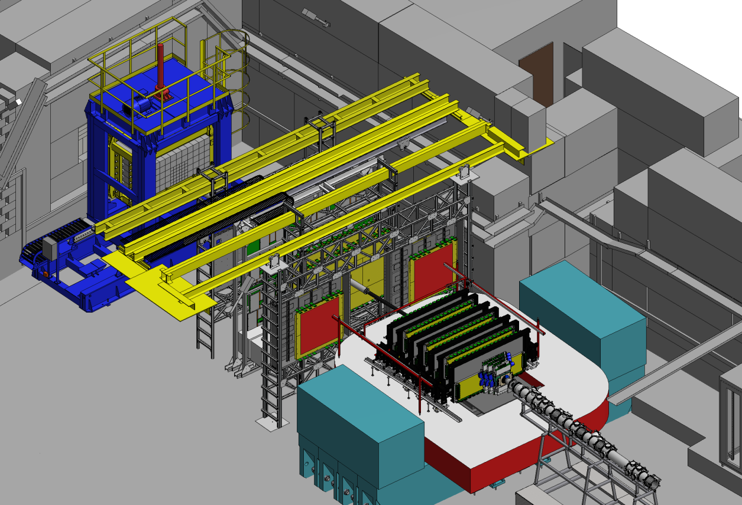
Installation of 2 ToF400 & 4 CSC & aluminum beam pipe
Kruglova I.
2.
1.
3.
We will be able to install the last 4 СSC only after the 2 ToF400 detectors are fully installed.
Kruglova I.
Notes:
After installing all GEM detectors, 2 CSC 1x1 m will be installed.
The next stage will be the installation of 2 new ToF400 detectors
3. We will be able to install the last 2 СSC only after the 2 ToF400 detectors are fully installed.

Slide 14
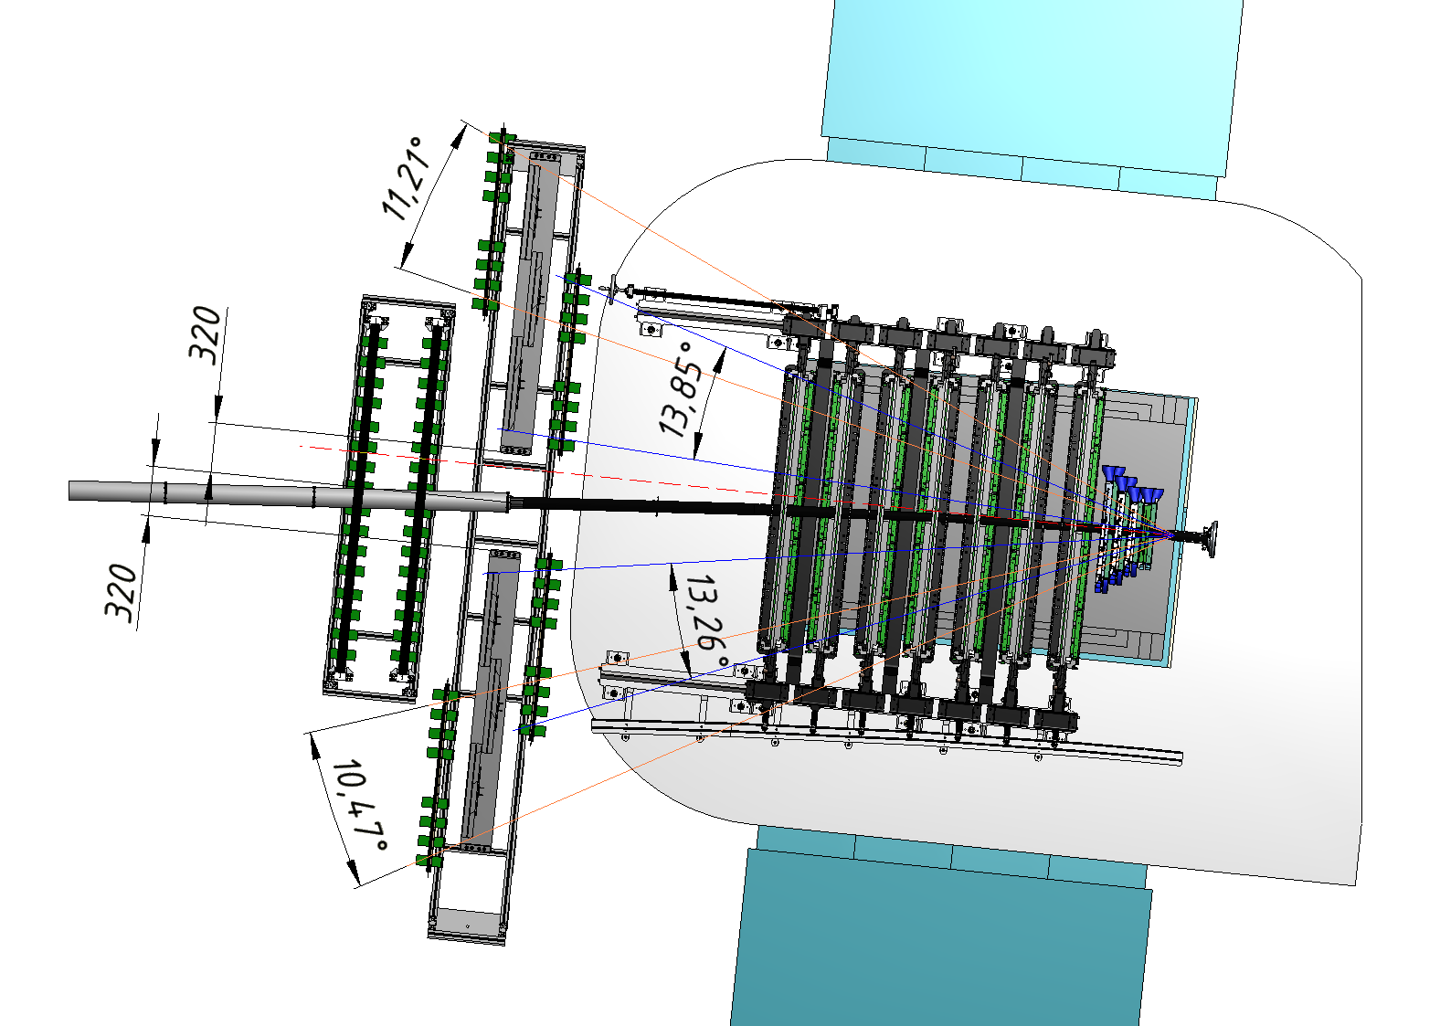
Installation of 2 ToF400 & 4 CSC & aluminum beam pipe
Kruglova I.
Notes:
After installing all GEM detectors, 2 CSC 1x1 m will be installed.
The next stage will be the installation of 2 new ToF400 detectors
3. We will be able to install the last 2 СSC only after the 2 ToF400 detectors are fully installed.

Slide 15
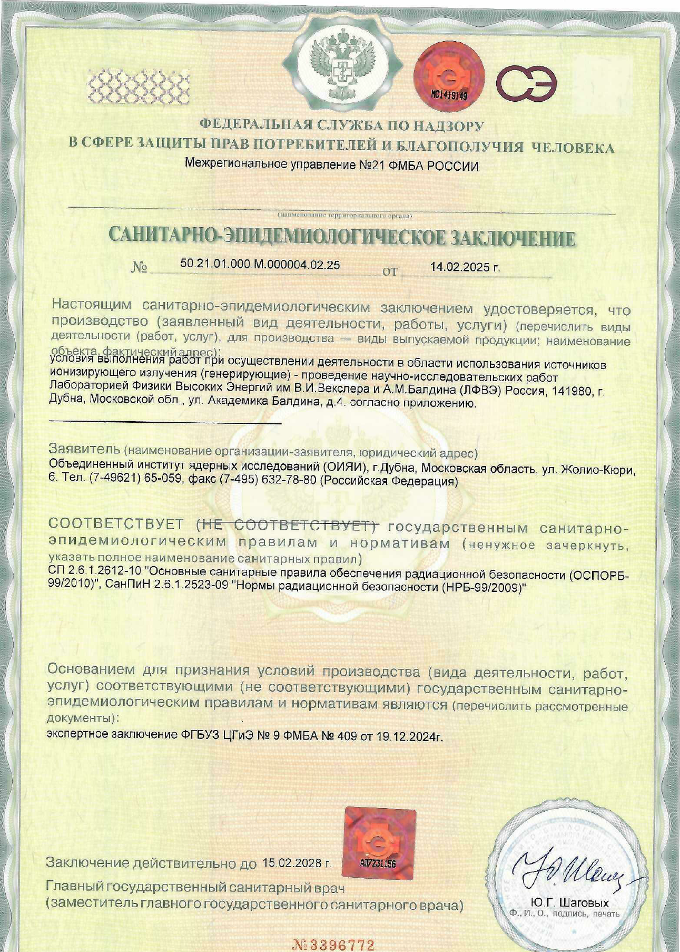
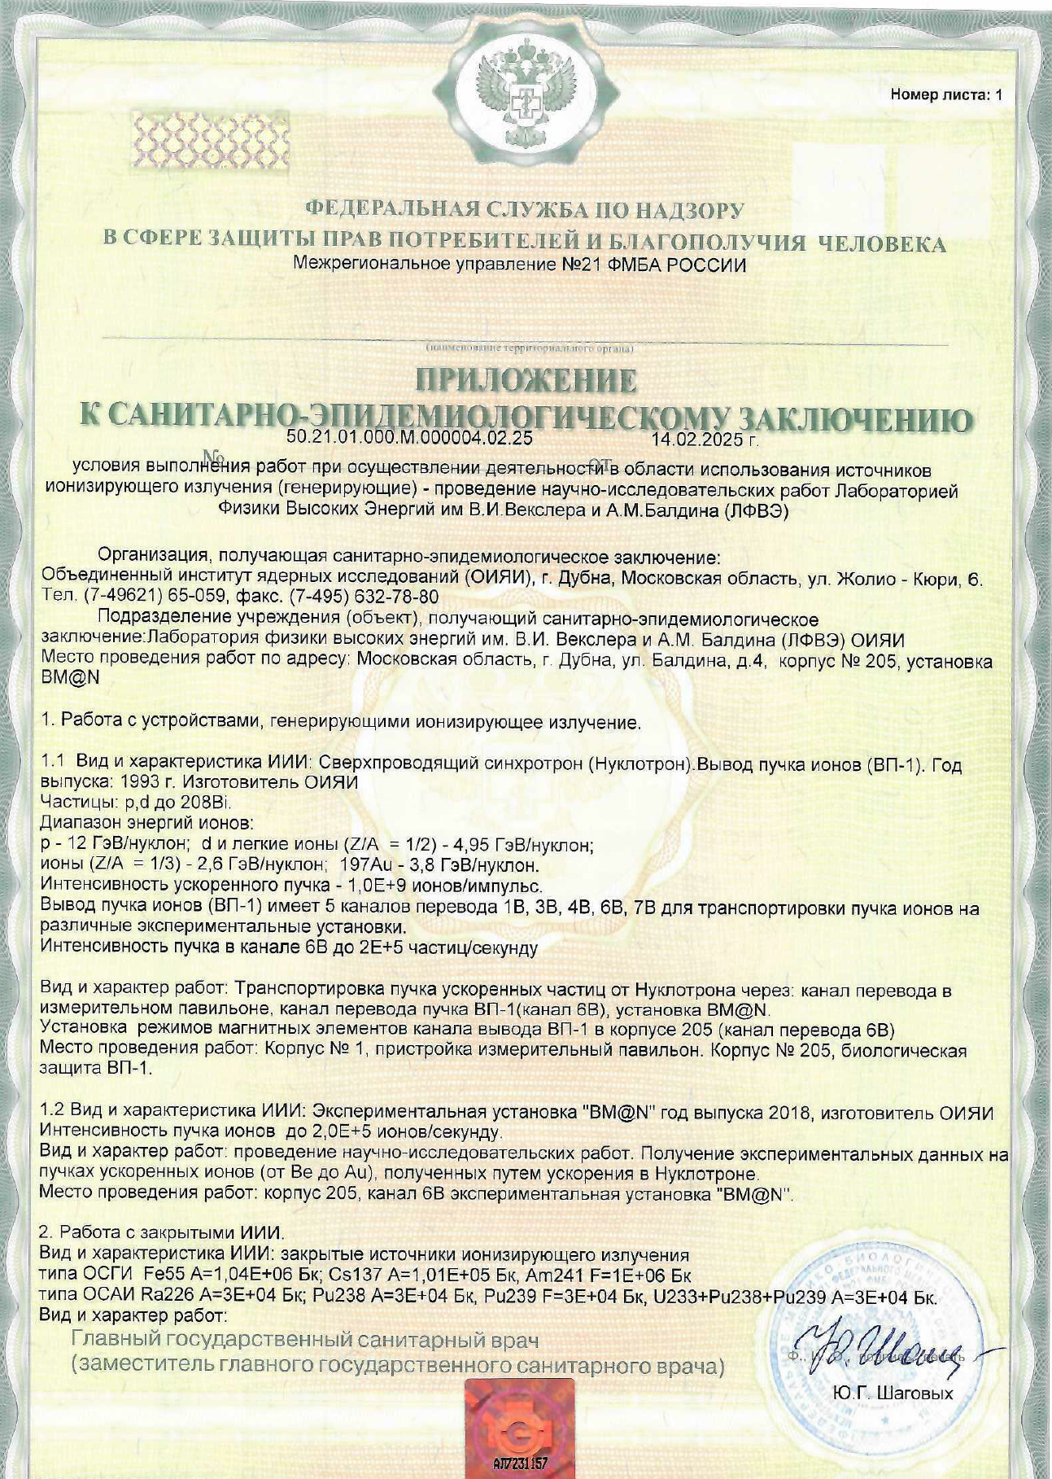
Sanitary and Epidemiological Conclusion on the BM@N setup
14.02.2025

Slide 16
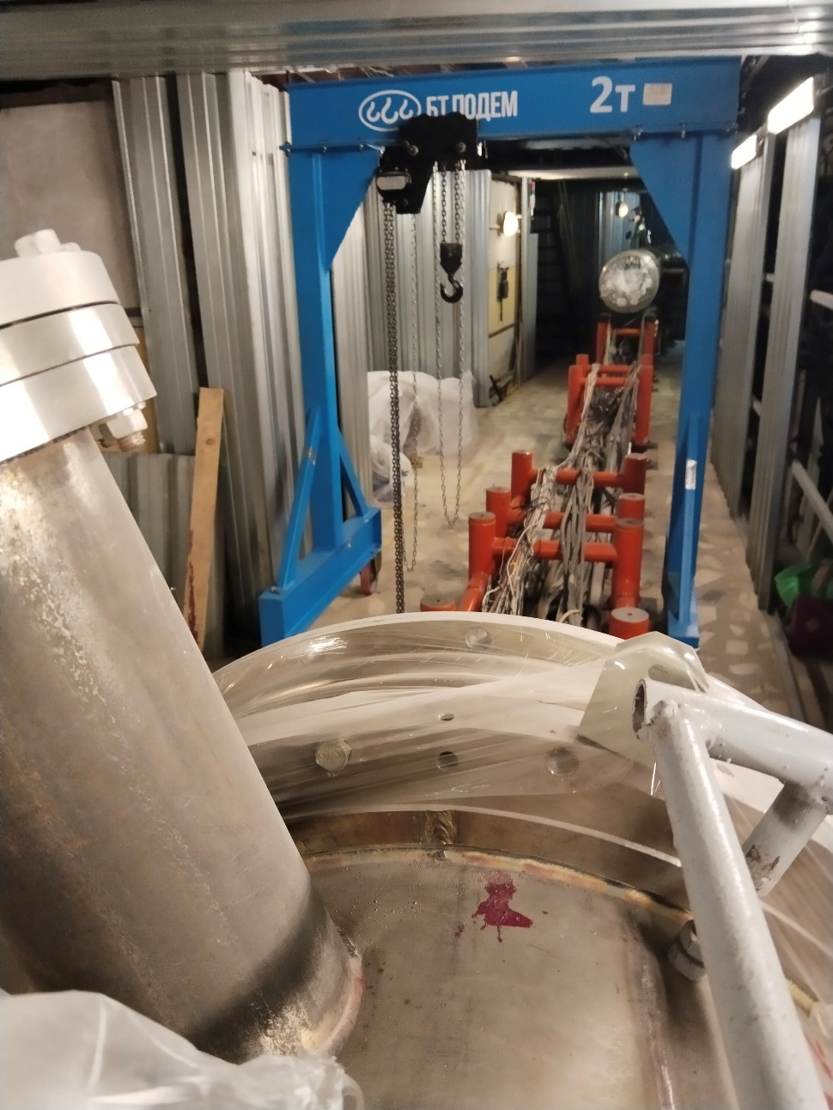
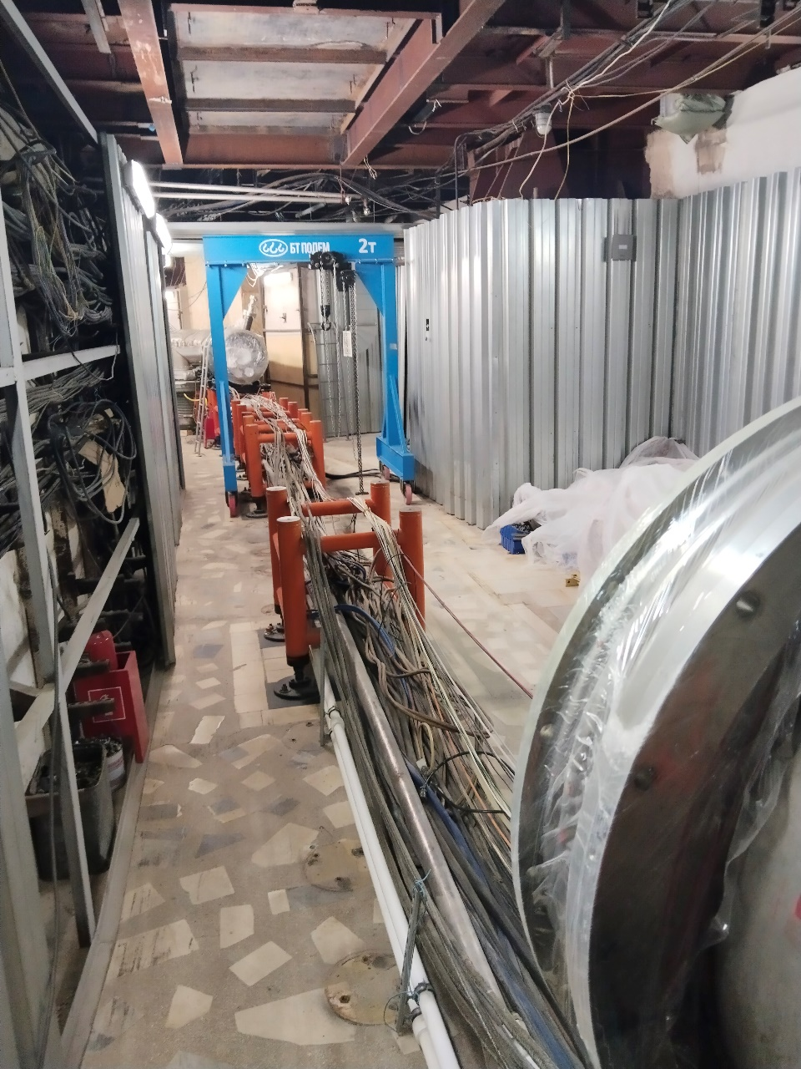
Status of Nuclotron
03.03.2025
Notes:
After installing all GEM detectors, 2 CSC 1x1 m will be installed.
The next stage will be the installation of 2 new ToF400 detectors
3. We will be able to install the last 2 СSC only after the 2 ToF400 detectors are fully installed.

Slide 17
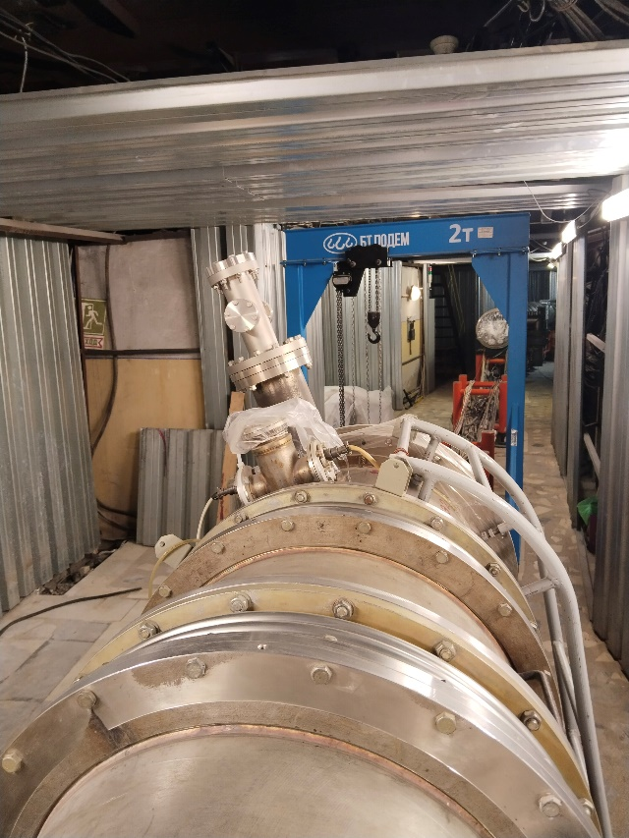
Status of Nuclotron
Installation of two elements in the Nuclotron for NICA :
1. Kicker magnet (ready for installation);
2. Lambertson magnet (will be ready after 09.03.2025).
Commissioning works at the accelerator complex:
20.03.2025 - Start of cooling the Nuclotron
13.04.2025 - Setting up the Nuclotron's slow beam extraction system
18.04.2025 - Beam transportation in channel VP1 to BM@N
Notes:
After installing all GEM detectors, 2 CSC 1x1 m will be installed.
The next stage will be the installation of 2 new ToF400 detectors
3. We will be able to install the last 2 СSC only after the 2 ToF400 detectors are fully installed.

Slide 18
Conclusions
All work on the design and creation of mechanical supports has been carried out taking into account the modernization of the external tracking system of the BM@N facility.
Installation of the central tracking system inside the SP-41 magnet has been completed after the process of modernization of the detectors themselves.
ScWall & 2 big CSCs have been installed in the experimental hall of the BM@N facility.
Mechanical support for 2 new ToF400 & 4 CSCs have been installed in the experimental hall.
The first ToF400 box has been installed.
It is necessary to install all BM@N elements by 15.04.2025

Slide 19
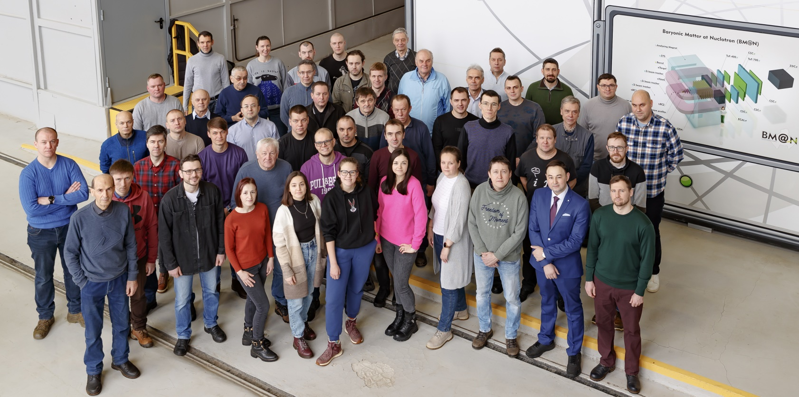
THANK YOU FOR YOUR ATTENTION

