Slide 1


Status of Forward Silicon detector on BM@N
N. Zamyatin on behalf of Forward Silicon Detector team
Analysis and Detector Meeting of the BM@N Experiment at NICA, 04-05 March 2025

Slide 2


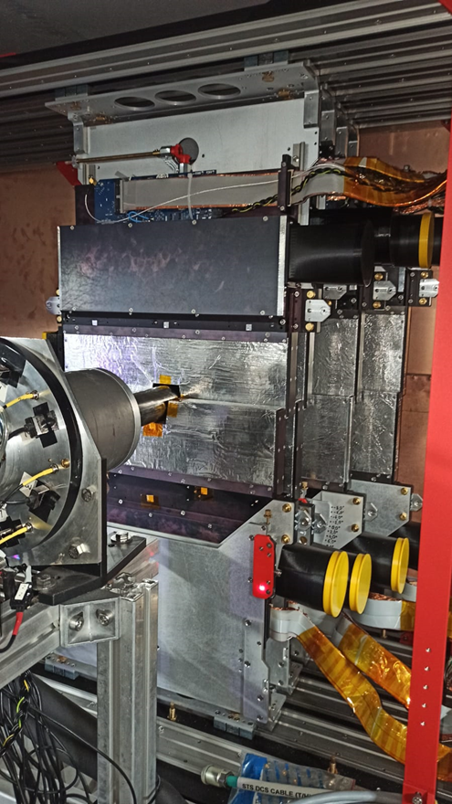
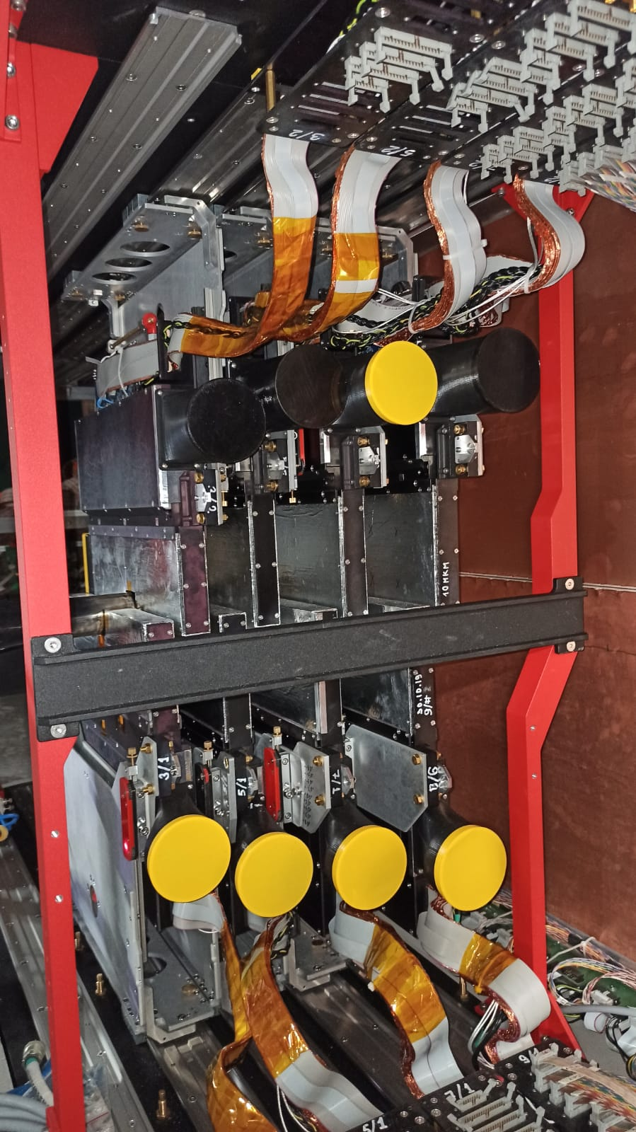
FWD-Si relative to the target on the BM@N experimental hall for the April-June-2025 session
All 8 FSD planes were installed and adjusted in the SP-41 magnet:
Reference points
After preliminary positioning of each half-plane relative to the beam pipe, the coordinates of the reference points on the planes in the coordinate system of the installation were measured using laser geodesy and the reversals (distortions) of the planes around the axes (ϕ_{x}; ϕ_{y}; ϕ_{z}) were determined;
Adjustments were made to minimize distortions (the difference between the corresponding coordinates of the two reference points is no more than 0.3 mm) and the final measurement of the coordinates of the reference points (with an accuracy of +/-0.01 mm).
Y
ϕy
ϕz
Z
X
ϕx

Slide 3
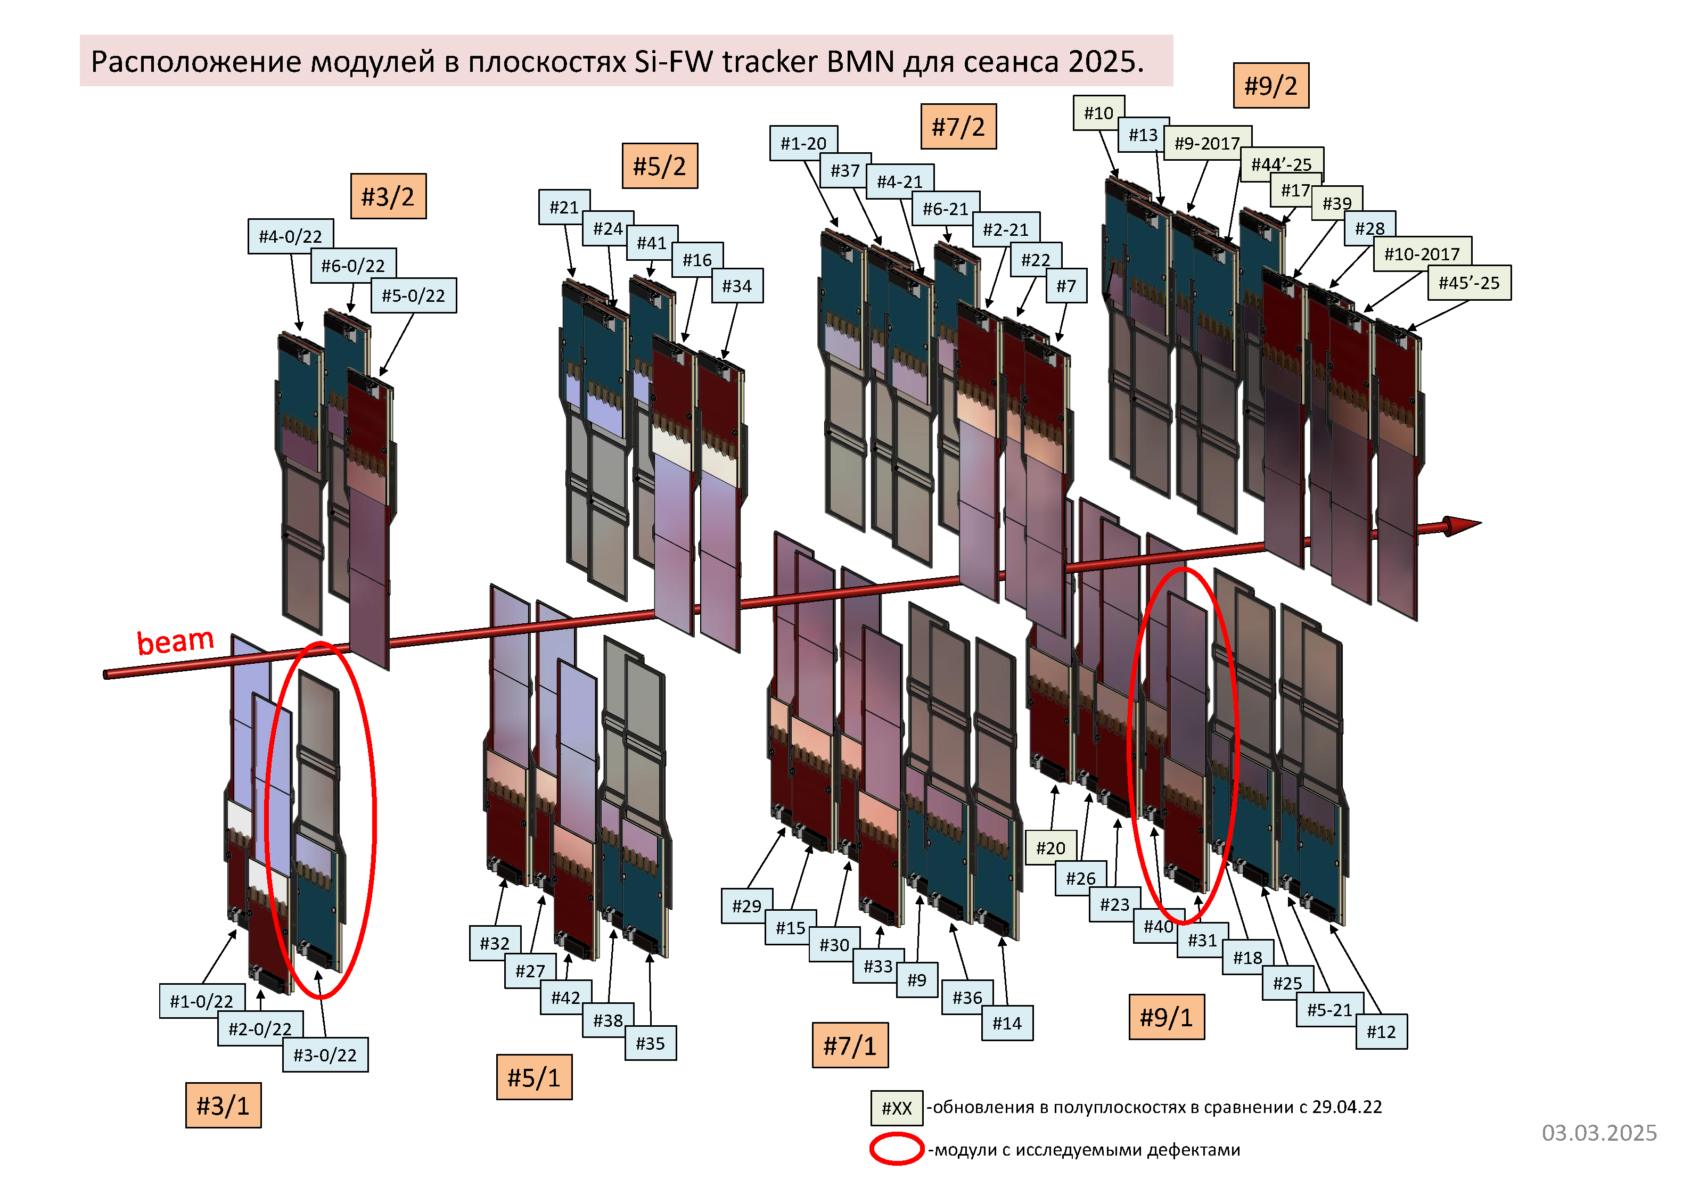

Slide 4
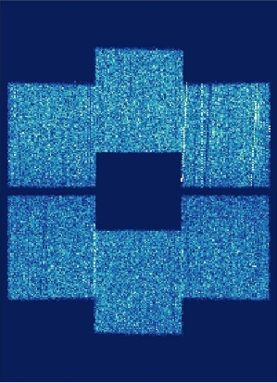
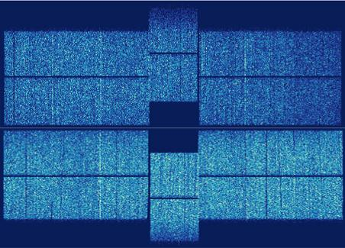
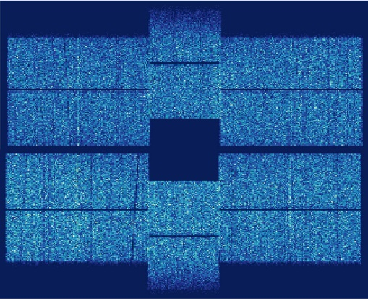
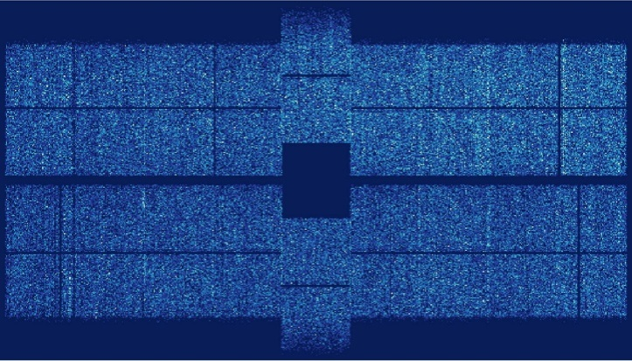
FSD: after replacing
Cosmic tests station 1
Cosmic tests station 3
93643 hit entries
165513 hit entries
Beam hole
111664 hit entries
All dead zones have been eliminated!
319725 hit entries
Cosmic tests station 2
Cosmic tests station 4
201548 hit entries
124789 hit entries
198035 hit entries
138624 hit entries
E.V. Martovitsky; D.D. Chemezov

Slide 5
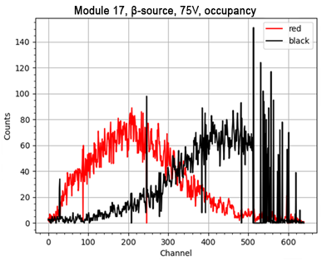
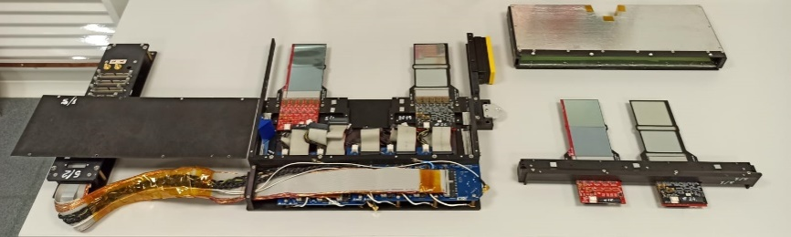
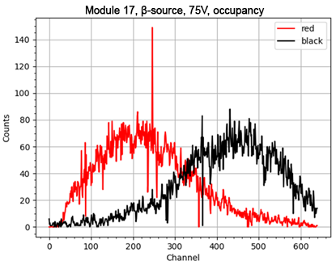
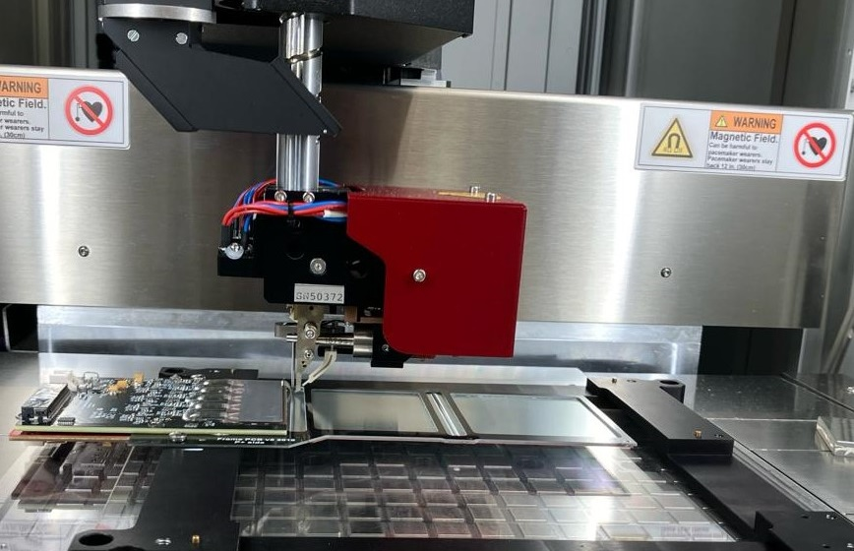
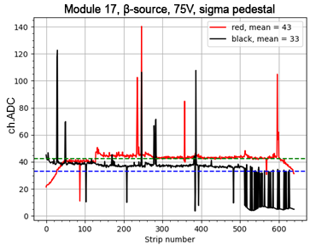
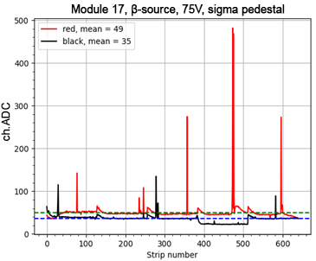
FEE board replacing
Mod #17
Mod #17
Bad zone Chip #5
To eliminate the dead zones it was necessary to assemble a new FEE board completely, 5 ASICs were spent to eliminate each of defects. The old boards were disconnected from the modules and replaced with a new ones. Total: 9 new black boards (p+ strips) were built, 45 VATAGP 7.2 ASICs were used (30 spare ASICs available).
Before replacement
After replacement
Yu.A. Kopylov; O.G. Tarasov

Slide 6
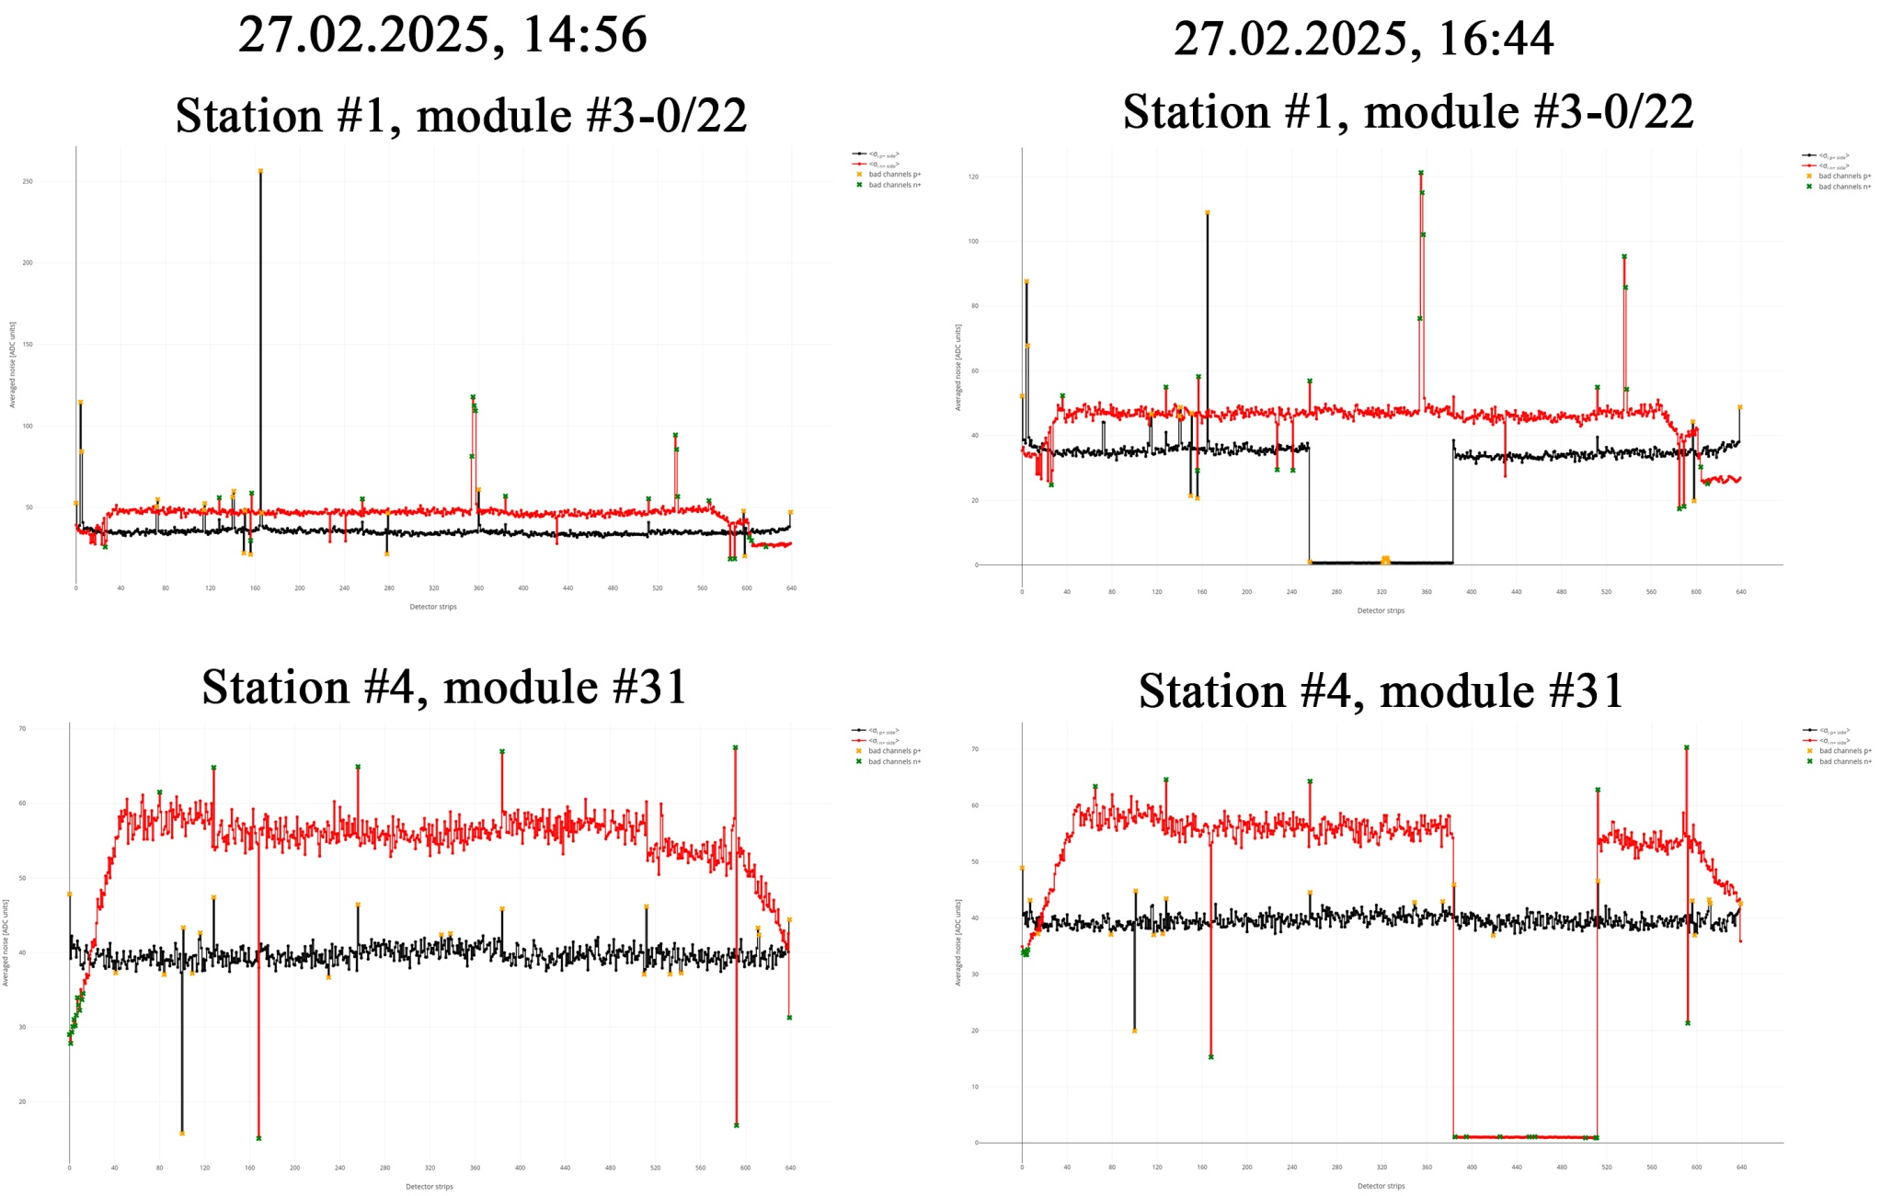

Slide 7
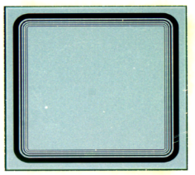
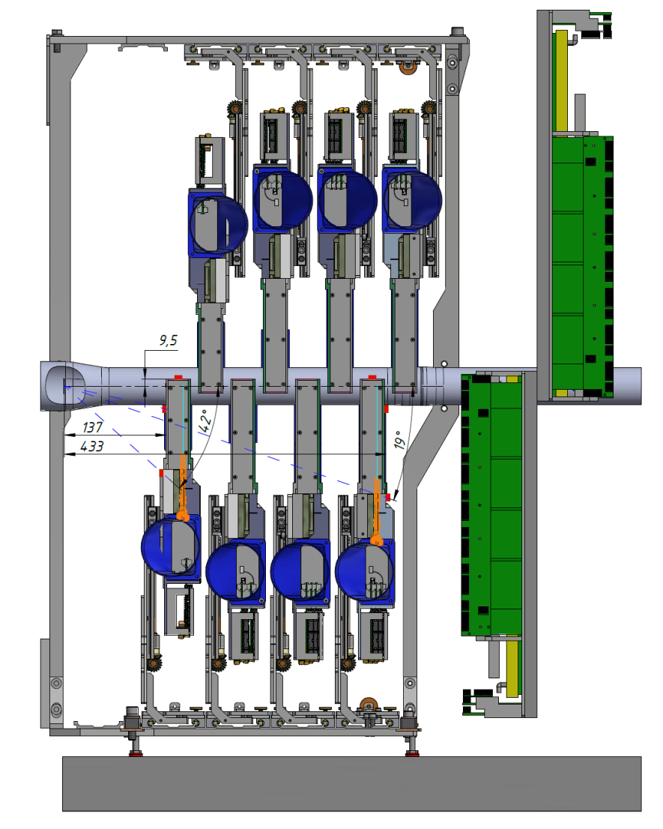
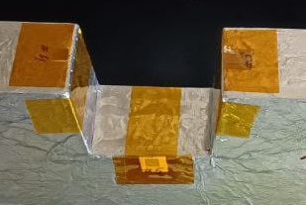
Radiation Si-monitors on FSD region for equivalent neutron fluence measurement
Si- pin-detector (rad_monitor) :
- Detectors size: (5×5×0,3) mm³
- Detectors thickness: 300 μm
- Active area: 13 mm²
5mm
5mm
FSD
GEM
ΔI=α_{I}×V×Ф
Y
Z
ΔI = I_{ф} − I₀, (A):
I_{ф} – dark current after irradiation;
I₀ - dark current before irradiation;
α_{I} = (5±0,5)·10⁻¹⁷ (A×cm⁻¹) – radiation damage constant-Si (for neutrons 1MeV at +20°);
V, (cm³) – volume of SCR (spice charge region at U_{fd});
Ф, (cm⁻²) – eq. neutron fluence (1 MeV)
target
Si-det.
FEE

Slide 8
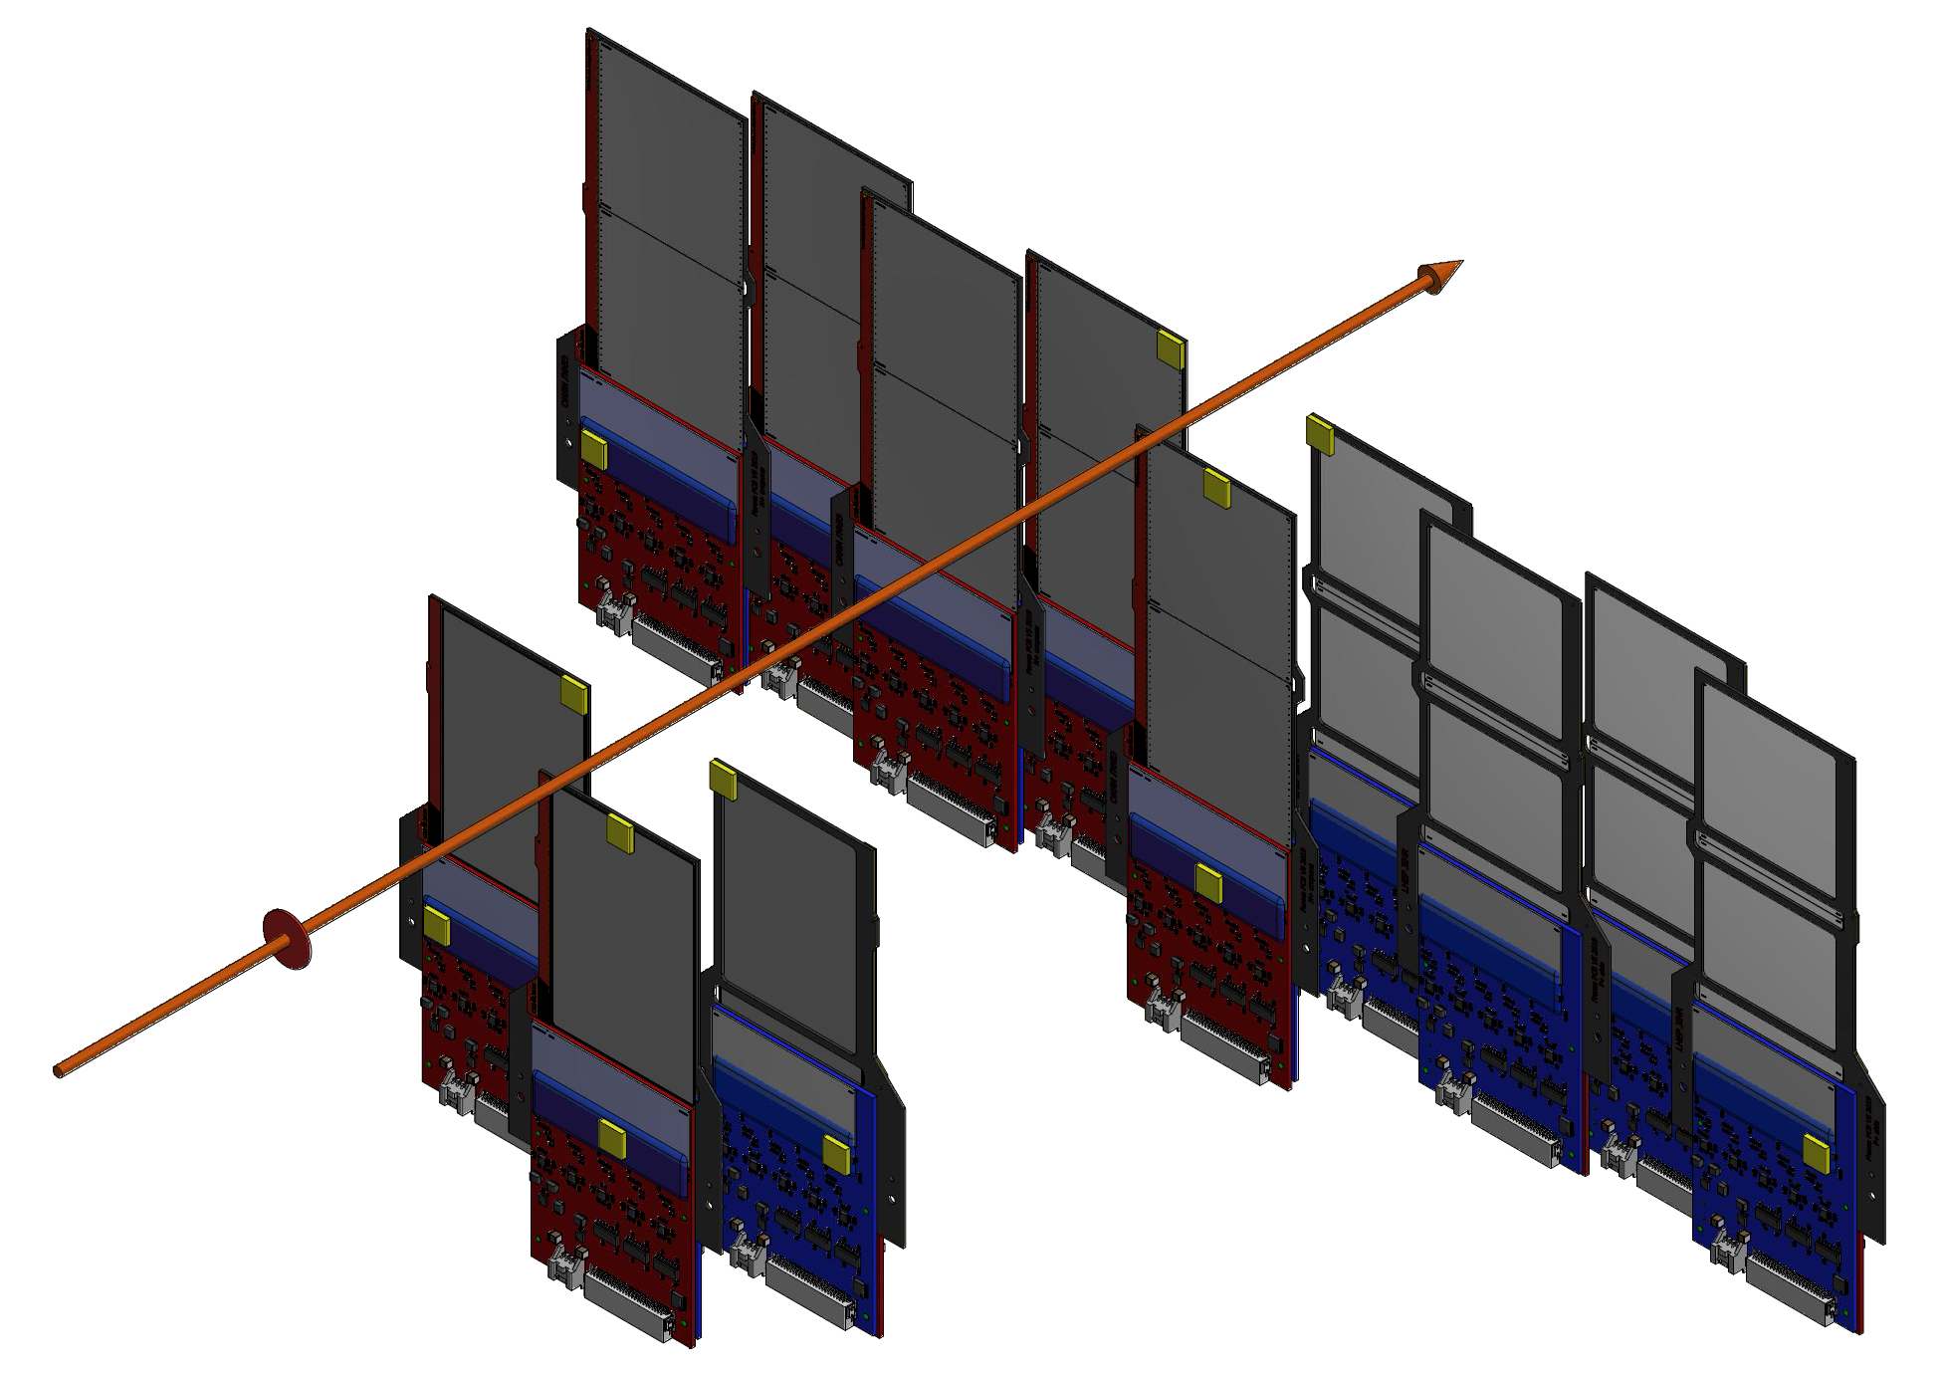
Radiation Si-monitors on FSD region for equivalent neutron fluence measurement
# Si-monitors | L – the distance from the center of the target to the center of the Si-monitor (mm)
1 | 156
2 | 137
3 | 156
4 | 197
5 | 190
6 | 197
7 | 415
8 | 432
9 | 415
10 | 532
11 | 438
12 | 532
Station #4
beam
7
10
9
8
1
3
L
2
4
11
target
Y
Z
5
6
12
Si-monitors
X
Station #1

Slide 9
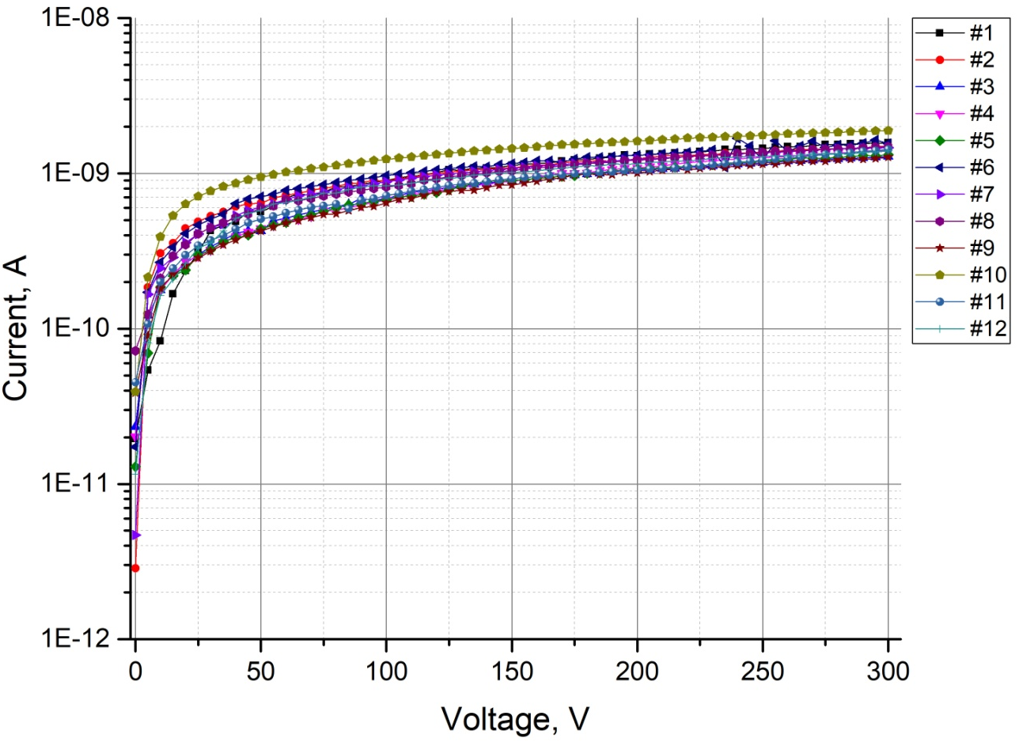
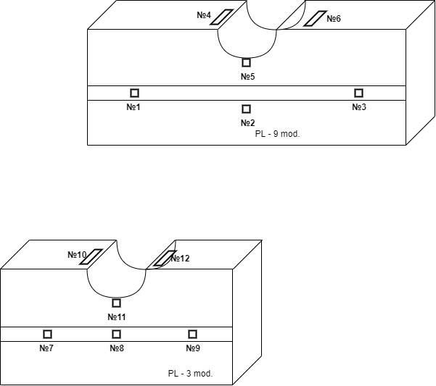
PAD detectors-monitors are installed on the FSD planes №1 and №4
Detector’s number | d, mm | S, mm² | V, mm³ | I, nA (V_{op}= 100V) (before irradiation) | Expected Ф, cm⁻² | Expected ΔI, nA (after irradiation)
1 | 0,248 | 13 | 0,003224 | 0,898 | 1×10¹⁰ | 1,61
2 | 0,250 | 13 | 0,00325 | 0,885 |  | 1,63
3 | 0,242 | 13 | 0,003146 | 0,691 |  | 1,57
4 | 0,248 | 13 | 0,003224 | 0,673 |  | 1,61
5 | 0,241 | 13 | 0,003133 | 0,671 |  | 1,57
6 | 0,249 | 13 | 0,003237 | 0,970 |  | 1,62
7 | 0,241 | 13 | 0,003133 | 0,882 |  | 1,57
8 | 0,249 | 13 | 0,003237 | 0,816 |  | 1,62
9 | 0,238 | 13 | 0,003094 | 0,646 |  | 1,55
10 | 0,253 | 13 | 0,003289 | 1,23 |  | 1,64
11 | 0,250 | 13 | 0,00325 | 0,719 |  | 1,63
12 | 0,242 | 13 | 0,003146 | 0,835 |  | 1,57

Slide 10
Current situation on FSD installation and tests on BM@N experimental hall, list of works to be done
In February-2025, FSD assembly, alignment and tests were performed on the BM@N experimental hall. By using of the developed device for coordinate planes position adjustment the alignment accuracy of 0.3 mm with XYZ axes was achieved. The accuracy of measurement of the reference points of the planes relative to the zero of the BM@N coordinate system is +/- 10 µm.
During tests (pedestal noise) after alignment, two “dead” chips (128 channels FEE=1 ch.ADC each) were found in half-plane Pl-(3-1) and half-plane Pl-(9-1), these half-planes have been removed from the experimental hall and will require re-alignment on the channel + repeat tests.
The behavior of defects in time is unstable (flickering), which indicates the operability of all electronic components of the module, we hope that this is a defect of PCB mounting contacts.
Disassembly of half-planes and removal of modules with defects will be required. After troubleshooting, the modules will be installed in the half-planes, and work on reassembling and adjusting the planes should be completed by early April 2025.

Slide 11
Backup

Slide 12
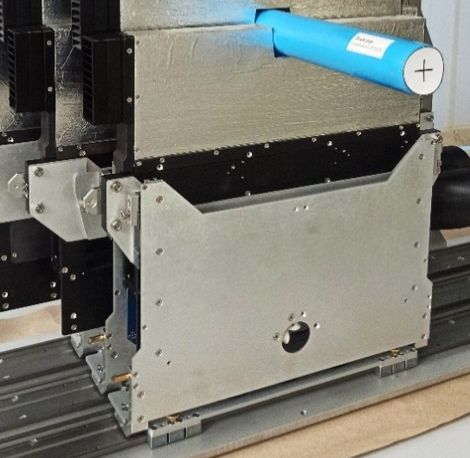
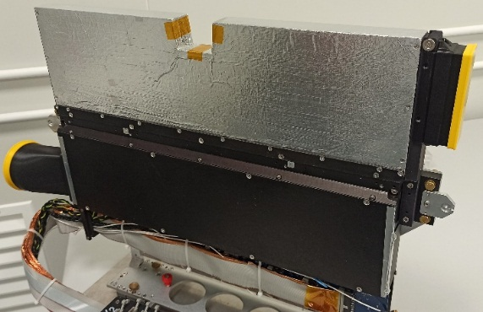
3
Y
ϕy
1
X
Z
ϕx
ϕz
2
После предварительного позиционирования каждой полуплоскости относительно трубы с помощью лазерной геодезии измерялись координаты ее трех реперных точек (1; 2; 3) в системе координат установки и определялись ее развороты вокруг осей (ϕ_{x}; ϕ_{y}; ϕ_{z}) (перекосы). Производилась регулировка для минимизации перекосов (разница соответствующих координат двух реперных точек не более 0.3 мм) и окончательный замер координат реперных точек (с точностью 0.01мм).

Slide 13
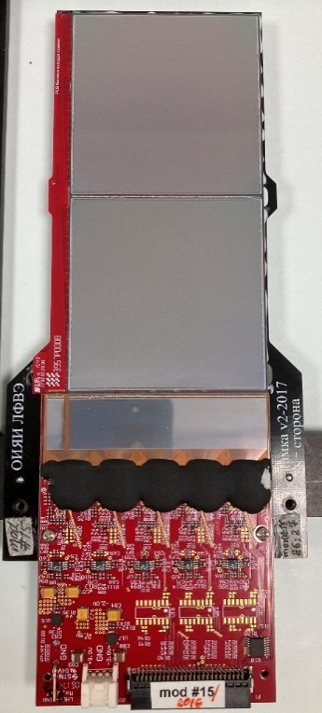
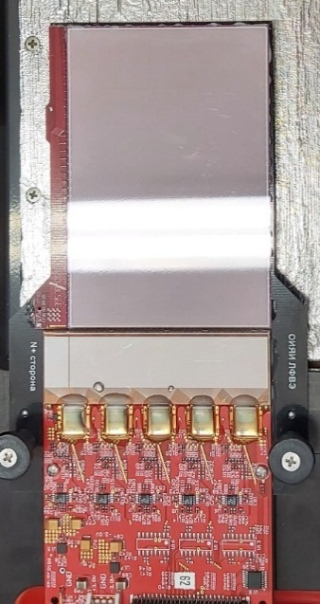
Two type of Si-modules for Forward Si detector
63
63
63
93
126
Station1
DSSD 63x93mm²
6 modules
Station 2,3,4
DSSD 63x63mm²
42 modules
FEE board
FEE board
Detectors size: 63x93x0,3 mm³ (on 6” – FZ-Si-n wafers)
Topology: double sided microstrip (DSSD)
(DC coupling)
Pitch p⁺ strips: 95 μm;
Pitch n⁺ strips 107,1 μm;
Stereo angle between p⁺/n⁺ strips: 2.5⁰
Number of strips/DSSD: 640 (p⁺)×603(n⁺)
Number of strips/module: 640 (p⁺)×640(n⁺)
Detectors size: 63x63x0,3 mm³ (on 4” – FZ-Si-n wafers)
Topology: double sided microstrip (DSSD)
(DC coupling)
Pitch p⁺ strips: 95 μm;
Pitch n⁺ strips 103 μm;
Stereo angle between p⁺/n⁺ strips: 2.5⁰
Number of strips/DSSD: 640 (p⁺)×614(n⁺)
Number of strips/module: 640 (p⁺)×640(n⁺)

Slide 14
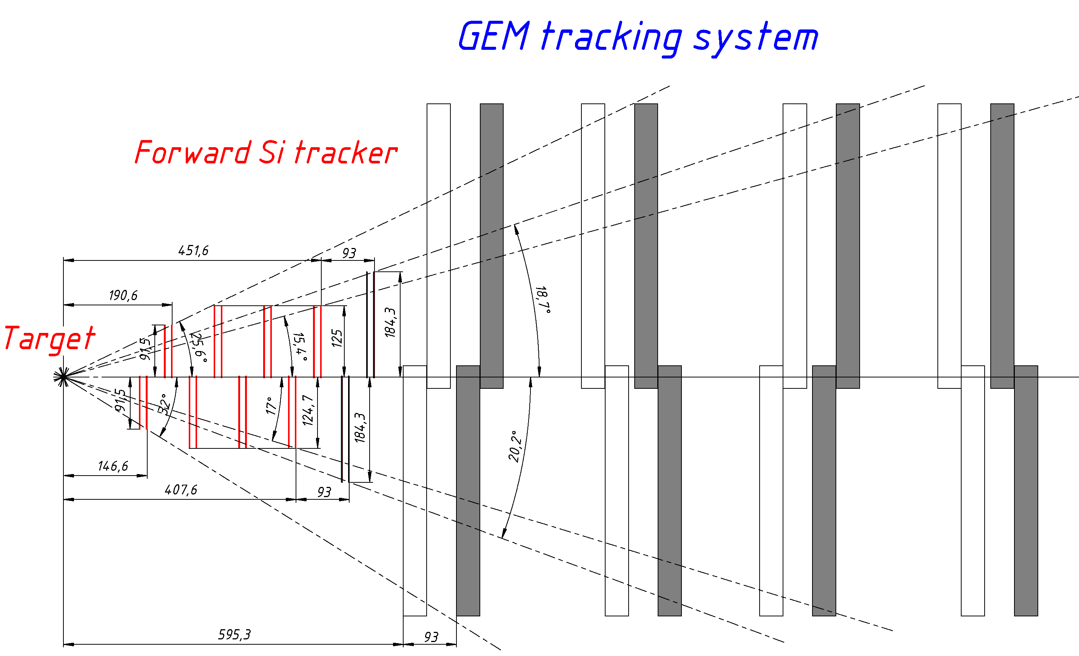
Y-Z cross section of central tracker
Y
Z
Current position of GEM stations
Position of GEMs after shift (Z+93 мм)

Slide 15
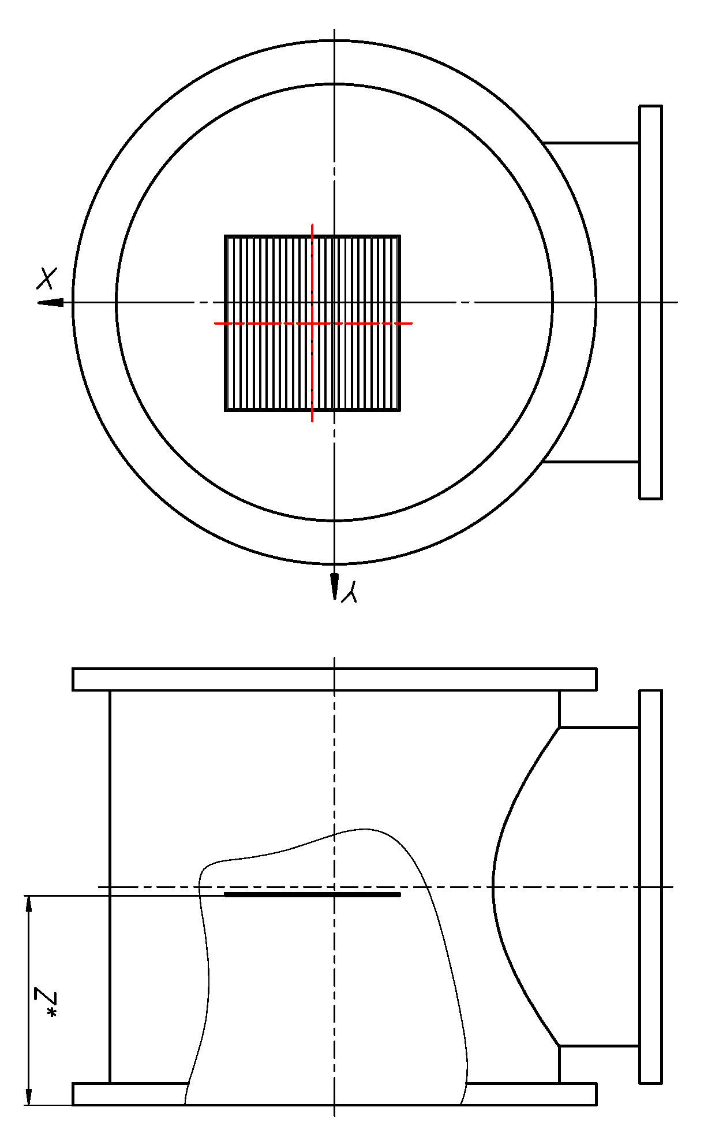
Position of double-coordinate Si-detectors relative to the axis of the ion guide
Y
Beam
Beam tracker detector center coordinates relative to the ion guide axis (mm)
Ch #128 (P⁺)
Ch #1 (P⁺)
# | X | Y | Z*
#1 | 0.0 | 0.9 | 94.7
#2 | 2.7 | -0.3 | 96.9
#3 (Al) | 0.4 | 0.1 | 94.9
Сh #128 (n⁺)
Y
Х
Ch #1 (n⁺)
Х
Strip pitch in the detector: 0.45 mm
Number of strips: 128x128
Thickness: 175 µm
Size: 63 x 63 mm²
P+ side of the detector
Beam directions
Beam profilometer detector center coordinates relative to the ion guide axis (mm)
# | X | Y | Z*
#1 (electric) | -1.3±0.1 | 0.7±0.1 | 99.7
#2 (pneumatic) | -2.7±0.5 | 1.4±0.2 | 100.7
Z*
Strip pitch in the detector: 1.87 мм
Number of strips : 32х32
Thickness: 175 µm
Size: 60 x 60 mm²
*Distance between the flange surface and the detector surface.
Detector rotation in the coordinate plane no more than 0.5⁰

Slide 16


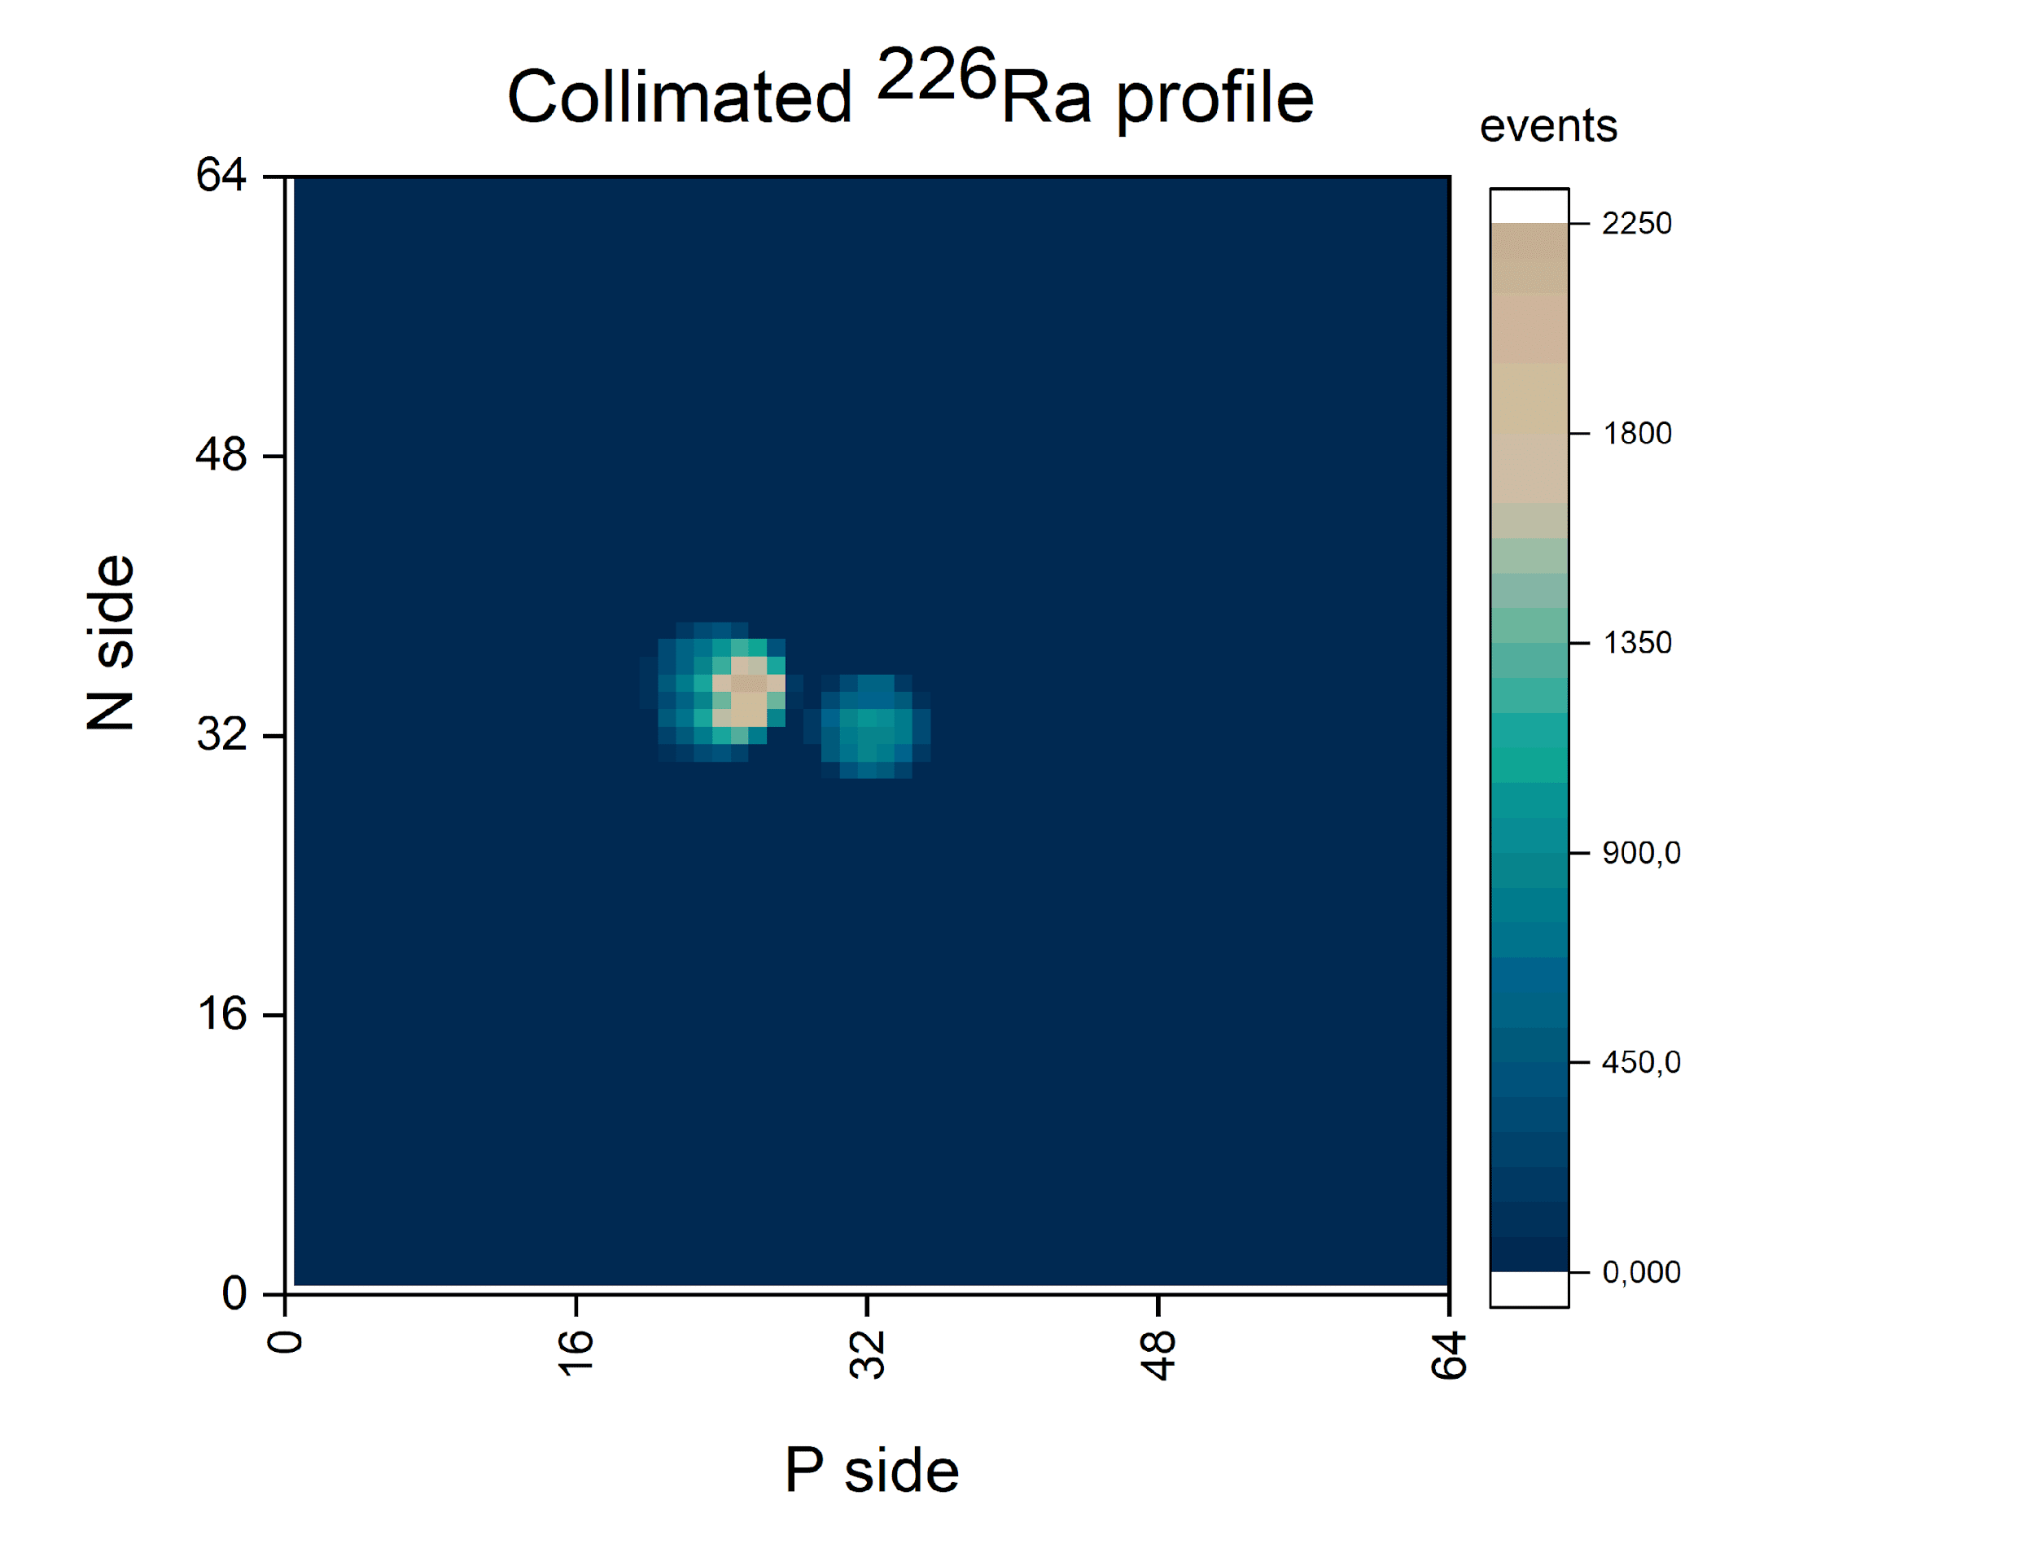
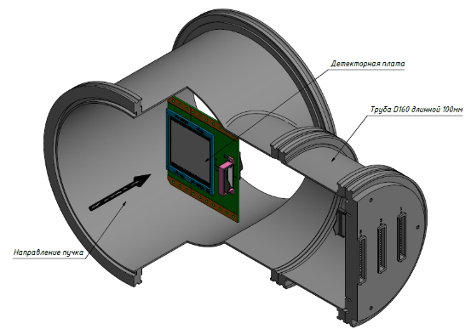
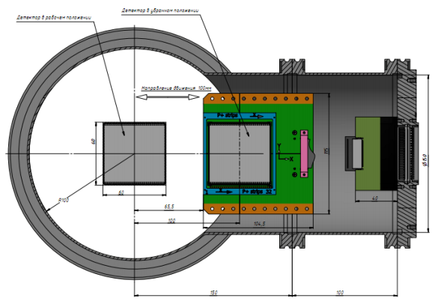
New beam profilometer (64×64) strips for heavy ions (Xe, Au, Bi)
На рис. результаты тестов-2022 с альфа источником Si – профилометра:
- такую же картину мы хотели получить при работе с пучком, но не удалось из-за наложений при «медленной» электронике ( ИС-VA163);
- оба профилометра были убраны в положение «парковка» и не использовались в сеансе;
- наши планы и действия – ведется новая разработка (С.Хабаров+О.Тарасов) конструкции плоскости детектора (128х128) стрипов превращаем в (64х64) стрипа + новая FEE на основе ИС HDR64/VA, чипы есть в наличии, детекторные платы разработаны, изготовлены и готовы к сборке детекторов, FEE-PCB в разработке (С.Хабаров), детекторы есть и тестируются (Е.Стрелецкая+Ю.Копылов), готовность – осень_23.
detector: DSSD, (32p⁺×32n⁺), strips pitch = 1.8 mm, thickness (Si) -175 μm, active area (60 × 60) mm²;
mechanical design: the plane of the profilometer is automatically removed from the beam zone to the parking position;
FEE: for light (₆C ÷ ₁₈Ar) ions based on VA163 + TA32cg2 (32 ch, dynamic range (DR): -750fC ÷ +750fC) desing in progress;
current status:
- two vacuum stations with flanges and cable connectors are ready, Silicon Detectors assembled on PCBs and tested with alpha-source (5.5 MeV), autonomus (ADC+DAQ) subsystem ready;
- for heavy (Kr ÷ Au) ions will be developed another version of the FEE with DR = ± 20 pC.
working position
parking position

Slide 17
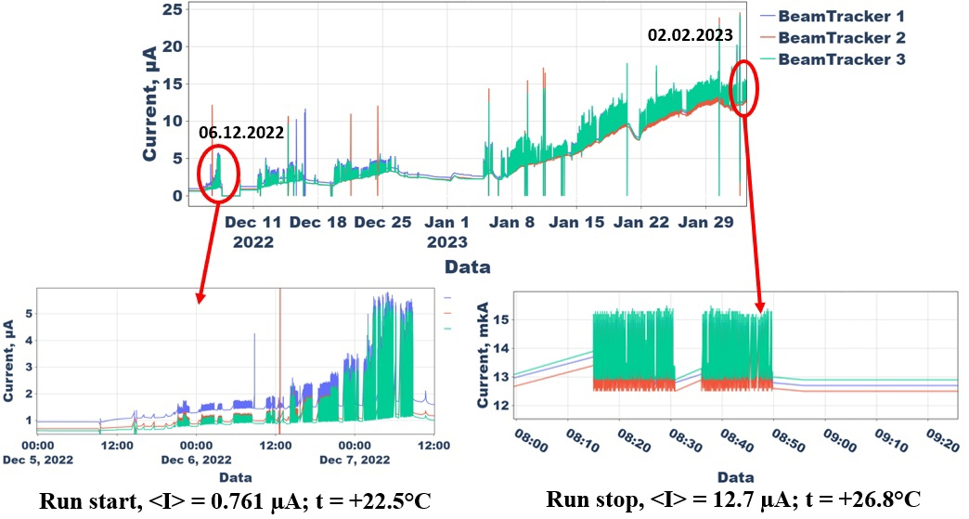
Currents of SiBT(1÷3) detectors at the beginning of the run and at the end of the run:
“substrate” is the dark current created by radiation defects of Xe-ions;
fast pulse component is the ionization current during the spill.

Slide 18
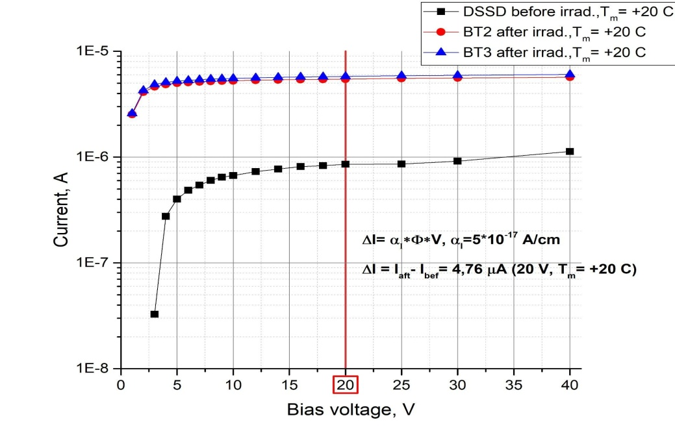
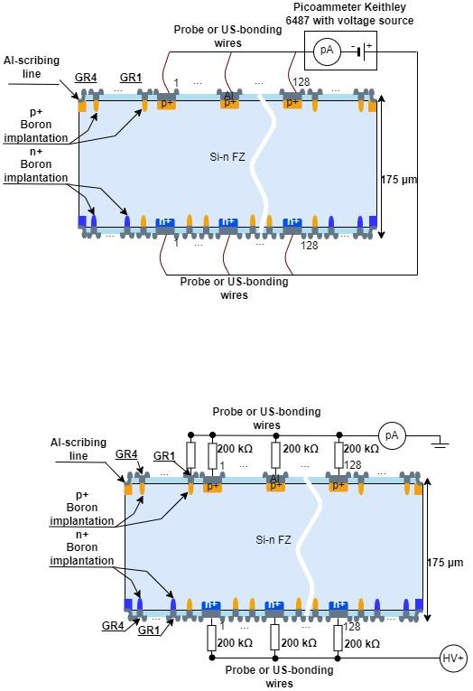

(а)
(b)
Schematic of measurements (a) of the dark current of the double-sided silicon strip detector and I–V curve (b) before and after the session.
Formula for determining the equivalent 1MeV neutron fluence from silicon damage:
where: α_{I} – current constant of silicon damage is equal to 5×10⁻¹⁷ A/cm, at +20˚C for neutrons with energy of 1 MeV and physically means the current increment in a silicon detector of 1 cm³ volume from the passage of one neutron (1 MeV),
Ф,cm⁻² – neutron fluence,
V, cm³ - detector volume.

Slide 19
 | I_{d0}, мкА/+20 В/+22.5°C (04.12.2022 начало сеанса) | I_{d(ф)}, мкА/+20 В/+26.8°C (2.02.2023 окончание сеанса) | ΔI = Id(ф) – Id0= αI ∙Ф∙V, мкА (приведённое к +20 °C)
BT1 | 0.965 | 12.7 | 4.76
BT2 | 0.692 | 12.5 | 4.6
BT3 | 0.626 | 12.9 | 4.93
 | Эквивалентный флюенс нейтронов 1 МэВ, см⁻² (измерен по радиационным повреждениям Si) | Флюенс ¹²⁸Xe, см⁻² расчет через NIEL, К(¹²⁸Xe/нейтрон 1МэВ)=276 | Число ядер ¹²⁸Xe, прошедших за сеанс через Si-детекторы BT(1÷3), S_{a}=37 см²
BT1 | 5.117e+12 | 1.854e+10 | 6.899e+11
BT2 | 4.945e+12 | 1.792e+10 | 6.667e+11
BT3 | 5.300e+12 | 1.920e+10 | 7.145e+11
Среднее | 5.117e+12 | 1.854e+10 | 6.899e+11

