Slide 1
Status of vector mesons reconstruction in Xe run
Ramin Barak
Analysis and Detector Meeting of the BM@N Experiment at NICA, Dubna, 04-05 March 2025

Slide 2
Introduction
Why $φ\text{(1020}\text{)}$and K*(892) are interesting to study?
$φ\text{(1020}\text{)}$is expected to have a small cross-section for interactions with other non-strange particles, and its life time is relatively long (∼41 fm/c), it may keep information of the early stage of the system’s evolution [1].
Neutral K*(892) mesons provide information about the properties of the late hadronic phase due to the presence of rescattering and regeneration effects that can modify resonance yields because of their short lifetimes (∼4 fm/c) [2].
[3]
[1] J. Phys. G: Nucl. Part. Phys. 32, S373-S380 (2006) DOI: 10.1088/0954-3899/32/12/S46.
[2] https://doi.org/10.1051/epjconf/201922202005
[3] efaidnbmnnnibpcajpcglclefindmkaj/https://lss.fnal.gov/conf2/C100715/Preghenella.pdf

Slide 3
Goal
Observation of $φ\text{(1020}\text{)}$and K*(892) signal in the MC and experimental data.

Slide 4
Data
Experimental data obtained in the physical session at the beginning of 2023 with a beam energy of 3.8 AGeV, a CsI target and Xe beam.
Dubna Cascade Model - Statistical Multifragmentation Model (DCM-SMM) and BOX Monte Carlo generators were used to model the data.
About 0.8 million Monte Carlo and 450 million experimental events were analyzed.

Slide 5
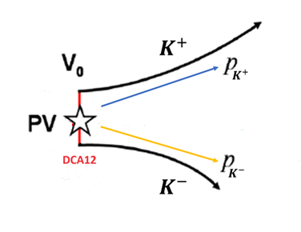
Data processing procedure
Reconstruction of particle tracks was carried out.
Mathematical algorithms were developed and implemented to search for the$φ\text{(1020}\text{)}→ K^{+}+ K^{−}$(K*(892) $→ K^{+}+ π^{−}$) decay:
shuffling pairs of particles with different signs
calculation of invariant mass
imposing a number of geometric restrictions on the parameters of each pair
DCA12 – the distance between $K^{+}$and $K^{−}$at the decay point of$φ\text{(1020}\text{)}$.
Other restrictions employed:
Constraints on the squared masses of the two products of decay ($K^{+}$and $K^{−}$).
Event topology $φ\text{(1020}\text{)}$

Slide 6
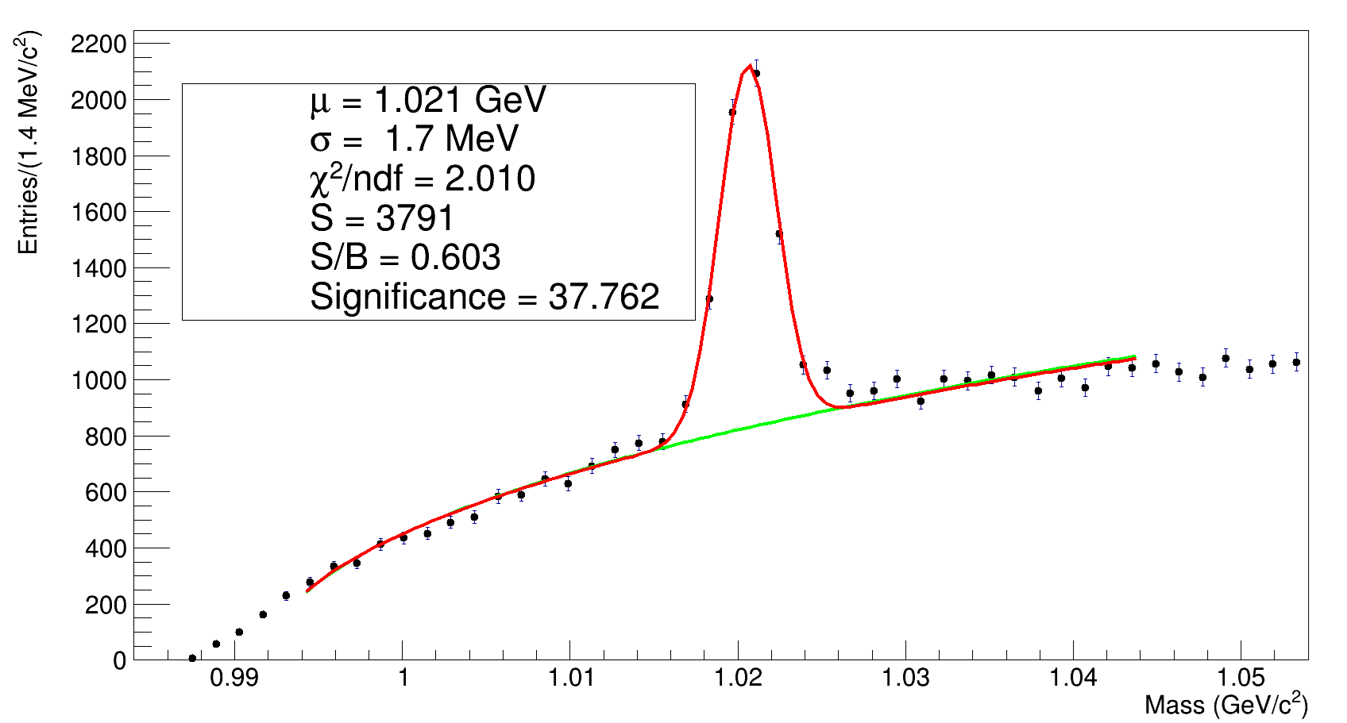
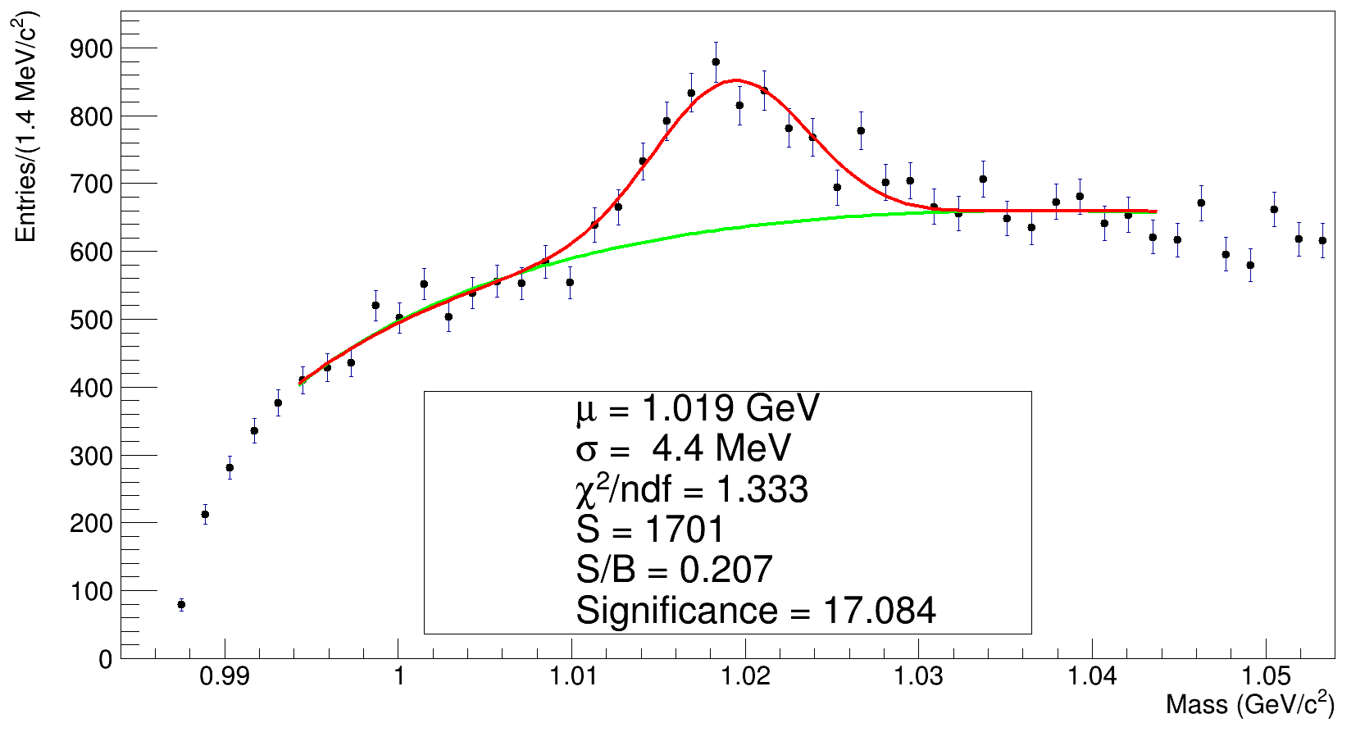
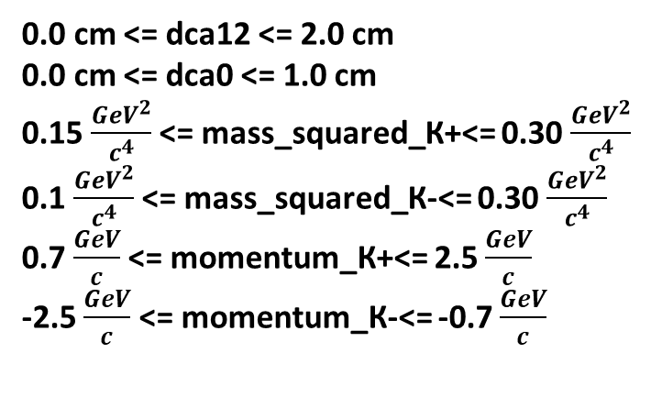
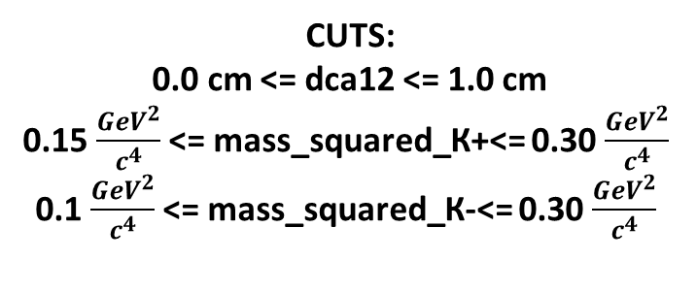
Results
MC
EXP
Efficiency = 0.47 %.
CUTS:
0.0 cm <= dca12 <= 2.0 cm
0.0 cm <= dca0 <= 1.0 cm
0.15 $\frac{{GeV}^{2}}{c^{4}}$ <= mass_squared_К+<= 0.30 $\frac{{GeV}^{2}}{c^{4}}$
0.1 $\frac{{GeV}^{2}}{c^{4}}$ <= mass_squared_К-<= 0.30 $\frac{{GeV}^{2}}{c^{4}}$
0.7 $\frac{GeV}{c}$ <= momentum_К+<= 2.5 $\frac{GeV}{c}$
-2.5 $\frac{GeV}{c}$ <= momentum_К-<= -0.7 $\frac{GeV}{c}$
CUTS:
0.0 cm <= dca12 <= 1.0 cm
0.15 $\frac{{GeV}^{2}}{c^{4}}$ <= mass_squared_К+<= 0.30 $\frac{{GeV}^{2}}{c^{4}}$
0.1 $\frac{{GeV}^{2}}{c^{4}}$ <= mass_squared_К-<= 0.30 $\frac{{GeV}^{2}}{c^{4}}$

Slide 7
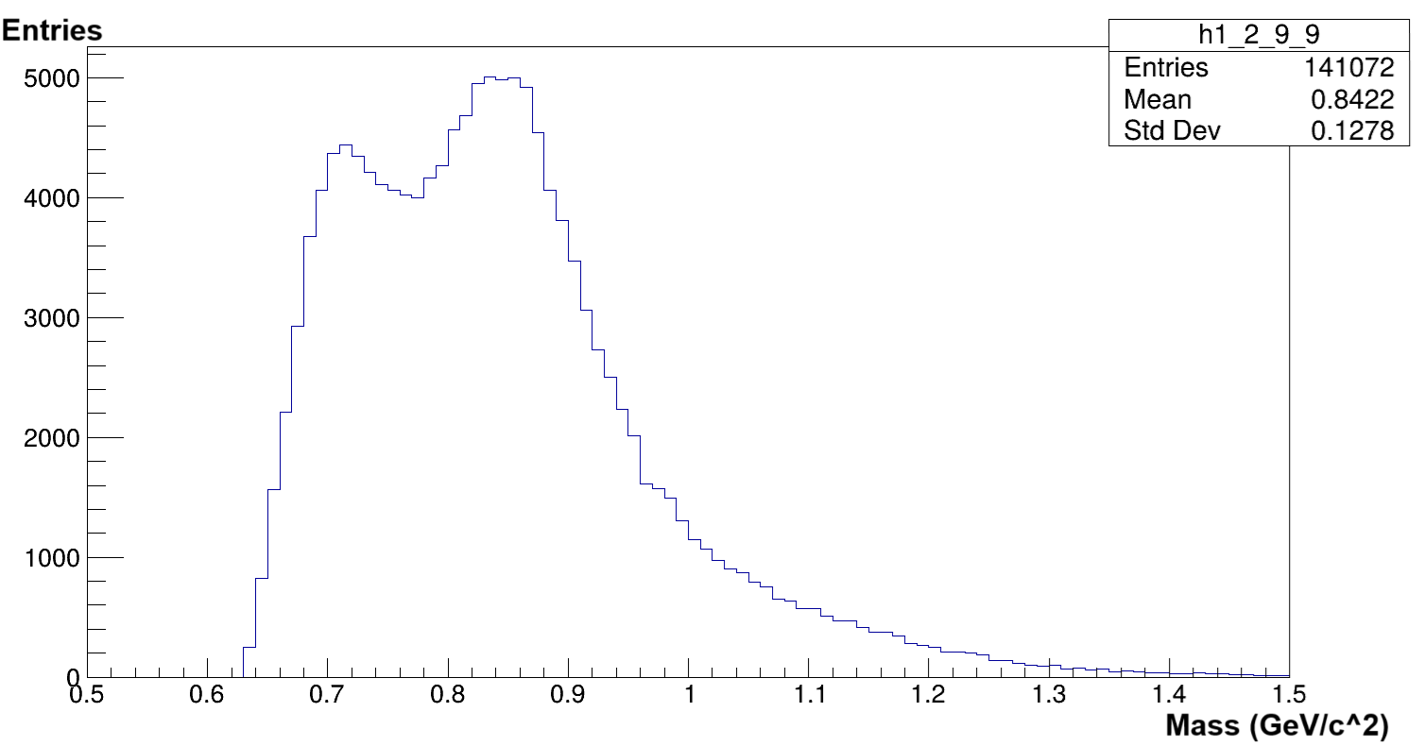
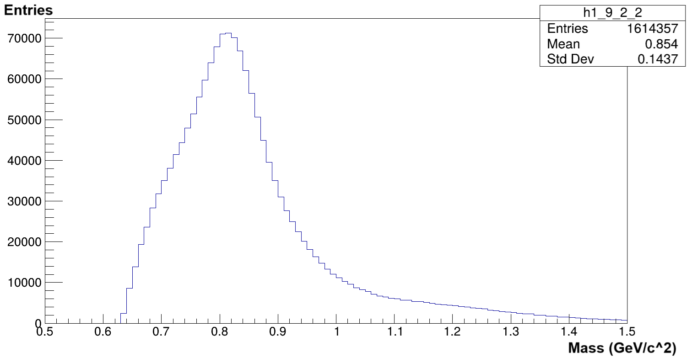
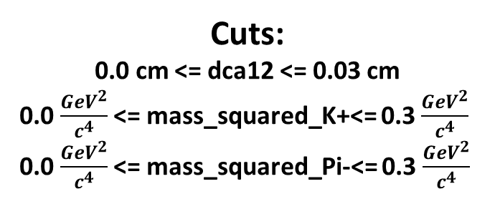
Results
EXP
EXP
K*(892)
$$\overline{\text{K}\text{∗(892)} }$$
Cuts:
0.0 cm <= dca12 <= 0.03 cm
0.0 $\frac{{GeV}^{2}}{c^{4}}$ <= mass_squared_K+<= 0.3 $\frac{{GeV}^{2}}{c^{4}}$
0.0 $\frac{{GeV}^{2}}{c^{4}}$ <= mass_squared_Pi-<= 0.3 $\frac{{GeV}^{2}}{c^{4}}$
$$\text{Cuts}\text{:}$$
0.0 cm <= dca12 <= 0.09 cm
0.0 $\frac{{GeV}^{2}}{c^{4}}$ <= mass_squared_К-<= 0.3 $\frac{{GeV}^{2}}{c^{4}}$
0.0$\frac{{GeV}^{2}}{c^{4}}$ <= mass_squared_Pi+<= 0.3 $\frac{{GeV}^{2}}{c^{4}}$
A peak at about 850 MeV, instead of 895.55 MeV, as is to be expected. A clear shift to the left of $\sim$50 MeV.
Possible reasons:
Influence of acceptance of the experimental setup, which can be verified by means of MC simulations.
Influence of the magnetic field, which can be verified by considering other particles.

Slide 8
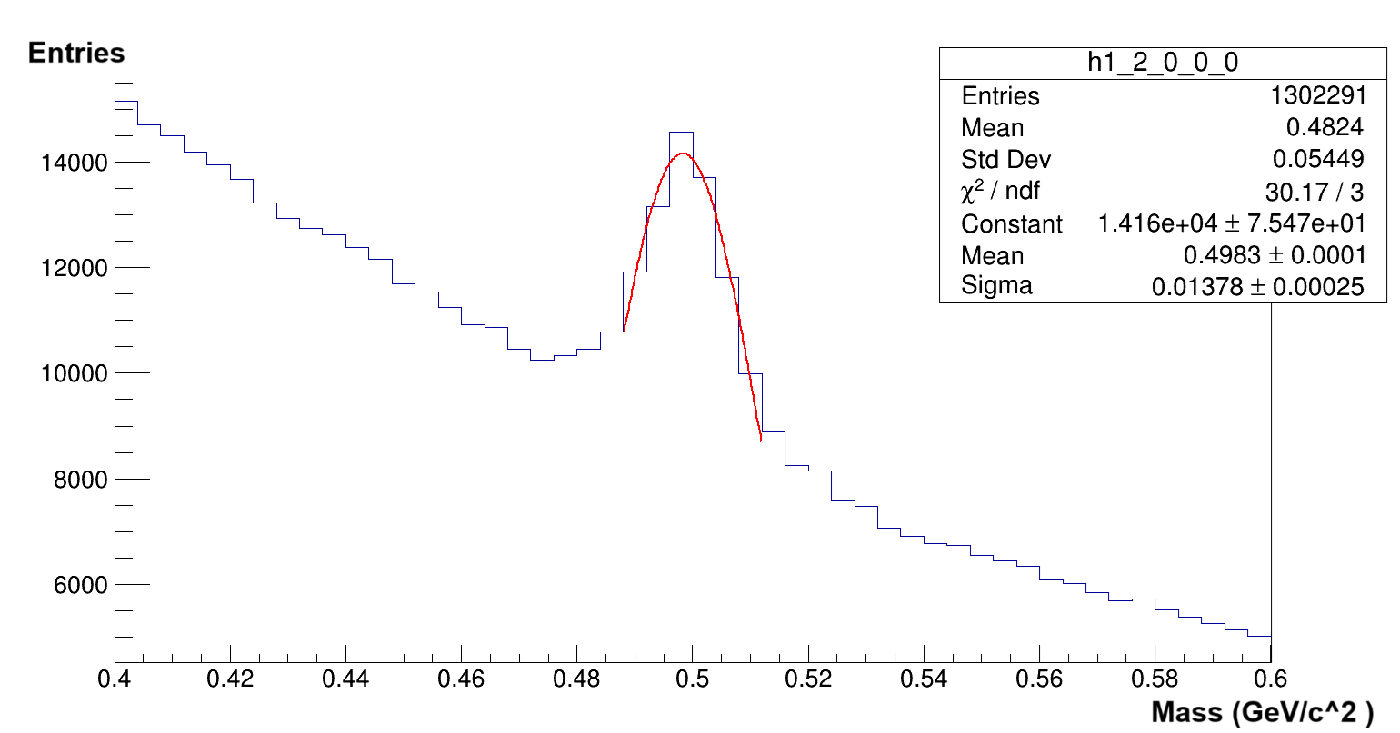
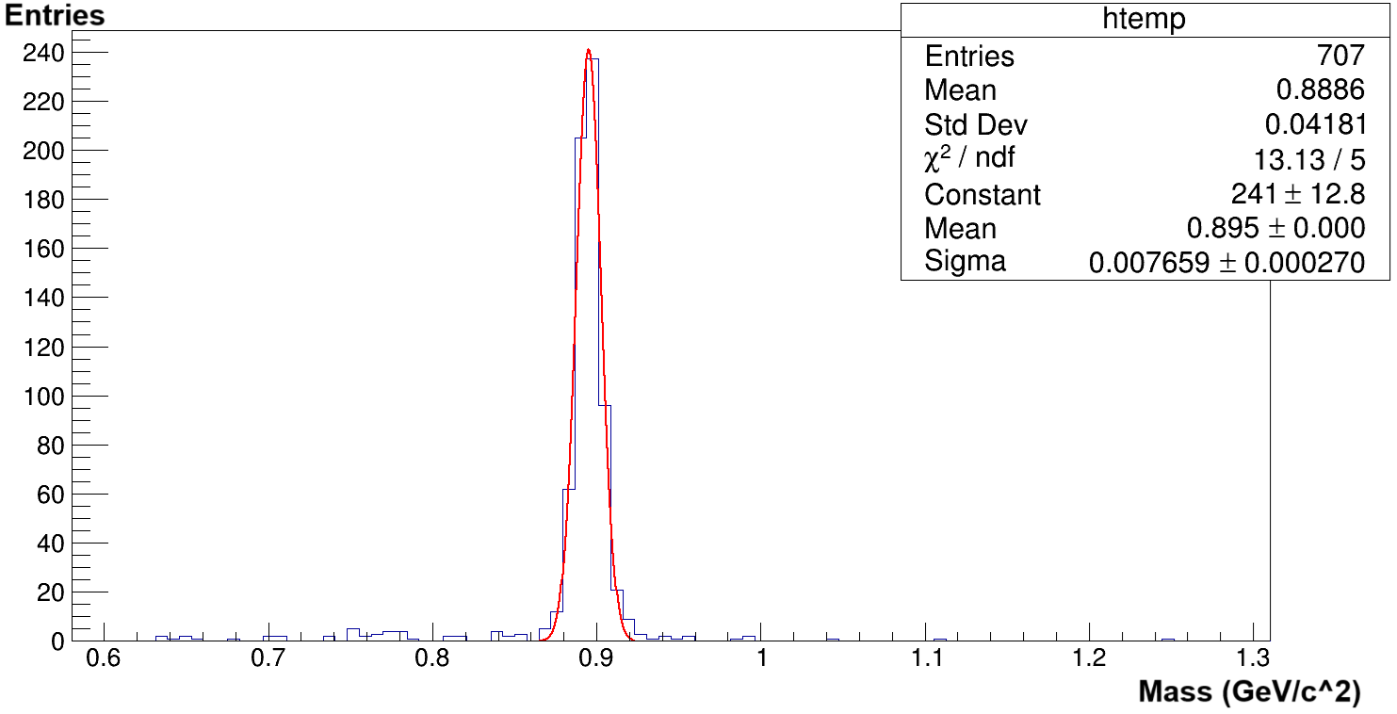
Results
EXP
MC
$$K_{S}^{0}$$
K*(892)
Masses of both $K_{S}^{0}$ and K*(892) (in the (ideal) MC case) correspond to the expected values.
Hence both hypotheses posed in the previous slide have been disproven.

Slide 9
Conclusion and future work
$φ\text{(1020}\text{) }$signal was observed in both MC and experimental cases. Signal was increased by almost a factor of 7 in the experimental case.
K*(892) signal was observed in the MC case. A signal with a shift of $\sim$50 MeV to the left from the expected value was observed in the experimental case.
Mass of $K_{S}^{0}$ observed in the experimental data corresponds to expected value.
Mass of K*(892) observed in MC data corresponds to expected value.
Continuation analysis K*(892) regarding the shift to the left of the expected mass value.

Slide 10
Backup

Slide 11
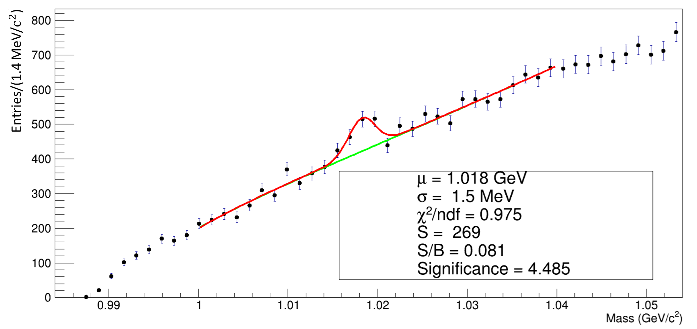
Old Results

