Slide 1

Weakening of the deconfinement phase transition in an external gravitational field
Prof. Alexander Molochkov, Prof. Maxim Chernodub,
Dr Vladimir Goy, ${Daniil Stepanov}^{1,2}$, Arina Pochinok
Pacific Quantum Center, Far Eastern Federal University, 690922, Vladivostok
Institute of Automation and Control Processes, Far Eastern Branch, Russian Academy of Science, 690041, Vladivostok
Speaker: PhD student, junior researcher PQC, Stepanov D.V.
International Workshop “Infinite and Finite Nuclear Matter” (INFINUM-2025)
May 12-16 2025
Степанов Даниил Вадимович, аспирант, лаборант-исследователь Т.К.Ц.
$$\left[Supported by grant No FZNS−2024−0002\right]$$

Slide 2

Outline
Motivation
Work plan
The analogy with temperature.
Acceleration on the lattice
Results
Conclusions

Slide 3
Motivation
Quantum field theory
Phenomena where particle physics and gravitational forces are significant.
The Early Universe
General relativity
Superheavy, superdense, magnetized cosmological objects
Phenomena associated with the appearance of the event horizon

Slide 4
Work plan
Pure gluodynamics
Deconfinement phase transition ?
Approach
Lattice quantum field theory
Acceleration
Tasks:
Obtaining a theoretical description of acceleration within the framework of the lattice approach.
Data generation for theory with zero acceleration.
Data generation for theory with non-zero acceleration.
Data analysis and processing.

Slide 5

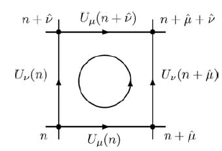
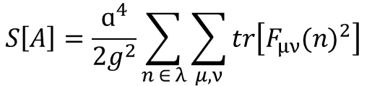

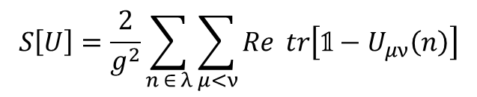


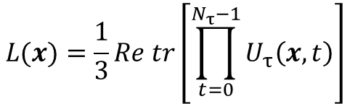
SU(3) gauge field theory on the lattice
Link:
Action:
Plaquette:
$$U_{μ}\left(n\right)=exp⁡(iɑA_{μ}(n))$$
$$S\left[U\right]=\frac{2}{g^{2}}\sum_{n ∈ λ}{\sum_{μ<ν}{Re} tr\left[𝟙−U_{μν}\left(n\right)\right]}$$
$$U_{μν}\left(n\right)=U_{μ}\left(n\right)U_{ν}\left(n+\hat{μ}\right){U_{μ}\left(n+\hat{ν}\right)}^{ϯ}{U_{ν}\left(n\right)}^{ϯ}$$
$$S\left[A\right]=\frac{ɑ^{4}}{2g^{2}}\sum_{n ∈ λ}{\sum_{μ,ν}{tr\left[F_{μν}{(n)}^{2}\right]} }$$
Observables :
Polyakov Loop:
Susceptibility of the Polyakov loop:
$$L(x)=\frac{1}{3}Re tr\left[\prod_{t=0}^{N_{τ}−1}{U_{τ}\left(x,t\right)}\right]$$
$$L\left(z\right)={\left\langle \left|L(x)\right|\right\rangle }_{x,y}$$
$$χ\left(z\right)={\left\langle {\left|L(x)\right|}^{2}\right\rangle }_{x,y}− {{\left\langle \left|L(x)\right|\right\rangle }^{2}}_{x,y}$$

Slide 6

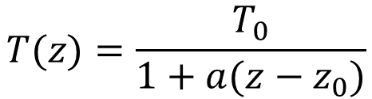



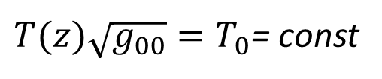




The analogy with temperature.
$$φ_{1}>φ_{2}$$
$$T_{1}>T_{2}$$
$$≈$$
$$T_{1}$$
$$T_{2}$$
Acceleration
Heat flow
$$φ_{1}$$
$$φ_{2}$$
The presence of a gravitational field $=>$ thermodynamic equilibrium with inhomogeneous temperature [1,2,3]:
$T(z)\sqrt{g_{00}}=T_{0}$= const
$$T(z)=\frac{T_{0}}{1+a(z−z_{0})}$$
[1] Tolman R. C. On the Weight of Heat and Thermal Equilibrium in General Relativity // Phys. Rev. — 1930. — Vol. 35. — P. 904–924
[2] Tolman C., Ehrenfest P. Temperature Equilibrium in a Static Gravitational Field // Phys. Rev. — 1930. — Vol. 36. — P. 1791–1798
[3] Luttinger J. M. Theory of Thermal Transport Coefficients// Phys. Rev. — 1964. — Vol. 135. — P. A1505–A1514

Slide 7

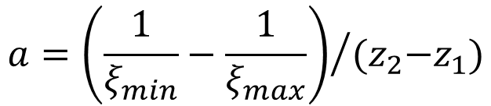
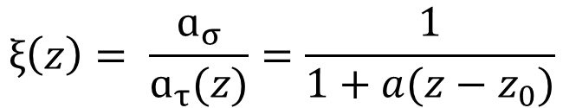
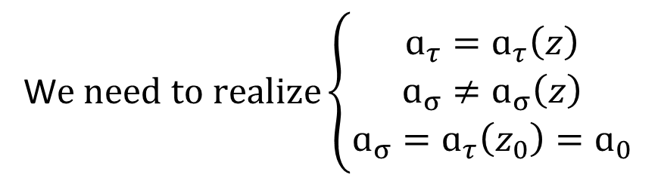
Acceleration on the lattice
Temperature:
W$e need to realize\left\{\begin{aligned}\begin{aligned}ɑ_{τ}=ɑ_{τ}\left(z\right) \\ ɑ_{σ}≠ɑ_{σ}\left(z\right) \\ ɑ_{σ}=ɑ_{τ}\left(z_{0}\right)=ɑ_{0}\end{aligned}\end{aligned}\right.$
$$T=\frac{1}{N_{τ}∙ɑ_{τ}}$$
Action [4] :
$$S\left[U\right]=\sum_{x}{\sum_{i>j}^{3}{β_{σ}\left(z\right) Re tr\left[𝟙−U_{ij}\left(x\right)\right]}}+\sum_{x}{\sum_{i=1}^{3}{β_{τ}\left(z\right) Re tr\left[𝟙−U_{4i}\left(x\right)\right])}}$$
Anisotropy coefficient:
Acceleration:
$$ξ\left(z\right)= \frac{ɑ_{σ}}{ɑ_{τ}(z)}=\frac{1}{1+a(z−z_{0})}$$
$$a={\left(\frac{1}{ξ_{min}}−\frac{1}{ξ_{max}}\right)}/{{(z}_{2}−z_{1})}$$
[4] Karsch F. SU(N) Gauge Theory Couplings on Asymmetric Lattices // Nucl. Phys. B. — 1982. — Vol. 205. — P. 285–300.

Slide 8
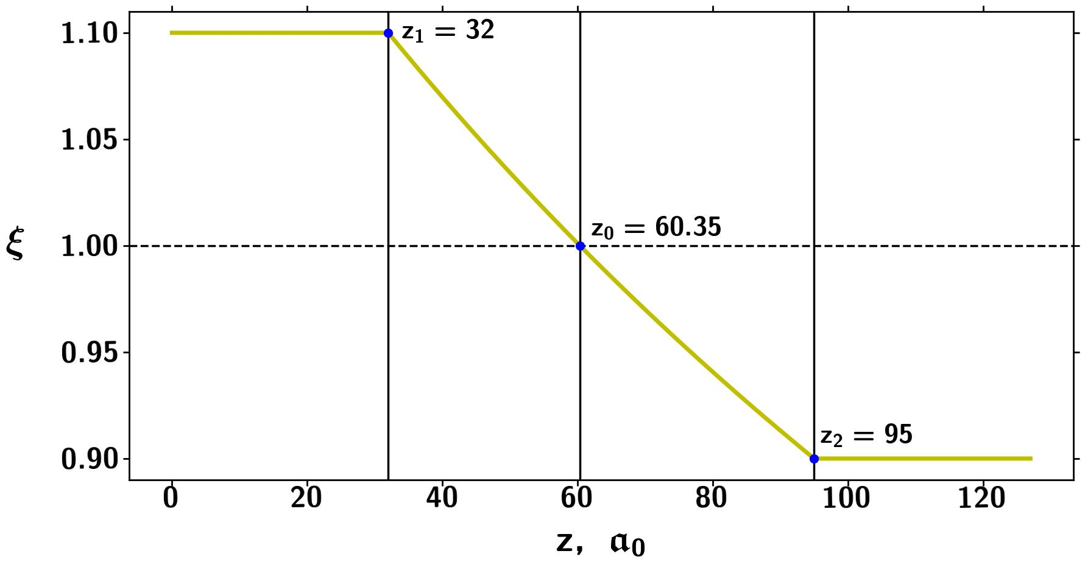

Temperature profile
$$ξ\left(z\right)=\frac{T(z)}{T_{0}}$$

Slide 9
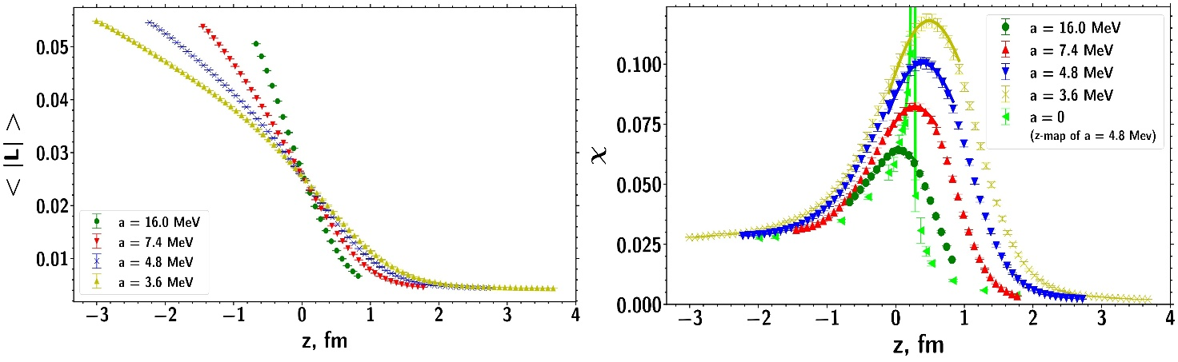
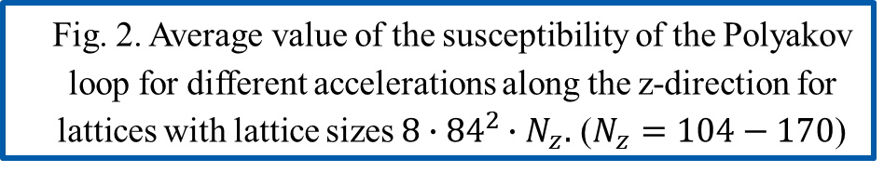
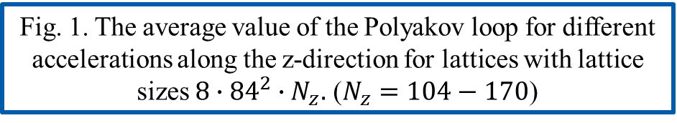
Polyakov loop
Fig. 1. The average value of the Polyakov loop for different accelerations along the z-direction for lattices with lattice sizes $8∙{84}^{2}∙N_{z}.$ ($N_{z}=104−170$)
Fig. 2. Average value of the susceptibility of the Polyakov loop for different accelerations along the z-direction for lattices with lattice sizes $8∙{84}^{2}∙N_{z}.$ ($N_{z}=104−170$)

Slide 10
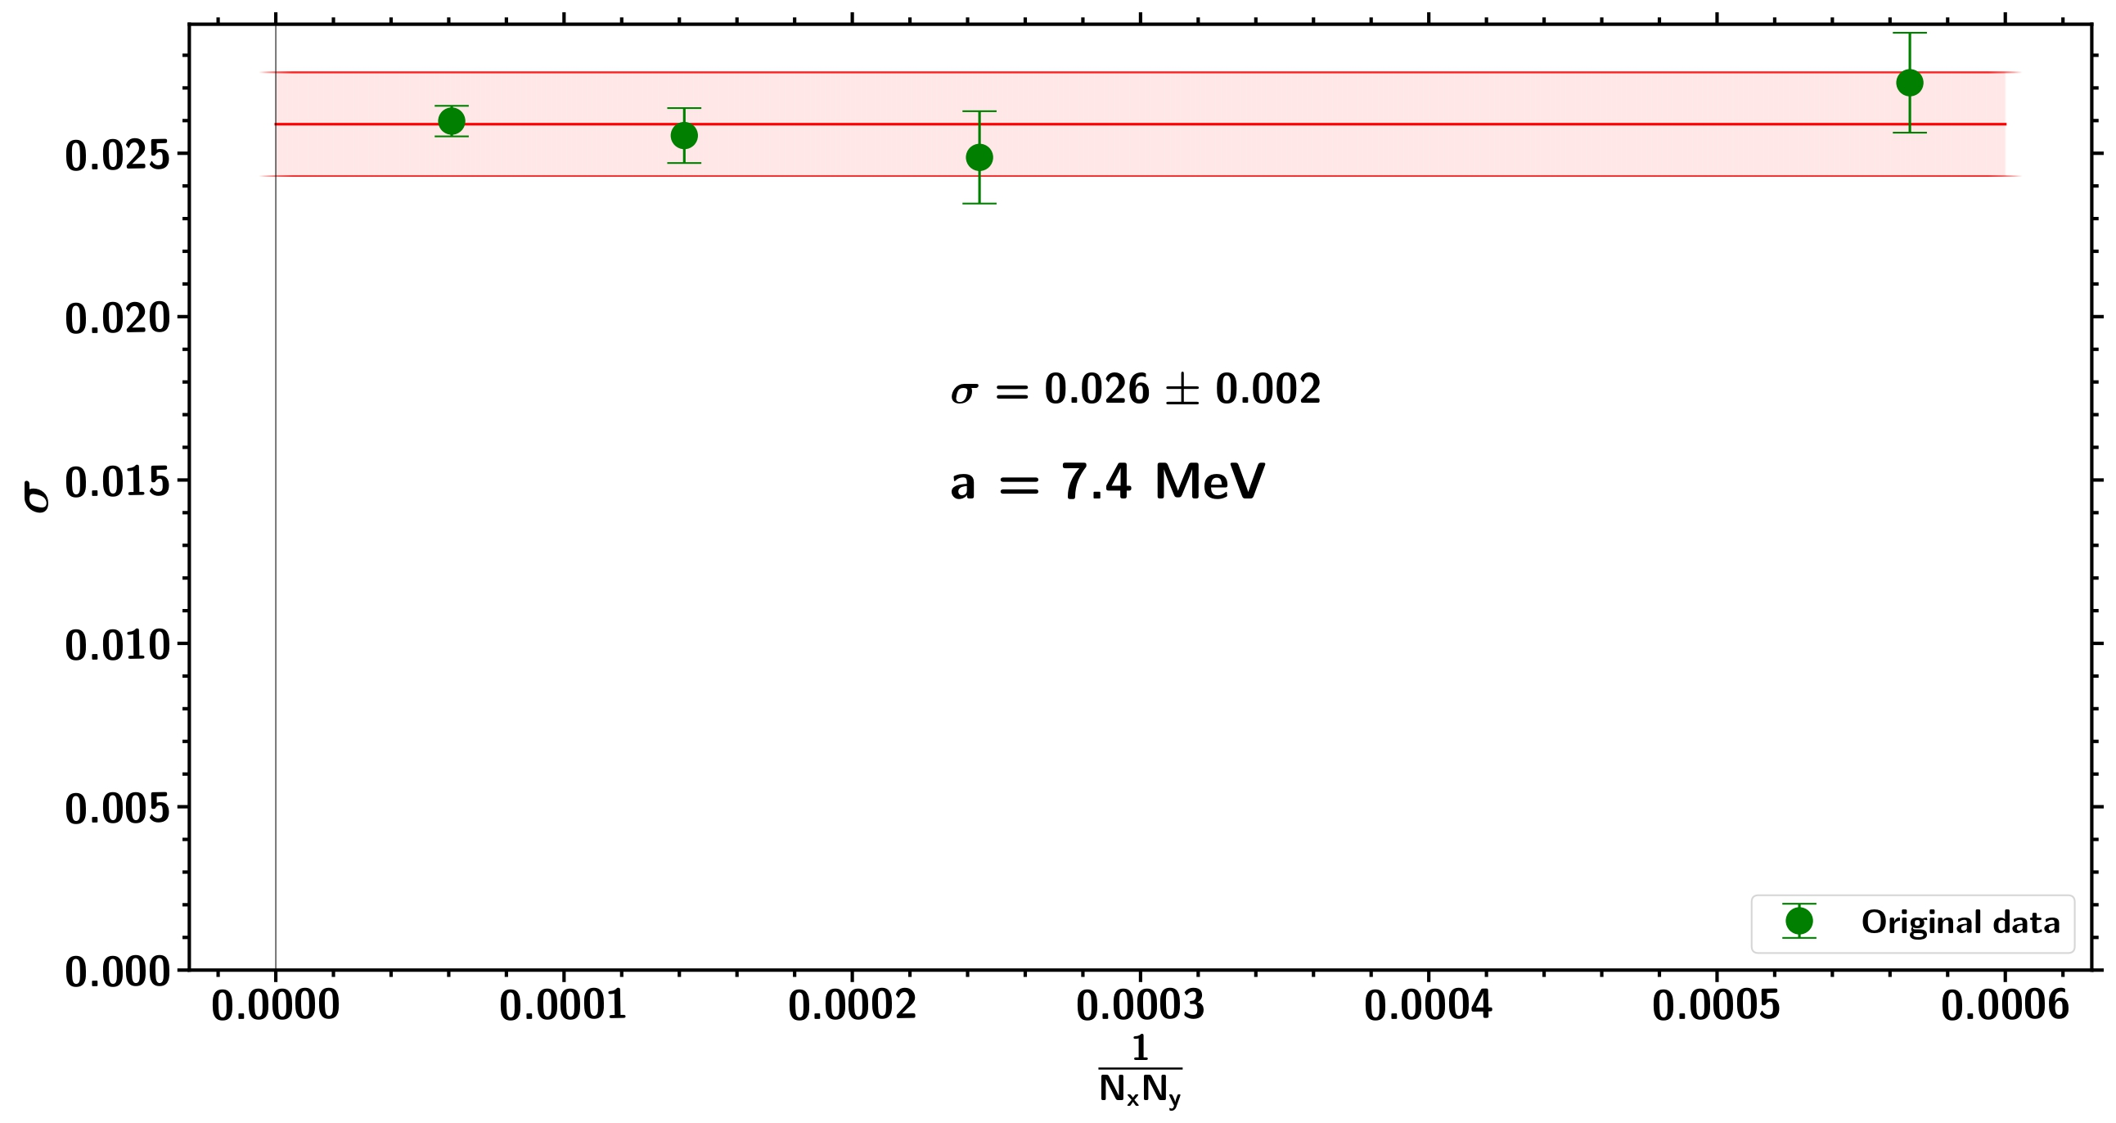
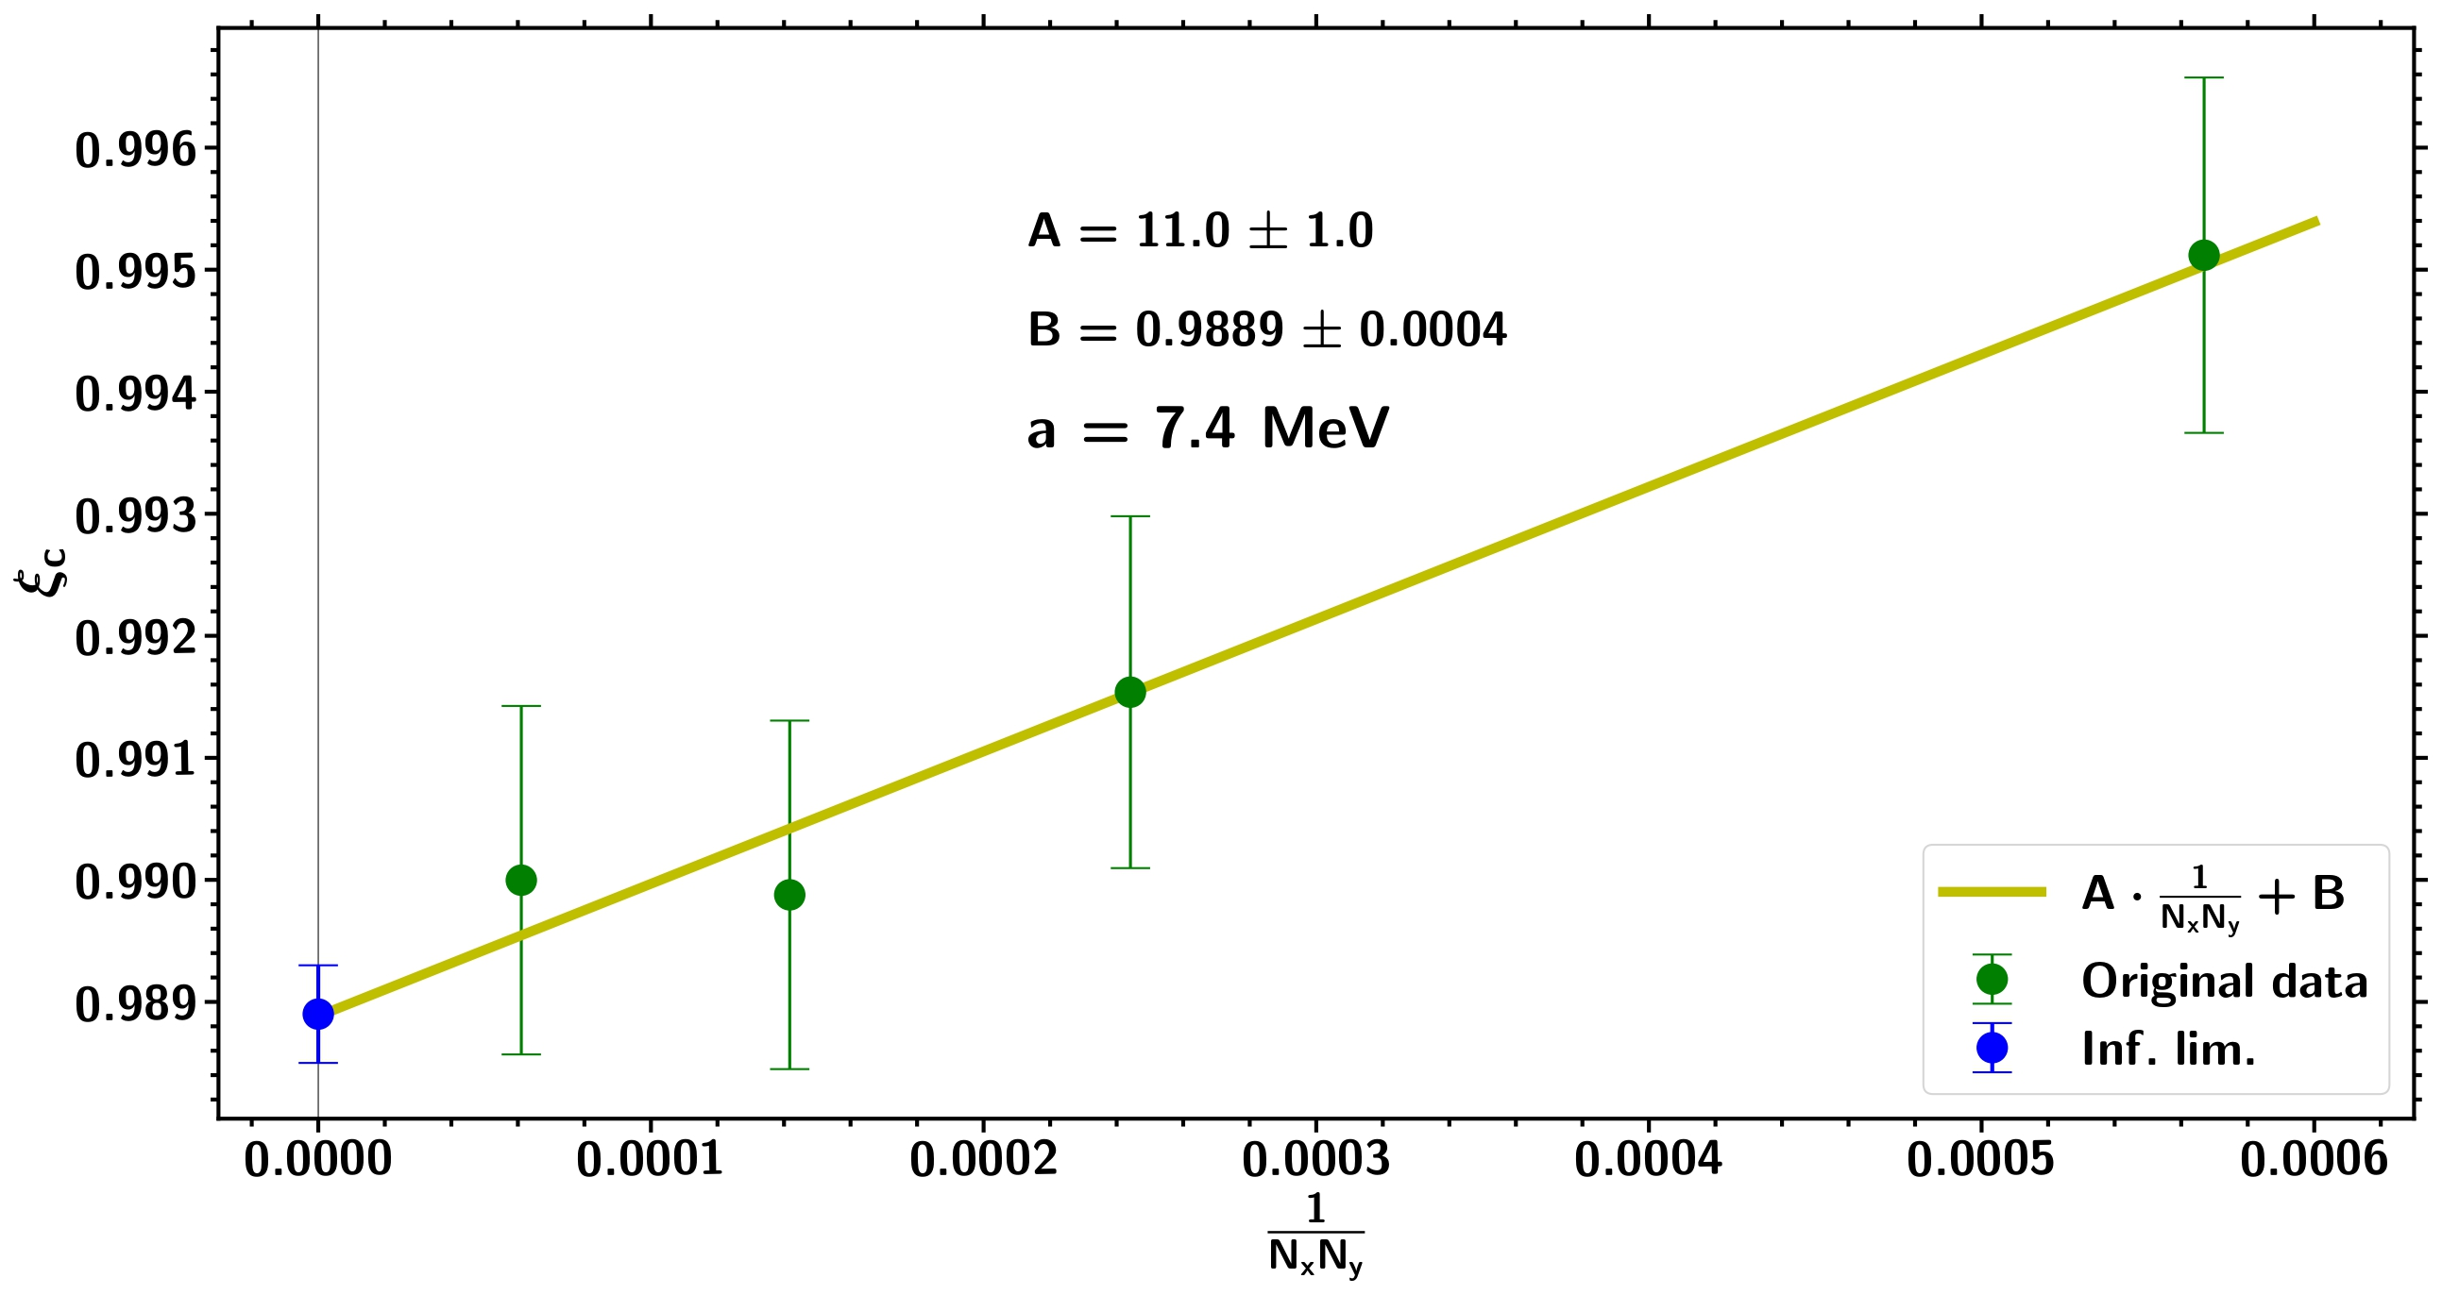
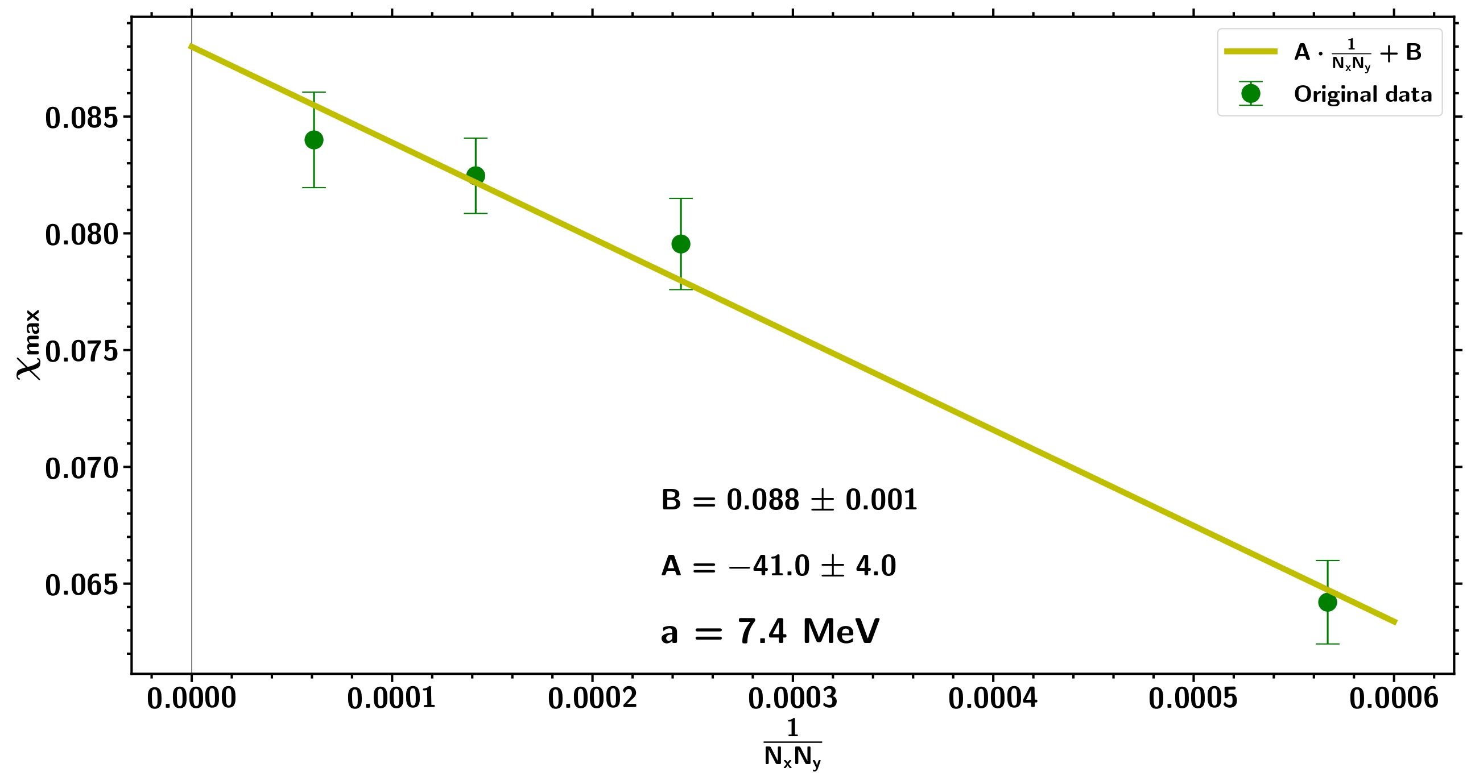
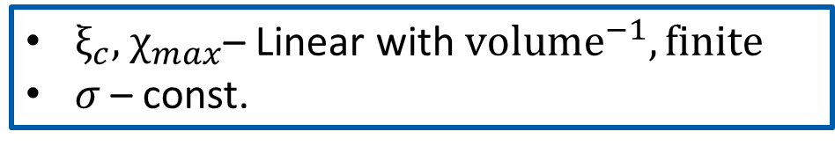
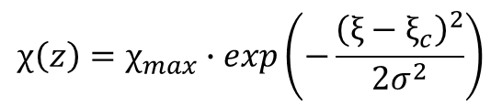
Infinite volume limit
Fit of susceptibility of the Polyakov loop:
$$χ\left(z\right)=χ_{max}∙exp\left(−\frac{{\left(ξ−ξ_{c}\right)}^{2}}{2σ^{2}}\right)$$
$ξ_{c},$ $χ_{max}\text{–}$ Linear with ${volume}^{−1}, finite$
$σ$ – const.

Slide 11
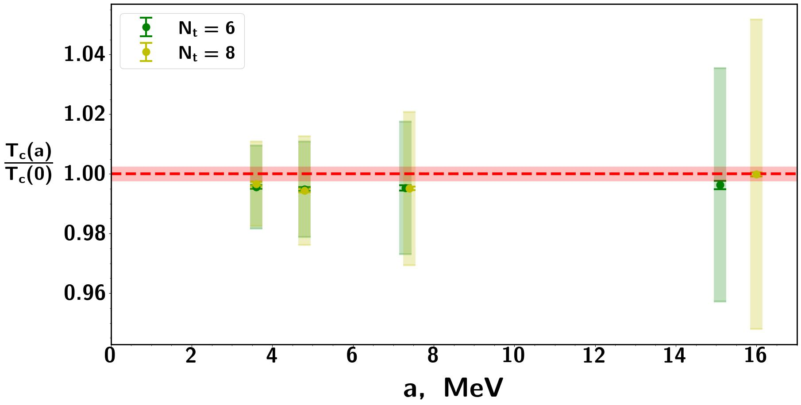
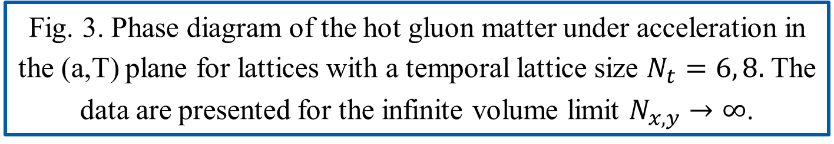
Phase structure
Fig. 3. Phase diagram of the hot gluon matter under acceleration in the (a,T) plane for lattices with a temporal lattice size $N_{t}=6, 8.$ The data are presented for the infinite volume limit $N_{x,y}→∞$.

Slide 12
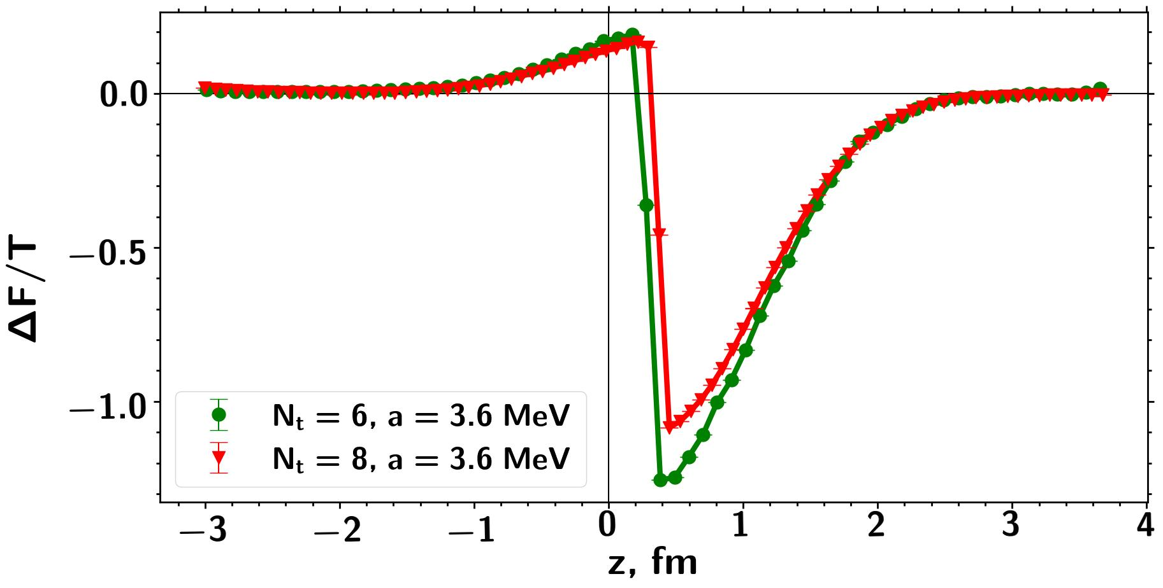
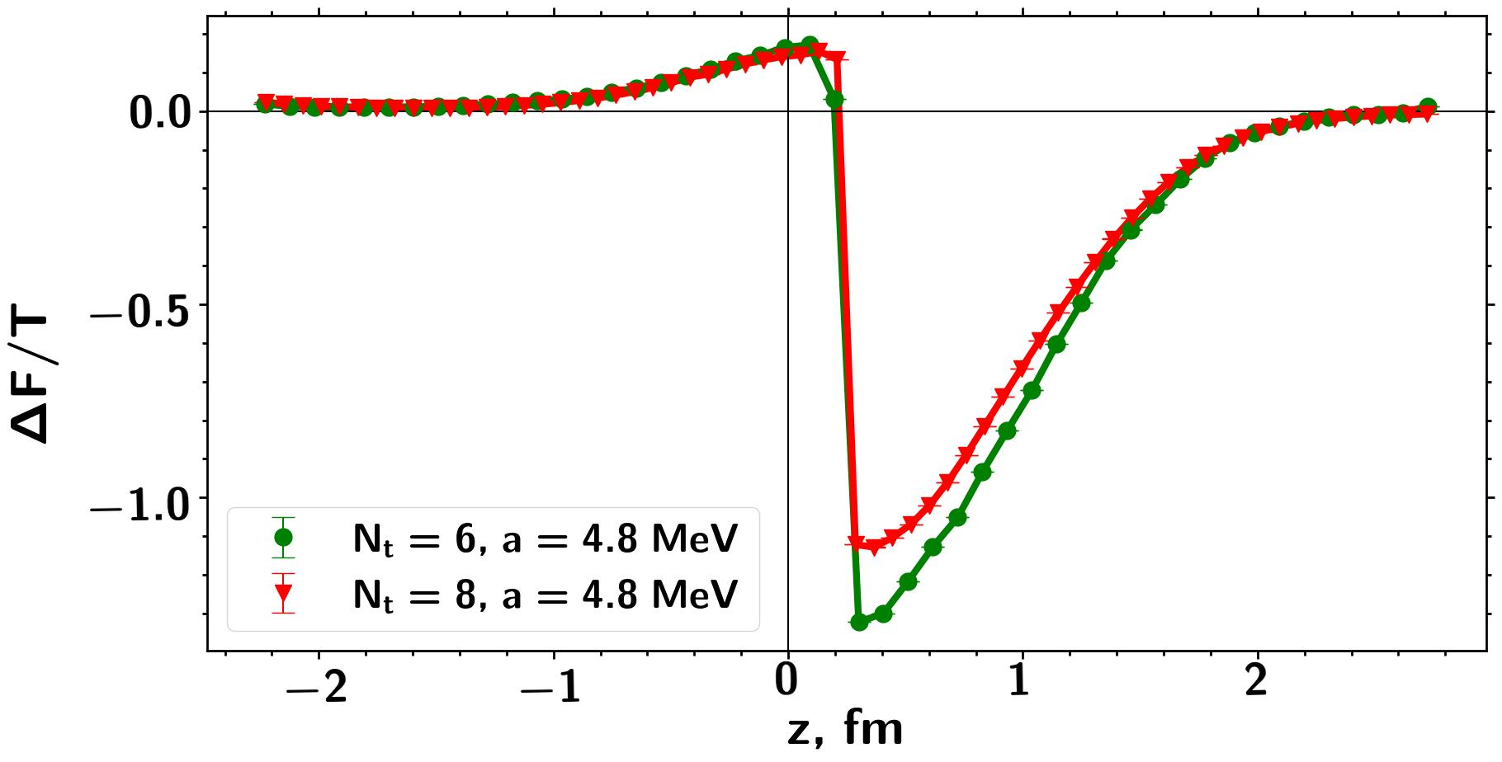
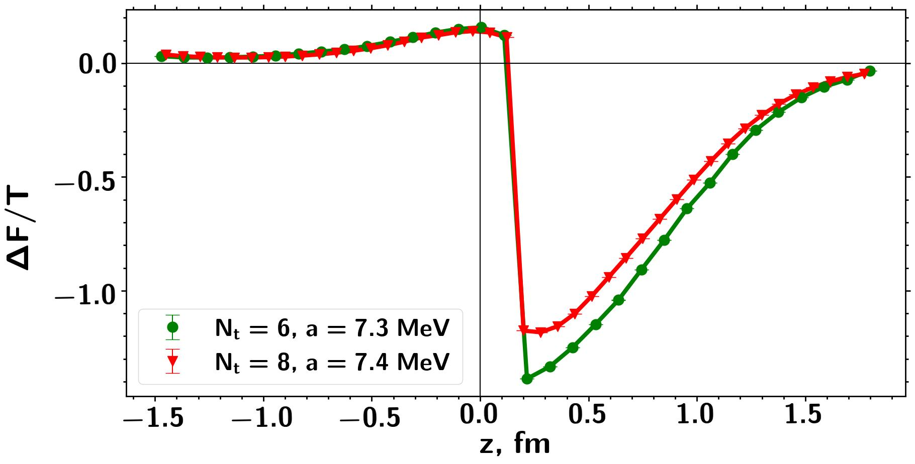
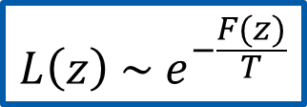
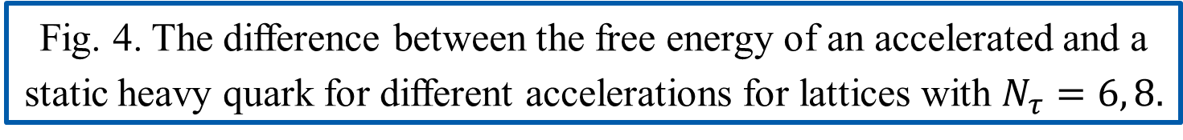
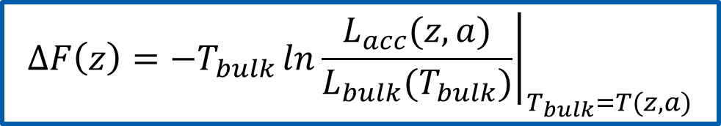
Free energy
$$L\left(z\right) \sim e^{−\frac{F(z)}{T}}$$
$$∆F\left(z\right)=−T_{bulk}{\left.ln\frac{L_{acc}(z,a)}{L_{bulk}(T_{bulk})}\right|}_{T_{bulk}=T(z,a)}$$
Fig. 4. The difference between the free energy of an accelerated and a static heavy quark for different accelerations for lattices with $N_{τ}=6, 8.$

Slide 13
Conclusions:
The presence of acceleration "smooths" the phase transition, turning it from a first-order phase transition into a smooth crossover.
As the acceleration value increases, so the width of the phase transition does.
The critical temperature value does not depend on the acceleration value and remains constant.
An article was published based on the results of this work:
Chernodub M. N., Goy V. A., Molochkov A. V., Stepanov D. V., Pochinok A. S. Extreme Softening of QCD Phase Transition under Weak Acceleration: First-Principles Monte Carlo Results for Gluon Plasma// Phys. Rev. Lett. – 2025. – Vol. 134 – p. 111904
Acknowledgments:
Completed within the framework of the state assignment of the Ministry of Education and Science of the Russian Federation №FZNS-2024-0002.
Numerical calculations were performed using the resources of the FEFU cluster and the Far Eastern Computing Resource Center of the IAP Far Eastern Branch of the Russian Academy of Sciences.

Slide 14
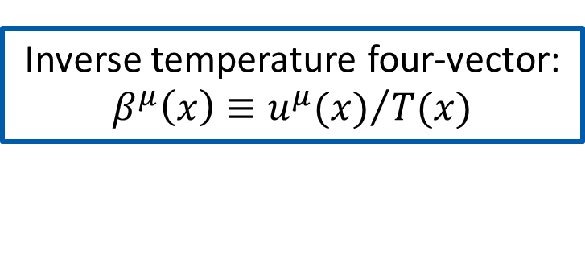

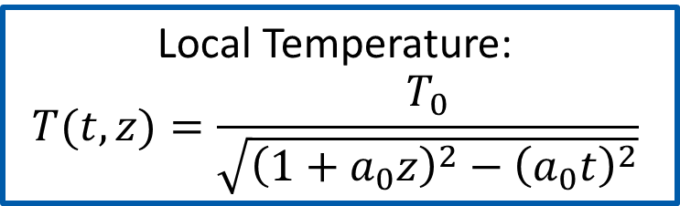
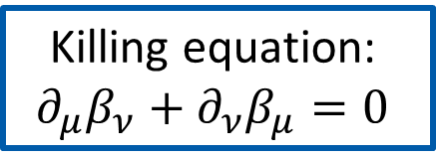
Some notes:
Inverse temperature four-vector:
$β^{μ}\left(x\right)≡{u^{μ}(x)}/{T(x)}$
Local fluid velocity
Killing equation:
$$∂_{μ}β_{ν}+∂_{ν}β_{μ}=0$$
Appropriate solution:
$β^{μ}\left(x\right)∂_{μ}={(1}/{T_{0})[\left(1+a_{0}z\right)∂_{t}+a_{0}t∂_{z}]}$
Local Temperature:
$$T(t,z)=\frac{T_{0}}{\sqrt{{\left(1+a_{0}z\right)}^{2}−{\left(a_{0}t\right)}^{2}}}$$

