Slide 1
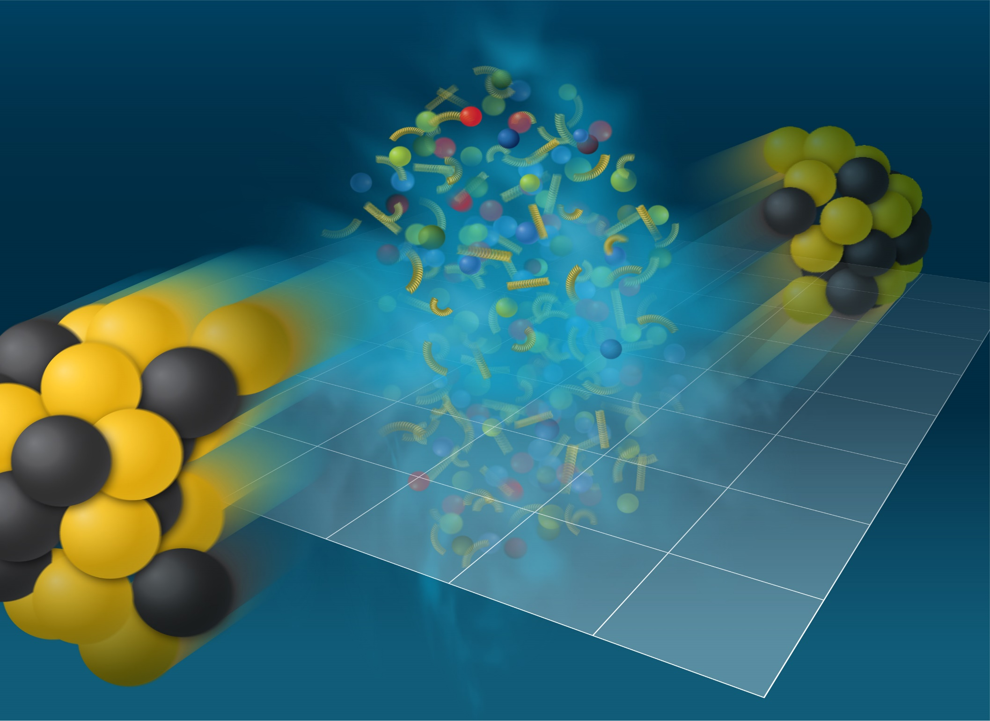
Systematic study of anisotropic flow in relativistic heavy-ion collisions

Slide 2
OUTLINE
1) Anisotropic flow: introduction
Flow and sQGP at RHIC/LHC?
Scaling properties of anisotropic flow
Flow results from Beam Energy Scans
Outlook for flow measurements at NICA

Slide 3
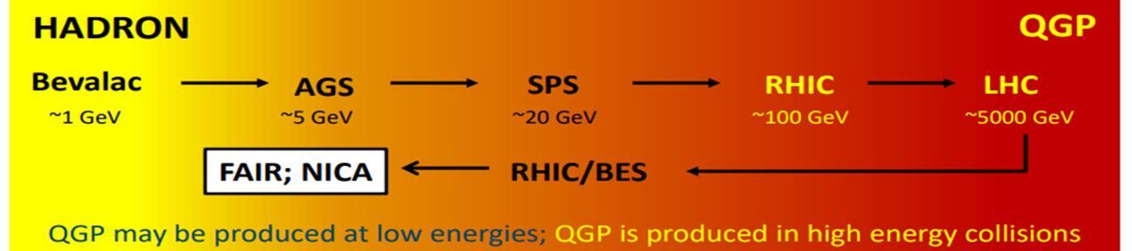
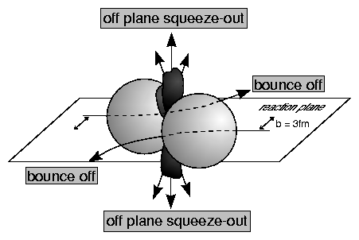
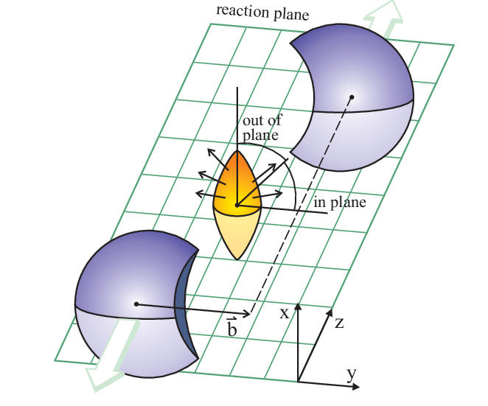
Anisotropic Flow in Heavy-Ion Collisions – 35 years
Plastic Ball, H.H. Gutbrod et al., Phys. Lett. B216, 267 (1989)
Diogene, M. Demoulins et al., Phys. Lett. B241, 476 (1990)

Slide 4
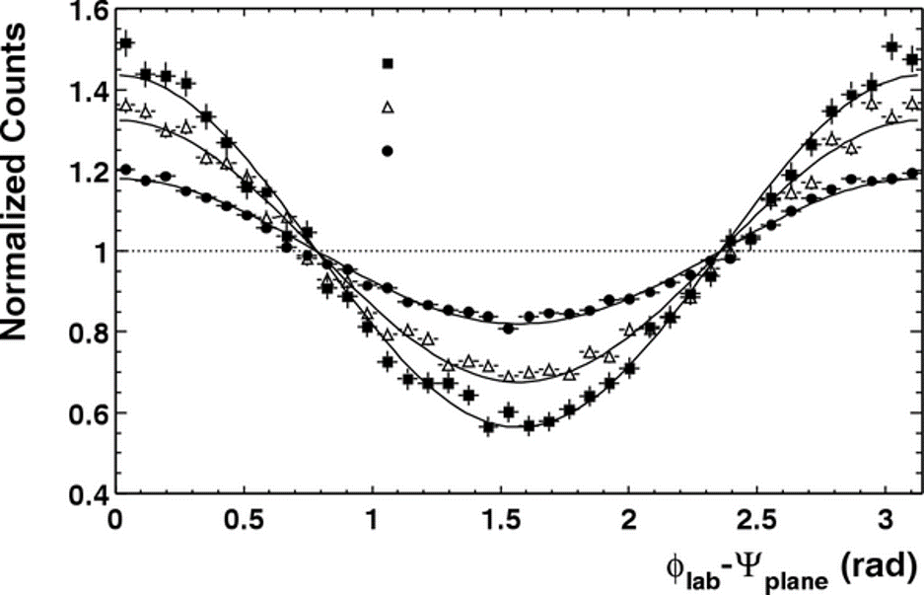
Azimuthal anisotropy of particles at HIC
STAR, PRL90 032301 (2003)
b ≈ 10 fm
𝜑 - Ψ_{RP}
b ≈ 6.5 fm
b ≈ 4 fm
4*v₂
Sergei Voloshin, Y. Zhang, Z. Phys. C70,(1996), 665
The sinus terms are skipped by symmetry arguments
From the properties of Fourier’s series one has
Fourier coefficients V_{n} quantify anisotropic flow:
v₁ is directed flow, v₂ is elliptic flow, v₃ is triangular flow, etc.
Term “flow” does not mean necessarily “hydro” flow – used only to emphasize the collective behavior of particles in event or multiparticle azimuthal correlation

Slide 5
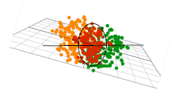
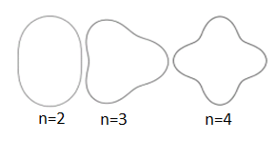


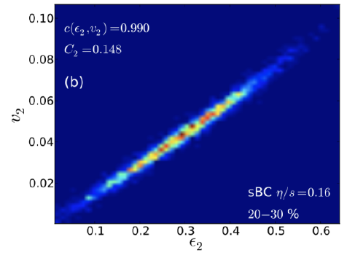
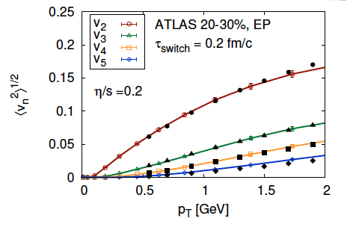
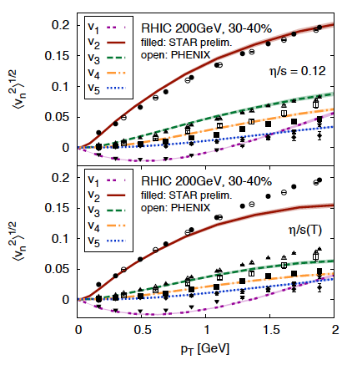
Anisotropic Flow at RHIC-LHC
Gale, Jeon, et al., Phys. Rev. Lett. 110, 012302

Slide 6
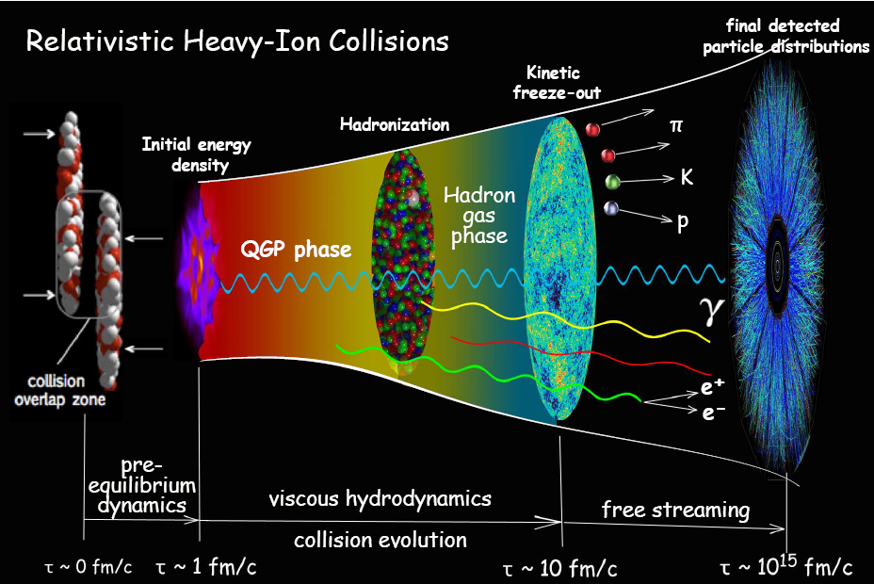
Evolution of the system created in RHIC
Fireball is ~10⁻¹⁵ meters across and lives for 5*10⁻²³ seconds
Initial state
QGP as a relativistic
fluid
Pre-equilibrium
dynamics
Hadronization
Transport/Freezeout
200+200 nucleons in 10⁻²² seconds = 1000-30000 hadrons

Slide 7
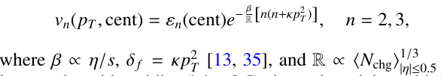


Flow is acoustic
R. Lacey Phys. Rev. C 98, 031901(R), 2018
R. Lacey Phys. Rev. C 110 (2024) 3, L031901
Same harmonic with variable centrality
For two harmonics at a fixed centrality

Slide 8
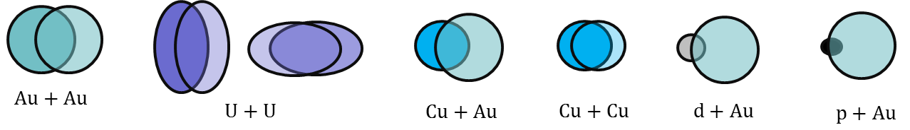
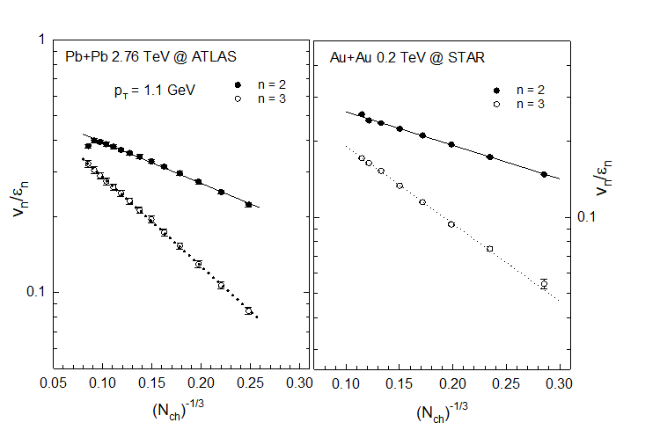
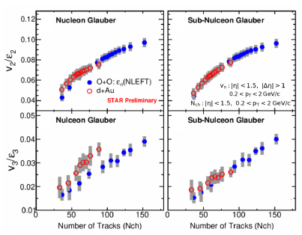
Flow is acoustic
R. Lacey Phys. Rev. C 98, 031901(R), 2018
STAR, Phys. Rev. Lett. 122 (2019) 172301

Slide 9
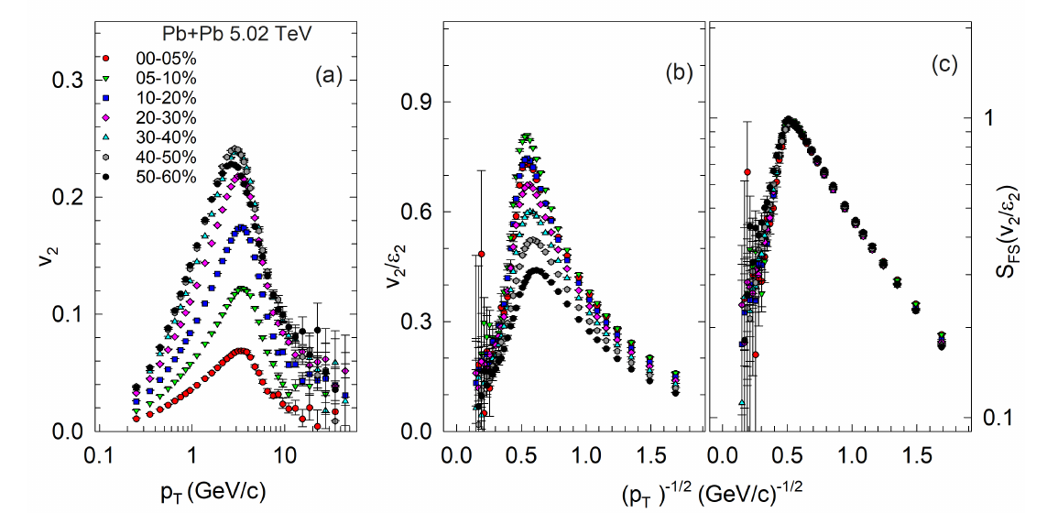
Flow is acoustic
R. Lacey Phys. Rev. C 110 (2024) 3, L031901

Slide 10
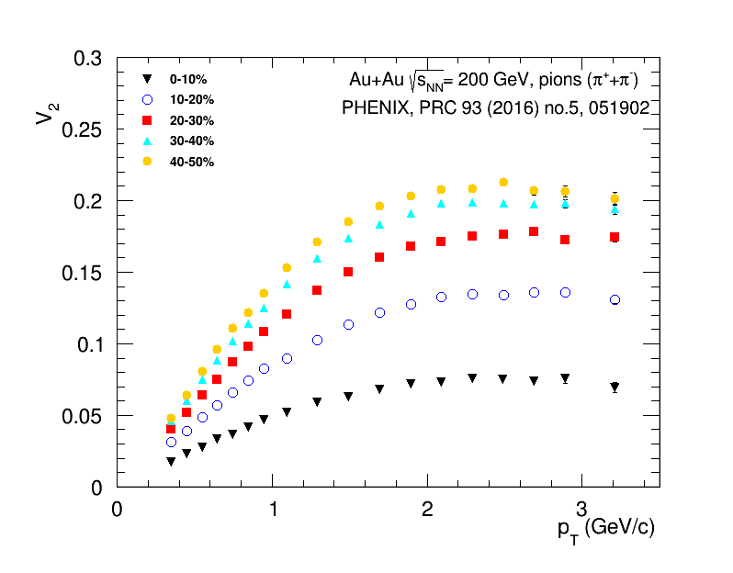
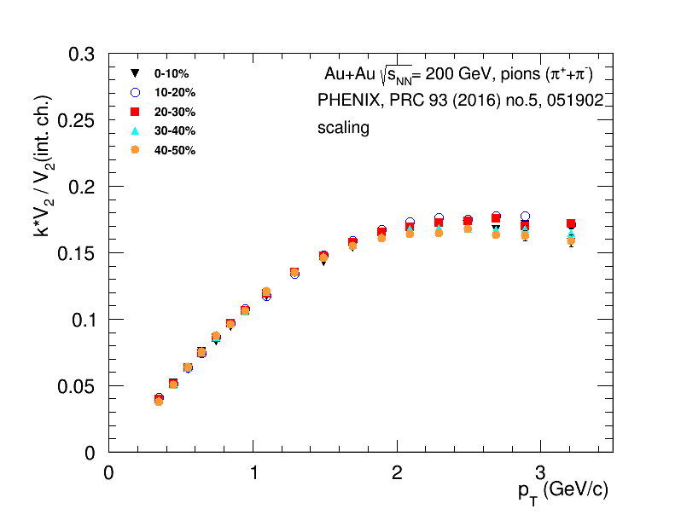
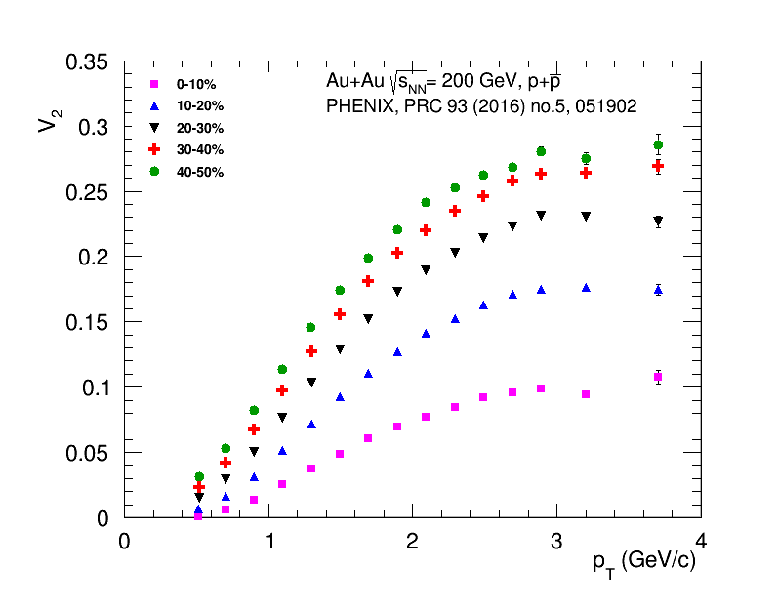
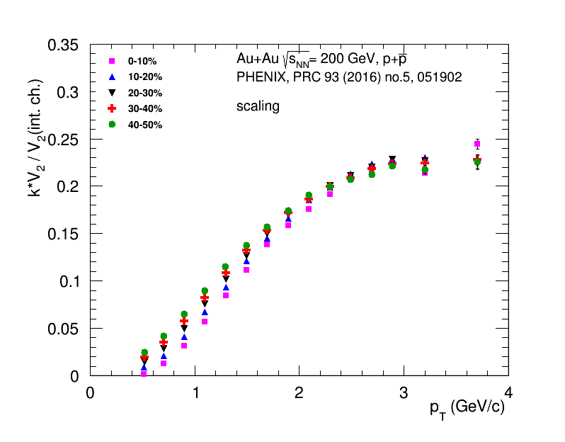
Scaling with integral flow of charged hadrons

Slide 11
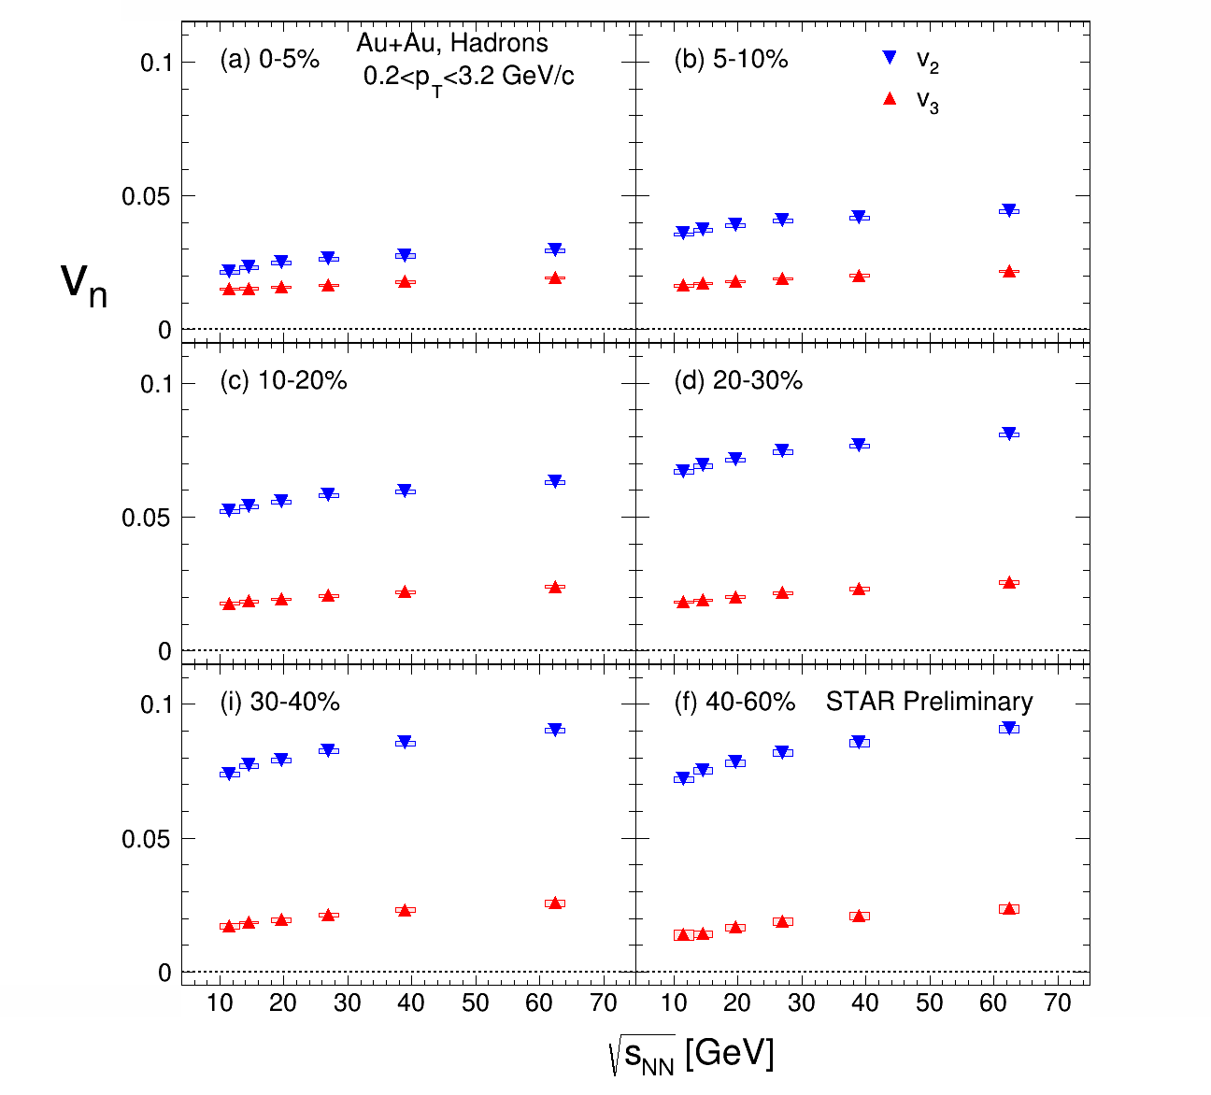
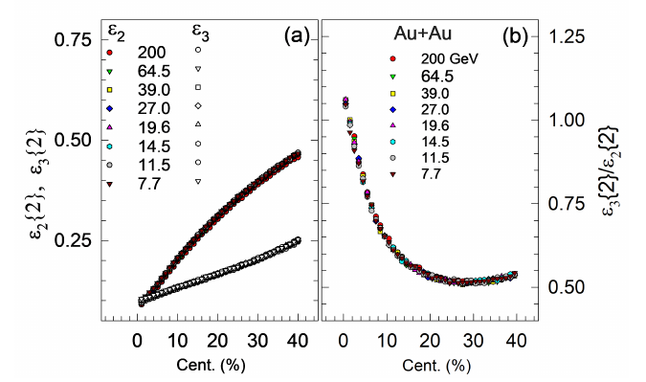
Beam-energy dependence of v₂ and v₃
Petr Parfenov for STAR Collaboration,
of normalized v2 and v3 for all centralities and beam energies J.Phys.Conf.Ser. 1690 (2020) 1, 012128
J.Phys.Conf.Ser. 1690 (2020) 1, 012128
Integrated v₂ and v₃ decrease with decreasing collision energy

Slide 12
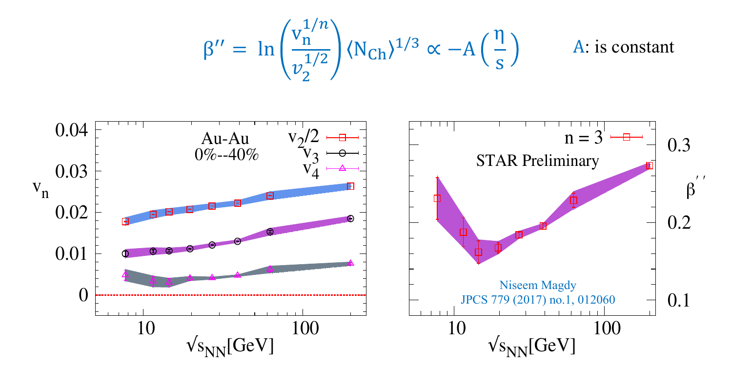
Beam energy dependence of V_{n}
V_{n} shows a monotonic increase with collision energy. The viscous coefficient, which encodes the transport coefficient (𝜼/𝒔), indicates a non-monotonic behavior as a function of collision energy.

Slide 13
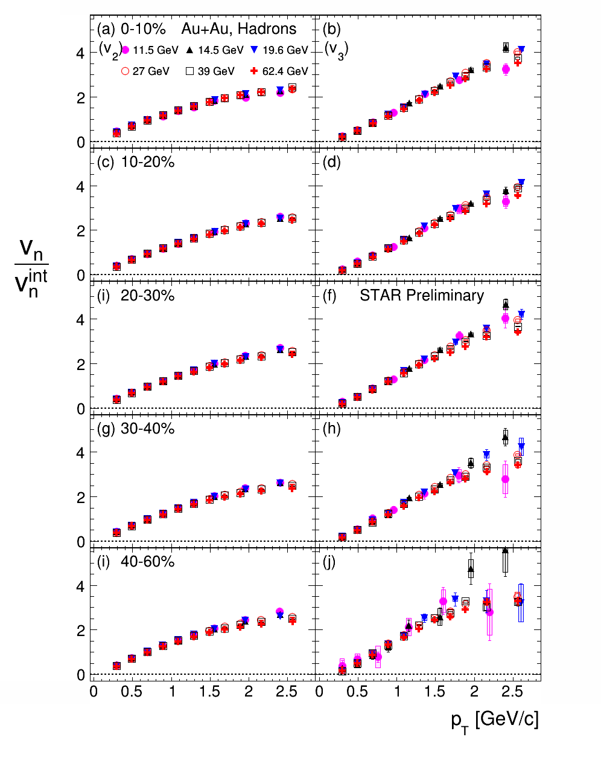
Beam-energy dependence of v₂ and v₃
J.Phys.Conf.Ser. 1690 (2020) 1, 012128
of normalized v2 and v3 for all centralities and beam energies J.Phys.Conf.Ser. 1690 (2020) 1, 012128
Integrated v₂ and v₃ decrease with decreasing collision energy
Similar shape of p_{T} dependence of normalized v₂ and v₃ for all centralities
and collision energies

Slide 14
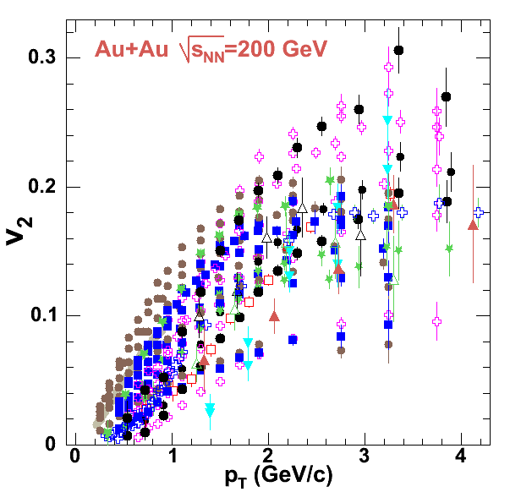
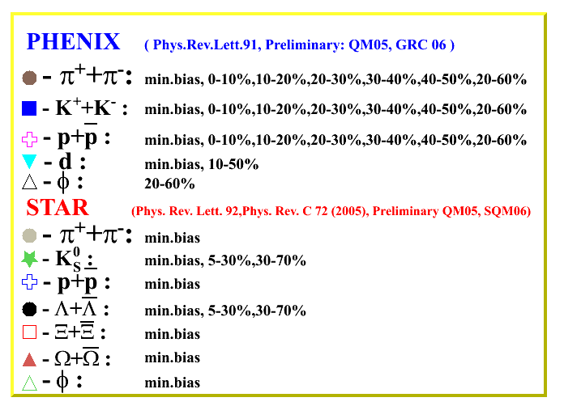
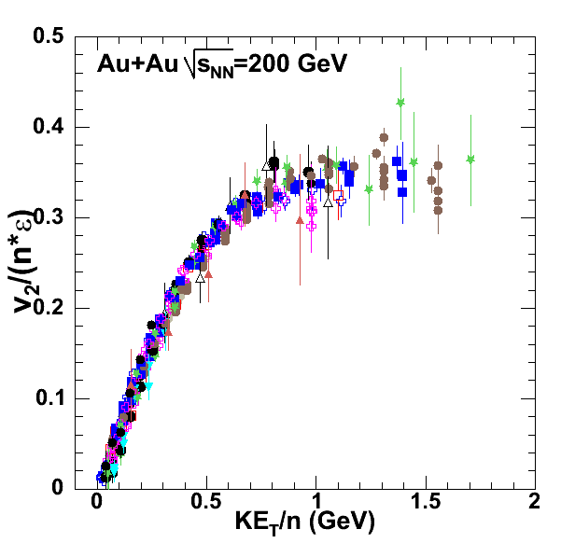
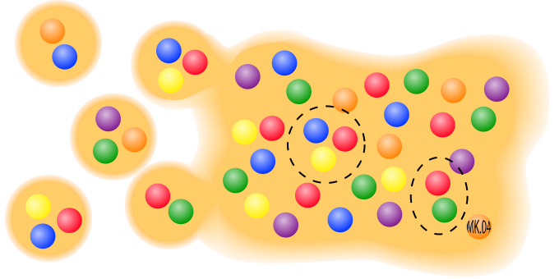

Anisotropic Flow at RHIC – partonic?
= m_{T} – m
n=2 for mesons and
n=3 for baryons
R. Lacey , A. Taranenko
PoS 2006 (2006) 021

Slide 15
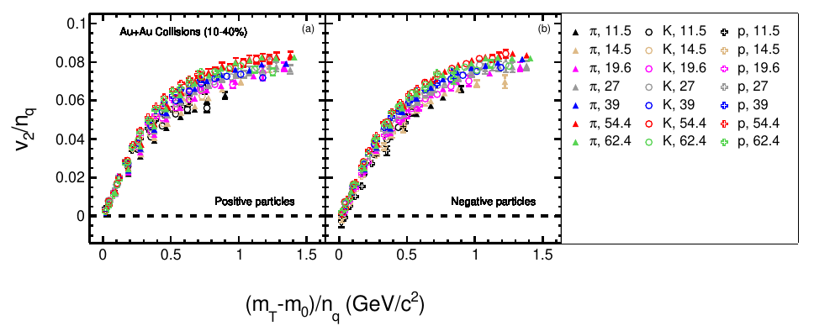
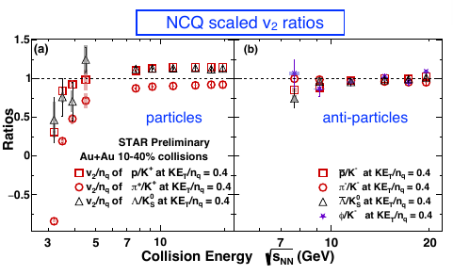
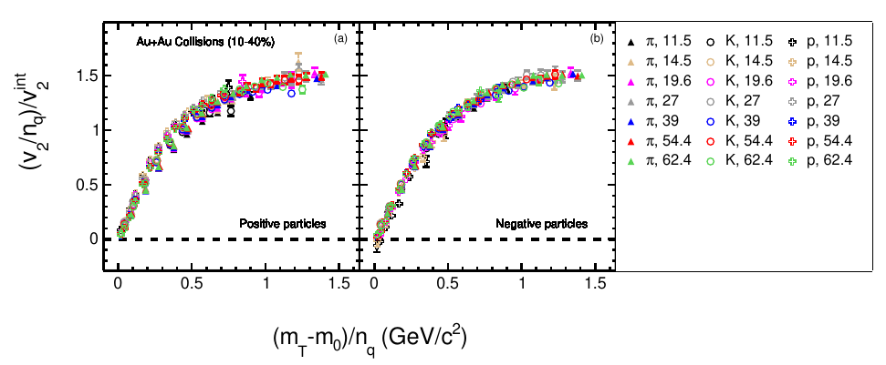
Elliptic flow from STAR BES program
STAR , Phys Rev C93, 14907 (2016)

Slide 16
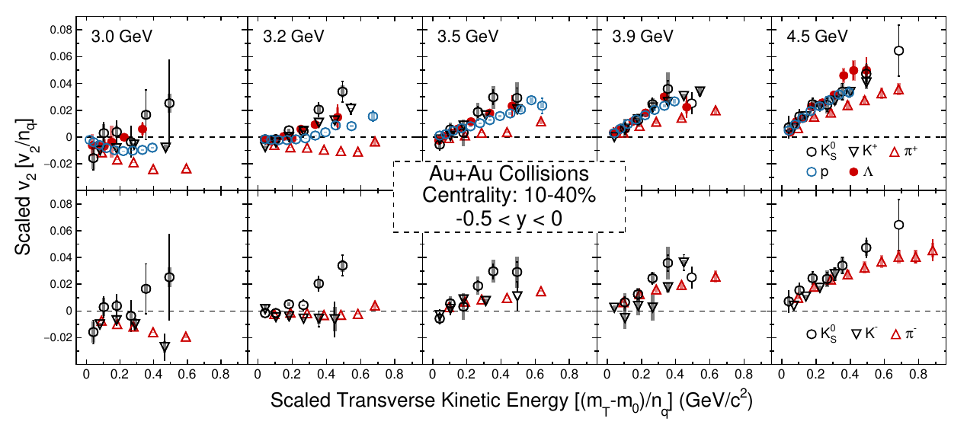
Anisotropic Flow at RHIC BES
Li-Ke Liu (CCNU), STAR Collaboration, CPOD 2024
At high energies, data follows NCQ scaling, indicating partonic collectivity???
NCQ scaling for v2 breaks completely at 3.5 GeV and below,

Slide 17
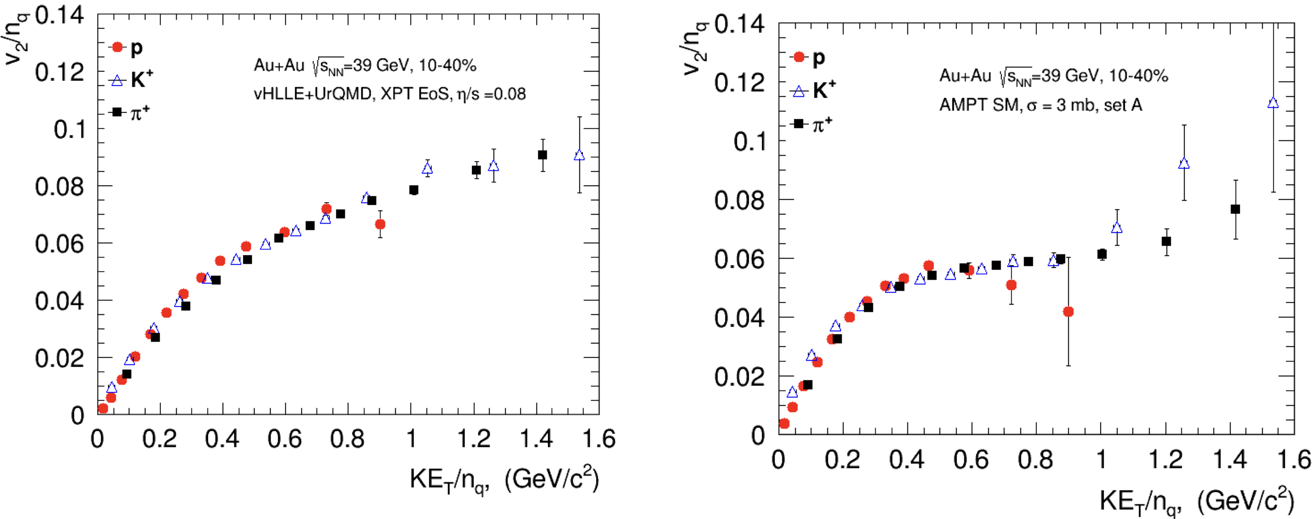
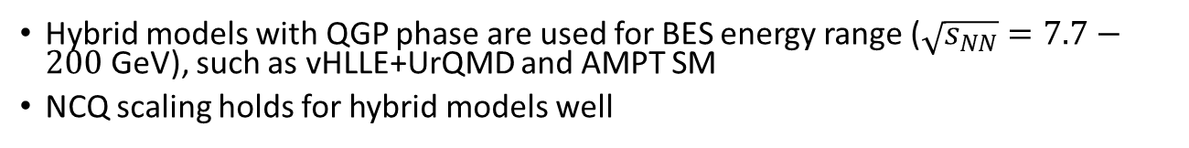
NCQ scaling: hybrid models
Hybrid models with QGP phase are used for BES energy range ($\sqrt{s_{NN}}=7.7−200$ GeV), such as vHLLE+UrQMD and AMPT SM
NCQ scaling holds for hybrid models well

Slide 18
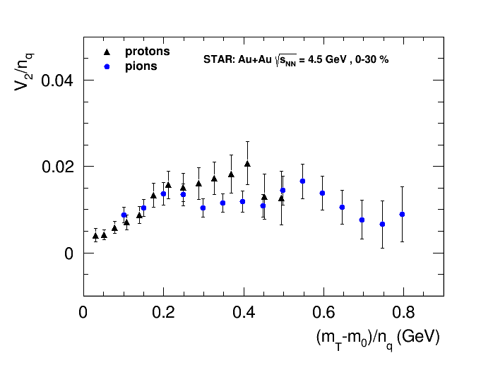
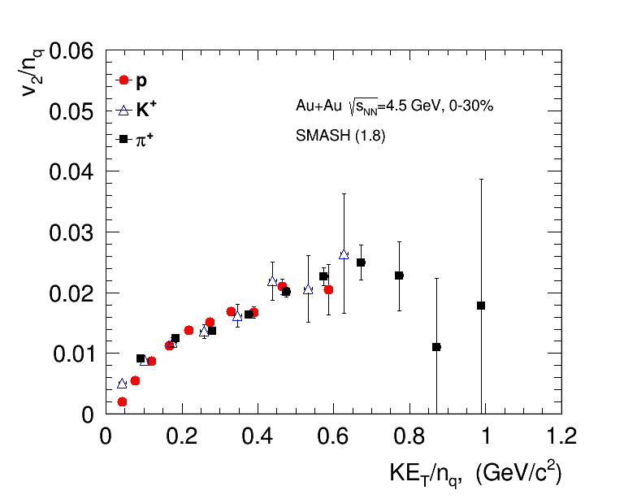
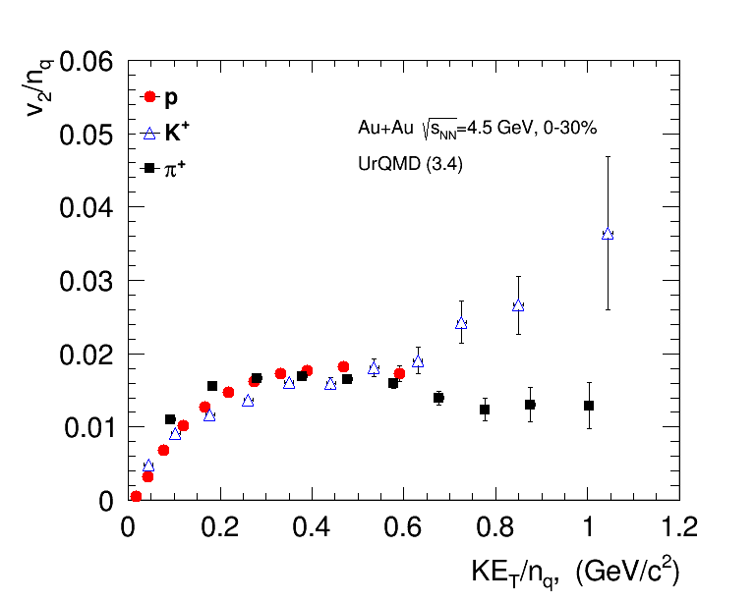
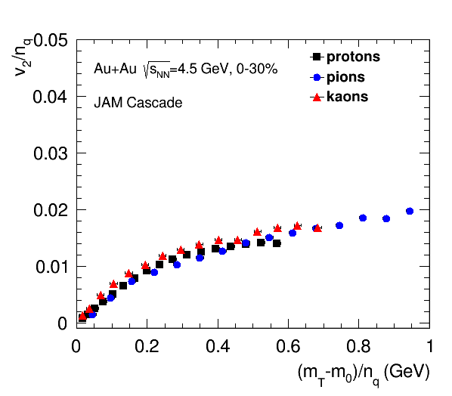
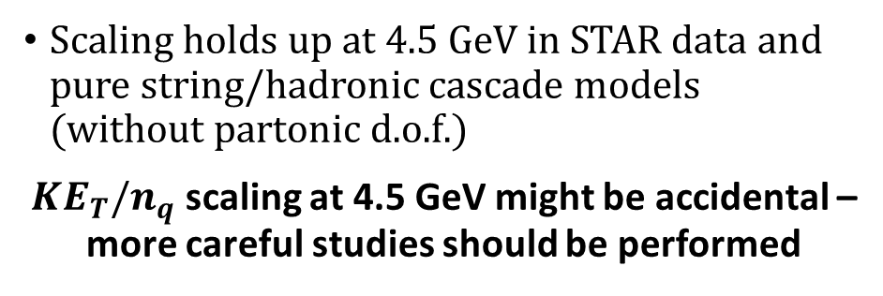
NCQ scaling: cascade models
STAR Collaboration, arxiv.org/abs/2007.14005
Scaling holds up at 4.5 GeV in STAR data and pure string/hadronic cascade models (without partonic d.o.f.)
$KE_{T}/n_{q}$ scaling at 4.5 GeV might be accidental – more careful studies should be performed

Slide 19
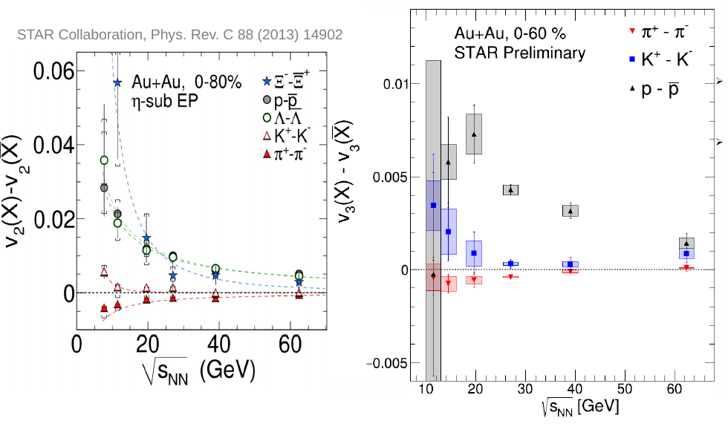
Anisotropic Flow of particles and antiparticles
STAR Collaboration, Phys Rev C93, 14907 (2016)
J.Phys.Conf.Ser. 1690 (2020) 1, 012128
Energy-dependent difference in elliptic and riangular flow between particles and antiparticles. This difference is increasing with decreasing collision energy and is almost identical for all baryons. It is larger for baryons than mesons.

Slide 20
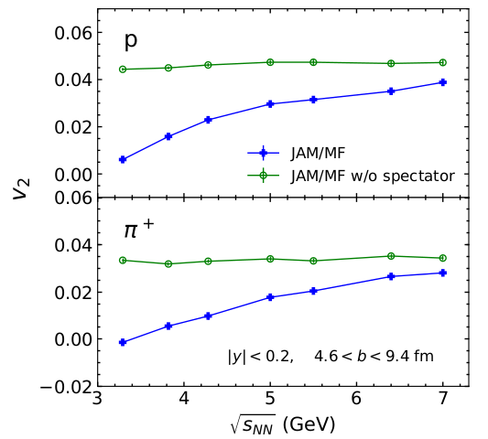
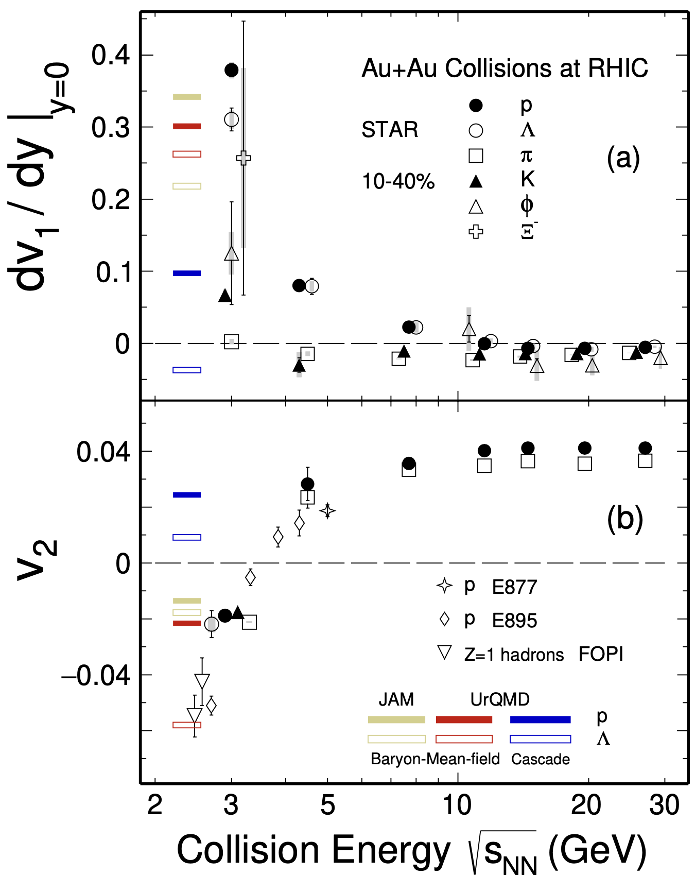
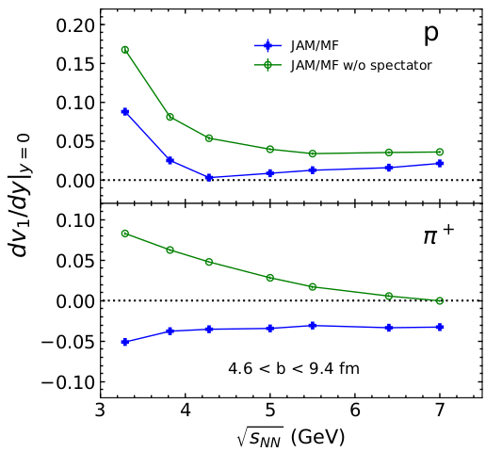

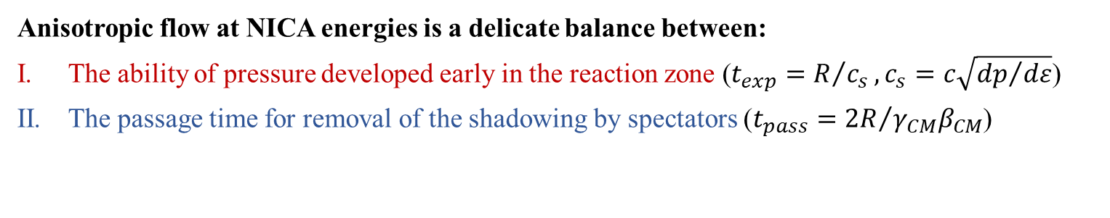
Anisotropic flow in heavy-ion collisions at high baryon density
M. Abdallah et al. STAR, Phys. Lett. B 827, 137003 (2022)
BM@N
CBM
MPD
Anisotropic flow at NICA energies is a delicate balance between:
The ability of pressure developed early in the reaction zone ($t_{exp}=R/{c_{s}}, c_{s}=c\sqrt{{dp}/{dε}}$)
The passage time for removal of the shadowing by spectators ($t_{pass}={2R}/{γ_{CM}β_{CM}}$)

Slide 21
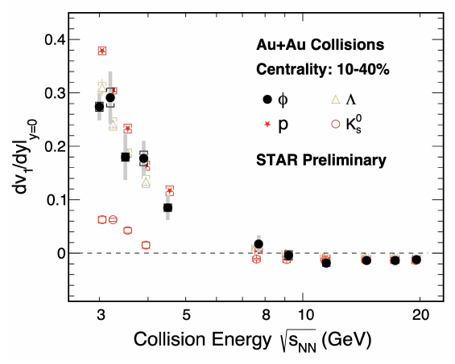
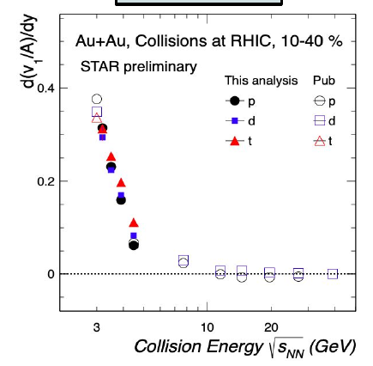
Beam Energy Dependence of Directed Flow (v₁)
Strong energy dependence of v₁ at √s_{NN} = 2.4-7 GeV

Slide 22
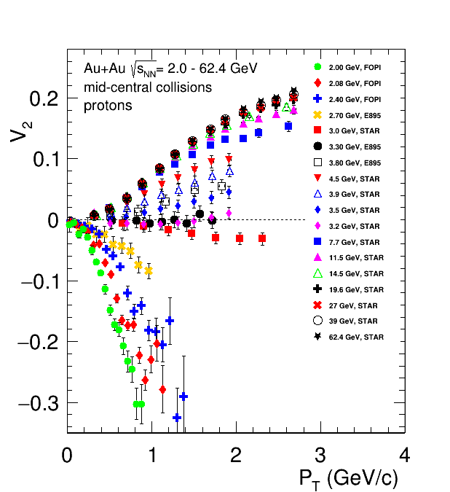
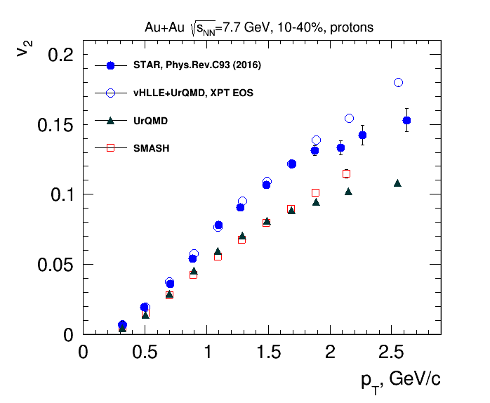
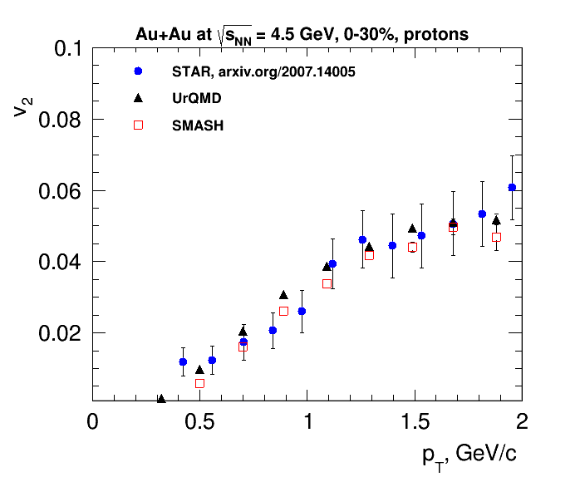
Beam Energy Dependence of Elliptic Flow (v₂)
Strong energy dependence of v₂ at √s_{NN} = 2.4-7 GeV

Slide 23
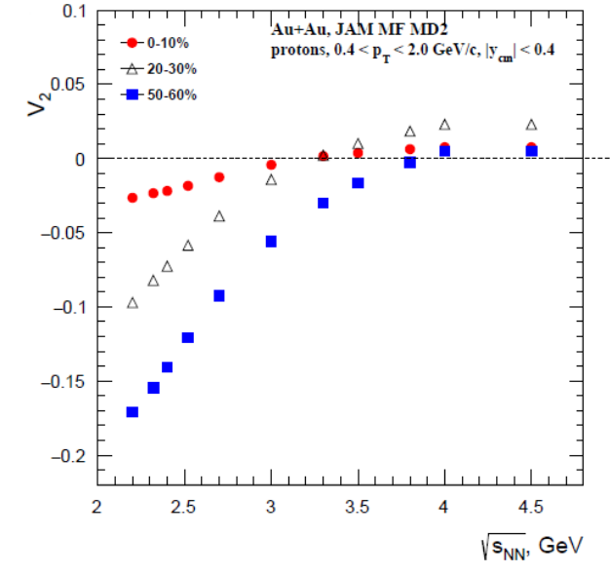


Beam Energy Dependence of Elliptic Flow (v₂)
Li-Ke Liu (CCNU), STAR Collaboration, CPOD 2024
Strong energy dependence of v₂ at √s_{NN} = 2.4-7 GeV

Slide 24





Scaling relations at SIS – scaling with passage time
$u_{t0}=\frac{p_{T}}{m_{0}β_{CM}γ_{CM}}≡\frac{p_{T}t_{pass}}{2Rm_{0}}$
$t_{pass}=\frac{2R}{β_{CM}γ_{CM}}$
Nucl. Phys A 876 (2012) 1-60
The rather good scaling observed suggests that $c_{s}$ does not change significantly over beam energy range $E_{kin}=0.4−2$ AGeV ($\sqrt{s_{NN}}=2−2.7$ GeV)
Scaling breaks at $E_{kin}=2.9$ AGeV ($\sqrt{s_{NN}}=3$ GeV)

Slide 25



Anisotropic flow at Nuclotron / NICA: 2.5-3.5 GeV
BM@N agrees with STAR
Please see talk of Mikhail Mamaev

Slide 26

Summary and outlook
NCQ scaling:
  Holds up for energies $\sqrt{s_{NN}}>4$ GeV in both experimental data and models (hybrid and pure string/hadronic cascade models)
  Scaling at $\sqrt{s_{NN}}=4.5$ GeV in the experimental data and pure string/hadronic cascade models can be accidental – more thorough study should be performed
Scaling with passage time:
  Holds up for energies $\sqrt{s_{NN}}=2−2.7$ GeV and breaks at $\sqrt{s_{NN}}≥3$ GeV
  Shows that at this energy range $v_{2}\left(\sqrt{s_{NN}}\right)$ changes due to the change of the passage time $t_{pass}$ of the spectators
Scaling relations provide a useful tool
to perform comparison between results from different experiments with different system size and beam energies
to constrain existing models

Slide 27



Flow is acoustic
R. Lacey Phys. Rev. C 110 (2024) 3, L031901

