Slide 1
Description of nucleus-nucleus interaction using the Skyrme energy density functional
M.S. Kosarev^{1,2}, N.V. Antonenko¹, N.N. Arsenyev¹, and A.P. Severyukhin^{1,3}
¹ Bogoliubov Laboratory of Theoretical Physics, Joint Institute for Nuclear Research, 141980 Dubna, Russia ² Moscow State University Branch in Sarov, Sarov, 607328, Russia ³ Dubna State University, Dubna, Moscow oblast, 141982 Russia
Infinite and Finite Nuclear Matter (INFINUM-2025), BLTP JINR Dubna, Russia, May 12-16, 2025

Slide 2
Motivation
To describe the ground state characteristics of the nucleus, it is necessary to adhere to the strategy of matching these characteristics to experimental data. The characteristics are
• Binding energy
• Charge radii
• Nucleon distribution densities
• Single-particle spectra
However, we can’t talk about the description of interaction between nuclei. In work [1], using the Giessen EDF, authors succeeded in description of sub-burrier fusion. Therefore, this work is devoted to obtain fusion barriers using the Skyrme EDF.
¹N. V. Antonenko ,G. G. Adamian, V. V. Sargsyan, H. Lenske,
Eur. Phys. J. A 58, 211 (2022)

Slide 3
Nucleus-nucleus interaction potential
The nucleus-nucleus interaction potential is represented as the sum
$$V\left(R\right)=V_{C}\left(R\right)+V_{N}\left(R\right)+V_{r}\left(R\right)$$
The double-folding procedure
$$V_{N}\left(R\right)=\int{dr_{1}dr_{2}}ρ_{1}\left(r_{1}\right)ρ_{2}\left(R−r_{2}\right)ℱ\left(r_{1}−r_{2}\right)$$
$$ρ_{i}\left(r_{i}\right)−density distribution of i nucleus$$
$ℱ\left(r_{1}−r_{2}\right)$ $−$ Nucleon-Nucleon force, chosen in Migdal type:
$$ℱ\left(r_{2}−r_{1}\right)=C_{0}\left[\left(F_{in}\frac{ρ_{1}\left(r_{1}\right)+ρ_{2}\left(R−r_{1}\right)}{ρ_{0}}+F_{ex}\left(1−\frac{ρ_{1}\left(r_{1}\right)+ρ_{2}\left(R−r_{1}\right)}{ρ_{0}}\right)\right)δ\left(r_{2}−r_{1}\right)\right]$$
N. V. Antonenko ,G. G. Adamian, V. V. Sargsyan, H. Lenske,
Eur. Phys. J. A 58, 211 (2022)

Slide 4
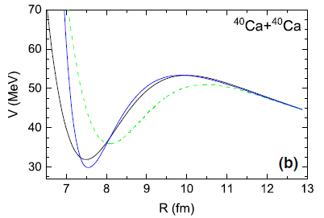
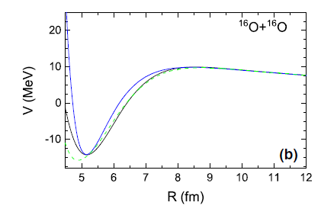
Nucleus-nucleus interaction potential
Comparison of nucleus-nucleus interaction potentials calculated with self-consistent (solid lines) and phenomenological (dashed lines) nucleon densities for the reactions ⁴⁰Ca+⁴⁰Ca and ¹⁶O+¹⁶O. The results of calculation with the parametrization of the nuclear part of the potential are shown by blue lines.
N. V. Antonenko ,G. G. Adamian, V. V. Sargsyan, H. Lenske,
Eur. Phys. J. A 58, 211 (2022)

Slide 5
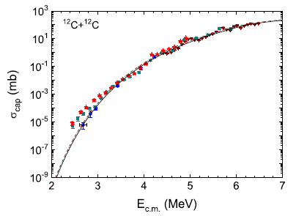
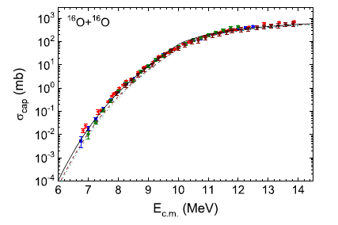
The fusion excitation functions
The fusion excitation functions calculated with phenomenologically adjusted (solid lines), self-consistent (dashed line), and parameterized (dotted line) potentials for the ¹²C+¹²C and ¹⁶O+¹⁶O reactions.
N. V. Antonenko ,G. G. Adamian, V. V. Sargsyan, H. Lenske,
Eur. Phys. J. A 58, 211 (2022)

Slide 6
Skyrme force
The Skyrme-like effective interactions is represented as
$$V\left(r_{1},r_{2}\right)$$
$$=t_{0}\left(1+x_{0}P_{σ}\right)δ\left(r\right)$$
Central term
$$+\frac{1}{2}t_{1}\left(1+x_{1}P_{σ}\right)\left[{k^{′}}^{2}δ\left(r\right)+δ\left(r\right)k^{2}\right]$$
$$+t_{2}\left(1+x_{2}P_{σ}\right){ k}^{′}δ\left(r\right)k$$
Non-local terms
$$+\frac{1}{6}t_{3}\left(1+x_{3}P_{σ}\right){\left[ρ\left(R\right)\right]}^{α}δ\left(r\right)$$
Density-dependent term
$$+iW_{0}σ\left[k^{′}×δ\left(r\right)k\right]$$
Spin-orbit term
$σ$ –the Pauli matrices, $P_{σ}$ – spin-exchange operator, ${ k}^{′}$, $k$– relative wave vectors and
$t_{0}$, $t_{1}$, $t_{2}$, $t_{3}$, $x_{0}$, $x_{1}$, $x_{2}$, $x_{3}$, $W_{0}$, $α$ – parameters of Skyrme EDF
D. Vautherin and D.M. Brink, Phys. Rev. C 5, 626 (1972)
D. Vautherin and D.M. Brink, Phys. Rev. C 5, 626 (1972)

Slide 7
Skyrme Energy Density Functional
$$E_{0}=\left\langle φ\right|\left(T+V\right)\left|φ\right\rangle =\int{ℋ\left(r\right)dr}$$
Expectation value of the energy
$$ρ_{q}\left(r\right)=\sum_{i,σ}{{\left|φ_{i}\left(r,σ,q\right)\right|}^{2}}$$
$$τ_{q}\left(r\right)=\sum_{i,σ}{{\left|∇φ_{i}\left(r,σ,q\right)\right|}^{2}}$$
$$ℋ\left(r\right)$$
$$=\frac{1}{4}t_{0}\left[\left(2+x_{0}\right)ρ^{2}−\left(2x_{0}+1\right)\left(ρ_{n}^{2}+ρ_{p}^{2}\right)\right]$$
$$J_{q}\left(r\right)=\left(−i\right)\sum_{i,σ,σ^{′}}{φ_{i}^{∗}\left[∇φ_{i}\left(r,σ^{′},q\right)×\left\langle σ\right|σ\left|σ^{′}\right\rangle \right]}$$
$$+\frac{1}{24}t_{3}ρ^{α}\left[\left(2+x_{3}\right)ρ^{2}−\left(2x_{3}+1\right)\left(ρ_{n}^{2}+ρ_{p}^{2}\right)\right]$$
$$+\frac{1}{8}\left[t_{1}\left(2+x_{1}\right)+t_{2}\left(2+x_{2}\right)\right]τρ+\frac{1}{8}\left[t_{2}\left(2x_{2}+1\right)−t_{1}\left(2x_{1}+1\right)\right]\left(τ_{n}ρ_{n}+τ_{p}ρ_{p}\right)$$
$$+\frac{1}{32}\left[3t_{1}\left(2+x_{1}\right)−t_{2}\left(2+x_{2}\right)\right]{\left(∇ρ\right)}^{2}−\frac{1}{32}\left[3t_{1}\left(2x_{1}+1\right)+t_{2}\left(2x_{2}+1\right)\right]\left[{\left(∇ρ_{n}\right)}^{2}+{\left(∇ρ_{p}\right)}^{2}\right]$$
$$+\frac{1}{2}W_{0}\left[J∇ρ+J_{n}∇ρ_{n}+J_{p}∇ρ_{p}\right]−\frac{1}{16}\left(t_{1}x_{1}+t_{2}x_{2}\right)J^{2}+\frac{1}{16}\left(t_{1}−t_{2}\right)\left[J_{n}^{2}+J_{p}^{2}\right]$$
E. Chabanat, P. Bonche, P. Haensel, J. Meyer, R. Schaeffer, Nuclear Phys. A 635 (1998) 231

Slide 8
Hartree-Fock equations
$$\left[−{\vec{∇}}^{2}\frac{ℏ^{2}}{2m_{q}^{∗}\left(\vec{r}\right)}+U_{q}\left(\vec{r}\right)+{\vec{W}}_{q}\left(\vec{r}\right)∙\left(−i\right)\left(\vec{∇}×\vec{σ}\right)\right]φ_{i}=e_{i}φ_{i}$$
$$\frac{ℏ^{2}}{2m_{q}^{∗}\left(\vec{r}\right)}=\frac{ℏ^{2}}{2m}+\frac{1}{8}\left[t_{1}\left(2+x_{1}\right)+t_{2}\left(2+x_{2}\right)\right]ρ+\frac{1}{8}\left[t_{2}\left(2x_{2}+1\right)−t_{1}\left(2x_{1}+1\right)\right]ρ_{q}$$
Effective mass
$$=\frac{1}{2}t_{0}\left[\left(2+x_{0}\right)ρ−\left({2x}_{0}+1\right)ρ_{q}\right]$$
$$U_{q}\left(\vec{r}\right)$$
$$+\frac{1}{24}t_{3}\left[\left(α+2\right)\left(2+x_{3}\right)ρ^{α+1}−\left(2x_{3}+1\right)\left(2ρ^{α}ρ_{q}+αρ^{α−1}\left(ρ_{n}^{2}+ρ_{p}^{2}\right)\right)\right]$$
$$−\frac{1}{16}\left[3t_{1}\left(2+x_{1}\right)−t_{2}\left(2+x_{2}\right)\right]∇^{2}ρ+\frac{1}{16}\left[3t_{1}\left(2x_{1}+1\right)+t_{2}\left(2x_{2}+1\right)\right]∇^{2}ρ_{q}$$
Nuclear central potential
$$+\frac{1}{8}\left[t_{1}\left(2+x_{1}\right)+t_{2}\left(2+x_{2}\right)\right]τ+\frac{1}{8}\left[t_{2}\left(2x_{2}+1\right)−t_{1}\left(2x_{1}+1\right)\right]τ_{q}−\frac{1}{2}W_{0}\left(∇∙J+∇∙J_{q}\right)$$
$${\vec{W}}_{q}\left(\vec{r}\right)=\frac{1}{2}W_{0}\left(∇ρ+∇ρ_{q}\right)+\frac{1}{8}\left(t_{1}−t_{2}\right)J_{q}−\frac{1}{8}\left(t_{1}x_{1}+t_{2}x_{2}\right)J$$
Single-particle spin-orbital potential

Slide 9
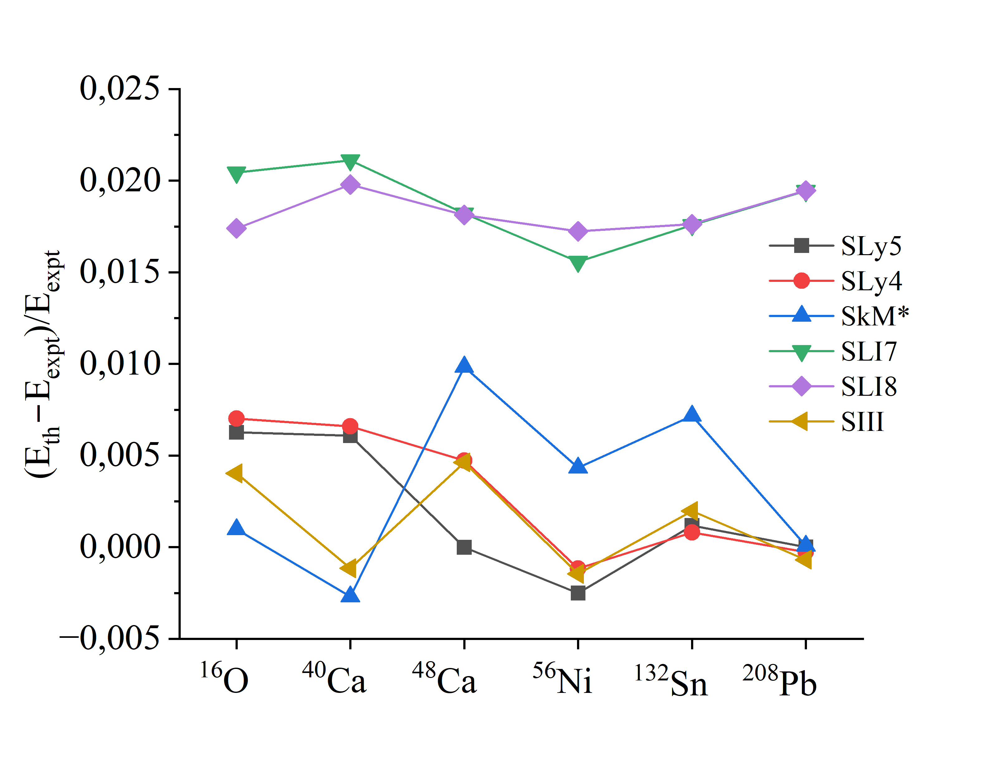
Binding energies

Slide 10
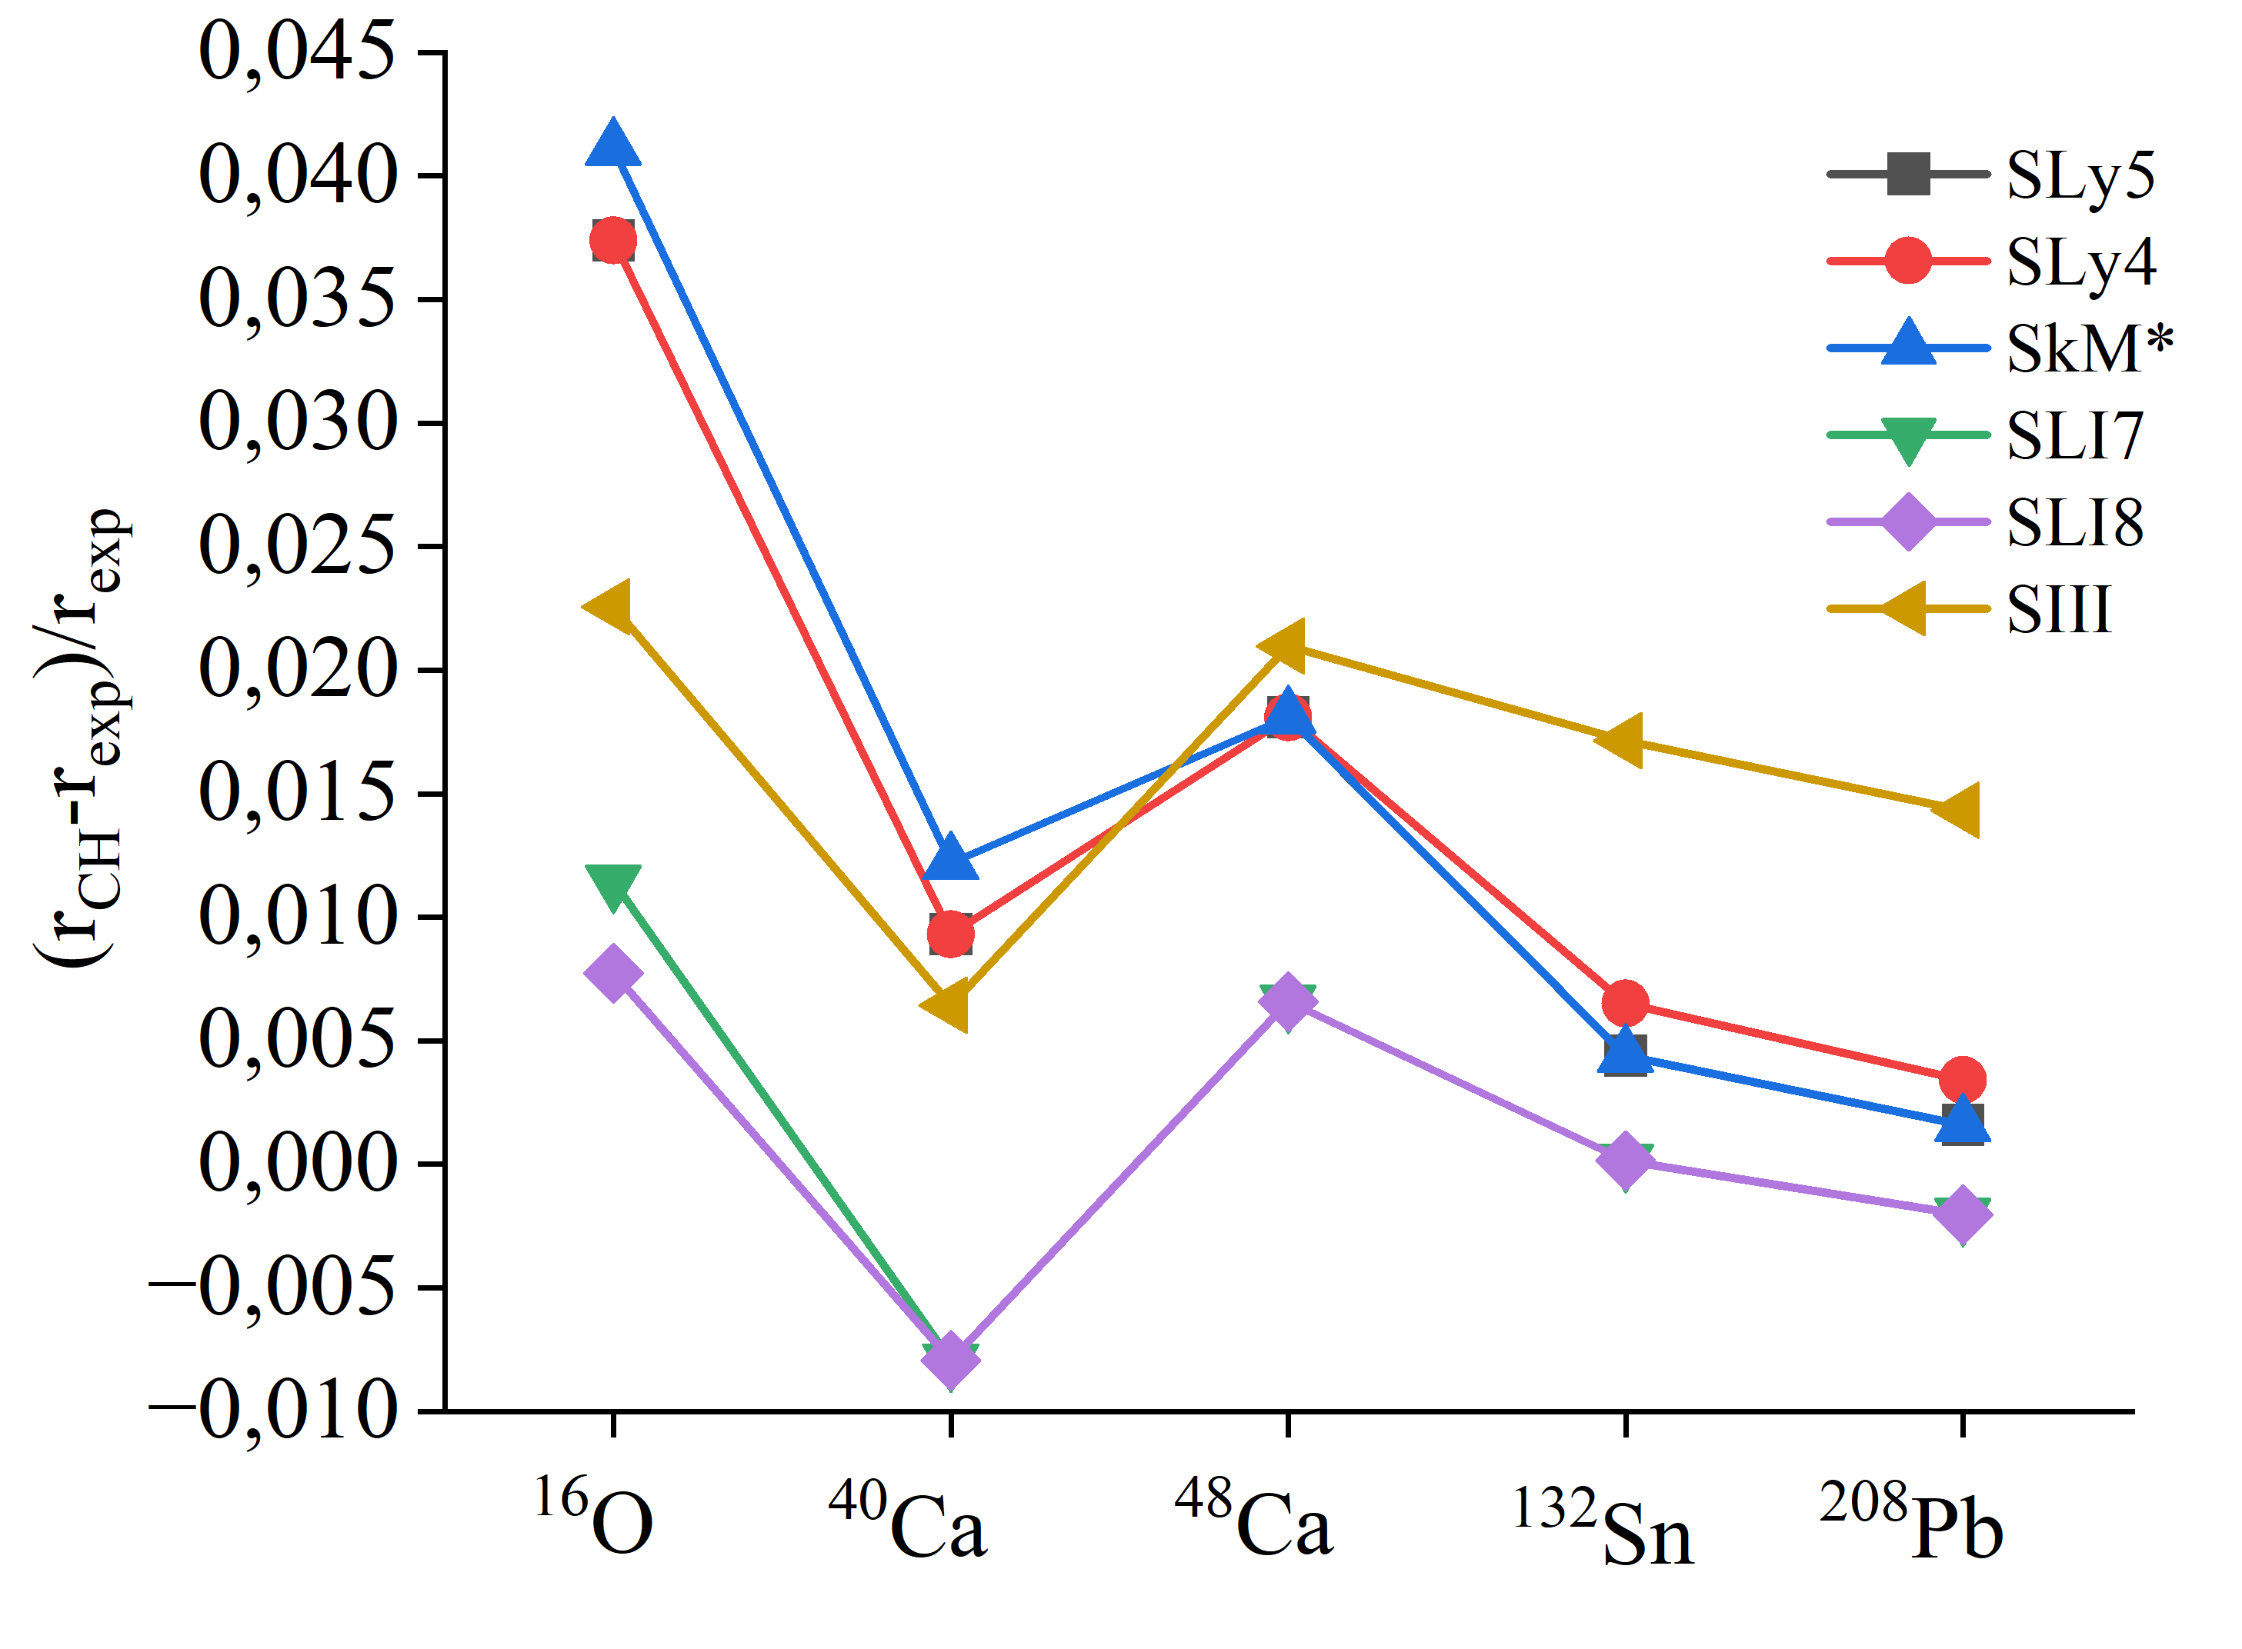
Charge radii

Slide 11
Density distributions
¹⁶O
⁴⁰Ca
⁴⁸Ca
⁵⁶Ni
¹³²Sn
²⁰⁸Pb

Slide 12
Skyrme-Landau-Migdal force
$$ℱ=N_{0}\sum_{l}{\left[F_{l}+F_{l}^{′}\left(τ_{i}∙τ_{j}\right)+G_{l}\left(σ_{i}∙σ_{j}\right)+G_{l}^{′}\left(τ_{i}∙τ_{j}\right)\left(σ_{i}∙σ_{j}\right)\right]}P_{l}\left(\frac{k_{1}k_{2}}{k_{F}^{2}}\right)$$
$$N_{0}=\frac{π^{2}ℏ^{2}}{2k_{F}m^{∗}}$$
where $F_{l}$, $F_{l}^{′}$, $G_{l}$, $G_{l}^{′}$ - Landau-Migdal parameters; $P_{l}$ - Legendre polynomials; $σ$ – spin, $τ$ – isospin
A.B. Migdal, Theory of Finite Fermi Systems and Applications to Atomic Nuclei (Wiley, New York, 1967)
The most significant part of decomposition is zero harmonics. Thus in coordinate space Landau-Migdal interaction is given in following form
$$ℱ\left(r_{1},r_{2}\right)=N_{0}\left[F_{0}+G_{0}\left(σ_{i}∙σ_{j}\right)+\left(F_{0}^{′}+G_{0}^{′}\right)\left(τ_{i}∙τ_{j}\right)\left(σ_{i}∙σ_{j}\right)\right]δ\left(r_{1}−r_{2}\right)$$
Severyukhin A. P. Rol phonon-phononnogo vzaimodejstviya v strukture nejtronno-izbytochnyh yader. [The role of phonon-phonon interaction in the structure of neutron-rich nuclei Dokt. Diss.]. Dubna, 2025. 263 p.

Slide 13
Skyrme-Landau-Migdal force
To calculate the Landau-Migdal parameters we need to calculate second variational derivative:
$$\frac{δ^{2}ℋ\left(r\right) }{δρ_{1}δρ_{2}}=\sum_{σ,τ,σ^{′},τ^{′}}{\frac{\left(1+{\left(−1\right)}^{σ−σ^{′}}σ_{1}σ_{2}\right)}{4}\frac{\left(1+{\left(−1\right)}^{τ−τ^{′}}τ_{1}τ_{2}\right)}{4}\frac{δ^{2}ℋ\left(r\right)}{δρ_{στ}δρ_{σ^{′}τ^{′}}}}$$
$$F_{0}=N_{0}^{−1}\left\{\frac{3}{4}t_{0}+\frac{1}{16}ρ^{α}\left(α+1\right)\left(α+2\right)+\frac{1}{8}k_{F}^{2}\left[3t_{1}+\left(5+4x_{2}\right)t_{2}\right]\right\}$$
$$F_{0}^{′}=−N_{0}^{−1}\left\{\frac{1}{4}t_{0}\left(1+2x_{0}\right)+\frac{1}{24}t_{3}ρ^{α}\left(1+2x_{3}\right)+\frac{1}{8}k_{F}^{2}\left[t_{1}\left(1+2x_{1}\right)−t_{2}\left(1+2x_{2}\right)\right]\right\}$$
$$G_{0}=N_{0}^{−1}\left\{\frac{1}{4}t_{0}\left(1−2x_{0}\right)+\frac{1}{24}t_{3}ρ^{α}\left(1−2x_{3}\right)+\frac{1}{8}k_{F}^{2}\left[t_{1}\left(1−2x_{1}\right)−t_{2}\left(1+2x_{2}\right)\right]\right\}$$
$$G_{0}^{′}=N_{0}^{−1}\left[\frac{1}{4}t_{0}+\frac{1}{24}t_{3}ρ^{α}+\frac{1}{8}k_{F}^{2}\left(t_{1}−t_{2}\right)\right]$$
N. Van Giai, H. Sagawa, Phys. Lett. B106 (1981) 379
G.F. Bertsch and S.F. Tsai, Phys. Rep. 18C, 126 (1975)

Slide 14
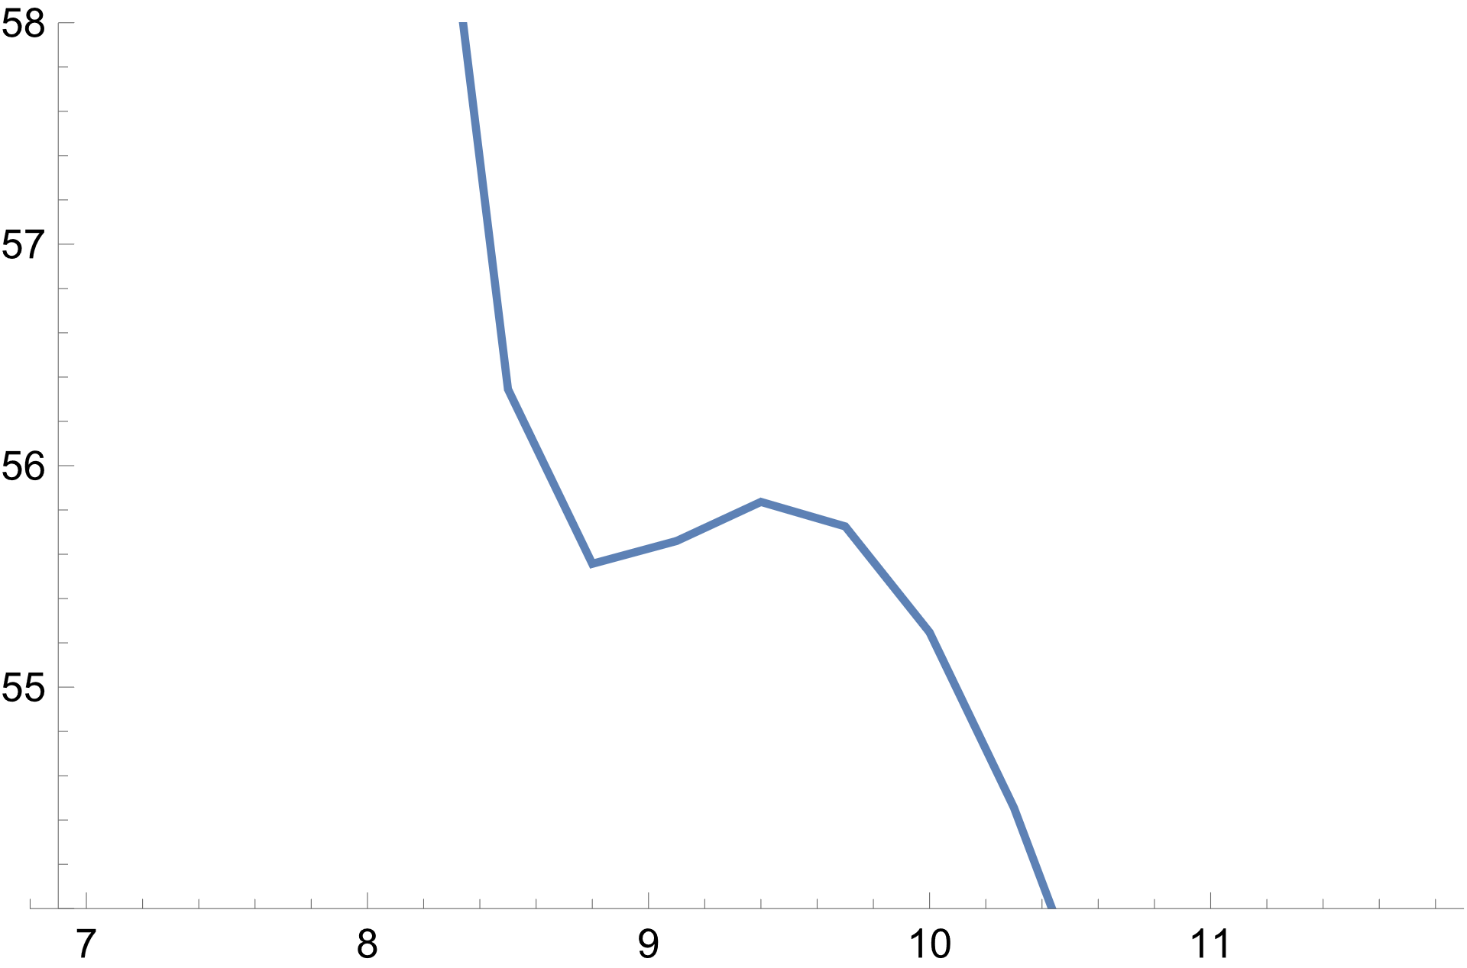
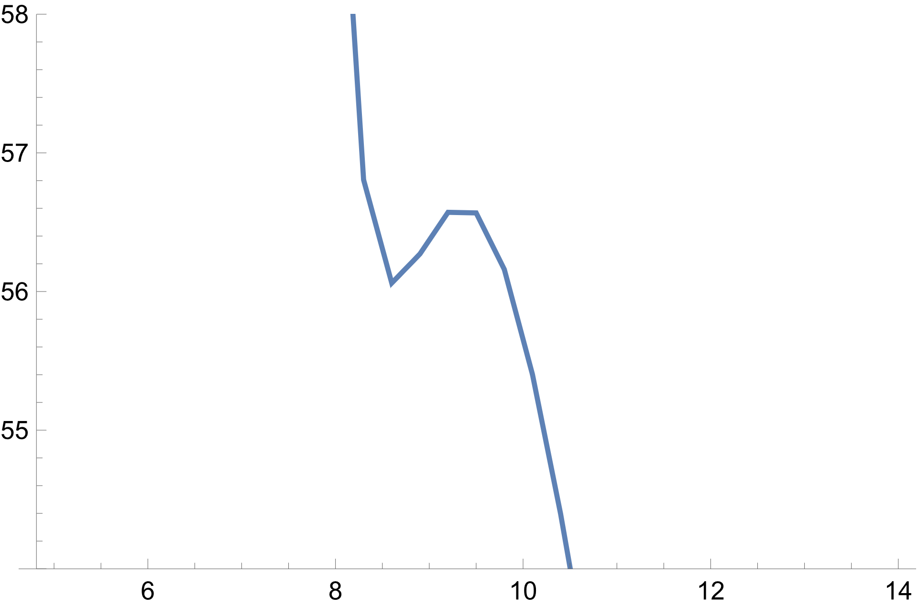
Nucleus-nucleus interaction potential with Skyrme EDF
$${r_{phen}=10.58 fm , V}_{phen}=\text{50.46 }\text{MeV}$$
⁴⁸Ca+⁴⁸Ca
SIII
SLI7
56.57 MeV
V, MeV
V, MeV
55.84 MeV
56.06 MeV
55.56 MeV
r, fm
r, fm

Slide 15
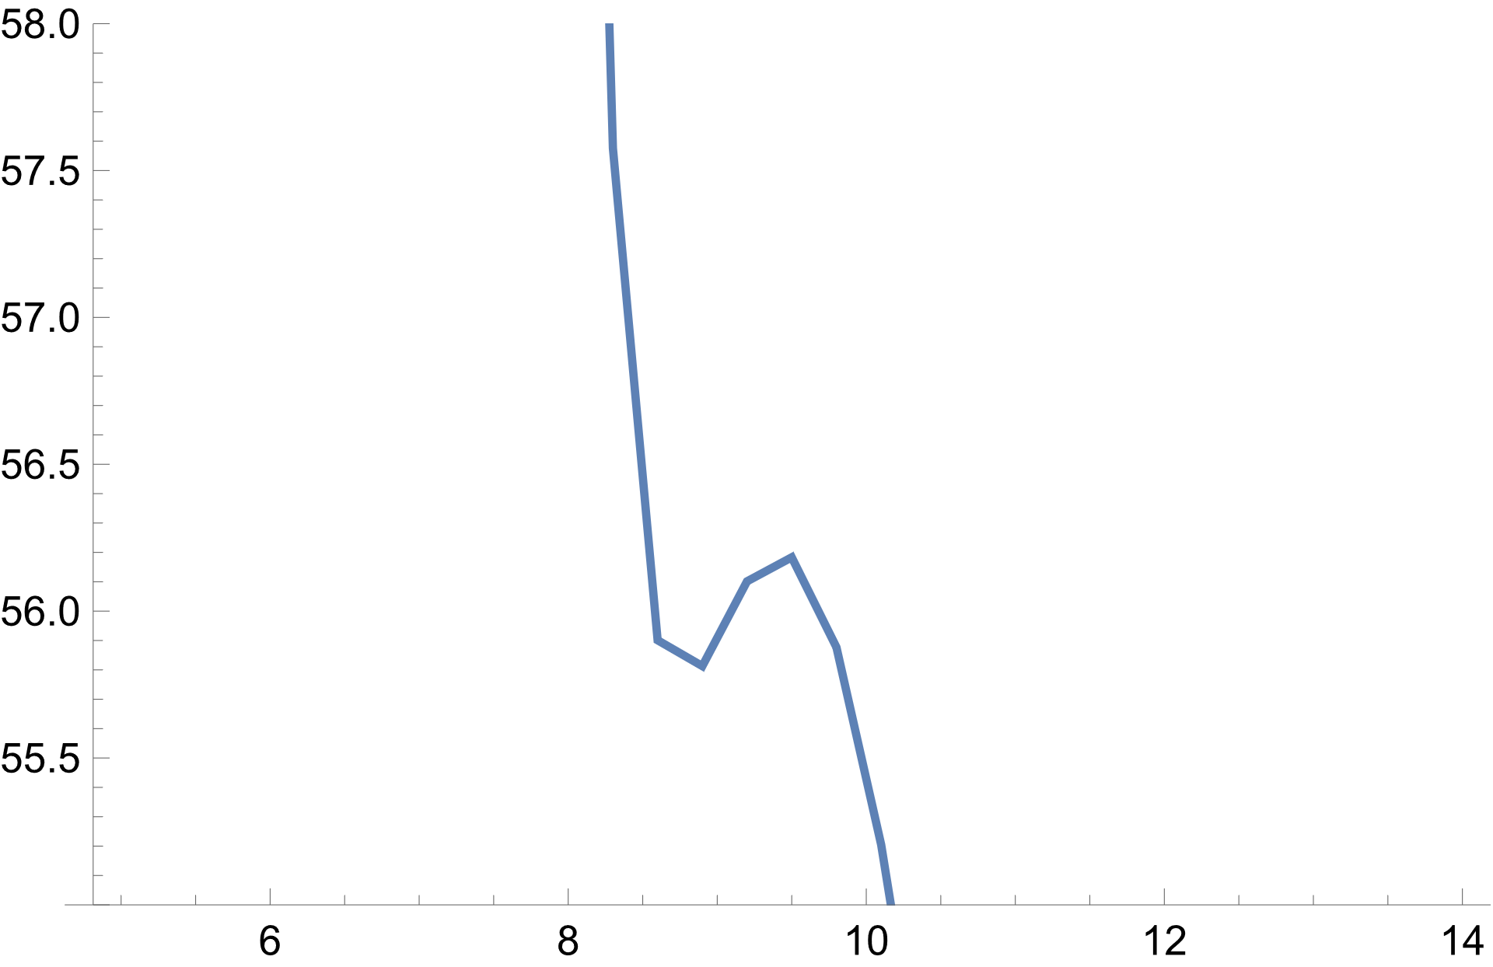
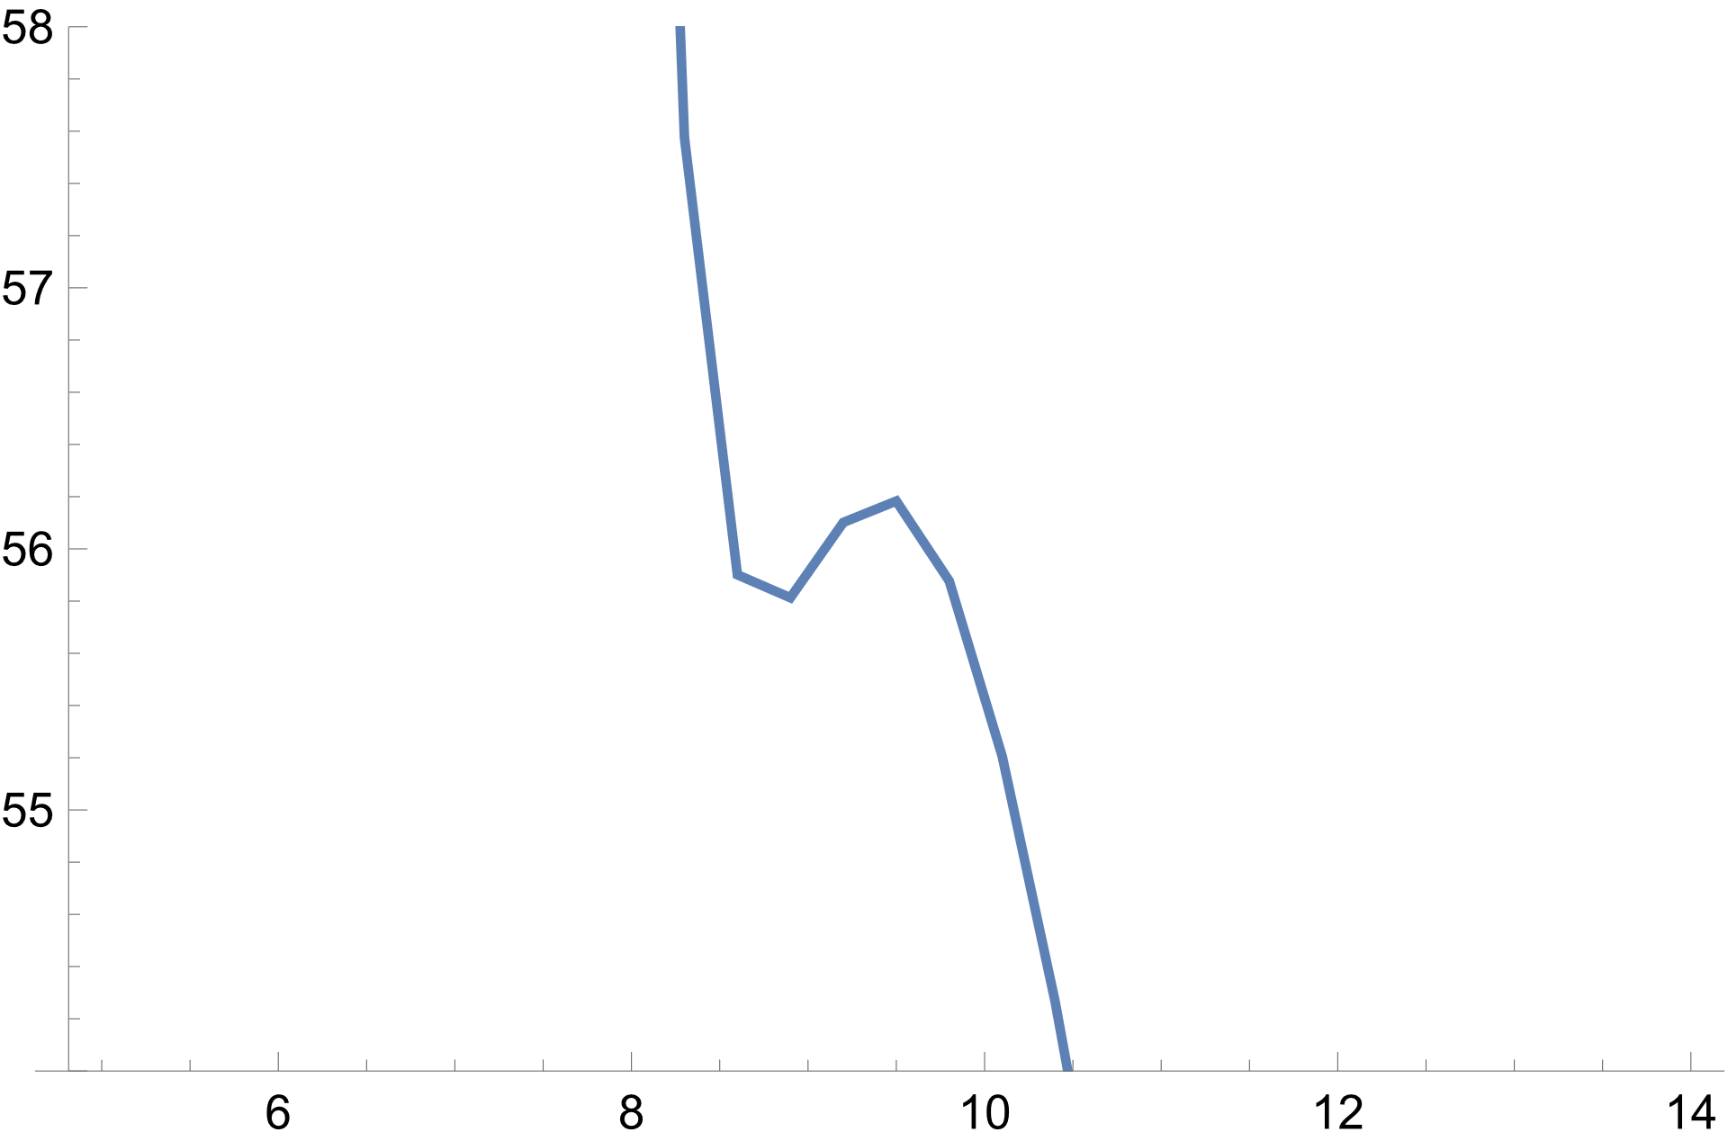
⁴⁸Ca+⁴⁸Ca
$${r_{phen}=10.58 fm , V}_{phen}=\text{50.46 }\text{MeV}$$
SLI8
SLI9
56.18 MeV
V, MeV
V, MeV
56.18 MeV
55.81 MeV
55.81 MeV
r, fm
r, fm

Slide 16
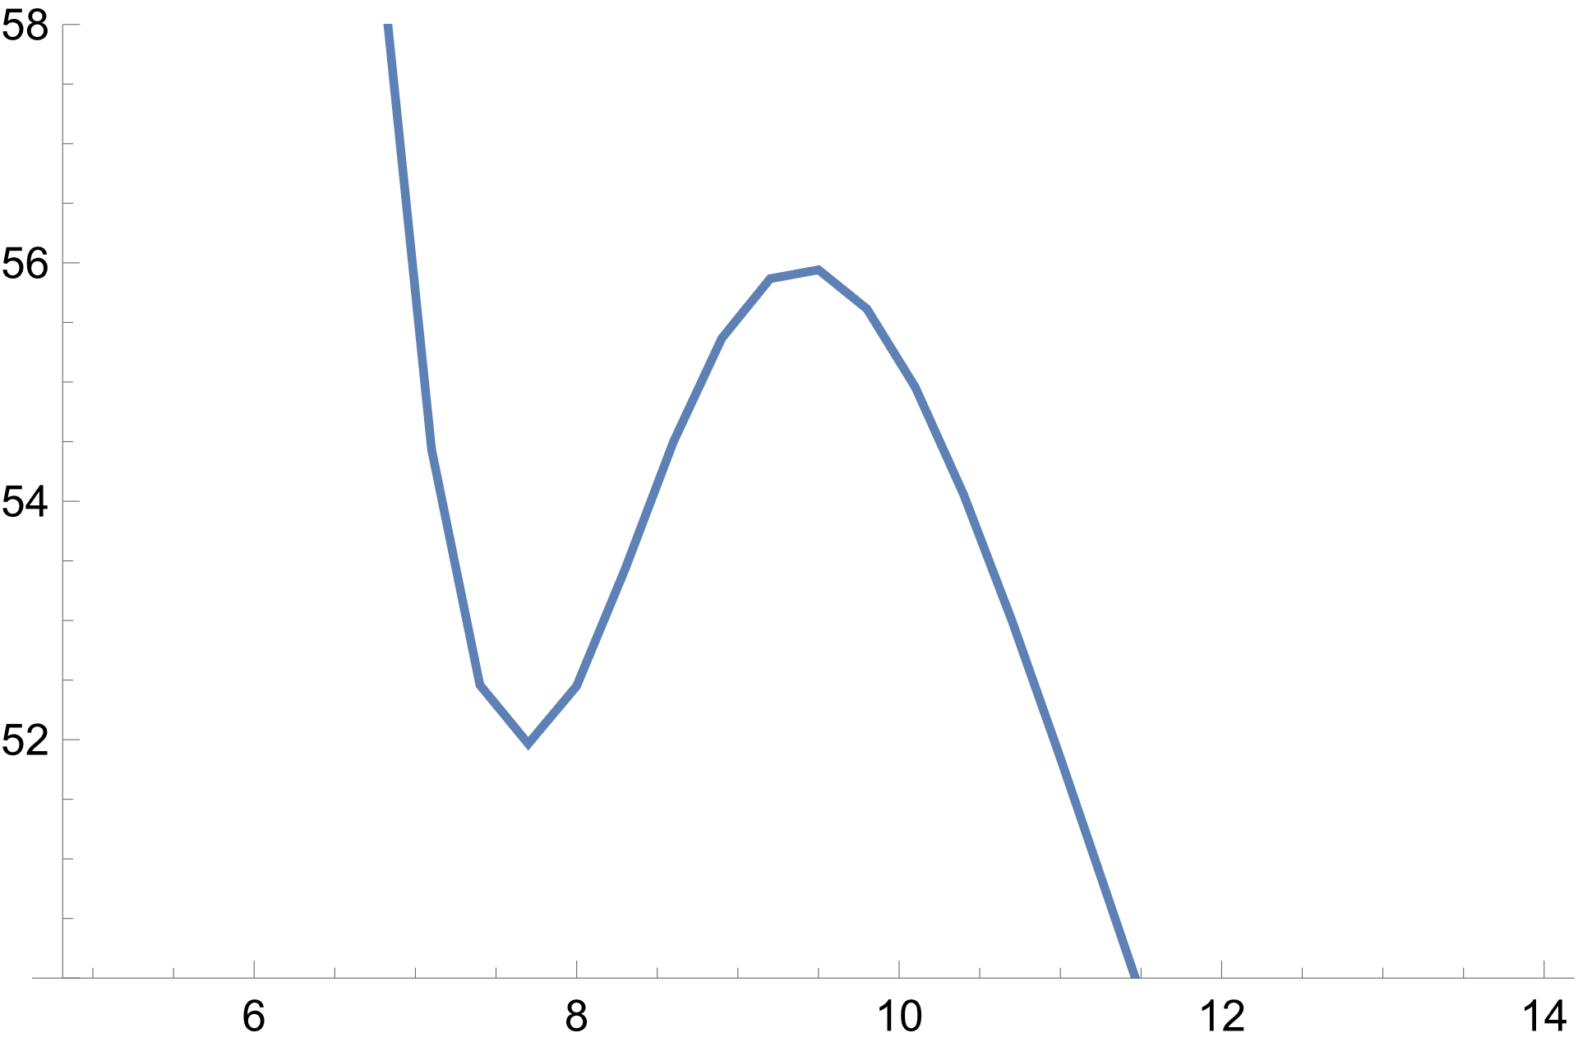
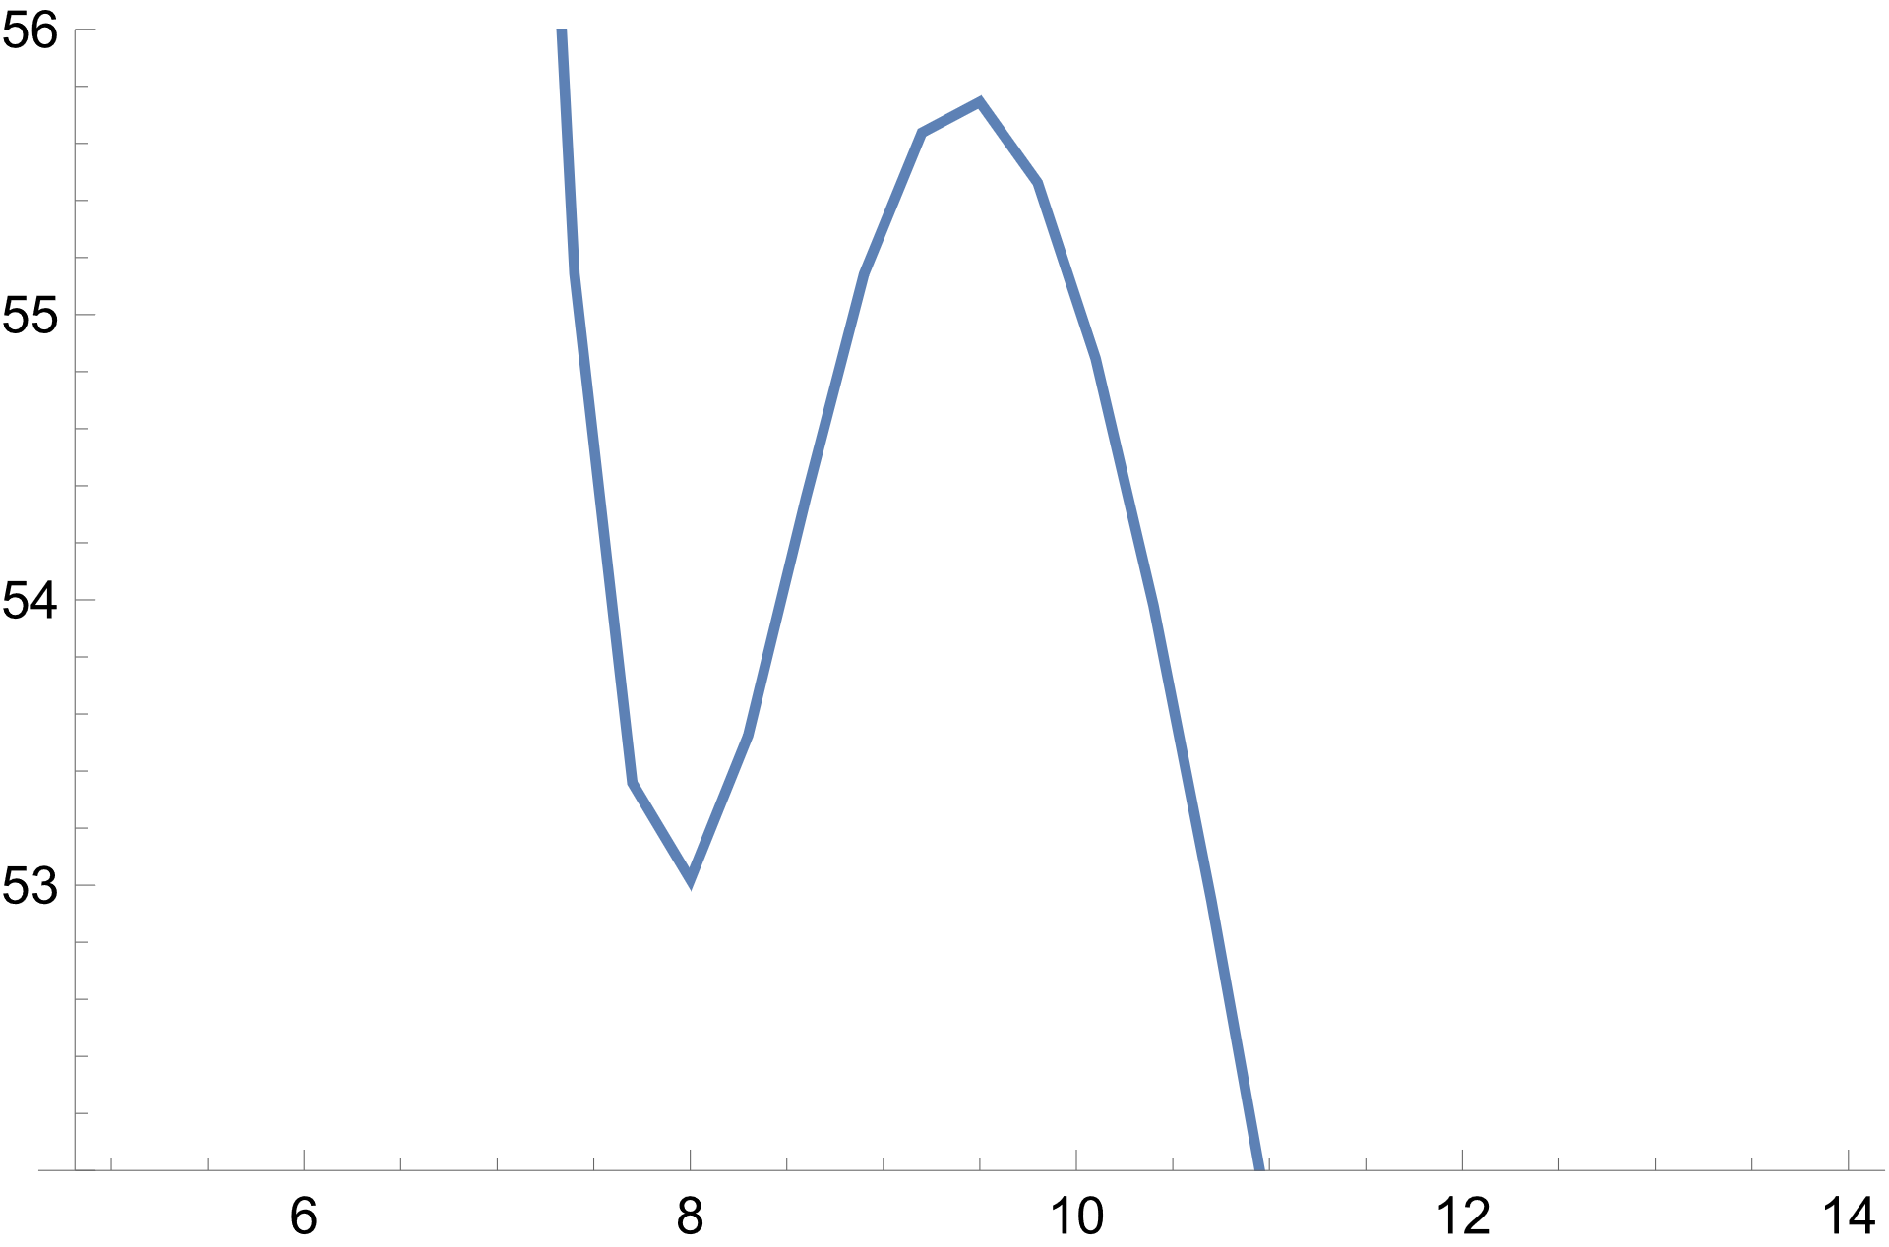
⁴⁸Ca+⁴⁸Ca
$${r_{phen}=10.58 fm , V}_{phen}=\text{50.46 }\text{MeV}$$
SLy4
SkM*
$55.75$ MeV
$55.96$ MeV
V, MeV
V, MeV
$r=9.4$ fm
$r=9.43$ fm
$52.04$ MeV
$53.02$ MeV
r, fm
r, fm
As we can see, the original Skyrme parameterizations give overestimated barrier values, compared to the Giessen EDF. But we can try to reduce it

Slide 17
Velocity term scaling
The first step in the construction of an effective interaction is to fix the saturation point of the symmetric infinite nuclear matter. Four quantities must be adjusted: the density at this point, the corresponding energy per nucleon, incompressibility modulus and isoscalar effective mass.
For a zero-range Skyrme force, the density functional gives the following energy per nucleon for symmetric matter:
$$\frac{E}{A}\left(ρ\right)=\frac{3ℏ^{2}}{10m}{\left(\frac{3π^{2}}{2}\right)}^{2/3}ρ^{2/3}+\frac{3}{8}t_{0}ρ+\frac{3}{80}θ_{s}{\left(\frac{3π^{2}}{2}\right)}^{2/3}ρ^{5/3}+\frac{1}{16}t_{3}ρ^{α+1}$$
where $θ_{s}=\left[3t_{1}+\left(5+4x_{2}\right)t_{2}\right]$ and defines effective mass on nucleons
Such construction also presents in Landau-Migdal parameter $F_{0}$
$$F_{0}=N_{0}^{−1}\left\{\frac{3}{4}t_{0}+\frac{1}{16}ρ^{α}\left(α+1\right)\left(α+2\right)+\frac{1}{8}k_{F}^{2}\left[3t_{1}+\left(5+4x_{2}\right)t_{2}\right]\right\}$$
This term comes from gradient terms (velocity), which we will change, finding the dependence how increasing of $F_{0}$ change the barrier

Slide 18
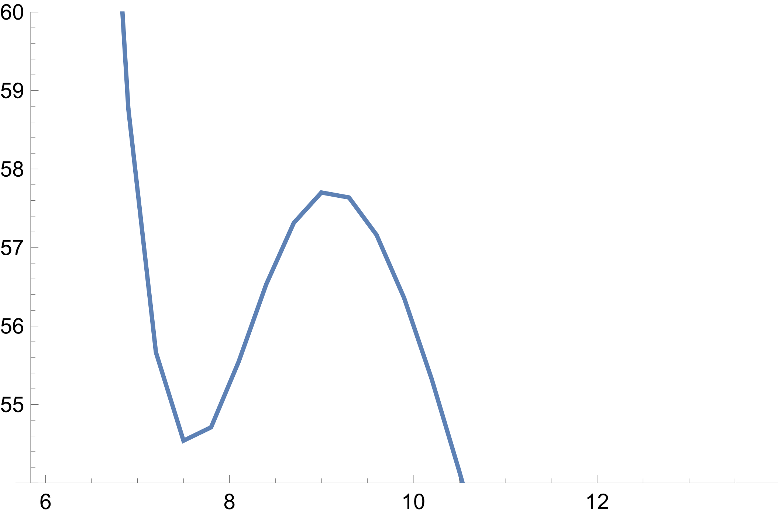
SLy4 ⁴⁸Ca+ ⁴⁸Ca
$${r_{phen}=10.58 fm , V}_{phen}=\text{50.46 }\text{MeV}$$
$θ_{s}=906$ MeV∙fm⁵, (original)
$θ_{s}=600$ MeV∙fm⁵
$55.96$ MeV
$57.73$ MeV
V, MeV
V, MeV
$r=9.4$ fm
$52.04$ MeV
$$54.54$$
$r=9.1$ fm
r, fm
r, fm

Slide 19
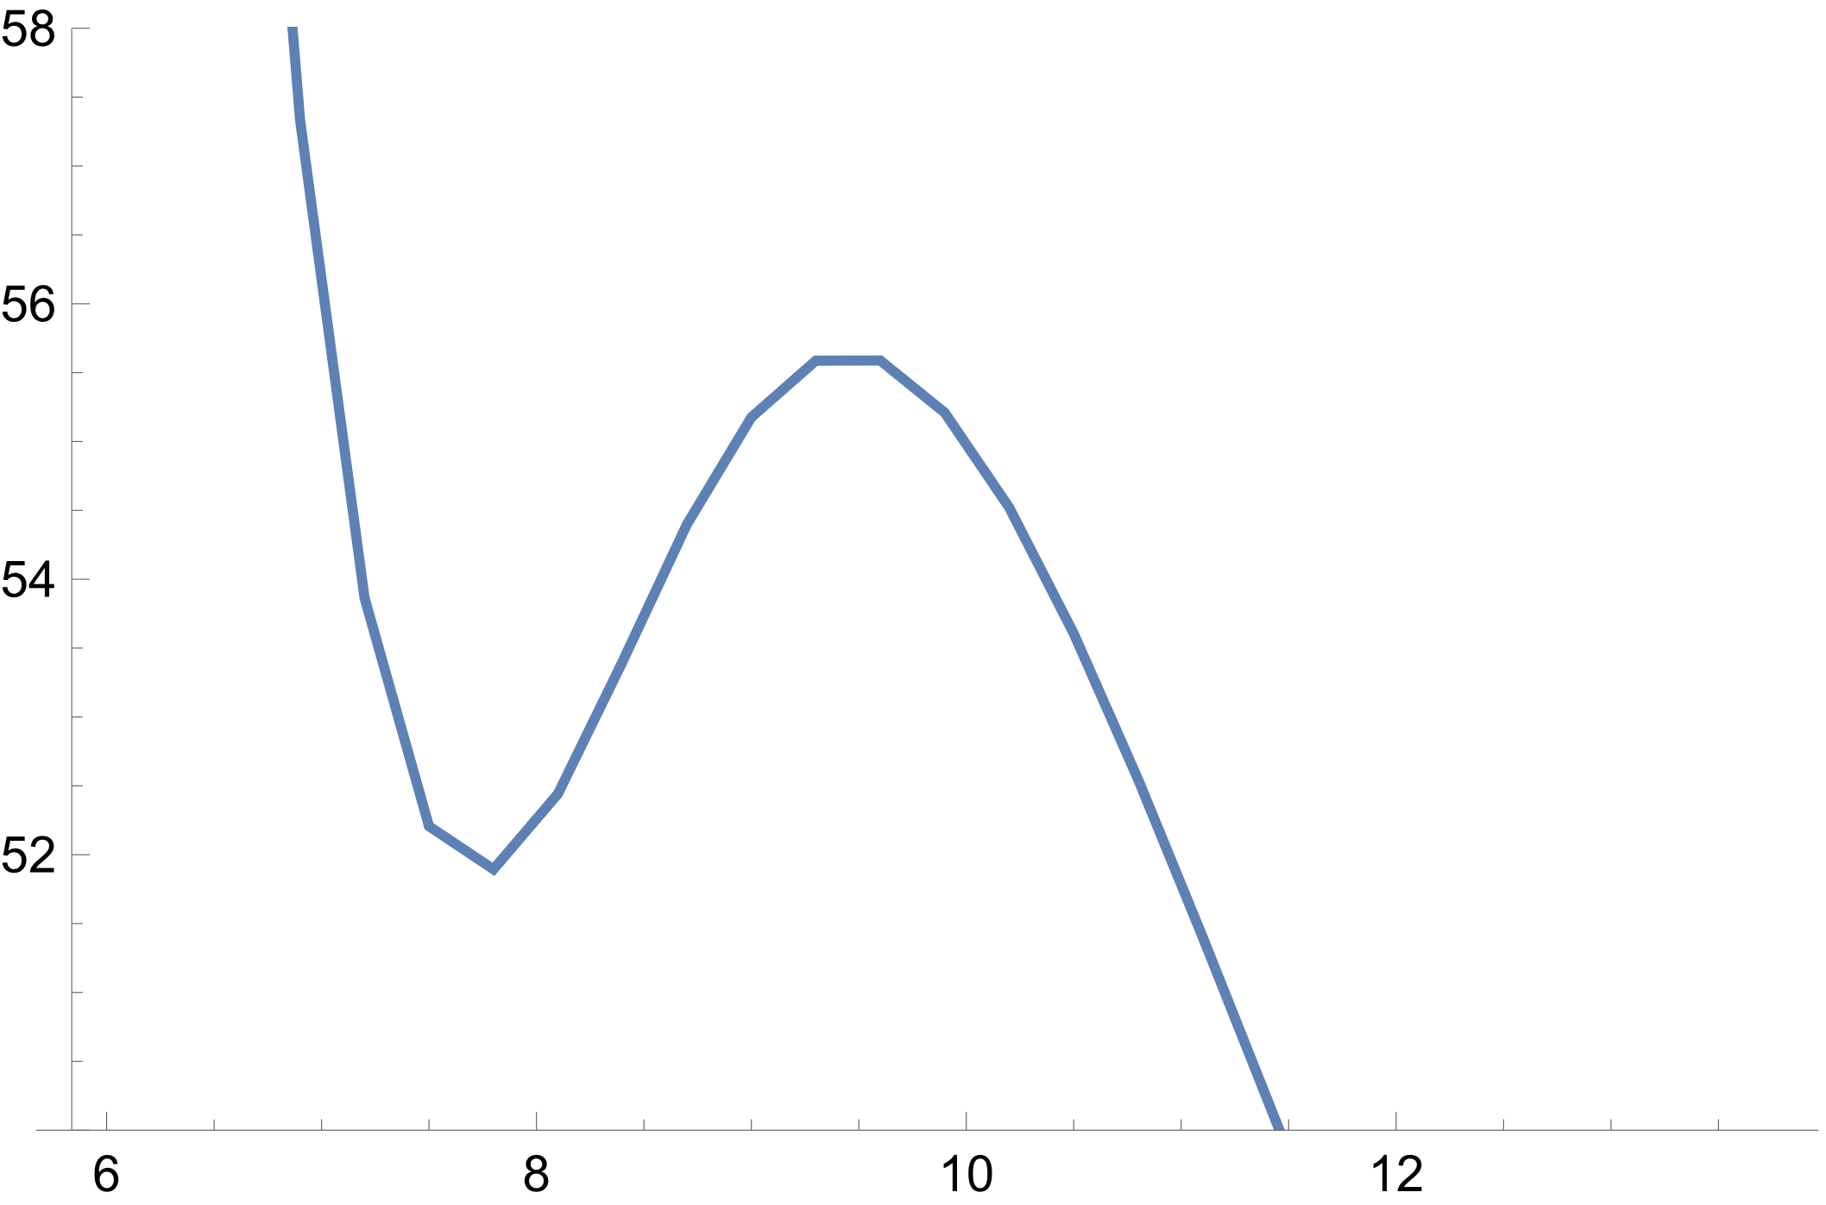
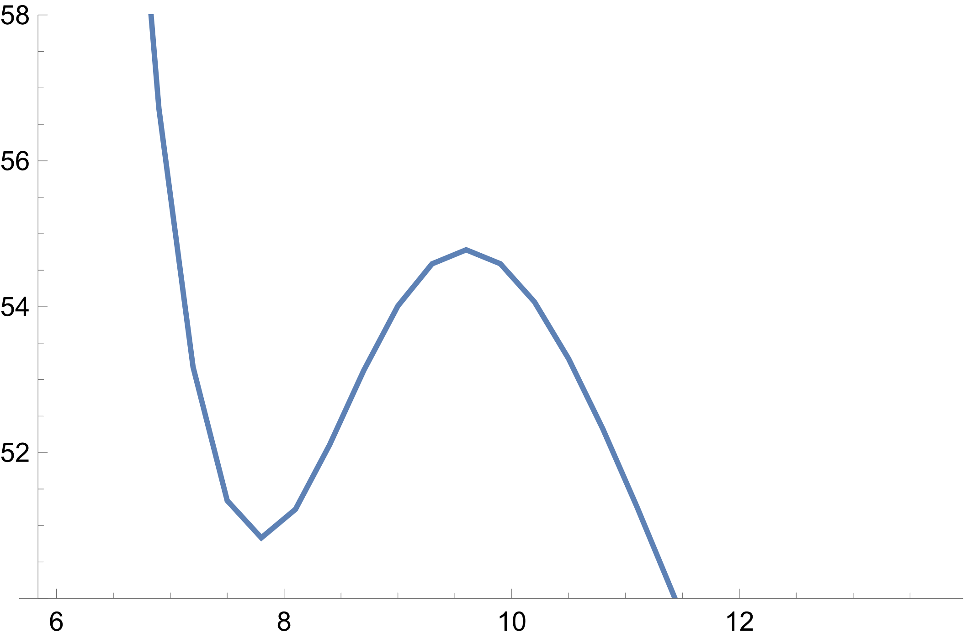
⁴⁸Ca+ ⁴⁸Ca
$${r_{phen}=10.58 fm , V}_{phen}=\text{50.46 }\text{MeV}$$
$θ_{s}=1000$ MeV∙fm⁵
$θ_{s}=1200$ MeV∙fm⁵
$55.64$ MeV
$54.78$ MeV
V, MeV
V, MeV
$r=9.6$ fm
$51.89$ MeV
$r=9.45$ fm
$50.83$ MeV
r, fm
r, fm

Slide 20
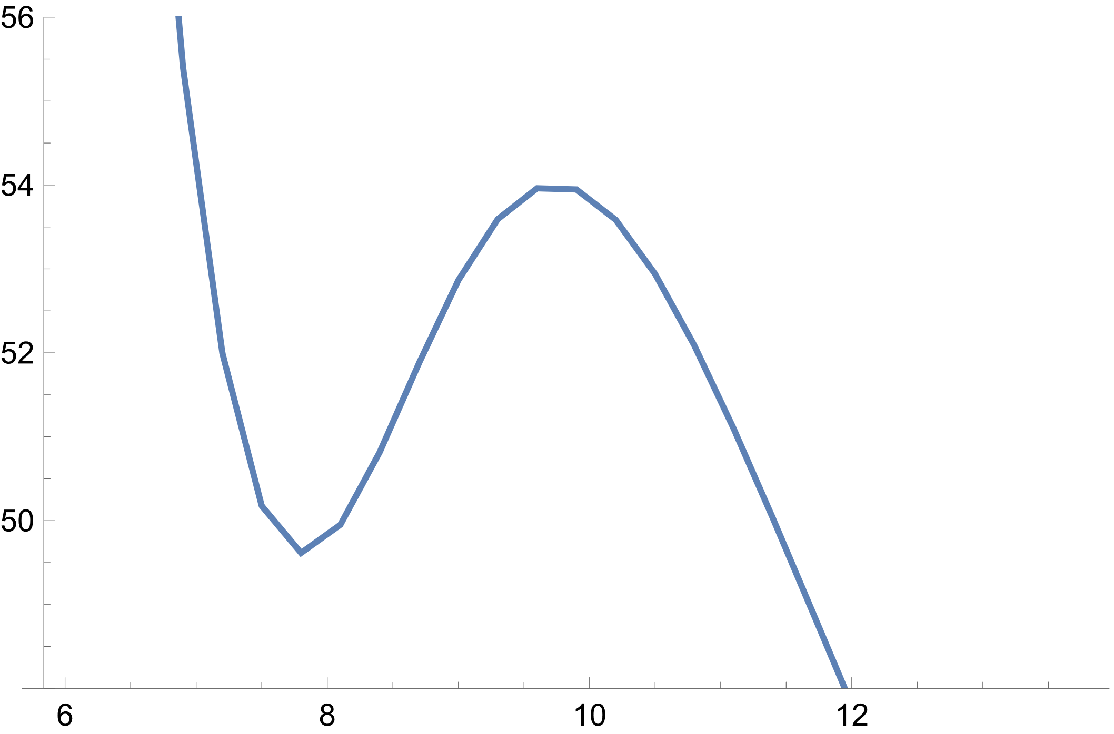
⁴⁸Ca+ ⁴⁸Ca
$${r_{phen}=10.58 fm , V}_{phen}=\text{50.46 }\text{MeV}$$
$θ_{s}=906$ MeV∙fm⁵, (original)
$θ_{s}=1400$ MeV∙fm⁵
$54$ MeV
$55.96$ MeV
V, MeV
V, MeV
$r=9.74$ fm
$r=9.4$ fm
$52.04$ MeV
$49.62$ MeV
r, fm
r, fm

Slide 21
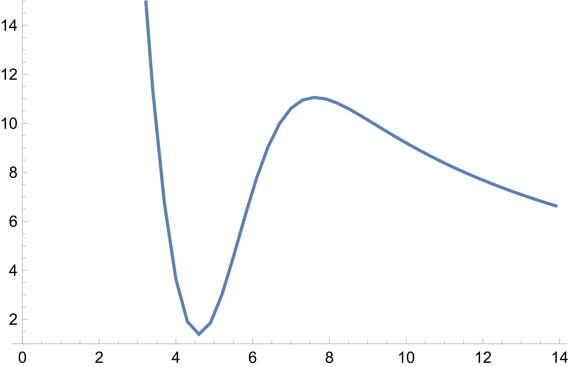
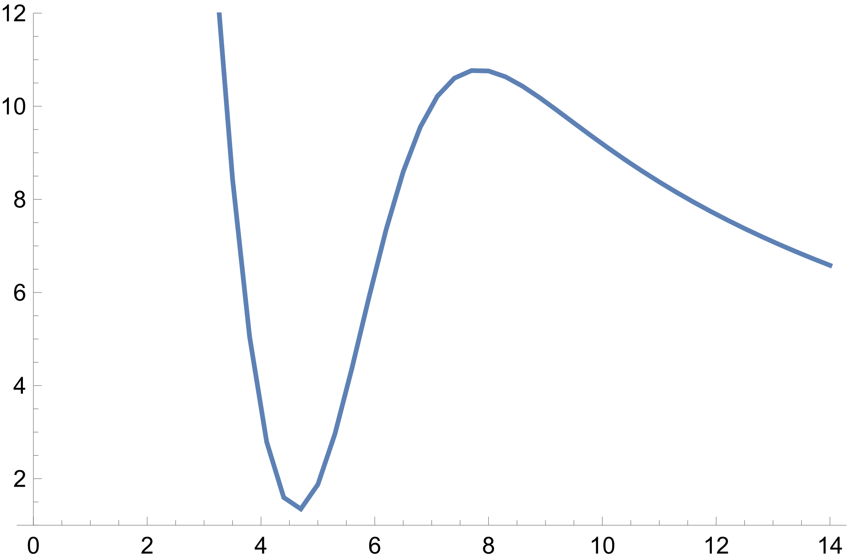
¹⁶O+¹⁶O
$${r_{phen}=8.69 fm ,V}_{phen}=9.75 \text{MeV}$$
$θ_{s}=906$ MeV∙fm⁵
$θ_{s}=1400$ MeV∙fm⁵
$10.78$ MeV
$11.06$ MeV
V, MeV
V, MeV
$r=7.83$ fm
$r=7.63$ fm
$1.39$ MeV
$1.35$ MeV
r, fm
r, fm

Slide 22
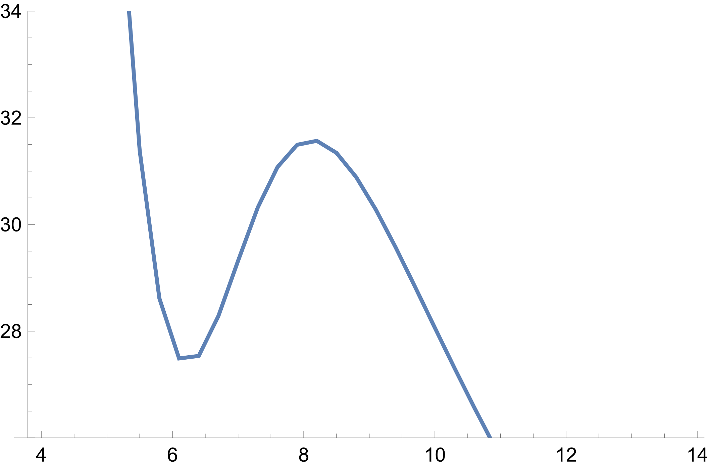
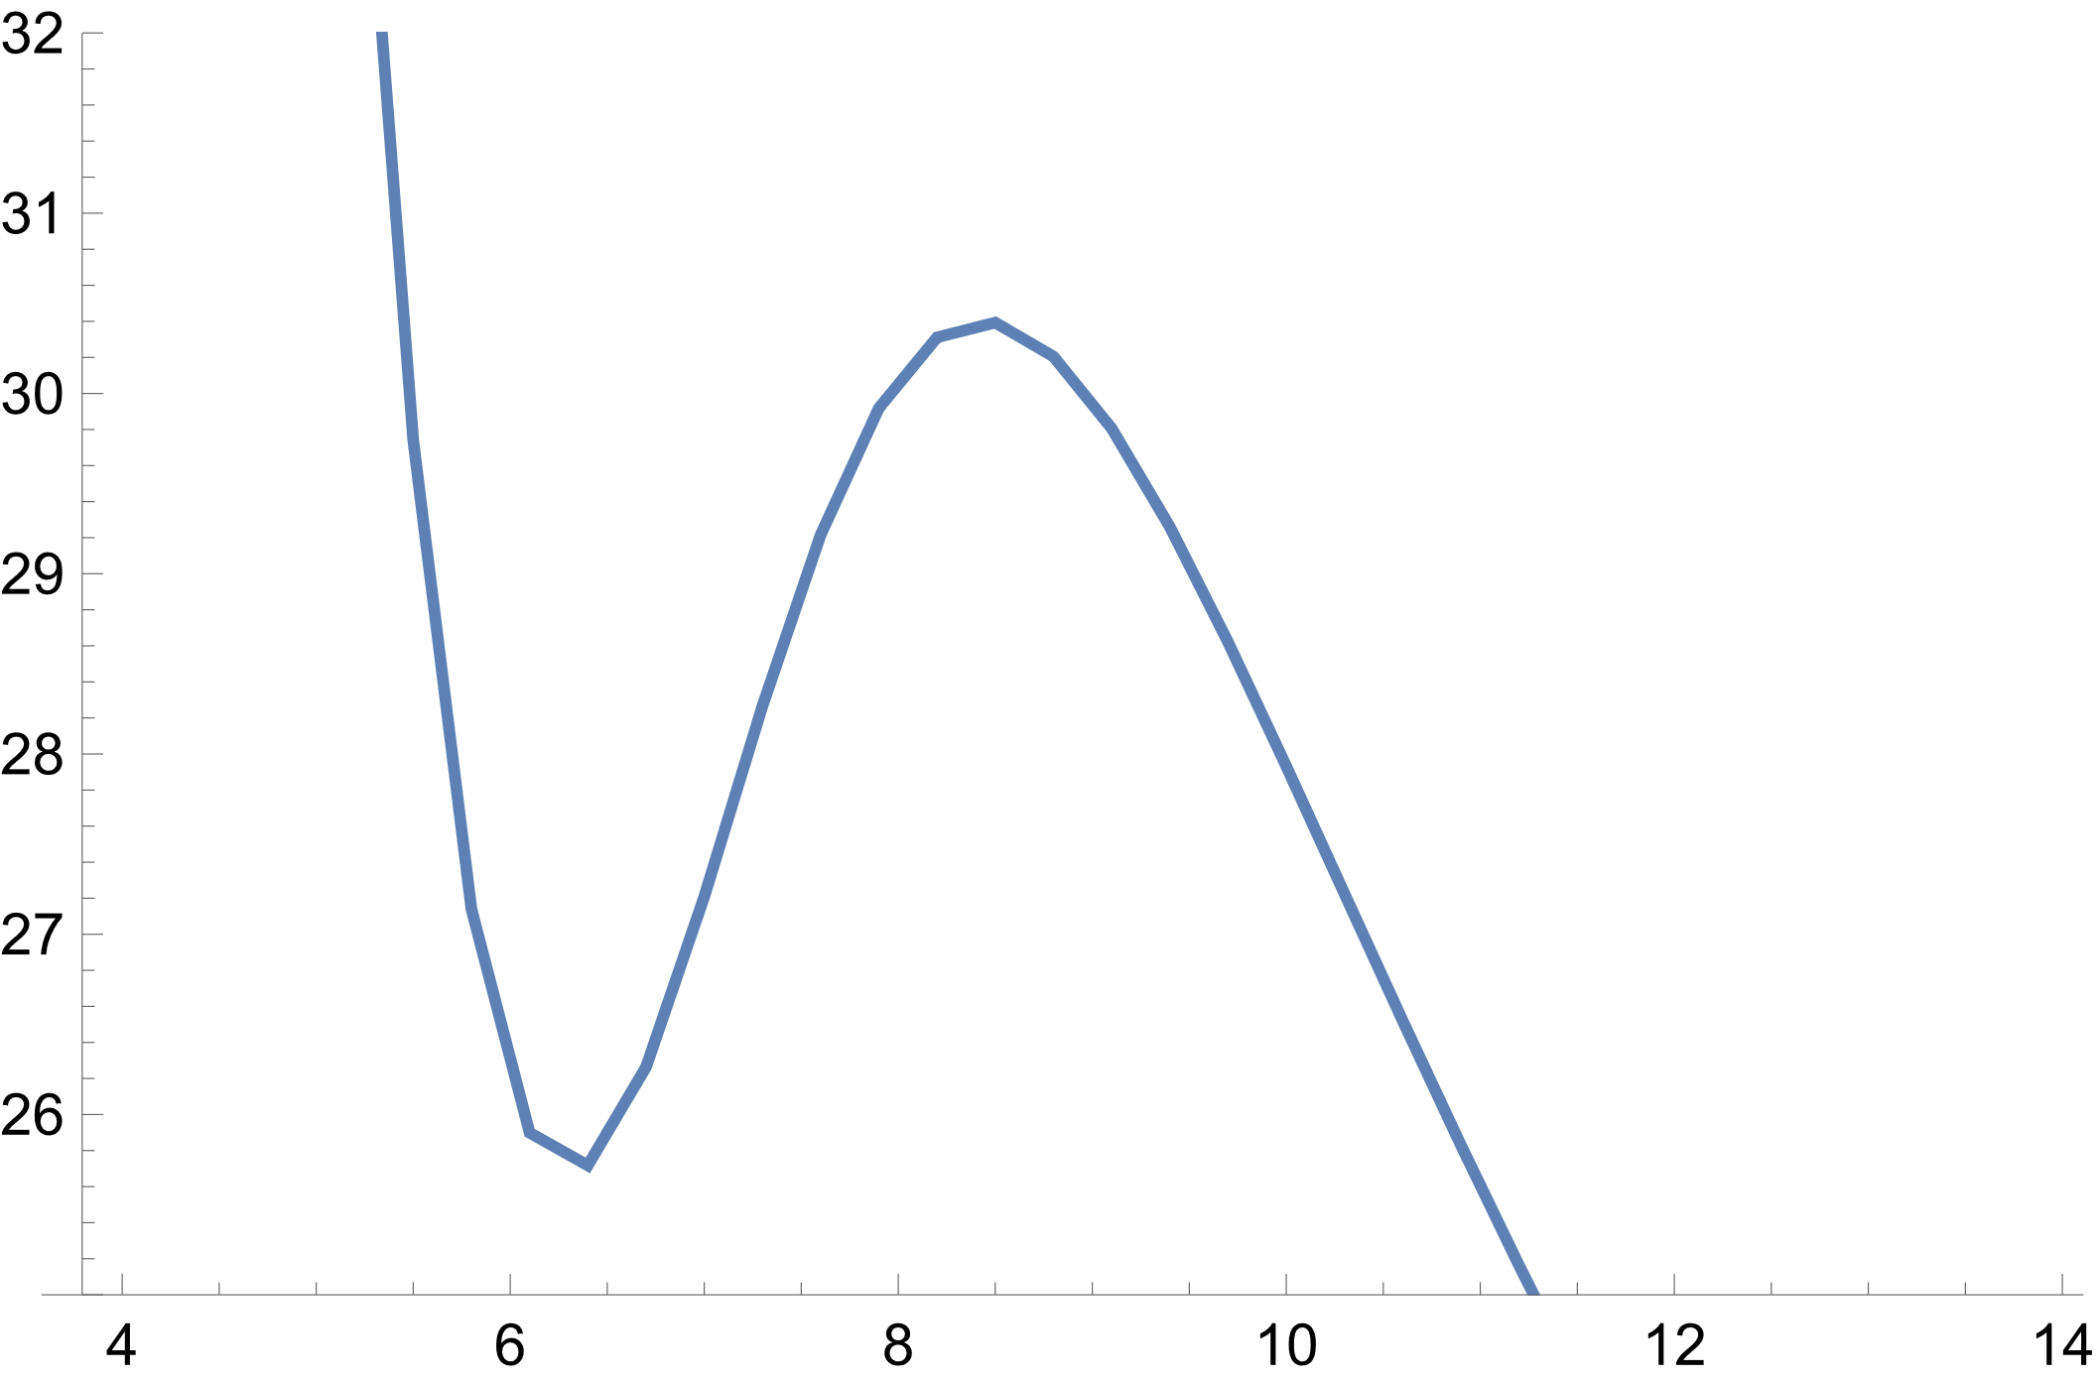
²⁸Si+²⁸Si
$${r_{phen}=9.08 fm ,V}_{phen}=28.64 \text{MeV}$$
$θ_{s}=906$ MeV∙fm⁵
$θ_{s}=1400$ MeV∙fm⁵
$30.4$ MeV
$31.58$ MeV
V, MeV
V, MeV
$r=8.43$ fm
$r=8.12$ fm
$27.49$ MeV
$$25.72$$
r, fm
r, fm

Slide 23
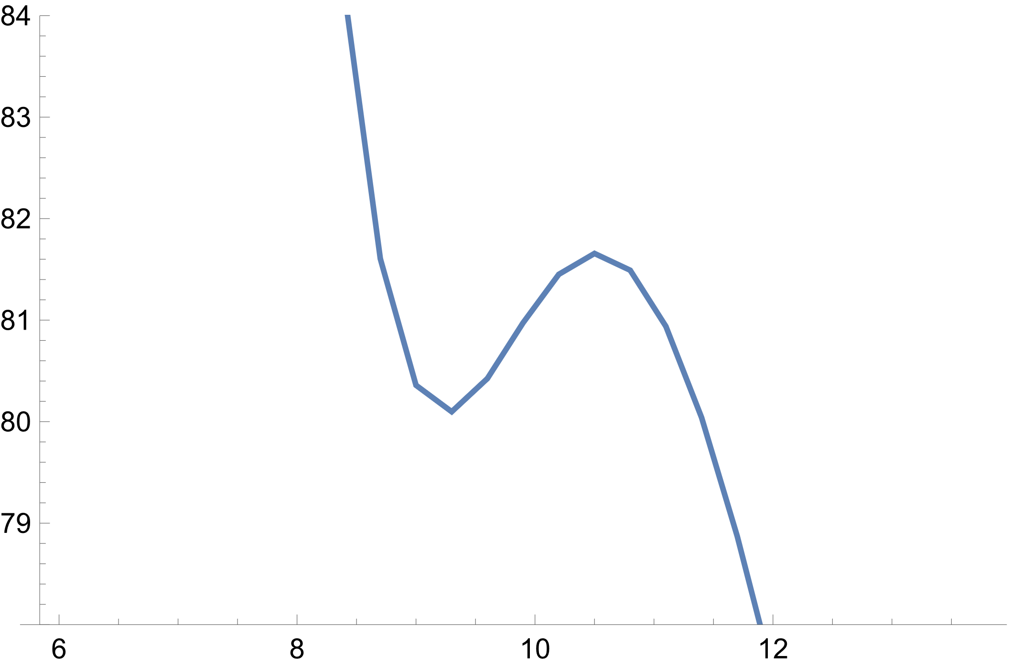
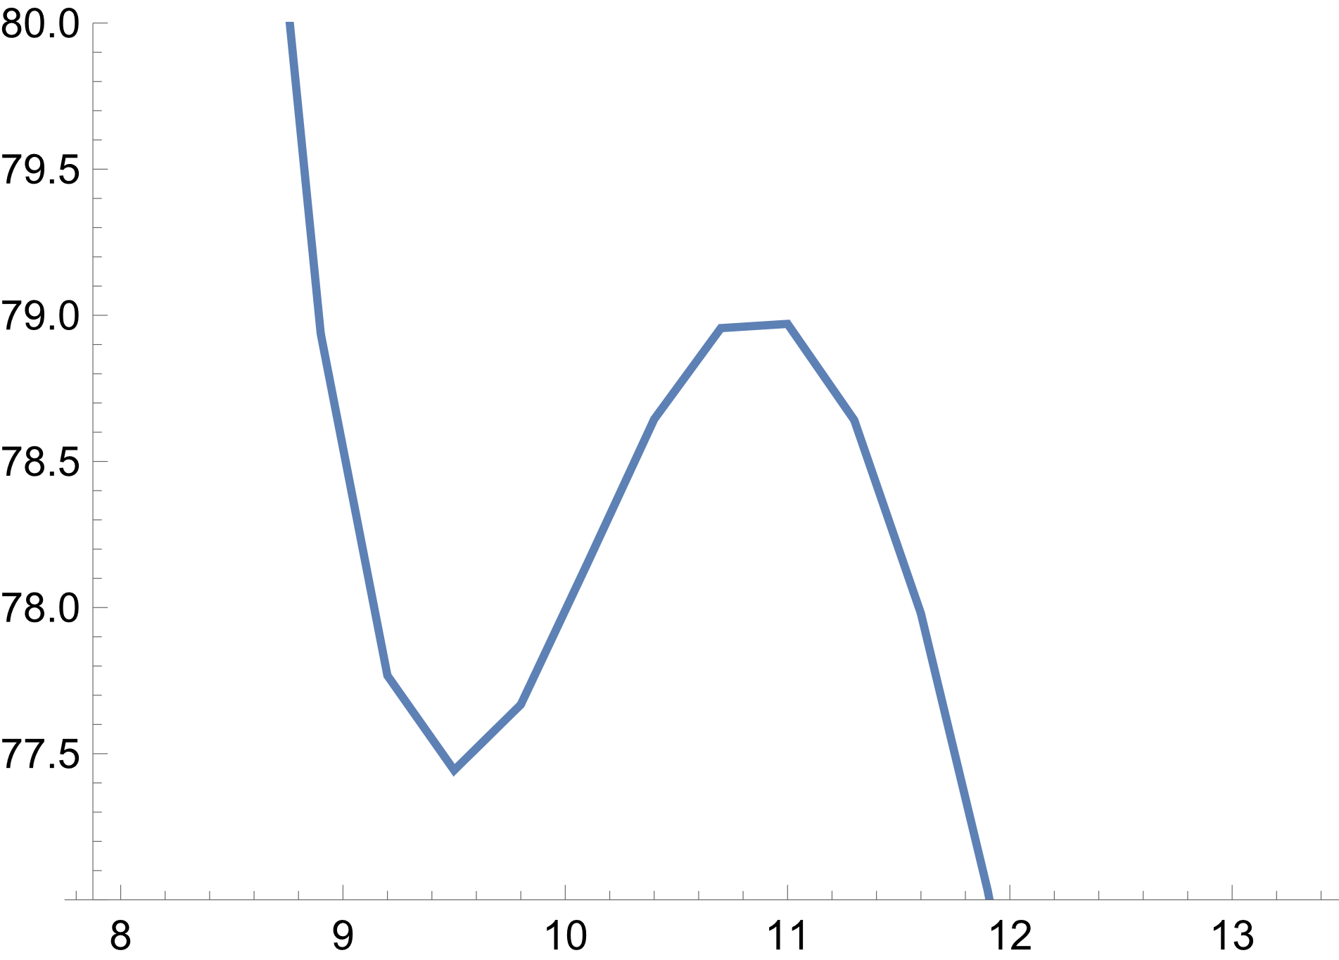
¹⁶O+²⁰⁸Pb
$V_{phen}=71.5$ MeV
$θ_{s}=906$ MeV∙fm⁵
$θ_{s}=1400$ MeV∙fm⁵
$78.97$ MeV
$81.66$ MeV
V, MeV
V, MeV
$r=10.5$ fm
$r=11$ fm
$80.1$ MeV
$77.44$ MeV
r, fm
r, fm

Slide 24
How we could see, increasing the $θ_{s}$ reduces the Coulomb barrier. Since then we can bring coefficients $κ$, $λ$ in nuclear central potential to see different affect from gradient terms
$$U_{q}\left(\vec{r}\right)$$
$$=\frac{1}{2}t_{0}\left[\left(2+x_{0}\right)ρ−\left({2x}_{0}+1\right)ρ_{q}\right]$$
$$+\frac{1}{24}t_{3}\left[\left(α+2\right)\left(2+x_{3}\right)ρ^{α+1}−\left(2x_{3}+1\right)\left(2ρ^{α}ρ_{q}+αρ^{α−1}\left(ρ_{n}^{2}+ρ_{p}^{2}\right)\right)\right]$$
$$−\frac{1}{16}κ\left[3t_{1}\left(2+x_{1}\right)−t_{2}\left(2+x_{2}\right)\right]∇^{2}ρ+\frac{1}{16}λ\left[3t_{1}\left(2x_{1}+1\right)+t_{2}\left(2x_{2}+1\right)\right]∇^{2}ρ_{q}$$
$$+\frac{1}{8}\left[t_{1}\left(2+x_{1}\right)+t_{2}\left(2+x_{2}\right)\right]τ+\frac{1}{8}\left[t_{2}\left(2x_{2}+1\right)−t_{1}\left(2x_{1}+1\right)\right]τ_{q}−\frac{1}{2}W_{0}\left(∇∙J+∇∙J_{q}\right)$$

Slide 25
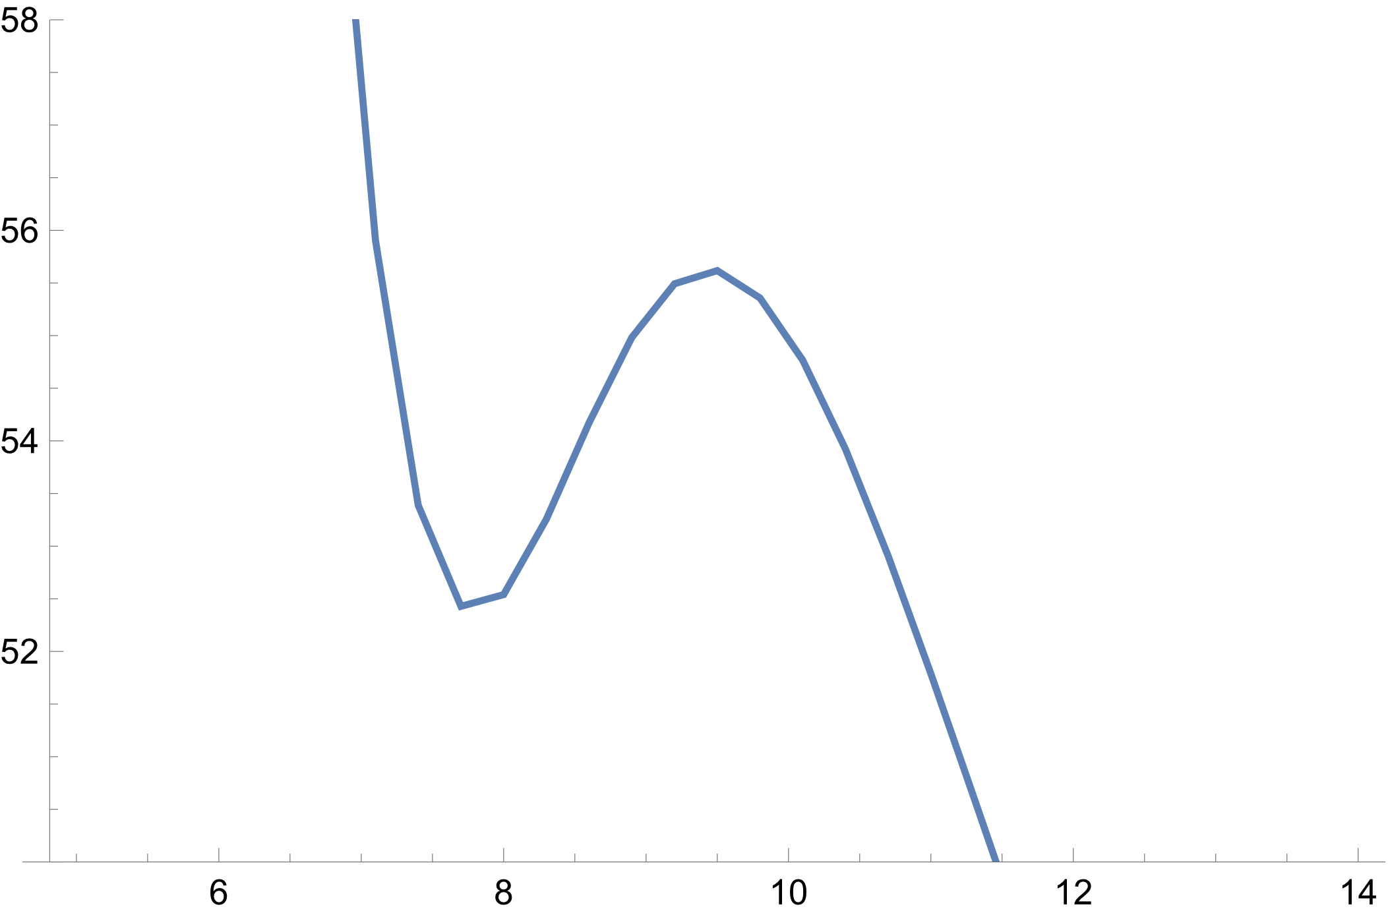
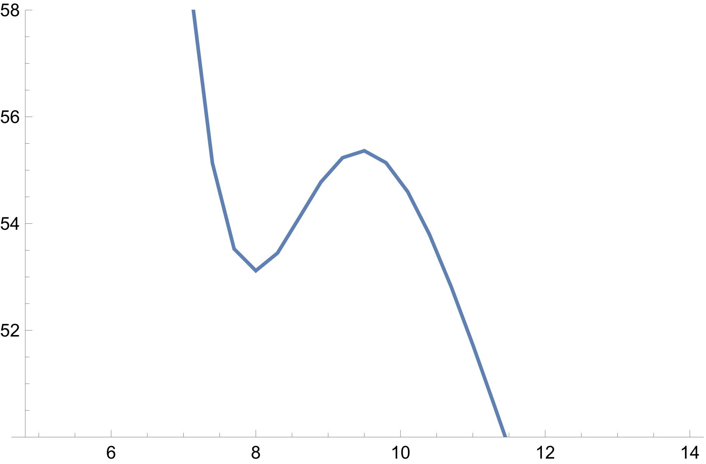
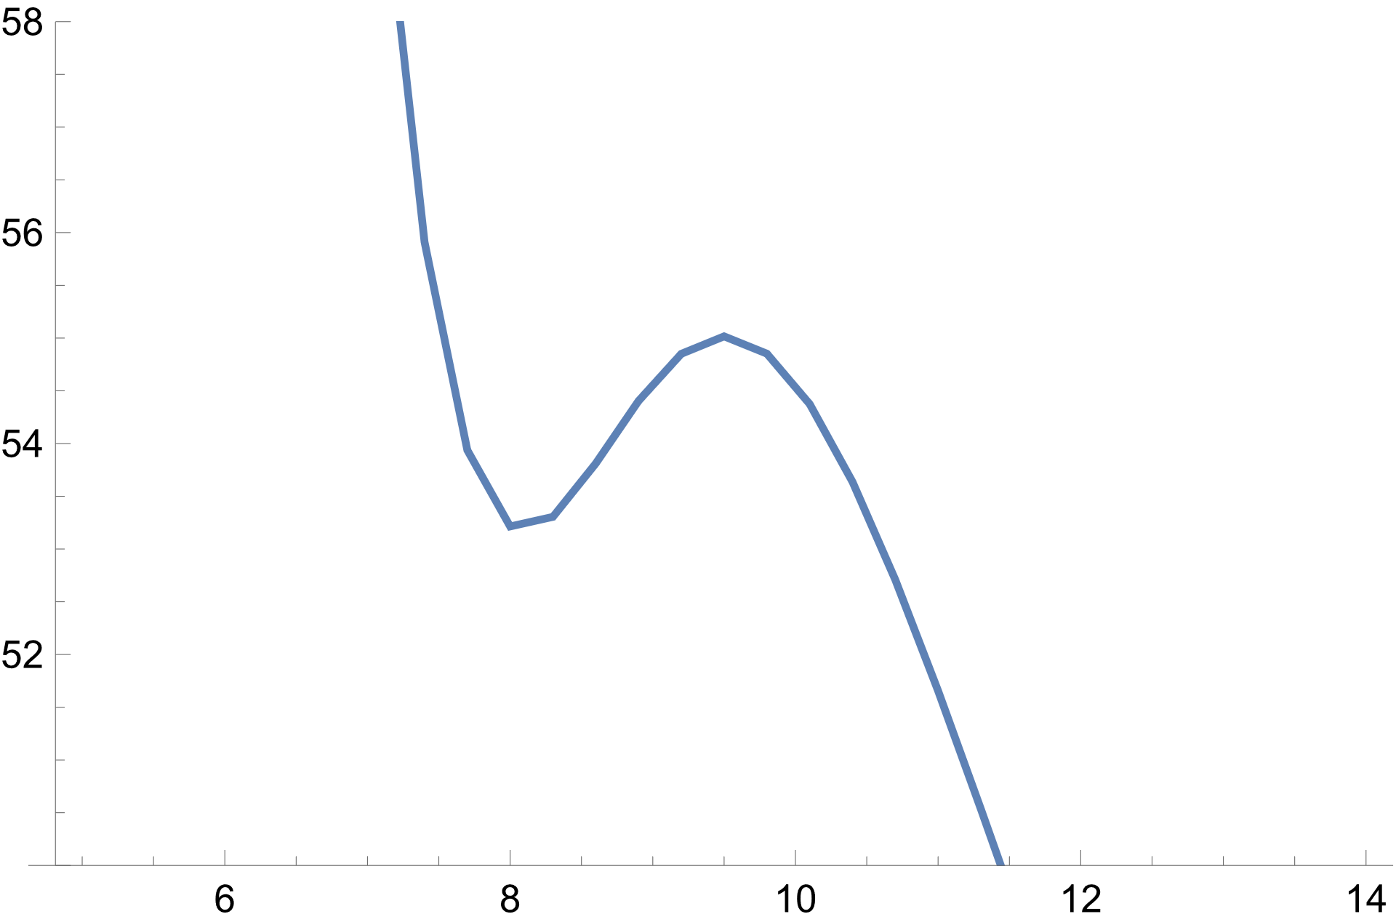
$55.96$ MeV
$55.62$ MeV
$$κ=1.0$$
$$λ=1.0$$
$$κ=1.1$$
$$λ=1.0$$
V, MeV
V, MeV
$52.43$ MeV
$52.04$ MeV
$r=\text{9.4}\text{5}$ fm
$r=9.4$ fm
SLy4 ⁴⁸Ca+ ⁴⁸Ca
r, fm
r, fm
$\text{55.3}\text{7}$ MeV
$$κ=1.2$$
$$λ=1.0$$
$$κ=1.3$$
$$λ=1.0$$
$55.02$ MeV
V, MeV
V, MeV
$53.12$MeV
$\text{5}\text{3}\text{.}\text{21}$ MeV
$r=\text{9.4}\text{6}$ fm
$r=\text{9.5}$ fm
r, fm
r, fm

Slide 26
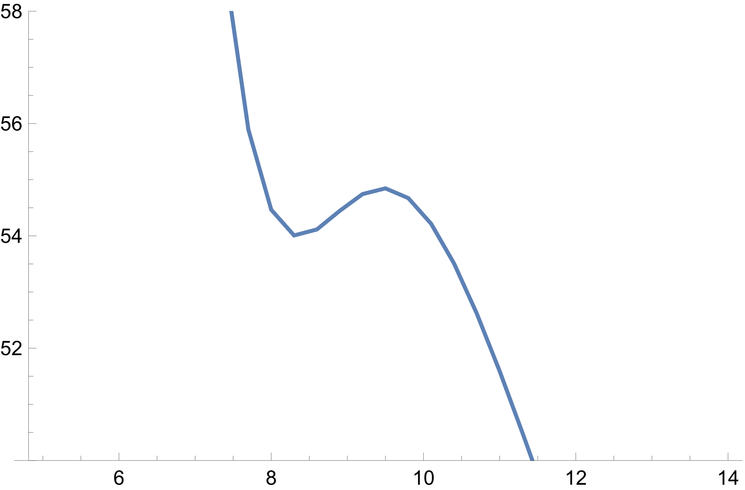
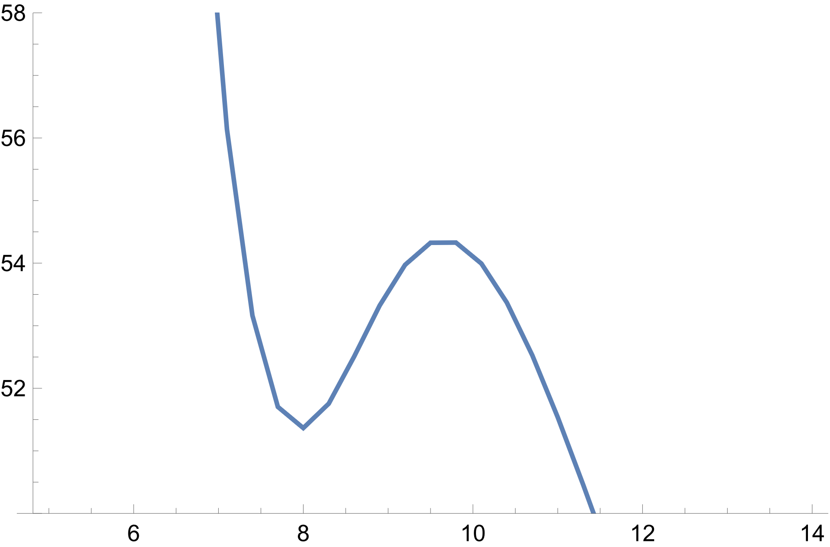
⁴⁸Ca+ ⁴⁸Ca
$${r_{phen}=10.58 fm , V}_{phen}=\text{50.46 }\text{MeV}$$
$54.85$ MeV
$54.37$ MeV
V, MeV
V, MeV
$54.01$ MeV
$r=\text{9.}\text{65}$ fm
$r=\text{9.}\text{47}$ fm
$51.36$ MeV
r, fm
r, fm
$$κ=1.44, λ=1.0$$
$$κ=1.44, λ=0.8$$

Slide 27
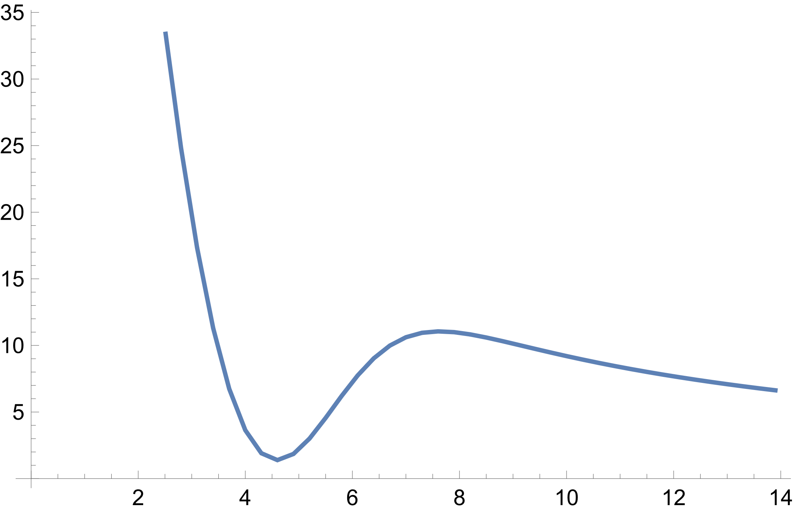
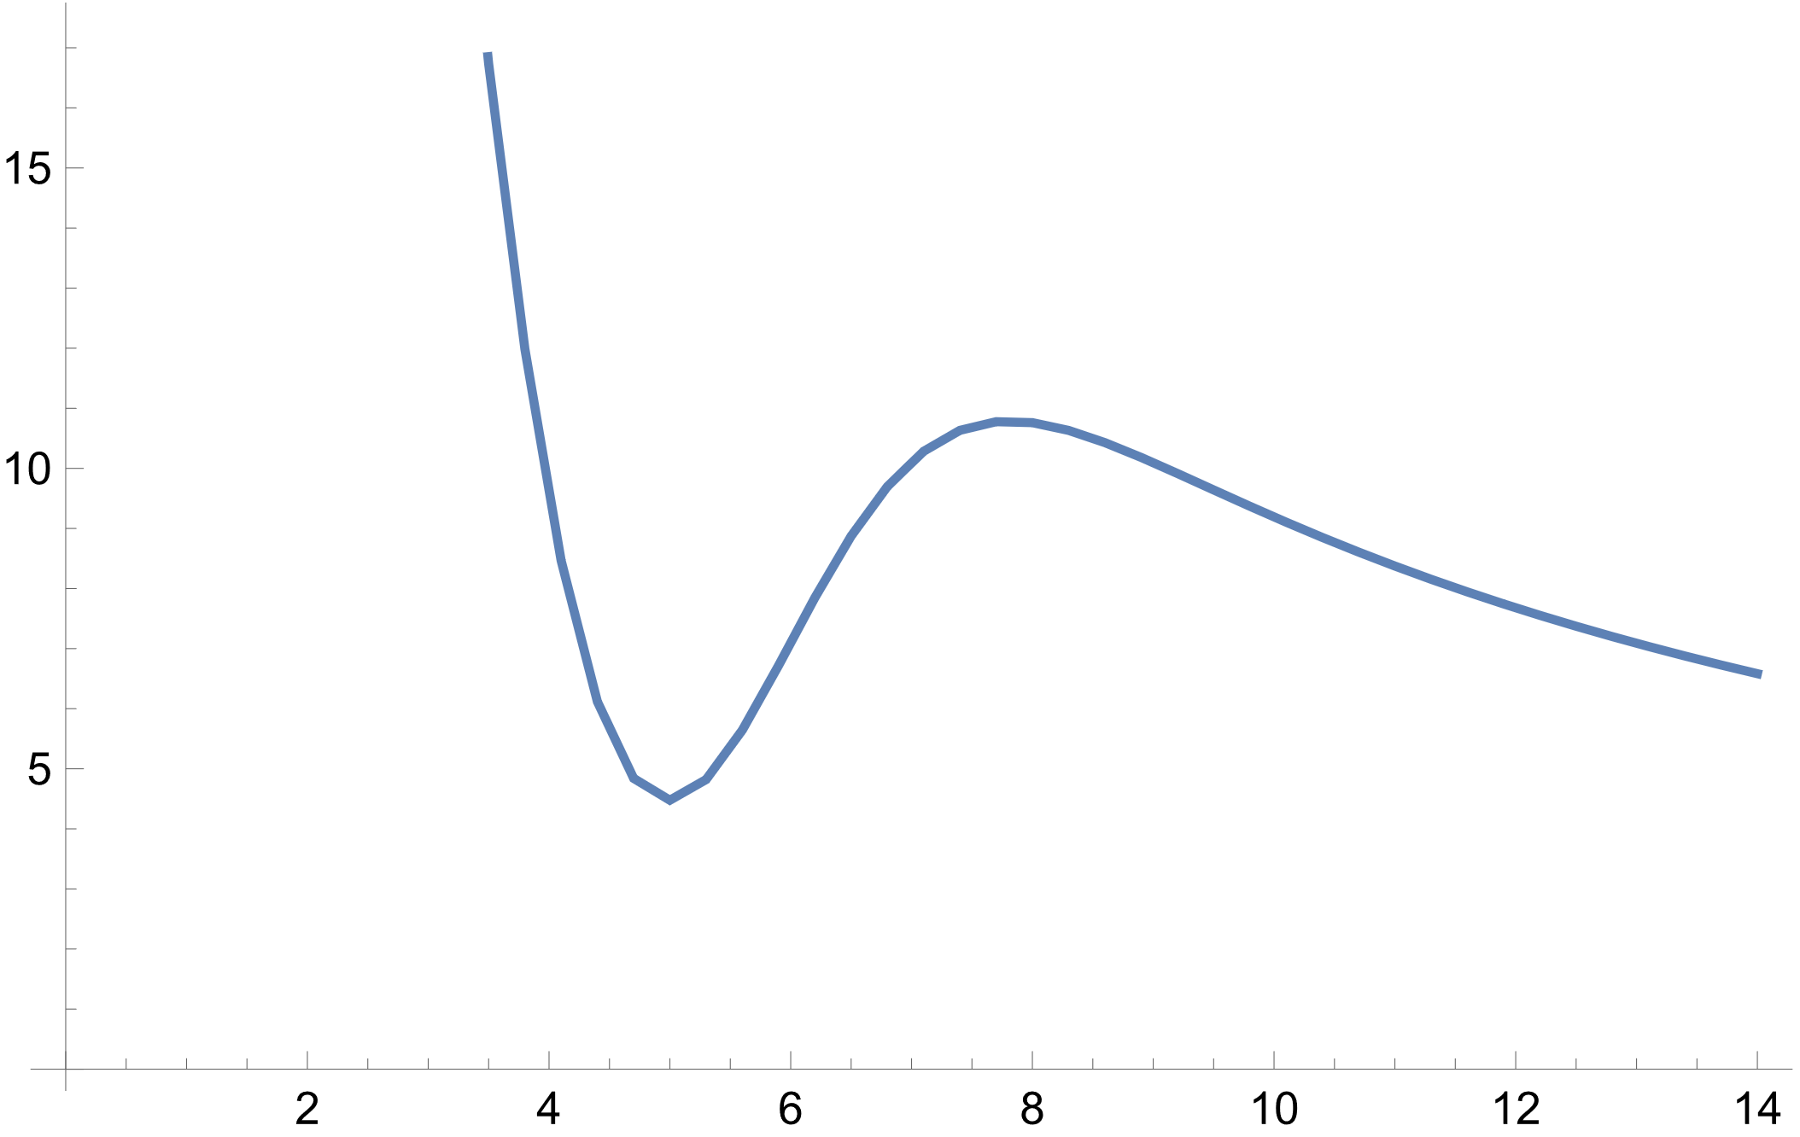
¹⁶O+¹⁶O
$${r_{phen}=8.69 fm ,V}_{phen}=9.75 \text{MeV}$$
$10.79$ MeV
V, MeV
V, MeV
$r=7.81$ fm
$11.06$ MeV
$r=7.63$ fm
$4.48$ MeV
$1.4$ MeV
r, fm
r, fm
$$κ=1.0, λ=1.0$$
$$κ=1.42, λ=1.0$$

Slide 28
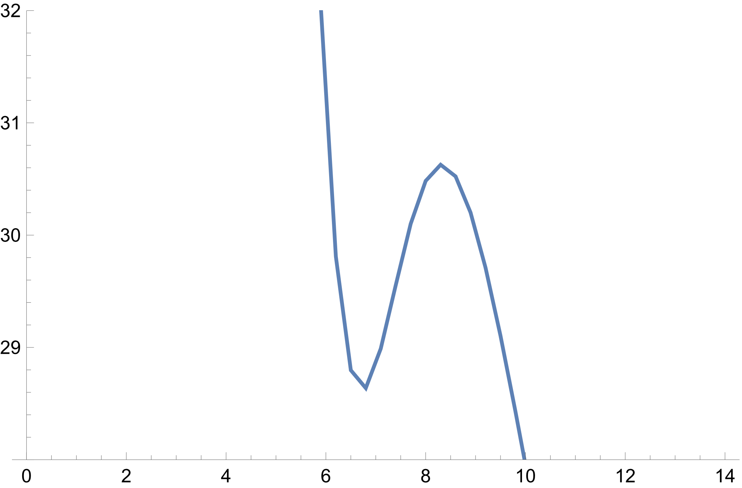
²⁸Si+²⁸Si
$${r_{phen}=9.08 fm ,V}_{phen}=28.64 \text{MeV}$$
$E_{max}=31.58$ MeV
$E_{max}=30.63$ MeV
V, MeV
V, MeV
$r=8.32$ fm
$r=8.12$ fm
$27.49$ MeV
$28.64$ MeV
r, fm
r, fm
$$κ=1.0, λ=1.0$$
$$κ=1.42, λ=1.0$$

Slide 29
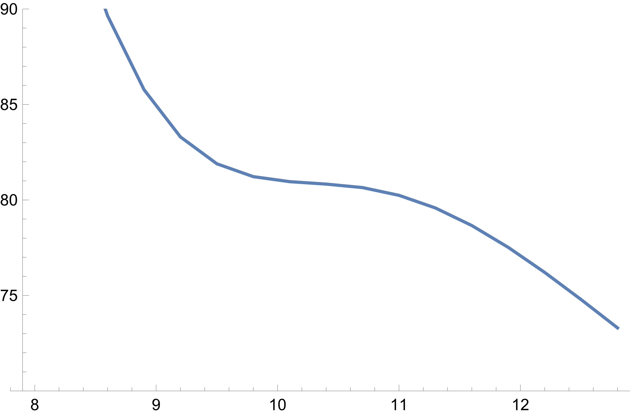
¹⁶O+²⁰⁸Pb
$V_{phen}=71.5$ MeV
$$81.66$$
V, MeV
V, MeV
$$r=10.5$$
$$80.1$$
r, fm
r, fm
$$κ=1.0, λ=1.0$$
$$κ=1.42, λ=1.0$$

Slide 30
Conclusion
The nucleon density distributions of spherical nuclei are calculated within the self-consistent HF approach based on the energy density functional. For the reactions with light nuclei, the nucleus–nucleus interaction potentials are calculated in the double-folding form with these nucleon densities. The Landau–Migdal parameters was applied for calculating the nucleus–nucleus interaction potentials in the double folding form
The characteristics of the Coulomb barriers obtained with original Skyrme EDF parametrizations aren’t in good agreement with those required to describe the sub-barrier complete fusion according to work¹. Since then, we found the way of improving the Skyrme EDF to minimize the Coulomb barrier
¹V.V. Sargsyan, G.G. Adamian, N.V. Antonenko, H. Lenske,
Phys.Lett. B 824, 136792 (2022)

