Slide 1
Structure of QCD string near the Casimir surface
K. R. Pak^{a,b}, A. S. Tanashkinª
ªPacific Quantum Center, Far Eastern Federal University, 690922, Vladivostok
^{b}Institute of Automation and Control Processes, 690041, Vladivostok
[Supported by grant № FZNS-2024-0002]
K. R. Pak INFINUM 15.05.2025 1/15

Slide 2
Purpose and Outline
Purpose:
To study the behavior of chromoelectro-magnetic fields between quarks in a quark-antiquark pair near the Casimir plane.
Outline:
Introduction
2) Distribution of fields between quarks in the absence of a Casimir plate.
3) Behavior of string at different values of distance between plane and quarks
4) Behavior of string at different values of coupling constant β.
5) Direction of chromoelectriс fields between quarks
K. R. Pak INFINUM 15.05.2025 2/15

Slide 3
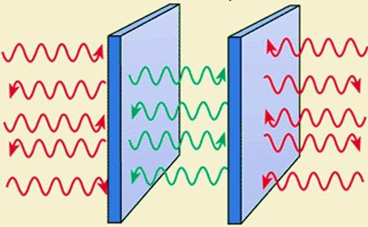
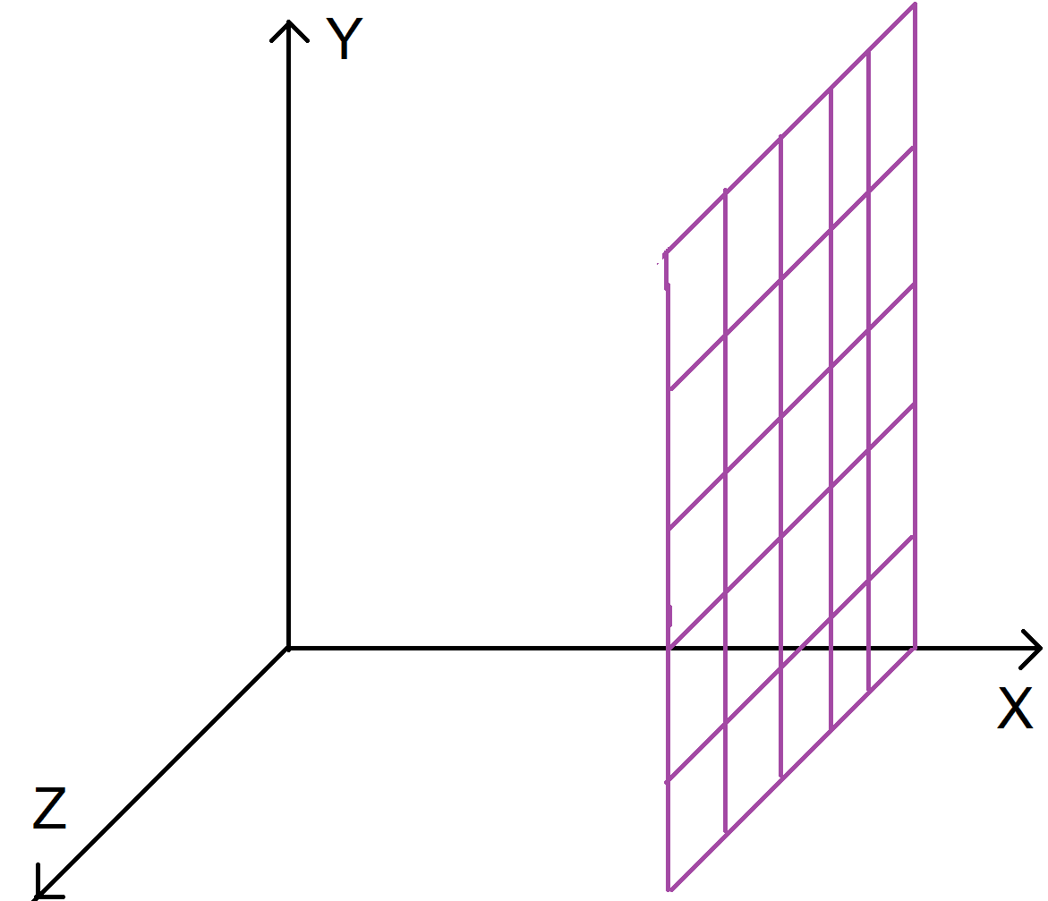
Introduction
Casimir surface S impose additional boundary conditions on the electromagnetic field Aμ.
$$E_{∥}\left(r\right)=0; B_{⊥}\left(r\right)=0; r∈S$$
If we locate Casimir plate perpendicular to X axis:
$$E_{y}\left(r\right)=E_{z}\left(r\right)= B_{x}\left(r\right)=0; r∈S$$
K. R. Pak INFINUM 15.05.2025 3/15

Slide 4
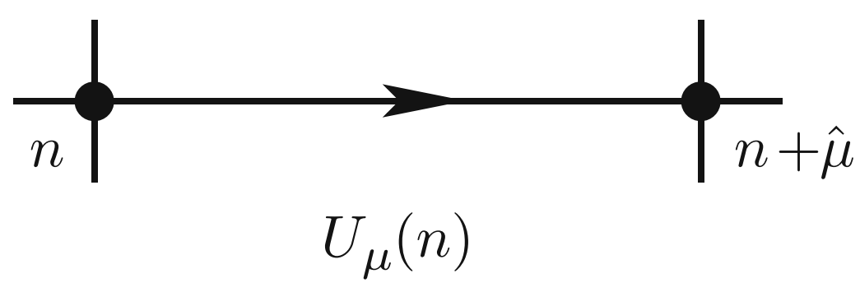
Introduction
$$U_{μ}\left(r\right)= exp(iaA_{μ}(r))$$
$$S_{G}\left[\overline{ψ},ψ,U\right]= \frac{β}{3}\sum_{n∈λ}{\sum_{μ<ν}{Re Tr(I - U_{μν}(n))}}$$
Parameters of lattice:
Nt - time size of lattice
Ni - size of lattice in i direction
a - lattice spacing
Needed observables:
1) Plaquete
2) Wilson's Loop
$$U_{μν} = U_{μ}(r)U_{ν}(r + μ)U_{μ}^{+}(r + ν)U_{υ}^{+}(r)$$
$$W_{L}[U] = \prod_{(k,μ)∈L}{U_{μ}(k)}$$
K. R. Pak INFINUM 15.05.2025 4/15

Slide 5
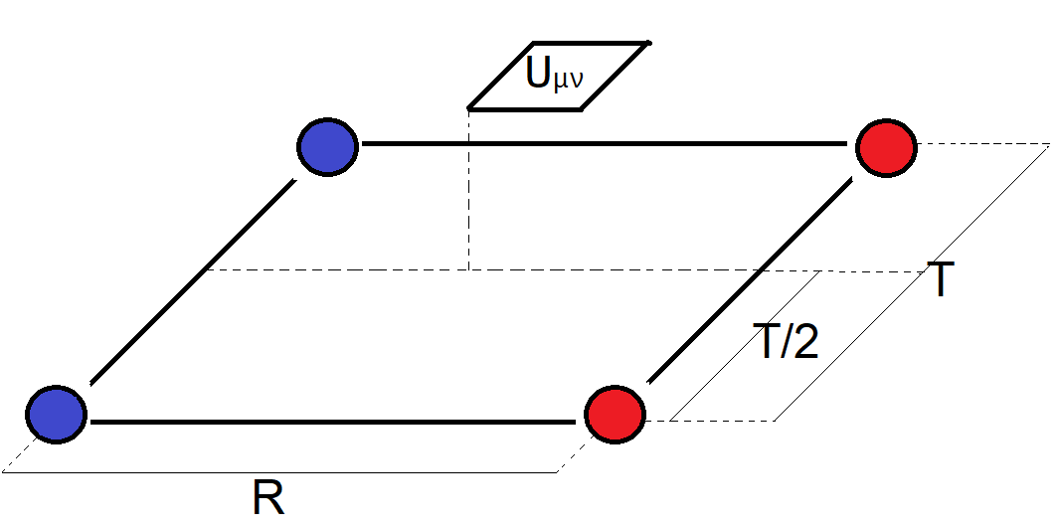
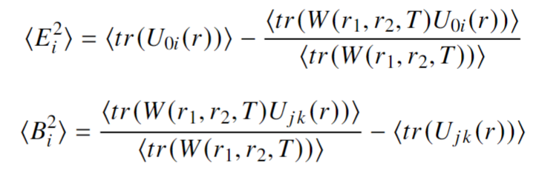
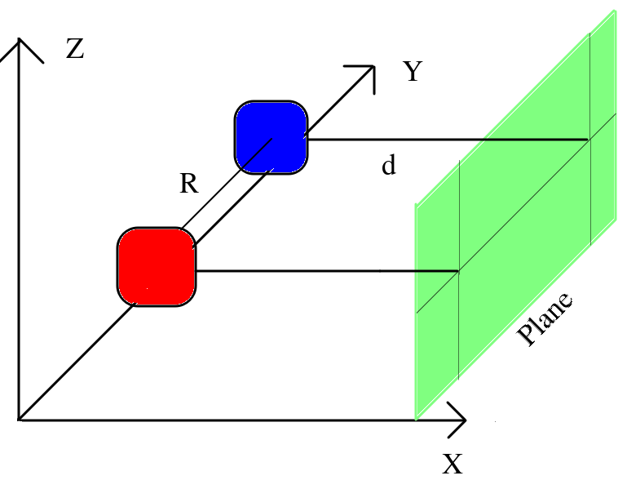
Calculation of <F_{μν}²>
R — spatial distance between quarks
d – distance between a pair of quarks and a plate
Cardoso N., Cardoso M., Bicudo P. Colour field flux tubes and Casimir scaling for various SU(3) representations // Physics Letters B. - 2011. - №710
K. R. Pak INFINUM 15.05.2025 5/15

Slide 6
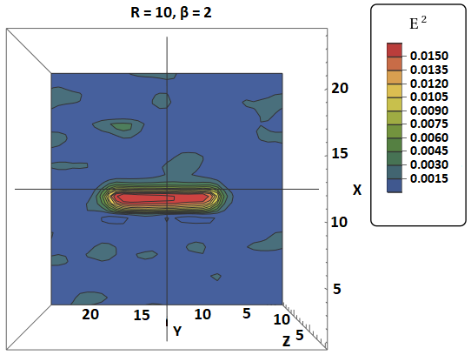
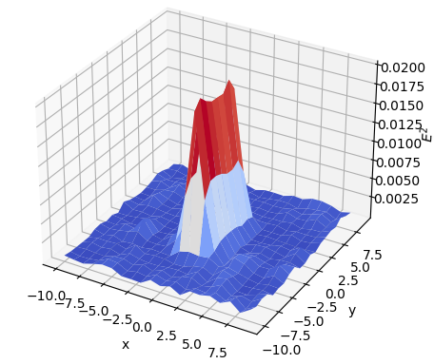
Field distribution in the absence of a plate
Dependencies E² on values x, y
Slice of the equipotential surface of the chromoelectric field
K. R. Pak INFINUM 15.05.2025 6/15

Slide 7
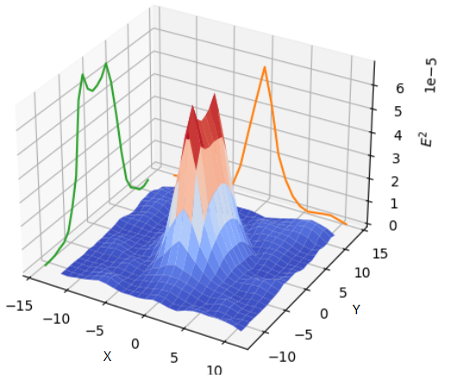
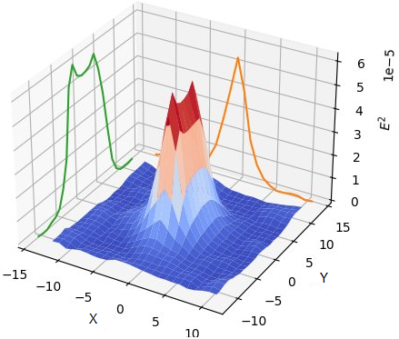
Dependence on distance between plane and quarks
R = 8, d = 5, β = 2
R = 8, d = 4, β = 2
K. R. Pak INFINUM 15.05.2025 7/15
8

Slide 8
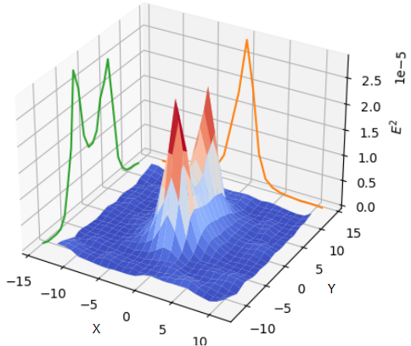
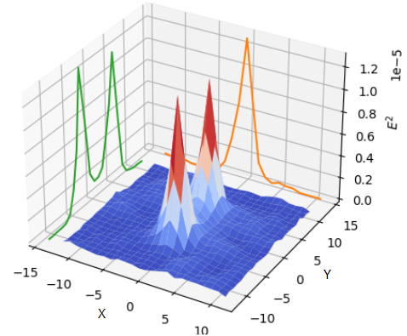
Dependence on distance between plane and quarks
R = 8, d = 2, β = 2
R = 8, d = 1, β = 2
K. R. Pak INFINUM 15.05.2025 8/15

Slide 9
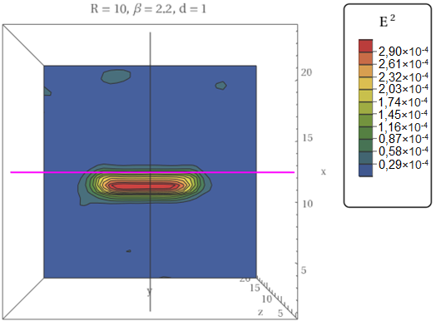
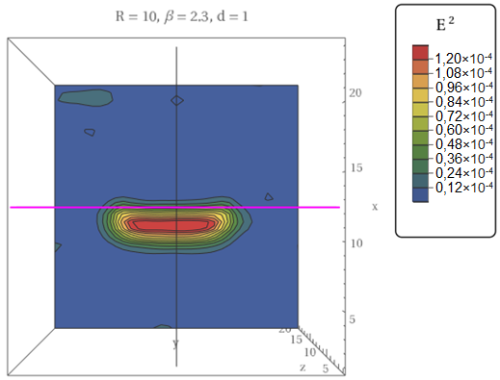
Distribution of fields with different values ​​of β
K. R. Pak INFINUM 15.05.2025 9/15

Slide 10
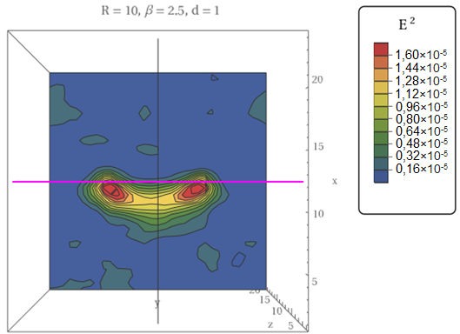
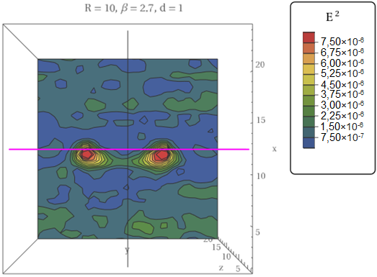
Distribution of fields with different values ​​of β
K. R. Pak INFINUM 15.05.2025 10/15

Slide 11
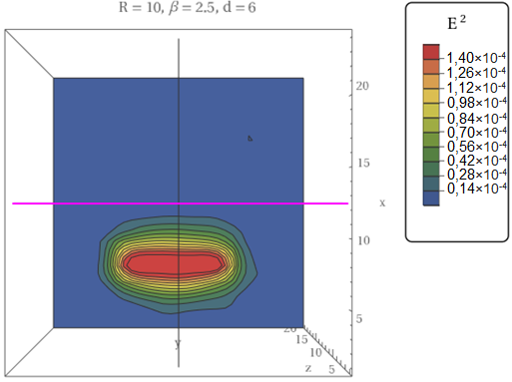
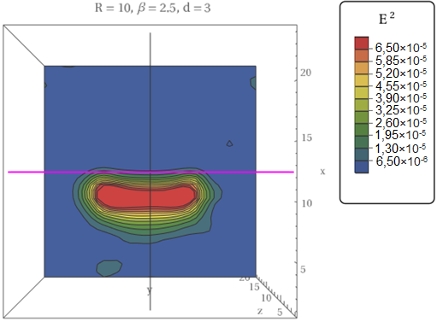
Determining the range of the plate's impact
K. R. Pak INFINUM 15.05.2025 11/15

Slide 12
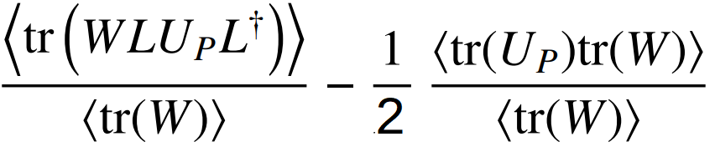

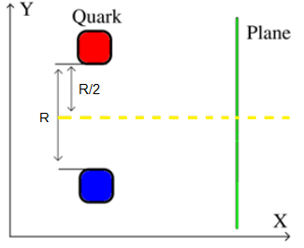
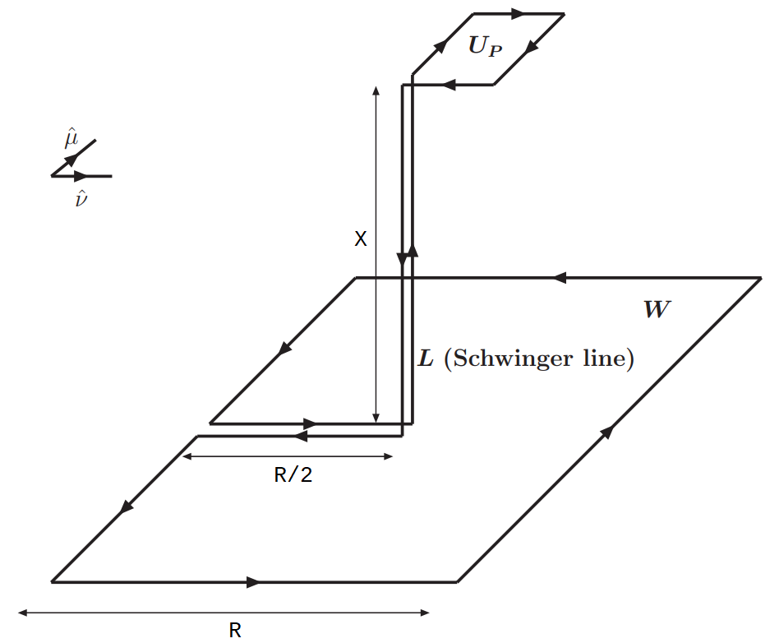
Calculation of <F_{μν}>
Cea P., Cosmai L., Cuteri F., Papa A QCD flux tubes across the deconfinement phase transition // preprint[arXiv.1710.01963]. - 2017
K. R. Pak INFINUM 15.05.2025 12/15

Slide 13
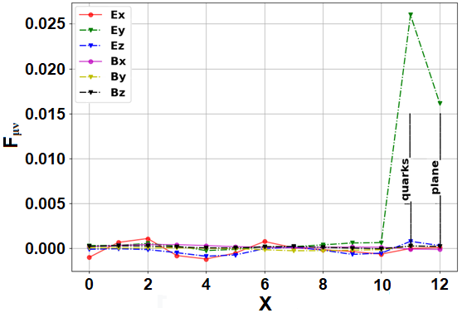
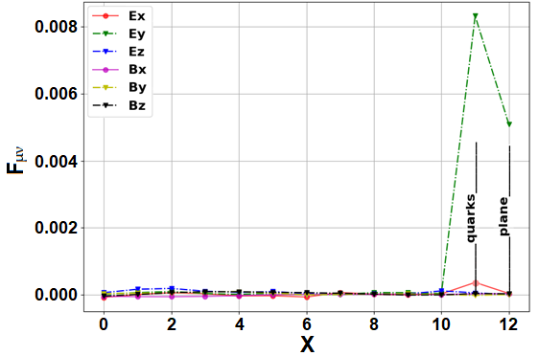
Field tensor components with different values ​​of β
R = 10, d = 1, β = 2.2
R = 10, d = 1, β = 2.3
K. R. Pak INFINUM 15.05.2025 13/15

Slide 14
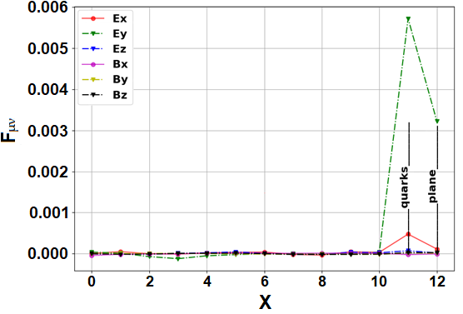
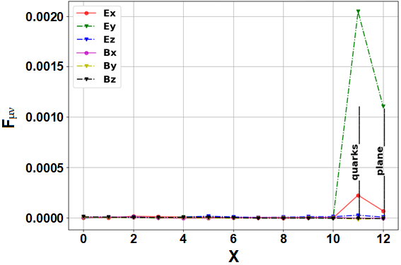
Field tensor components with different values ​​of β
R = 10, d = 1, β = 2.5
R = 10, d = 1, β = 2.7
K. R. Pak INFINUM 15.05.2025 14/15

Slide 15
Conclusion
The Casimir plate affects on the distribution and intensity of chromoelectric fields between a quark-antiquark pair.
Several interesting regularities are observed:
The values ​​of the components of the force tensor of the field decrease when a pair of quarks come closer to the plate, which indicates a weakening of the interaction between quarks.
2) Plate changing phase structure of the system. Temperature near Casimir plate increases.
3) The plate begins to affect the fields between quarks only at close enough distances. At a large distance from the plate, the behavior of the fields differs little from systems without a Casimir plate.
K. R. Pak INFINUM 15.05.2025 15/15

