Slide 1
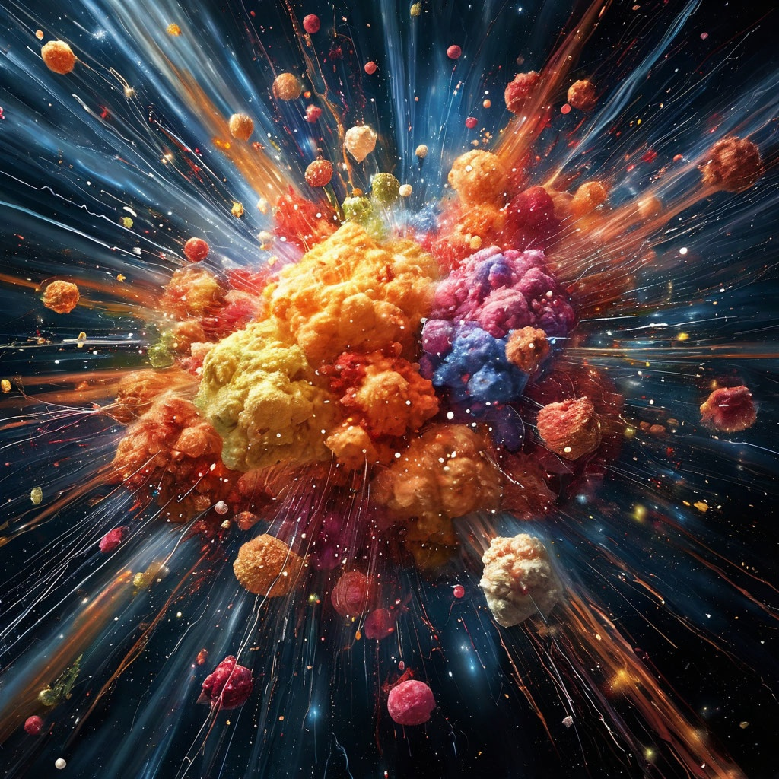
International Workshop (INFINUM-2025)
Infinite and Finite Nuclear Matter

Slide 2

History of NFINUM
INFINUM 2019, March 20-22, 2019 (3days, 36 participants)
in memory of Eduard Evseevich Sapershtein (1939 - 2018)
INFINUM 2023, February 23-March 3, 2023 (5days, 75 participants)
Proceedings published in Special Issue of Particles
10 papers will be issued as a book
INFINUM 2023, May 12-16, 2025 (5days, 73 participants)

Slide 3
‘
The aim of our meeting is to exchange ideas and experiences in the descriptions
of finite nuclear systems (ground state characteristics and excitations in atomic nuclei) and in the description of “extended” nuclear objects like neutron stars, fireballs created in heavy-ion collisions or “nuclear matter”.
QCD
(lattice)
HIC
Atomic
nuclei
HIC experiments
The golden tree of life springs ever green
[Grün (ist) des Lebens goldner Baum.]
Compact
stars

Slide 4
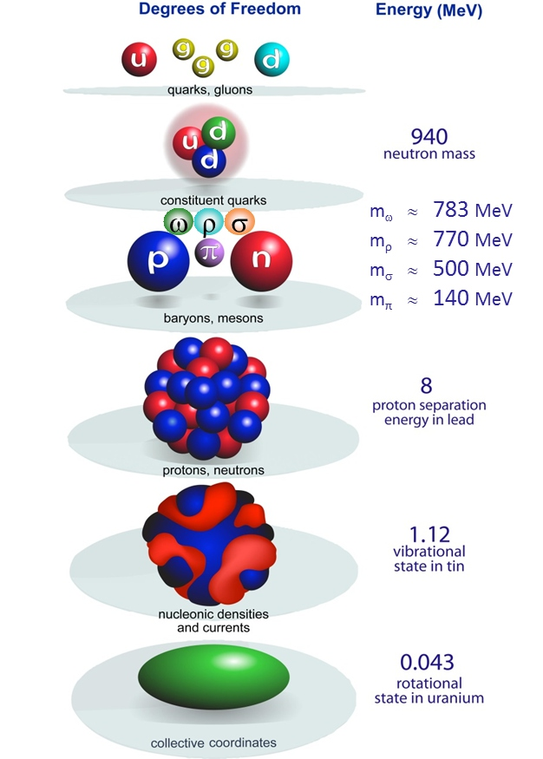

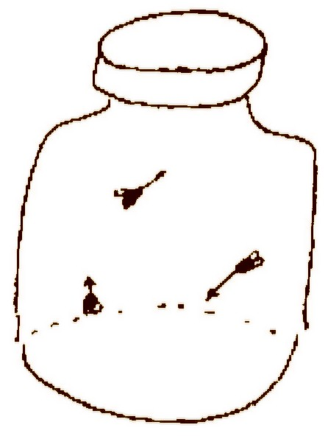
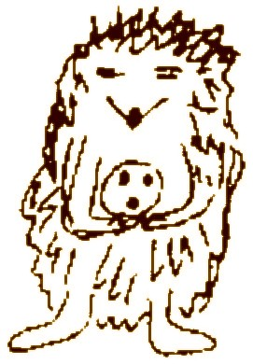

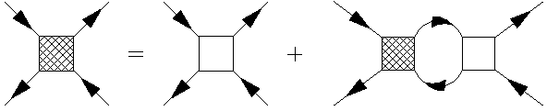

Nuclear scales: Hierarchy problem
non trivial
QCD background
Nucelon’s portrait gallery
effective
theories
© Ed Shuryak NPA 606
many-body
methods
NN-intearaction: OMEP, chiral counting
various resummation schemes
BHF, DBHF, SGFM
separation short vs. long range
Fermi liquid
parameters
Jolos, Nuclear EDF
SF Fermi liquid, pairing gaps

Slide 5
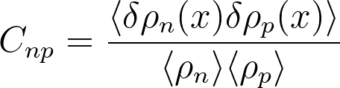
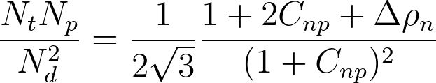
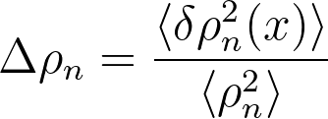
Clusters in HICS
“Snowball-in-hell” Phenomena in Heavy-ion Collisions
PBM, Doenigus arXiv:1809.04681
D. Oliinychenko, arXiv:2003.05476
How a loosely bound hadronic molecule registered in RHICs as can emerge from a hadron resonance gas whose temperature is orders of magnitude larger than the binding energy of the molecule?
coalescence model
talks by Bratkovskaya, Ivanov, Kireyeu, Kozhevnikova

Slide 6
Cluster binding energy in matter
symmetric nuclear matter
Cluster dissolves = the bound states disappears
Resonance state?
Typel, Roepcke, Klaehn, Blaschke, Wolter, PRC 81, 015803 (2010)

Slide 7


Neutron-rich clusters (tiny ``neutron stars’’)
ACCULINA
[Muzalevskii, Phys.Rev.C 111 (2025) 014612]
Hunt for tetra-neutron
[Duer et al., Nature 606, 678 (2022)
A statistically convincing peak (reported as “resonance-like structure” comprising around 44 events) was observed in a ¹H(⁸He,pα) experiment at E_{T} (4n) = 2.37 MeV with Γ= 1.75 MeV.
These correlated states could be important for
The description of dilute neutron-reach nuclear gas
in the virial approximation

Slide 8
Hyperclusters
A. Gal, E. V. Hungerford, and D. J. Millener:
Strangeness in nuclear physics, RMP 88 (2016) 035004

Slide 9
Hypernuclei
talks by Tretyakova and Mikheev
A. Gal, E. V. Hungerford, and D. J. Millener:
Strangeness in nuclear physics, RMP 88 (2016) 035004

Slide 10

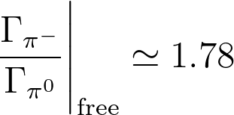











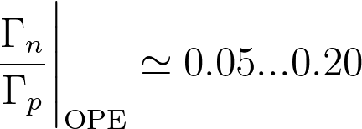





Hypernucleus decay
Mesonic channels
Pauli blocked in the nucleus center (surface production)
Non-mesonic channels
without change of nucleus
Λ
n
for all nuclei
n
n
Exp:
Λ
n
Λ
p
p
p
p
n
pion modifications!

Slide 11
Hypernuclei in HICS
RHIC BES-II offers great opportunity for
hypernuclei measurements
Xianglei Zhu talk at the XV MPD meeting

Slide 12
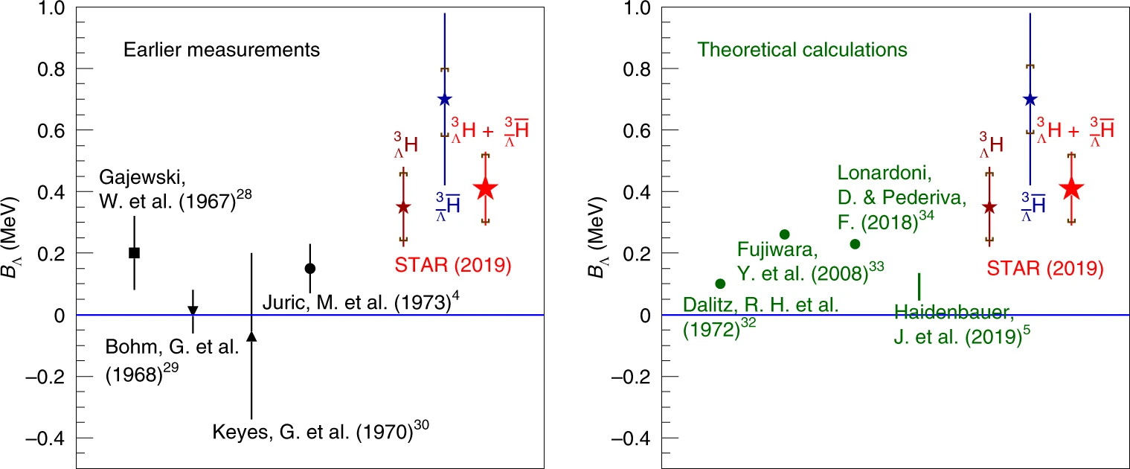
Hypertriton-at-RHIC puzzle

Slide 13
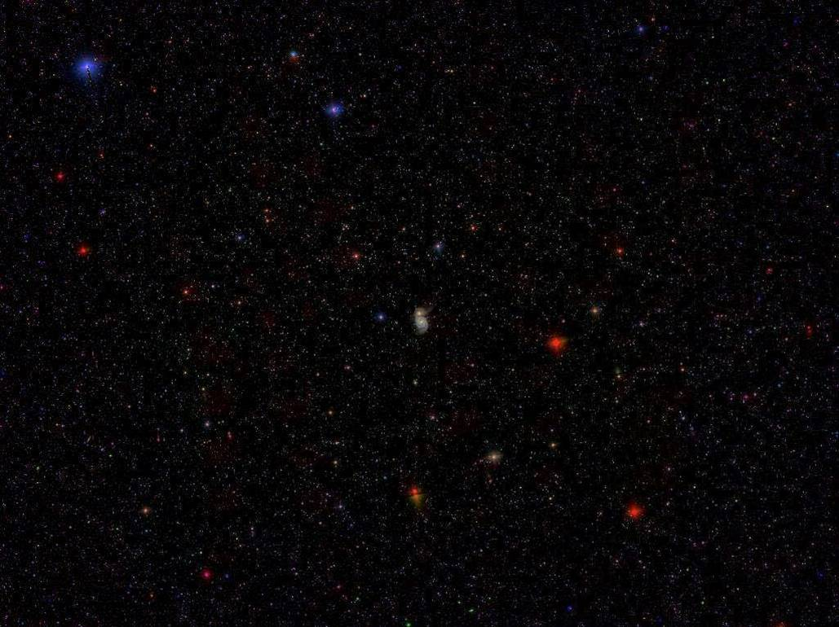
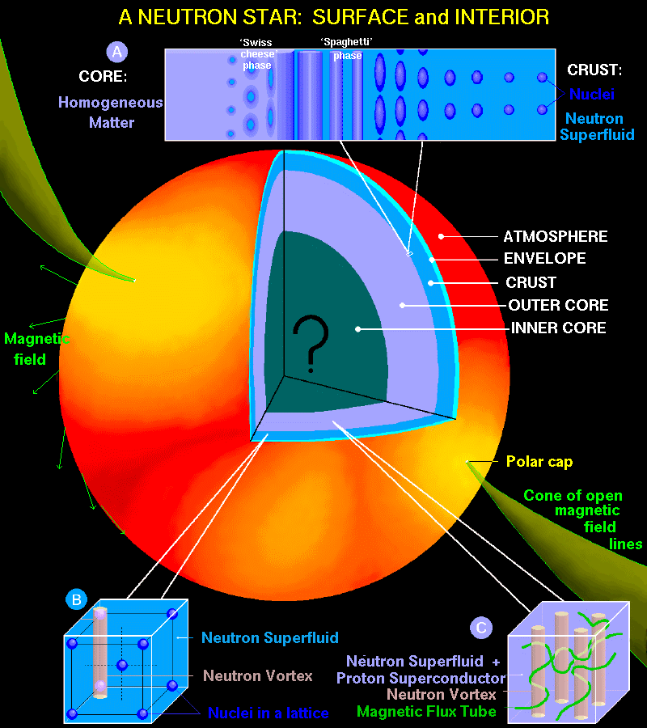
Deformed nuclei,
neutron-rich nuclei, cluster
Talk by Chugunov
Quark matter
Vortices

Slide 14
From astro. data to EoS?
Demonstration of the Oppenheimer-Volkoff mapping
[D.D. Ofengeim et al]
Mass-Radius measurements select EoS
Talks by Ofengeim, Seif

Slide 15
“Hyperon puzzle”
If we allow for a population of new Fermi seas (hyperon, Δ baryons, …)
EoS will be softer and the NS will be smaller
[Vidana et al, arXiv:2412.12729]
Simple solutions: -- make nuclear EoS as stiff as possible [flow constraint]
-- suppress hyperon population (increase repulsion/reduce attraction)
against phenomenology of YN,NN,YY interaction in vacuum
+hypernuclear physics

Slide 16
“Enforced” hadron-quark transition scenario
HQ percolation
[G. Baym, Physica 96A 131]
percolation
See talk by
Three-window scenario

Slide 17

New neutron star radius measurements
Form of the M-R curve
“gees”
~200 various EoS
“swans”

Slide 18
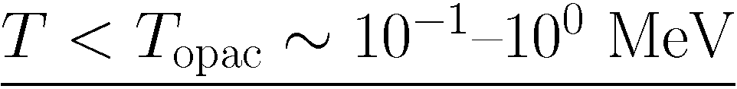
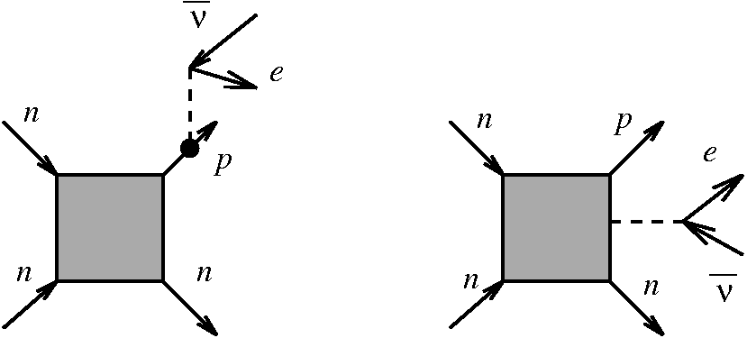

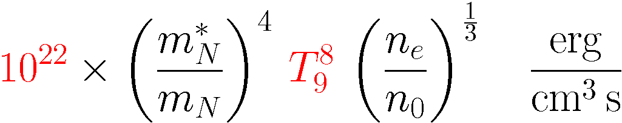
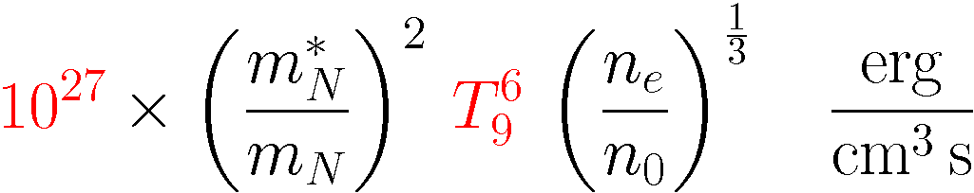
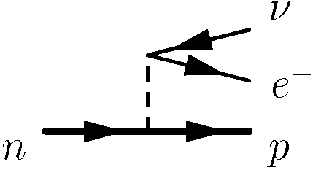
Neutron star cooling
neutron star is transparent for neutrino
modified Urca (MU)
neutrino emissivity
direct Urca (DU)

Slide 19


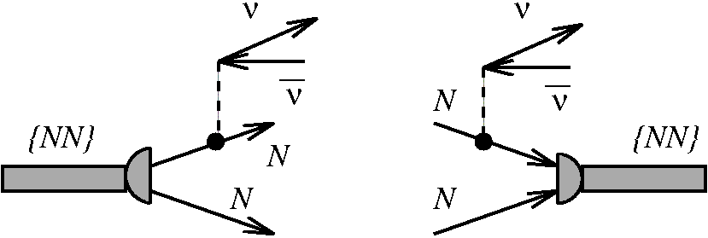
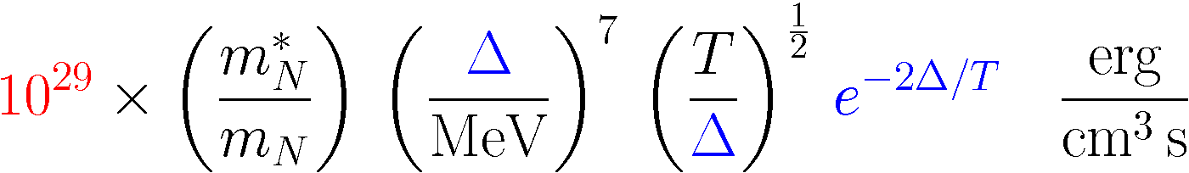
modified Urca (MU)
neutrino emissivity
direct Urca (DU)
pair-breaking-formation (PBF)

Slide 20
Modern data on NS temperatures
Questions:
Can we describe all data?
What are the values of pairing gaps?
Calculation of neutrino emission in Fermi systems with
s and p-wave pairing?
see talks by Potekhin, Shternin, Grigorian, Kalagov

Slide 21
Not inertial systems
rotation
Description of rotating systems (active and passive rotation)
System rotating as a whole
Influence of rotation on the phase transitions
Response of particle spins on rotation
talks by Braguta, Roenko, Pak, Stepanov
acceleration
Unruh effect
acceleration induced phase transition
talks Zakharov, Teryaev, Prokhorov

Slide 22




Standard measurements in HIC: PID, momenta distributions
“New” measurements: averaged spin orientation
Can be done for hyperons which are “self-analyzing particles”.
β
p
π⁻
Λ [at rest]
Origin of global polarization in collective processes Initial angular momentum of colliding nuclei
angular momentum
per nucleon
Polarization is used to define the vorticity (“swirlingness”) of the medium created in HIC
hydrodynamics with spin
see talk by Jaiswal

Slide 23
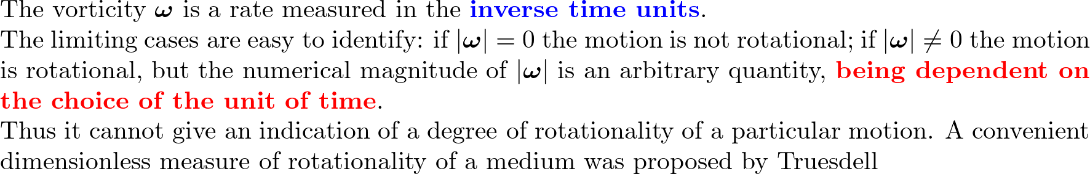


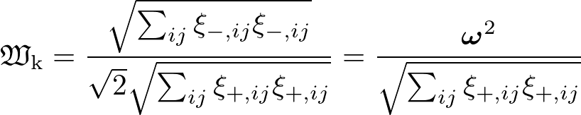


Measure of rotationality
sugar cube vs. coffee pot
The quality of rotation is essential!
[J. Rational Mech. Anal. 2,173 (1953)]
kinematic vorticity number

Slide 24
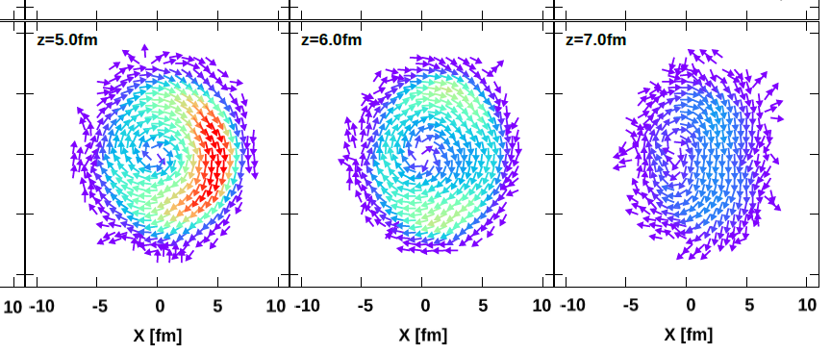

Measure of rotationality
[c/fm]
Au+Au @ 7.7 GeV
b=7.5 fm
t=11 fm/c
vorticity
kinematic vorticity number
Maximum of vorticity does not correspond with the maximum of the kinematic vorticity number

Slide 25


Discussion
Speakers should make an effort to be understandable!
Not all in the auditorium are specialists in the speaker’s field of nuclear physics.
Discussions is one of the important part of the workshop program.
Time is allocated at the end of each day.
Questions will be collected during all day in two forms:
notes with questions passed to me or chairmen
questions written in the Google doc:
https://docs.google.com/document/d/1TeZN-3c2uk4cY1V4TGHDxBB-vMQF3P0mI_fRohRBFNs/edit?usp=sharing

