Slide 1
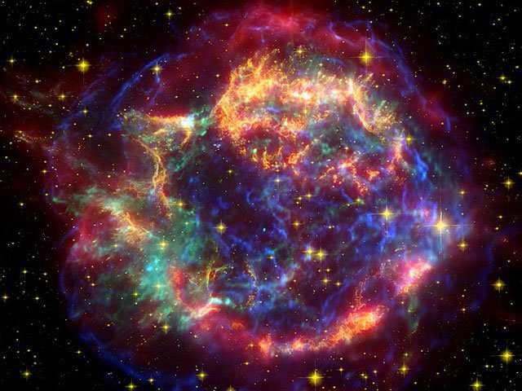
Reconstruction of Neutron Stars Mass Distribution from Cooling Evolution
Hovik Grigorian:
JINR LIT (Dubna),
Yerevan State University,
AANL CP&IT
(Yeravan, Armenia)
(INFINUM-2025)
12–16 May 2025
BLTP, Dubna - Russia
my co-authors: D.Blaschke, D.Voskresensky, A. Ayriyan

Slide 2
Simulation of Cooling Evolution
of Neutron Stars
Introduction
Neutron Stars structure
Neutron Stars cooling problem
Simulations algorithm
Results for NS cooling
H. Grigorian, D. N. Voskresensky and D. Blaschke
Eur. Phys. J. A 52: 67 (2016).

Slide 3
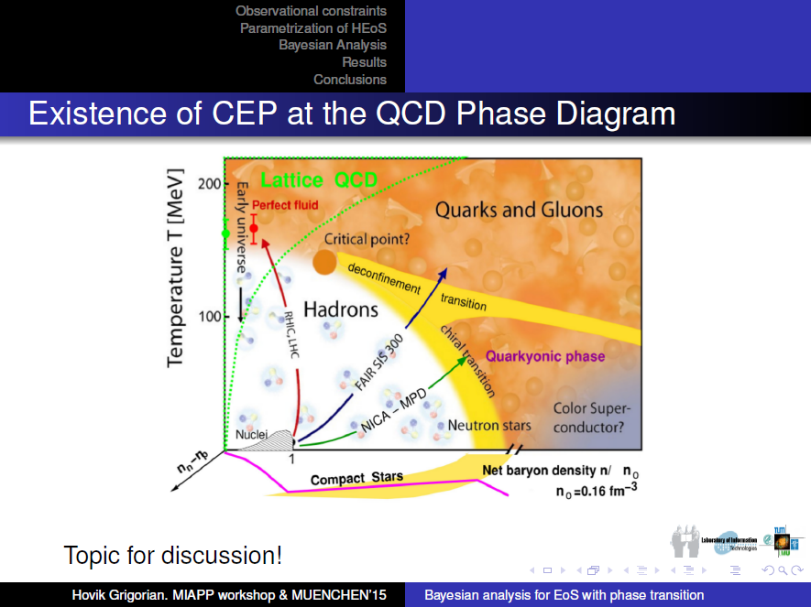
Phase Diagramm & Cooling Simulation
Description of the stellar matter - local properties (EoS of super-dense matter)
Modeling of the gravitationally self bound compact star - including the density profiles
Extrapolations of the energy loss mechanisms to higher densities and temperatures
Consistency of the approaches
Comparison with observational data

Slide 4
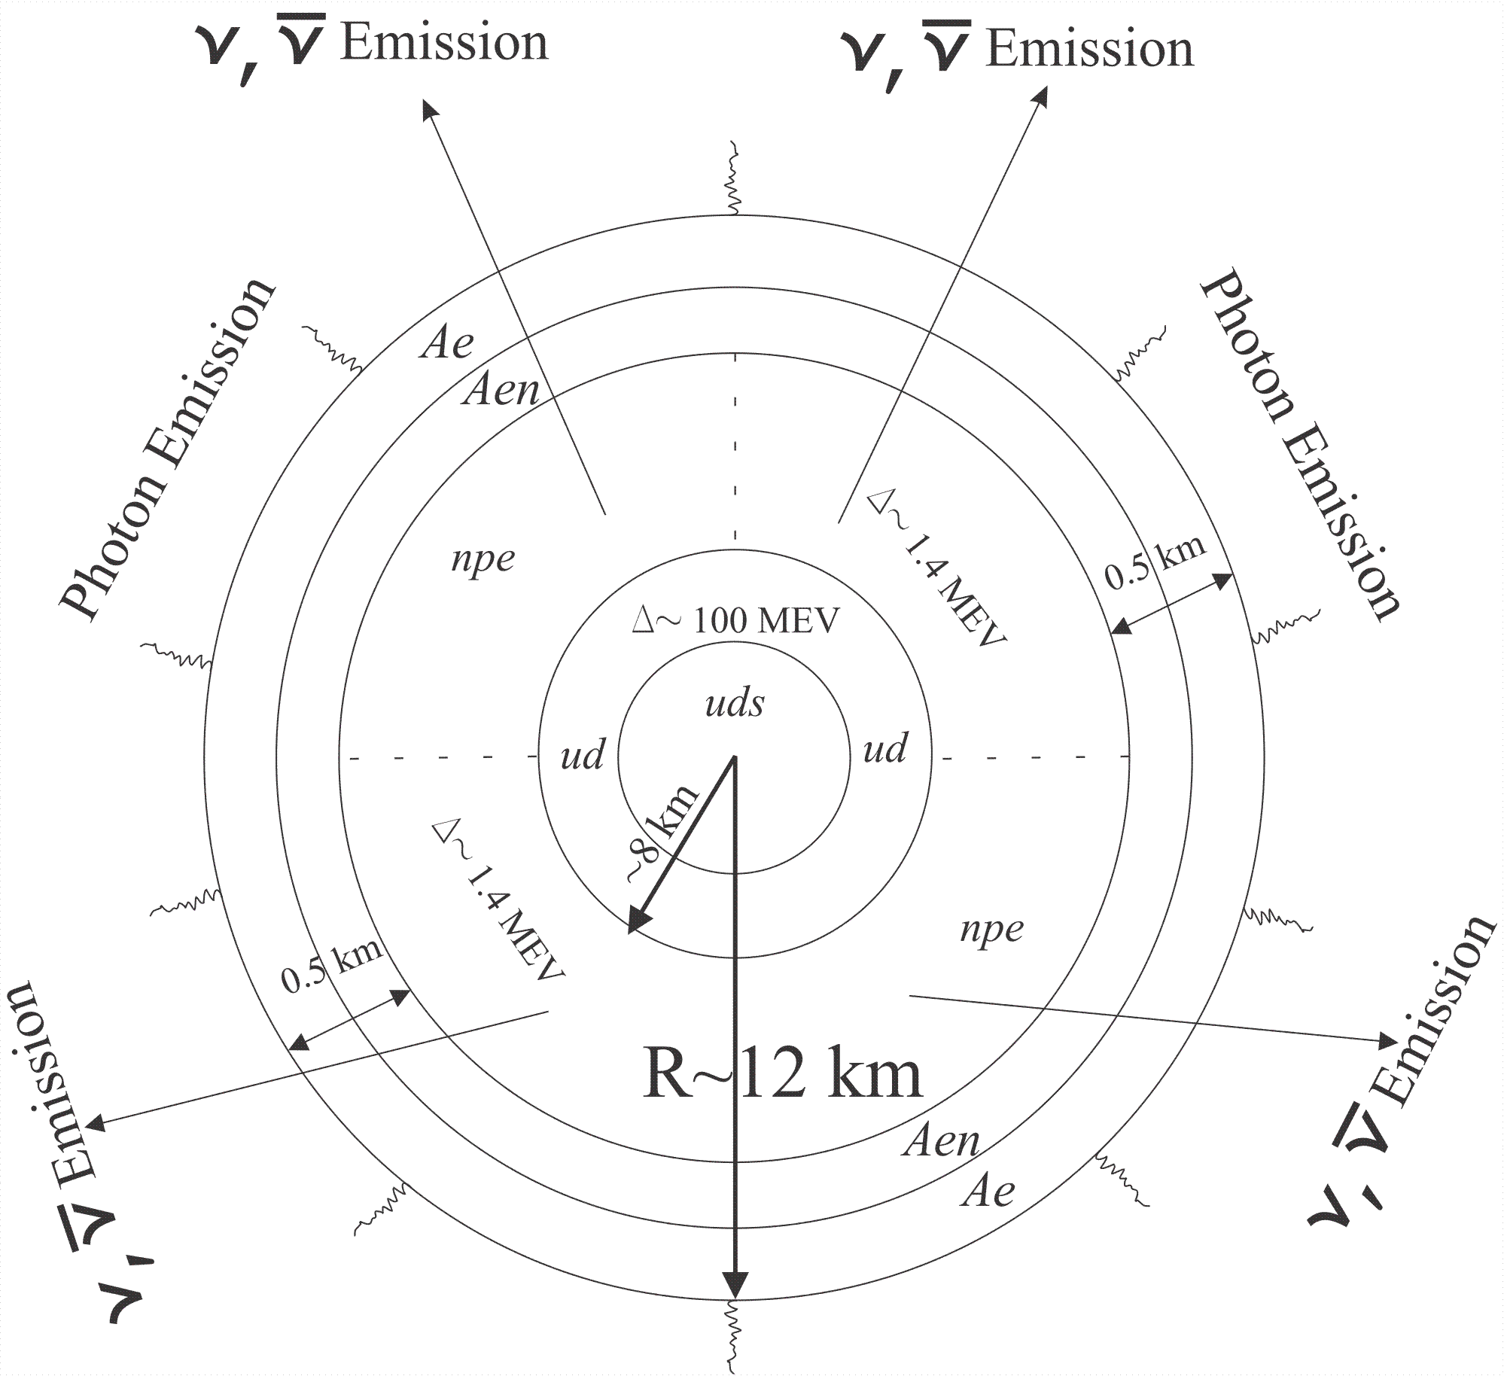
Structure Of Hybrid Star
1
1

Slide 5
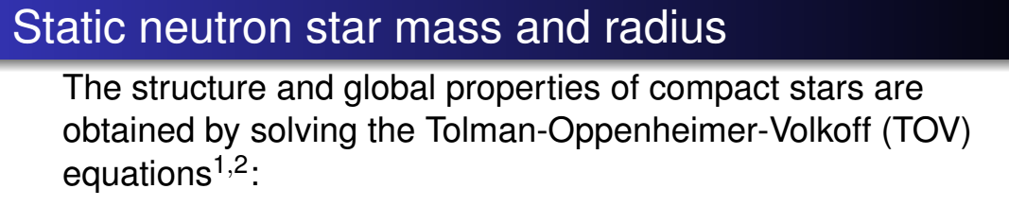
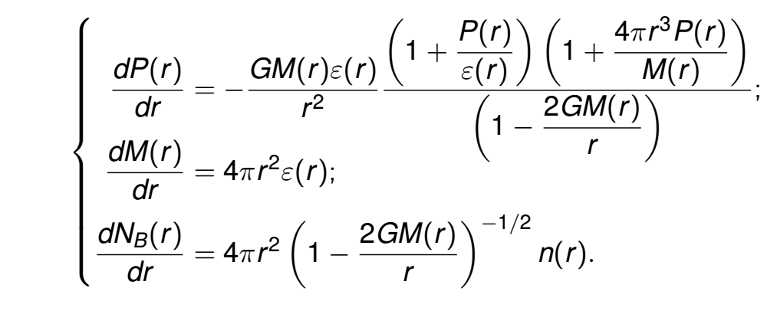


Slide 6
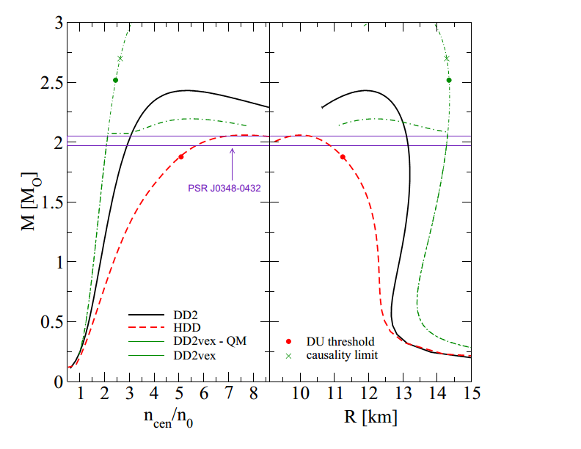
Stability of stars
HDD, DD2 & DDvex-NJL EoS models

Slide 7
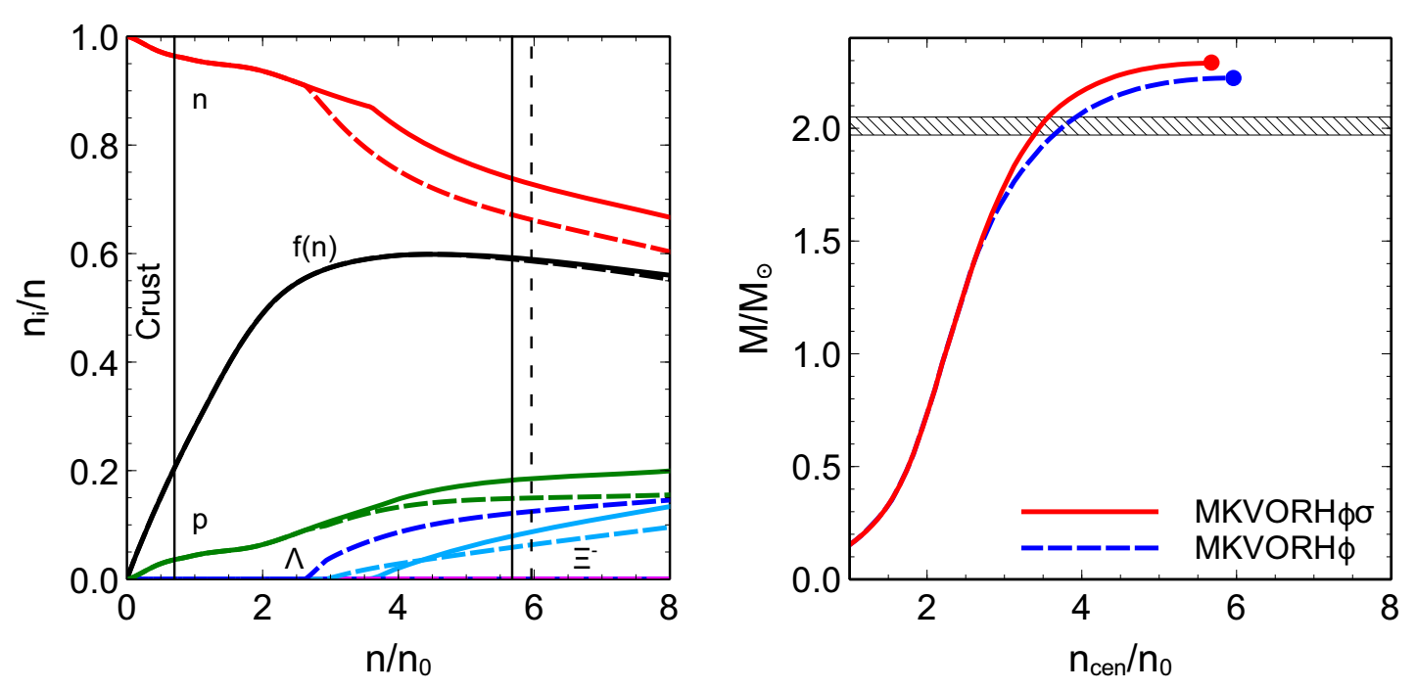
MKVOR – EoS model

Slide 8
Different Configurations with the same NS mass

Slide 9
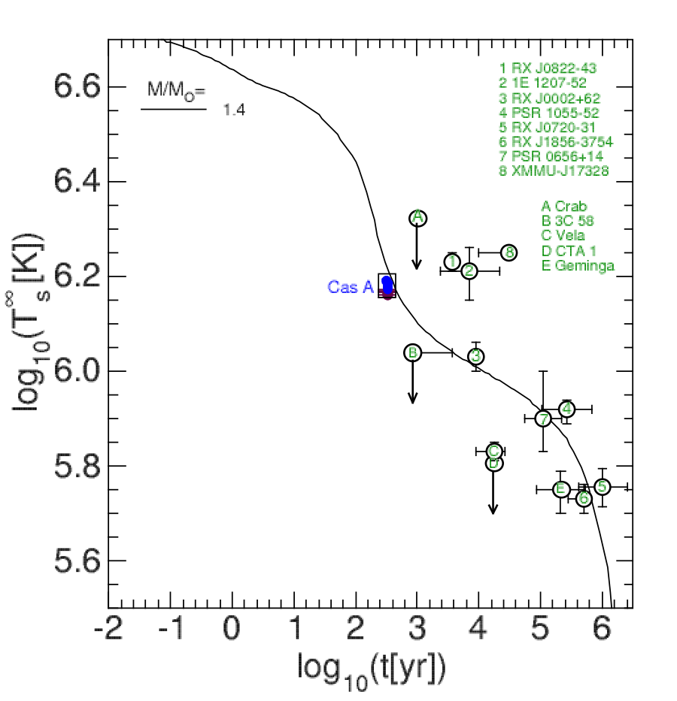
Surface Temperature & Age Data

Slide 10
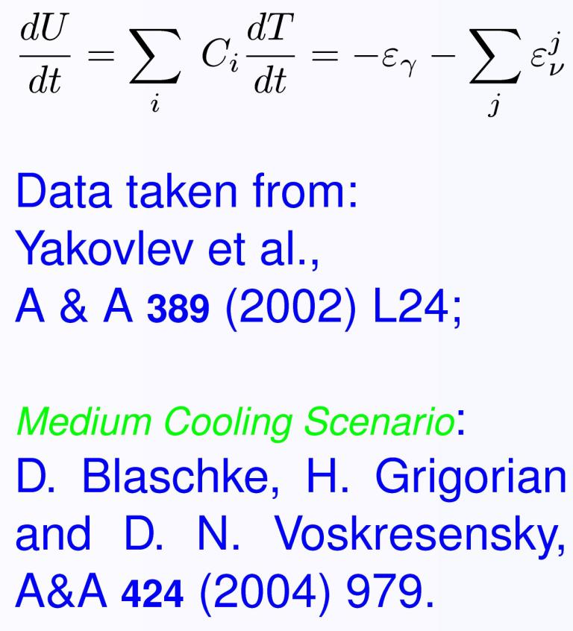
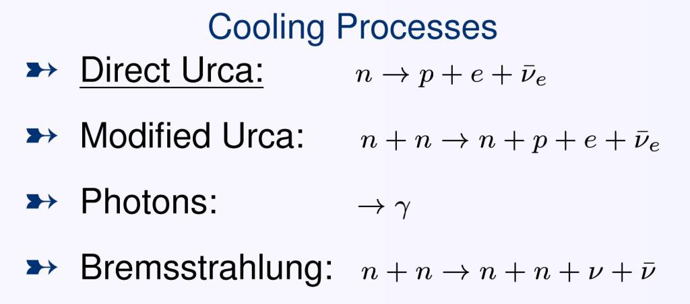
Cooling Mechanism

Slide 11

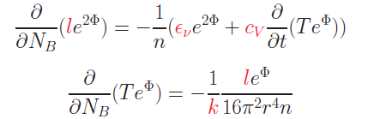

Cooling Evolution
The energy flux per unit time l(r) through a spherical slice at distance r from the center is:
The equations for energy balance and thermal energy transport are:
where n = n(r) is the baryon number density, NB = NB(r) is the total baryon number in the sphere with radius r
F.Weber: Pulsars as Astro. Labs ... (1999);
D. Blaschke Grigorian, Voskresensky, A& A 368 (2001)561.

Slide 12
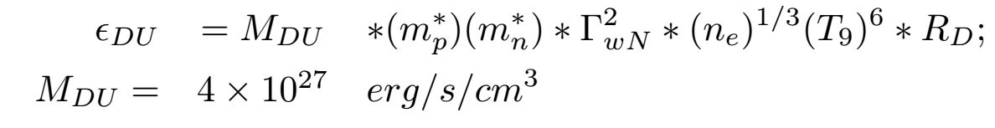
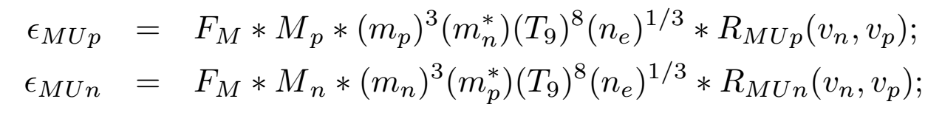
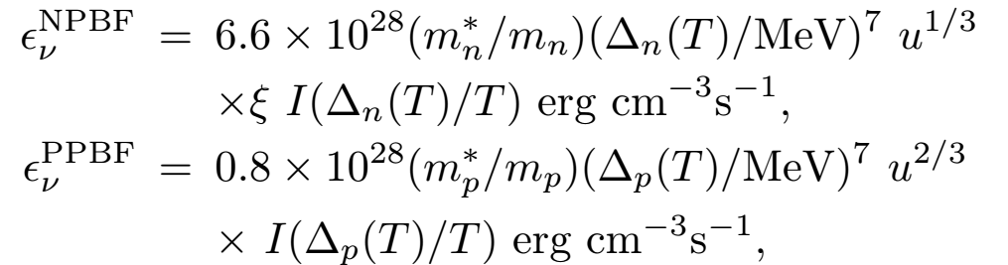
Neutrino emissivities in hadronic matter:
Direct Urca (DU) the most efficient processes
Modified Urca (MU) and Bremsstrahlung
Suppression due to the pairing
Enhanced cooling due to the pairing

Slide 13
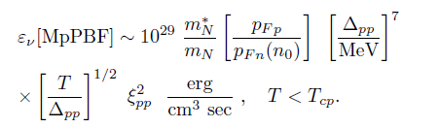
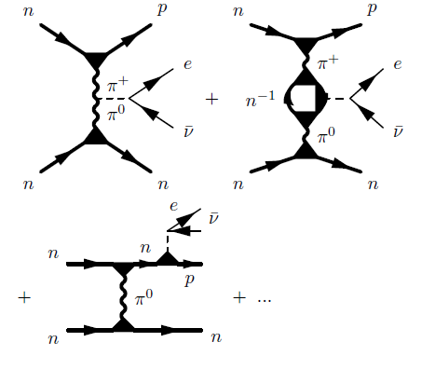
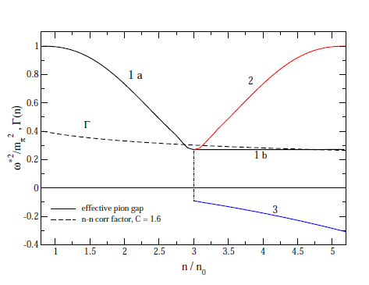

Medium Effects In Cooling Of Neutron Stars
Based on Fermi liquid theory ( Landau (1956), Migdal (1967), Migdal et al. (1990))
MMU – insted of MU
Main regulator in Minimal Cooling

Slide 14
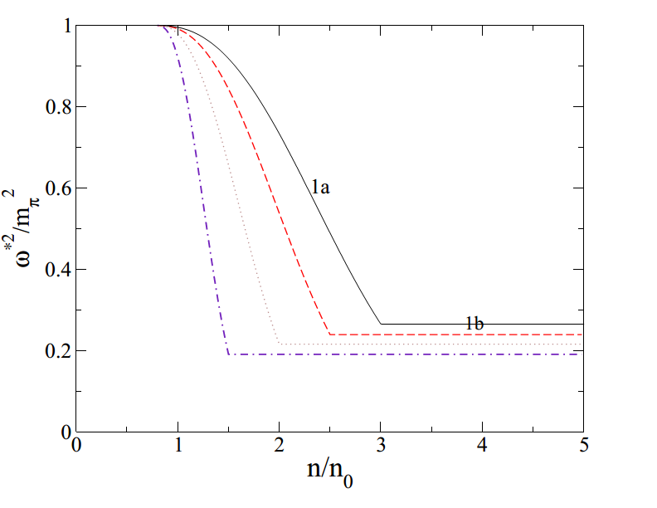
Medium Effects In Cooling Of Neutron Stars

Slide 15
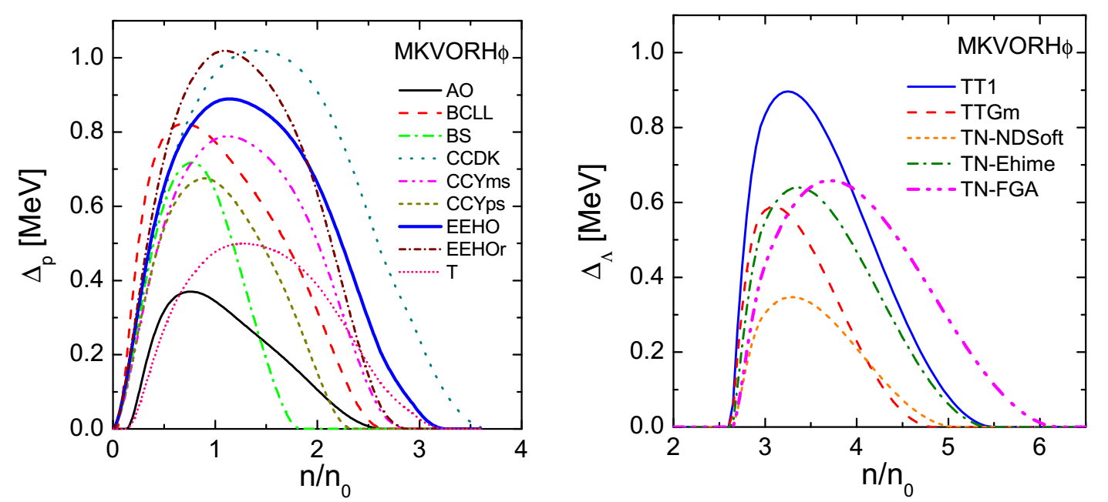
MKVORHp – Gap models

Slide 16
Equations for Cooling Evolution

Slide 17
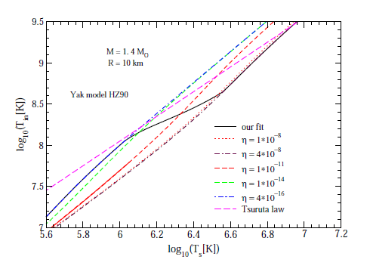

Crust Model
Time dependence of the light element contents in the crust
Blaschke, Grigorian, Voskresensky, A& A 368 (2001)561.
Page,Lattimer,Prakash & Steiner, Astrophys.J. 155,623 (2004)
Yakovlev, Levenfish, Potekhin, Gnedin & Chabrier , Astron. Astrophys , 417, 169 (2004)

Slide 18
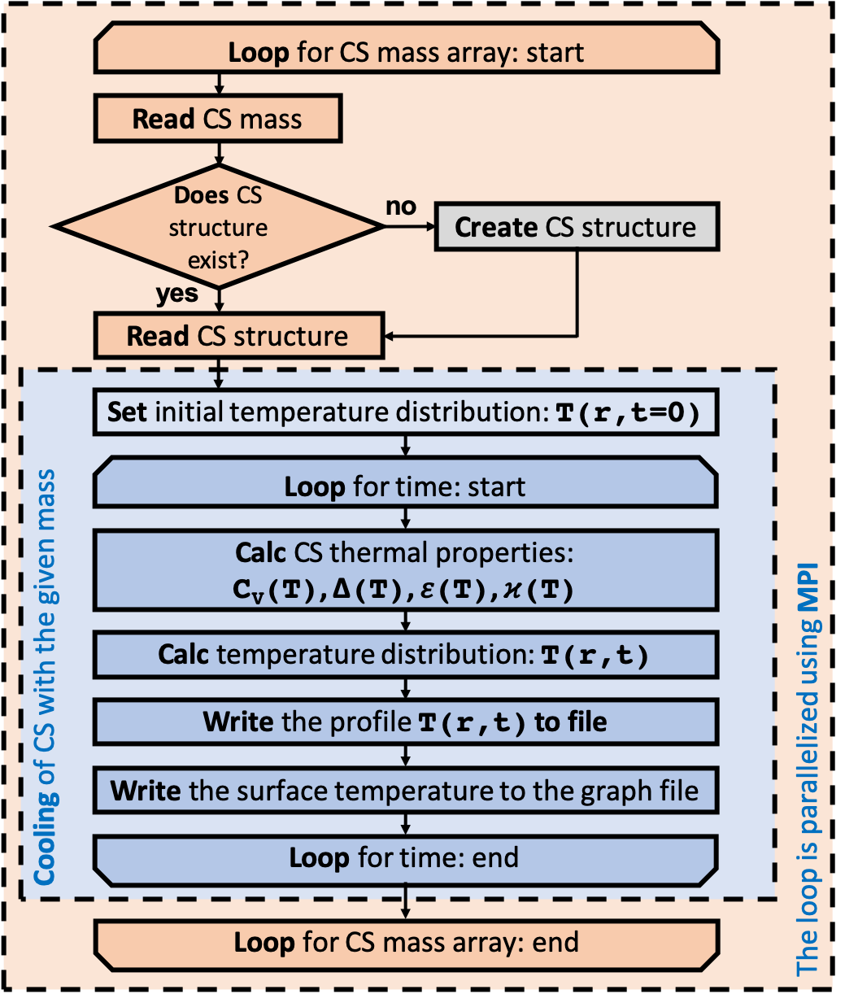
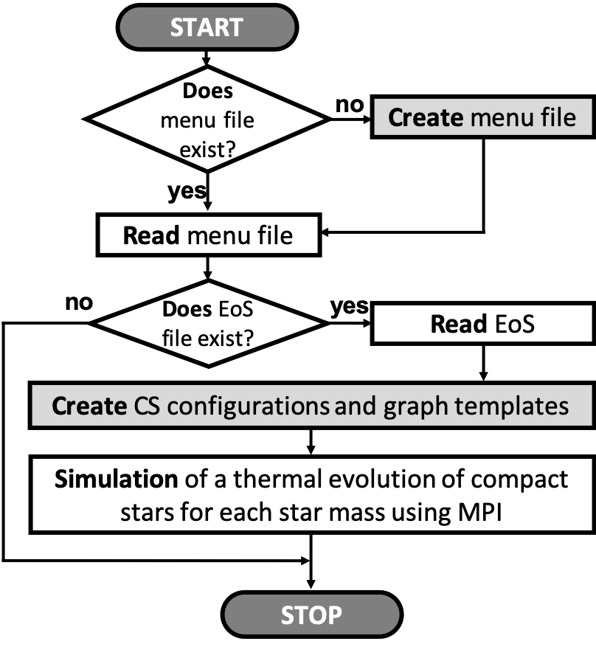
Program Algorithm

Slide 19
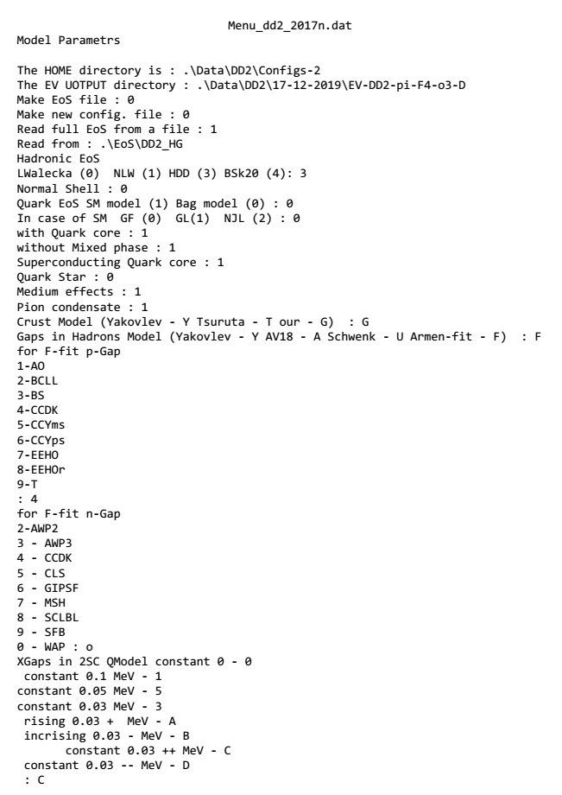
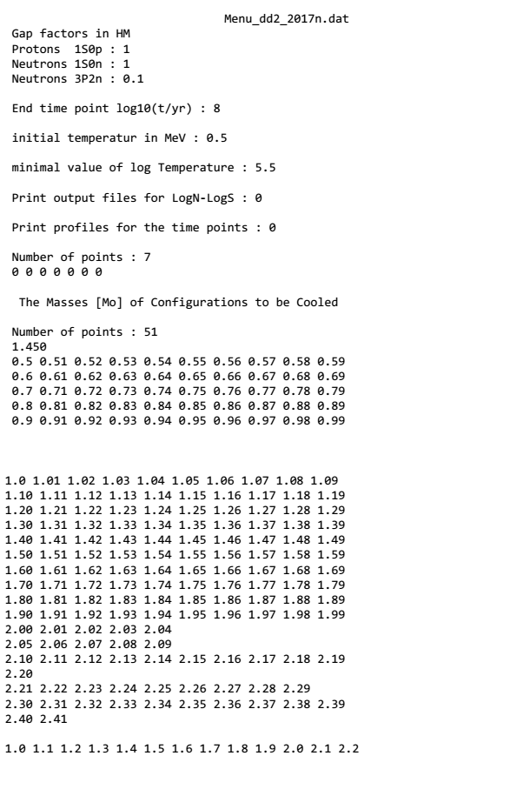
Model parameters – DD2

Slide 20
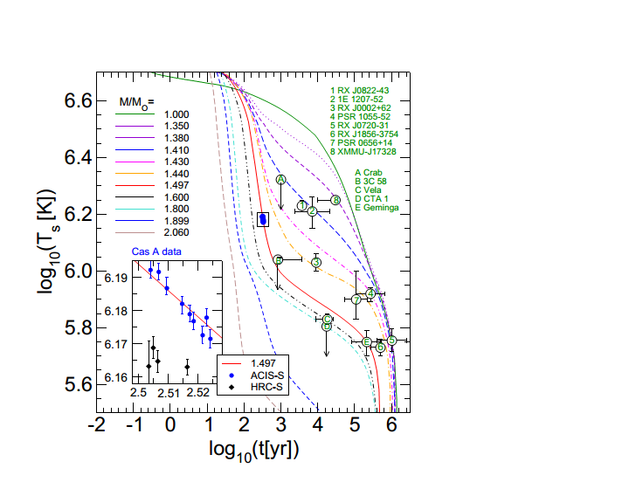
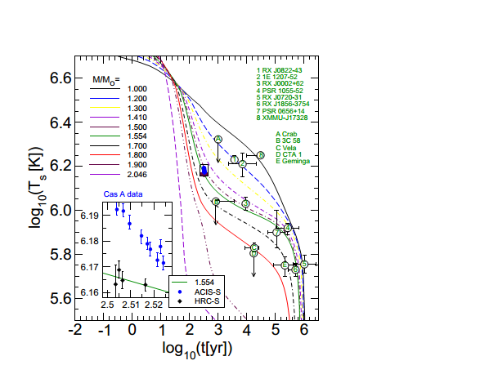
HDD – AV18 , Yak.
ME nc = 3 n0

Slide 21
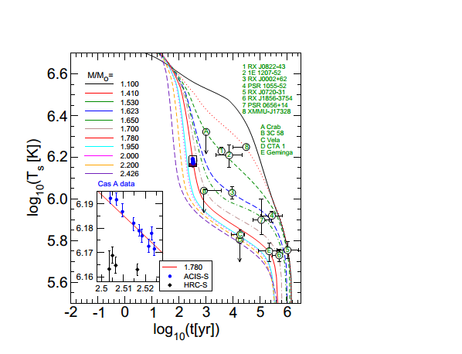
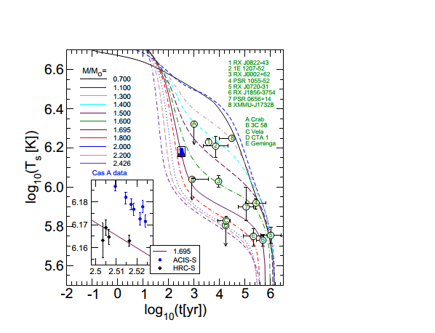
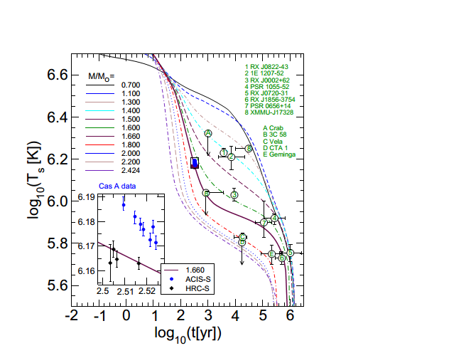
DD2 – EEHOr
ME-nc=1.5,2.0,2.5n0

Slide 22
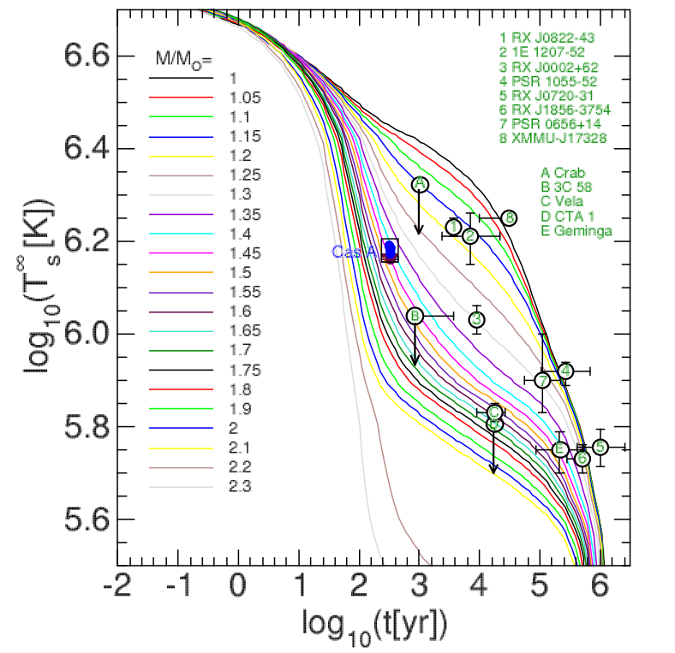
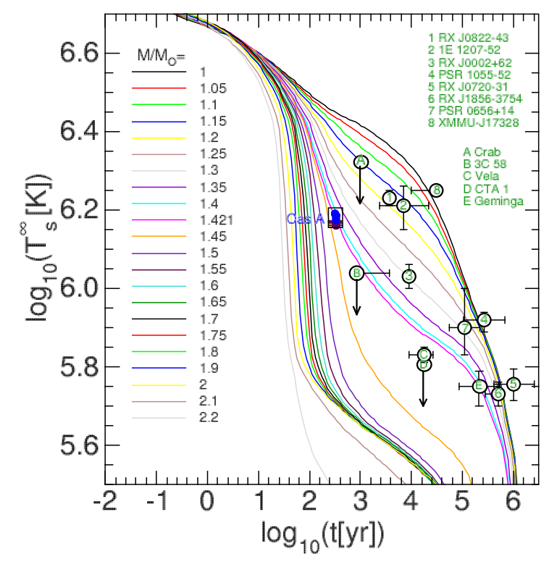
MKVOR – BCLL, TN-FGA
ME-nc=3.0n0

Slide 23
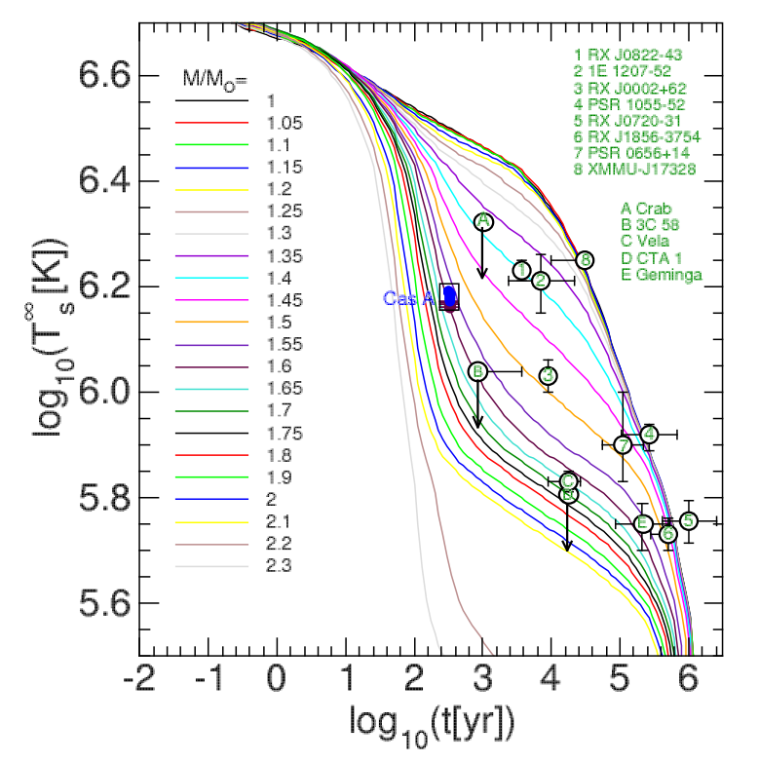
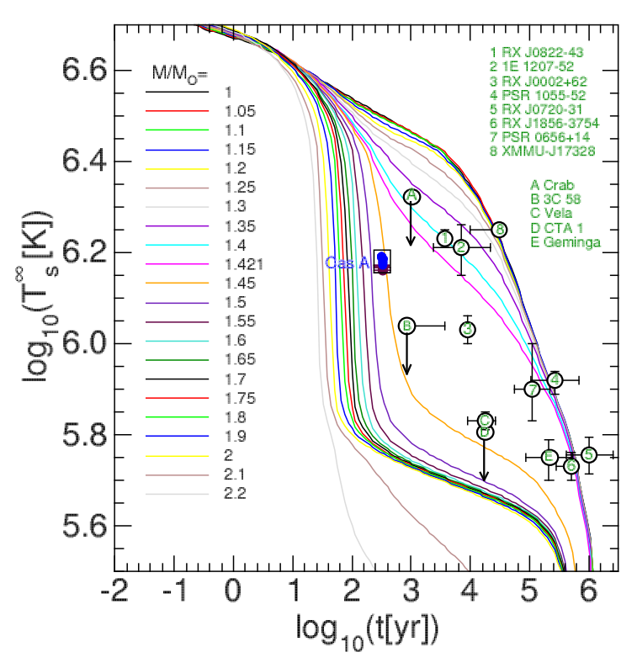
MKVOR Hyp – EEHOr, TN-FGA
ME-nc=3.0n0

Slide 24
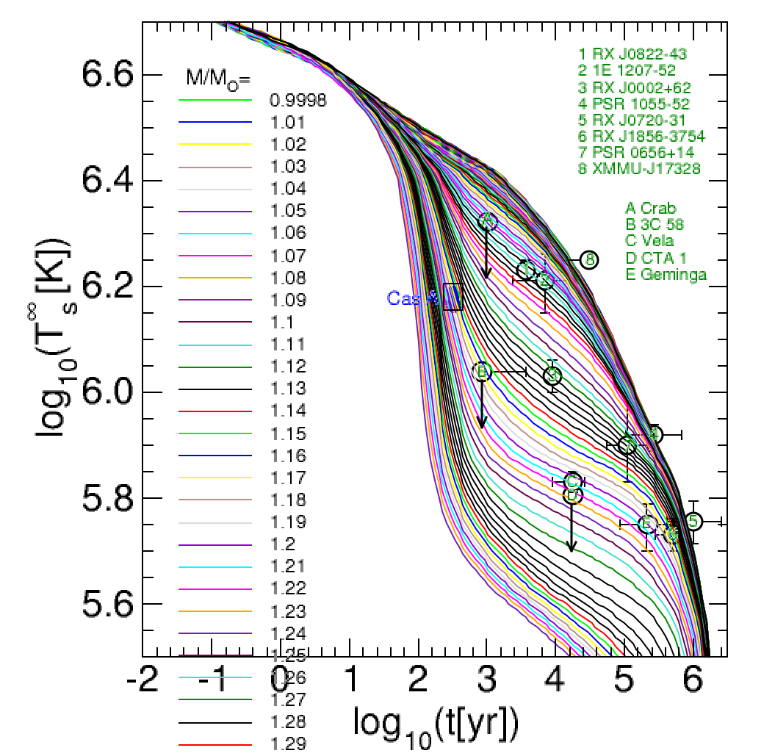
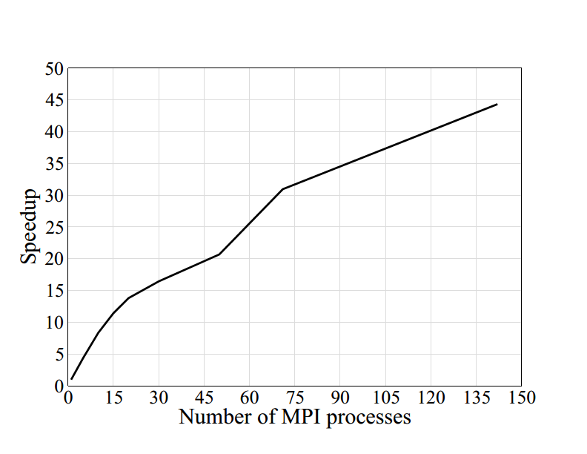
Results produced with use of MPI Technology
142 configurations has been calculated in 0m49s on the 142 processes.
On 1 process it takes 36m14s
– acc is ~ 44 times

Slide 25
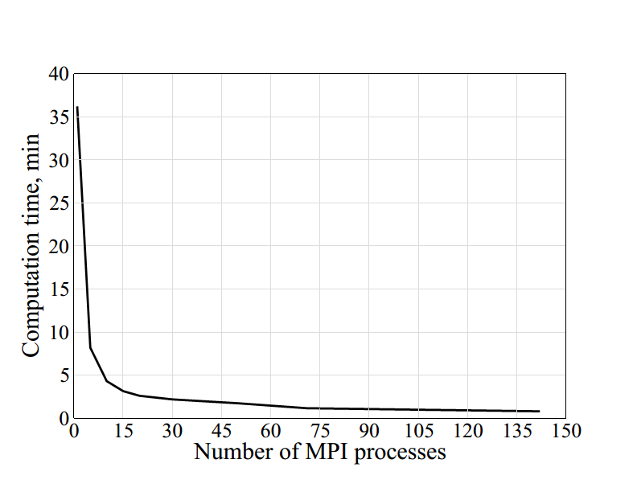
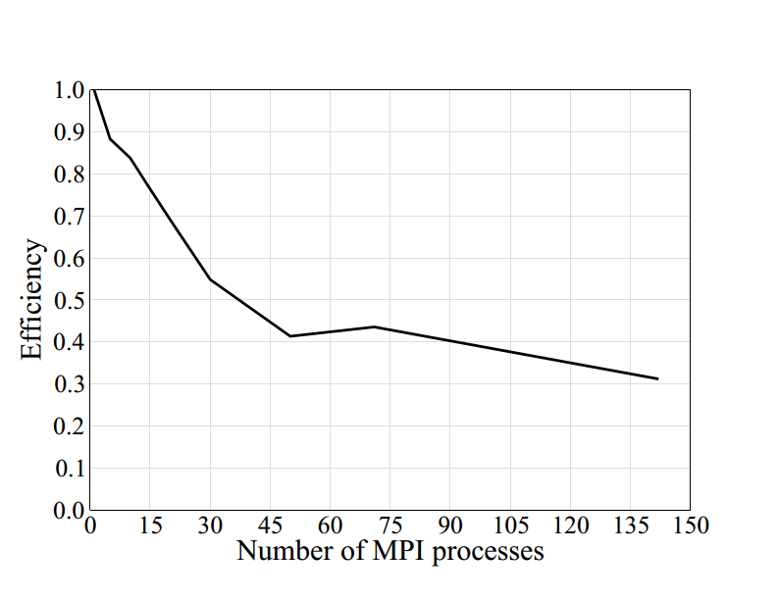
Calculation Time and efficiency

Slide 26
Mass Distribution of NS

Slide 27
Extracted Mass Distribution

Slide 28
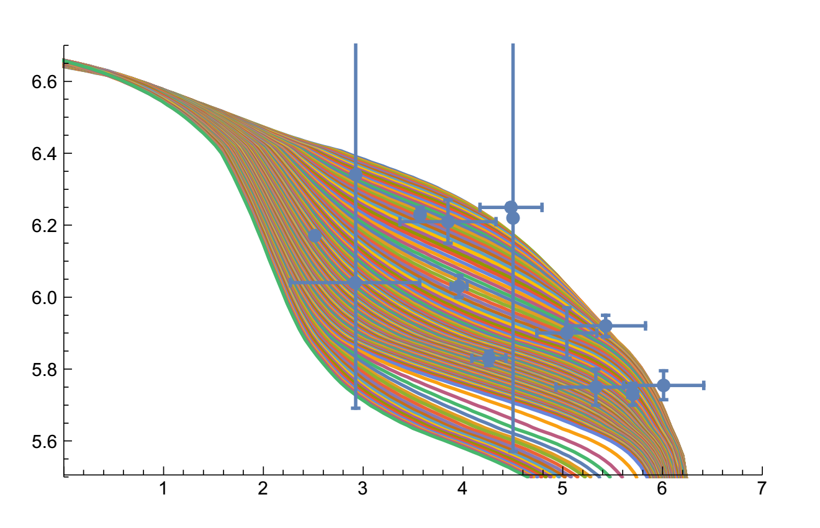
Distribution of Evolution tracks via Temperature at given Time

Slide 29
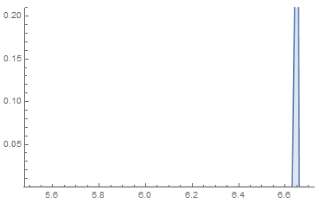
Distribution of Evolution tracks via Temperature at given Time

Slide 30
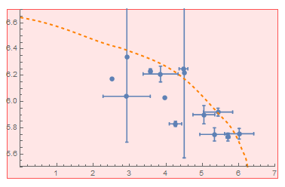
Evolution tracks for different NS Masses

Slide 31
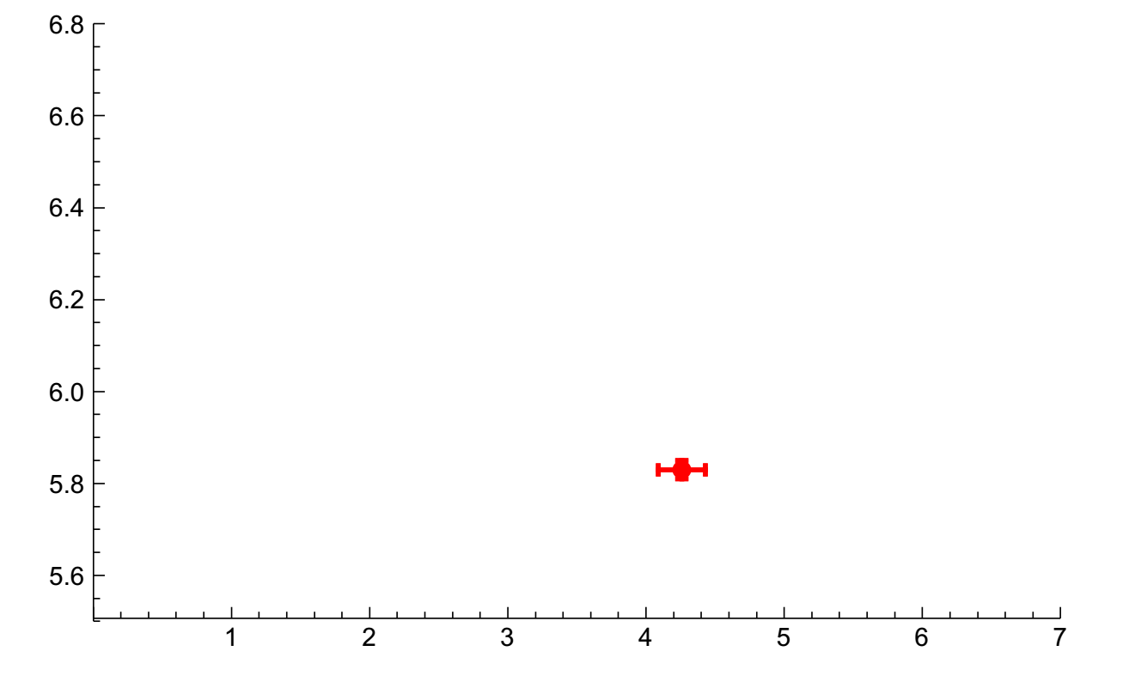
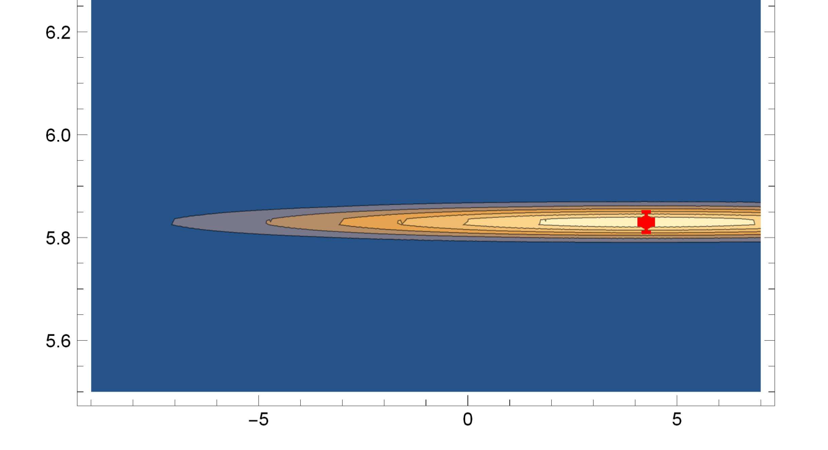
Weighting of Data point on the Temperature - Age Diagram
w(T,t) = Exp{ - (logT- logT_{D})²/σT - (log t -logt_{D})²/σt }
Log T
Log T
W_{M}= ʃ w(T_{M}(t),t) dt
log t
log t

Slide 32
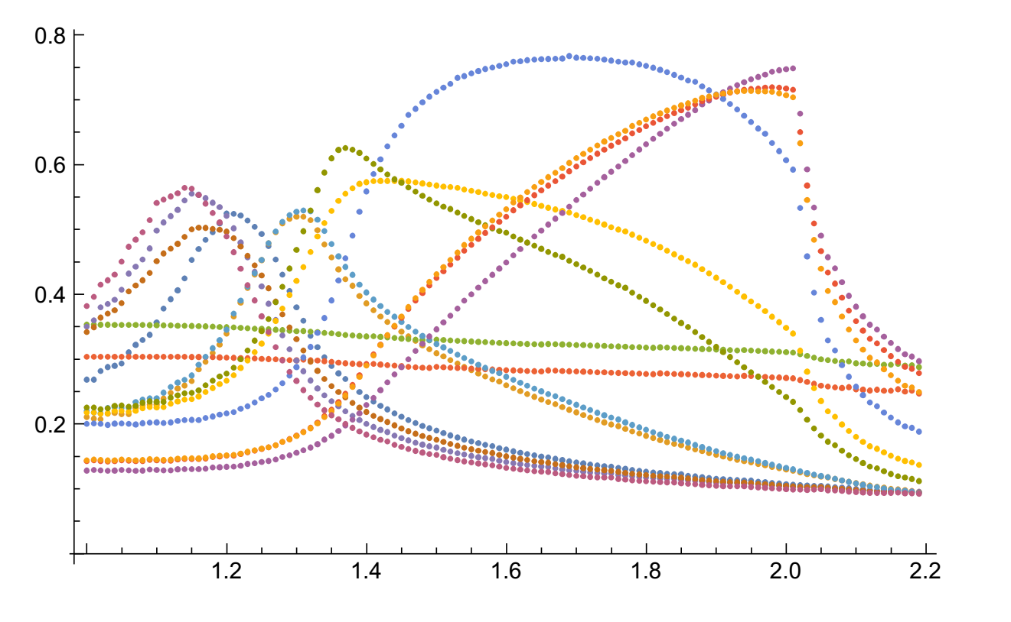
Expected Mass value for the Data points on the T - t Diagram
W_{M}
Mass value

Slide 33
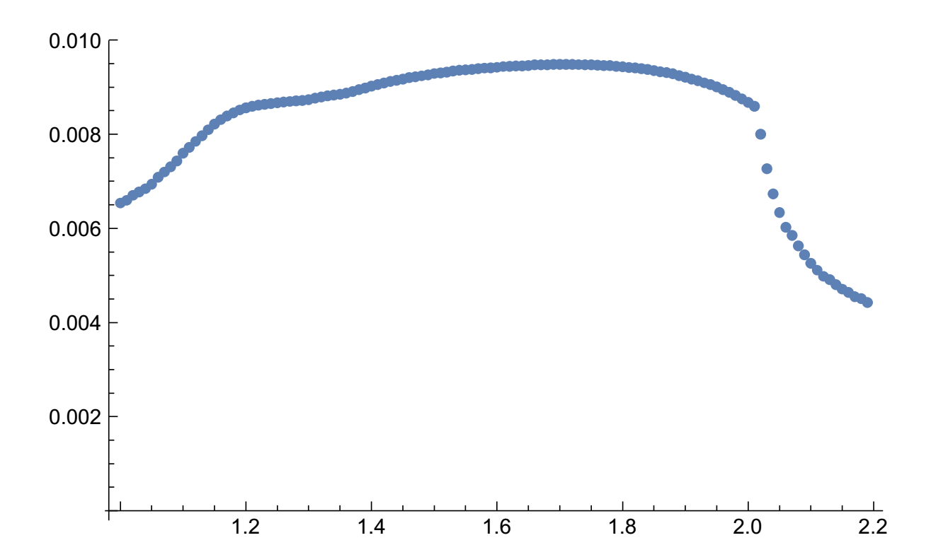
Expected Mass value for the Data points on the T - t Diagram
EoS: DD2; Proton Gap : BCLL
Medium Eff : nc = 3.0 n0
with π –cond.
Mass value

Slide 34
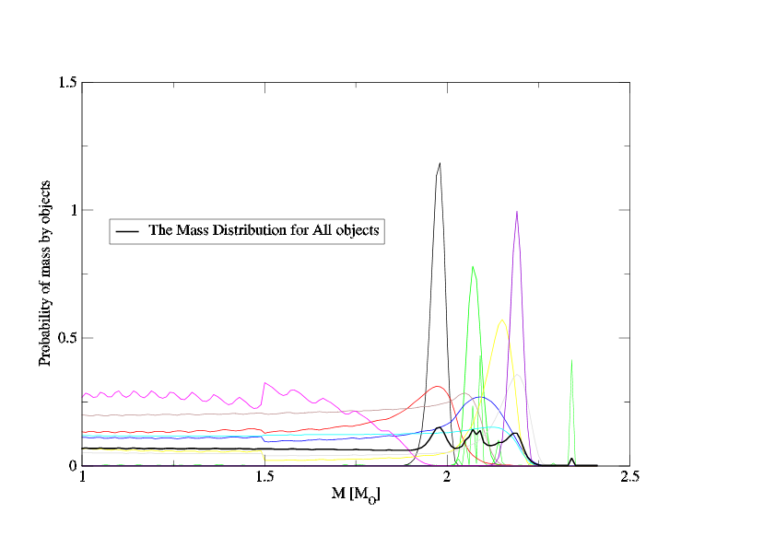
Expected Mass value for the Data points on the T - t Diagram
EoS: DD2; Proton Gap : BCLL
Medium Eff : nc = 3.0 n0
with π –cond.
Mass value

Slide 35
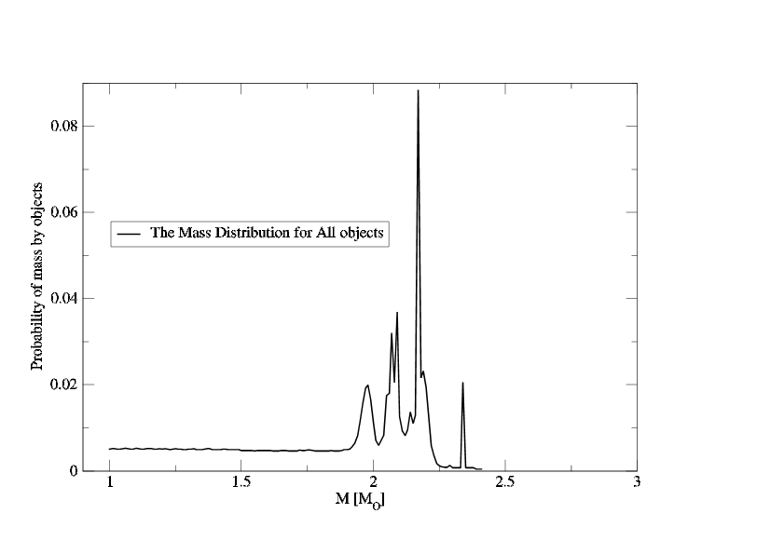
Expected Mass value for the Data points on the T - t Diagram
EoS: DD2; Proton Gap : BCLL
Medium Eff : nc = 3.0 n0
with π –cond.
Mass value

Slide 36
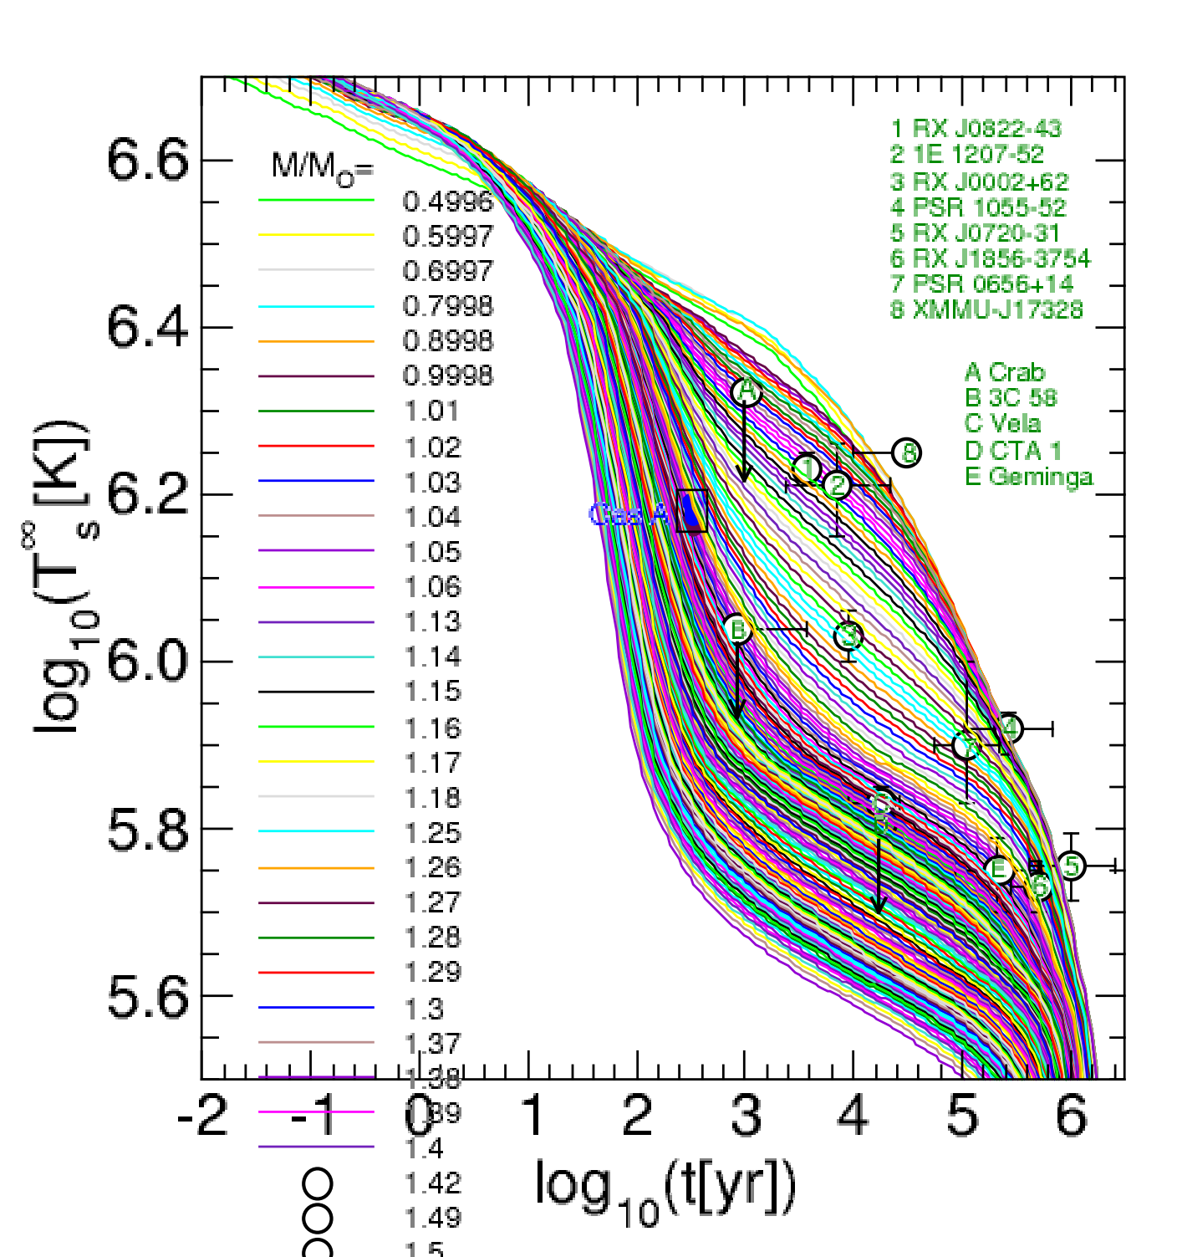
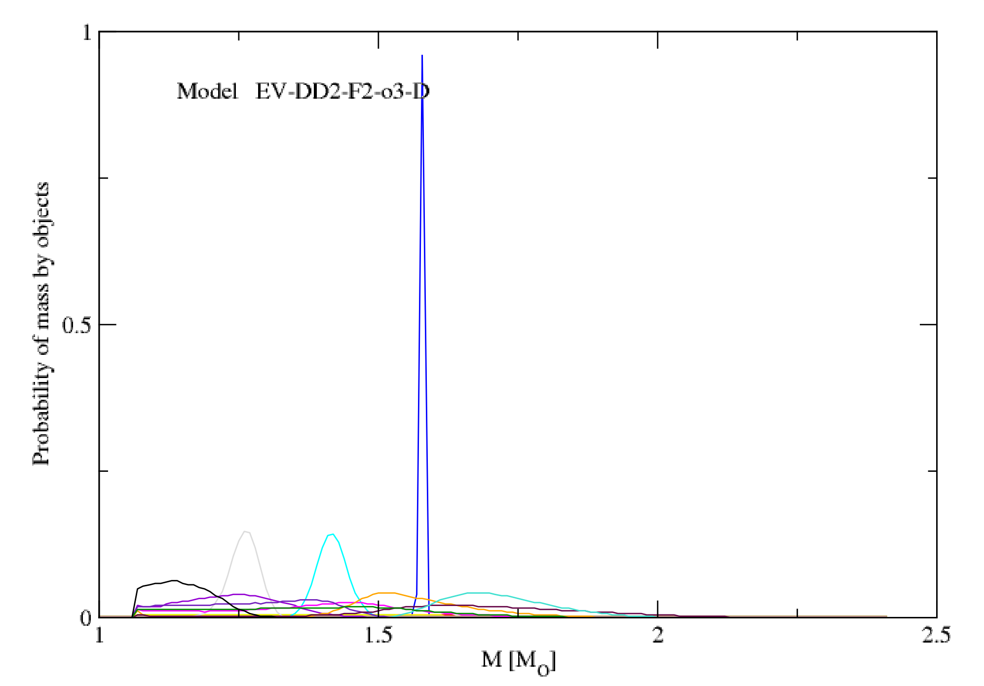
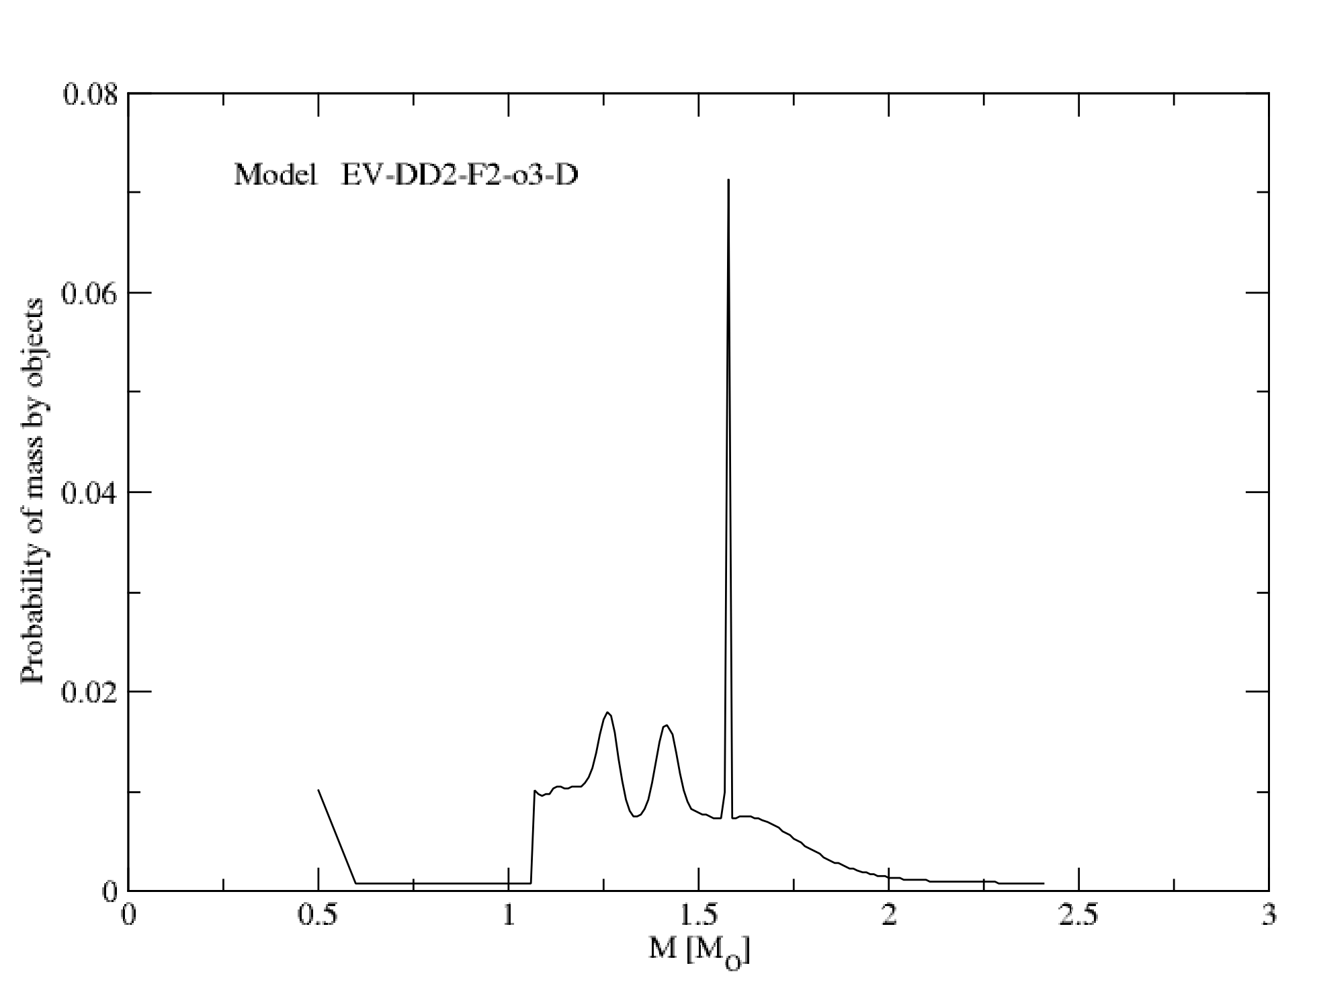
Model DD2 F2 o 3.0

Slide 37
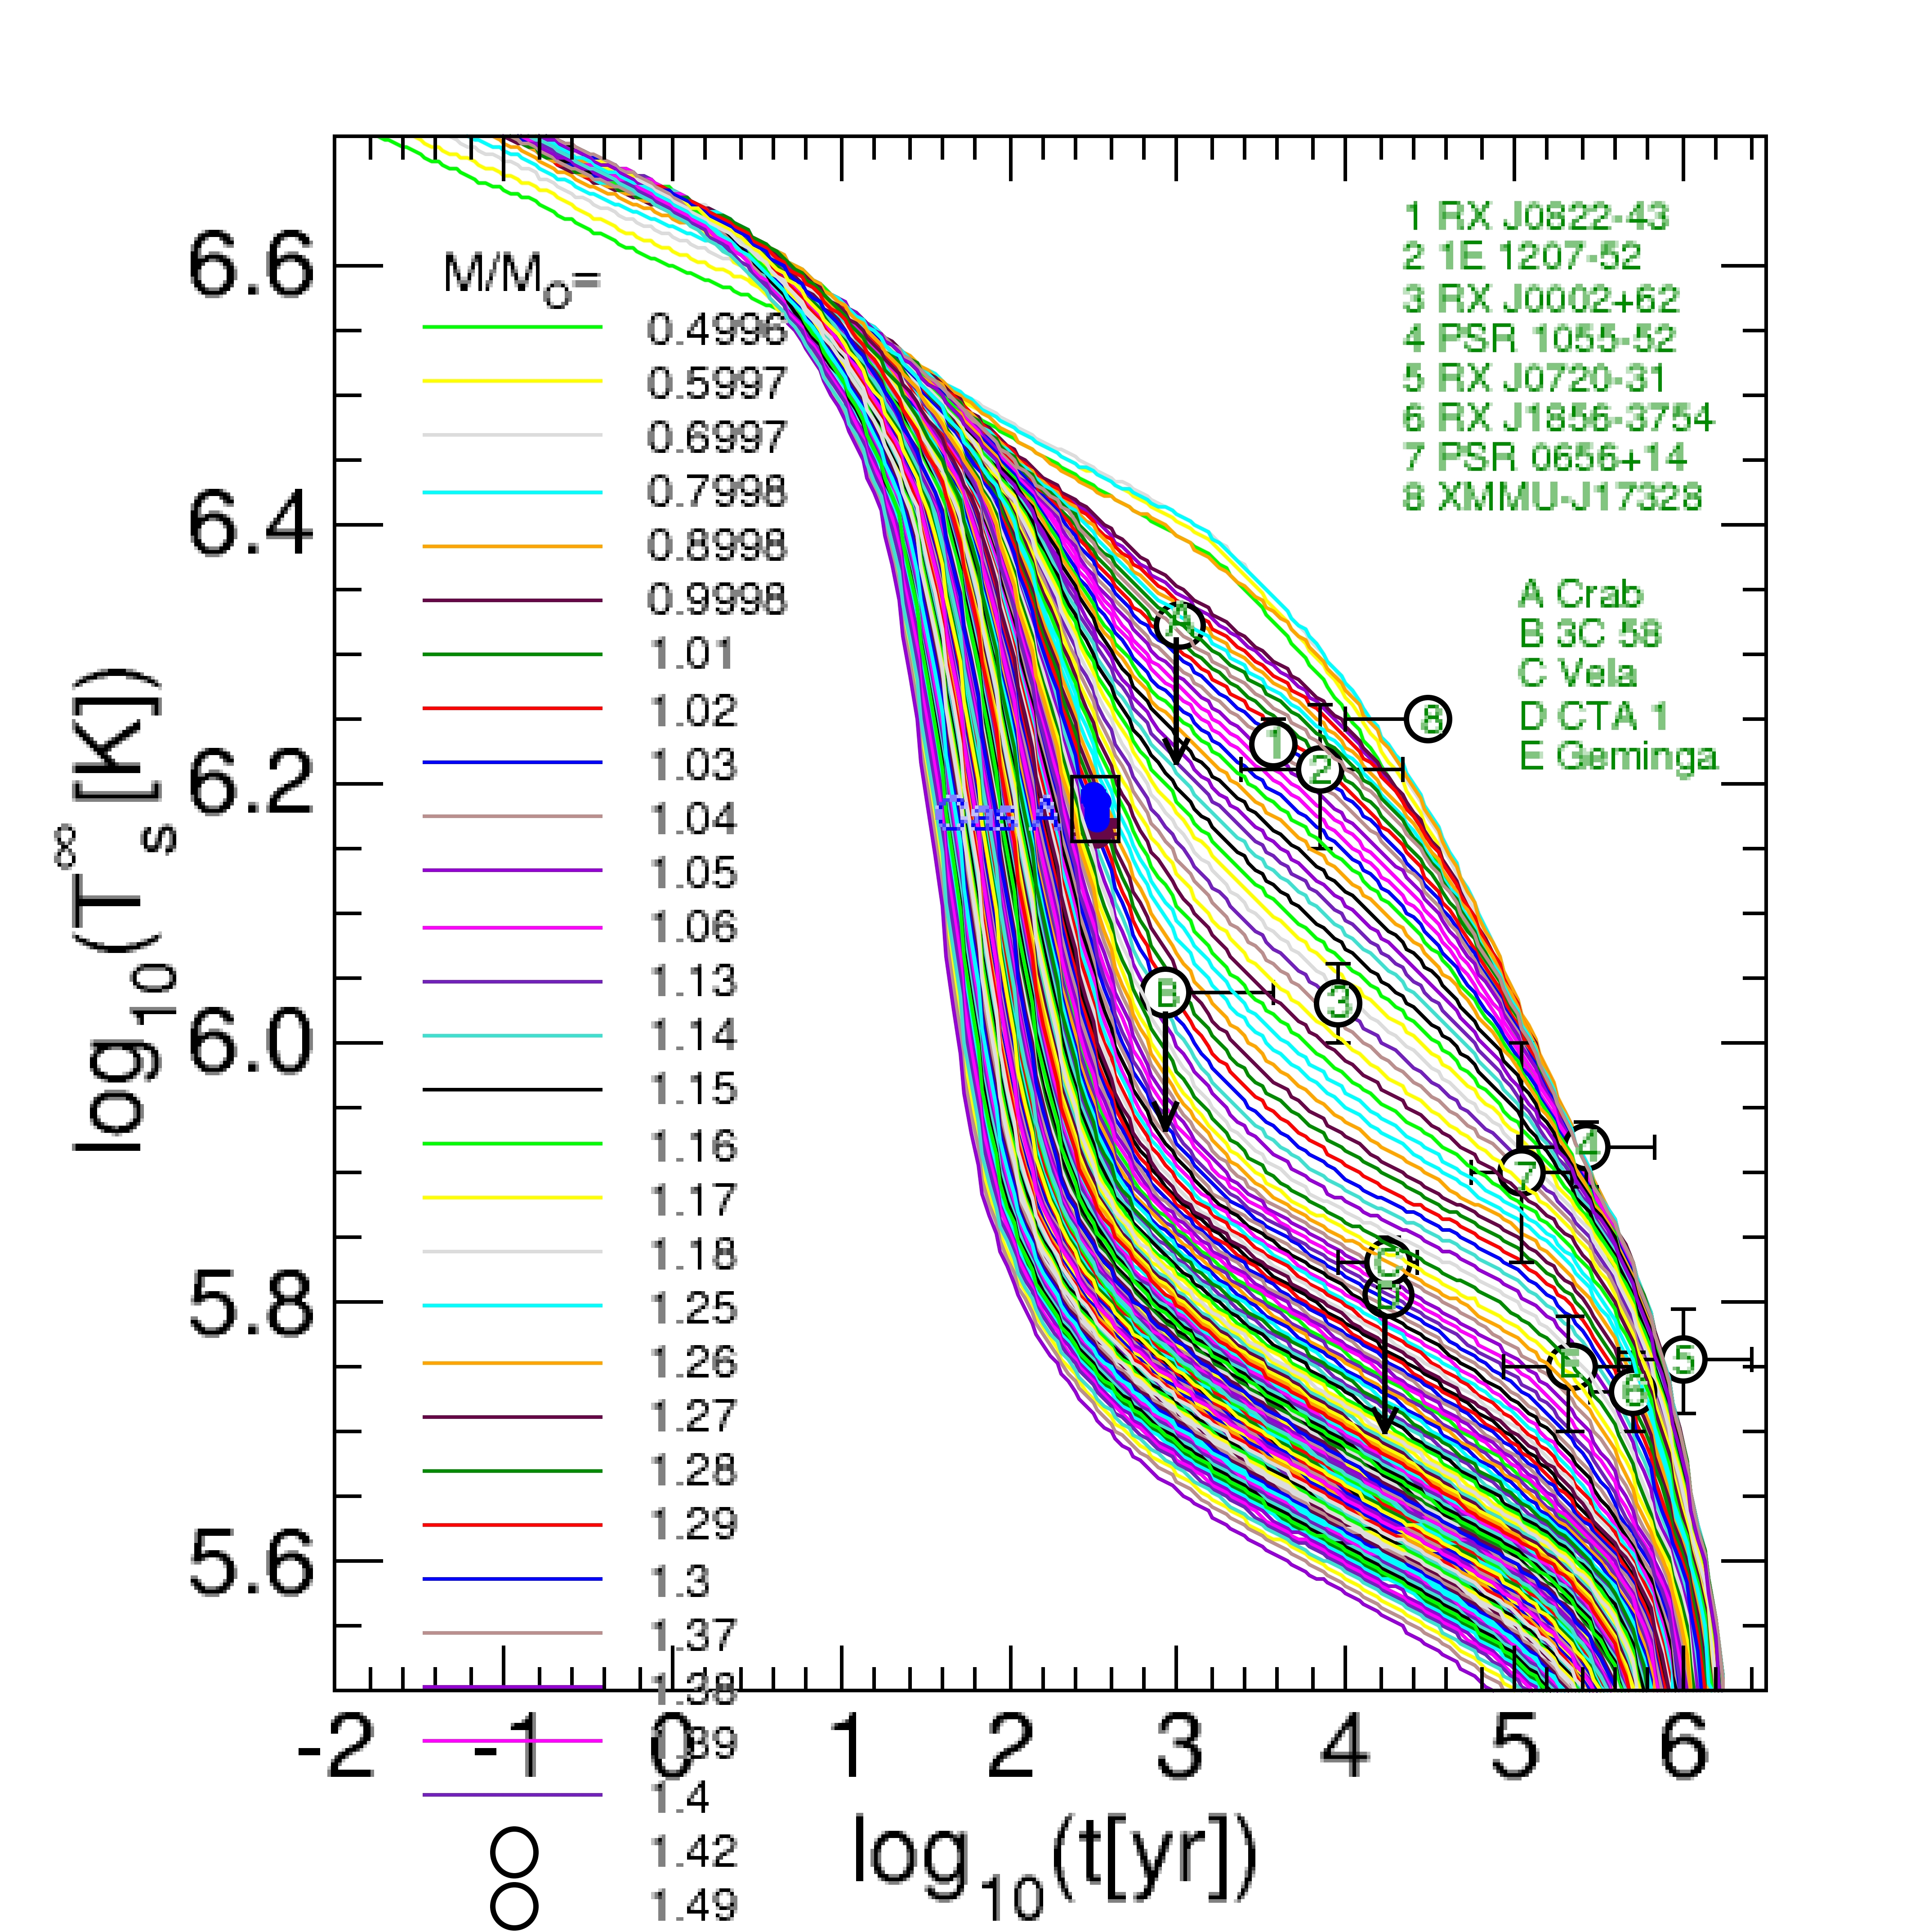


Model DD2 F2 o 2.5

Slide 38



Model DD2 F4 o 2.5

Slide 39



Model DD2 pi F1 o 2.5

Slide 40



Model DD2 pi F2 o 2.5

Slide 41



Model DD2 pi F2 o 3.0

Slide 42



Model DD2 pi F4 o 3.0

Slide 43



Model DD2 pi F5 o 3.0

Slide 44



Model DD2 pi F8 o 3.0

Slide 45



Model DD2 pi Y o 3.0

Slide 46



Model DD2 pi Y o 2.5

Slide 47



Model DD2 F8 o 3.0

Slide 48



Model DD2 F8 o 2.5

Slide 49



Model DD2 Y o 2.5

Slide 50



Model DD2 Y o 3.0

Slide 51
Conclusions
All known cooling data including the Cas A rapid cooling consistently described by the “nuclear medium cooling” scenario
Influence of stiffness on EoS and cooling can be balanced by the choice of corresponding gap model.
Parallelization allowed to make the calculations for statistical analyses of models in reasonable time
For each choice of different gap models and the influence of the medium effects it is possible to extract the masses of observed objects and the mass spectrum of neutron stars.

Slide 52
Thank YOU!!!!!

Slide 54

EoS vs. Mass Radious of NS

Slide 55

Mixed Phase in Quark-Hadron
Phase Transition

Slide 56


High Mass Twin CS

Slide 57
High Mass Twin CS

Slide 58


Different Configurations
with the same NS mass

Slide 59





Neutrino emissivities in quark matter:
Quark direct Urca (QDU) the most efficient processes
Compression n/n0 ≃ 2 , strong coupling αs ≈ 1
Quark Modified Urca (QMU) and Quark Bremsstrahlung
Suppression due to the pairing
Enhanced cooling due to the pairing

Slide 60

Modern MR Data and Models

Slide 61
Different Configurations
with the same NS mass

Slide 62
Stability of stars
HDD, DD2 & DDvex-NJL EoS model

Slide 63

Temperature in the Hybrid Star Interior

Slide 64
Cas A as an Hadronic Star

Slide 65

Cas A As An Hybrid Star

Slide 66
Possible internal structure of CasA

Slide 67

High Mass Twin CS

Slide 68
Different Configurations with the same NS mass

Slide 69


Highmass Twins: QM SC Effect

Slide 70



Slide 71





Cooling of Neutron Stars admixed with Light Dark Matter

Slide 72



Slide 73


Cooling of Twin CS

Slide 74


M. Ángeles Pérez-García
,H. Grigorian, C. Albertus,
D. Barba, J. Silk
Physics Letters B 827(2022)136937

