Slide 1


Department of Theoretical Astrophysics
Peter Shternin
Matrix kinetic equation approach to calculation of neutrino emission accompanying formation of Cooper pairs in superfluid neutron star matter
RSF # 24-12-00320
Infinite and Finite Nuclear Matter (INFINUM-2025)
JINR, Dubna, May 12 – May 16, 2025

Slide 2
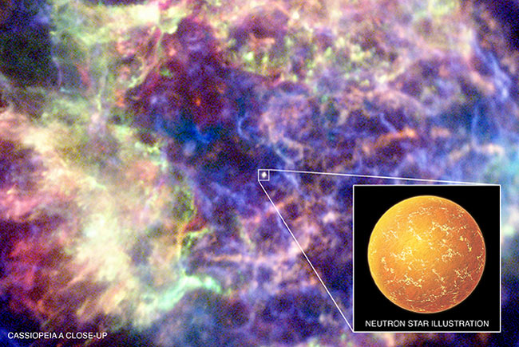
Plan
Motivation
Matrix kinetic equation formalism
Application: ¹S₀ pairing
Application: ³P₂ pairing
New observations of Cas A NS
Conclusions

Slide 3
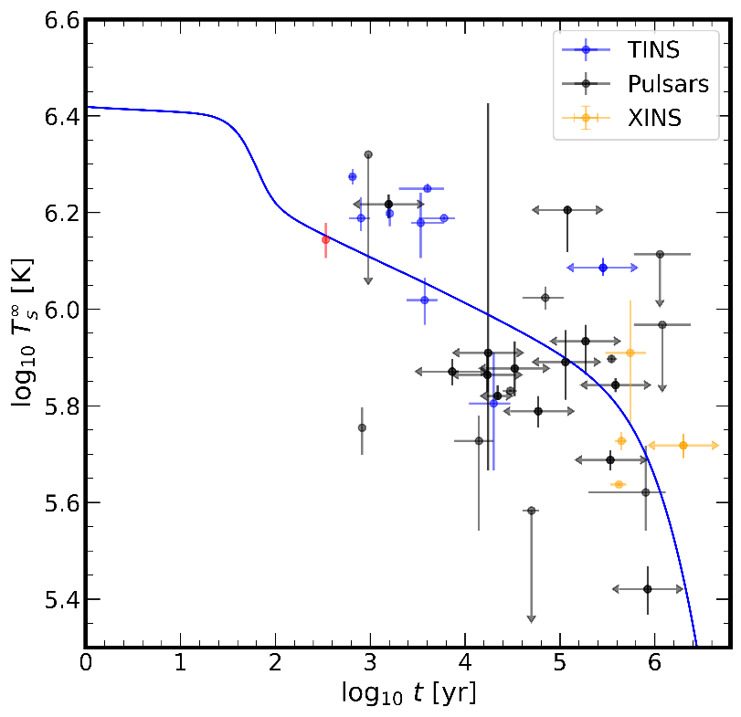
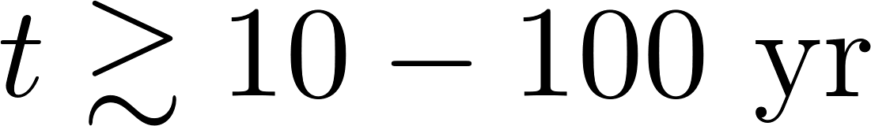
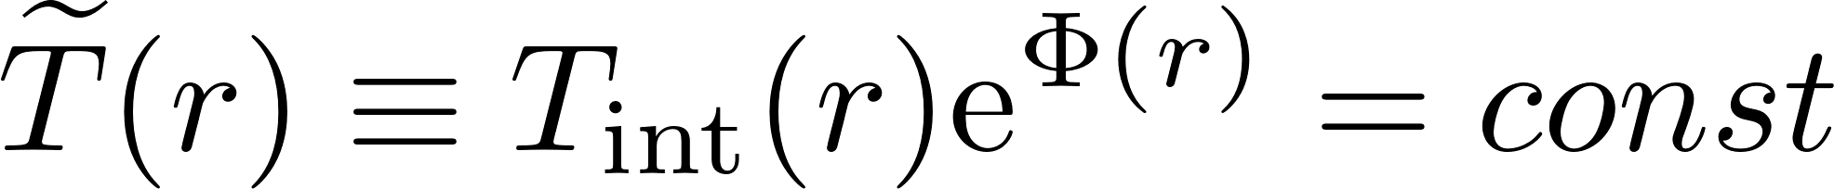
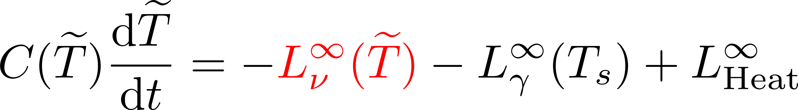
Motivation: NS cooling
Neutrino cooling stage
Isothermal interiors
Global thermal balance equation
Neutrino emissivity is one of the main cooling regulators
Among those, in superfluid NSs emission due to neutron Cooper pairing is important
Remind the talk by Potekhin

Slide 4
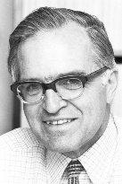
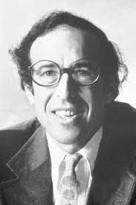
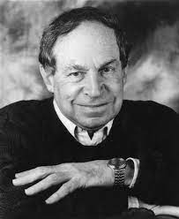
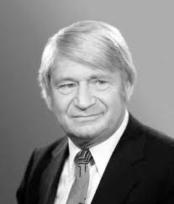
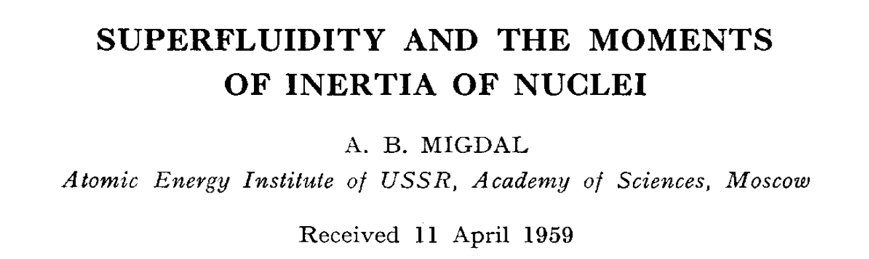
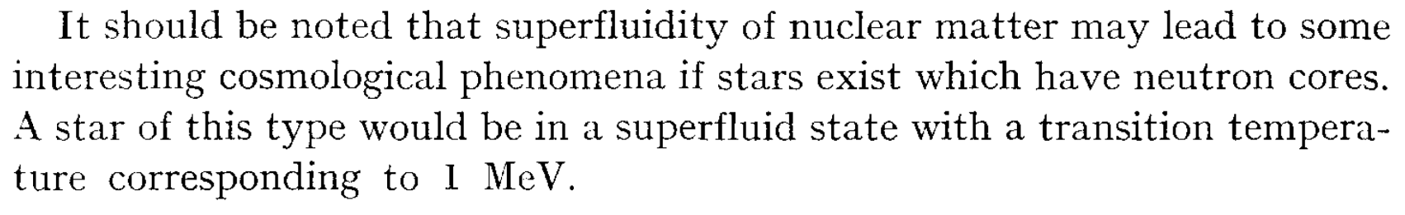
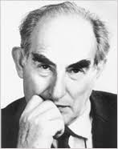

Cooper pairing in nuclear matter

Slide 5
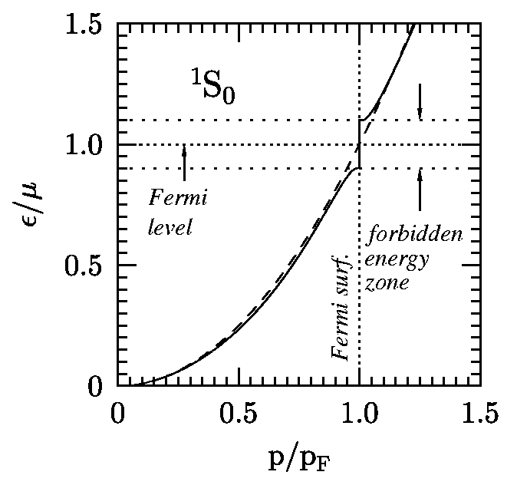
Pairing phenomenon
System of degenerate fermions with attractive interaction is subject to Cooper pair instability
Nucleon-nucleon phase shifts
Quasiparticle dispersion. A gap in spectrum.
There should exist pairing in finite nucleon systems and neutron stars due to attractive component on nuclear interaction (positive phase shifts)
relevant for n in NS crust and p in NS cores
¹S₀ pairing
relevant for n in NS cores
³PF₂ pairing
Bohr et al 1959, Migdal 1959, …

Slide 6
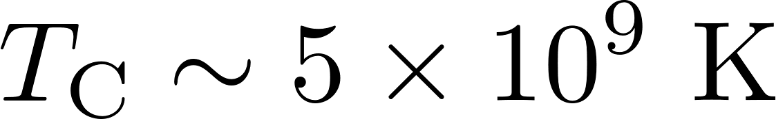
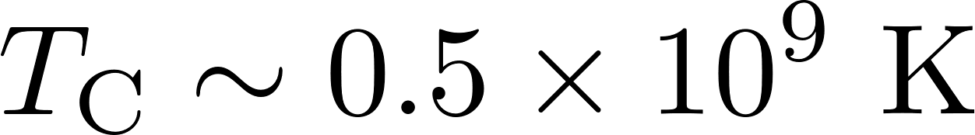

Superfluidity in NS cores. Zoo of the superfluid models
npe$μ$
¹S₀ proton pairing
³P₂ neutron pairing
Figures from Ho et al. 2015
Effectively damps electroweak processes with paired species

Slide 7
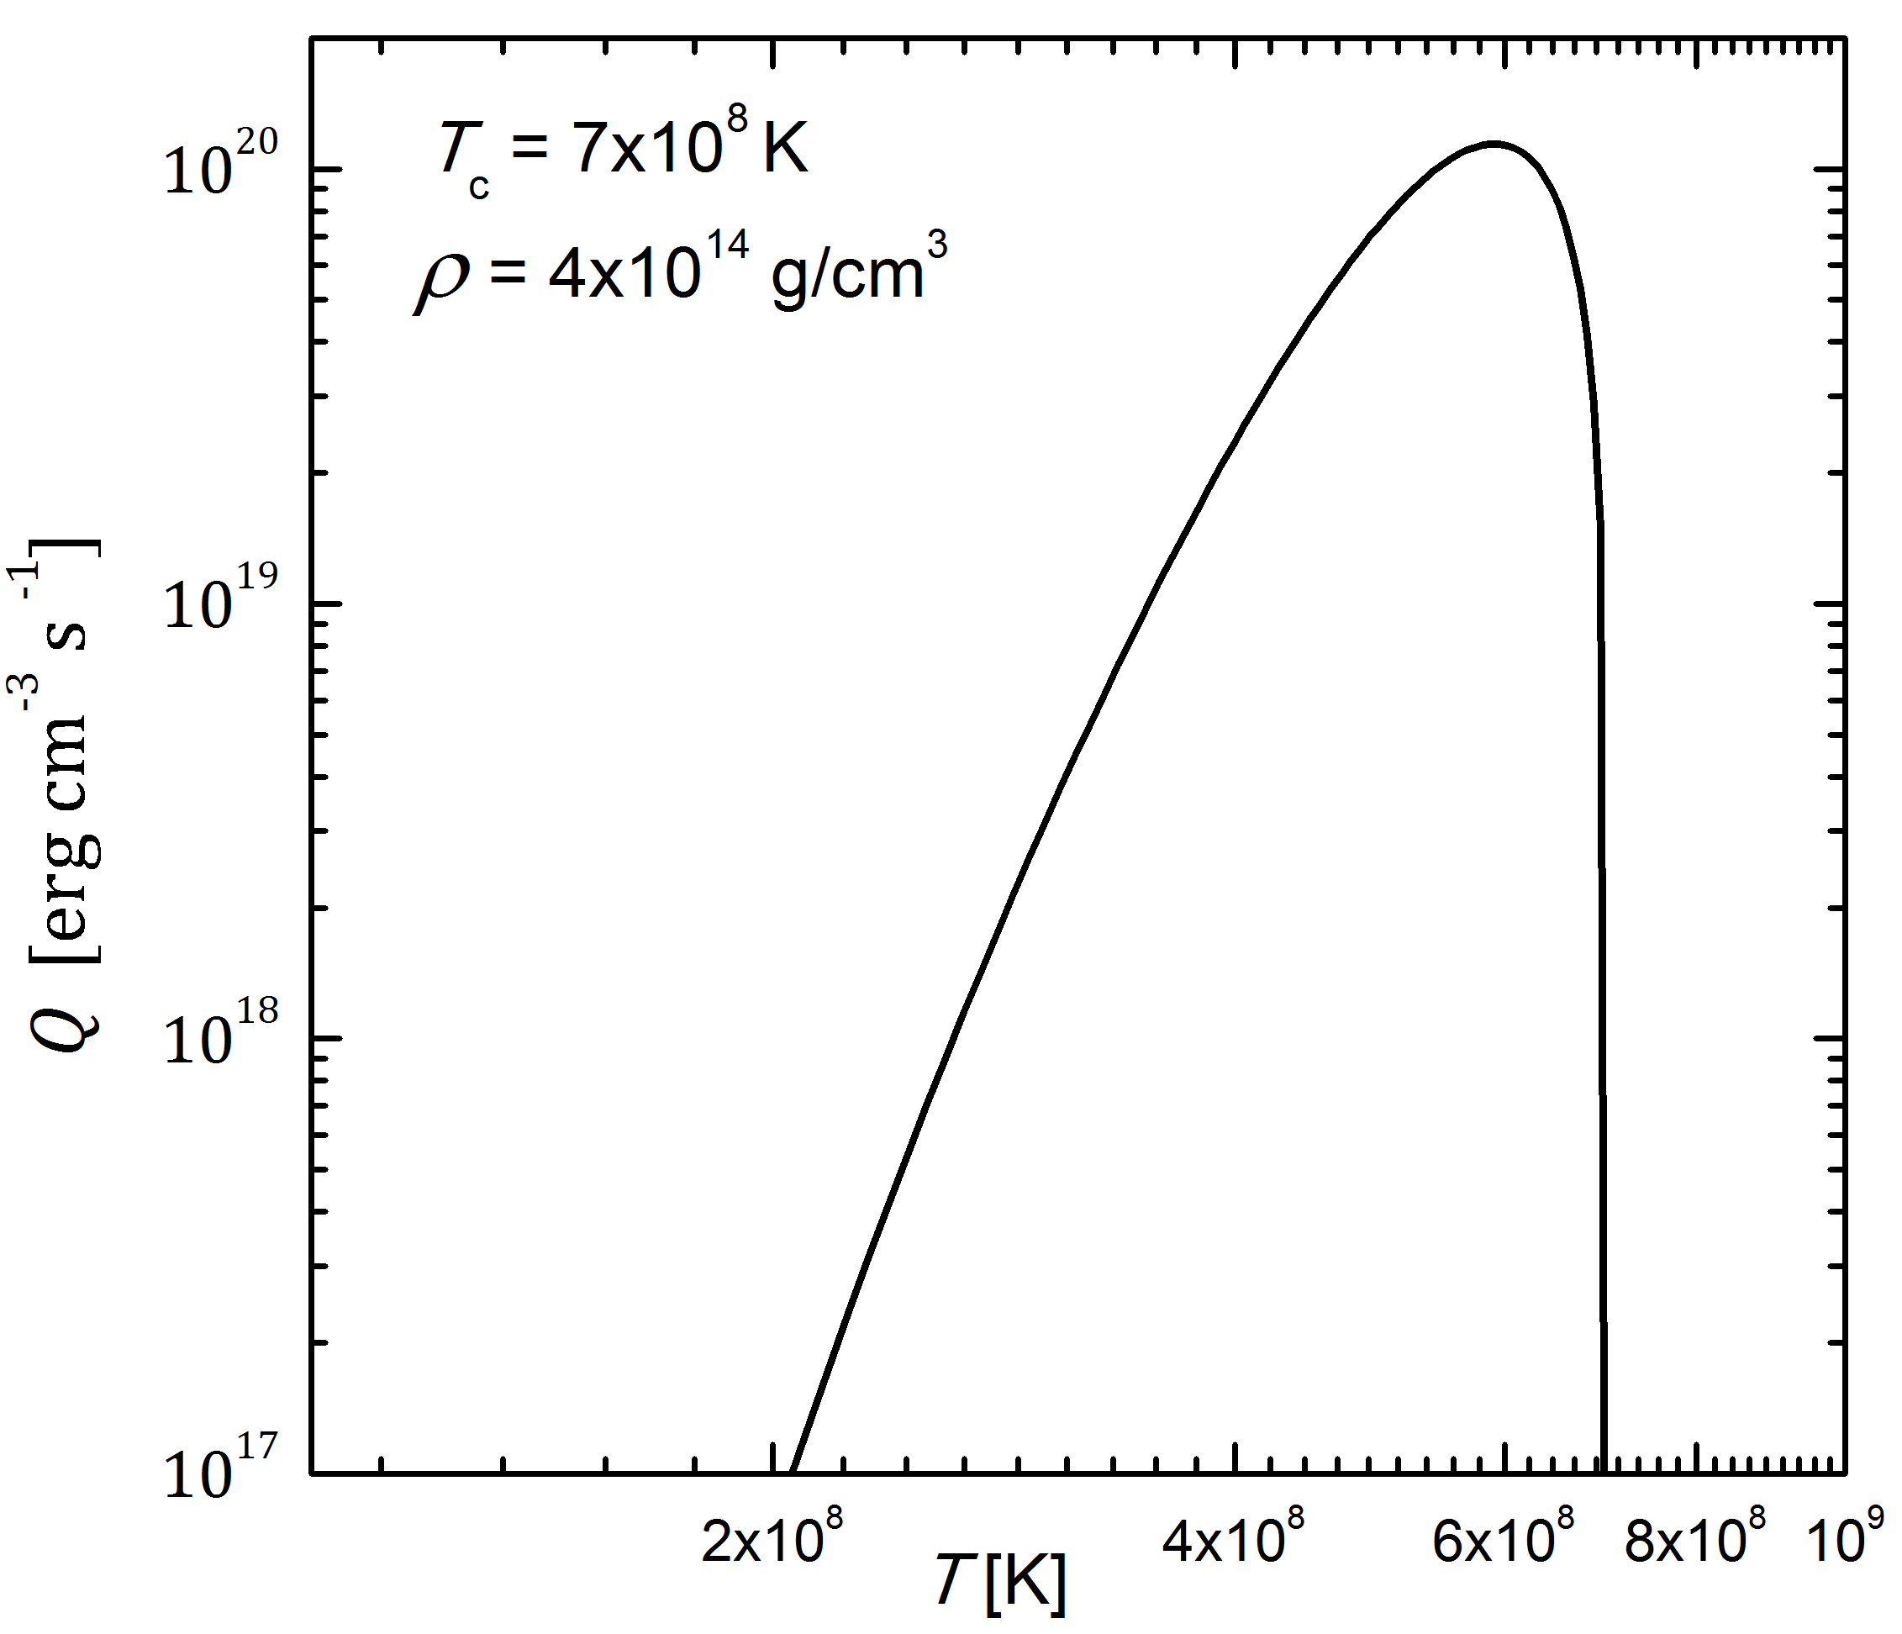
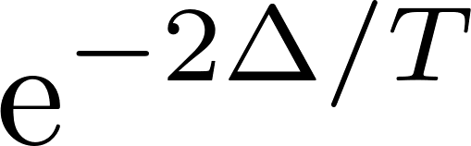
Focus of the talk: Neutrino emission due to Cooper pairs formation (CPF)
Flowers, Ruderman and Sutherland (1976)
Quasiparticle dispersion
Specific neutrino pair emissivity

Slide 8
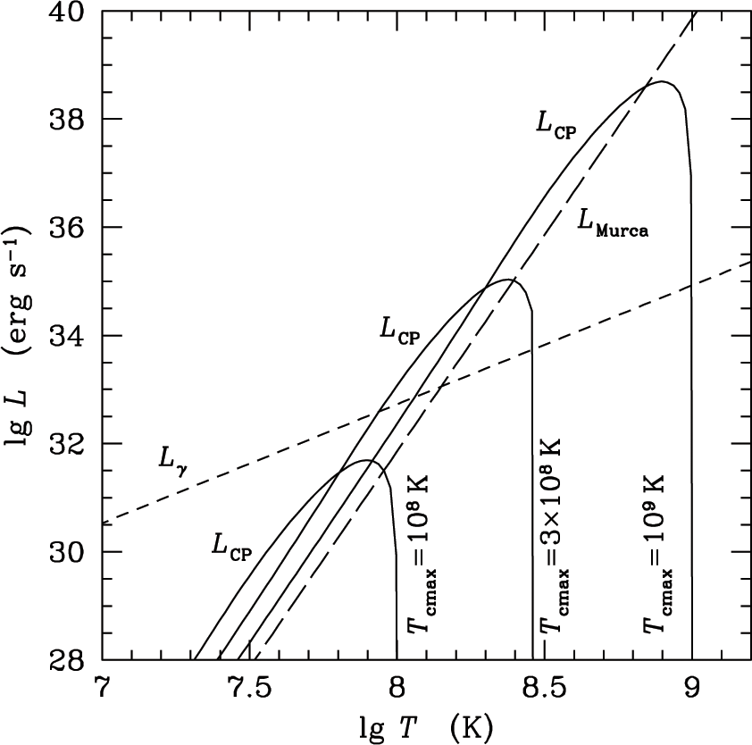
CPF neutrino emission of triplet neutron pairing
Neutrino emission due to Cooper pairing of neutrons can be 10—100 times stronger than MUrca in non-superfluid NSs
This statement, however, strongly depends on the model parameters

Slide 9

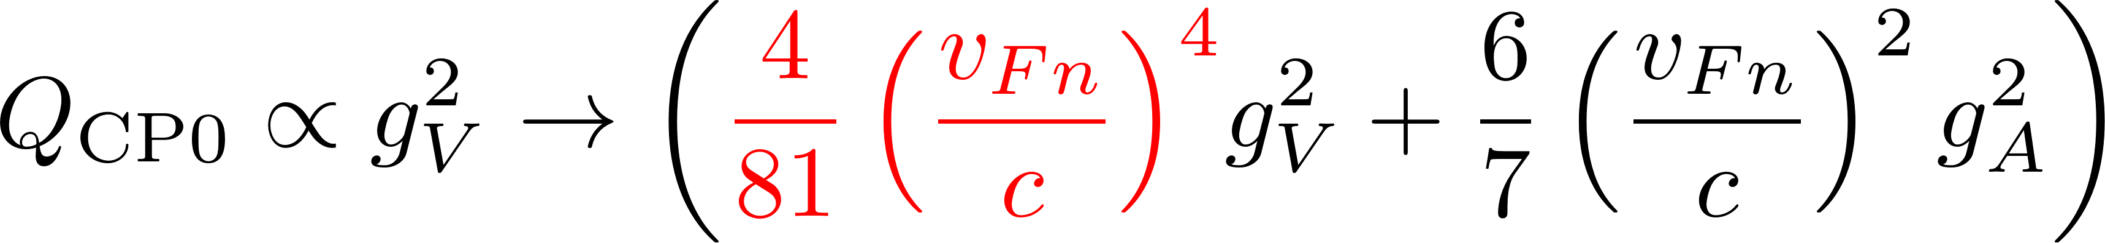
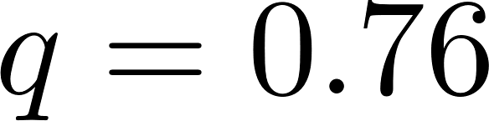
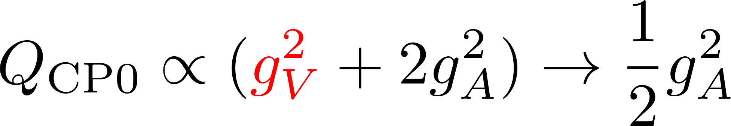
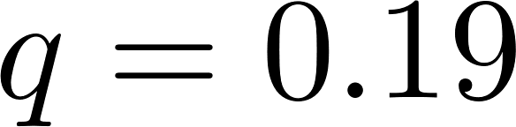

CPF emission. Collective effects
Response of the Cooper pair condensate should be properly accounted for
Leinson & Perez 2006; Leinson 2008; Kolomeitsev & Voskresensky 2008, 2010; Steiner & Reddy, 2009,…
¹S₀ pairing
of neutrons in NS crust
(similarly, for protons in the core)
Page et al. 2009
³P(F)₂ pairing of neutrons in the NS core
Leinson 2010+
$$v_{Fn}→0$$
Analyzing observations, one treats $q$ as a phenomenological parameter

Slide 10
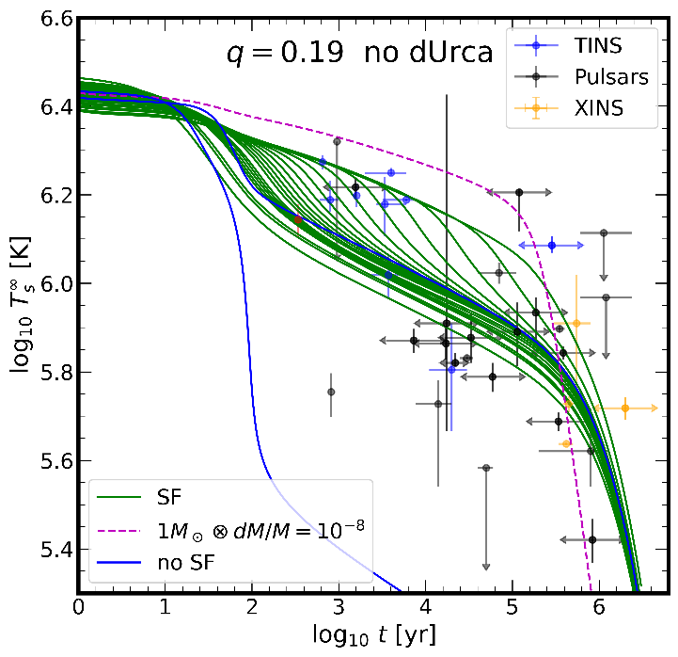
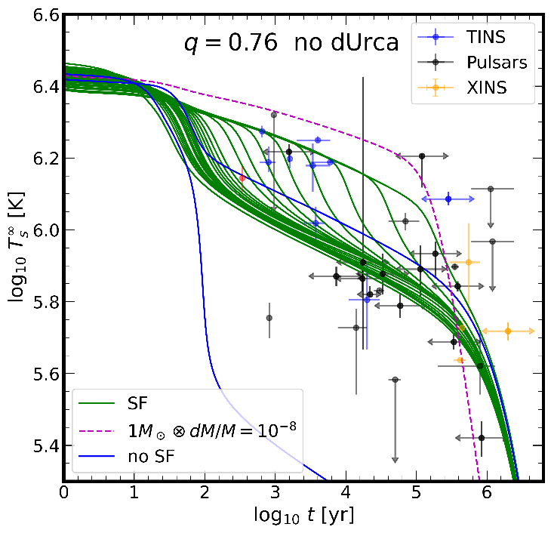
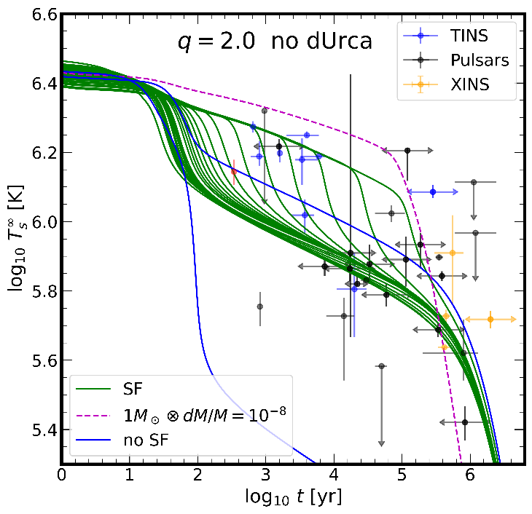
Minimal cooling paradigm
Explain thermal states of all isolated neutron stars without fast cooling
Page et al. 2004,2009, Gusakov et al. 2004
Strong proton, moderate neutron superfluidity (but damped at low densities – `knee’ stars)
Explanation of coolest stars is problematic
Faster cooling mechanisms seems to be necessary
Here Direct Urca switched off by hand

Slide 11
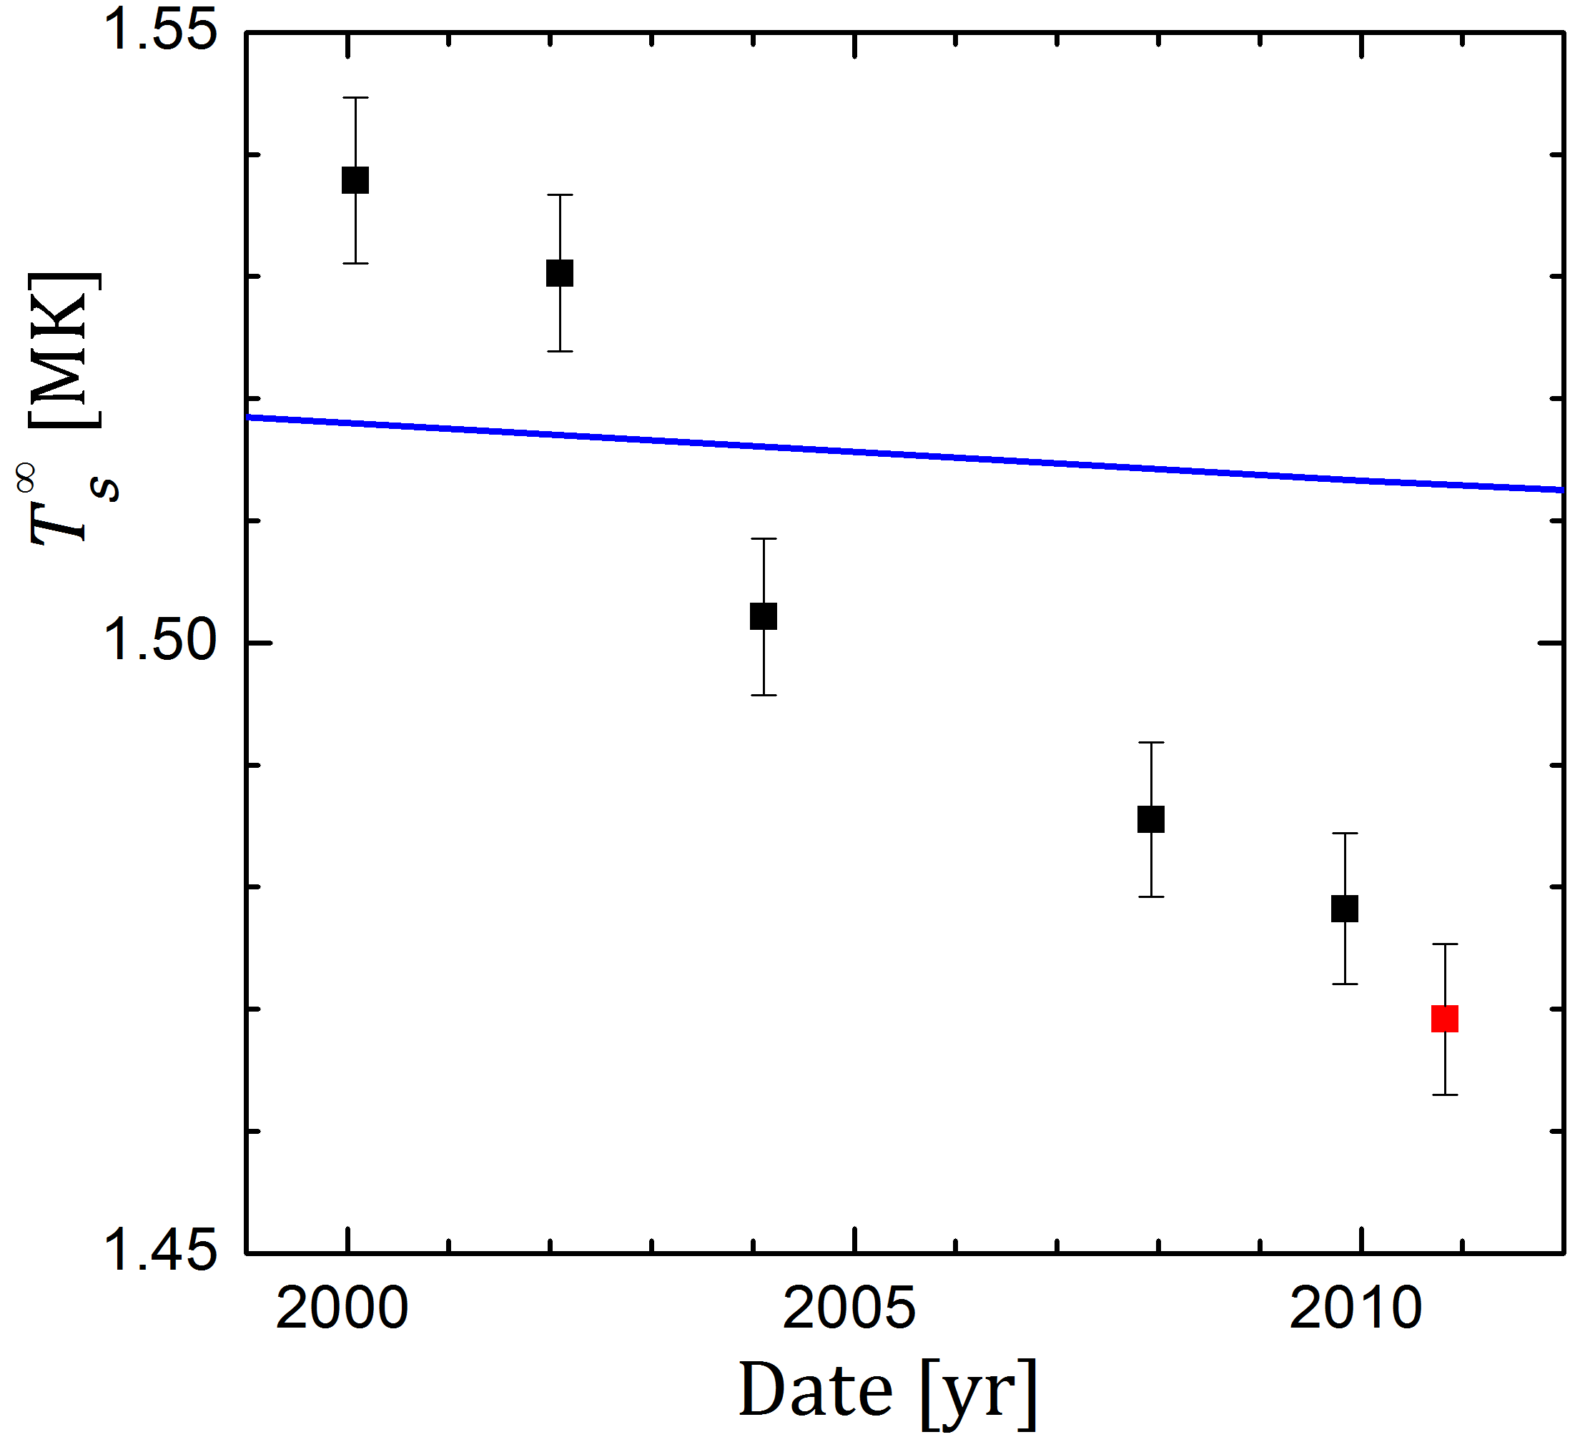
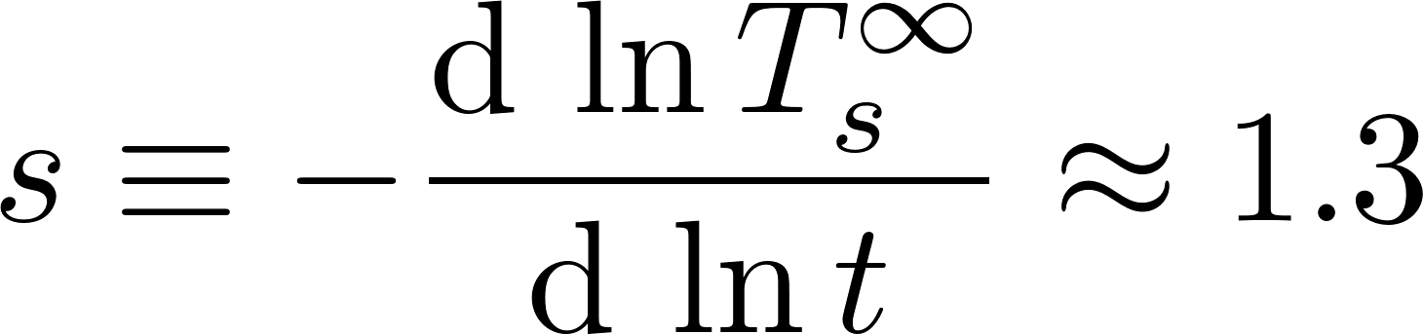
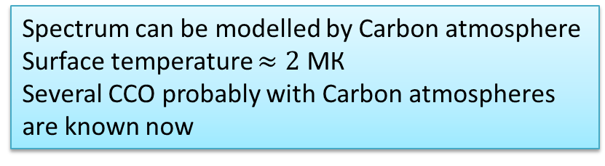
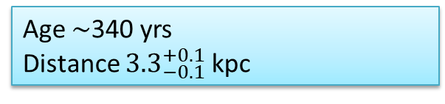
Motivation II: NS in Cassiopeia A SNR
Heinke & Ho, ApJL 2010
Real-time cooling of the star
4% in 10 yr
Age $\sim$340 yrs
Distance ${3.3}_{−0.1}^{+0.1}$ kpc
Standard cooling
Ho & Heinke , Nature 2009
Spectrum can be modelled by Carbon atmosphere
Surface temperature $≈2$ МК
Several CCO probably with Carbon atmospheres are known now
Cooling curve slope
11

Slide 12
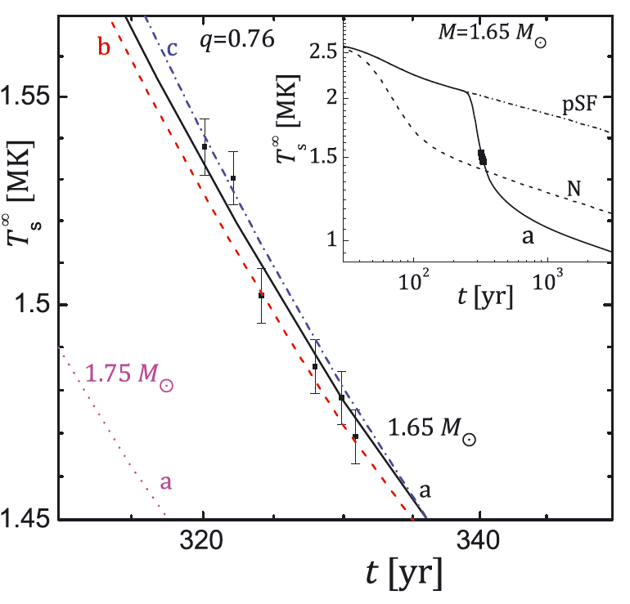
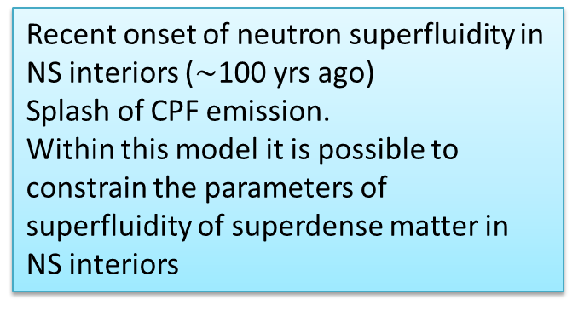
Cooling NS in CasA supernova remnant: superfluidity
Page et al., 2011; Shternin et al., 2011
Recent onset of neutron superfluidity in NS interiors ($\sim$100 yrs ago)
Splash of CPF emission.
Within this model it is possible to constrain the parameters of superfluidity of superdense matter in NS interiors
Cooling can be explained by the superfluidity
Other explanations exist:
Blaschke+12,13, Bonanno +14
Negreiros+13, Taranto+16, Yang+11,
Noga+13, Sedrakian+13, Hamaguchi+18, Leinson 22,
Potekhin, INFINUM25
Long-standing debates on observations:
no statistically significant cooling:
Posselt et al., 2013;
Posselt&Pavlov 2018
Figure from Shternin et al. 2011, MNRAS 412, L108

Slide 13
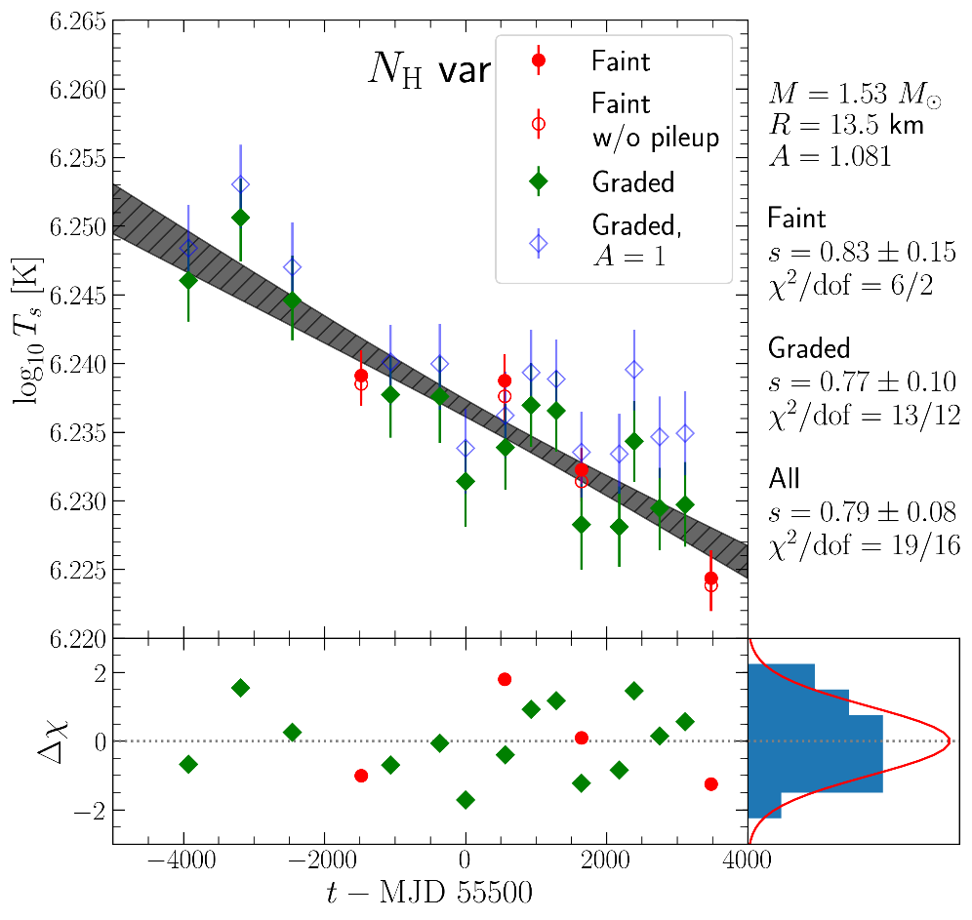

Cooling NS in CasA supernova remnant: observational status quo
Shternin et al 2023
The source was observed in the “bad” (GRADED) mode as a byproduct of SNR observations.
And in the “good” (FAINT) mode intentionally.
Initial discrepancy (FAINT mode observations show slower cooling of moderate significance) are finally eliminated by the improvements of calibration. The cooling in two modes is converged.
Cooling rate about twice lower than initially found

Slide 14
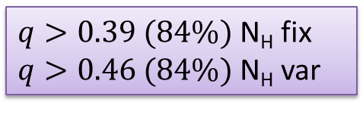


Motivation II. CasA cooling
A joint spectral analysis with attempt to incorporate all systematics results in good constraints on SF critical temperature
$${\tilde{T}}_{C}=(3.3−5.2)×{10}^{8} K$$
$$T_{C}=(4−10)×{10}^{8} K$$
But the CPF emissivity is found not enough:
$q>0.39 (84\%)$ N_{H} fix
$q>0.46 (84\%)$ N_{H} var
1) cooling is overestimated (e.g., calibration model for ACIS-S contamination is incomplete)
2) microscopic calculations underestimate CPF neutrino emission rate
3) cooling is real, and the rate is correct, but the model is wrong/incomplete
We focus on the check of point 2
See the talk by Potekhin for a point 3
Announce: q=0.19 confirmed, but there will be something new…

Slide 15
Plan
Motivation
Calculations are performed by many authors for ¹S₀.
Kolomeitsev& Voskresensky: Larkin/Migdal approach
Leinson: Leggett correlation functions
By Leinson for ³P₂
Matrix kinetic equation approach
Application: ¹S₀ pairing
Application: ³P₂ pairing
Calculate CPF emissivity of neutrons within a closely related by slightly different kinetic equation approach
New observations of Cas A NS
Conclusions

Slide 16
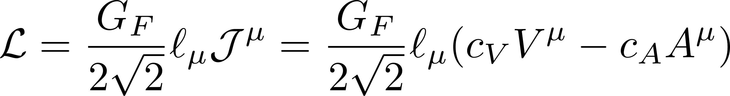
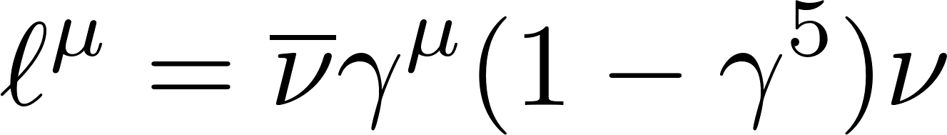
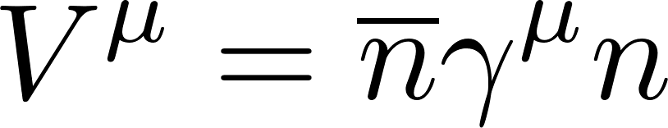
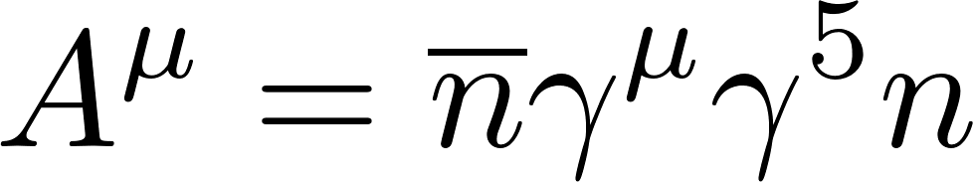
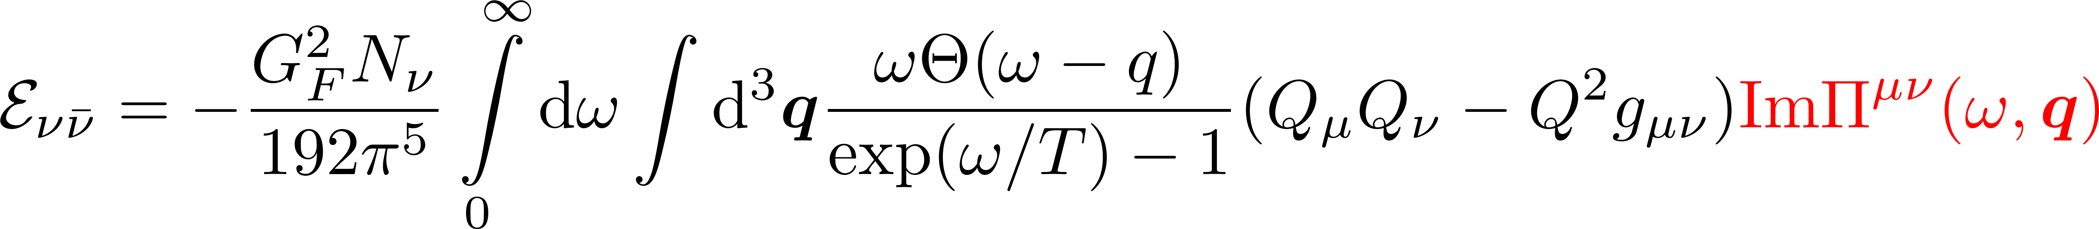
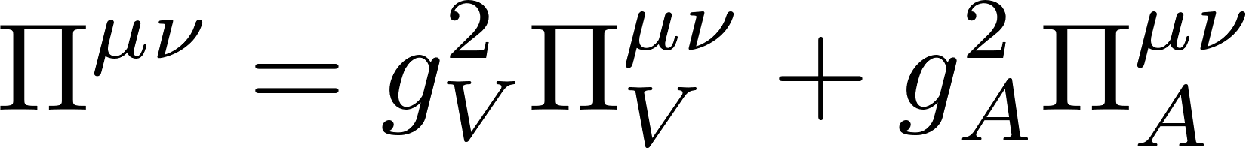
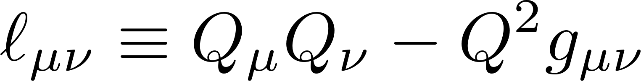
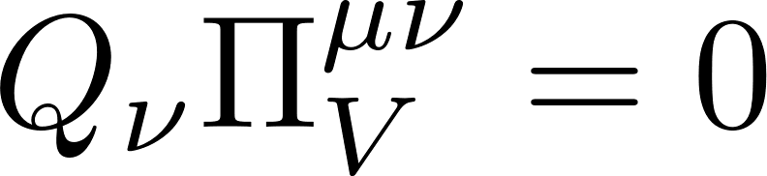
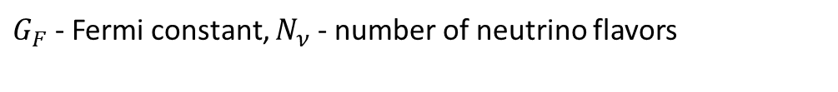
General formalism
Weak Lagrangian (V-A model)
Neutrino current
Neutron vector current
Neutron axial-vector current
Neutrino emissivity
$G_{F}$ - Fermi constant, $N_{ν}$ - number of neutrino flavors
4-vector of neutrino pair
Polarization tensor
Lepton tensor
We calculate polarization operator by means of the matrix kinetic equation for superfluid Fermi-liquid
Vector current conservation implies

Slide 17
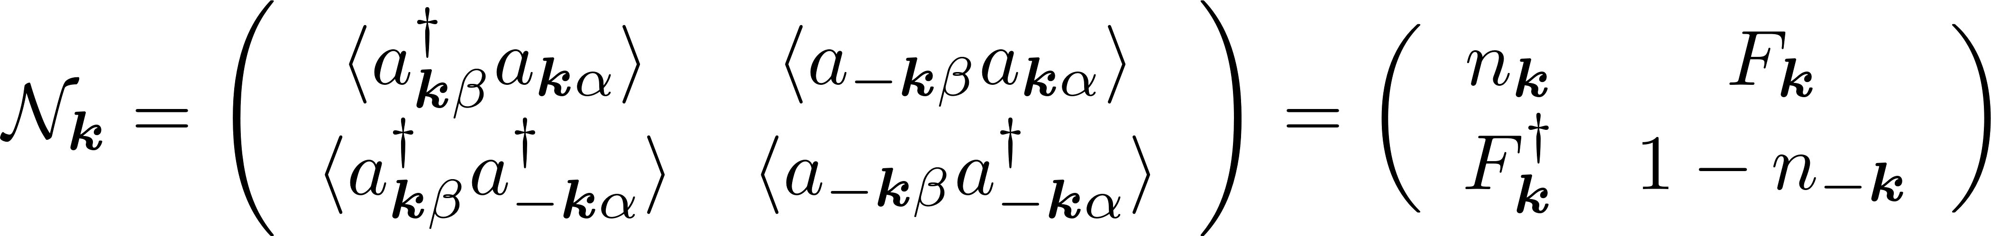
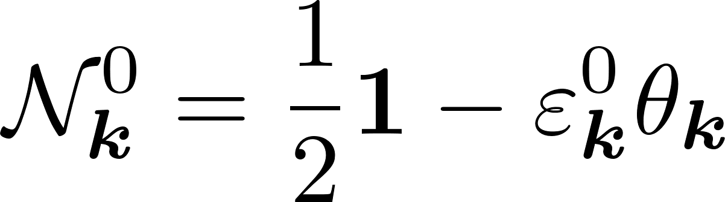
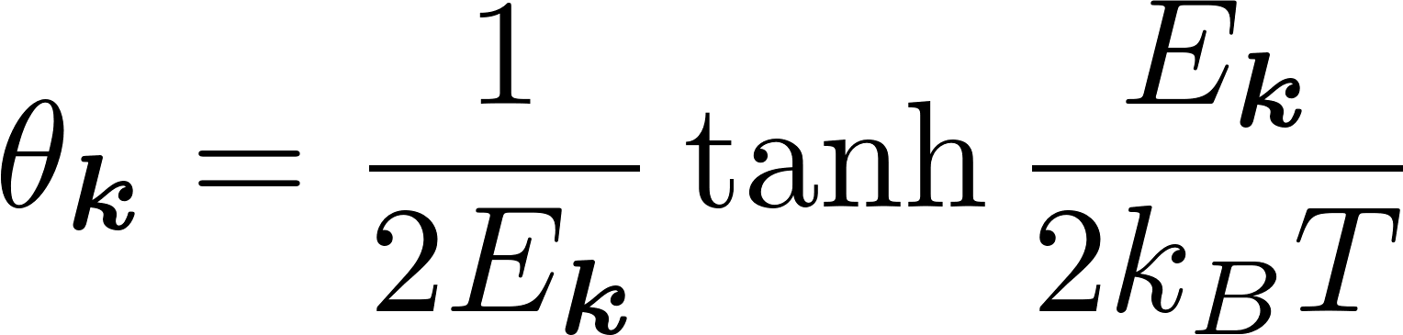
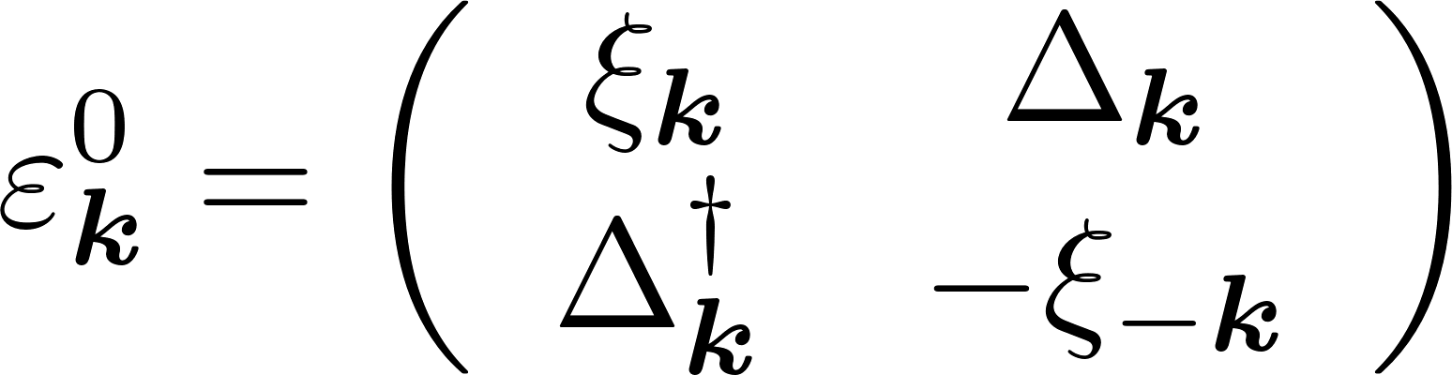
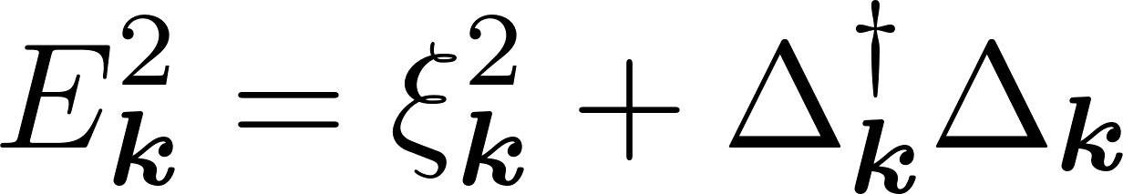
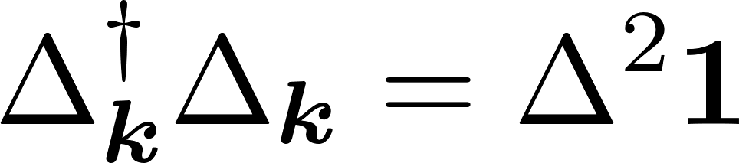
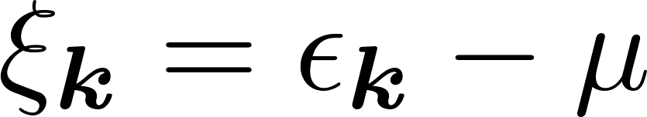
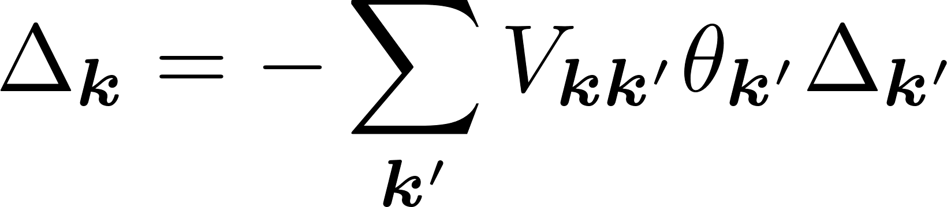

Matrix kinetic equation
Superfluid Fermi-liquid is described by the
matrix distribution function
All entries are matrices in spin space
Equilibrium distribution
Energy of thermal excitations
(Bogoliubov quasiparticles)
Gap equation
– pairing interaction
Betbeder-Matibet & Nozieres, 1969
Pairing interaction and the gap are cast in partial waves
Wölfle 1976

Slide 18







Partial wave expansion
Assume dominate pairing in a single partial wave channel
Expansion of pair interaction
Basis harmonics
(spherical tensors)
Expansion of the gap
In spin-singlet case S=0

Slide 19







Partial wave expansion
Assume dominate pairing in a single partial wave channel
Expansion of pair interaction
Basis harmonics
(spherical tensors)
Basis vectors
Expansion of the gap
In spin-triplet case S=1
Angular-integrated gap equation
or

Slide 20









Linearized kinetic equation
Consider response on the harmonic perturbation $\left(ω ,q\right)$ in collisionless limit ($I_{coll}=0$):
Deviation from equilibrium
Abbreviations
Perturbation induced by the external field
Non-diagonal elements are connected through the pair interaction
Fermi-liquid effects

Slide 21









Linear response theory
Non-relativistic approximation
Vertices of relevant external perturbations
Induced currents give the polarization tensor
Fermi-liquid effects
The vector current is conserved by the kinetic equation

Slide 22












Linearized kinetic equation. Symmetrized matrix form
One introduces symmetrized combinations
For energy matrix similar
Linearized kinetic equation takes the form
Notations:
Inversion of the matrix $Ω$ gives collisionless poles of $Π^{μν}$
Cooper pair pole
Vollhardt & Woelfle 1990
Causality: $ω→ω+i0$

Slide 23






Solution for particle part
Long-wavelength limit
Superfluid response
Normal Fermi-liquid response
Particle/hole asymmetry terms
“Cooper pair susceptibility”
Denominator
Fermi-liquid effects

Slide 24




Cooper pair formation pole
For any current schematically
Imaginary part (dissipation) – from $Im λ$(but not exclusively)
Cooper pair pole
Other contributions arise from Fermi-liquid renormalization, condensate collective modes, etc.

Slide 25




Solution for a condensate part
Anomalous (condensate) response:
Particle/hole asymmetry terms
The terms in l.h.s. are combined on purpose. They eliminate dangerous (divergent) terms
Integration with pairing interaction results in Dyson equation
Here l.h.s. is zero by virtue of the gap equation
In r.h.s all terms are put on the Fermi surface with coupling constant elimination

Slide 26





Regularization in spin-triplet case
Spin-triplet gap
Deviation expansion
For anisotropic case, one projects the equation on the partial wave and uses the angular-averaged gap equation
This completes the regularization since the term in brackets vanishes far from the Fermi surface, allowing to put $v^{λ}$ constant and cancel it in both parts of the equation

Slide 27


Dyson equation in spin-triplet case
Regularized and projected equation
Adding complex conjugate equations, one finds finally $d_{m_{i}}and$ $d_{m_{i}}^{∗}$

Slide 28
Plan
Motivation
Matrix kinetic equation approach
Application: ¹S₀ pairing
Application: ³P₂ pairing
New observations of Cas A NS
Conclusions

Slide 29









¹S₀ pairing. Vector response
Isotropic gap
Vector response
For $Π_{V}^{00}$
For $Π_{V}^{ab}$
Anomalous part
In the leading order
Spatial part is of the same order
Leading-order for vector current is $v_{F}^{4}$

Slide 30
















¹S₀ pairing. Axial vector response
Axial-vector response
For $Π^{00}$
For $Π^{ji}$
No anomalous response
In leading order $∝v_{F}^{2}$
In the limit $u→0$
Cooper pair pole $ω^{2} = 4ξ^{2}+4Δ^{2}=4E^{2}$
Final answer
Kolomeitsev & Voskresensky 2010

Slide 31
Plan
Motivation
Matrix kinetic equation approach
Application: ¹S₀ pairing
Application: ³P₂ pairing
New observations of Cas A NS
Conclusions

Slide 32









³P₂ pairing
Basis vectors
Gap structure
Unitary state with real vector d.
By rotating coordinate system, only two real non-zero parameters
Average gap

Slide 33






Final equations in spin-triplet case
V/A
Angular average approximation + long-wavelength limit $(u=0)$
Consider the dominant contribution – spatial part of axial-vector response

Slide 34






Solution
Consider the dominant contribution – spatial part of axial-vector response
Normal part
Condensate part
Angular average approximation
condensate modes

Slide 35



Solution
Consider the dominant contribution – spatial part of axial-vector response
Normal part
Condensate part
Angular average approximation
neglecting condensate modes
even without angular-average approximation in first ($m_{i}$) term

Slide 36

Results for ³P₂
Final result in the leading order
This reproduces the results of L.B. Leinson obtained by different approach but in similar approximations
q=0.19
General expressions allow to systematically improve to next orders in $v_{F}$, Fermi-liquid effects, etc. with vector current conservation respected. These are the plans to the future.

Slide 37
Plan
Motivation
Matrix kinetic equation formalism
Application: ¹S₀ pairing
Application: ³P₂ pairing
New observations of Cas A NS
Conclusions

Slide 38


New results on CasA cooling
Unpublished “good” (FAINT) mode observation (PI B. Posselt) from 1st Jan 2023 supports continuous cooling
Apparently, the problem ($q>0.4$) persists
1st May 2015
19th Oct 2006
5th May 2012
10th May 2020
1st Jan 2023

Slide 39

New results on CasA cooling
Unpublished “good” (FAINT) mode observation (PI B. Posselt) from 1st Jan 2023 supports continuous cooling
Apparently, the problem ($q>0.4$) persists
1st May 2015
19th Oct 2006
But: a misprint in the implementation of CPF emissivity in Shternin et al. 2021, 2023
5th May 2012
Without going into details, everything stays put, but restrictions on q should be relaxed by a factor of 2.5
10th May 2020
1st Jan 2023
Corrected limit: $q>0.16$
Is the “convergence” reached?

Slide 40


CasA cooling. Chandra/HRC-S observations
Chandra/HRC-S observations with new (2024) data
HRC-S has poor spectral resolution, but different systematics w.r.t. ACIS-S camera
Only total number of counts is used in analysis
std. cooling
Details of SF model
BSk24 $M=1.6 M_{⊙}$
$T_{cn max}= 6.7× {10}^{8}$ K
${\tilde{T}}_{cn max}=4.9× {10}^{8}$ K
proton SF model – CDDK
neutron SF model – TTav
q=0.19
Zhao et al. 2025 in press
New puzzle to Chandra calibration team…..

Slide 41
Conclusions
Matrix kinetic equation allows to calculate the CPF neutrino emission in superfluid neutron star matter, properly taking into account the anomalous part of the response. It respects vector current conservation.
Axial-vector current suppression for ³P₂ neutron pairing by a factor of 0.25 (Leinson 2010) is reproduced
The obtained expressions are general and can be readily used for calculation of next orders in $v_{F}$ , inclusion of FL effects, etc.
Observations of Cassiopeia A NS do not want to behave properly
Thank you for attention!

Slide 42


Slide 43





Skepticism – is the cooling real?
Posselt et al., 2013; Posselt&Pavlov 2018
ACIS-S/subarray (FAINT)
Problems:
ACIS detector contamination
Pileup in the GRADED mode
Conclusions:
“no significant (i.e. $3σ$) temperature decrease”

Slide 44



ACIS-S modes
https://cxc.harvard.edu/proposer/POG/html/chap6.html
Frame time
3.0-3.2 s (full-frame)
In subarray mode
(100 rows) 0.3 s
Telemetry modes
Graded – the grade (pattern code) is transferred
Faint – data in 3*3 island are transferred

Slide 45

Pileup
https://cxc.harvard.edu/proposer/POG/html/chap6.html
Two or more photons are registered as one event
The spectral model for pileup
exists
Davis J.E. APJ 562, 575 (2001)
The main parameter – probability of a bad (piled-up) event to be accepted as a good one

Slide 46



Spectral model
XSPEC
$$PILEUP⊗[TBABS\left(N_{H}\left(t\right)\right)∗SPEXPCUT∗NSX\left(M,R,T_{s}\left(t\right),d\right)]$$
Model parameters
Example of the spectral fitting
NS Carbon atmosphere (nsx)
M, R, $T_{s}$, d, norm=1
Absorption (TBABS*SPEXPCUT)
$$N_{H}$$
PILEUP
grade migration parameter $α$
FAINT: 4 epochs (2004 – 2020)
GRADED: 14 epochs (2000 – 2019)
Reduction of all data with the same calibration database CalDB 4.9.8

Slide 47

FAINT vs GRADED
Introduction of the calibration constant
After “calibration correction” the results are in a good agreement which suggests that pileup model of Davis 2001 actually works very well
Variable N_{H} – stronger cooling

Slide 48

FAINT vs GRADED
N_{H} variation
Interestingly, N_{H} decreases
(this is unexpected if one assumes that N_{H} variation effectively describes increasing contamination)

Slide 49



Joint spectral analysis
$$PILEUP⊗[TBABS\left(N_{H}\left(t\right)\right)∗SPEXPCUT∗NSX\left(M,R,T_{s}\left(t\right),d\right)]$$
FAINT: 4 epochs (2004 – 2020)
GRADED: 14 epochs (2000 – 2019)
Spectral analysis is performed with account for the cooling law
Calibration factor
$$A×Model_{GRADED}$$
Bayesian analysis. MCMC
pyXSpec+emcee
Prior on d:
Hierarchical model for absorption
Nuisance pileup model parameters are different for each observation

Slide 50


CasA mass and radius
$$M={1.60}_{−0.12}^{+0.17} M_{⊙}$$
$$R={13.7}_{−1.8}^{+1.1} km$$
$$M=1.53±0.14 M_{⊙}$$
$$R=13.5±1.2 km$$

Slide 51











Dimensionless cooling function profile
Shternin et al. 2021
Yakovlev et al. 2001:$q=1$
max $F$ a$t τ\sim 0.3−0.4$
Maximal $ℓ_{CP}$ – at maximal $μ=τ^{6}F(τ)$
max $μ$ at $τ\sim 0.8$
Universal behavior at $0.6<τ<1$
Self-similar cooling curves
Shternin & Yakovlev 2015
${\tilde{T}}_{C} −$ maximal (redshifted) critical temperature in the core

Slide 52


Max F (old)
9 EOS + 9 $T_{C}$ profiles
Symbols – different masses (central densities)

Slide 53


Max F (corrected)
9 EOS + 9 $T_{C}$ profiles
Symbols – different masses (central densities)

