Slide 1
Vorticity in Heavy-Ion Collisions (coordinate vs momentum space)
Eduard Dlin
MIPT
In collaboration with
Oleg Teryaev

Slide 2
Overview
Vorticity in coordinate and momentum space
Definition and ordering in energy
Simulations in Parton-Hadron-String Dynamics (PHSD) model for different energies.
Compare the results for coordinate and momentum vorticities.

Slide 3
Quantities
Standard vorticity is defined by:
We suggest consider pulse-vorticity:
Which can be interpreted as two particle handedness. It makes more sense, if you substitute derivatives in first expression with corresponding pulse components, as in the uncertainty principle.
Our new quantity depends only on observables, which makes it possible for calculations not only in different models, but hopefully with real data also.

Slide 4
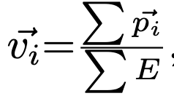
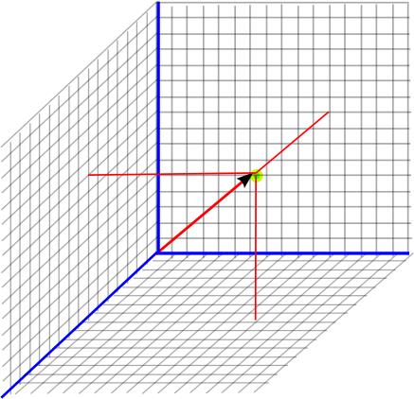
Velocity space
First of all we need to create the velocity space. It is modeled as so:
We divide either coordinate or momentum space into small cells of 1.25, 1.0, 1.25 fm/c and 0.25, 0.2 and 0.25 fm/c respectively.
For each cell velocity of that elementary volume is calculated as:
where p are the pulse of particles in that cell and E is the
energy.
By doing so, we automatically arrange particles by their energy required for all the P-odd quantities:

Slide 5
Data
The PHSD model is used to generate Au+Au collisions @11.5 GeV, @14.5 GeV. Different impact parameters are used: b=0 fm/c, 4 fm/c and 8 fm/c. All the observables are calculated at the moment of kinetic freeze-out: t = 500 fm/c.

Slide 6
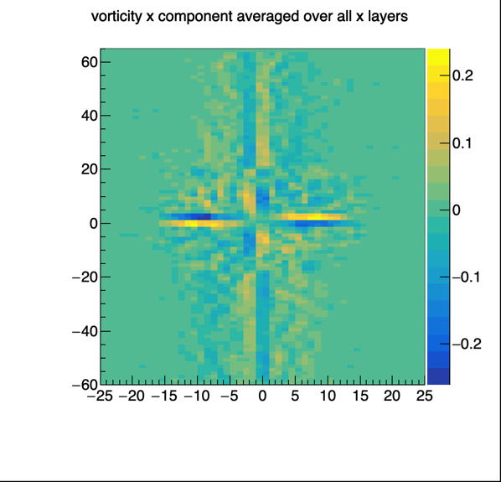
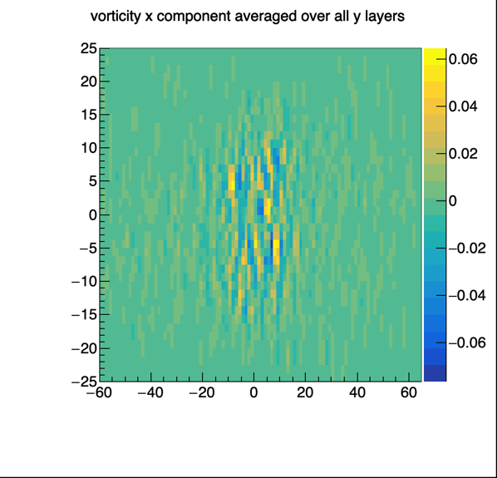
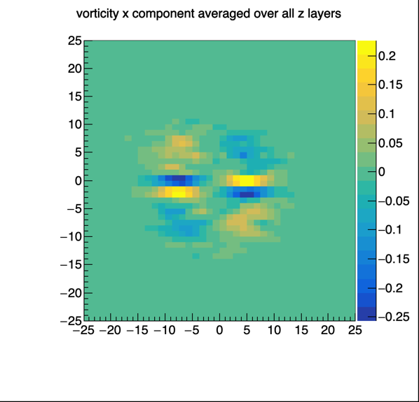
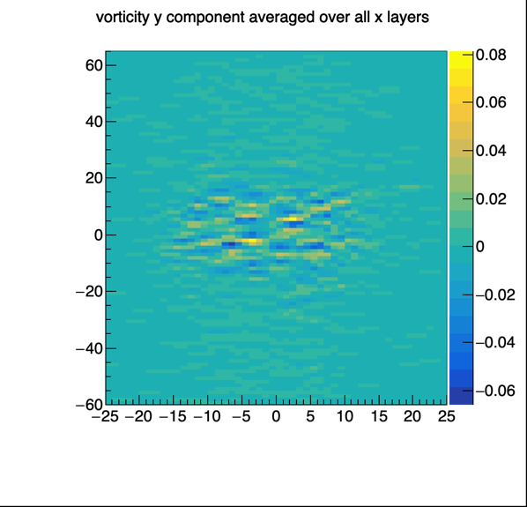
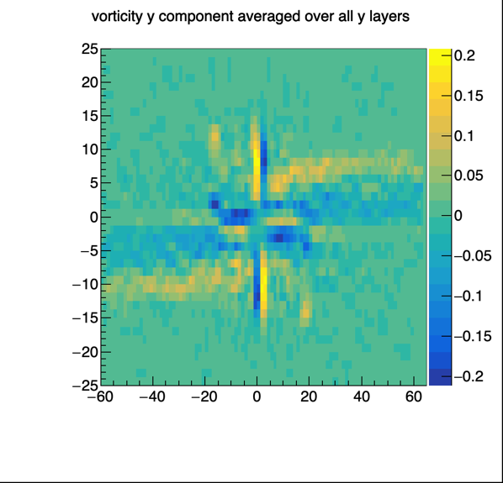
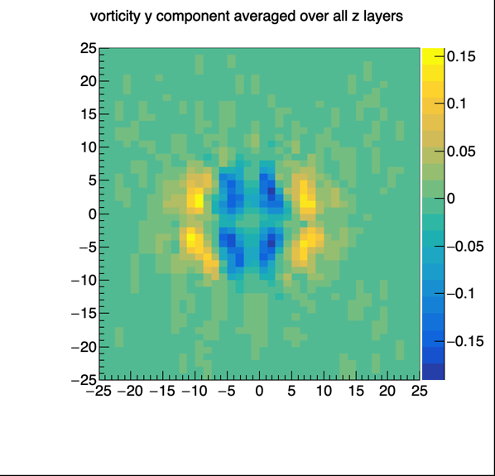
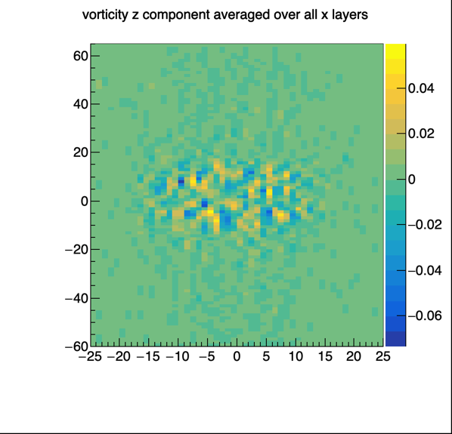
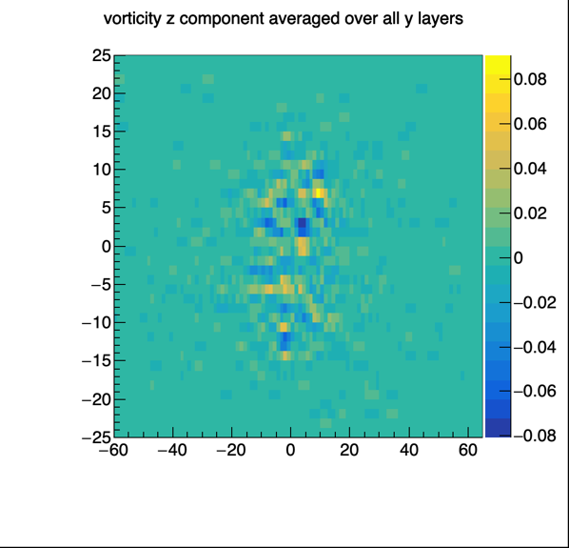
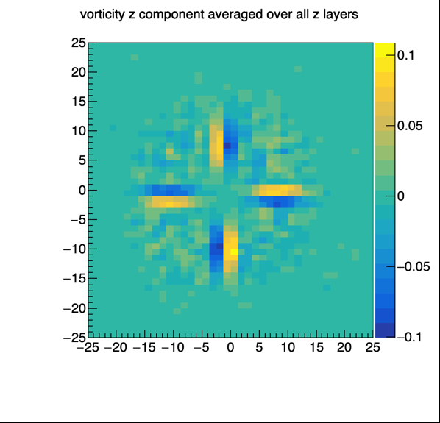
Results. Vorticity @11.5 Gev
Each column along a chosen axis is averaged and projected to the perpendicular plane.
Qualitatively behaviour does not vary for different impact parameters.
Quantitatively average values is in between 80-100 MeV, which corresponds well to previous calculations.

Slide 7
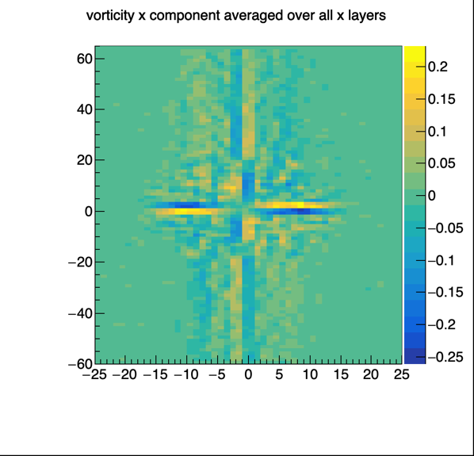
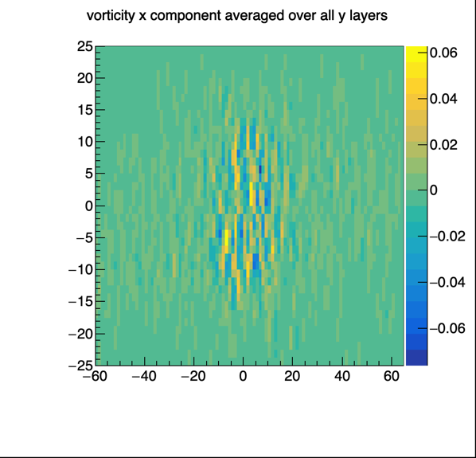
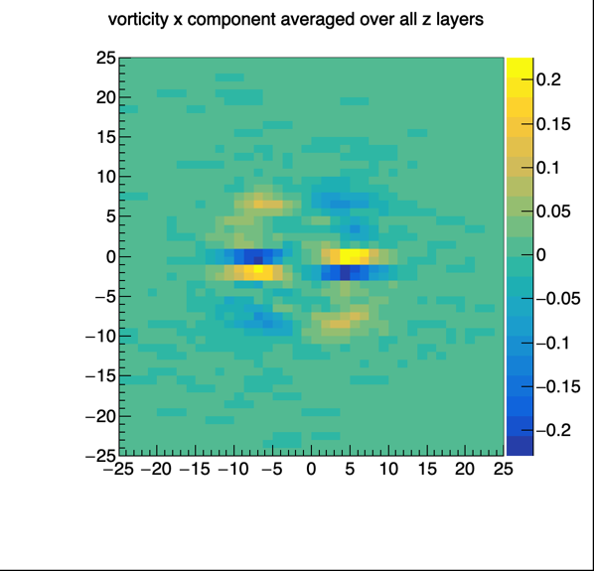
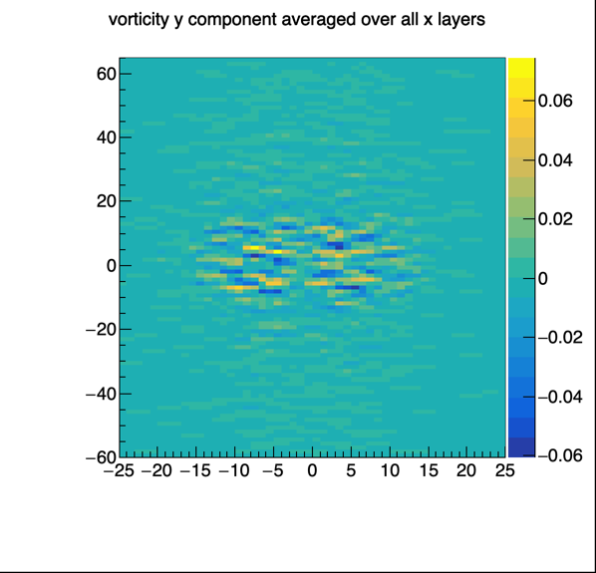
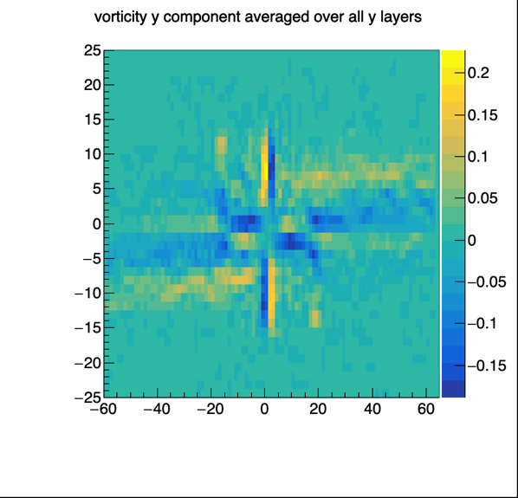
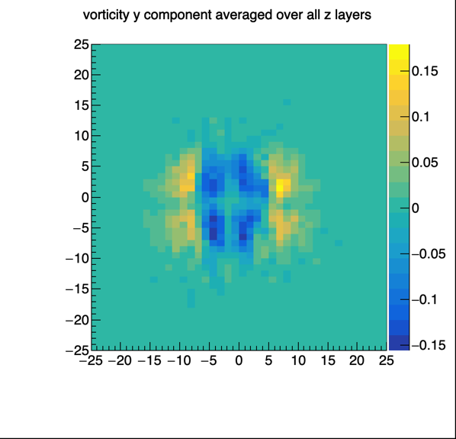
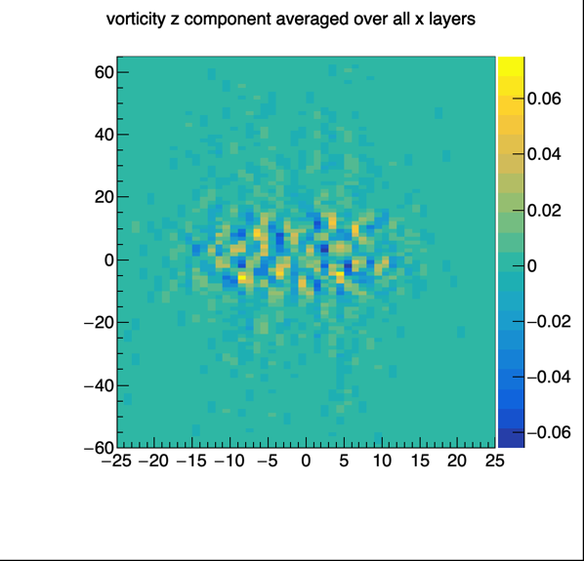
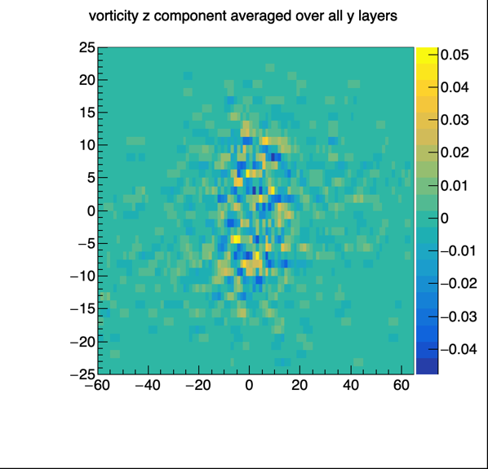
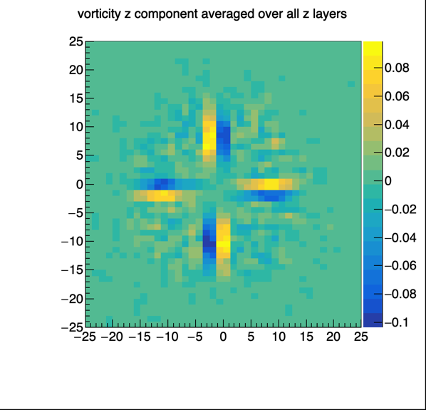
Results. Vorticity @14.5 Gev

Slide 8
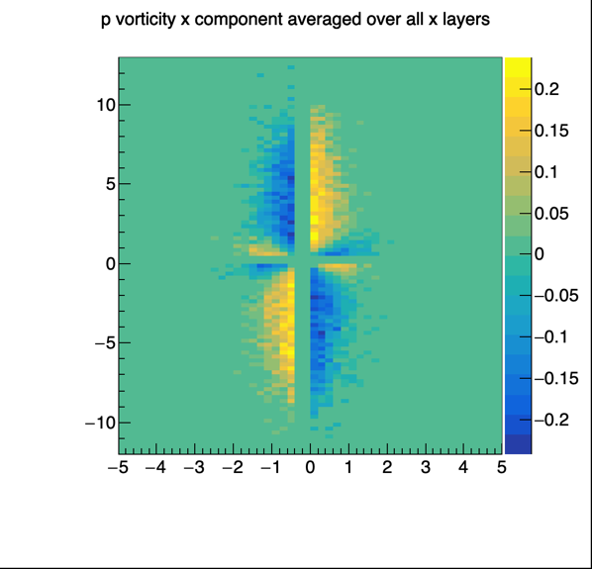
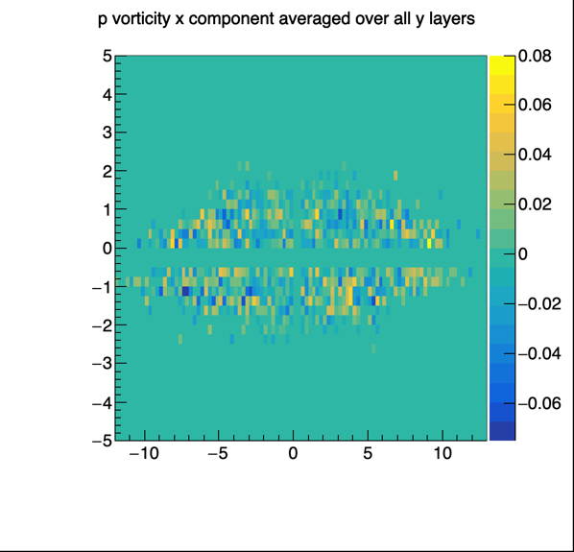
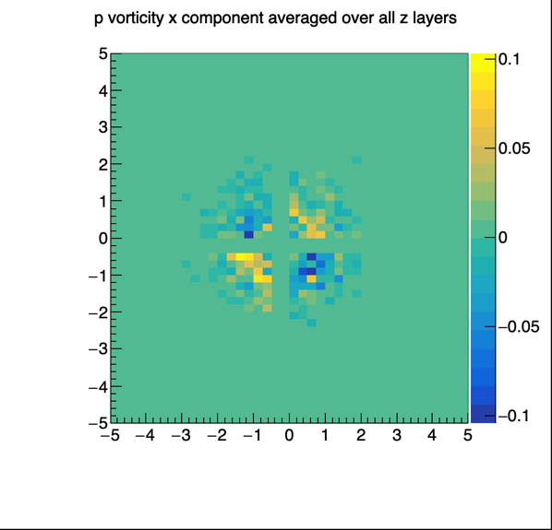
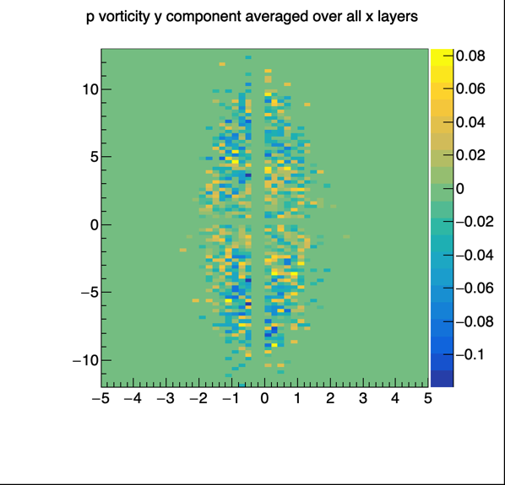
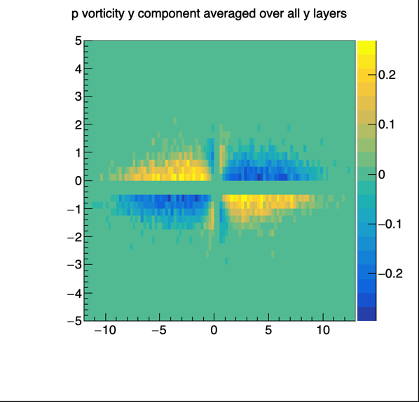
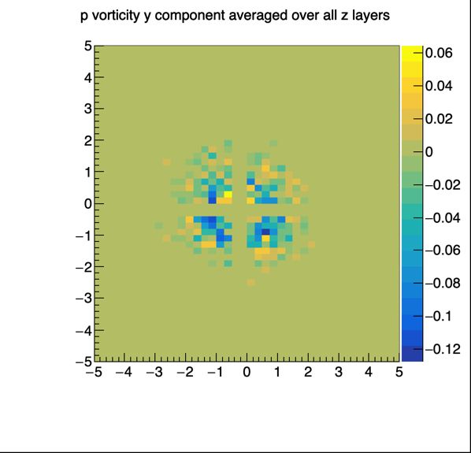
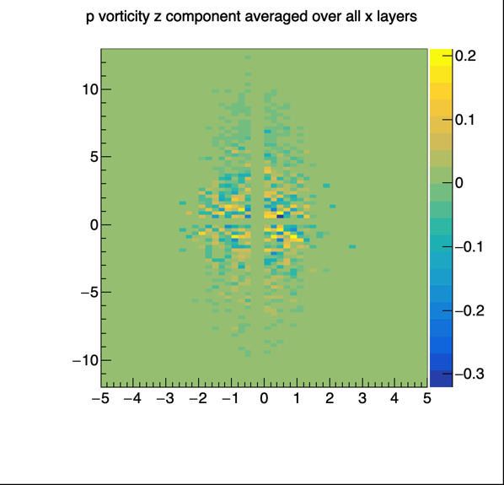
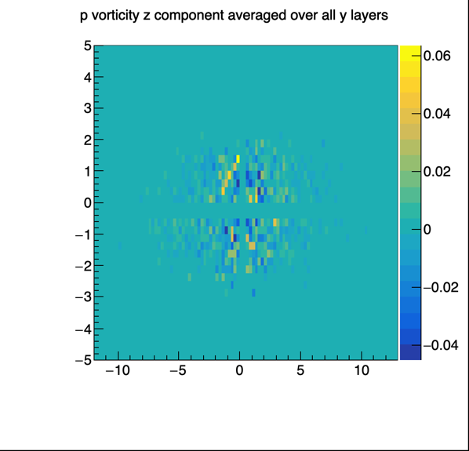
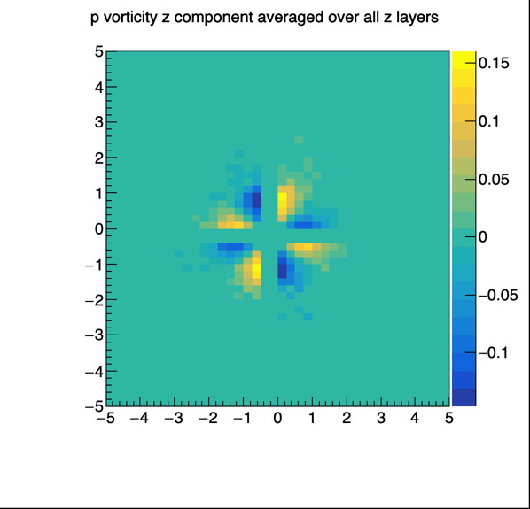
Results. Pulse-Vorticity @11.5 Gev
We see that qualitatively behaviour matches.
Quantitatively pulse vorticity is in the same range. Almost always does not differ from its more common analog.
Difference in sign is described by a “minus” in uncertainty principle.

Slide 9
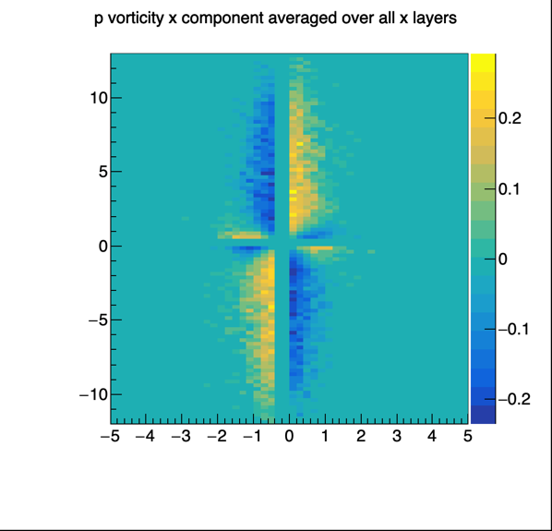
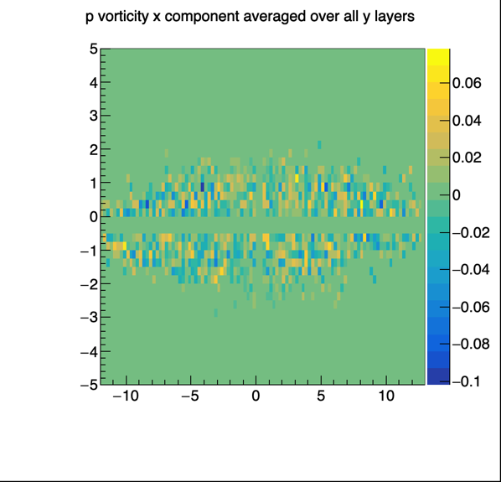
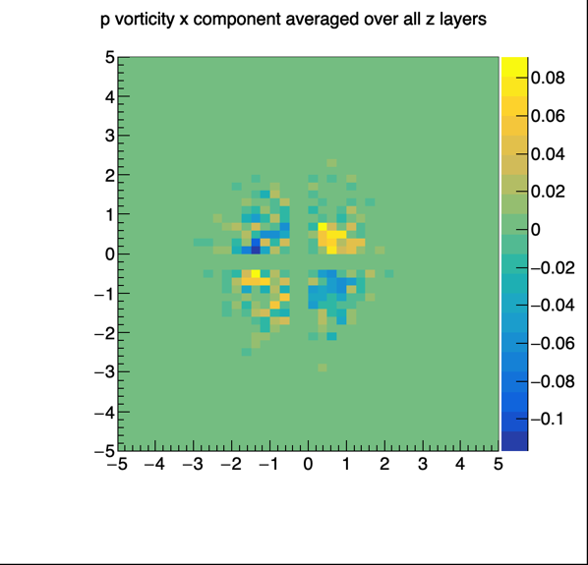
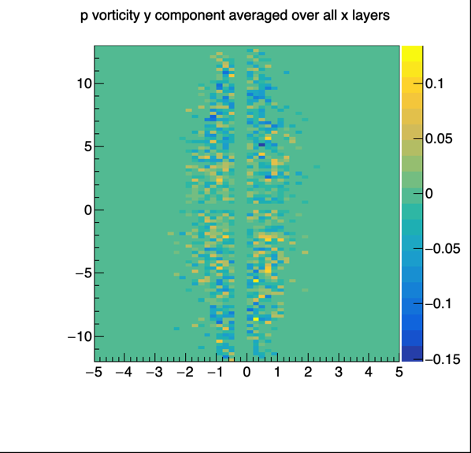
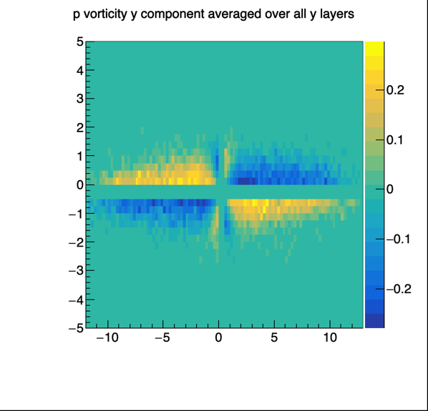
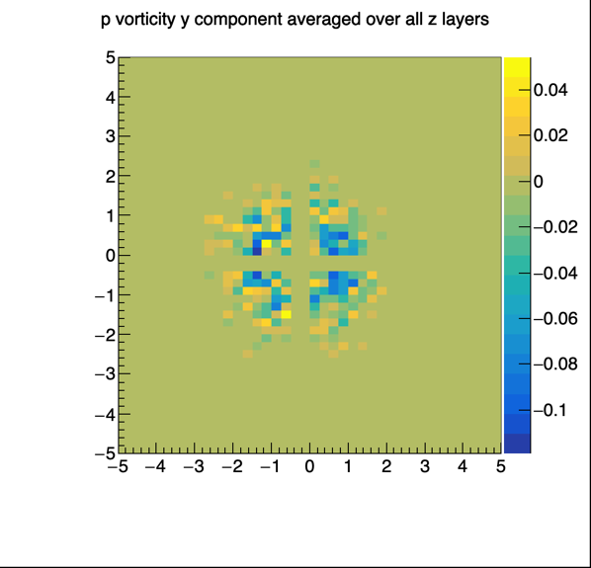
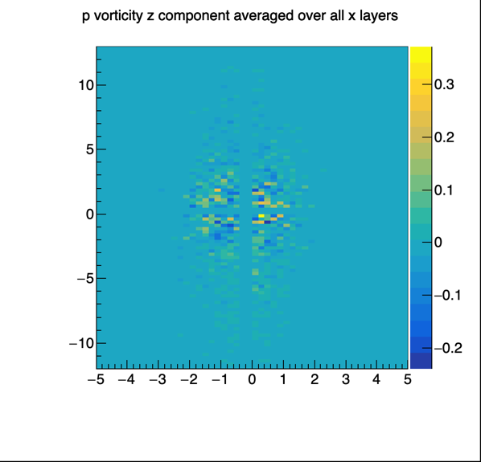
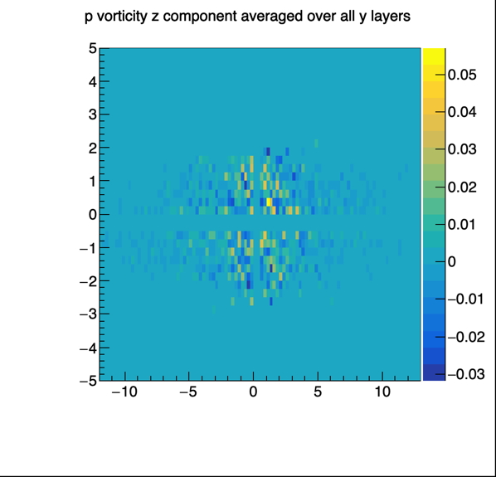
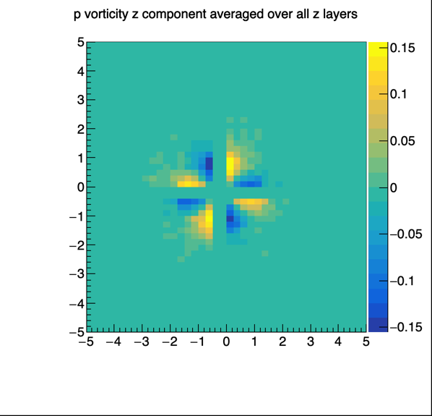
Results. Pulse-Vorticity @14.5 Gev
Pulse vorticity behaves similarly with change of energies.

Slide 10
Further investigation
Also it is important to mention that shear and hydrodynamic helicity could both be transferred into pulse space. Shear is transferred the same as vorticity and for helicity integral is replaced with delta-function: A Fourier transform representation of helicity. For both quantities their behaviour is preserved well.
Moreover, some oscillations in helicity are seen. However, no Kolmogorov cascade-like structure is seen, rather even no degree dependence is observed.

