Slide 1


I. N. Borzov ^{1,2} , S.V. Tolokonnikov ¹
1 National Research Centre “Kurchatov Institute”, Moscow, Russia
2 Bogolubov Laboratory of Theoretical Physics JINR, Dubna, Russia
Modified Fayans functional. Constraints from nuclear ground state properties,
collective excitations and nuclear matter equation of state.
For unstable nuclei produced at the RIB facilities, laser-ionization spectroscopy supplies precise data on the ground state properties. Nowadays, the measurements of the excitations spectra and decay rates are also feasible within the same experiments.
In such a way, the nuclear charge radii (Rch), dipole polarizability (α_{D}), β-decay half-lives (T1/2) … are explored at CERN, GSI etc.
A challenge for theory is to reliably describe very different observables of very neutron-rich nuclei within universal energy-density functional (EDF) …..rather than invent specific EDF for each observable in question … :)
There are additional constraints on the EDFs which are installed …or better to say hidden in neutron matter Equation of State (EoS) in the range from subnuclear to neutron star densities. Of course, reliable EOS should also comply with the bulk of astrophysical data on the masses and radii of neutron stars, etc.
We will address these goals via fine tuning of the isovector part of Fayans energy density functional.
Notes:
I will talk about description of nuclear structure observables and nuclear matter properties
in a self-consistent framework based on modified Fayans EDF.
Nowadays, for unstable nuclei produced at the RIB facilities
laser-ionization spectroscopy supply precise data on the ground state properties.
And, the measurements of the excitations spectra and decay rates are also feasible within the same experiments.
In such a way, the nuclear charge radii, dipole polarizability, β-decay half-lives
are intensively explored at CERN, GSI and other facilities…
From nuclear structure side, a challenge for theory is to treat very different observables of very neutron-rich nuclei
within universal energy-density functional (EDF) …..rather than invent specific EDF for each observable in question….
From astrophysical side, additional constraints on the EDFs are installed …or better to say hidden
in neutron matter Equation of State as displayed from subnuclear to neutron star densities.
Of course, a reliable EOS should comply with the bulk of astrophysical data on the masses and radii of neutron stars, etc.
We have tried to adress these goals by fine tuning of the Fayans energy density functional.
---------------------------------------------------------------------------------------------------------------------------------------------
Магистральное направление развития современной ядерной физики –
Это исследования свойств и структуры НЕСТАБИЛЬНЫХ изотопов – экзот.ЯДЕР - с сильной N/P асимметрией.
На совр. УСКор .РАДиоакт.ИОНОВ
Прециз. Лазерно-спектроск. Измерения спектров сверх.тонк.расщ.
проводятся теперь одновр. С изм. Периодов бета-расп..
Такие измерения проводимые в ЦЕРН, GSI…. и на многих други установках
ОСОБО важны в менее иссл.области тяжелых ядер вблизи и сверх нейтр. Обол. N=126.
Для тестирования state-of-art ядерных моделей необх.
такие фундам. Ядерн. Характер. как R, МЮ, периоды бета распада
Они позв. Определить форму и параметры ядерных Функц.пл
Или NN-ВЗАИМОД. В ab-inicio подходах.
Эксп по бета-распаду в области ядер 3-его пика r-процесса – важны для модел.АСТРОФ. Нуклеос.
Все это стимулирует РАСЧЕТЫ в рамках ЕДИНого подхода
свойств основных и возб. состояний
Мы ограничимся РАДИУСами и х-ками БЕТА РАСПАДА)
Совсем недавно в ЦЕРН провели такие измерения для изотопов ртути.

Slide 2
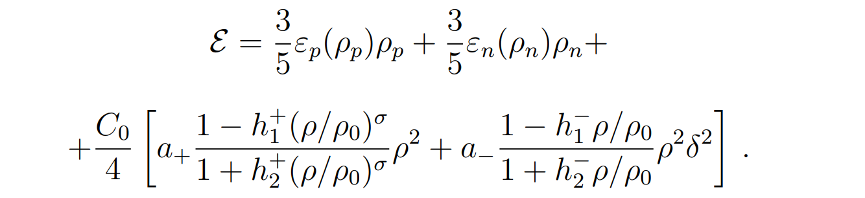
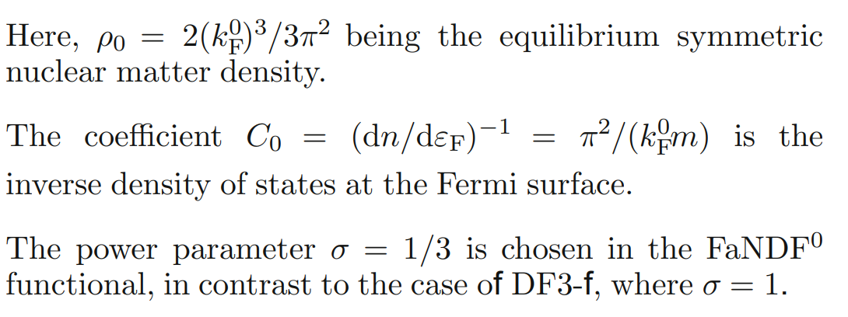
Fayans functionals DF3-a, DF3-f vs. FaNDF⁰
a ₊ , h ⁺_{1,2}
DF isoscalar part
(SNM)
a ₋ h ⁻_{1,2} , δ²
DF isovector part
(PNM)
Here a ^{+,−} h ^{+,−}_{1,2} are iso-scalar (-vector) parameters of volume part ;
isotopic asymmetry δ = ρ_{n}-ρ_{p} / ρ_{n}+ρ_{p} .
DF3-a has fractional-linear density dependence (σ =1, linear Pade approximant).
Notably, such factional density dependence allows for extrapolation to neutron star EoSs up to high density ~ 6ρ_{0 .}
Notice, that for h -₂ = h+₂ =0, the DF3-a volume part reduces to the one of Skyrme-like EDFs.
In FANDF⁰ σ = 1/3 (non-linearity). This EDF was by origin fitted to FP81 and WFF88 SNM and PNM EoSs .
Previously we had not had enough data for fine tuning of h -₂ in DF3 family,
No fitting to SNM and PNM EOSs had been attempted for DF3-type EDF widely used for nuclear structure studies .
1. FANDF0 S.A. Fayans, JETP Lett. 68 (1995)
2. DF3-a E.E. Saperstein, S.V. Tolokonnikov
Phys.At.Nucl. 77 (2010).
DF3-f I.N.B, S.V. Tolokonnikov
Phys. At. Phys. At. Nucl. 83 (2019).
Notes:
We have performed calibration of the Fayans functionals of DF3-type .
To remember, for the DF3-type functionals, the volume part contains
ISOscalar part (defining the SNM EOS)
And ISOVECTOR part (related to the PNM)
! DF#- EDFs have less param. than FANDF0 f-l.
In particular the power of density here is 1.
Ранее для DF3-a было h-1 = 0 h-2 =3
Поиск h-2 - есть новые данные по J L Rnp.

Slide 3
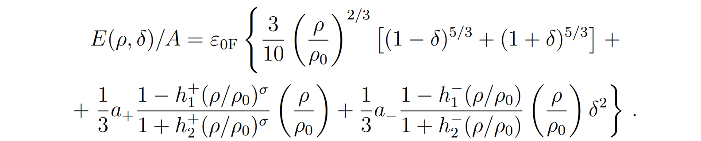
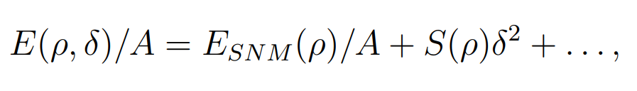
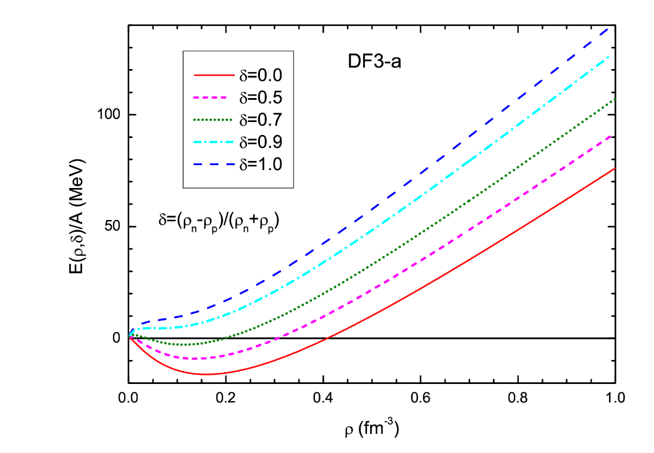
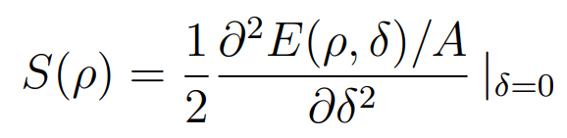
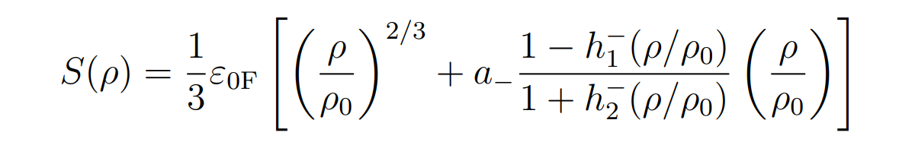
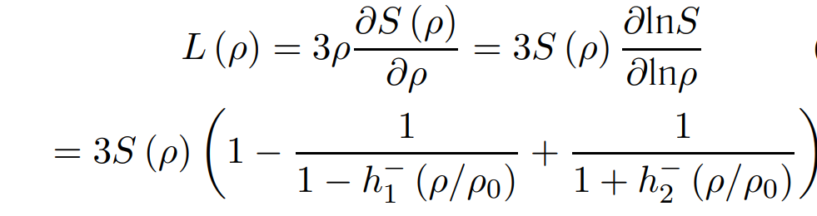
Infinite nuclear matter EoS : E(ρ, δ)/A ≡ E(ρ_{p} , ρ_{n})/ρ
DF3-a
σ =1
δ<< 1
Notes:
The inf matter EoS for DF3-a functional is shown here.
It can be parametrized as quadratic Tailor expansion.
S(rho) = and L are defined by ISOVECTOR volume TERMs.
An informative parameter L is
the slope of Esym WHICH it strongly correlates with the n-SKIN

Slide 4
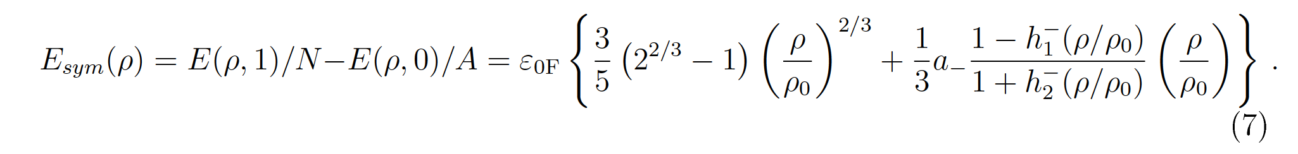
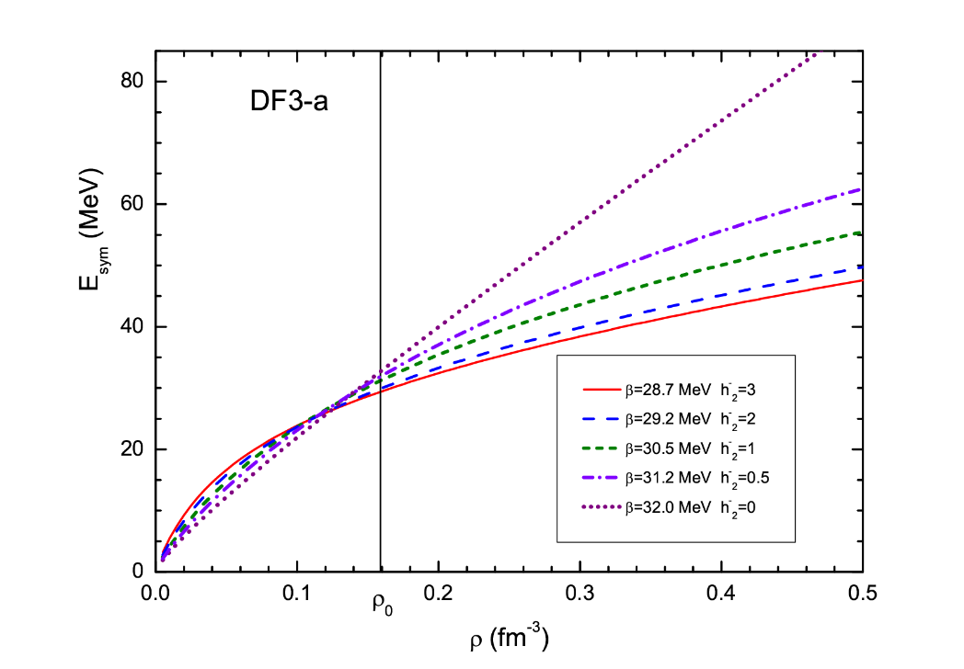
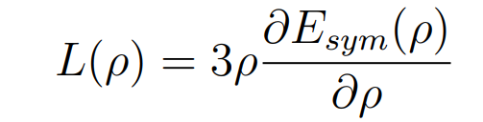
1. Constraints based on PREX-II,
NS masses, LIGO/Virgo, NICER + χEFT+ αD:
L = 59 ± 16 МeV
ΔRnp (208Pb) = 0.19 ± 0.07fm
J. Lattimer at S@INT, Seattle, 2021.
2.Non-parametric EOS within the Gauss Processes
L = 49+14-15 MeV,
ΔRnp(208) = 0.17 ± 0.004 fm
J = 32.7+1.9-1.8
R.Essick , I. Tews , P. Landry , A. Schwenk, P.R.L 127, (2021).
3. Skyrme (SV, DD-PC…) calibrated on B(A,Z), Rch and αD.
If the quantified value of A_{PV} + αD were added :
L = 54 ± 8 MeV,
ΔRnp(208) = 0.19 ± 0.02 fm
P-G. Reinhard et.al . Phys.Rev.Lett. 127 (2021)
First, we vary only h-2 in order to get the constraints
on the parameters J = E_{sym}(ρ₀) and L - its slope
near the nuclear-saturation density ρ_{0 .}
J = E_{sym}(ρ₀ ) is not that sensitive to h⁻₂ :
for DF3-a: J=S(ρ₀) ~ 30.0 MeV
L= L ( ρ₀ ) - “slope parameter” of E_{sym} (ρ)
depends on h-2
It is known to be (linearly) correlated with
ΔRnp - neutron skin thickness !
L =59 ± 16 MeV → h-2 = 0.5 - 2.0
J. Lattimer in "S@INT,2021
L =54 ± 8 MeV → h-2 = 1.0 – 2.0
P-G. Reinhard et.al . Phys.Rev.Lett. 127 (2021)
The “slope parameter” L derived from ΔRnp (208Pb) :
Parity violating (e,e’) data - Jefferson Lab exp. PREX-II
D. Adhikari et.al. Phys.Rev.Lett 126, 172502 (2021)
ΔRnp (²⁰⁸ Pb) = 0.283 ± 0.071 fm → L=106 ± 37 MeV
Notes:
The L parameter -the slope of Esym - is sensitive to the h-2 parameter
And at first we vary only h-2 parameter in order to get the
constraints on the parameters J and L near the nuclear-saturation density.
L is known to strongly correlate with the neutron skin – the diff of Rn-Rp =Rnp.
Thus, it was a lot of activity to derived L from Rnp. PREX-II values.
However, the later estimates which included additional the full glory of data, non-parametric
EOS and quantified values of PV-asymmetry which was directly measured in {PV-e,e’)
Have Resulted in much lower d Rnp for 208Pb.

Slide 5
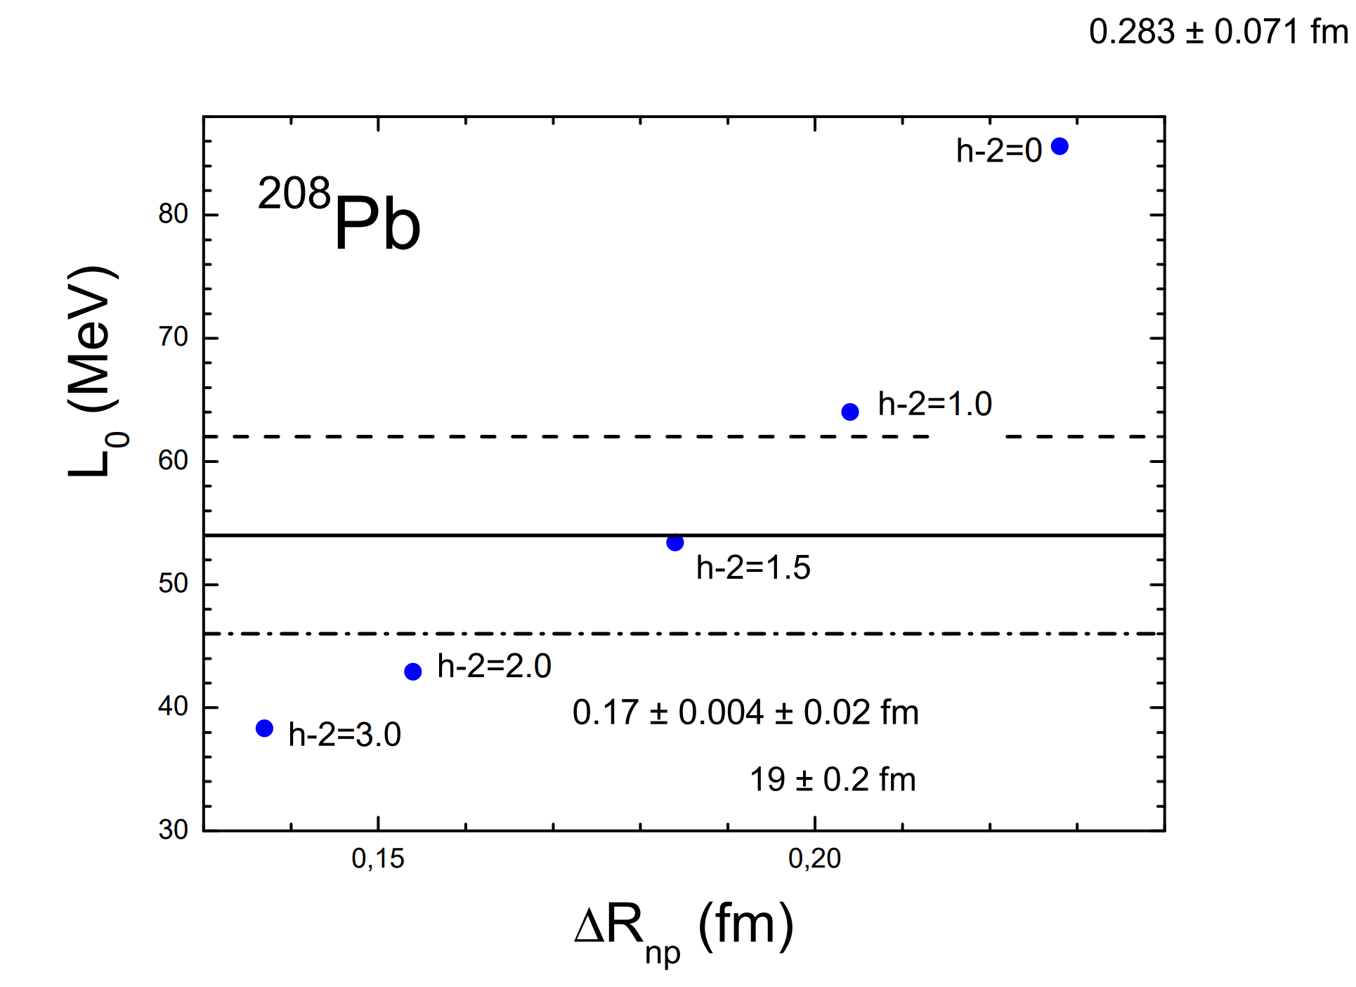
For h-2 = 1.5 Rnp (208Pb) = 0.171 fm
208 Pb Estimated Rnp = 0.19 ± 0.2 fm
Ex th E1 = 14.0 MeV
Ex exp E1 = 14.2 ± 0.2 MeV
For h-2 = 1.5 Rnp (48Ca) = 0.160 fm
48 Ca CREX Rnp = 0.121 + 0.026 - 0. p+(A,Z) Rnp= 0.158 ± 0.023±0.012 (T.Wakasa et al) 2024
L(ρ₀) = 54 ± 8 MeV
ΔRnp (PREX+Astro+χETF) = 0.19 ± 0.2 fm
can be met at 1.0 < h₂₋ < 1.5
0.
PREX-II
0.283 ± 0.071
Additional fitting to the upper limit of the Ex (GDR) max in 208Pb
Ex = 14.2 ± 0.2 MeV
Fayans Functional. Constraints from Equations of State
I.N. Borzov1),2)* and S. V. Tolokonnikov1),3)
Physics of Atomic Nuclei, 2023, Vol. 86, No. 3, pp. 304–309.
Notes:
Next, we analyse the dependence of L on delta Rnp estimates
together with the exp. data on the upper limit of the
maximum of Giant DipoleResonance in 208Pb.
xventually, the estimated range of h-2 is further shrinked to 1 - 1.5

Slide 6
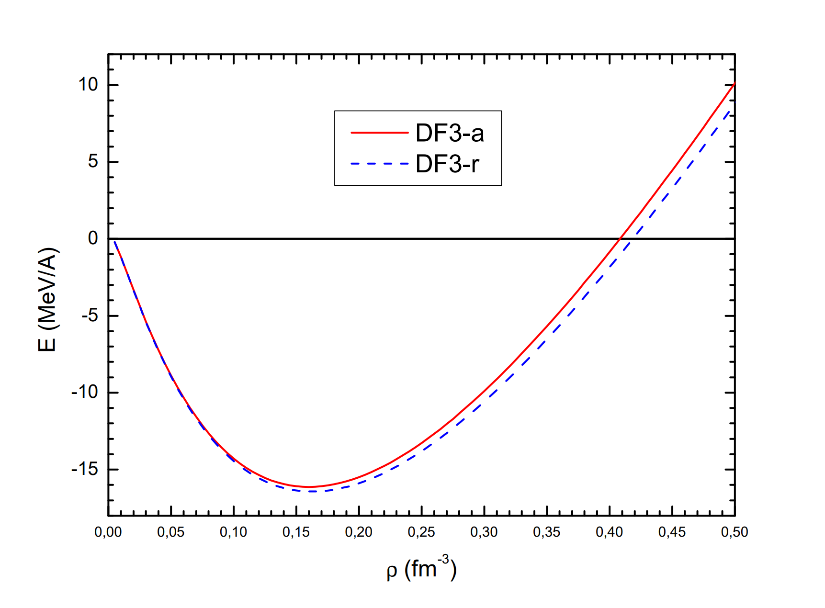
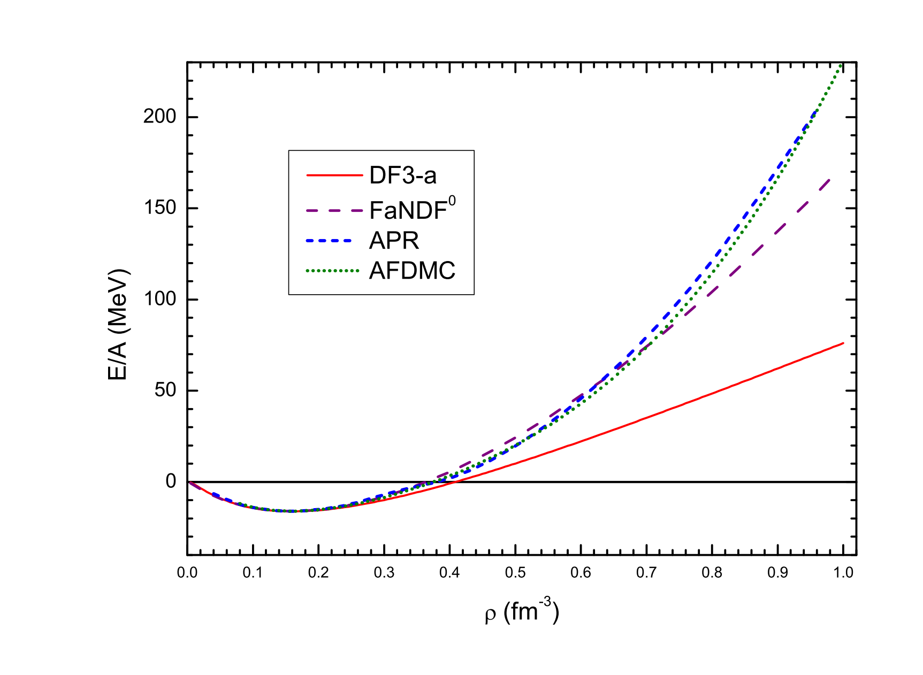
RELATIVISTIC CORRECTION for SNM EOS
(valid for y= h*k_{F} /mc ∼ 1)
E_{kin}(ρ) / A = mc² [ g(y) /8y³−1]
g(y) = 3y(2y² − 1) √(1 + y²) − 3 ln √(y + 1+y²)
y= h*k_{F} /mc ∼ ρ/2
Here k_{F}³/3π² = ρ/2 (SNM) ;
FANDF0 S.A. Fayans, JETP Lett.68 (1998).
DF3-a S.V. Tolokonnikov, E.E. Saperstein, Phys.At.Nucl (2010).
APR A.Akmal, V.R. Panharipande, D. Ravenhall Phys.Rev. C59 (1998 ).
AFDMC S. Gandolfi et.al. ,Phys. Rev. C 79, 054005 (2009).
Notes:
This slide just gives an idea how the FaNDF0 and df3-a SNM EOS look like.
in comparison with the recent rel. EOS/
Here we also incl-ed the relativistic corr. to kin. Energy.
As it seen, up to 2rho-0 our EOSes agrees with these rel.ones.
And for higher densities FANDF is softer and original version of DF3-a is much softer.

Slide 7
From E. Kolomeitsev , Nuclei-2024, Dubna
“Fayans functional in application to neutron stars”
Two popular set of parameters: FaNDF⁰ [Fayans, JETP Lett 68, 169 (1998)]
DF3 [Borzov, Fayans, Kroemer, Zawischa, Z. Phys. A 355, 117 (1996)]
FANDF⁰ was fitted to reproduce both nuclear masses, radii, as well as energy density calculated by
FP81 - Fridman, Pandharipande, NPA 361(1981)502
WFF88 - Wiringa, Fiks, Fabrocini, PRC38(1988)1010
DF3 parameters must be refitted
Neutron stars with masses > ~ 2 M_{sol} are found

Slide 8
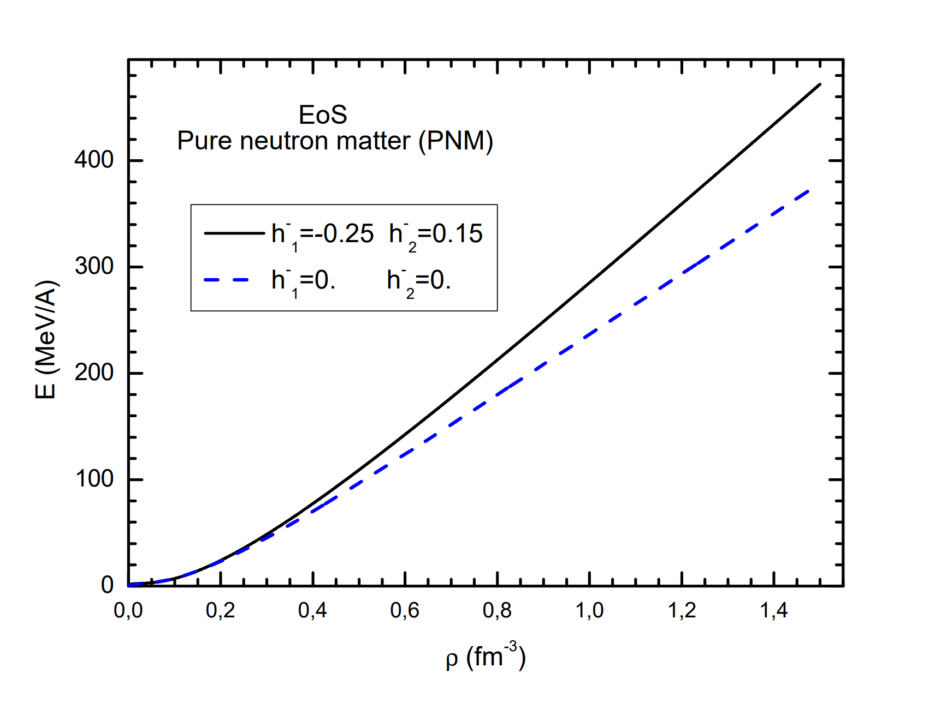
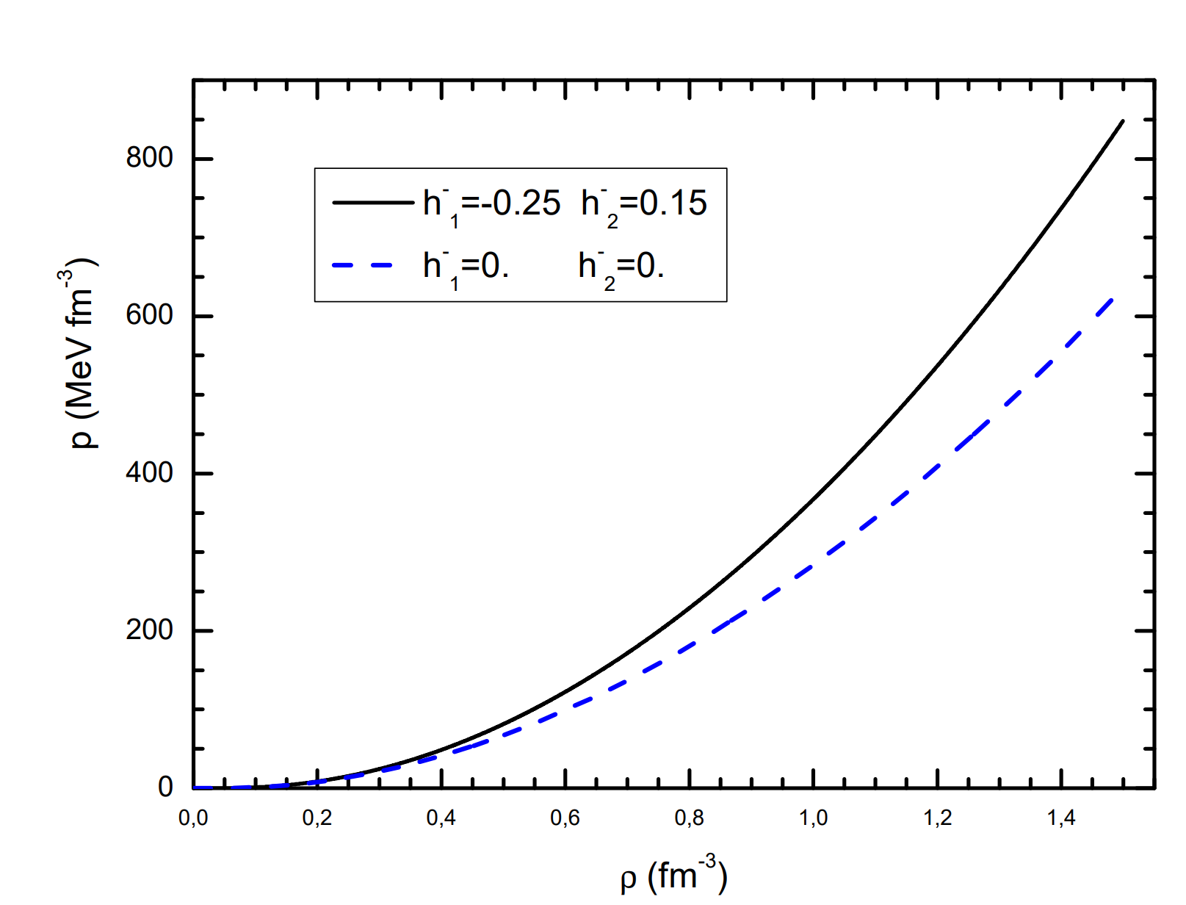
To get stiffer EoS at high densities
one has to vary h-1 parameter.
But then both h-1 and h-2 come to the game !
Here dashed line h-1, h-2= {0 ; 0 } corresponds to the most simple form of the isovector term.
Next we vary both h-1 and h-2 parameters in order to get a stiffer EoS.
In fact, there is not much room for varying the isovector parameter h-1 .
Namely, for |h-1| > 0.2, the P (ρ) already has a zone with d P/d ρ < 0 which is thermodynamically unstable.
Up to now, the best (stable) fit is found to be h-1, h-2= → { - 0.25 ; 0.15}.
Some readjustment of h-2 to available nuclear data and L is still to be done.
Notes:
здесь h-2=0.15 h-1=-0.25 ( знак минус -, так как в формуле энергии в числителе есть знак минус)
Конечно для h-2>0 необходима доп. Readjustment k значениям J, L из эксперимента )
J подгоняется бетой
L→ при фиксированной h-1>0 (!!!) подгонка h-2.
Неустойчивость проявляется уже при h-1~ + 0.2
Андрей comments- В графике зависимости P(rho) появляется
область с dP/drho<0 - эта зона термодинамически
неустойчива.
В принципе, если есть такая область, здесь должен быть фазовый
переход первого рода, но я не думаю, что тут этот случай...
Наверное, можно посчитать и с таким УрС (не знаю, справится ли мой код), но физического
смысла в этом нет (IMHO). Нужно как-то этот УрС "подправить".

Slide 9
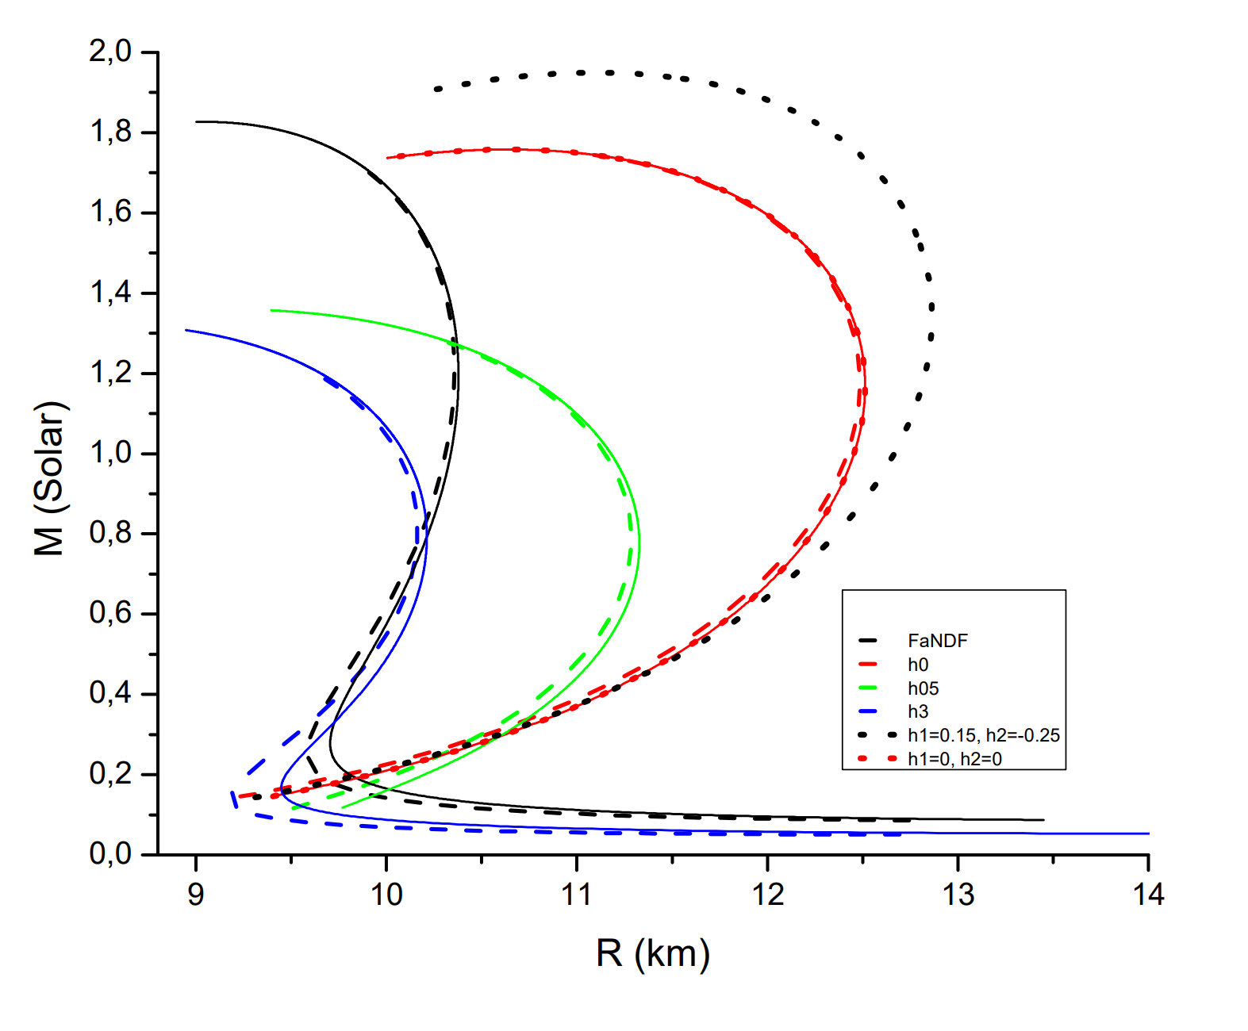
{ h-1, h-2 } are varied
1.98 ± 0.1 M sol
^{DF3-a}
^{NEW}
FANDF⁰
^{DF3-a}
^{0LD}
Courtesy of A. Yudin
Notes:
With newly obtained Eos in hand, the calculation of mass-radii dependence was calculated.
We thank A. Yudin for doing that with his code.
Here the OLD DF3-a, FandF0 results are shown.
AS seen with newly modified DF3-a * - dotted line (for negative h-1,
notice the minus sign in the formula on the top of slide)
the maximal mass is 1.98 ± 0.1 M sol which is close to the FandF0 result.

Slide 10
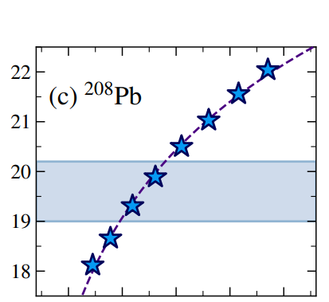
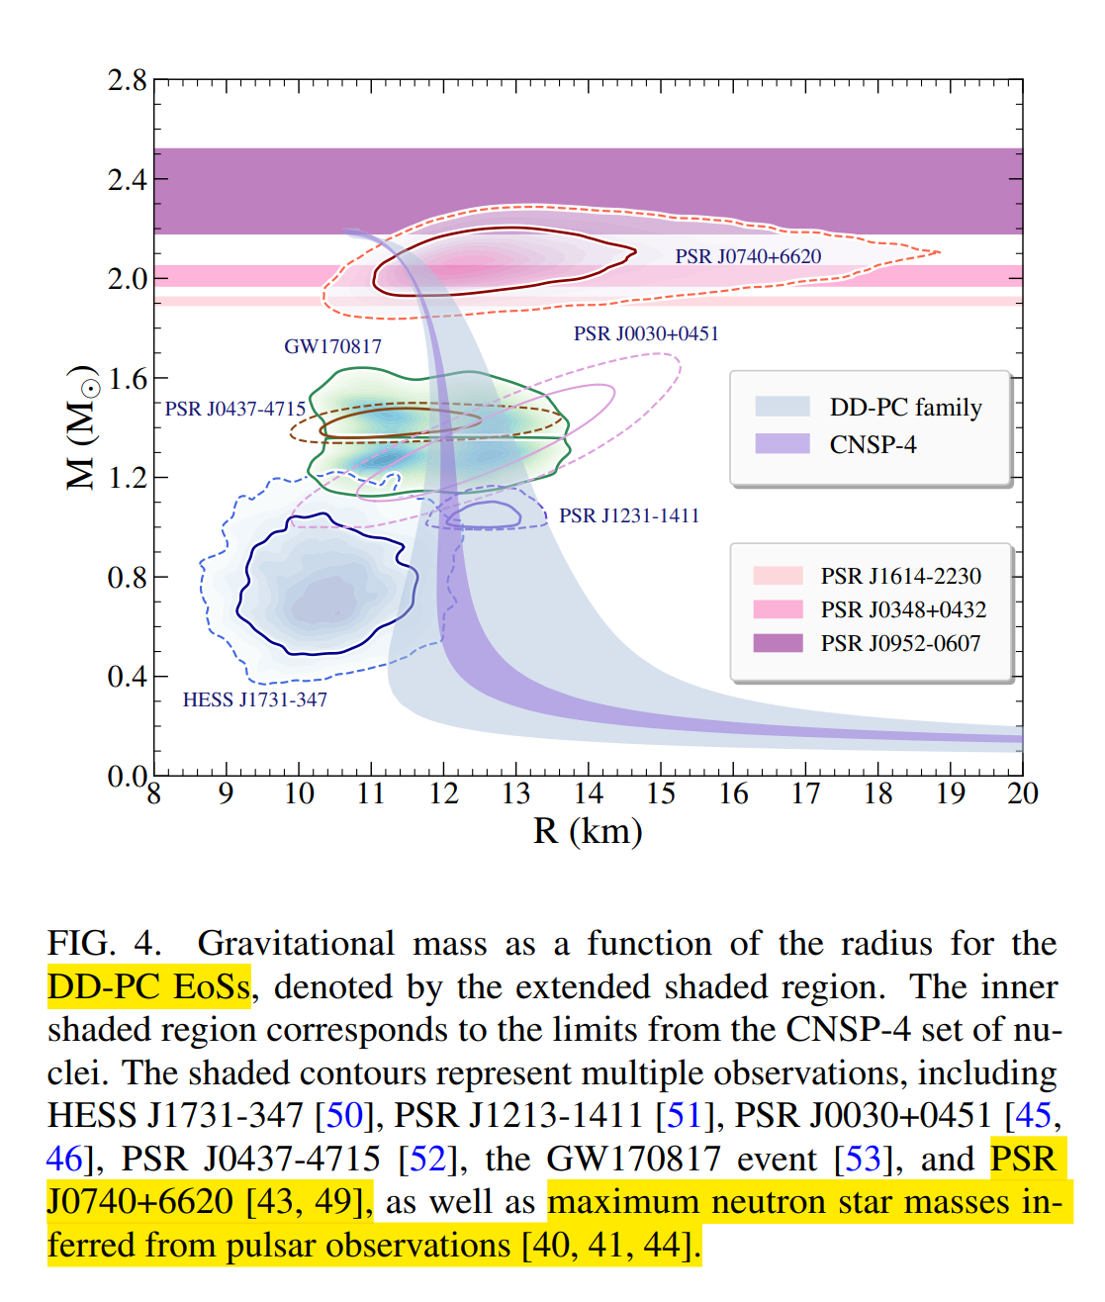
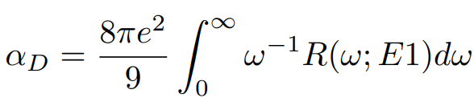

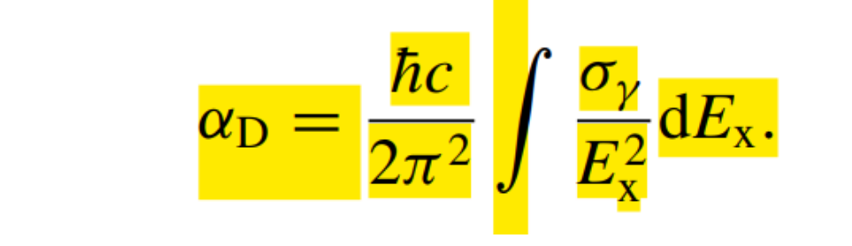
Potential adjustment of {h-1,h-2”} and L from electrical dipole excitation spectra.
Dipole polarizability
α_{D}
The inverse energy-weighted
dipole strength function R(ω; E1)
over the excitation energy ω
R(ω; E1) strength function in
quasiparticle random phase
approximation (QRPA).
L = 46.08 ± 6.06 MeV
J = 31.34±0.79 MeV
The inverse energy-weighted
Photo-absorbtion cross-section:
Dipole Polarizability of Finite Nuclei as a Probe of Neutron Stars P.S. Koliogiannis , E. Yu¨kse , T. Ghosh and N. Paar arXiv:2503.17143
Notes:
Another sensitive marker to the slope of symmetry energy
Is Dipole polarizability α_{D} . It is……..
Another recipy for Calculation of alfaD is…
Here is the most accurate
exp.data on the a_D is shown for doubly-magic 208Pb.
The rel QRPA calculations including 4 others isotopes - 48 Ca, 68Ni and 112Sn
From 10 available GIVE an estimate of L/
The corresponding calc with DD-PC functional / for describes the data for
M(R)~2.1 Msol/ DD-PC functional
The details has not been given/

Slide 11

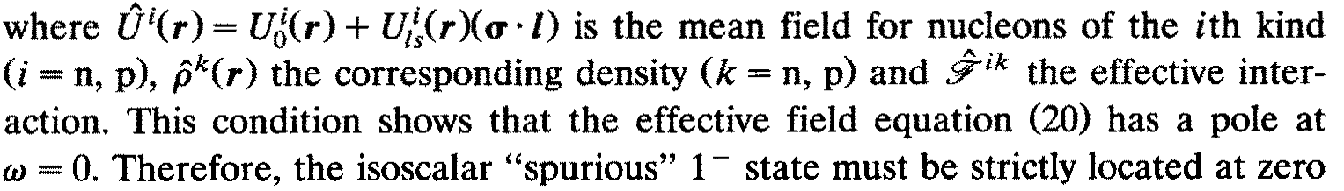
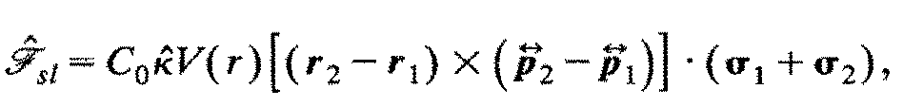
Two-body spin-orbit interaction
S.A. Fayans , E.L. Trykov , D. Zawischa Nuclear Physics A568 (1994) 523-543
Influence of effective spin-orbit interaction on the collective states of nuclei
DF3-a K₀=230 MeV
Potential study of
Dipole polarizability
α_{D}
in fully self-consistent framework
(with 2-body effective spin-orbit NN-interaction )
V.F. Dmitriev and V.B. Telicin, Nucl.Phys. A 402, (1983) 581
Including two-body spin-orbit
effective NN-interaction can change
Dipole polarizability
α_{D}
DF1 functional with unrealistic K₀=135 MeV
Notes:
It is worthwhile to calculate the Dipole polarizability α_{D}
In fully self-consistent framework incl. 2-body s-o

Slide 12
Simultaneous description of the charge radii and
charge-exchange excitations.
Comparison of non-relativistic and relativistic EDFs.
DF3-a* Charge radii of thallium isotopes in the vicinity of magic N =126.
Z.Yue, A. N. Andreyev, A. E. Barzakh , I.N. Borzov, et.al. Phys.Rev. C 110, 034315 (2024).
NL3* U. C. Perera et.al., Phys.Rev. C 104, 064313 (2021)
R_{ch}
T_{1/2 β - decay} DF3-a* I.N. Borzov, Physics of Atomic Nuclei 81, 680 (2018).
NL3* T.Marketin, L. Huther, G. Mart’ínez-Pinedo. Phys. Rev. C 93, 025805 , 2016
Notes:
Comparison of the M(R) dependence obtained from the EoSs from diff nucl. EDFs
Does not give much info/ They has to be taken as the fact/// and with some reservation
As I have mention in the beginning of this talk/
simultaneous description of different nucl. Structure Data /
with one and the same EDF/ Of first importance/
Of course, it is even more important to understand what’s the physics behind a
@excellent, good, reasonable etc. agreement@/
A common phrase we usually write in Conclusions of the papers /
A good agreement may stem from different physics built in the models.
In particular it concerns the results obtained within the non-rel and rel DFunctionals/
This issue can be exemplified by such important observables as:
Charge radii and beta-decay half-lives/

Slide 13
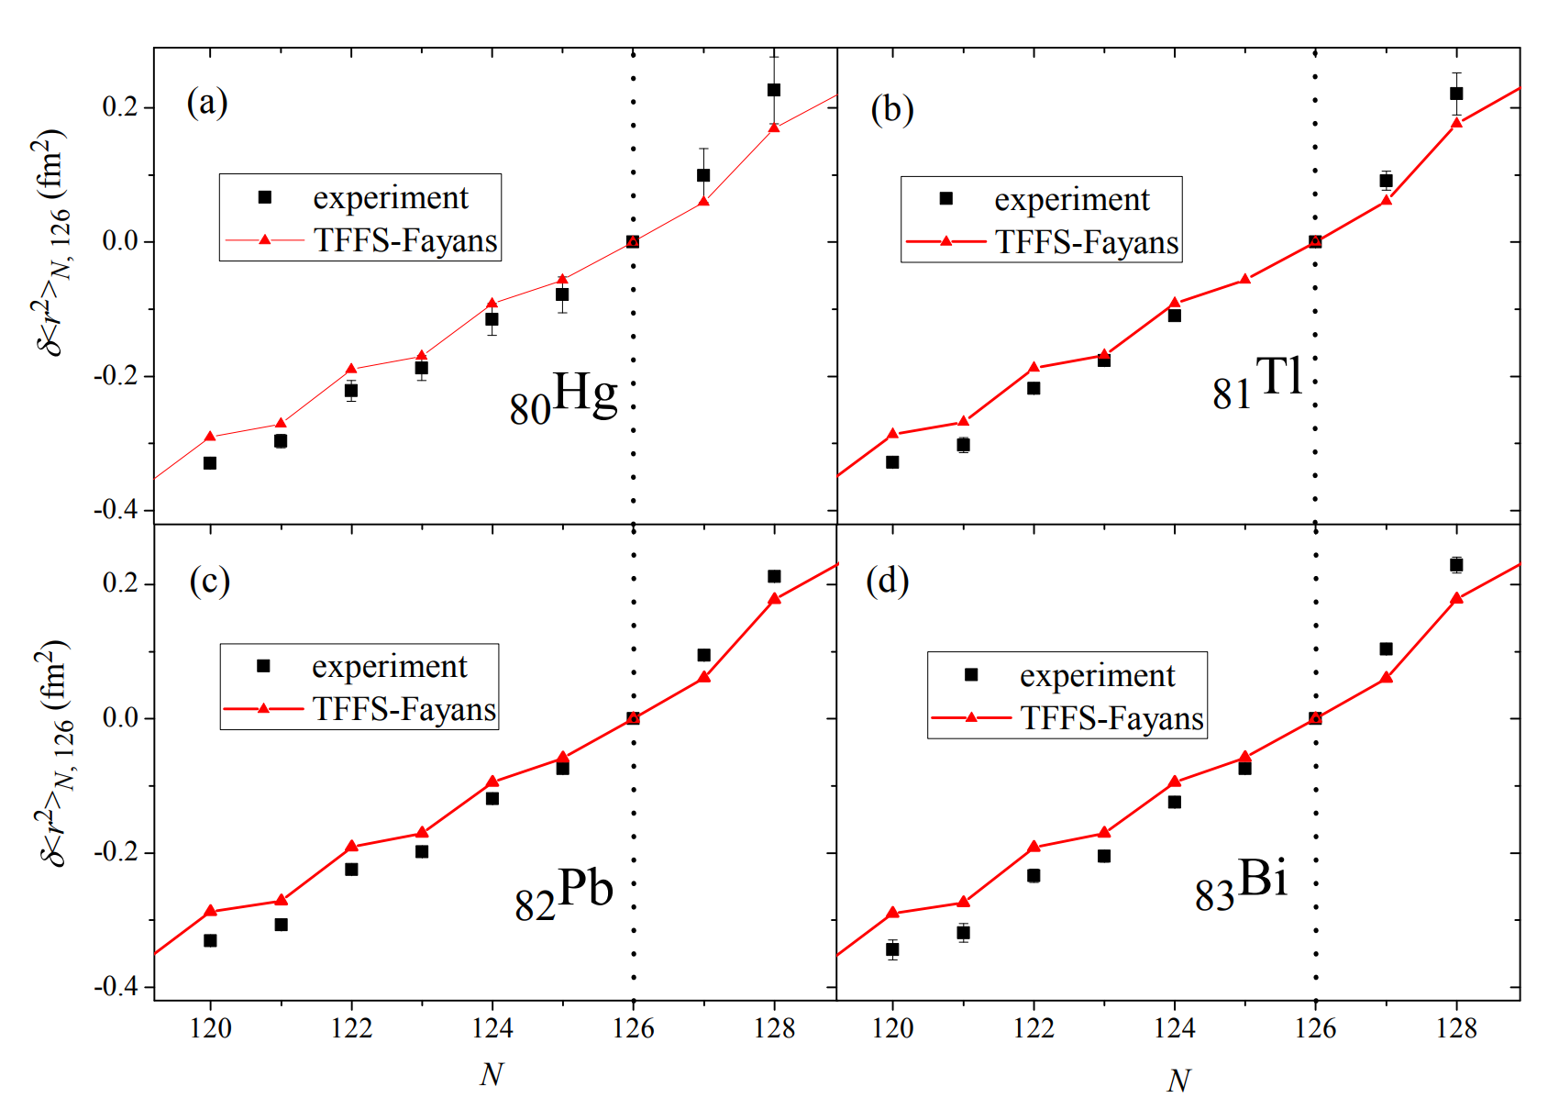
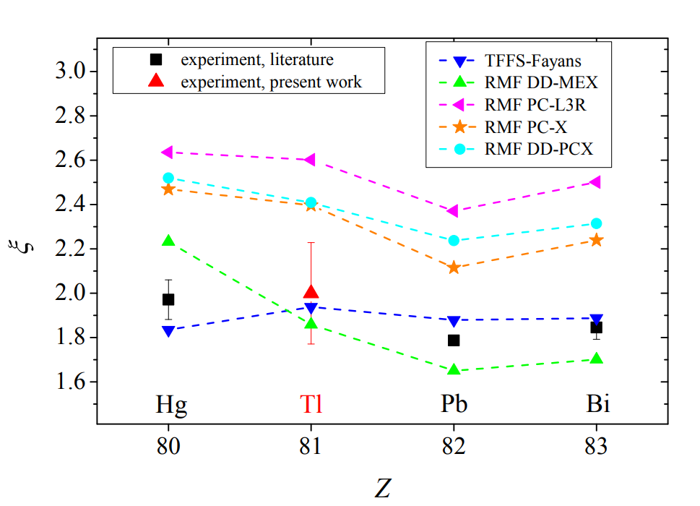
Kink in the charge radii at N=126
ξ = δ<r2> (128,126) / δ<r2> (126,124)
Для ф-ла Фаянса индикаторы излома
согласуются с экспериментальными данными
Известные RMF функционалы
U. C. Perera et.al., Phys.Rev. C 104, 064313 (2021)
либо завышают ξ,
либо приводят к сильной Z-зависимости.
Charge radii of thallium isotopes in the vicinity of magic N =126.
Z.Yue, A. N. Andreyev, A. E. Barzakh , I.N. Borzov, et.al. Phys.Rev. C 110, 034315 (2024).
Electromagnetic moments and radii near N=126.
I.N.Borzov,S.V.Tolokonnikov , Physics of Atomic Nuclei 87, 423 (2024).
Notes:
Полная картина. Здесь показаны ВО ПЕРВЫХ новые измерения для радиусов Tl при А>207 (N>126)
В нашей совм. Работе с ЦЕРН иниц. А Е Барзахом и АндАндреевым
и ВО-ВТОРЫХ предыдущие измерения ЦЕРН Hg Pb Bi, Наши расчеты - КРАСНЫМ
Классический kink-effect Pb ИЗЛОМ изотоп зависимости (производной по N)
Он наблюдается также в Hg Bi и в Tl картина похожая.
Для количеств х-ки использ. Более простой ИНДЕКС излома –
отношение наклонов (производных) 2 ед. от 126 Справа и слева от N=126/
использ экспер-таторами -ЧТО ВИДИМ

Slide 14
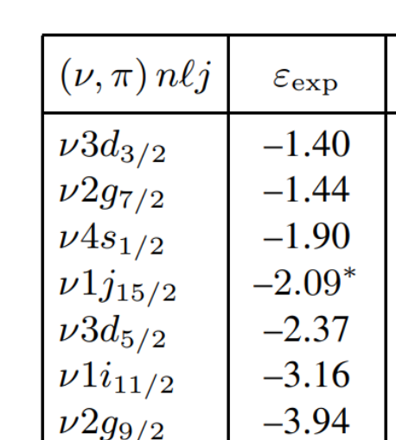
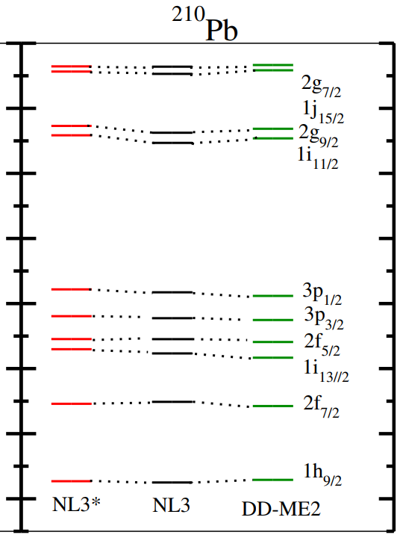
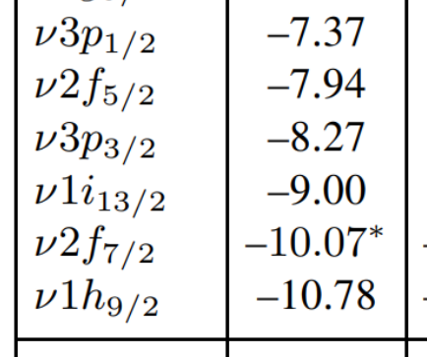

Neutron single-particle spectrum of 208Pb.
RMF 2g9/2 – 1i112 levels inversion vs experiment.
ε, MeV
N>126
N>126
-3.0
n2g9/2 is 780 keV lower!
-5.0
-7.0
N=126
N=126
Neutrons
Notes:
One has to realize that in the rel.calc. In the LEAD region
INVERSION of the g I levels EXISTs.

Slide 15
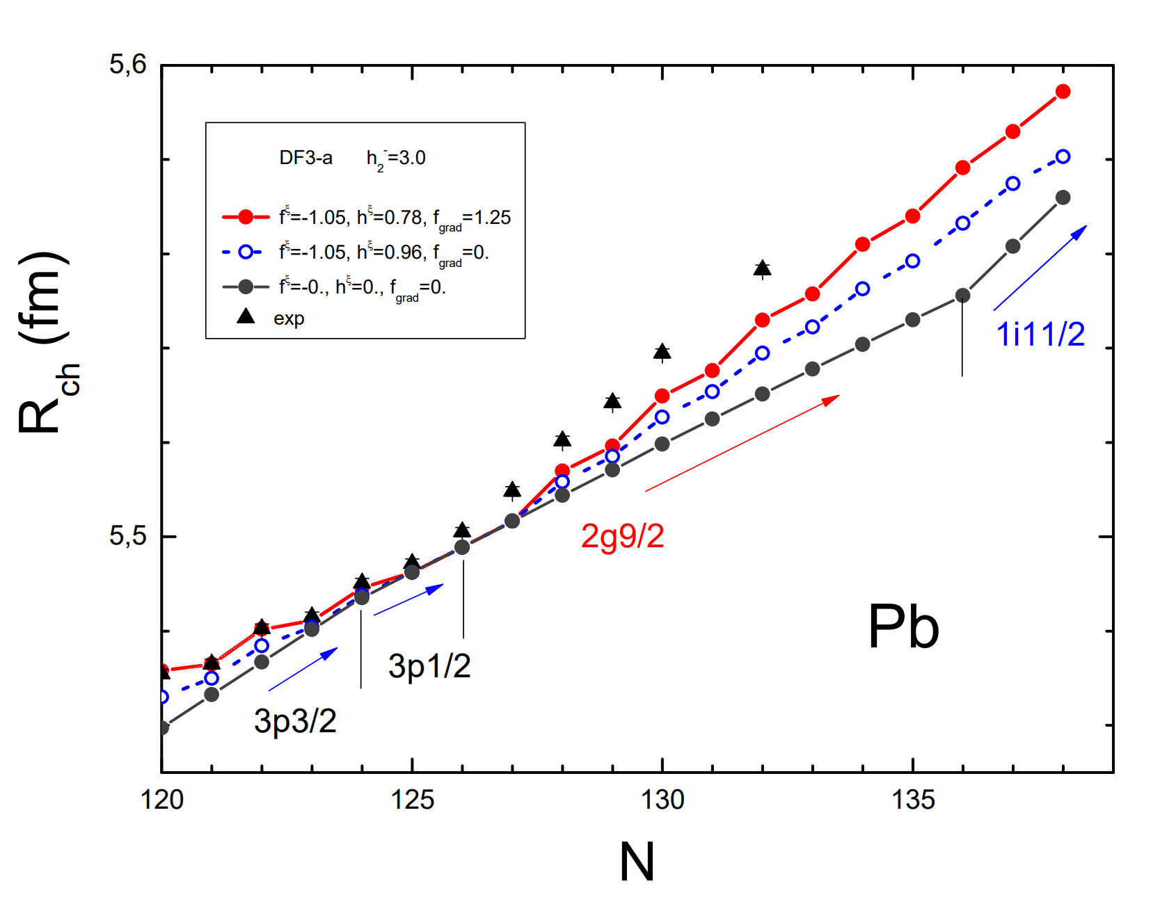
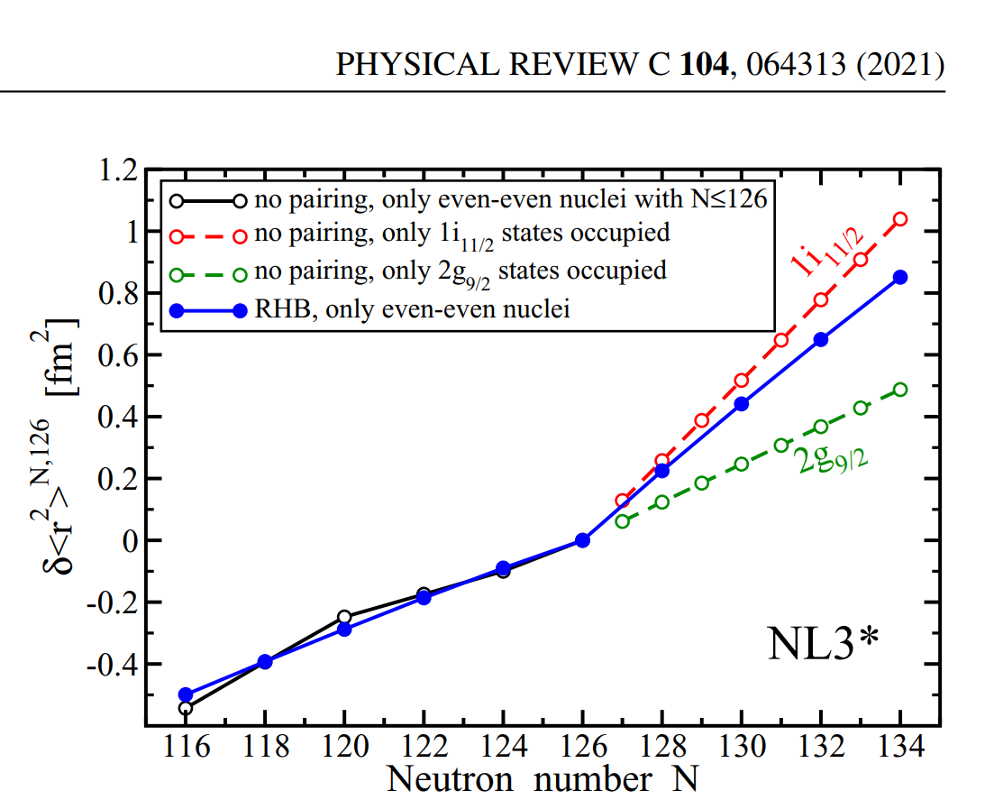
Kink in the charge radii at N=126
RMF : kink exist even without pairing due to inversion n2g9/2 – n1i11/2 .
DF3-a : kink originates mostly due to the gradient pairing
Electromagnetic moments and radii near N=126.
I.N.Borzov,S.V.Tolokonnikov,
Physics of Atomic Nuclei 87, 423 (2024).
U. C. Perera ,A. V. Afanasjev , and P. Ring.
Charge radii in covariant density functional theory:
A global view Phys.Rev. C 104, 064313 (2021)
Notes:
The kink produced by i11/2 relative to g9/2 always exist WITHOT PAIRING
Especially the i11/2 kink cf p1/2

Slide 16
₈₀Hg isotopes. One quasiparticle approximation.
The total β-decay rate depends on the neutron orbitals ordering.
Which one ( 2g9/2 (l=4) or 1i11/2 (l=6) ) is filled the first at N>126 ?
Partial β-decay rate λ depends on :
1. decay energy
ε s.p
arbitrary
scale
1i 11/2
GT
2g 9/2
at N>126 ω_{FF} >> ω _{GT}
λ_{i} ~ t_{1/2} ⁻¹ ~ ω_{i}⁵ < Q ⁵_{β}
GT
N=126
1i 13/2
vs
3p1/2
2. orbital momenta and occupation factors
of combining n and р levels.
1f 7/2
FF
FF
B(GT ⁻) ~ |<p|M|n ⁻¹ >| ²_{s.p.} ~
~ (n_{λn} – (1 – n _{λp} * 8l (l+1) / (2l+1)
1h 9/2
1h 9/2
Z=80
3s 1/2
p
n
Assuming the experimental (!) level’s ordering,
high-energy FF decays from n2g9/2 (l = 4)
give the main contribution to the total rate .
At N>126 low-energy Gamow-Teller decays compete with first-forbidden
cross-shell decays from n2g9/2 и n1i11/2 levels
GT и FF decays from n1i11/2 (l = 6)
are quenched by small n_{λn}.
Notes:
beta-decay of Hg isotopes at N>126 .
Pairing in p and n systems
What is a dependence of q-p level ordering on the TOTAL rate?
The answer – the TOTAL rate is governed by competition
of the low-energy in-shell GT and cross-shell/ h-e FF decays
For N<126 there are some FF decays
For N>126 new GT and FF are opened
For N<126, 1- GT and 1 - FF decays are possible due to
1n ih9/2 to 1nh11/2
1n i13/2 to 1nh11/2
For N>126 (assuming normal ordering)
Ns fill the 2g9/2 state New cross-shell transitions are opened
both from 2g9/2 and also from 1i11/2due to pairing.
Obviously, the intensity of the b-decays
depends on WHICH orbital is filled first g or i.

Slide 17
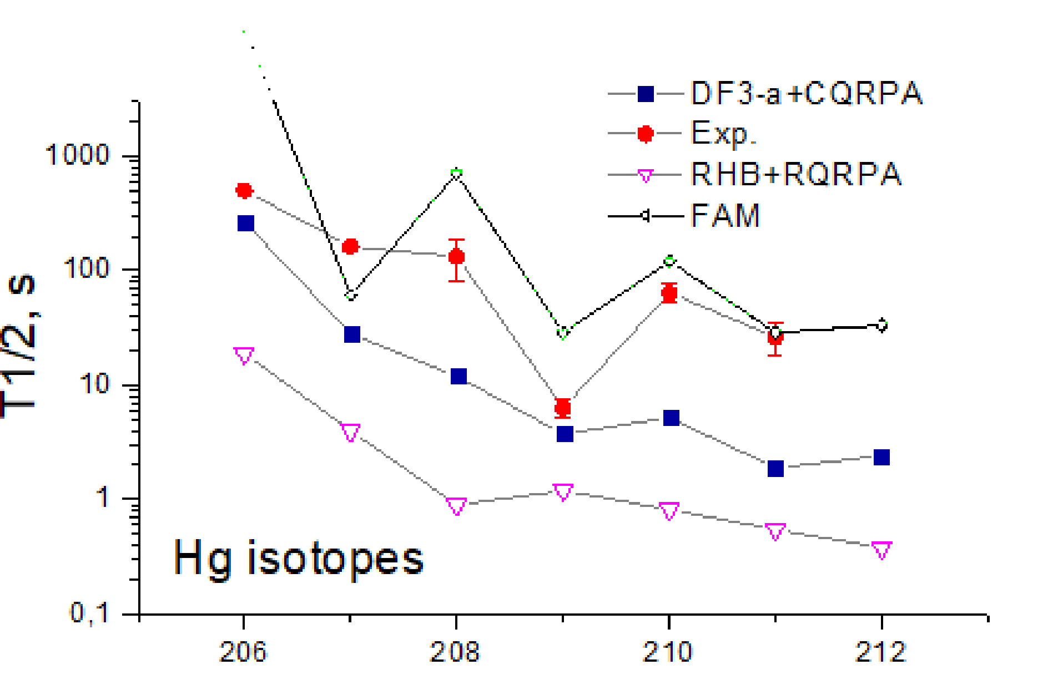
Beta-decay half-lives and Pn-values for Hg isotopes.
DF3-a (with no inversion) vs RMF NL3* (with g-i inversion)
DF3-a
T1/2 at N> 126 factor 2 - 10 underesimate.
RMF (NL3*)
Marketin, L. Huther, G. Martínez- Pinedo. Phys. Rev. C 93, 025805 , 2016
T1/2 up to 100 раз underestimate
inversion increases the FF contribution and
speeds up beta-decay
FAM (UNIDEF)
T. Shafer* and J. Engell, et.al Phys. Rev C94, 055802 (2016)
Up to factor 10 overestimate T1/2
Strong odd-even staggering in Qbeta and T1/2.
»We have new data from ISOLDE's October 2024 run, but they were not yet analyzed properly.»
A.N. Andreev p.c.
А
CERN-ISOLDE
New exp. run for A=209-211 Hg
in Oct.2024
Including the quasiparticle-phonon interaction further speeds up the beta-decay
C. Robin , G.Mart´ınez-Pinedo arXiv:2403.17115v1 2024; Phys.Rev. C (2024)
Notes:
Here are the T1/2 versus the mass number.
A factor of 5 -100 difference of the RMF and exp/ T1/2
Questions to the present exp.data – what is the reason for irregular T1/2 at 208 and 209 ?

Slide 18
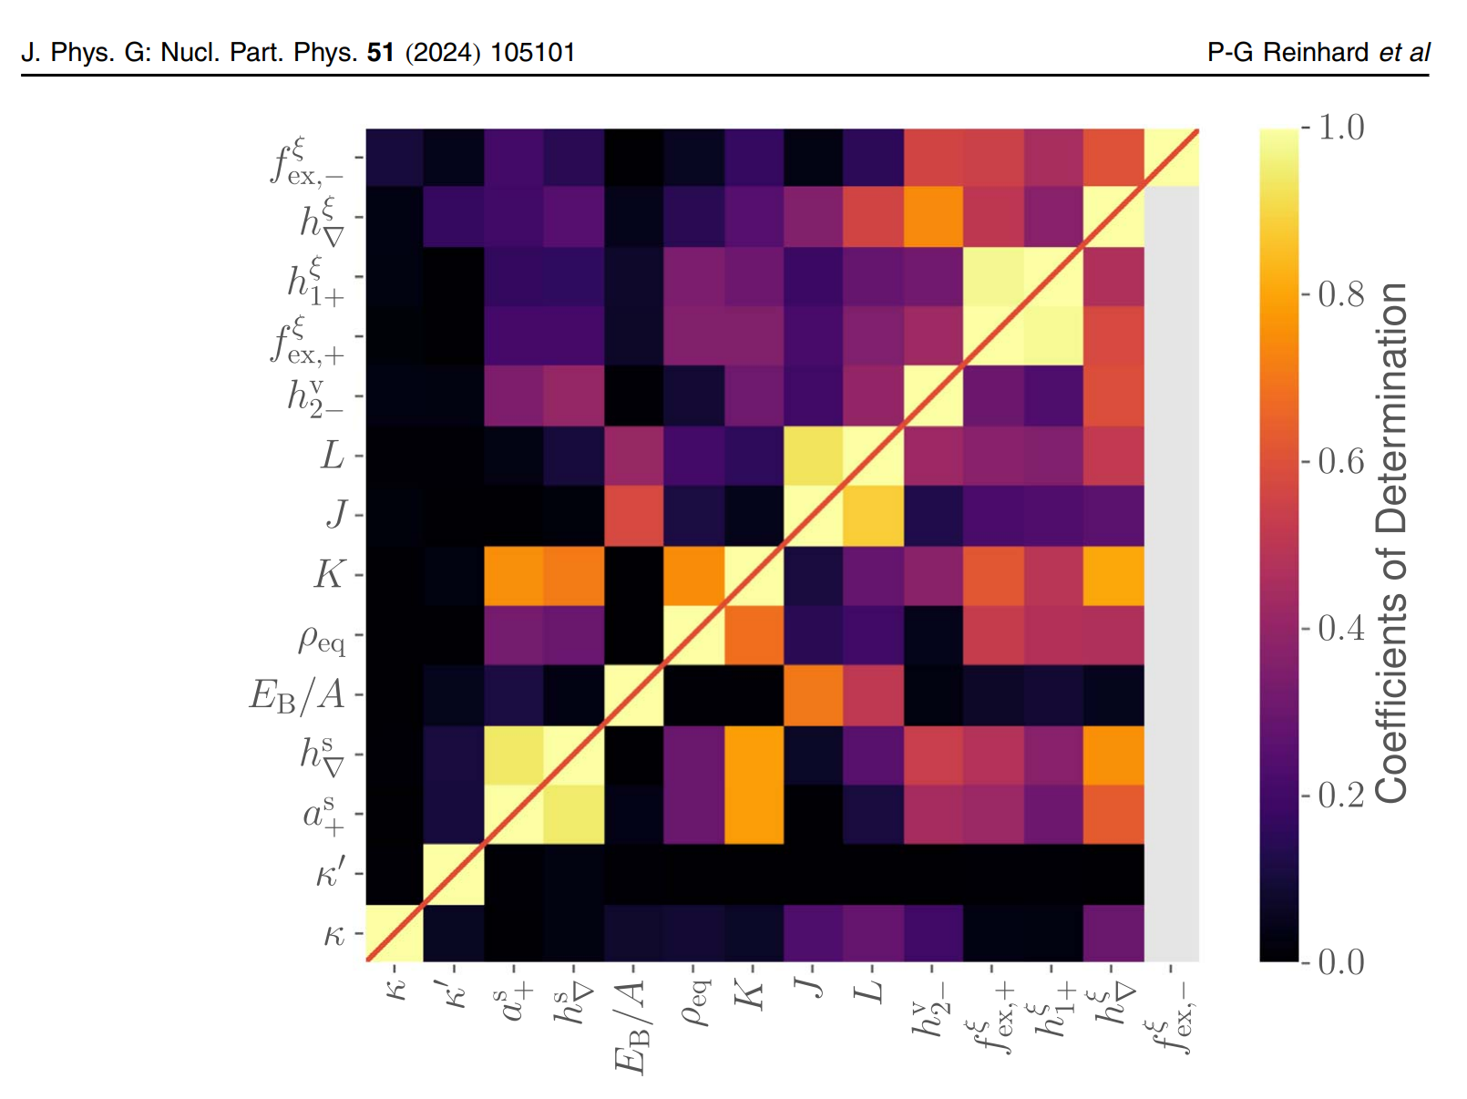
Correlation of the EoS parameters Correlation between the Fayans EDF
with nuclear data on g.s and excited states. and EoS parameters
There is one-to-one correspondence between the EDF parameters and nuclear matter parameters at the saturation
J [MeV]
Reinhard P G and Nazarewicz W 2022 Phys. Rev. C 105 L021301
h-1, h-2 ~ L
Notes:
To summarise /
There is a correlation of …. And …..
The fine tuning of the DF3-type functionals will be continued/

Slide 19
Conclusion
Previously unused isovector volume parameter h-₂ of DF3-a, f functionals is varied.
We keep the same quality of the DF3 fits to densities, nuclear masses, single-particle levels, charge radii.
The slope parameter L=L(ρ₀ ) of symmetry energy S(ρ) is found to be very sensitive to h-₂ .
h-2 can be fixed within rather narrow interval of 1 .0 – 1.5
in order to simultaneously describe :
- the nuclear EOS parameters {J, L} as estimated in P-G Reinhard (PRL127 2021);
- the experimental energy of the E1 giant dipole resonance.
- but the corresponding EoS can not describe the NS with M~2.1Msol !
Varying two isovector paramerers h-1, h-2 leads to a stiffer EOS of PNM
and improves neutron star mass M max ≈ 1.98 ± 0.1 M sol which is comparable to that of FANDF⁰
What next ? Further fitting h-1, h-2 of DF3-a
- to the standard set of nuclear structure data;
- to systematics of α_{D} within the fully self-consistent model;
- to systematics of “mirror neutron skin” ΔRnp -m

Slide 20


Acknowledgments
A.E. Barzakh, A.N. Andreev for collaboration on
Charge radii of thallium isotopes in the vicinity of magic N =126.
Z.Yue, A. N. Andreyev, A. E. Barzakh , I.N. Borzov, et.al. Phys.Rev. C 110, 034315 (2024).
E.E. Kolomeitsev and A. Yudin for their contribution to the RSCF - 10161
Partially supported by RSCF – 10161 in 2021-2023

Slide 21
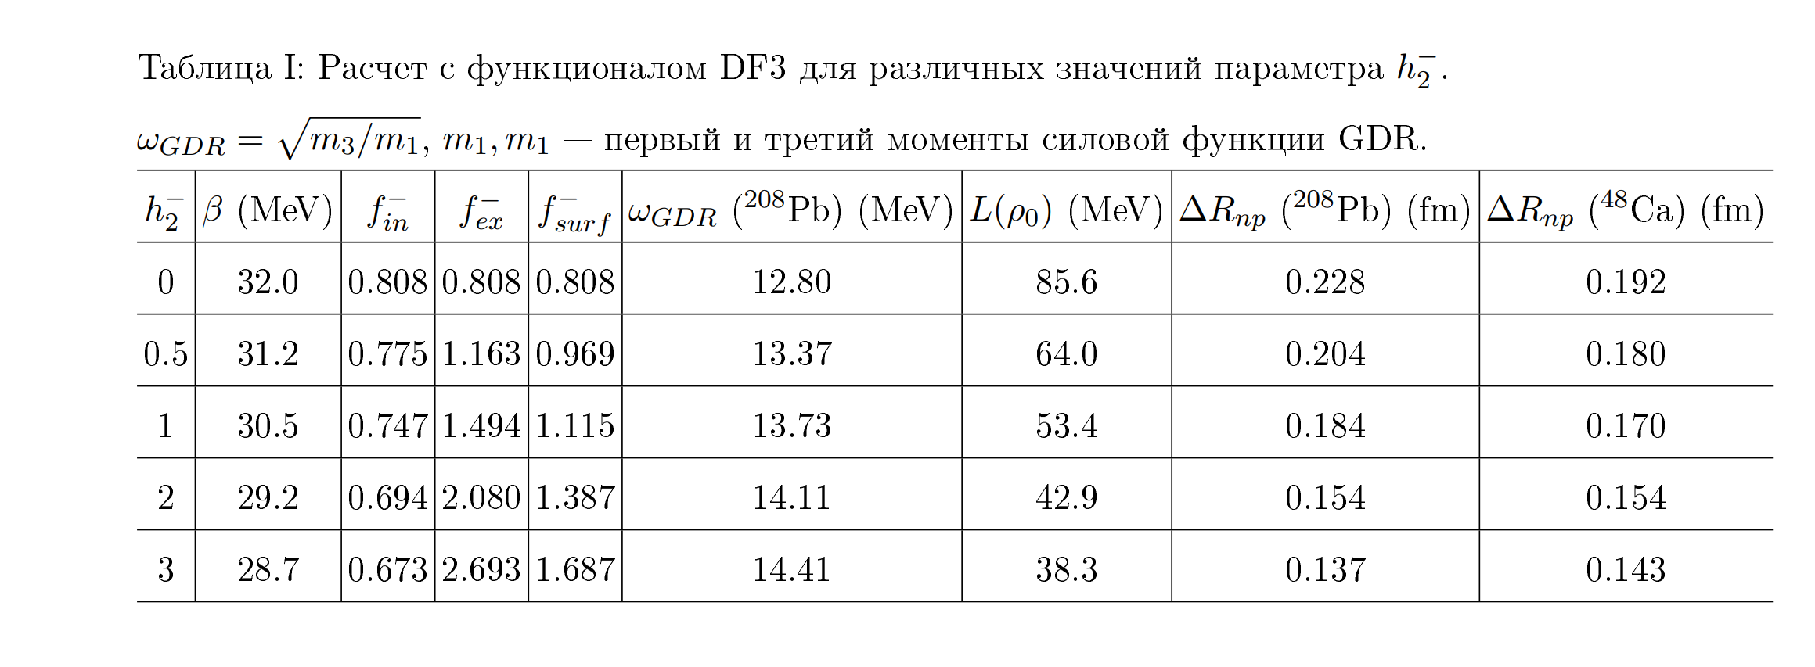
DF3-f. Giant dipole resonance (E1, GDR,208Pb) = 14.2 + - 0.2 MeV
For h-2 = 1.5 Rnp (208Pb) = 0.171 fm
208 Pb Estimated Rnp = 0.19 ± 0.2 fm
Ex th E1 = 14.0 MeV
Ex exp E1 = 14.2 ± 0.2 MeV
For h-2 = 1.5 Rnp (48Ca) = 0.160 fm
48 Ca CREX Rnp = 0.121 + 0.026 - 0.024
p+(A,Z) Rnp= 0.158 ± 0.023±0.012 (T.Wakasa et al)
FANDF⁰ Rnp (208Pb) = 0.134 fm
FANDF⁰ Rnp (48Ca) = 0.154 fm
h-2 = 1.0 -1.5
Fayans Functional. Constraints from Equations of State
I.N. Borzov1),2)* and S. V. Tolokonnikov1),3)
Physics of Atomic Nuclei, 2023, Vol. 86, No. 3, pp. 304–309.
Notes:
Adding the exp.data on the upper limit of the E1 GDR in 208Pb in the fit,
shrinks the h-2 acceptable interval to ~1.0 – 1.5. With these values in hand:
For 208Pb h-2 1.5 we are close to the cenrtal values estimated
from the extended data set I ‘ve mentioned.
And for 48Ca - we are at upper limit of the CREX and close to p+(AZ).
At the same time for FANDF the 208Pb neutron skin is much smaller that the estimated one.
For comparison FANDF gives much lower Rnp for 208Pb. For Ca – the same.

Slide 22

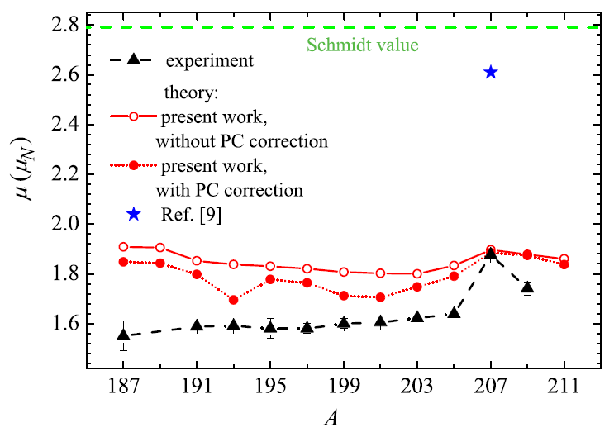
Фундаментальные исследования
в области физики атомного ядра
Описание магнитных моментов изотопов Талия
Z. Yue, A.N. Andreyev, A.E. Barzakh, I.N. Borzov, S.V. Tolokonnikov et al.
Magnetic moments of thallium isotopes in the vicinity of magic N = 126.
Phys. Lett. B 849 (2024) 138452
Работа в рамках тематического плана НИЦ КИ:
теоретики из КЯФК (тематика 10Ф.5.2) совместно с экспериментаторами из ПИЯФ и CERN
Методами теории конечных ферми-систем с использованием оригинального энергетического функционала плотности Фаянса (разработан в НИЦ КИ), успешно описаны магнитные моменты изотопов Талия, в частности впервые измеренные магнитные моменты ²⁰⁹Tl g.s и ²⁰⁷Tl i.s.
Значимость: развитие и верификация методов описания структуры атомных ядер
Рис.: магнитные моменты изотопов Tl
в основном состоянии J^{π} =1/2+

