Slide 1
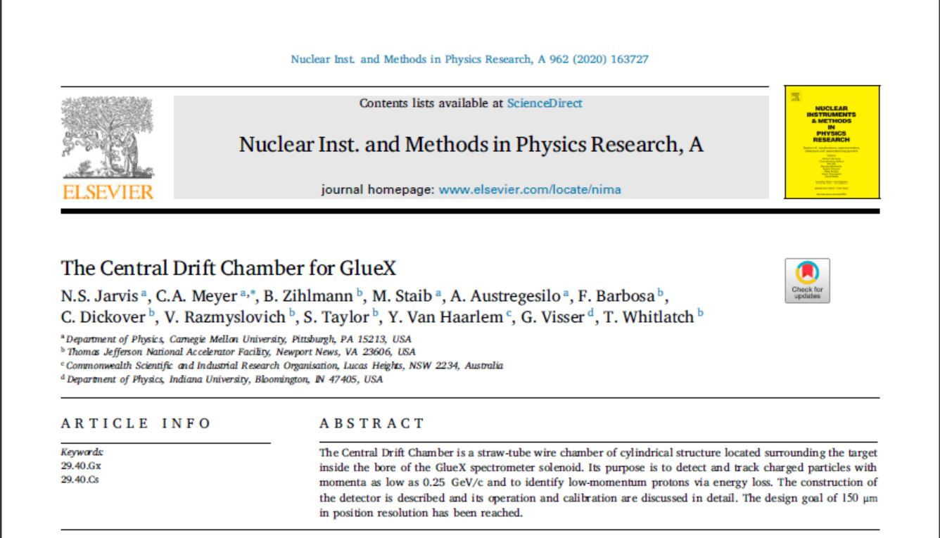
CDC for GlueX

Slide 2
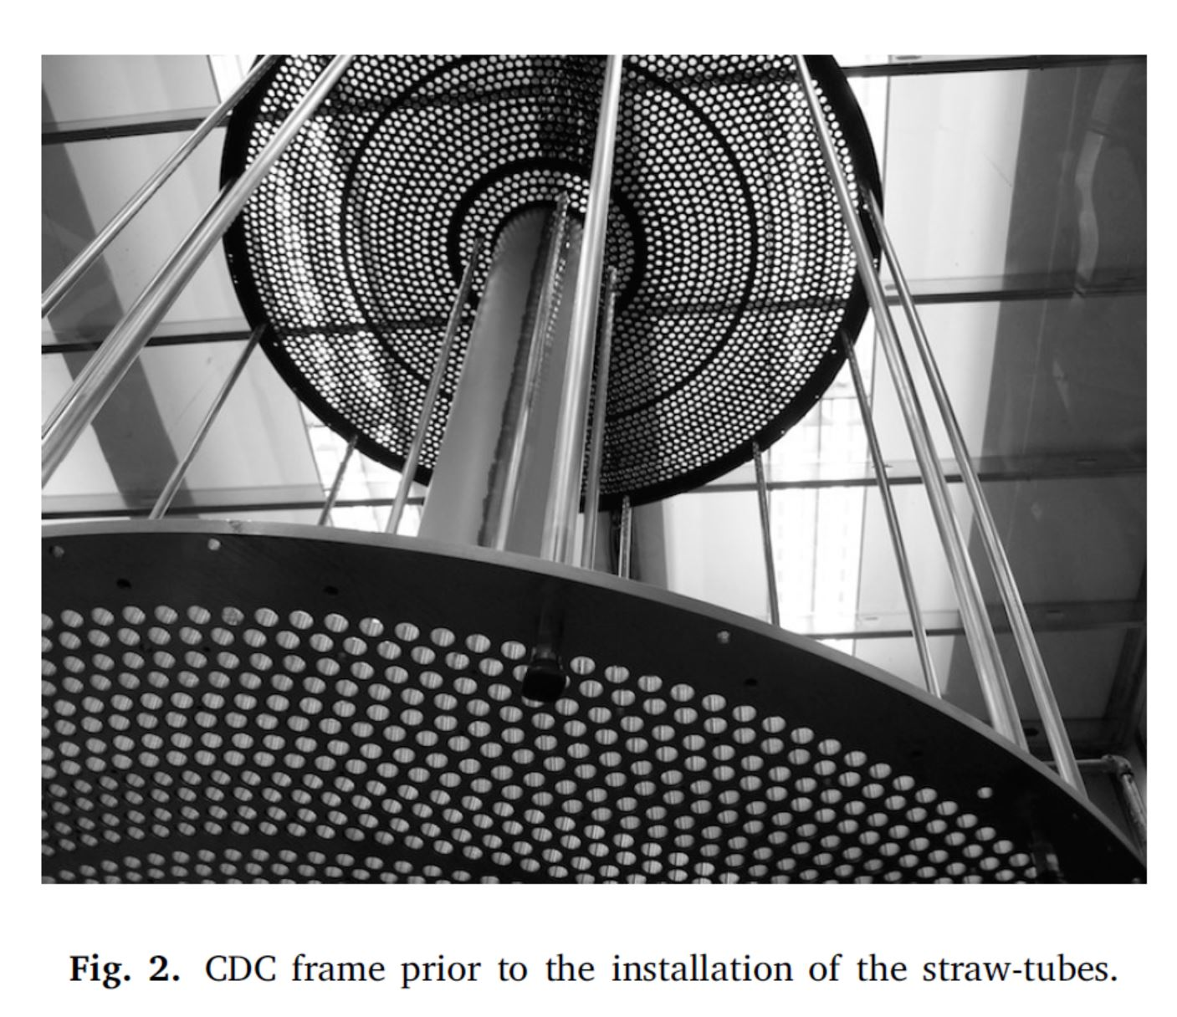
CDC for GlueX

Slide 3
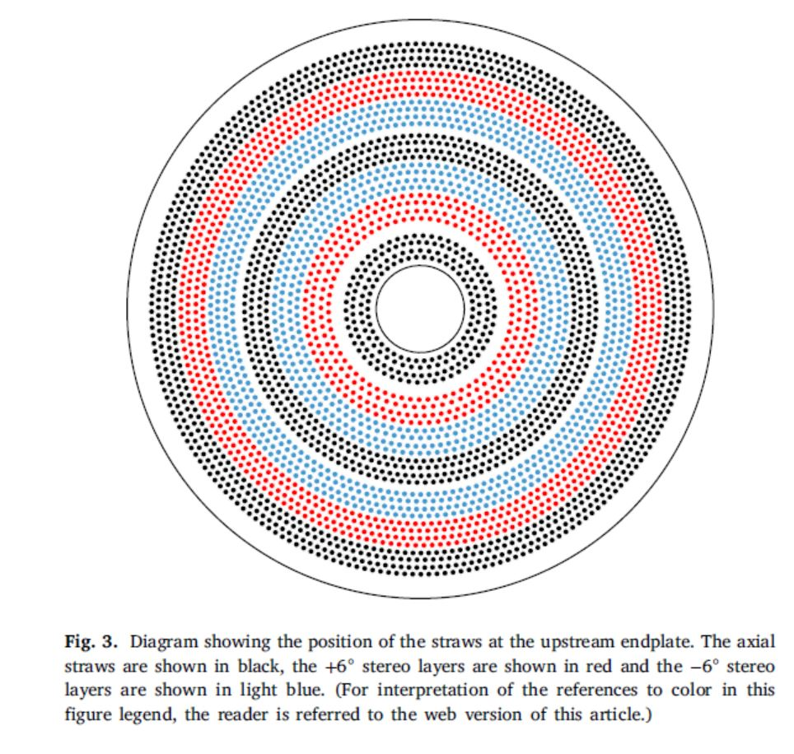
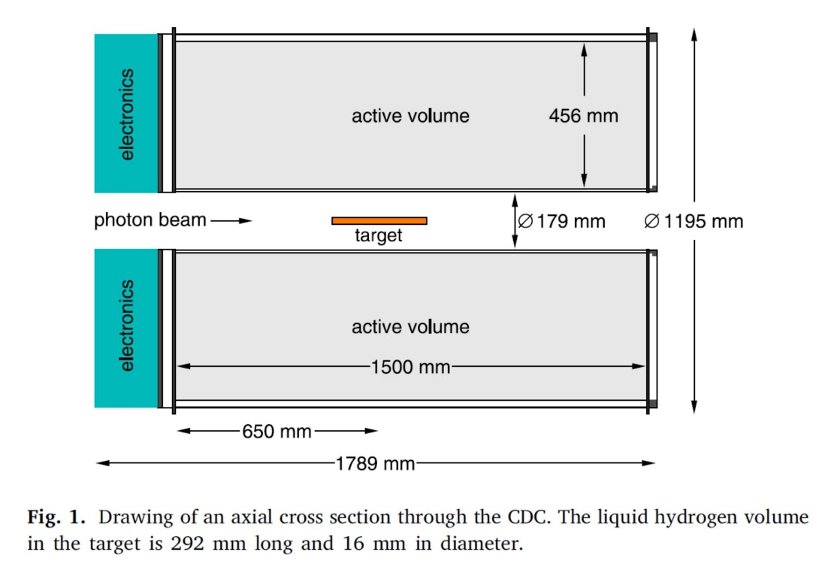
CDC for GlueX

Slide 4
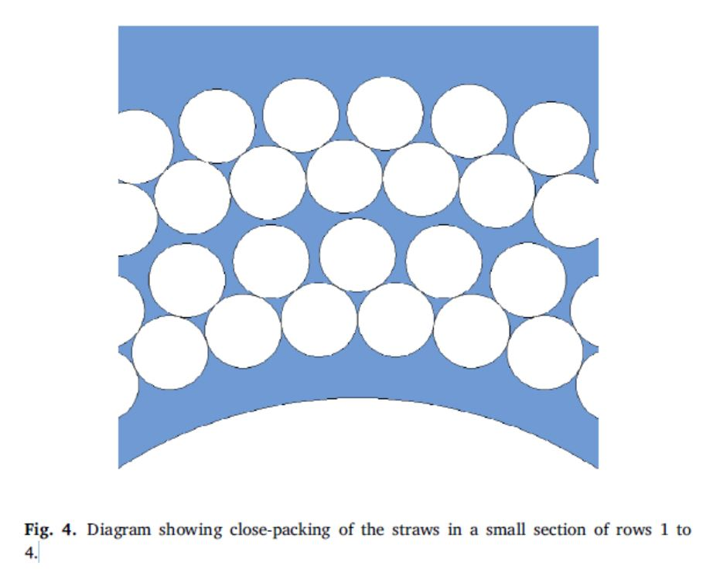
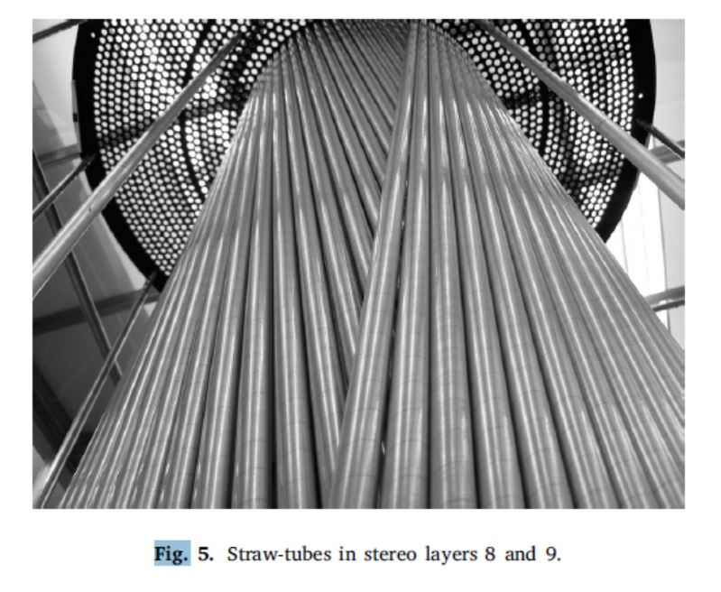
CDC for GlueX

Slide 5
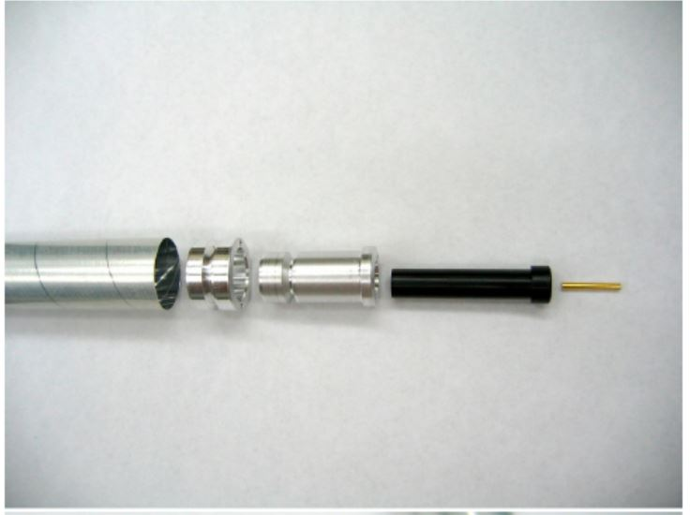
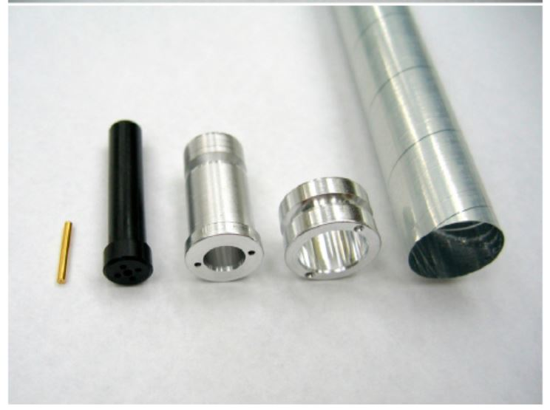
CDC for GlueX

Slide 6
CDC for GlueX

Slide 7
CDC for GlueX

Slide 8
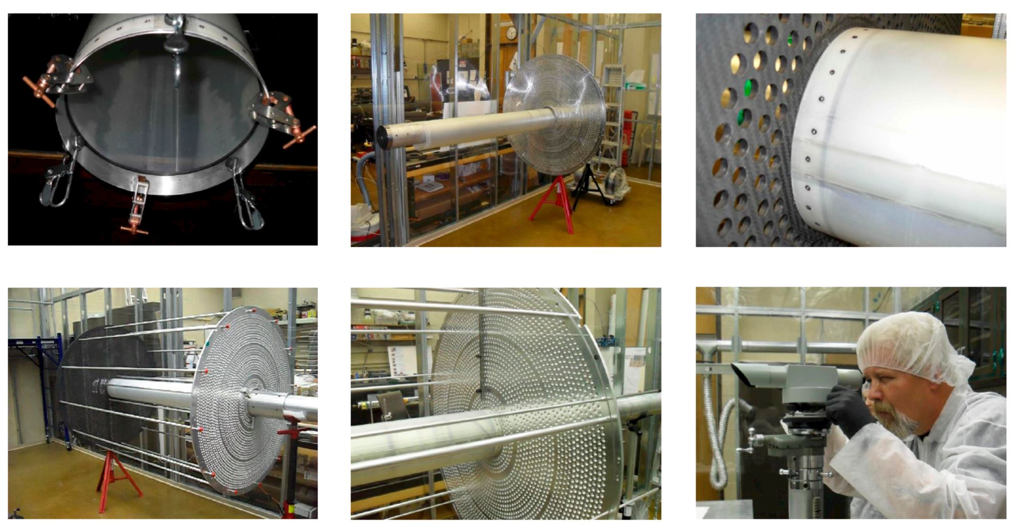
CDC for GlueX

Slide 9
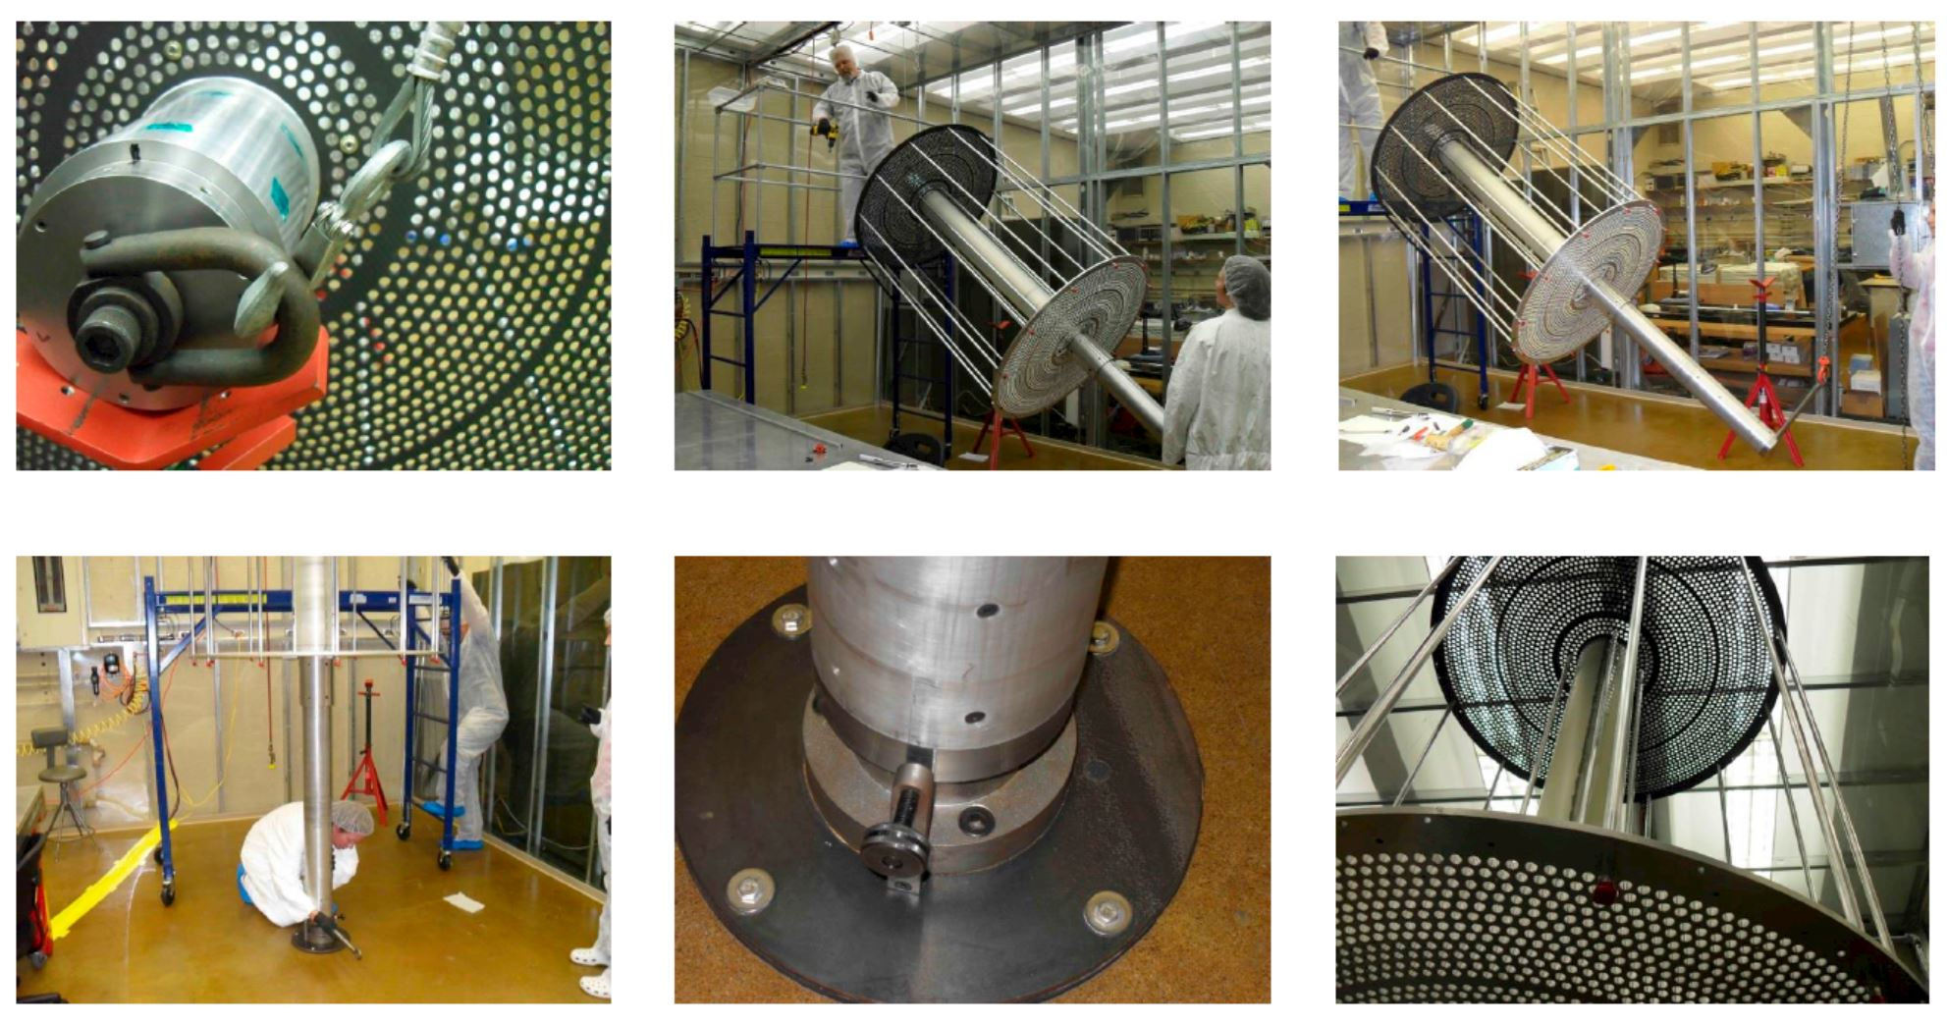
CDC for GlueX

Slide 10
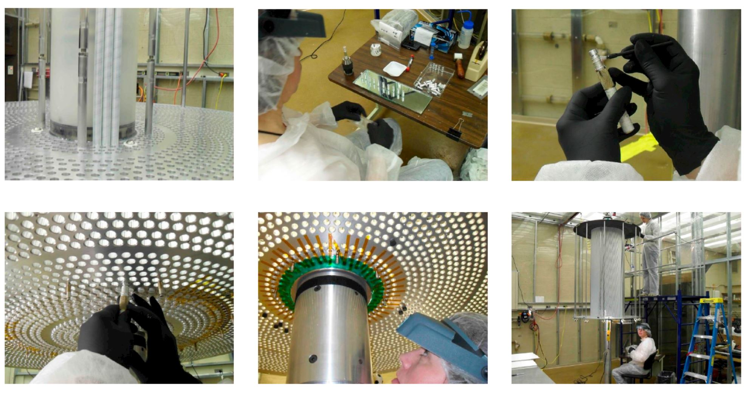
CDC for GlueX

Slide 11
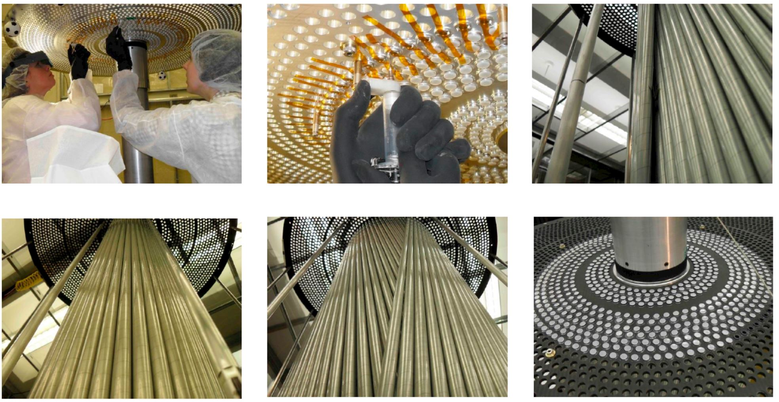
CDC for GlueX

Slide 12
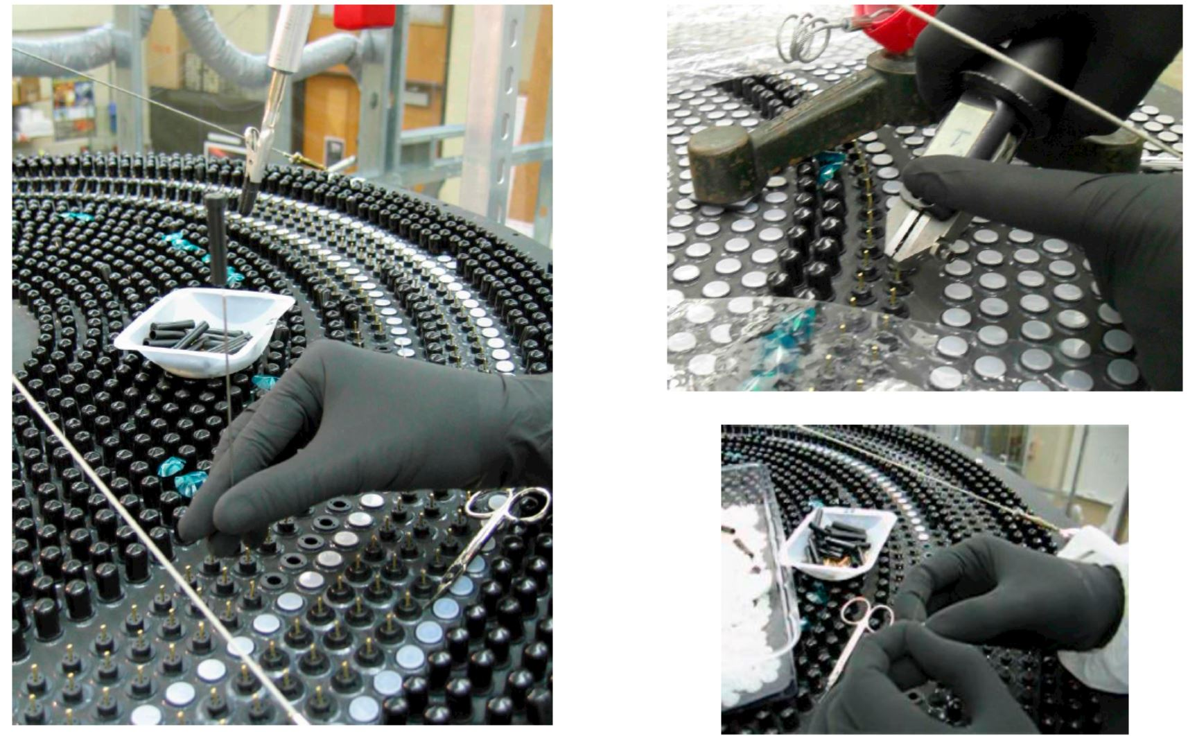
CDC for GlueX

Slide 13
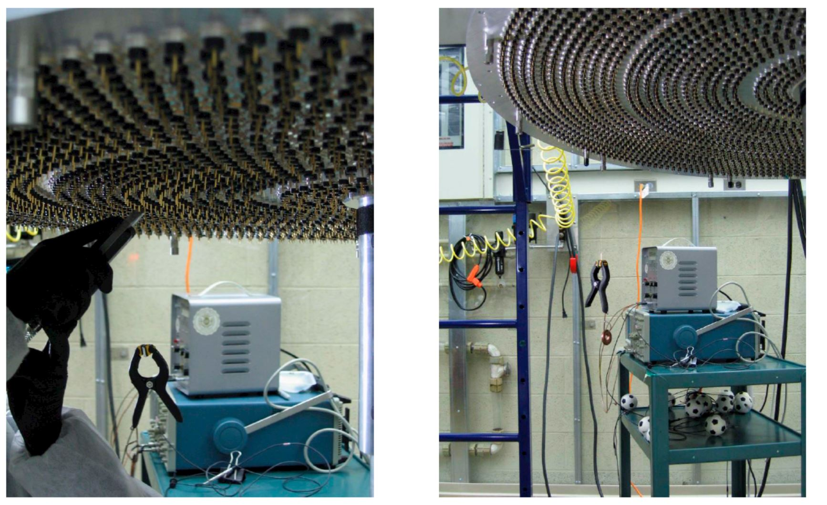
CDC for GlueX

Slide 14
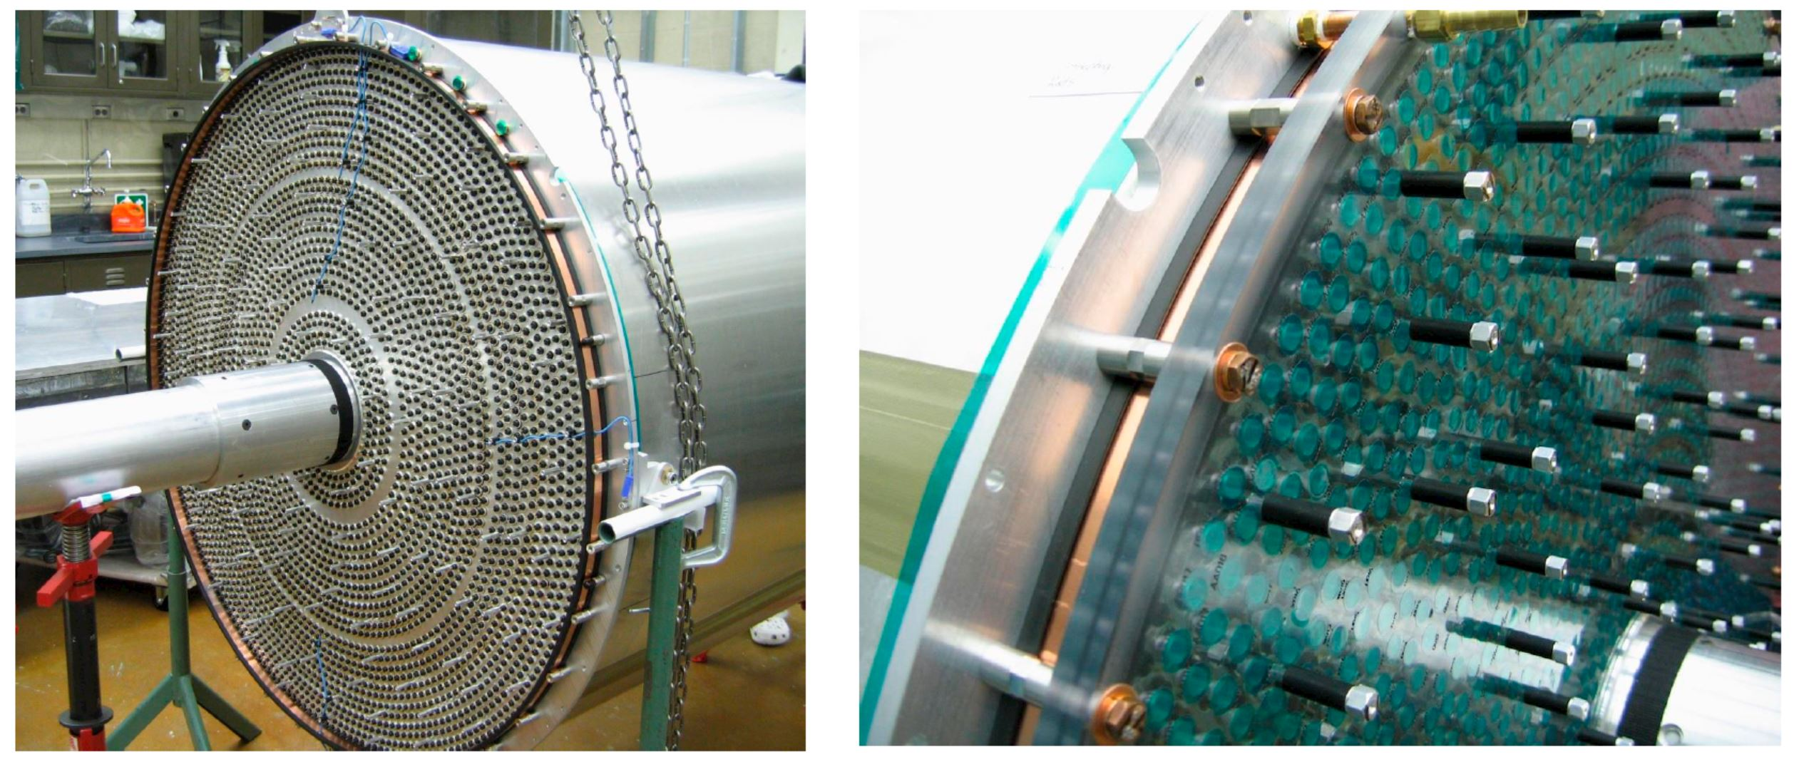
CDC for GlueX

Slide 15
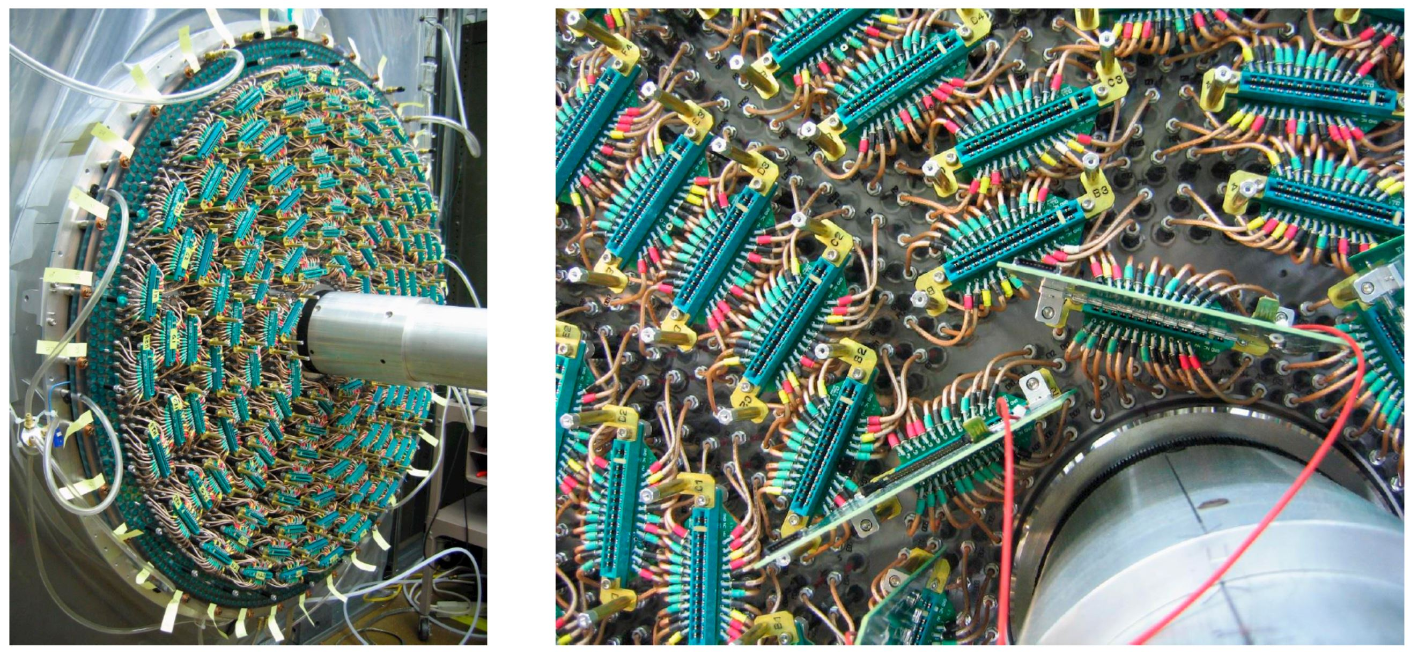
CDC for GlueX

Slide 16
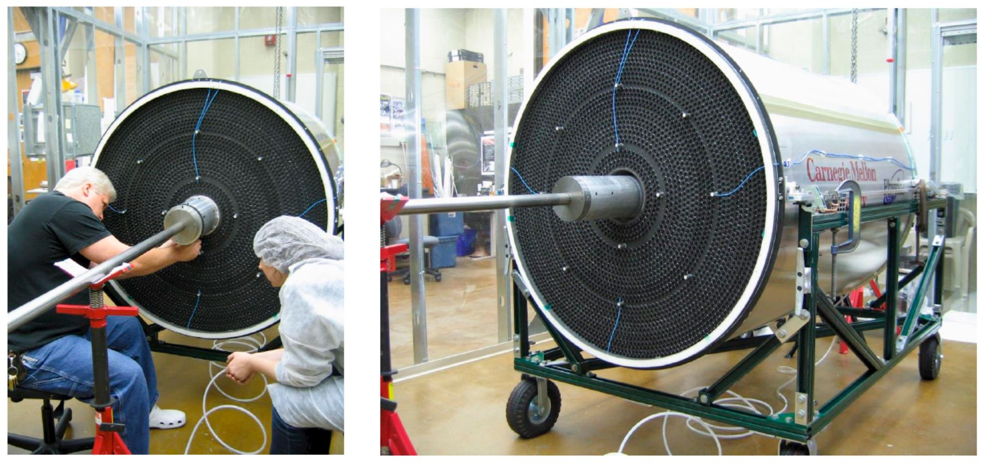
CDC for GlueX

Slide 17
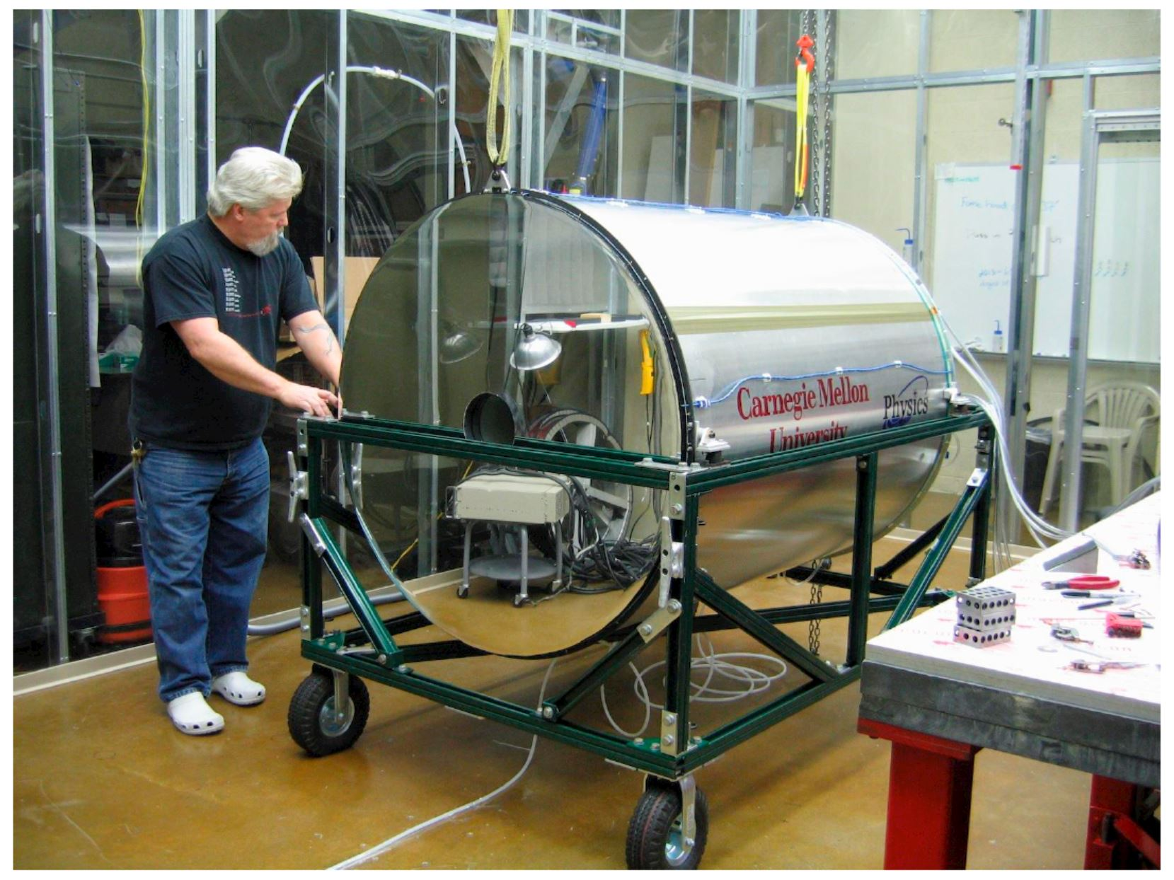
CDC for GlueX

Slide 18
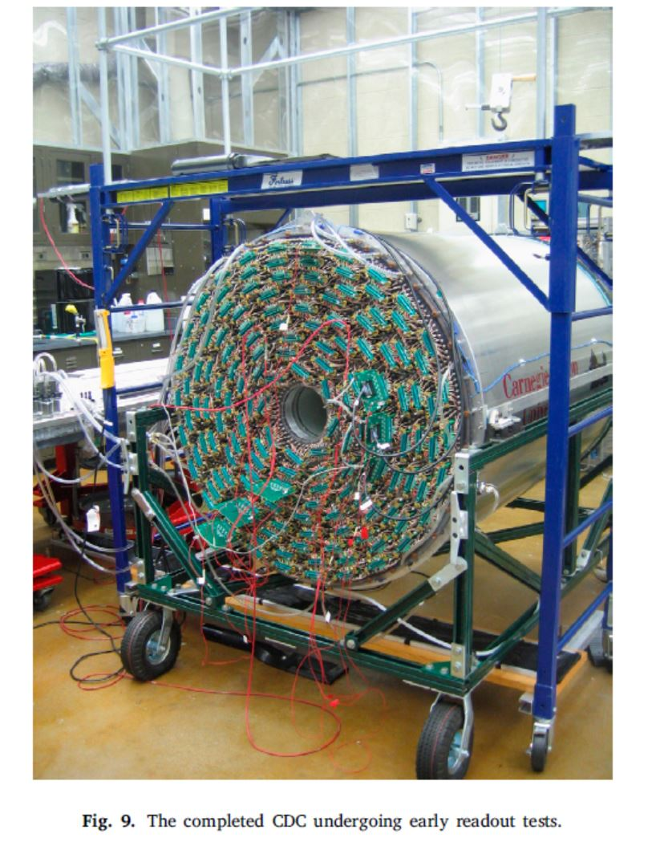
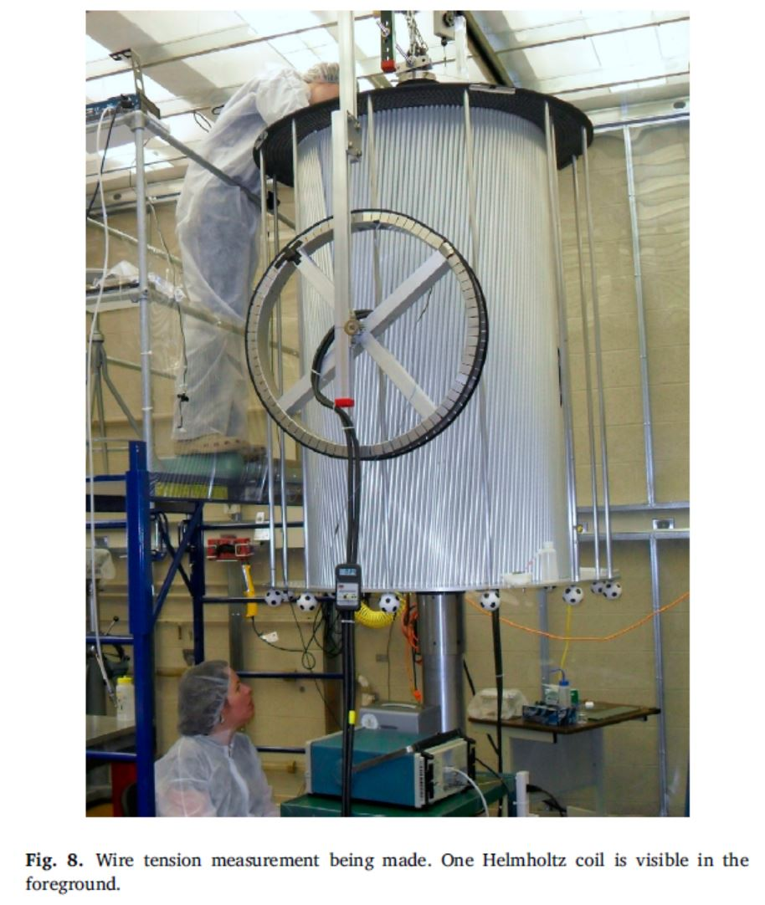
CDC for GlueX

Slide 19
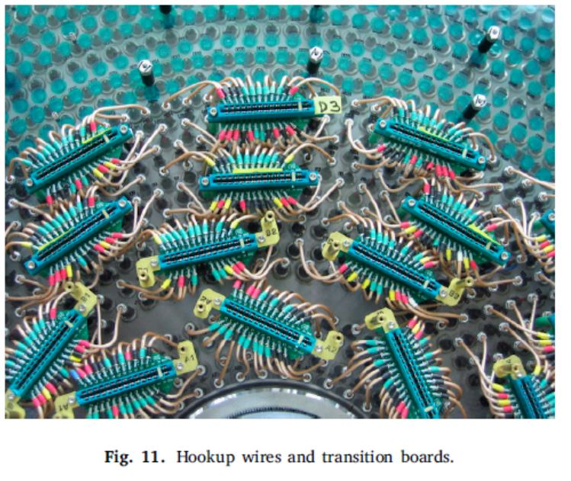
CDC for GlueX

Slide 20
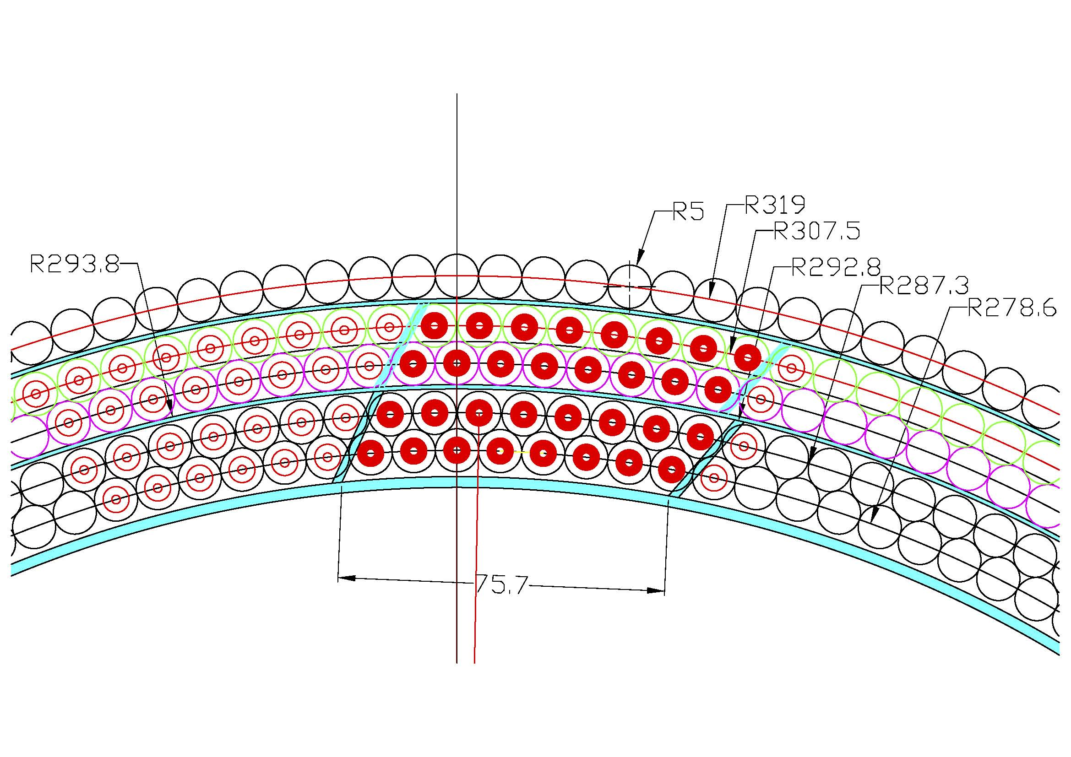
Предложение сделать как в CDC for GlueX

Slide 21
CDC for GlueX
SiPMs, scintillator and reflector samples irradiation by IBR and testing
One prototype scintillator module is being tested in JINR
3 prototype scintillator modules sent for study at CERN, DESY and US(FNAL…) for testing.

