Slide 1
A Critical Evaluation of GAN-Based Data Extension Methods for Plant Disease Classification in Low-Resource Settings
Alexander Uzhinskiy
auzhinskiy@jinr.ru
https://t.me/bigzmey
11th International Conference "Distributed Computing and Grid Technologies in Science and Education“
(Dubna, G]RID'2025) 7–11 July 2025

Slide 2


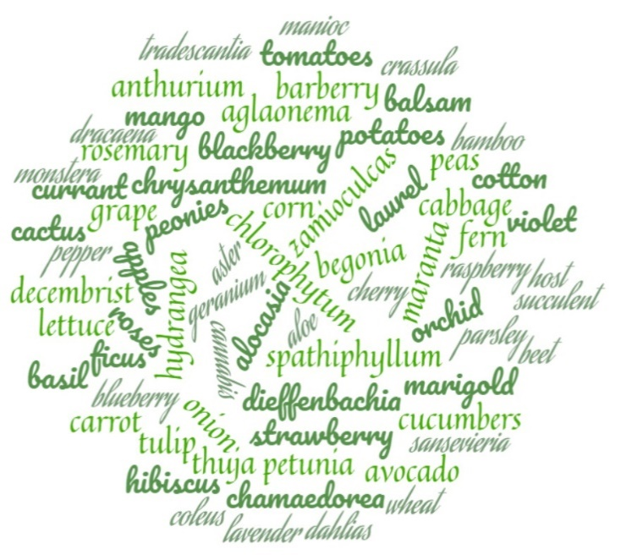
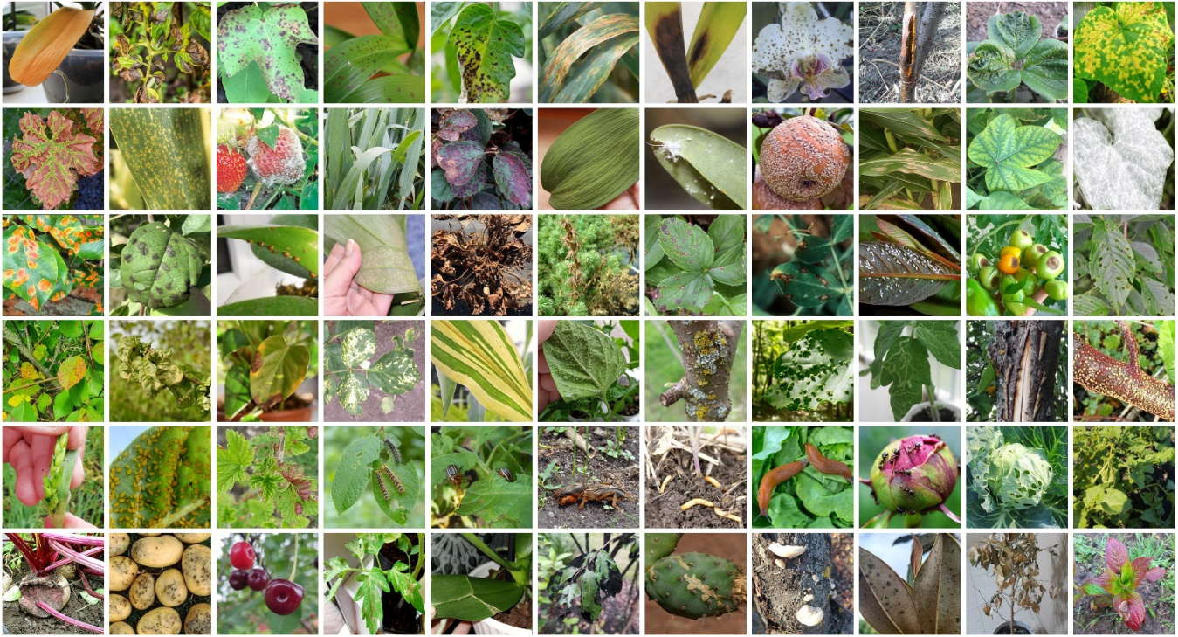
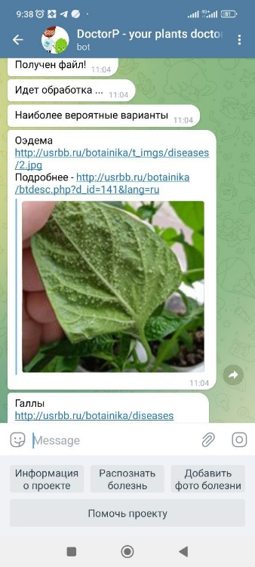
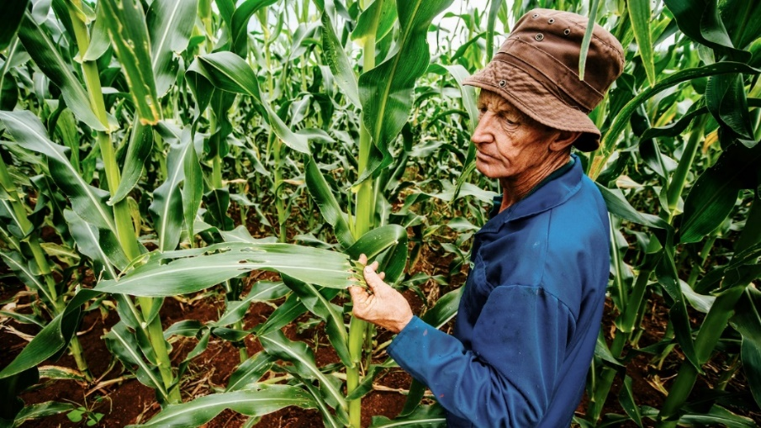
Background
2

Slide 3
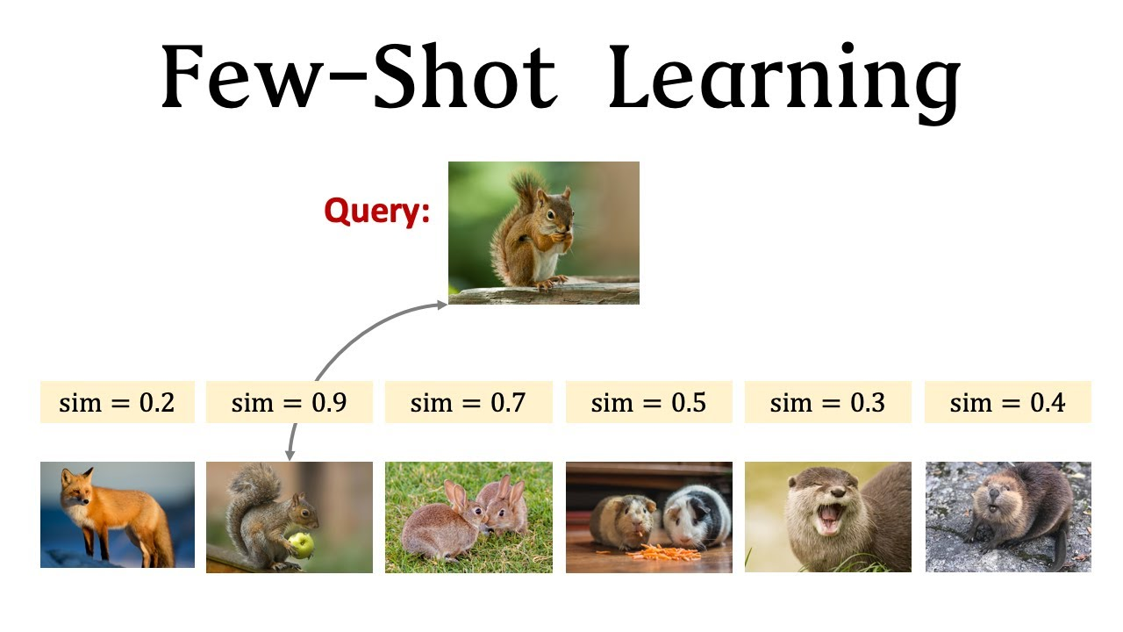
What to do?
Few-shot learning (FSL) is a branch of supervised machine learning, focused on learning from limited number of examples
Inspired by human/animal ability to rapidly generalize from few examples.
Typical scenarios:
Learning for rare cases – when obtaining labelled data is hard or impossible
Reducing data gathering effort and computational cost
Variations:
(<50, e.g. 5,10)-shot learning: General case, where only few examples are given
1-shot learning: Extreme case, where only one data example is given (e.g. 1 image per class)
0-shot learning: Instead of image, we have description of new class
‘Less than 1’-shot learning²: N classes, M examples, M<N, use soft-labels
Why does it work?
In ML, experience is gained by fitting data.
In FSL we also have prior knowledge.Two training phases:
Gain prior knowledge by fitting large amount of examples that are similar to goal task
Gain experience on small dataset for goal task.
3

Slide 4
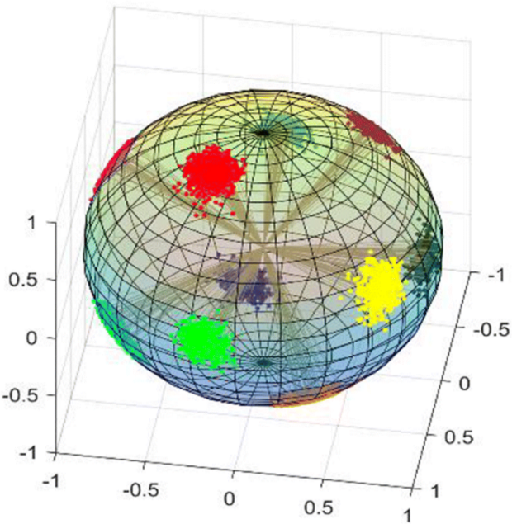
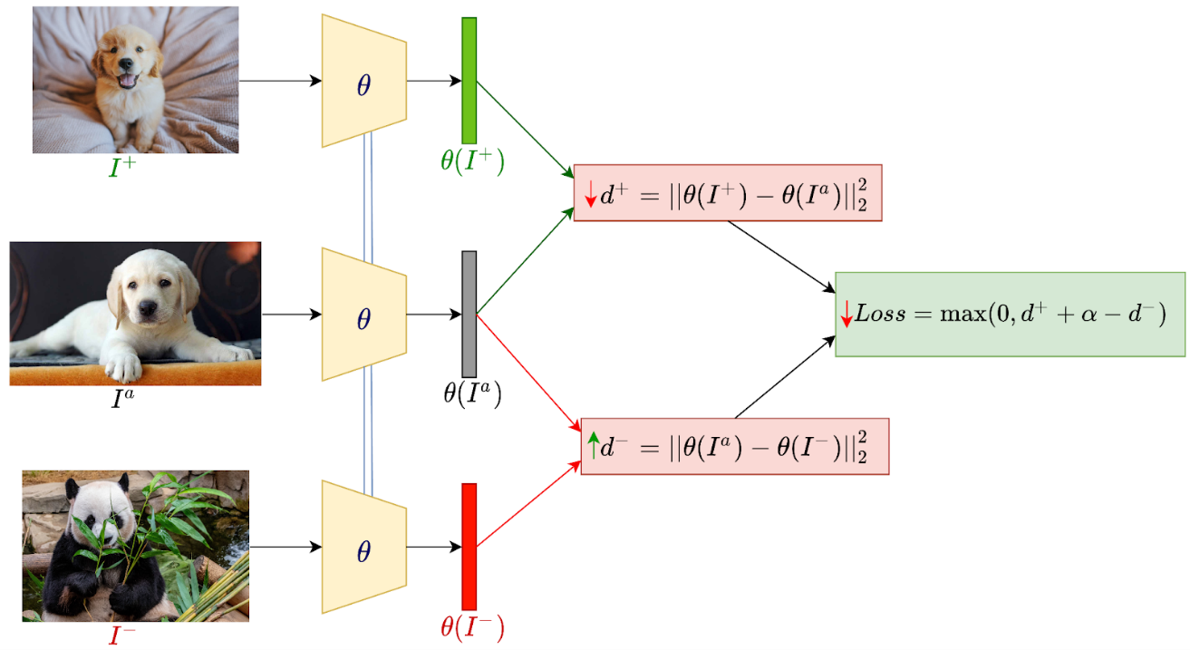
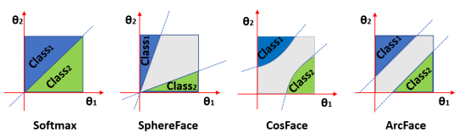
Similarity learning
Base networks:
ResNet,
MobileNet, EfficientNet,
ViT,
ConvNeXt
Triplet loss is a technique used in similarity learning, where the model is trained using three data points at a time: an anchor, a positive sample (similar to the anchor), and a negative sample (different from the anchor). The goal is for the model to learn meaningful representations by ensuring that the positive sample is closer to the anchor than the negative sample in the learned feature space. The method is valued for its ability to learn robust features even from limited data, but it requires careful selection of training triplets to maintain effectiveness.
ArcFace, or Additive Angular Margin Loss, is a loss function used in face recognition tasks. The softmax is traditionally used in these tasks. However, the softmax loss function does not explicitly optimise the feature embedding to enforce higher similarity for intraclass samples and diversity for inter-class samples, which results in a performance gap for deep face recognition under large intra-class appearance variations.
4

Slide 5
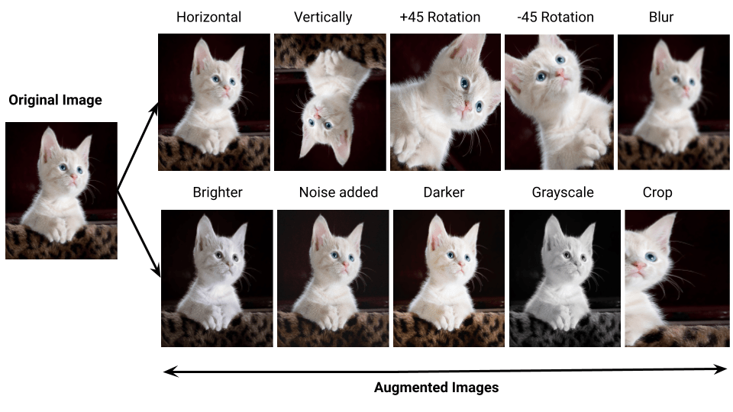
Data augmentation
In addition to (or as an alternative to) similarity learning, we can use data augmentation techniques to increase training data.
The effectiveness of classical data augmentation techniques in small dataset scenarios can vary; in our case, we always observe a decrease in accuracy.
5

Slide 6
A Generative Adversarial Network (GAN)
A Generative Adversarial Network (GAN) is a type of artificial intelligence system that uses two neural networks—called the generator and the discriminator—to create new, realistic-looking data.
Generator: This network tries to make fake data (like images) that look real.
Discriminator: This network tries to tell if the data is real or fake.
They work together like a game: the generator tries to fool the discriminator, and the discriminator tries to catch the fakes. As they keep playing, the generator gets better at making realistic data, and the discriminator gets better at spotting fakes. Eventually, the generator makes data so good that the discriminator can’t tell it apart from real data
6

Slide 7
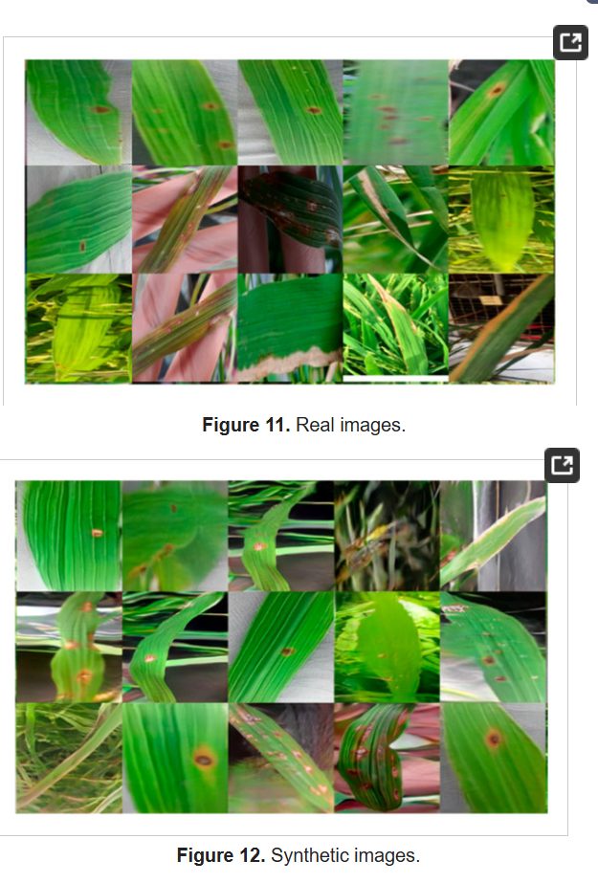
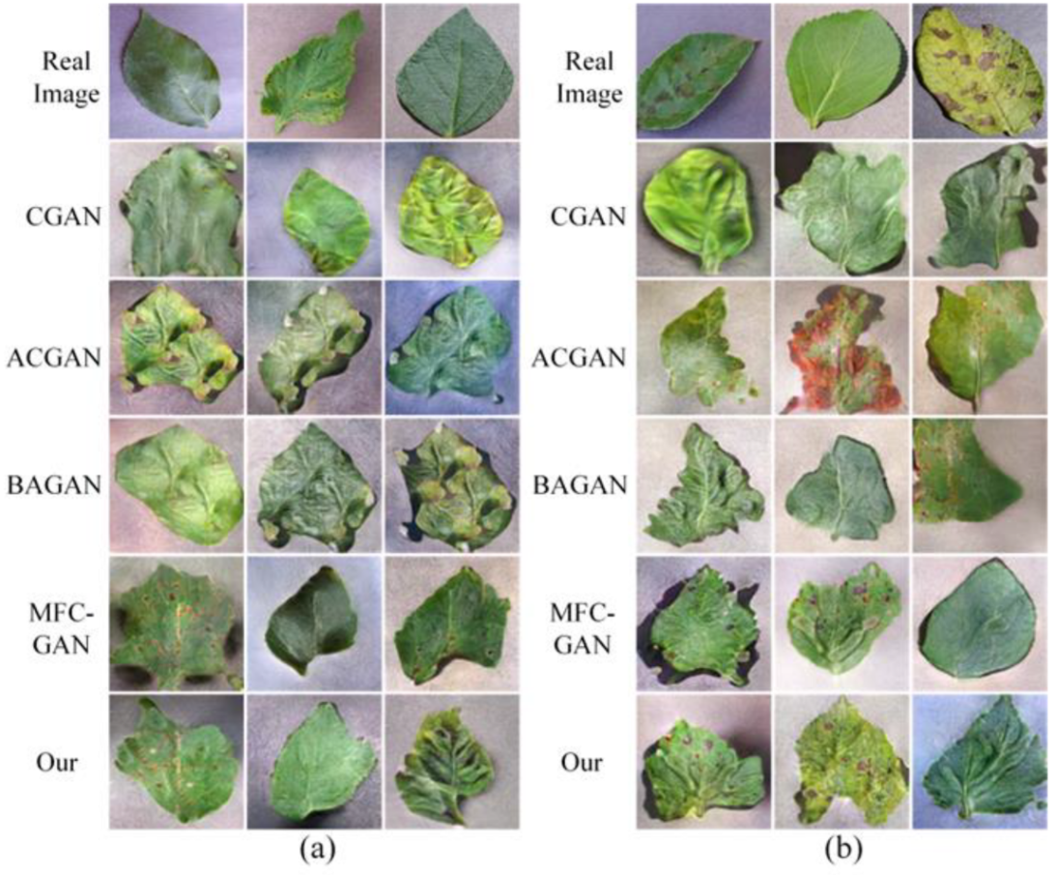
A Generative Adversarial Network (GAN)
One can find many research studies where GANs are used to generate additional data for the classification of plant diseases, improving the accuracy of classification methods.
Wang, X.; Cao, W. GACN: Generative Adversarial Classified Network for Balancing Plant Disease Dataset and Plant Disease Recognition. Sensors 2023, 23, 6844. https://doi.org/10.3390/s23156844
Haruna, Y.; Qin, S.; Mbyamm Kiki, M.J. An Improved Approach to Detection of Rice Leaf Disease with GAN-Based Data Augmentation Pipeline. Appl. Sci. 2023, 13, 1346. https://doi.org/10.3390/app13031346
7

Slide 8
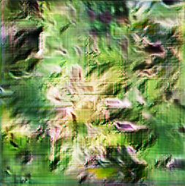
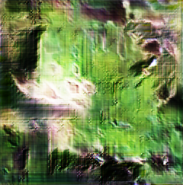
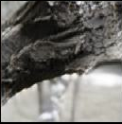
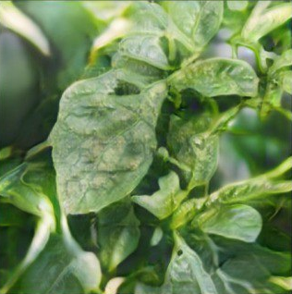
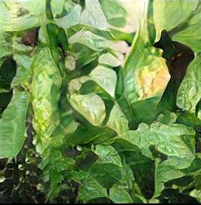
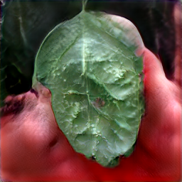
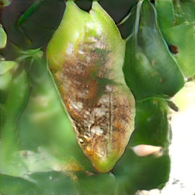
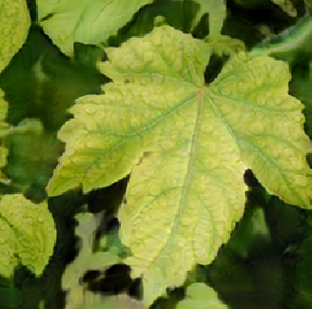
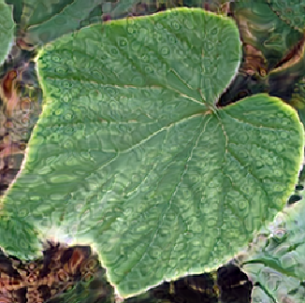
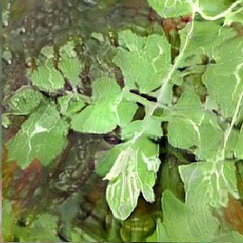
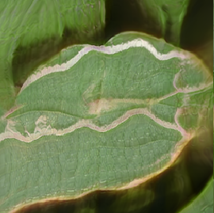
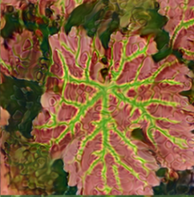
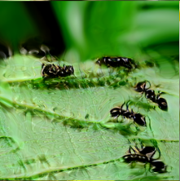
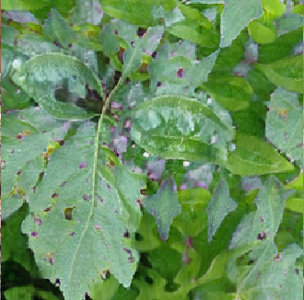
A Generative Adversarial Network (GAN)
We examined several methods, including DCGAN, WGAN, FastGAN, WGAN-GP, StarGAN, AWGAN, and StyleGAN. However, in our case—with 68 classes, some having as few as 20 samples and others up to 160—these models did not perform sufficiently well for our task.
Various training parameters and configurations were tested, including transfer learning–based approaches; however, the results remained unsatisfactory.
In cases where data variability is low—such as straight leaves and similar disease lesion patterns—GANs can generate fairly realistic synthetic data. However, in data-limited scenarios, the usefulness of such data remains questionable. When data variability is high—due to differences in leaf types, orientations, and lesion appearances—the quality of the synthetic data tends to degrade significantly.
8

Slide 9

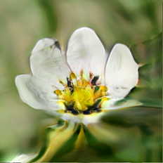
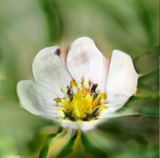
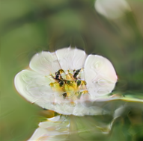
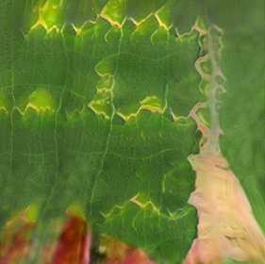
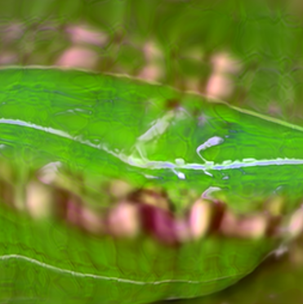
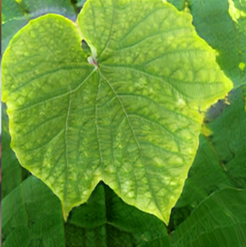
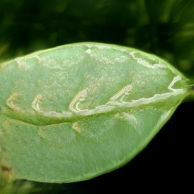
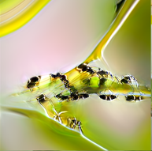
A Generative Adversarial Network (GAN)
High Computational Cost
GANs like WGAN and StyleGAN require substantial compute and extended training time, making them impractical in many real-world research settings .
Mode Collapse & Limited Diversity
GANs often produce repetitive or overly similar images when trained on small datasets.
Poor High-Frequency Detail & Realism
GAN-generated plant disease imagery often lacks fine lesion edges, texture, and detail, resulting in blurry or distorted disease symptoms, which limits their usefulness for accurate classification
Training Instability and Overfitting
In low-data scenarios, the discriminator quickly overfits to the limited real images, leading to unstable adversarial training. The generator may stop improving or diverge entirely due to vanishing gradients or discriminator dominance.
GANs are effective when the plant disease symptoms have consistent visual patterns—such as uniform leaf shapes, similar lesion types, and controlled backgrounds (e.g., lab or greenhouse images). In such cases, GANs can generate realistic synthetic images that could support classifier training.
9

Slide 10
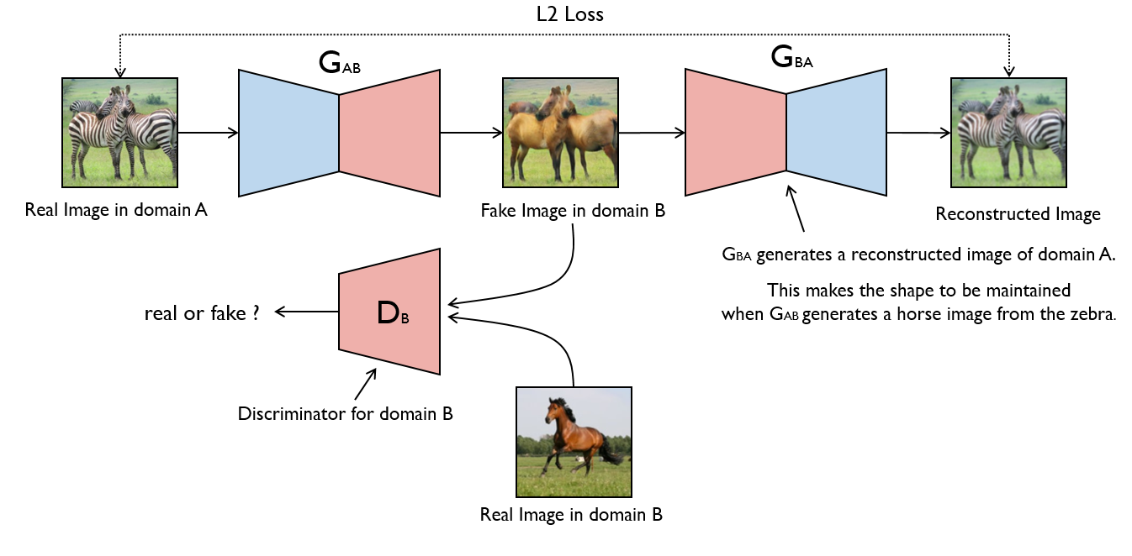
CycleGAN
CycleGAN is a type of Generative Adversarial Network (GAN) used for image-to-image translation without paired data.
CycleGAN uses two generators and two discriminators to translate images between two domains without paired data. Generator G converts images from domain A to B, and generator F does the reverse. Discriminators D_A and D_B help ensure the generated images look real. A key idea is cycle consistency: translating an image to the other domain and back should return the original.
10

Slide 11
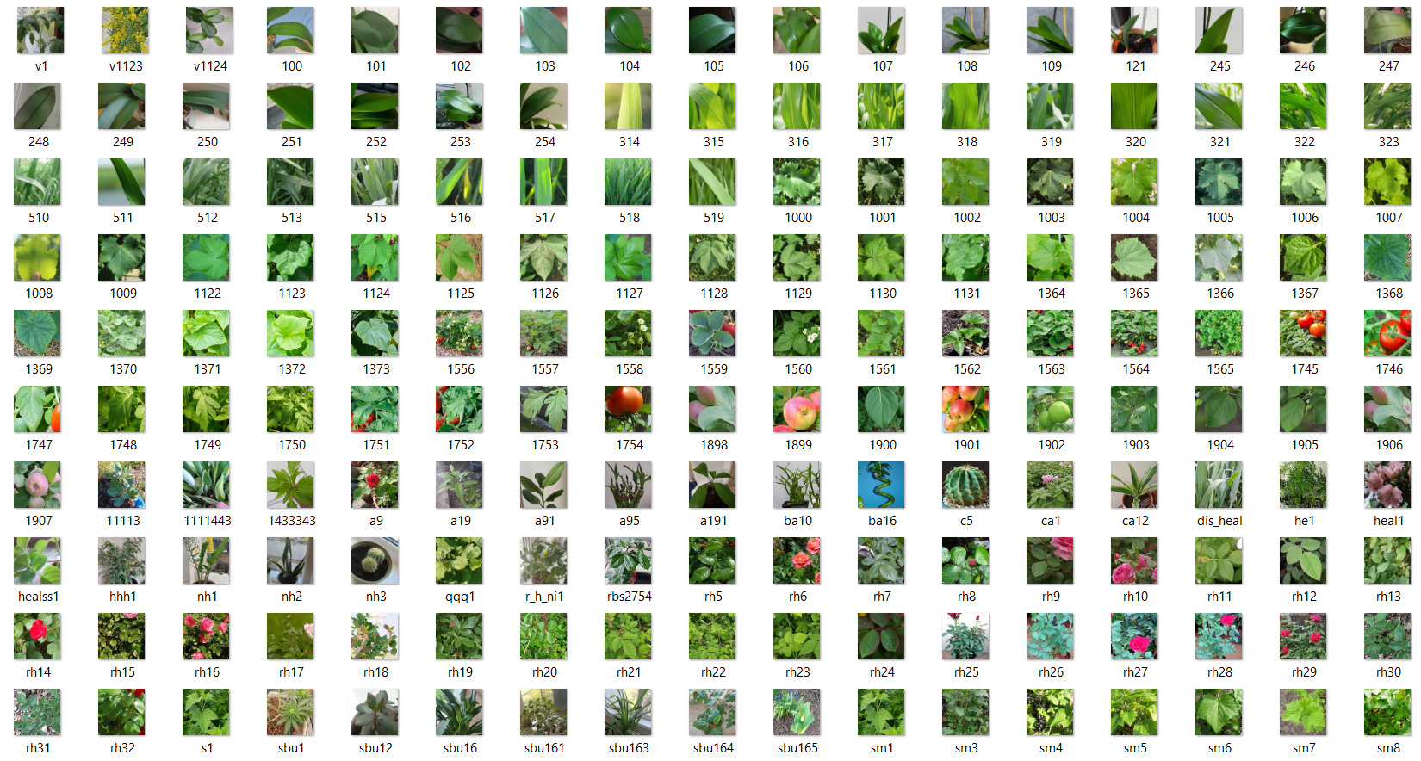
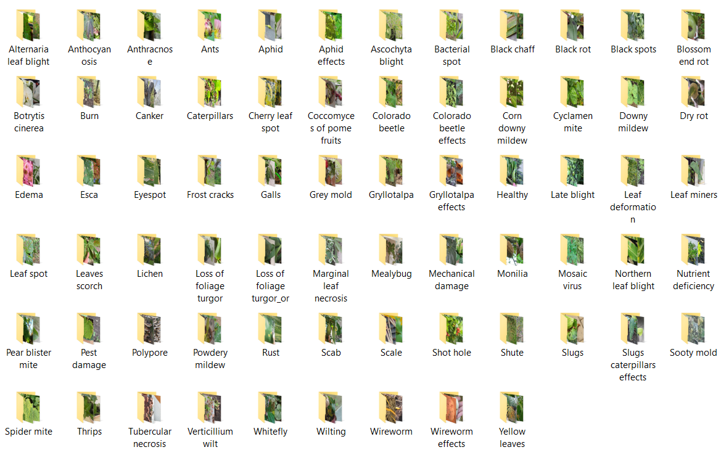
CycleGAN
11
11

Slide 12
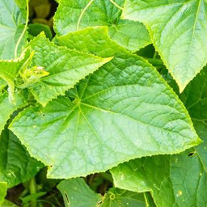
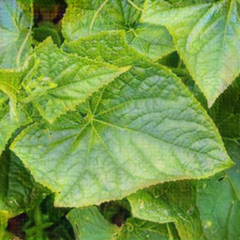
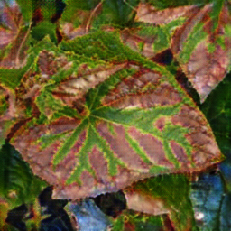
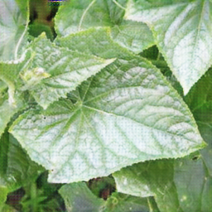
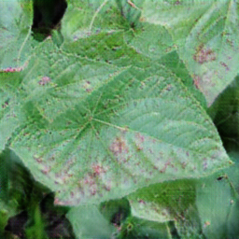
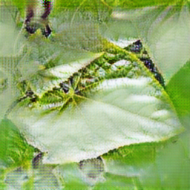
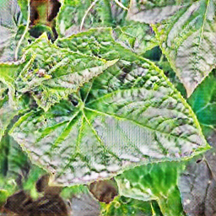
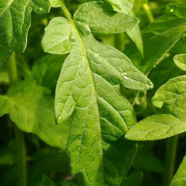
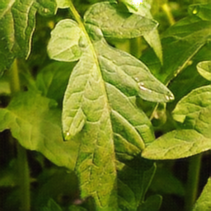
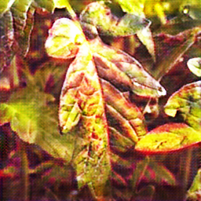
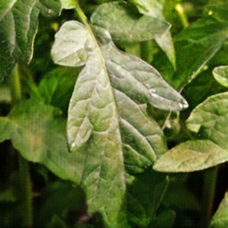
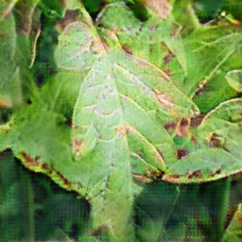
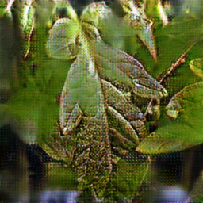
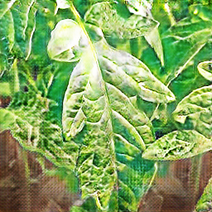













CycleGAN
1371
1749
Healthy
rh23
Ascochyta blight
Ants
Leaf deformation
Nutrient deficiency
Esca
Powdery mildew
12

Slide 13








CycleGAN
Inconsistent or Uncontrolled Feature Translation
CycleGAN does not provide control over what features are modified. It may translate non-disease features (e.g., leaf shape, background, or lighting conditions) along with or instead of actual disease symptoms—leading to unreliable or misleading synthetic images.
Ants
Poor Handling of Structural Changes
While CycleGAN performs well in style transfer, it struggles to generate localized structural anomalies such as lesions, holes, or deformations—common in many plant diseases. The model is biased toward global texture and color changes, not local geometry.
Shot hole
Dependency on Well-Matched Source and Target Domains
CycleGAN requires unpaired but domain-consistent datasets. This means the "healthy" and "diseased" image sets must be visually similar in all aspects except for disease traits (lighting, scale, background, angle). Mismatches cause the model to learn incorrect mappings.
+
=
Struggles with Multi-Form Diseases
Diseases like scale insect infestation may manifest differently on different plant types. CycleGAN struggles when the same disease exhibits varied shapes, making it hard for the model to generalize and synthesize accurate transformations.
* For more advanced CycleGAN-like approaches (e.g., LeafGAN), additional manual work is needed to create segmentation masks, which increases labor and computational costs.
CycleGAN is particularly effective when disease symptoms manifest as distinct and consistent color changes (e.g., chlorosis, mildew coating) rather than shape-based symptoms. In such cases, it can produce realistic and convincing diseased variants. Even with relatively small datasets, if healthy and diseased samples are well-curated and aligned in style, CycleGAN can generate valuable synthetic data.
13

Slide 14

Conclusion
GANs can support data augmentation but often fail under limited data conditions due to poor diversity, mode collapse, and low realism.
CycleGANs improve color and texture translation but struggle with structure and require carefully matched healthy/diseased datasets.
Realistic synthetic images with CycleGANs require:
- Sufficient variability in source data
- Expert guidance during dataset curation and model optimization
In general, GAN-based methods are not universally applicable and require custom design and preprocessing for specific diseases. In our case, with 68 disease classes, their use is unjustified due to high resource demands and limited scalability.
Despite limitations, they are useful when disease symptoms are distinct and localized, such as color changes or texture distortions.
14

Slide 15





Where to move next?
The topic of applying GANs is closed for me; I do not see any serious prospects in this direction. However, there are still possibilities for data extension even under limited dataset conditions, particularly with diffusion models.
LoRa (Low-Rank Adaptation):
- Stable difusion,
- Kadinskiy
- FLUX
15

Slide 16

Thank you for your attention!
email: auzhiskiy@jinr.ru
https://t.me/bigzmey

