Slide 1
Agricultural Land Monitoring and Crop Identification Using Remote Sensing Data and Deep Learning Neural Network
Valery Grishkin, SPbSU,
valery-grishkin@yandex.ru
Sardor Karimov, SPBSU

Slide 2
Monitoring agricultural land and the crops grown on it can significantly improve the accuracy and objectivity of information on the use of agricultural land. We propose an approach that can be used to build a system for such monitoring of the state of a certain territories. Within the framework of this approach, satellite images of a given territory are processed.
First, medium-resolution multispectral satellite images are requested for the spring and summer periods. The obtained images are processed and maps of the distribution of vegetation indices NDVI, SAVI, EVI and MSAVI are formed. These maps are then clustered to detect areas of vegetation.
2
GRID 2025

Slide 3
For the identified areas, higher resolution satellite images are additionally obtained, which serve as input for the deep neural network. This neural network is pre-trained to identify crops from known satellite datasets.
Time interval,
area coordinates
NDVI,
SAVI,
Index Clustering and Thresholding
Areas of
interest
Request for multispectral images
Atmospheric correction
Calculation of vegetation indices
Index Clustering and Thresholding
medium
resolution
EVI,
MSAVI
Areas of
interest
Request for optical and NIR images
Atmospheric correction
Splitting images of areas of interest into parts
Identification by neural network
Formation of crop maps
high
resolution
3
GRID 2025

Slide 4
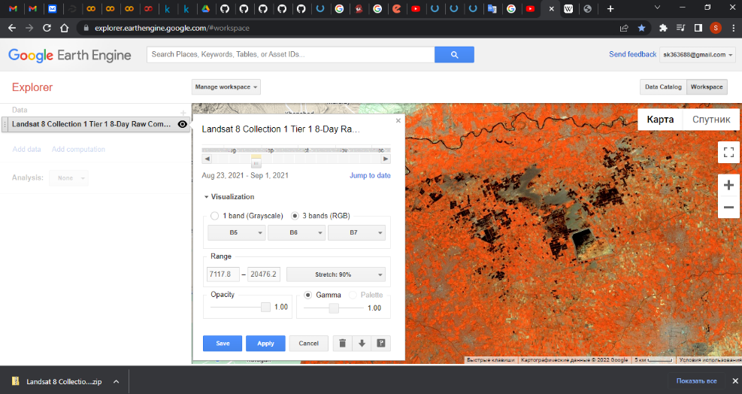
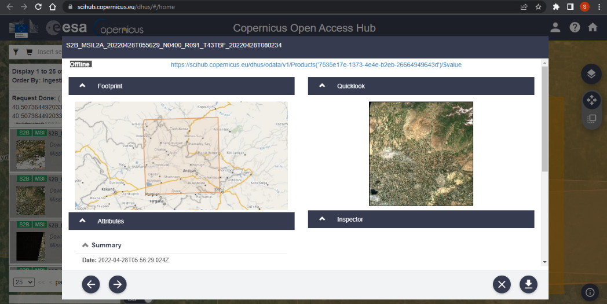
Google Earth Engine and Sentinel HUB platforms are used as data sources. Requesting data from platforms can be done both interactively and automatically. To obtain data automatically, the corresponding APIs are used - Google Earth Engine API and Sentinel Hub API
Google Earth Engine
Sentinel HUB
4
GRID 2025

Slide 5
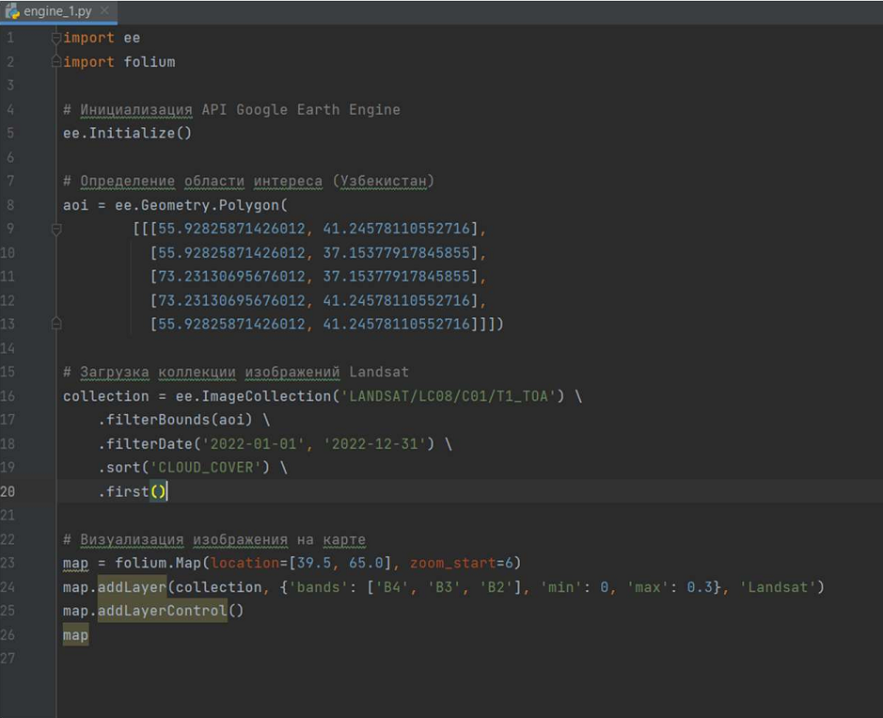
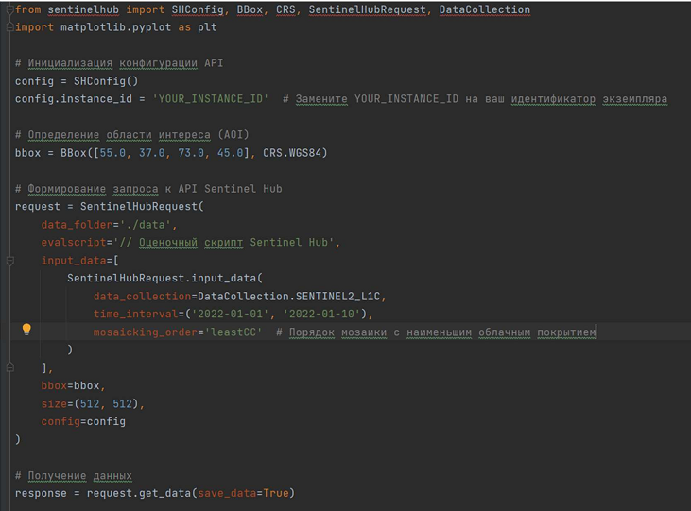
Examples of API usage
Google Earth Engine
Sentinel HUB
5
GRID 2025

Slide 6
Atmospheric correction is the process of eliminating the influence of the atmosphere on the reflectivity values ​​of images obtained by satellite sensors. Atmospheric correction is not present for all received data. In this case, it is performed using a neural network with an encoder-decoder architecture. This network was presented at the GRID 2023 conference. In practice, the error of atmospheric correction using a neural network, compared to the interactive correction supported by the Sentinel Hub platform, is approximately 8%.
The following spectral indices are used to detect vegetation areas: NDVI, EVI, SAVI, MSAVI.
NDVI (Normalized Difference Vegetation Index). This is a standardized index that shows the presence and condition of vegetation (relative biomass).
EVI (Enhanced vegetation index). This is an index designed to improve the vegetation signal with improved sensitivity in high biomass regions.
6
GRID 2025

Slide 7
SAVI (Soil-Adjusted Vegetation Index). This is a vegetation index that attempts to minimize the effect of soil brightness by using a soil brightness correction factor.
MSAVI (Modified Soil-Adjusted Vegetation Index). The index is designed to minimize the impact of bare soil on the soil-adjusted vegetation index.
Index | Formula | Vegetation
NDVI | (NIR-RED)/(NIR+RED) | 0.4 – 0.85
EVI | G * ((NIR –RED)/(NIR +C₁*RED + C₂*BLUE +L)) G = 2.5 C₁ = 6 C₂ = 7.5 | 0.3 – 0.8
SAVI | ((NIR-RED)/(NIR+RED+L)) * (1 +L)) L= 0.5 | 0.3 – 0.6
MSAVI | 0.5*(2*NIR + 1 – sqrt((2*NIR + 1)*2 - 8 * (NIR - RED)) | 0.55 – 0.7
7
GRID 2025

Slide 8
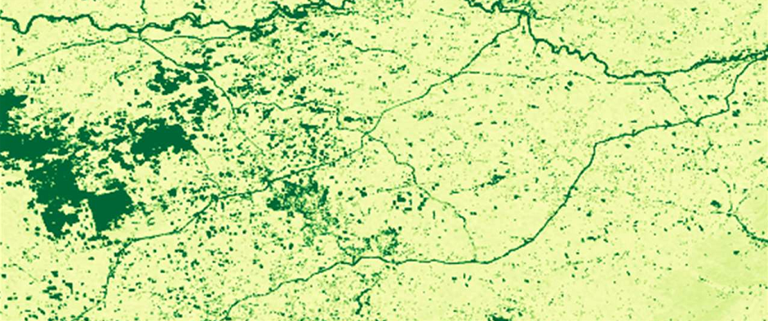
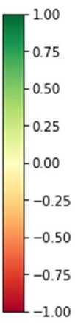
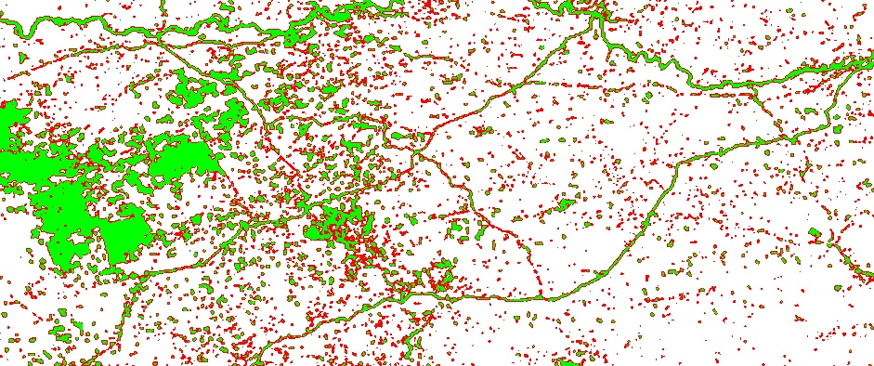
Distribution of the NDVI index
Result of NDVI Clustering
and Thresholding
8
GRID 2025

Slide 9
For classification, a modified convolutional network VGG16 is used. The modification consists of replacing conventional convolutions with depth wise separable convolutions in last convolutional layers of the network. This modification allows to reduce the number of parameters configured during network training, which reduces the requirements for the computing resources used.
Image
Conv3 64
Conv3 64
MP
Conv3 128
Conv3 128
MP
Conv3 256
Conv3 256
Conv3 256
MP
Conv3 512
224x224x3
Classes
Conv3 512
Conv3 512
MP
DWC3 512
DWC3 512
DWC3 512
MP
FC
4096
FC
4096
FC
5
Soft
Max
9
GRID 2025

Slide 10
For this modified network we use transfer learning. In this case, the weights of all unmodified layers are "frozen" in the trained network VGG16. The remaining weights are adjusted during training on the corresponding data set. This dataset contains 800 high-resolution satellite images. It is divided into 5 classes, each represented by 160 images and consists of 4-band (R, G, B, NIR) images. The set contains masks indicating the type of agricultural product for each pixel of the corresponding image. The set includes the following types: wheat, corn, rice, sunflower, soybeans.
The original set is augmented using rotation, reflection, and scaling operations.
10
GRID 2025

Slide 11
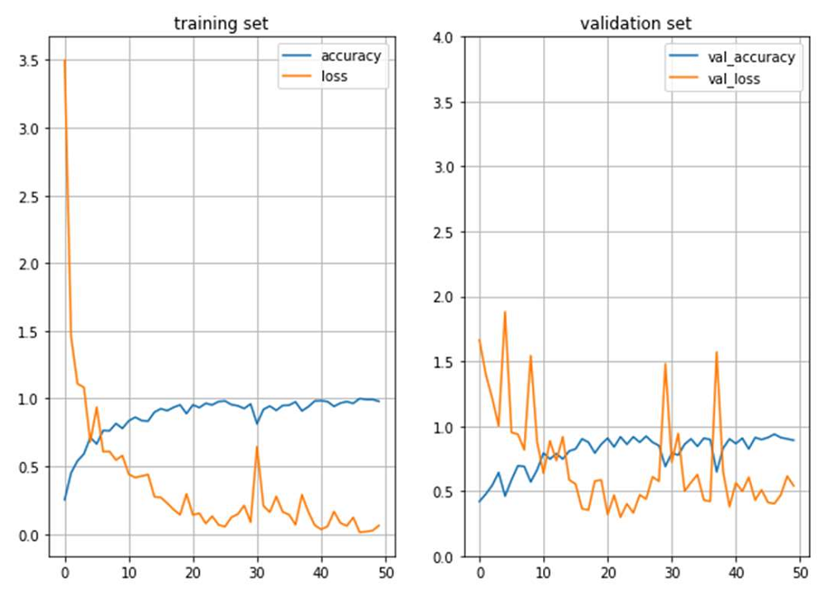
Training parameters:
Dataset size: 2,500 samples;
Train/validation/test ratio: 70/20/10%;
Batch size: 16;
Number of epochs: 60;
Optimizer: Adam (learning rate = 0.001);
Loss function: categorical_crossentropy.
11
GRID 2025

Slide 12
 | Precision | Recall | F1-score
wheat | 0.92 | 0.89 | 0.9
corn | 0.88 | 0.91 | 0.89
sunflower | 0.85 | 0.87 | 0.86
soybeans | 0.83 | 0.82 | 0.82
rice | 0.89 | 0.86 | 0.87
Average accuracy: 87.3%
12
GRID 2025

Slide 13
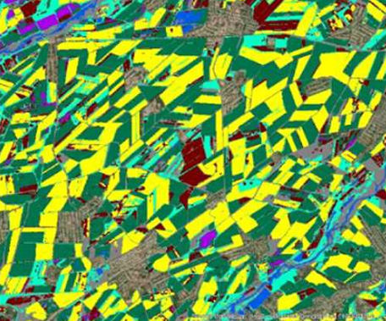
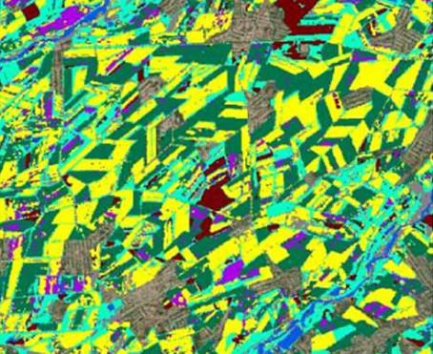
Sentinel
Landsat
weat
corn
rice
others
13
GRID 2025

Slide 14
Thank you for your attention
GRID 2025
14

