Slide 1



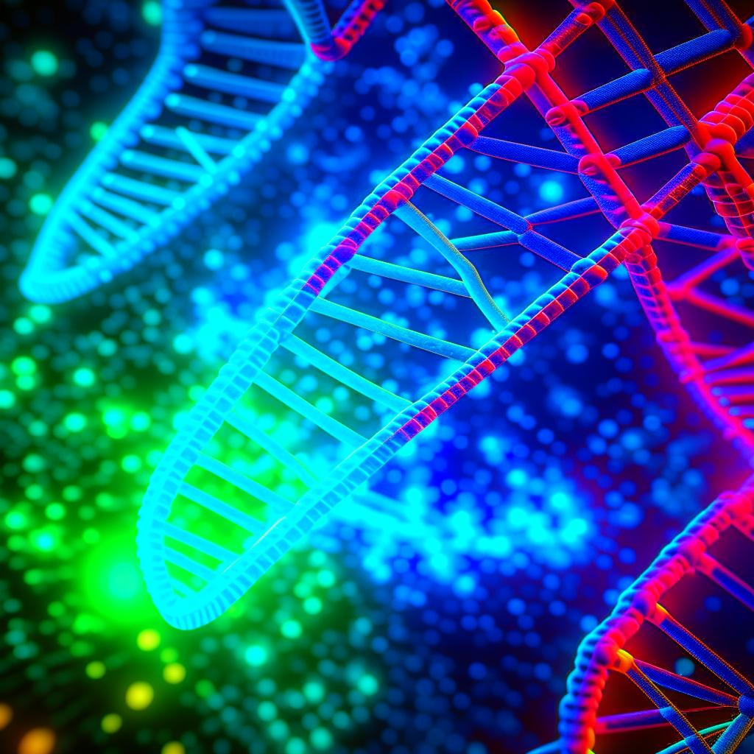

Web service for automated detection and analysis of radiation-induced foci in cell nuclei
S.Shadmehri¹, A.V. Boreiko², M. E. Krupnova²,
M. I. Zuev¹, M. Yu. Bondarev^{1,3}, O. I. Streltsova^{1,3},
T. S. Khramko², T.G. Bezhanyan^{1,3}
¹Meshcheryakov Laboratory of Information Technologies, JINR
² Laboratory of Radiation Biology, JINR
³ Dubna State University, Dubna, Russia
11th International Conference "Distributed Computing and Grid Technologies in Science and Education" (GRID’2025) 7–11 July 2025
This work was carried out within the state assignment of Ministry of Science and Higher Education of the Russian Federation (theme No. 124092700007-4).
Dubna, 2025

Slide 2





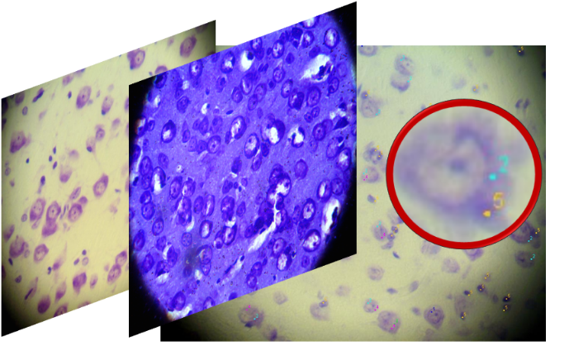
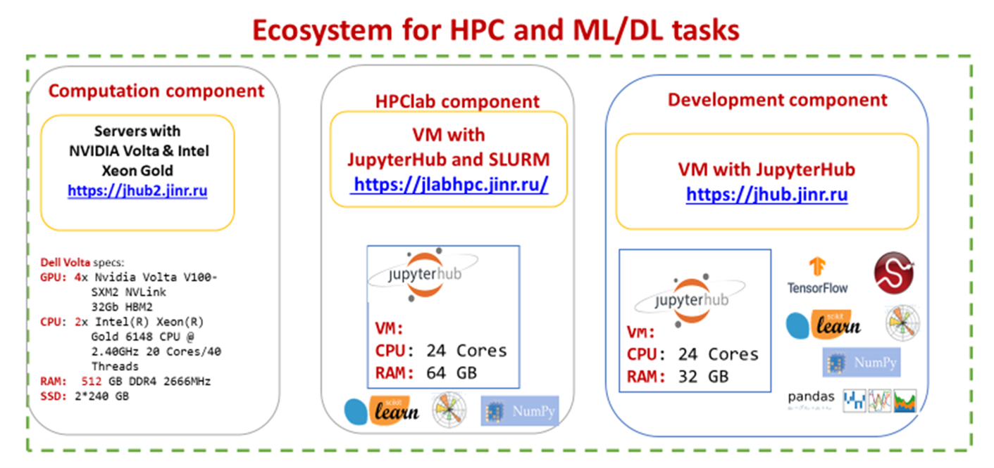
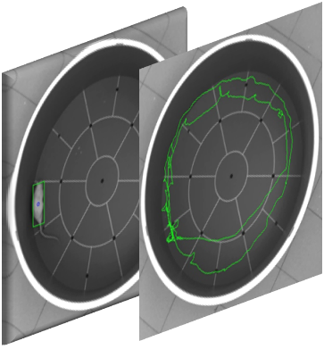






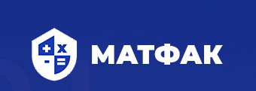
BIOHLIT group
Meshcheryakov Laboratory of Information Technologies, JINR
Laboratory of Radiation Biology,
JINR
Anikina A.I. Bezhanyan T.Zh. Nechaevskiy A.V. Podgainy D.V. Shadmehri S. Streltsova O.I. Zuev M.I.
Boreyko A.V.
Kolesnikova I.A.
Lyakhova K.N. Severiukhin Yu.S.
Utina D.M.
Chausov V.N.
Chramko T.S.
With the participation of undergraduate
and graduate students
Dubna University, TSU, RUDN University
In collaboration with
Stadnik A.V.
In collaboration with
University of Belgrade
Coordinator: Dr Marko Ćosić
In collaboration with
Germany:
Streltsov Alexei I.
Gromov E.

Slide 3
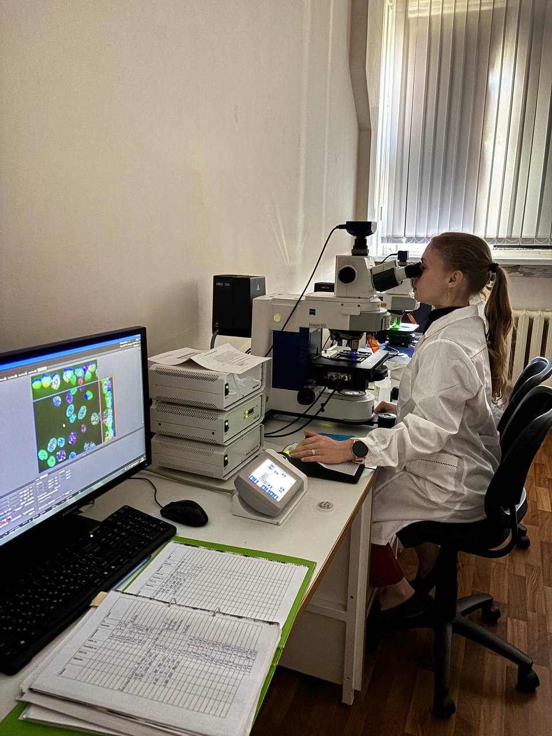
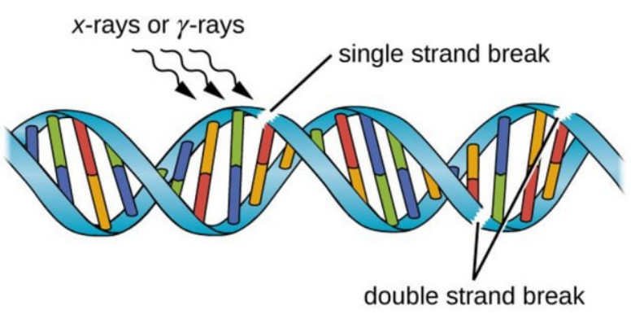
Problem statement. Materials and methods
Двунитевые разрывы ДНК
DNA double-strand breaks (DSB)
Problem:
In 3D and 2D
  При действии ИИ на живые клетки возникает целый спектр повреждений ДНК. Наиболее сложным для восстановления являются двунитевые разрывы ДНК (ДР ДНК).
  Для визуализации ДР ДНК используется метод иммунофлуоресцентного окрашивания: выявляются специфические белки-маркеры, которые накапливаются в сайтах возникновения ДР ДНК и формируют радиационно-индуцированные фокусы (РИФ)
  The crucial feature of ionizing radiation as a DNA damaging agent is the range of lesions it induces and DNA double-strand breaks (DSBs) are the most lethal mechanism of DNA lesions. DNA DSBs quantification method is based on the analysis of its biomarkers as the radiation induced foci (RIF).
Chramko T.S.

Slide 4
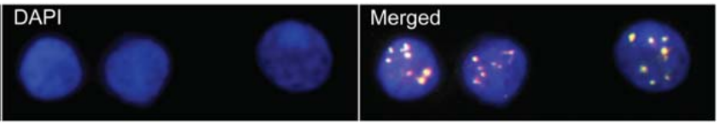
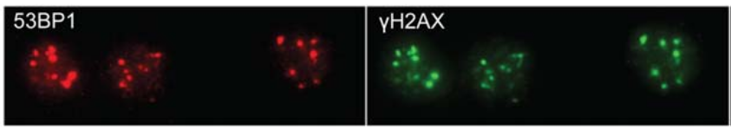
Problem statement. Materials and methods
DNA double-strand breaks (DSB): The most deadly DNA damage induced by ionizing radiations
DSB quantification : a tool to analyze the damaging effect of radiation exposure
Immunofluorescent staining method: Revealing the specific protein biomarkers involved in the process of DNA DSB repair where the proteins accumulate at the sites of DNA DSBs to form foci
γ-H2AX and 53BP1: the most reliable biomarkers of DSBs
Human blood lymphocytes 24h after 4Gy X-irradiation ex vivo
?
A tool for detecting cells in fluorescence images and counting the number of radiation-induced foci (RIF) providing analytical information: cell area, average number of RIF per cell and per image set.

Slide 5
Problem statement. Data analysis

Slide 6
Problem statement. Data analysis
Клетки с 53BP1
DAPI+красные РИФ
Клетки с γH2AX
DAPI+зелёные РИФ
Клетки
DAPI

Slide 7
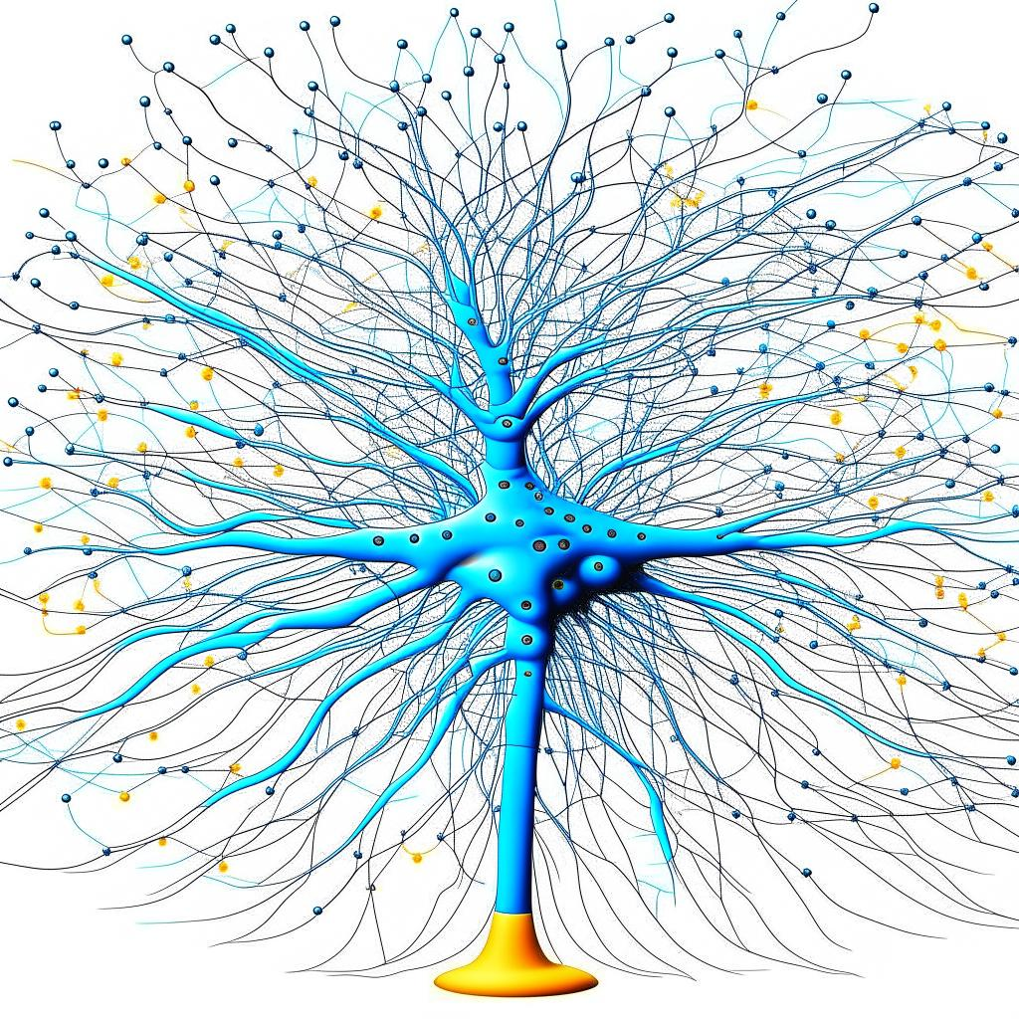
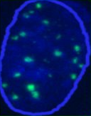
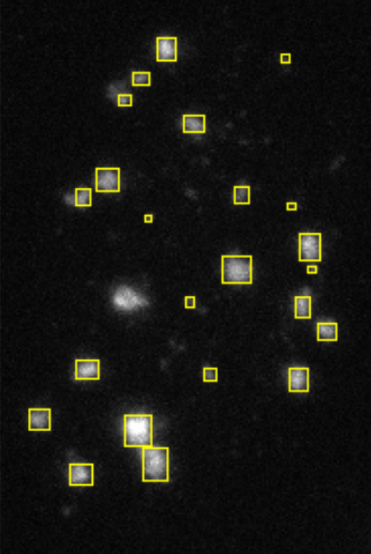
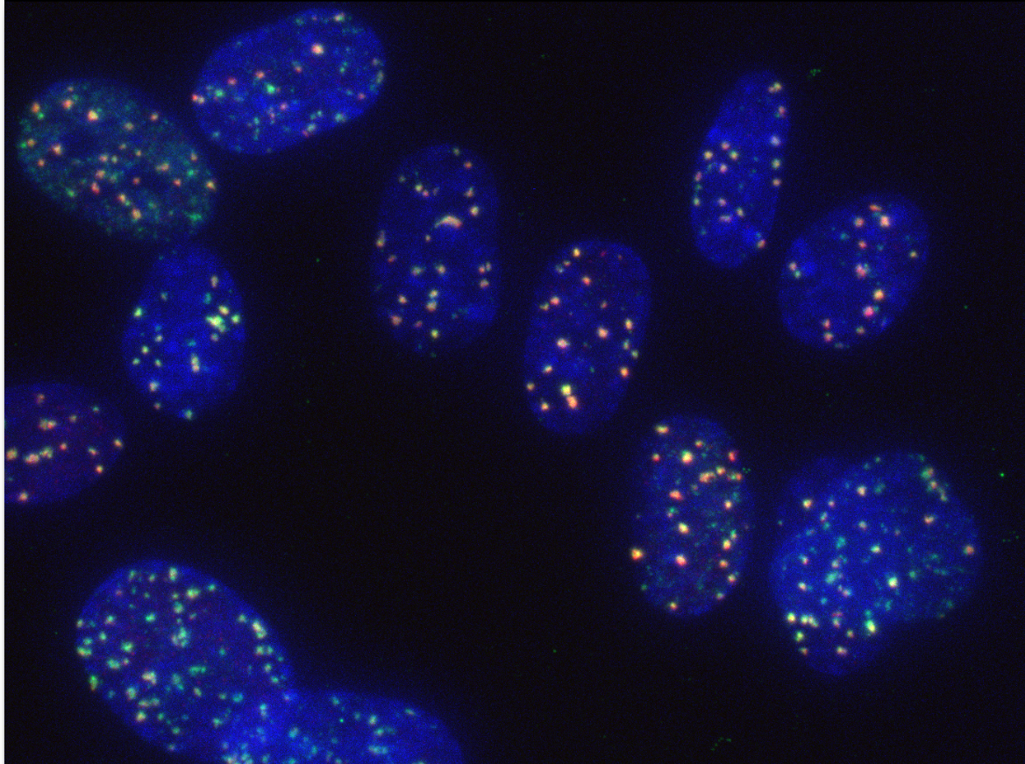
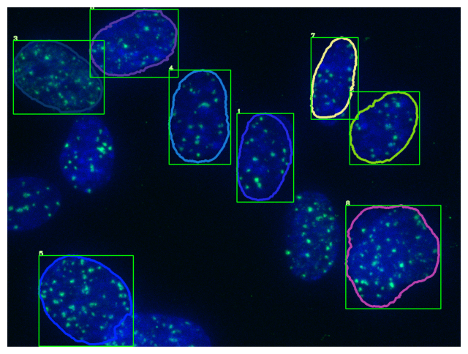
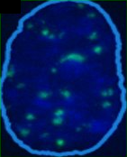
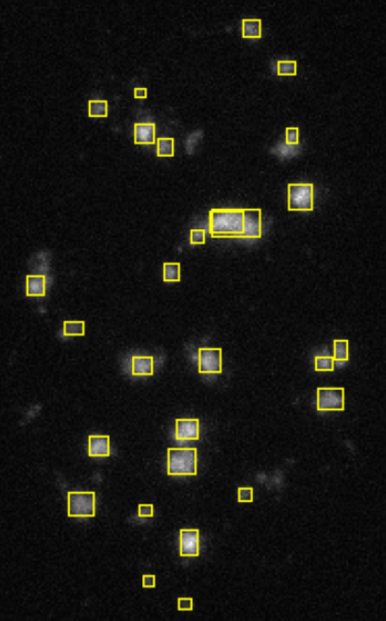
Overview of the Foci Detector Algorithm
Upload
the Image File
Marking
the Cell Nuclei
Extracting Cell Images
Marking the Foci per Cell
Cell Detection
Neural Network
Algorithm,
OpenCV
Neural Network based on YOLO Algorithm
OpenCV
Deleting Small and Boundary Cells
R. Wanotayan et al. , Scientific Reports 12, 5527 ( 2022)

Slide 8
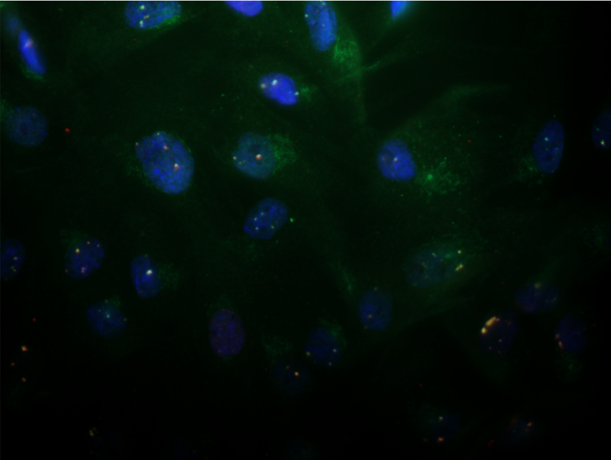
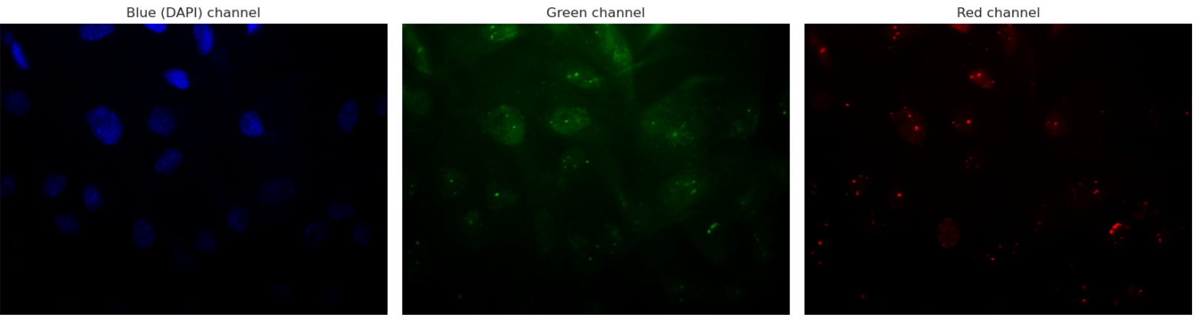
First Stage: Cell Detection
Separating the color channels

Slide 9
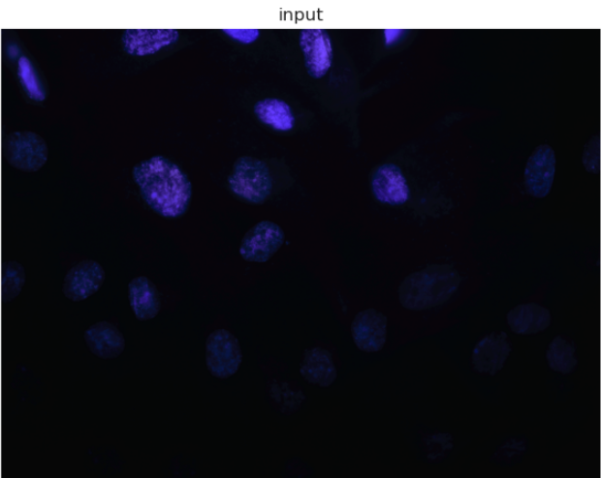
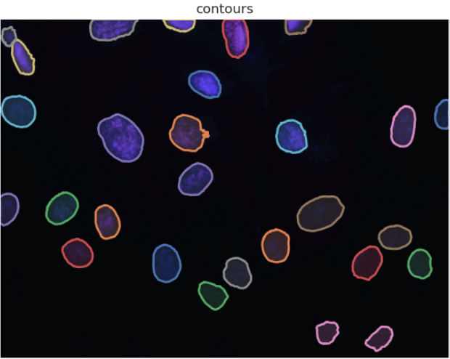
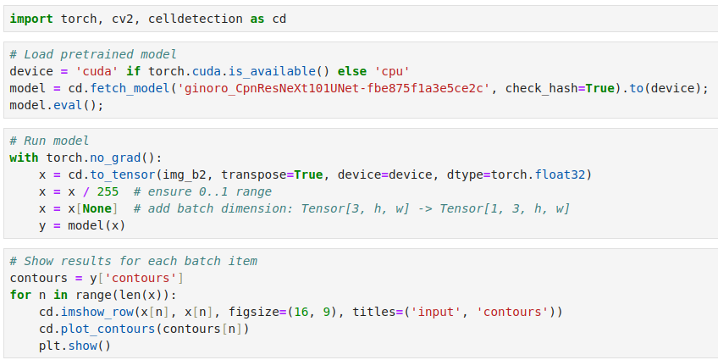
Find and Mark the Cells by Contours
Pretrained
Neural Network Model
https://github.com/FZJ-INM1-BDA/celldetection
E. Upschulte et al. , Medical Image Analysis 77, 102371 (2022)

Slide 10
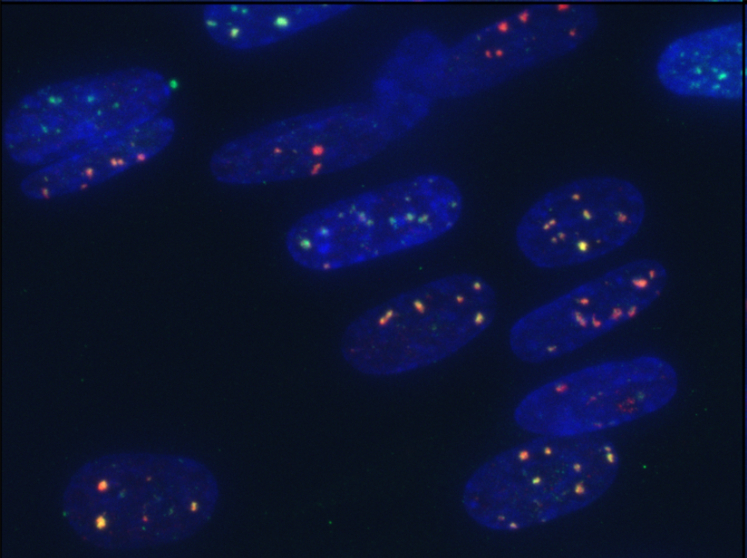
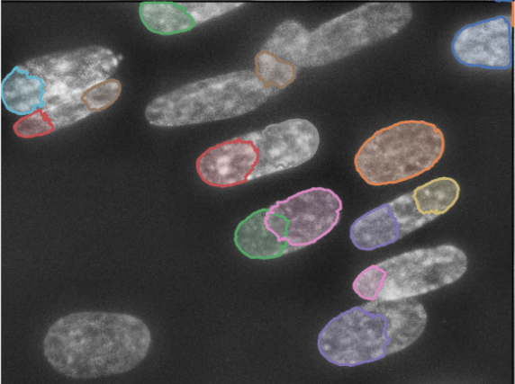
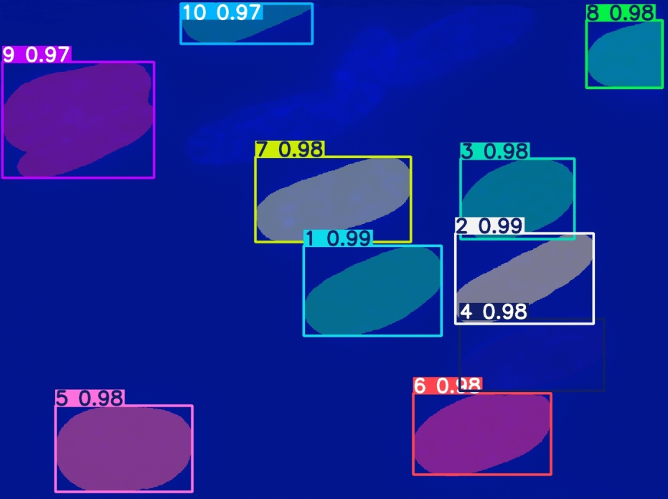
Comparison of the application of neural network models
Image
SAM (Segment Anything Model) - Ultralytics
"Celldetection" contours

Slide 11
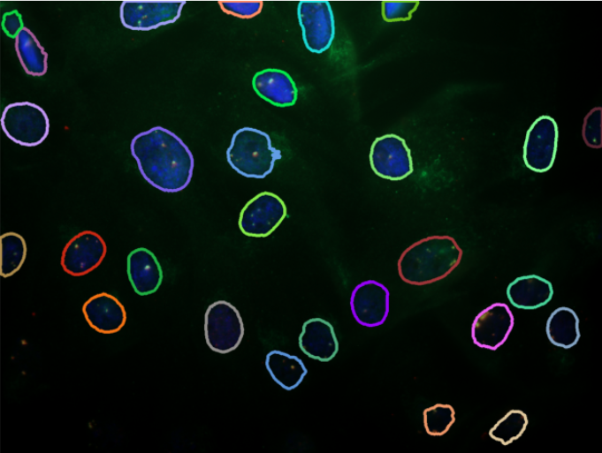
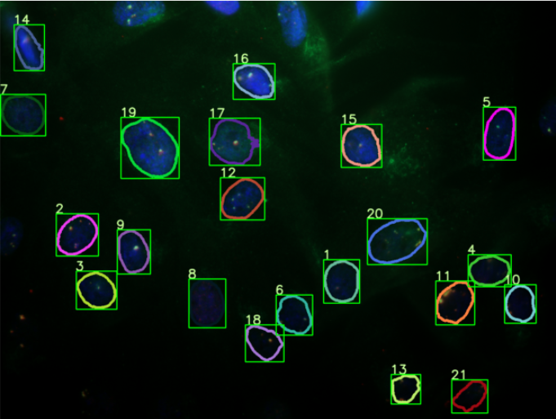
Deleting Small and Boundary Objects
Creating DataFrame for
Bounding Box Coordinates
Deleting Small
and Boundary Objects

Slide 12
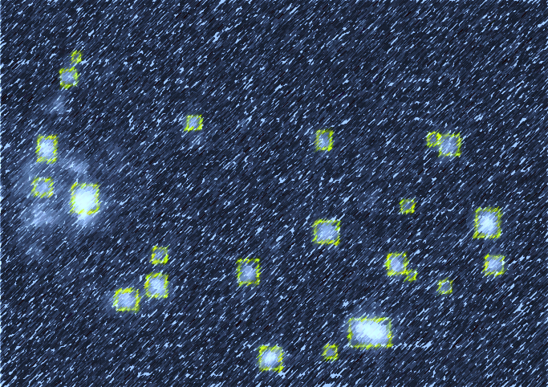
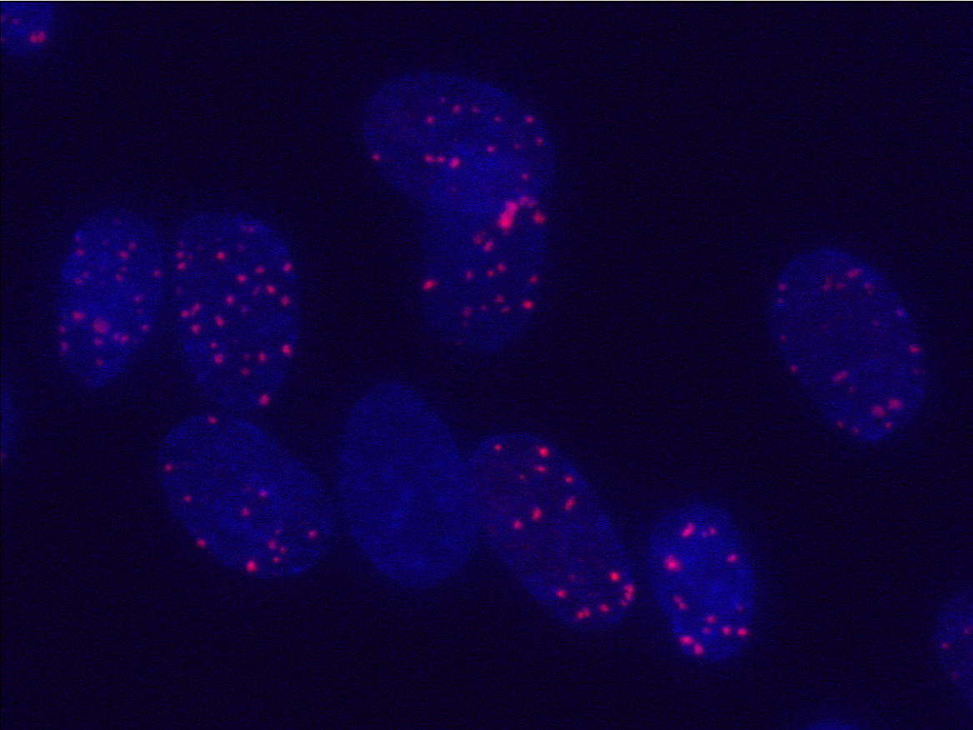
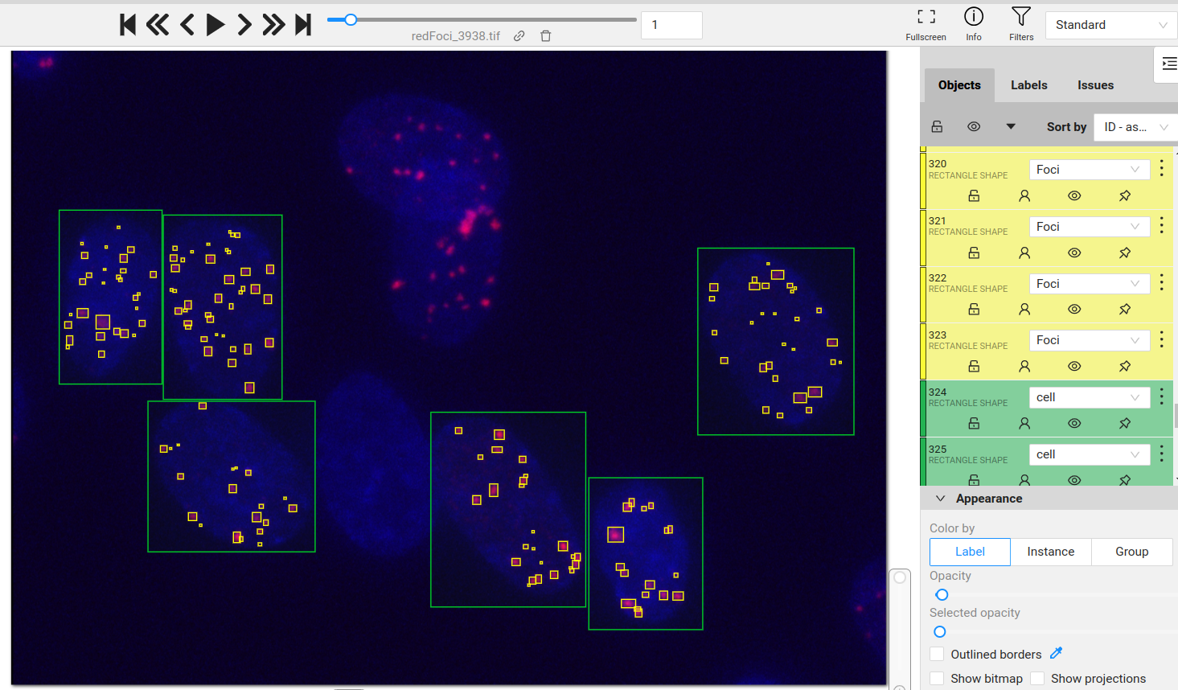
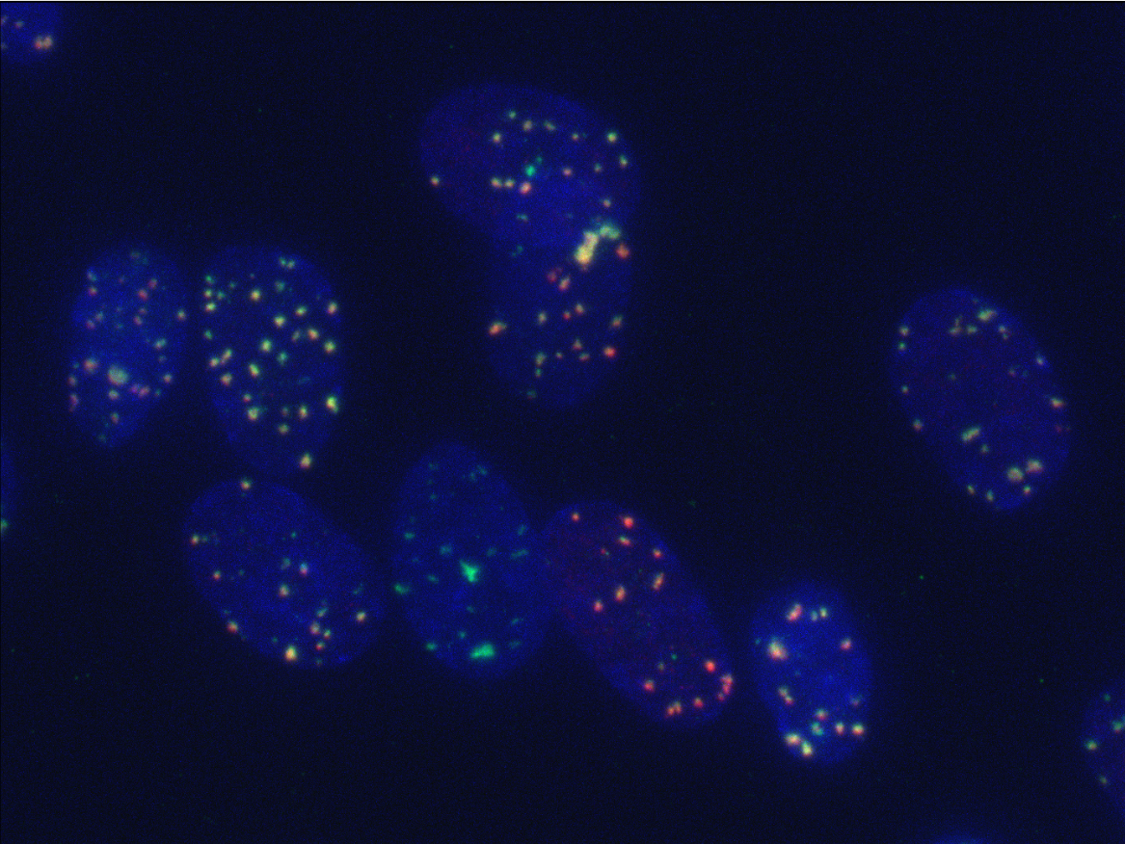
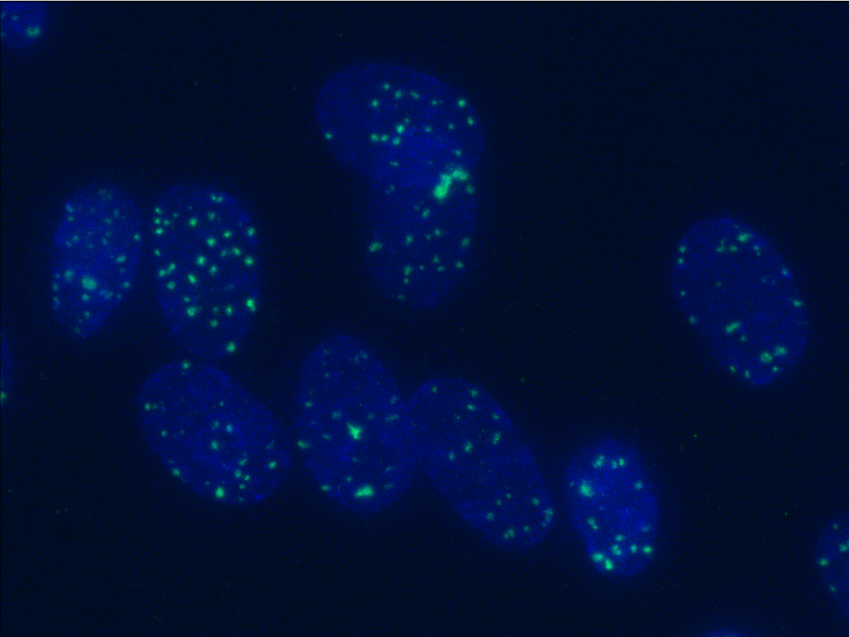
Second Stage: Foci Detection in each cell
Annotating the Image Data as two classes; Foci and Cell
Data Annotation on CVAT in Yolo format
CVAT is installed on the ML/DL/HPC ecosystem of the HybriLIT Heterogeneous Computing Platform.

Slide 13
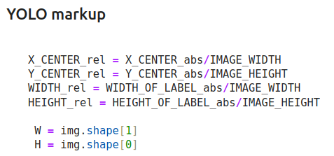
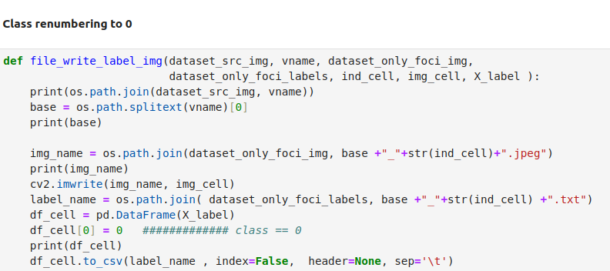
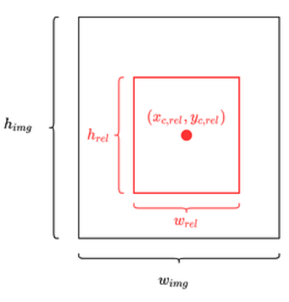
Second Stage: Foci Detection in each cell
2) Cropping the annotated images to separate cells
3) Reducing the classes to only one class: Foci

Slide 14
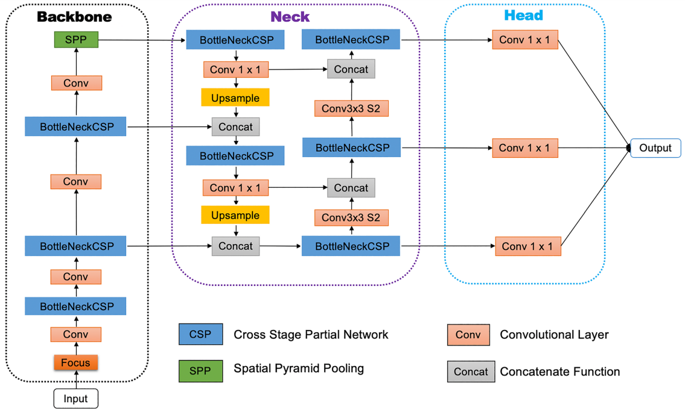
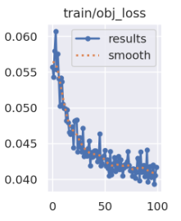
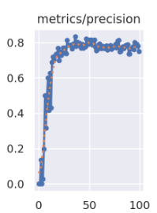
Second Stage: train model
Yolov5 Network Architecture
4) Using the annotated data
(individual cell images with labeled Foci)
as the Train/Test/Validation set for the Convolutional Neural Network based on Yolov5 algorithm
Input: Preprocessed Images
Backbone: feature extraction
Neck: feature fusion
Head: final processing to generate a model
Output: detected results (class, score, location, size)

Slide 15
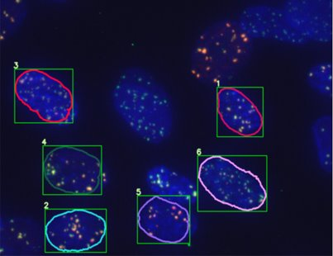
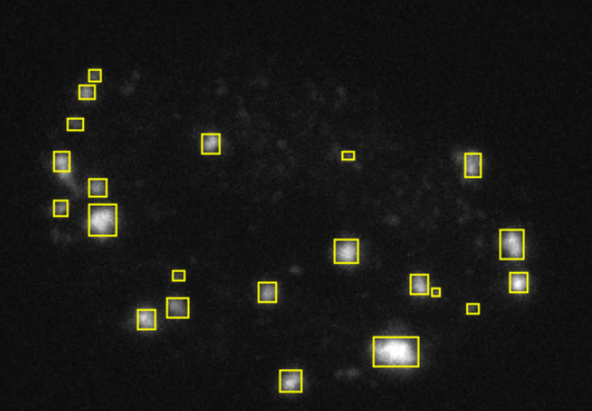
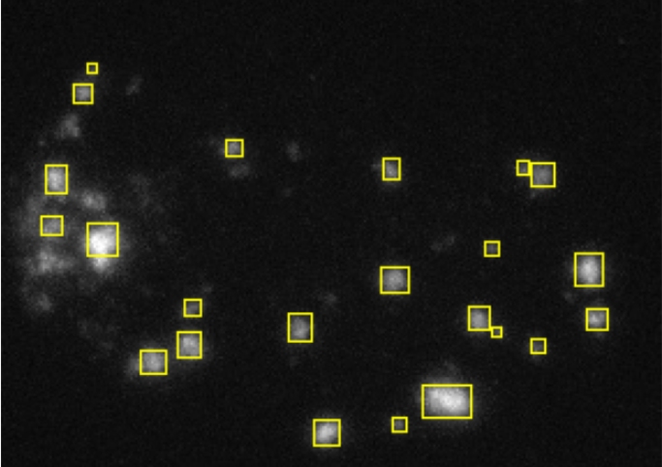
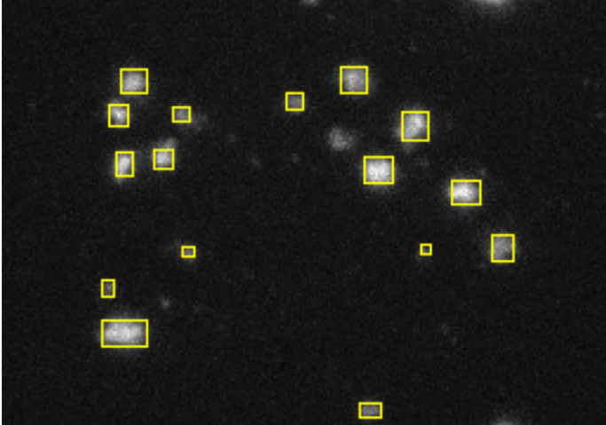
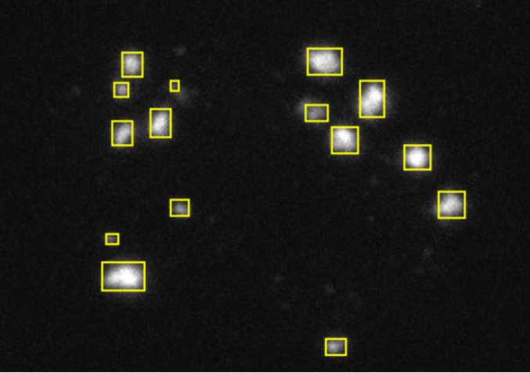
5) Applying the Trained NN on the given images
The Detected Red and Green Foci

Slide 16
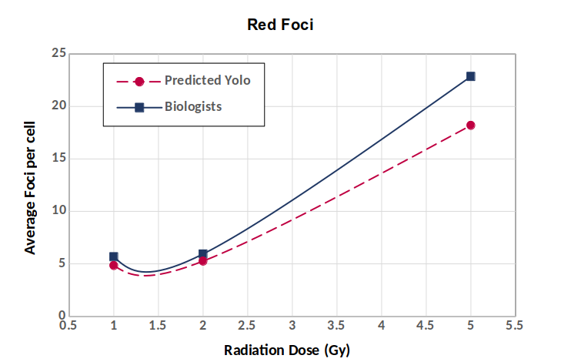
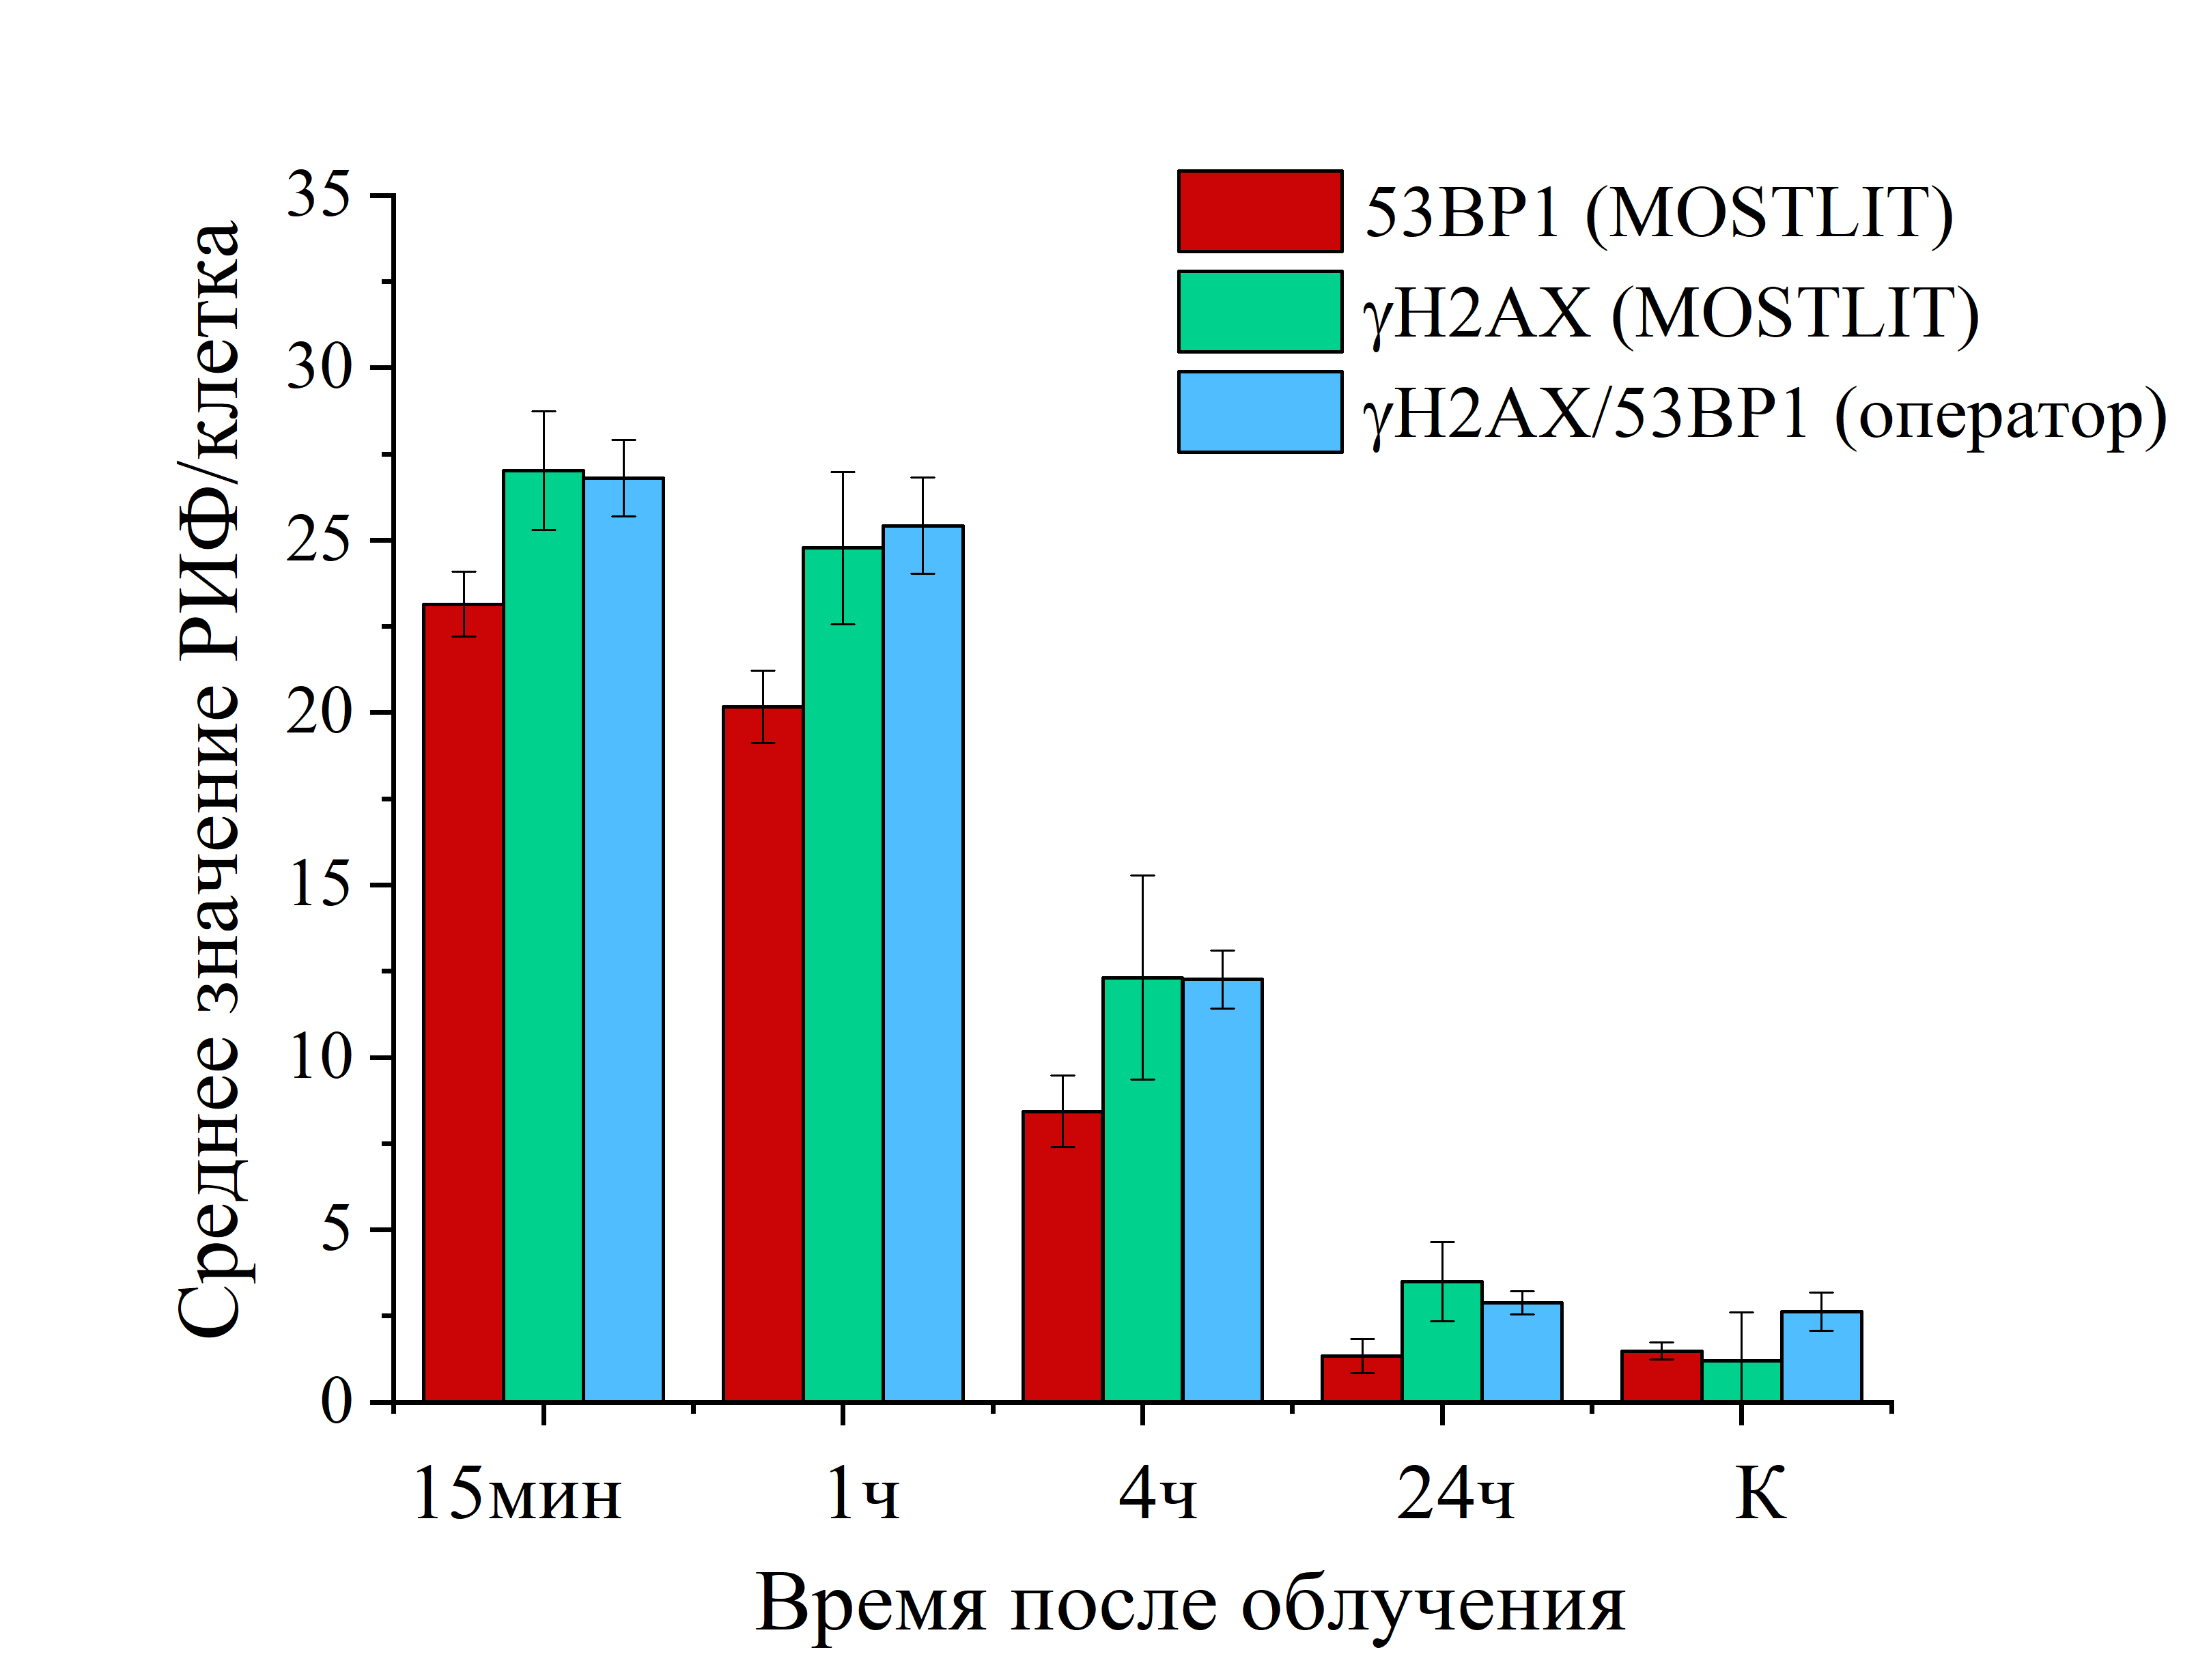
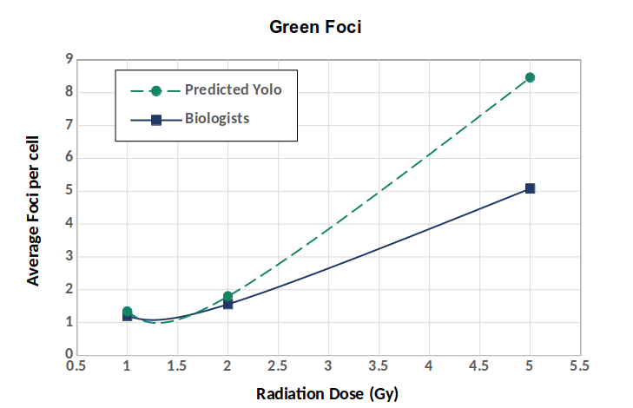
Comparison with Biologists' Counting
Average Foci per cell
(Time after irradiation)

Slide 17
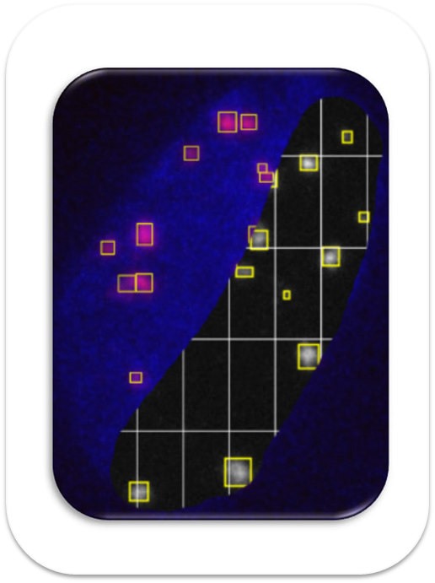
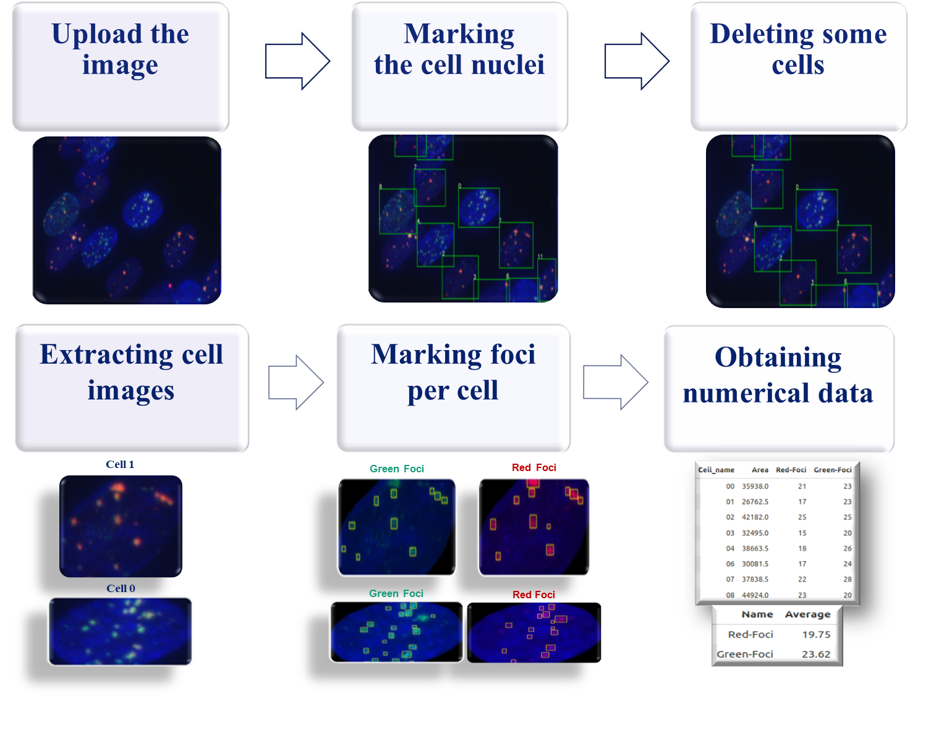
MOSTLIT. Service for FOCI detection and analysis
Developed web service to extract the cells from each data image and count the number of radiations induced foci. Functionality of the service allowed to analyze the group of images of an experiment, provide analytic information about average foci per cell, foci area and some other parameters.

Slide 18
MOSTLIT
http://mostlit.jinr.ru
LIT JINR
M – Maksim Zuev
О – Oksana Streltcova
S – Sara Shadmehri
T – Tatevik Bezhanyan
Within the framework of the joint project between MLIT and LRB JINR for
creating an information system for automating the analysis of radiation induced DNA double-strand breaks
In collaboration with:
LRB JINR: Dr. Boreyko Alla Vladimirovna, Hramco Tatiana Sergeevna, Krupnova Marina Evgenevna;
Burnazyan Medical Research Center of the FMBA of Russia;
Dubna State University: Bondarev Maxim Yurevich.

Slide 19




Web service for automated detection and analysis of radiation-induced foci in cell nuclei
$$∪$$
Thank you for your attention
Спасибо за внимание!

