Slide 1


Development of an Algorithm for Recognizing Behavioral Patterns of Small Laboratory Animals in the Open Field Test System
Presented by: Chesnokova Maria, Dubna State University.
Scientific Supervisor: O.I. Streltsova, LIT JINR, Dubna State University.
Scientific Consultants: T.Zh. Bezhanian, LIT JINR, Dubna State University,
I.A. Kolesnikova, LRB JINR, Dubna State University.
Dubna, GRID - 2025
1

Slide 2
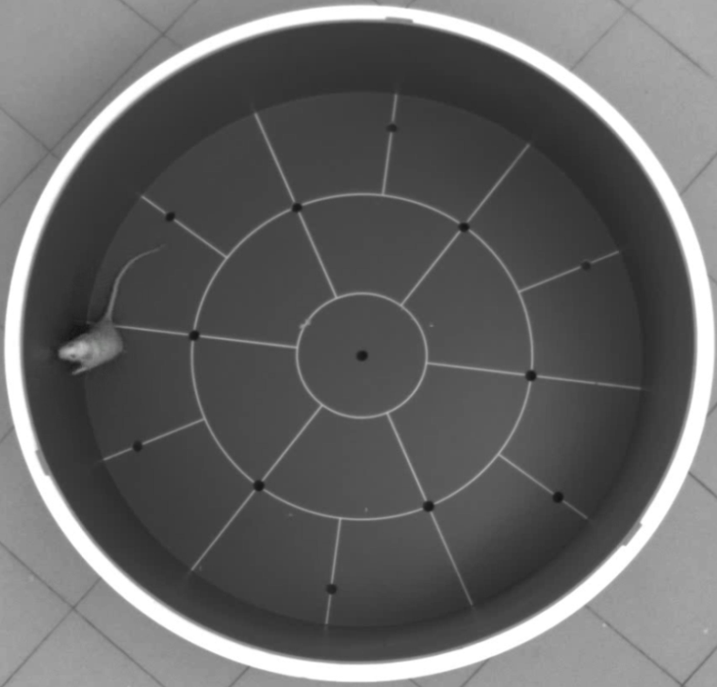
Problem Statement
As part of the experiment, rodents were administered various drugs, exposed to radiation, and their behavior was recorded on video. Experts manually annotated individual behavioral patterns, such as:
Freezing.
Grooming.
Locomotion.
Rearing.
Due to the insufficient number of examples for some behavioral patterns, this work focuses on the task of recognizing vertical and horizontal motor activity of the subjects within the test arena.
Figure 1. The Open Field Test System
2

Slide 3
Research Goals and Objectives
The main goal of this work is to develop an algorithm for recognizing individual behavioral patterns of rodents in the Open Field test system, along with extracting additional information about the time intervals of the identified behaviors within the overall video recording.
To achieve this goal, the following objectives were set:
To investigate the capabilities of neural network architectures for solving the task of behavioral pattern recognition.
To create an annotated dataset.
To develop an algorithm for recognizing the “rearing” behavioral pattern.
To conduct testing and evaluate the performance of the models.
3

Slide 4
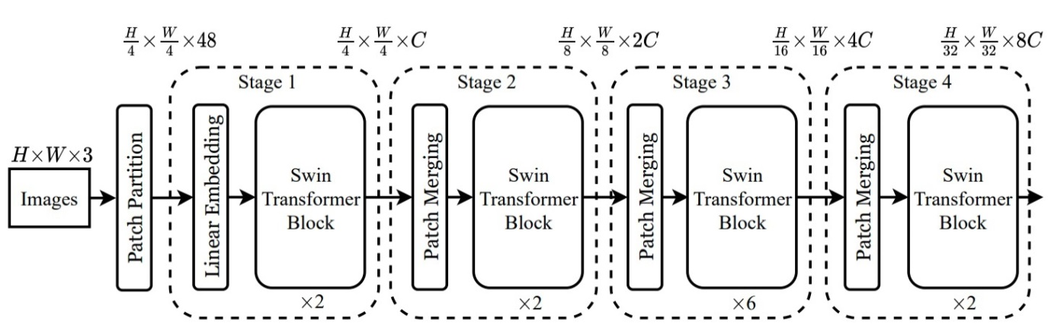
Swin Transformer Tiny Architecture
Swin Transformer Tiny is an architecture from the Swin Transformer family, developed in 2021 by researchers at Microsoft Research to address computer vision tasks. One of the key features of the model is the application of the self-attention mechanism not to the entire image at once, but to local fixed-size square windows, which significantly reduces computational complexity. According to the original paper¹, the base models were trained
trained on the ImageNet-1K dataset, and in the image classification task, the model achieved an accuracy of 81.2%.
Figure 2. Swin Transformer Architecture¹
¹Liu Z., Lin Y., Cao Y., et al. Swin Transformer: Hierarchical Vision Transformer using Shifted Windows [Electronic resource]. – 2021. – Available at: https://arxiv.org/pdf/2103.14030 (accessed: 09.11.2024).
4

Slide 5
Approaches to Model Fine-Tuning
To adapt the model for the task of classifying laboratory animal behaviors, fine-tuning is required. Several approaches exist:
Fine-tuning all layers of the model
In this approach, all layers of the model are fine-tuned.
Fine-tuning the last layers and the classifier
Early layers are frozen, and only the top layers and the classifier are fine-tuned.
Fine-tuning only the classifier
All layers are frozen, and only the final layer — the classifier — is trained.
5

Slide 6
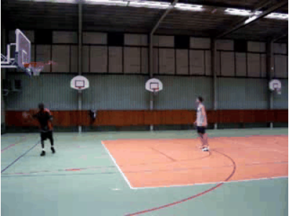
Testing of the Swin Transformer Tiny Architecture
Before starting video data annotation, it is necessary to evaluate the applicability of the Swin Transformer Tiny neural network architecture for the task of recognizing motor activity of rodents.
The model was trained on the publicly available UCF101 dataset, which contains 101 types of human actions. To simplify the task, only three classes were selected: Biking, Bowling, and Basketball. This dataset includes 341 video clips, each lasting 5–7 seconds.
Fine-tuning of the model was performed on all layers of the architecture.
Figure 3. Frame from a test video file of UCF101
Accuracy on the specially prepared dataset — 94%
6

Slide 7
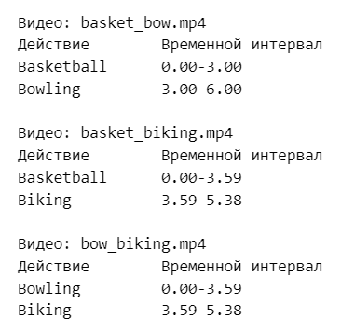
Functions for Testing and Determining Time Intervals
To evaluate the model’s ability to recognize changes in actions, testing was conducted on composite video clips. In these composite videos, the first half of the frames belonged to one class, and the second half to another.
This dataset contains 6 video clips, each 6 seconds long.
Special functions were implemented to create the test dataset, determine time intervals, and display testing results.
Figure 4. Program output on the concatenated dataset
7

Slide 8
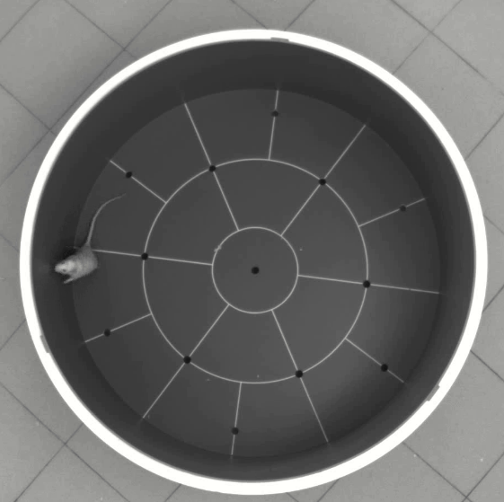
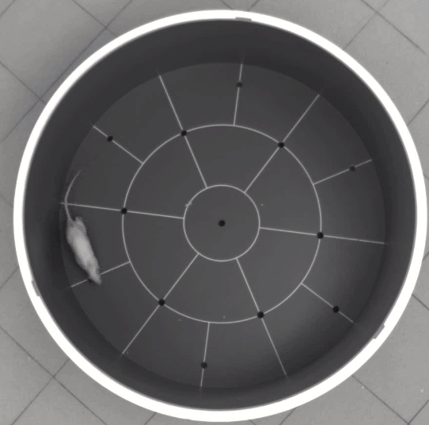
Creation of an Annotated Dataset for Behavioral Pattern Recognition in the Open Field Test System
Data annotation was performed on the HybriLIT heterogeneous computing platform (JINR LIT), using the standard CVAT (Computer Vision Annotation Tool) platform.
A total of 22 videos were annotated, each containing approximately 8,300 frames.
Figure 5. Animal’s Vertical Posture
Figure 6. Animal’s Horizontal Posture
The study used data obtained from experiments conducted at the Radiation Physiology Sector of the Laboratory of Radiation Biology, JINR.
8

Slide 9
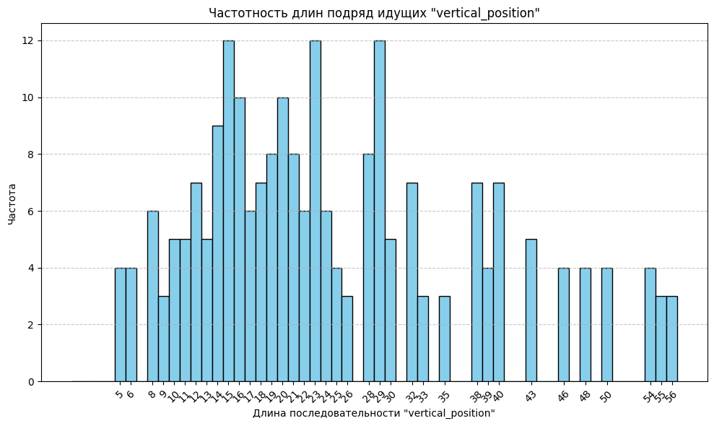
Determination of the Optimal Length of Video Clips
Frequency
Length of the sequence "Vertical Posture"
9
Figure 7. Frequency of consecutive durations of “vertical Posture"

Slide 10
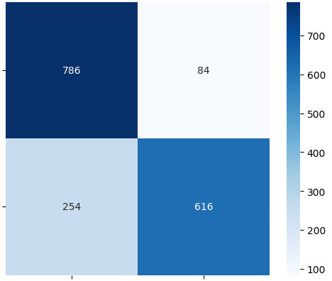
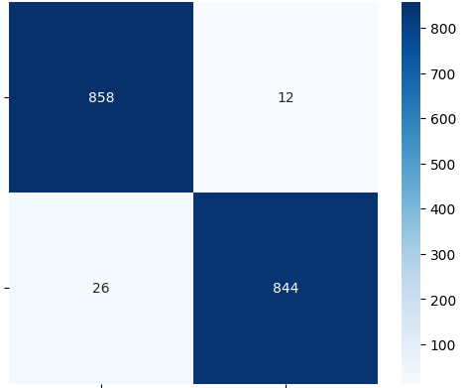
Results of Applying the Swin Transformer Tiny Model with Different Fine-Tuning Approaches
Achieved Accuracy: 80.57%
Achieved Accuracy: 97,82%
Horizontal
Horizontal
True Labels
True Labels
Vertical
Vertical
Horizontal
Vertical
Horizontal
Vertical
Predicted Labels
Predicted Labels
Figure 8. Confusion Matrix of Swin Transformer Tiny with Fine-Tuning Only the Classifier
Figure 9. Confusion Matrix of Swin Transformer Tiny with Fine-Tuning of the Last Block and Classifier
10

Slide 11
Neural Network Architectures
The following architectures were considered as alternative solutions:
ResNet-18
2015
Microsoft
44 MB
MobileNetV2
2018
Google
14 MB
EfficientNetB0
2019
Google
20 MB
ConvNeXt-Tiny
2022
Facebook
109 MB
Used for computer vision tasks
Pretrained on the ImageNet-1K dataset
Based on convolutional neural networks
11

Slide 12
Comparative Analysis of the Results Obtained
Table 1. Comparative Analysis of Accuracy for 5 Architectures and Different Training Methods
Название архитектуры | Accuracy (%) | Precision | Recall | F1-score
Swin Transformer Tiny (fine-tuning only the classifier) | 80.57 | 0.88 | 0.70 | 0.78
Swin Transformer Tiny (fine-tuning the last block and classifier) | 97.82 | 0.98 | 0.97 | 0.97
ResNet-18 (fine-tuning all layers) | 96.84 | 0.97 | 0.96 | 0.96
ResNet-18 (fine-tuning only the classifier) | 94.50 | 0.97 | 0.92 | 0.94
EfficientNet (fine-tuning only the classifier) | 62.82 | 0.66 | 0.53 | 0.59
MobilenetV2 (fine-tuning only the classifier) | 93.85 | 0.94 | 0.94 | 0.94
ConvNeXt-Tiny (fine-tuning only the classifier) | 88.97 | 0.90 | 0.88 | 0.89
12

Slide 13
Results
A review of neural network architectures for behavioral pattern recognition tasks was conducted.
The Swin Transformer Tiny architecture was evaluated for recognizing human actions in videos, achieving an accuracy of 94%.
An annotated dataset was created for recognizing vertical and horizontal motor activity of rodents, comprising 754 video clips, each 15 frames long.
A study was carried out on the applicability of five neural network architectures — Swin Transformer Tiny, ResNet-18, MobileNetV2, EfficientNet, and ConvNeXt-Tiny — for the binary classification task.
A comparative analysis showed that the best performance was achieved by Swin Transformer Tiny, with an accuracy of 97%.
13

Slide 14
Thank you for your attention!

