Slide 1
11th International Conference "Distributed Computing and Grid Technologies in Science and Education" (GRID'2025)
Neural-Network identification of
Clinical Target Distribution
Authors:
Svetlana Dima, DLNP
Gennady V. Mytsin, DLNP
Dubna, 2025

Slide 2
Contents
Clinical Target Volume (CTV) vs Clinical Target Distribution (CTD);
Training Neural Networks for Radiation Targeting;
Results of Neural-Network Implementation;
Conclusion.

Slide 3
Clinical Target Volume vs Clinical Target Distribution
CTV
CTD
GTV
0.8
GTV
0.6
0.4
0.2
- binary concept; - modern continuous probabilistic concept;
- OAR make to modify or redraw a CTV; - advanced tradeoff between target coverage
and sparing of OAR;
- inter-user variability; - reduced physician hypothesis variability
Shusharina, N., Craft, D., Chen, Y. L., Shih, H., & Bortfeld, T. (2018). The clinical target distribution: a probabilistic alternative to the clinical target volume. Physics in Medicine & Biology, 63(15), 155001.

Slide 4
What do we want?
- Tissue heterogeneities
- Imaging limitations
- Patient motion
ACCURACY
- Target geometry
- Dose fall-off effects
- Technical constraints
CONFOR-MITY
- Time economy
- Computational load
- Accuracy trade-off
SPEED
Automatic Segmen-tation?
- Setup variations
- Beam calibration drift
- Human factor
REPRODU-
CIBILITY
INTE-
GRATION
- Multi-modal data fusion
- TPS-RTIS interoperability
SAFETY
- Organs at risk
- RBE uncertainty
- Imaging artifacts

Slide 5
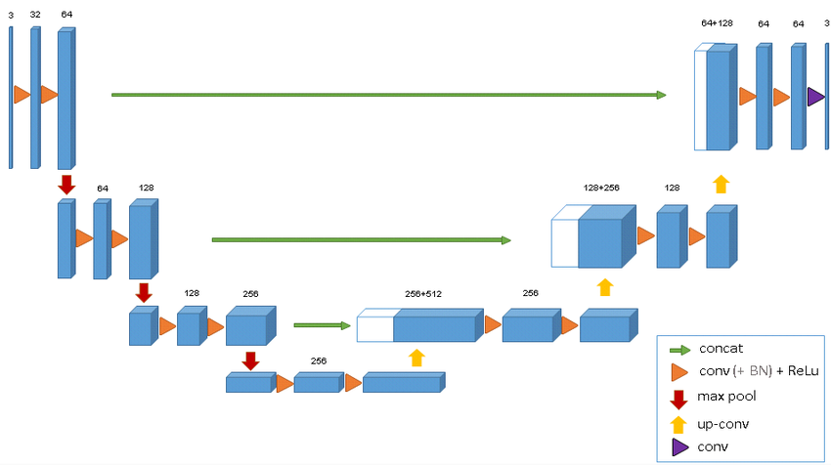
Training Neural Networks for Targeting
CT/MRI
Synthetic Training Data ("ground truth")
- 2D/3D MRI phantoms (tumor + OARs)
- Simulated infiltration (Gaussian/sigmoid decays)
Brainstem – cyan, Optic Nerve - yellow
Contouring
AI Model
- Bayesian 3D U-Net
- Custom loss function: Dice + KL divergence
→ balances accuracy/confidence
Plan design
- Dose goal for chordoma >70 Gy;
- OAR constraints: <50 Gy;
- Spot spacing and layer spacing - 5 mm;
- Monte Carlo simulation;
Optimization
(L-BFGS)
Evaluation
https://doi.org/10.48550/arXiv.1606.06650

Slide 6
Example
MRI with OARs
(Brainstem – cyan, Optic Nerve – yellow)
Clinician-defined (Red) vs AI-Predicted CTD (Blue)
Optimized Dose Distribution

Slide 7
Results
Table 1. Treatment plan's characteristics.
 | CTV | AI-CTD
Target Coverage, % | 99.1 (97.3 – 99.5) | 98.2 (96.8 – 99.1)
OAR (Dmax), Gy | 48.44 (43.55 – 49.37) | 34.24 (30.95 – 38.63)
Time, min | 30 (20.90 – 44.95) | 1.5 (0.44 – 1.93)
Prescription dose is reached for both plans (p=0.12)
29.3% less dose to OARs (p<0.01)
20x faster

Slide 8
Conclusion
CTD is an advanced concept that eliminates the limitations of CTV (especially variability, uncertainty, and binary concept);
Using AI-Driven Probabilistic Targeting we managed to obtain better precision and efficiency (speed). These improvements come without compromising therapeutic objectives;
For introduction into clinical practice, further studies are required, including real-world clinical trials to assess the impact of AI-Driven Probabilistic Targeting on treatment accuracy, workflow efficiency, and patient outcomes.
Not just better targeting - but smarter and safer radiotherapy

Slide 9
Thank you for your attention!

