Slide 1
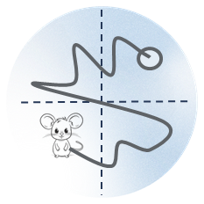
Web Service for the Trajectory Analysis of Laboratory Animals in the «Morris Water Maze» based on deep learning algorithms
Bezhanyan T.Zh. ^{1,2}, Streltsova O.I.^{1,2}, Stadnik A.V. ⁴, Shadmehri S.¹, Podgaynii D.V. ¹, Zuev M.I.¹, Bondarev M.Yu. ^{1,2},
Nechaevski A.V. ^{1,2}, Kolesnikova I.A.^{2,3}, Severiukhin Y.S.^{2,3}
GRID 2025
7-11 July 2025
DUBNA
¹ Meshcheryakov Laboratory of Information Technologies JINR, Dubna, Russia
² Dubna State University, Dubna, Russia
³ Laboratory of Radiation Biology Joint Institute for Nuclear Research, Dubna, Russia
⁴ NN Sputnik
The research was carried out within the state assignment of Ministry of Science and Higher Education of the Russian Federation
(theme No. 124112200072-2).

Slide 2
«Morris Water Maze» behavioral test
Mouse/rat | Latency time
Ionizing radiation | Travel distance
Up 2 groups (each group contains up to 10 rodents) | Speed
2 stages (before irradiation and after irradiation on the 30th and 90th days) | Finding the platform
Each stage takes 5 days | trajectory
Every animal being tested 3 times per day | Classification task
~450 Video files
60 seconds
2

Slide 3
Goal
Developing the Web Service for the Trajectory Analysis of Laboratory Animals in the «Morris Water Maze» based on Deep Learning Algorithms
3

Slide 4
Object tracking problems
01
02
03
04
450
Video data
Different conditions for each video/experiment (water reflection, size of lab. animal)
Movable background, changeable lighting
Determination of the beginning of movement of a laboratory animal
Problem with detecting moving (floating) object
4

Slide 5
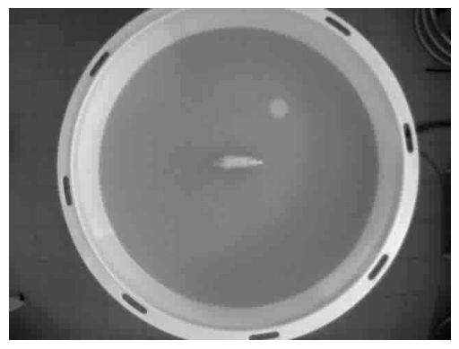
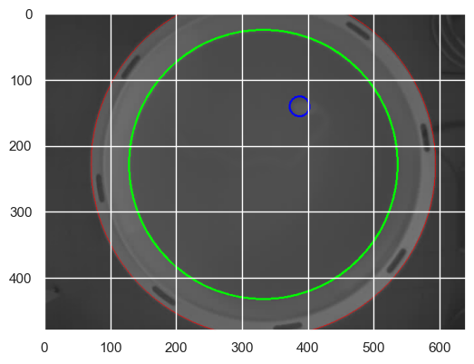
Setup field marking
Median image construction
Filtering
Hough transformation
Finding external boundary
Finding internal boundary
Finding platform location
5

Slide 6
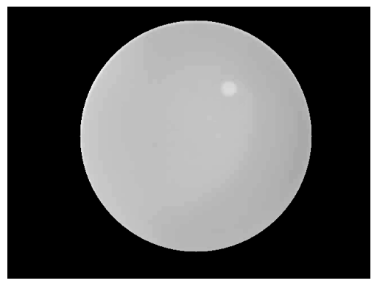
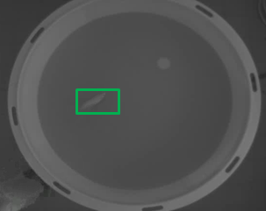
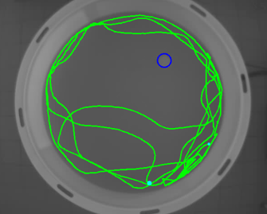
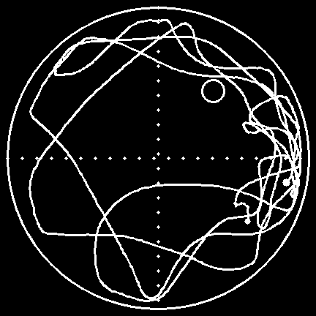
Object tracking
Step 1
Step 2
Step 3
Step 4
Computer vision algorithms
Setup field marking
Finding object contour
Local tracking
Detect an object on the first frame
Determine local area centered on the point of the object`s CM
Detect the object in the next frame
Construction the trajectory
Superimposed it to a video file and saving as an image
Created Data set
For further classification tasks
6

Slide 7
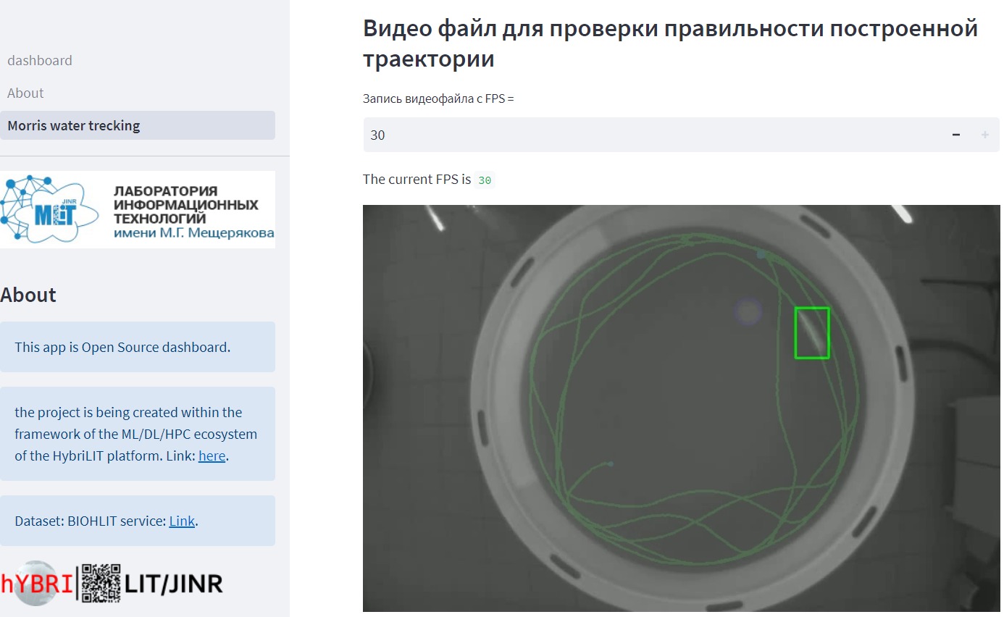
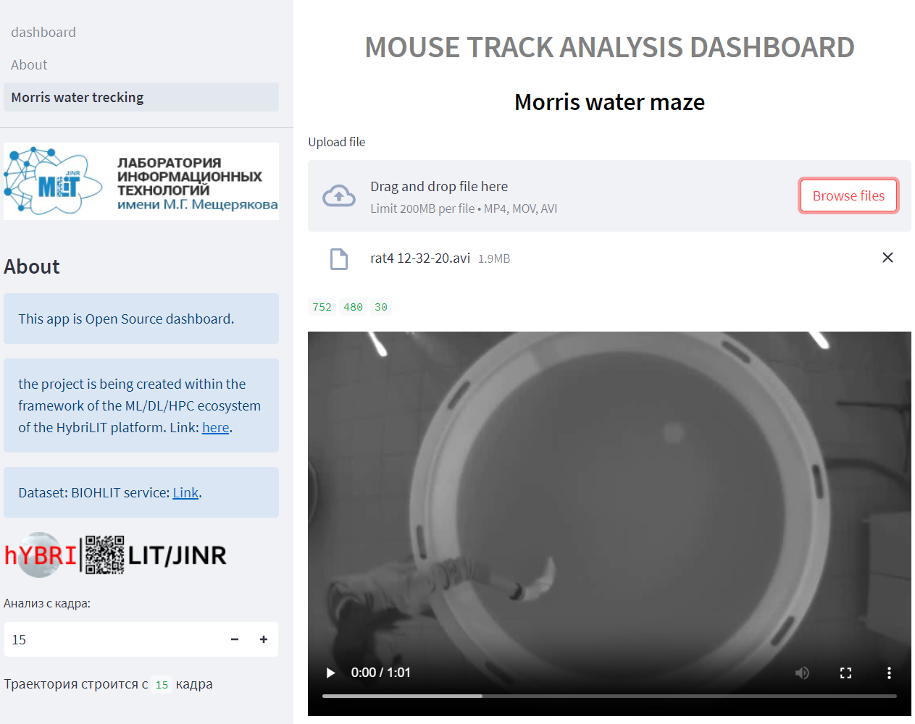
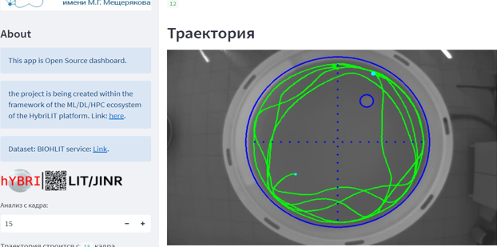
Prototype of Web service for «Morris Water Maze» behavioral test
0 | Characteristic | Value
1 | Total time traveled (sec) | 60.97
2 | Total distance (cm) | 5400.26
3 | FPS | 30
4 | Speed (cm/s) | 88.58
5 | First frame | 26
6 | Last frame | 1855
7 | Finding platform | No
7

Slide 8
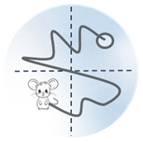
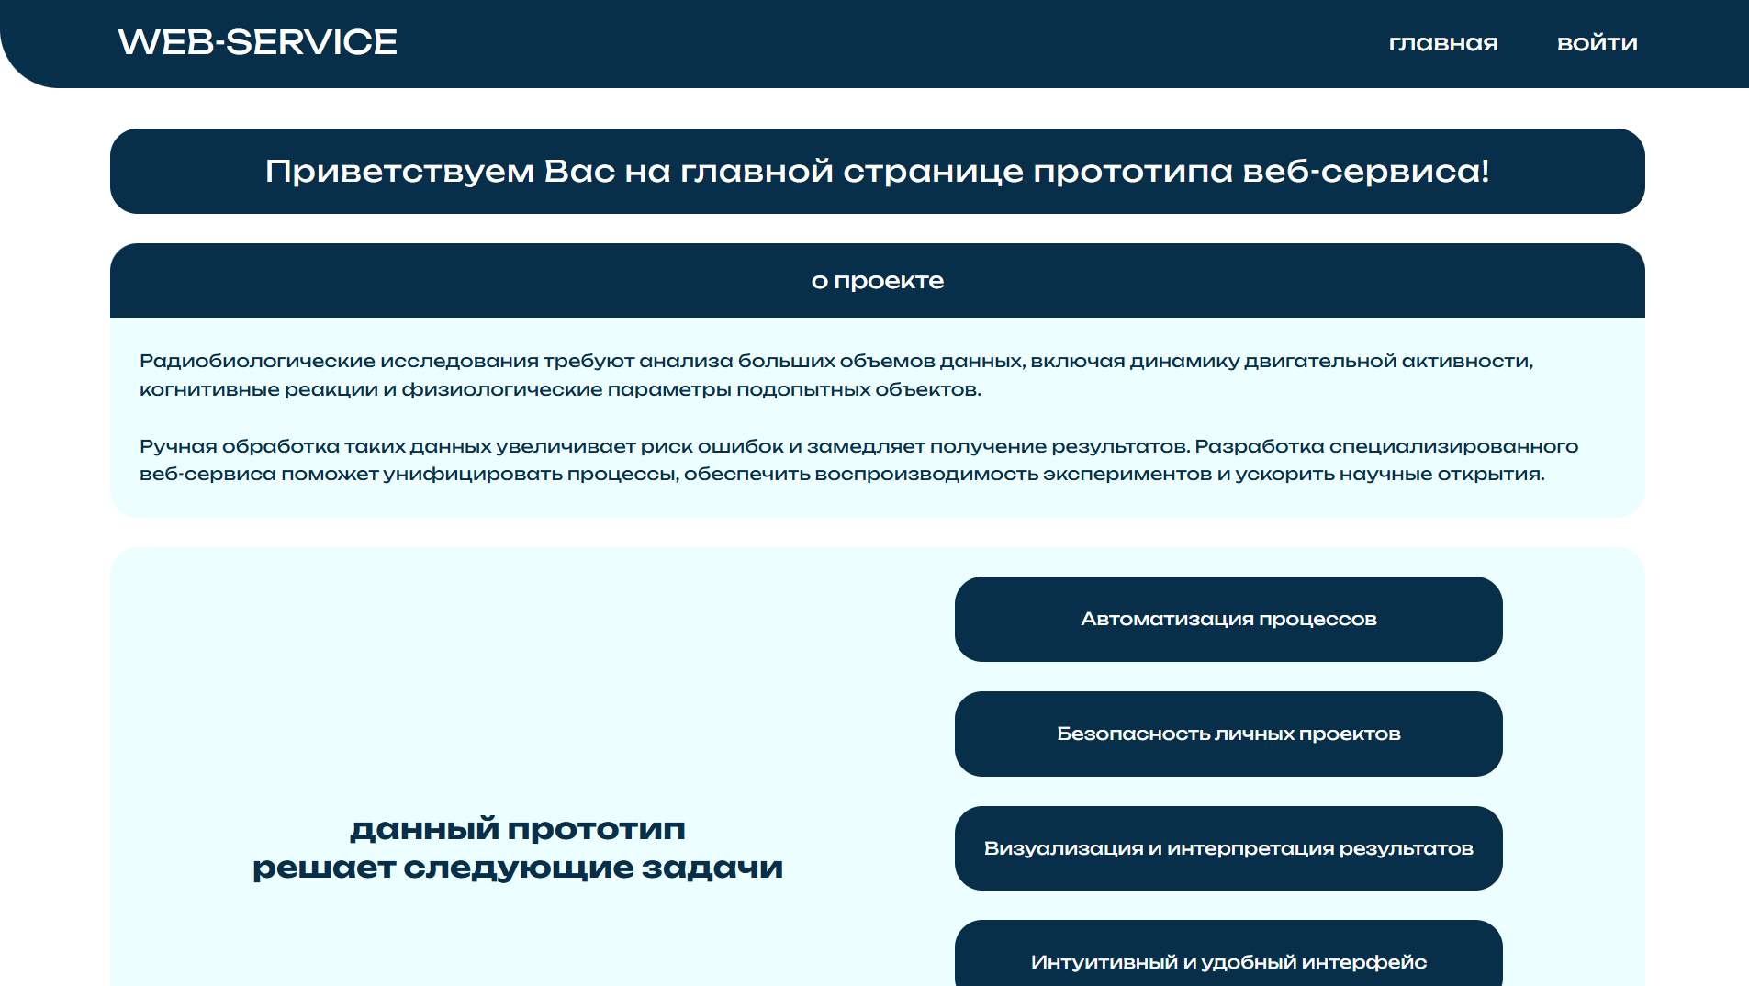
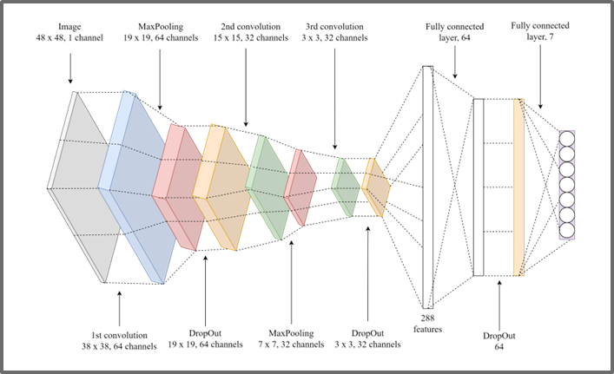
Deep learning algorithms for
MORRISS WATER maze
1500
Video data
01
02
03
Neural Network architecture Yolo11 for object tracking
Classification task – based on Convolutional Neural Network
Web service for analyzing video data
~2%
61%
37%
New ~1500 video data, <2% object is lost, ~97% object tracking (~61% is from the first frame, ~37% must select the starting frame)
8

Slide 9
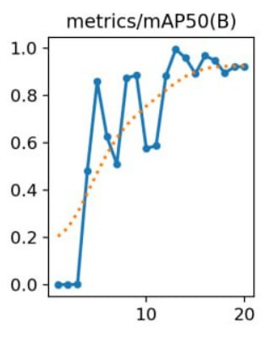
01
Deep learning model Yolo11 for object detection
CVAT – for data annotation
mAP50(B) – computed over bounding boxes; evaluates how accurately the model localizes objects with rectangles (reflects the effectiveness of object detection and localization)
9

Slide 10
Results for deep learning algorithm YOLO11
01
10

Slide 11
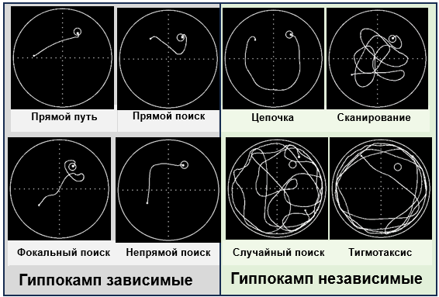
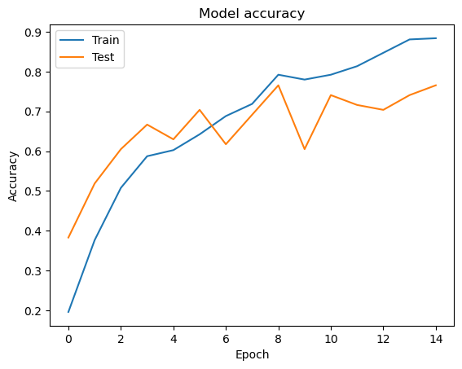
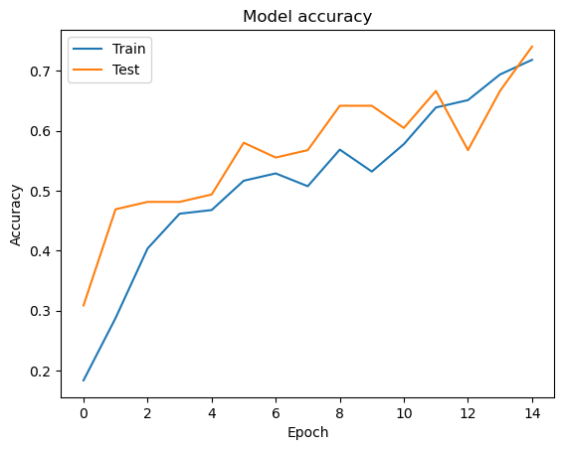
Classification task CNN Web service for the Trajectory Analysis of Laboratory Animals in the «Morriss Water Maze» behavioral test
02
8 class
7 class
Classification for 8 class
With an increase the number of epochs, the accuracy drops, due to the fact that the model begins to «remember» the images of the training sample
1. Direct path
2. Direct search
3. Indirect search
4. Focal search
5. Chaining
6. Scanning
7. Random search
8. Thigmotaxis
11

Slide 12
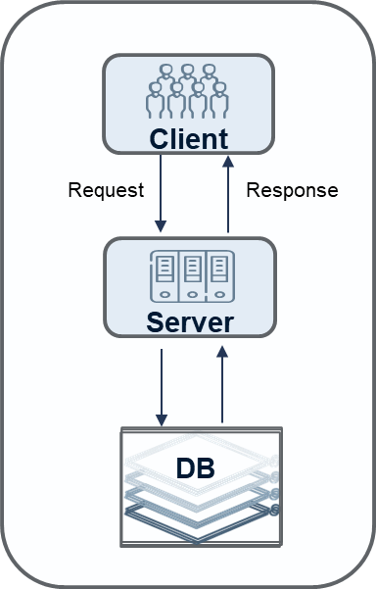
Web Service for the Trajectory Analysis of Laboratory Animals in the «Morris Water Maze» based on deep learning algorithms
03
12

Slide 13
Results
We are developing Web Service for the Trajectory Analysis of Laboratory Animals in the «Morris Water Maze» based on deep learning algorithms
Developed and tested algorithm for trajectory construction based on computer vision algorithms
Developed prototype of Web service for «Morris Water Maze» behavioral test
Created a dataset for classification task
Developing an algorithm for trajectory construction based on deep learning algorithms

Slide 14
Thanks for your attention
Authors acknowledge the support of the JINR Multifunctional Information and Computing Complex
for providing computational resources http://hlit.jinr.ru/
11th International Conference "Distributed Computing and Grid Technologies in Science and Education" (GRID’2025) 7–11 July 2025

